Slide 1



PUMA transport and handling
PUMA collaboration meeting – Roberto RINALDESI, María PÉREZ ORNEDO– CERN EN-HE
2025-03-12

Slide 2
Agenda
Review of previous steps
Modification of ISOLDE crane to include the power line
Arrival of PUMA @ CERN
Next steps

Slide 3

Next steps (presented in previous meetings)
  Modification of ISOLDE crane to include the power line
    Scheduled for January’25.
    It is needed to have the machine warm and no LHe in the Cryo system for the intervention. Additionally, a protective scaffolding needs to be added above the Cryo jumper boxes.
  Test of the AD lifting beam
    Adjustments need to be done to achieve stability. The design of ISOLDE lifting beam depends on the test
  Design and manufacturing of ISOLDE lifting beam
  Receive the information regarding the test campaign to be able to prepare accordingly.

Slide 4
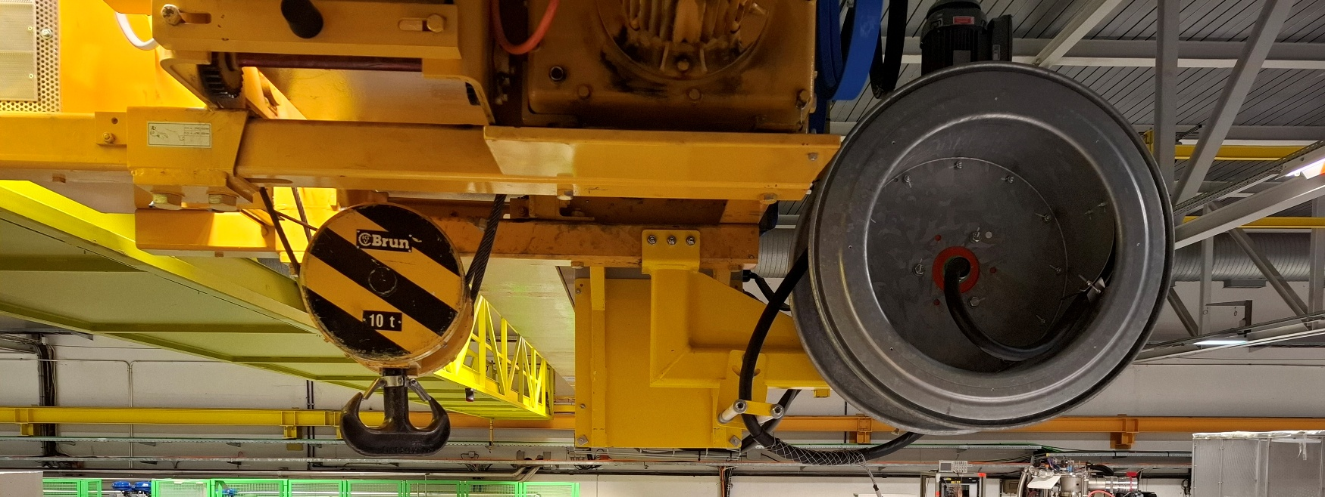
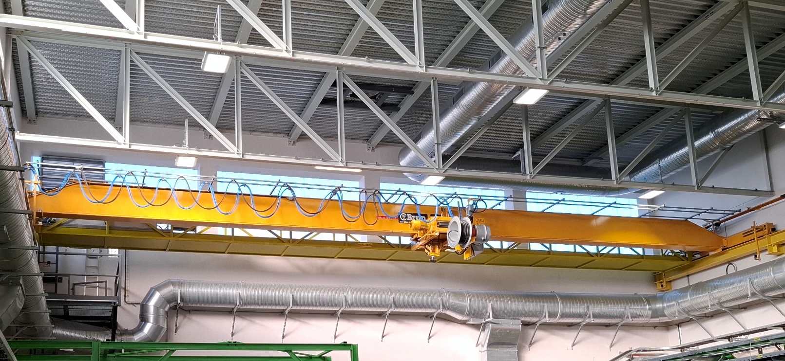
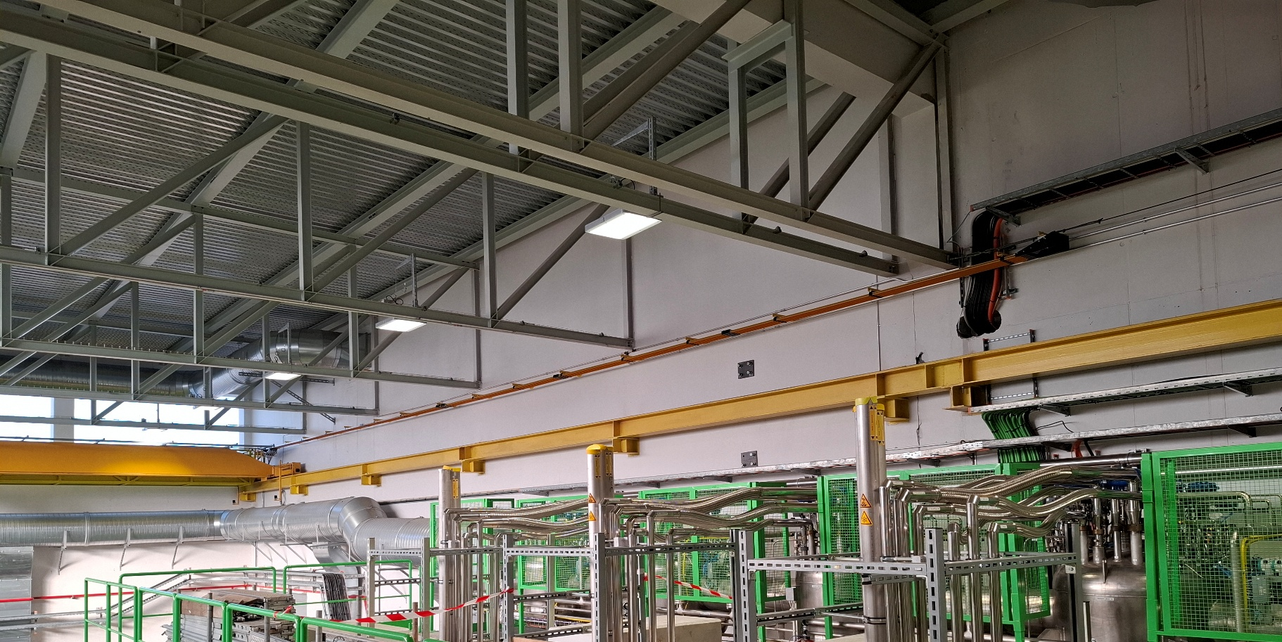
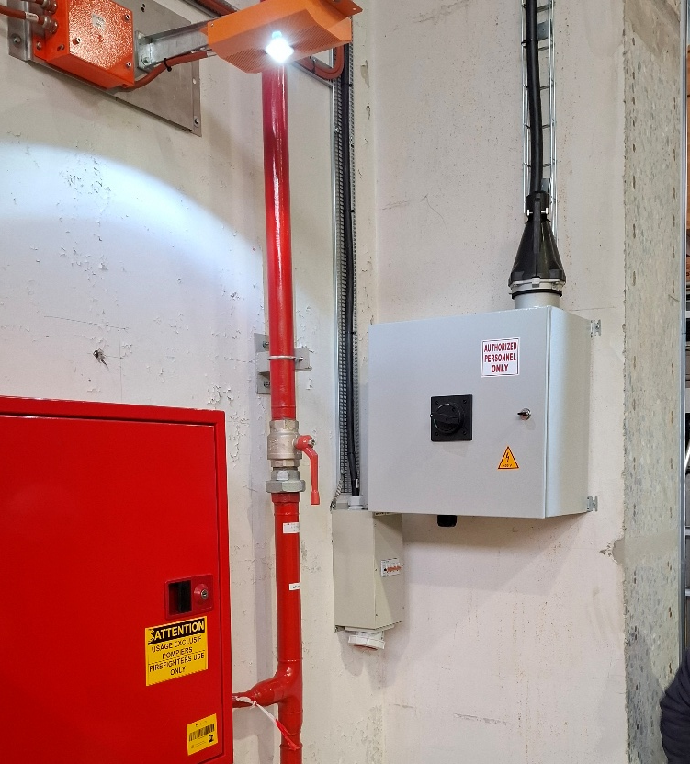
Modification of ISOLDE crane to include the power line
Cable reel on the trolley
On-board festoon
Dedicated busbar
Main switch

Slide 5
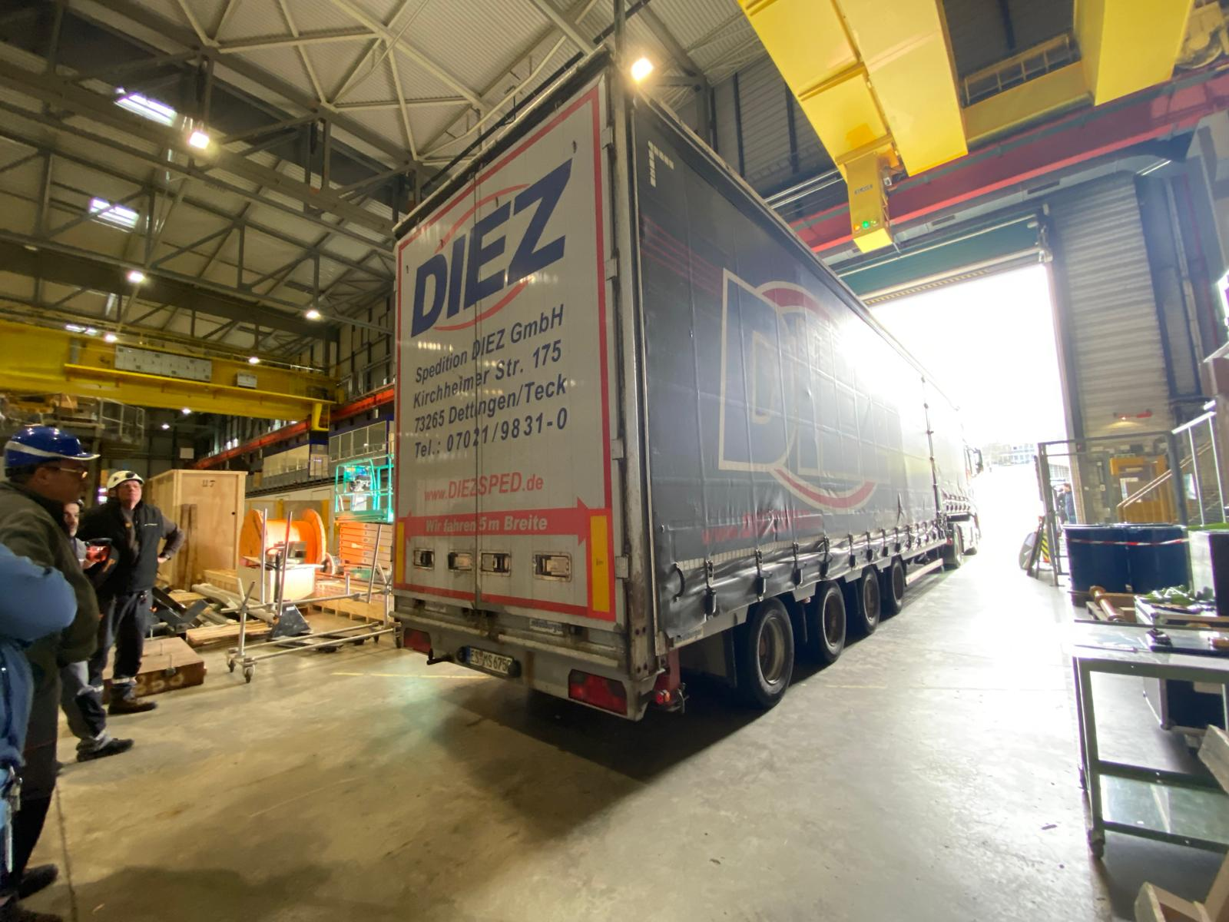
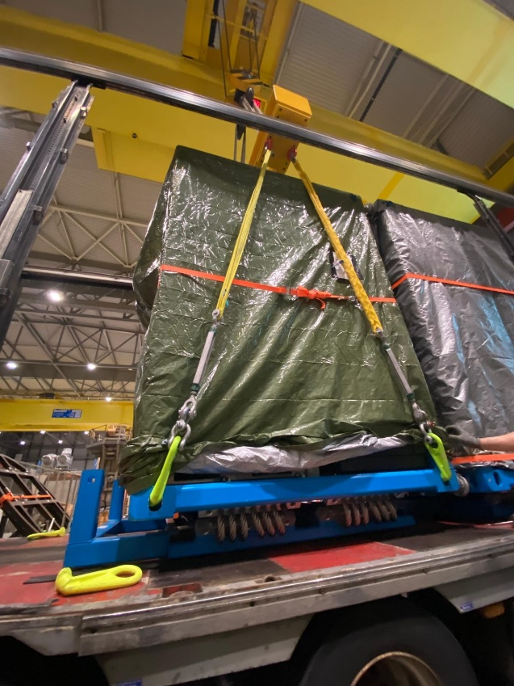
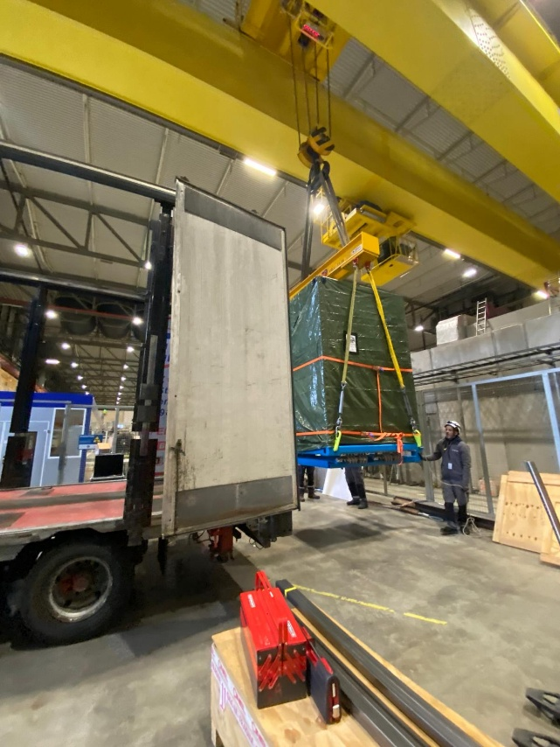
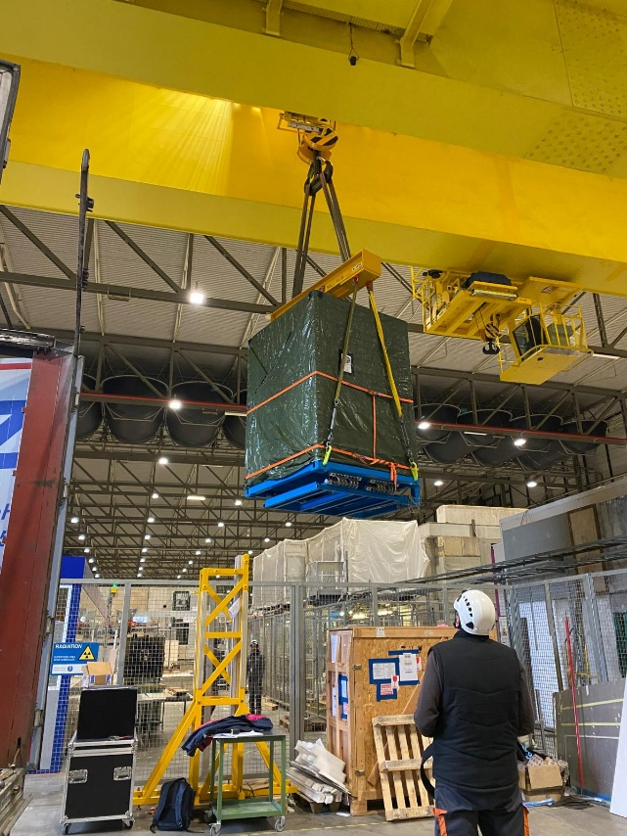
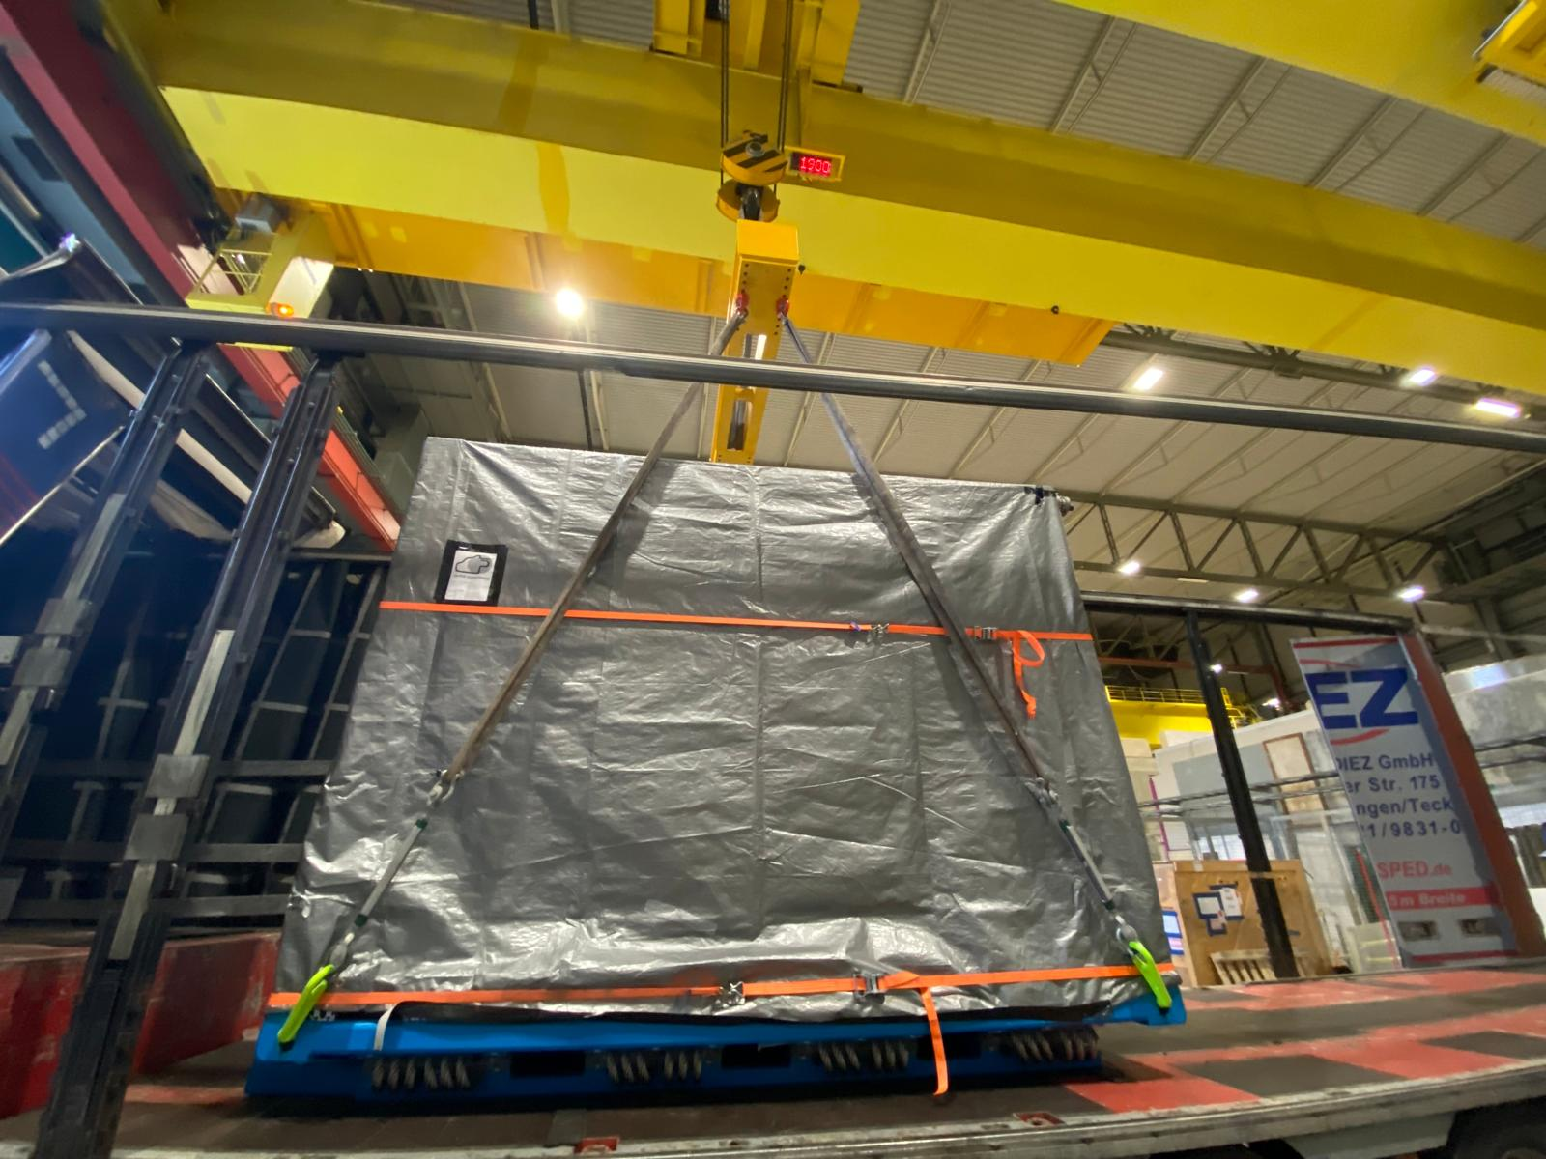
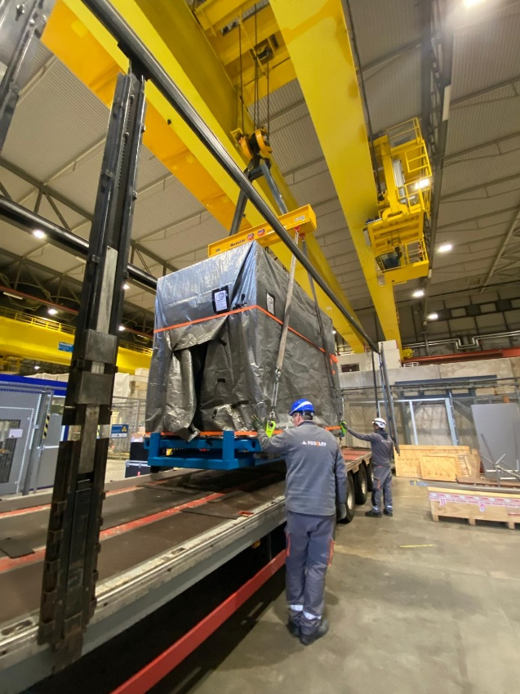
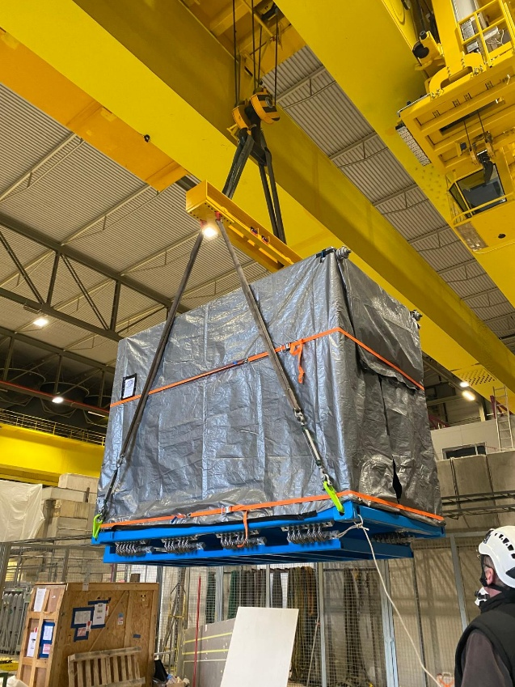
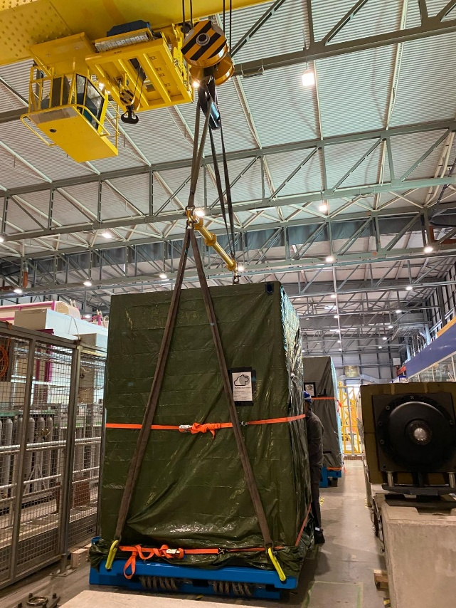
Arrival of PUMA @ CERN

Slide 6
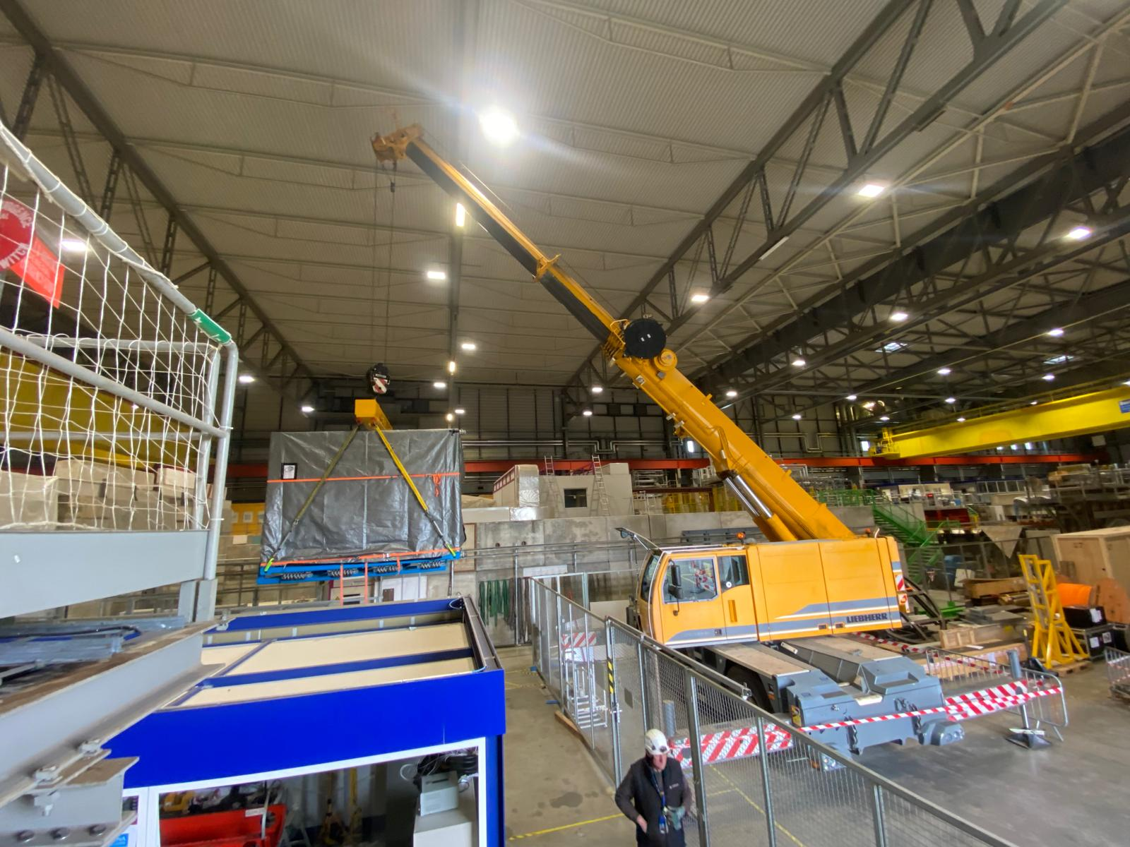
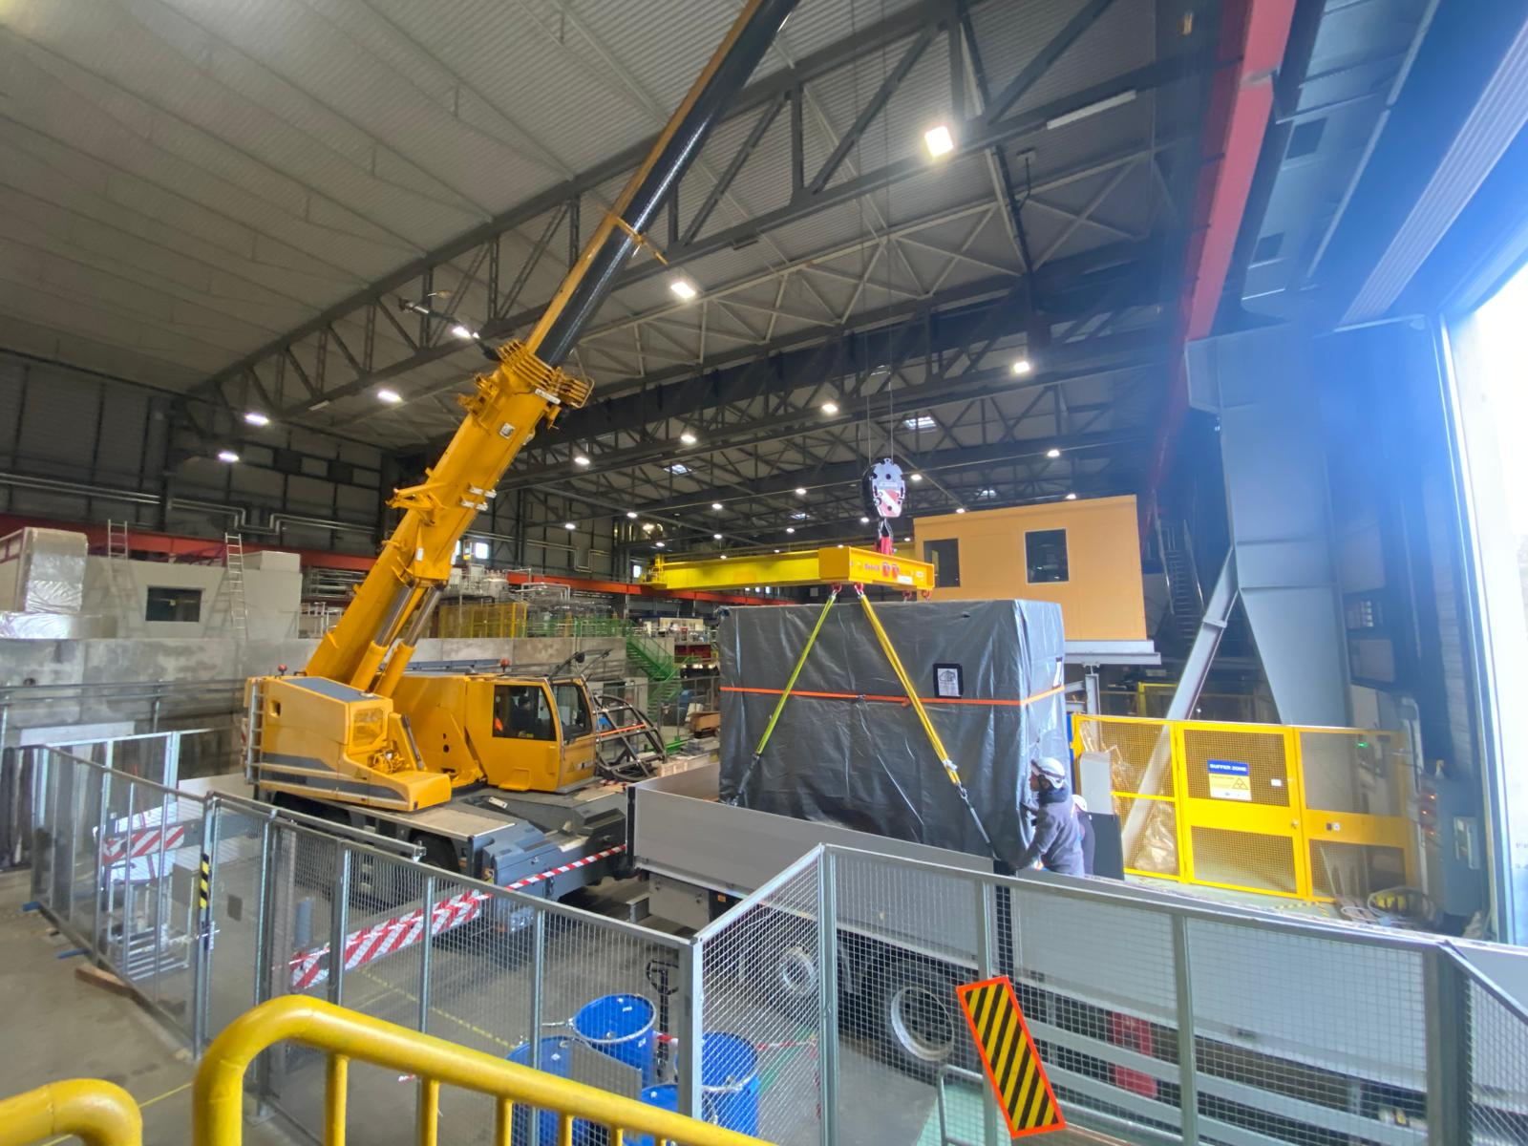
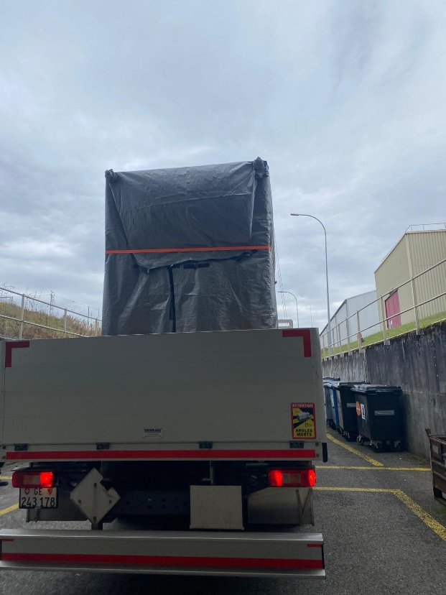
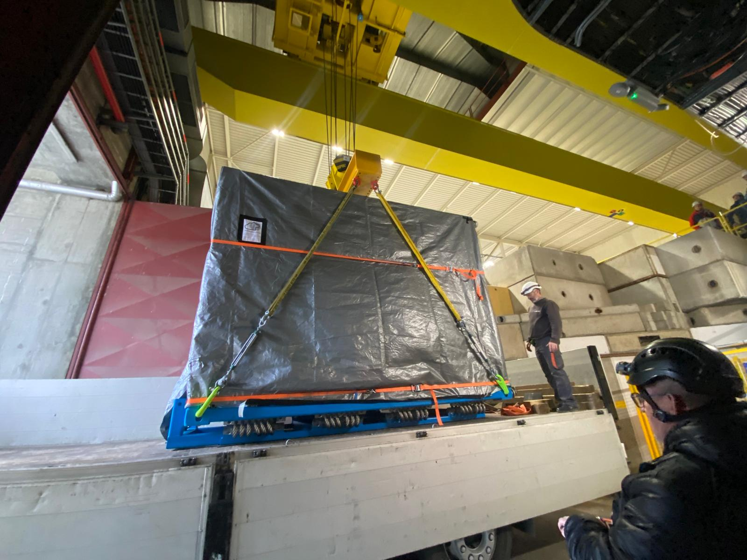
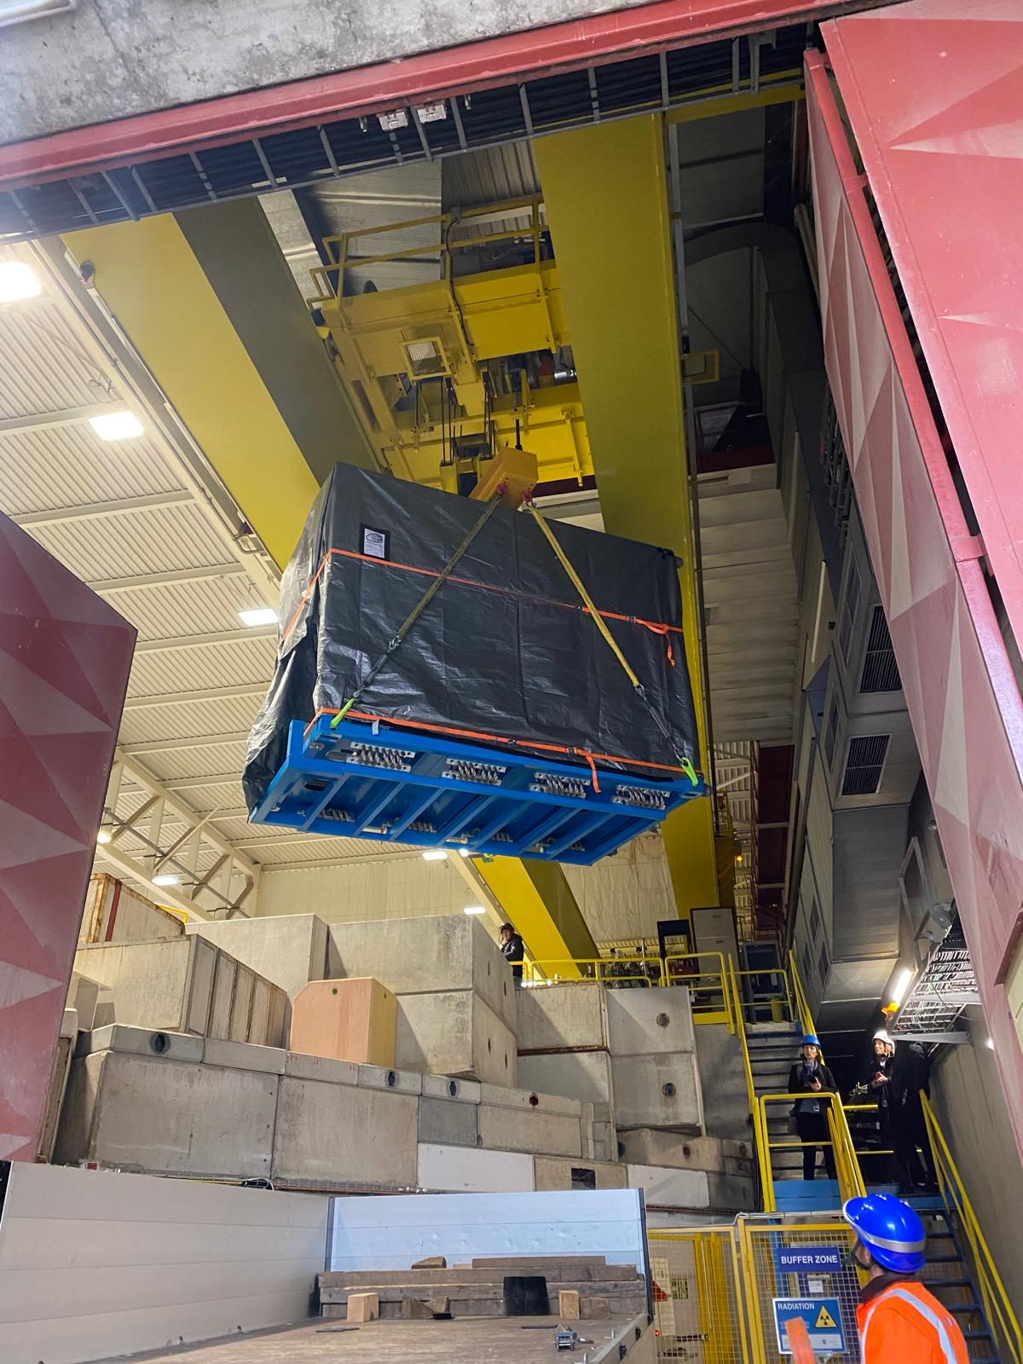
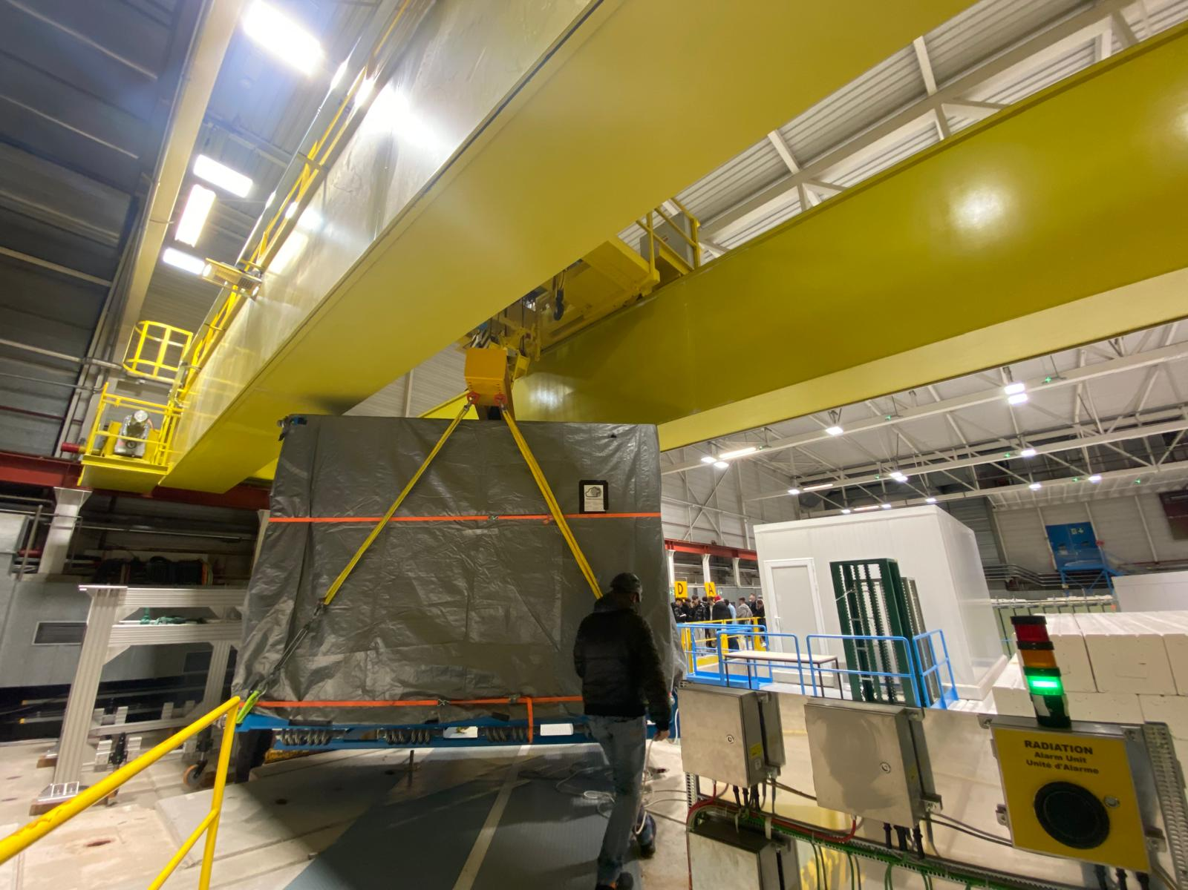
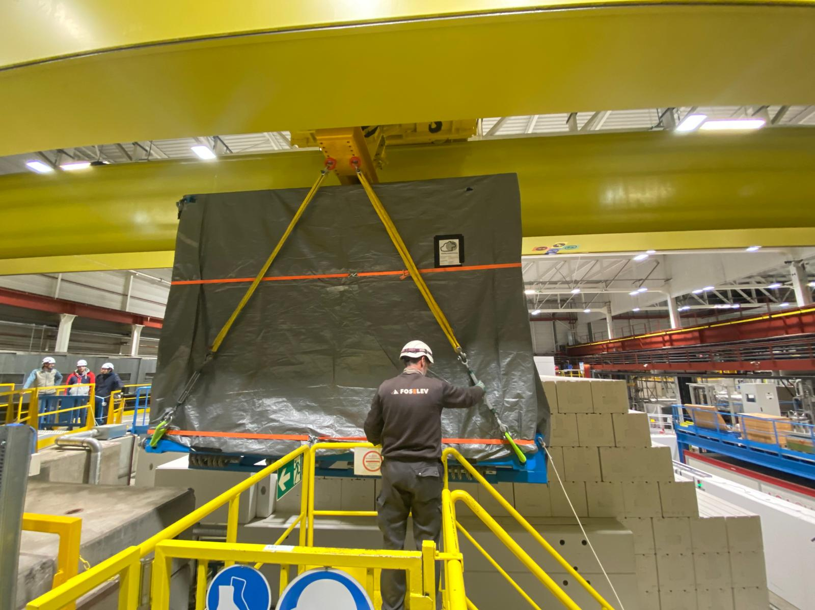
Arrival of PUMA @ CERN

Slide 7
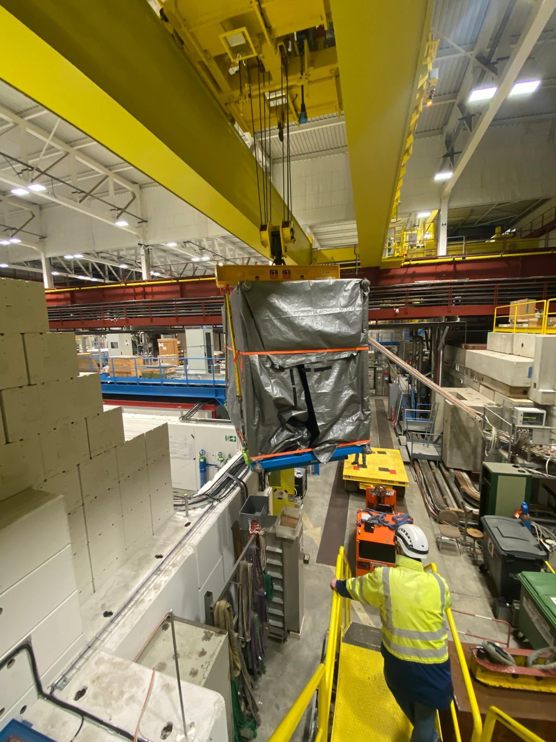
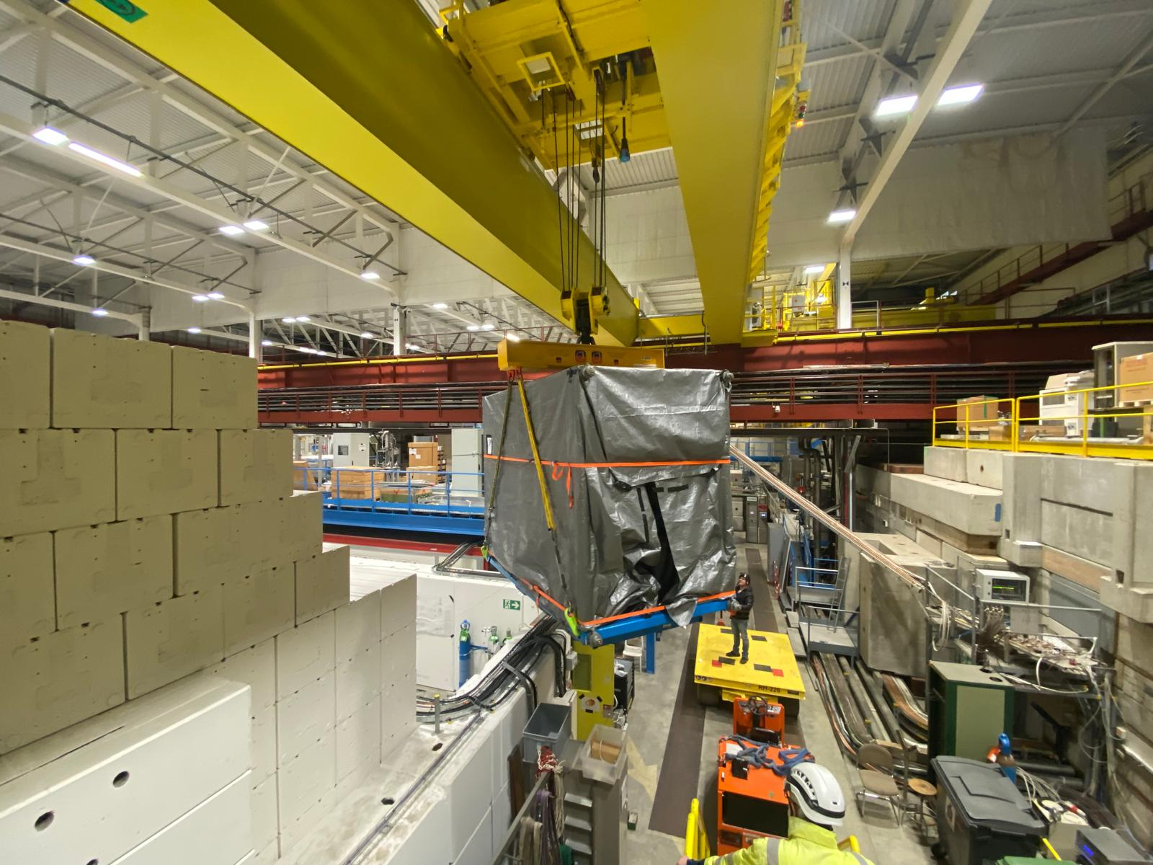
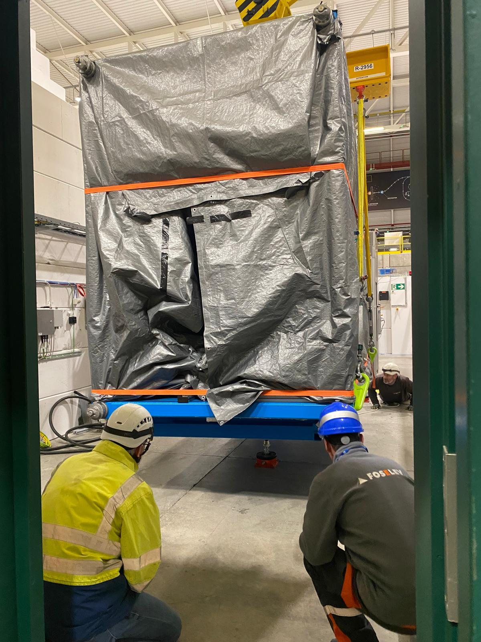
Arrival of PUMA @ CERN

Slide 8
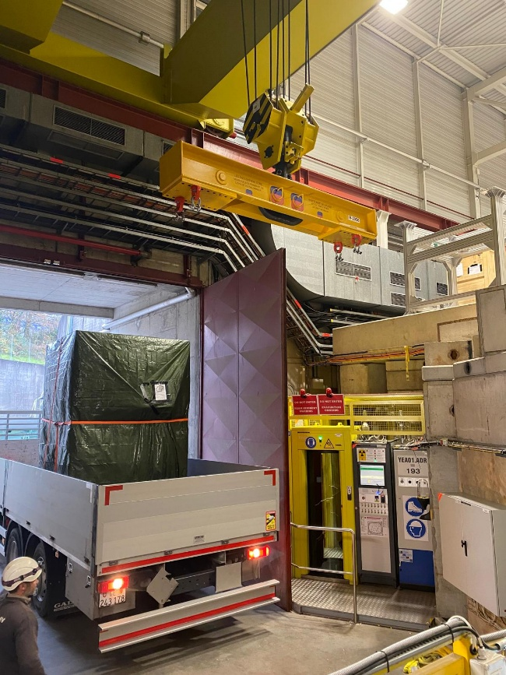
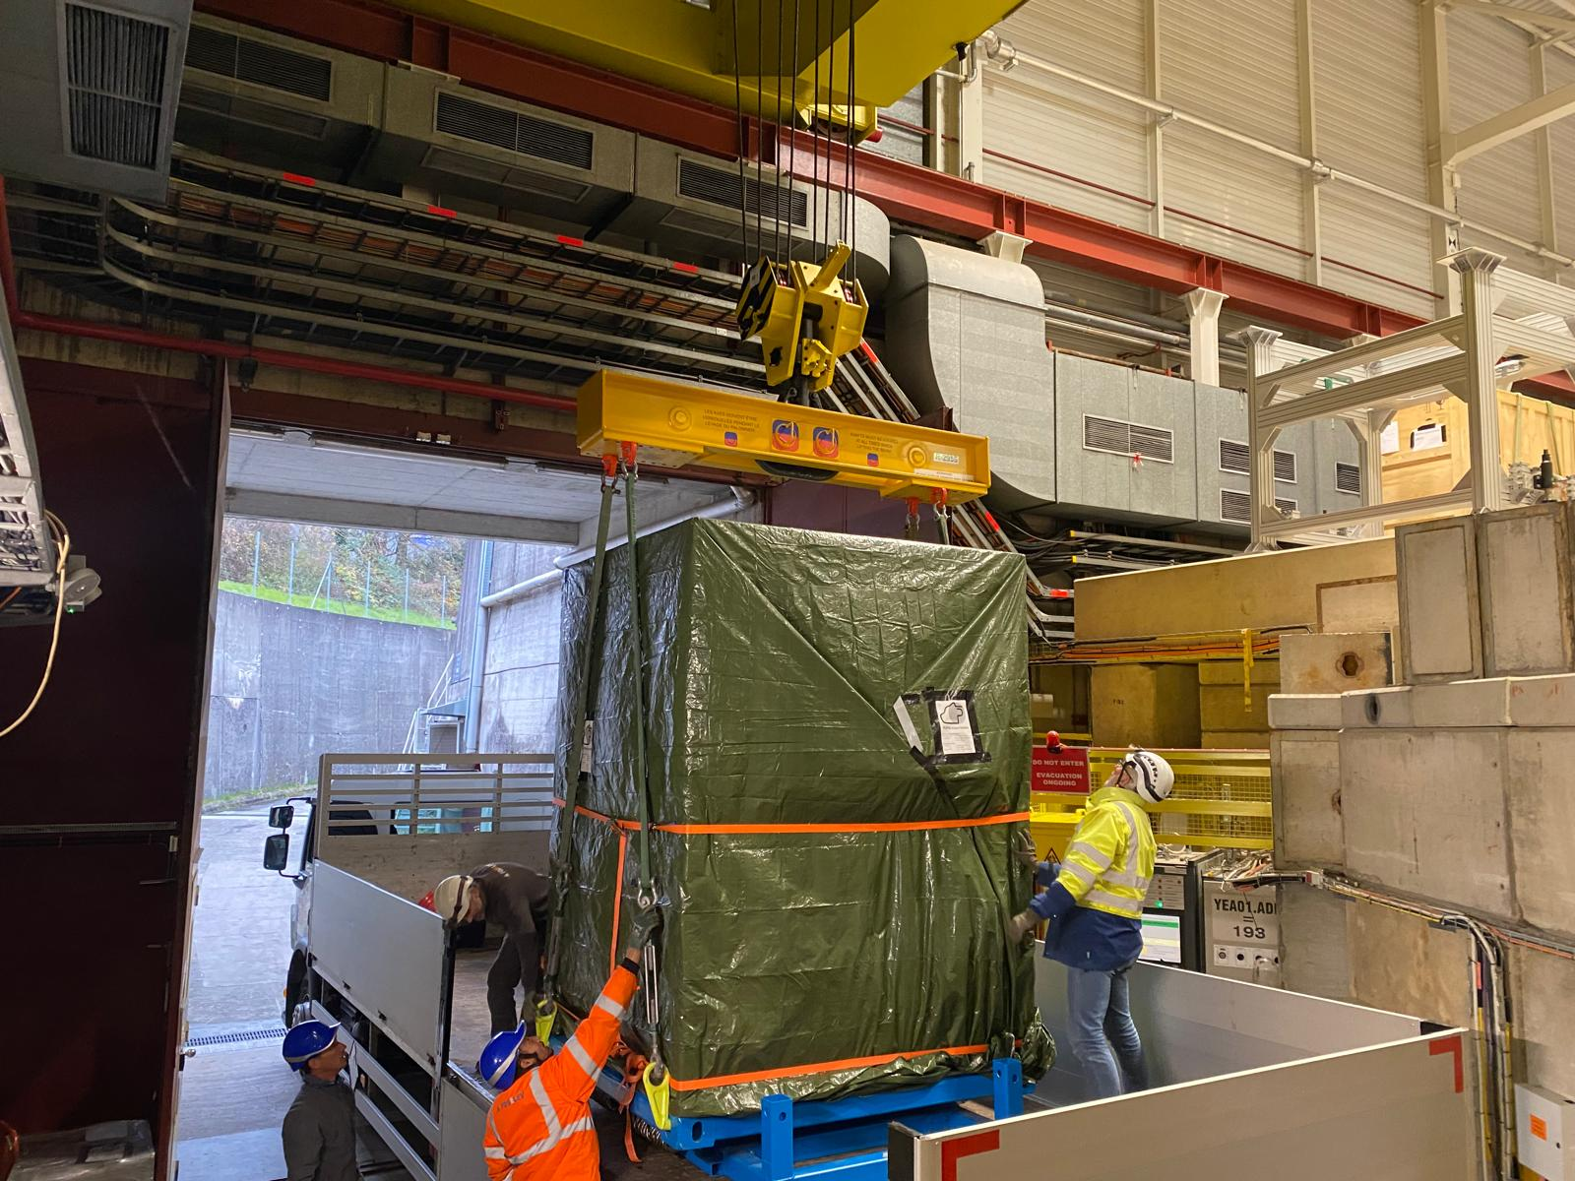
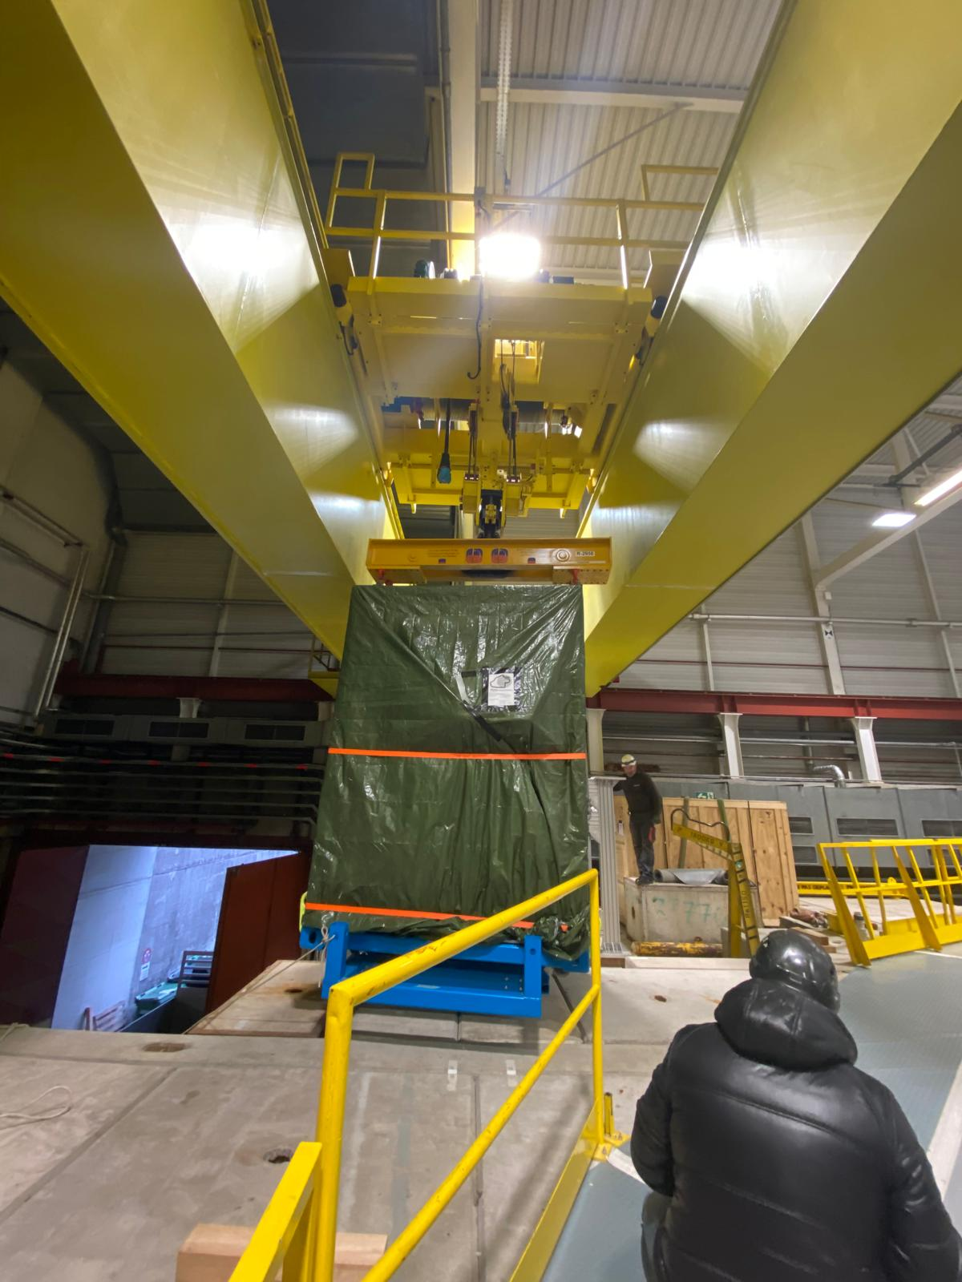
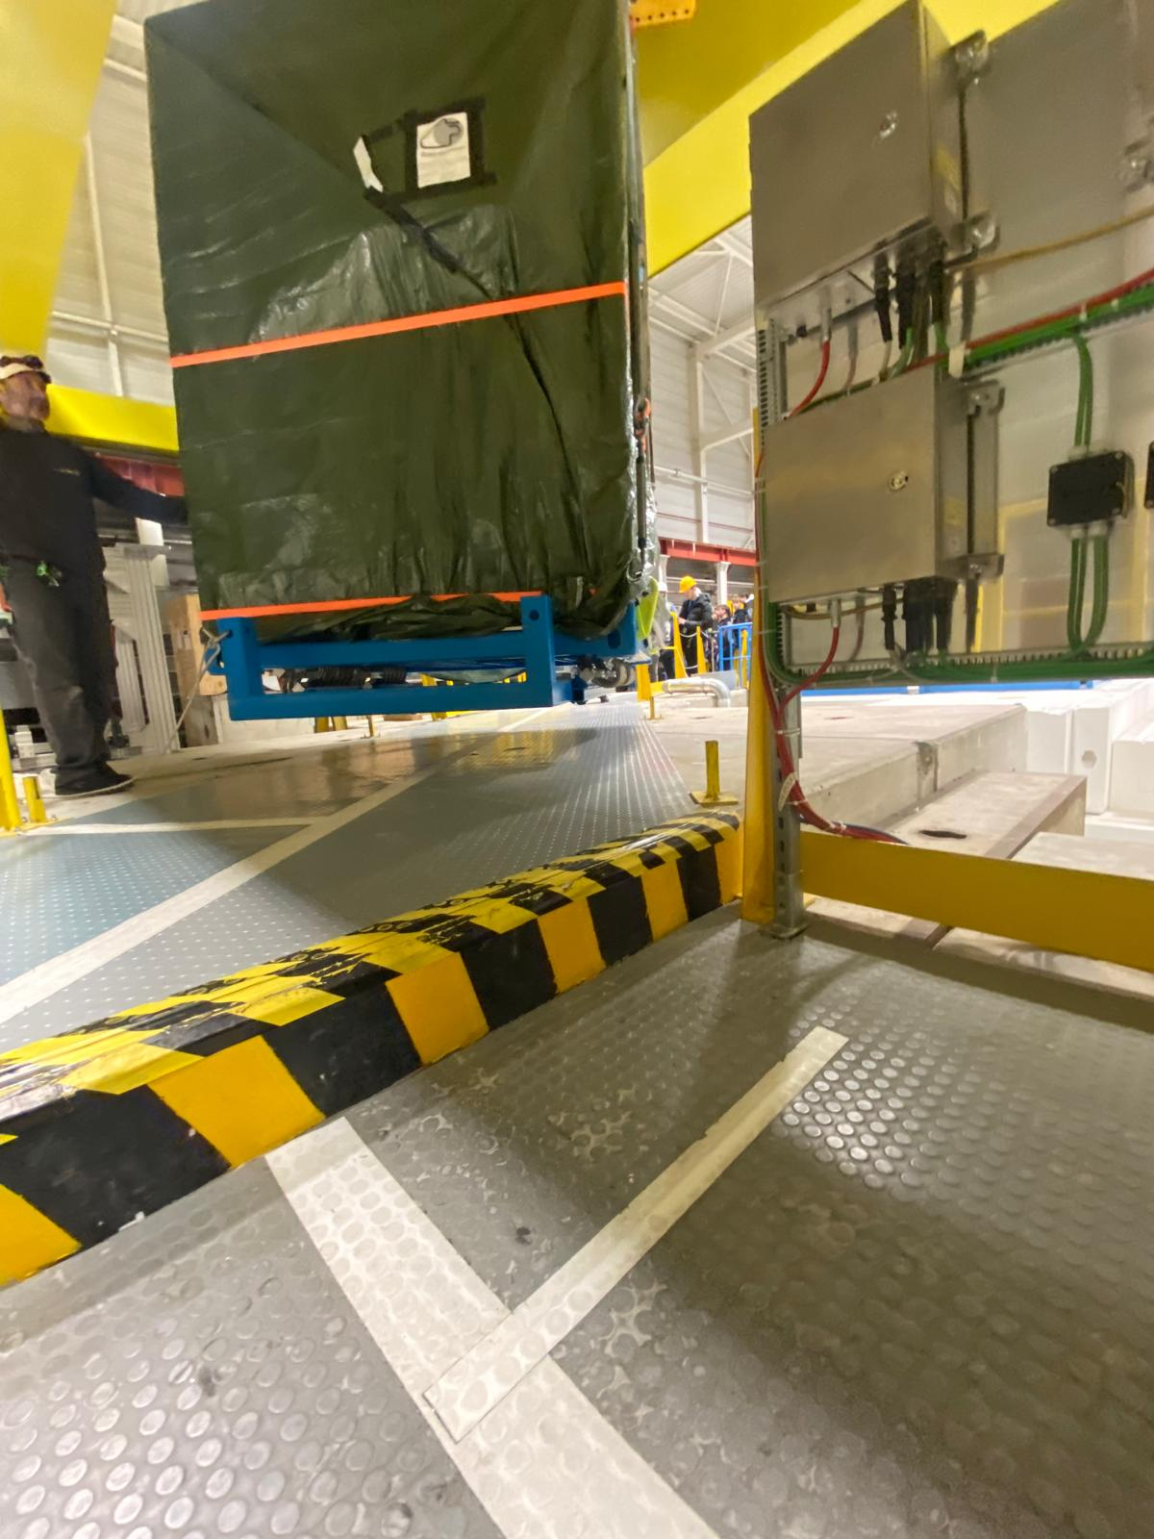
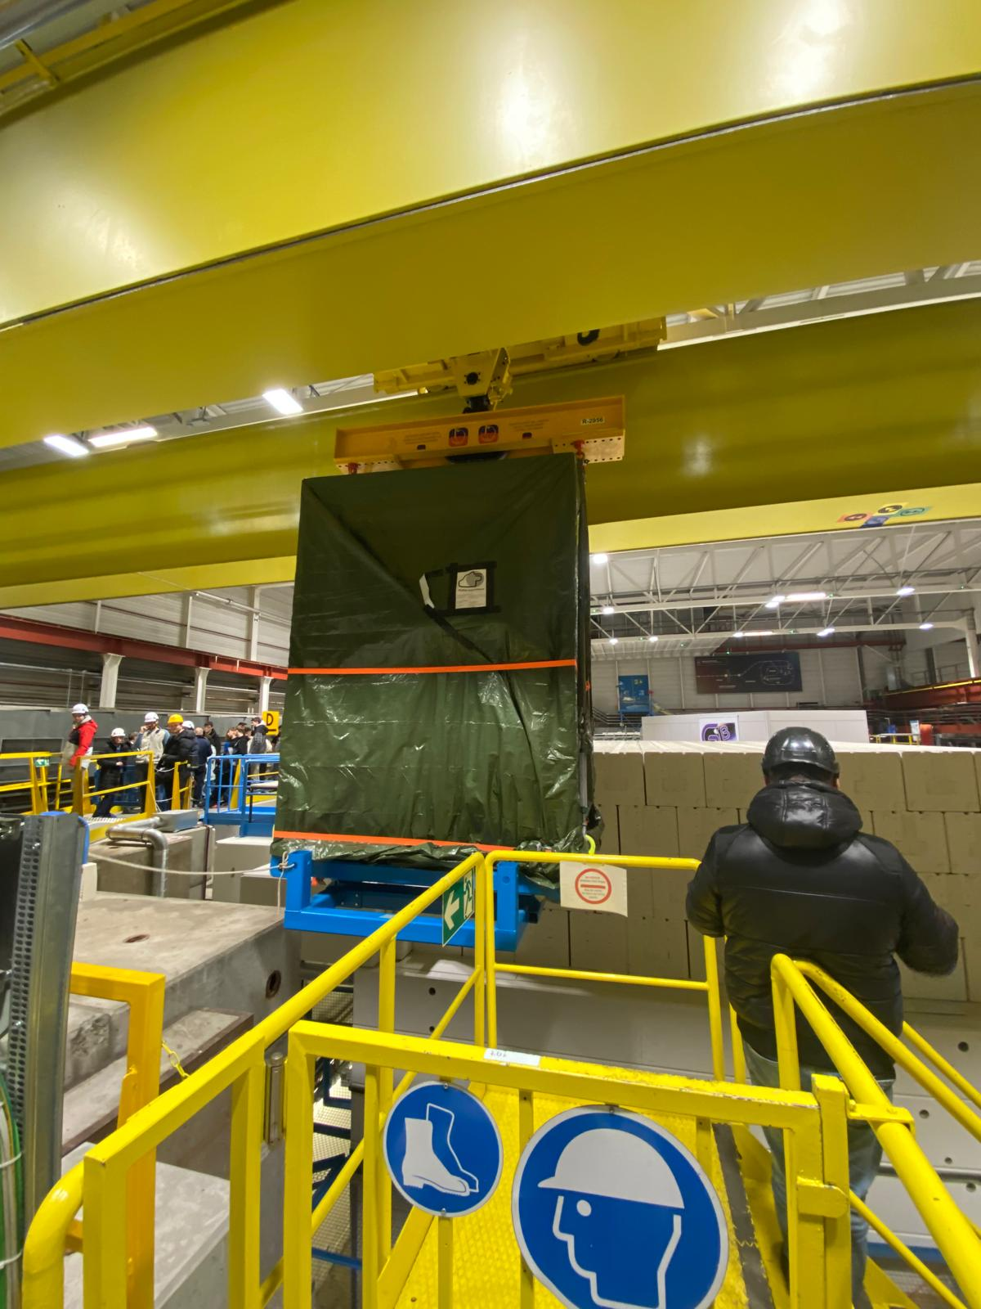
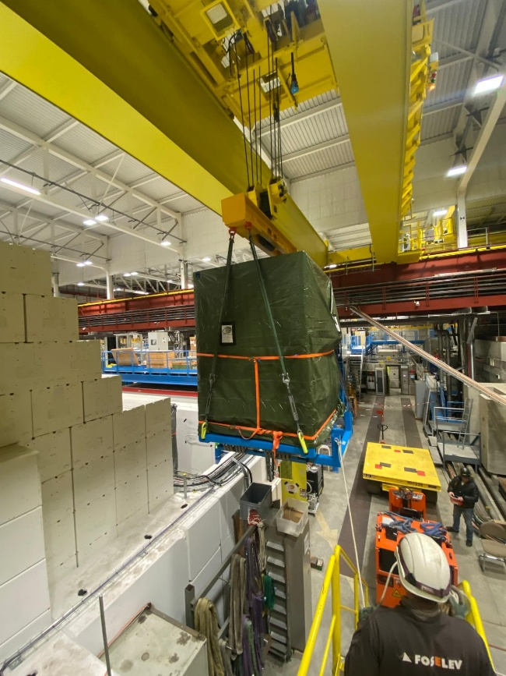
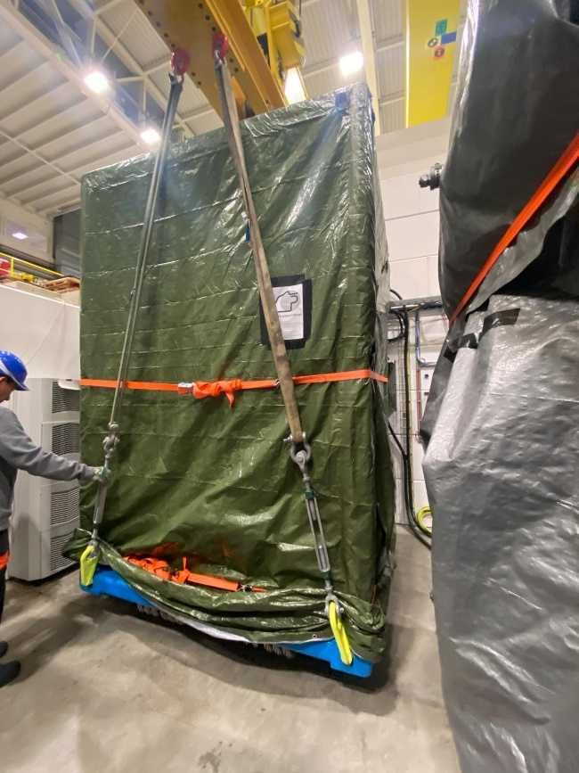
Arrival of PUMA @ CERN

Slide 9
Next steps
  Test in AD with full assembly
    In the previous lifting not all the components were installed, the c.o.g. was not representative
    Adjustments need to be done to achieve stability. The design of ISOLDE lifting beam depends on the test
  Design and manufacturing of ISOLDE lifting beam
  Receive the information regarding the test campaign to be able to prepare accordingly.

