Slide 1
Beam Instrumentation for PUMA@ISOLDE
M. Martin Nieto , P. Martins, J. Tassan-Viol
W. Andreazza, S. Bart Pedersen
C. Pasquino, F. Roncarolo
Puma@Isolde – 12 March 2025

Slide 2
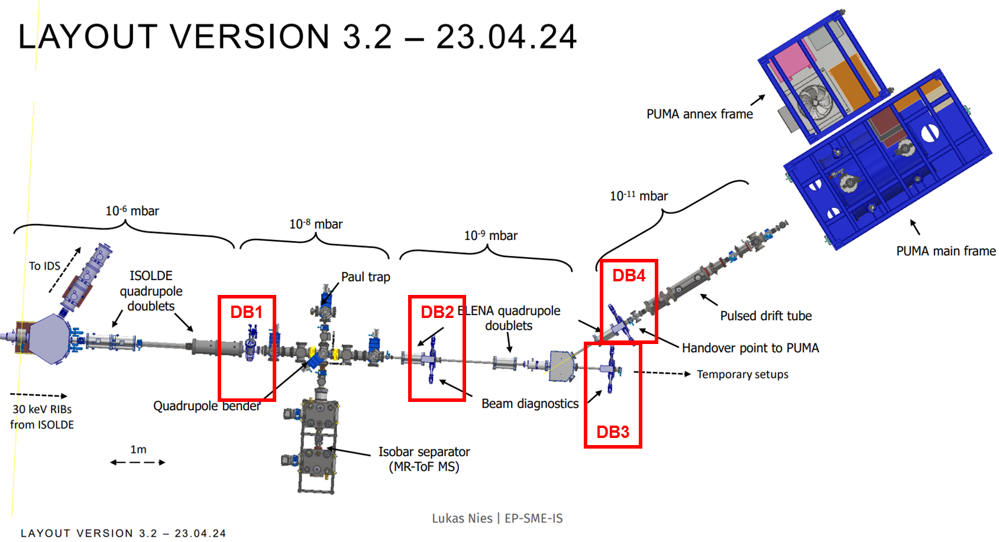
Beamline layout – BI Diagnostic boxes
DB1
  Isolde type:
    Faraday Cup
    Scanner
DB2-4
  HIE-ISO type:
    Faraday Cup
    Scanner
    MagneToF
    Slit/collimator

Slide 3
Status and Plans of DBs
Mechanical Design, Integration and Procurement

Slide 4
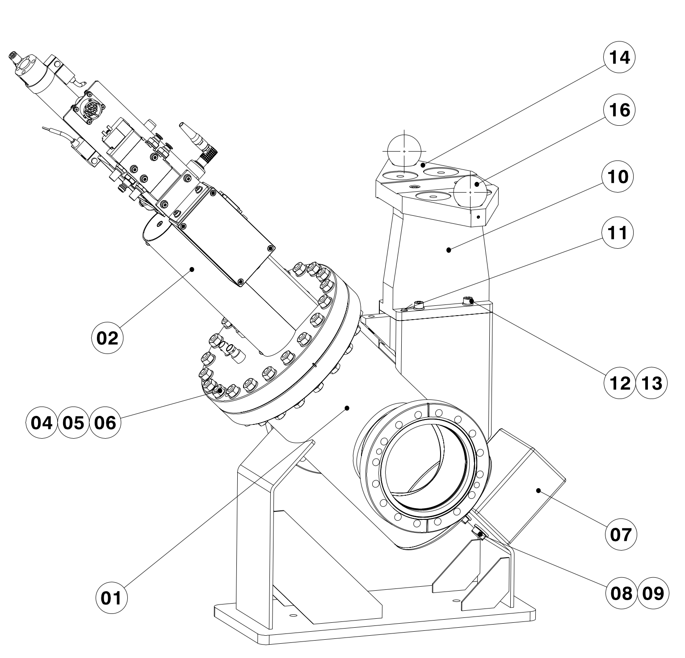
DB1
1x Scanner + Faraday cup for DC beam (low energy ISOLDE)
  1E-8 mbar
  New design from Standard Models with CF flange.
  2 Instruments SC+FC on same flange.
  Collaboration with EN-MME Design Office.

Slide 5
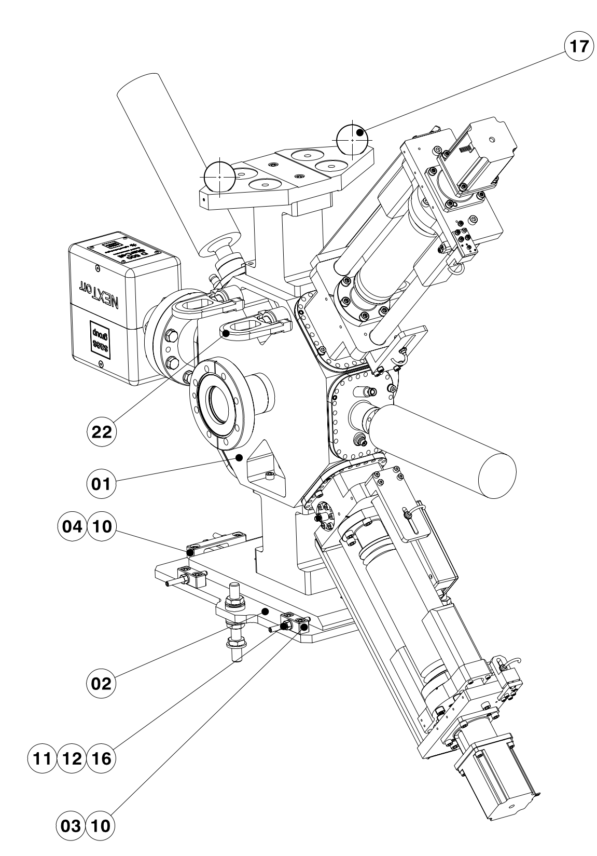
DB2, DB3, DB4
3 (+1) HIE Isolde (Long) DBs for DC and Pulsed Beam
  1E-9, 1E-11 mbar
  Based on HIE-ISO design.
  1 Instrument per flange.
    FC, SC, MT, Slits/collimator.
  MagneToF supplied by the collaboration.
  Collaboration with EN-MME Design Office.

Slide 6
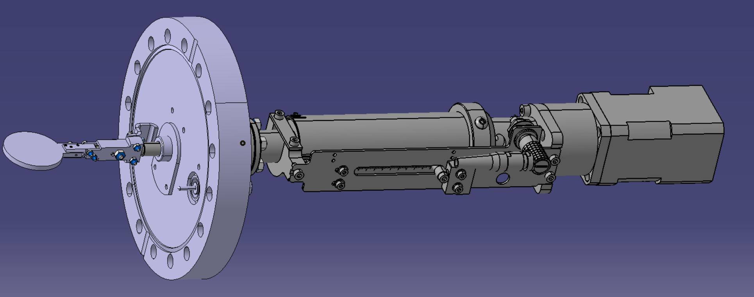
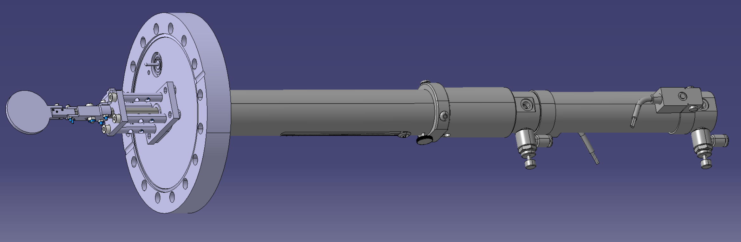
HV Cage Collector Plates
Main priority are the DB
  Design finished.
  2 variants with different stroke (not interchangeable).
  Single PAM for measuring, manually connected.
  Production for end of year.
  Delivery Q1 2026.
MagneToF
  We can connect to electronics.
  Responsibility remains with PUMA (not BI).
  Maintenance will require more resources.

Slide 7
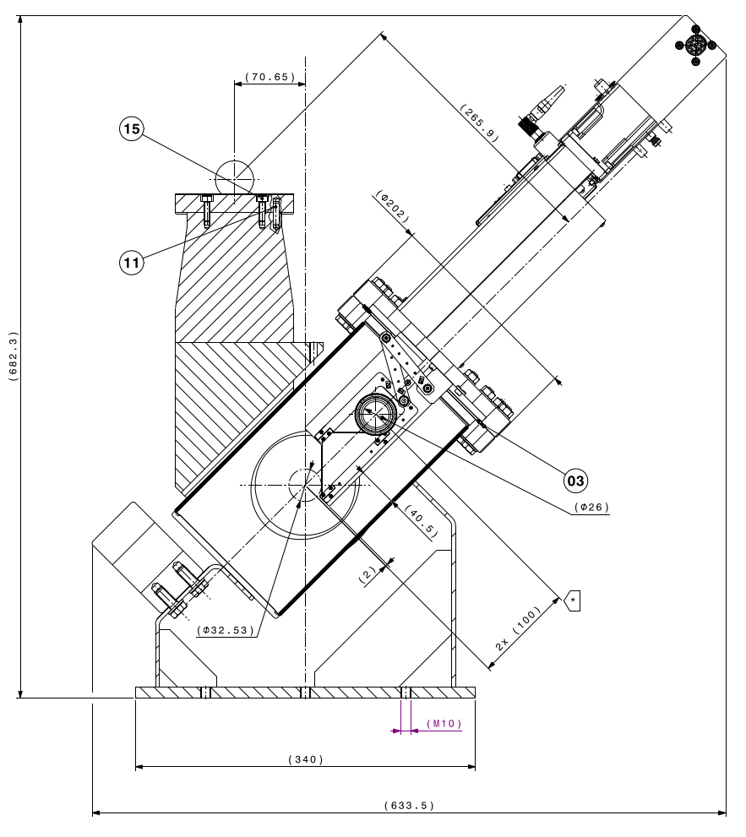
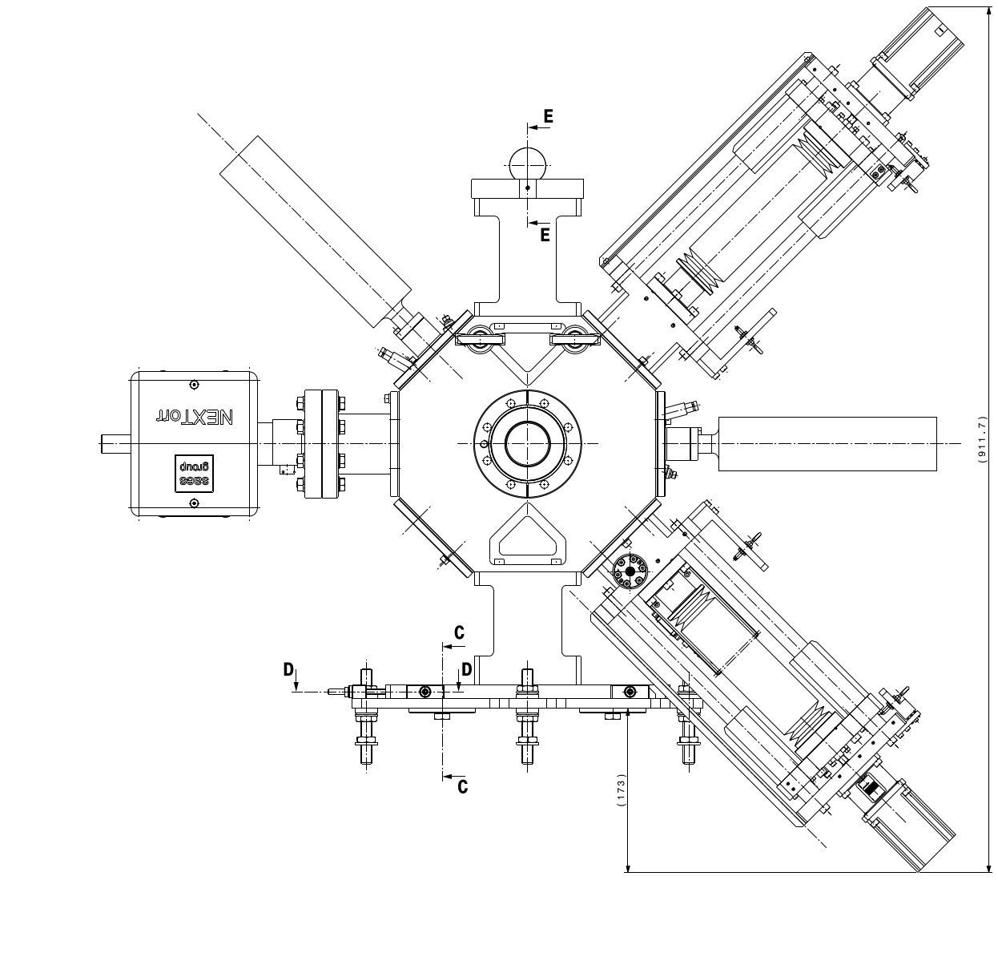
Manufacturing
Study, integration, drawings are finished and with the workshop.
  Delivery of machined parts for end of September.
  Procurement will be finalised this month.
  Around 1000 milled pieces (plus turned, EDM, bending, waterjet…).
  Around 1000 detailed drawings.
  80% of pieces will be machined at CERN.
  Assembly, calibration… will take ~1.5 months.
Calibration setup will be reused from HIE-ISO DBs.
  We are preparing a dry run to streamline the calibration process.

Slide 8
Status and Plans of DBs
Electronics and Acquisition

Slide 9
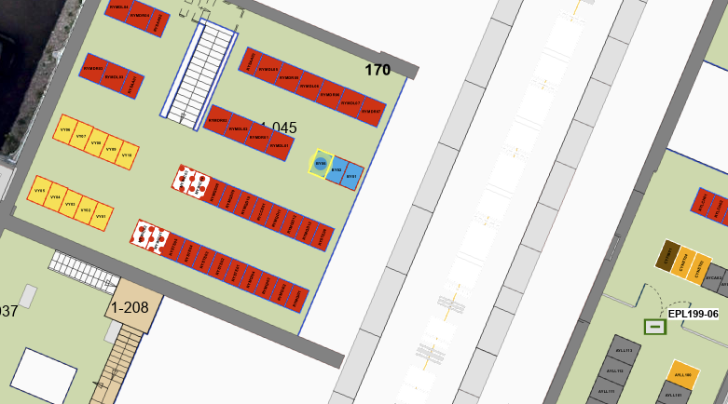
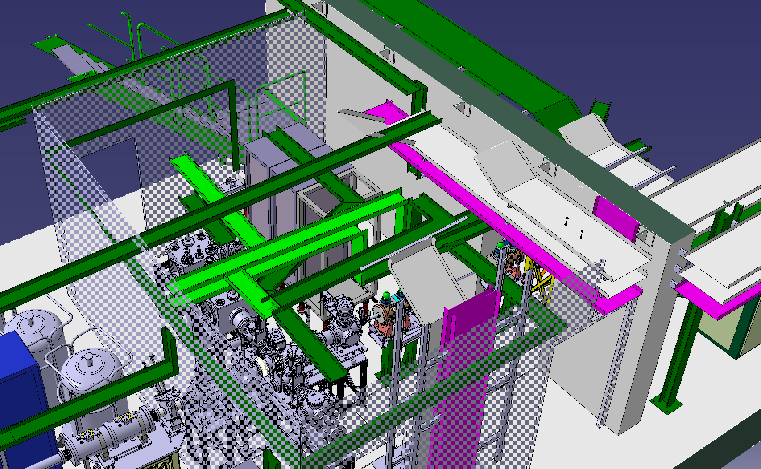
Rack and electronics
Rack is already installed: BY06=170.
Cabling will be pulled after the HV cage and cable trays are installed (EN-EL planning).
Electronics for FC, scanners and slits are in production or in stock.
TDC for MagneToFs:
  TDCs received.
  FEC installed.
  FESA class to be adapted from LHC BSRL.
New rack
installed

Slide 10
Outlook

Slide 11
Outlook
DBs in production queue:
  Delivery of machined components scheduled for end of September.
  Other components to be received by end of June.
  Time needed for assembly, metrology, calibration, cleaning, vacuum acceptance, installation.
  Delivery for mid-November absolute best case.
Electronics:
  Crate ready, in rack.
  Electronic cards in production / some ready.
  TDC received, FESA class to be implemented. Initial interfacing tests with MT to be done in OL2.
Budget:
  Mechanical: 350k (estimate) + 75k (collector plates).
    Machining at CERN estimate: 110k.
  Electronics: 65k (MT + electronics) + 20k (PAMs) + 18k (TDCs).
  These are still estimations.

Slide 12
Questions
Can management ask for priority in the main workshop?
Partial delivery?
  In extremis, we can deliver DB1 + DB2 and/or DB4 first.
Responsibility of development of control application?
Requirements for MToF FESA?
  Measurement window, resolution, etc.
Calibration and alignment needs?
  Faster 1st stage and final calibration with beam? Precision?
  Once installed, calibration will be much more difficult.
  Should be a dedicated meeting.
HV Cage MagneToF maintenance?

