Slide 1
WP2: the RC6 beam line
P. Arrutia
PUMA@ISOLDE #9
12/03/2025

Slide 2
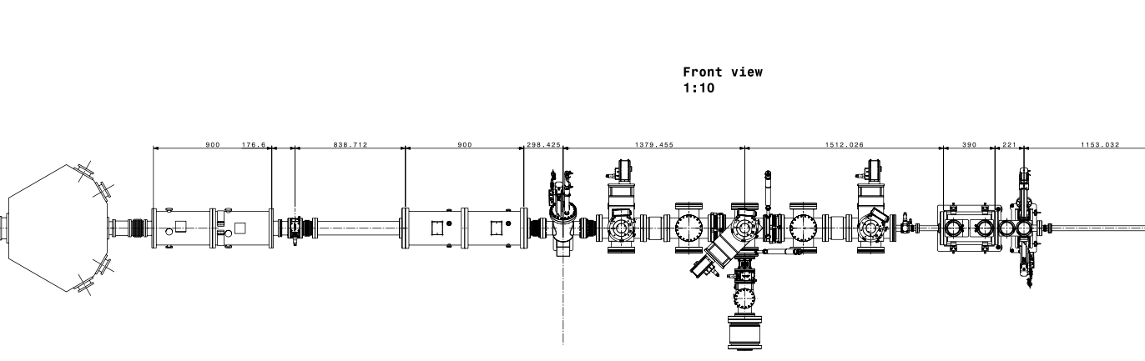
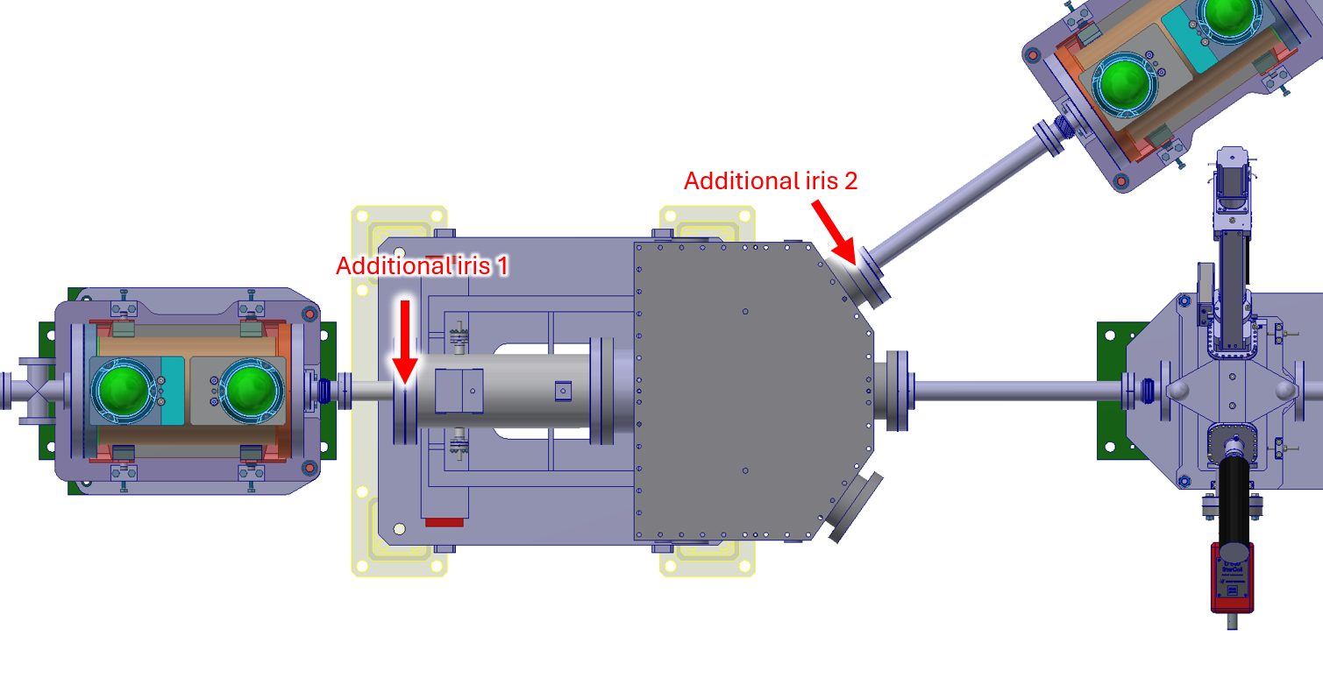
Iris study
Was asked by L. Nies and J. Ferreira Somoza to check the possibility of installing additional irises in RC6.
Goal: understand reasonable opening sizes that preserve good transmission.

Slide 3
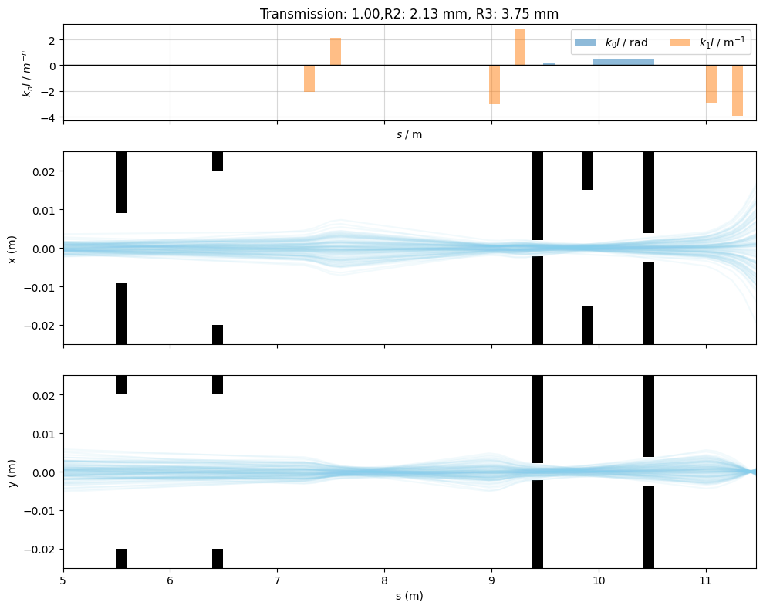
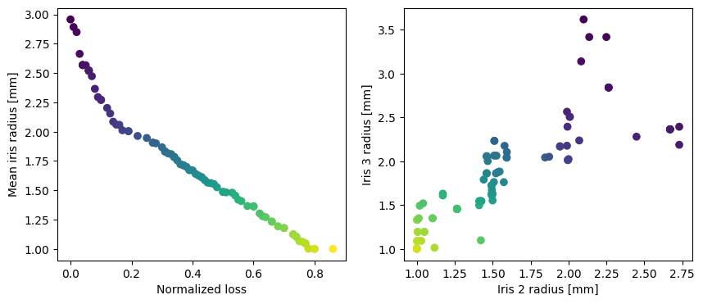
Iris study (ii)
Assuming circular irises, the optimiser finds the relationship between beam loss and iris radius.
Irises of ~3-4 mm in radius seem like a good choice for bunched beam.
Miracles exit
Iris2
Iris3

Slide 4
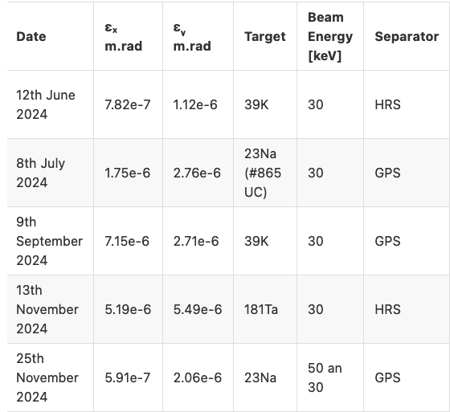
Optics measurements 2024
Research Fellow Q. Vuillemin performed several quadrupole scans last year.
All optics parameters, target types and beam energies compiled here.
Emittances compared to Allison scan performed for PUMA in Dec. 5th 2022 (epsx=9e-6 m.rad, epsy=6.5e-6 m.rad).
In general, PUMA values on the pessimistic side, so safe option for optics calculations, beam loss, etc.

Slide 5
Update on ZQNAs
Ready to launch production of ZQNA spare for PUMA -> no particular rush, waiting for additional requests to produce several units together.
Price estimation from expert ~25kCHF per unit -> included within consolidation budget.

Slide 6
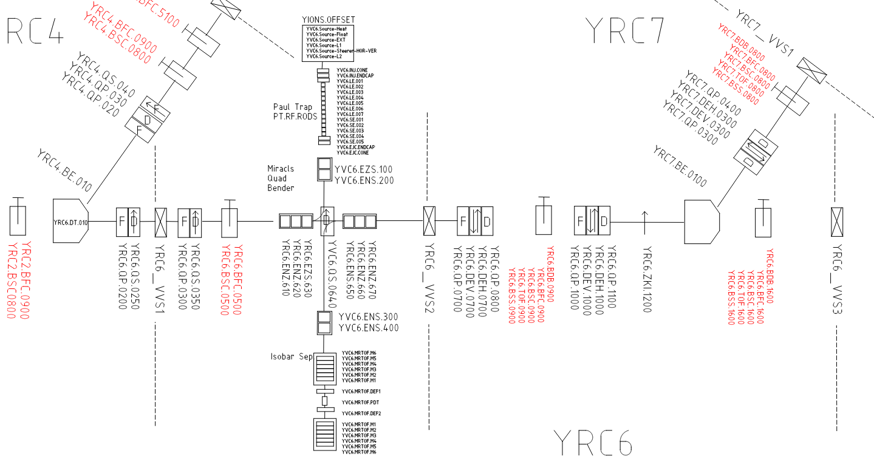
Layout DB
Recommendations for S. Mataguez on how to input the PUMA lines onto Layout DB:
Break up the transfer lines “kicker to kicker” to have correct beam path lengths (EDMS3160880).
For the MIRACLS device:
  Shoot-through option: define entire device as “instrument”.
  For non shoot-through option: no “canonical way”, since this is an experimental device… Perhaps, just make single line from Paul Trap to MRToF?
YRC2 to YRC4
YRC2 to YRC6
YRC6 to YRC7
MIRACLS
YRC2.ZKI.0700

Slide 7
Conclusion
Optics model used to recommend 3-4 mm radius irises at end of RC6.
Measurement campaign in 2024 provided additional info on expected emittances for PUMA line.
ZQNA production ready to launch. Price per unit 25 kCHF.
Input of MIRACLS in Layout DB requires a bit of thought… not a typical “optics layout”.

Slide 8
Extra slides

Slide 9
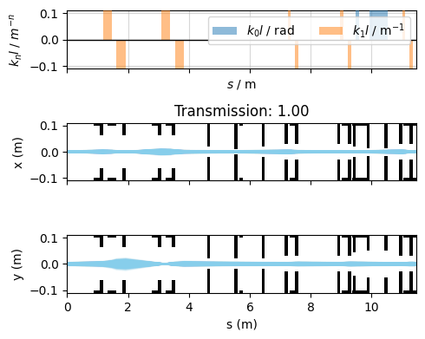
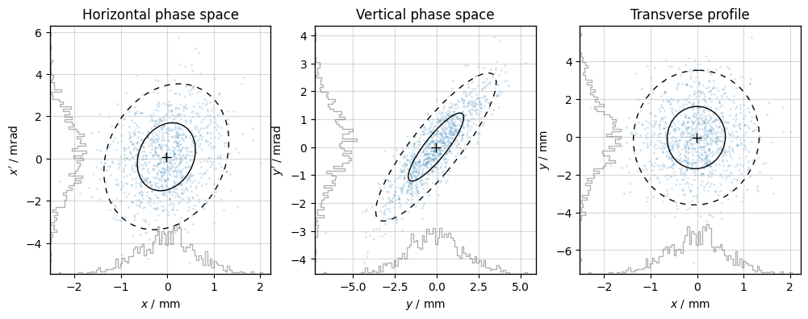
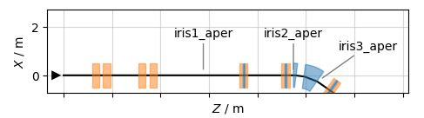
Problem setup
I ignore iris1, since beam size there will heavily depend on einzel+MR-TOF.
Trying to understand reasonable openings for iris2 and iris3.
Incoming beam taken from shoot-through config, but reduced remittances to emit_x = emit_y=1 mm.mrad (RMS).
Open iris transport

Slide 10
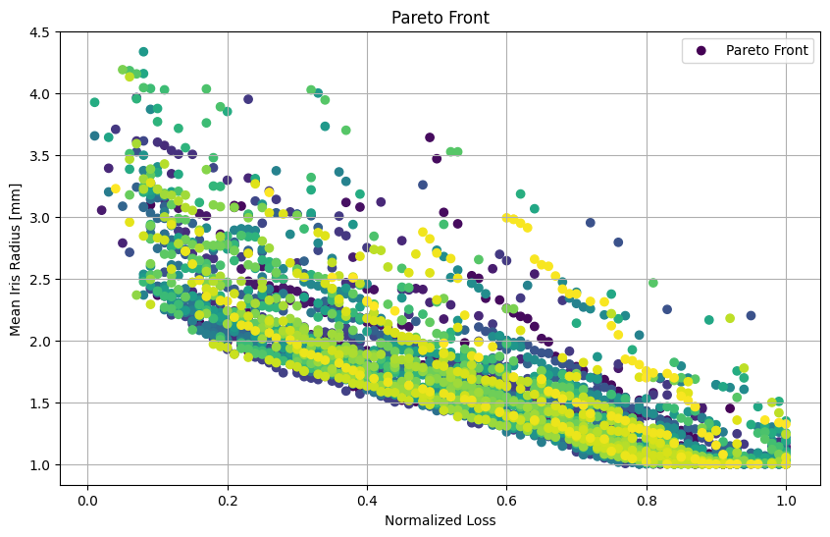
Limitations of study
An estimate of the output distribution of mrTOF is needed to make an accurate prediction of beam sizes.
  Robustness was tested by changing the initial optics parameters of the beam (keeping emittance constant):

