Slide 1




Experimental tests for winding technology of Final Cooling Solenoid
M. Abdel Hafiz
& Final Cooling Solenoid working group

Slide 2
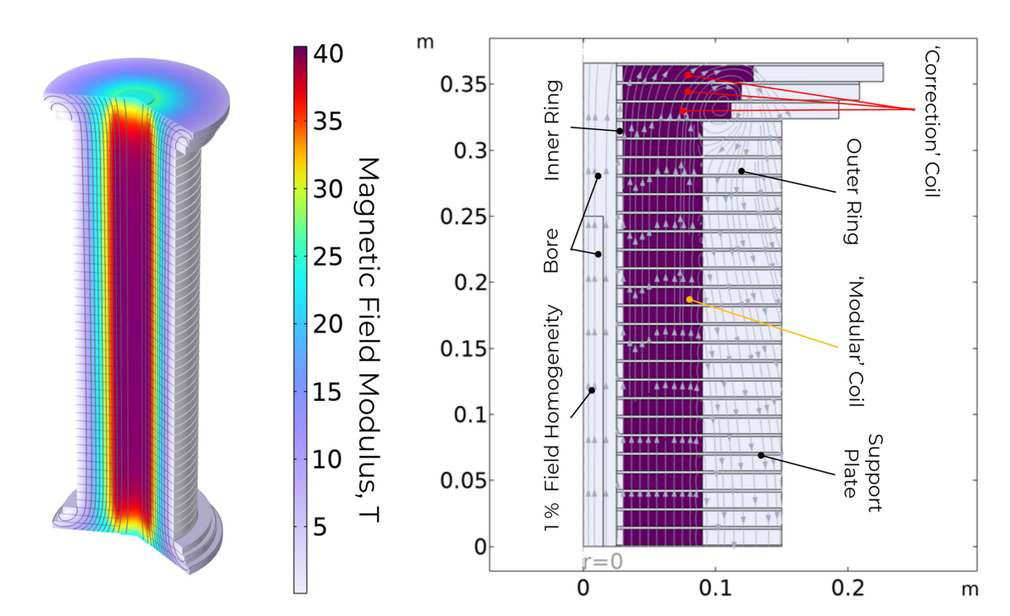
Final Cooling Solenoid
40 T , 50 mm bore diameter
Each pancake is in a solder matrix to redistribute stress
Proposal for widing a pancake :
How does that effect the tape properties ?
B. Bordini & al., 2024

Slide 3
Final Cooling Solenoid
Outline
Effect of Temperature on tape
Description of the winding
Effect of the winding proposal on pancake properties
Chemical etching to control transverse resistance
Effect of the etching on pancake properties
All results presented from this study have been performed on a Theva TPL4421

Slide 4
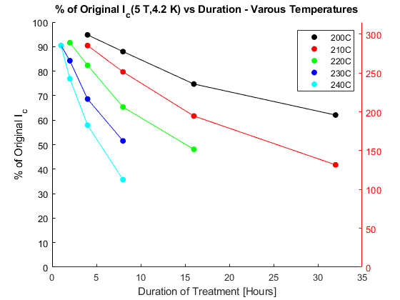
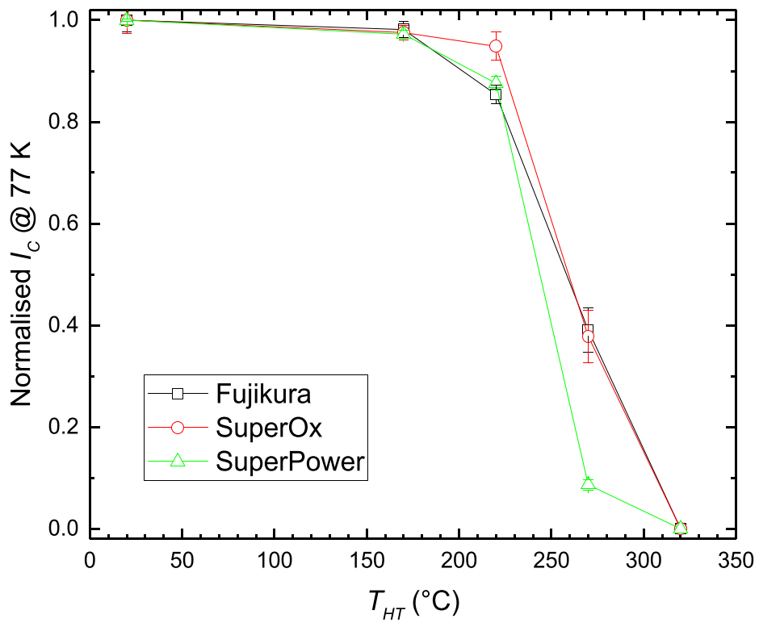
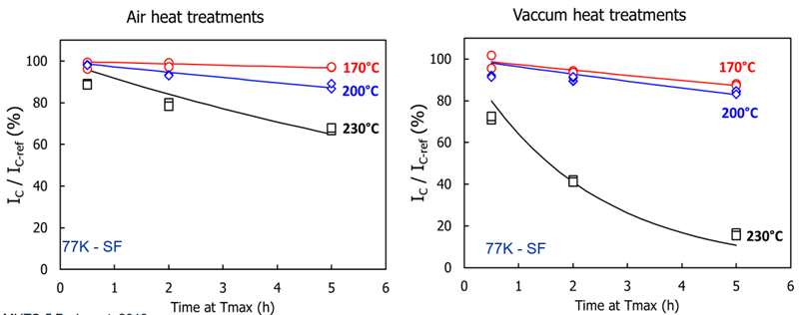
Temperature influence on I_{C}
Literature
I_{C} degrades with time and temperature
2 mechanisms of degradation :
  Oxygen-out diffusion from grain boundaries of ReBCO layer
  T > 250°C → Oxygen-out diffusion from grains of ReBCO layer
Heat treatment cycle does not affect
Stabilizer thickness is a parameter of degradation
Depends on the manufacturing process
Vacuum could have an effect
G. Bradford & al. MT26 (2019)
20 minutes plateau
M. Bonura & al. (2022)
I. Falorio (2020)
M. Abdel Hafiz | Experimental tests for winding technology of Final Cooling Solenoid

Slide 5
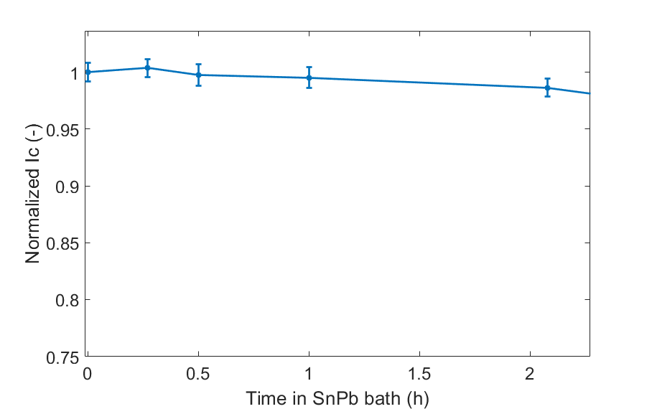
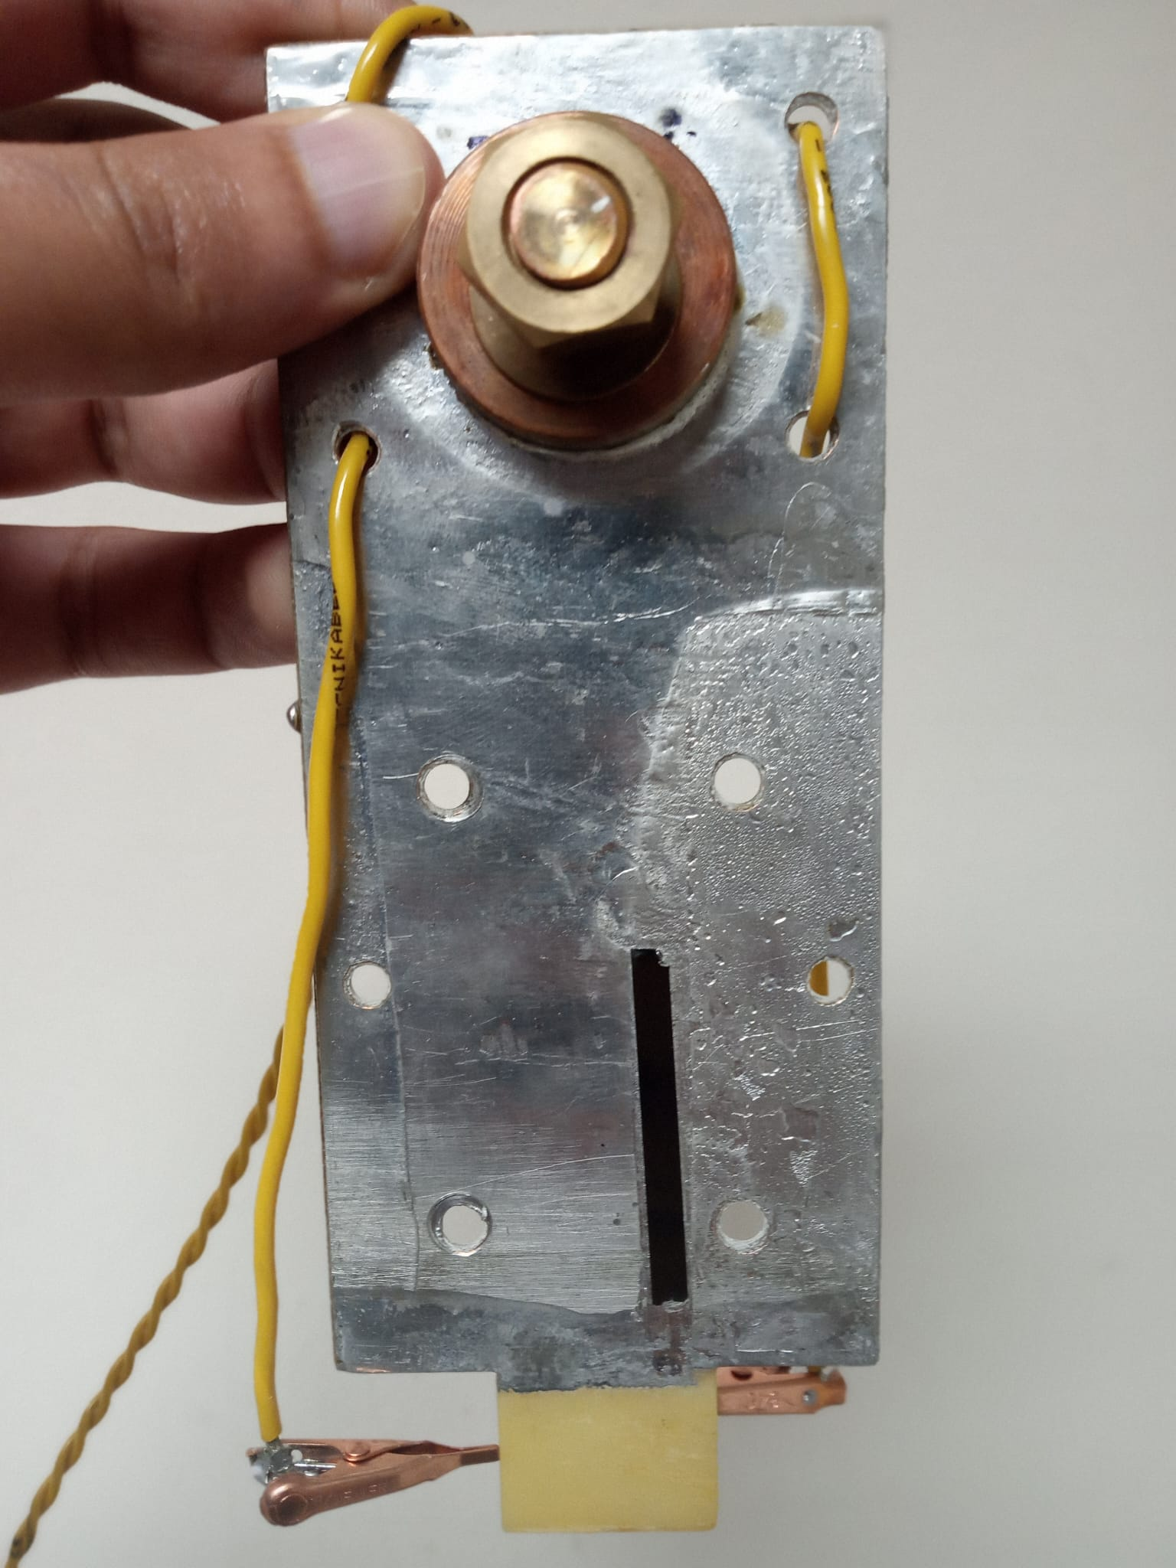
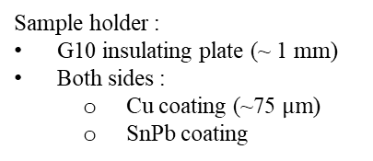
Temperature influence on I_{C}
Preparing samples
Sample holder :
G10 insulating plate (~ 1 mm)
Both sides :
  Cu coating (~75 $μm$)
  SnPb coating
Sample cycled :
Coating tape and soldered to the sample holder
I_{C} measurement @ 77K
Heated in solder bath @200 °C
Cycling process
Sample Holder
Preparing and coating samples do not visibly affect I_{C} on measured length
I_{C} Degradation of Theva TPL tape < 3% after 2h @200°C in SnPb bath
M. Abdel Hafiz | Experimental tests for winding technology of Final Cooling Solenoid

Slide 6
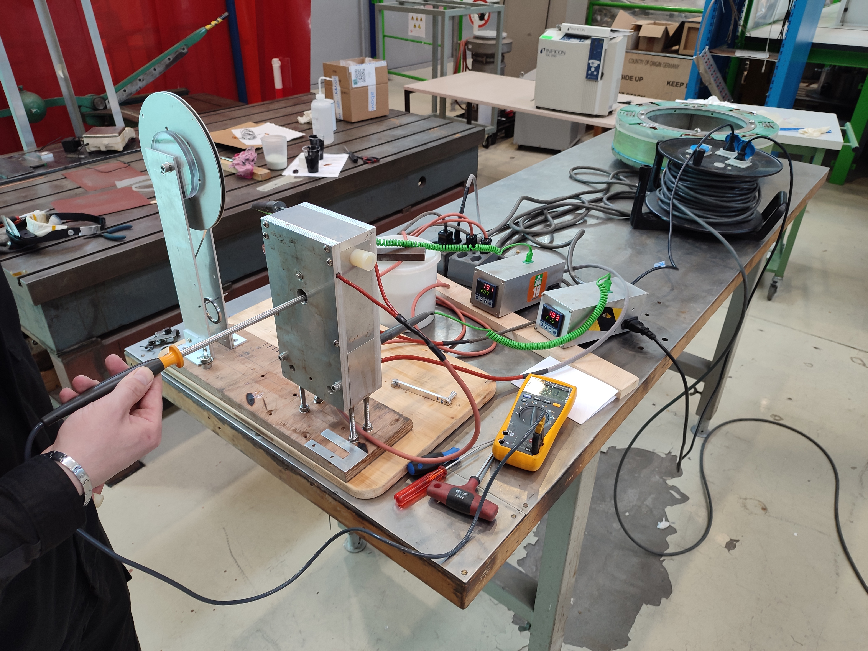
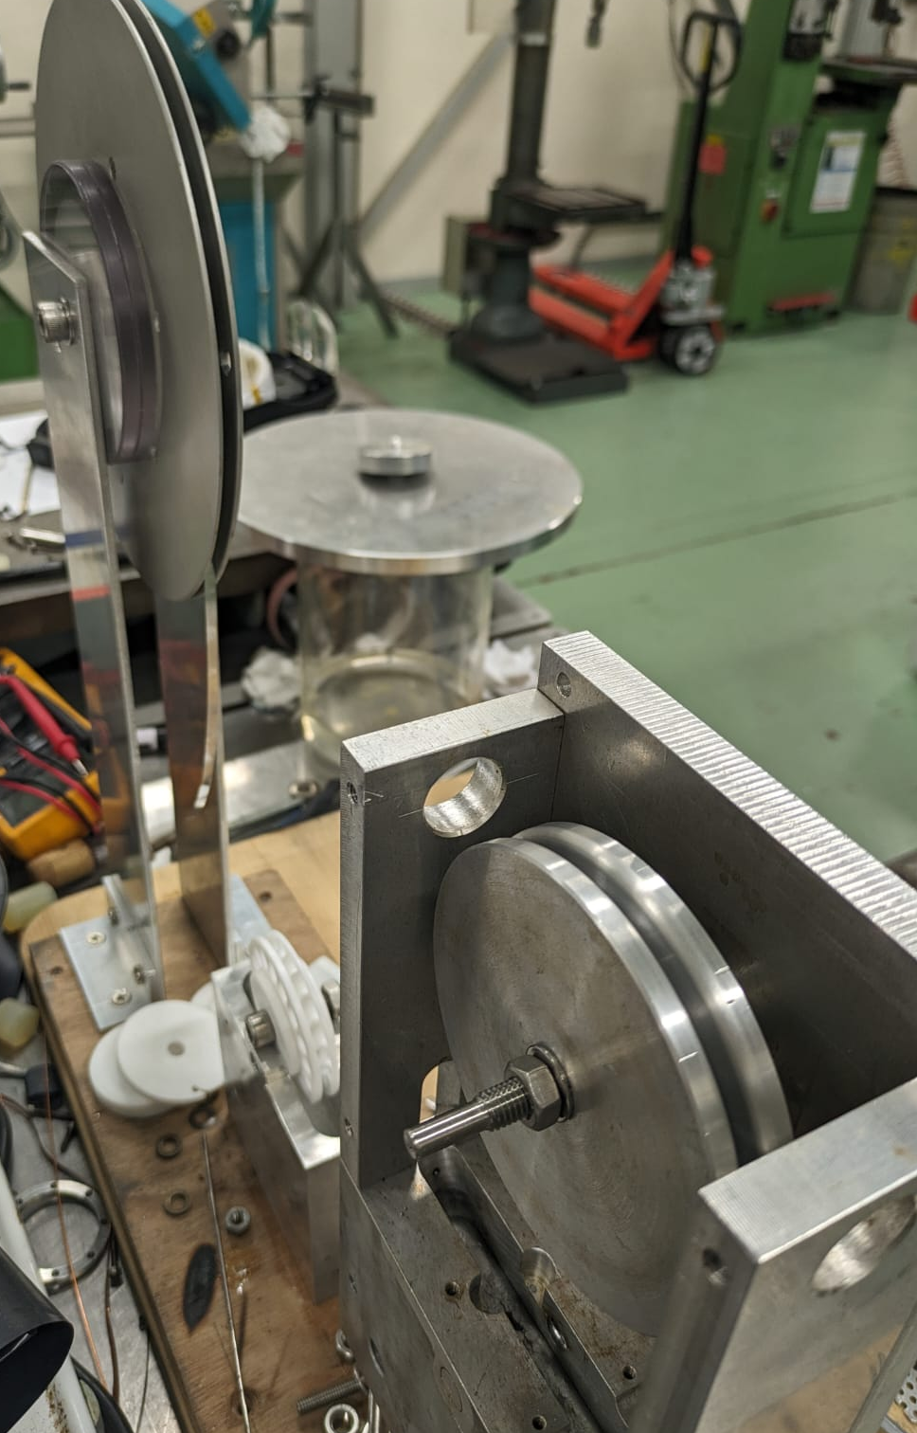
Hot winding
Winding tool prototype
Tape spool
Rotating wheel
(Opened) Oven
Flux bath
Wound spool
Heater slot
Solder bath
M. Abdel Hafiz | Experimental tests for winding technology of Final Cooling Solenoid

Slide 7
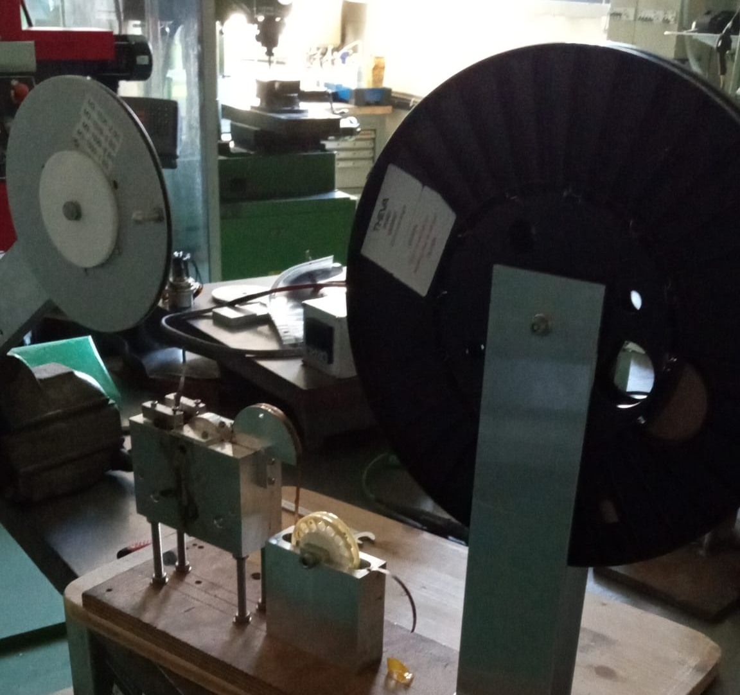
Hot winding
Winding protocol
Precoating tape
  Heat up to 200°C to melt SnPb (~15 min)
  Tape passes through flux and solder (~ 10 s)
  Gravity seems to be enough to remove some excess of solder
  Precoating tapes allows to :
    Control coating of tapes
    Remove flux bath during winding process
Tape spool
Winding spool
Solder bath (Sn₆₃Pb₃₇)
Flux bath
M. Abdel Hafiz | Experimental tests for winding technology of Final Cooling Solenoid

Slide 8
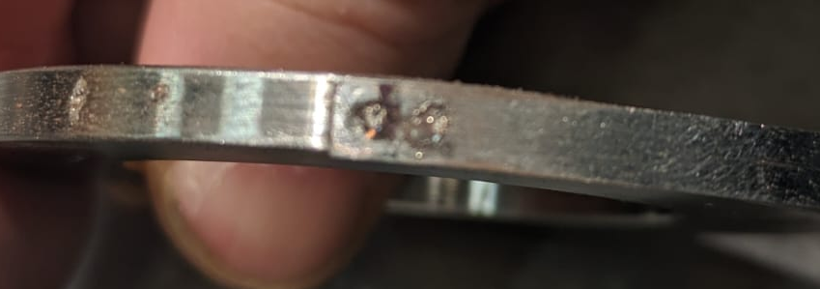
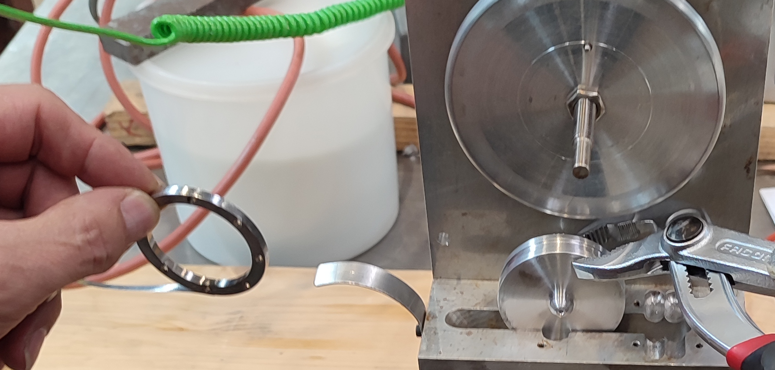
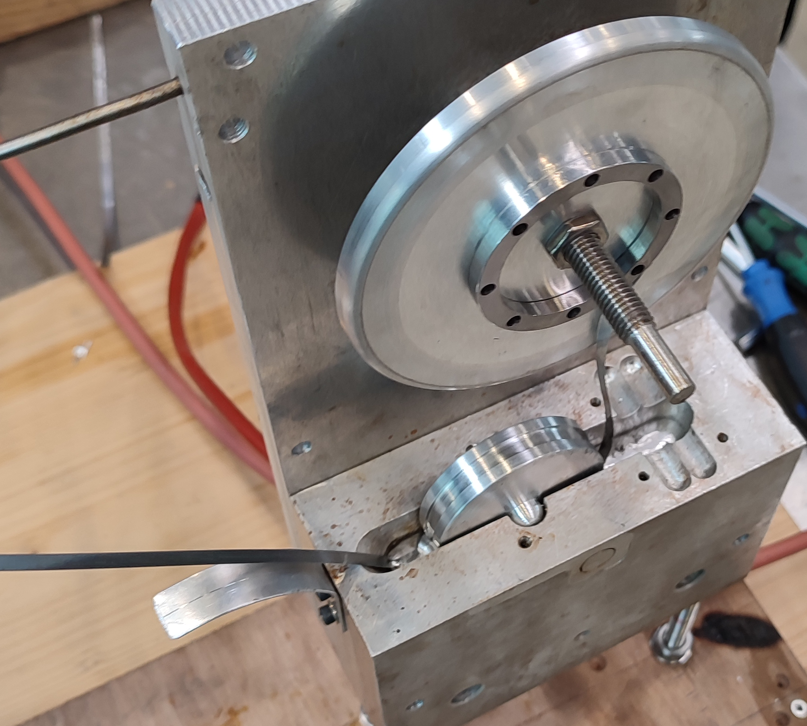
Hot winding
Winding protocol
Precoating tape
  Heat up to 200°C to melt SnPb (~20 min)
  Tape passes through flux and solder (~ 10 s)
  Gravity seems to be enough to remove some excess of solder
  Precoating tapes allows to :
    Control coating of tapes
    Remove flux bath during winding process
Starting winding
  Heat up the oven to 200°C to melt SnPb (~45 min)
  Remove the door & install the mandrel
    Invar mandrel has been chosen for these tests
      Invar shrinkage from 473K to 77K is lower than HTS and limiting radial tensile stresses in the pancake during cooling down
      Invar bounds well and easily to SnPb
    Tape is pre-installed on the mandrel
      Hooked in a groove
      Spot welded to the mandrel
  Close the door and reheat to 200°C (~20 min)
M. Abdel Hafiz | Experimental tests for winding technology of Final Cooling Solenoid

Slide 9
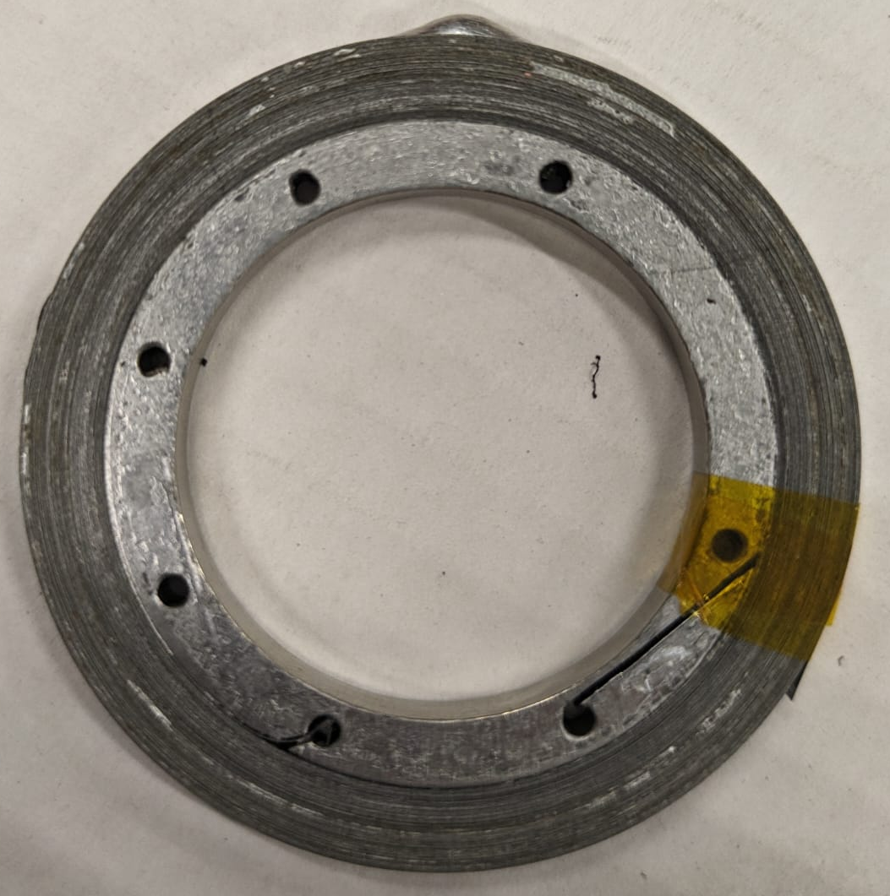
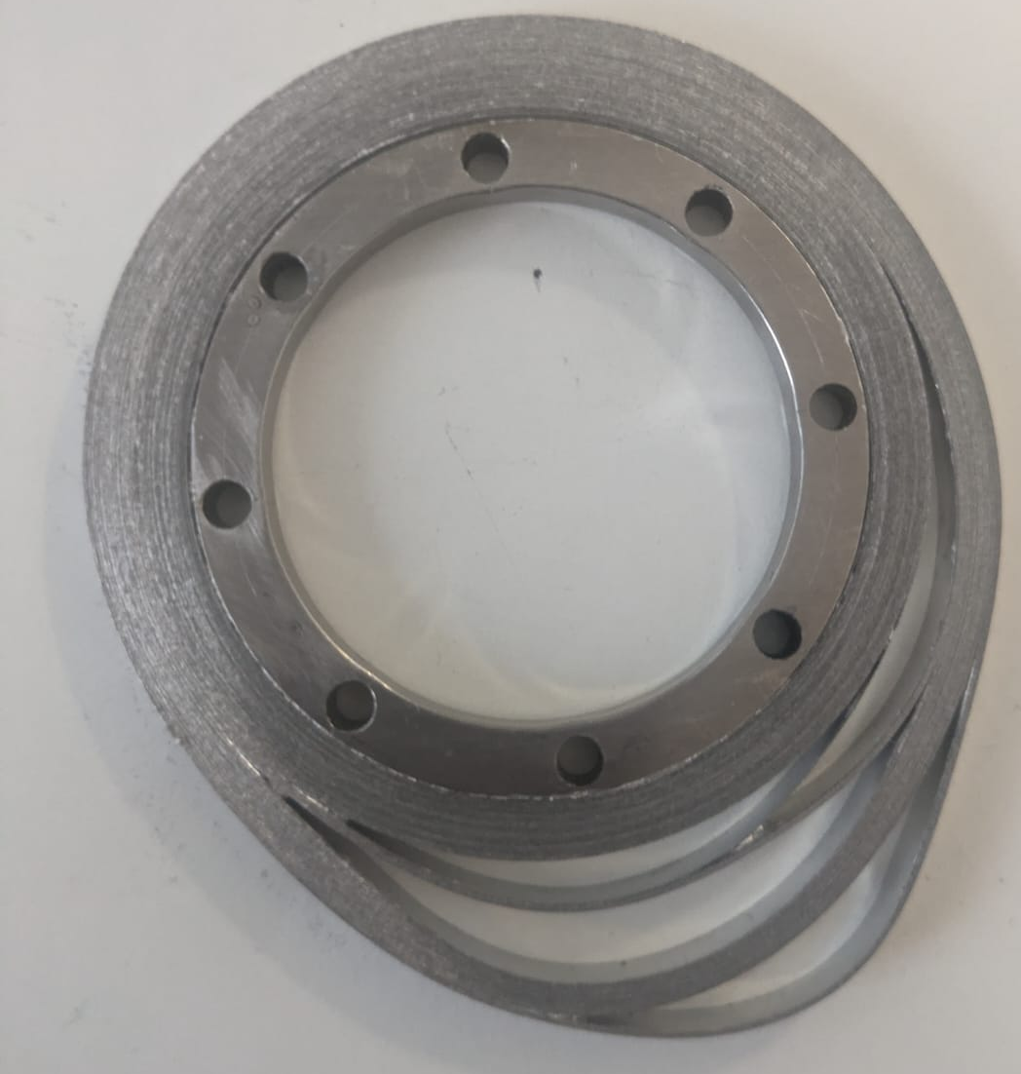
Hot winding
Winding protocol
Precoating tape
  Heat up to 200°C to melt SnPb (~20 min)
  Tape passes through flux and solder (~ 10 s)
  Gravity seems to be enough to remove some excess of solder
  Precoating tapes allows to :
    Control coating of tapes
    Remove flux bath during winding process
Starting winding
  Heat up the oven to 200°C to melt SnPb (~45 min)
  Remove the door & install the mandrel
    Invar mandrel has been chosen for these tests
      Invar shrinkage from 473K to 77K is lower than HTS and limiting radial tensile stresses in the pancake during cooling down
      Invar bounds well and easily to SnPb
    Tape is pre-installed on the mandrel
      Hooked in a groove
      Spot welded to the mandrel
  Close the door and reheat to 200°C (~20 min)
Winding pancake
  No controlled tension is applied nor measured
  Winding duration for 15m of tape took 20 to 40 minutes
Cooling down
  To room temperature (~ 1h)
Tin drop
2h of heating for the tape
4 Pancakes successfully prepared
M. Abdel Hafiz | Experimental tests for winding technology of Final Cooling Solenoid

Slide 10
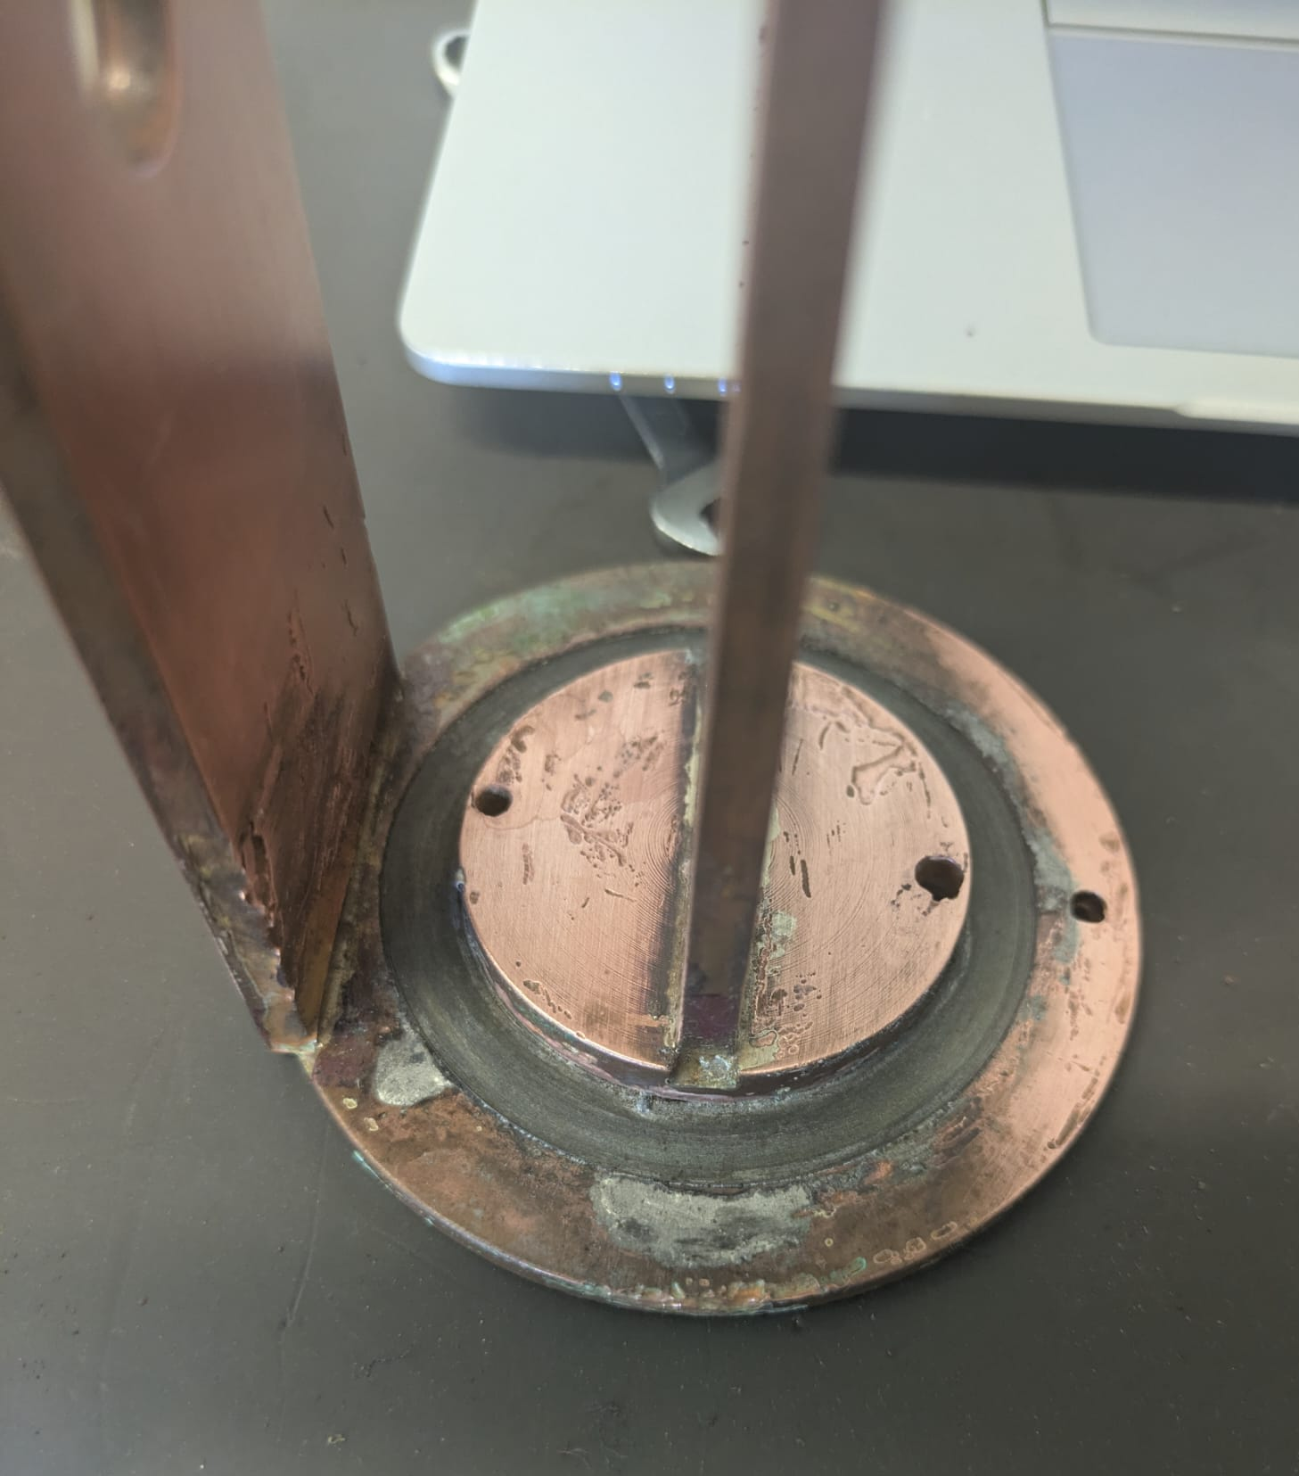
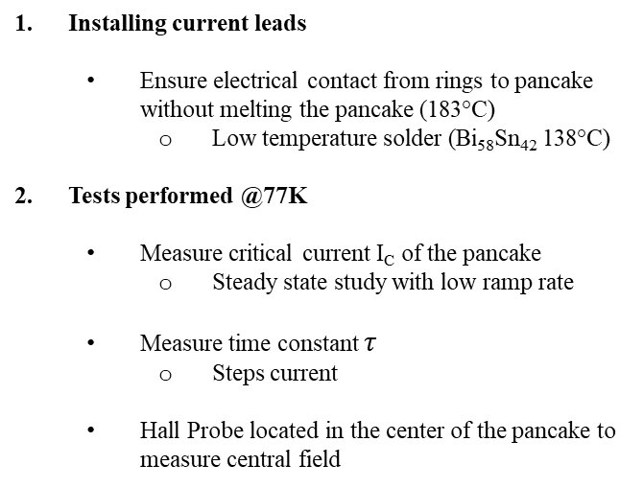
Pancake Properties
Preparation for experiment
Installing current leads
  Ensure electrical contact from rings to pancake without melting the pancake (183°C)
    Low temperature solder (Bi₅₈Sn₄₂ 138°C)
Tests performed @77K
  Measure critical current I_{C} of the pancake
    Steady state study with low ramp rate
  Measure time constant $τ$
    Steps current
  Hall Probe located in the center of the pancake to measure central field
Current leads
Outer ring
Inner ring
Voltage taps slots
Pancake
M. Abdel Hafiz | Experimental tests for winding technology of Final Cooling Solenoid

Slide 11
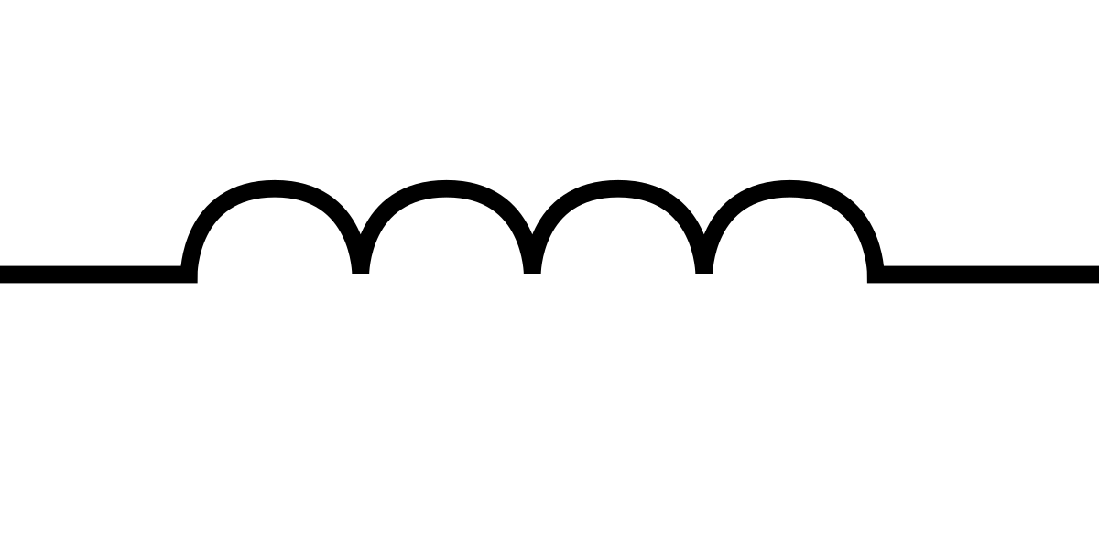





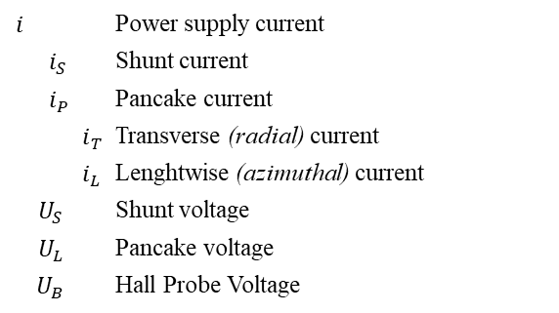


Pancake Properties
Experiment Scheme
Pancake
$$i_{T}$$
R_{T}
$i$
U_{S}
$$i_{P}$$
$$i_{S}$$
$$i_{L}$$
R_{S}
R_{L}
$i_{P}$
$$L$$
U_{L}
$$i$$ |  |  | Power supply current
 | $$i_{S}$$ |  | Shunt current
 | $$i_{P}$$ |  | Pancake current
 |  | $$i_{T}$$ | Transverse (radial) current
 |  | $$i_{L}$$ | Lenghtwise (azimuthal) current
$$U_{S}$$ |  |  | Shunt voltage
$$U_{L}$$ |  |  | Pancake voltage
$$U_{B}$$ |  |  | Hall Probe Voltage
Pancake
U_{B}
Hall probe
M. Abdel Hafiz | Experimental tests for winding technology of Final Cooling Solenoid

Slide 12
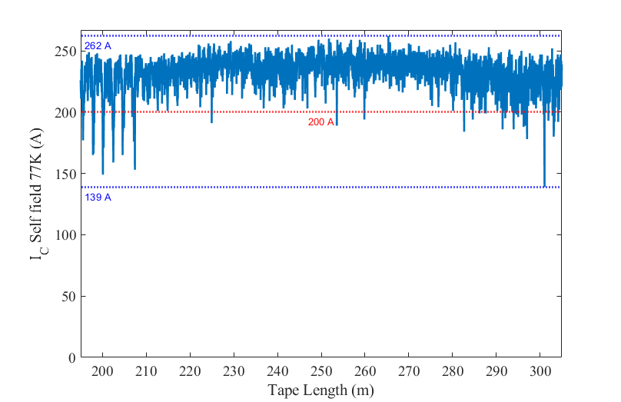
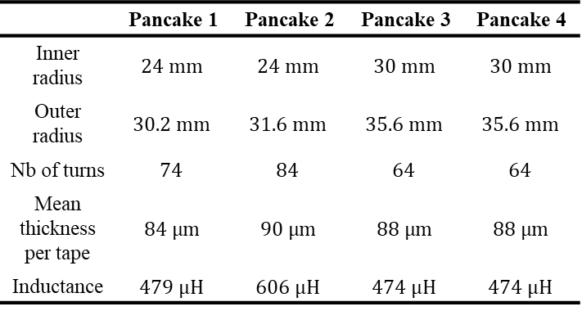
Pancake Properties
Tape I_{C} map
 | Pancake 1 | Pancake 2 | Pancake 3 | Pancake 4
Inner radius | $$24 mm$$ | $$24 mm$$ | $$30 mm$$ | $$30 mm$$
Outer radius | $$30.2 mm$$ | $$31.6 mm$$ | $$35.6 mm$$ | $$35.6 mm$$
Nb of turns | $$74$$ | $$84$$ | $$64$$ | $$64$$
Mean thickness per tape | $$84 μm$$ | $$90 μm$$ | $$88 μm$$ | $$88 μm$$
Inductance | $$479 μH$$ | $$606 μH$$ | $$474 μH$$ | $$474 μH$$
M. Abdel Hafiz | Experimental tests for winding technology of Final Cooling Solenoid

Slide 13
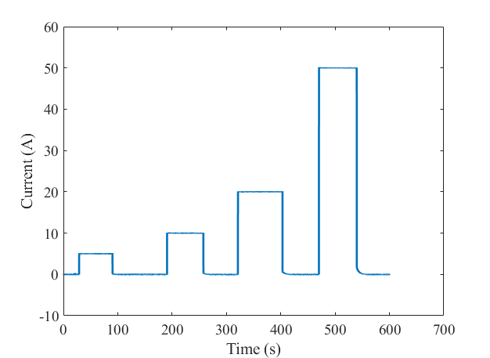
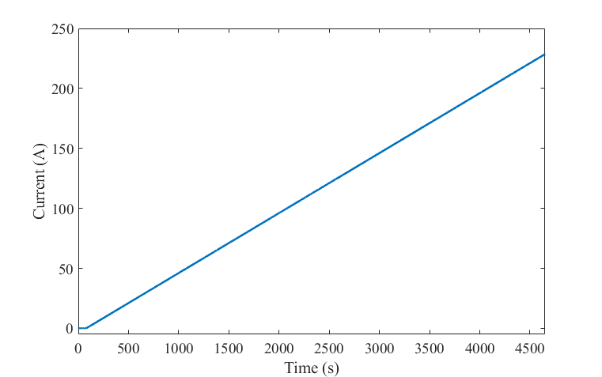
Pancake Properties
 | Pancake 1 | Pancake 2 | Pancake 3 | Pancake 4
Inner radius | $$24 mm$$ | $$24 mm$$ | $$30 mm$$ | $$30 mm$$
Outer radius | $$30.2 mm$$ | $$31.6 mm$$ | $$35.6 mm$$ | $$35.6 mm$$
Nb of turns | $$74$$ | $$84$$ | $$64$$ | $$64$$
Mean thickness per tape | $$84 μm$$ | $$90 μm$$ | $$88 μm$$ | $$88 μm$$
Inductance | $$479 μH$$ | $$606 μH$$ | $$474 μH$$ | $$474 μH$$
Transient study: Steps at different current
Steady state study : ramp of 0.05A/s
M. Abdel Hafiz | Experimental tests for winding technology of Final Cooling Solenoid

Slide 14
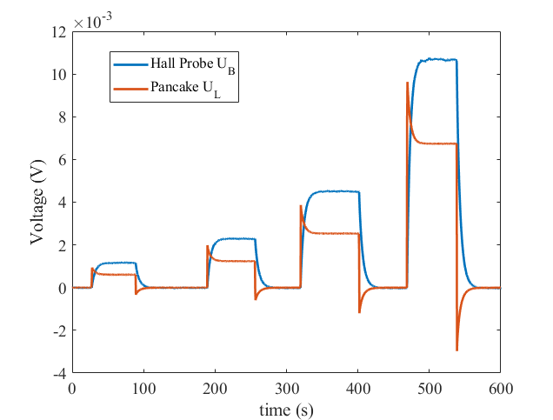
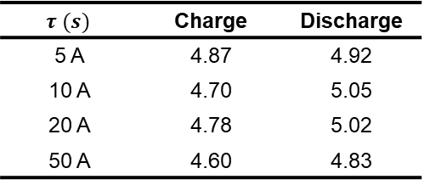
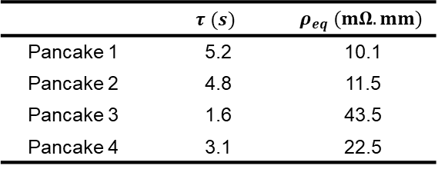

Pancake Properties
Transient Study
$$τ (s)$$ | Charge | Discharge
5 A | 4.87 | 4.92
10 A | 4.70 | 5.05
20 A | 4.78 | 5.02
50 A | 4.60 | 4.83
$τ=\frac{L}{R_{eq}}$ with $R_{eq}=∫\frac{ρ_{eq}}{2πrw}dr$
 | $$τ (s)$$ | $$ρ_{eq} (mΩ.mm)$$
Pancake 1 | 5.2 | 10.1
Pancake 2 | 4.8 | 11.5
Pancake 3 | 1.6 | 43.5
Pancake 4 | 3.1 | 22.5
M. Abdel Hafiz | Experimental tests for winding technology of Final Cooling Solenoid

Slide 15
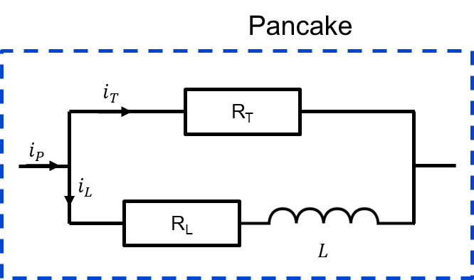
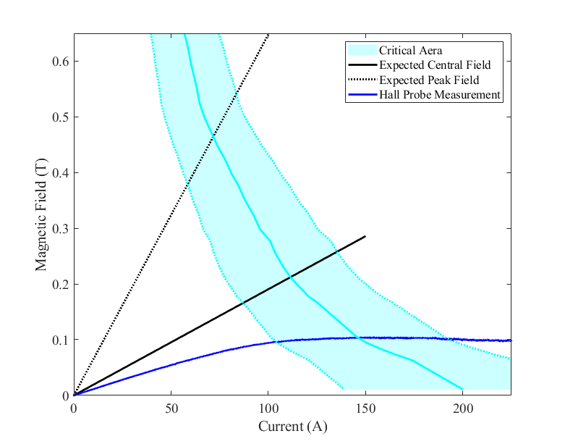
Pancake Properties
Steady State Study
M. Abdel Hafiz | Experimental tests for winding technology of Final Cooling Solenoid

Slide 16
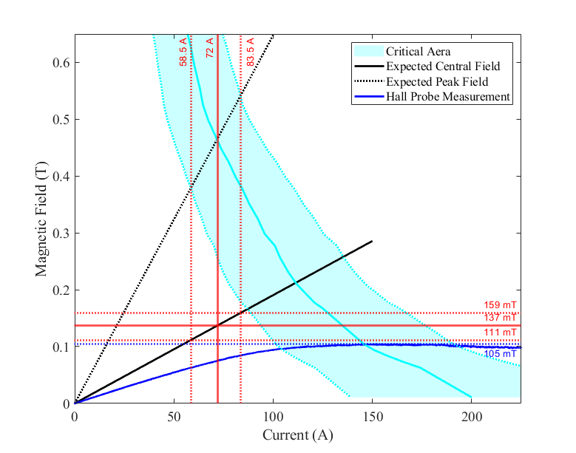
Pancake Properties
Steady State Study
‘Maximum’ Field (mT) | Expected | Measured
Pancake 1 | 129 | 115 (89%)
Pancake 2 | 137 | 105 (77%)
Pancake 3 | 93 | 72 (77%)
Pancake 4 | 93 | 68 (73%)
75 % of the expected maximum field
M. Abdel Hafiz | Experimental tests for winding technology of Final Cooling Solenoid

Slide 17
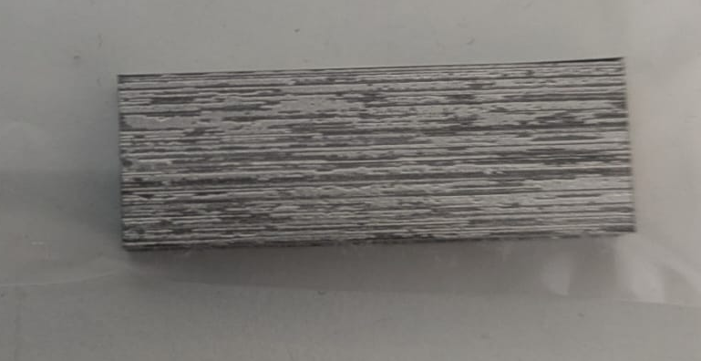
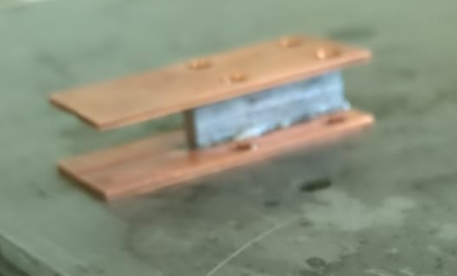
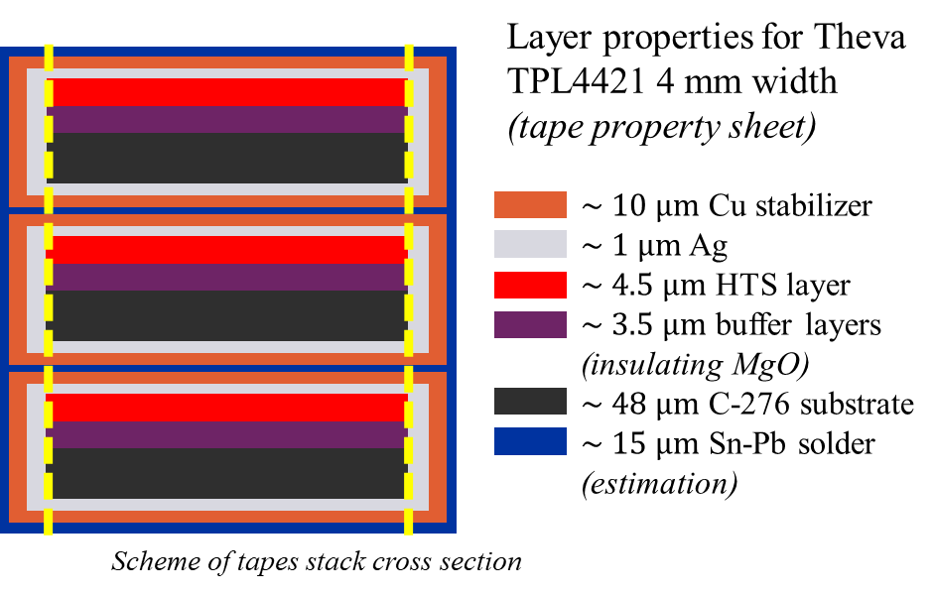
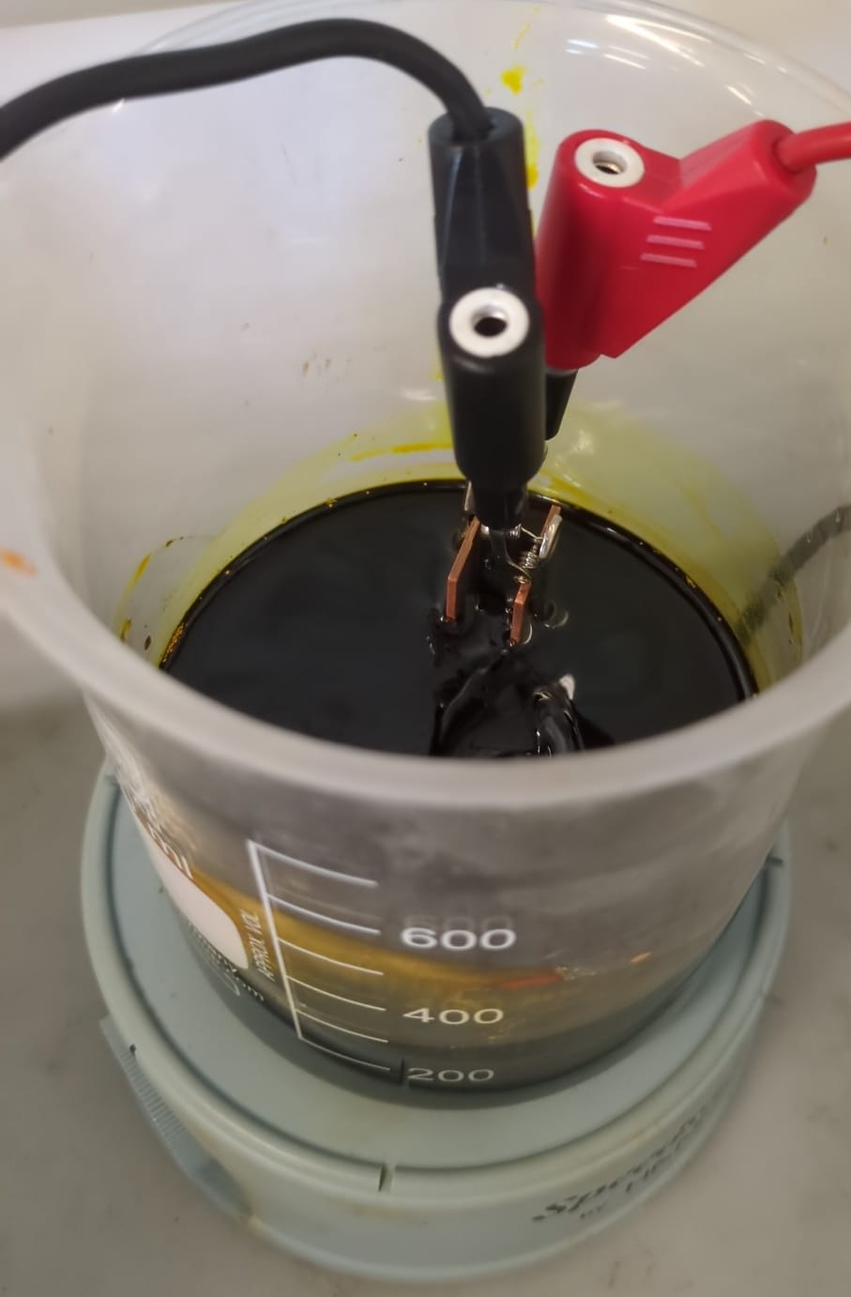
Chemical Etching
Ohmmeter
Chemically (FeCl₃ etching) remove both side of the tape to increase resistance
Magnetic stirrer
M. Abdel Hafiz | Experimental tests for winding technology of Final Cooling Solenoid

Slide 18
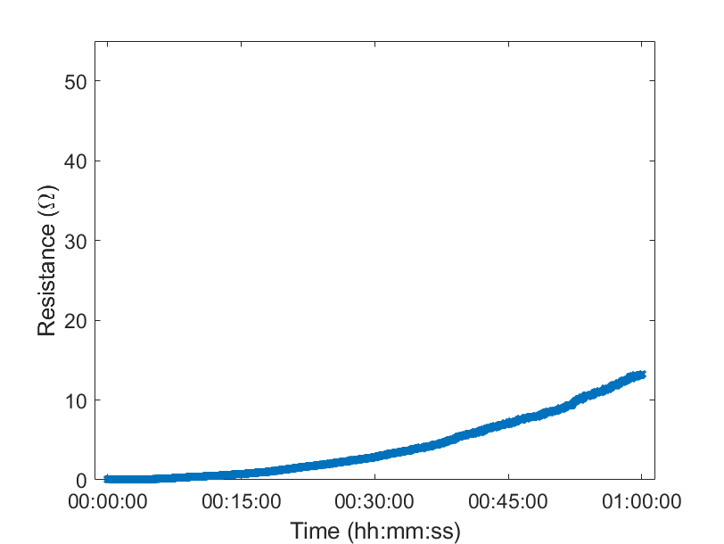
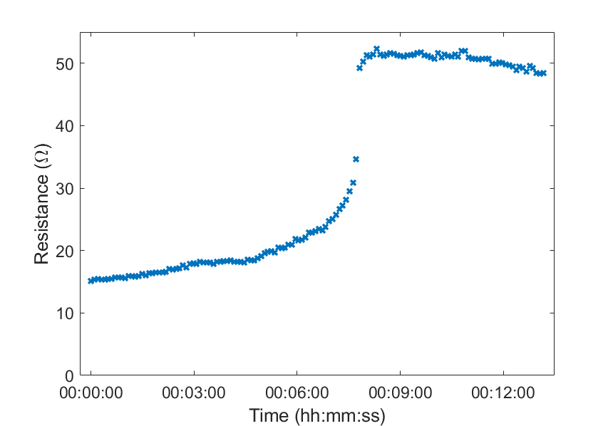
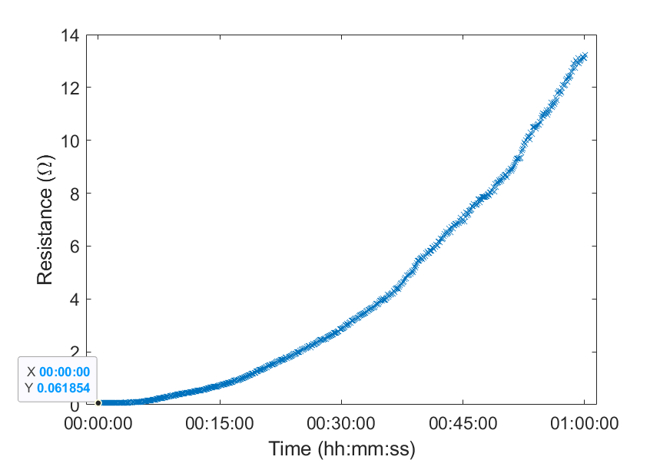
Chemical Etching
Stack 01
Program shut down for a few minutes
M. Abdel Hafiz | Experimental tests for winding technology of Final Cooling Solenoid

Slide 19
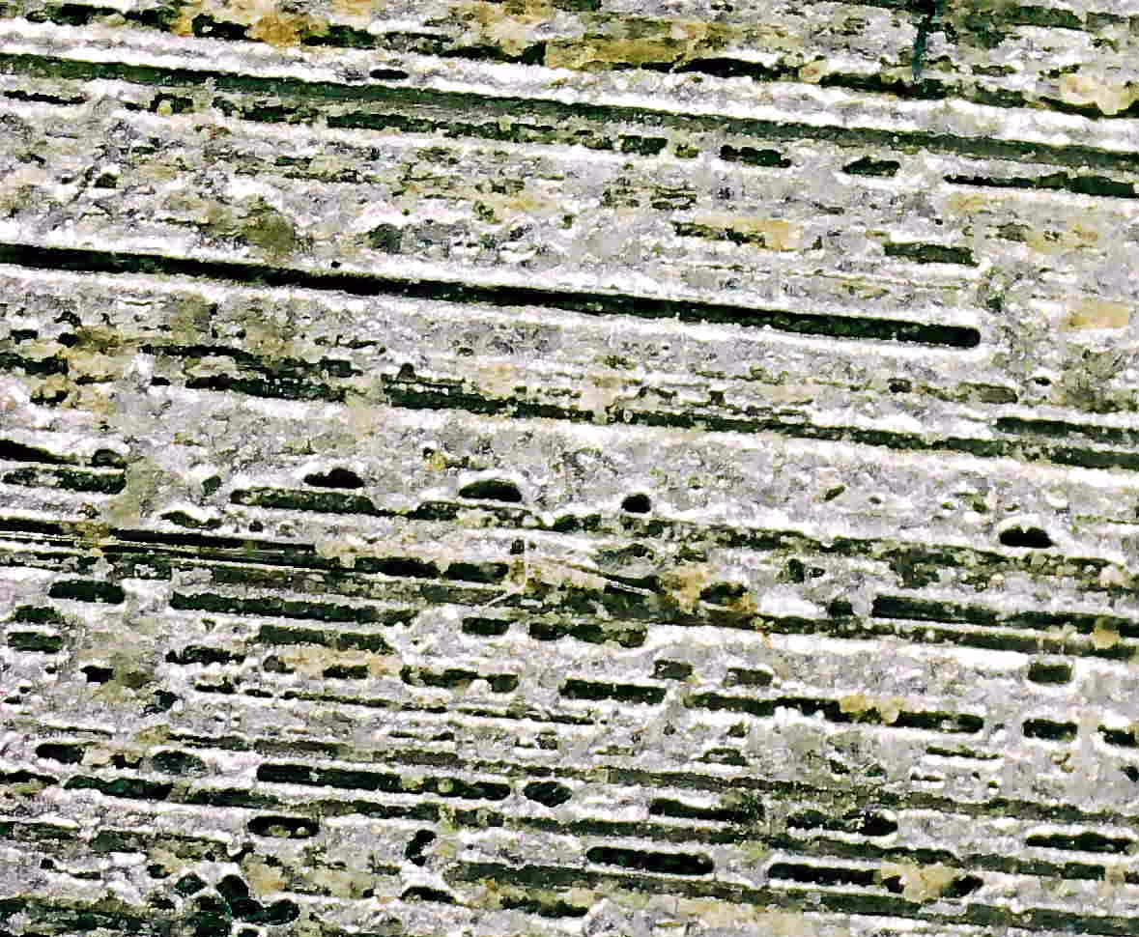
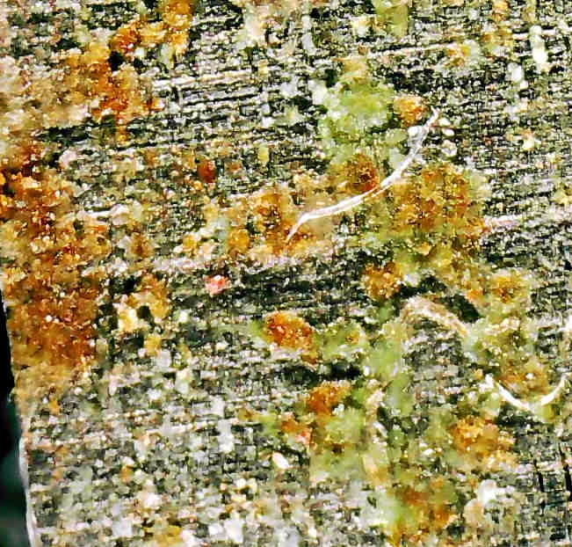
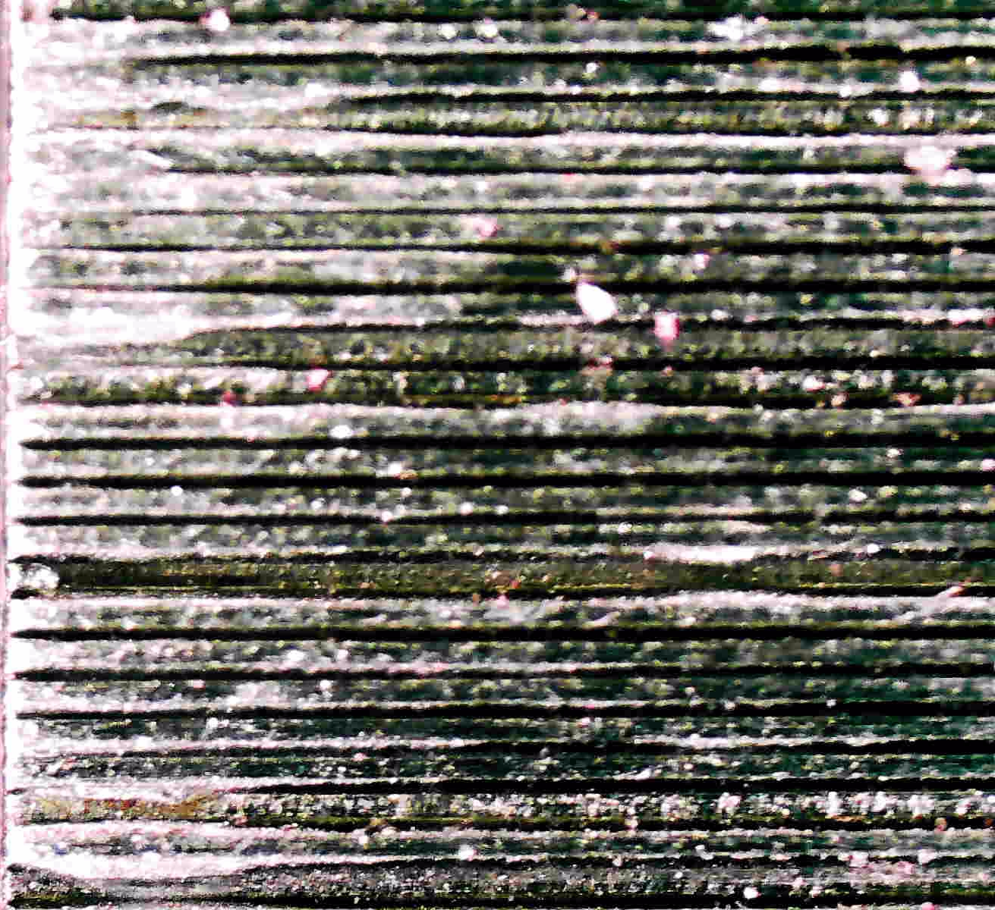



Chemical Etching
Stack 01
< 0.05 $Ω$
0.5 $Ω$
200 $Ω$
Resistance @77K increased by 4 order of magnitude after etching
What about I_{C} ?
M. Abdel Hafiz | Experimental tests for winding technology of Final Cooling Solenoid

Slide 20
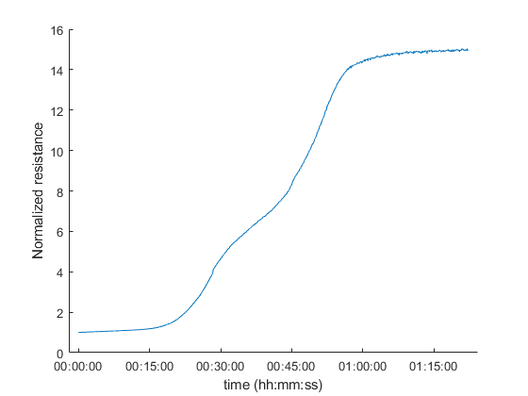
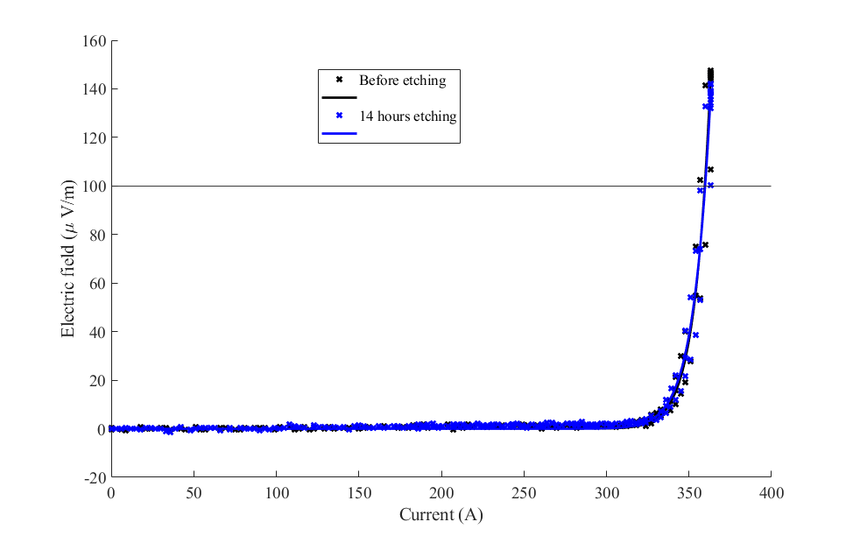
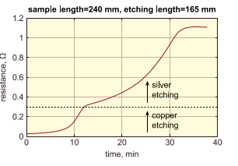
Chemical Etching
Stack 01
Two tapes soldered to each other
N. Bykovskiy and al. 2019
  Cu removed in ~30min
  Ag removed (?) in ~ 1h
Etching seems to have no effect on I_{C} need to be determined
Further experiments required to confirm
M. Abdel Hafiz | Experimental tests for winding technology of Final Cooling Solenoid

Slide 21
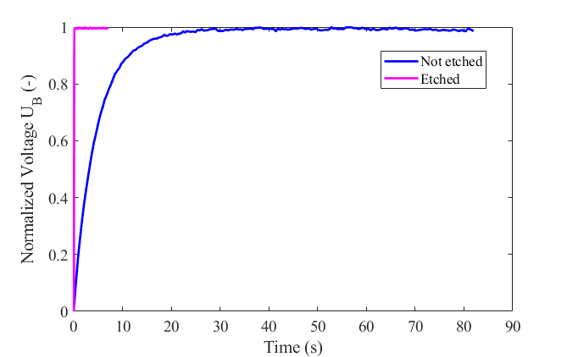
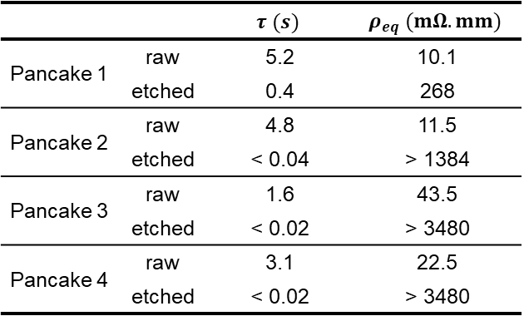
Chemical Etching
Pancake Properties
Stack 01
 |  | $$τ (s)$$ | $$ρ_{eq} (mΩ.mm)$$
Pancake 1 | raw | 5.2 | 10.1
 | etched | 0.4 | 268
Pancake 2 | raw | 4.8 | 11.5
 | etched | < 0.04 | > 1384
Pancake 3 | raw | 1.6 | 43.5
 | etched | < 0.02 | > 3480
Pancake 4 | raw | 3.1 | 22.5
 | etched | < 0.02 | > 3480
Time constant decreased by a factor 100
M. Abdel Hafiz | Experimental tests for winding technology of Final Cooling Solenoid

Slide 22
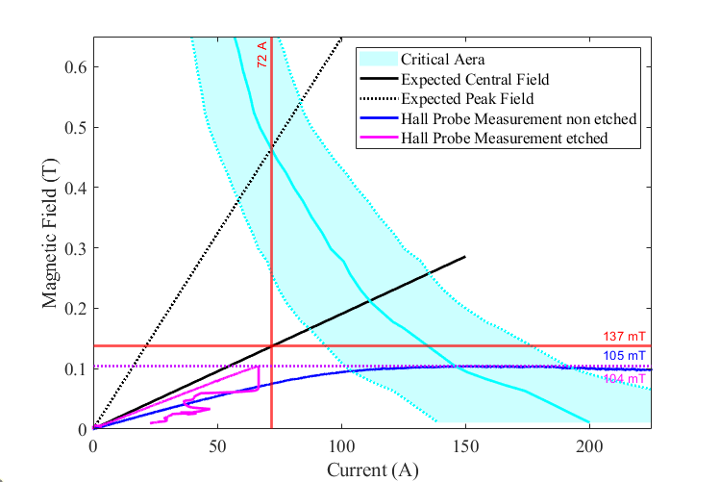
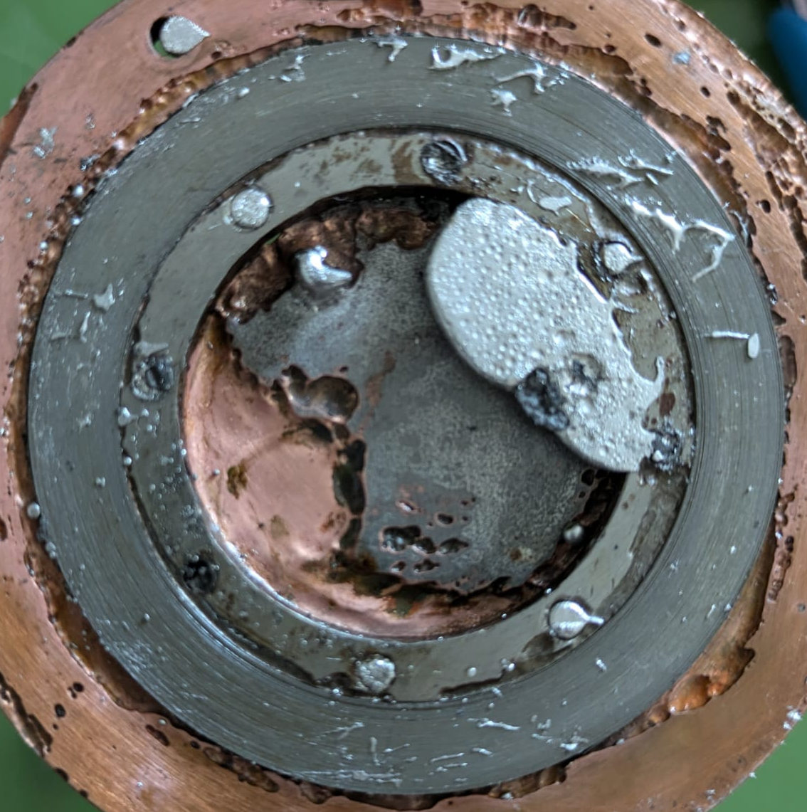
Chemical Etching
Pancake Properties
Stack 01
‘Maximum’ Field (mT) | Measured
Pancake 1 129 | Non etched Etched | 115 (89%)
 |  | 98 (76%)
Pancake 2 137 | Non etched Etched | 105 (77%)
 |  | 104 (76%)
Pancake 3 93 | Non etched Etched | 72 (77%)
 |  | 50 (54%)
Pancake 4 93 | Non etched Etched | 68 (73%)
 |  | 52 (56%)
- 15 % of from the non-etched maximum field
M. Abdel Hafiz | Experimental tests for winding technology of Final Cooling Solenoid

Slide 23
Conclusion
Stack 01
These conclusions can only be assessed for Theva TPL 4421 tapes :
I_{C} of the tape degrades by less than 5% after 2h in solder bath
We have no control of current distribution in the pancake
  It is difficult to define a critical current for the pancake
  The magnetic field produced is about 25% lower than expected
Chemical etching increases the transverse resistance by about 4 order of magnitude and does not seem to affect I_{C}
  Concerning the pancakes it reduces the time constant by at least a factor 100
  The magnetic field is reduced by another 15%
    It is not clear whether that is the effect of etching, or the presence of defects already here highlighted by the removal of the stabilizer
  Thermo-mechanical tests are needed to characterize the properties of an etched stack
M. Abdel Hafiz | Experimental tests for winding technology of Final Cooling Solenoid

Slide 24
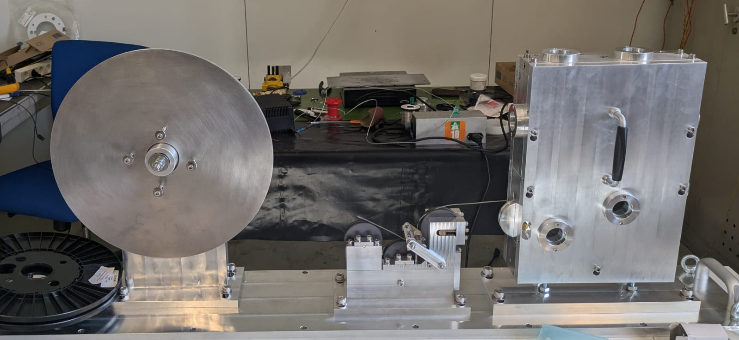
Conclusion
Stack 01
On going work :
New winding tool has been machined and assembled for further pancake production (F. Sanda, A. Kolehmainen, A. Dudarev, A. Dallocchio)
M. Abdel Hafiz | Experimental tests for winding technology of Final Cooling Solenoid

Slide 25
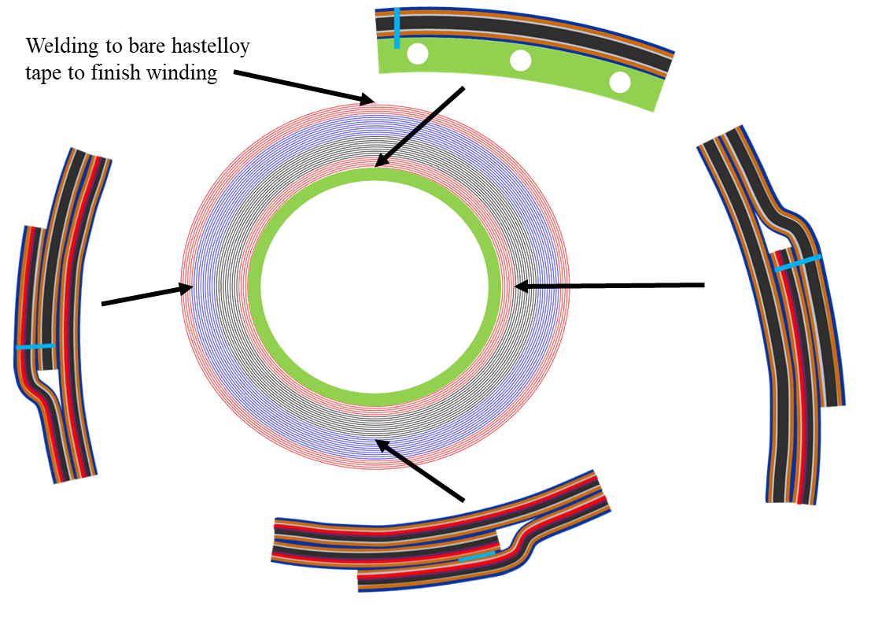
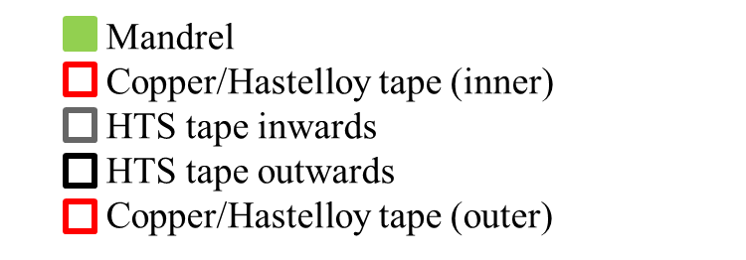
Conclusion
Stack 01
On going work :
New winding tool has been machined and assembled for further pancake production (F. Sanda, A. Kolehmainen, A. Dudarev, A. Dallocchio
Problematic of the joints
  Tape to inner/outer ring
  Tape to outer ring
    Layer jump
M. Abdel Hafiz | Experimental tests for winding technology of Final Cooling Solenoid

Slide 26
Thank you for your attention
M. Abdel Hafiz
& Cooling Solenoid working group

Slide 27
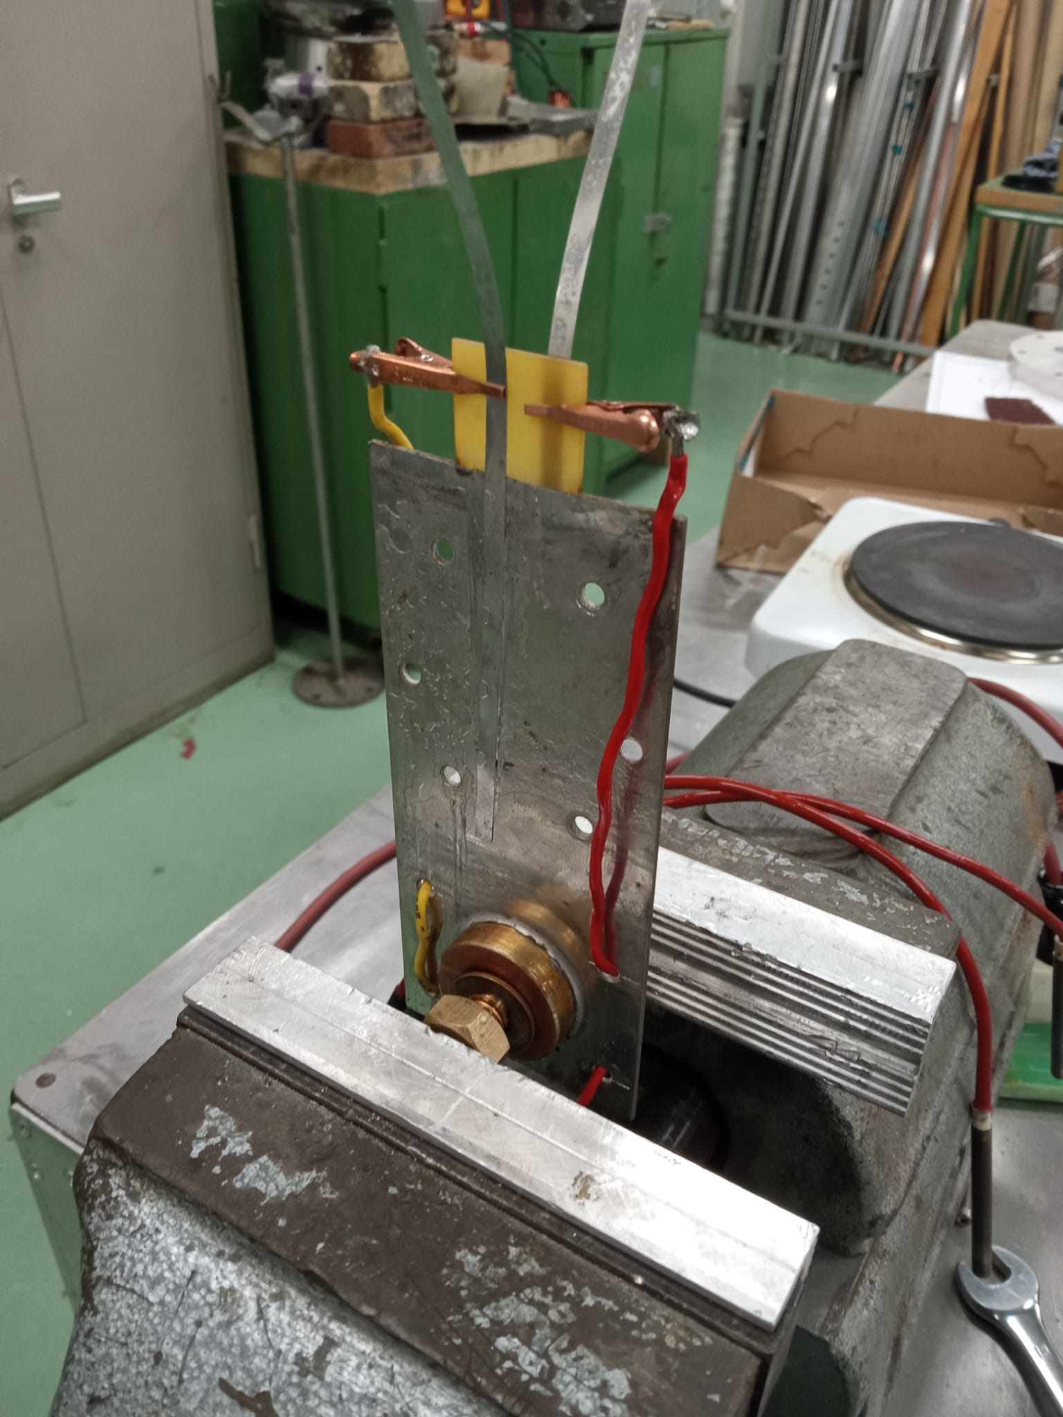



Temperature influence on I_{C}
Preparing samples
Sample cycled :
Preparing sample
I_{C} measurement @ 77K
Heated in solder bath @200 °C
Cycling process
Sample holder :
G10 insulating plate (~ 1 mm)
Both sides :
  Cu coating (~75 $μm$)
  SnPb coating
  Extremity etched for clamping voltage tapes
Sample preparation :
Screw Al blocs to sample holders
Heat up to 200°C to melt SnPb (~10 min)
Insert tape within groove (~ 1 min)
Wait for cooling down (~10 min)
Voltage tapes
Heater
Al blocs
Thermcouple
Sample holder
Heater
Bloc and heaters @200°C for 25 minutes for test
Preparing sample does not degrade I_{C} of measured length
Coating sample does not visibly affect I_{C}
  @77K
Sample Holder
Sample Preparation
M. Abdel Hafiz | Experimental tests for winding technology of Final Cooling Solenoid

Slide 28




Temperature influence on I_{C}
Experiment
Sample cycled :
Preparing sample
I_{C} measurement @ 77K
Heated in solder bath @200 °C
Cycling process
$$I_{0}=190$$
Crack ?
Degadation of Theva TPL tape < 2% after 2h @200°C in SnPb bath
Solder bath
M. Abdel Hafiz | Experimental tests for winding technology of Final Cooling Solenoid

Slide 29


Pancake Properties
Critical Current (A) | Expected | Measured
Pancake 1 | 75 | 54
Pancake 2 | 72 | 86
Pancake 3 | 76 | 53
Pancake 4 | 76 | 143
M. Abdel Hafiz | Experimental tests for winding technology of Final Cooling Solenoid

Slide 30

Etching effect on I_{C}
I_{C} measured @77K at the end of R measurements (~ 1h20)
Single tape
How much time needed to remove copper from side ?
  Lengthwise resistance measured in FeCl @ room temperature
  Length sink in FeCl solution ~10 cm
Degradation < 20%
N. Bykovskiy and al. 2019
Single tape still superconductive after removing Cu and Ag(?) (1h20) in FeCl
Further experiments required to confirm
According to N. Bykovskiy, depends on the tape
  Cu removed in ~30min
  Ag removed (?) in ~ 1h

Slide 31



Mandrel
Mandrel thermal shrinkage be lower than tape
  Only lengthwise (tape) thermal shrinkage found
  Materials considered : Invar, Titanium, Niobium,
    Very low shrinkage
    High electrical resistivity ($50 μΩ.cm @77K$)
    Easy to coat with SnPb

Slide 32
Layout
Winding direction
Different areas in pancake
  Mandrel (invar)
  Copper/Hastelloy tape (inner)
  HTS tape inwards
  HTS tape outwards
  Copper/Hastelloy tape (outer)
Joints
  Connections should handle 200°C during winding
  Spot welding Hastelloy/Hastelloy and gluing copper/copper are retained methods
    Introducing local default
    Is it mechanically fragile ?
  These steps can all be done before winding ( not necessarally preferably )

Slide 33

First turns
Winding direction
First turns with hastelloy/copper tape (without HTS)
  Redistributing stress
  Electrical connection
  Calculations to estimate n° of turns and acceptable stresses (?)
  Resistance ~ 0.1 $μΩ$ per turn

Slide 34

Inward tape joint
Welded spot
Winding direction

Slide 35

HTS to HTS joint
Glued spot
Winding direction
Where to perform layer jump ?
  At the begining to save material in case of failling ?
  At lowest magnetic field location to reduce stresses ?
Can be glued
Resistance < 2 $μΩ$ for 5 mm contact

Slide 36
Outward tape joint
Welded spot
Winding direction

Slide 37

Last turns
Winding direction
Last turns with hastelloy/copper tape (without HTS)
  Allow machining
    For a deviation of 10 $μm$ per tape → 1 mm per 100 turn
  Electrical connection
  Resistance ~ 0.2 $μΩ$ per turn
End of the winding with bare hastelloy tape
  Removes the drop of solder
  See the two last pancakes

Slide 38




Sum up
Welding to bare hastelloy tape to finish winding

Slide 39


Homogeneity
$$θ$$
Current in
Current flow quasi homogeneous in inner part
Current flow linearly decreases along the first turn
Current
$$θ$$
Last turn current flow

Slide 40


Homogeneity
$$θ$$
$$θ$$
Current in
Current out
Current flow quasi homogeneous in inner part
Current flow linearly increases along the first turn
Current
Current
$$θ$$
$$θ$$
Last turn current flow
Last turn current flow

Slide 41


Homogeneity
Current in
$$θ$$
$$θ$$
Issue for field homogeneity ?
Acceptable tolerance ?
Current out
Equivalent current in double pancake
Current
Current
$$θ$$
$$θ$$
$$θ$$
Last turn current flow
Last turn current flow
Last turn current flow

Slide 42




Pancake 2 – Compare Time constant
Etching
  Parts protected with silicon coating
  Whole pancake drowned into iron chloride
  Cleaned into sodium becarbonate
  Dried with pressurized air
  Cleaned with acetone
  Cleaned with water
  Dried with pressurized air
$$τ (s)$$ | Pancake 2
 | Charge | Discharge
5 A | 4.87 | 4.92
10 A | 4.70 | 5.05
20 A | 4.78 | 5.02
50 A | 4.60 | 4.83
$$\sim 4.8 s$$
$$τ (ms)$$ | Pancake 2 after etching
 | Charge | Discharge | Charge 2 | Discharge 2
5 A | 41.8 | 28.2 | 42.2 | 29.8
10 A | 40.6 | 51.4
20 A | 30.4 | 43.1
30 A | 36.4 | 40.7 | 34.1 | 41.1
40 A | 50.4 | 45.4 | 44.8 | 41.2
50 A | 51.8 | 50.5
$$<40 ms$$

Slide 43




Last time presentation
 | Time Constant $τ (s)$
Double Pancake | 4.6
Pancake A | 1.6
Pancake B | 3.1
Where do these differences come from ?

Slide 44




Ansys simulation
$$z$$
$$r$$
Variation $\sim 10\%$ of central field within $±5$ mm from center

Slide 46


