Slide 1


A tool for unbinned frequentist inference for quasi-background free searches
Sam Borden, Louis Varriano, Jason Detwiler, and Grace Song, CJ Nave, Leon Lin
07/16/2025

Slide 2

Statistical inference challenges in rare-event searches
HEP
Binned
CLs
Control/validation/signal regions
Test statistic: $q_{0}$ for discovery, $q_{μ}$ for limit/exclusion
Good background modeling
Neutrinoless double-beta decay searches
Unbinned
Orthodox frequentist limit construction
Single region
Test statistic: ${\overset{˜}{t}}_{μ}$
  DM has conventions [1]
  CUPID uses ${\overset{˜}{q}}_{μ}$ recently [2]
Difficult to model background
[1] D. Baxter et al., Recommended conventions for reporting results from direct dark matter searches, Eur. Phys. J. C 81, 907 (2021). https://doi.org/10.1140/epjc/s10052-021-09655-y
[2] K. Alfonso et al. Sensitivity of the CUPID experiment to 0νββ decay of 100Mo, arxiv (2025) arxiv.org/abs/2504.14369

Slide 3
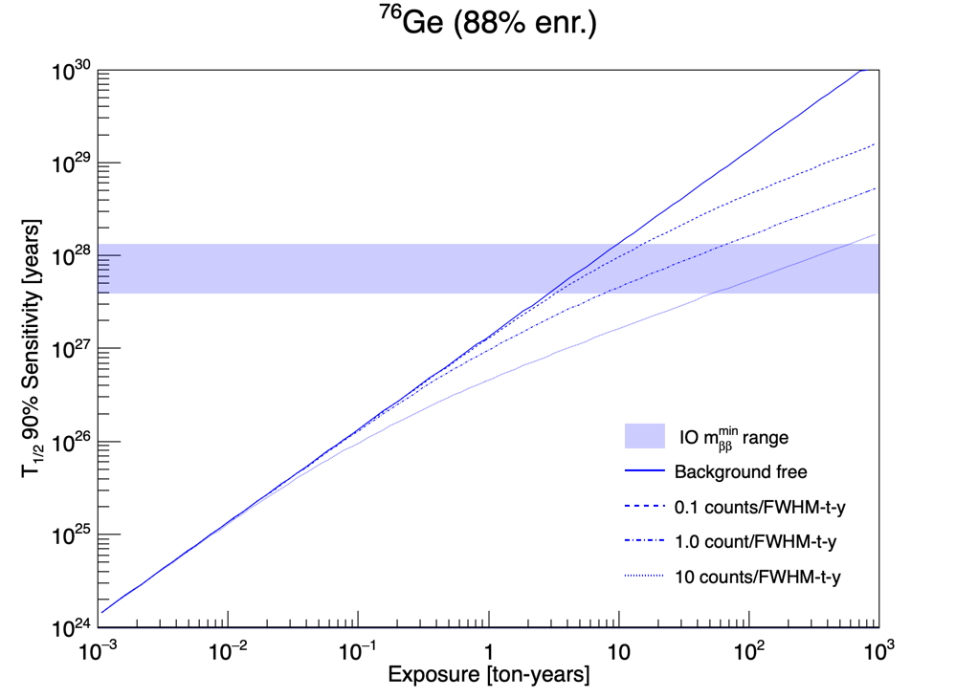
What does it mean to be “quasi-background free”?
Quasi-background free experiments have ~linear sensitivity scaling
  $b<1$ within +/-2 keV of $Q_{ββ}$ requires only a few counts to make a discovery
Credit: Jason Detwiler

Slide 4
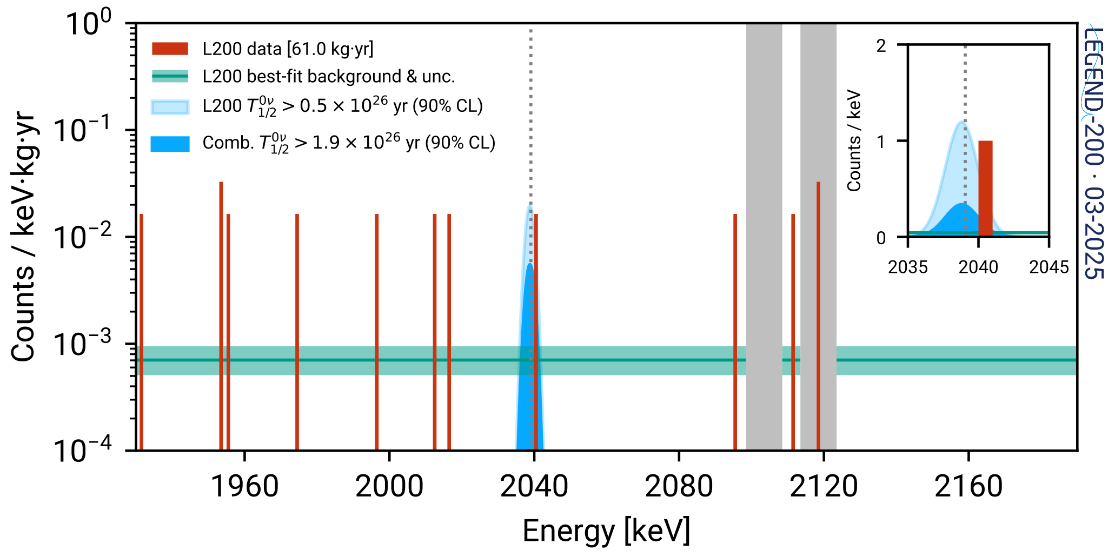
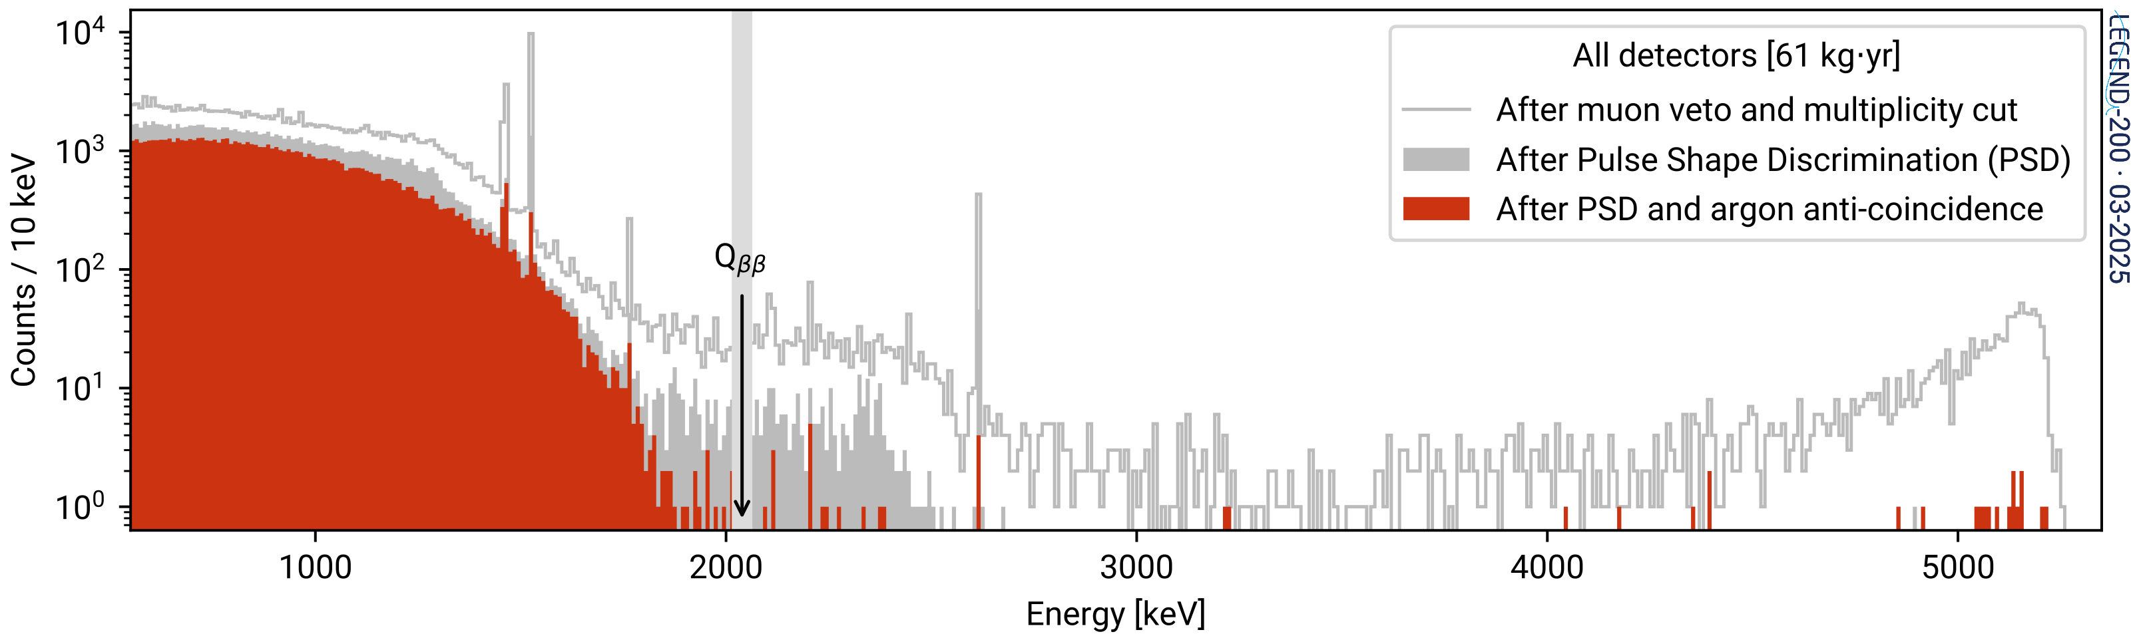
LEGEND-200: a quasi-background free experiment
Only have 11 events in our region of interest (ROI) [1930,2190] keV
No separate control window to estimate background
Flat background is a nuisance parameter that is fit during statistical analysis
First Results on the Search for Lepton Number Violating Neutrinoless Double Beta Decay with the LEGEND-200 Experiment
arXiv:2505.10440
$⟹$ Want to do an extended unbinned statistical analysis
analysis region

Slide 5
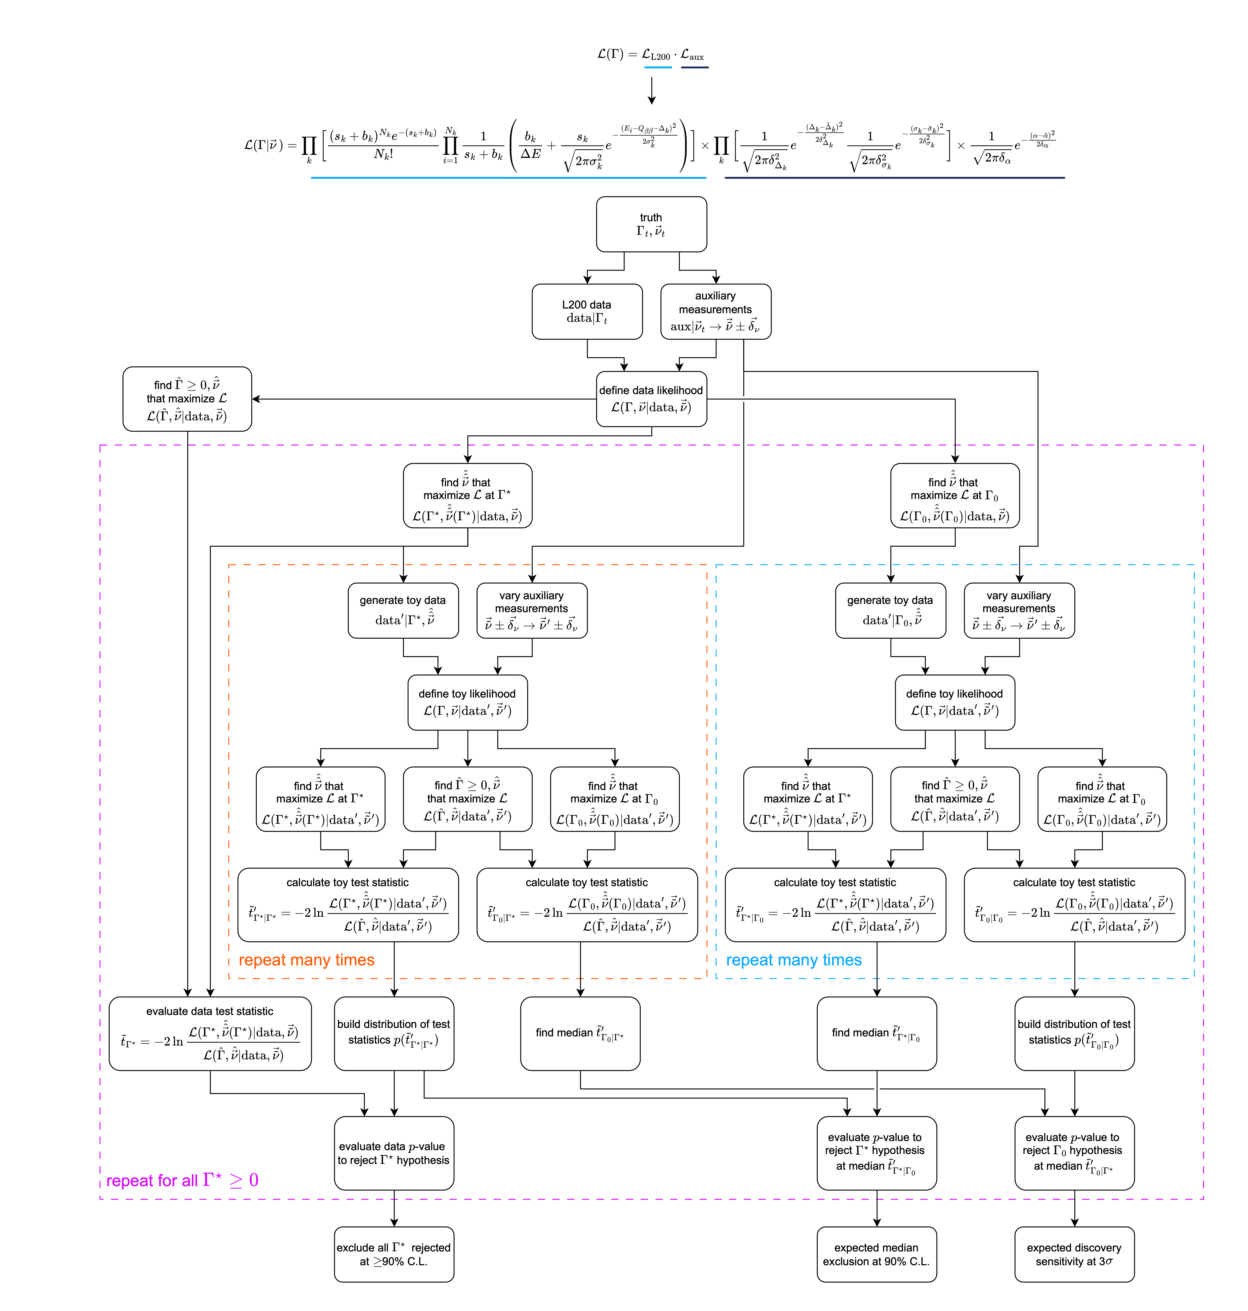
LEGEND-200’s first ROI (61 kg$⋅$yr)
LEGEND partitions its data into periods of stable data taking per detector
Likelihood is product of all partitions
Order 300 datasets, each with 7 model parameters ~ 1300 parameters
$Γ_{1/2}^{0ν}=0$ : SM prediction
$Γ_{1/2}^{0ν}>0$ : BSM physics
$$L_{partition}(Γ|BI,\overset{⃗}{ν})=Pois(Γ,BI,\overset{⃗}{ν})\underset{i}{∏}PDF(Γ,BI,\overset{⃗}{ν},E_{i})$$
flat background + Gaussian signal
nuisance constraints

Slide 6
freqfit: a python tool for unbinned frequentist analysis

Slide 7

freqfit at a glance
Define a likelihood
  User passes both data and a model in a config YAML file
  Then create an iminuit object to handle minimizations
Draw pseudo-experiment (toy) data
  models contain instructions on how to draw MC data and fit it
Compute test statistic distributions
  Test statistics measure the incompatibility of data with a hypothesis of $Γ$
  User can specify which test statistic to compute in config file
L. Varriano, S. Borden, G. Song, CJ Nave, L. Lin, & J. Detwiler. (2025).
cenpa/freqfit: v0.2 https://doi.org/10.5281/zenodo.15185402

Slide 8


Likelihood initialization and handling
  User passes both data and a user-defined model in a config YAML file
  Each dataset is then stuffed into an iminuit cost function [1]
  freqfit then creates an iminuit.costum object to hold the negative log likelihood
  PDFs are accelerated using numba [2]
Gaussian signal + flat background
dataset_1:
costfunction: ExtendedUnbinnedNLL
data: [2040]
model: legendfreqfit.models.correlated_efficiency_0vbb
model_parameters:
BI: BI_1
S: S
delta: delta_dataset_1
eff: eff_dataset_1
effunc: effunc_dataset_1
effuncscale: effuncscale
exp: exp_dataset_1
sigma: sigma_dataset_1
Can link parameters between datasets for fitting
[1] Dembinski, H., et al. Scikit-hep/iminuit. v2.31.1, Zenodo, 5 Apr. 2025, doi:10.5281/zenodo.15157028.
[2] Siu Kwan Lam, et al. Numba/numba: Numba 0.61.2. 0.61.2, Zenodo, 9 Apr. 2025, doi:10.5281/zenodo.15182388.

Slide 9
Test statistic
Choice of test statistic provided by user in config
experiment class has methods to compute test statistic
LEGEND uses a two-sided test statistic for both discovery and exclusion
Physical boundary at zero signal rate
  Handled in iminuit using a limit on the fit parameter
options:
test_statistic: t_mu_tilde
experiment
likelihood
test statistic
test statistic:
measures incompatibility of data with hypothesis of $Γ$
$${\overset{˜}{t}}_{Γ}=ln\frac{L(Γ,\overset{̂}{\overset{̂}{B}},\overset{̂}{\overset{̂}{ν}}(Γ))}{L(\overset{̂}{Γ},\overset{̂}{B},\overset{̂}{ν})},\overset{̂}{Γ}≥0$$

Slide 10
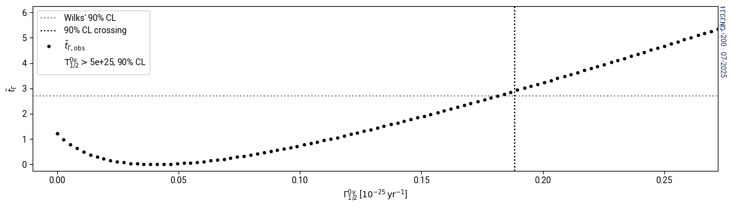
Likelihood: example with LEGEND-200
perf: ~7 seconds
1.7 s to create experiment
~5.3 s to scan 100 points
>>> experiment = freqfit.load(“config.yaml”)
>>> experiment.set_var_to_profile(“global_S”)
>>> L = experiment.scan_ts(np.linspace(0,0.25e-25,100))

Slide 11
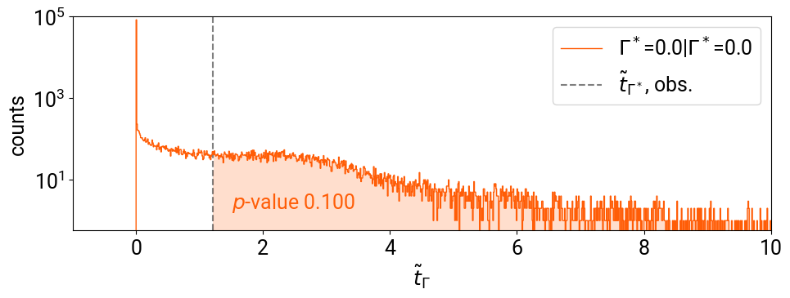
Pseudo-experiments
The model the user passes contains instructions on how to do the following
  Draw new number of events and event energies per-dataset:
  User can choose if auxiliary measurements are randomized or not
$$p(\{E_{i}\}^{′}|Γ^{⋆},\overset{̂}{\overset{̂}{α}}(Γ^{⋆}))→\{E_{i}^{′}\}$$
$$L(\{E_{i}\},\overset{˜}{α}|Γ^{⋆},\overset{̂}{\overset{̂}{α}})=p(\{E_{i}\}|Γ^{⋆},\overset{̂}{\overset{̂}{α}})⋅G(\overset{˜}{α}|\overset{̂}{\overset{̂}{α}},δ_{α})→\overset{̂}{\overset{̂}{α}}(Γ^{⋆})$$
$$L(\{E_{i}\},\overset{˜}{α}|Γ,α)=p(\{E_{i}\}|Γ,α)⋅G(\overset{˜}{α}|α,δ_{α})$$
experiment
$$G({\overset{˜}{α}}^{′}|\overset{̂}{\overset{̂}{α}}(Γ^{⋆}),δ_{α})→{\overset{˜}{α}}^{′}±δ_{α}$$
likelihood
test statistic
$${\overset{˜}{t}}_{Γ^{⋆}|Γ^{⋆}}^{′}=-2ln\frac{L^{′}(\{E_{i}^{′}\},{\overset{˜}{α}}^{′}|Γ^{⋆},{\overset{̂}{\overset{̂}{α}}}^{′})}{L^{′}(\{E_{i}^{′}\},{\overset{˜}{α}}^{′}|{\overset{̂}{Γ}}^{′},{\overset{̂}{α}}^{′})}$$
make_toy

Slide 12
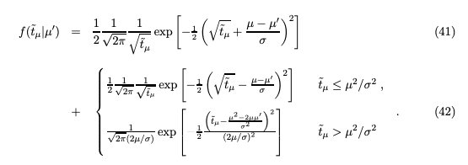
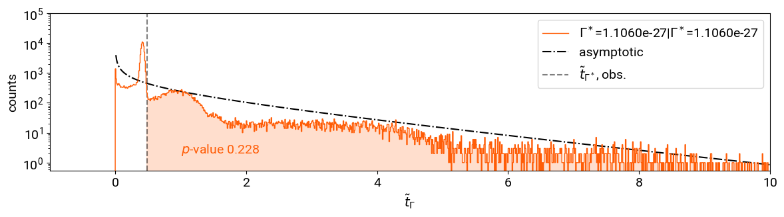
Why go through all this trouble?
Cowan et al. in 2011 derived asymptotic formula using the Wald approximation (Eur.Phys.J.C71:1554)
p-value from asymptotics: 0.485!
Asymptotics don’t work for us!

Slide 13
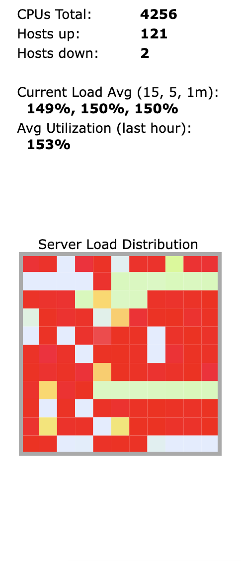
Performance: LEGEND-200 as an example
Takes ~14,000 core-hours to run 100,000 toys on 100 signal-rate grid points, O(100) fit parameters
  On CENPA cluster with 100 nodes with 20 cores each takes ~ 5 hours
  On NERSC using 10 nodes with 128 cores each takes 10 hours
Previous tools in the collaboration took days or weeks (!) to run
Utilizes numba for faster fitting
Pseudo-experiment generation is embarrassingly parallel
  multi-processing support for experiment.make_toy on HPC systems
CENPA HPC
load

Slide 14
freqfit tricks
User can choose to combine empty data sets into one averaged data set
  Saves a lot of time, at least for experiments that can use this trick
  Semi-specific to $0νββ$ experiments
User-defined initial guess strategies
  Sometime simplex won’t cut it, likelihood is too flat
User can evaluate test statistic on a parameter grid to ease numerical issues
dataset_1:
costfunction: ExtendedUnbinnedNLL
data: []
model: legendfreqfit.models.correlated_efficiency_0vbb
empty_dataset: empty_dataset_name
3700 model parameters —> 95 fit parameters
by combining empty datasets

Slide 15
Use case: LEGEND-200

Slide 16
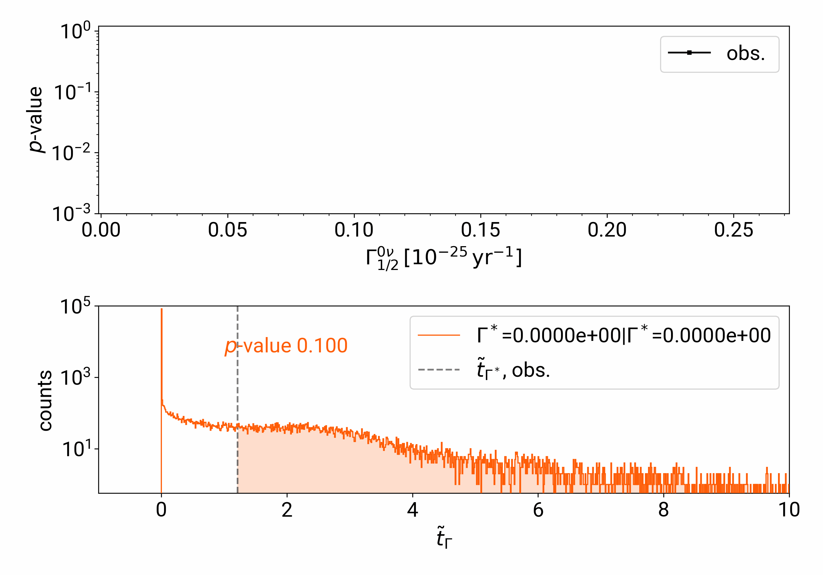
Building a limit

Slide 17
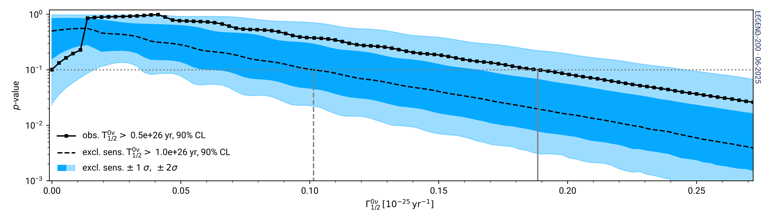
LEGEND-200’s first result
First Results …LEGEND-200 Experiment arXiv:2505.10440
BI = ${0.5}_{-0.2}^{+0.3}$ counts/keV/ton/yr
Lower limit at 90% CL
$$T_{1/2}^{0ν}>0.5×{10}^{26}yr$$
Lower limit at 90% CL for combination
of 76Ge data
$$T_{1/2}^{0ν}>1.9×{10}^{26}yr$$

Slide 18
LEGEND-200’s first result
First Results …LEGEND-200 Experiment arXiv:2505.10440
p = 0.100
3 sigma discovery threshold is p=0.0027

Slide 19
LEGEND-200’s first result
First Results …LEGEND-200 Experiment arXiv:2505.10440
Lower limit at 90% CL
$$T_{1/2}^{0ν}>0.5×{10}^{26}yr$$

Slide 20
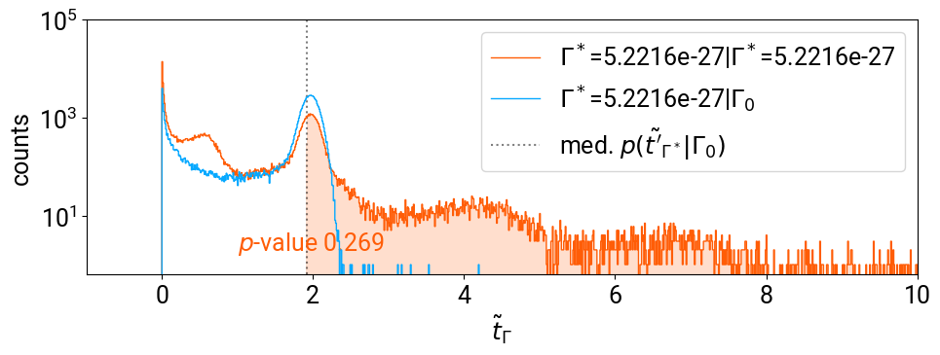
LEGEND-200’s first result
First Results …LEGEND-200 Experiment arXiv:2505.10440
Median exclusion sensitivity at 90% CL
$$T_{1/2}^{0ν}>1.0×{10}^{26}yr$$
median significance given $Γ=0$ data to reject $Γ≠0$

Slide 21
Nitty-gritty stats stuff

Slide 22
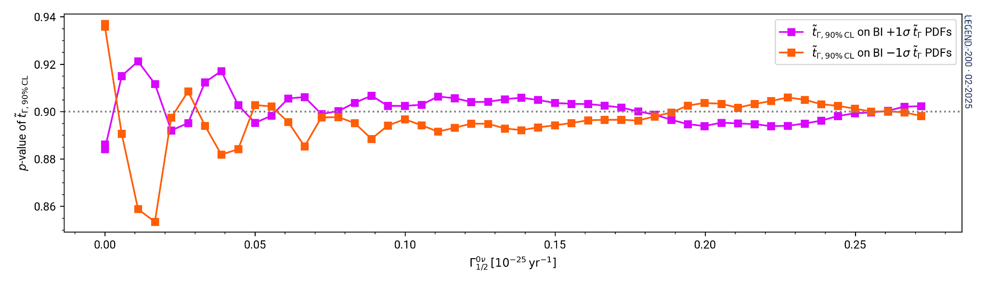
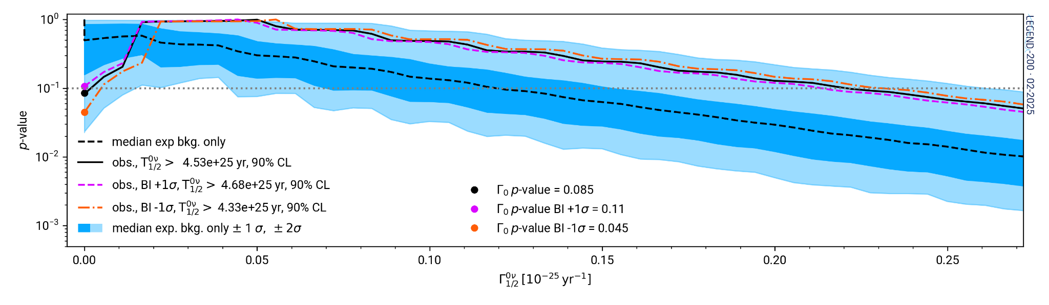
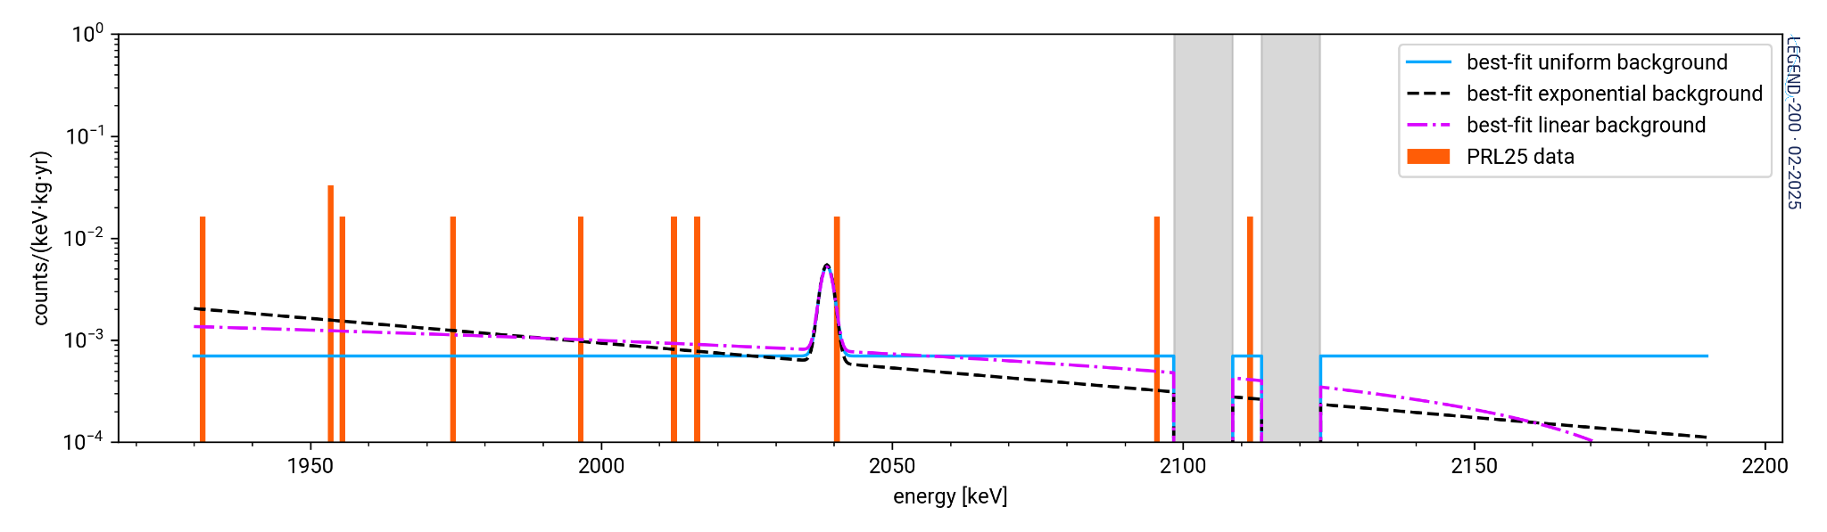
Background shape — no impact on limits
freqfit can easily test mis-modeling
Coverage under background mismodelling is close to stated 90% CL for backgrounds within ± 1σ of nominal
Limits change by < 5% under background mismodelling within ± 1σ of nominal
Tests of different background models
(uniform, linear, exponential)
Different background models result in ≲ 1% change in limit

Slide 23
What’s next?

Slide 24
The future of freqfit
Undergoing first refactor
  Learning from our mistakes
  Improved readability and usability
As is, tool will work for next generation of $0νββ$ experiments
Couple of “obvious” upgrades
  Dask integration for fast deployment on alternate clusters
  GPU acceleration of minimization
Should we play around with JAX? Iminuit already runs fairly fast for O(100) parameters
But, where should this live?
Is there a demand for a tool that can do unbinned statistical inference?

Slide 25



Acknowledgements
Michael Hank (UPenn, ATLAS) for helpful stats advice on how HEP does it
DOE ONP support
The LEGEND collaboration for beautiful data to do statistical inference on
CENPA computing staff: Gary Holman and Clint Wiseman

Slide 26
That’s all, folks!

Slide 27
Backup

Slide 28

Iminuit flexibility, problems (and solutions!)
Iminuit is a wonderful back-end and useful for cost-function handling and minimization
User can specify minimizer algorithm
  Can run with migrad or scipy minimizers
Scipy minimizers work almost out of the box
  Iminuit used to not use 0 as a parameter bound, but 0+epsilon for scipy minimizer
  Caused convergence issues near the boundary
  Fixed! with PR #1060 (user can now pass options to scipy that override the boundary issues)
options:
backend: minuit
iminuit_precision: 1.0e-20
iminuit_tolerance: 1.0e-05
minimizer_options:
iterate: 100
ncall: 10000
scipy_minimizer: None
user_gradient: false

Slide 29
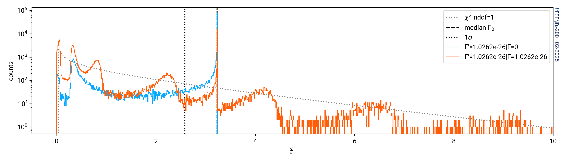
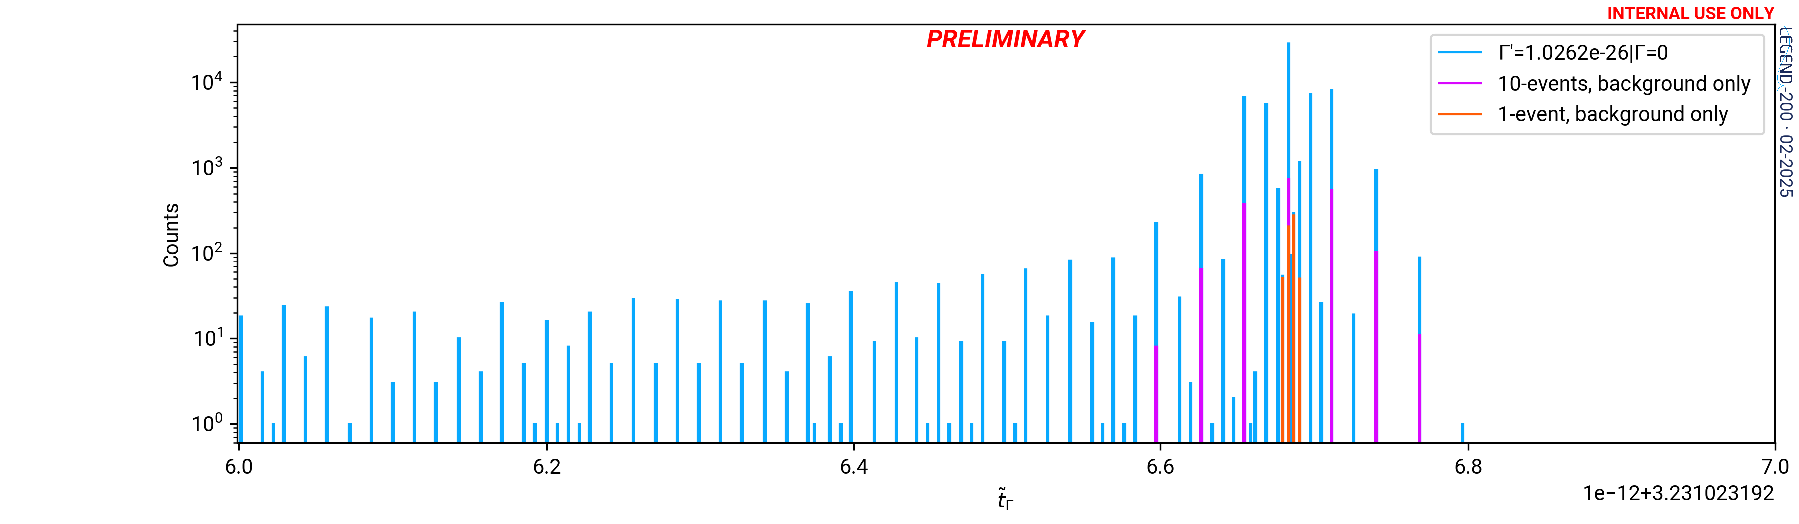
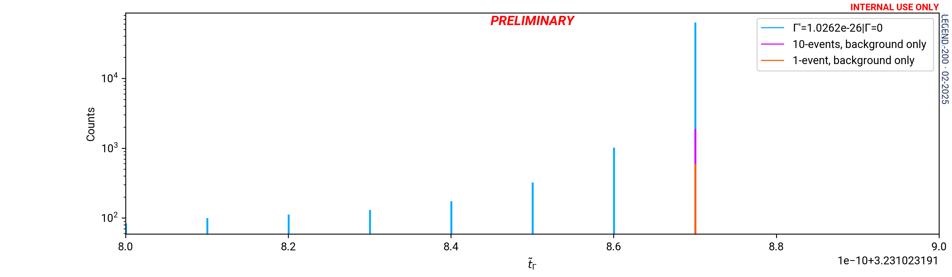
Numerical stability issues
Mostly caused by toys without any counts within +/- 5 keV of the signal region
  Can derive the expected test statistic
  $${\overset{˜}{t}}_{Γ}^{bkg.only}=2Γ\overset{M}{\underset{i=0}{∑}}(ϵ_{i}+δ_{ϵ_{i}}\overset{˜}{α})E_{i}-Γ^{2}δ_{α}^{2}{\left(\overset{M}{\underset{j=0}{∑}}δ_{ϵ_{j}}E_{j}\right)}^{2}$$
In the absence of any nuisance parameters, we become extremely sensitive to floating point errors
  W/o nuisance parameters ${\overset{˜}{t}}_{Γ}^{bkg.only}$ becomes a Dirac delta function
${\overset{˜}{t}}_{Γ}^{bkg.only}$ also becomes a Dirac delta when we test $Γ=0$
  We manually set the median exclusion to p=0.5 for $Γ=0$
PDF w/o nuisance params
This should be a Dirac delta
Parameter grid enforces correct PDF distribution

Slide 30
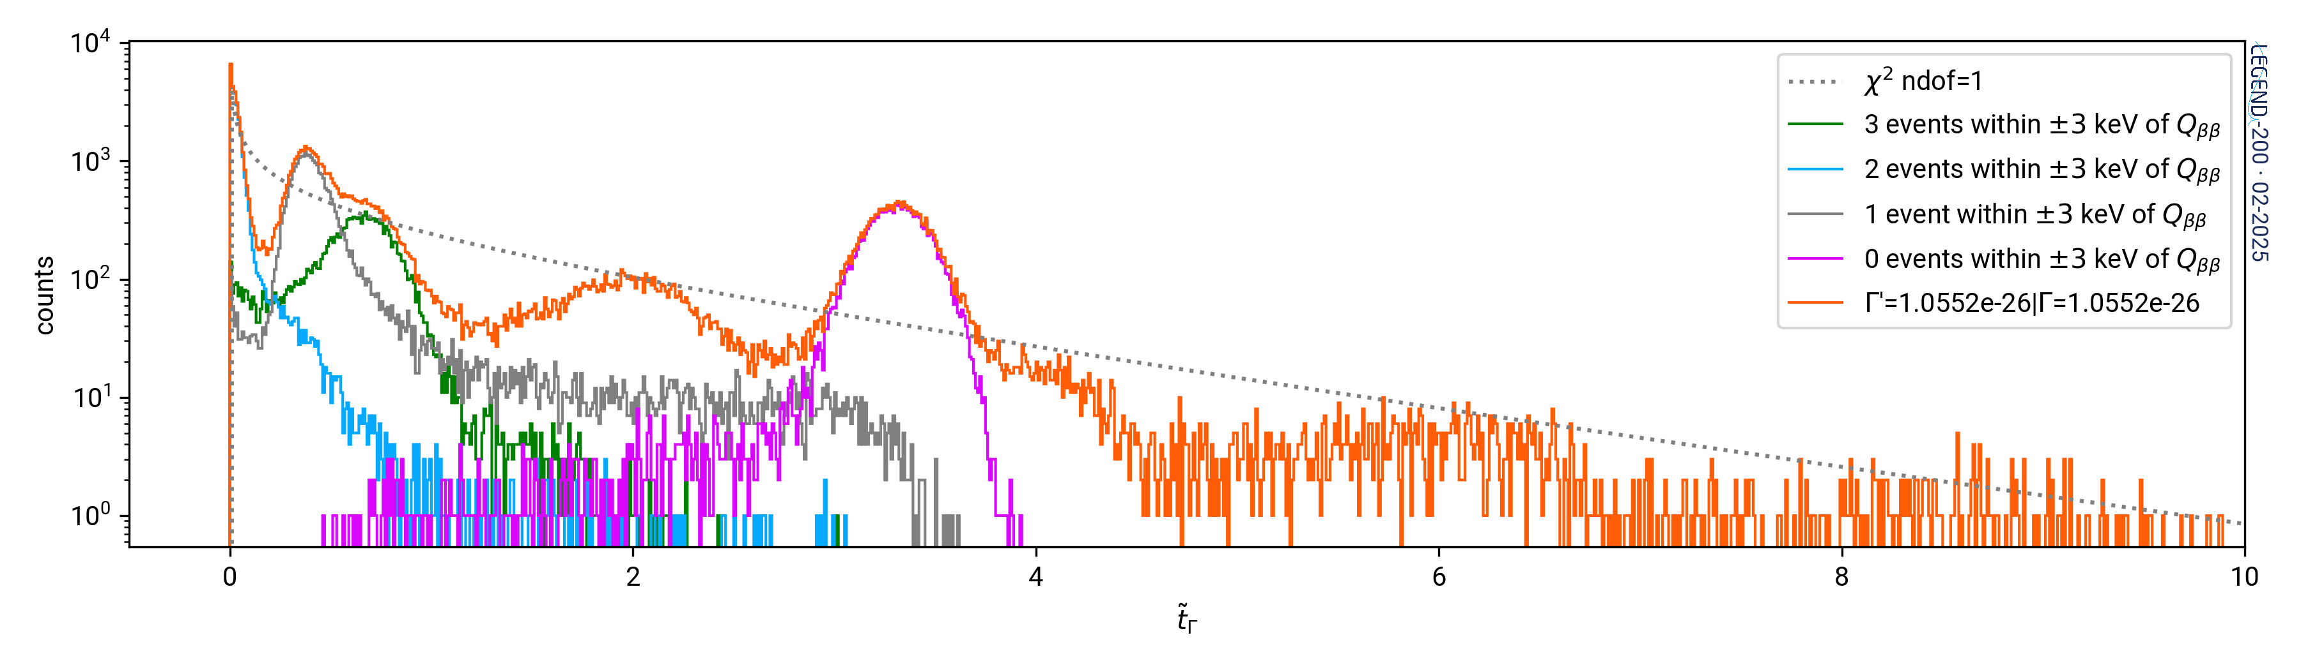
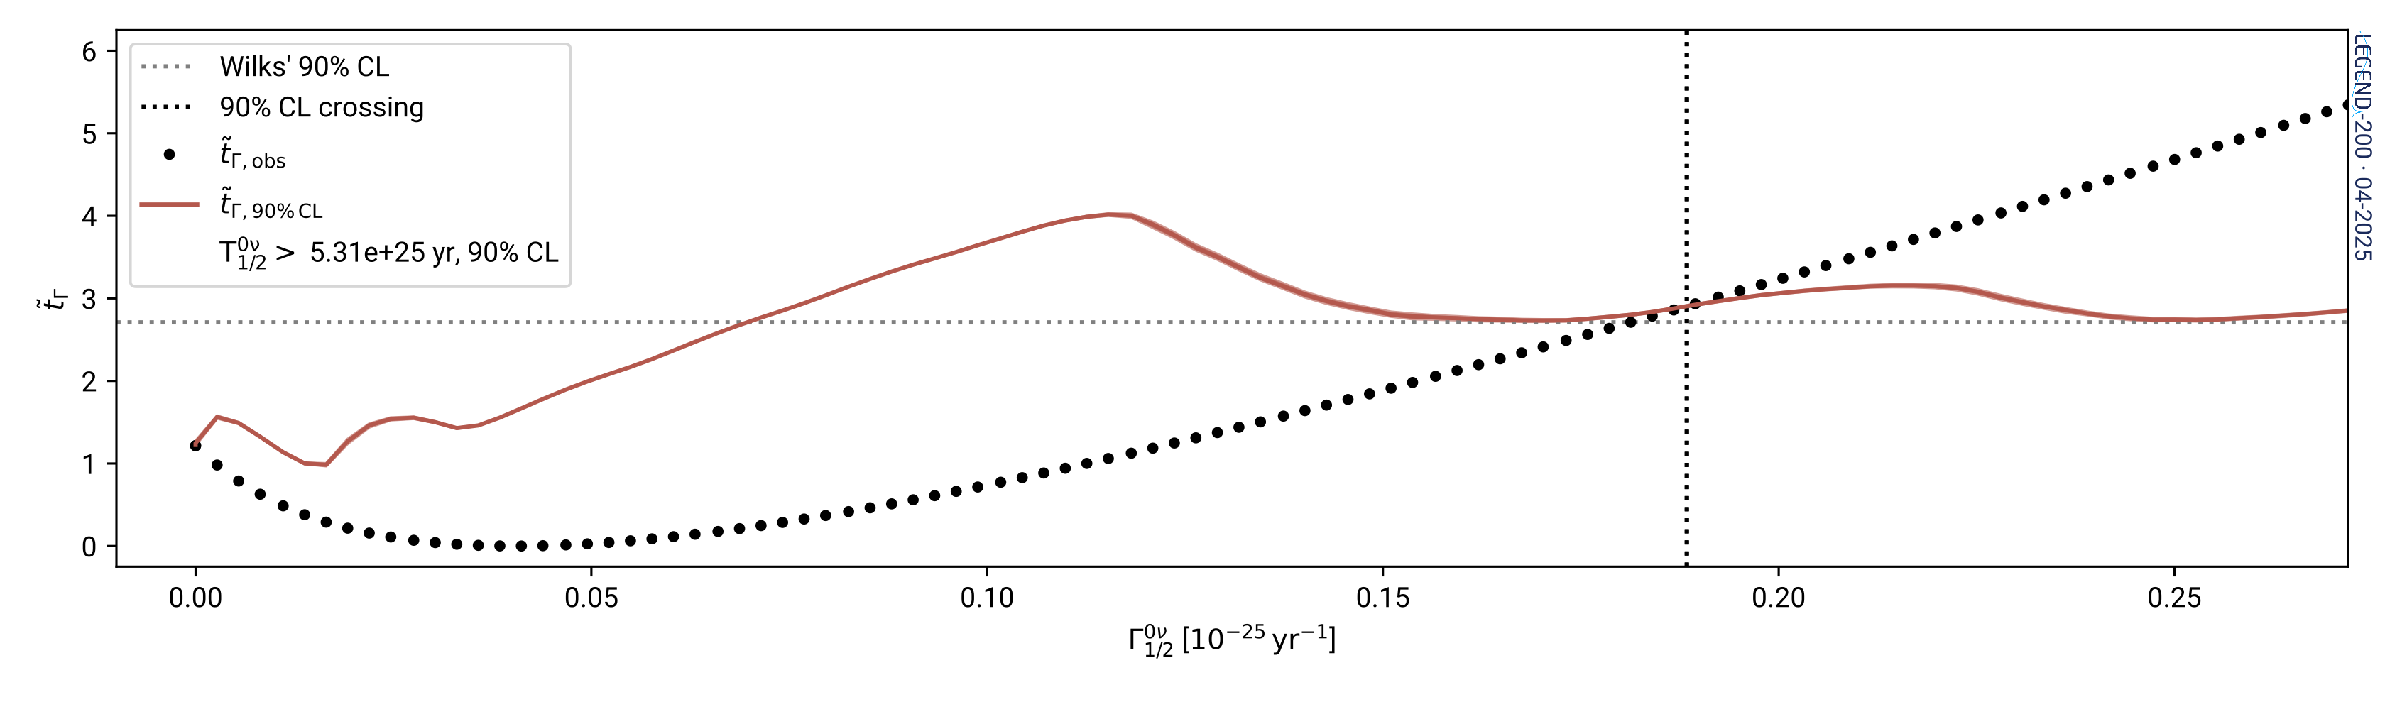
Where does the structure come from in the L200 limit?
$${\overset{˜}{t}}_{Γ}^{bkg.only}=2Γ\overset{M}{\underset{i=0}{∑}}(ϵ_{i}+δ_{ϵ_{i}}\overset{˜}{α})E_{i}-Γ^{2}δ_{α}^{2}{\left(\overset{M}{\underset{j=0}{∑}}δ_{ϵ_{j}}E_{j}\right)}^{2}$$

Slide 31
Where does the structure come from in the L200 limit?
$${\overset{˜}{t}}_{Γ}^{bkg.only}=2Γ\overset{M}{\underset{i=0}{∑}}(ϵ_{i}+δ_{ϵ_{i}}\overset{˜}{α})E_{i}-Γ^{2}δ_{α}^{2}{\left(\overset{M}{\underset{j=0}{∑}}δ_{ϵ_{j}}E_{j}\right)}^{2}$$

Slide 32
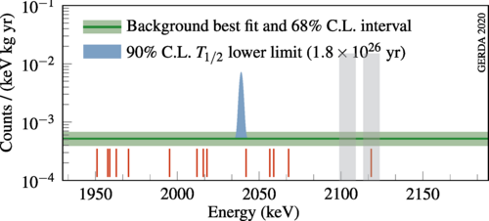
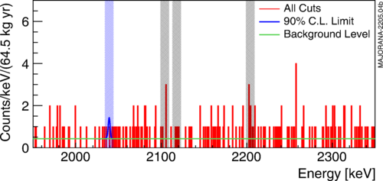
What if we combined ⁷⁶Ge data?
$$L(Γ_{1/2})=L_{\text{L200}}⋅L_{\text{GERDA}}⋅L_{\text{MJD}}⋅L_{\text{aux}}$$
share largest systematic uncertainties in $ε_{PSD}$
LEGEND-200
GERDA
Majorana demonstrator
First Results on the Search for Lepton Number Violating Neutrinoless Double Beta Decay with the LEGEND-200 Experiment
arXiv:2505.10440
Final Results of GERDA on the Search for Neutrinoless Double-beta Decay
Phys. Rev. Lett. 125, 252502
Final Result of the Majorana Demonstrator’s Search for Neutrinoless Double-𝛽 Decay in ⁷⁶Ge
Phys. Rev. Lett. 130, 062501

Slide 33
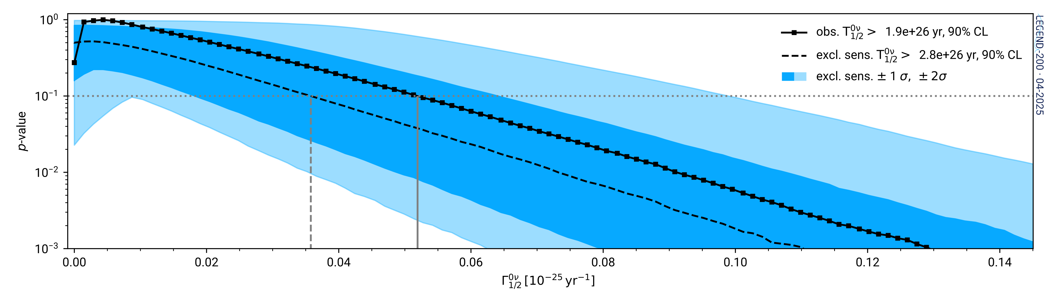
Limit from GERDA + LEGEND-200 + Majorana Demonstrator
Lower limit at 90% CL
$$T_{1/2}^{0ν}>1.9×{10}^{26}yr$$
Best limit on $0νββ$ in ⁷⁶Ge to date!
Have we squeezed all the information we can out of existing data?

Slide 34
Pseudo-experiments
Define likelihood $L$ that contains experiment data and auxiliary measurement $\overset{˜}{α}±δ_{α}$
  $$L(\{E_{i}\},\overset{˜}{α}|Γ,α)=p(\{E_{i}\}|Γ,α)⋅G(\overset{˜}{α}|α,δ_{α})$$
Maximize $L$ assuming $Γ=Γ^{⋆}$ and find best fit $\overset{̂}{\overset{̂}{α}}(Γ^{⋆})$
  $$L(\{E_{i}\},\overset{˜}{α}|Γ^{⋆},\overset{̂}{\overset{̂}{α}})=p(\{E_{i}\}|Γ^{⋆},\overset{̂}{\overset{̂}{α}})⋅G(\overset{˜}{α}|\overset{̂}{\overset{̂}{α}},δ_{α})→\overset{̂}{\overset{̂}{α}}(Γ^{⋆})$$
Generate toy data assuming $Γ_{t}=Γ^{⋆}$and $α_{t}=\overset{̂}{\overset{̂}{α}}(Γ^{⋆})$
  $$p(\{E_{i}\}^{′}|Γ^{⋆},\overset{̂}{\overset{̂}{α}}(Γ^{⋆}))→\{E_{i}^{′}\}$$
Generate new auxiliary measurement ${\overset{˜}{α}}^{′}±δ_{α}$ from Gaussian distribution $G(α|\overset{̂}{\overset{̂}{α}}(Γ^{⋆}),δ_{α})$
  $$G({\overset{˜}{α}}^{′}|\overset{̂}{\overset{̂}{α}}(Γ^{⋆}),δ_{α})→{\overset{˜}{α}}^{′}±δ_{α}$$
Evaluate the test statistic and record it; repeat.
  $${\overset{˜}{t}}_{Γ^{⋆}|Γ^{⋆}}^{′}=-2ln\frac{L^{′}(\{E_{i}^{′}\},{\overset{˜}{α}}^{′}|Γ^{⋆},{\overset{̂}{\overset{̂}{α}}}^{′})}{L^{′}(\{E_{i}^{′}\},{\overset{˜}{α}}^{′}|{\overset{̂}{Γ}}^{′},{\overset{̂}{α}}^{′})}$$
experiment
likelihood
test statistic
make_toy

Slide 35
Frequentist statistics
flat background + Gaussian signal
systematics constraints
test statistic:
measures incompatibility with hypothesis of $Γ$
define your likelihood
compute the test statistic for data
Monte Carlo pseudoexperiments to create a PDF
compute p-values from the PDF
$${\overset{˜}{t}}_{Γ}=ln\frac{L(Γ,\overset{̂}{\overset{̂}{B}},\overset{̂}{\overset{̂}{θ}}(Γ))}{L(\overset{̂}{Γ},\overset{̂}{B},\overset{̂}{θ})}\overset{̂}{Γ}≥0$$
$$p=∫_{{\overset{˜}{t}}_{Γ,obs.}}^{∞}PDF({\overset{˜}{t}}_{Γ}|Γ)d{\overset{˜}{t}}_{Γ}$$

Slide 36
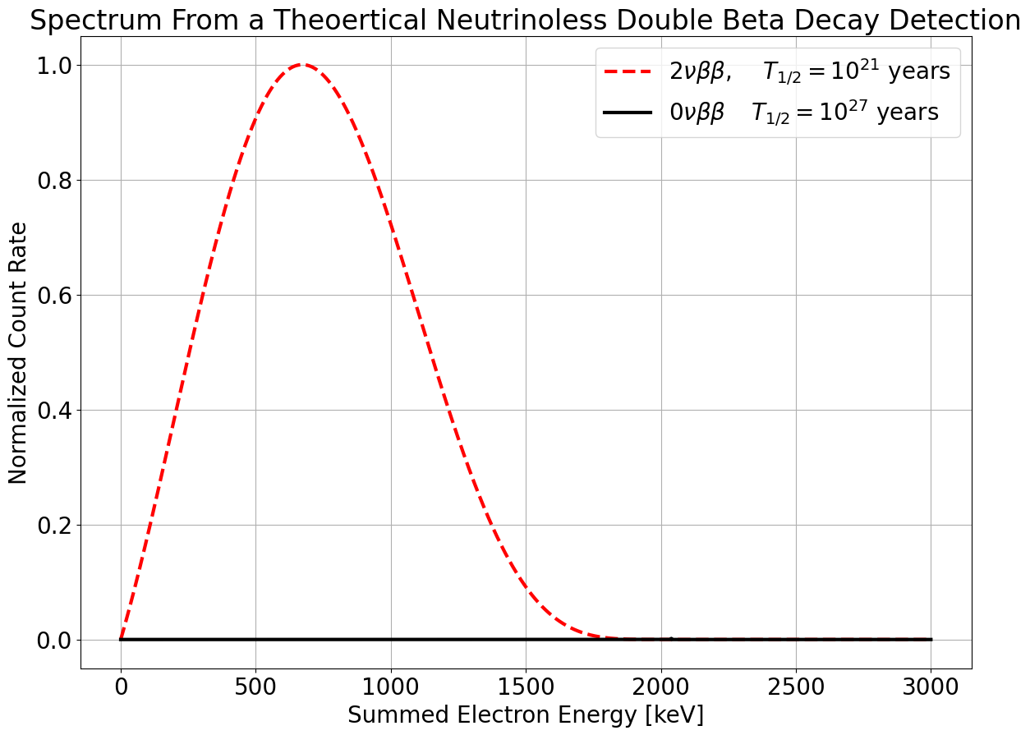

Neutrinoless double-beta decay
$$(A,Z)⟶(A,Z+2)+2e^{-}$$
Very clean experimental signature
  Summed electron energies “easy” to measure
Available energy in the decay is $Q_{ββ}$
Measure the half-life of this decay

Slide 37
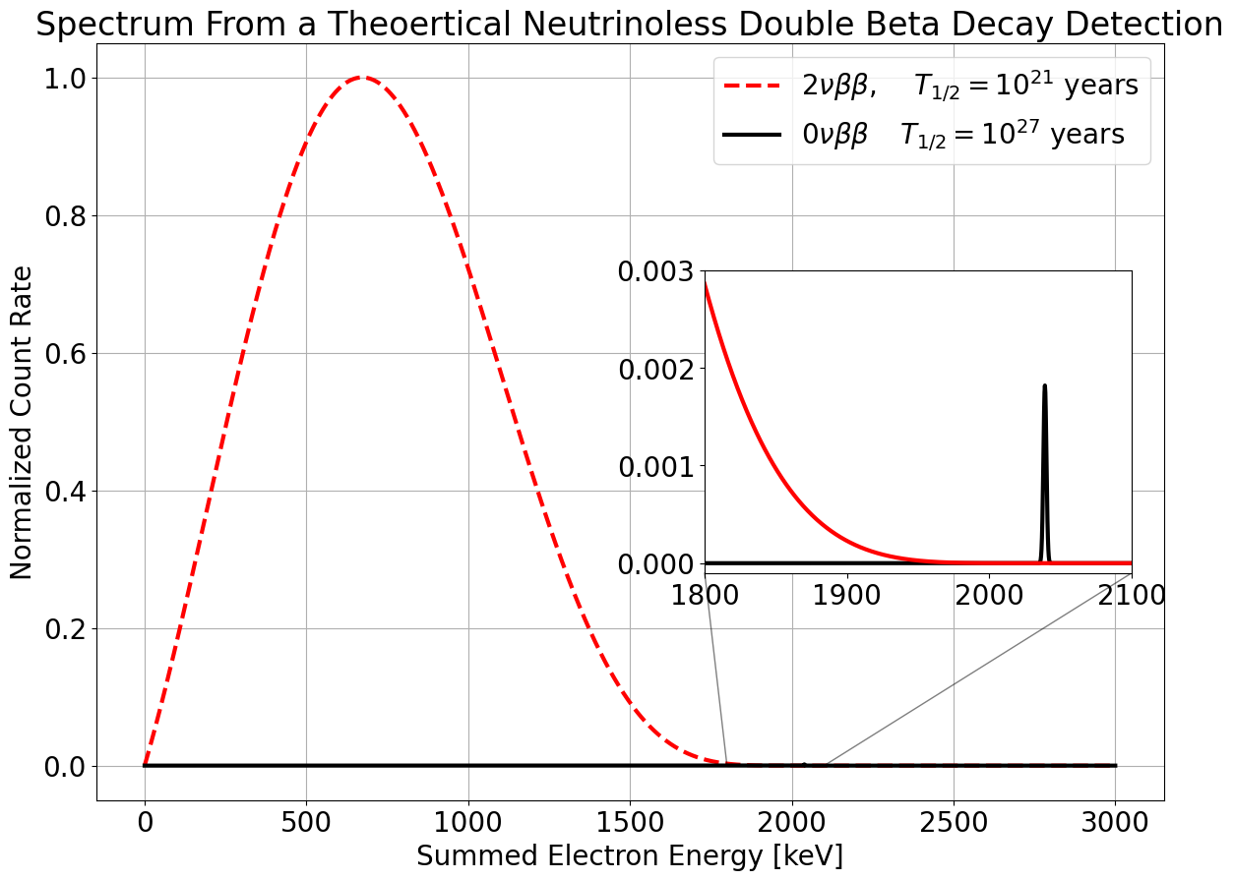
Neutrinoless double-beta decay
$$(A,Z)⟶(A,Z+2)+2e^{-}$$
Very clean experimental signature
  Summed electron energies “easy” to measure
Available energy in the decay is $Q_{ββ}$
Measure the half-life of this decay
$$(A,Z)⟶(A,Z+2)+2e^{-}$$

