Slide 1







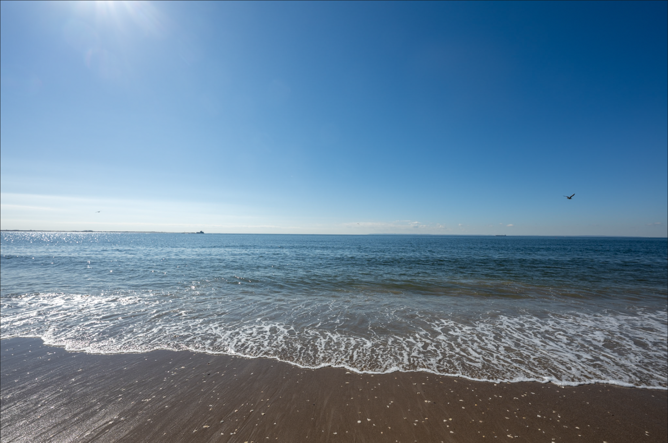
Gordon Watts
My career is all over the place!
AMY, CDF, DZERO, ATLAS
B-tagging, top & single top discovery, higgs, long lived particle searches
Got into HEP because of the overlap between hardware, software, and physics
  The hardware component has mostly been lost in the LHC era!
Machine learning (RNN’s, GNN’s) in physics
Heavily involved in IRIS-HEP (also Deputy Executive Director)
Software Interests
Primary driver: how do we make analysis simpler
ServiceX: Columnar Data Delivery
How can we use modern LLM’s to improve our… lives
  Information overload, conferences, large code bases, etc.
  Coding – how far can we push this towards making a plot?
`uv` and `uvx` for installing a tool in its own environments is so cool!

