Slide 1
Alignment specification
IT string
R. De Maria

Slide 2
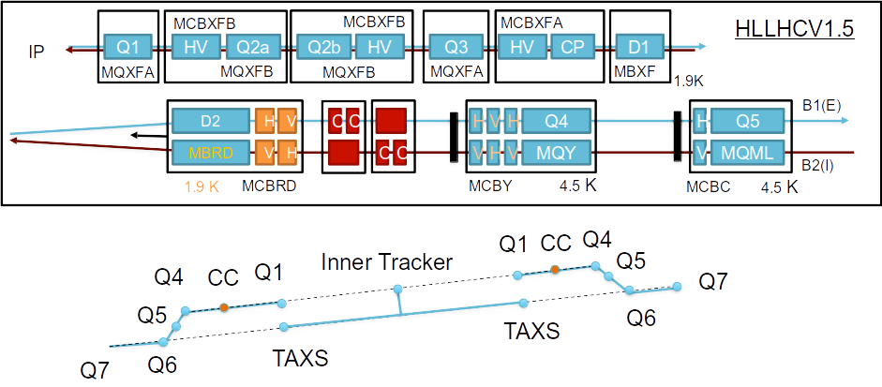
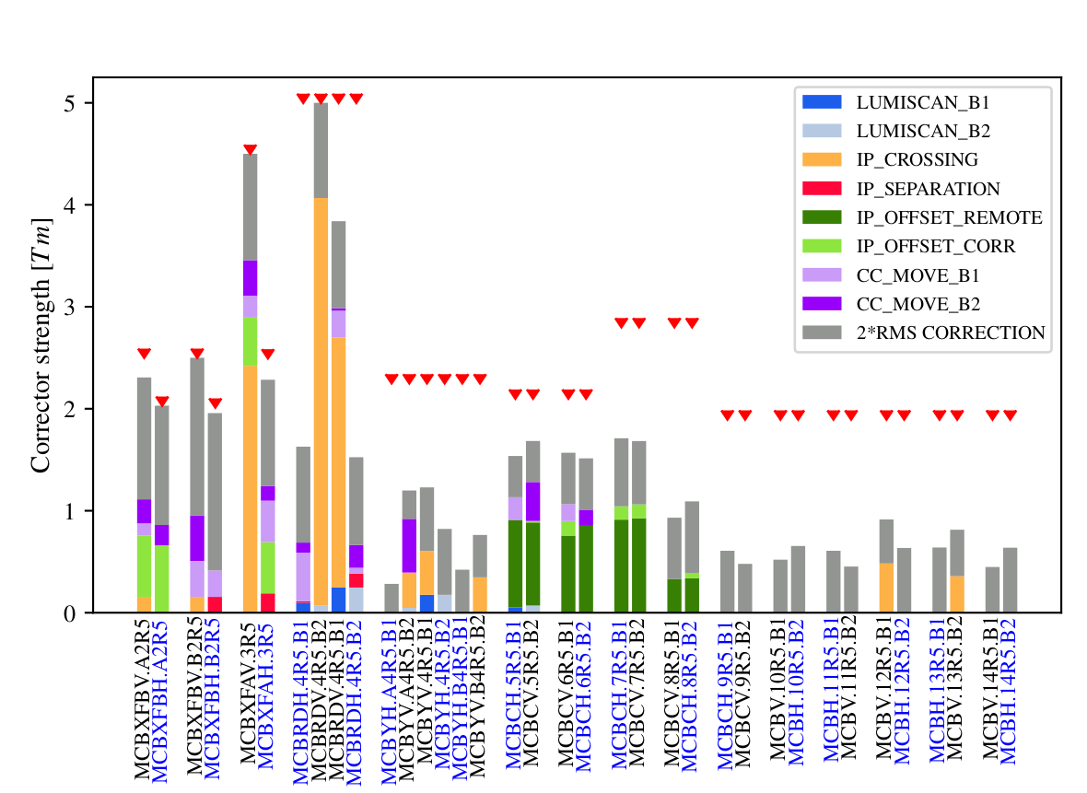
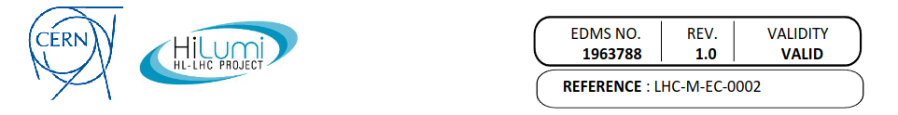
Context
To have collisions with crab cavities we need to control the orbit at IP and crab cavities better than ±0.5 mm.
Thus, we can only use the MCBX/MCBRD, specified for ±0.5 magnetic offset errors. Since orbit correction is not local, correcting orbit also optimizes apertures.
MQSX corrector can correct up to 1 mrad of magnetic axis error.
Tracker
D2 CC
Q1 Q2 Q3 D1
B1
IP
B2
The main strategy is to align the magnetic axis of Q1-Q3.

Slide 3
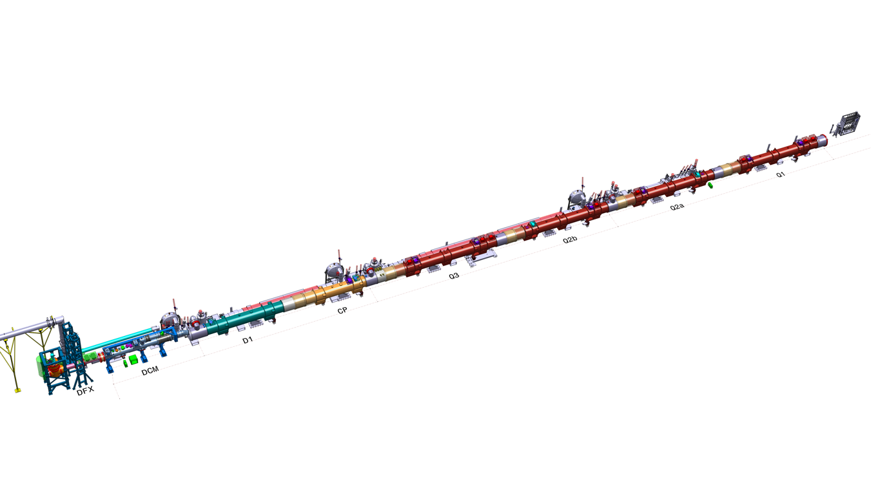
IT String test
One of the goal of the IT string test is to connect and align the triplet as we would do in the tunnel.
Q3
Q2b
Q2a
Q1
CC
IP
Alignment strategy: minimize only average offsets (not RMS) to preserve bellow range.

Slide 4
Status
Presently Q2a, Q2b, CP and D1 are installed but not connected.
Connection are foreseen for June.
Metrology data of Q2a, Q2b, Q3 sent by V. Rude, P. Bestmann, L. Fiscarelli.

Slide 5
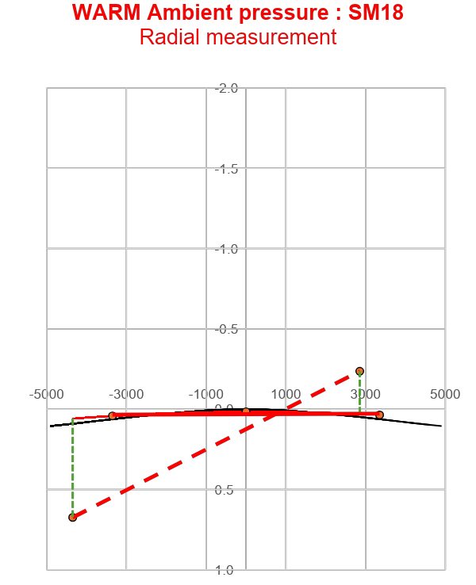
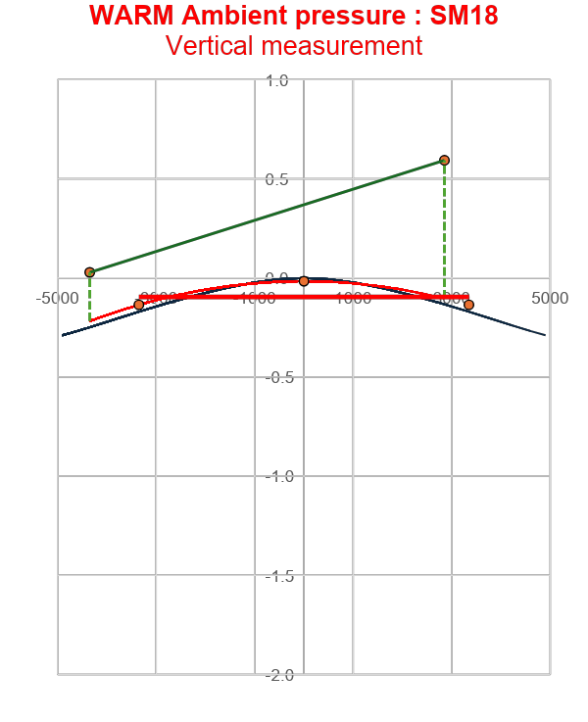
Q2a-P3
Radial
Vertical
Roll
WARM Ambient pressure : SM18
Magnetic field
Mechanical direction
(Z axis)
Conn side
=NIP side
NConn side
=IP side
Magnetic
field
Magnetic axis
Z
Δ =0.70 mm
Mechanical axis
0.259 mrad
Conn side
=NIP side
NConn side
=IP side
Δ =0.25 mm
Y
Z
Mechanical axis
Y
Δ =-0.27mm
X
Vacuum Vessel
Δ =0.62 mm
X
Magnetic axis
View from Conn side to Nconn side
=View from NIP side to IP side
V. Rude

Slide 6
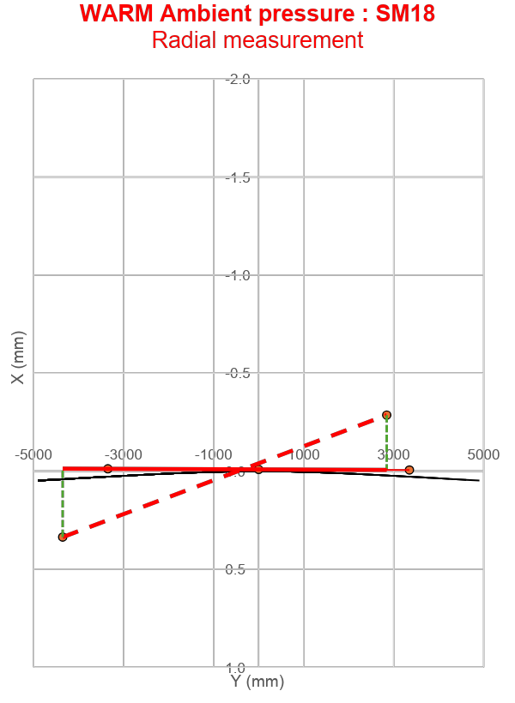
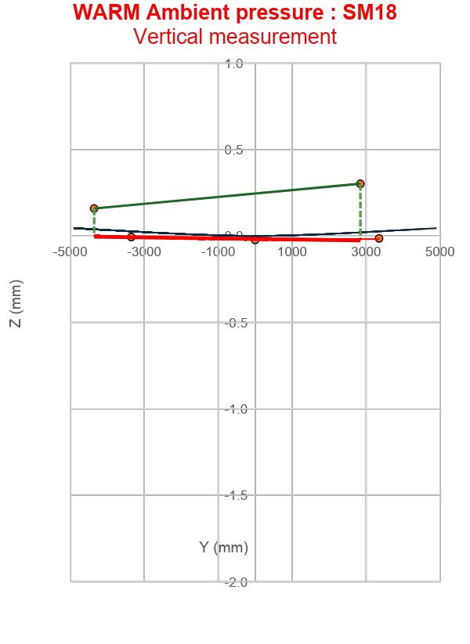
Q2b-P2
Radial
Vertical
Roll
WARM Ambient pressure : SM18
Magnetic field
Mechanical direction
(Z axis)
Conn side
=IP side
NConn side
=NIP side
Magnetic
field
Magnetic axis
Δ = + 0.16 mm
Z
Conn side
=IP side
NConn side
=NIP side
Y
Δ = + 0.33 mm
Vacuum
vessel
0.615 mrad
Mechanical axis
Z
X
Y
Δ = - 0.28 mm
Δ = + 0.35 mm
Mechanical axis
Vacuum
vessel
Magnetic axis
X
View from Conn side to Nconn side
=View from IP side to NIP side
V. Rude

Slide 7
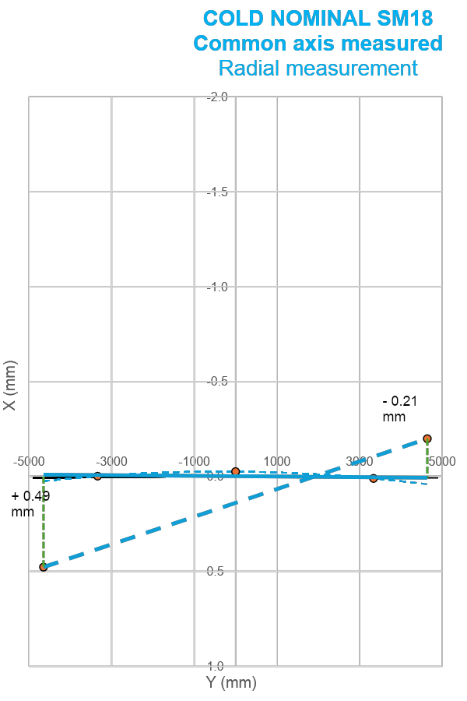
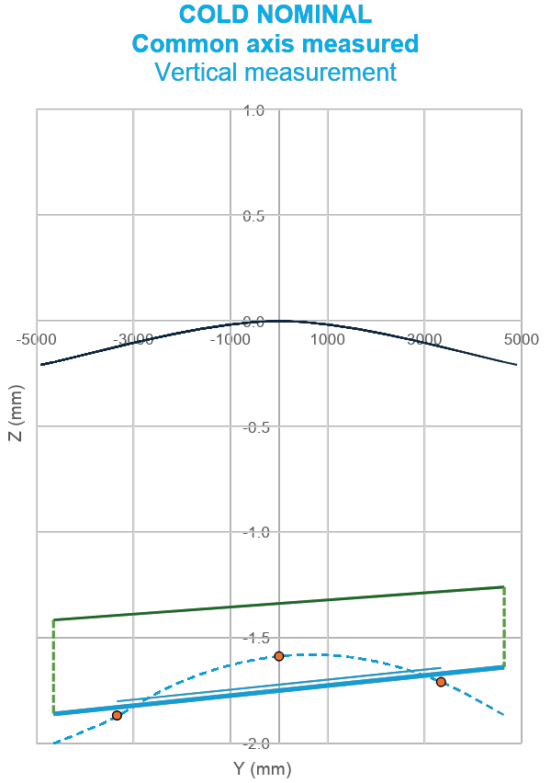
Q3
Radial
Vertical
Roll
COLD : SM18
Magnetic field
Mechanical direction
(Z axis)
Magnetic
field
Conn side
=NIP side
NConn side
=IP side
Z
Y
+ 2.461 mrad
Conn side
=NIP side
NConn side
=IP side
Vacuum
vessel
Z
X
Mechanical axis
Y
Vacuum
vessel
Magnetic axis
X
Magnetic axis
+ 0.38 mm
View from Conn side to Nconn side
=View from NIP side to IP side
+ 0.44 mm
Mechanical axis
V. Rude

Slide 8
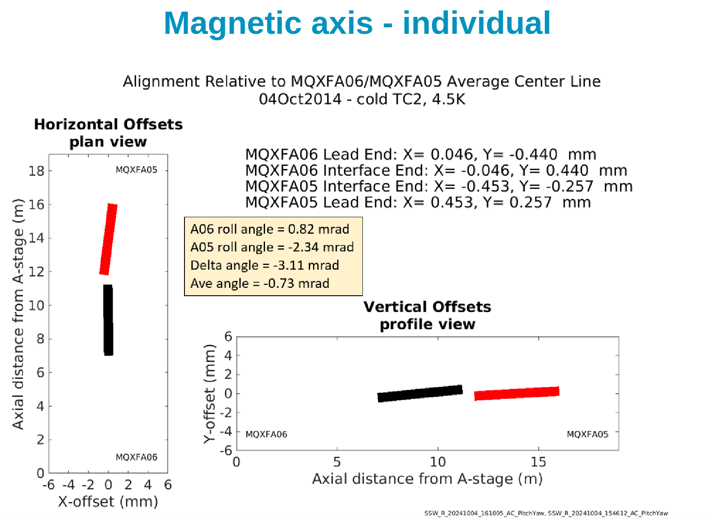
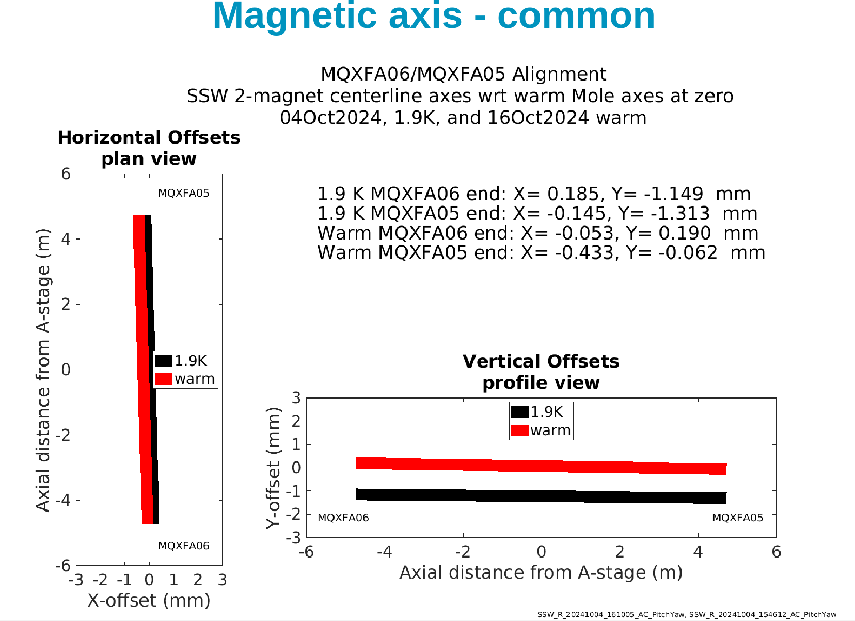
Q1
L. Fiscarelli 17/2/2025

Slide 9
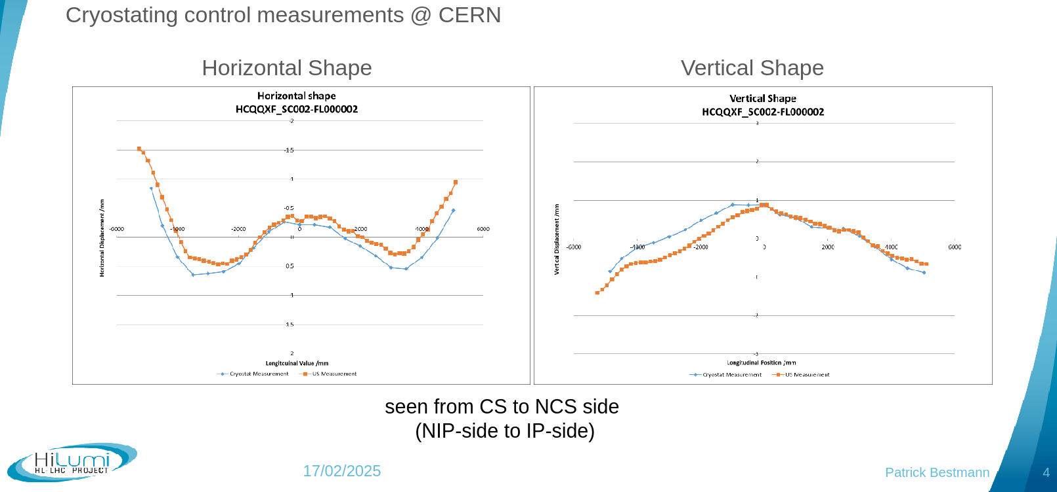
Q1

Slide 10
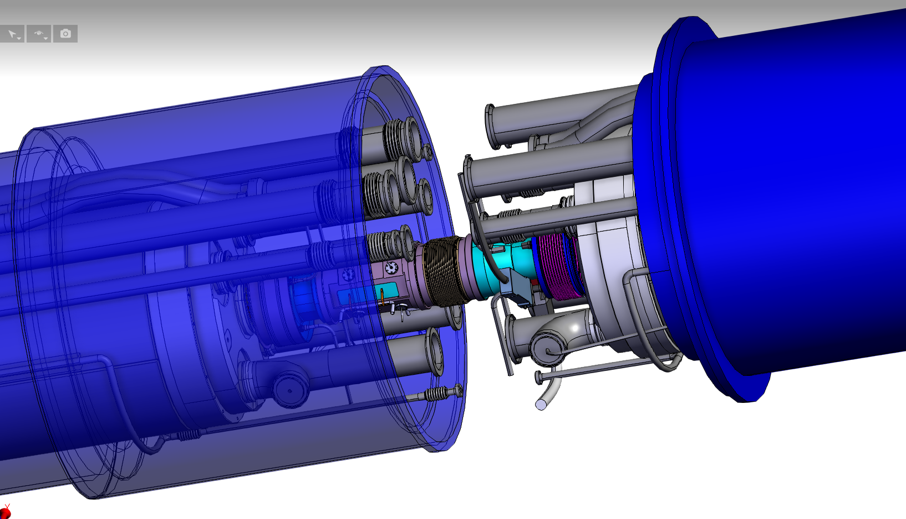
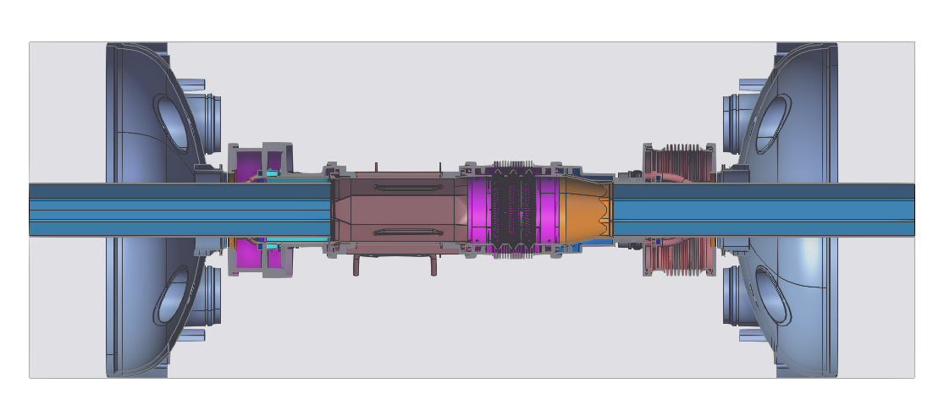
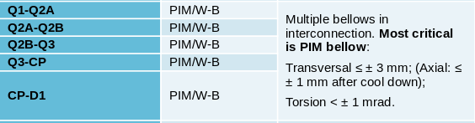
Status
Present measurement workflow allows to specify desired offsets, need to digest and complete measurements.
Tilts needs to be corrected at the installation time, while offsets are not possible.
String test does not have BPMs and beam screen. Unfortunately not possible to test BPM, DRF interconnections in the string.
Still very useful to verify in-situ realistic misalignments.
https://plm.cern.ch/PLM/?StartItem=CAD%3A878D444236C44A8F9F40419495AE41BF
M. Sosin WG meeting #78
https://plm.cern.ch/PLM/?StartItem=CAD%3ABED461D57FAB438F8B9D0F292492C00F

Slide 11
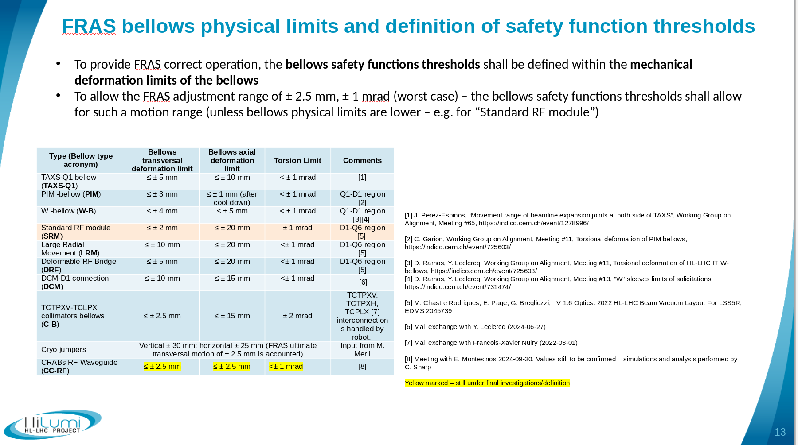
M. Sosin WG meeting #78

Slide 12
Follow up
Need to have also Q1 measurements. Ideally we should have all cold measurements, or at least all warm. I need to digest the values. ID cards do not have yet a glossary document to explain how the values are defined and measured.
For production would important to know also the position of the interfaces to estimate the offsets of all bellows such as BPMs and critical lines.
For the string test, I propose to position the magnets with magnetic axis aligned before the connection. Measure the offsets between interfaces and evaluate the residual range of motion to be compatible with 2.5 mm offset and 1 mrad range roll.
Very important to verify the possibility to correct Q3 roll angle at installation time and it is operational alignment margins. If Q3 would positionally locked and/or roll not corrected, coupling correction will be critical.

