Slide 1
HL-LHC high bandwidth BPMs: preliminary impedance studies
C. Antuono, N. Mounet
Acknowledgements: L. Giacomel, M. Krupa

Slide 2
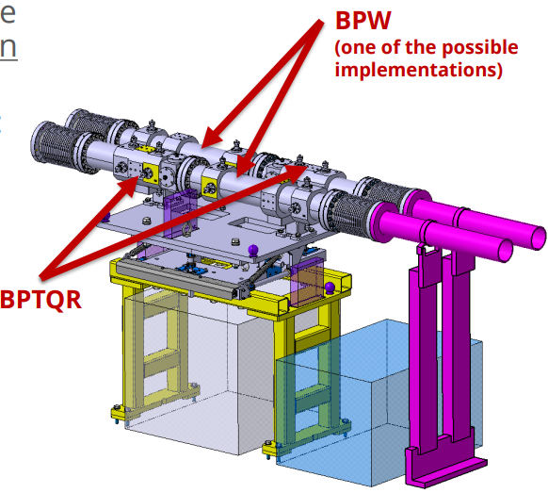
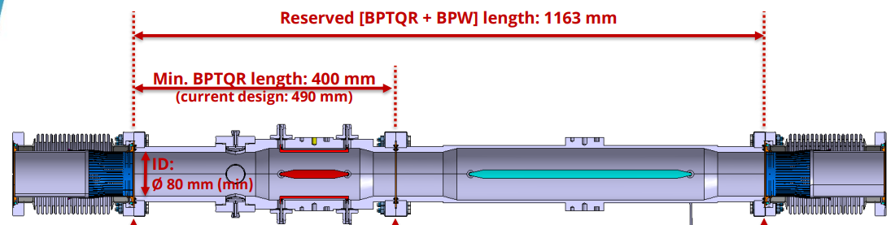
Background
Ongoing efforts to choose the best possible technology for the high-bandwidth beam position monitors in the HL LHC era.
Two different BPMs in the CC region (see M. Krupa at the BPM review)
  Installed in a common support
BPTQR: BPM for CC amplitude noise feedback
BPW: BPM for CC and instability diagnostics
Courtesy of M. Krupa
BPTQR
BPW

Slide 3
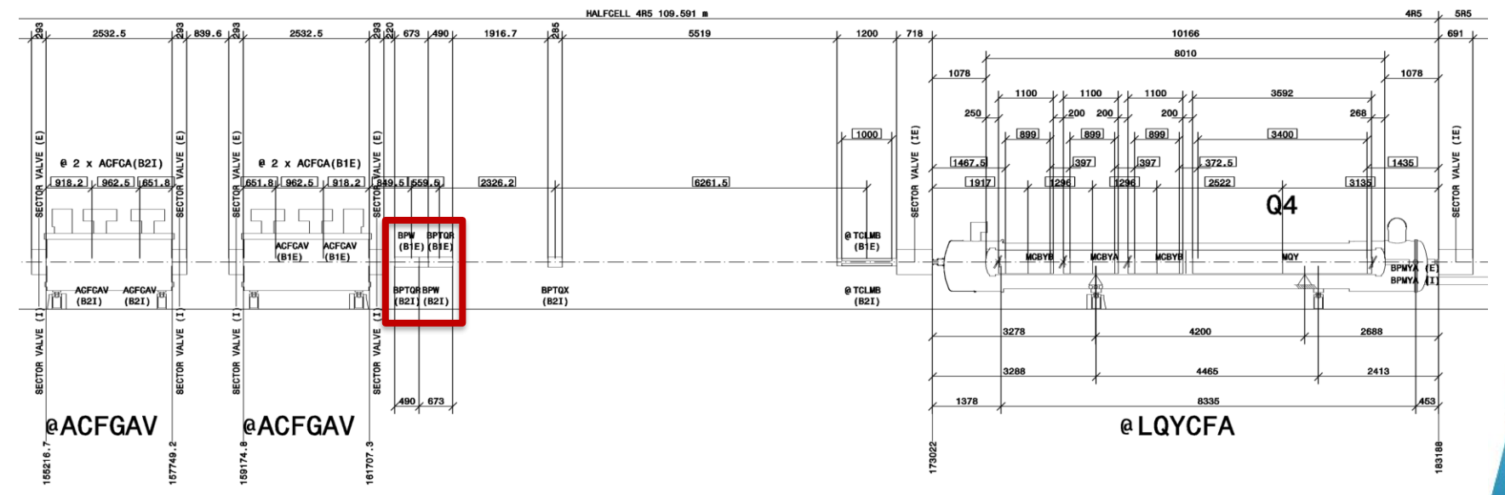
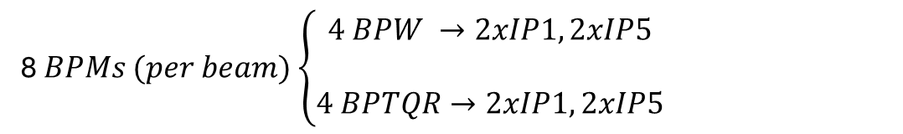
Background
Two different BPMs in the CC region (see M. Krupa at the BPM review)
  Installed in a common support
Eight BPWs and Eight BPTQRs on the CCs side (far from IP)
8 $BPMs (per beam)$ $\left\{\begin{aligned}4 BPW →2xIP1, 2xIP5 \\ \\ 4 BPTQR→2xIP1, 2xIP5\end{aligned}\right.$

Slide 4

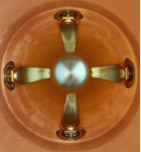

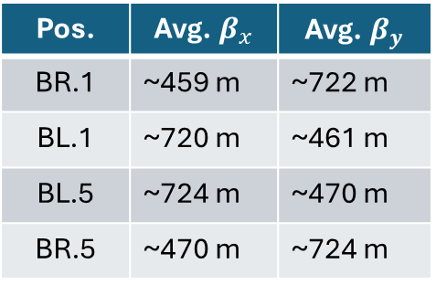
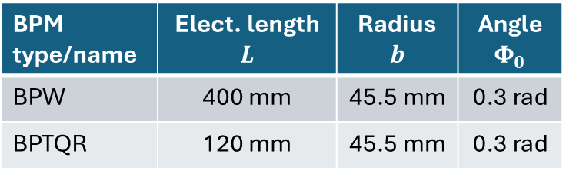
Preliminary Impedance studies: relevant parameters and scenario
Study on the impact on the total transverse impedance at flat top
Assumptions and specifications:
  Specific design ongoing: impedance computed with analytical model
    Ng formula for stripline BPMs
  Geometric properties (length, electrode length etc.) found in the HL-LHC review link
  Computations performed without CCs
BPM type/name | Elect. length $$L$$ | Radius $$b$$ | Angle $$Φ_{0}$$
BPW | 400 mm | 45.5 mm | 0.3 rad
BPTQR | 120 mm | 45.5 mm | 0.3 rad
$$Φ_{0}$$
L
Pos. | Avg.${ β}_{x}$ | Avg.${ β}_{y}$
BR.1 | ~459 m | ~722 m
BL.1 | ~720 m | ~461 m
BL.5 | ~724 m | ~470 m
BR.5 | ~470 m | ~724 m
For this preliminary computation I assumed each BPMs (1 BPW and 1 BPTQR) on the same location at each side of the CC per IP (per beam)

Slide 5
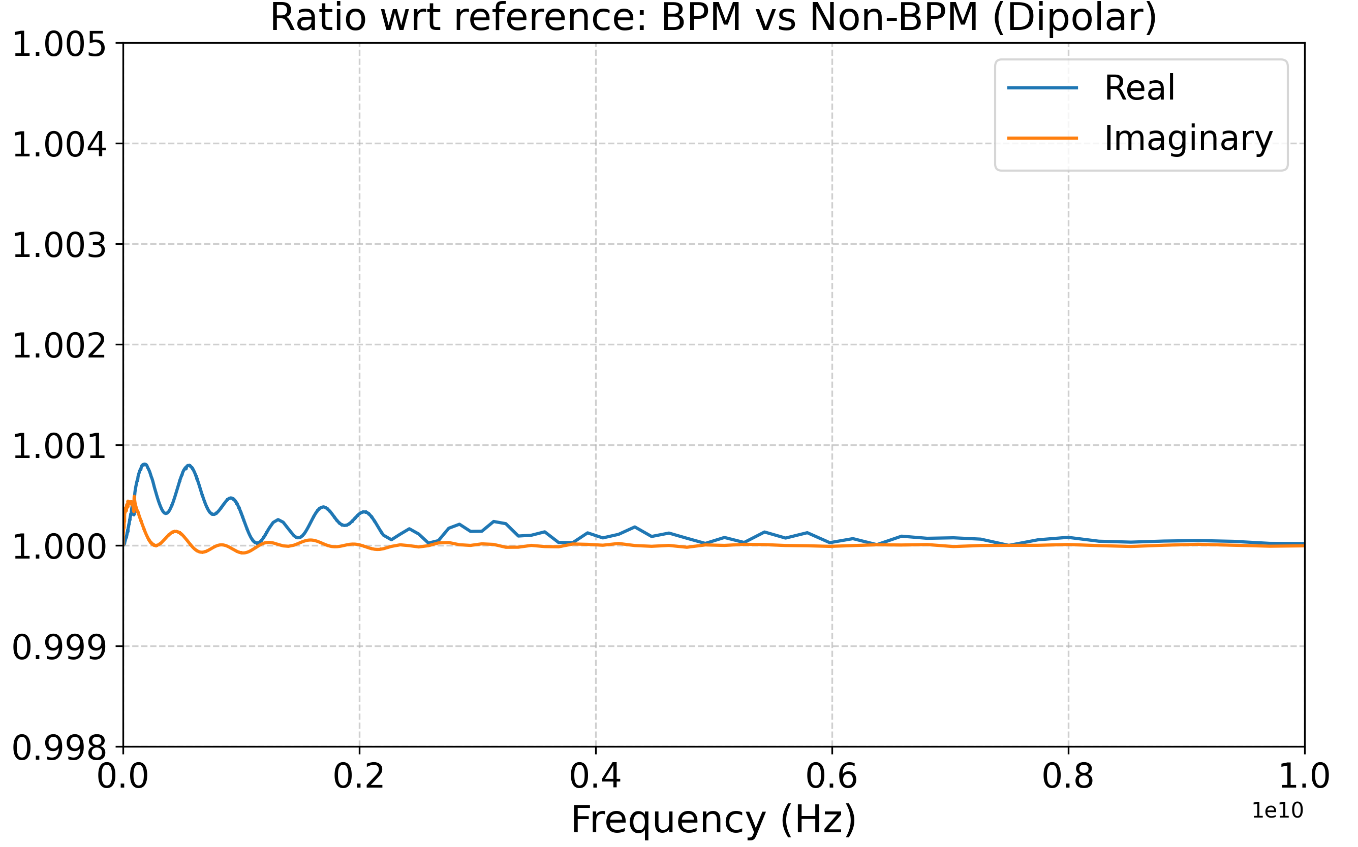
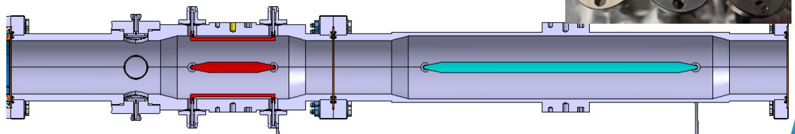
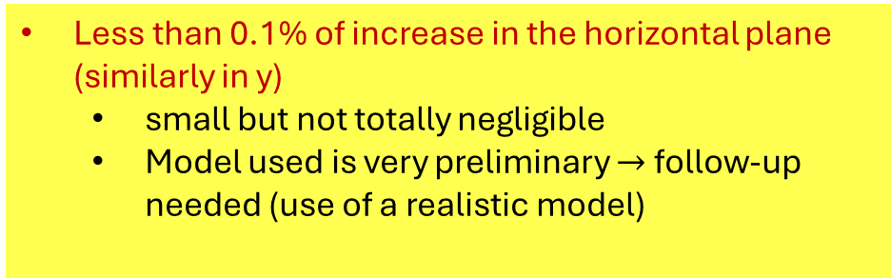
Preliminary Impedance studies: results
Less than 0.1% of increase in the horizontal plane (similarly in y)
  small but not totally negligible
  Model used is very preliminary $→$ follow-up needed (use of a realistic model)
Next steps
Compute impedance from the 3D realistic model with the latest design considered (or more)
  If needed, assess the precise impact on stability through Oct. threshold computation
Example of Realistic model

Slide 6
Thank you!

Slide 7
Backup

Slide 8
