Slide 1
Renovation of the survey database
and GEODE Application
KATARZYNA FIERGOLSKA
BE-GM-APC
14/02/2025

Slide 2
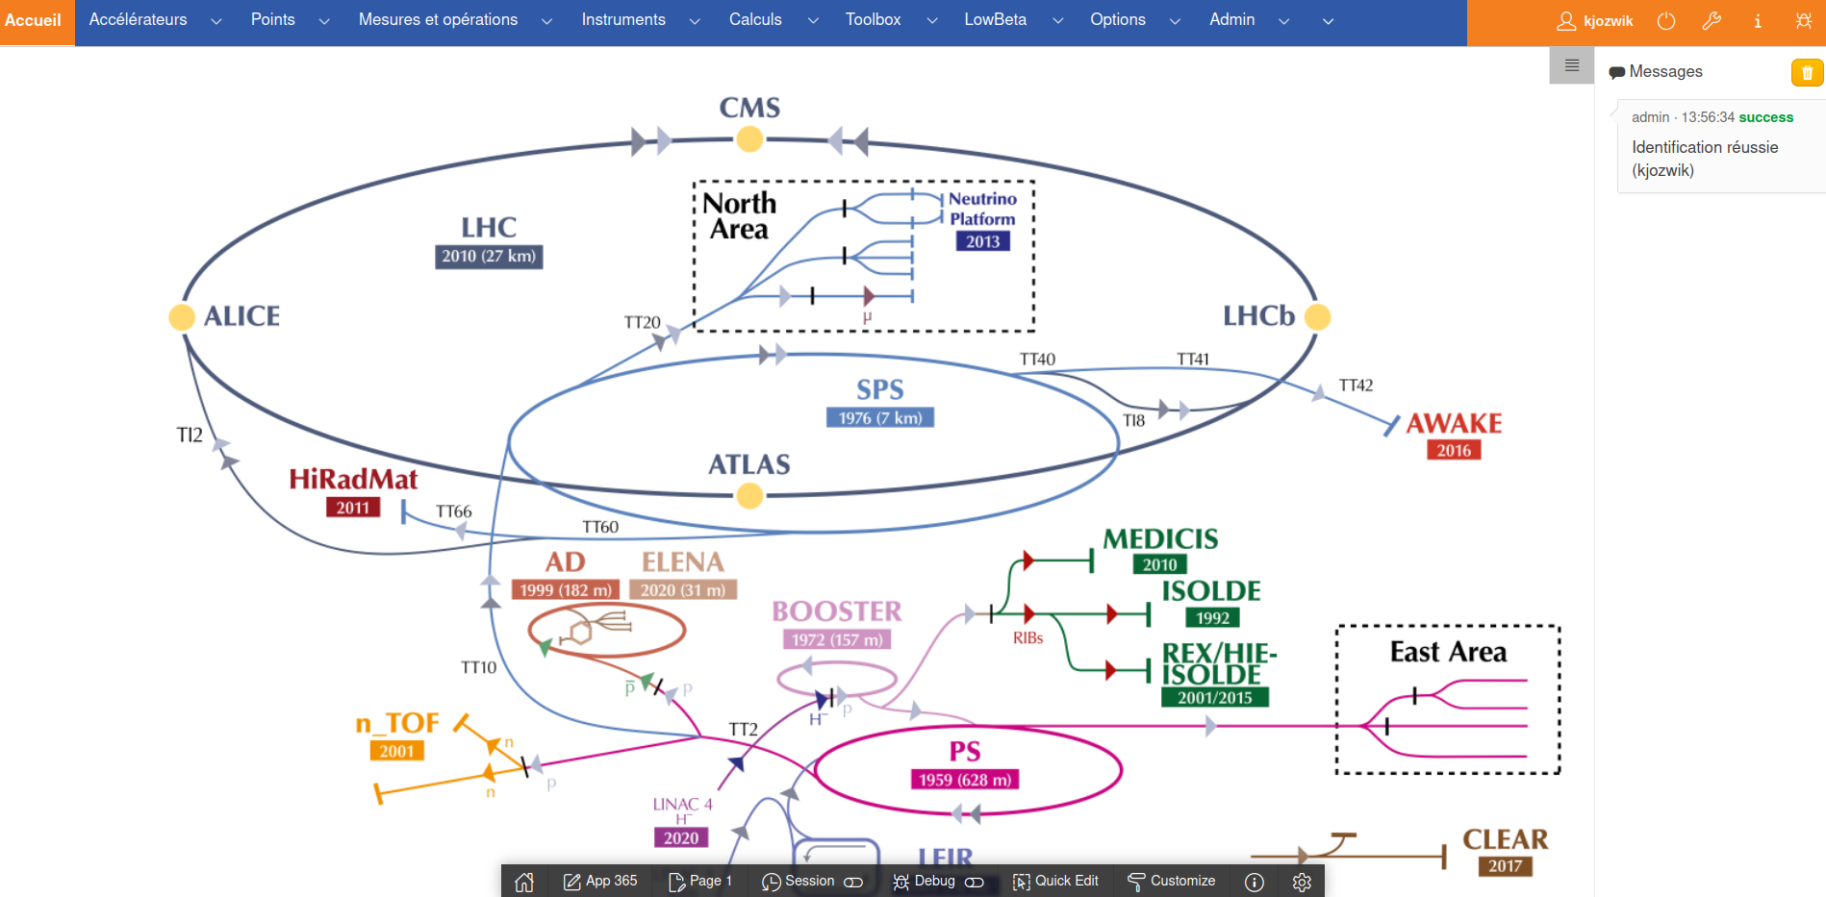
AGENDA
Accdb database
  Statistics
  Issues of the database
  Conclusions
Geode APEX pages
  Statistics and analysis
  Conclusions
  Solution to APEX’s limitations
Open questions about mixed solution
Next steps

Slide 3
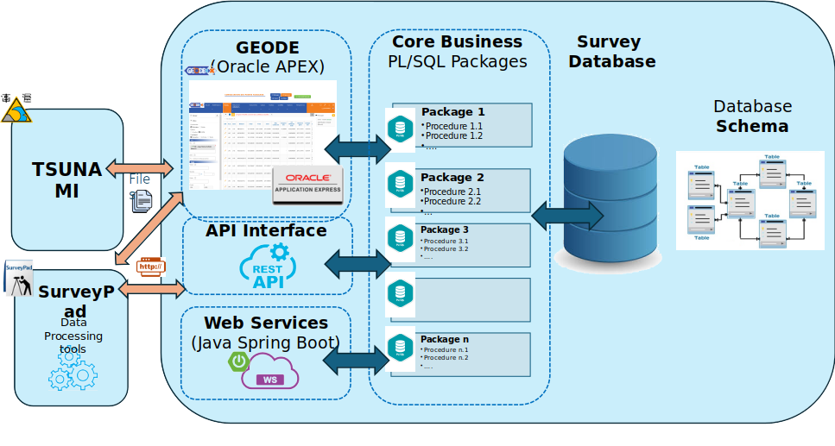

Database statistics
Packages
118585 lines of code
1 page ~40 lines
3000 pages
Database statistics - accdb
Year | 2010 | 2016 | 2025
Tables | 148 | 197 | 218
Views | 138 | 177 | 138
Materialized views | 16 | 16 | 14
Packages | 7 | 78 | 78
Procedures | 9 | 9 | 5
Functions | 6 | 13 | 14
Indexes | 327 | 337 | 436
Triggers | 204 | 177 | 186
The Lord of the Rings
"The Fellowship of the Ring"
"The Two Towers"
"The Return of the King"
"The Hobbit"
Business logic
Type | Count | Lines
Packages | 78 | 118 585
Triggers | 186 | 4672
Views | 138 | 5120
~1500 pages
Additionally:
111 pages of Oracle APEX
APEX - RESTful Data Services
2 Java Spring Boot microservices
1 page ~ 15 minutes
Minuts | 45000
Hour | 750
Working days | 93.8
Weeks | 18.8
Months | 4.3

Slide 4
Database statistics
Packages
118585 lines of code
1 page ~40 lines
3000 pages
Database statistics - accdb
Year | 2010 | 2016 | 2025
Tables | 148 | 197 | 218
Views | 138 | 177 | 138
Materialized views | 16 | 16 | 14
Packages | 7 | 78 | 78
Procedures | 9 | 9 | 5
Functions | 6 | 13 | 14
Indexes | 327 | 337 | 436
Triggers | 204 | 177 | 186
The Lord of the Rings
"The Fellowship of the Ring"
"The Two Towers"
"The Return of the King"
"The Hobbit"
Business logic
Type | Count | Lines
Packages | 78 | 118 585
Triggers | 186 | 4672
Views | 138 | 5120
~1500 pages
Does it need to be so extensive?
Additionally:
111 pages of Oracle APEX
APEX - RESTful Data Services
2 Java Spring Boot microservices
1 page ~ 15 minutes
Minuts | 45000
Hour | 750
Working days | 93.8
Weeks | 18.8
Months | 4.3

Slide 5
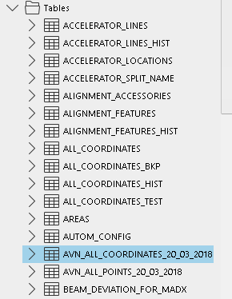
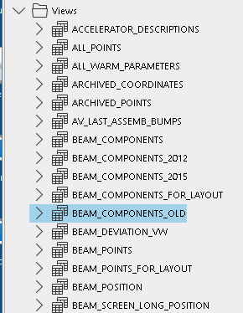
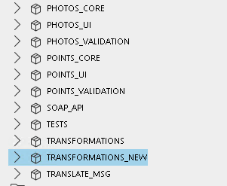
Database - at first glance
Obsolete, unused tables, views and packages
Proper versioning, such as using Git, would allow the removal of object snapshots.

Slide 6
SonarQube summary
Packages | Lines of Code | Lines of Code without comments | Bugs | Code Smells | Security Hotspots | Duplications
Total | 118,585 | 82,277 | 353 | 4,616 | 146 | 13.50%
tests.pkg | 15336 | 11,520 | 17 | 457 | 43 | 42.90%
points_validation.pkg | 12318 | 9,169 | 37 | 542 | 7 | 14.00%
calculs_files.pkg | 11588 | 8,384 | 32 | 499 | 8 | 12.60%
low_beta_core.pkg | 10695 | 7,217 | 29 | 418 | 0 | 12.10%
points_ui.pkg | 10358 | 7,012 | 25 | 772 | 8 | 6.00%
points_core.pkg | 6849 | 4,583 | 12 | 158 | 5 | 7.70%
calculs_ui.pkg | 5548 | 3,549 | 20 | 169 | 5 | 1.10%
measurements_ui.pkg | 4724 | 3,126 | 5 | 192 | 1 | 7.10%
calculs_validation.pkg | 4504 | 3,527 | 13 | 139 | 0 | 3.20%
instruments_ui.pkg | 3478 | 2,433 | 18 | 147 | 6 | 2.00%
measurements_validation.pkg | 3179 | 2,255 | 6 | 37 | 0 | 1.00%
measurements_core.pkg | 3155 | 2,293 | 22 | 119 | 0 | 3.10%
logger.pkg | 2705 | 753 | 5 | 181 | 2 | 0.00%
instruments_core.pkg | 2324 | 1,820 | 21 | 83 | 6 | 2.30%
transformations.pkg | 2200 | 1,389 | 0 | 39 | 0 | 44.80%
transformations_new.pkg | 2049 | 1,451 | 0 | 29 | 0 | 54.00%
calculs_core.pkg | 1818 | 1,292 | 4 | 24 | 2 | 0.00%
global_data.pkg | 1447 | 1,043 | 0 | 108 | 0 | 1.40%
file_management.pkg | 1401 | 810 | 5 | 22 | 1 | 0.00%
geode_webservices.pkg | 1331 | 977 | 3 | 62 | 2 | 5.90%
geode_ui.pkg | 1242 | 846 | 6 | 45 | 2 | 7.40%
coo_collections.pkg | 1185 | 776 | 1 | 79 | 0 | 2.50%
geode_core.pkg | 840 | 474 | 2 | 21 | 28 | 0.00%
filter_ui.pkg | 820 | 548 | 3 | 41 | 2 | 6.60%
photos_ui.pkg | 792 | 502 | 12 | 20 | 0 | 0.00%
env_test.pkg | 721 | 483 | 0 | 31 | 18 | 3.60%
operations_ui.pkg | 667 | 366 | 1 | 7 | 0 | 0.00%
low_beta_ui.pkg | 610 | 430 | 4 | 37 | 0 | 0.00%
instruments_validation.pkg | 607 | 455 | 7 | 20 | 0 | 14.50%
sample_data_pkg.pkg | 553 | 538 | 2 | 8 | 0 | 48.70%
format_util.pkg | 516 | 354 | 8 | 18 | 0 | 0.00%
photos_core.pkg | 462 | 291 | 6 | 5 | 0 | 0.00%
auth_ui.pkg | 431 | 283 | 0 | 4 | 0 | 0.00%
logger_su.pkg | 367 | 177 | 3 | 25 | 0 | 0.00%
filter_core.pkg | 313 | 214 | 0 | 12 | 0 | 0.00%
photos_validation.pkg | 275 | 196 | 13 | 3 | 0 | 0.00%
cgc.pkg | 254 | 166 | 2 | 18 | 0 | 23.30%
soap_api.pkg | 235 | 138 | 0 | 15 | 0 | 0.00%
operations_core.pkg | 203 | 123 | 1 | 0 | 0 | 0.00%
sample_pkg.pkg | 196 | 139 | 7 | 6 | 0 | 0.00%
geode_validation.pkg | 118 | 62 | 0 | 1 | 0 | 48.70%
translate_msg.pk | 108 | 82 | 1 | 3 | 0 | 0.00%
auth_core.pkg | 63 | 31 | 0 | 0 | 0 | 0.00%
https://sonarqube-dev.cern.ch/project_roles?id=apc_database_geode-sonar_AZMqgCeIZluD1ITgyApX

Slide 7
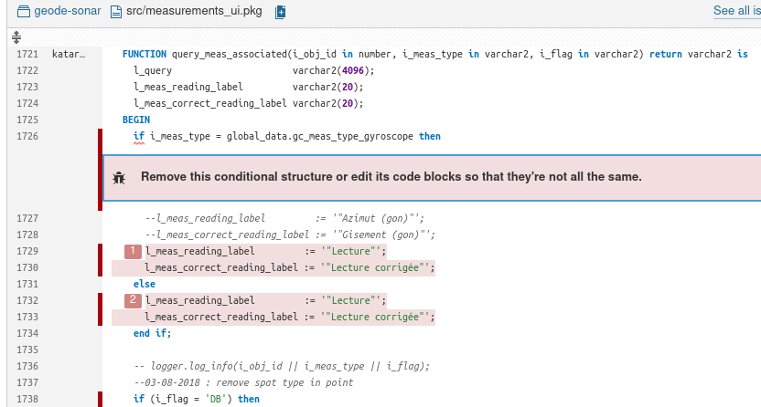
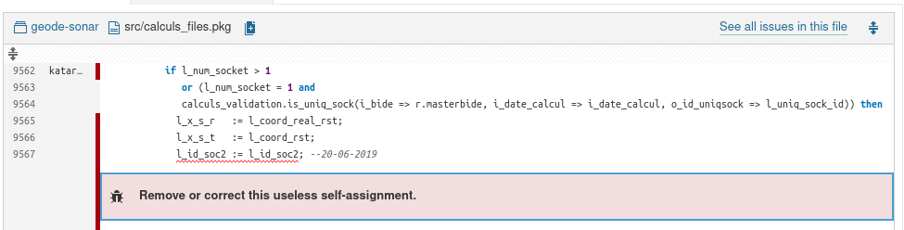
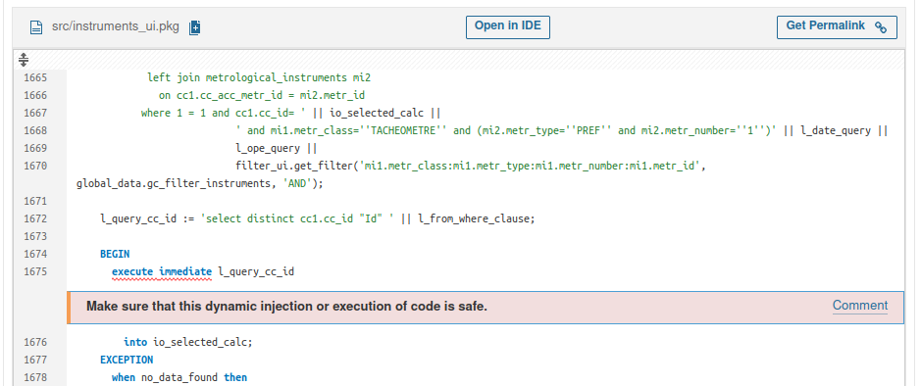
SonarQube findings
Bugs
Remove this conditional structure or edit its code blocks so that they're not all the same
Use either named - or positional - arguments, but not a mix of both.
Replace this FOR loop by a more robust WHILE one.
Remove or correct the useless self-assignment
This function should be refactored so that its last statement is a RETURN one.
Refactor this piece of code to not have any dead code after "return".
Security bugs
Make sure that this dynamic injection or execution of code is safe.

Slide 8
SonarQube findings
Bugs
Remove this conditional structure or edit its code blocks so that they're not all the same
Use either named - or positional - arguments, but not a mix of both.
Replace this FOR loop by a more robust WHILE one.
Remove or correct the useless self-assignment
This function should be refactored so that its last statement is a RETURN one.
Refactor this piece of code to not have any dead code after "return".
Security bugs
Make sure that this dynamic injection or execution of code is safe.

Slide 9
SonarQube findings
Bugs
Remove this conditional structure or edit its code blocks so that they're not all the same
Use either named - or positional - arguments, but not a mix of both.
Replace this FOR loop by a more robust WHILE one.
Remove or correct the useless self-assignment
This function should be refactored so that its last statement is a RETURN one.
Refactor this piece of code to not have any dead code after "return".
Security bugs
Make sure that this dynamic injection or execution of code is safe.

Slide 10
SonarQube findings
Bugs
Remove this conditional structure or edit its code blocks so that they're not all the same
Use either named - or positional - arguments, but not a mix of both.
Replace this FOR loop by a more robust WHILE one.
Remove or correct the useless self-assignment
This function should be refactored so that its last statement is a RETURN one.
Refactor this piece of code to not have any dead code after "return".
Security bugs
Make sure that this dynamic injection or execution of code is safe.

Slide 11
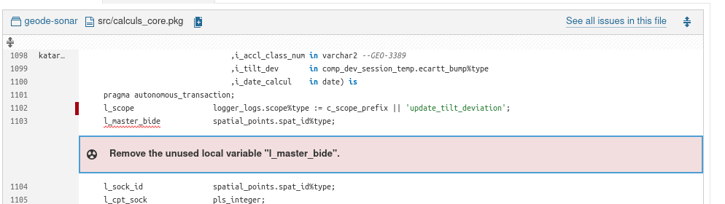
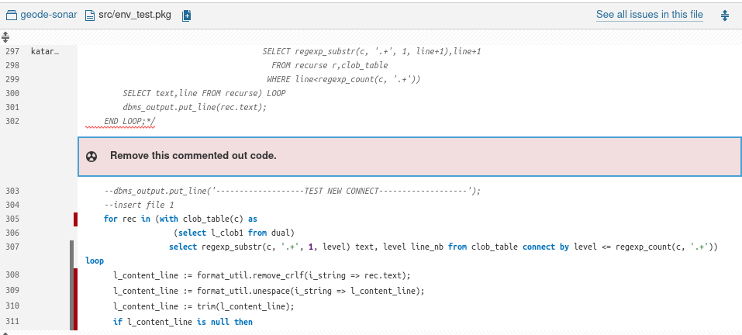
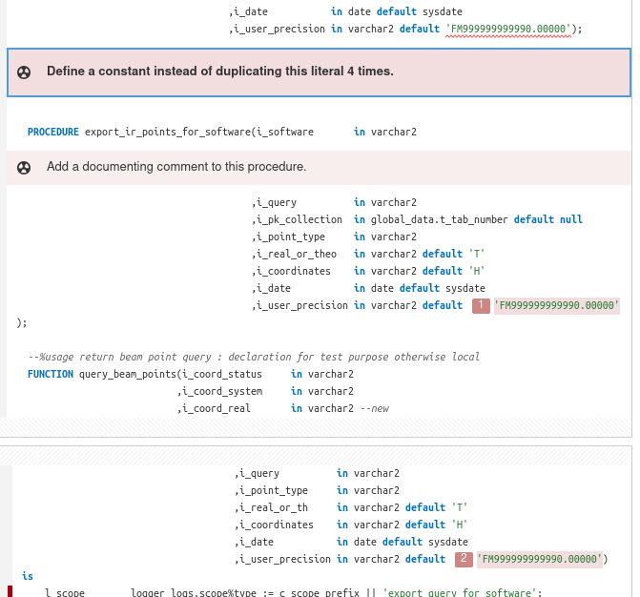
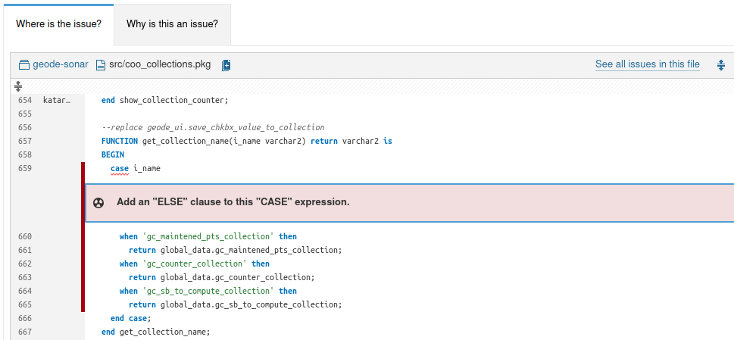
SonarQube findings
Code smells
Remove the unused local variable "l_maser_bids".
Remove the commented out code
SELECT * should not be used.
The EXCEPTION_INT -20,NNN call should be moved to a central place
Refactor this SQL query to eliminate the use of EXISTS.
The procedure "create_lgc_input_file" should be refactored to take at most 10 parameters instead of 21 as currently.
Define a constant instead of duplicating literal few times
Add a WHEN OTHERS exception handler to ensure that all exceptions are trapped.
Add a documenting comment to this procedure.
Add an "ELSE" clause to this "CASE" expression.

Slide 12
SonarQube findings
Code smells
Remove the unused local variable "l_maser_bids".
Remove the commented out code
SELECT * should not be used.
The EXCEPTION_INT -20,NNN call should be moved to a central place
Refactor this SQL query to eliminate the use of EXISTS.
The procedure "create_lgc_input_file" should be refactored to take at most 10 parameters instead of 21 as currently.
Define a constant instead of duplicating literal few times
Add a WHEN OTHERS exception handler to ensure that all exceptions are trapped.
Add a documenting comment to this procedure.
Add an "ELSE" clause to this "CASE" expression.

Slide 13
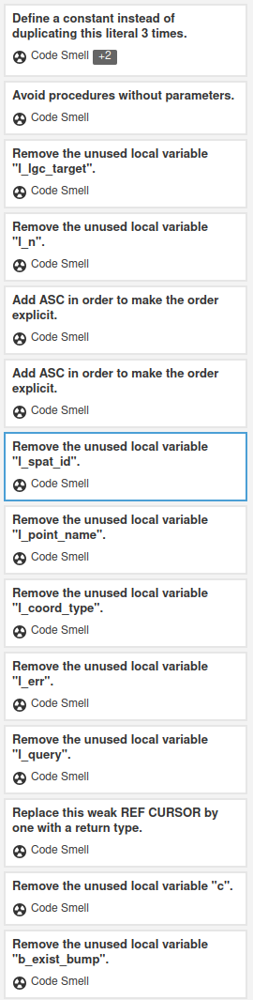
SonarQube findings
Code smells
Remove the unused local variable "l_maser_bids".
Remove the commented out code
SELECT * should not be used.
The EXCEPTION_INT -20,NNN call should be moved to a central place
Refactor this SQL query to eliminate the use of EXISTS.
The procedure "create_lgc_input_file" should be refactored to take at most 10 parameters instead of 21 as currently.
Define a constant instead of duplicating literal few times
Add a WHEN OTHERS exception handler to ensure that all exceptions are trapped.
Add a documenting comment to this procedure.
Add an "ELSE" clause to this "CASE" expression.

Slide 14
SonarQube findings
Code smells
Remove the unused local variable "l_maser_bids".
Remove the commented out code
SELECT * should not be used.
The EXCEPTION_INT -20,NNN call should be moved to a central place
Refactor this SQL query to eliminate the use of EXISTS.
The procedure "create_lgc_input_file" should be refactored to take at most 10 parameters instead of 21 as currently.
Define a constant instead of duplicating literal few times
Add a WHEN OTHERS exception handler to ensure that all exceptions are trapped.
Add a documenting comment to this procedure.
Add an "ELSE" clause to this "CASE" expression.

Slide 15
SonarQube findings
Code smells
Remove the unused local variable "l_maser_bids".
Remove the commented out code
SELECT * should not be used.
The EXCEPTION_INT -20,NNN call should be moved to a central place
Refactor this SQL query to eliminate the use of EXISTS.
The procedure "create_lgc_input_file" should be refactored to take at most 10 parameters instead of 21 as currently.
Define a constant instead of duplicating literal few times
Add a WHEN OTHERS exception handler to ensure that all exceptions are trapped.
Add a documenting comment to this procedure.
Add an "ELSE" clause to this "CASE" expression.

Slide 16
SonarQube findings
Code smells
Remove the unused local variable "l_maser_bids".
Remove the commented out code
SELECT * should not be used.
The EXCEPTION_INT -20,NNN call should be moved to a central place
Refactor this SQL query to eliminate the use of EXISTS.
The procedure "create_lgc_input_file" should be refactored to take at most 10 parameters instead of 21 as currently.
Define a constant instead of duplicating literal few times
Add a WHEN OTHERS exception handler to ensure that all exceptions are trapped.
Add a documenting comment to this procedure.
Add an "ELSE" clause to this "CASE" expression.

Slide 17
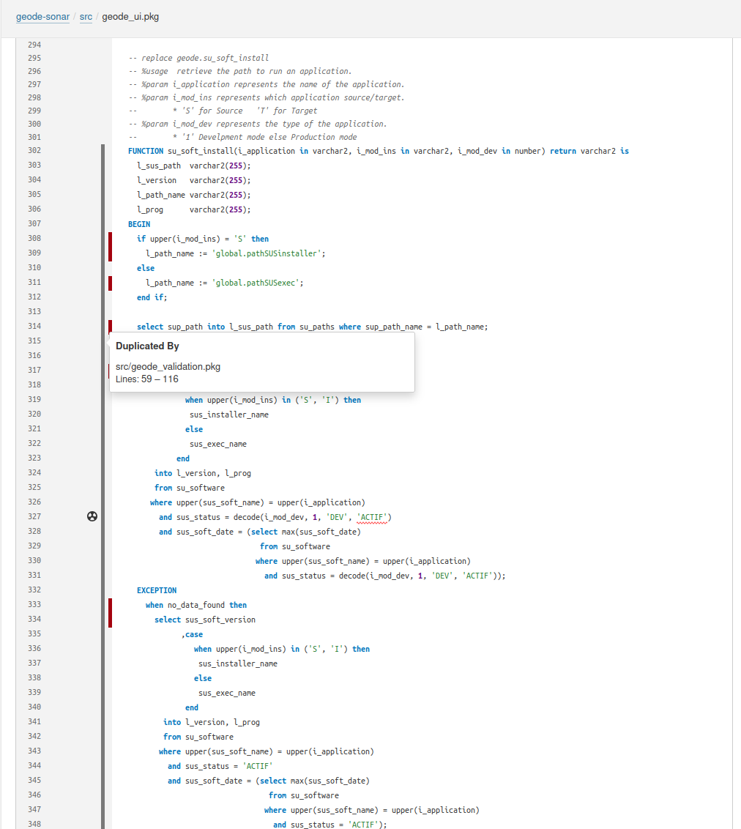
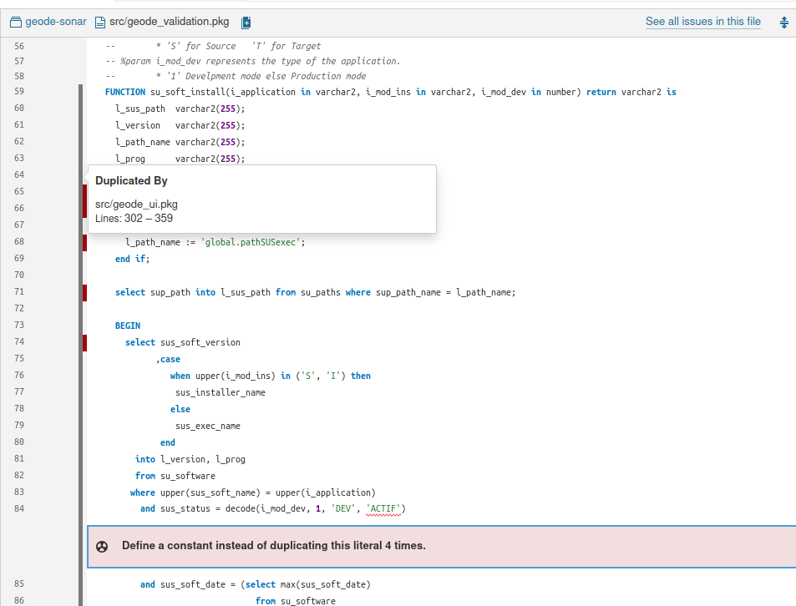
SonarQube findings
Duplications
13% of the code

Slide 18
Database - conclusions
The database code can be improved by relatively simple changes (without deep code refactorization):
Removal of unused packages, view, tables, triggers, jobs etc.
Elimination of unused procedures and functions, variables within the packages
Elimination of duplicated code
Elimination of commented-out code
Versioning of tables, views, triggers and jobs in GitLab
Further improvements:
based on SonarQube analysis results
To avoid issues in the future:
implement a code quality tool checks (e.g. SonarQube) in the Gitlab pipelines

Slide 19
Geode APEX pages analysis
Geode APEX

Slide 20
Geode APEX pages - conclusions
The APEX pages can be improved by:
Removing unassigned pages.
Removing unused or rarely used pages (careful selection is required).
Translating the application into English.

Slide 21
APEX technology - limitations
Some main limitations of APEX technology (already addressed during our last meeting):
Oracle Dependency
Problematic versioning
Not ideal for parallel work by multiple developers
Learning curve
Limited flexibility compared to full custom solutions
Community and support
Solution - mixed implementation:
Based on a Java service (Spring Boot)
Java-based frontend (e.g., Angular or React)
APEX pages accompanied by a Java frontend
Gradual porting of APEX pages to the Java frontend

Slide 22
Mixed solution - open questions to Pioneer :)
How can we run APEX and Java (i.e., with Spring and Angular/React) together and in parallel? Assuming Java is used as the frontend, how can we redirect calls from Java to APEX pages that haven’t been ported yet? Are there any code examples available?
How can we systematically handle returns from APEX pages to Java for pages that have already been ported? Could a centralized component in APEX manage this?
How should we maintain APEX pages with filters? Is it possible to set APEX filters (e.g., via URL parameters) when redirecting to APEX pages from Java? Alternatively, does APEX’s RESTful service allow control of APEX filters through API calls?
How should authentication and authorization be implemented? Can we use SSO token exchange? Is this supported by APEX? Are there any code examples for this?
How should we handle business logic? Should it be moved from the database to Java?
How should we organize version control for compatible APEX and Java releases?
Java will have unit tests, but how can we test the implementation at the Java-APEX interface? How can we mock APEX in unit tests?
Why did you choose Angular over React?

Slide 23
Mixed solution - open questions to Pioneer :)
How can we run APEX and Java (i.e., with Spring and Angular/React) together and in parallel? Assuming Java serves as the frontend, how can we redirect calls from Java to APEX pages that haven’t been ported yet? Are there any code examples available?
How can we systematically handle returns from APEX pages to Java for pages that have already been ported? Could a centralized component in APEX manage this?
How should we maintain APEX pages with filters? Is it possible to set APEX filters (e.g., via URL parameters) when redirecting to APEX pages from Java? Alternatively, does APEX’s RESTful service allow control of APEX filters through API calls?
How should authentication and authorization be implemented? Can we use SSO token exchange? Is this supported by APEX? Are there any code examples for this?
How should we handle business logic? Should it be moved from the database to Java?
How should we organize version control for compatible APEX and Java releases?
Java will have unit tests, but how can we test the implementation at the Java-APEX interface? How can we mock APEX in unit tests?
Why did you choose Angular over React?

Slide 24
Mixed solution - open questions to Pioneer :)
How can we run APEX and Java (i.e., with Spring and Angular/React) together and in parallel? Assuming Java serves as the frontend, how can we redirect calls from Java to APEX pages that haven’t been ported yet? Are there any code examples available?
How can we systematically handle returns from APEX pages to Java for pages that have already been ported? Could a centralized component in APEX manage this?
How should we maintain APEX pages with filters? Is it possible to set APEX filters (e.g., via URL parameters) when redirecting to APEX pages from Java? Alternatively, does APEX’s RESTful service allow control of APEX filters through API calls?
How should authentication and authorization be implemented? Can we use SSO token exchange? Is this supported by APEX? Are there any code examples for this?
How should we handle business logic? Should it be moved from the database to Java?
How should we organize version control for compatible APEX and Java releases?
Java will have unit tests, but how can we test the implementation at the Java-APEX interface? How can we mock APEX in unit tests?
Why did you choose Angular over React?

Slide 25
Mixed solution - open questions to Pioneer :)
How can we run APEX and Java (i.e., with Spring and Angular/React) together and in parallel? Assuming Java serves as the frontend, how can we redirect calls from Java to APEX pages that haven’t been ported yet? Are there any code examples available?
How can we systematically handle returns from APEX pages to Java for pages that have already been ported? Could a centralized component in APEX manage this?
How should we maintain APEX pages with filters? Is it possible to set APEX filters (e.g., via URL parameters) when redirecting to APEX pages from Java? Alternatively, does APEX’s RESTful service allow control of APEX filters through API calls?
How should authentication and authorization be implemented? Can we use SSO token exchange? Is this supported by APEX? Are there any code examples for this?
How should we handle business logic? Should it be moved from the database to Java?
How should we organize version control for compatible APEX and Java releases?
Java will have unit tests, but how can we test the implementation at the Java-APEX interface? How can we mock APEX in unit tests?
Why did you choose Angular over React?

Slide 26
Mixed solution - open questions to Pioneer :)
How can we run APEX and Java (i.e., with Spring and Angular/React) together and in parallel? Assuming Java serves as the frontend, how can we redirect calls from Java to APEX pages that haven’t been ported yet? Are there any code examples available?
How can we systematically handle returns from APEX pages to Java for pages that have already been ported? Could a centralized component in APEX manage this?
How should we maintain APEX pages with filters? Is it possible to set APEX filters (e.g., via URL parameters) when redirecting to APEX pages from Java? Alternatively, does APEX’s RESTful service allow control of APEX filters through API calls?
How should authentication and authorization be implemented? Can we use SSO token exchange? Is this supported by APEX? Are there any code examples for this?
How should we handle business logic? Should it be moved from the database to Java?
How should we organize version control for compatible APEX and Java releases?
Java will have unit tests, but how can we test the implementation at the Java-APEX interface? How can we mock APEX in unit tests?
Why did you choose Angular over React?

Slide 27
Mixed solution - open questions to Pioneer :)
How can we run APEX and Java (i.e., with Spring and Angular/React) together and in parallel? Assuming Java serves as the frontend, how can we redirect calls from Java to APEX pages that haven’t been ported yet? Are there any code examples available?
How can we systematically handle returns from APEX pages to Java for pages that have already been ported? Could a centralized component in APEX manage this?
How should we maintain APEX pages with filters? Is it possible to set APEX filters (e.g., via URL parameters) when redirecting to APEX pages from Java? Alternatively, does APEX’s RESTful service allow control of APEX filters through API calls?
How should authentication and authorization be implemented? Can we use SSO token exchange? Is this supported by APEX? Are there any code examples for this?
How should we handle business logic? Should it be moved from the database to Java?
How should we organize version control for compatible APEX and Java releases?
Java will have unit tests, but how can we test the implementation at the Java-APEX interface? How can we mock APEX in unit tests?
Why did you choose Angular over React?

Slide 28
Mixed solution - open questions to Pioneer :)
How can we run APEX and Java (i.e., with Spring and Angular/React) together and in parallel? Assuming Java serves as the frontend, how can we redirect calls from Java to APEX pages that haven’t been ported yet? Are there any code examples available?
How can we systematically handle returns from APEX pages to Java for pages that have already been ported? Could a centralized component in APEX manage this?
How should we maintain APEX pages with filters? Is it possible to set APEX filters (e.g., via URL parameters) when redirecting to APEX pages from Java? Alternatively, does APEX’s RESTful service allow control of APEX filters through API calls?
How should authentication and authorization be implemented? Can we use SSO token exchange? Is this supported by APEX? Are there any code examples for this?
How should we handle business logic? Should it be moved from the database to Java?
How should we organize version control for compatible APEX and Java releases?
Java will have unit tests, but how can we test the implementation at the Java-APEX interface? How can we mock APEX in unit tests?
Why did you choose Angular over React?

Slide 29
Mixed solution - open questions to Pioneer :)
How can we run APEX and Java (i.e., with Spring and Angular/React) together and in parallel? Assuming Java serves as the frontend, how can we redirect calls from Java to APEX pages that haven’t been ported yet? Are there any code examples available?
How can we systematically handle returns from APEX pages to Java for pages that have already been ported? Could a centralized component in APEX manage this?
How should we maintain APEX pages with filters? Is it possible to set APEX filters (e.g., via URL parameters) when redirecting to APEX pages from Java? Alternatively, does APEX’s RESTful service allow control of APEX filters through API calls?
How should authentication and authorization be implemented? Can we use SSO token exchange? Is this supported by APEX? Are there any code examples for this?
How should we handle business logic? Should it be moved from the database to Java?
How should we organize version control for compatible APEX and Java releases?
Java will have unit tests, but how can we test the implementation at the Java-APEX interface? How can we mock APEX in unit tests?
Why did you choose Angular over React?

Slide 30
Next steps
Improve the database according to the conclusions (slide 18)
  Address at least the simple changes.
Improve the APEX pages according to the conclusions (slide 20).
Set up the Java framework for the mixed solution:
  Implement the skeleton for the Java service based on Spring Boot.
  Choose a frontend framework (possibly: Angular, React, or another option).
  Implement the basic frontend.
Port APEX pages to mixed solution :
  Port a simple APEX page (without a filter) to mixed solution.
  Port an APEX page (with a filter) to mixed solution.
Prepare a plan for migrating Geode APEX to the mixed solution:
  Together with Anne-Valérie, identify pages to be ported.
Review the migration plan.
Start executing the plan.

