Slide 1
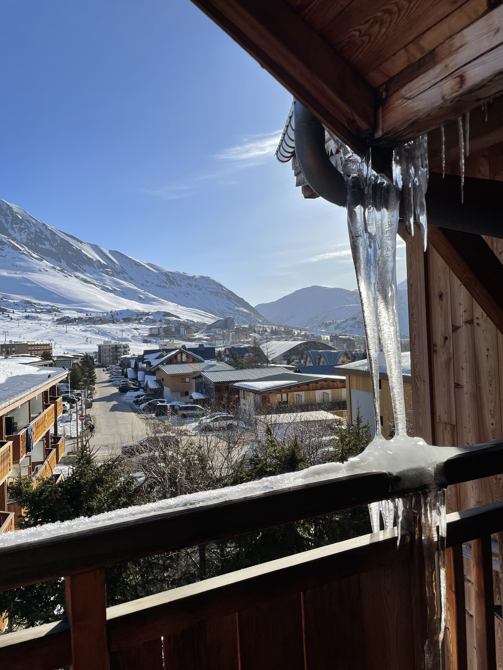

Report from physics coordinator
-
102nd ISCC
Schedule 2025
Announcements
YETS activities
March 2025 - Hanne Heylen

Slide 2
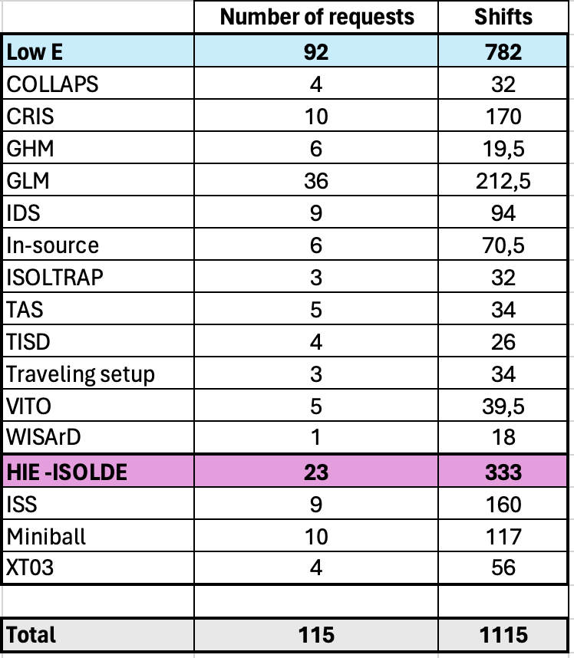
1. Schedule – beam requests 2025
2024
Beams were delivered to 44 distinct IS/LOIs (9 HIE-ISOLDE)
A total of 426 shifts were delivered for physics, beam development and ad-hoc measurements
INTC 78 – Feb 2025
127 shifts accepted
  5 proposals
  3 LOIs (2 without shifts)
  2 clarification letters
Comment from Technical Advisory Committee: The current performance of the 7-gap amplifiers in the post-accelerator restricts the acceptable A/Q ratio and, consequently, put constraints on the beam's charge state

Slide 3
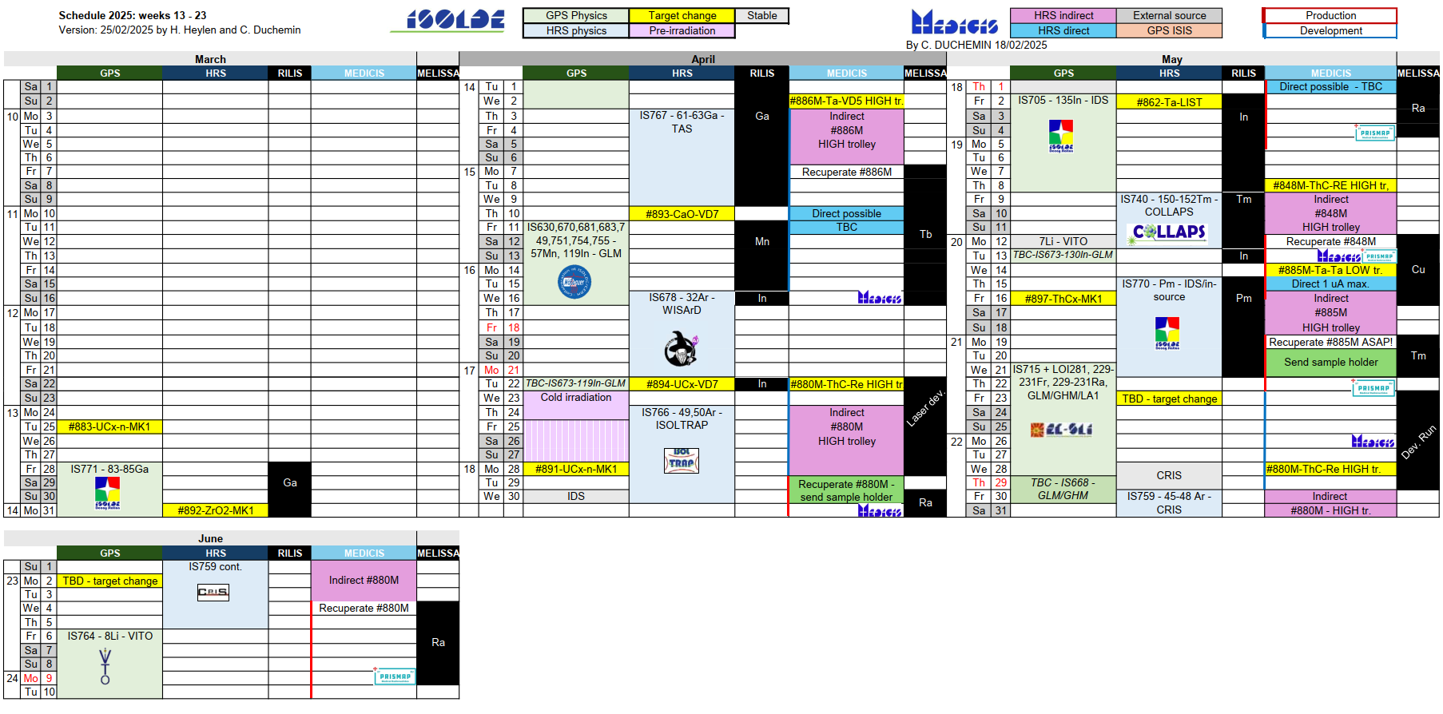
1. Schedule 2025
Start low E - March 28th.
Start HIE ISOLDE - June 13th.
Stop protons - December 8th.
No winter physics campaign in 2026
Scheduling goal: beam for as many groups as possible
Priorities from experimental collaborations
From summer onwards, priority to HIE-ISOLDE runs
Groups affected by suspension of GLM/GHM in 2024
INTC input: priority for physics over beam development

Slide 4
1. Schedule 2025
Start low E - March 28th.
Start HIE ISOLDE - June 13th.
Stop protons - December 8th.
No winter physics campaign in 2026
MEDICIS aims to start clinical trials in 2025
Subject to approval of CERN council in March 2025
3x 24h direct irradiation, known several months in advance
Minimise impact on physics by good coordination, take advantage of setup time etc. when no/minimal protons are used

Slide 5
2. Announcements
Guidelines for spokespersons of scheduled experiments
1. Register Participants
Spokespersons are responsible to ensure all participants are registered with CERN
2. Hands-On Safety Training
If no registrations 2 weeks before, the course is canceled. No on-site training available.
3. Safety Procedures
Contact the local responsible person (or physics coordinator) for procedures and the safety declaration.
4. Safety Inspections
Plan general and electrical safety inspections ~1 week before the experiment (earlier if setup changes).
5. Experiment Timeline
Arrive 2+ days early for start-up meetings, technical discussions, and safety briefings. Beam may be available a day early (not guaranteed).
Ensure vacuum level is ready 1–2 days before receiving the beam.
6. After the Experiment
Contact RP to check equipment before removal.
Discuss storage options with the physics coordinator if leaving equipment at CERN.
7. CERN Rules & Regulations
All experiments and participants must comply with CERN’s General Conditions and Safety Rules.

Slide 6
2. Announcements
Technician (Oscar Fjeld) has started beginning of March
  Workshop supervisor → open 508 workshop again
  Help traveling experiments as well as permanent setups
    Work managed via Physics Coordinator and Technical Coordinator
  Space management
  Other tasks which would benefit from being done by someone who will be at CERN longer than the typical fellow/student
    LN2 filling/LHe filling
    Management of chemicals
    Craning

Slide 7
2. Announcements
Crane activities for users is allowed again (under certain conditions)
Changes in radioactive source management – storage location will be modified and a Source Responsible will be appointed per installation
Activities in GLM/GHM area are allowed again
  Subject to additional measures (Declarations for spokespersons, participants; New role of collection coordinator; Modifications to procedures)
Temporary storage location in b. 263 ends March 2025
  Encourage experiments to return equipment to home institutes
Spare 300l LN2 dewar (maybe 2?) instead of big dewar (after LS3)

Slide 8
3. YETS activitites
YETS work
  Modifications to the overhead crane for PUMA setup powering
  RILIS laboratory electrical works
  WISArD crane modification
  RFQ tests → switching voltage for bunch ejection
HIE-ISOLDE 2024: reduced commissioning time by several weeks: start already in June this year
508 external stairs removal (197 ventilation works) – March until June 2025
  Impact on size of visits group in the visits room (12 instead of 24). Alternative location available for bigger groups
  Entrance to ISOLDE hall from Jura side remains open. Without the external stairs, access from the experimental DAQ room will require a short detour via the internal stairs.

