Slide 1

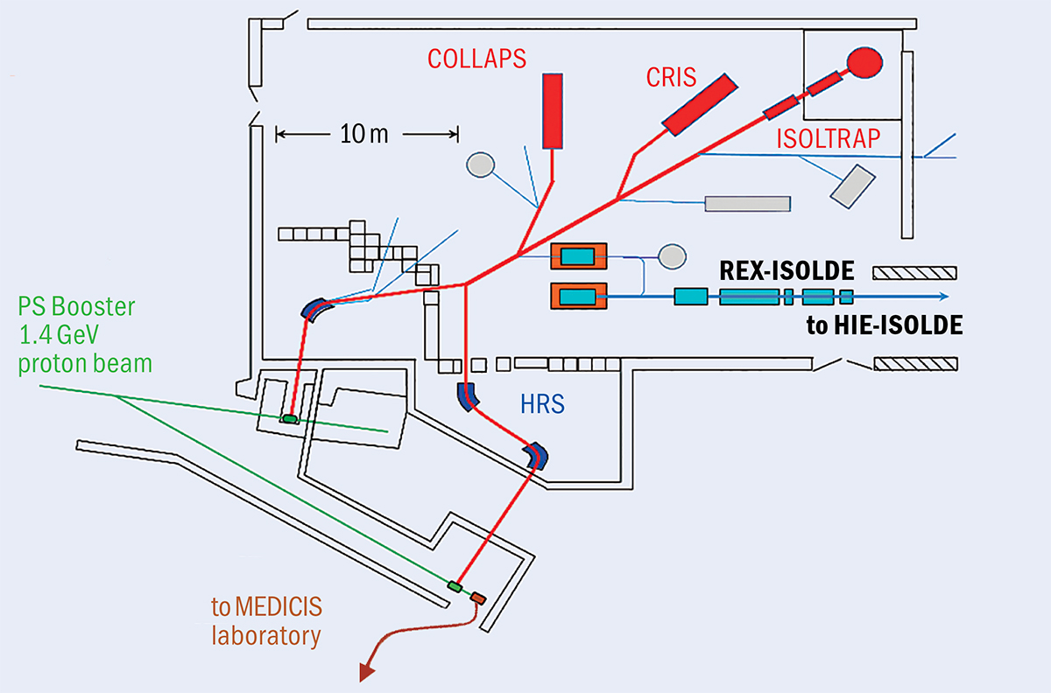
“Proposal to enhance laser spectroscopy infrastructure in the ISOLDE hall”
Liss Vázquez-Rodríguez^{1,2} on behalf of the COLLAPS and CRIS collaborations
¹Max-Planck-Institut für Kernphysik, Heidelberg, Germany
²Experimental Physics Department, CERN, Geneva, Switzerland

Slide 2
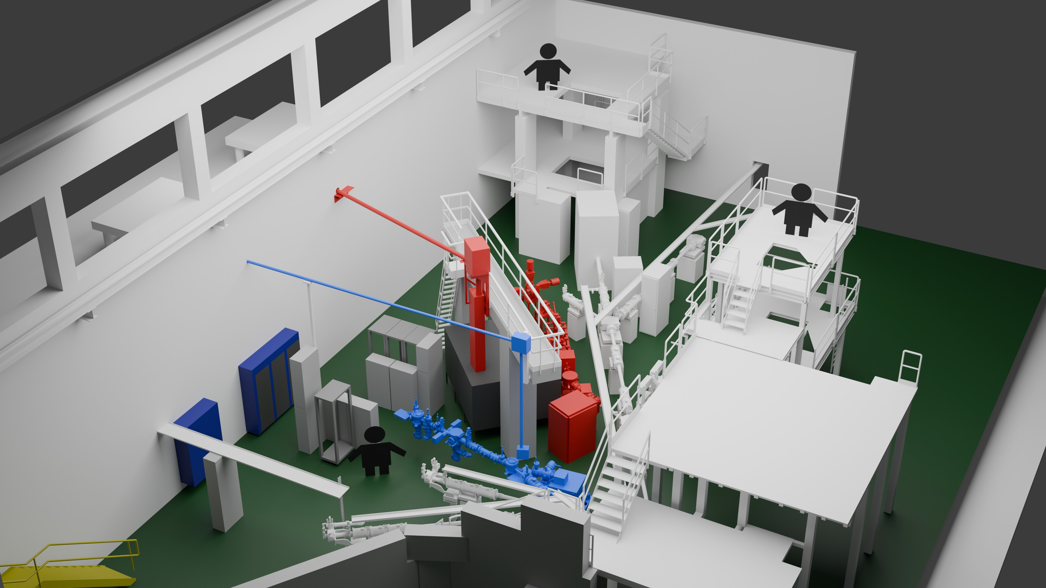
Collinear laser spectroscopy: Where we stand
Two CLS setups in operation (not including MIRACLS here)
COLLAPS: LA3 line
CRIS: LB0 line
CRIS laser lab
COLLAPS laser lab
CRIS laser tent
Laser beam delivery via a concrete structure

Slide 3
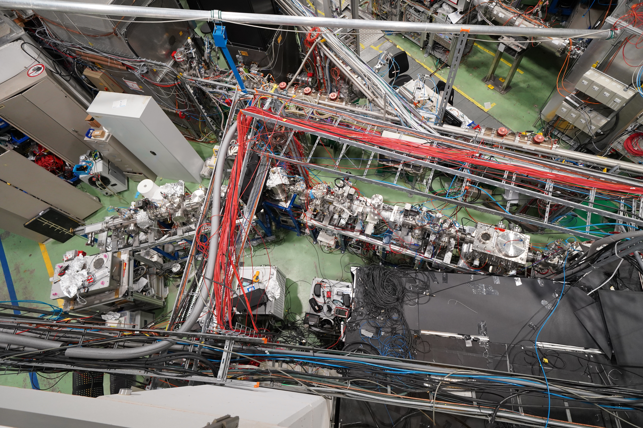
Collinear laser spectroscopy: Where we stand
What it looks like in reality:
CRIS

Slide 4
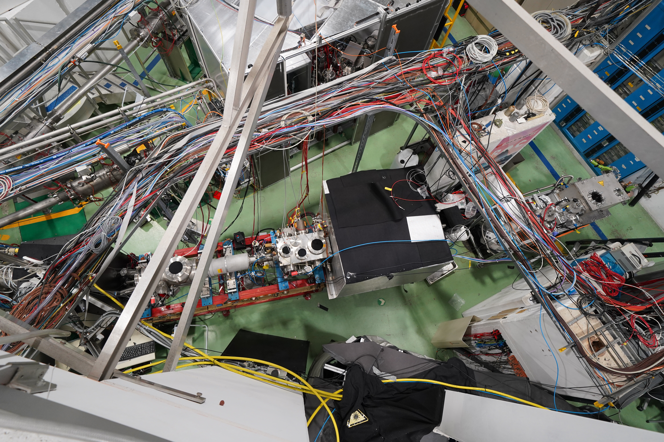
Collinear laser spectroscopy: Where we stand
What it looks like in reality:
COLLAPS

Slide 5
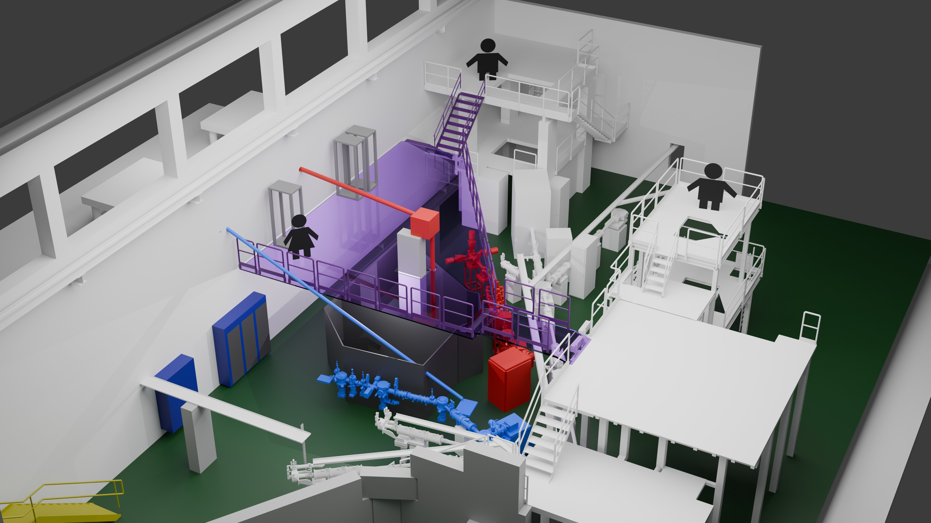
Collinear laser spectroscopy: Our request
Request for platform installation over COLLAPS and CRIS at ISOLDE
Benefits:
Short transport path for high-power lasers
Higher stability (AC unit inside the laser room)
Clean environment for the lasers (Implementation of an airflow enclosure)
Electronic and vacuum racks can be relocated to the platform
Additional escape path for ISOLTRAP from the upper platform
Proposed Solution: Construction of two dedicated laser rooms next to the experiments
Logistical Constraint: Direct transport of high-power lasers from existing laser labs is not feasible
Primary Reason: Upcoming developments during LS3 will require the use of high-power lasers for both experiments
The existing concrete installation for laser beam delivery must be replaced as it fails to comply with building regulations

Slide 6
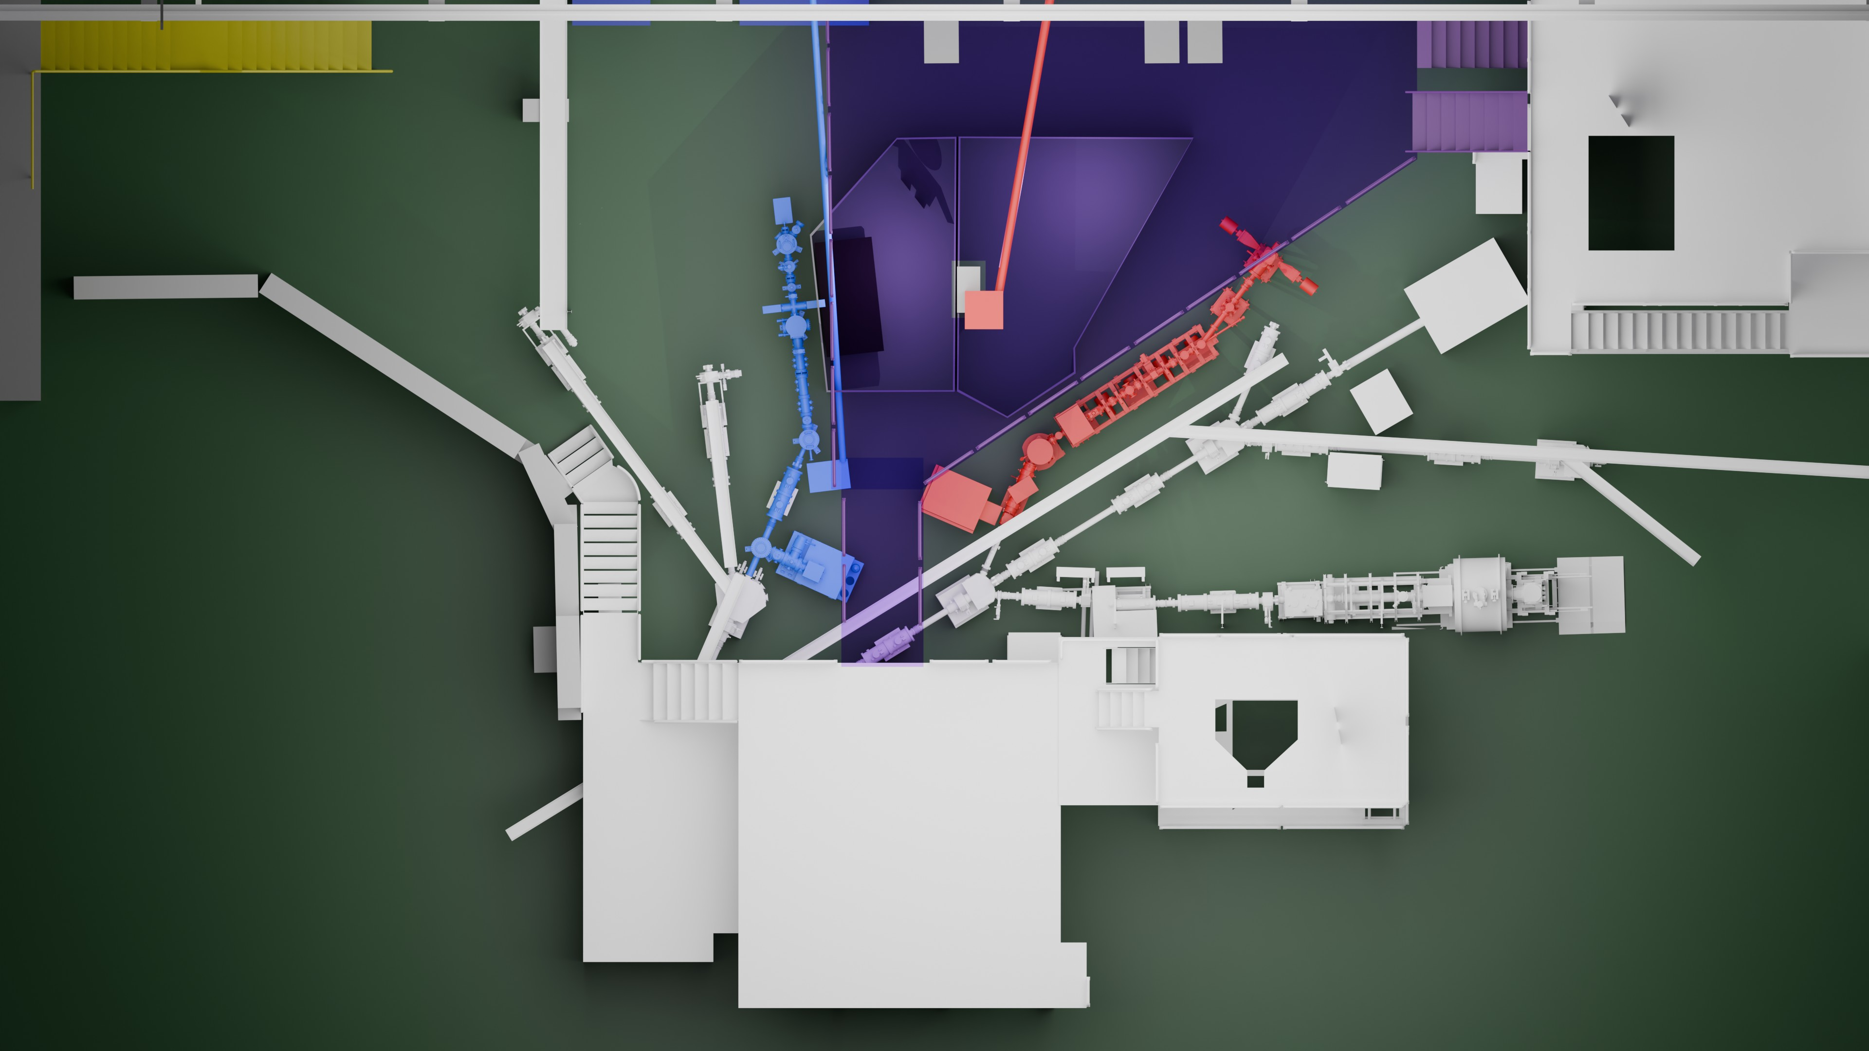
Collinear laser spectroscopy: Our request
Two CLS setups in operation (not including MIRACLS here)
COLLAPS: LA3 line
CRIS: LB0 line
Platform – Top View

Slide 7
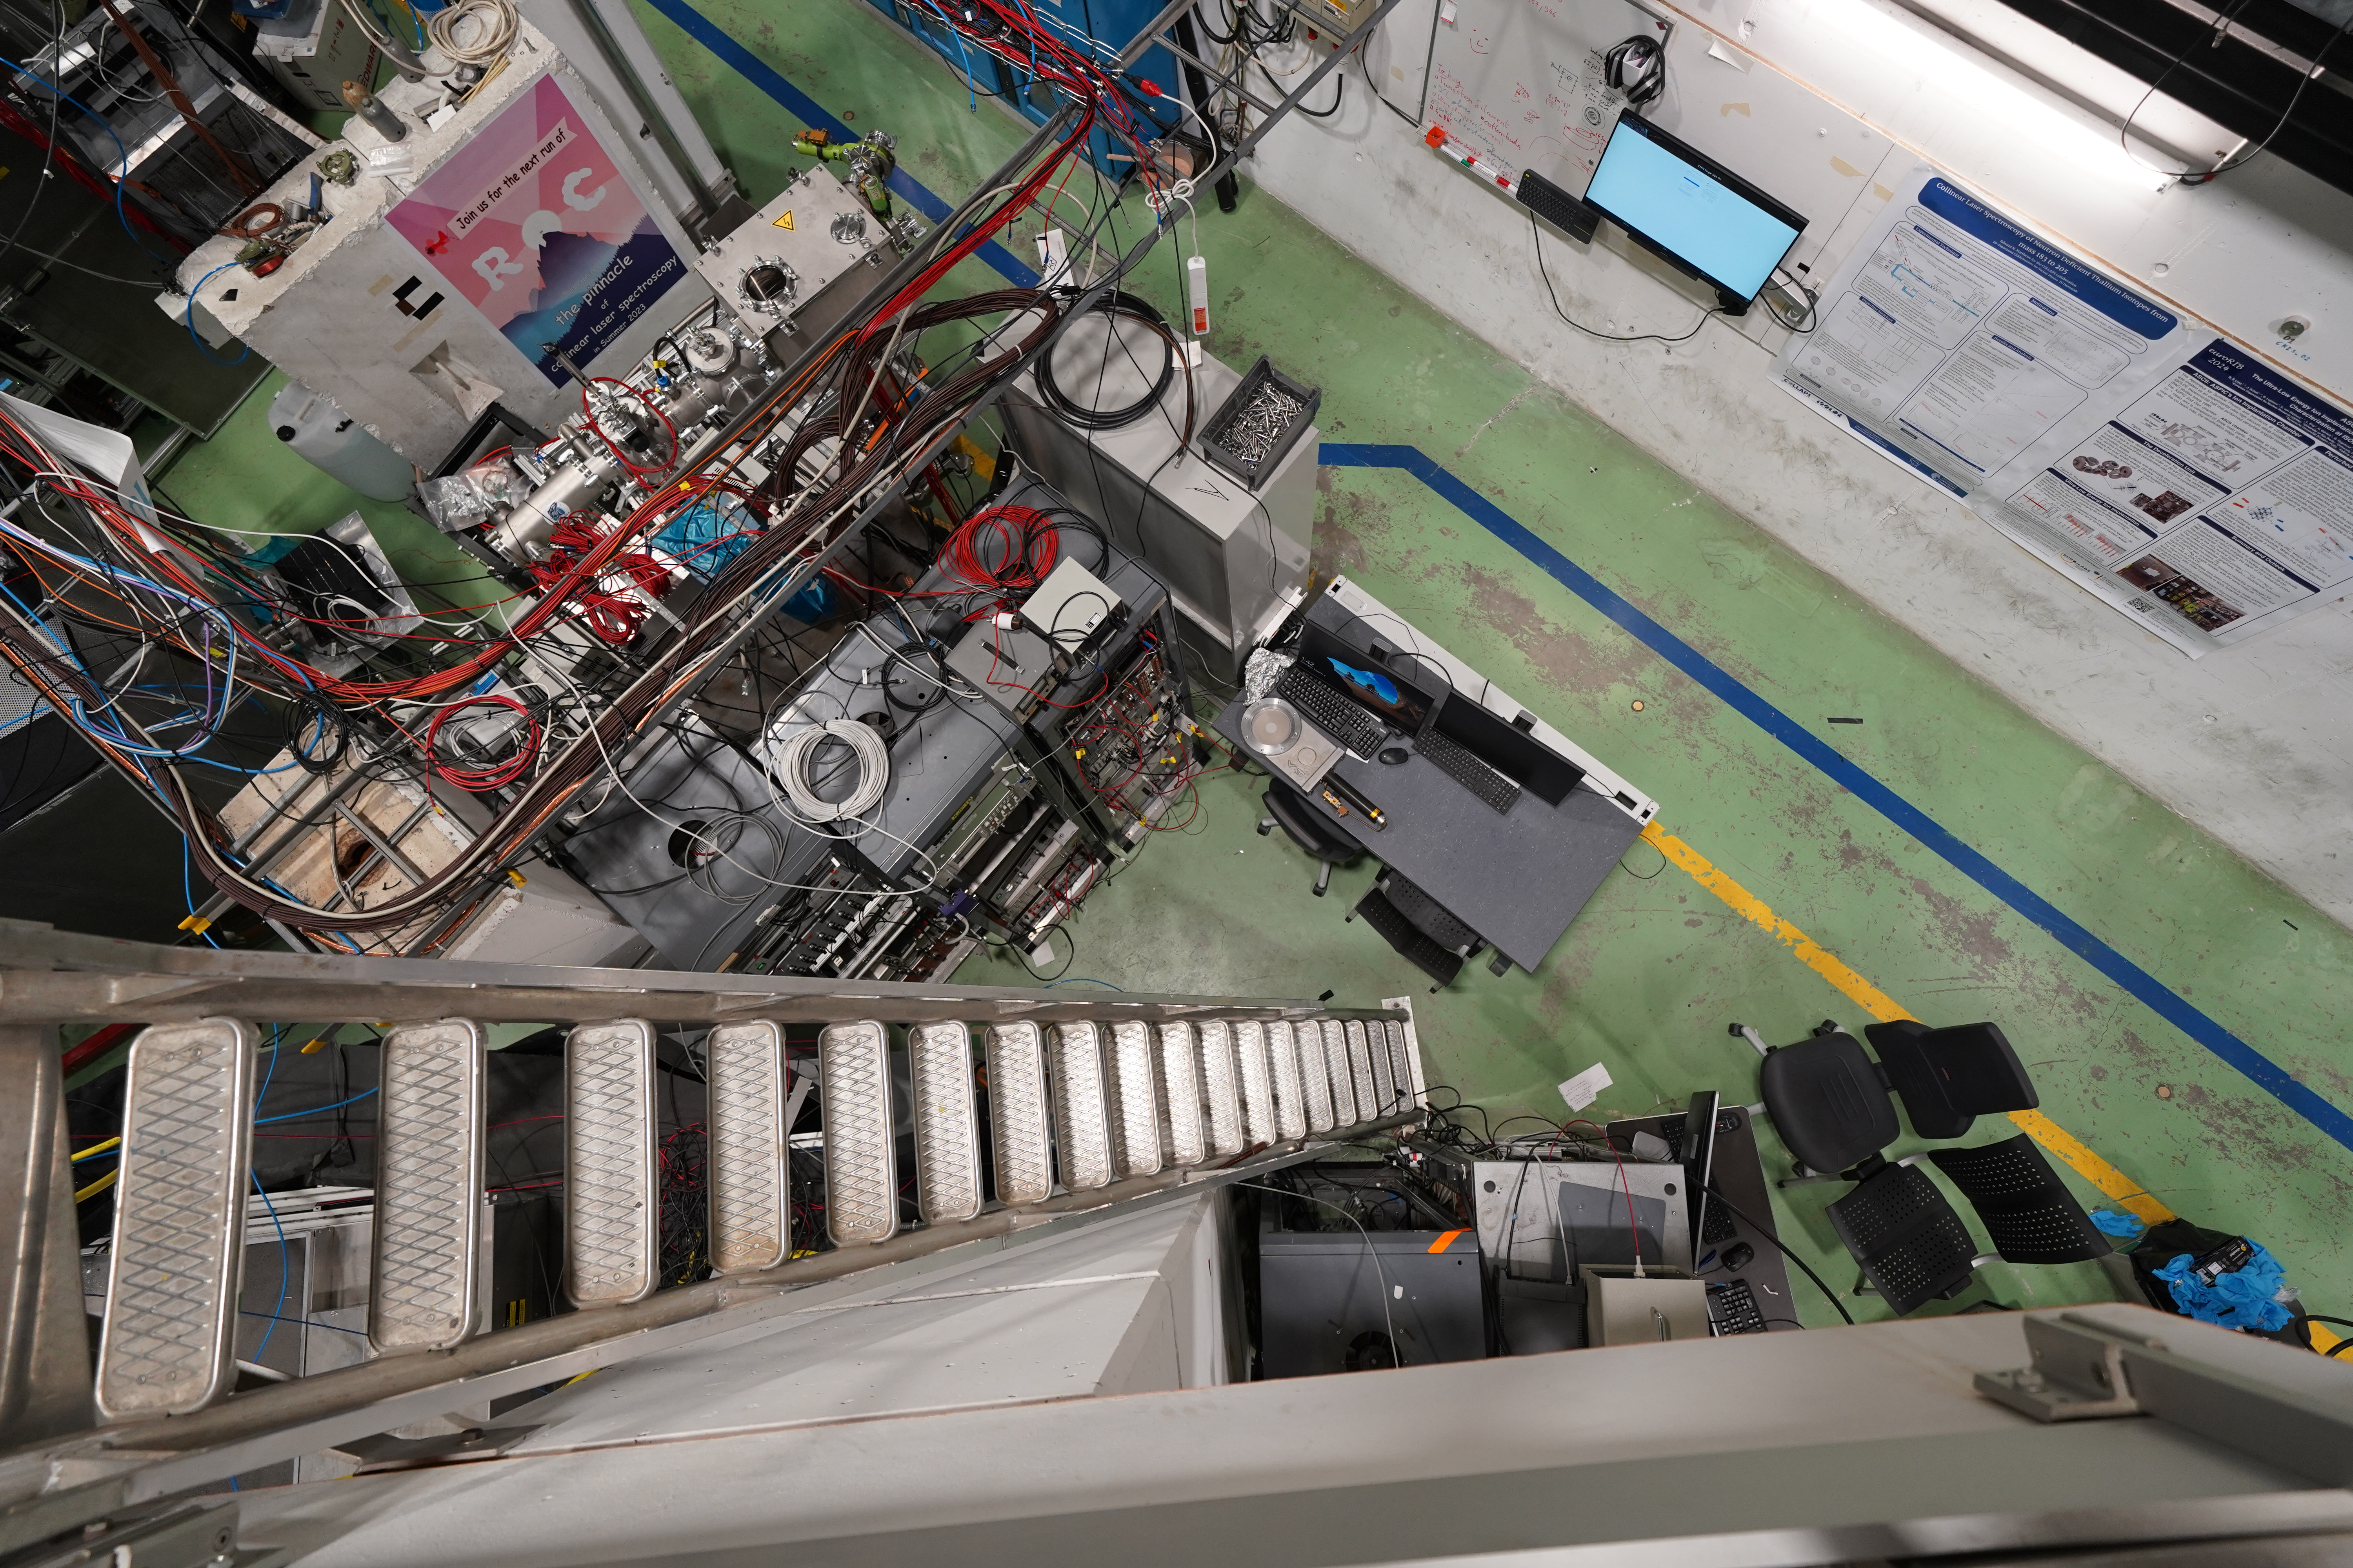
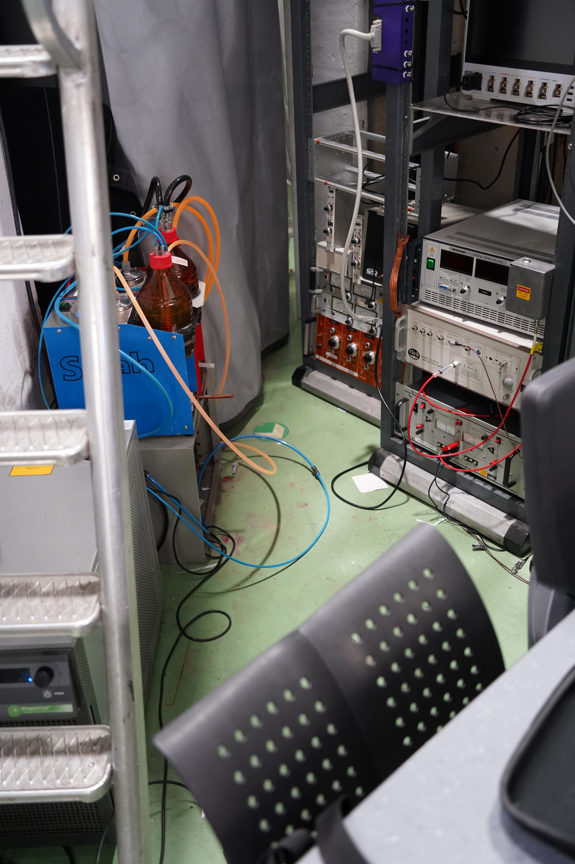
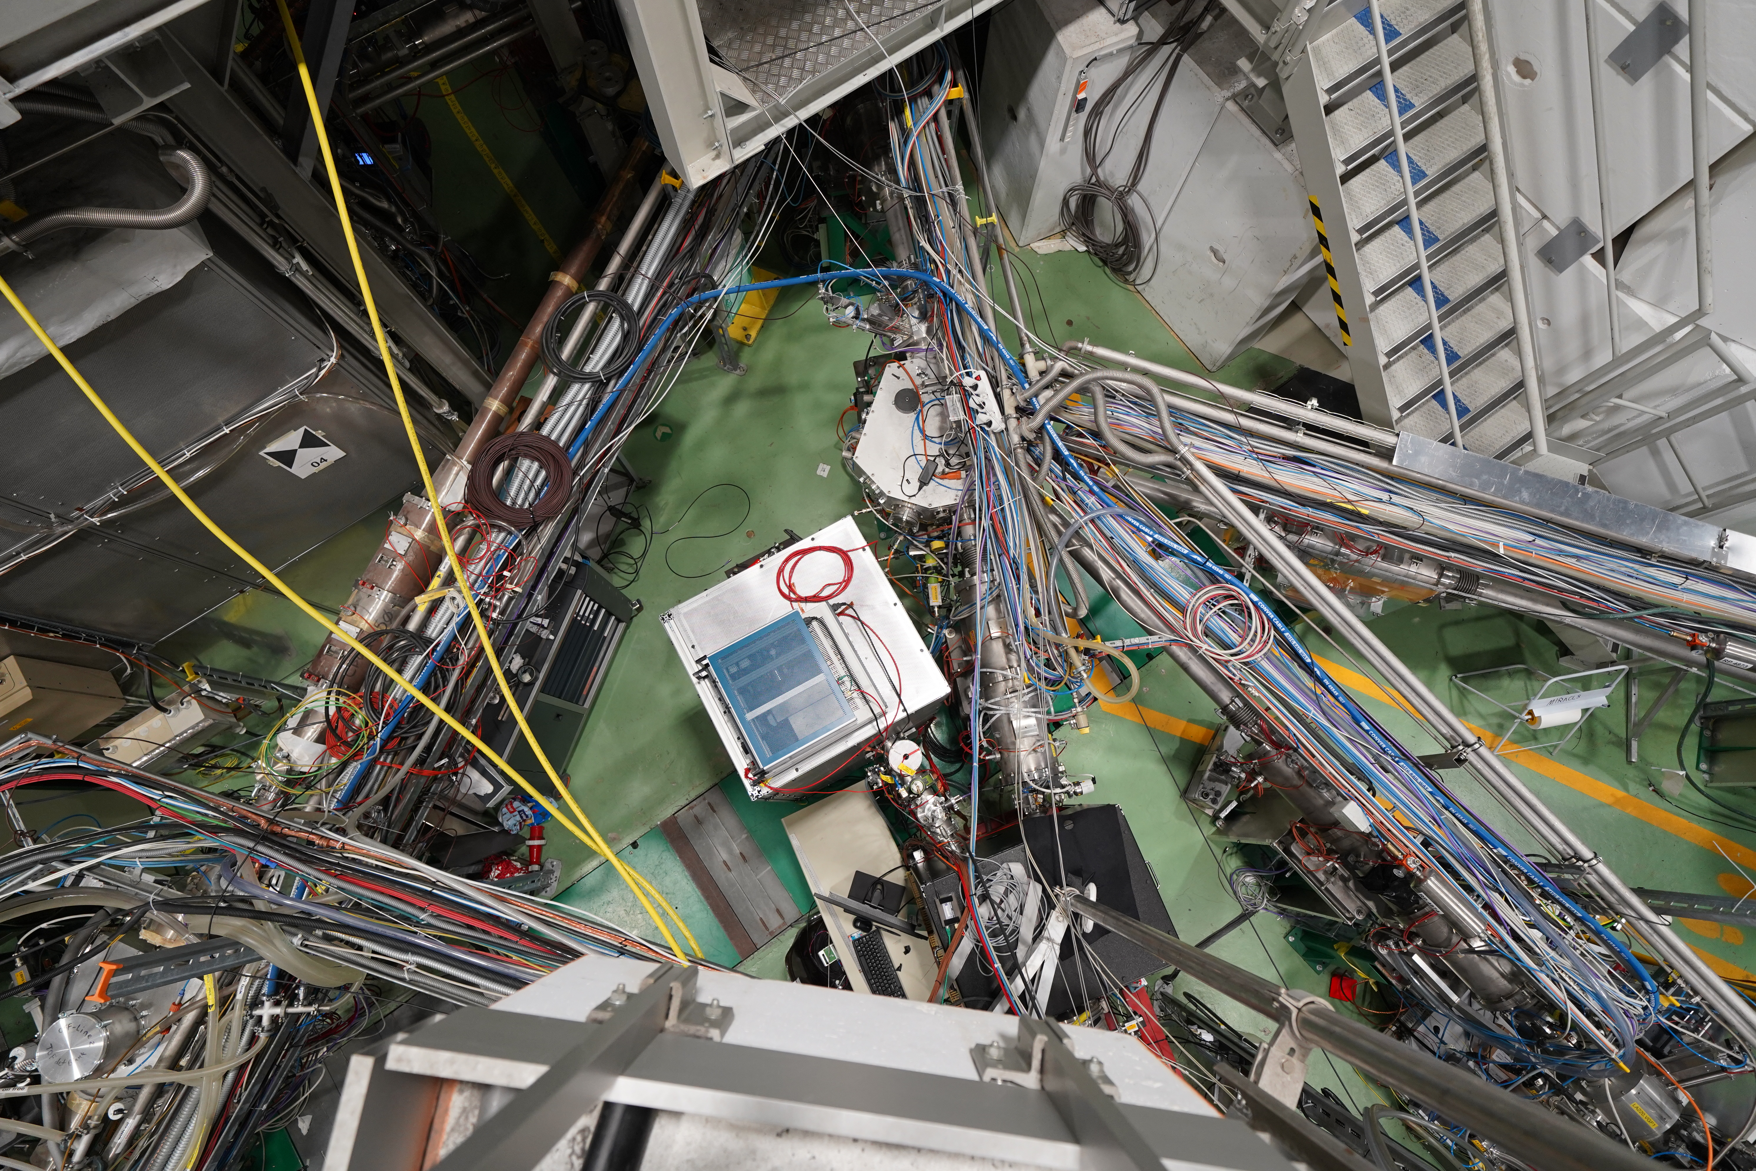
Collinear laser spectroscopy: Our request
Additional Benefits
We are going to have a very clean hall and safety is very happy about it ☺

Slide 8
Thank you!

