Slide 1
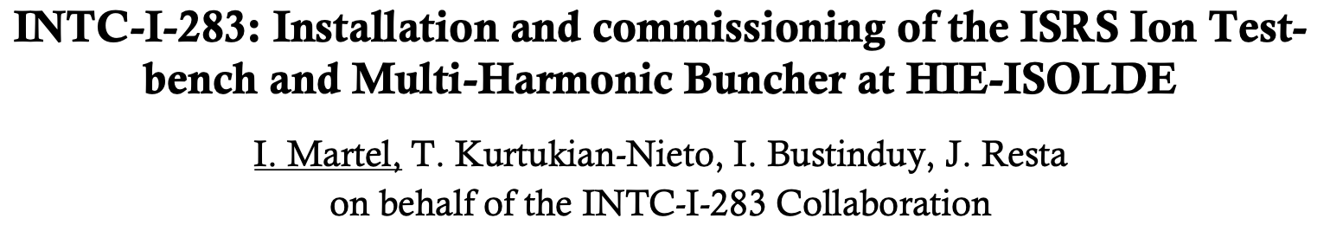

March 6, 2025

Slide 2
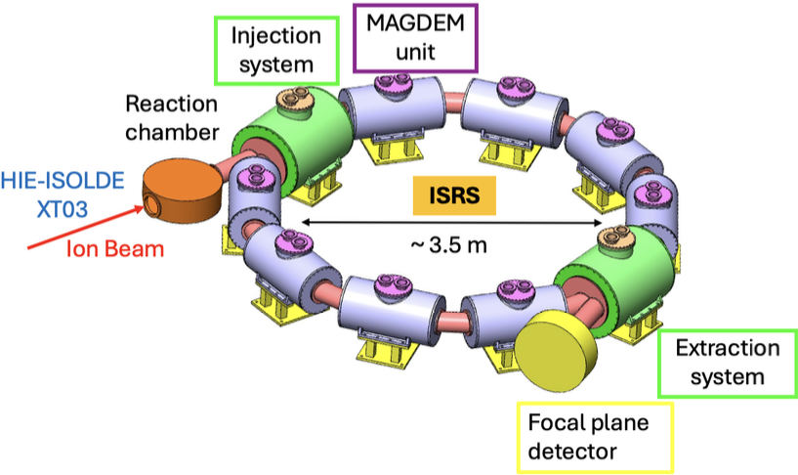
1. IONTB & MHB: a quick description
FFAG Cell (F-D-F)
ISRS: ISOLDE SUPERCONDUCTING RECOIL SEPARATOR
Recoil separator with unprecedent mass resolving power and acceptance
Li - Ra isotopes, E= 5-10 MeV/u
D
F
F
D
D
F
HIE- ISOLDE LINAC
F
D
D
F
10 MHz
EBIS
MULTI HARMONIC BUNCHER
ISRS PROTOTYPES
  MHB: Multi Harmonic Buncher
    Single cavity using modern solid state RF amplifiers
    Reduce HIE-ISOLDE frequency to < 10 MHz / 100 ns
    Required for TOF experiments
    Improve IONTB and ISRS (future) performance.
  IONTB: Ion Test Bench
    MAGDEM: prototype of nested Superconducting Magnet for ISRS (dipole + quad)
    IONTB: Complete bench including reaction chamber, MAGDEM, focusing system, focal plane detector
    Prove MAGDEM performance & ISRS experimental concepts
    Can operate as a linear spectrometer, but limited mass resolution and acceptance.

Slide 3
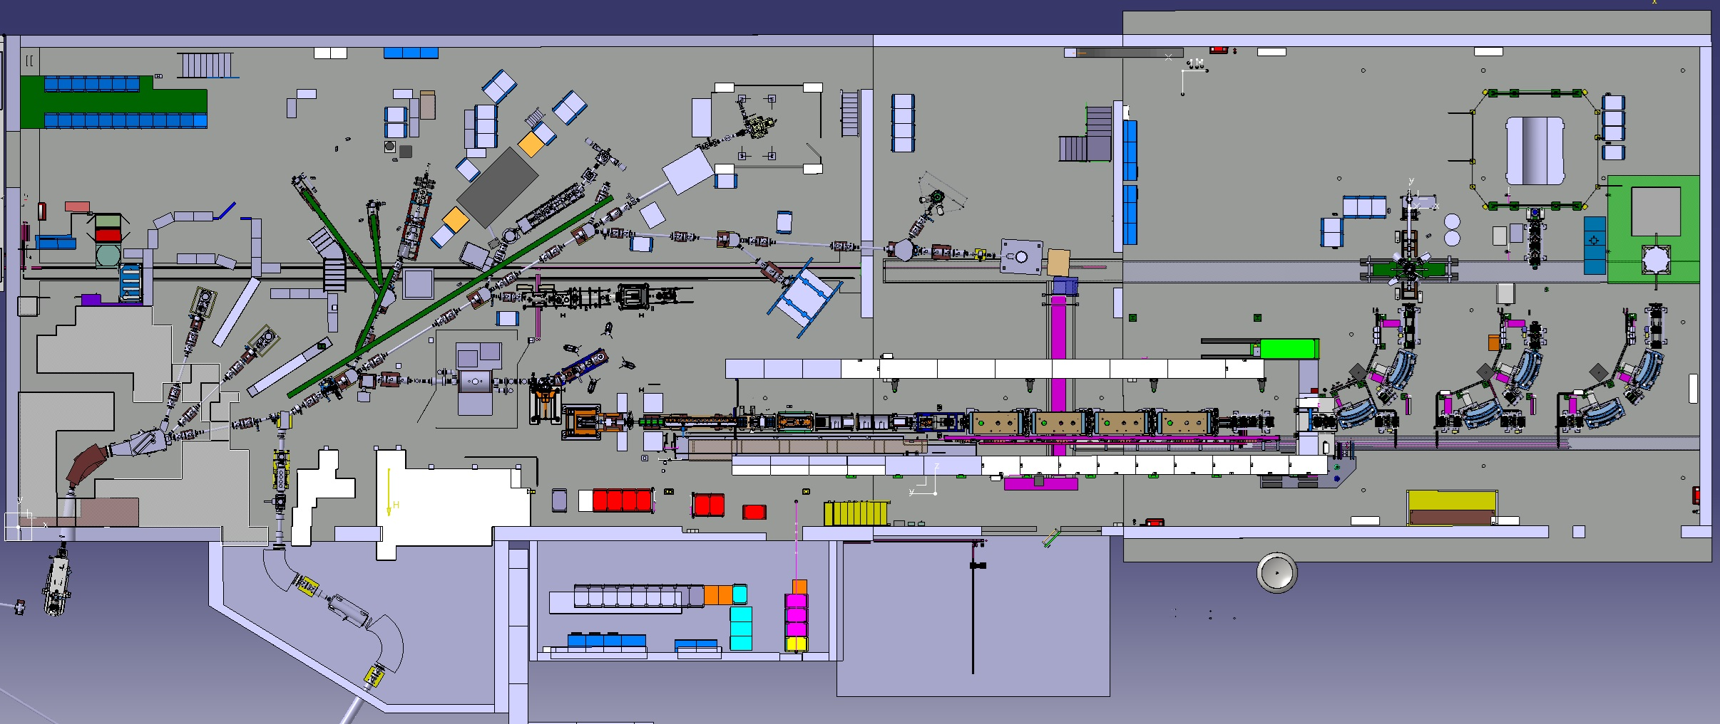
MHB & IONTB AT ISOLDE HALL
IONTB
ISS
MINIBALL
MHB
HIE ISOLDE
EBIS
XT01
XT02
XT03
GPS
HRS

Slide 4
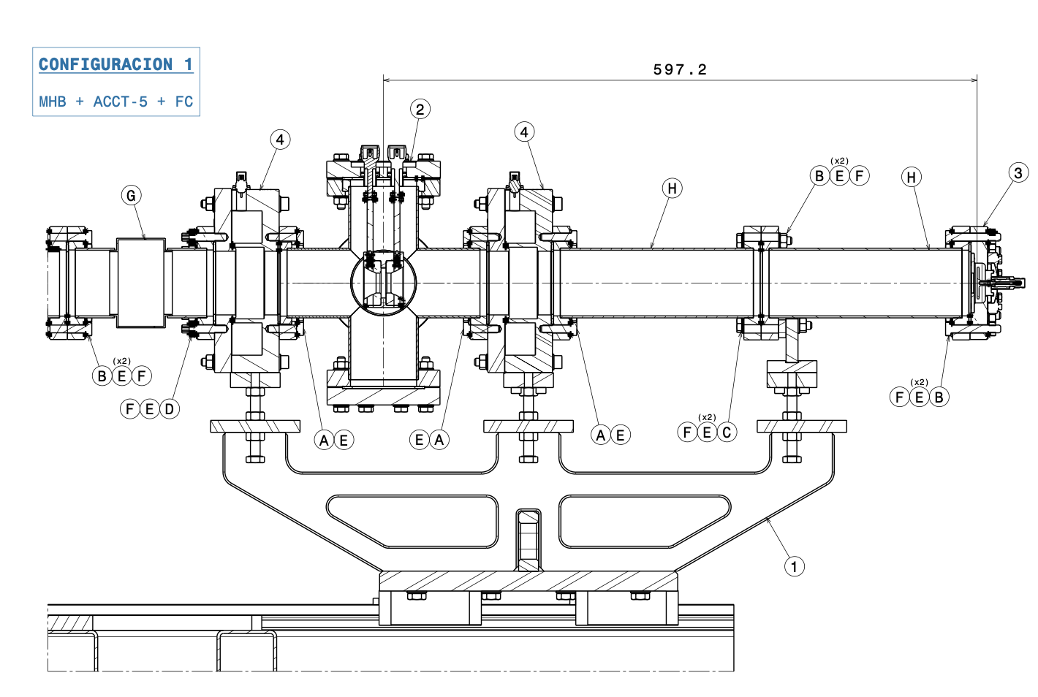
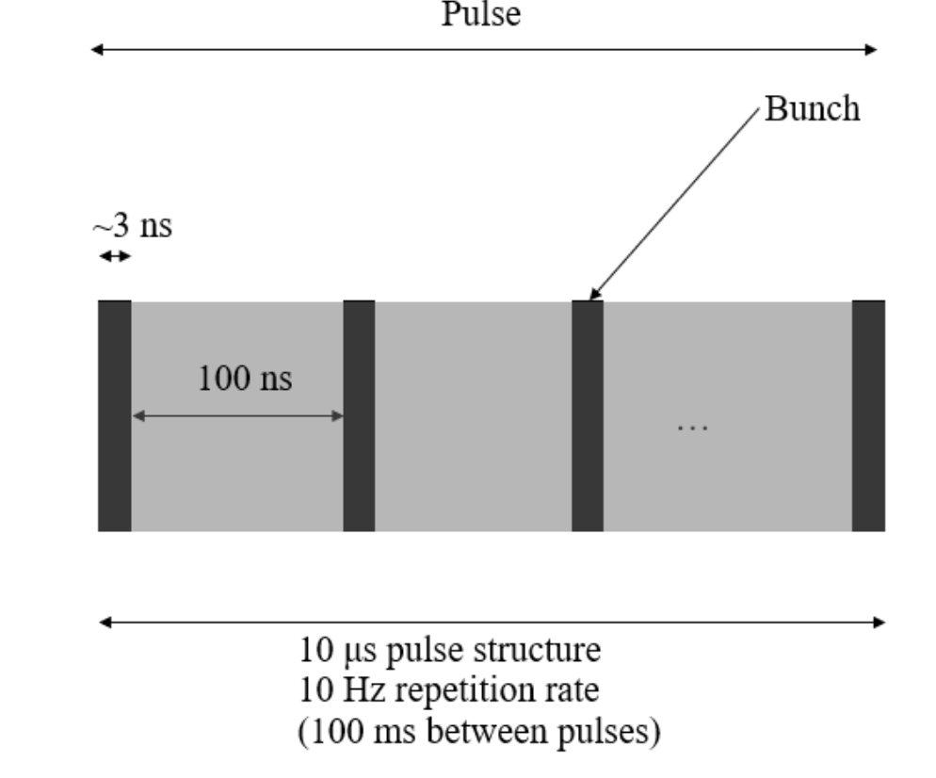
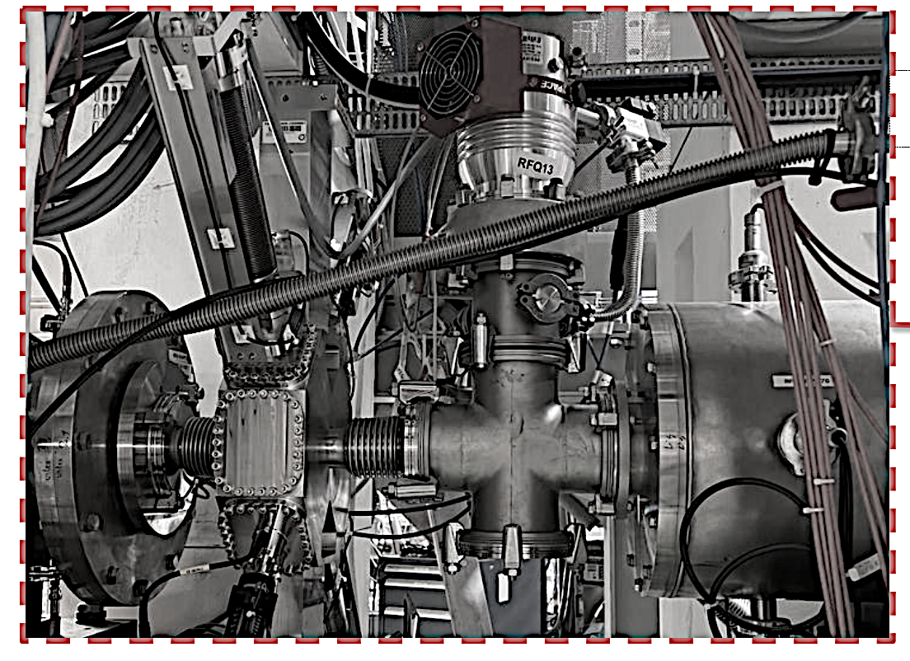
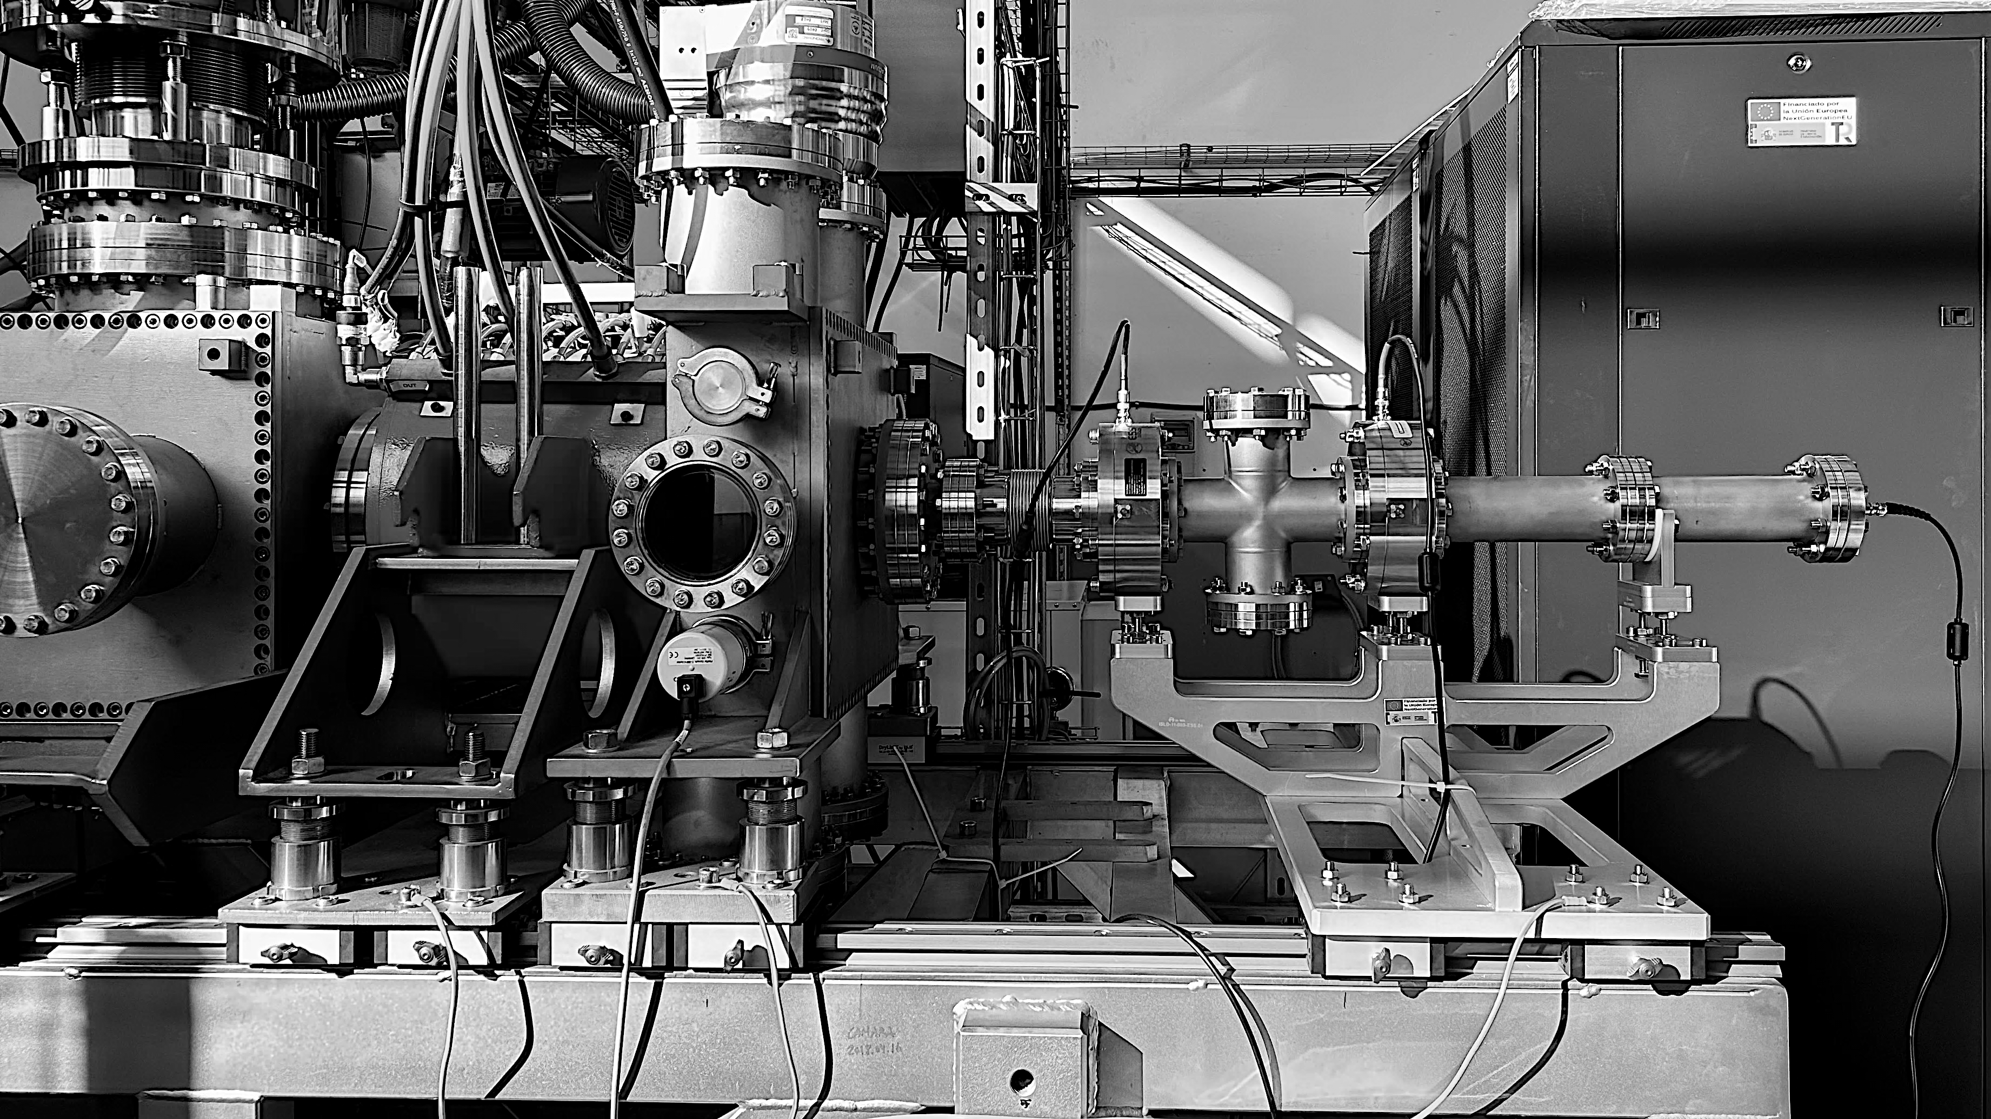
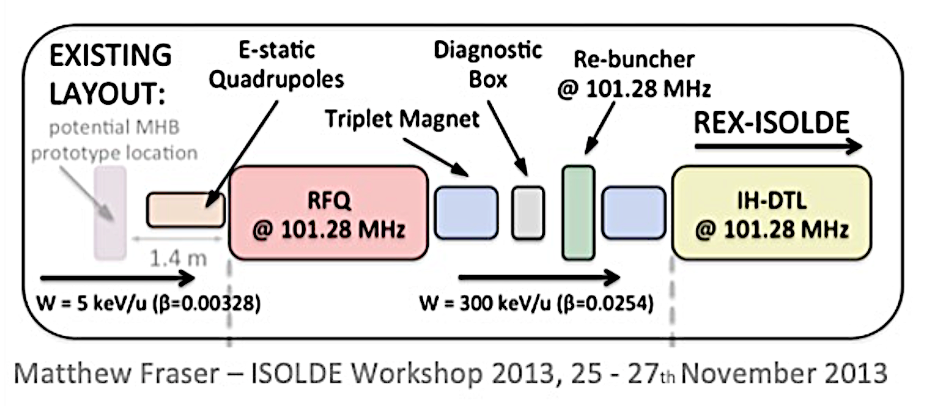
MULTI HARMONICS BUNCHER
ISRS operation requires downscaling HIE-ISOLDE bunch time structure to 1/10th of the linac frequency –> 100 ns
Low energy dispersion, high transmission, multi-harmonic buncher (MHB).
SSPA, LLRF, EPICS ctrl
FC
ACCT
MHB
ACCT
MHB
December 2024 in Bilbao Injector
FC
ACCT
MHB
ACCT

Slide 5
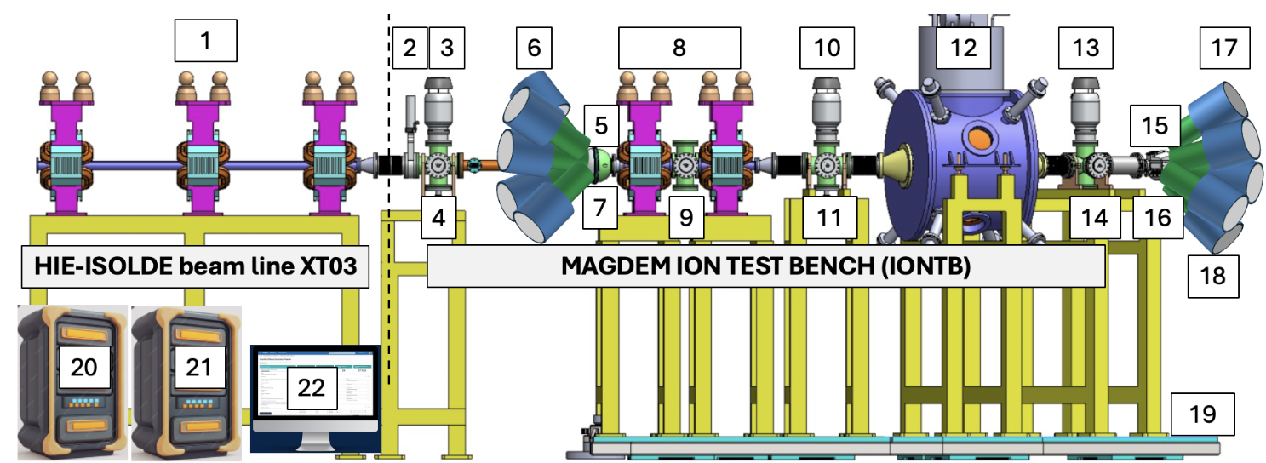
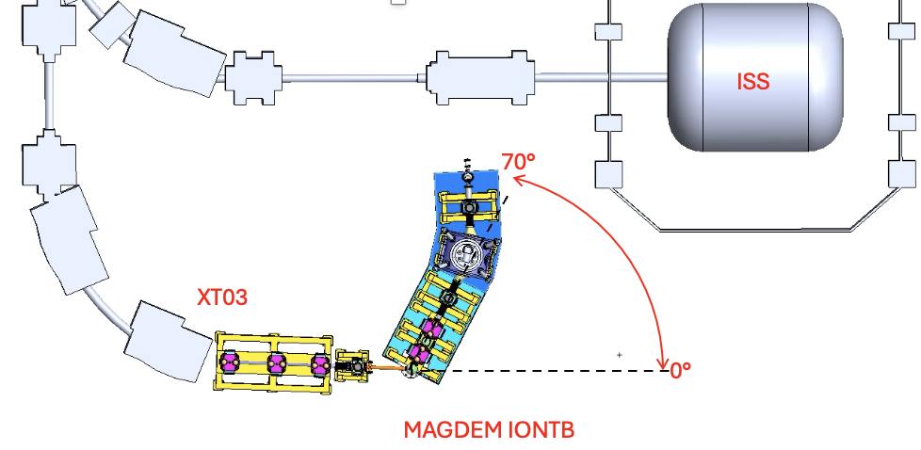
ION TEST BENCH
MAGDEM
HIE-ISOLDE triplet/XT03
Beam valve
Diff. pumping < 10-7mb
Beam diagnostics
Reaction chamber (RC)
RC-Gamma array
RC-particle detector array
Quadrupole doublet
Beam diagnostics
Vacuum system
Beam diagnostics
MAGDEM (Dipole+ quad)
Vacuum system
Beam diagnostics
Focal plane chamber (FP)
FP-particle detector array
FP-Gamma array
Beam dump
Rotary platform
Data acquisition and control (DAC) hardware
Machine & personal protection system (MPS & PPS) hardware
DAC-Software
2. IONTB & MHB: Improvements gained
MHB –> TOF experiments at HIE-ISOLDE
IONTB + MHB – Physics experiments @ XT03 complementary to ISS and MINIBALL using gamma-particle correlations
Performance better than previous HiFi project
Low, Medium and High mass resolution configurations
Reduced footprint to avoid interaction with ISS
Possibility to rotate up to 70°
Most experiments: zero degree

Slide 6
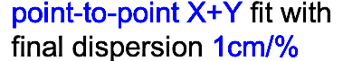

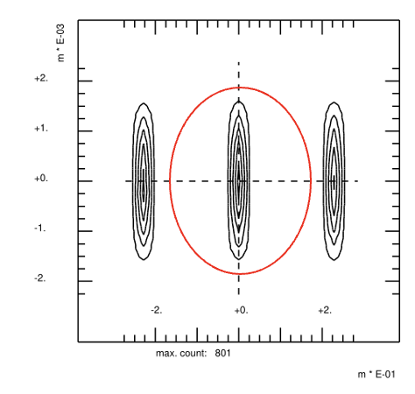
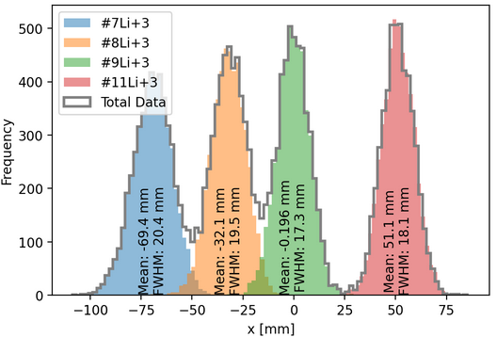
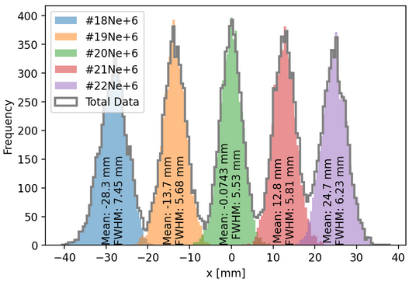
IONTB as LINEAR SPECTROMETER
  Optimisation work in progress!!
  BMAD (Univ. Valencia) + GICOSY (IEM, CSIC, Madrid)
  Small footprint ~ 4 m max (Univ. Huelva)
  Rejection of primary beam
  Ancillary detectors → gamma-particle correlations
  Tagging on selected reaction fragments
    Isotopic separation
    Acceptance – dP/P – 𝛿θ
  Most experiments at 0°, rotate up to 70° possible
  Combine IONTB with MHB for TOF → improved PID
SIMPLE
LOW
PRISMA like (LNL)
MEDIUM
Shown in LOI
SUPERB
Example for (d,p) (d,n) (t,p) (t,d)... reactions
    ~ 4 m max.
Config C. Preliminary results BMAD- MEDIUM
Config D. Preliminary results GICOSY - SUPERB
Lithium recoils
Neon recoils
Div. ±1 deg, Δp/p = 3%
Div. ±1 deg, Δp/p = 1%

Slide 7
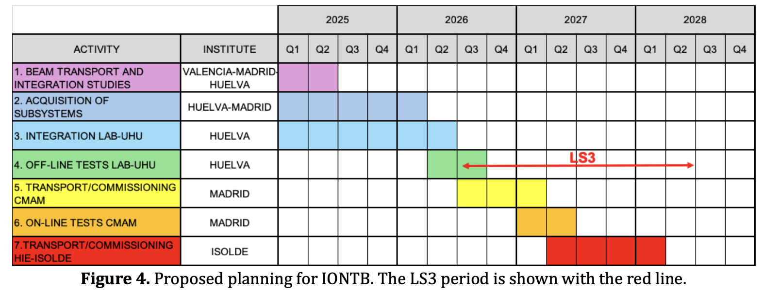
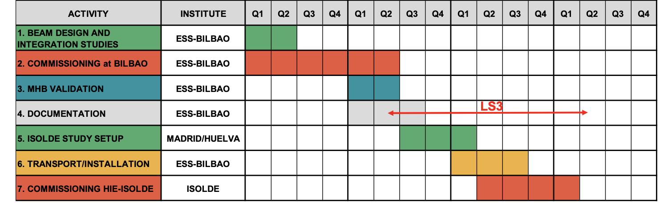
3. SOURCES OF FUNDING
2023-2026. Agreement Spain – CERN (Univ. Huelva, Univ. Valencia, IEM-CSIC-Madrid, 3 MEuro.
2026-2028
  MHB: ESS-Bilbao own resources (personnel, travel)
  IONTB+MHB: Univ. Huelva and Univ. Valencia. Submitted Spain Grant application (hardware, personnel, travel)
ION TEST BENCH/
LINEAR SPECTROMETER
MULTI HARMONIC BUNCHER

Slide 8
4. STATUS OF THE PROJECT
5. PRACTICAL ISSUES BEING WORKED ON
MULTI HARMONIC BUNCHER
MHB
Beam diagnostics for low intensity ISOLDE beams.
Available test beams.
MHB already built and operational.
Beam current transformers (ACCT) and fast FC developed
Validation process at ESS-Bilbao with H₂⁺ ~10keV, same ISOLDE ß = 0.00328.
IONTB
Test MAGDEM optics at CMAM-MADRID.
Test linear spectrometer config at CMAM-MADRID.
Setup as linear spectrometer at ISOLDE.
A number of components can be provided by the collaboration (particle/gamma detectors, reaction chamber) → on-going discussions.
Evaluation of quad units from CERN pool. Otherwise purchase/tender. Decision end of April.
ION TEST BENCH
Physics program in progress.
Beam transport optimisation in progress.
  Good for transfer on light targets/primary beam reject.
MAGDEM superconducting magnet
  Ordered- Delivery Feb 2026.
3D-magnetic scanner
  Subsystems ready.
  Integration and software development in progress.
Focussing system
  First design for QQD finished (medium resolving power).
  Purchasing of subsystems in progress (pumps, diagnostics,...).
Focal plane detector
  DACQ ready.
  Detectors (SiC) and FEE being designed.
THANKS!!

