Slide 1
BDF Proximity shielding status update
Truls Kolstad & Mike Parkin
10/02/2025

Slide 2
Content:
Shielding comparison
  Model used in FLUKA simulations vs Current ST model.
Simulation results
  Cooling in middle section only
  Adding thermal fluid to simulations -> improved accuracy
Future simulations and considerations
Discussion

Slide 3
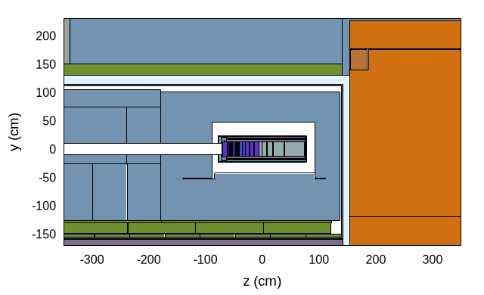
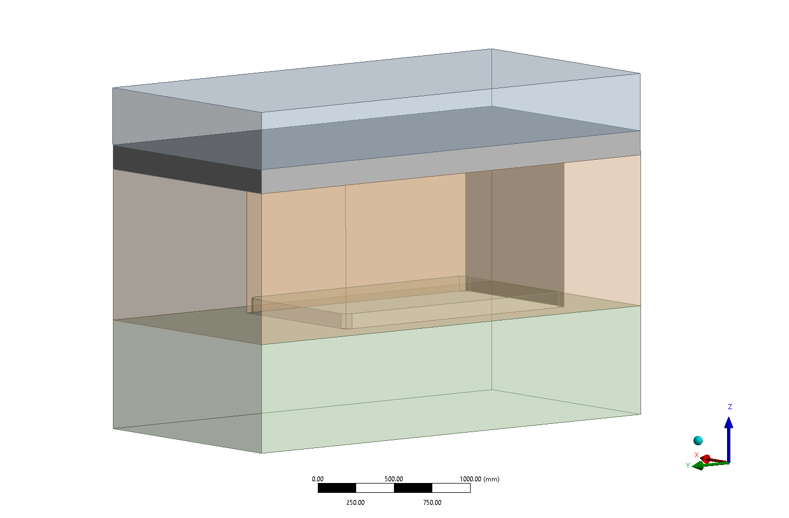
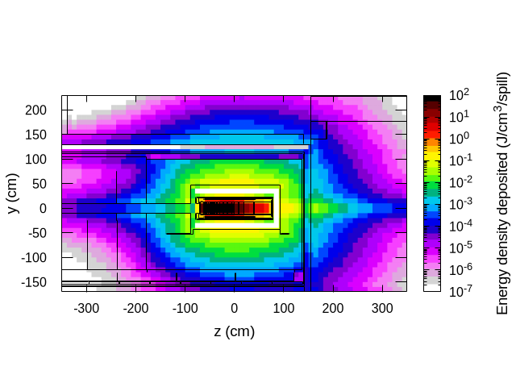
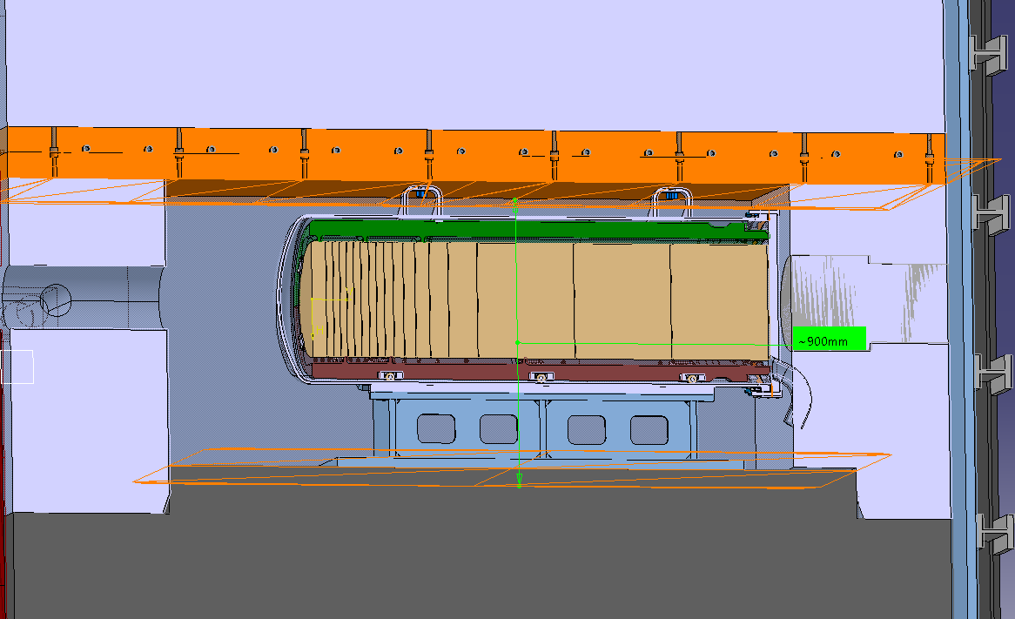
Nomenclature of models
Fluka model
Thermo model:
FLUKA model
  Used within FLUKA to get energy deposition.
Thermo model
  Geometry conforming to FLUKA model. Used in current thermal simulations.
New ST Model
  Updated geometry from target complex assembly. Currently no simulation data.
Fluka model
New ST model:

Slide 4
FLUKA simulation details
FLUKA simulation includes entire target complex.
In FLUKA all parts of the proximity shielding is cast iron.
Current Thermo model corresponds to dimensions of the FLUKA model.
FLUKA simulation outputs coordinates for the heat deposition to be used in ANSYS thermal simulations.
Different proximity shielding dimensions would require a new FLUKA simulation to attain accurate values of energy deposition.

Slide 5
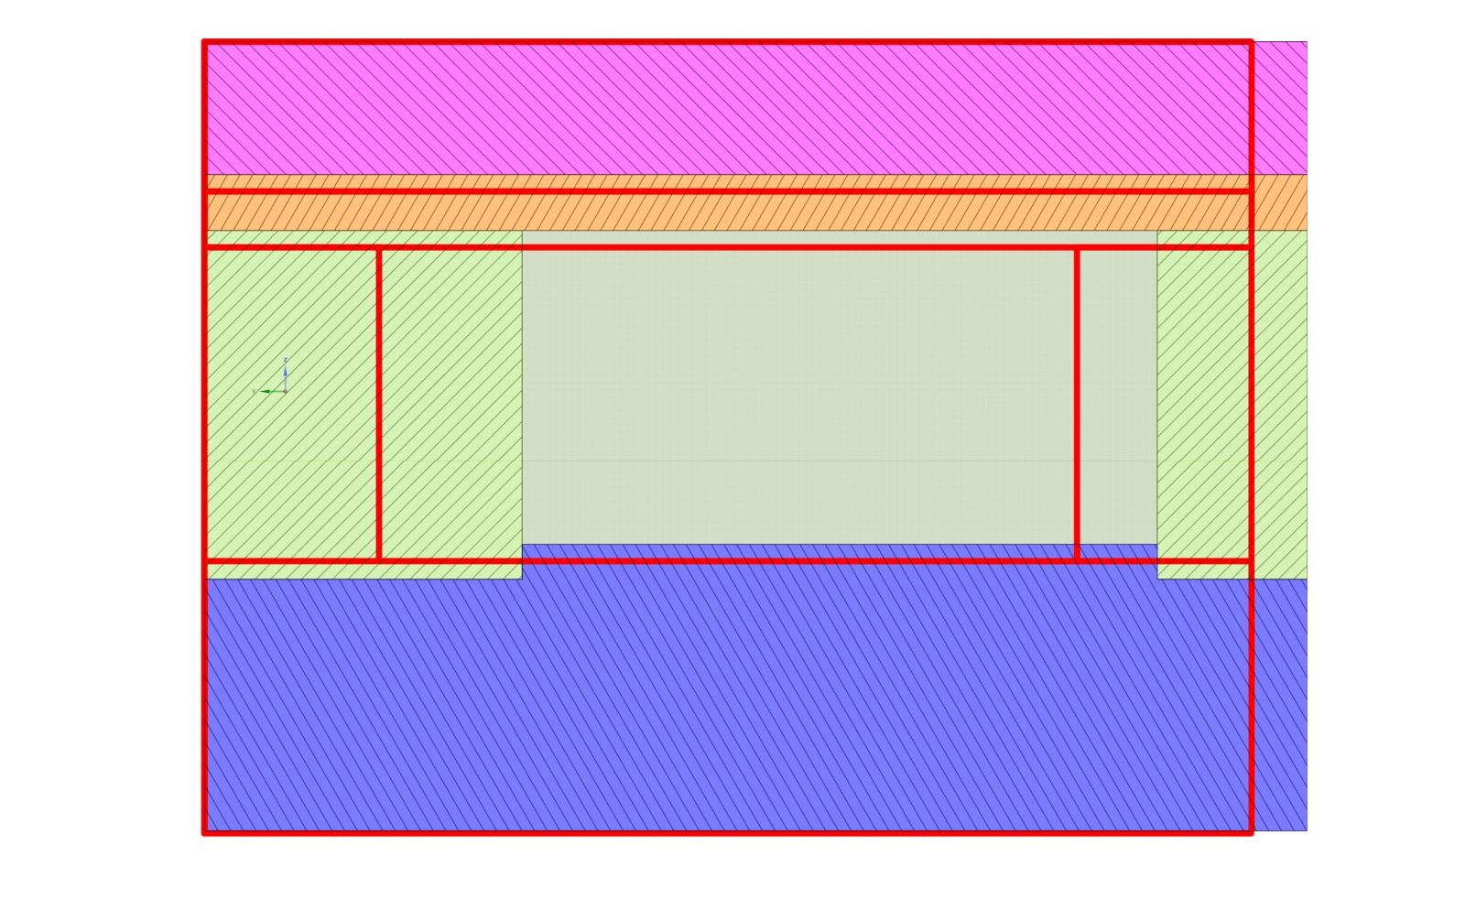
Shielding comparison between FLUKA model and ST file model
Parameter | FLUKA model | New ST model
Front shielding | 910 mm | 500 mm
Rear shielding | 430 mm | 500 mm
Sidewall thickness | 265 mm | 265 mm
Upper shielding | 380 mm | 428 mm
Lower shielding | 820 mm | 779 mm
Cooling plate thickness | 160 mm | 160 mm
Inner area width | 1050 mm | 1050 mm
Inner area length | 1820 mm | 2000 mm
Inner area height | 900 mm | 900 mm
Overall width | 1580 mm | 1580 mm
Overall length | 3160 mm | 3000 mm
Overall height | 2260 mm | 2267 mm
Red outline = New ST Model
Model | FLUKA/Thermo | New ST Model | Unit
Volume | 9.564 | 8.856 | [m^3]
Change | 0% | -7.41% | [%]
Estimated energy deposition* | 2353 | 2178 | [W/m3]
Total energy deposited | 22500 | 19291 | [W]
Beam dir.
Colored solids: FLUKA model
*Assuming energy deposition scales linearly with volume, and uniform deposition in all directions.
Future simulations should show more realistic effects.

Slide 6
Real thermal contact conductance
Using CMY*-model to approximate realistic thermal contact conductance.
Dependent on:
    Contact pressure
    Thermal conductance
    Surface roughness
    Youngs modulus
    Asperity surface slope (approximated)
New for this meeting:
Will have to verify the equations.
  Equations from EDMS documents which do not have very good sources.
Hopefully TCC values are more or less correct
*Cooper-Mikic-Yovanovich

Slide 7
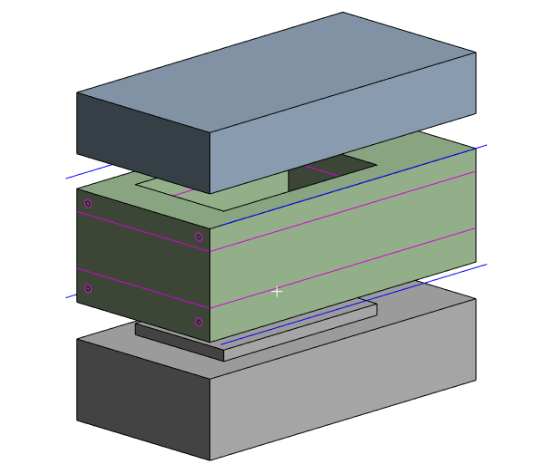
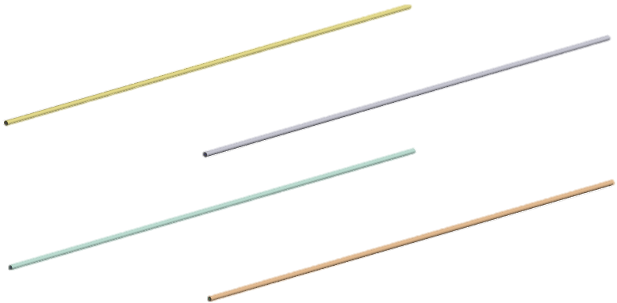

New simulation model
Cooling plate(s) removed
Added fluid116 elements
  Simulates bulk temperature of fluid along pipe
  Proved some assumptions were not conservative enough…

Slide 8
Previous assumptions for thermal rise in fluid:
Pipe 1
T(z) = | 30+9.5*z [°C]
T(0m) = | 30 [°C]
T(3.16m) = | 60 [°C]
Pipe 2
T(z) = | 60+9.5*z [°C]
T(0m) = | 60 [°C]
T(3.16m) = | 90 [°C]
Etc…
Temperature rise based on isobaric temperature rise when absorbing ¼ of the total energy
  ~30°C dT per pipe linearly over the length of the pipe

Slide 9
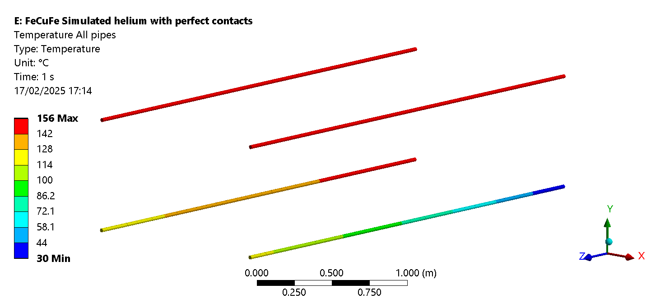






New simulated helium gas temperatures (in most cases) with thermal fluid elements
In most cases, first two cooling pipes provide ~90% of the overall cooling capacity
3rd pass
Outlet
4th pass
Inlet
2nd pass
1st pass

Slide 10
Biggest difference between pipe temperatures:
Assumption fluid temperatures:
  3rd pass: 90-120 °C
  4th pass: 120-150 °C
Simulated temperatures (generally)
  3rd pass: 140-155 °C
  4th pass: 144-155 °C
    (4th pass gets cooled by 1st pass due to its proximity)

Slide 11







To reduce temperature gradient across shielding:
Current:
Proposal:

Slide 12
Current results

Slide 13
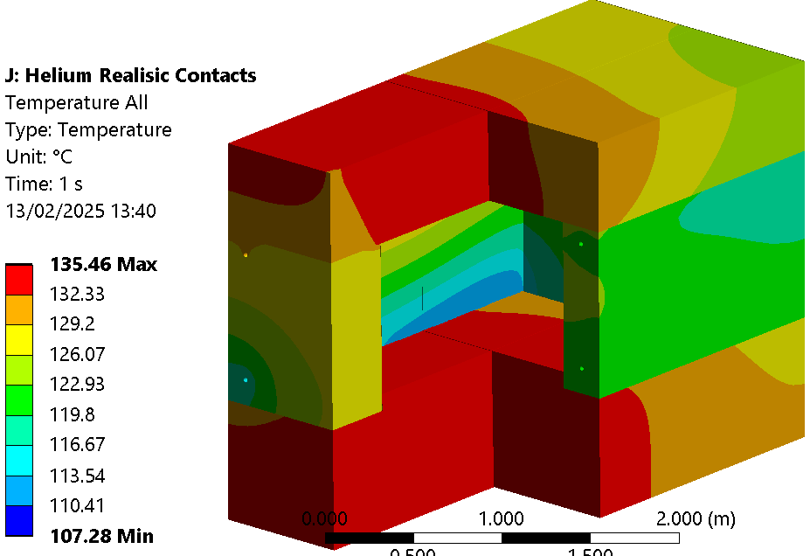
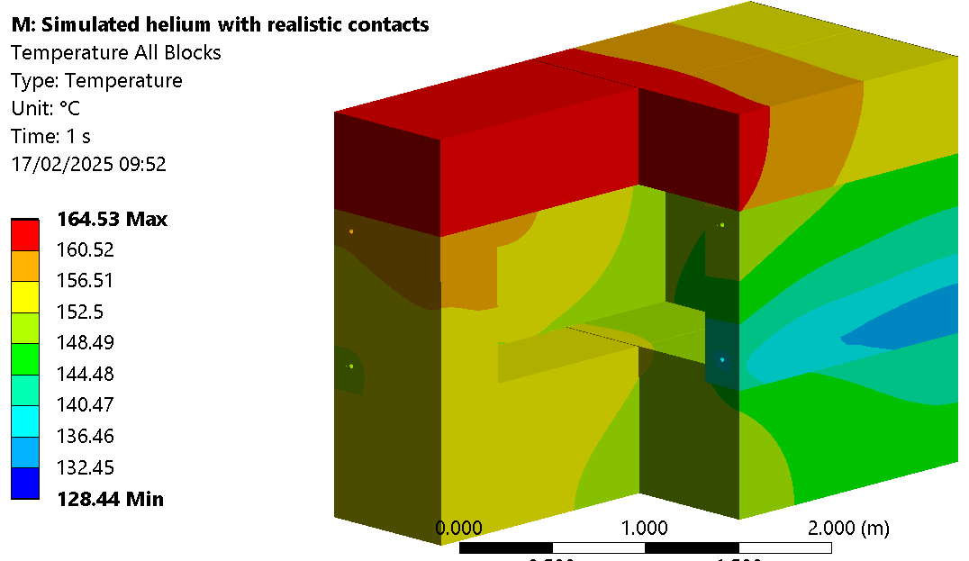
All copper realistic contacts helium cooled
Fluid temp assumption vs simulation
Assumed temperature rise in fluid:
Simulated temperature rise in fluid:

Slide 14
Results with 3 solid bodies so far (perfect contacts)
Configuration | Block | Mass [tons] | Material | Active cooling | Coolant mass flow [g/s] | Coolant T_in [°C] | Coolant ∆T [°C] | Heat Deposition [kW] | TCC [W/m2*K] | T min [°C] | T max [°C] | T avg [°C]
1 | All | 85.3 | Cu | - | - | - | Assumed | 19.2 | Perfect | 30.0 | 35.4 | 30.7
1 | Bottom | 33.8 | Cu | No | - | - | - | - | Perfect | 30.8 | 35.4 | 32.9
1 | Middle | 27.5 | Cu | Water | Inf | 30 | Negligble | -19.2 | Perfect | 30.3 | 34.1 | 30.9
1 | Top | 24.1 | Cu | No | - | - | - | - | Perfect | 30.6 | 35.4 | 32.8
2 | All | 85.3 | Cu | - | - | - | Assumed | 19.2 | Perfect | 108.5 | 130.5 | 120.6
2 | Bottom | 33.8 | Cu | No | - | - | - | - | Perfect | 113.1 | 122.8 | 119.8
2 | Middle | 27.5 | Cu | Helium | 30 | 30 | 124 | -19.2 | Perfect | 110.6 | 130.1 | 120.8
2 | Top | 24.1 | Cu | No | - | - | - | - | Perfect | 118.0 | 130.2 | 126.0
3 | All | 85.3 | Cu | - | - | - | Simulated | 19.2 | Perfect | 129.1 | 157.7 | 149.0
3 | Bottom | 33.8 | Cu | No | - | - | - | - | Perfect | 136.7 | 152.3 | 148.0
3 | Middle | 27.5 | Cu | Helium | 30 | 30 | 122.8 | -19.2 | Perfect | 129.1 | 156.7 | 148.4
3 | Top | 24.1 | Cu | No | - | - | - | - | Perfect | 146.8 | 157.7 | 153.5
4 | All | 68.0 | Cast Fe | - | - | - | Simulated | 19 | Perfect | 72.7 | 195.3 | 141.5
4 | Bottom | 26.9 | Cast Fe | No | - | - | - | - | Perfect | 100.9 | 166.3 | 143.2
4 | Middle | 21.9 | Cast Fe | Helium | 30 | 30 | 122.8 | -19 | Perfect | 72.7 | 181.5 | 136.6
4 | Top | 19.2 | Cast Fe | No | - | - | - | - | Perfect | 135.4 | 195.3 | 169.1
5 | All | 68.0 | Fe/Cu/Fe | - | - | - | Simulated | 18.9 | Perfect | 123.5 | 184.9 | 152.0
5 | Bottom | 26.9 | Cast Fe | No | - | - | - | - | Perfect | 128.7 | 176.6 | 155.2
5 | Middle | 27.5 | Cu | Helium | 30 | 30 | 121.1 | -18.9 | Perfect | 123.5 | 164.3 | 149.7
5 | Top | 19.2 | Cast Fe | No | - | - | - | - | Perfect | 142.5 | 184.9 | 162.1

Slide 15
Results with 3 solid bodies so far (perfect contacts)
Configuration | Block | Mass [tons] | Material | Active cooling | Coolant mass flow [g/s] | Coolant T_in [°C] | Coolant ∆T [°C] | Heat Deposition [kW] | TCC [W/m2*K] | T min [°C] | T max [°C] | T avg [°C]
1.1 | All | 85.3 | Cu | - | - | - | Assumed | 19.2 | Realistic BC | 30.0 | 42.2 | 31.0
1.1 | Bottom | 33.8 | Cu | No | - | - | - | - | 896 | 35.8 | 42.2 | 39.1
1.1 | Middle | 27.5 | Cu | Water | Inf | 30 | Negligble | -19.2 | 280-896 | 30.3 | 35.4 | 30.9
1.1 | Top | 24.1 | Cu | No | - | - | - | - | 280 | 32.1 | 38.3 | 35.2
1.2 | All | 85.3 | Cu | - | - | - | Assumed | 19.2 | Realistic WC | 30.0 | 48.1 | 31.3
1.2 | Bottom | 33.8 | Cu | No | - | - | - | - | 448 | 41.1 | 48.1 | 44.9
1.2 | Middle | 27.5 | Cu | Water | Inf | 30 | Negligble | -19.2 | 140-448 | 30.4 | 35.7 | 30.9
1.2 | Top | 24.1 | Cu | No | - | - | - | - | 140 | 33.7 | 40.6 | 37.4
2.1 | All | 85.3 | Cu | - | - | - | Assumed | 19.2 | Realistic BC | 107.9 | 132.4 | 121.0
2.1 | Bottom | 33.8 | Cu | No | - | - | - | - | 896 | 121.0 | 129.5 | 126.2
2.1 | Middle | 27.5 | Cu | Helium | 30 | 30 | 124 | -19.2 | 280-896 | 109.8 | 130.4 | 120.9
2.1 | Top | 24.1 | Cu | No | - | - | - | - | 280 | 121.3 | 132.4 | 128.4
2.2 | All | 85.3 | Cu | - | - | - | Assumed | 19.2 | Realistic WC | 107.4 | 135.3 | 121.2
2.2 | Bottom | 33.8 | Cu | No | - | - | - | - | 448 | 127.0 | 135.3 | 131.9
2.2 | Middle | 27.5 | Cu | Helium | 30 | 30 | 124 | -19.2 | 140-448 | 109.2 | 130.5 | 120.9
2.2 | Top | 24.1 | Cu | No | - | - | - | - | 140 | 123.3 | 134.2 | 130.1
3.1 | All | 85.3 | Cu | - | - | - | Simulated | 19.2 | Realistic BC | 128.4 | 164.5 | 150.4
3.1 | Bottom | 33.8 | Cu | No | - | - | - | - | 896 | 141.2 | 154.1 | 150.3
3.1 | Middle | 27.5 | Cu | Helium | 30 | 30 | 123.3 | -19.2 | 280-896 | 128.4 | 158.2 | 148.8
3.1 | Top | 24.1 | Cu | No | - | - | - | - | 280 | 153.4 | 164.5 | 160.2
3.2 | All | 85.3 | Cu | - | - | - | Simulated | 19.2 | Realistic WC | 128.1 | 170.9 | 151.6
3.2 | Bottom | 33.8 | Cu | No | - | - | - | - | 448 | 144.1 | 156.1 | 152.3
3.2 | Middle | 27.5 | Cu | Helium | 30 | 30 | 123.7 | -19.2 | 140-448 | 128.1 | 159.1 | 149.0
3.2 | Top | 24.1 | Cu | No | - | - | - | - | 140 | 159.8 | 170.9 | 166.6
4.1 | All | 68.0 | Cast Fe | - | - | - | Simulated | 19 | Realistic BC | 73.4 | 271.9 | 153.3
4.1 | Bottom | 26.9 | Cast Fe | No | - | - | - | - | 92 | 126.1 | 189.7 | 164.3
4.1 | Middle | 21.9 | Cast Fe | Helium | 30 | 30 | 121.4 | -19 | 26-92 | 73.4 | 191.8 | 136.8
4.1 | Top | 19.2 | Cast Fe | No | - | - | - | - | 26 | 195.8 | 271.9 | 239.5
4.2 | All | 68.0 | Cast Fe | - | - | - | Simulated | 19 | Realistic WC | 73.7 | 340.7 | 164.0
4.2 | Bottom | 26.9 | Cast Fe | No | - | - | - | - | 46 | 145.0 | 209.2 | 182.5
4.2 | Middle | 21.9 | Cast Fe | Helium | 30 | 30 | 121.1 | -19 | 13-46 | 73.7 | 193.8 | 136.7
4.2 | Top | 19.2 | Cast Fe | No | - | - | - | - | 13 | 257.8 | 340.7 | 306.0

Slide 16
Generally:
3 main bodies copper (top middle bottom)
  Helium cooled worst case contacts with simulated values:
    128-171 C across all bodies.
  Copper conduction a lot more manageable
  Link to spreadsheet:
  https://cernbox.cern.ch/s/PyNn8v9fvRjluzM

Slide 17
Future work
Slice model so bodies are appropriate weight (should get worse cooling performance)
Different flow parameters and routing
Studies with new ST model

Slide 18
Previous results

Slide 19
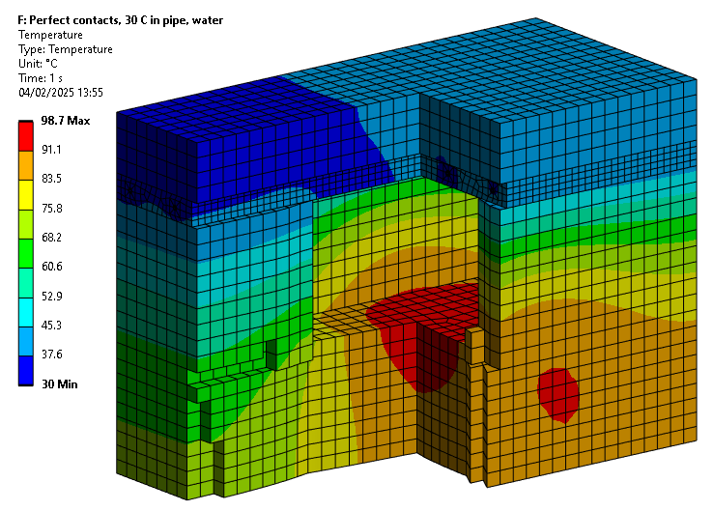
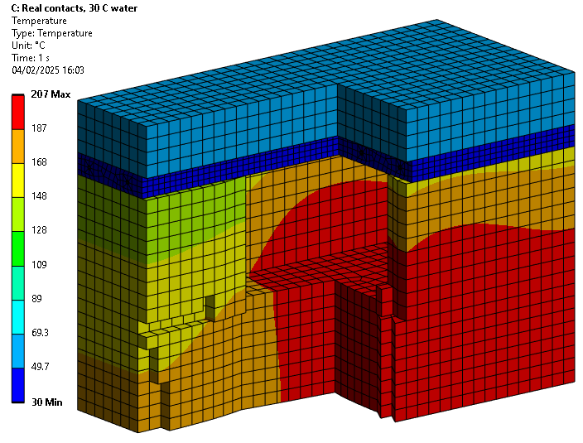
Simulations with FLUKA model:
Water cooled top plate
Assuming:
  30 C inside all pipes to represent ideal conditions with water cooling
  Water cooling plate on top is cast iron with stainless-steel pipes inside the cast. Perfect thermal conductivity.
  Assumed real conductance calculated from CMY model.
Conclusion:
  Realistic thermal contact conductance is very low and affects the cooling performance severely.
  Cooling performance can be increased with more contact pressure and/or a copper cooling plate

Slide 20
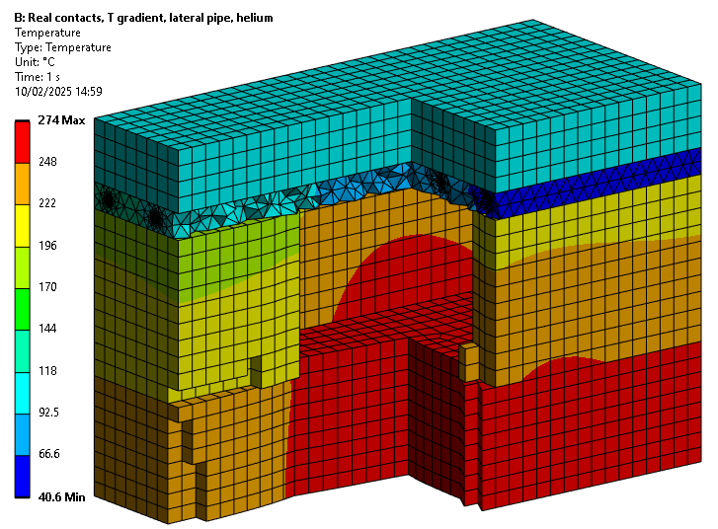
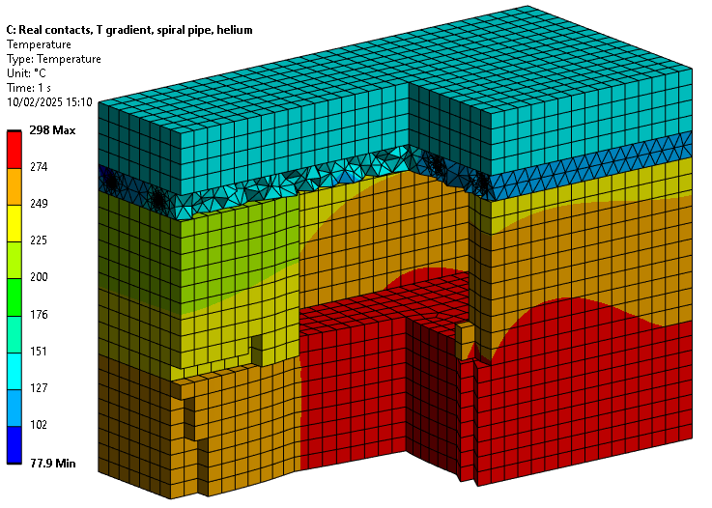
Simulations with FLUKA model:
Helium cooled top plate
Assuming:
  Helium flow in cooling pipes is fully turbulent. At the inlet: 16 bar, 30 g/s, 20 C
  Cooling plate on top is cast iron with stainless-steel pipes inside the cast. Perfect thermal conductivity.
  Assumed real conductance calculated from CMY model.
Conclusion:
  Realistic thermal contact conductance is very low and affects the cooling performance severely.
  Cooling performance can be increased with more contact pressure and/or a copper cooling plate

Slide 21
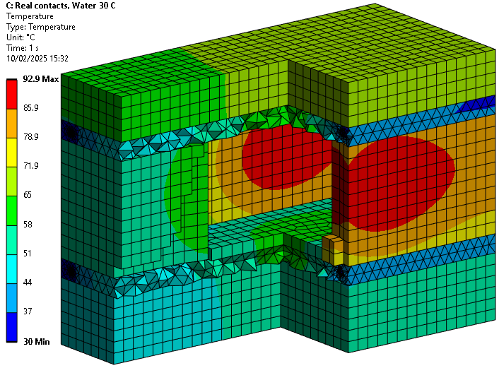
Simulations with FLUKA model:
Water cooled top plate and bottom plate
Added cooling plate top bottom
Two pipes goes to the top, and two pipes to the bottom, all in the same circuit

Slide 22
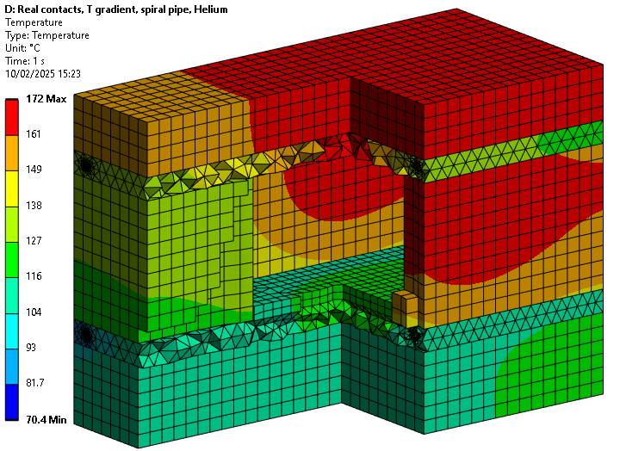







Simulations with FLUKA model:
Helium cooled top and bottom plate
Assuming:
  Helium flow in cooling pipes is fully turbulent. At the inlet: 16 bar, 30 g/s, 20 C
  Cooling plate on top is cast iron with stainless-steel pipes inside the cast. Perfect thermal conductivity.
  Assumed real conductance calculated from CMY model.
Conclusion:
  Realistic thermal contact conductance is very low and affects the cooling performance severely.
  Cooling performance can be increased with more contact pressure and/or a copper cooling plate

Slide 23
Water results:
Top cooling plate
Top and bottom cooling plate
a
b
c

Slide 24
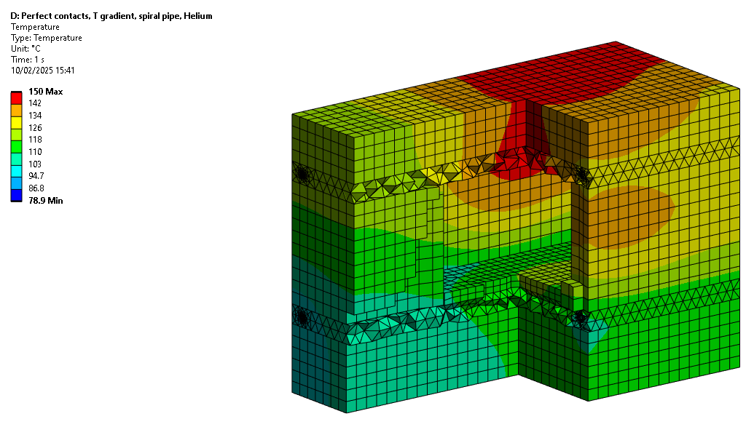
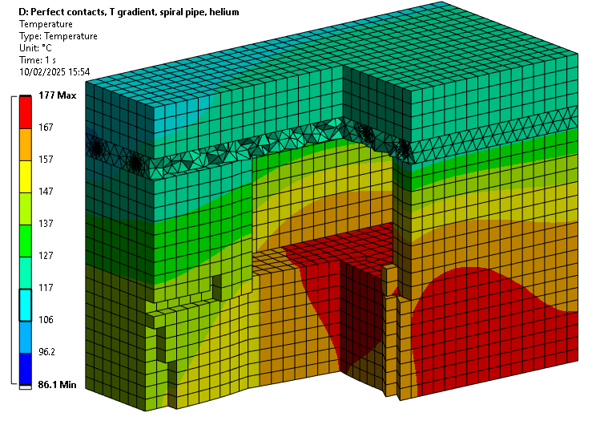
Perfect contacts with helium
Top and bottom cooling plate
Top cooling plate
b
a

Slide 25
Real contacts helium
Top cooling plate
Top and bottom cooling plate
a
b
c

Slide 26
Findings compacted:

