Slide 1
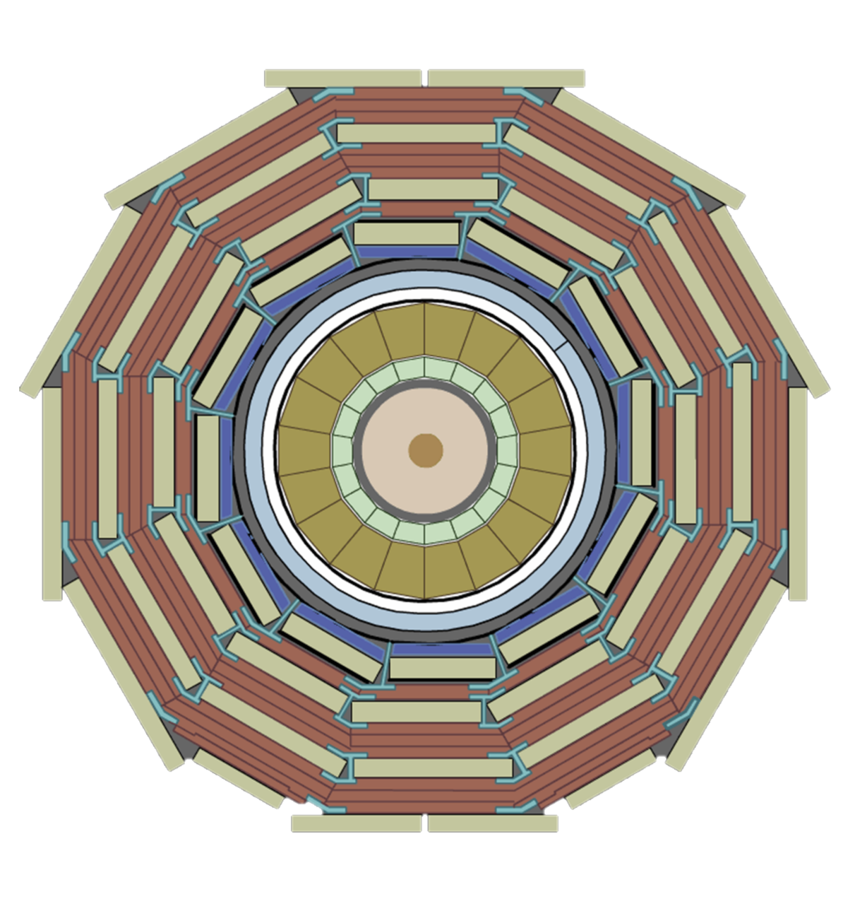


LVPS community meeting #4
News since December 2024
+
-
Krzysztof Stachon
Credits:
Raul Jimenez Estupinan , Ben Farnham, Magnus Hansen, Werner Lustermann, WIENER
28/02/2025

Slide 2
Agenda
Early pre-production delivery schedule update
Recent work
Future steps
Test system proposal

Slide 3
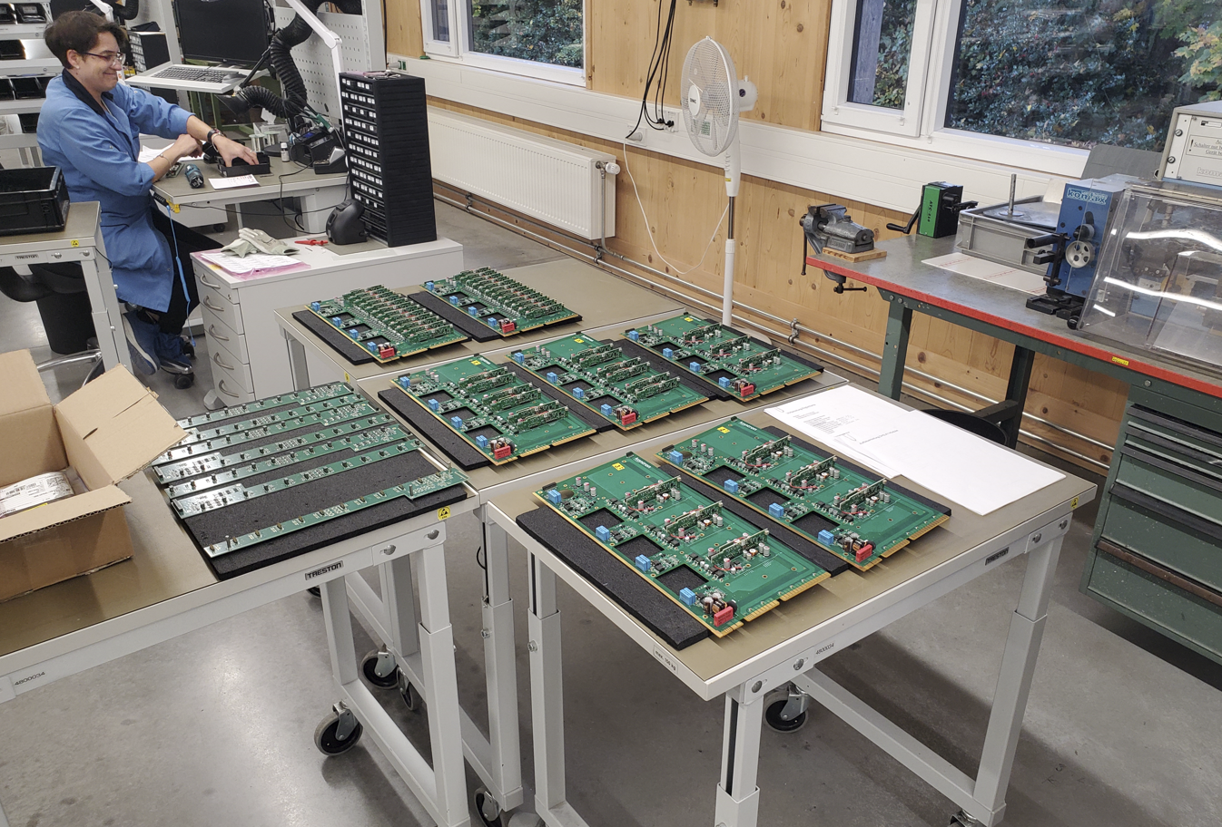
Early pre-production delivery
WIENER has provided an update on the early pre-production delivery:
  Delivery promised by the end of April 2025 to meet the radiation qualification timeline
    Assembly of PCBs will be done by Kontron, who has now all the material in hands.
    Integration and testing will take place at WIENER’s premises
    I was informed, that the delay was caused by extensive communication exchange with manufacturing company, who needed clarifications about the design files and parts procurement.
This date should be kept, as radiation test relays on this date!

Slide 4
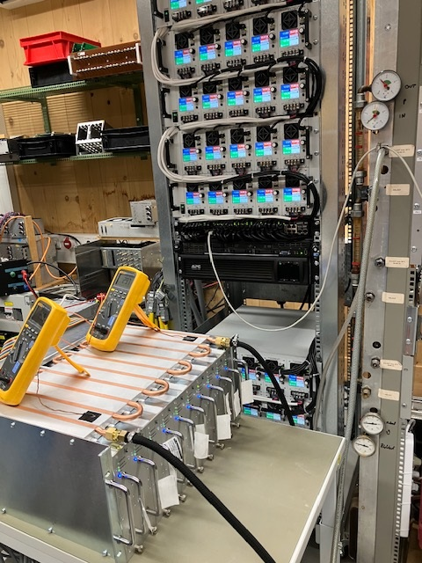
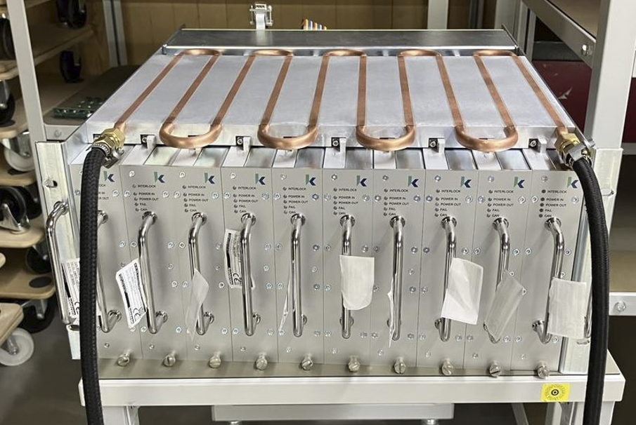
News
Customized chassis specification finalized [1]
Tim, one of key engineers, deeply involved in the design of the modules left WIENER end of January.
  Big loss for WIENER, excellent engineer with problem-solving mindset
  We should not be affected as long as there is no new issue to be solved.
Full chassis test under the load completed
in January.
  No problems detected due to heating
  Waiting for written report from WIENER
  Problem with CAN addressing detected..
[1] https://cernbox.cern.ch/s/B8ZKqiv9WJQ7cbu

Slide 5
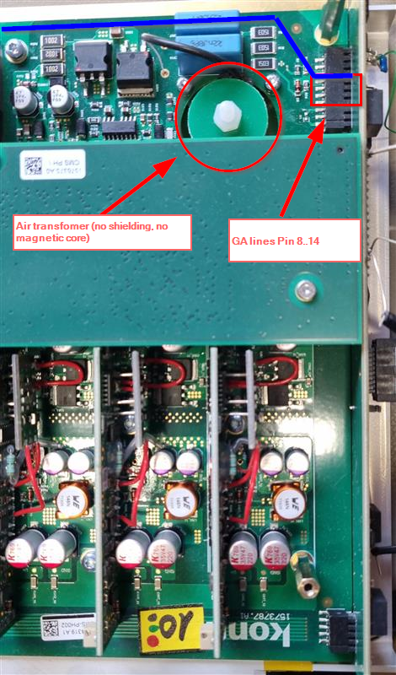
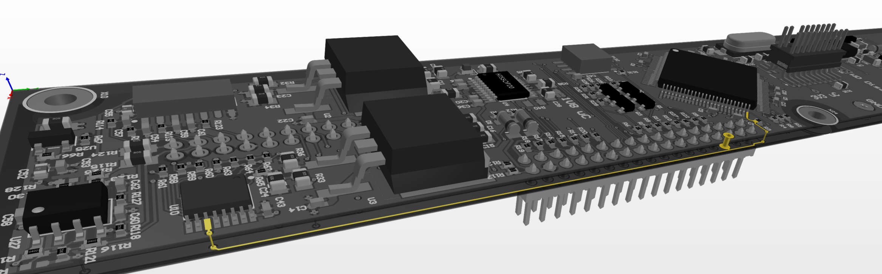
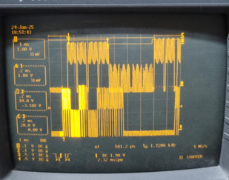
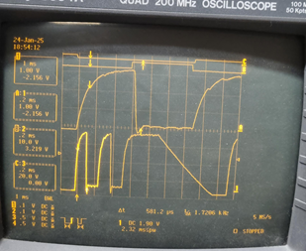
CAN addressing issue
CAN address is assigned based on position in the chassis and chassis address (selectable with a switch)
It turned out that with some (low) likelihood, two modules may have the same address detected. This creates colission in responses and practically makes communication with the two modules impossible.
Root cause: EMI (pickup by long, low-level signal trace)
The issue was now fully solved by replacing pasive components

Slide 6
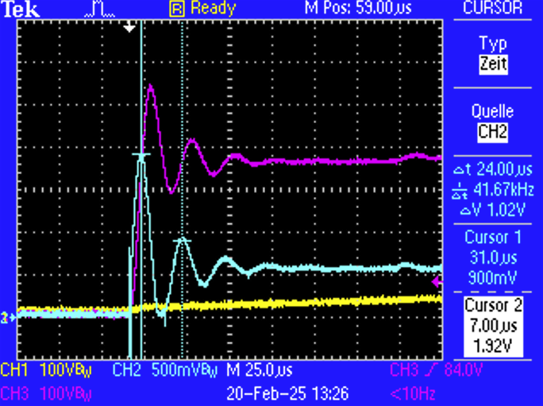
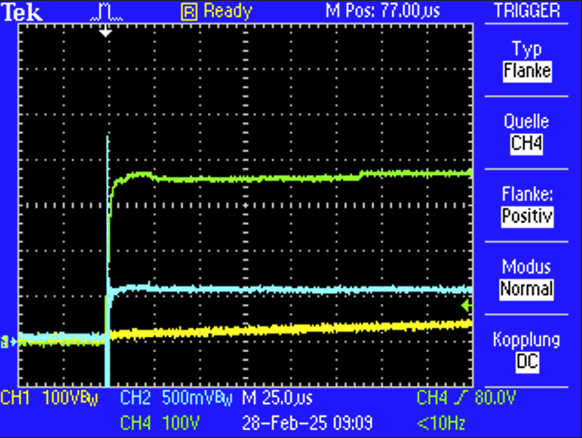
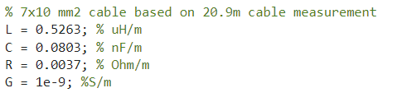
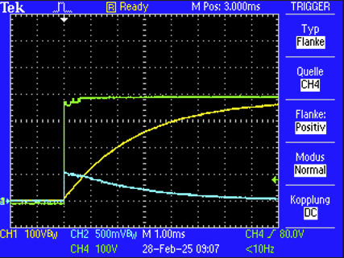
Inrush current study
Based on simulations, there was a hypotesis issued that 100 nF capacitor before NTC resistor may cause excessive inrush current.
Inrush current was measured by WIENER with a cable equivalent model (RLGC)
Short (tens us), 20A transient was measured (on a single module).
Without the capacitor, the transient was reduced to 6 A, which will not trip MCB’s overload protection.
120 m
Before
(ringing up to 20A)
After
(no ringing up to 6A)
AC/DC
NTC
380 V
100 nF
44 uF

Slide 7
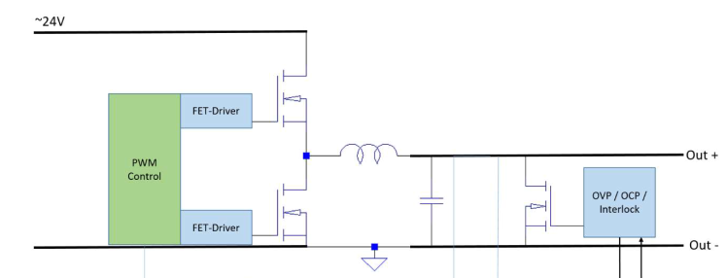
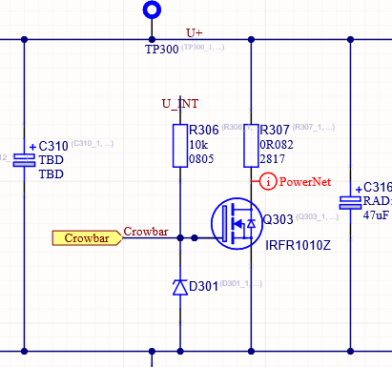
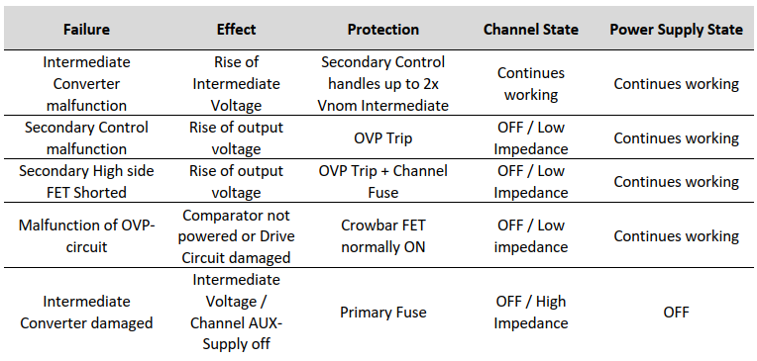
Crowbar issue
During disucssions about BTL variants, I’ve found out another issue: too high crowbar resistance in the present implementation.
  Makes over-voltage protection not functional
  This reisstance was a temporary fix for reworked modules (prototype v2)
  Introduced ‚killswitch’ – a feedback from OVP/OCP/interlock disabling PWM
  Res. be restored to low value (0.4 Ohm, 360 W peak power via transistor @ 1 mF)
Fuse
68 Ω
0.4 Ω
Simplified step-down stage of the LVPS
Actual implementation of the crowbar
LVPS design file: mitigation of possible failures.

Slide 8
Near future
Finalizing OPC server with real LVPS (Big credits for the work done by Raúl Jimémez Estupiñán, Ben Farnham). Optimistic delivery: April
Reception test of early pre-production (May 2025)
Radiation and magnetic field qualification
Made a request for radiation slot with a prefered start date of 21 May 2025 (dry run)
Once date is confirmed, magnetic field test will be scheduled shortly before / after.
Expected verdict on technical acceptance of LVPS: end of June 2025
positive => place the order for pre-production and production quantities.

Slide 9
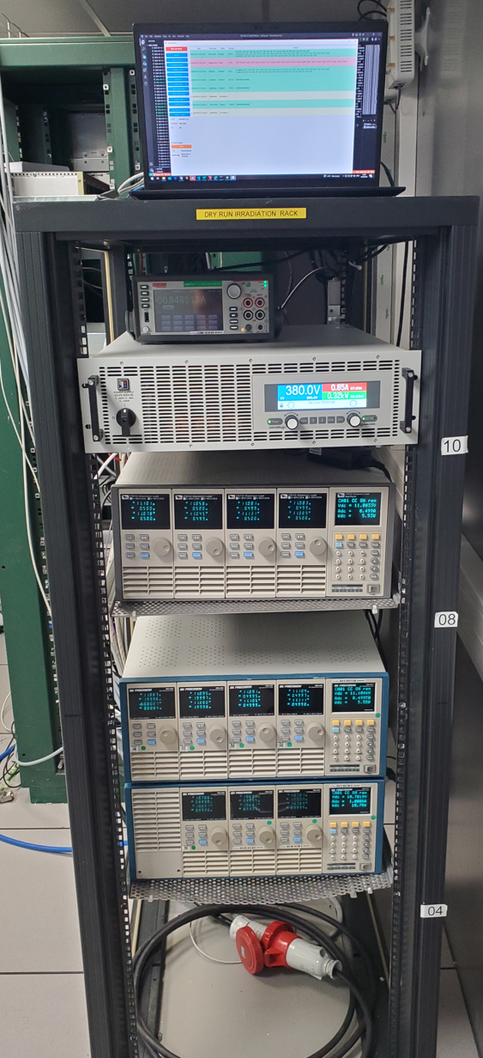
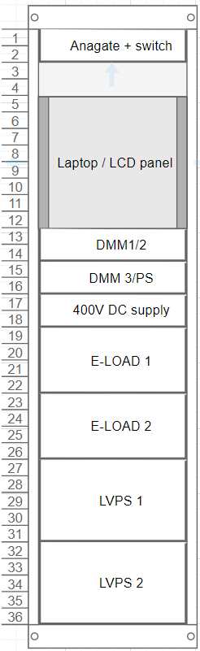
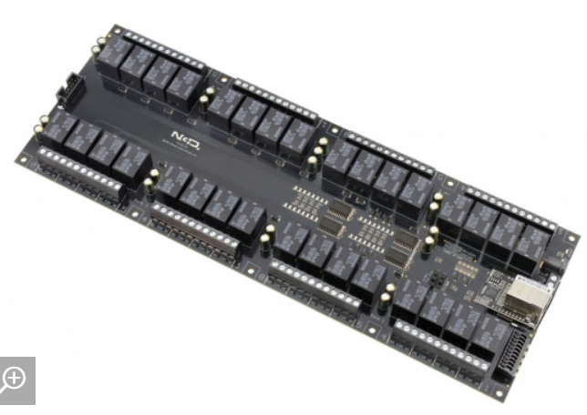
LVPS test rack – proposal.
Having prior experience with testing LVPS, I would like to build a test rack, which will be used for:
  Reception test (SAT)
  Later, for verification of modules on stock before use
  Verification of faulty modules – is it useful? If yes, where the test would be placed? (supervised area)
Features:
  36U rack on wheels, which can test 1 module of any type at the time
  Expected test time per module:
    Core functionality around expected operating area (2 min/module)
    Full functionality with extended operating area (10 min/module)
  Storage of results in the database
  Extensions possible:
    by use of relays, up to 5 modules can be inserted to the chassis and tested sequentialy (64 relays needed)
    Sequential burn-in (limited to 1 module at the time)
Estimated cost of a single test system: 36k CHF
Without e-loads (can be rented): 21k CHF

Slide 10
Thank you for your attention
Contact
Krzysztof Stachon
krzysztof.stachon@cern.ch

Slide 11
Open disucssion notes

