Slide 1
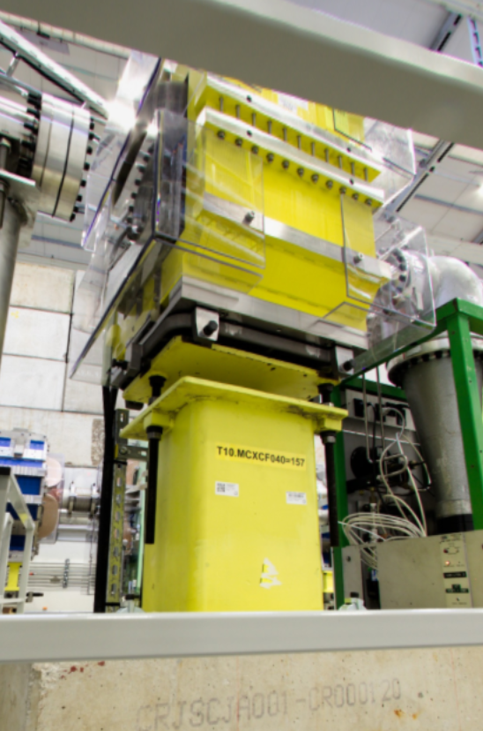
East area Magnets status
Audio visual inspection
All magnets in extraction, mixte and secondary area inspected.
No issue to report, excellent reliability.
Magnet removal for vacuum chamber installation
The magnet T10.MCXCF040 type MDXL has been removed from the beam line to allow vacuum chamber installation.
Re-installation was made with no particular issue.
Polarity checks
The MDXL magnet needs a thermal / polarity measure to ensure a correct operation parameters.
Other magnets were not touched therefore are in the same configuration as before the YETS 2024-25
Fig.1 T10.MCXCF040

