Slide 1
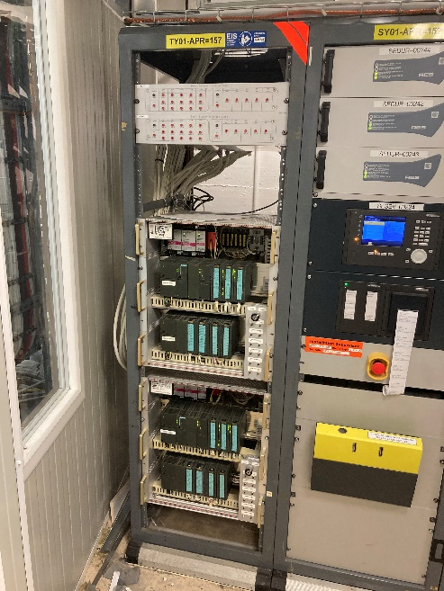
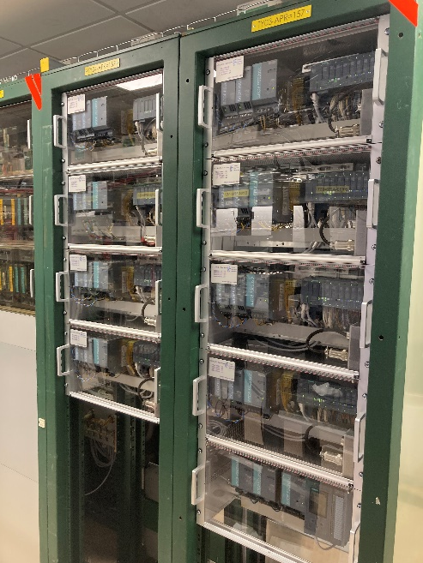
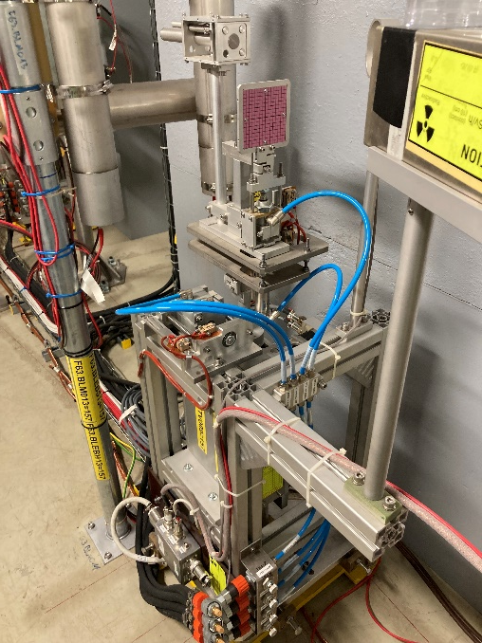
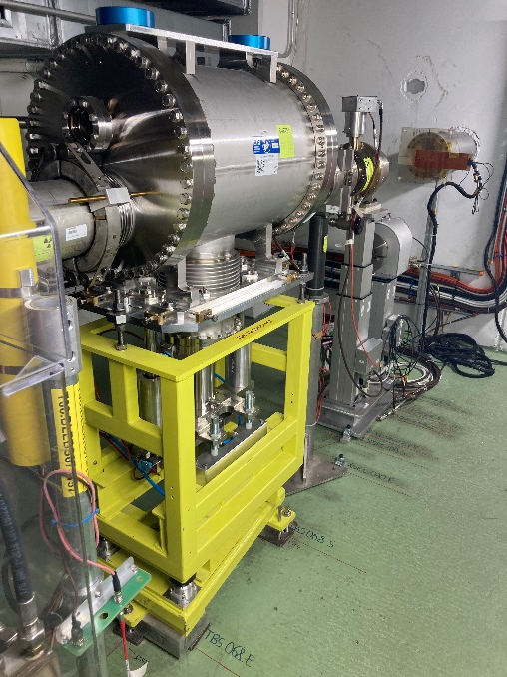
East Area BIDs Controls Status
All BIDs and associated control systems have been inspected and tested in collaboration with SY/STI and BE/EA.
During this test phase, the functionality of the control systems was fully validated from the middleware level (FESA).
Several parameters of the collimator controls were fine-tuned to optimize motion and minimize the risk of errors during operation.
All BIDs are fully operational.
  Beam stoppers : T08, T09, T10, T11, F61
  Multitargets : F62, F63
  Collimators XCSH/V , XCHV and XCON : T08, T09, T10, T11
Beam stoppers control systems
Collimators control systems
Multitarget
Beam stopper

Slide 2
East Area BIDs Controls Status
The YETS activities in the East area were completed smoothly and without any significant issues.
A big thank you to all the teams and individuals involved in the coordination, including the STI and EA teams, the radioprotection group, and the access system team, for their dedication and excellent collaboration.

