Slide 1
IDEA Tracking Concept and Lessons Learned
Fabrizio Palla
Fabrizio Palla
INFN Pisa and CERN
FCC-ee Workshop: Tracking Detectors and Software
Brookhaven National Laboratory (USA)
7-9 May 2025

Slide 2
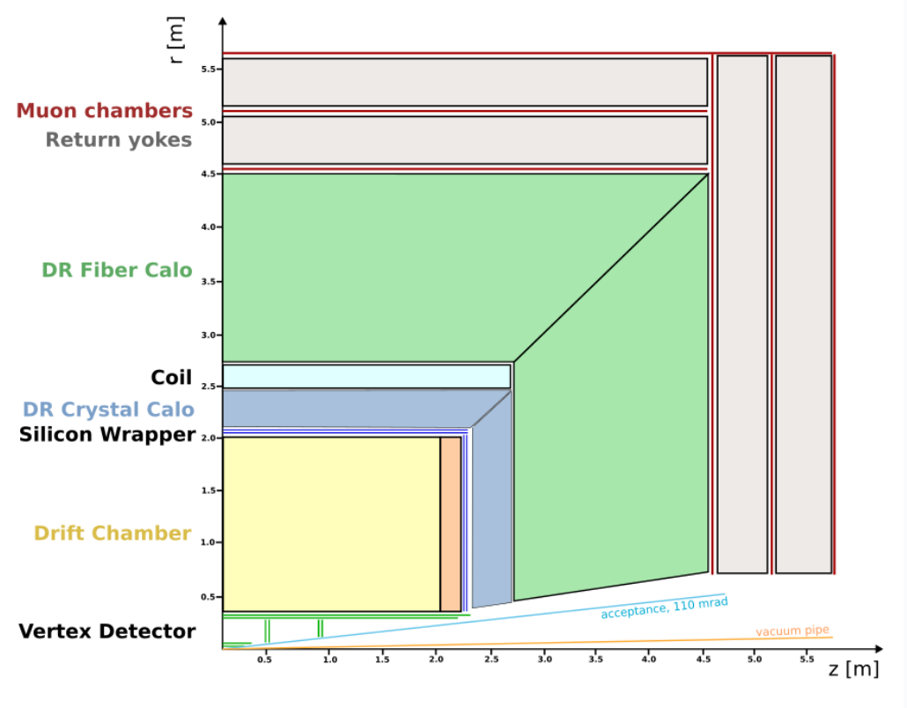
IDEA detector layout
Innovative Detector for E+e- Accelerator
Sophisticated Tracker
  Precise MAPS based Vertex detector
  Large volume, Helium drift chamber with PID
  Surrounding Silicon Tracking wrapper with PID
Dual Reaout Crystal EM Calorimeter
Superconducting Solenoid up to 3 Tesla
Dual Readout Hadron Fibre Calorimeter
µ-Rwell muon detectors
https://doi.org/10.48550/arXiv.2502.21223

Slide 3
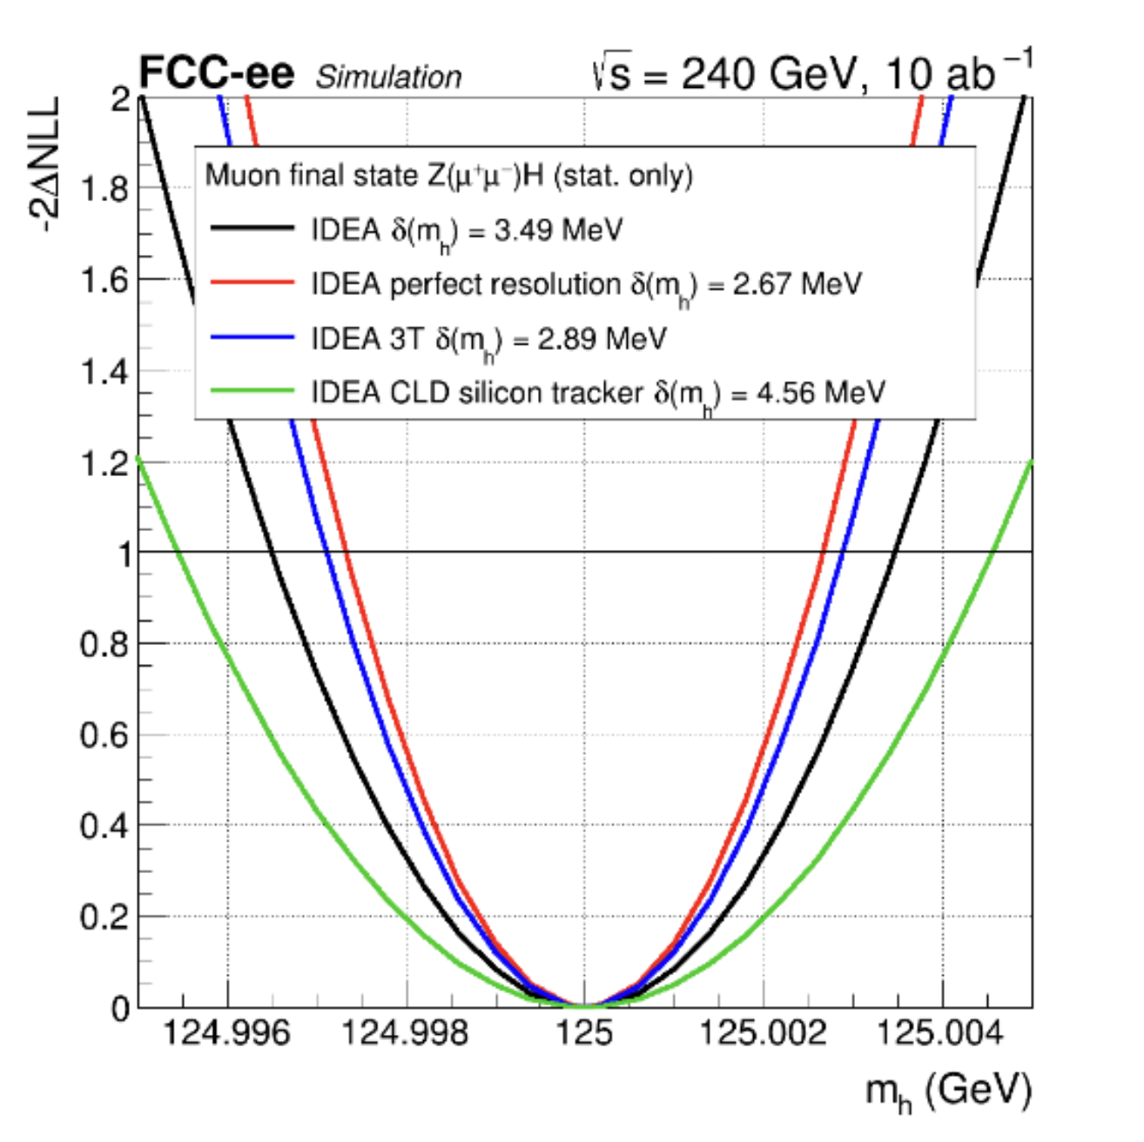
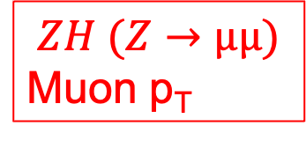
Physics drivers for tracking and vertexing
Higgs mass measurement
  Aim at 4 MeV (intrinsic width) using recoil and beam energy constraint
    Momentum resolution of 0.2% at 50 GeV
    However, µ momentum spectrum is largely smaller
$$ZH (Z→µµ)$$
Muon p_{T}

Slide 4
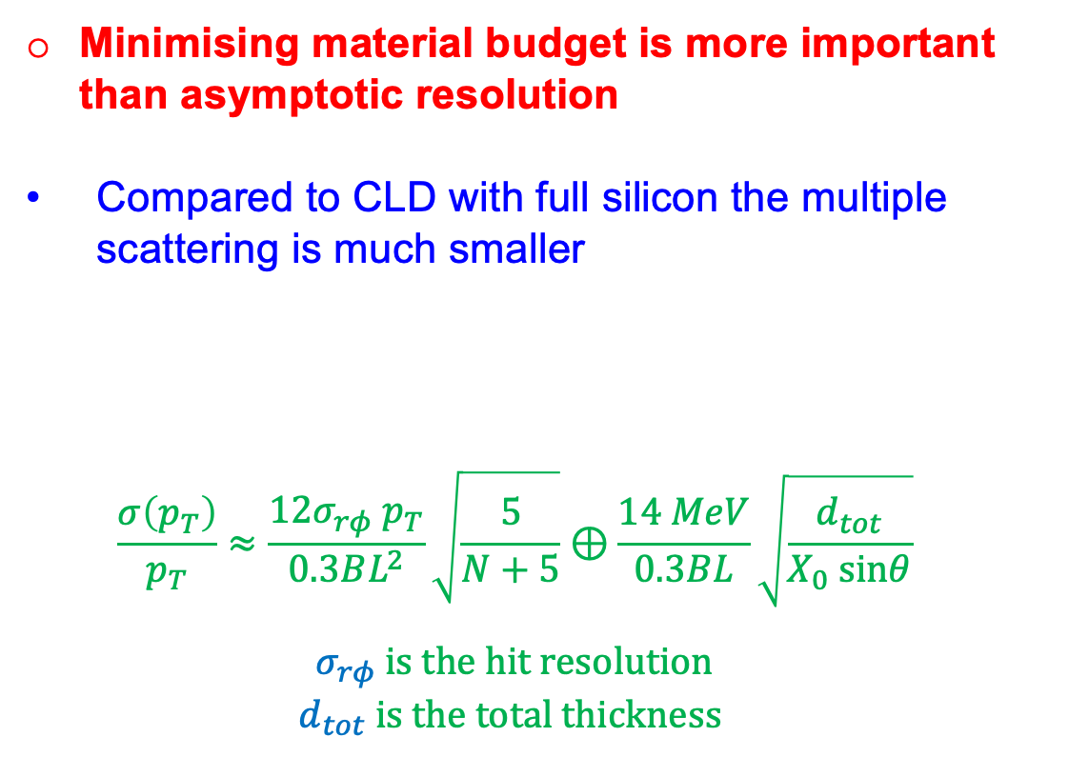
Minimising material budget is more important than asymptotic resolution
  Compared to CLD with full silicon the multiple scattering is much smaller
    $$\frac{σ\left(p_{T}\right)}{p_{T}}≈\frac{12σ_{rφ}{ p}_{T}}{0.3BL^{2}}\sqrt{\frac{5}{N+5}}⊕\frac{14 MeV}{0.3BL}\sqrt{\frac{d_{tot}}{X_{0} sinθ}}$$
    $$σ_{rφ} is the hit resolution$$
    $$d_{tot} is the total thickness$$
MS only

Slide 5
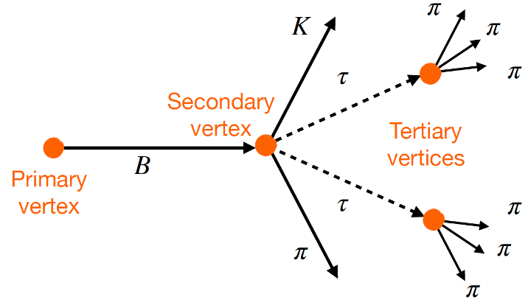
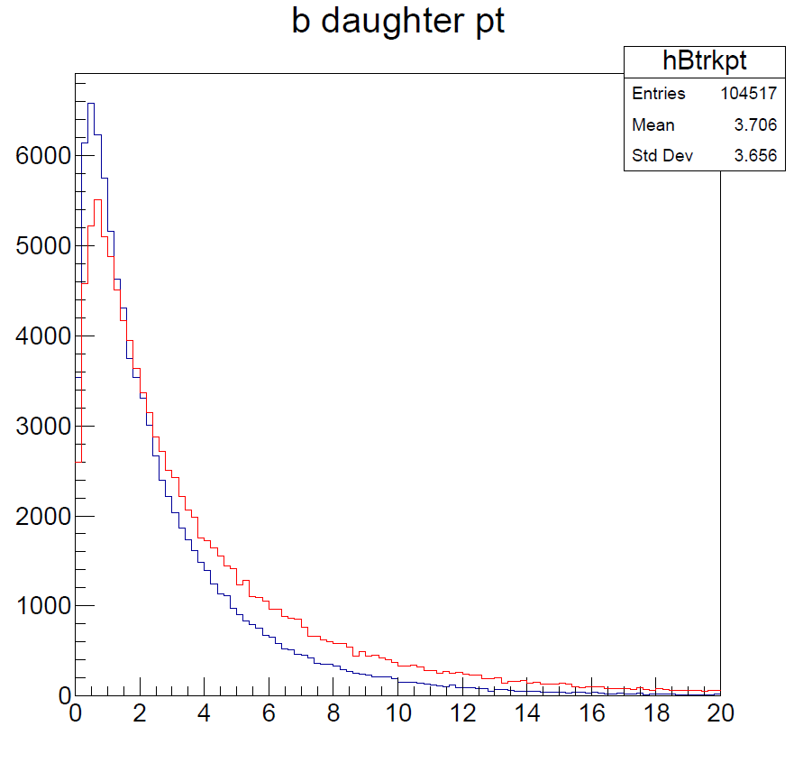



Higgs couplings and B-physics
Relatively small p_{T} tracks from b-hadron decays
$$B^{0}→K^{∗0}τ^{+}τ^{−}$$
Stable charged tracks from b-hadron decays
$$ZH→b\overline{b}$$
A 50% decrease of the material budget is ~equivalent to a 30% better hit resolution
    However, a 30% better hit resolution (2 µm) is very hard to achieve; a 50% material budget reduction (at least for the vertex) might be on sight (see later)
$$Z→b\overline{b}$$
p_{T} (GeV)

Slide 6
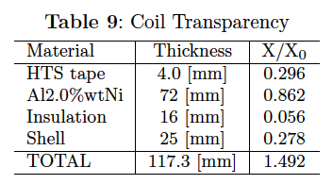
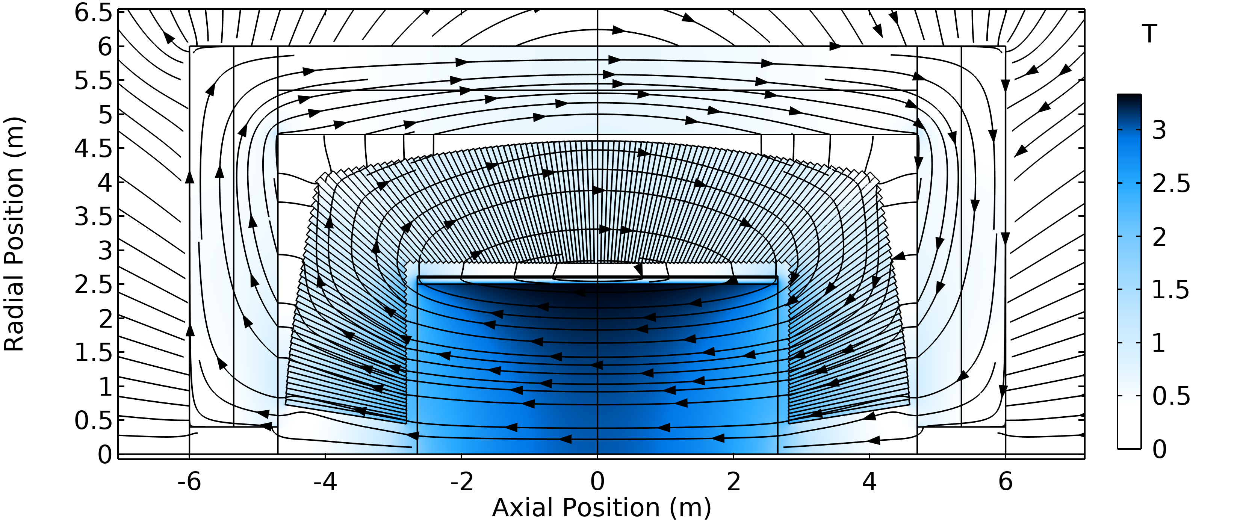
Detector Solenoidal field
Old option: Ultra light 2T solenoid:
  Radial envelope 30 cm
  Single layer self-supporting winding (20 kA)
    Cold mass: X₀ = 0.46, λ = 0.09
  Vacuum vessel (25 mm Al): X₀ = 0.28
    Can improve with new technology
      Corrugated plate: X₀ = 0.11
      Honeycomb: X₀ = 0.04
Current default: REBCO conductors and 3T @20K
  Extended radius to allow for ECAL inside
    Lower X0 requirements
  Lighter cold mass
  Radial envelope only 10 cm
  Can be accomodated with MDI
    (see A. Ciarma talk)
Courtesy of H. TenKate

Slide 7
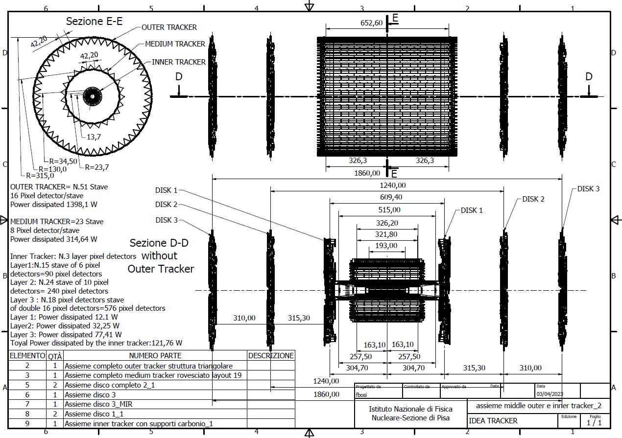
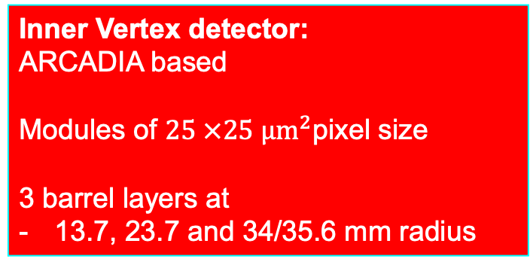
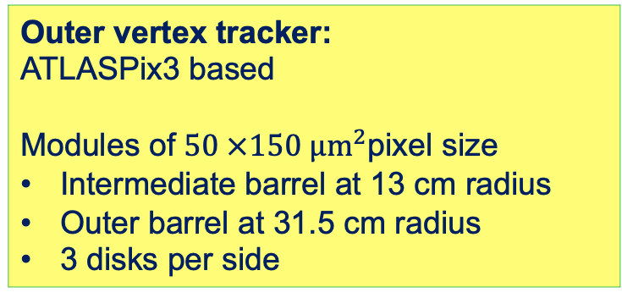
Feasibility study vertex detector layout
See presentations from A. Ilg
Outer vertex tracker:
ATLASPix3 based
Modules of $50 ×150 µm^{2}$pixel size
Intermediate barrel at 13 cm radius
Outer barrel at 31.5 cm radius
3 disks per side
Inner Vertex detector:
ARCADIA based
Modules of $25 ×25 µm^{2}$pixel size
3 barrel layers at
13.7, 23.7 and 34/35.6 mm radius

Slide 8
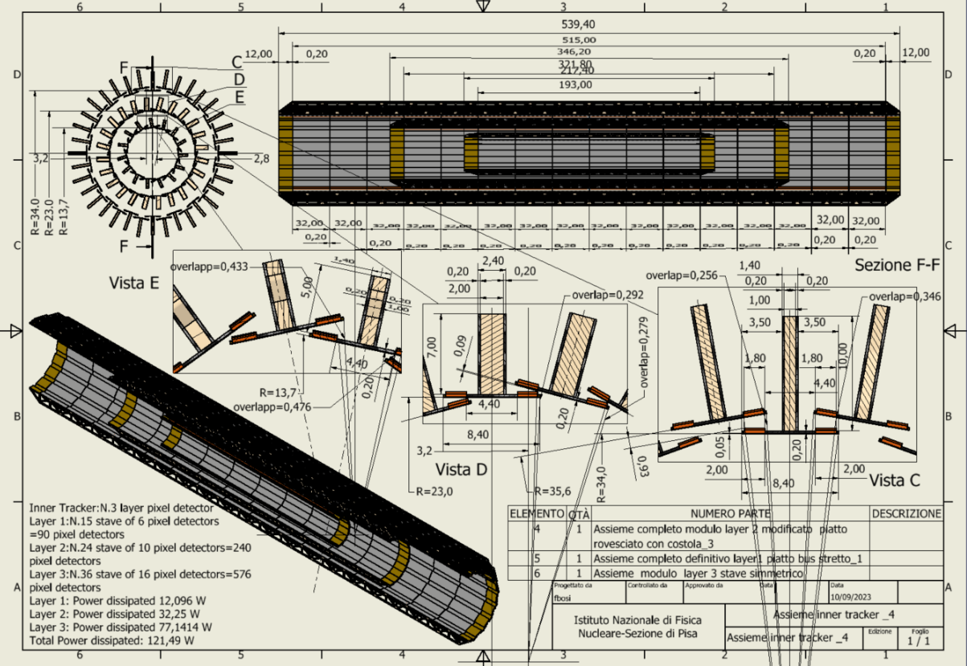
Inner Vertex layout
Total thickness per layer 0.25% X/X0​
Carbon Fibre ~60 %​
Silicon: ~20%​
Power and readout bus: ~20%
Layer # | Radius [mm] | No staves | No modules /stave | Total Length [mm] | Active Area [cm²] | Power [W]
1 | 13.7 | 15 | 6 | 217.40 | 241.92 | 12
2 | 23.7 | 24 | 10 | 346.20 | 645.12 | 32
3 | 34 & 35.6 | 36 | 16 | 539.40 | 1548.29 | 77

Slide 9
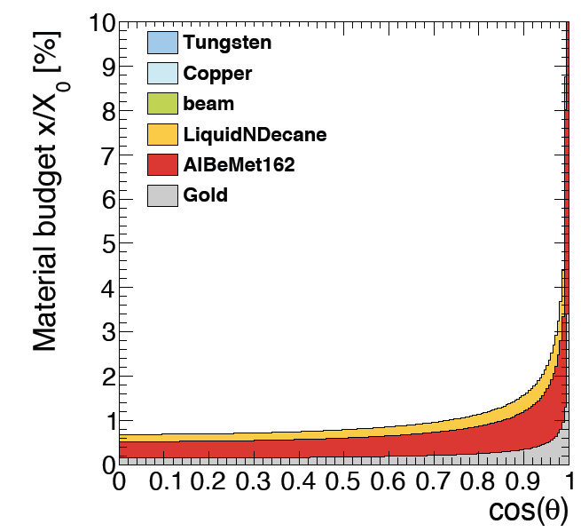
Simulated material budget
In agreement with CAD estimates
Smaller X/X₀ wrt IDEA CDR estimates even including power and readout cables in the sensitive region
Silicon only ~15% of the total
Outer and middle barrel
supports
Beam pipe
0.68%X/X₀ @ 90º
Inner Vertex only

Slide 10
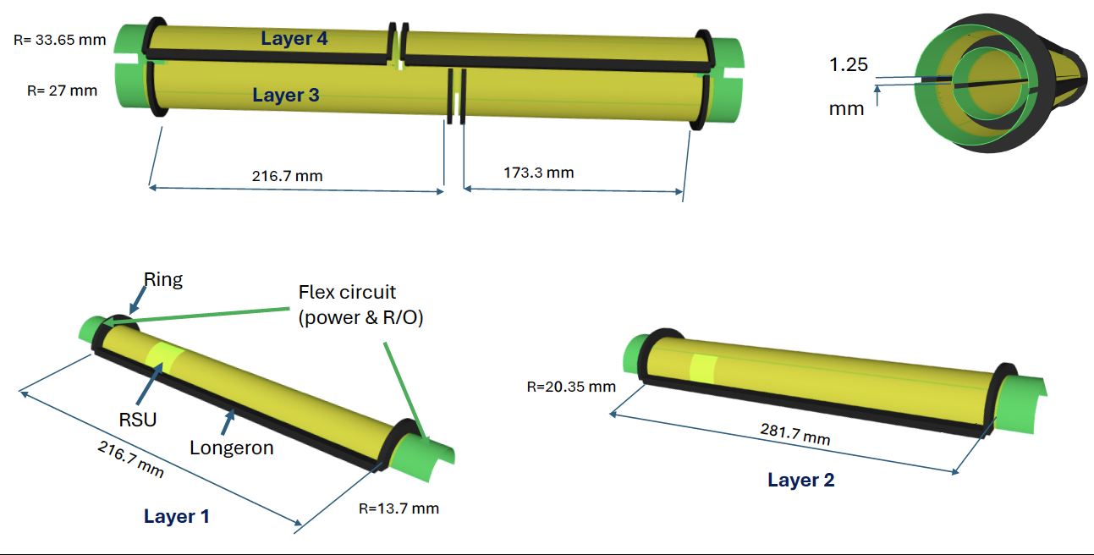
Curved vertex layout for FCC-ee

Slide 11
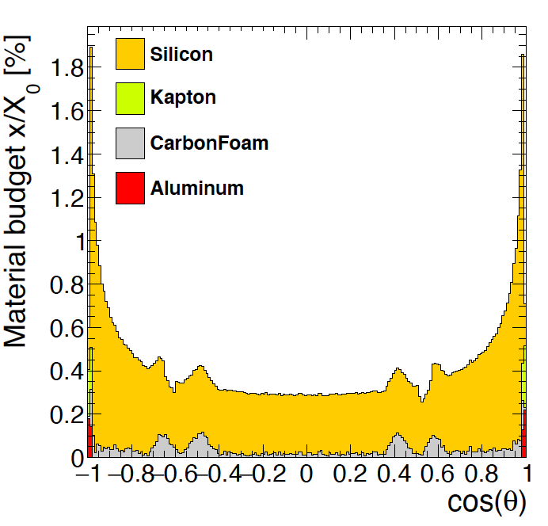
Material budget improvement
Curved
Layers 1 to 4
Flat vertex

Slide 12
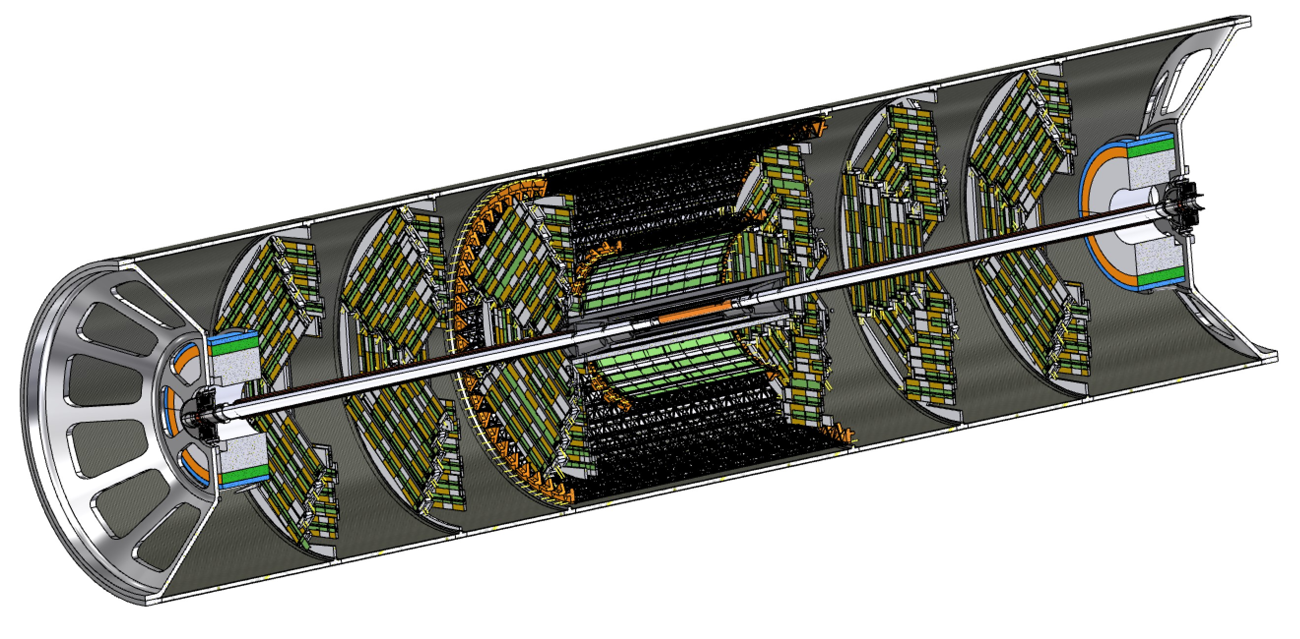
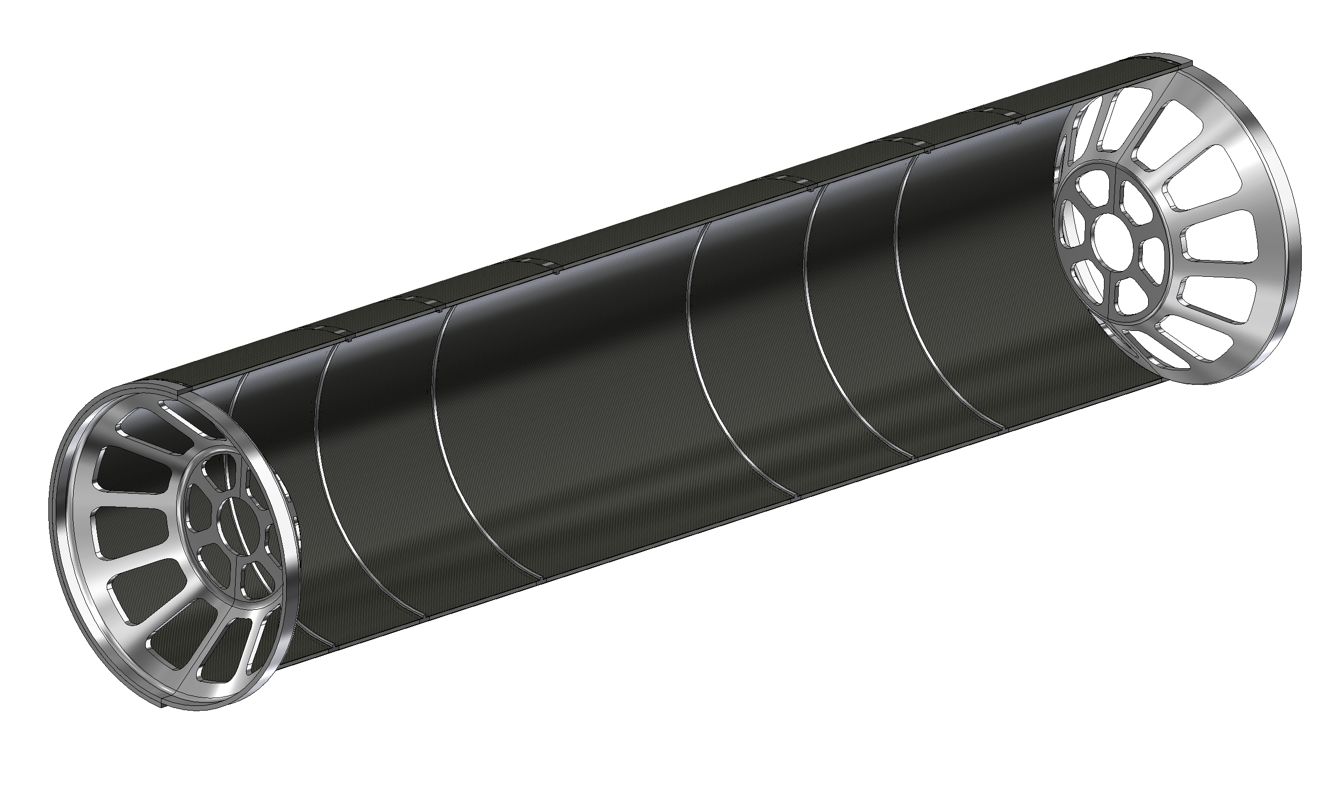
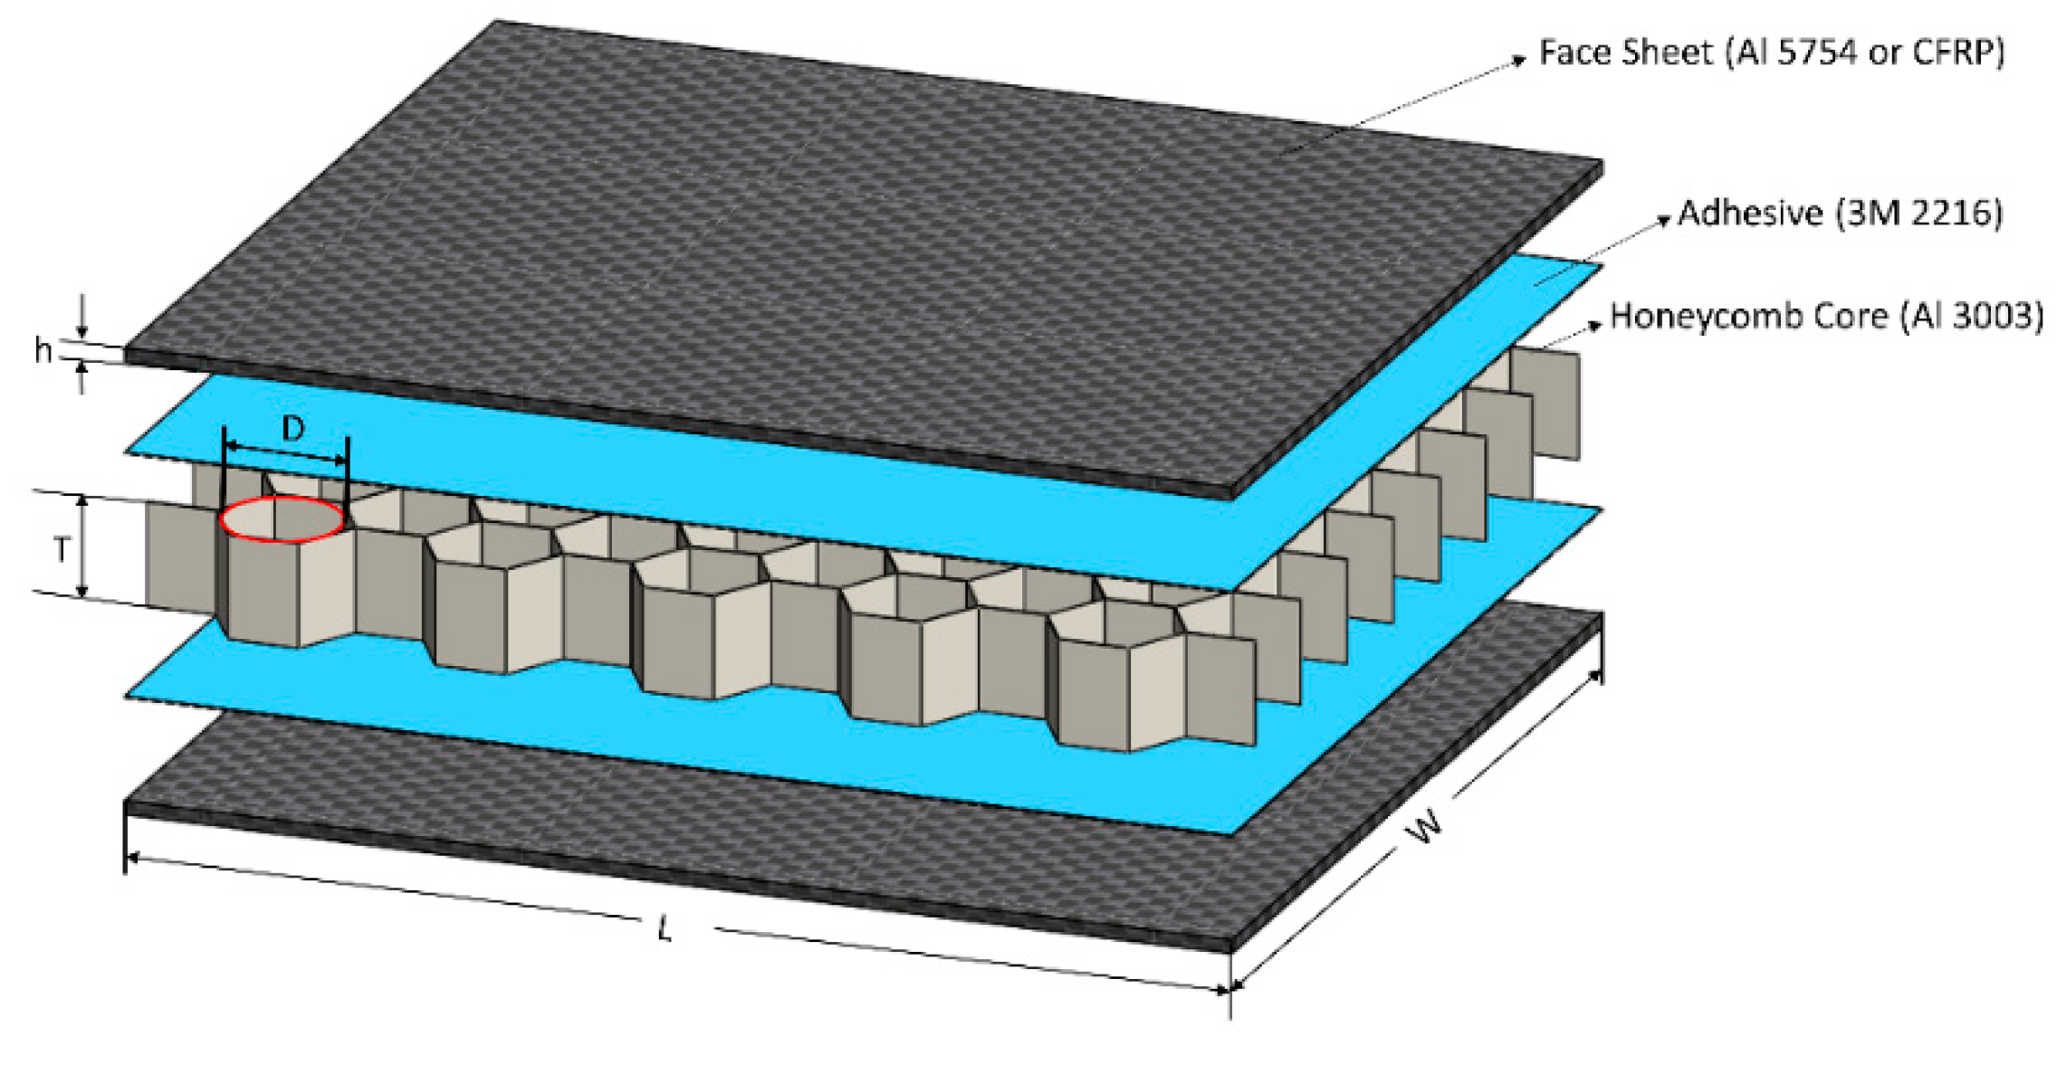
Support cylinder
All elements in the interaction region (Vertex and LumiCal) are mounted rigidly on a support cylinder that guarantees mechanical stability and alignment
  Once the structure is assembled it is slided inside the rest of the detector
    M. Boscolo, F. Palla, F. Fransesini, F. Bosi and S. Lauciani, Mechanical model for the FCC-ee MDI, EPJ Techn Instrum 10, 16 (2023). https://doi.org/10.1140/epjti/s40485-023-00103-7
Aluminium endcaps
Aluminium ribs
1mm CF + 4mm HC + 1mm CF

Slide 13
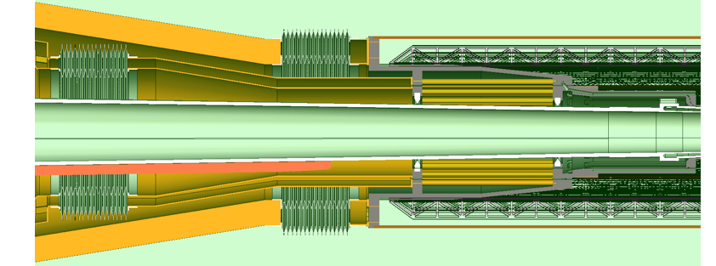
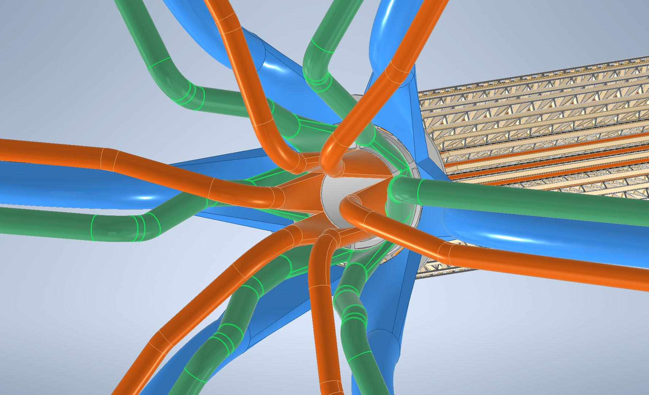
Integration with beam pipe and drift chamber
Layer 1&2 cooling cone
Support cone
Beam pipe cooling manifold
Layer 3 cooling cone
Work in progress to integrate beam pipe cooling manifolds with the vertex support cone.
(see tomorrow session)

Slide 14
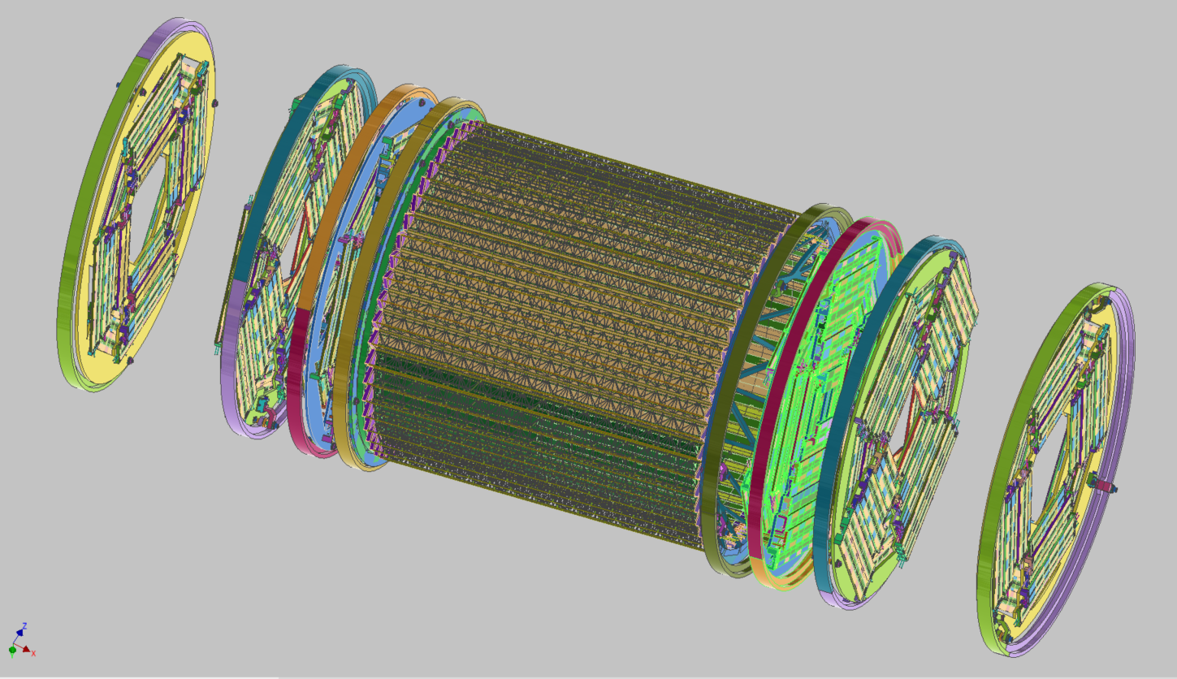
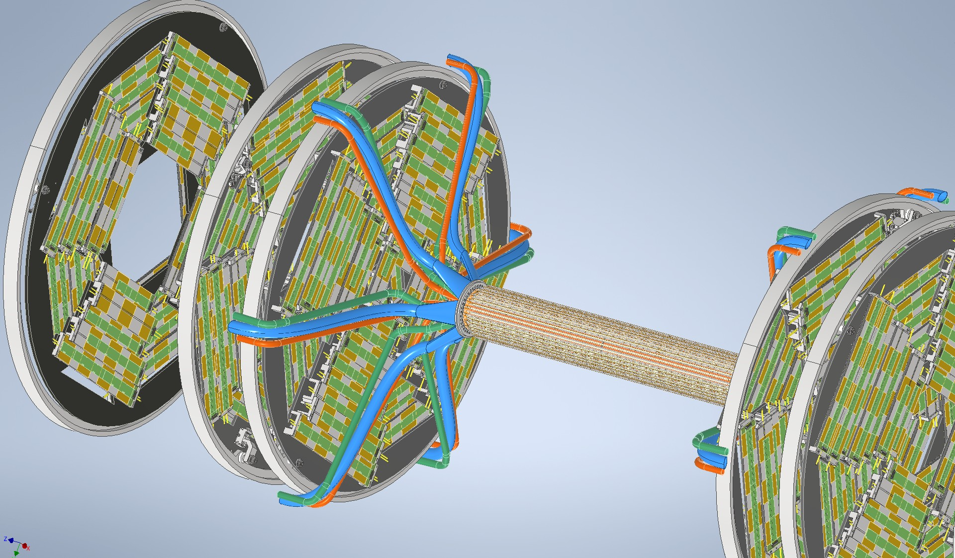
Service routings
Services (cables and cooling pipes – water or air) will be routed outside of the support tube
Outer Vertex
Disk1
Disk 2
Disk 3
Disk 3
Disk2
Disk1
Suppporting Ribs

Slide 15
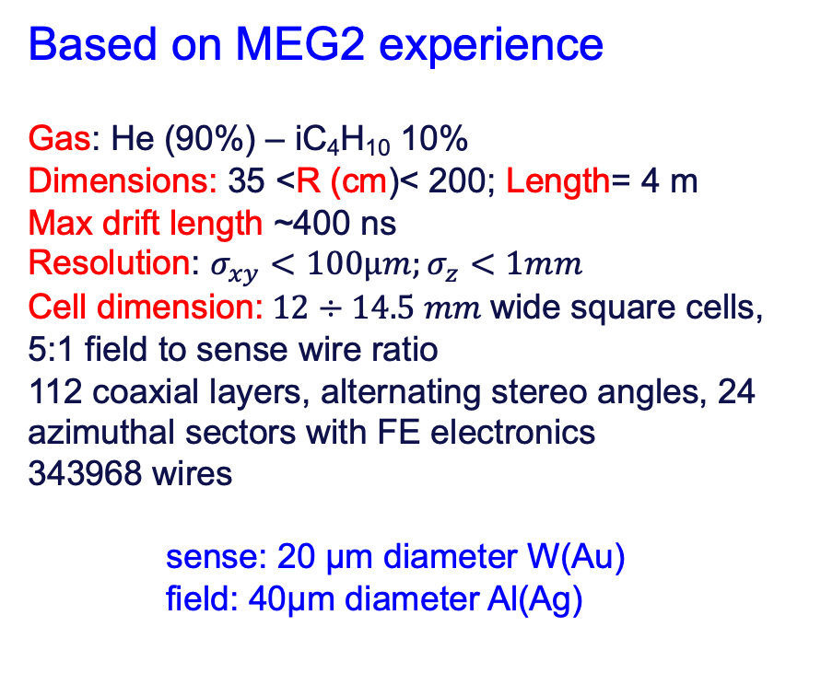
Drift chamber
Based on MEG2 experience
Gas: He (90%) – iC₄H₁₀ 10%
Dimensions: 35 <R (cm)< 200; Length= 4 m
Max drift length ~400 ns
Resolution: $σ_{xy}<100µm;σ_{z}<1mm$
Cell dimension: $12÷14.5 mm$wide square cells, 5:1 field to sense wire ratio
112 coaxial layers, alternating stereo angles, 24 azimuthal sectors with FE electronics
343968 wires
sense: 20 µm diameter W(Au)
field: 40µm diameter Al(Ag)
Included in DRD 1.2
See presentations from N. De Filippis

Slide 16
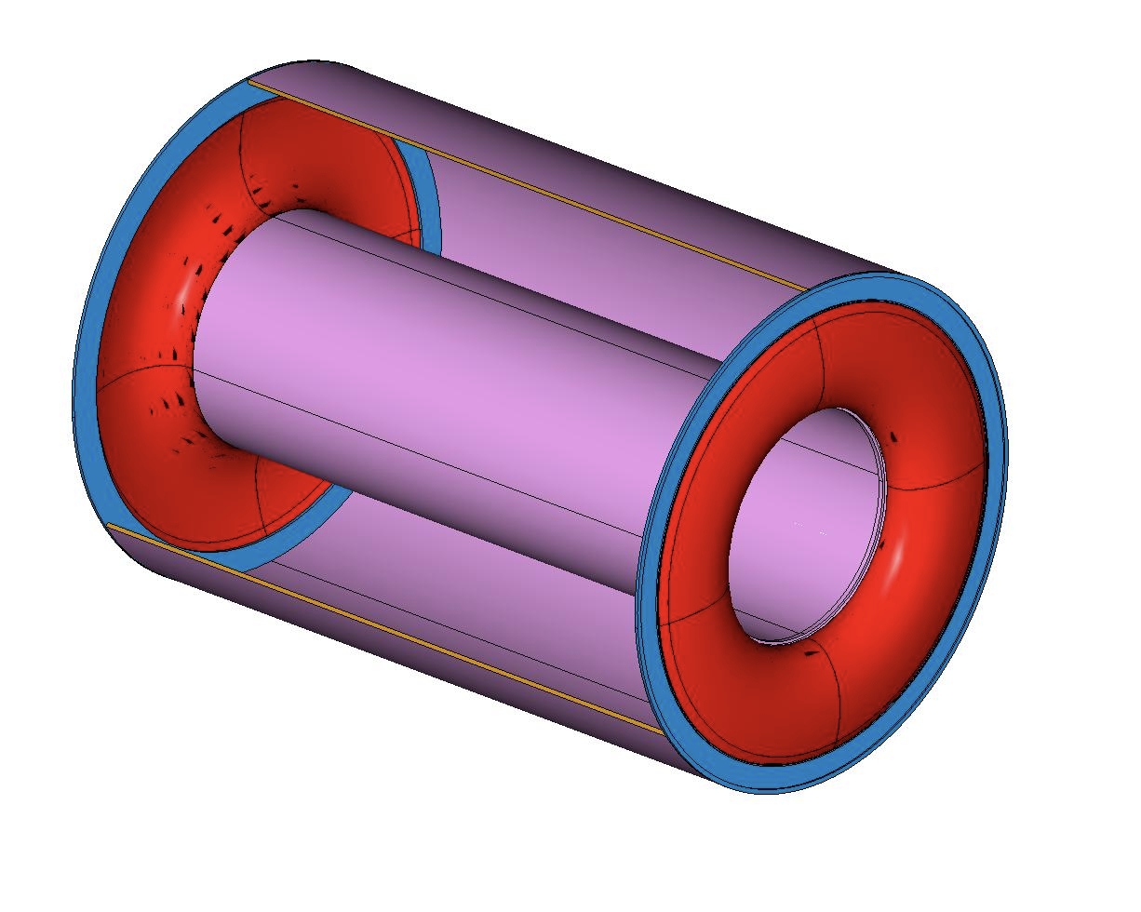
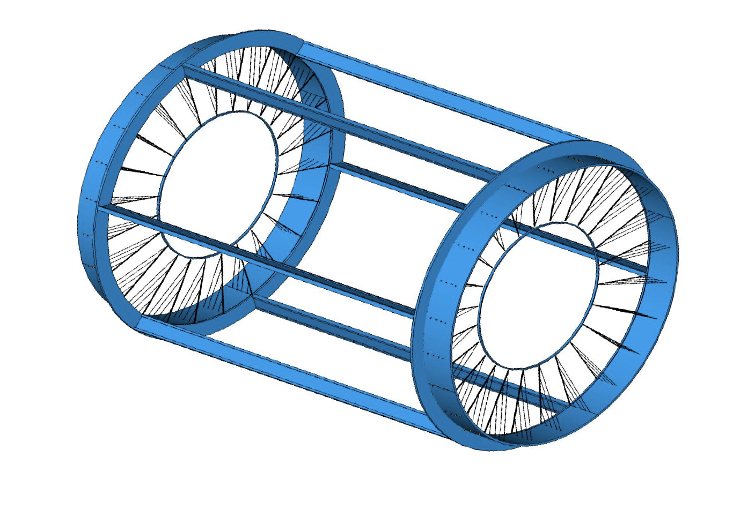
Gas envelope and wire cage
Gas containement:
Gas envelope can freely deform without
affecting the internal wire position and tension.
Wire support:
Wire cage structure not subject to differential
pressure can be light and feed-through-less.

Slide 17
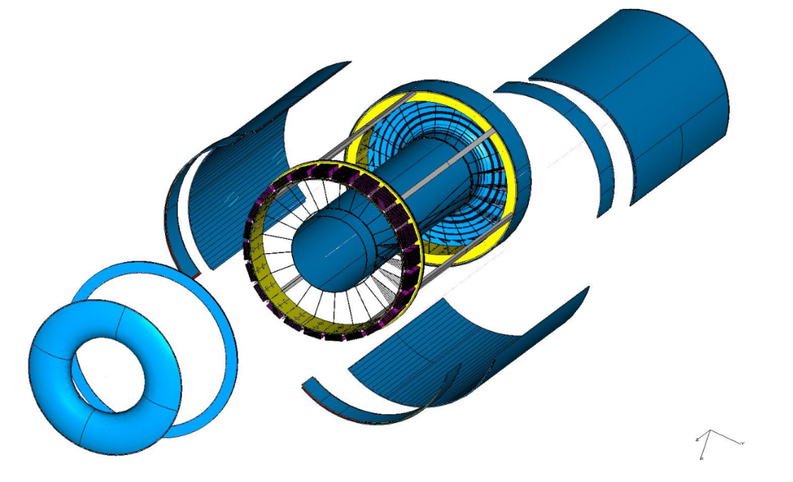
Drift chamber
Wire Cage
Gas envelope

Slide 18
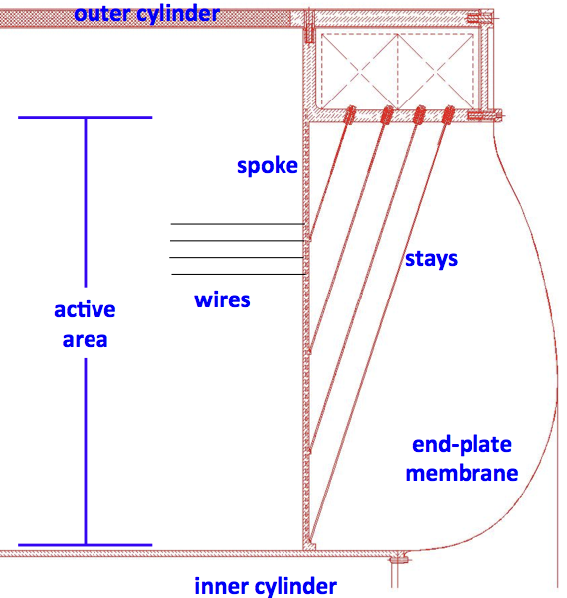
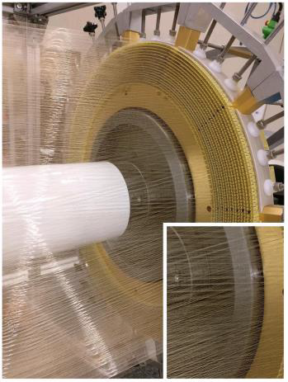
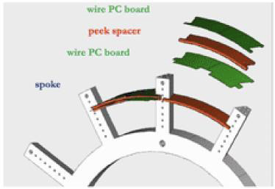
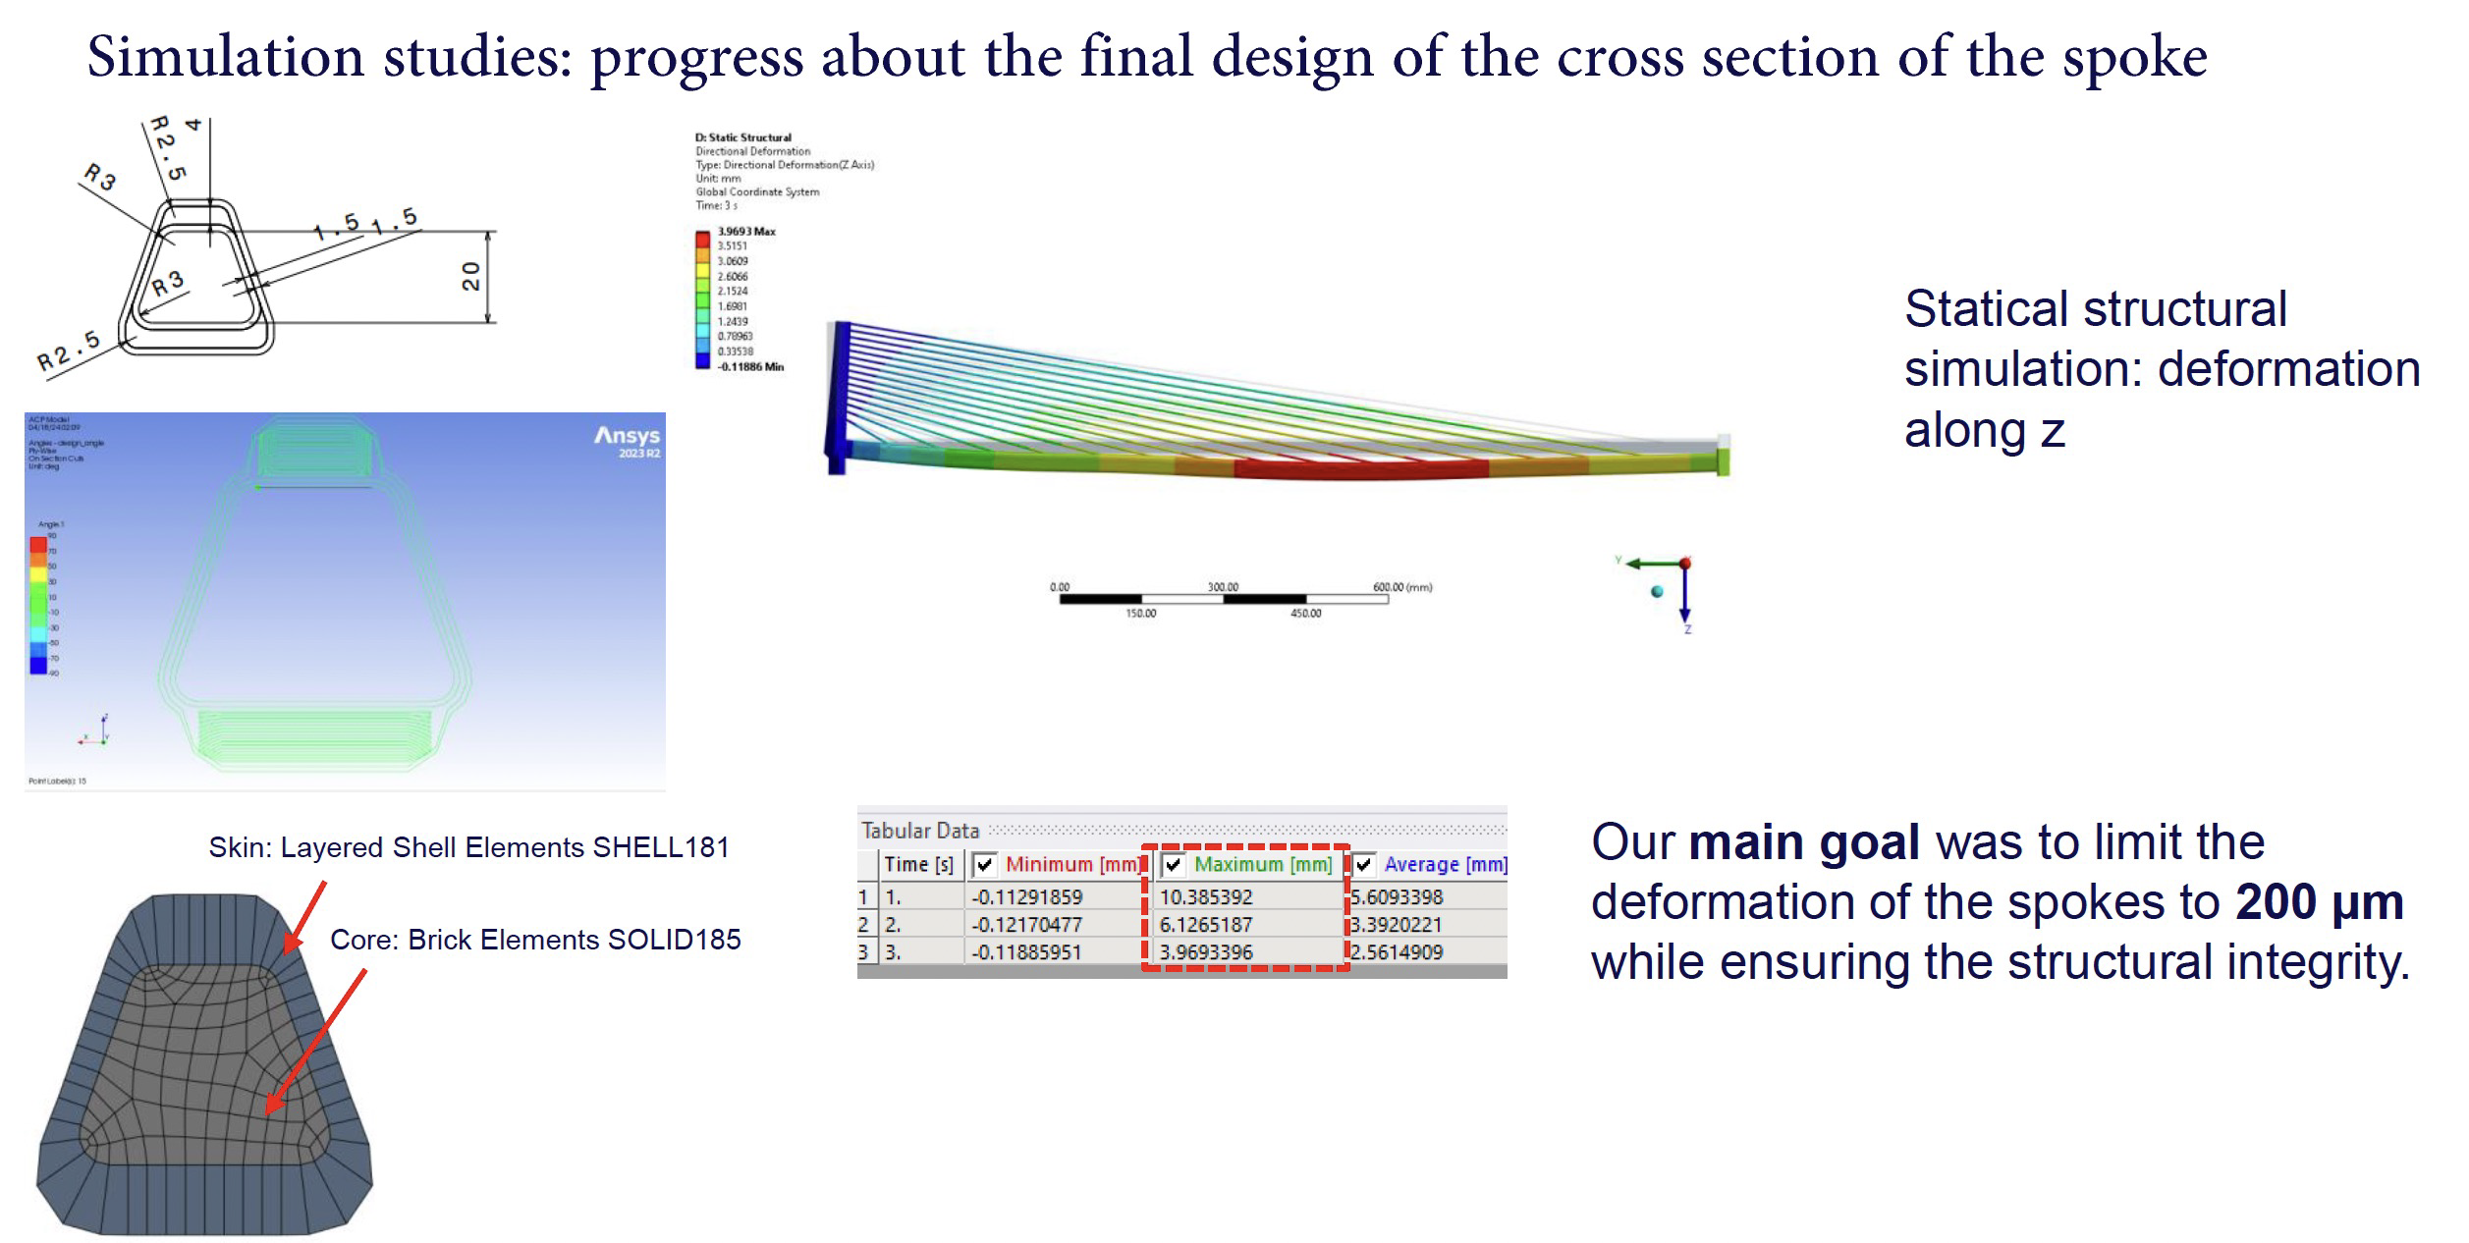
Spokes and wires supports
MEG2
Instrumented end-plate:
Wire PCB, spacers, HV distribution and cables

Slide 19
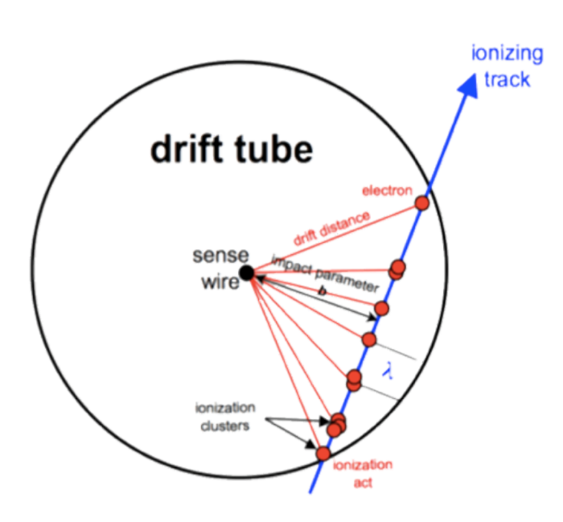

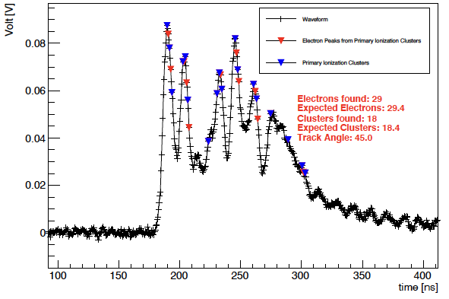
Cluster counting/timing PID
signals from each ionization are spread in time to few ns, which can be identified using a fast read-out electronics
By counting the number of ionization acts per unit length (dN/dx), it is possible to identify the particles (P.Id.)
with a better resolution w.r.t the dE/dx method.
Collect signal and identify peaks
Record the time of arrival of electrons
generated in each ionisation cluster
Reconstruct the most probable trajectory
Needs fast electronics and FPGA processing
Landau distribution of dE/dx originated by the mixing of primary and secondary ionizations, has large fluctuations and limits separation power of PID, while primary ionization is a Poisson process, has smaller fluctuations

Slide 20
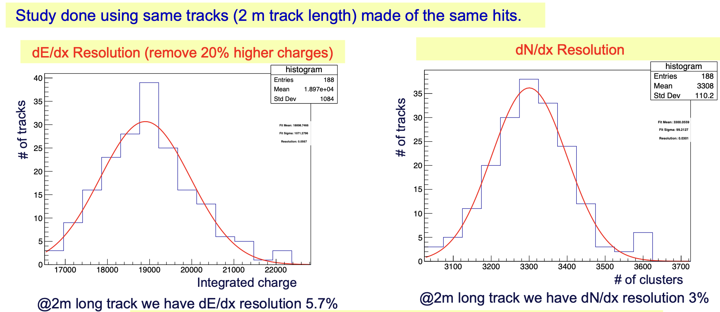
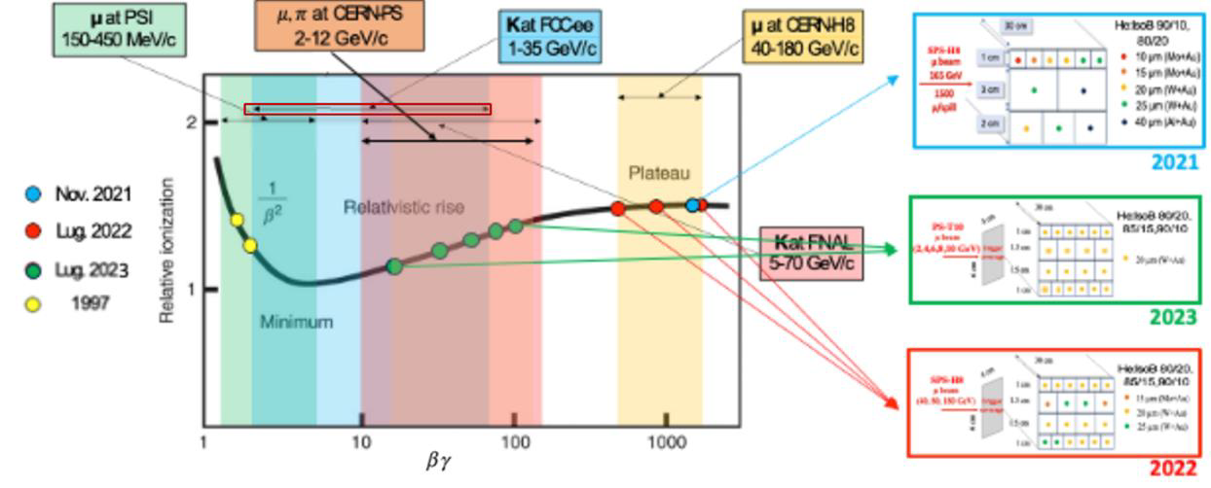
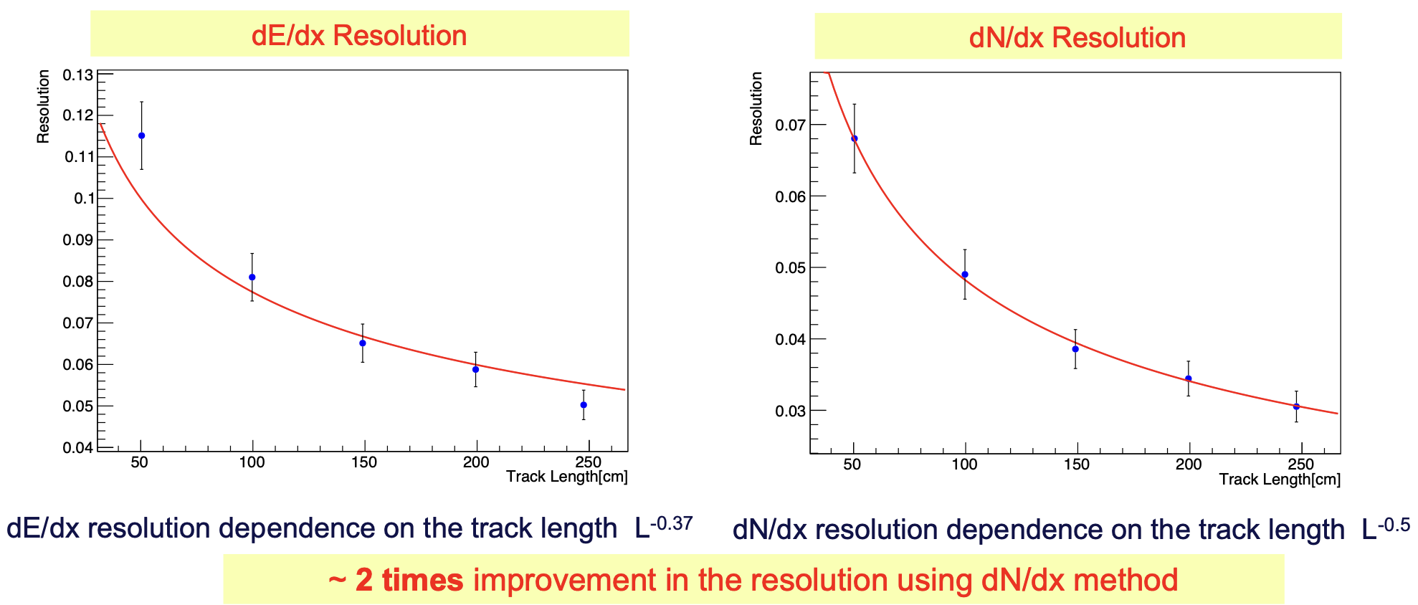
Test beam results

Slide 21
Particle identification
Expect > 3σ K/π separation from cluster counting in Drift Chamber up to ~ 30 GeV
  ToF at 50 – 100 ps resolution covers region ~ 1 GeV
3σ
GeV

Slide 22
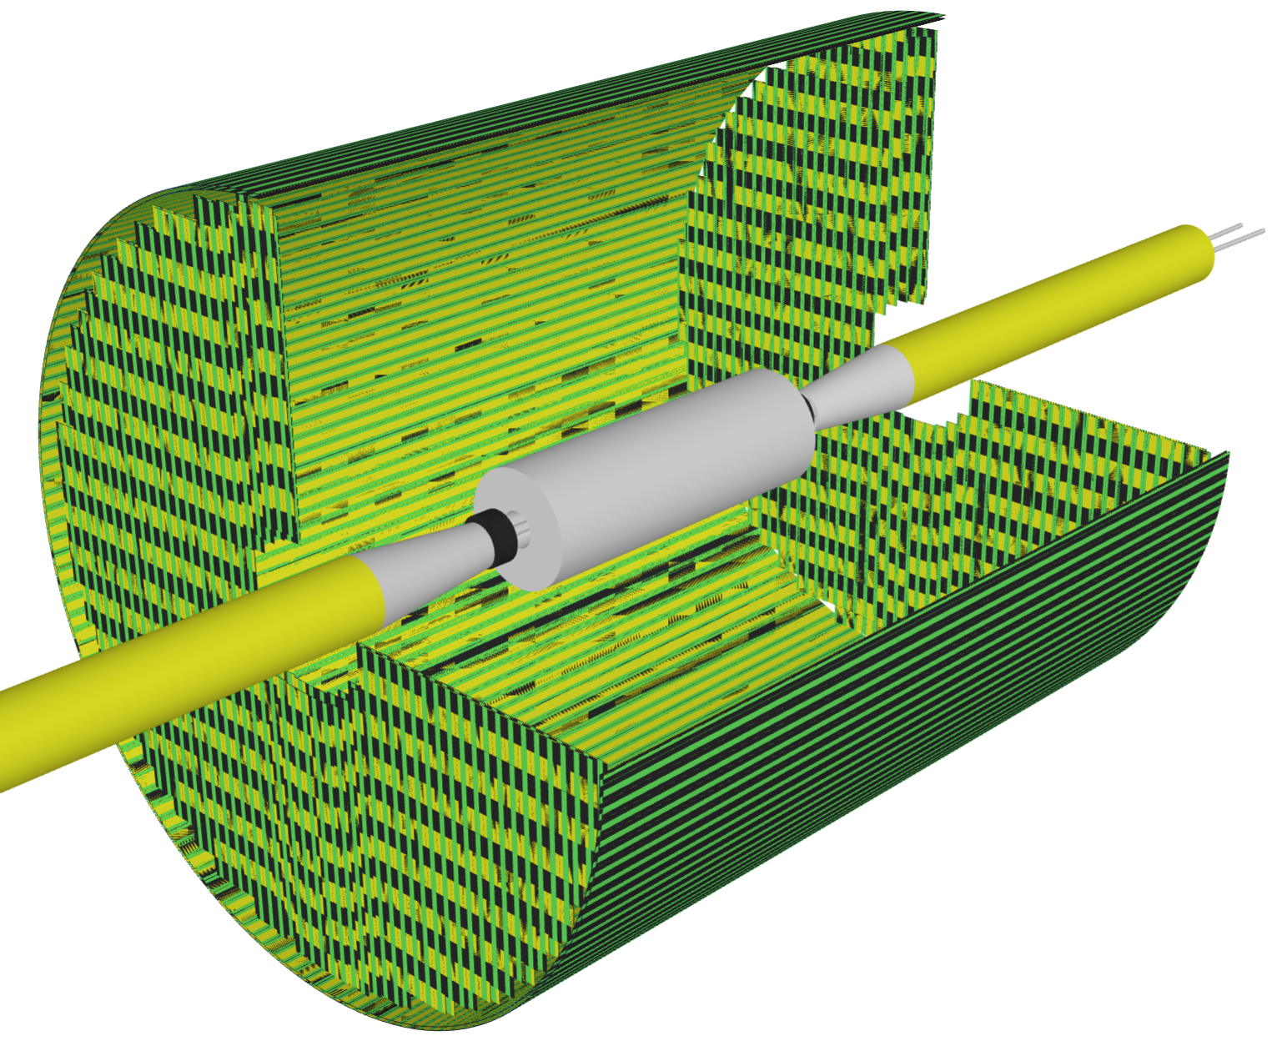
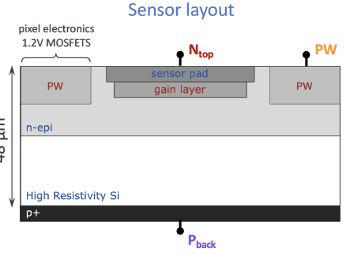
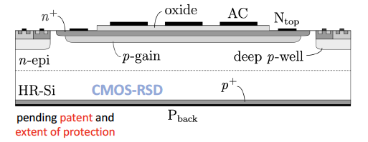
Silicon wrapper
Enhances the momentum resolution and can provide PID in the region of ~1 GeV
  Large area: ~100 m²
  Spatial resolution 10 µm
  Options under study
    MAPS
    Resistive LGAD
Monolithic CMOS AC-LGAD R&D in ARCADIA
Lower number of channels
Spatial resolution: 3% of the pitch
Time resolution ~20 ps
See presentations from M. Mandurrino
ARCADIA MADPIX R&D for ALICE 3
Time resolution ~80 ps

Slide 23
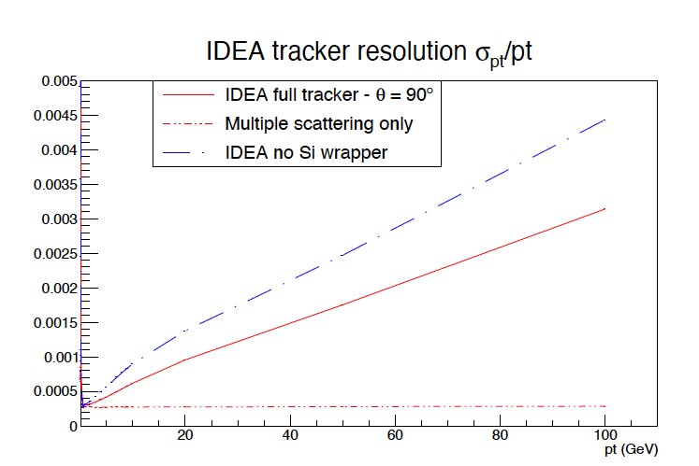
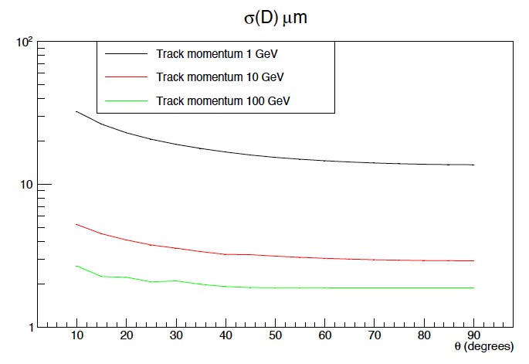
Performances
Impact parameter
Momentum resolution

Slide 24
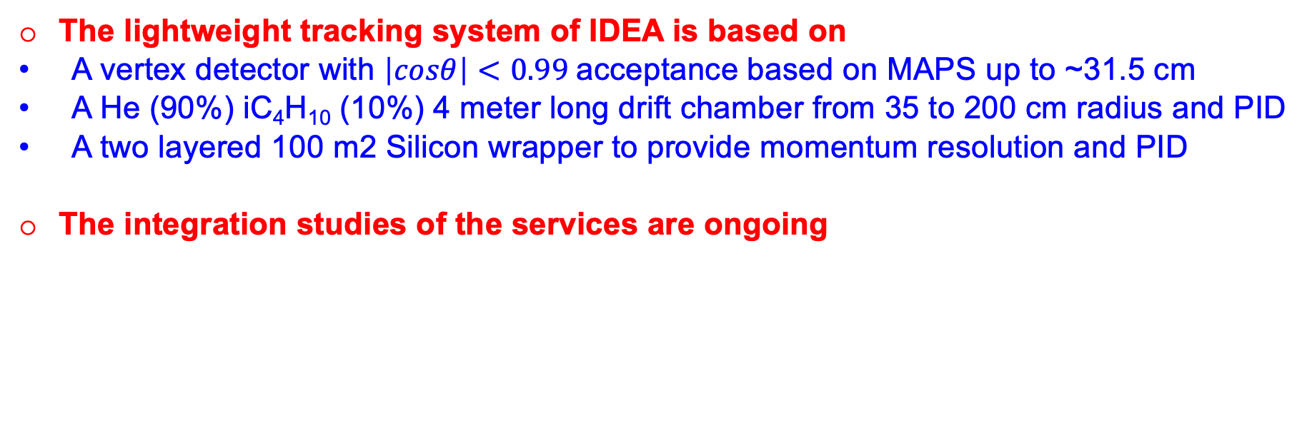
Conclusions
The lightweight tracking system of IDEA is based on
  A vertex detector with $\left|cosθ\right|<0.99$acceptance based on MAPS up to ~31.5 cm
  A He (90%) iC₄H₁₀ (10%) 4 meter long drift chamber from 35 to 200 cm radius and PID
  A two layered 100 m2 Silicon wrapper to provide momentum resolution and PID
The integration studies of the services are ongoing

Slide 25
Backup

Slide 26
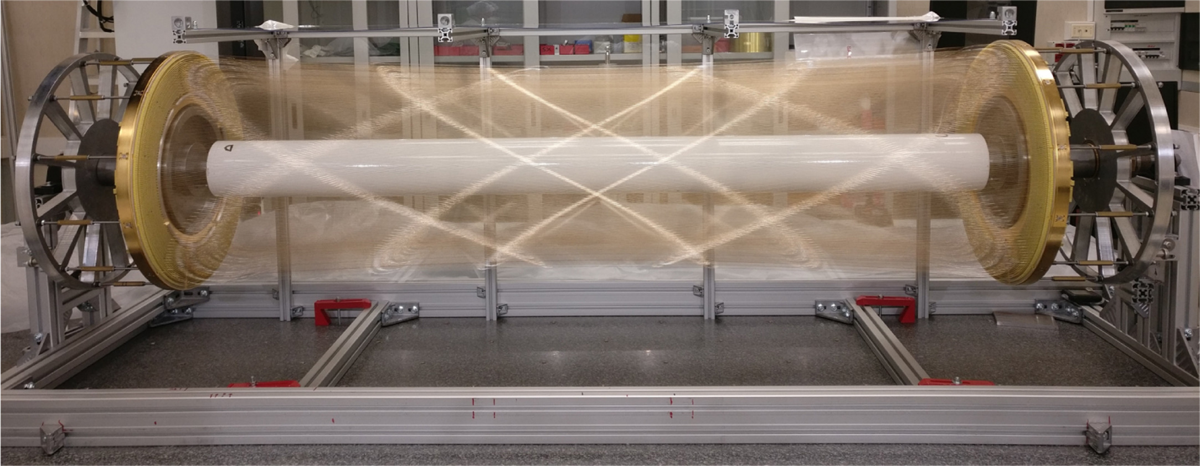
MEG2 drift chamber

