Slide 1
Open issues on MDI

Slide 2
Beam pipe
Cooling
  Is this due only for the Z pole?
  Can we lower the thickness of the cooling layer?
    Now is 1 mm and two 350 µm thin walls
    Studies have been done showing that with 600 µm water is possible, still the same material budget but have smaller radius
  Can we incorporate the cooling of the inner vertex first layer to the one of the beam pipe?
How long the central beam pipe could be ?
  Decrease the interference between pipe cooling manifolds and vertex detector air ducts
  Decreases the length of not cooled beam pipe
  Can we go to ~30 cm? (now is 18 cm)
    This helps not to interefere with the vertex detector acceptance (see next slide from CEPC)

Slide 3
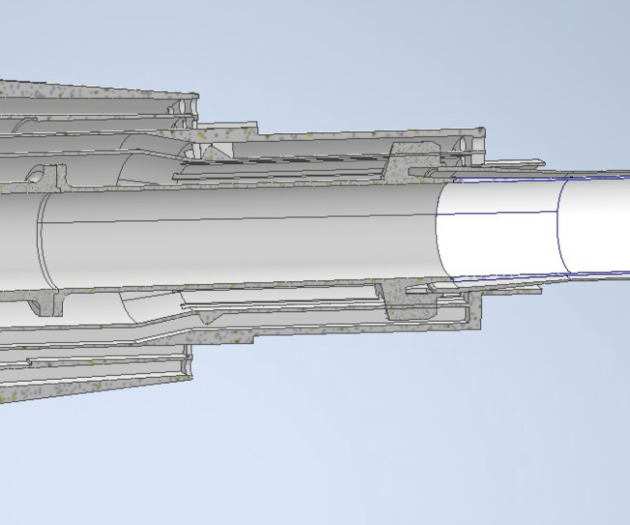
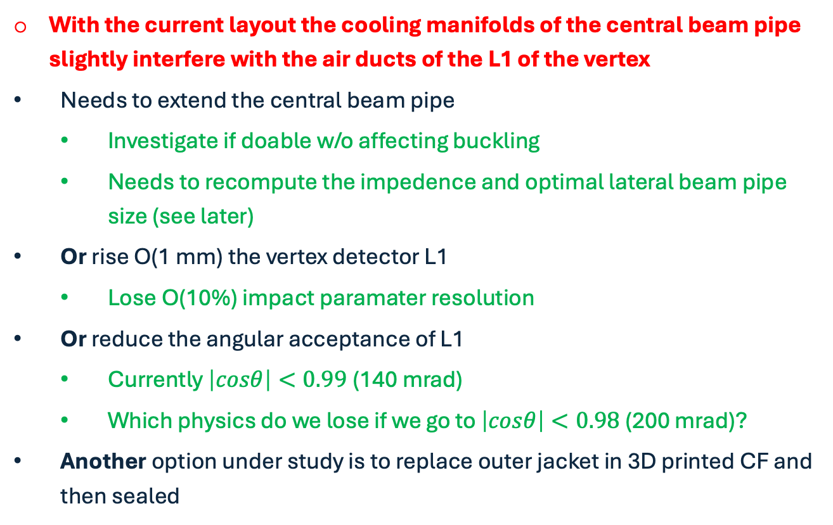
Beam pipe cooling manifold and inner vertex integration issues
With the current layout the cooling manifolds of the central beam pipe slightly interfere with the air ducts of the L1 of the vertex
  Needs to extend the central beam pipe
    Investigate if doable w/o affecting buckling
    Needs to recompute the impedence and optimal lateral beam pipe size (see later)
  Or rise O(1 mm) the vertex detector L1
    Lose O(10%) impact paramater resolution
  Or reduce the angular acceptance of L1
    Currently $\left|cosθ\right|<0.99$(140 mrad)
    Which physics do we lose if we go to $\left|cosθ\right|<0.98$ (200 mrad)?
  Another option under study is to replace outer jacket in 3D printed CF and then sealed
Courtesy of Gherardo Ammirabile

Slide 4
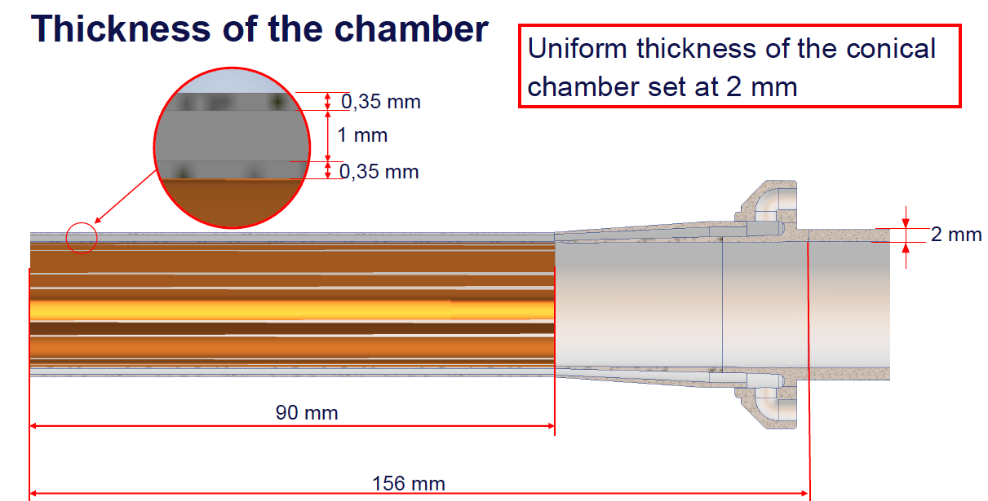

Slide 5
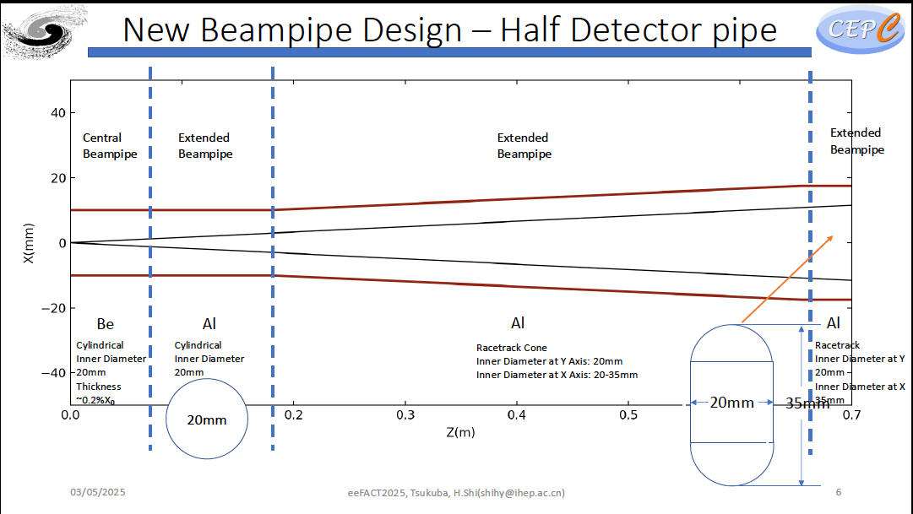

Slide 6
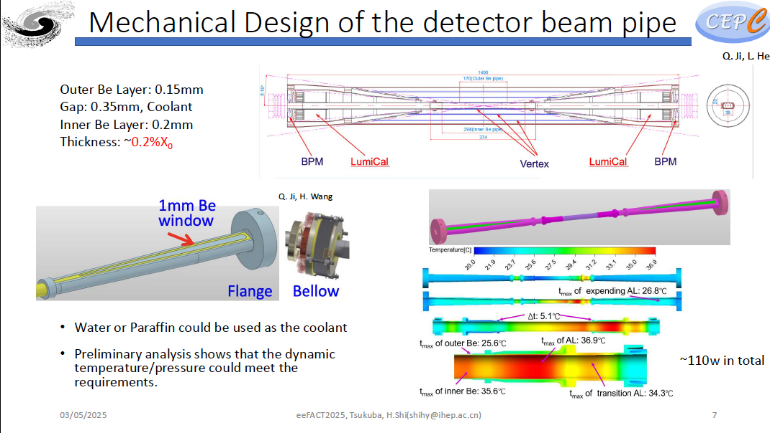

Slide 7
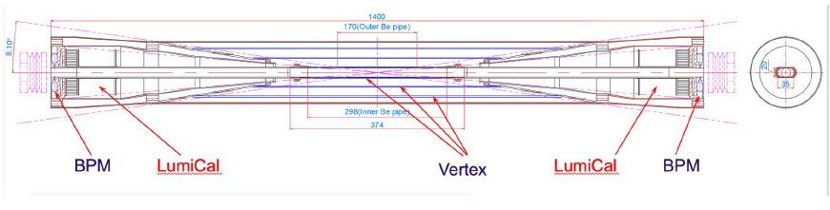

Slide 8
Beam backgrounds
The procedure to “deliver” the backgrounds to the subdetectors is outlined and in work for most
  IPC
  Radiative Bhabha
  Synchrotron Radiation
  Some other backgrounds will follow, especially
    Beam-gas
    Injection backgrounds
Some visible effects in reducing the backgrounds due to Y-beam pipe material change are visible
Need to evaluate the effects in the subdetectors
  Need detector experts to take in charge

Slide 9
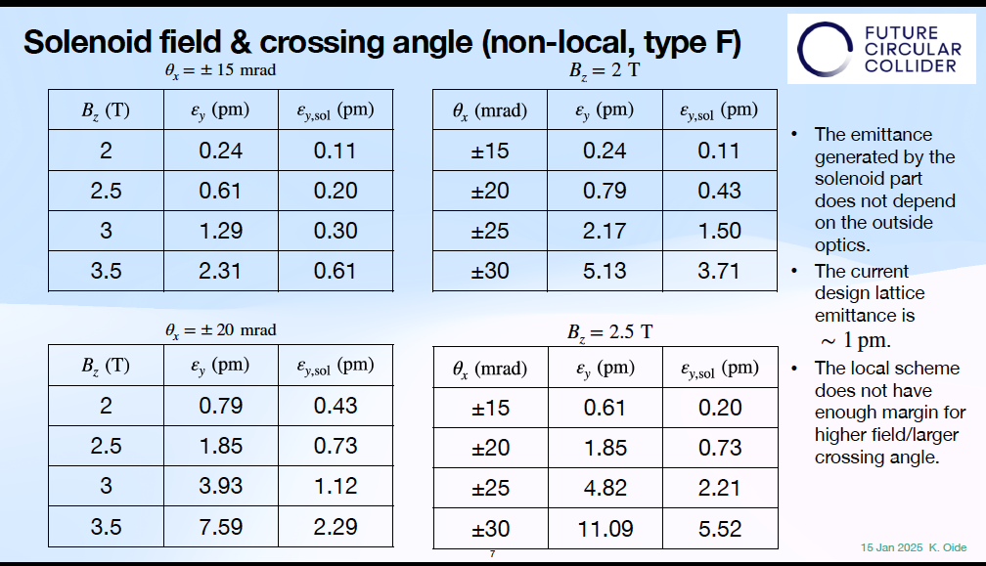
Solenoidal magnetic field

