Slide 1
Detector Development - Challenges
- discussion
Grzegorz W. Deptuch,
FCCee workshop May 7-9, 2025
email: gdeptuch@bnl.gov

Slide 2
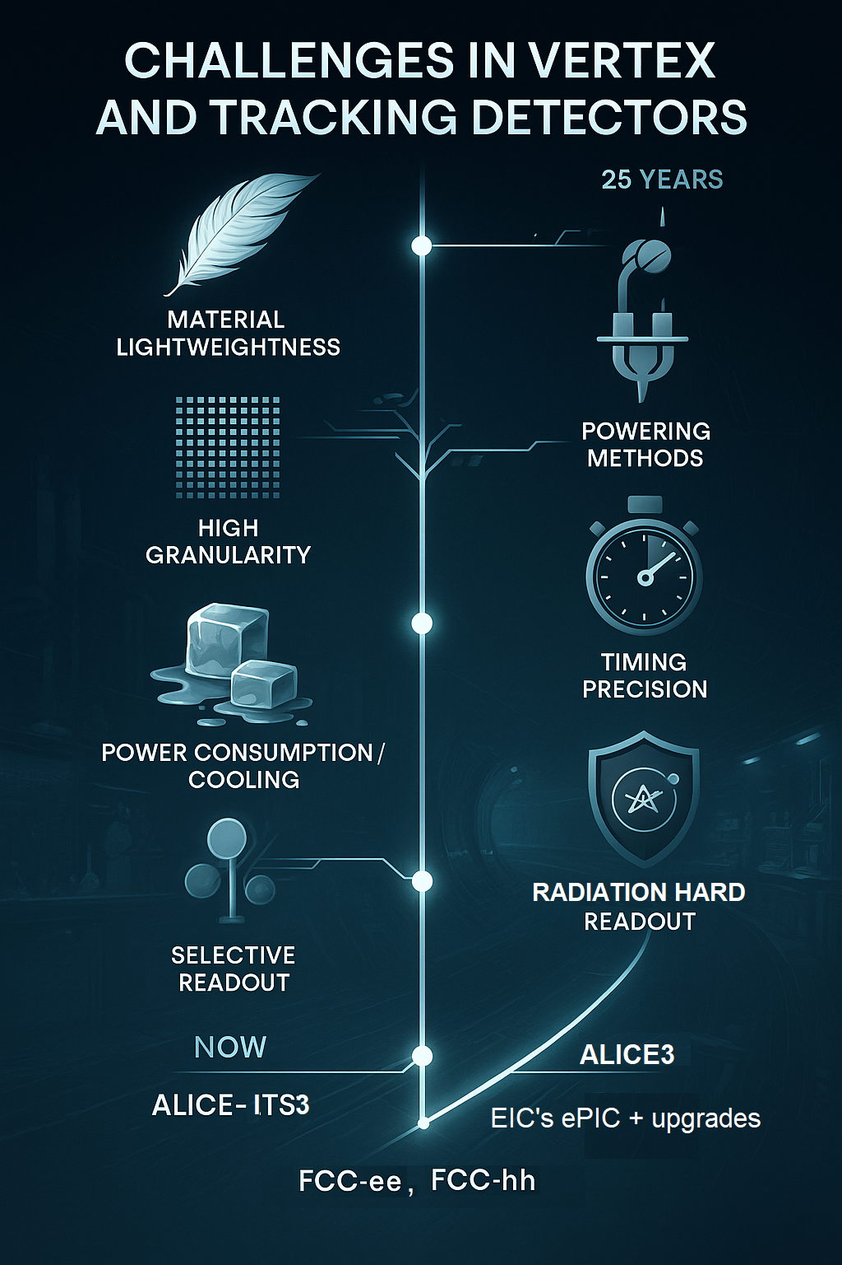
Introduction
Directions for future detectors
Specifications and comparison
Challenges (all interwoven)
Material Lightweightness
High Granularity / Rate
Powering Methods
Power Consumption / Cooling
Timing Precision
Selective Readout
Radiation Hardness
Next-generation experiments in relativistic heavy-ion and particle physics demand trackers that combine high-rate capability, low material budget, spatial precision, and time stamping.

Slide 3
Outline
Requirements
Front-End
Back-End
Readout
Powering
Power Distribution
require a two-order-of-magnitude enhancement in time stamping while preserving their light material budget (~50 μm thickness) and low power consumption (~50 mW/cm²).

Slide 4
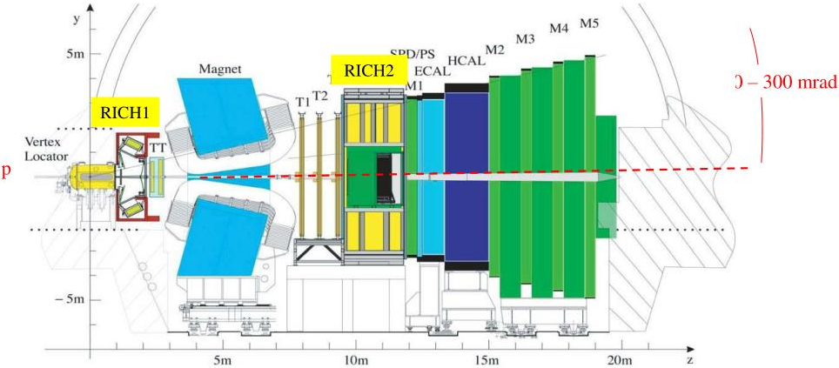
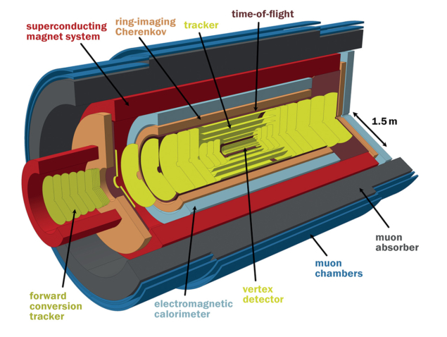
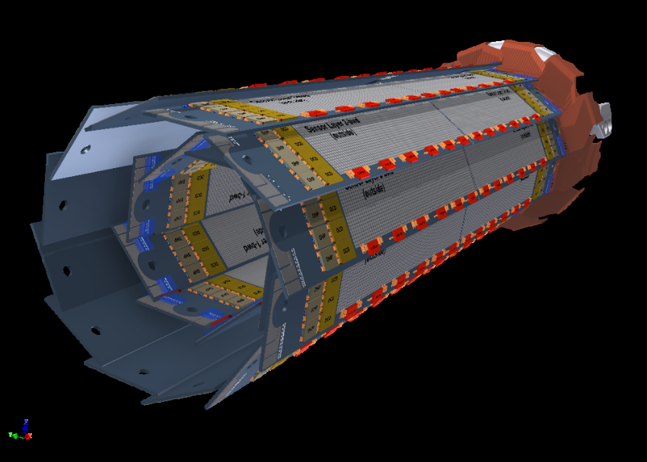
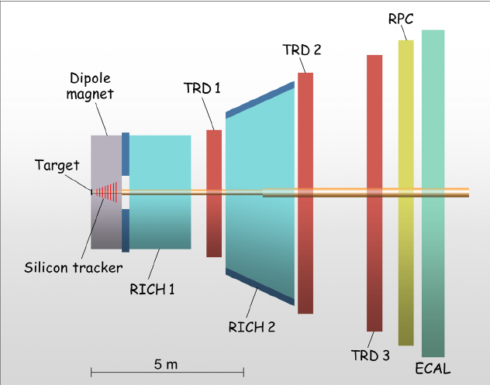
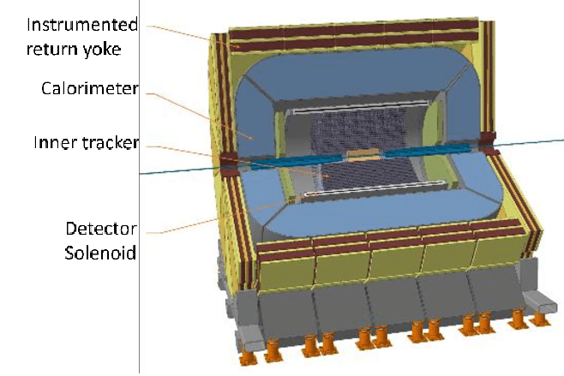
Requirements - 1
 | ALICE3 OT | Belle II trk | CBM trk | LHCb UT | FCCee trk
Position resolution | ~10 µm | <15 µm | ~10 µm | <10 µm | <10 µm
Pixel pitch (µm) | 50 | 50 | ~30 | 50 | 50
Hit rate (MHz/cm²) | 0.05 to 2 | <1 | 60/180 | 160 | <10
Data rate (Gb/s) |  |  | 8 | 20
Time figure (ns) | 100 | ~1 | 25 | ~1 (<25) | 20 to 1000
Triggering | No | yes | no | no | ?
Power (mW/cm²) | ~20 | <50 | ~50 | <100 | ~20?
TID (kGy) | 50 | 10? | ~10 | 2400 | 10?
NIEL | 10¹⁴ | 10¹¹? | few 10¹⁴ | 3x10¹⁵ | 10¹¹?
ALICE3 [1], BelleII [2], CBM [3], EIC [4], FCCee [5], LHCb [6].
Geometry of the LHCb experiment
Belle II Pixel Vertex Detector (PXD)
ALICE 3: a heavy-ion detector for the 2030s
Geometry of the CBM experiment
The FCC-ee + IDEA detector with an ultra-thin solenoid inside the calorimeter

Slide 5
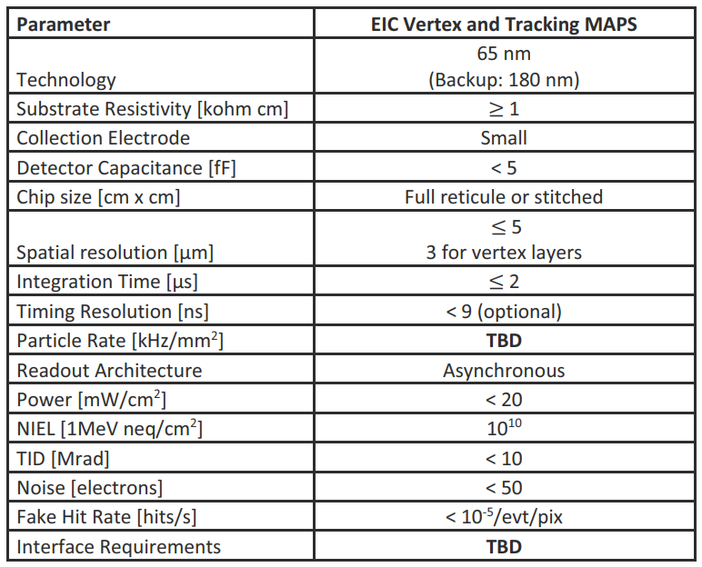
Requirements - 2
References (examples)ALICE-3 [1], Belle-II [2], CBM [3], EIC [4], FCCee [5], LHCb [6]:
[1] R. Vertesi (ALICE Collaboration), “The ALICE 3 detector concept for LHC Runs 5 and 6 and its physics performance”, (2024), https://arxiv.org/abs/2409.12148, DOI:
https://doi.org/10.48550/arXiv.2409.12148 (ALICE3)
[2] H. Ye, F. Abudinen, K. Ackermann, P. Ahlburg, M. Albalawi, O. Alonso, et al., “Commissioning and performance of the Belle II pixel detector”, Nuclear Instruments and Methods in Physics Research Section A: Accelerators, Spectrometers, Detectors and Associated Equipment, Vol. 987, (2021), DOI: https://doi.org/10.1016/j.nima.2020.164875 (Belle2)
[3] F. Matejcek, A.-M. Altingun, J. Andary, B. Arnoldi-Meadows, J. Baudot, G. Bertolone et al.,” Integration Concept of the CBM Micro Vertex Detector”, (2025), https://arxiv.org/abs/2502.04858, DOI: https://doi.org/10.48550/arXiv.2502.04858 (CBM)
[4] R. Abdul Khalek, A. Accardi, J. Adam, D. Adamiak, W. Akers, M. Albaladejo, et al., “Science Requirements and Detector Concepts for the Electron-Ion Collider “, Nuclear Physics A Volume 1026, October (2022), DOI: http://dx.doi.org/10.1016/j.nuclphysa.2022.122447 (EIC)
[5] A. Abada, M. Abbrescia, S.S. AbdusSalam, et al. “FCC-ee: The Lepton Collider”, Eur. Phys. J. Spec. Top. 228, 261–623 (2019) DOI: https://doi.org/10.1140/epjst/e2019-900045-4 (FCC)
[6] A.F. Prieto, P.V. Regueiro, K. Hennessy, J. Buytaert, M. van Beuzekom, et al., “Phase I Upgrade of the Readout System of the Vertex Detector at the LHCb Experiment”, IEEE Trans. Nucl. Sci. 67 (2020) 4, 732-739, DOI: 10.1109/TNS.2020.2970534 (LHCb)
The growing size and complexity of detectors introduce new challenges.

Slide 6
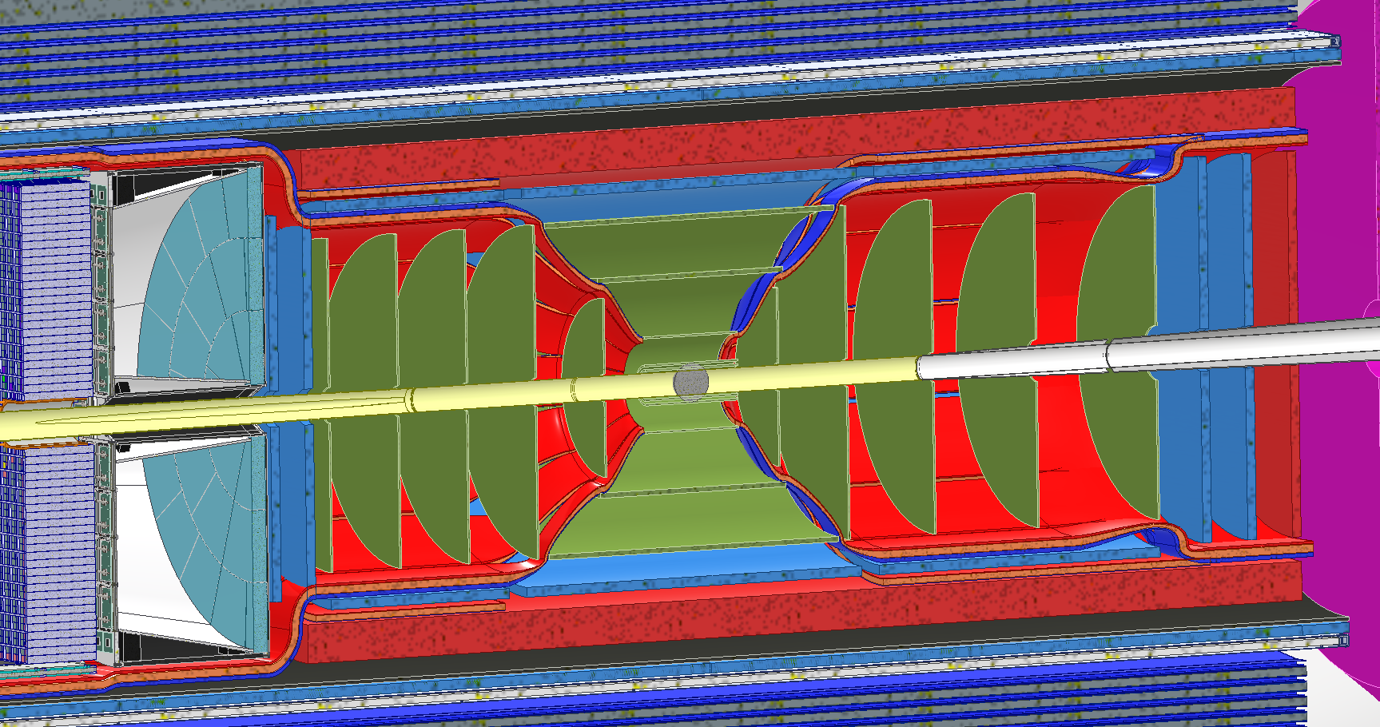
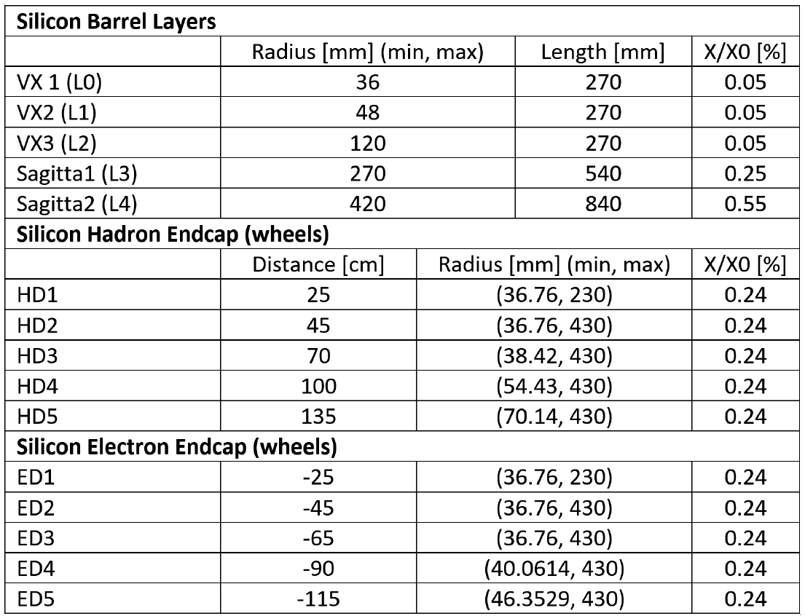
MAPS ePIC SVT - Illustration
ePIC SVT detector layout configuration
(in total sub 100B pixels, on ∼ 10 m² of Si)
Optimized layout
IB
OB
EE
IB
HE
OB
H-End Cap Disks
cables & services for μvertex & OuterBarrel layers
+ first 2 disks exit on a cone along 45º line and
cables run in-front of MM
3 equal sized MM modules
MM cables can run on
front or back face of MM
fewer sharp bends
E-End Cap Disks
MAPS Barrel + Disks
MPGD Barrels + Disks
AC-LGAD based ToF
Baseline technology of choice: MAPS in TPSCo 65 nm process, following CERN’s ALICE ITS3 upgrade development of bent silicon
some numbers, mainly X/X0, are evolving due to stave approach and cooling.
Upgrades of ePIC with needed improvements:
require an order-of-magnitude enhancement in time stamping, while preserving light material budget (~50 μm thickness) and low power consumption (~50 mW/cm²) 2-5 μs σt Æ 100 ns)
G. Feofilov et al.,
ITS3 WP4 10 October 2023.

Slide 7
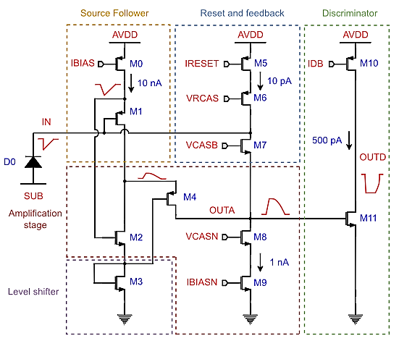
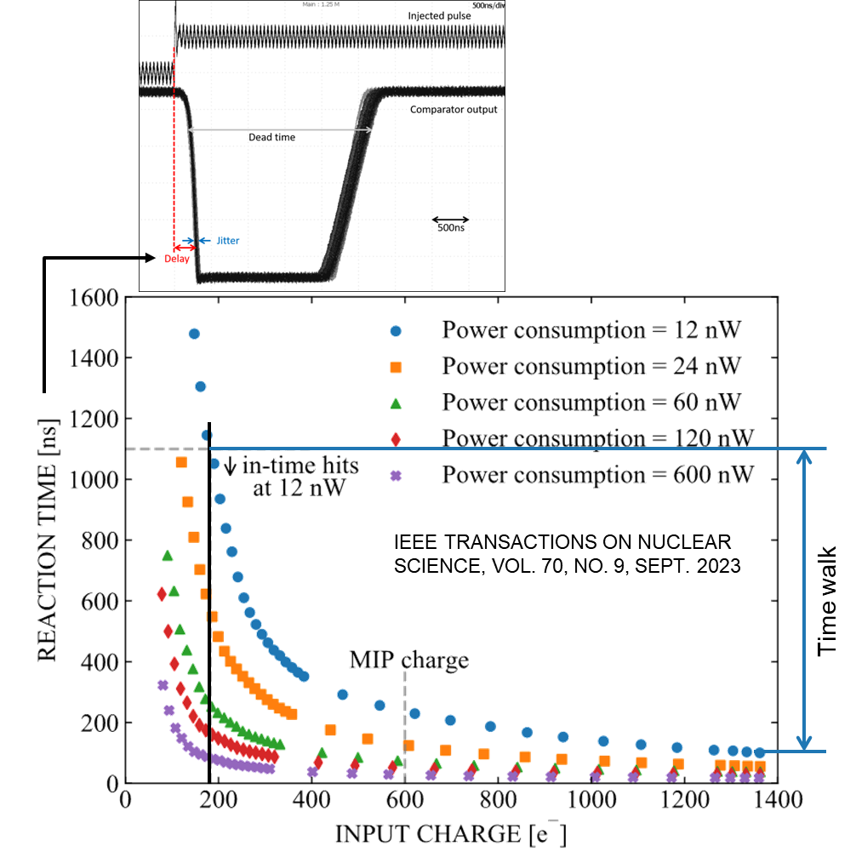
Front-End / Readout - 1
small size <20 μm pixel’s pitch
low power ~50 nW/pixel Æ <50 mW/cm²
But
SLOW
Low Power Front-End:
Technology: 65 nm CMOS (TPSco)
One of several versions of FE for ALICE-ITS3 F. Piro et al., IEEE TNS, VOL. 70, NO. 9, SEPT 2023)

Slide 8
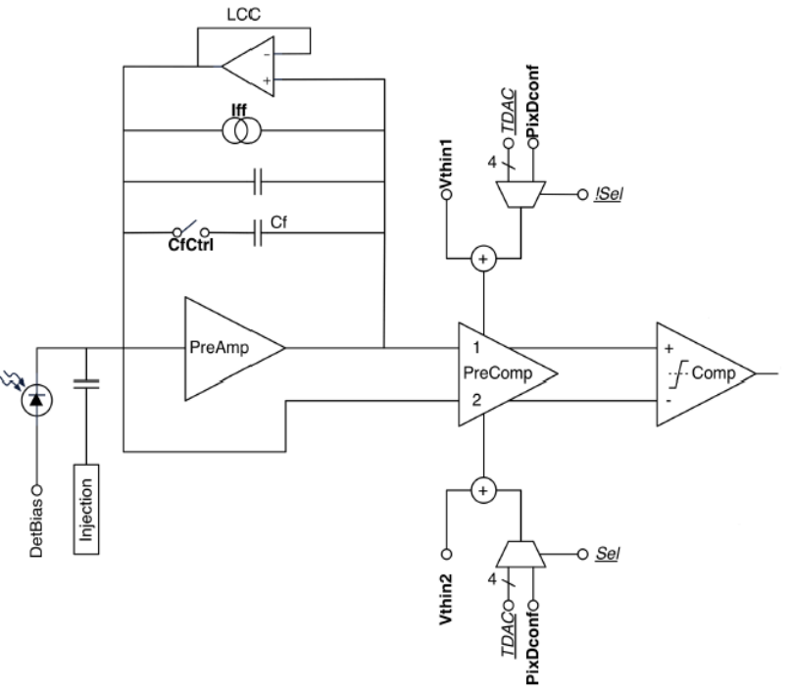
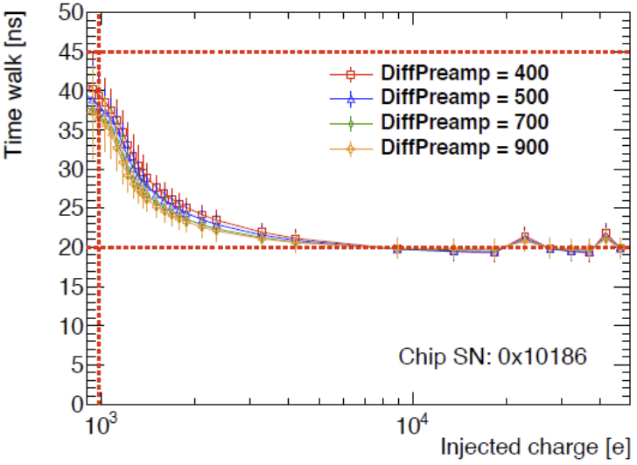
Front-End / Readout - 2
Comparison with RD53 A/B (fast 25ns resolution)
Technology: 65 nm CMOS (TSMC)
Pixel Size: 50 μm × 50 μm
Power Consumption: aiming at less than 1 W/cm², including losses from on-chip voltage regulators (Shunt-LDOs) and per-pixel analog and digital current consumption is approximately 4 μA each with Front-End Variants:
    Synchronous Front-End: total current, including latch, is close to 5.5 μA per pixel
    Linear Front-End: approximately 4 μA per pixel
    Differential Front-End: around 4 μA per pixel
Design Considerations: RD53 chips are to handle rates up to 3 GHz/cm² and radiation up to 500 Mrad. ​

Slide 9

Front-End / Readout - 3
Precise timing needs two: sensor and front-end electronics —
— Elephant in the room: primary optimization factor for practical 4D tracking system (millions of readout channels) is power consumption (scales with # of channels not with detector area)
Main challenge for future 4D trackers remains front-end power consumption.
Vertex 2023, Sestri Levante, 2023

Slide 10
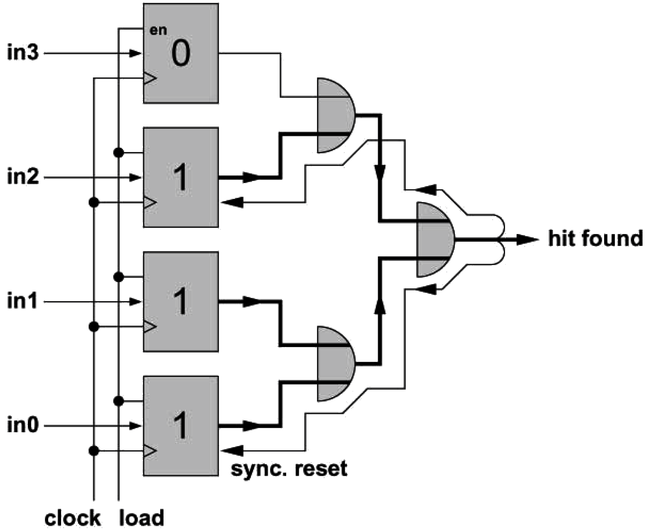
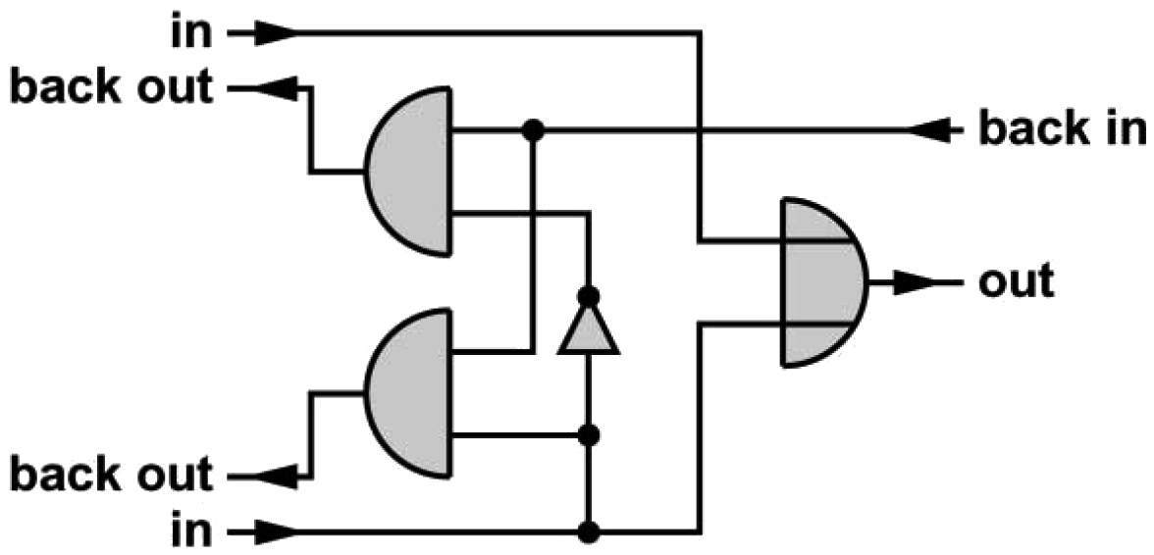
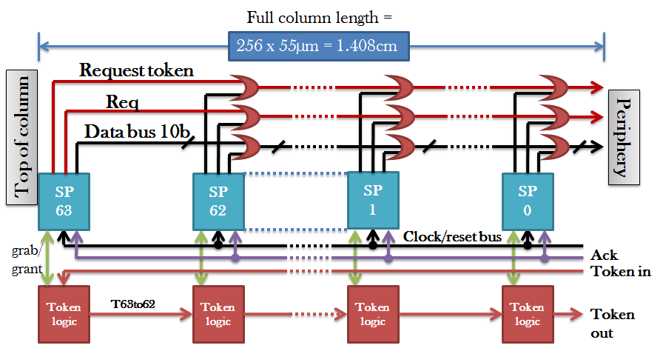
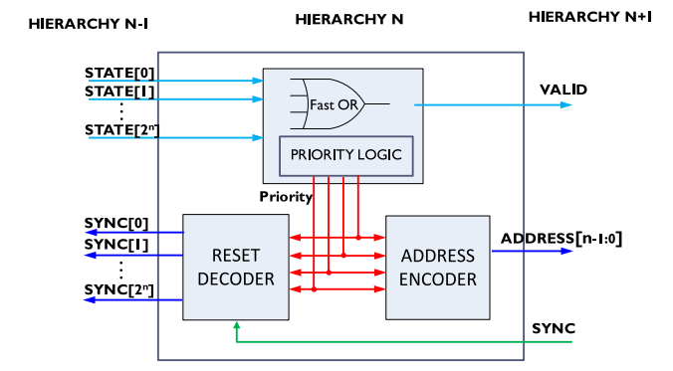
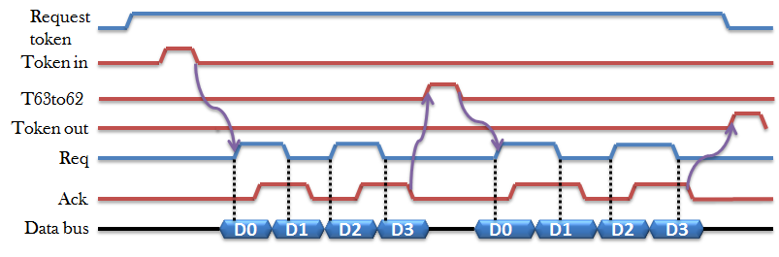
Back-End /Readout - 1
Mephisto
Token Passing - Timepix
ALICE
ITS
FRAME-BASED no intrinsic timing
T Poikela et al 2014 JINST 9 C01007
P. Fischer, Nuclear Instruments and Methods in Physics Research A 461 (2001) 499–504
P. Yang et al., Nuclear Instruments and Methods in Physics Research A 785, pp. 61–69, 2015
G.W.Deptuch, https://lss.fnal.gov/archive/test-tm/2000/fermilab-tm-2709-ppd.pdf
POLLING intrinsic timing affected by varied latency

Slide 11
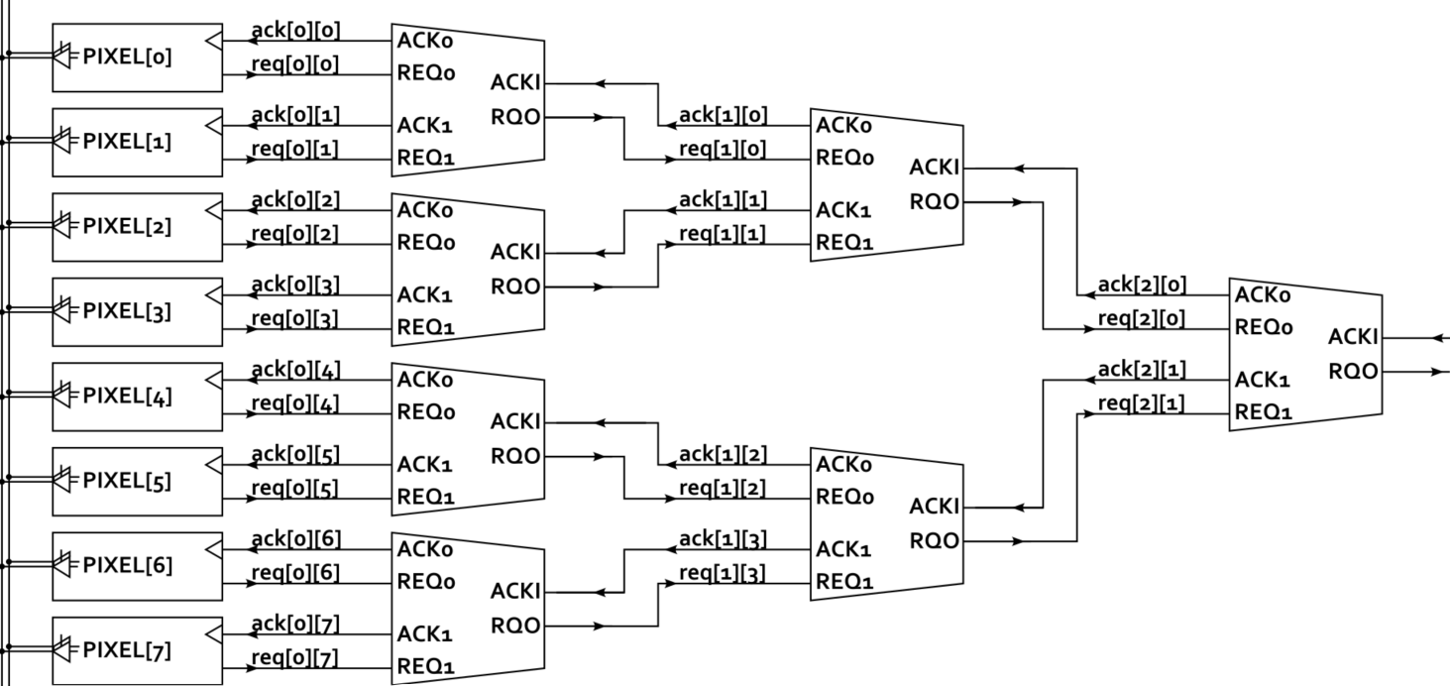
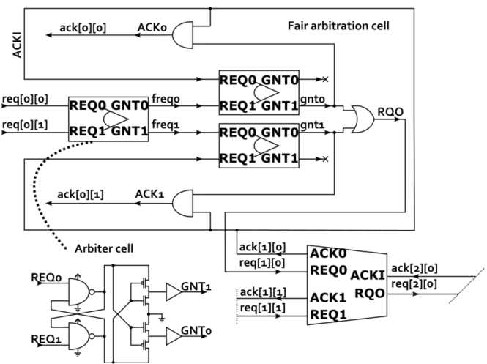
Back-End / Readout - 2
Lot of attention given to event-driven readout
EDWARD – Event-Driven With Access and Reset Decoder – developed at BNL (no priority – dynamic Priority Arbitration)
SPARC – use of Fixed Priority Arbitration
D. Gorni et al., “Event driven readout architecture with non-priority arbitration for radiation detectors,” Journal of Instrumentation, vol. 17,no. 04, p. C04027, 2022
D. S. Gorni et al., “Integration of EDWARD readout architecture in full-field fluorescence imaging detector,” Journal of Instrumentation, vol. 19,no. 04, p. C04035, 2024.
E. Aguénounon, et al., “Design and Characterization of an Asynchronous Fixed Priority Tree Arbiter for SPAD Array Readout”, Sensors 2021, 21, 3949
FRAME-LESS preserving intrinsic latency
Event-driven readout can lower power and dead-time in radiation imagers, yet only if arbitration remains fast, fair, and clock-free.

Slide 12
Powering - 1
Options:
Low-Voltage Parallel Powering
  Simple but faces high losses in resistive trace Æ need of accounting for sagging of power supply in providing operational voltage
  Material budget increase for providing satisfactory cross-section
DC-DC Power Converters (charge pumps or inductive converters)
  Increased complexity, but reduction of losses in resistive traces
  Concerns about electromagnetic interferences
  Large (coreless if operated in B-field) inductances and capacitors needed for high currents
Serial Powering
  Simple (when operating) conceptually with reduced losses in resistive traces as one trace instead of multiple allows providing larger cross-section
  Accumulated concerns:
    Risky startup:
      shunt regulator needs to be powered before switching main power (how to do it?);
      optimal ramping of current to avoid instabilities
    Need of multiple protection modes Å by-pass mode, overcurrent, overvoltage
    Low and nominal load operation mode needed
    Difficult indirect monitoring Å regulator need to be equipped with measurement features
  Complications Å NO common ground complicates:
    biasing sensors with High Voltage - especially difficult if precisely defined reverse bias is need – local bias generators are needed (negative voltage in ePIC) or accept multiple HV lines or differences in HV bias (ATLAS ITk) if delivered all from outside
    AC-coupling for slow control and data – restarting transmission requires synchronization (power off?)
DC-DC Power Converter Æ many power traces and small currents v.s. Serial Powering Æ one power trace and large current

Slide 13
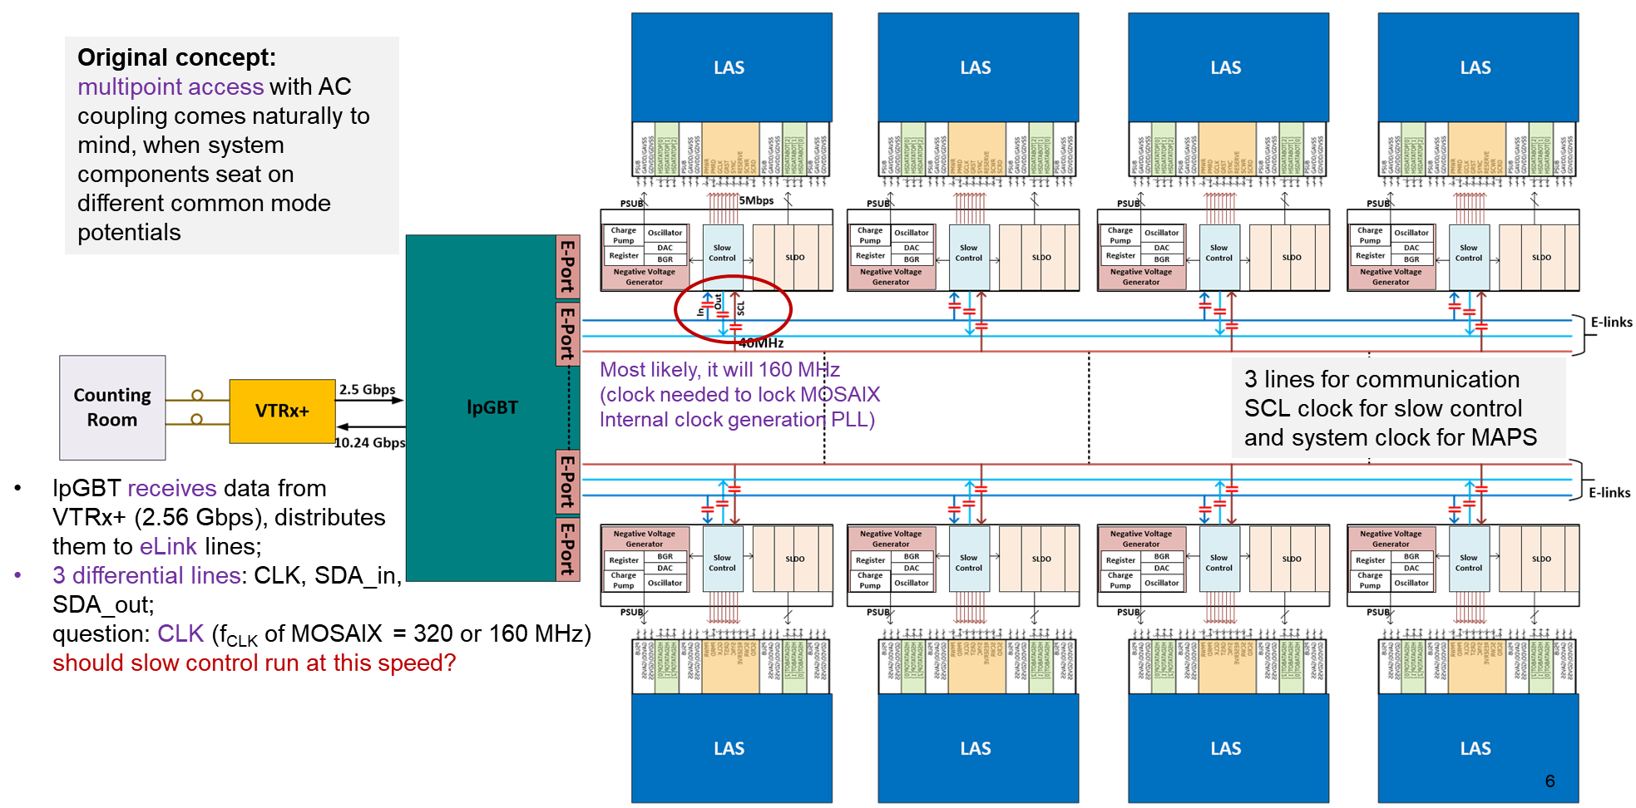
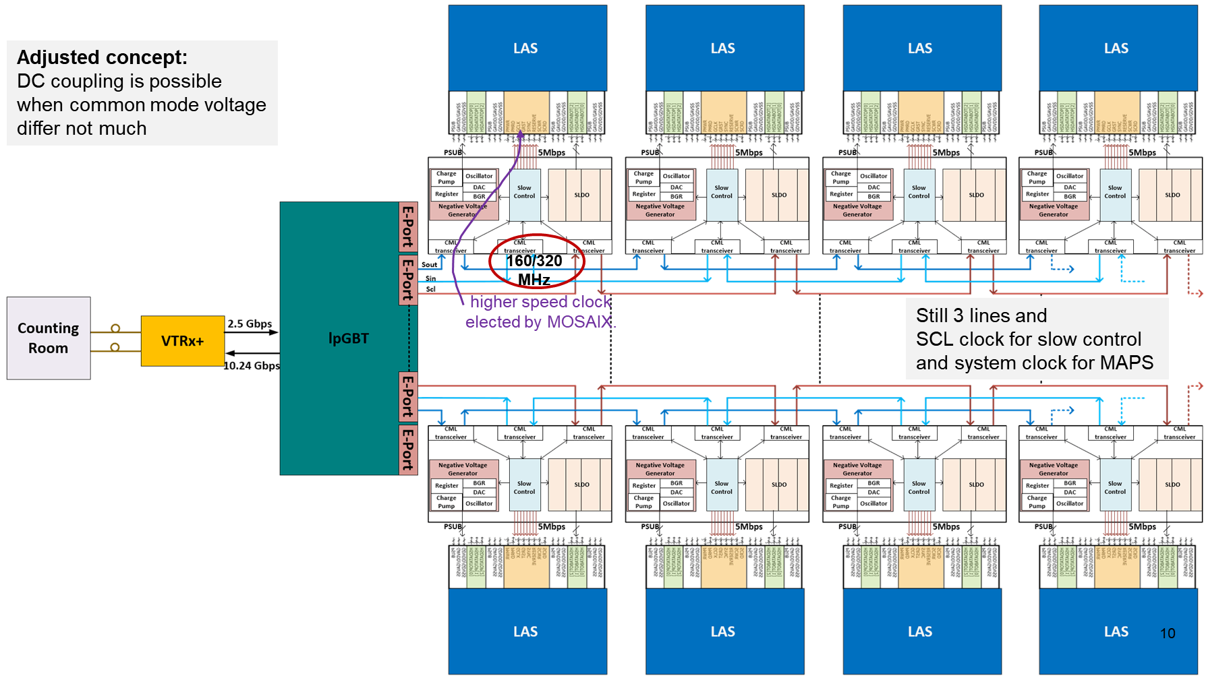
Powering - 2
Power supply sagging
in large area sensors/modules:
Significant supply and ground drops Å large sizes of devices:
  nonuniform distribution of biases
  spread of performances
Serial powering
and DC-coupling (ePIC SVT):
Default AC-coupled
Opt. DC-coupled
Key: use PD-SOI process with ability to isolate each transistor in Deep Trench Isolation à la DMILL ☺

Slide 14
Power Disribution
Key Challenges in Power Distribution for High-Precision Timing ASICs:
Voltage Drops and IR Drop Effects:
as ASICs scale up, maintaining uniform power distribution becomes challenging due to voltage drops across the power grid, leading to timing skews and degraded performance
High Instantaneous Current Demands:
achieving picosecond timing resolution requires fast signal processing, which demands rapid current transients. Supplying these currents without inducing voltage fluctuations necessitates careful power network design
Thermal Management:
increased power consumption leads to heat generation, affecting the performance and reliability of both the ASIC and the sensor. Effective thermal management strategies are essential to dissipate heat efficiently​
Radiation-Induced Effects:
operating in radiation-rich environments introduces challenges like total ionizing dose effects and single-event upsets, impacting the power distribution network's reliability and necessitating radiation-hardened design techniques

Slide 15
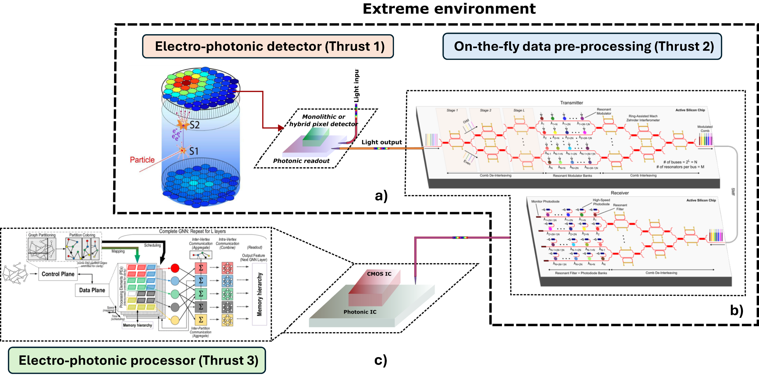
Readout - option
Data Reduction -
- Energy Efficiency
Sensing with electro-photonic signal conversion a) processing data on the fly b) and the end of the data route with electro-photonic computing c).

