Slide 1
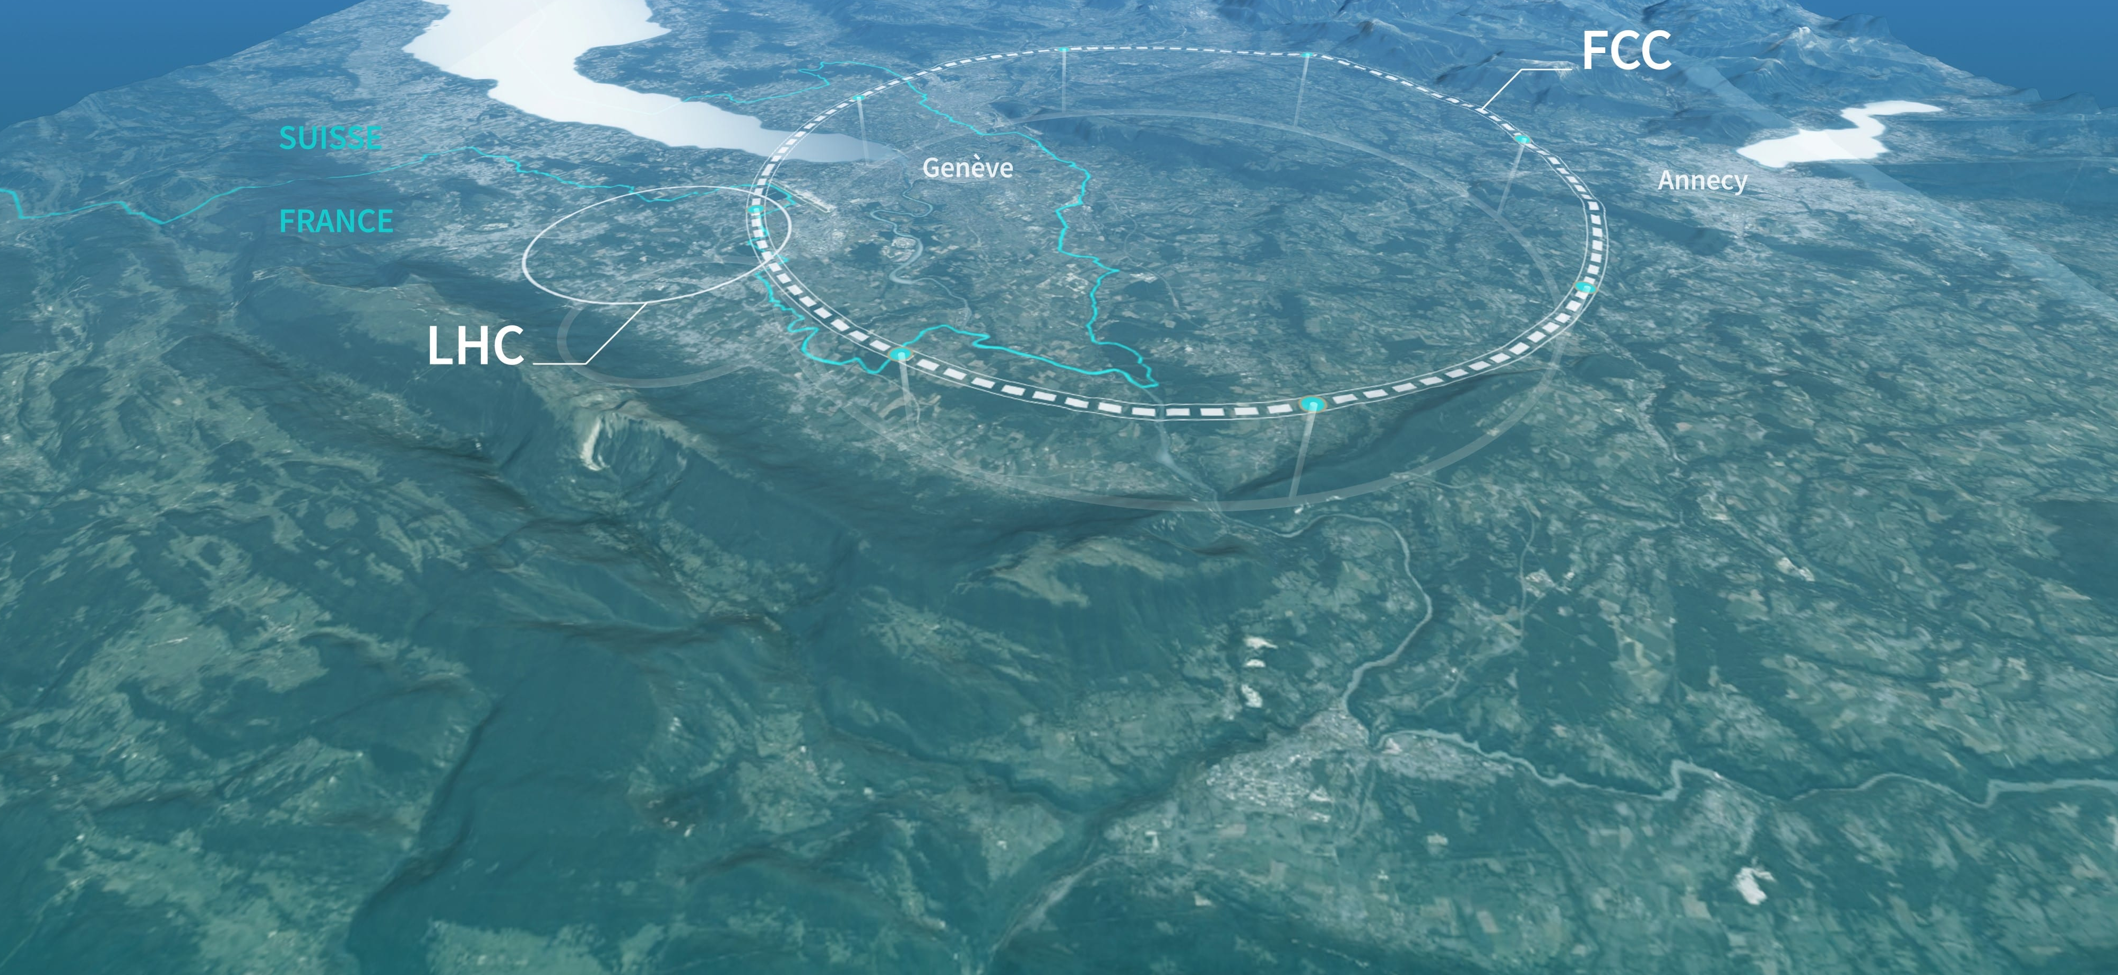
A drift chamber for FCC-ee
F. Bedeschi,
FCC tracking workshop
BNL, May 2025
Outline
IDEA DCH recap
The CDF COT
  Features/Performance
Similarities/differences

Slide 2
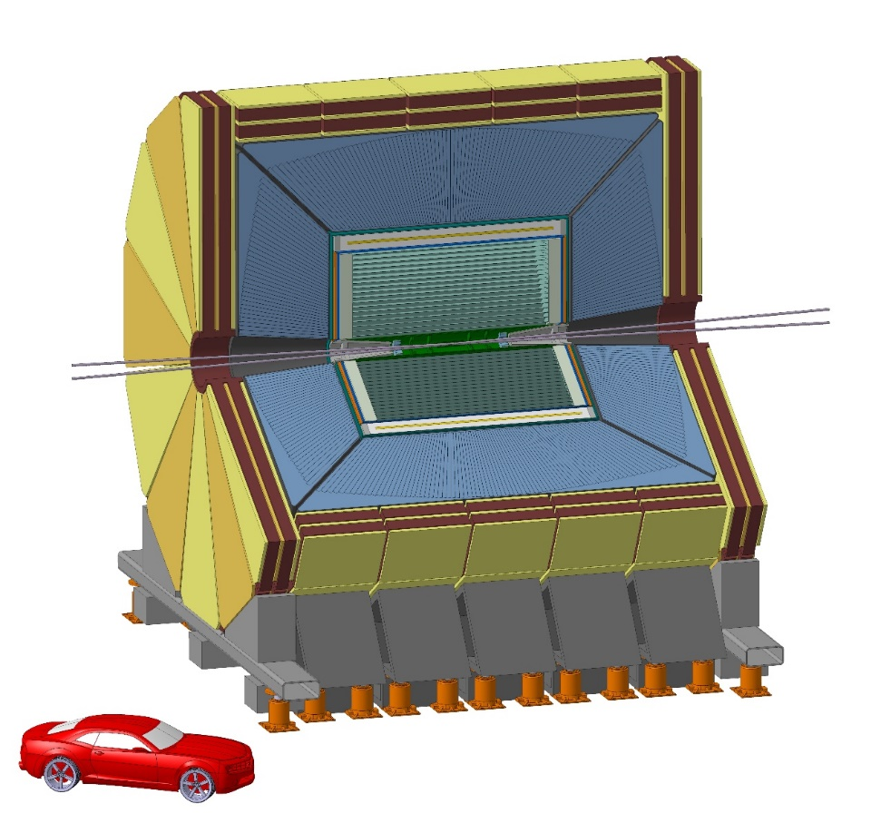
DCH
IDEA concept
Innovative Detector for e+e- Accelerator

Slide 3
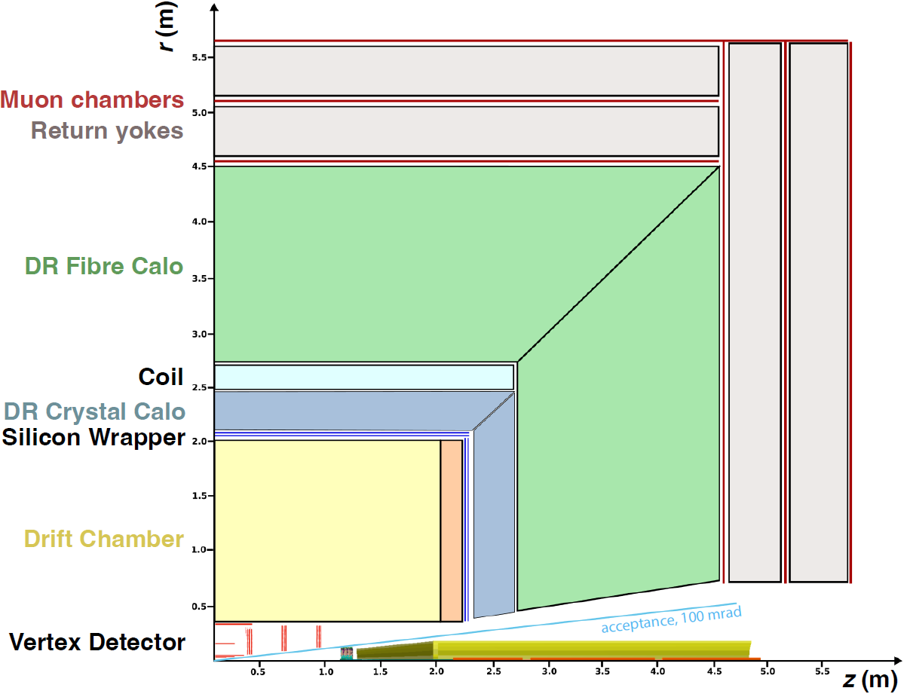
IDEA DCH details
DCH dimensions (active):
  Rin = 36 cm, Rout = 200 cm
  Length = 400 cm
56,448 Cells:
  Size: 1.2 -> 1.45 cm
  Max drift time < 400 ns
  in 90% He – 10% Isobuthane
Full stereo (±15◦ endplate rot.):
  Stereo angle 50 to 250 mrad
Total material 1.6% X₀ :
  Inner can 0.1% X₀
  Outer can 1.2% X₀
  Gas volume 0.3% X₀
B = 2 → 3 T
DCH

Slide 4
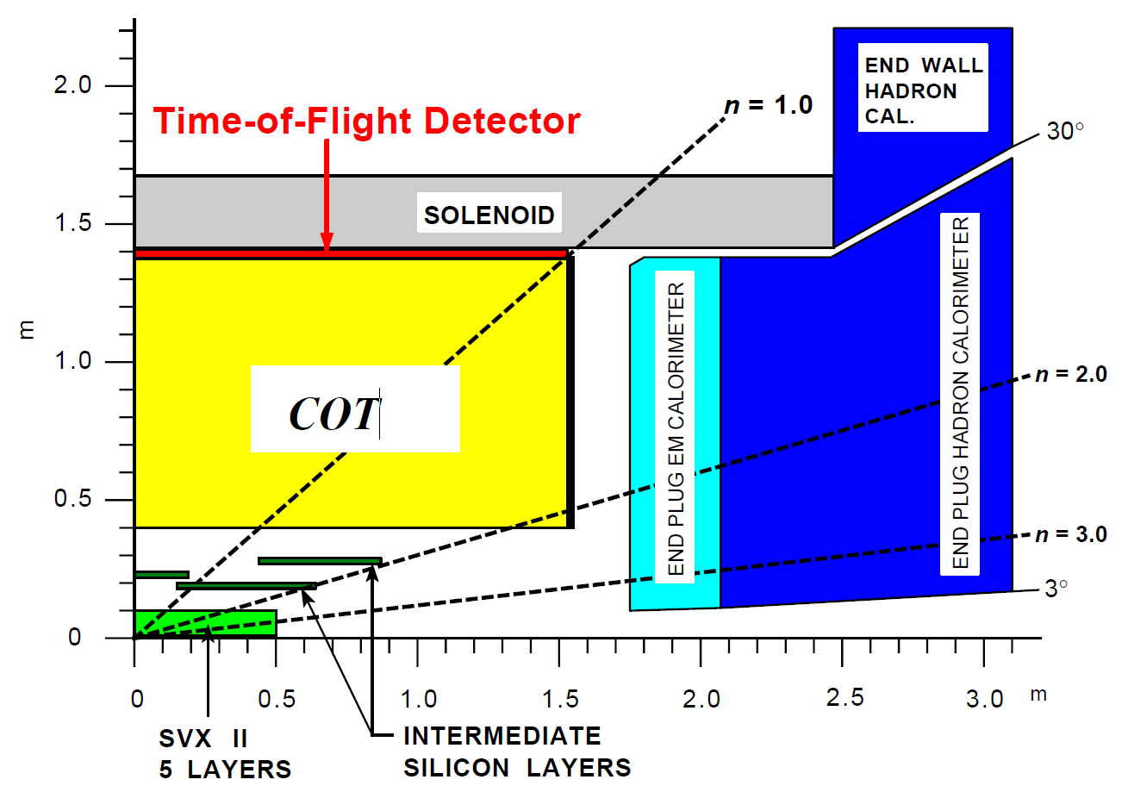
The CDF COT
B = 1.41 T
Length = 310 cm
R_{min} = 40.6 cm (43.4 active)
R_{max} = 138 cm (132 active)
#sense wires = 30,240
50% axial
50% stereo (2◦ const.)

Slide 5
Assemblying the COT
Nuclear Instruments and Methods in Physics Research A 526 (2004) 249–299
Stringing
Align endplates

Slide 6
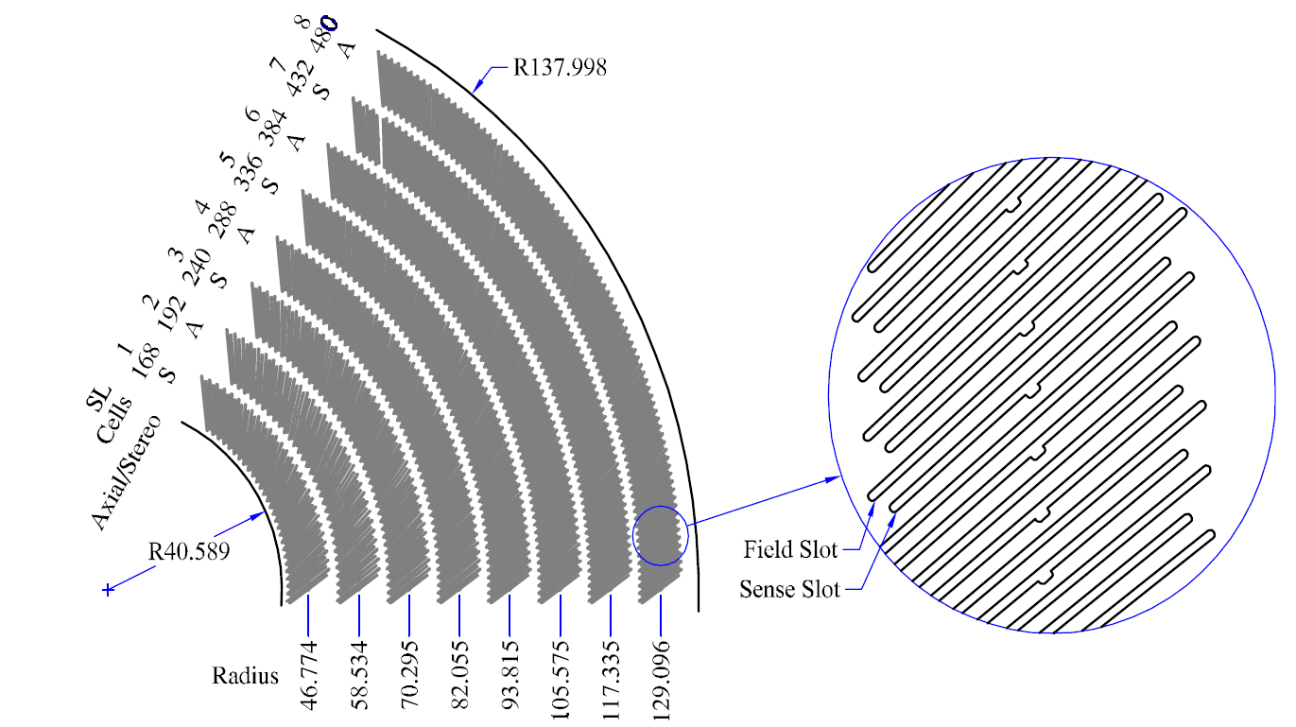
Layer structure
96 layers
8 super layers
4 Axial
4 stereo

Slide 7
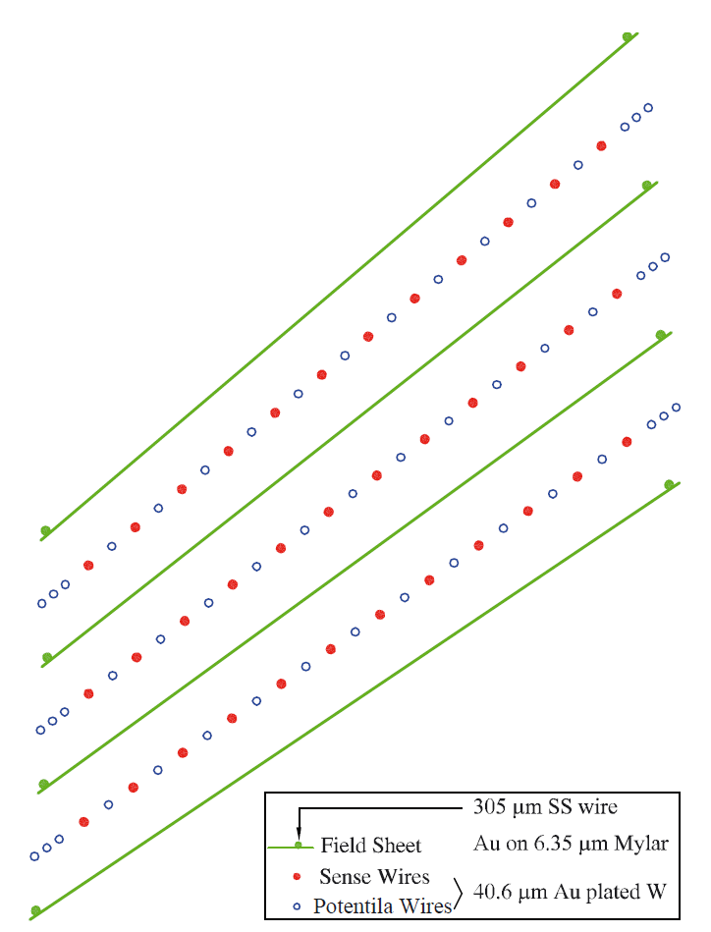
Cell structure
Sense plane: 12 sense wires
17 potential wires
Field Sheet: Au on 6.5 μm mylar
2 x 305 μm steel wires
Max drift distance = 0.88 cm
Max drift time ~ 180 nsec in Ar/Ethane 50/50
Max drift field 1.9 kV/cm
40 μm
Au plated W

Slide 8
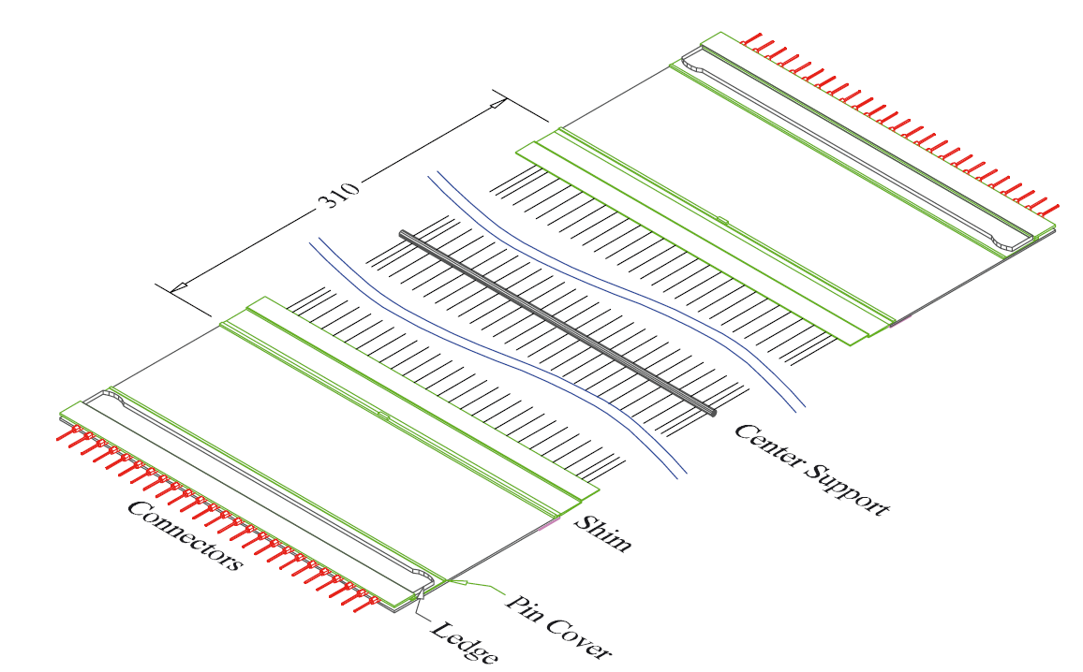
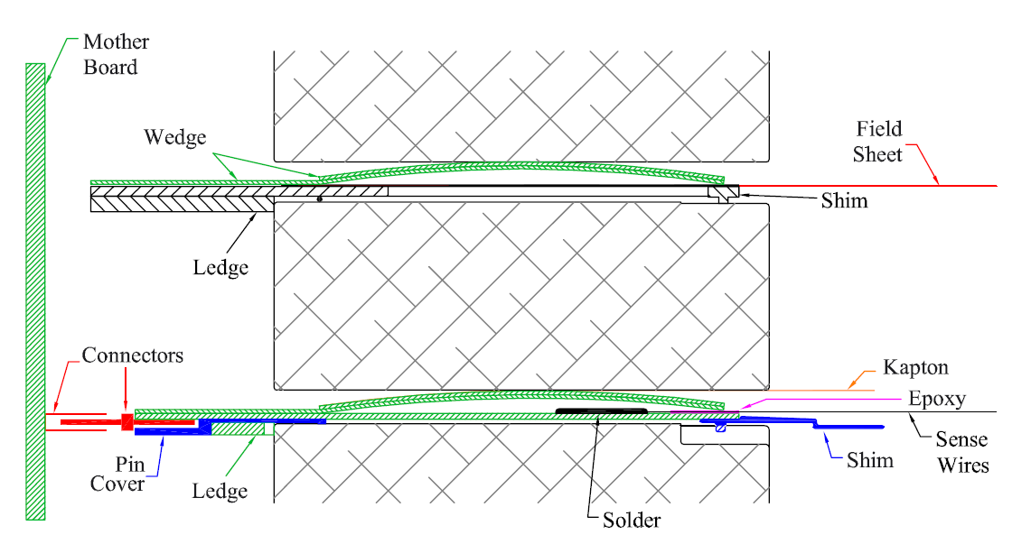
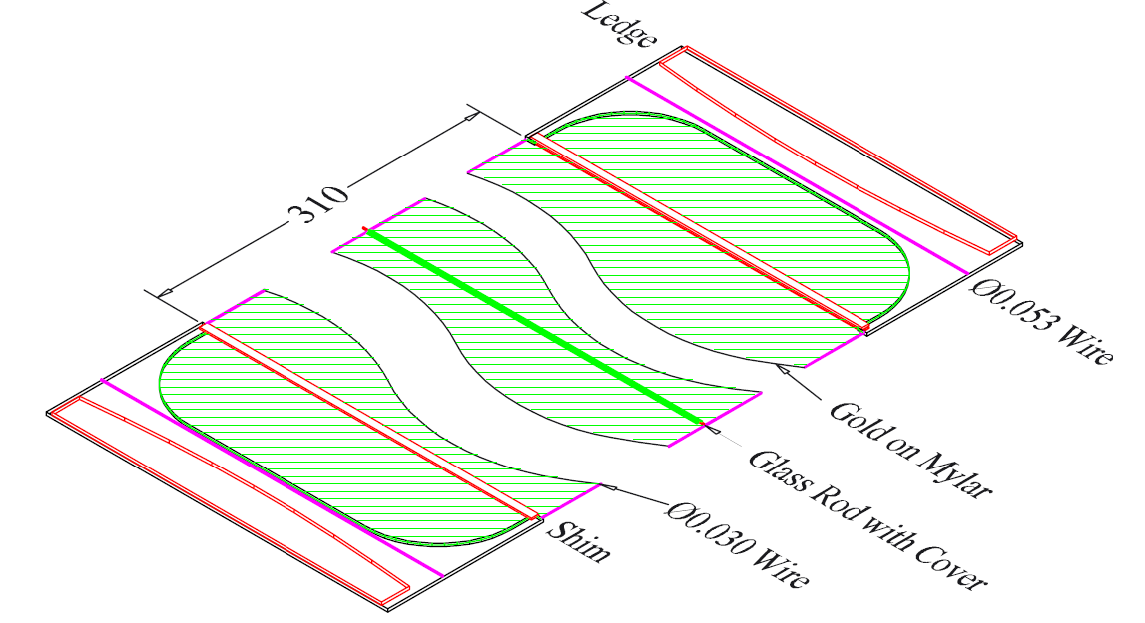
Wire/field planes
Broken sense wires can be removed in situ by partially extracting a wire plane

Slide 9
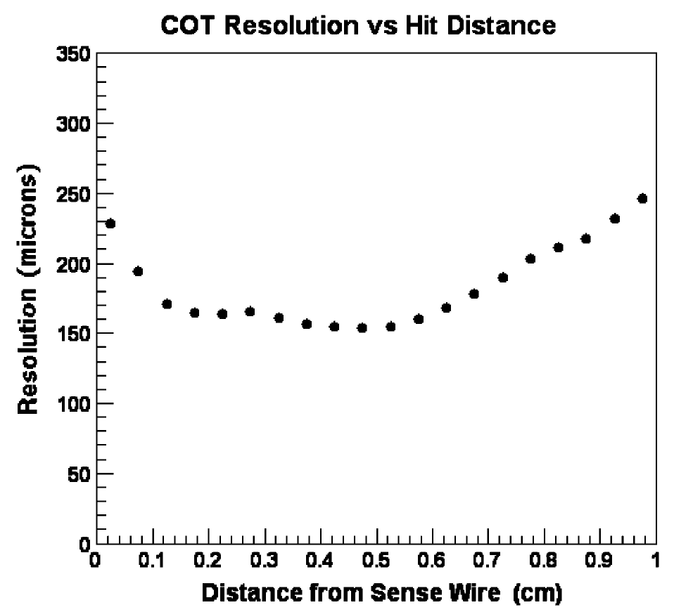
Cell performance
35◦ tilt to drift in R φ direction
ExB effect
~ 150 μm resolution
in center cell region

Slide 10
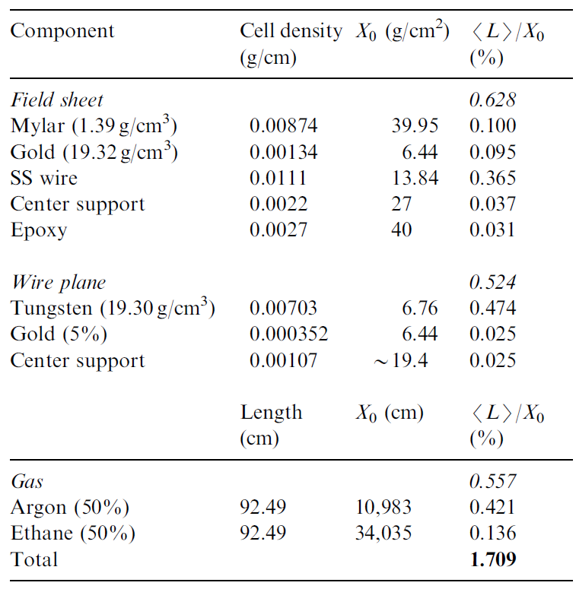
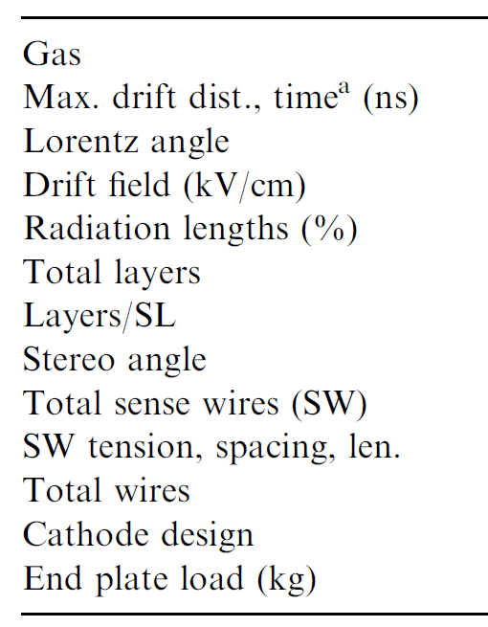
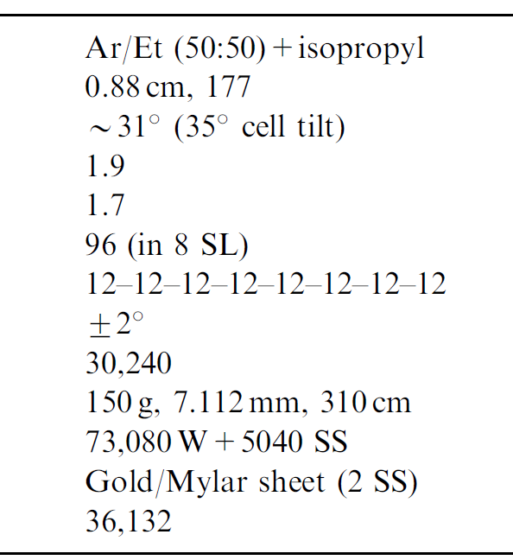
Parameter summary & material
Material estimate
COT parameter summary

Slide 11
IDEA vs CDF (similarities)
Similar dimensions:
  Rmax: 200 cm IDEA (go to 180 cm?) vs 132 cm CDF
  Length: 400 cm IDEA vs 310 cm CDF
  #layers: 112 IDEA vs 96 CDF
# cells is comparable:
  56,448 IDEA vs 30,240 CDF → 74,088 scaling by area (59,440 if Rmax =180 cm)
Max drift distance/time:
  0.7 cm IDEA vs 0.8 cm CDF
  IDEA drift time longer due to Ar/Ethane being ~2.5 times faster than He
    5.2 vs 2.2 cm/μs

Slide 12
IDEA vs CDF (differences 1)
# stereo and axial layers
  S/A: 112/0 IDEA vs 48/48 CDF
    Does axial/stereo mixture and/or supercells help pattern recognition?
    Is high polar angle resolution in the chamber important?
Stereo angle
  50 to 250 mrad IDEA vs 35 mrad CDF
    Is high polar angle resolution in the chamber important?
    Can the CDF stereo angle be increased?

Slide 13
IDEA vs CDF (differences 2)
Field wires IDEA vs field planes CDF
  Better E field, less wires, adds material
  Constrain loose wire in case of broken wire
CDF DCH allows to remove broken wires in situ
  Partial extraction of wire plane
Material comparison discussion
  Wires/gas 0.3 % X₀ IDEA vs 1.7 % X₀ CDF
    CDF field planes 0.63 - potential to reach 0.26 using C-fiber wires
    CDF wire planes 0.524 – potential to reach 0.14 (sense 40 → 25 μm) & Al potential wires
    CDF gas 0.557 - Ar/Ethane ->He/Isobuthane 0.07
  Potential for ~ 0.5 % X₀ with CDF-like structure
  Scaling for transverse size x 1.4 = 0.66%X₀

Slide 14
Conclusion
A CDF-like chamber could be adapted to fit the needs for IDEA
Pros:
  Well established proven technology
  Center support improves wire stability → could increase max length achievable
  Allows for broken wire removal in situ
  Supercell structure simplifies (on-line) pattern recognition
    Allows for local stub reconstruction
Cons:
  Reduced R-z resolution due to smaller stereo angles
  Higher material in gas volume
  Rather massive endplates

Slide 15
Backup slides

Slide 16
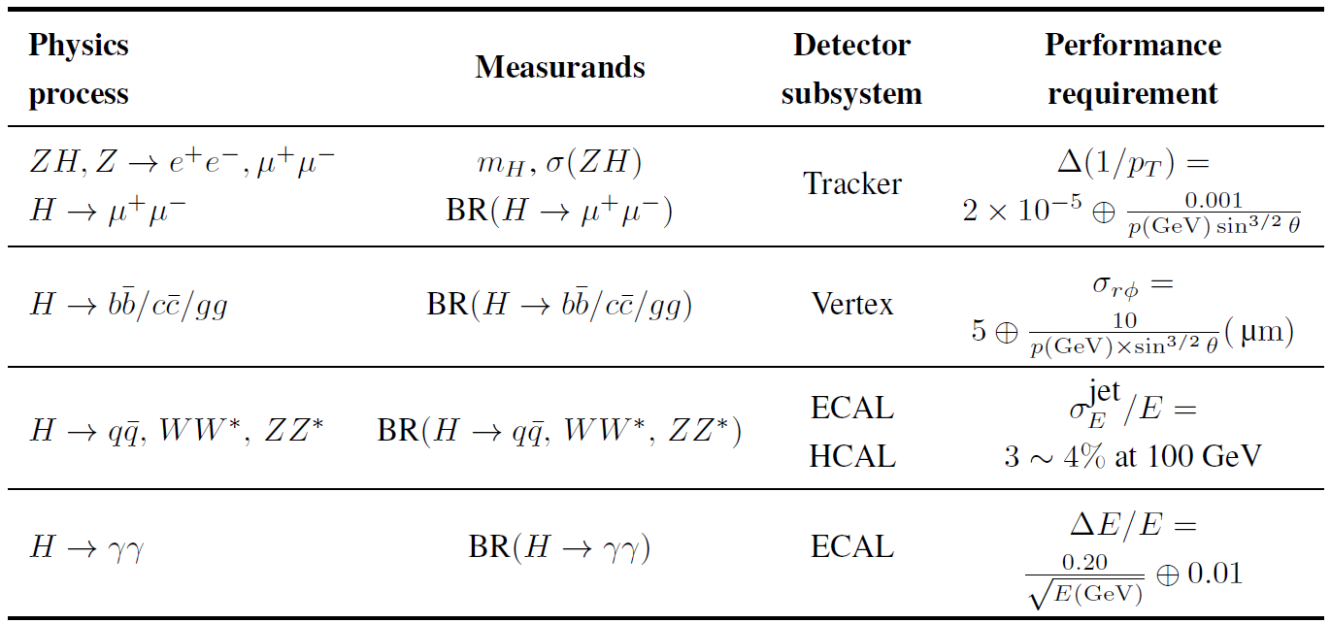
Detector requirements
Constraints from physics (some similar to LC)
  Addditional constraints
    Excellent acceptance and luminosity control
    PID & π⁰ ID for HF/τ physics
    Low B field to avoid emittance blow up
    Power pulsing not allowed
Not present at LC

Slide 17
Size concerns
Inner radius:
  Are the inner layers useless due to beam related backgrounds?
Outer radius going from 2 to 3 T
  Can tracks around 1 GeV reach the timing detectors?
Chamber length:
  Can such length be achieved or should we make it shorter?

Slide 18
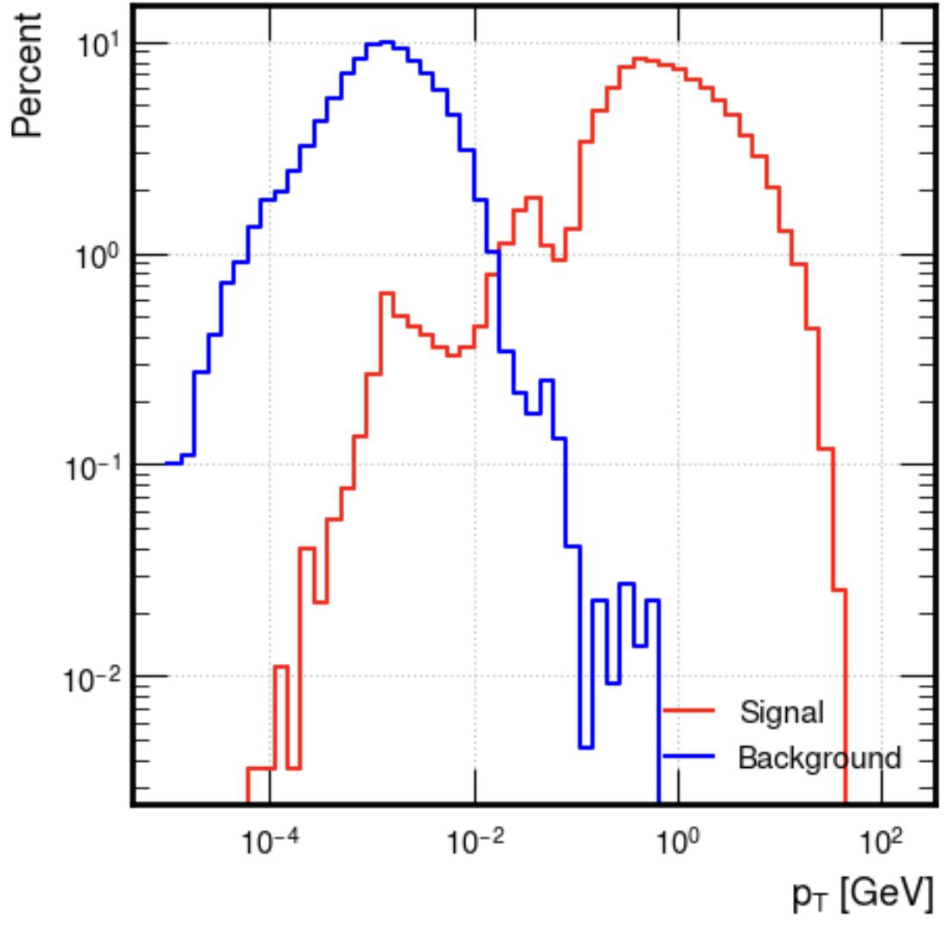
Backgrounds
Background vs signal
  Cutoff looks OK even at B = 2 T, however
Most background origins from backscattering
  Few cm larger inner R could help
Current raw estimates not yet completely understood
  Do not include any filtering
Z→qq

Slide 19
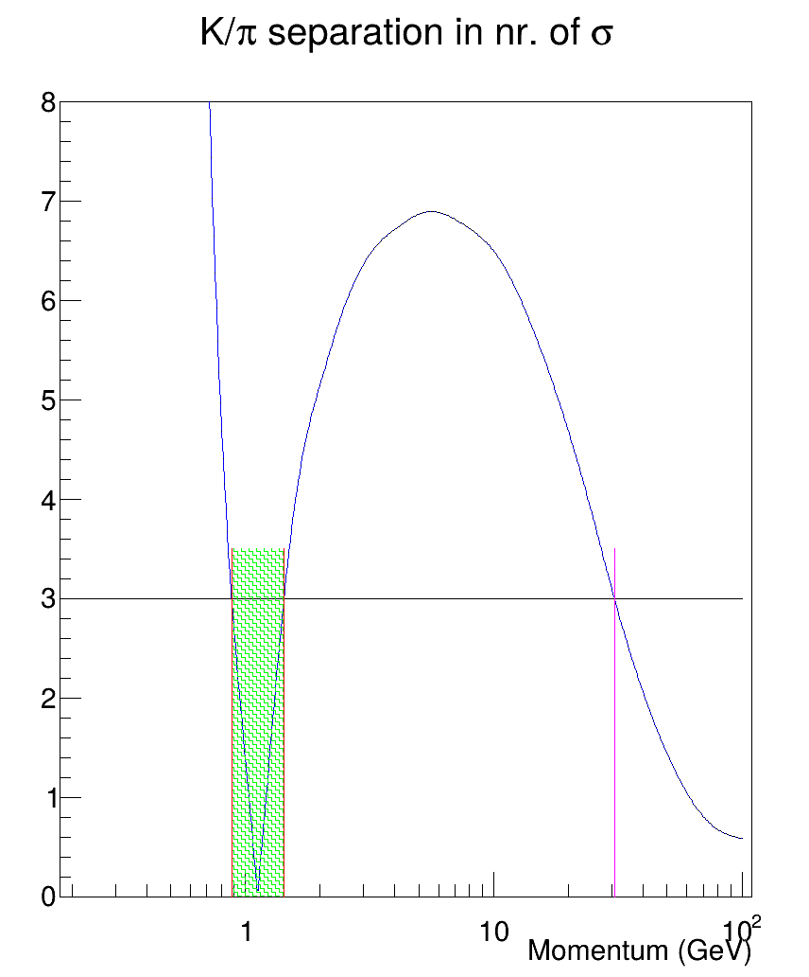
Cluster counting PID
Range not covered by cluster counting PID: [0.9, 1.4] GeV
Max. momentum: 30 GeV

Slide 20
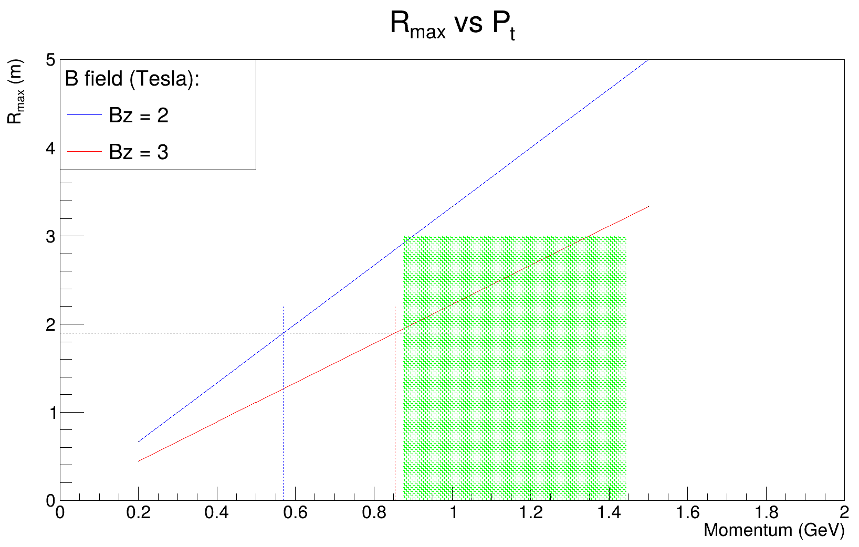
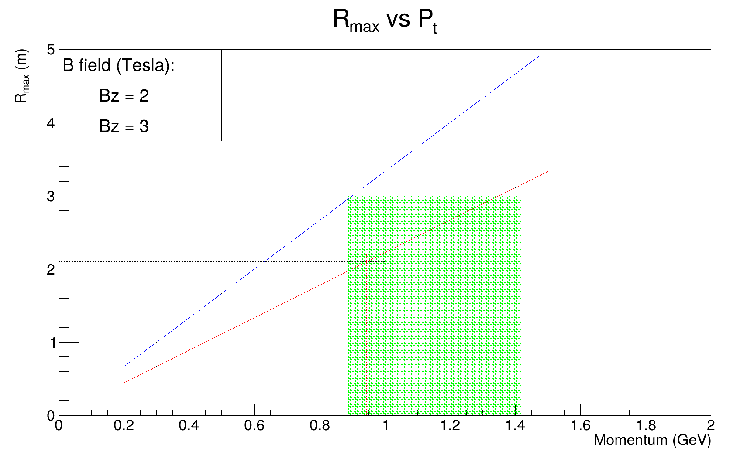

DCH – TOF compatibility
R_{TOF}= 2.0 m
R_{TOF} = 2.1 m
R_{TOF}= 1.9 m
No problems when B = 2 T
B field = 3 T
Requires smaller
Drift chamber
R_{DCH} ~ 1.8 m

Slide 21
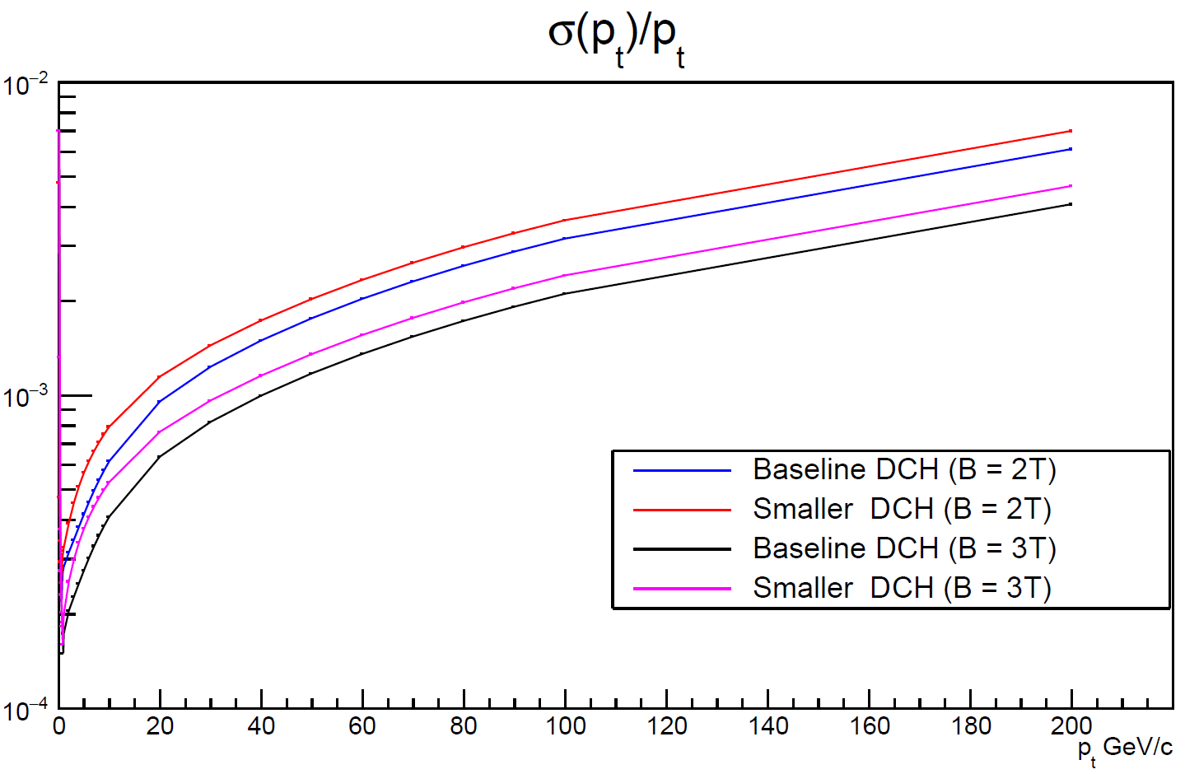
Impact on pt resolution
@100 GeV at 2 T
.32% → .36%
Asymptotic degradation
14.5% at the Z pole
But gain 30% going to 3 T at ZH !!
0.32% → 0.21%

Slide 22
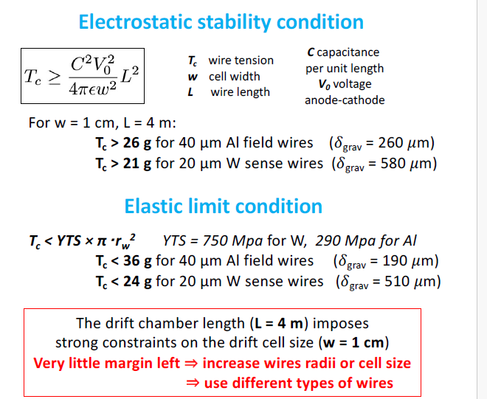
Wire stability
From F. Grancagnolo
  ECFA WG3: Topical workshop on tracking and vertexing
  CERN, 30–31 May 2023
Very little margin for wire stability → wire R&D
  Central wire support gains x 4

Slide 23
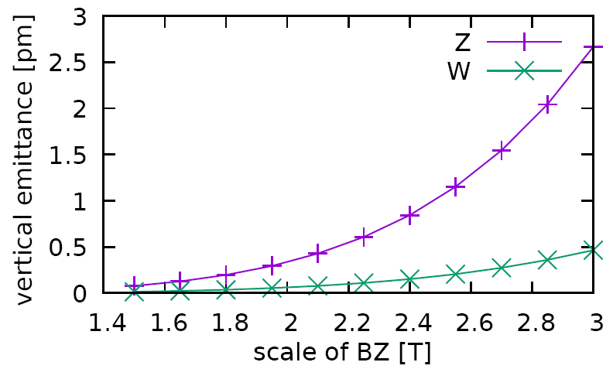
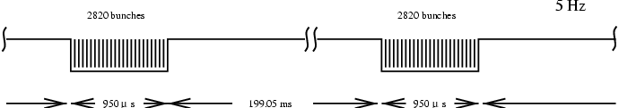
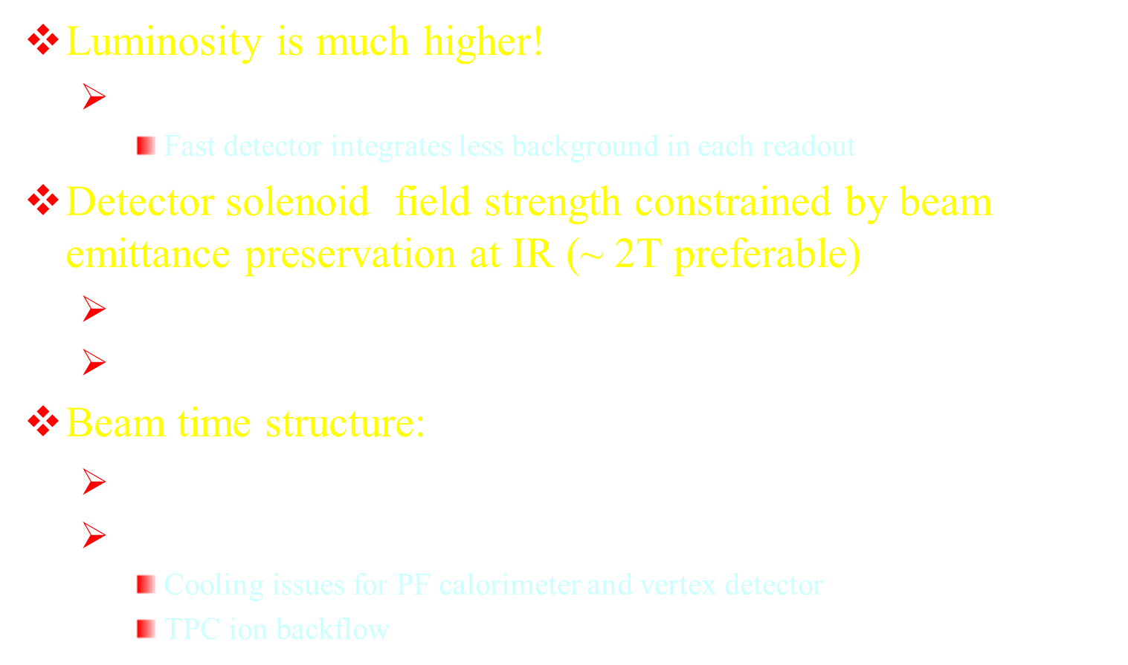
Differences with ILC/CLIC
Luminosity is much higher!
  Non-negligible machine backgrounds
    Fast detector integrates less background in each readout
Detector solenoid field strength constrained by beam emittance preservation at IR (~ 2T preferable)
  TPC: issues with transverse diffusion
  Silicon: can’t compensate smaller tracking radius with large field
Beam time structure:
  Short bunch spacing (~ 20 ns Z, ~ 1 μs H, ~ 3 μs $t\overline{t}$)
  No large time gap
    Cooling issues for PF calorimeter and vertex detector
    TPC ion backflow
ILC

Slide 24
FCC detector concepts

Slide 25
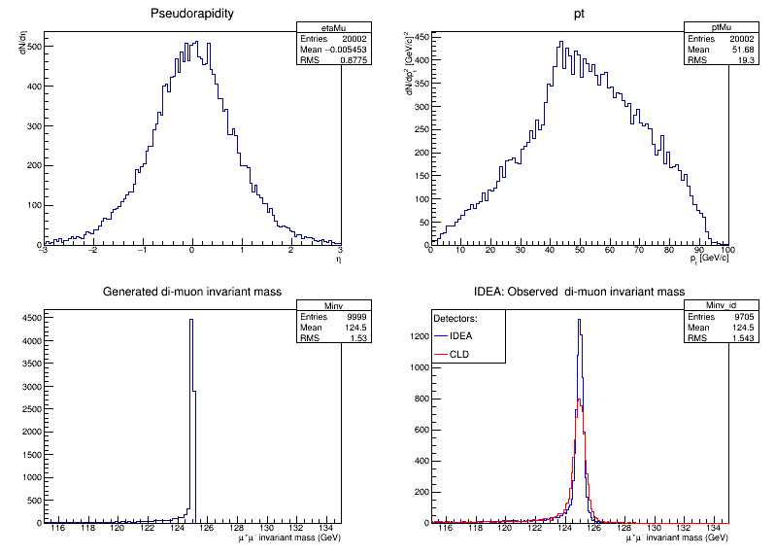
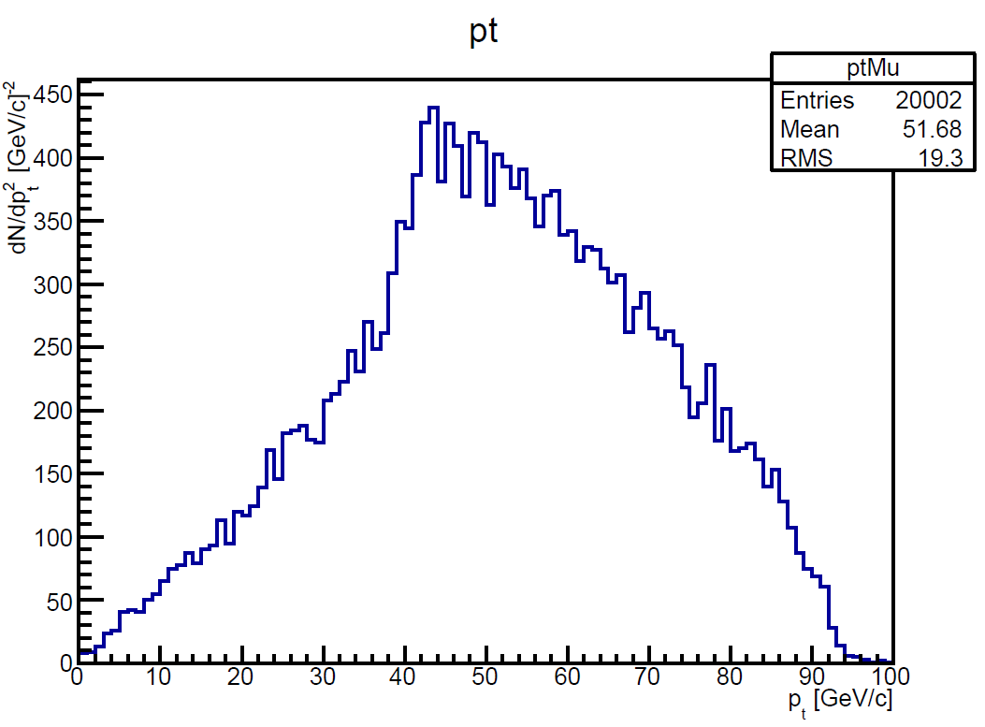
Momentum measurement
Z or H decay muons in ZH events have rather small p_{t}
  Transparency more relevant than asymptotic resolution
  parency more relevant than asymptotic resolution
MS only
ZH (H→μμ)
Muon pt
DCH endplate
H inv. mass
ZH→Z μμ
Higgs recoil
HZ →H μμ
ZH (Z→μμ)
Muon pt
90 degree

Slide 26
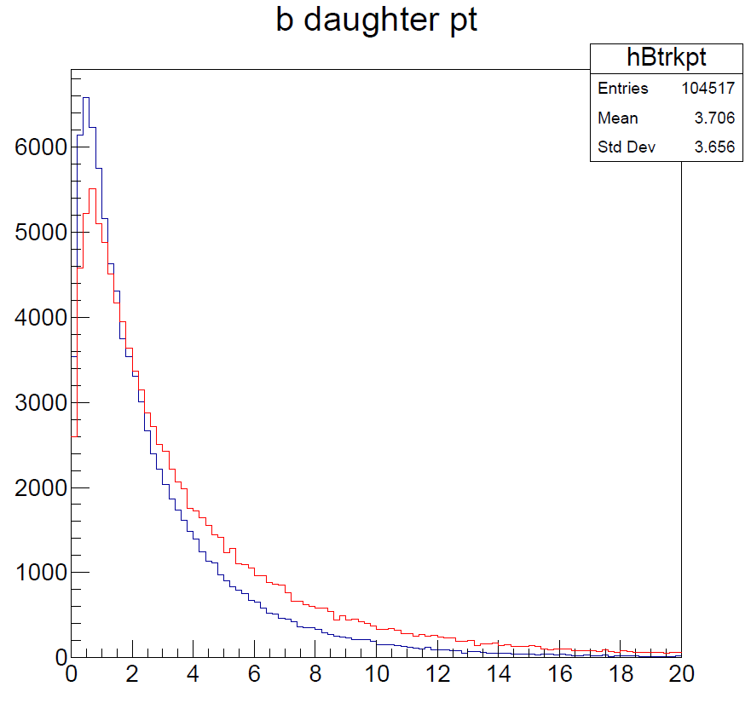
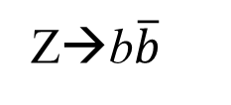

Vertex resolution
Transparency again very important
  Tracks from secondary and tertiary HF decays have few GeV
Stable charged tracks from b-hadron decays
ZH→b$\overline{b}$
Z→b$\overline{b}$
Pt (GeV)

Slide 27
PID
Expect > 3σ K/π separation from cluster counting in Drift Chamber up to ~ 30 GeV
  ToF at 50-100 ps resolution covers region ~ 1 GeV
30 ps
30 ps assumed
3σ
dN/dx from Garfield++
GeV

Slide 28
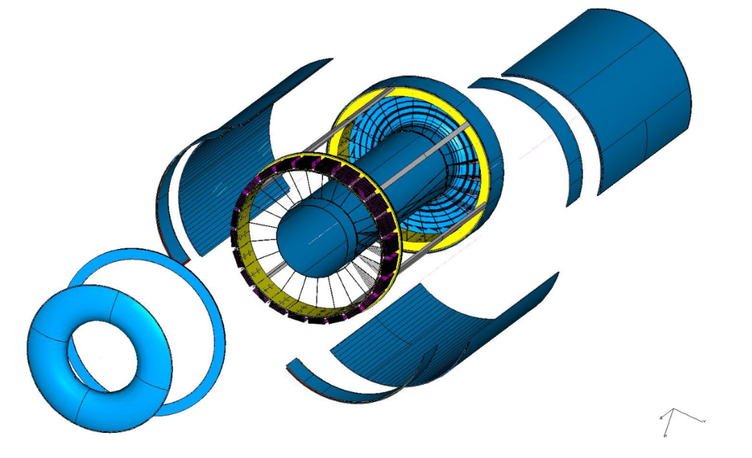
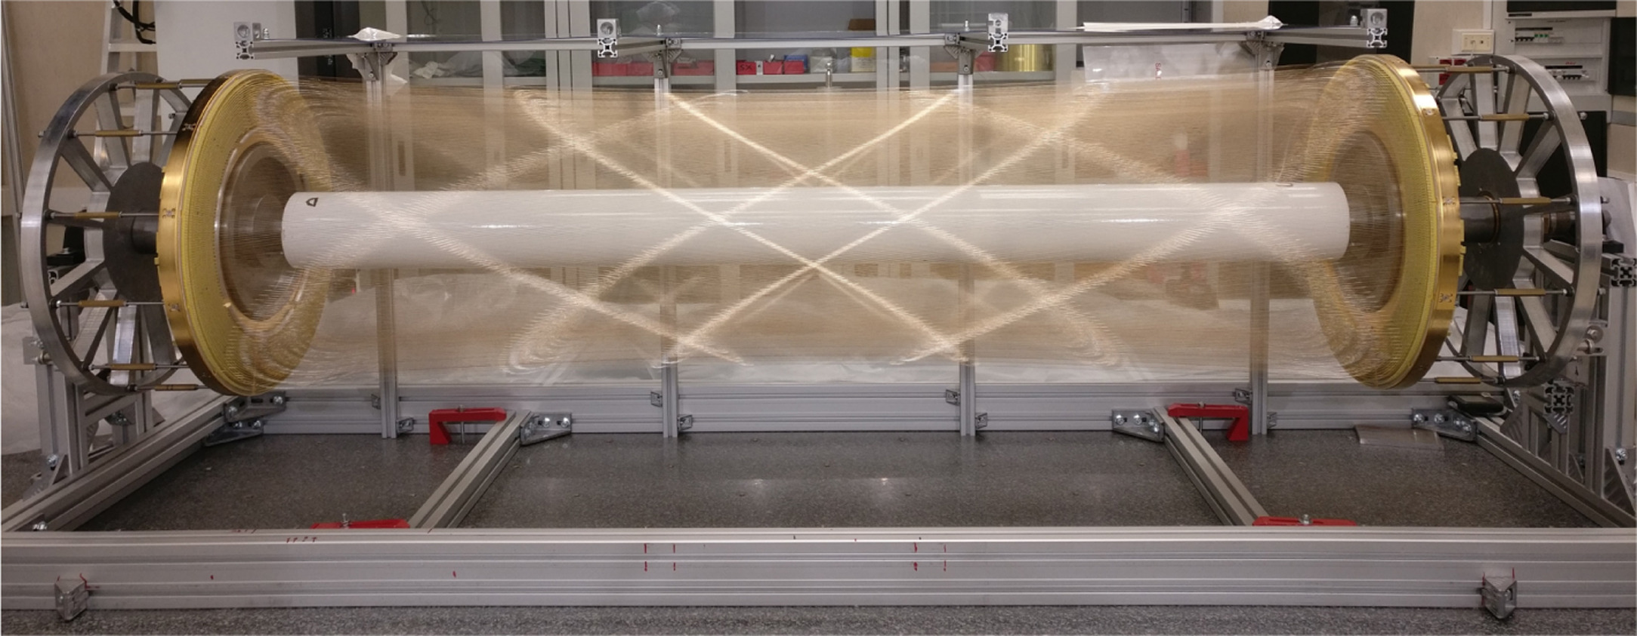
Drift chamber
(Contacts: F. Grancagnolo, N. De Filippis, M. Primavera)
90% He/ 10% C₄H₁₀ – All stereo – σ ~ 100 μm
Small cells ~ 1 cm, max drift time ~ 400 ns
Wire Cage
Gas envelope
Included in DRD 1.2
Based on MEG2 experience
Based on MEG2 experience

Slide 29
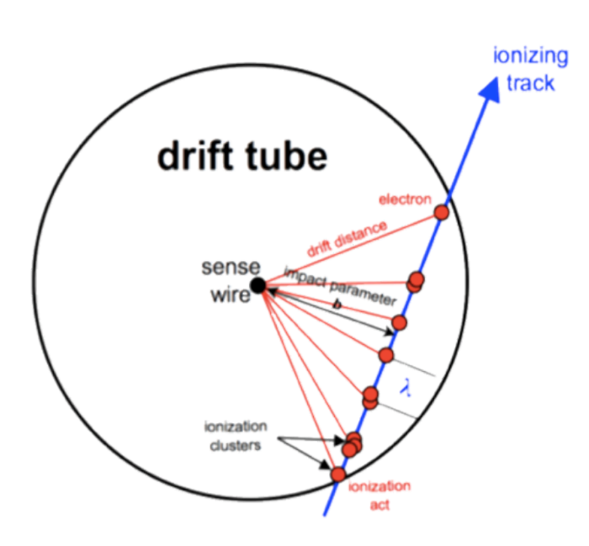
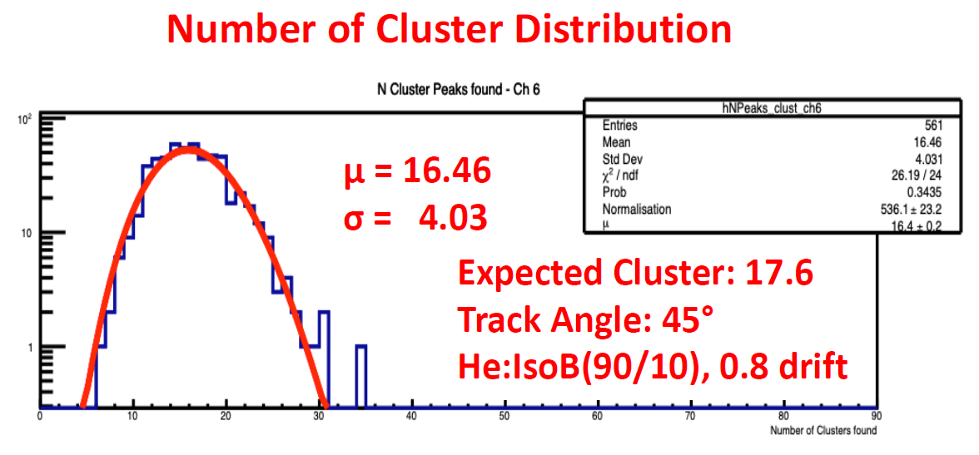
Cluster counting
Cluster counting x2 better than dE/dx
  Poisson vs . Landau → no large tails
Sample signal ~ GHz → on detector electronics R&D
Test beam data 2022

Slide 30
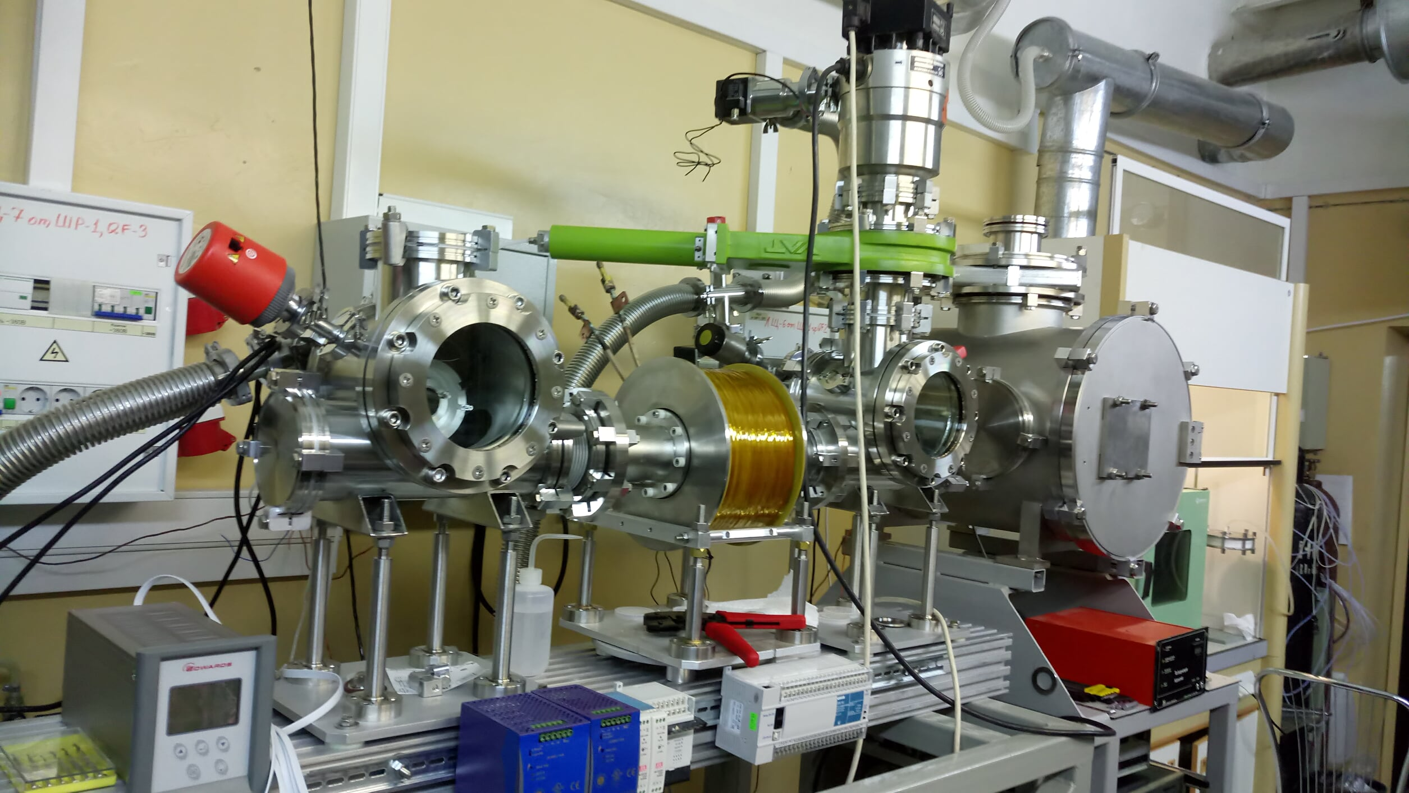
Mechanical R&D
Current layout based on Kloe/MEG2 experience, but
  Extrapolated to ~ 60k sense wires + ~ 300 k field wires, 4 m long
Current R&D:
  End-plate spokes deformation FEM studies in progress
  Optimal materials
  New wire types, e.g. coated carbon filaments for field wires
  Green, non-flammable gases
Magnetron to coat C-wires

Slide 31
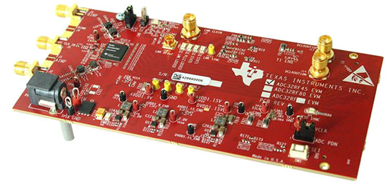
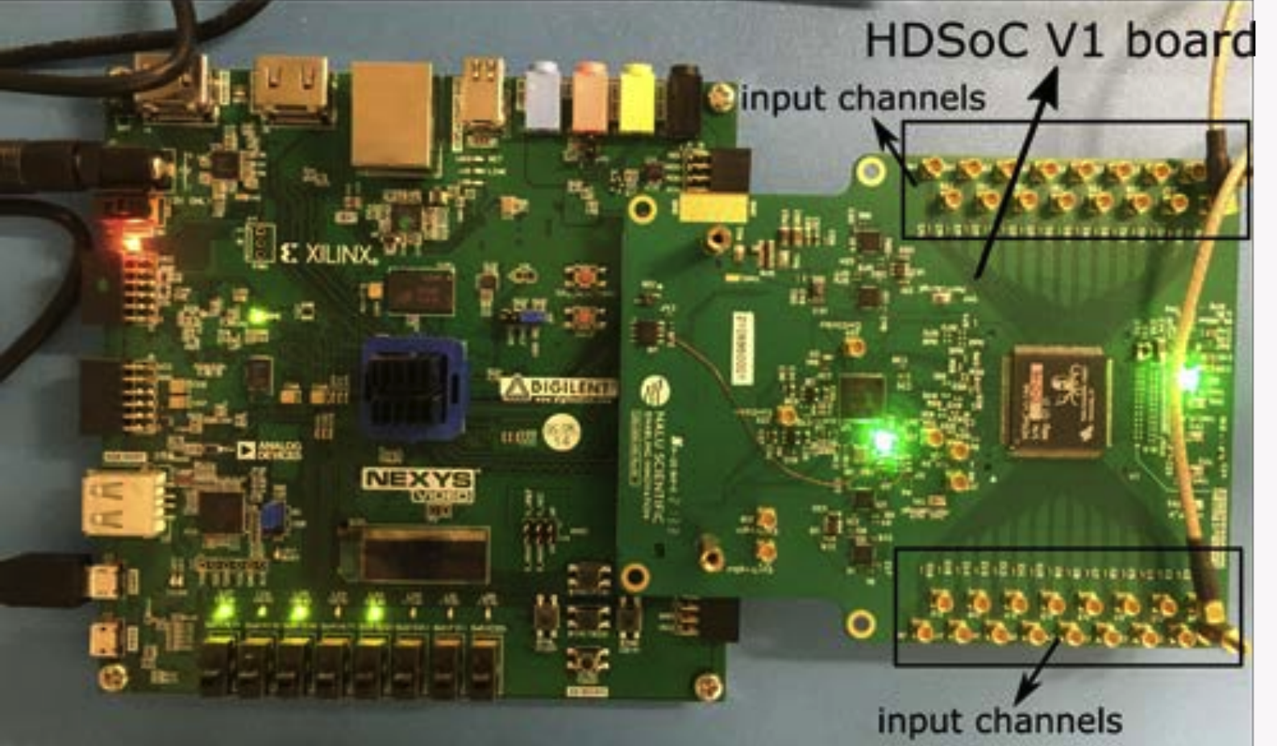
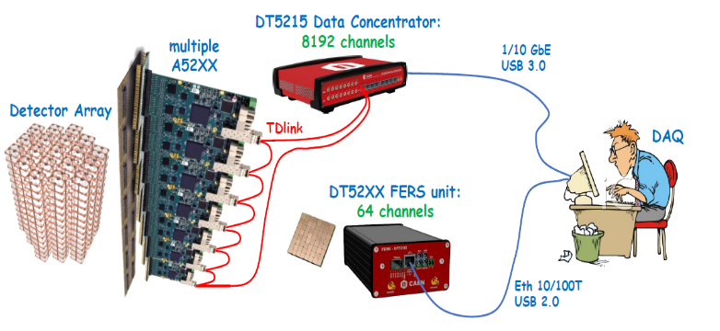
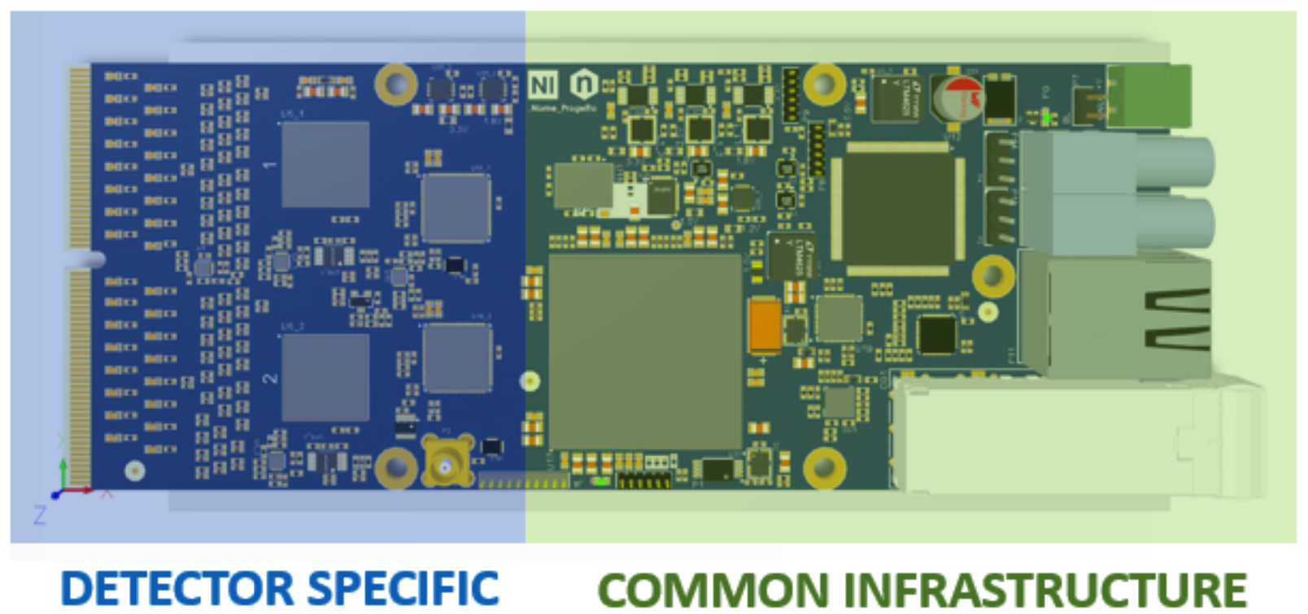
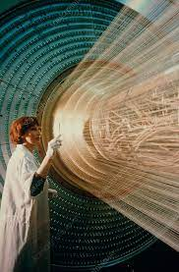
Electronics R&D
1-2 GHz / 12 bit digitizer/channel needed for cluster counting
  Need compact/ cheap solution followed by FPGA to find clusters and reduce data output
    Currently studying:
      (ADC32RF45 or LMH6522) + FPGA KCU105
      CAEN digitizer VX2751
      NALU Scientific ASoCv3 and HDSoCv1
      PYNQ based solution for ML algorithms
2 x 2-ch ADC32RF45
64 ch’s A52XX
16 x
7 x DT5215
Data Concentrators
= 57,344 ch’s
per side
DRIFT CHAMBER SPECIFIC
FERS INFRASTRUCTURE
56,448 ch’s
x 2 sides
16 boards x 64 ch’s
= 1024 ch’s
x 8 Tdlink
= 8192 ch’s
CAEN FERS

Slide 32
Drift Chamber:
Areas of potential collaboration
Electronics:
  Front-end ASIC: low mass/power, 1 GHz, high gain (20 db), low cost
  Off-detector: (digitizer), FPGA for peak finding and data reduction
  LV/HV distribution with controls
Mechanics:
  Full length prototype
  Design optimization
  Construction fixtures (wiring and assembly)
  Wire issues: tension control, replacement procedures
  Gas system
Software:
  Tracking and cluster counting with full sim
Participation in test beams and associated data analysis
Potential collaboration with ALLEGRO

Slide 33
Simulation results: field map
Brass or copper calorimeters
Large variations in tracking volume
1m Yoke is oversized (2x50 cm in fig.)
Copper

Slide 34
Iron calorimeter
Much nicer!
Almost no need for yoke
Iron

