Slide 1
Powering Future Tracker Systems
Mitch Newcomer
May 9, 2025
Technologies & Serial Power Techniques

Slide 2

IEEE Spectrum March 2025 Technology
Makng Today’s Mainstream Commercial Technologies
Barnard’s Loop [left], in the constellation Orion, is the apparent remnant of an ancient supernova. The physics of celestial explosions is surprisingly similar to that of the tin-plasma bursts [right] used to illuminate chips in lithography machines, despite drastically different scales: tens of light years for the supernovas versus tens of millimeters for the tin plasma
Jayson Stewart Rudolf Schultz Daniel Brown
05 Mar 2025
https://spectrum.ieee.org/euv-light-source
Notes:
IEEE spectrum Tiny Star Explosions Are Powering Moore's Law

Slide 3
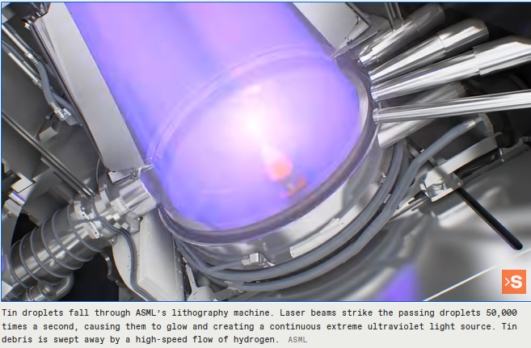
Extreme UV Light
The shock wave produced by a laser-heated tin droplet in a thin hydrogen atmosphere is similar enough to a supernova blast that they can both be described by the same math.
The whole sequence takes less than a millionth of a second.

Slide 4
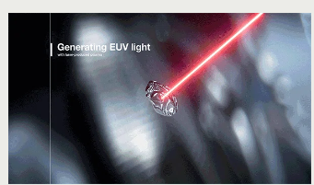
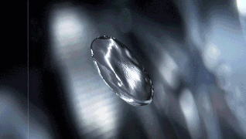

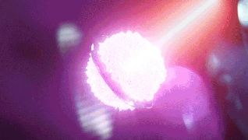
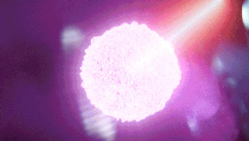
Creating 10 eV Lithography Quality EUV light
Amazingly, the Taylor-von Neumann-Sedov formula describes atomic-bomb shocks with radii of hundreds of meters, supernova shocks that stretch across light years, and tin-plasma shocks just millimeters wide.
EUV lithography systems
Using extreme ultraviolet (EUV) light, our NXE and EXE systems deliver high-resolution lithography and make mass production of the world’s most advanced microchips possible
The move to ever-shorter wavelengths hit a wall at 193nm because almost all known lens materials absorb light with wavelengths of less than about 150 nm.

Slide 5


ASML
Advanced Technology Today

Slide 6
BCD ASIC technology Bipolar, CMOS, DMOS
Bipolar- High gm with high speed, Predictable Precision Performance
  CMOS - High Density, High Speed Digital, ANALOG switches / near Zero Leakage
    DMOS - High Voltage MOSfets for Power & Biasing Applications
System on a Chip (SoC) applications - perfect technology pallete
  Power conversion / Sensor Biasing
  MAPS
  Analog & Digital Processing
  High Speed Communications

Slide 7
BCD is Embraced by Industry
TSMC…
  TSMC continued to increase its 12-inch BCD technology competitiveness in 2023 by expanding its 0.13μm and 90nm BCD technology.
  The logic baseline of second-generation 40nm BCD is fully compatible to ultra-low power (ULP) process, which also provides 5-28V high-voltage components, enabling more power management chip applications.
Global Foundries….
  BCDLite is GF’s BCD improved efficiency and simpler manufacturing.
  in 55, 130 and 180 nm
  Low power and high voltage LDMOS transistors available for 5V-65V
ST MicroElectronics ST invented the BCD (Bipolar-CMOS-DMOS) technology in the mid-eighties and continually developed it ever since.
  160nm BCD8s -P .. 5-60V BCD-SOI 100-200V
  110nm BCD9s … 5-100V
  90nm 40nm Being prototyped & Under development 5 – 50V ..& more

Slide 8
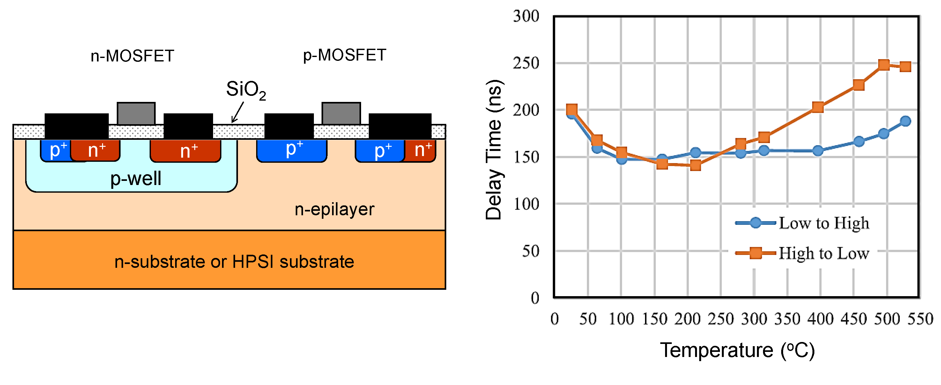
Large Band Gap Semiconductors
High Voltage Power Applications
Low heat susceptibility
Excellent Radiation Tolerance
SiC Silicon Carbide GaN Gallium Nitride
Earliy Days for complex control circuitry
ASIC Complementary SiC MOS (CMOS)

Slide 9
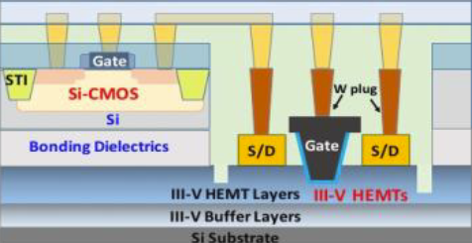
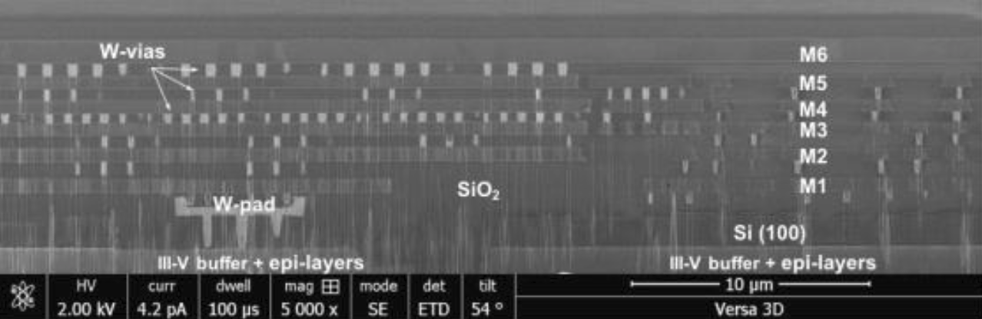
Integration of CMOS and GaN Transistors
P. Choi et al., "Monolithically Integrated GaN+CMOS Logic Circuits Design and Electro-Thermal Analysis for High-Voltage Applications," 2020 IEEE BiCMOS and Compound Semiconductor Integrated Circuits and Technology Symposium (BCICTS), Monterey, CA, USA, 2020, pp. 1-4, doi: 10.1109/BCICTS48439.2020.9392934.

Slide 10
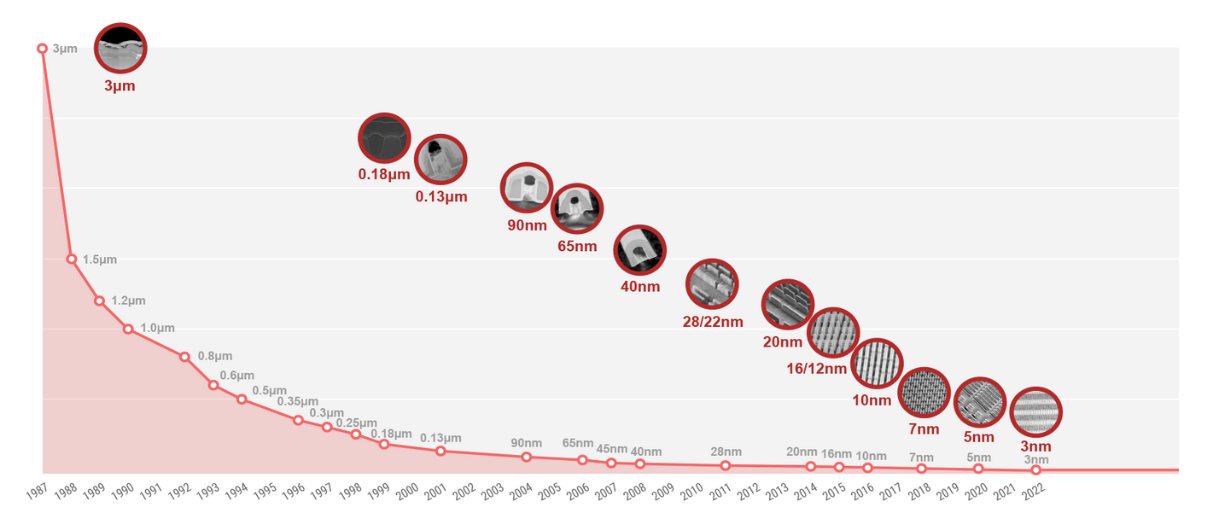
Looking back @ TSMC’s ASIC Fab History
HL LHC Concept to Production
….~20 years…
Notes:
In 2007 we began thinking seriously about trackers for HL-LHC and just about 20 years later we in production of the systems we dreamt up…

Slide 11
Looking back @ TSMC’s Fab History
PrimaryHL LHC
Technologies
HL LHC Concept to Production
….20 years…
First production
FinFETs

Slide 12
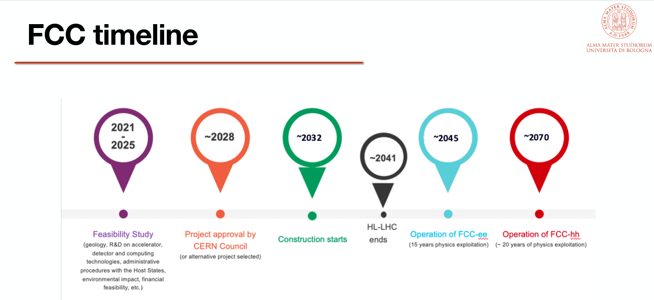
FCC timeline
I. Vivarelli - Workshop on FCC-ee and Lepton Colliders - 22-24 January 2025

Slide 13
Next round of Collider Physics ~2045??
Notional Timeline…
Concept and early Detector studies NOW to 2028…
Design Studies 2027-2030
Early work on Detector designs 2028 – 2035
TDR’s 2030 – 2035
Building 2035 – 2042…
Physics 2045- 2050 ??
~20 years →
It may be that the ASIC SoC and Powering Technologies we finally use are similar to or mostly the same as what is available today….

Slide 14
Techniques we know/can extend today…

Slide 15
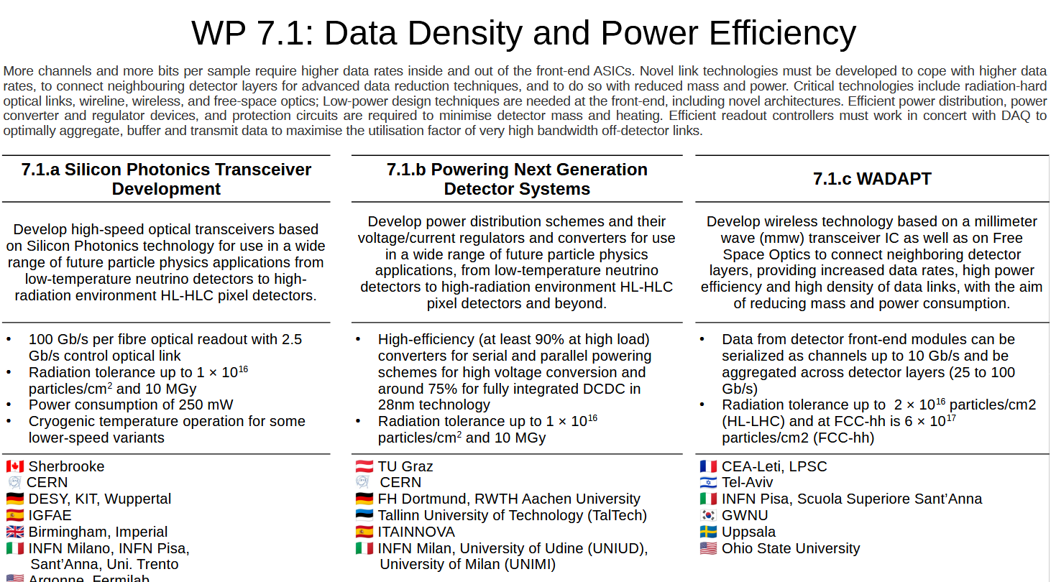
DRD 7.1 Meeting September 2024
Develop power distribution schemes and their
voltage/current regulators and converters for use
in a wide range of future particle physics
applications, from low-temperature neutrino
detectors to high-radiation environment HL-HLC
pixel detectors and beyond.
Jan Trotska

Slide 16
7.1.b Powering Next Generation
Detector Systems
Develop power distribution schemes and their voltage/current regulators and converters for use in a wide range of future particle physics applications, from low-temperature neutrino detectors to high-radiation environment HL-HLC pixel detectors and beyond.
High-efficiency (at least 90% at high load) converters for serial and parallel powering schemes for high voltage conversion and around 75% for fully integrated DCDC 28nm technology
https://indico.cern.ch/event/1436991/timetable/#20240909

Slide 17
DRD 7.1b on chip Regulation
DCDC
DCDC
from WP 7.1b workshop 9/24 presentation by Stefano Michelis
Notes:
A potentially useful advancement for FCC-ee trackers

Slide 18
On Chip DCDC Preliminary Results

Slide 19
DRD 7.1b Powering
from WP 7.1b presentation by Stefano Michelis

Slide 20
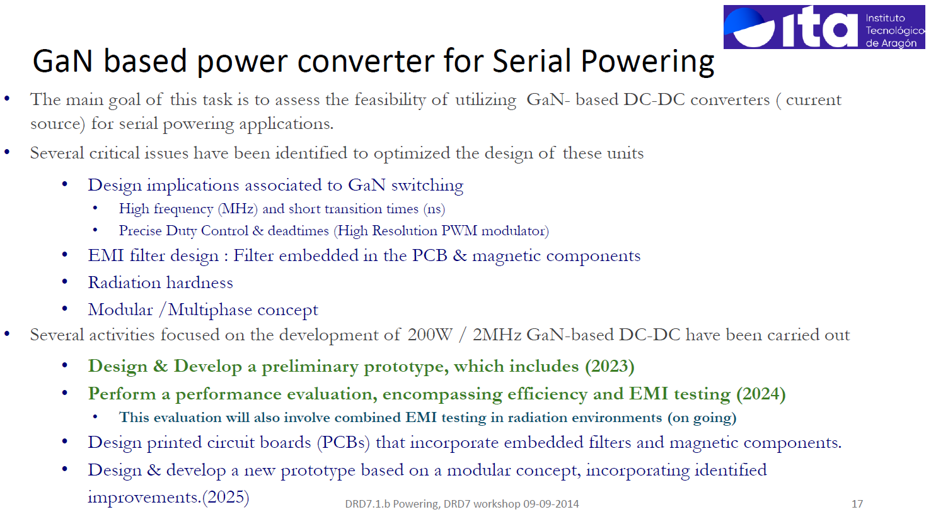
DRD 7.1b Power Efficiency
from presentation by Stefano Michelis

Slide 21
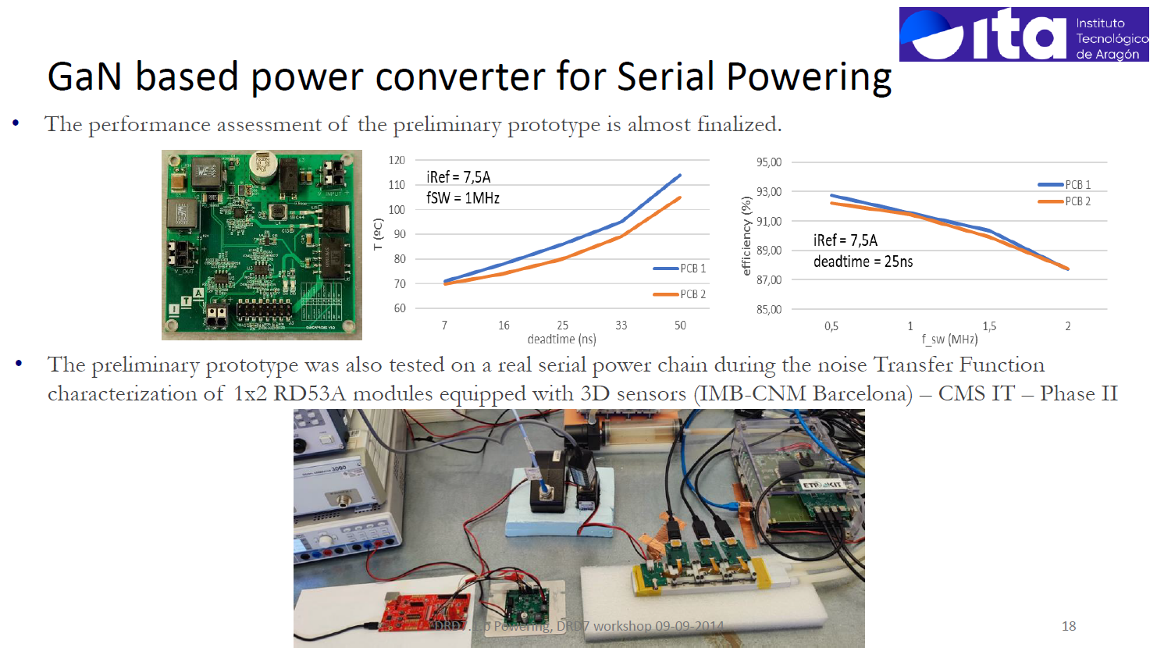
Additional Info
DRD 7.1b Power Efficiency
From DRD7.1b presentation by Stefano Michelis

Slide 22
Serial Powered Trackers

Slide 23
Notional Serial Power system
V(n)
SP Advantage = recycle Module Curren 8X
Module Electronics
`
8
R_{analog}
R_{digital}
7
Vmodule
Digital FE
Vout = n(Vmodule)
Analog FE
6
An ref
Excess Current Path
Dig ref
Excess Current Path
Programmable
current &
voltage compliance
5
Serial Power Loop
4
Global Detector Reference
3
V(n-1)
Module Current = i(Ranalog) + i(Rdigital)
Module Power = Vmodule X i(Ranalog) + Vmodule X i(Rdigital)
Excess Power = V(Ranalog) X i(Ranalog) + V(digital) X i(digital)
2
1
0V Return
Minimum Loop Current -> Set by Highest Consumption SP Element + variations within the loop. ( Modules in a loop may have widely varying occupancy eg. along a barrel stave for instance. )

Slide 24
Serial Power Implementation Details
Number of parallel devices in a voltage Step
along Serial power step especially important Uniformity of Occupancy for digital logic where power consumption is a f(activity)
Real time local monitoring within a step
  Can the LDO within the ASIC be externally addressed / controlled?
Realistic Operational Modes:
  power up / regulation while powered / power down
    Ramp UP/Down Speed
    One of several ASICs powered down …at startup? ….during a run?
  Architecture for control / data signals within a step

Slide 25
Module organization within a Serial Step
Vsp(n+1)
Single
FEE
Cntrl
Data
Vsp(n)
Vsp(n+1)
Parallel Identical
Cntrl
1
2
n
………….
Data
Vsp(n)
Function
Specific
Vsp(n+1)
Data Concentrator & LDO
1
n
Cntrl
2
…………
Hi RateData
Vsp(n)
LDO Shunt with common Analog Control in in FEE to ensure even heat distribution.

Slide 26
Advantages of a Serial Powered System
The ADVANTAGE → LOW Mass Cable/Control units & No switching
Reduced gauge supply & return cable Need only provide a single module with power.
SP control unit ~ OpAmp, No Coil mass, Potential for Evenly distributed module heat load
→ Simplicity of a nearly DC control structure.. LDO for each voltage with consideration for Maximum power excursions capacitive filtering for instantaneous current deviations eg clocked logic or trigger response
→No clocked switching circuits to generate pattern noise Or Switching related heat.
→Possibility of aggregating many module consumers in parallel where detector topology permits.
Evens out SP voltage step current loading. Allows the SP voltage step to take advantage of security in numbers when single units have deviations or may need to be turned off ..
But this is not magic, simply parallel powering so there is no wire gauge material reduction advantage.

Slide 27
Serial Power Disadvantages
An unfamiliar approach to module powering
Serial power Loop Supply is crucial for fault free operation. Requires a somewhat novel, programmable constant current, programmable voltage compliant approach. An Accelerator driven feed forward control could be advantageous here.
Communications need to be capacitively coupled requiring balanced code or receivers with hysteresis and startup procedures.
To maintain high levels of operability Module failure modes need to be addressed. Current flow in the SP loop must be maintained. A serial step can be taken out of the loop by shorting the Module with a current bypass element. The time frame is important.
  Slow changes in voltage steps can result in overheating & damage to current shunt elements.
  Fast changes can cause cascade communication failures in the Serial Loop

Slide 28
Maximizing a Stable SP system
Loop Current Uniformity Maximizes Efficiency
Start with the ASIC. Minimize data taking power variations. For system stability it may be best to shunt unavoidable trigger related readout current in quiescent operational states to avoid data taking spikes.
Choose loops with common occupancy levels where possible.
Design with care the reference potential system for proximal read out loops.
Isolate Communication in Serial Loops with capacitive or optical communication schemes if TID and SEU effects are manageable.
Co-design a SP Supply with FB from the serial loop and potentially spigots for Feed Forward from the Accelerator control room to provide tuneable increased current during predictable data taking spikes.
Design in connection redundancy & provision for controlled failure behavior.
Make sure powered down modules don’t present low impedances on bussed communication lines.

Slide 29
Serially Powered Trackers
ATLAS Pixels and CMS CROC chip…

Slide 30


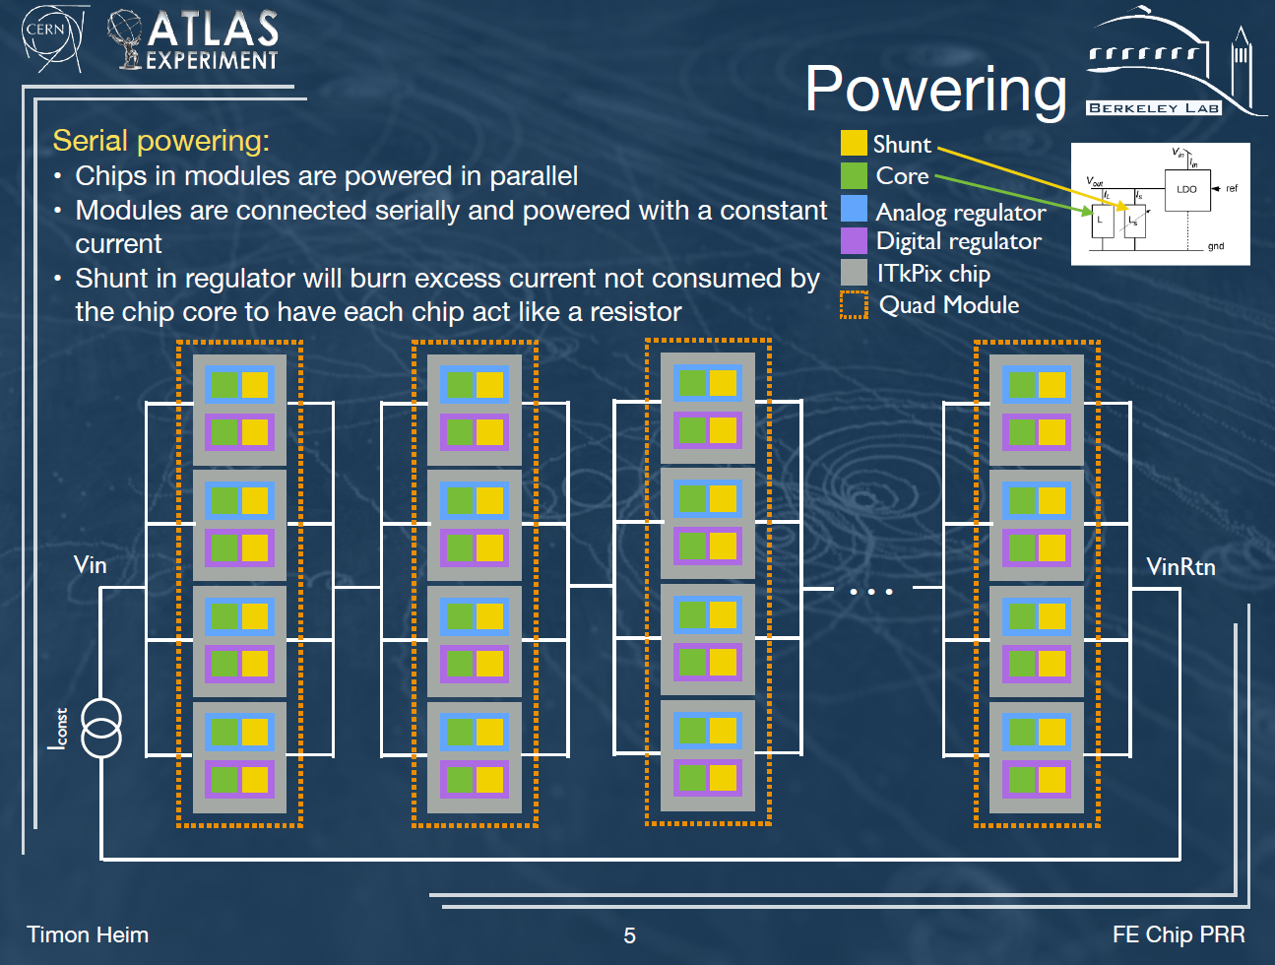
Serial Powered Modules with Multiple Parallelpowered ASICs

Slide 31
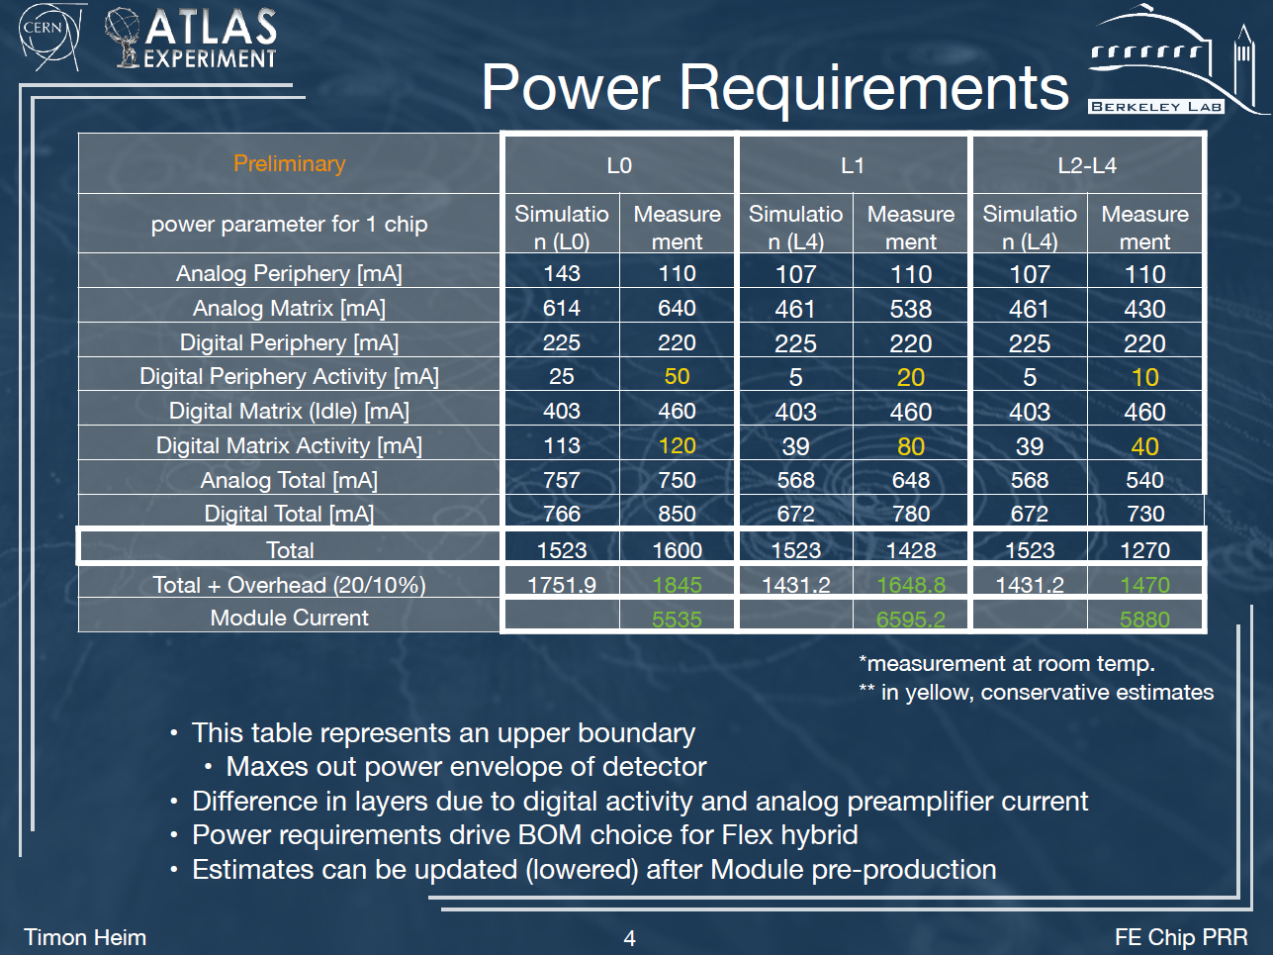
ATLAS Pixel Experience with SP systems

Slide 32
Operational Design

Slide 33
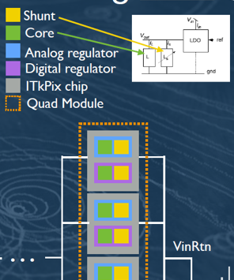
ATLAS Pixel Chip has a Analog & Digital Shunt LDO

Slide 34
IV curves show the operating current Stability/Efficiency
Vin controlled by SP Loop supply
152mΩ

Slide 35
Efficiency Depends on current Overburden
Loop Supply Current Determines Efficiency
152mΩ
1.1W Overburden
2W Overburden
6W to Module
6W to Module
88% Eff
75% Eff

Slide 36
CMS pixel Readout Chip * CROC
Part of the RD53 joint CMS and ATLAS collaboration to design the pixel electronics of the experiment upgrades for the HL-LHC.
Designed in 65nm CMOS technology, features 1.5 × 10⁵ pixel channels and
Consumes about 8 − 10 μA per channel.
Current per chip is ∼ 1.5 A, with a supply voltage of 1.2V.
Shunt-LDO (SLDO) constant current drain in time, independently of the chip power consumption
Hit rates of 3Ghz/cm² and TID of 500MRad
Serial powering scheme to provide the ∼ 60 kW required by ∼ 4000 modular units.
  Total current at 1.2V = 50kA
* Jinst 2024 JINST 19 C01056 Rudy Ceccarelli, 16th Topical Seminar on Innovative Particle and Radiation Detectors

Slide 37
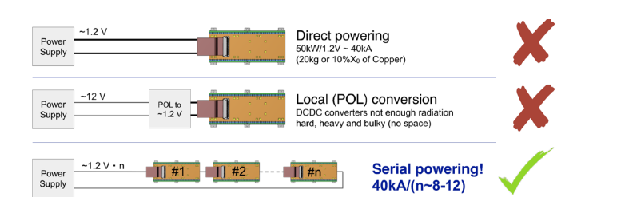
CMS Inner tracker Powering scheme
Current RE-USED in each Chip in the SP Loop
10 Step CMS CROC Serial Powering Test Setup with a Mix of 3D and Planar Pixel Sensors

Slide 38
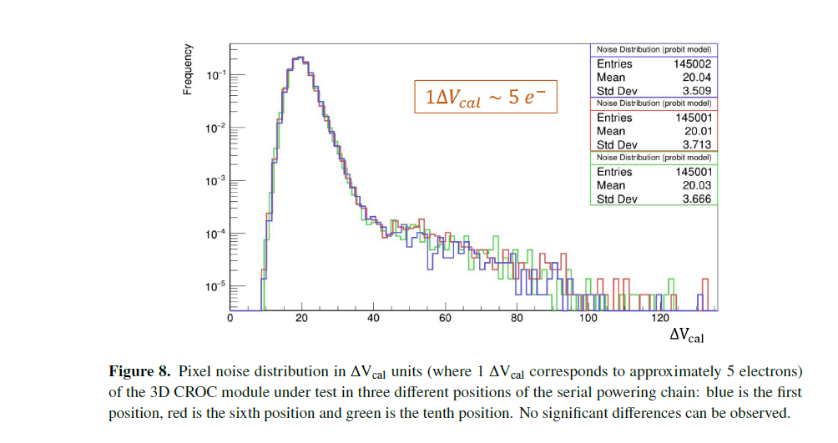
Pixel Performance comparison under Serial Power
Serial power step Position 1, 6, 10 of 10 total
Pixel Noise Distribution

Slide 39
Extras

Slide 40
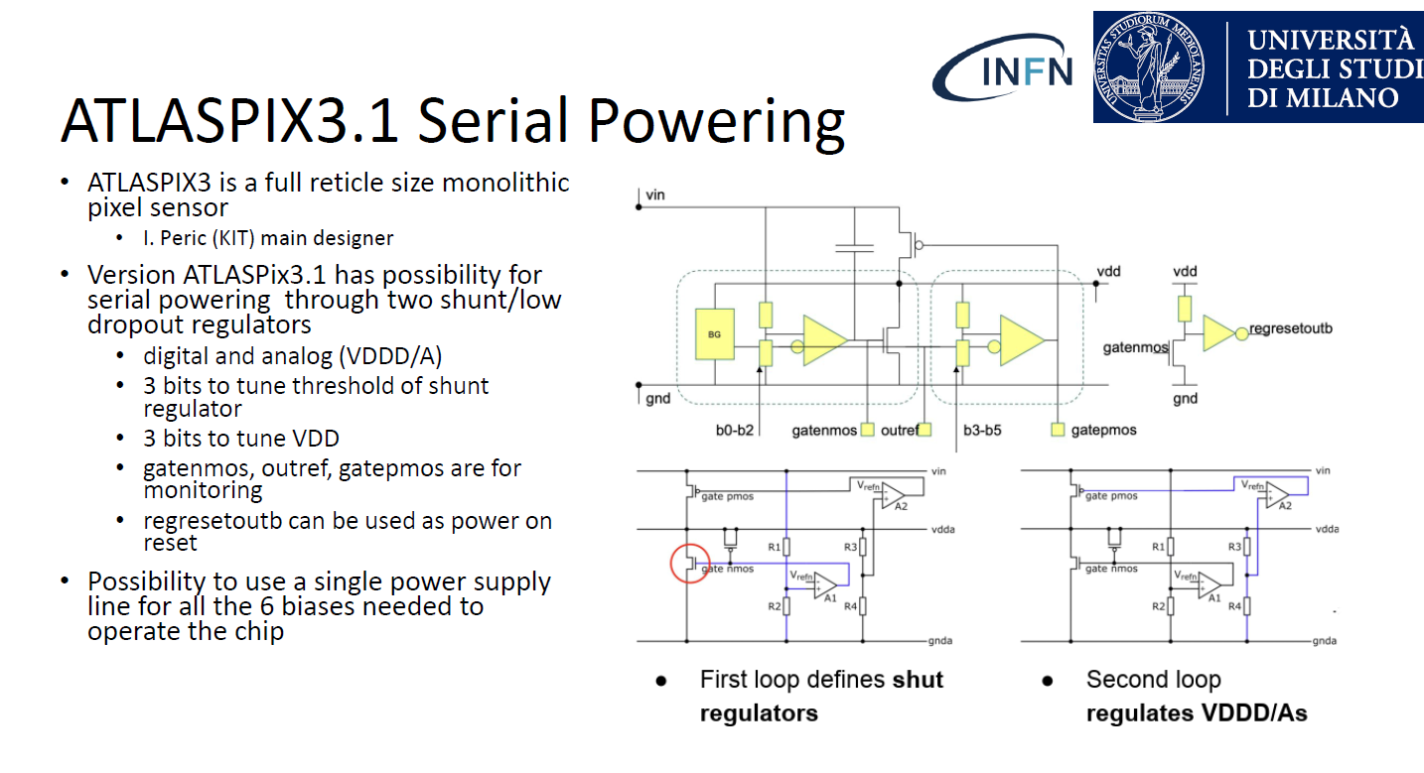
DRD 7.1b Power Efficiency
from WP 7.1b presentation by Stefano Michelis

Slide 42
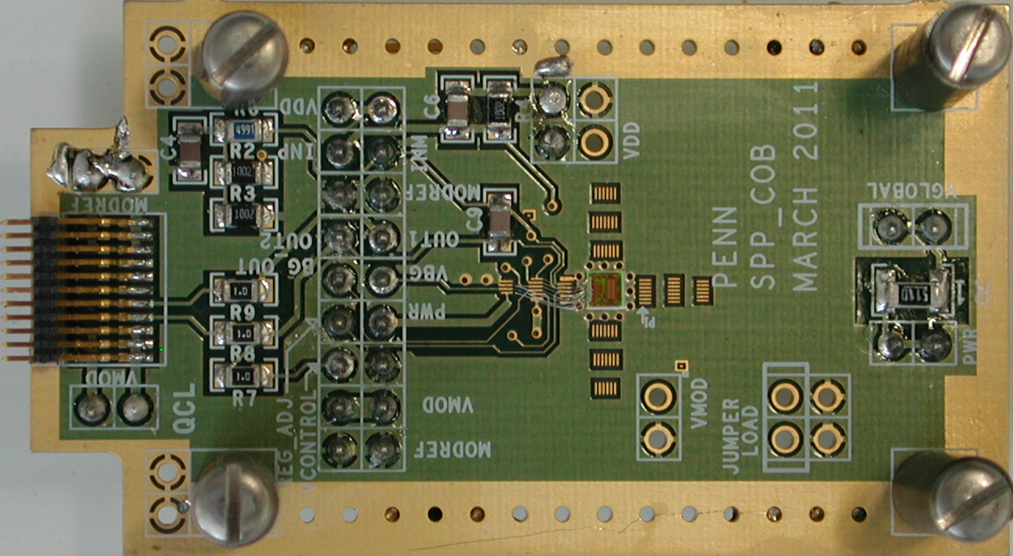
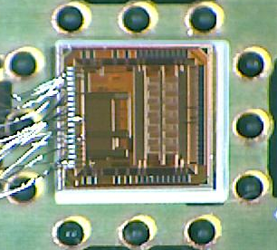
Serial Powering Bench Test PCB Prototype for the ATLAS strips Detector 2011
This ASIC plus Filter Caps go onto the Strips Module

