Slide 1
Vertex detector and intermediate silicon layers: issues and optimisations
Fabrizio Palla
Fabrizio Palla
INFN Pisa and CERN
FCC-ee Workshop: Tracking Detectors and Software
Brookhaven National Laboratory (USA)
7-9 May 2025

Slide 2
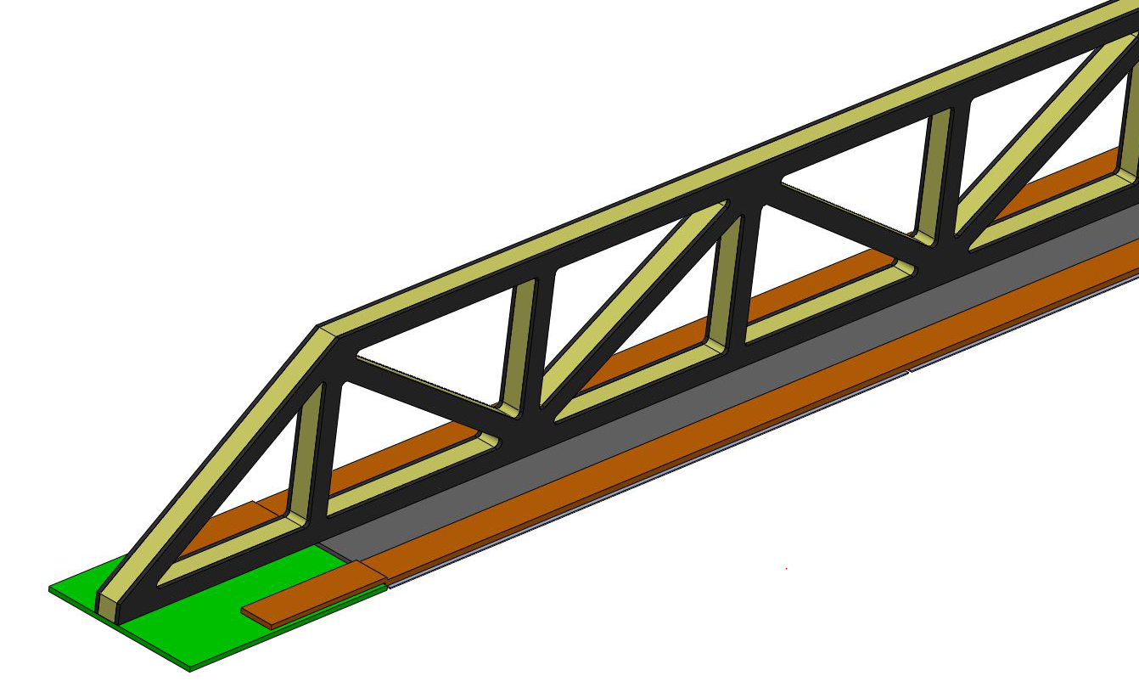
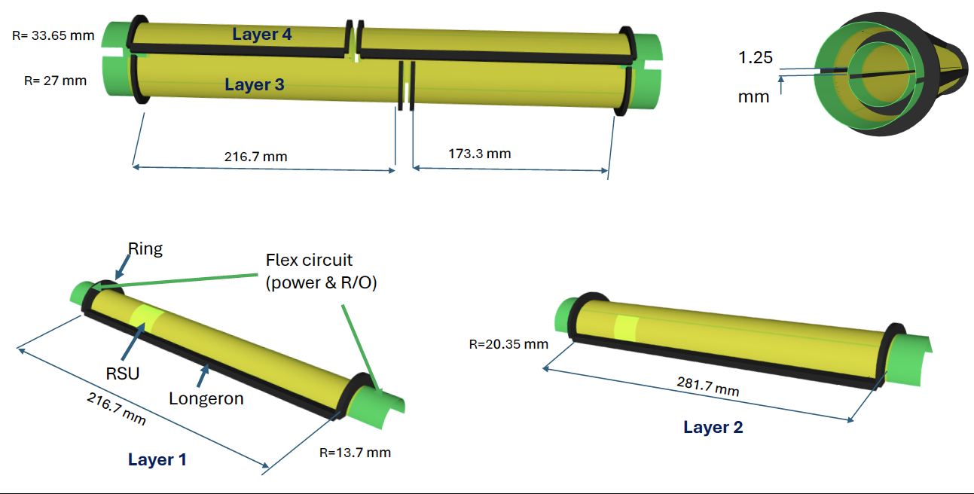
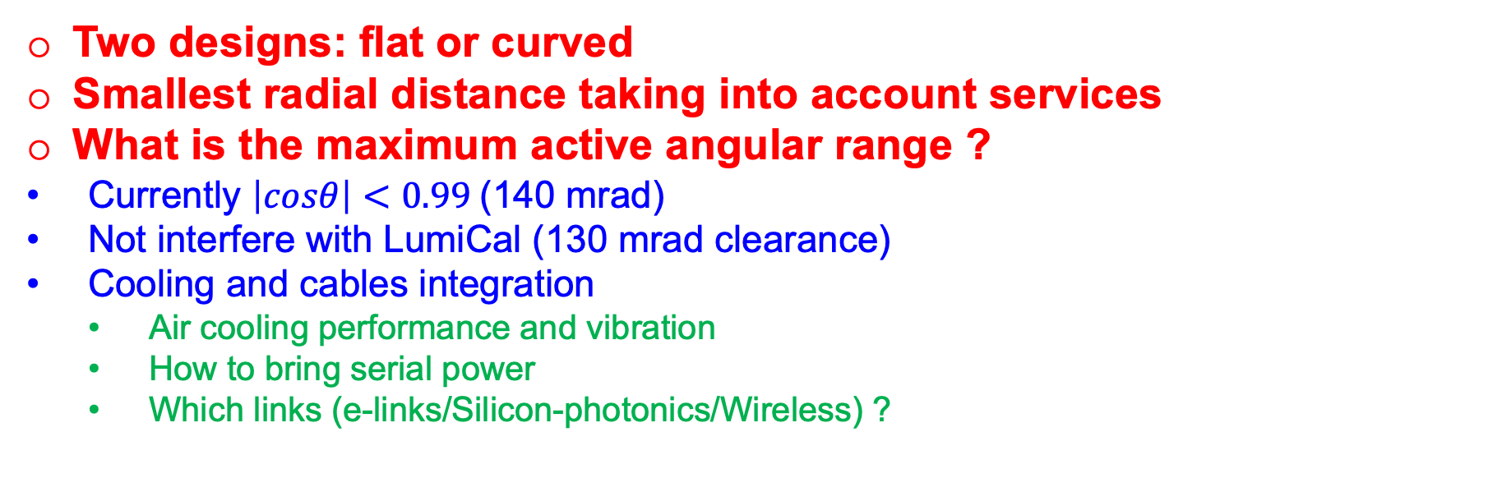
Mechanics and acceptance
Longitudinal «sandwich» beam
Carbon fiber plate
Bus
Two designs: flat or curved
Smallest radial distance taking into account services
What is the maximum active angular range ?
  Currently $\left|cosθ\right|<0.99$(140 mrad)
  Not interfere with LumiCal (130 mrad clearance)
  Cooling and cables integration
    Air cooling performance and vibration
    How to bring serial power
    Which links (e-links/Silicon-photonics/Wireless) ?
Hybrid board

Slide 3
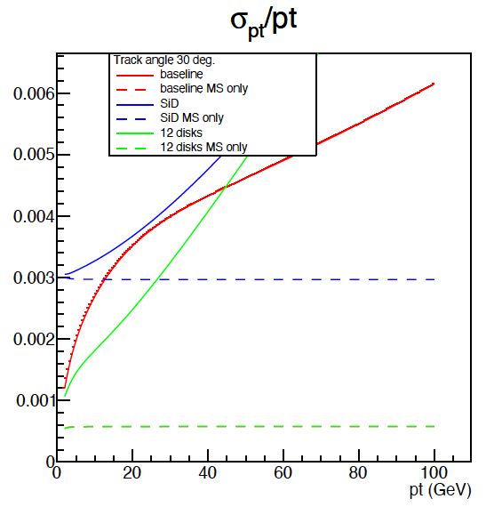
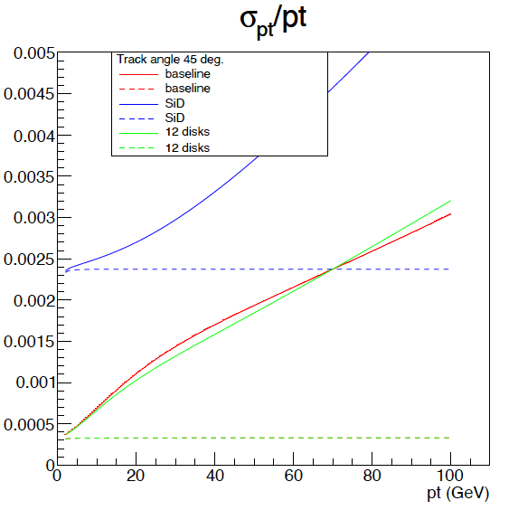
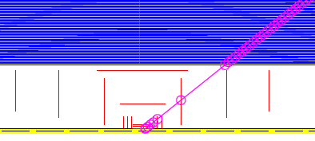
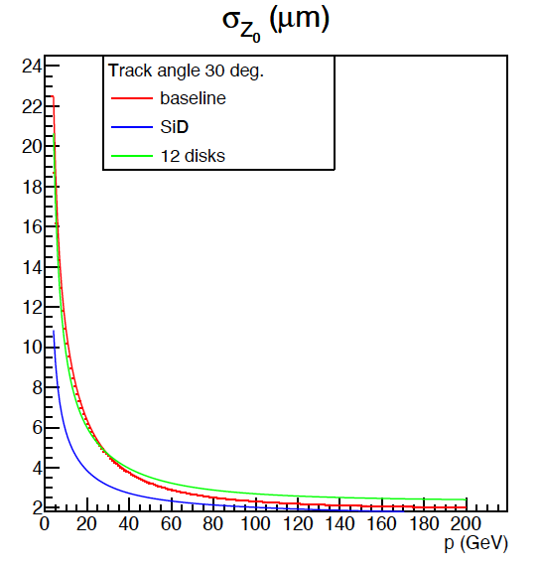
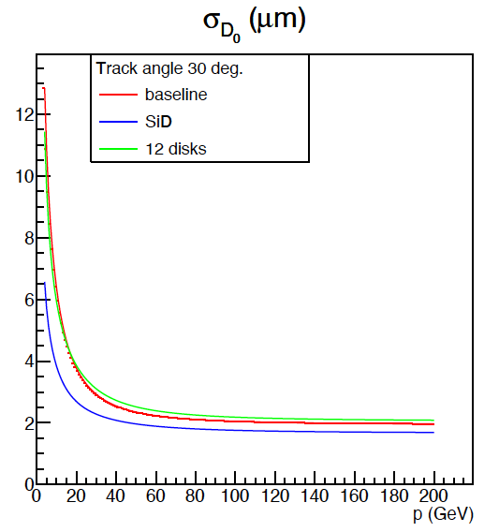

Inner vertex disks?
Courtesy of Caterina Vernieri
(Silicon) material increases at the edges of the acceptance
  Slightly better i.p. resolution at lower momenta. Worse at high
  Improved resolution in momentum resolution at $θ∈\left[30º − 45º\right]$
How difficult is the mechanics to be implemented taking into account services?
  Where to route the cables
  How to cool the vertex?

Slide 4
What is the boundary between Vertex detector and Drift chamber?
6 inner DC layers removed
(inner radius DC R=449 mm;
AND outer vertex R=400 mm)
Currently at 35 cm, can go to 40 cm ?
  More space for vertex service routings
  Less occupancy of DC at smaller radii
  Do not lose anything on the tracking performance (maybe better if outer vertex radius shifted
What is the optimal radius?
  Need simulations
Courtesy of Franco Bedeschi
Standard

Slide 5
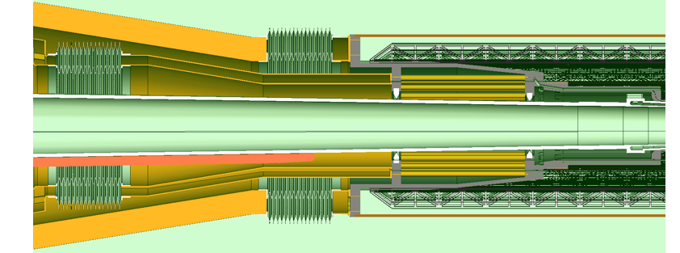
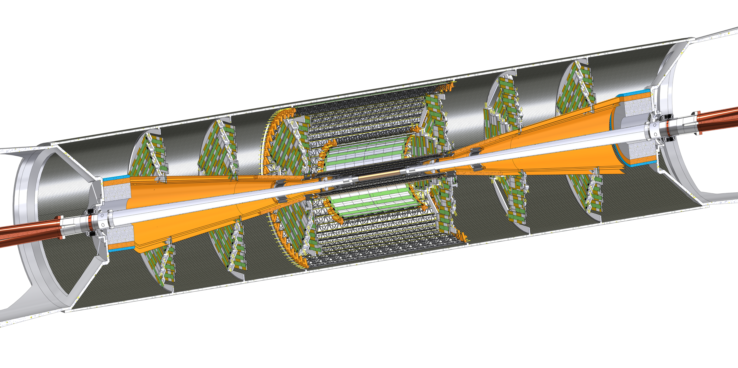
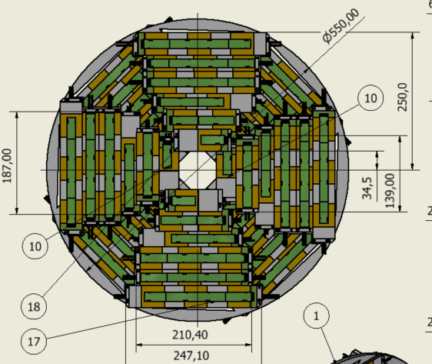
Inner vertex cooling and services routings
Air-Cones solution and its problems
  Need 3 air-cones to efficiently cool the vertex
    Difficulty in regulating the air flow a priori
  Almost projective geometry
    Paraffine cooling manifolds need to exit below the cones
    Might cause showers and material in front of the disks and LumiCal
  Assembly/maintenance problems
    Cones limit disks acceptance to allow 130 mrad clearance for LumiCal
    Maintenance uneasy in opening the detector and accessing inner vertex
    How to connect the cooling cones at the end?
Layer 1&2 cooling cone
Beam pipe cooling manifold
Layer 3 cooling cone

Slide 6
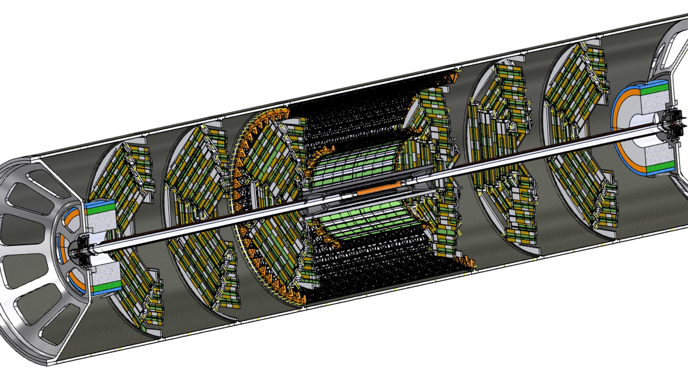



































Option A
Drawbacks:
Some material in front of the LumiCal
Some material close to the disks
Difficult integration
Benefits:
Less material in front of Drift chamber

Slide 7
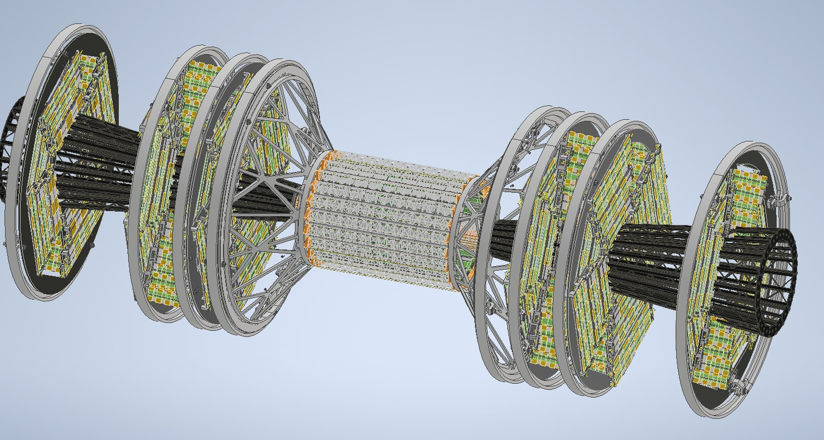

Slide 8











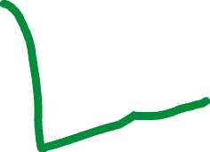









Option B
Drawbacks:
Some material in front of first disk
Benefits:
Easier integration
Less material in front of LumiCal

Slide 9
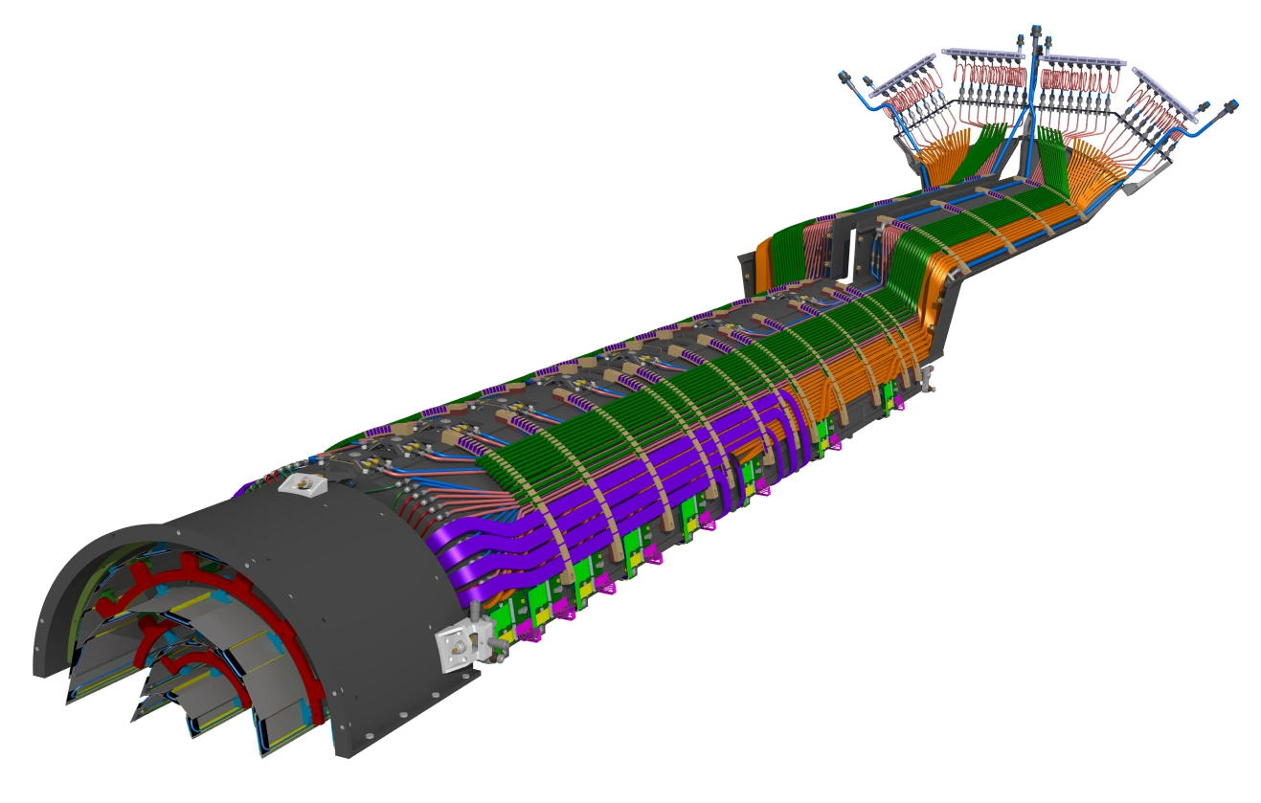
Cooling and cables space on the support cylinder
Courtesy of Daniele Benvenuti
Similar to CMS Phase-2 vertex detector
E-links (1.28 Gb/s) 1 and 1.6 meters long from CROC to LGBT on portcards in the service cylinder
(3 e-links for CMS – 4 e-links for ATLAS)

Slide 10
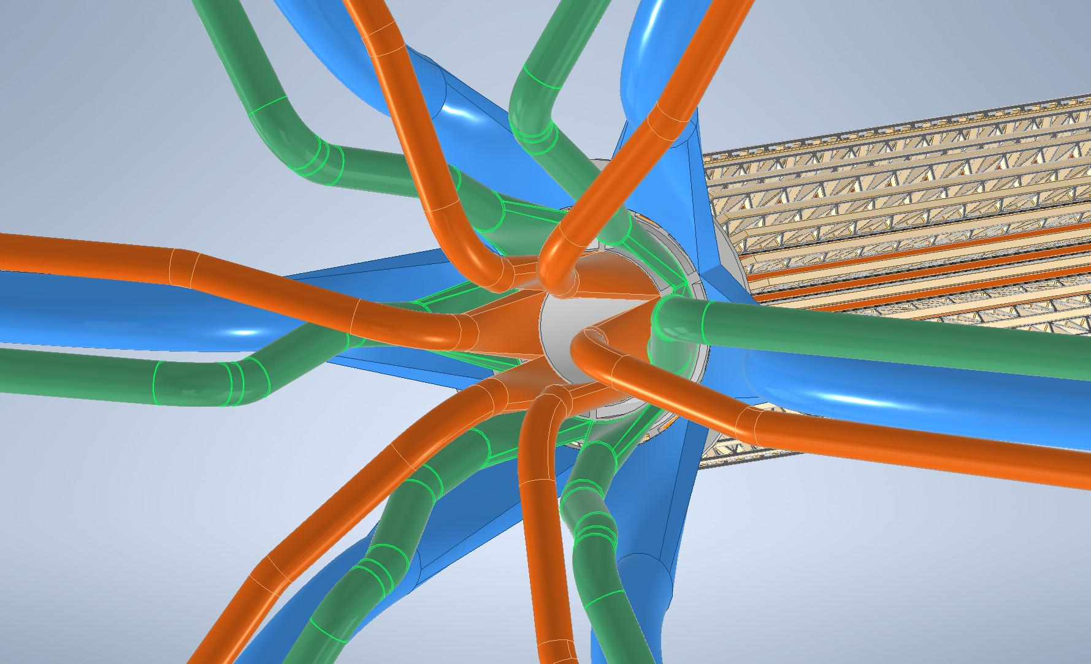
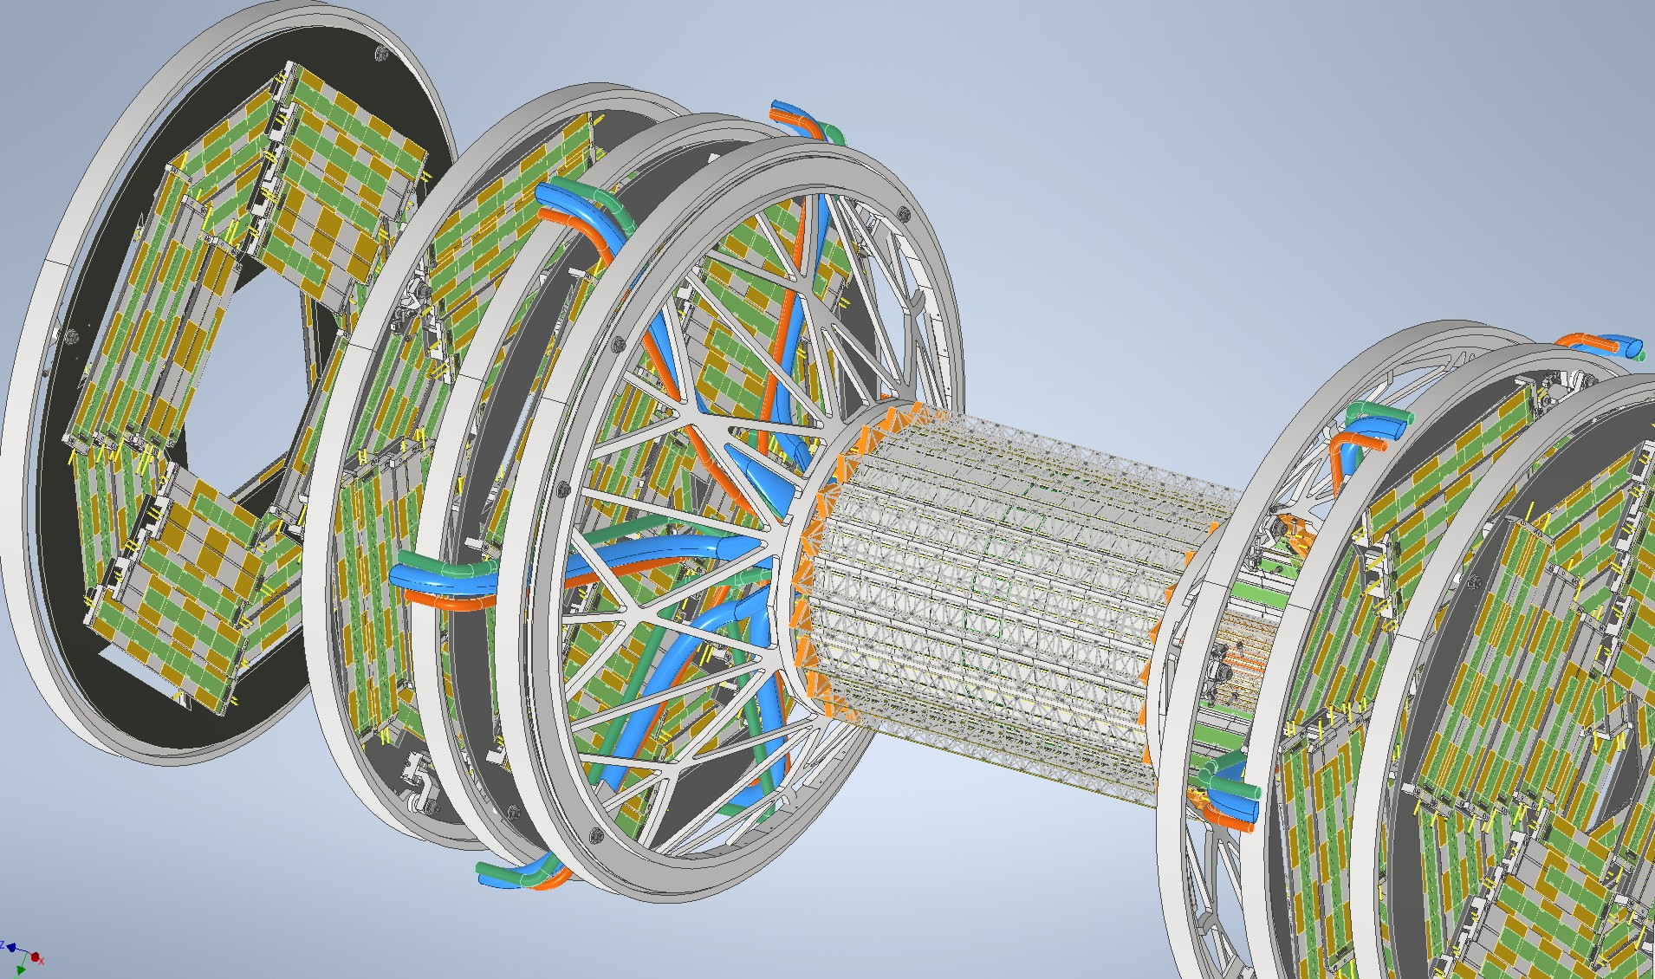
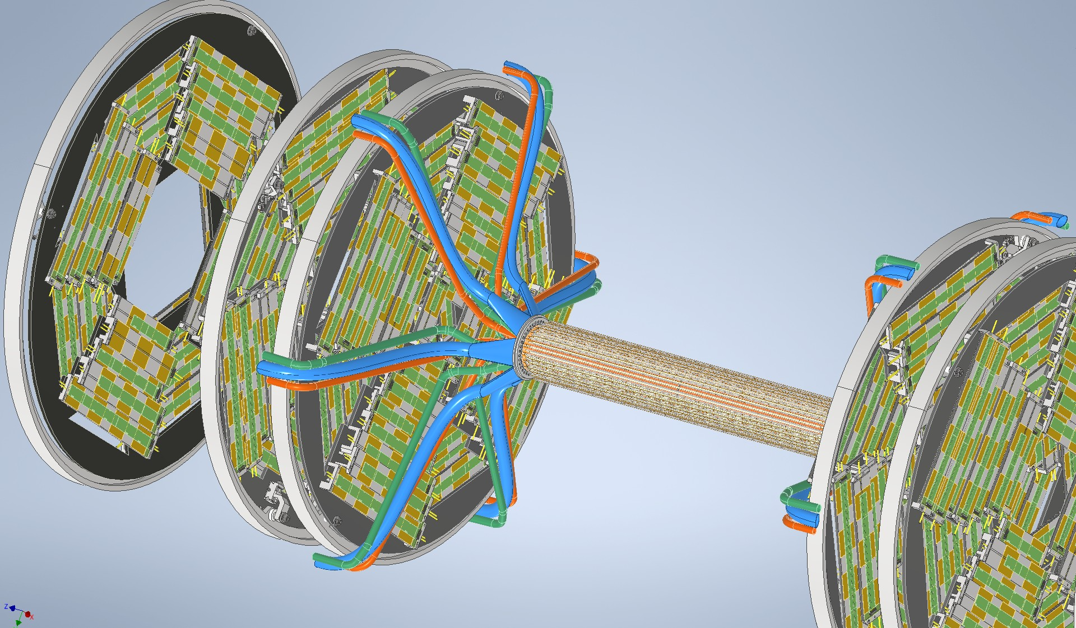
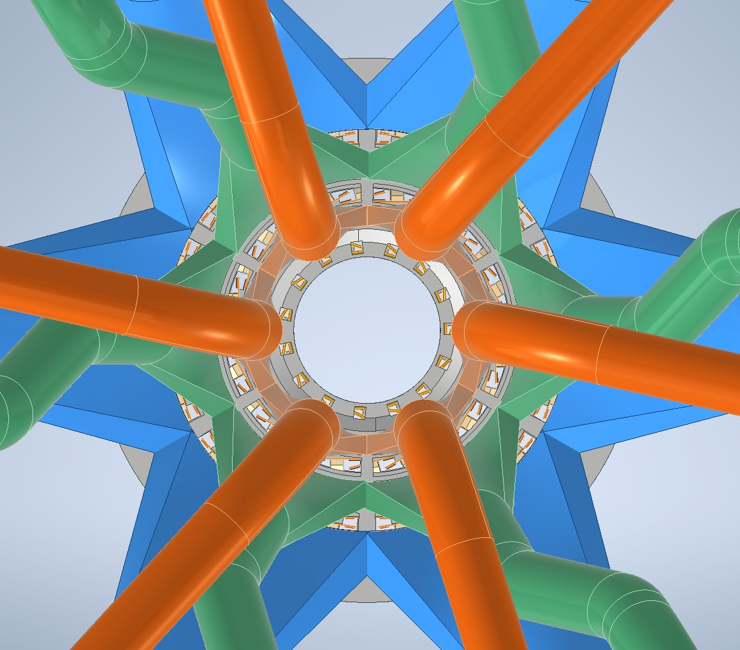
Inner vertex detector air ducts
Courtesy of Gherardo Ammirabile

Slide 11
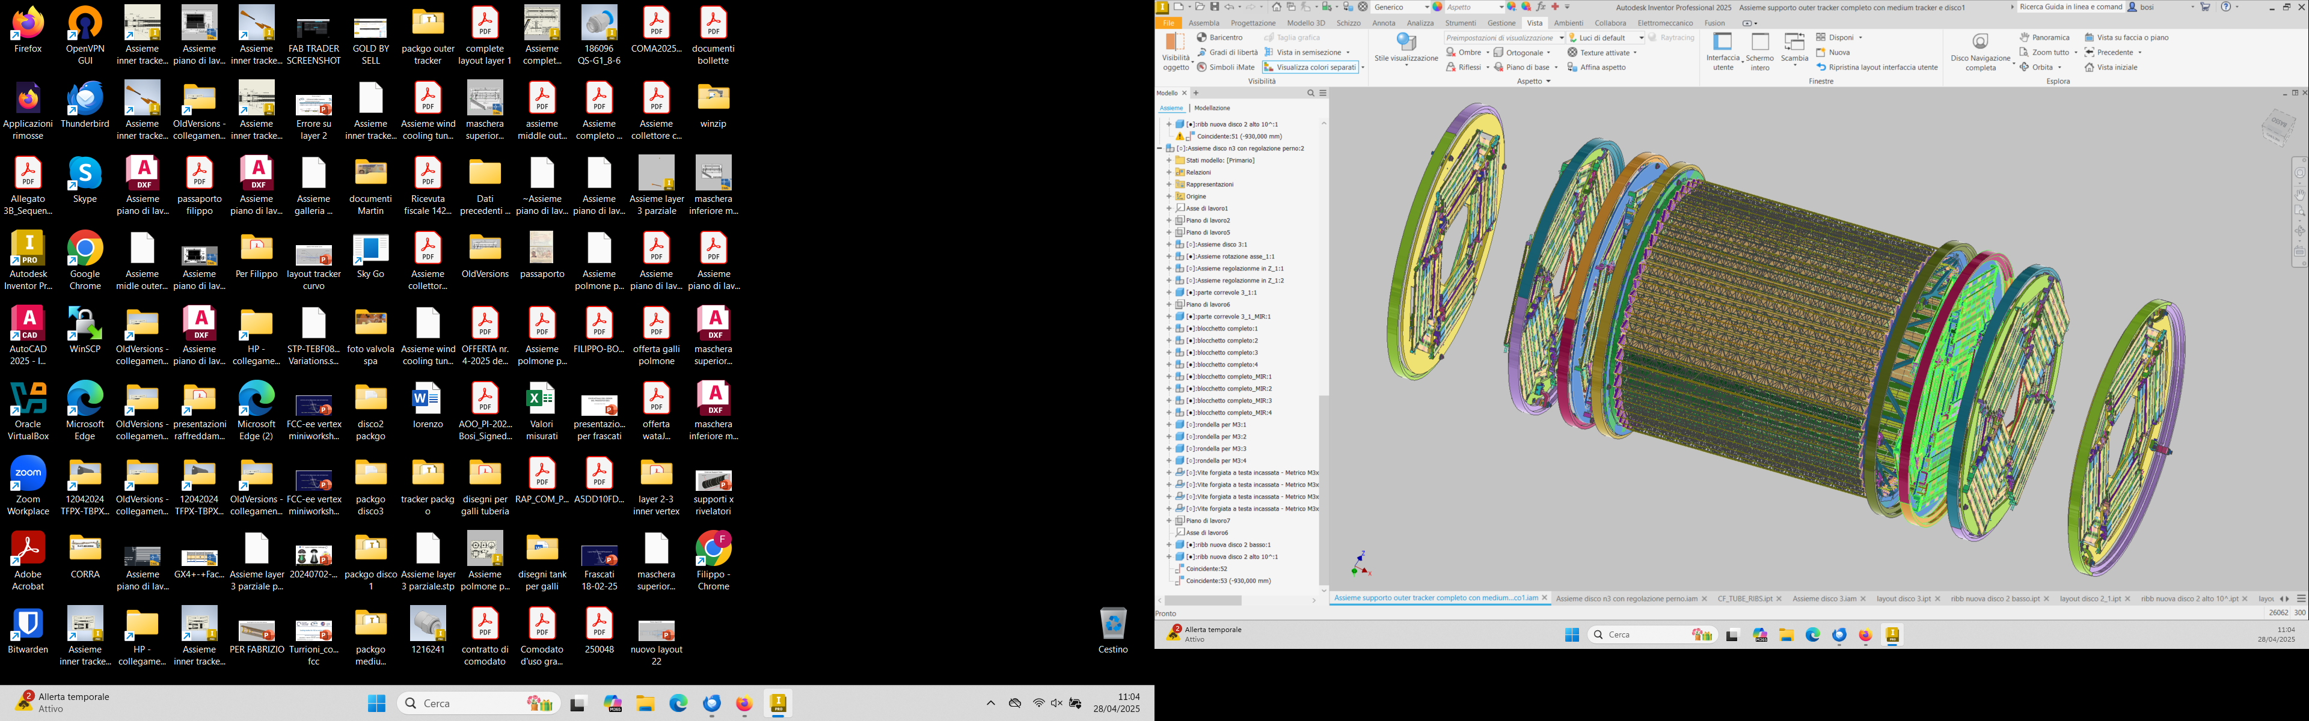
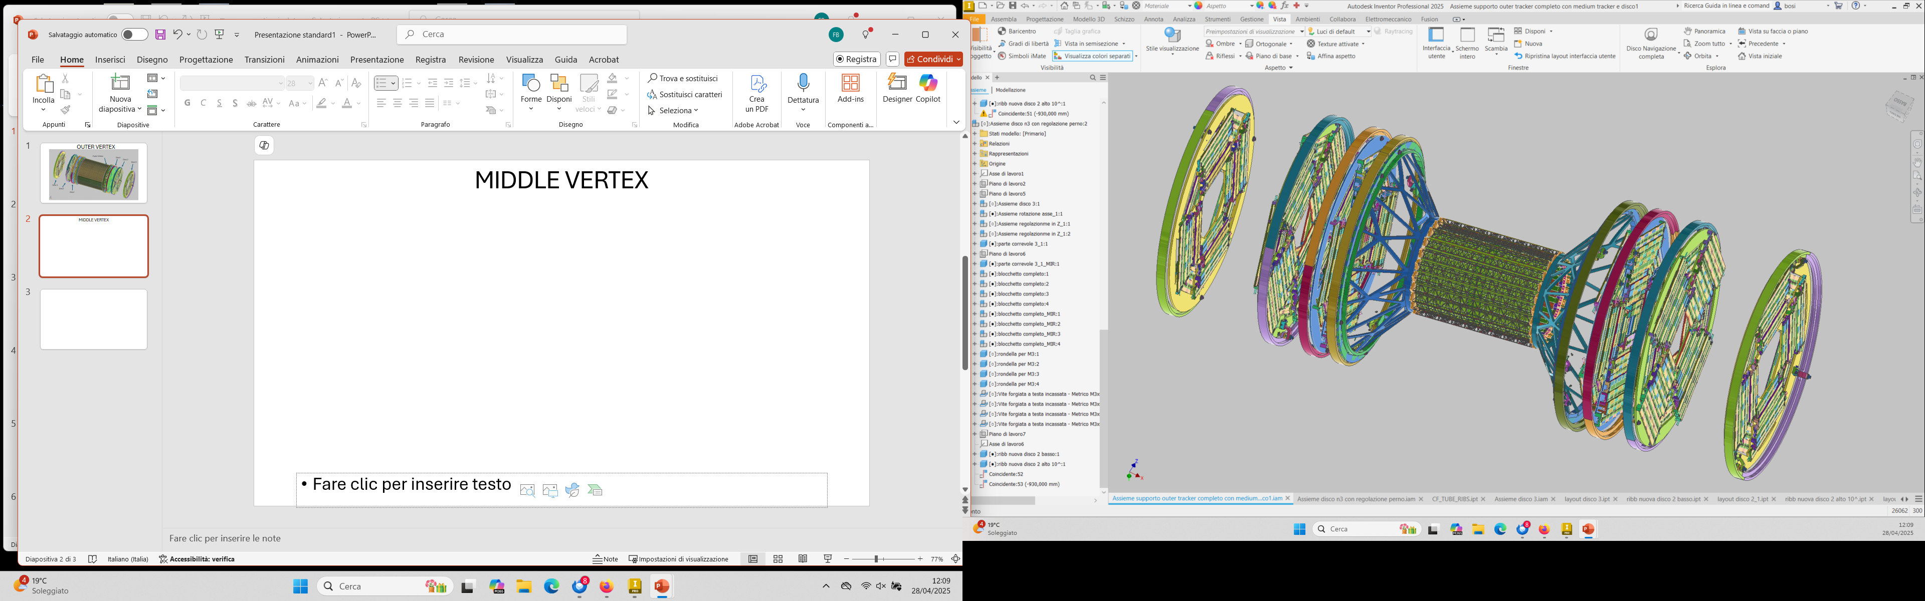
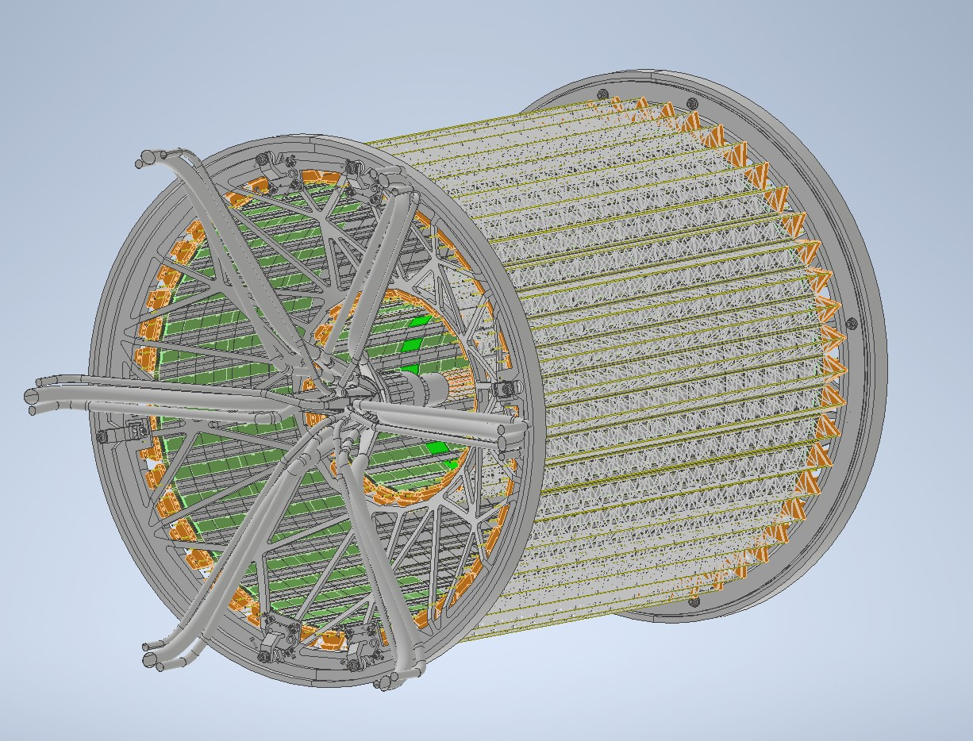
MIDDLE VERTEX
Disk 1
Outer Vertex
Disk 2
Disk1
Disk 2
Disk 3
Disk 3
Disk 3
Disk 3
Disk2
Disk 2
Disk 1
Disk1
Suppporting Ribs
Supporting Ribs
Courtesy of Gherardo Ammirabile and Filippo Bosi

Slide 12
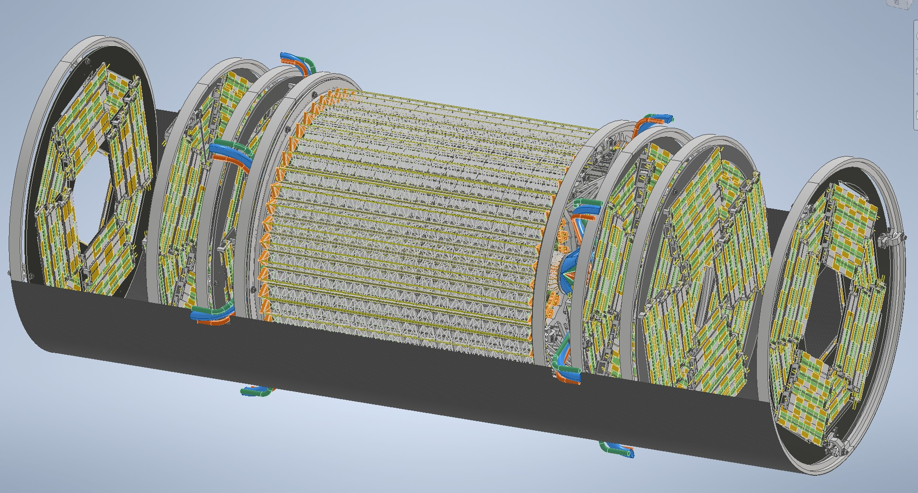
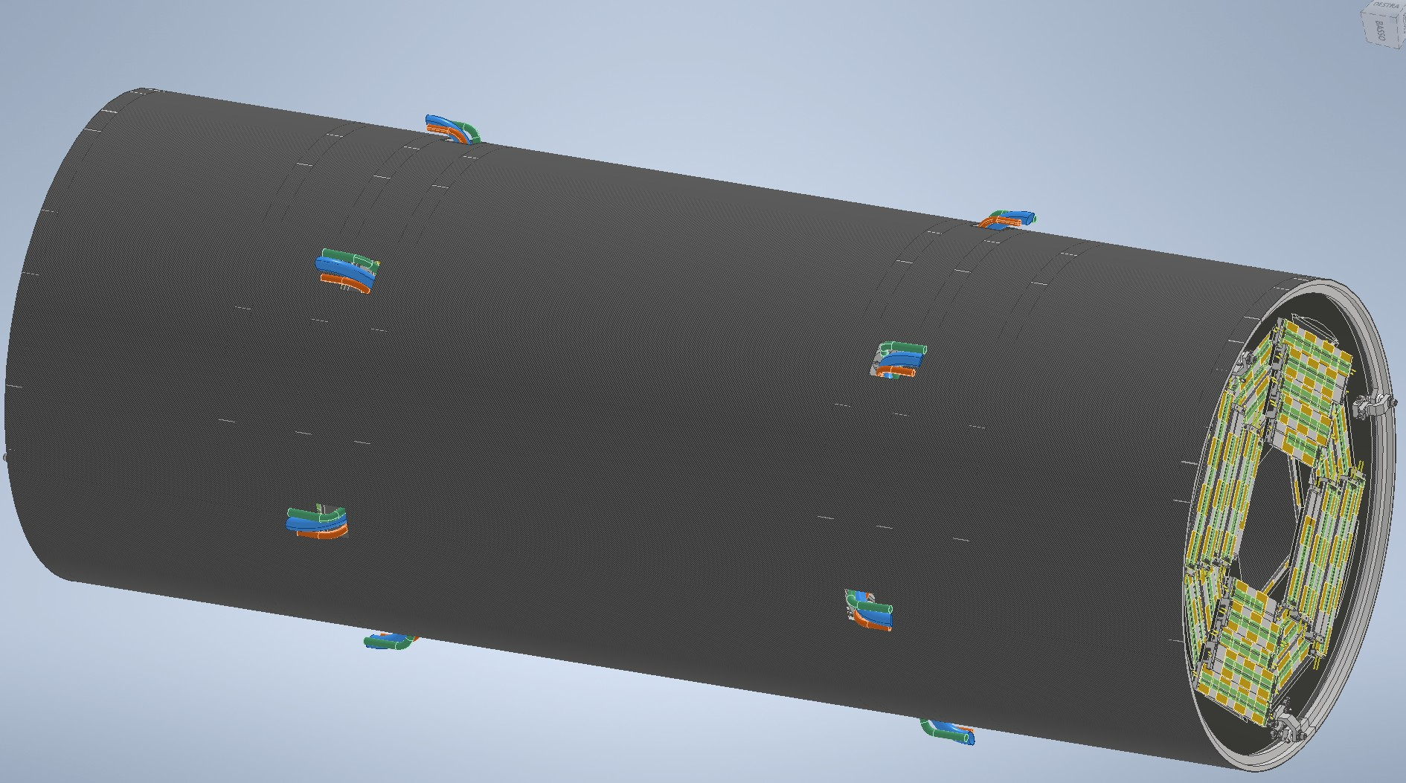

Slide 13
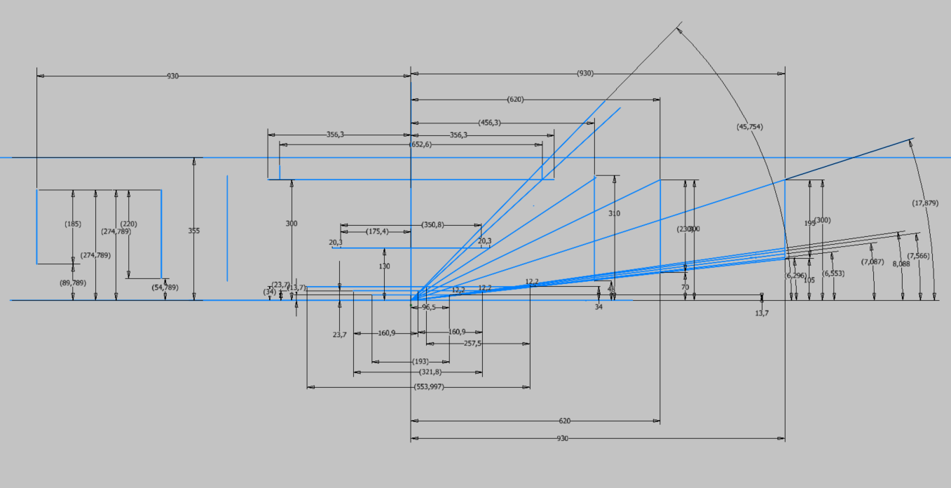
Possible new Vertex Layout without cones
Push disk-1 forward
Reduce outer vertex radius 30 cm (instead of 31.5) to cover the gap
  Also put sensors inward to have less material budget in the outer vertex

Slide 14
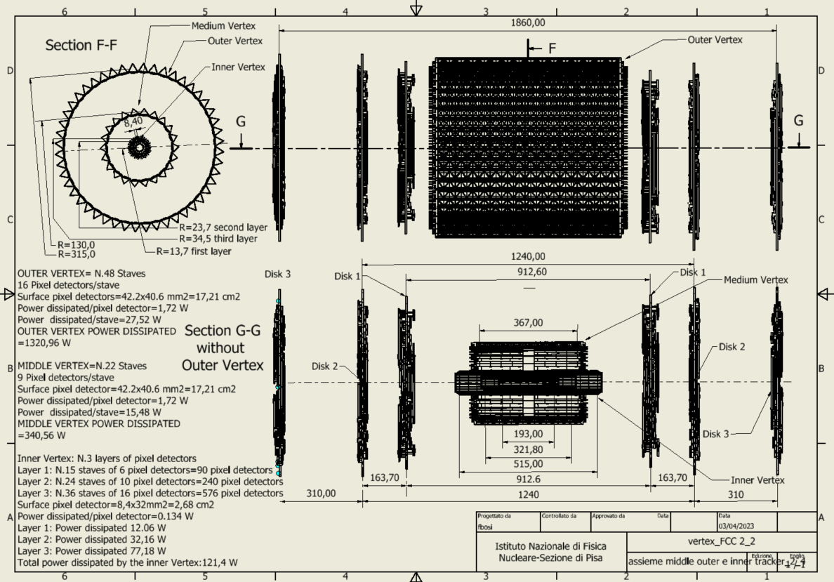
New possible layout

Slide 15
Bake out of the vacuum chambers
Depending on the needs to desorb the beam pipe materials from gases and contaminants, the vertex detector needs to be cooled
  Currently it is envisaged to decouple the vertex from the beam pipe through rings of peek.
    However it is important to compute the thermal load on the vertex during bake-out

Slide 16
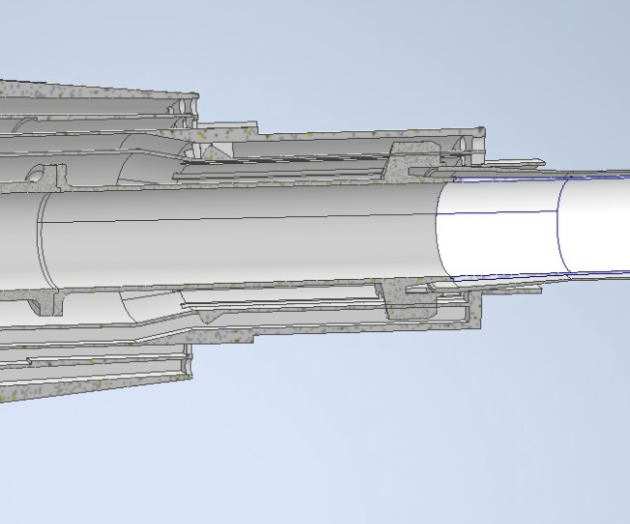
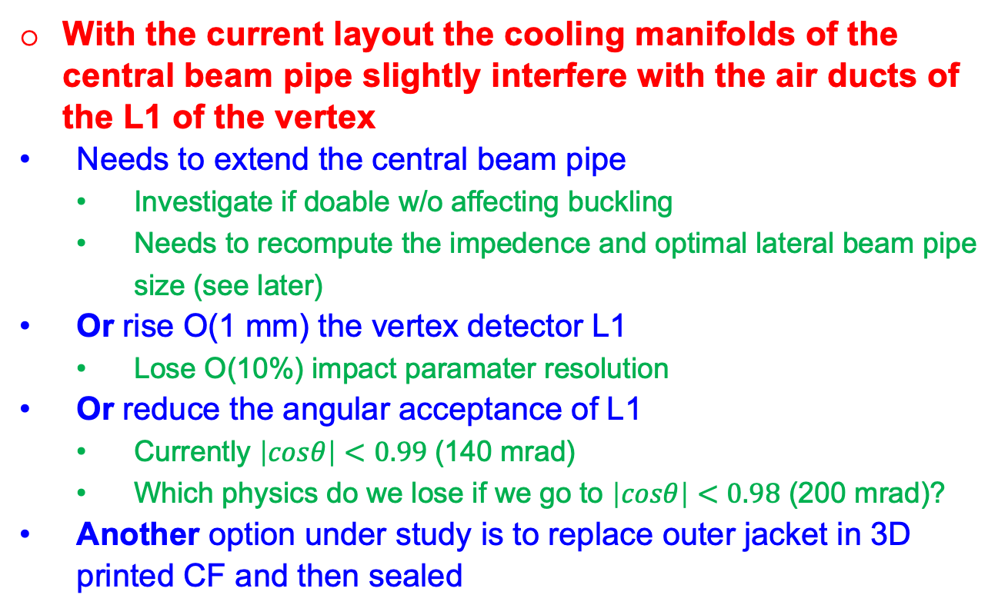
Beam pipe cooling manifold and inner vertex integration issues
With the current layout the cooling manifolds of the central beam pipe slightly interfere with the air ducts of the L1 of the vertex
  Needs to extend the central beam pipe
    Investigate if doable w/o affecting buckling
    Needs to recompute the impedence and optimal lateral beam pipe size (see later)
  Or rise O(1 mm) the vertex detector L1
    Lose O(10%) impact paramater resolution
  Or reduce the angular acceptance of L1
    Currently $\left|cosθ\right|<0.99$(140 mrad)
    Which physics do we lose if we go to $\left|cosθ\right|<0.98$ (200 mrad)?
  Another option under study is to replace outer jacket in 3D printed CF and then sealed
Courtesy of Gherardo Ammirabile

Slide 17
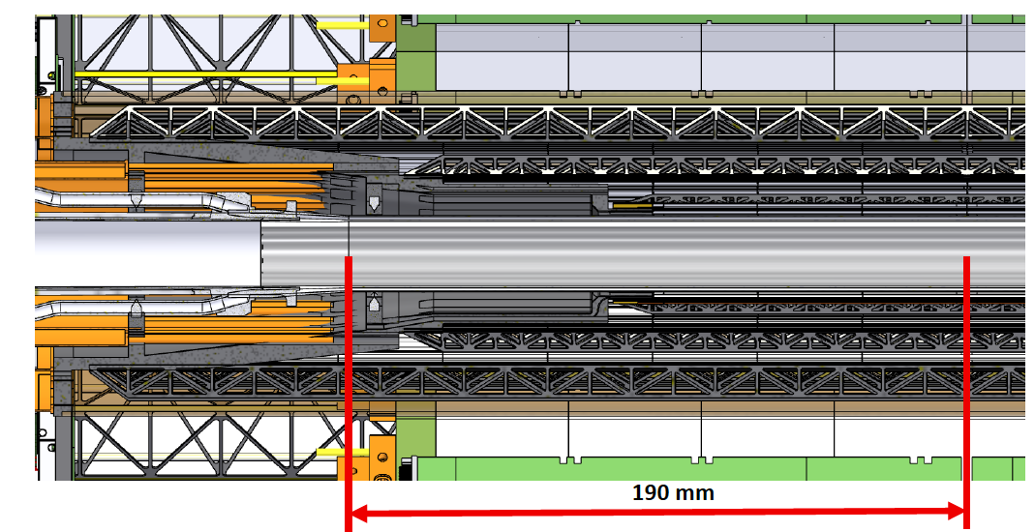
Longer central beam pipe?

Slide 18
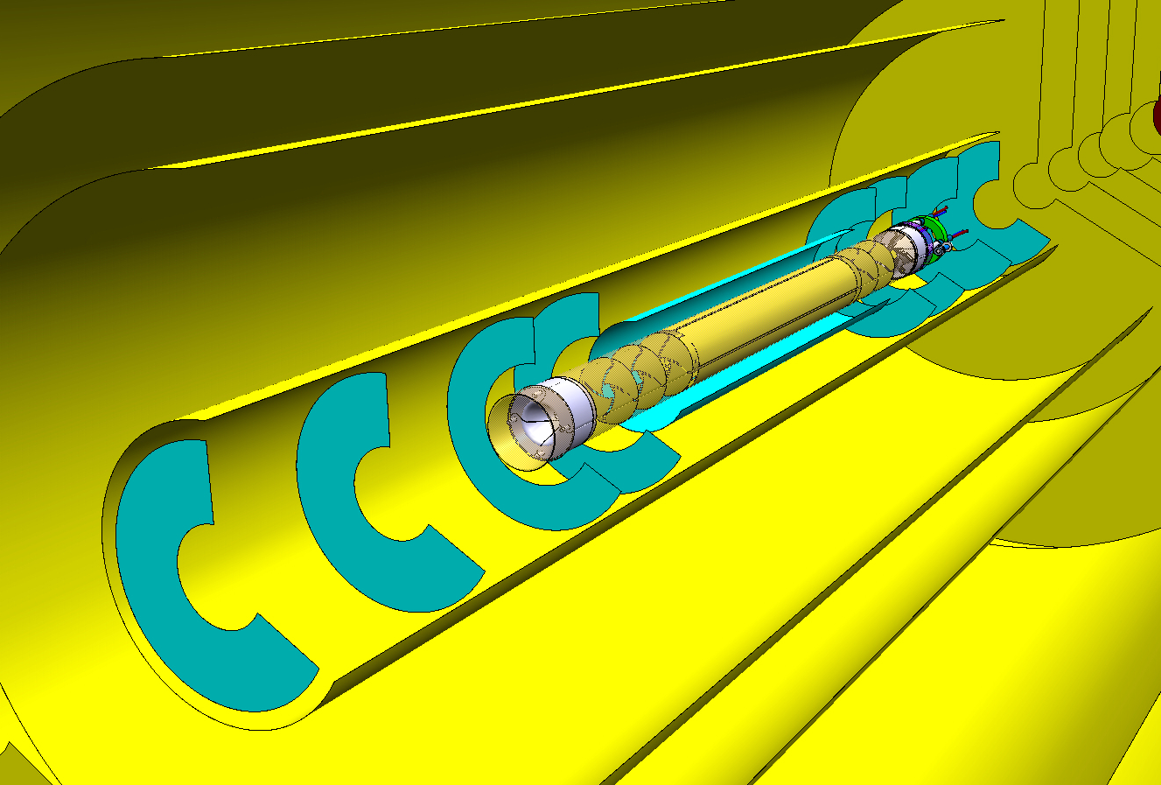

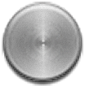
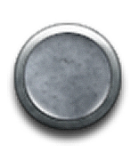
Going inside beam pipe?
Even more aggressive put everything in beam pipe with a secondary vacuum (ALICE IRIS) needs to solve several other problems
  Beampipe aperture
  Vacuum
  Resistive wall effects (heating and beam instability)
  Cooling and services
  …

Slide 19
Backup

Slide 20
MAPS technology for the vertex
Cope with hit rate of 200 MHz/cm² (large safety factors)
  Keep power dissipation to less than 50 mW/cm²
  20 ns time resolution to limit triggerless bandwidth
  Triggered readout needs buffers in the chip periphery – may mitigate power dissipation
3 µm hit resolution
  Pixel pitch vs technology
Stitching/abuttability
  How long a sensor can be made?

Slide 21
Hit resolution
Standard process:
Diffusion dominated charge collection
Slow and subject to charge trapping
High charge sharing
Better resolution
Lower hit efficiency at high thresholds
Modified with gaps process:
Drift dominated charge collection
Fast
Low charge sharing
Worse resolution
high hit efficiency even at high thresholds
E. Ploerer
IWORID2024
CE-65 standard
CE-65 modified

Slide 22
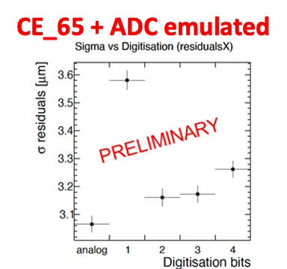
Hit resolution
CERN-LHCC-2024-003 ; ALICE-TDR-021
APTS
Strasbourg:
High pitch (25µm)
and small ADC
DPTS 15 µm pitch

Slide 23
Standard (35 cm inner radius)
Courtesy of Franco Bedeschi

Slide 24
Modified (40 cm inner radius)
Courtesy of Franco Bedeschi

