Slide 1



Emittance and bunch length diagnostics for run 2c
J. Wolfenden, D. Ghosal, A-M. Guisao Betancur,
C. Swain, and C. Welsch
22nd AWAKE Instrumentation meeting
11/03/2025

Slide 2
Overview
Emittance - OTR/OSR measurements at CLEAR
Bunch length – CTR/CSR measurements at MAX IV
J. Wolfenden (joseph.wolfenden@cockcroft.ac.uk)
22nd AWAKE Instrumentation meeting 11/03/2025
2

Slide 3
Emittance

Slide 4
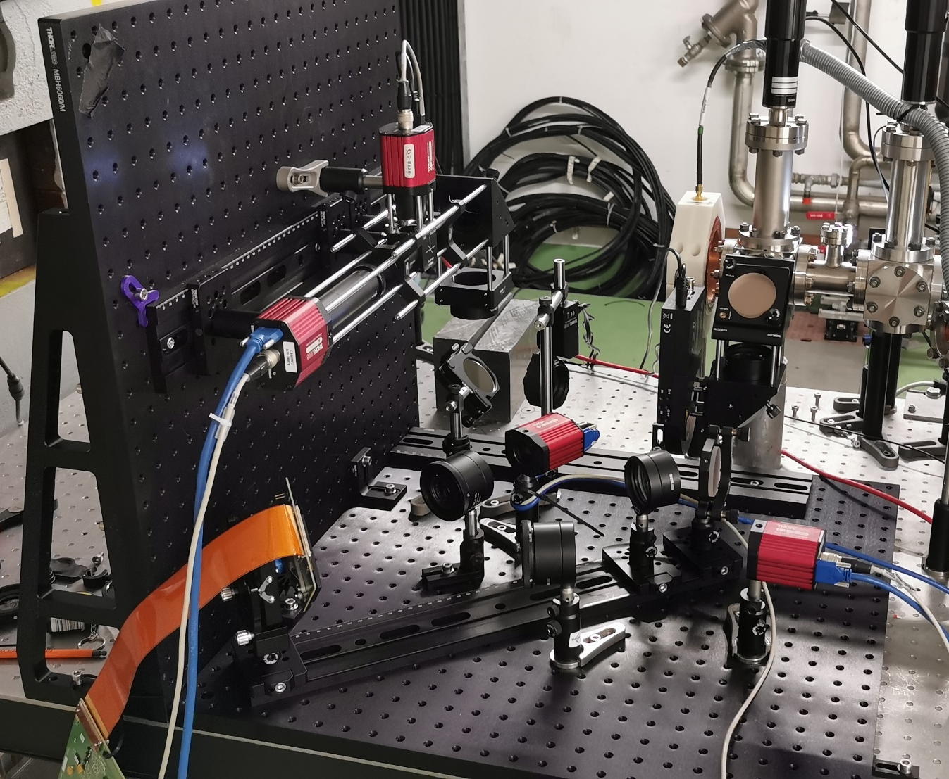
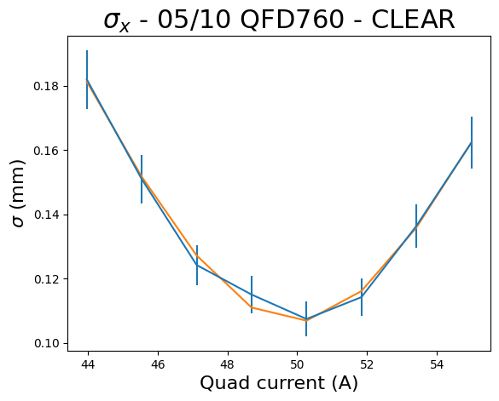
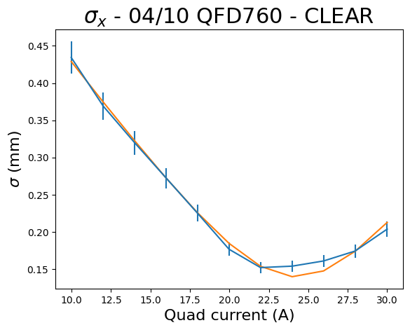
Emittance – Review Oct. ‘23
Data from October ‘23 run provided PoC for the measurement procedure for the MLA
Benchmarking was done using quadrupole scans – inconsistencies in the data
Emittance varied wildly between all measurements
ε_{x} =27 mm mrad
ε_{x}=15 mm mrad
J. Wolfenden (joseph.wolfenden@cockcroft.ac.uk)
22nd AWAKE Instrumentation meeting 11/03/2025
4

Slide 5
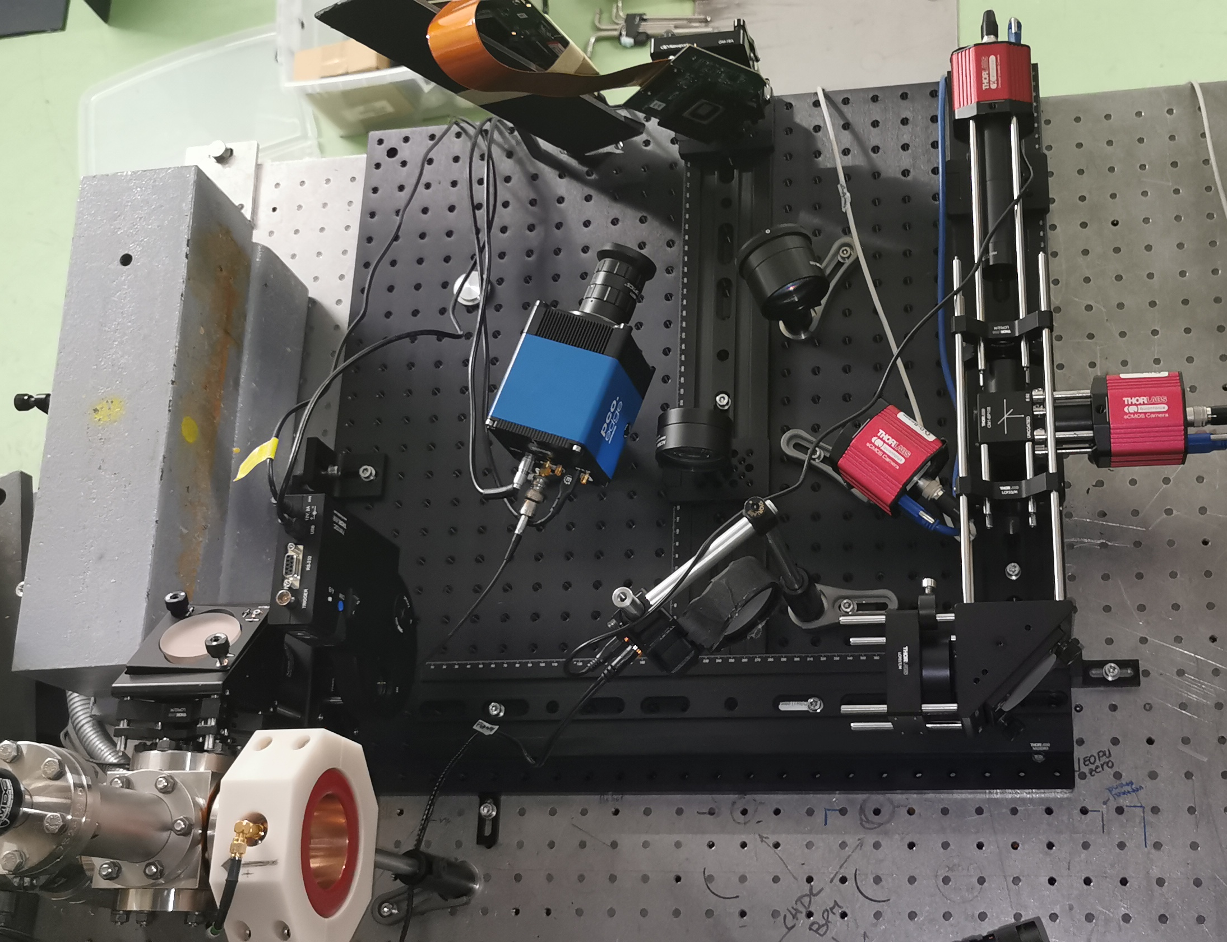
Emittance – Review Jun. ‘24
MLA unchanged from previous run
DMD system updated with new camera and angular optics
Extensive quadrupole scan study undertaken with online analysis
A range of (magnetic) optics were captured
  inconsistencies highlighted online
“Consistent” benchmark values found:
  ε_{x} ≈ (15.6 ± 2.6) mm mrad
  ε_{y} ≈ (4.2 ± 0.7) mm mrad
J. Wolfenden (joseph.wolfenden@cockcroft.ac.uk)
22nd AWAKE Instrumentation meeting 11/03/2025
5

Slide 6
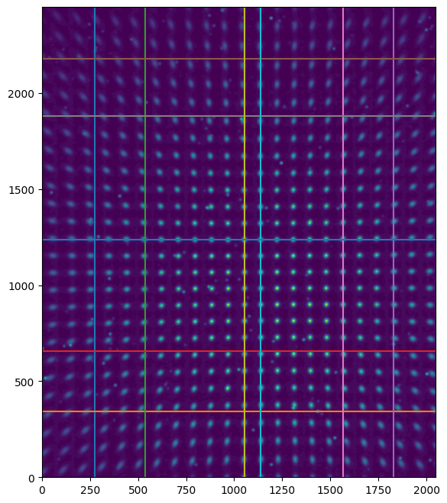
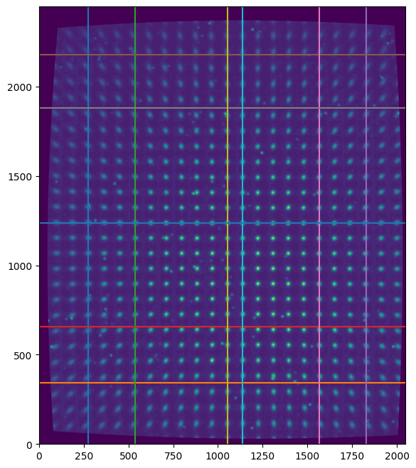
Emittance – Review Jun. ‘24
Pincushion distortion found in images
“Correction”
J. Wolfenden (joseph.wolfenden@cockcroft.ac.uk)
22nd AWAKE Instrumentation meeting 11/03/2025
6

Slide 7
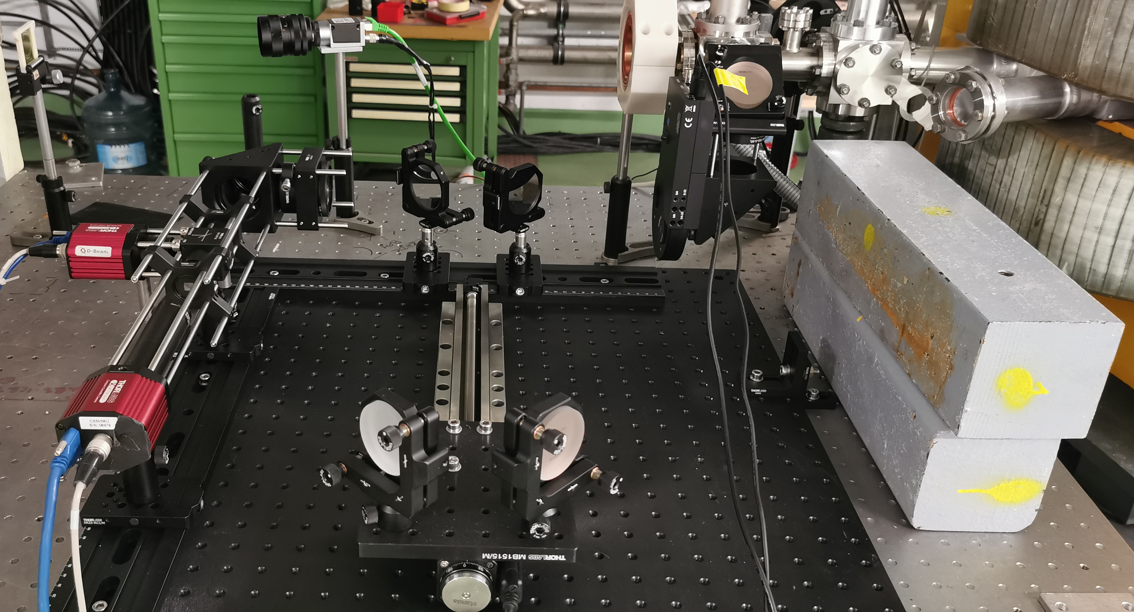
Emittance – Review Jun. ‘24
A final goal of the measurements was to test the potential for OSR from CLEAR
Modified setup on final afternoon, ended up with 20 minutes(!) of beam to test
Idea to return late 2024 to try
non-invasive version of MLA/DMD
No screen on diverted beamline
Very quick alignment
No beam optimisation
J. Wolfenden (joseph.wolfenden@cockcroft.ac.uk)
22nd AWAKE Instrumentation meeting 11/03/2025
7

Slide 8
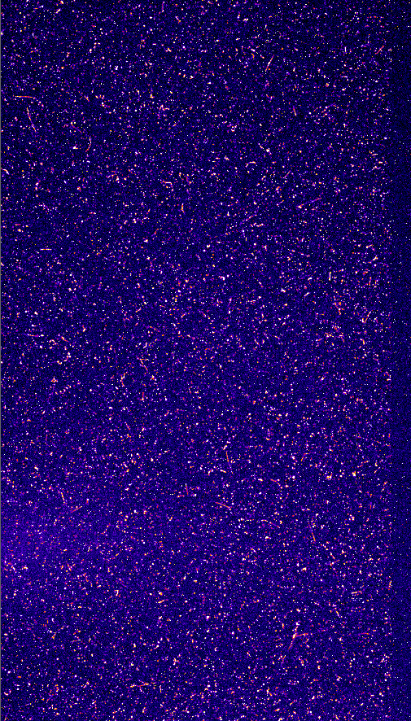
Emittance – Review Jun. ‘24
~19nC @ ~200 MeV
Signal definitely beam dependent
Couldn’t centre signal in the time we had
Not at focus – steered off screen by delay line
Very promising first glimpse!
J. Wolfenden (joseph.wolfenden@cockcroft.ac.uk)
22nd AWAKE Instrumentation meeting 11/03/2025
8

Slide 9
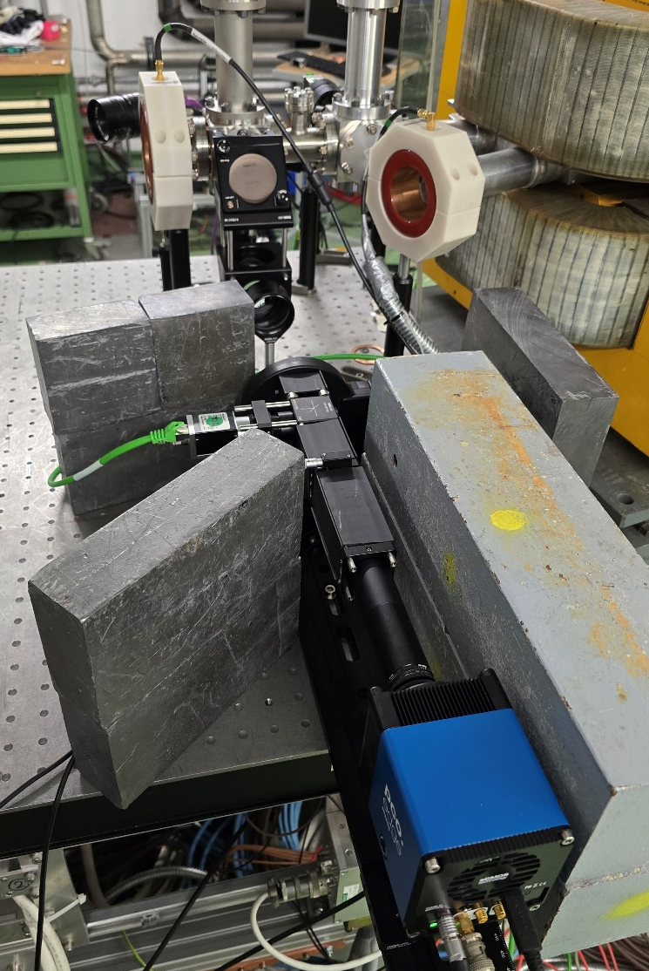
Emittance – CLEAR Dec. ‘24
Changed final imaging optic to a matched pair of air spaced achromats – removed pincushion distortion
Using high resolution sCMOS
Significantly simplified installation and alignment
Much better background shrouding (light) and shielding (radiation)
Took both OSR and OTR data
Spatial distribution
Micro-lens array
Angular distribution
J. Wolfenden (joseph.wolfenden@cockcroft.ac.uk)
22nd AWAKE Instrumentation meeting 11/03/2025
9

Slide 10
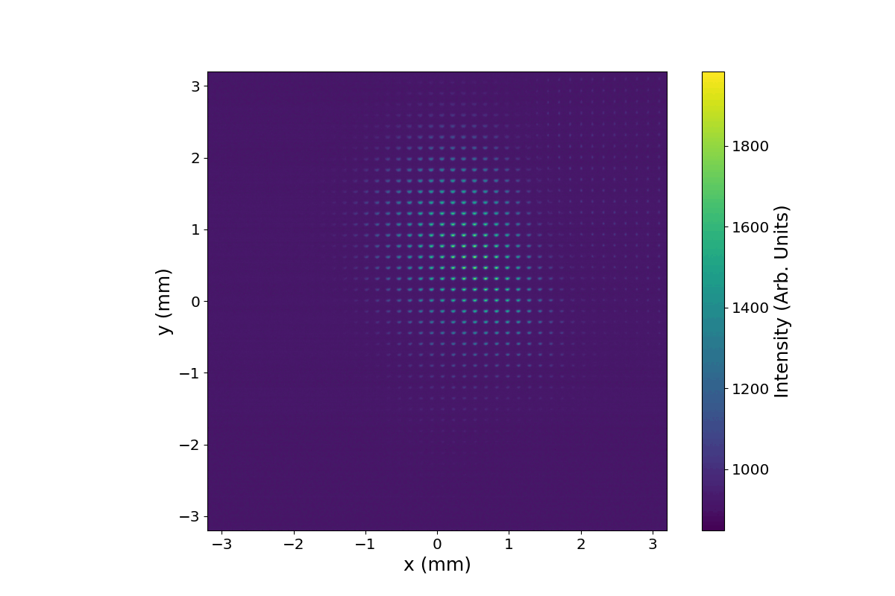
Emittance – CLEAR Dec. ‘24
Majority of measurements taken from 700pC to 2.2nC @ 200 MeV
  Went as low as <100pC @ <100MeV
Restricted beam optics for quad scans to “reliable range”
Found out following week that scatterer had been left in
the beamline from the week before and unplugged
Positives are the PoC on the feasibility of OSR as a
radiation source for this measurement
Confirmed beam time W/C April 28th
J. Wolfenden (joseph.wolfenden@cockcroft.ac.uk)
22nd AWAKE Instrumentation meeting 11/03/2025
10

Slide 11
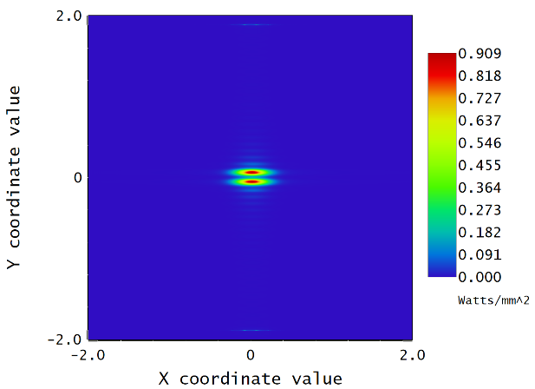
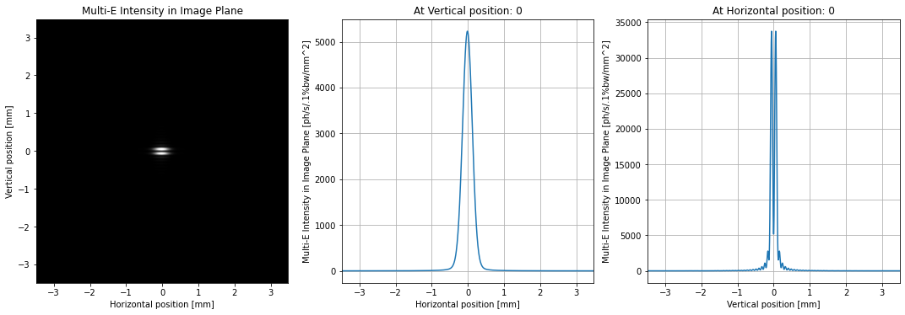
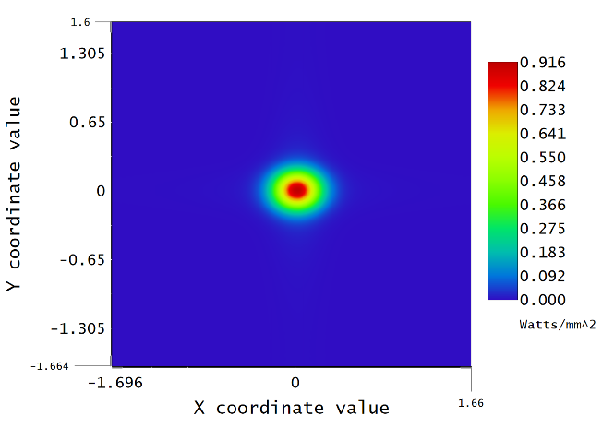
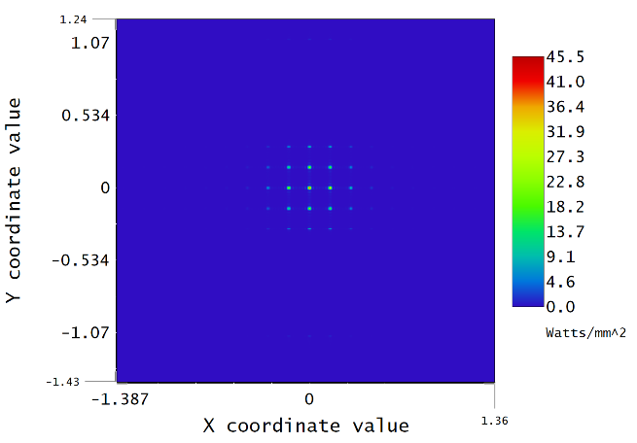
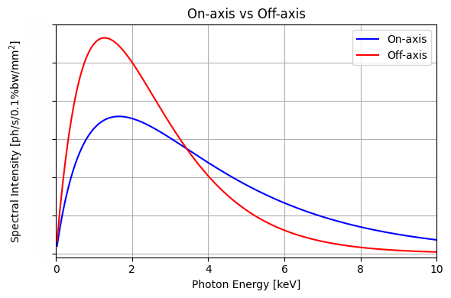
Emittance – OSR simulation
SRW – Ansys Zemax OpticStudio Benchmarking with ideal lenses
Full end-to-end simulations
Extraction scenarios for Run 2c
Image Plane
MLA Focal Plane
J. Wolfenden (joseph.wolfenden@cockcroft.ac.uk)
22nd AWAKE Instrumentation meeting 11/03/2025
11

Slide 12
Emittance - Outlook
5 days of beam time confirmed at CLEAR for W/C April 28th
OSR source has proven to be a viable option, measurements just need to be retaken
Online analysis codes of MLA almost complete
Assessment of # lenslets illuminated/energy spread impact on emittance/phase space
OSR simulations progressing well, should be completed prior to beam time
  Looking at reconstruction from OSR simulated image
  Ongoing work with Spectrometer Team regarding Run 2c installation options
J. Wolfenden (joseph.wolfenden@cockcroft.ac.uk)
22nd AWAKE Instrumentation meeting 11/03/2025
12

Slide 13
Bunch length

Slide 14
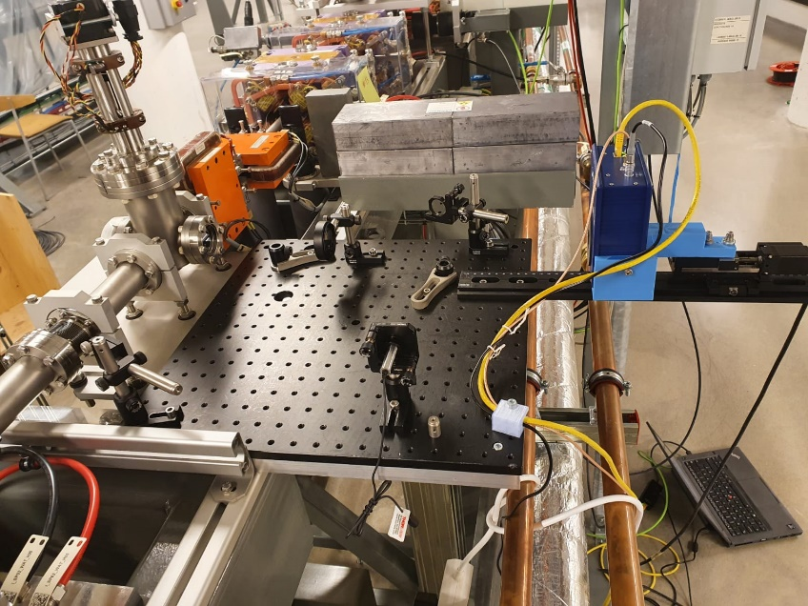
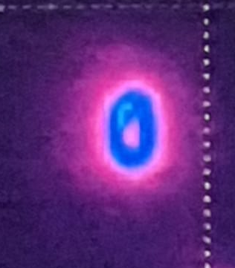
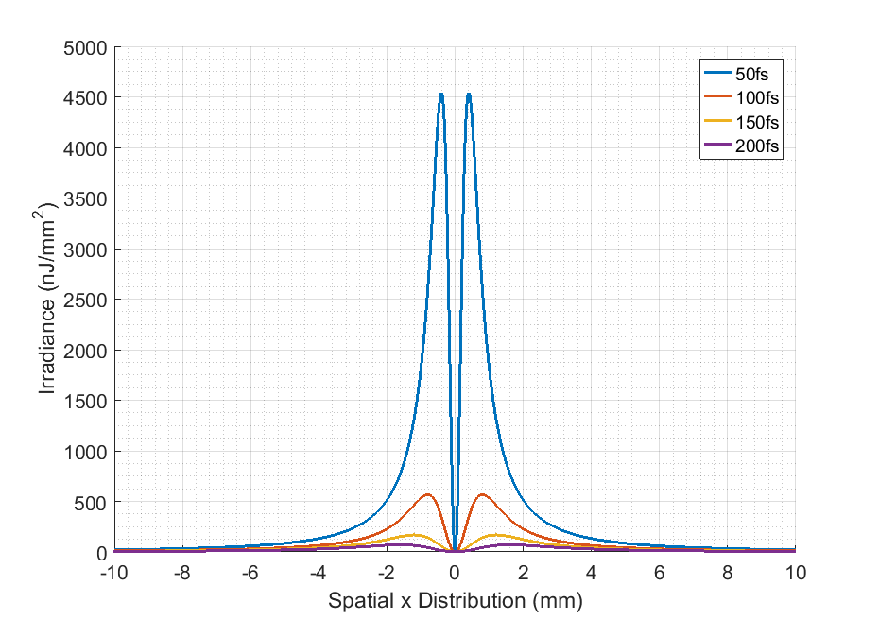
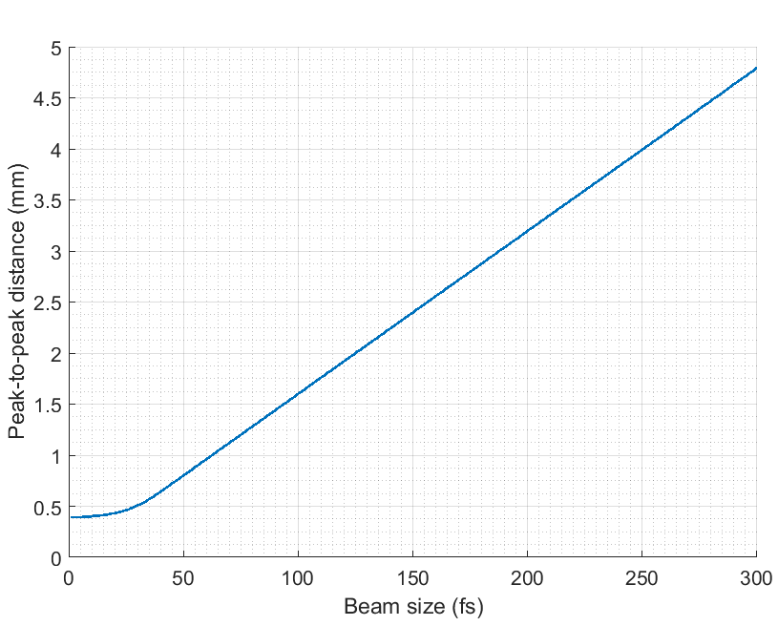
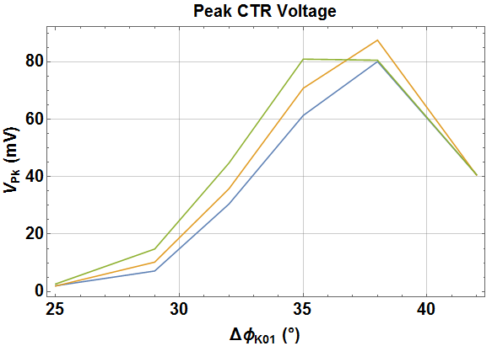


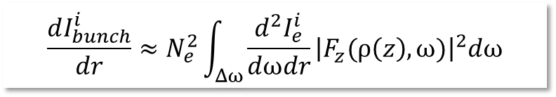
Bunch length – Experimental Review
$$\frac{dI_{bunch}^{i}}{dr}≈N_{e}^{2}\int_{Δω}{\frac{d^{2}I_{e}^{i}}{dωdr}{\left|F_{z}(ρ\left(z\right),ω)\right|}^{2}dω}$$
HRFZ Si Lens
Pyrocam
Pyrocam
[1]
Next steps:
New measurements with improved image resolution
Upgrade to OAP-based system
Test of ML-based analysis on experimental data
J. Wolfenden (joseph.wolfenden@cockcroft.ac.uk)
22nd AWAKE Instrumentation meeting 11/03/2025
14

Slide 15
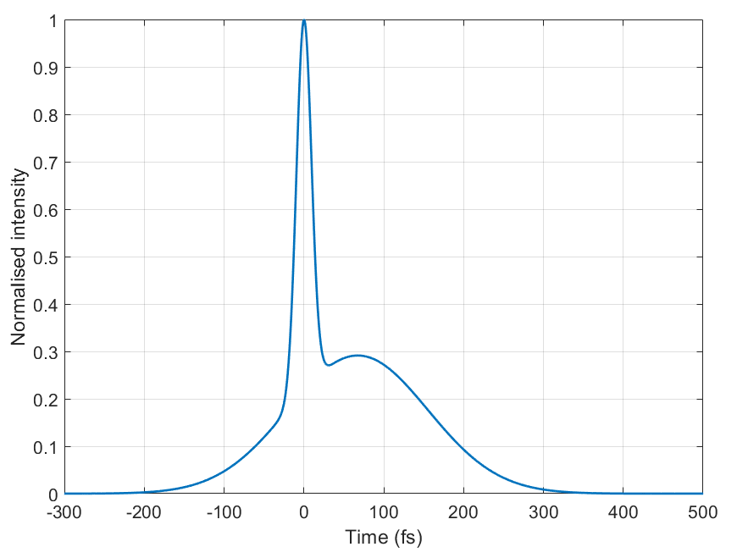
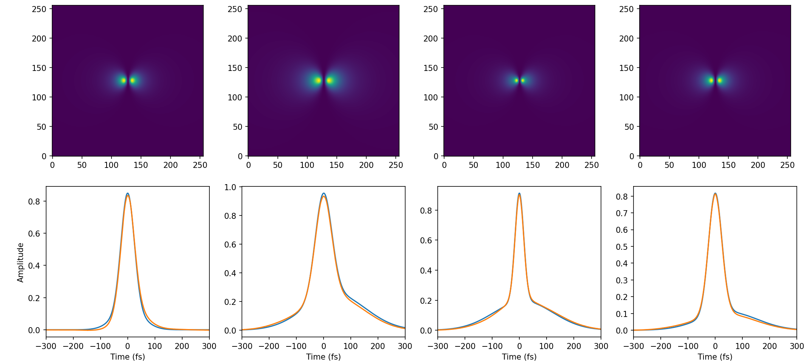
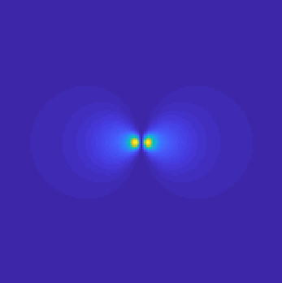
Bunch length – Analysis Review
Ground Truth
Model Prediction
x100,000
Next steps:
Training with more realistic beam-based profiles
Application to CSR simulations
Application to CxR data
J. Wolfenden (joseph.wolfenden@cockcroft.ac.uk)
22nd AWAKE Instrumentation meeting 11/03/2025
15

Slide 16
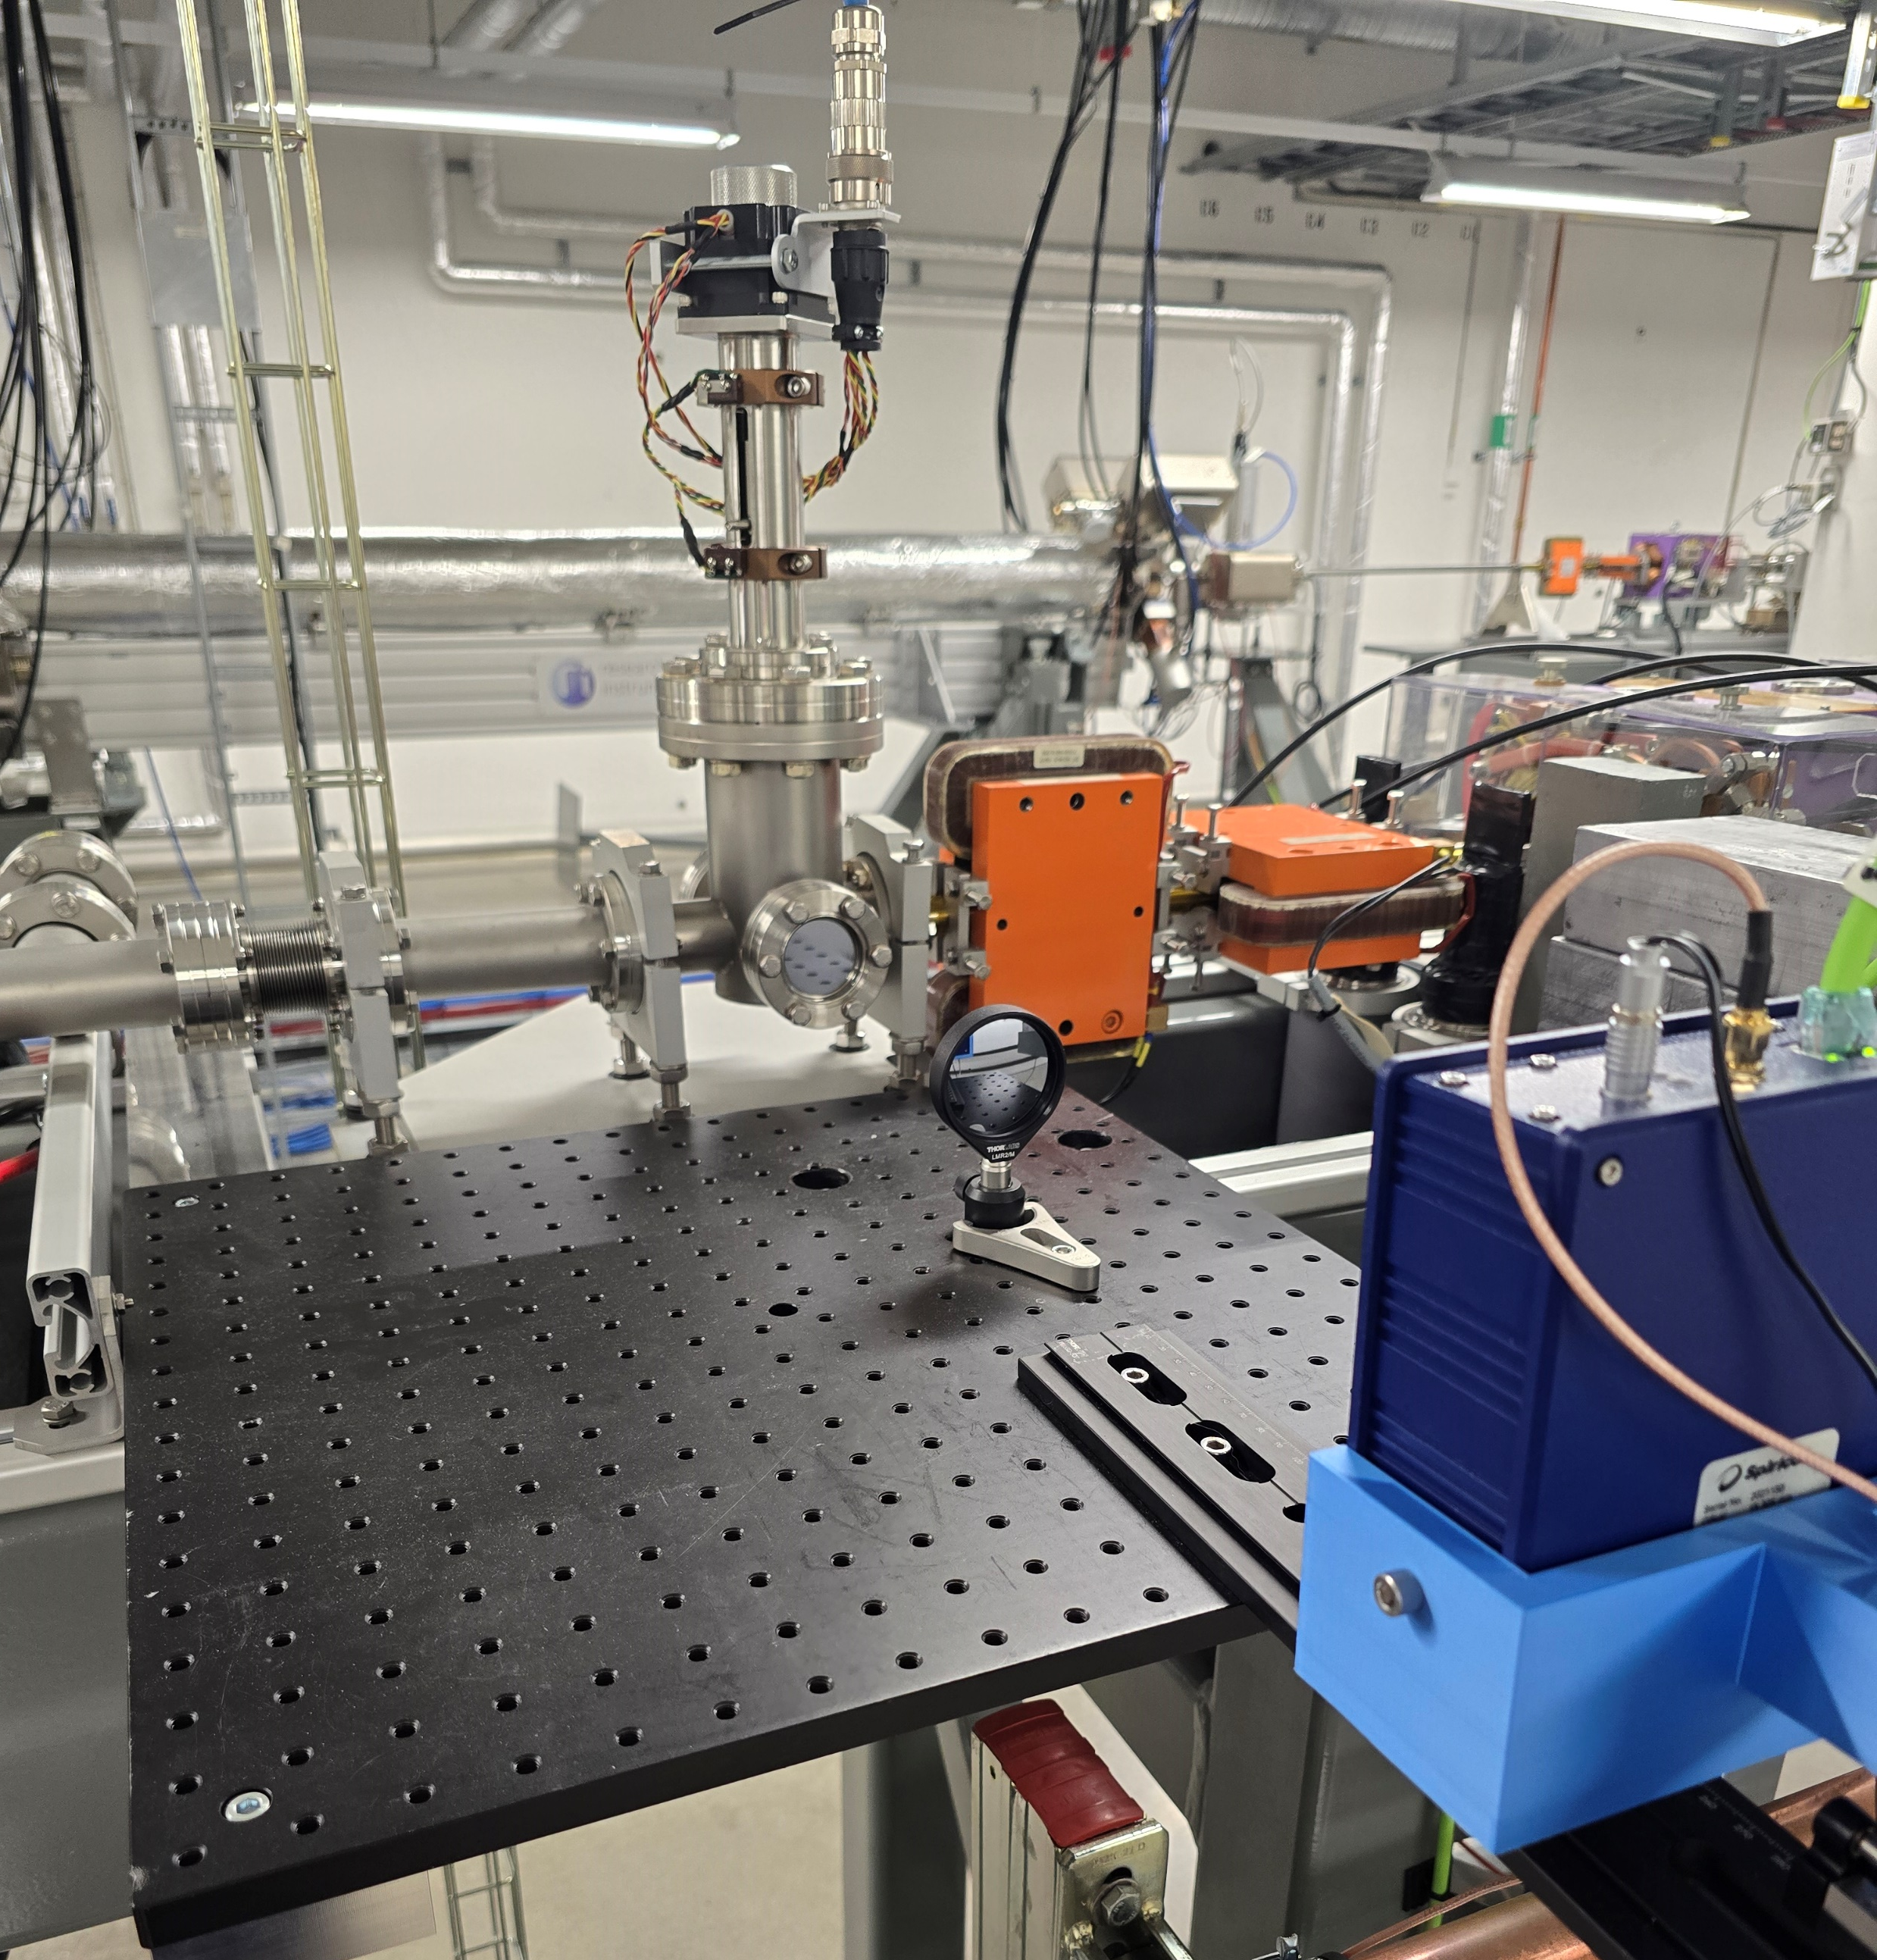
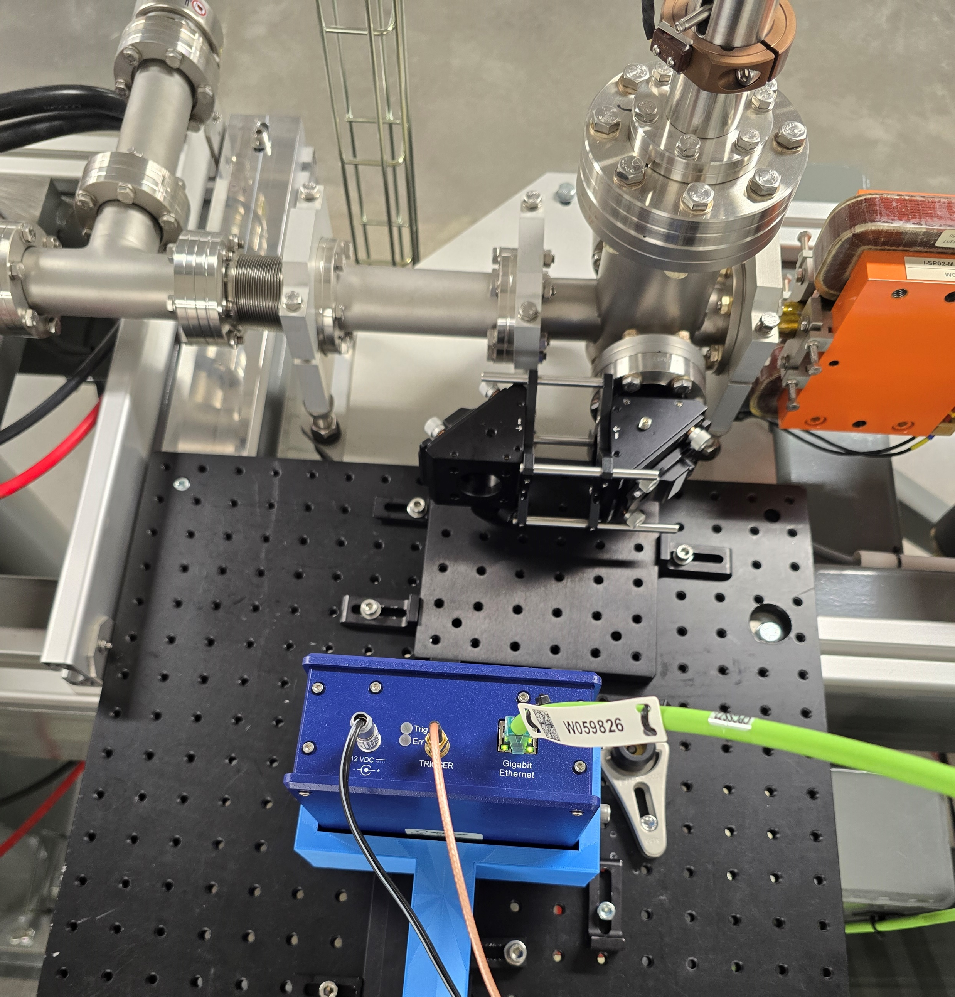
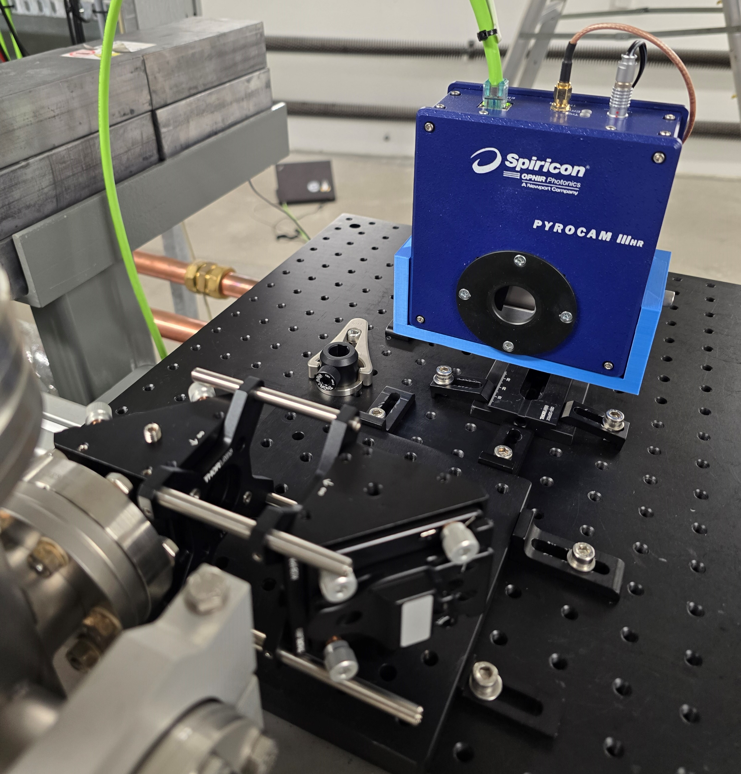
Bunch length – MAX IV Feb. ‘25
Upgrade!
Existing HRFZ Si system tidied up and adjusted before benchmarking
Replaced with x2 magnification confocal OAP system
J. Wolfenden (joseph.wolfenden@cockcroft.ac.uk)
22nd AWAKE Instrumentation meeting 11/03/2025
16

Slide 17
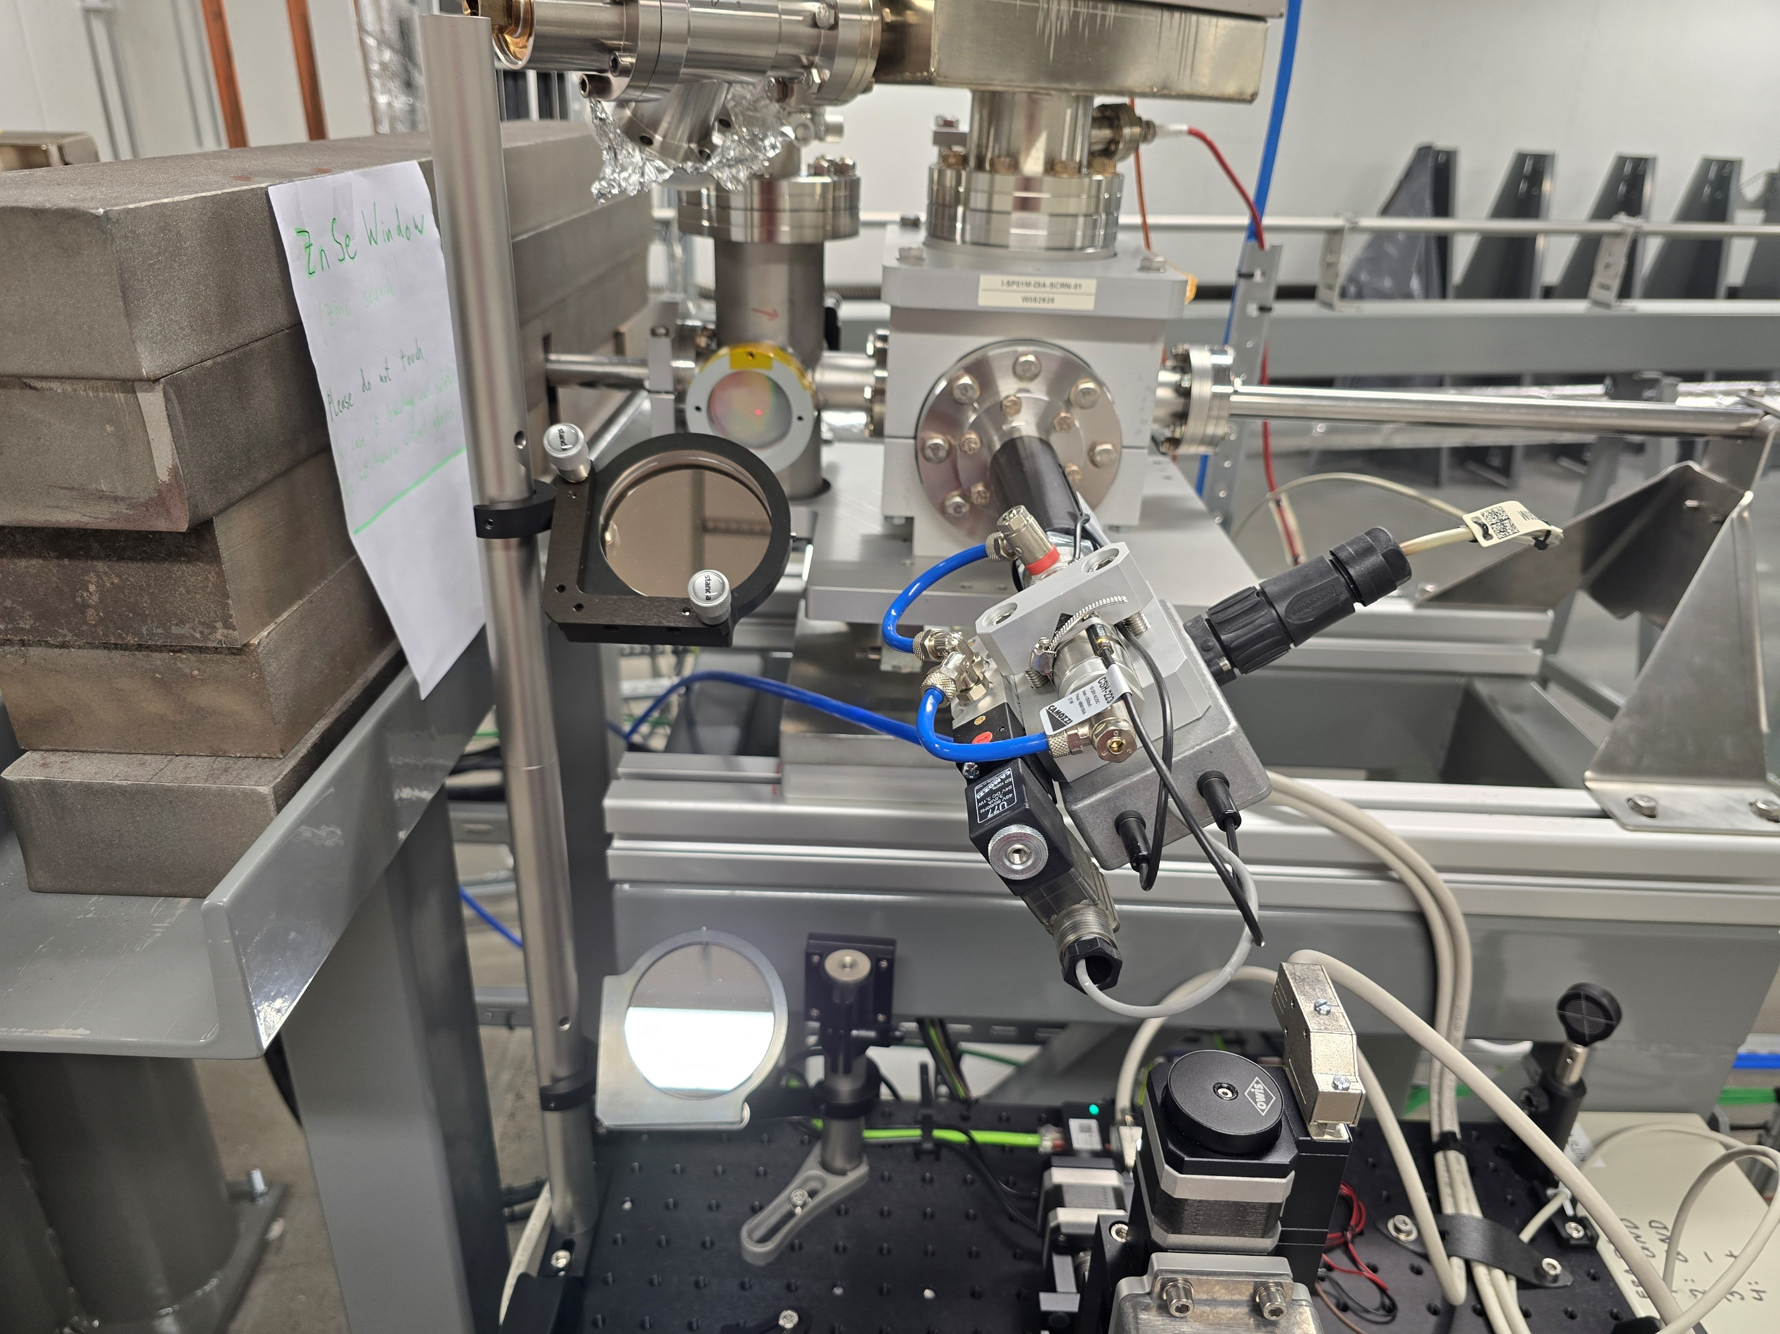
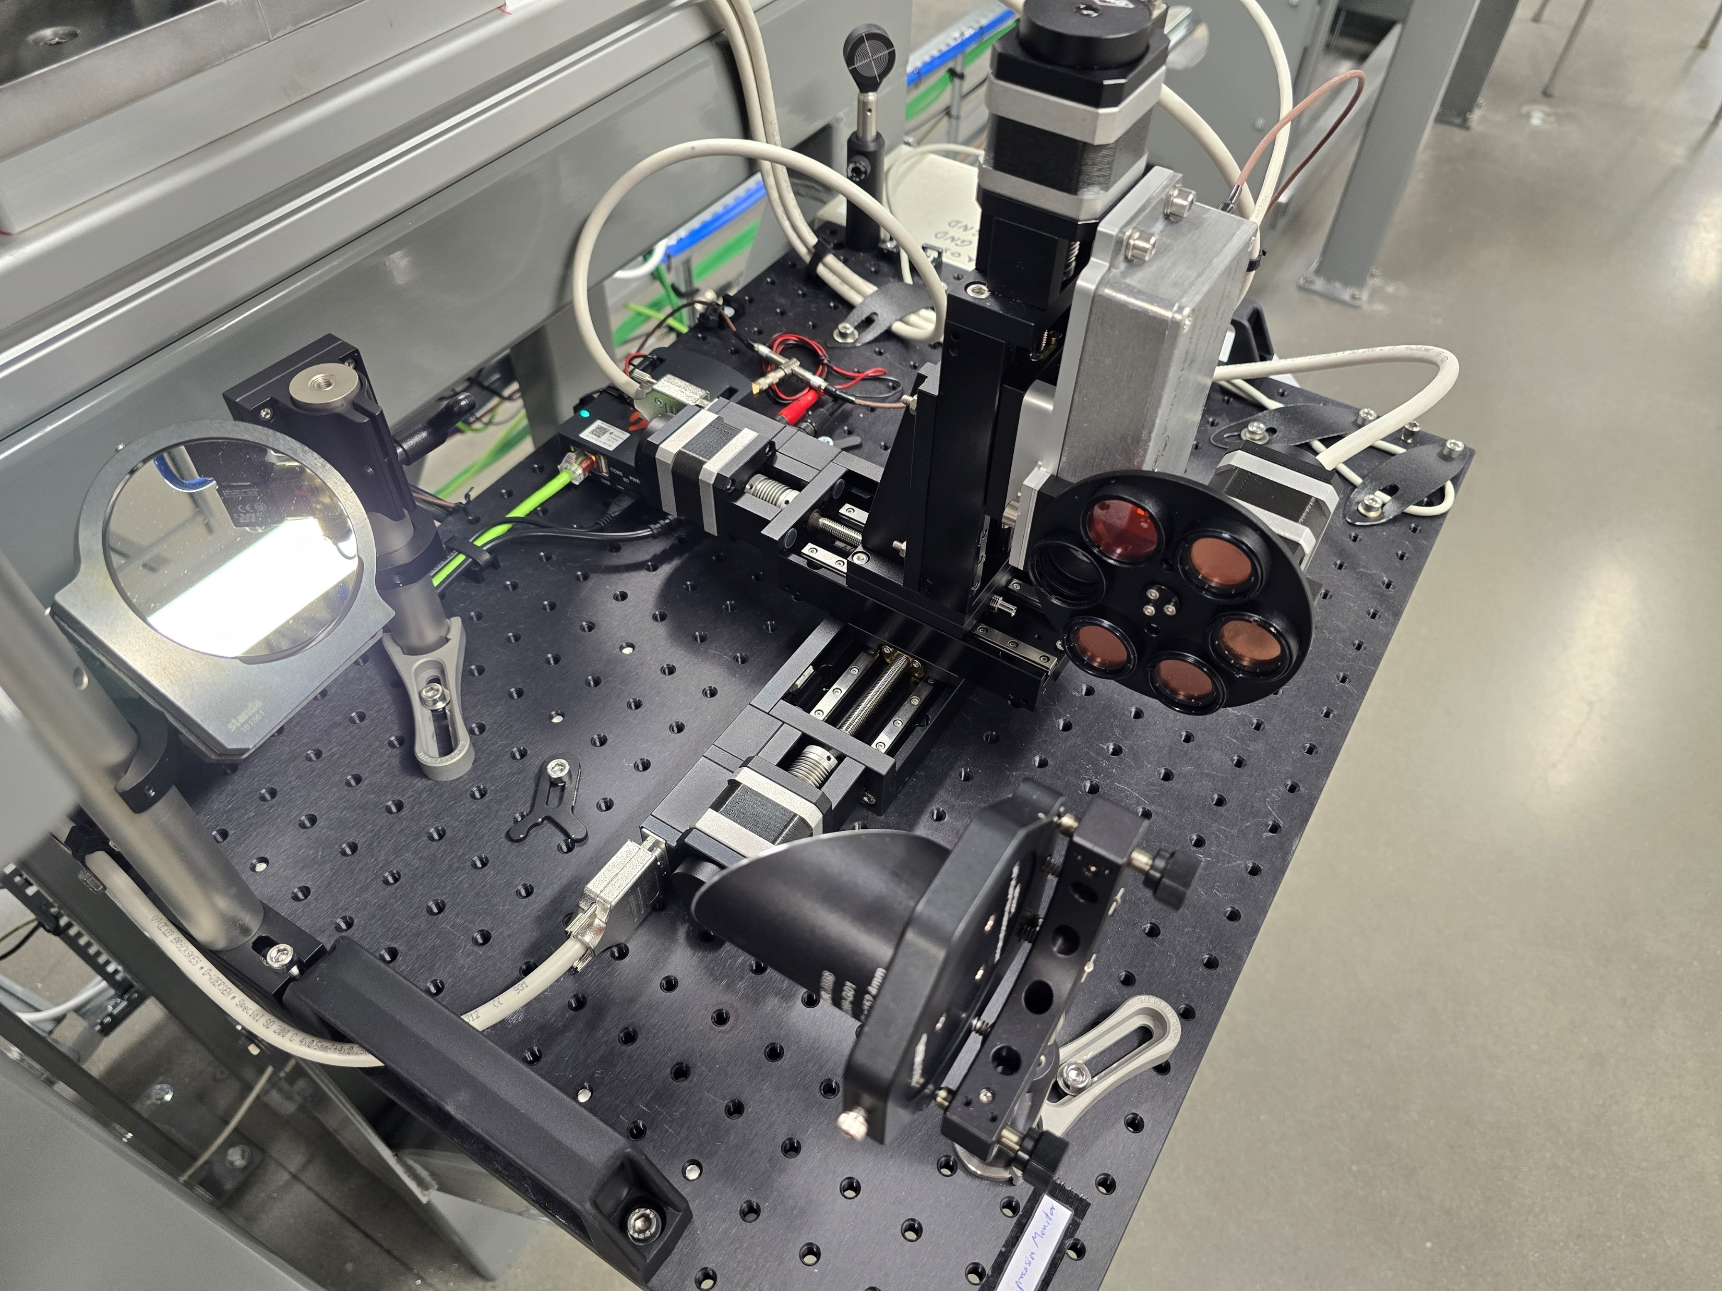
Bunch length – MAX IV Feb. ‘25
New CxR compression monitor installed by MAX IV (BCM)
Took comparative intensity measurements non-invasively – repeat previous measurements
J. Wolfenden (joseph.wolfenden@cockcroft.ac.uk)
22nd AWAKE Instrumentation meeting 11/03/2025
16

Slide 18
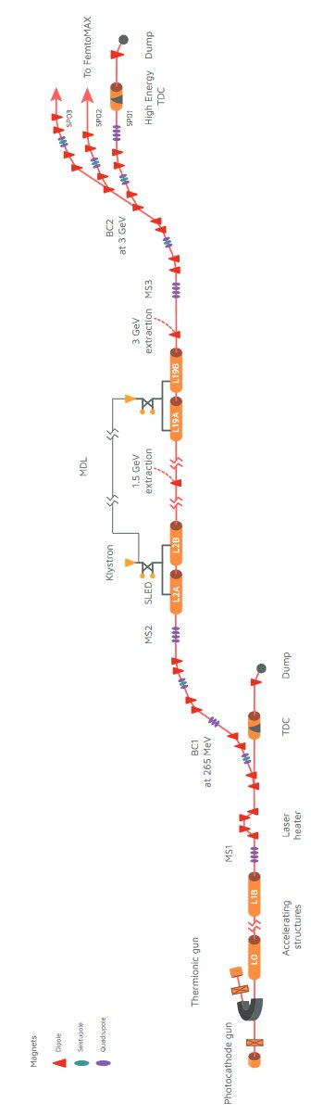
Bunch length – MAX IV Feb. ‘25
Measurements taken single-shot with 90pC @ 3 GeV
Bunch lengths varied from ~150 fs to ~10 fs
Scanned fill time (phase) and sextupoles (LPS linearisation)
Benchmarking with TDC (and BCM)
J. Wolfenden (joseph.wolfenden@cockcroft.ac.uk)
22nd AWAKE Instrumentation meeting 11/03/2025
17

Slide 19
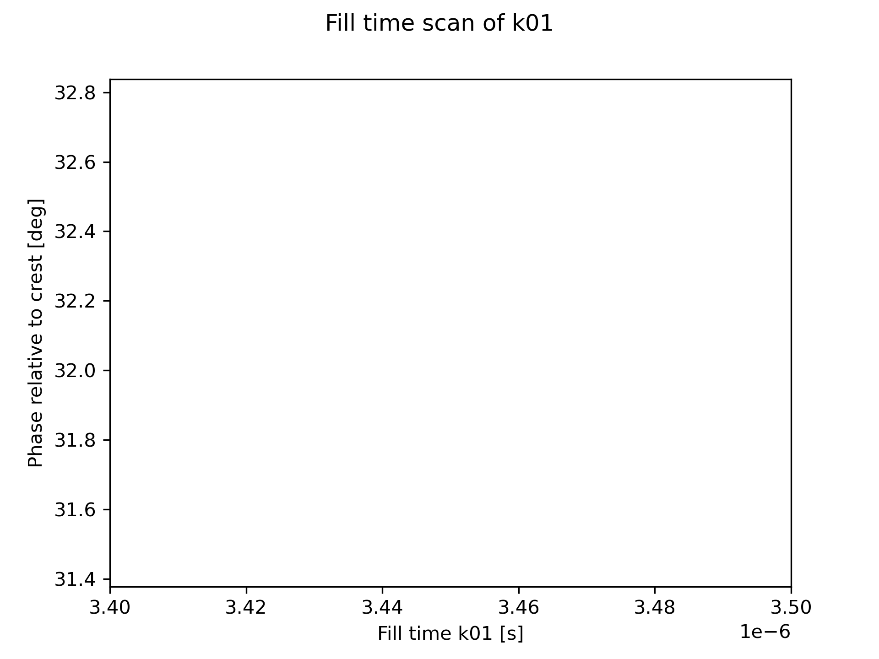
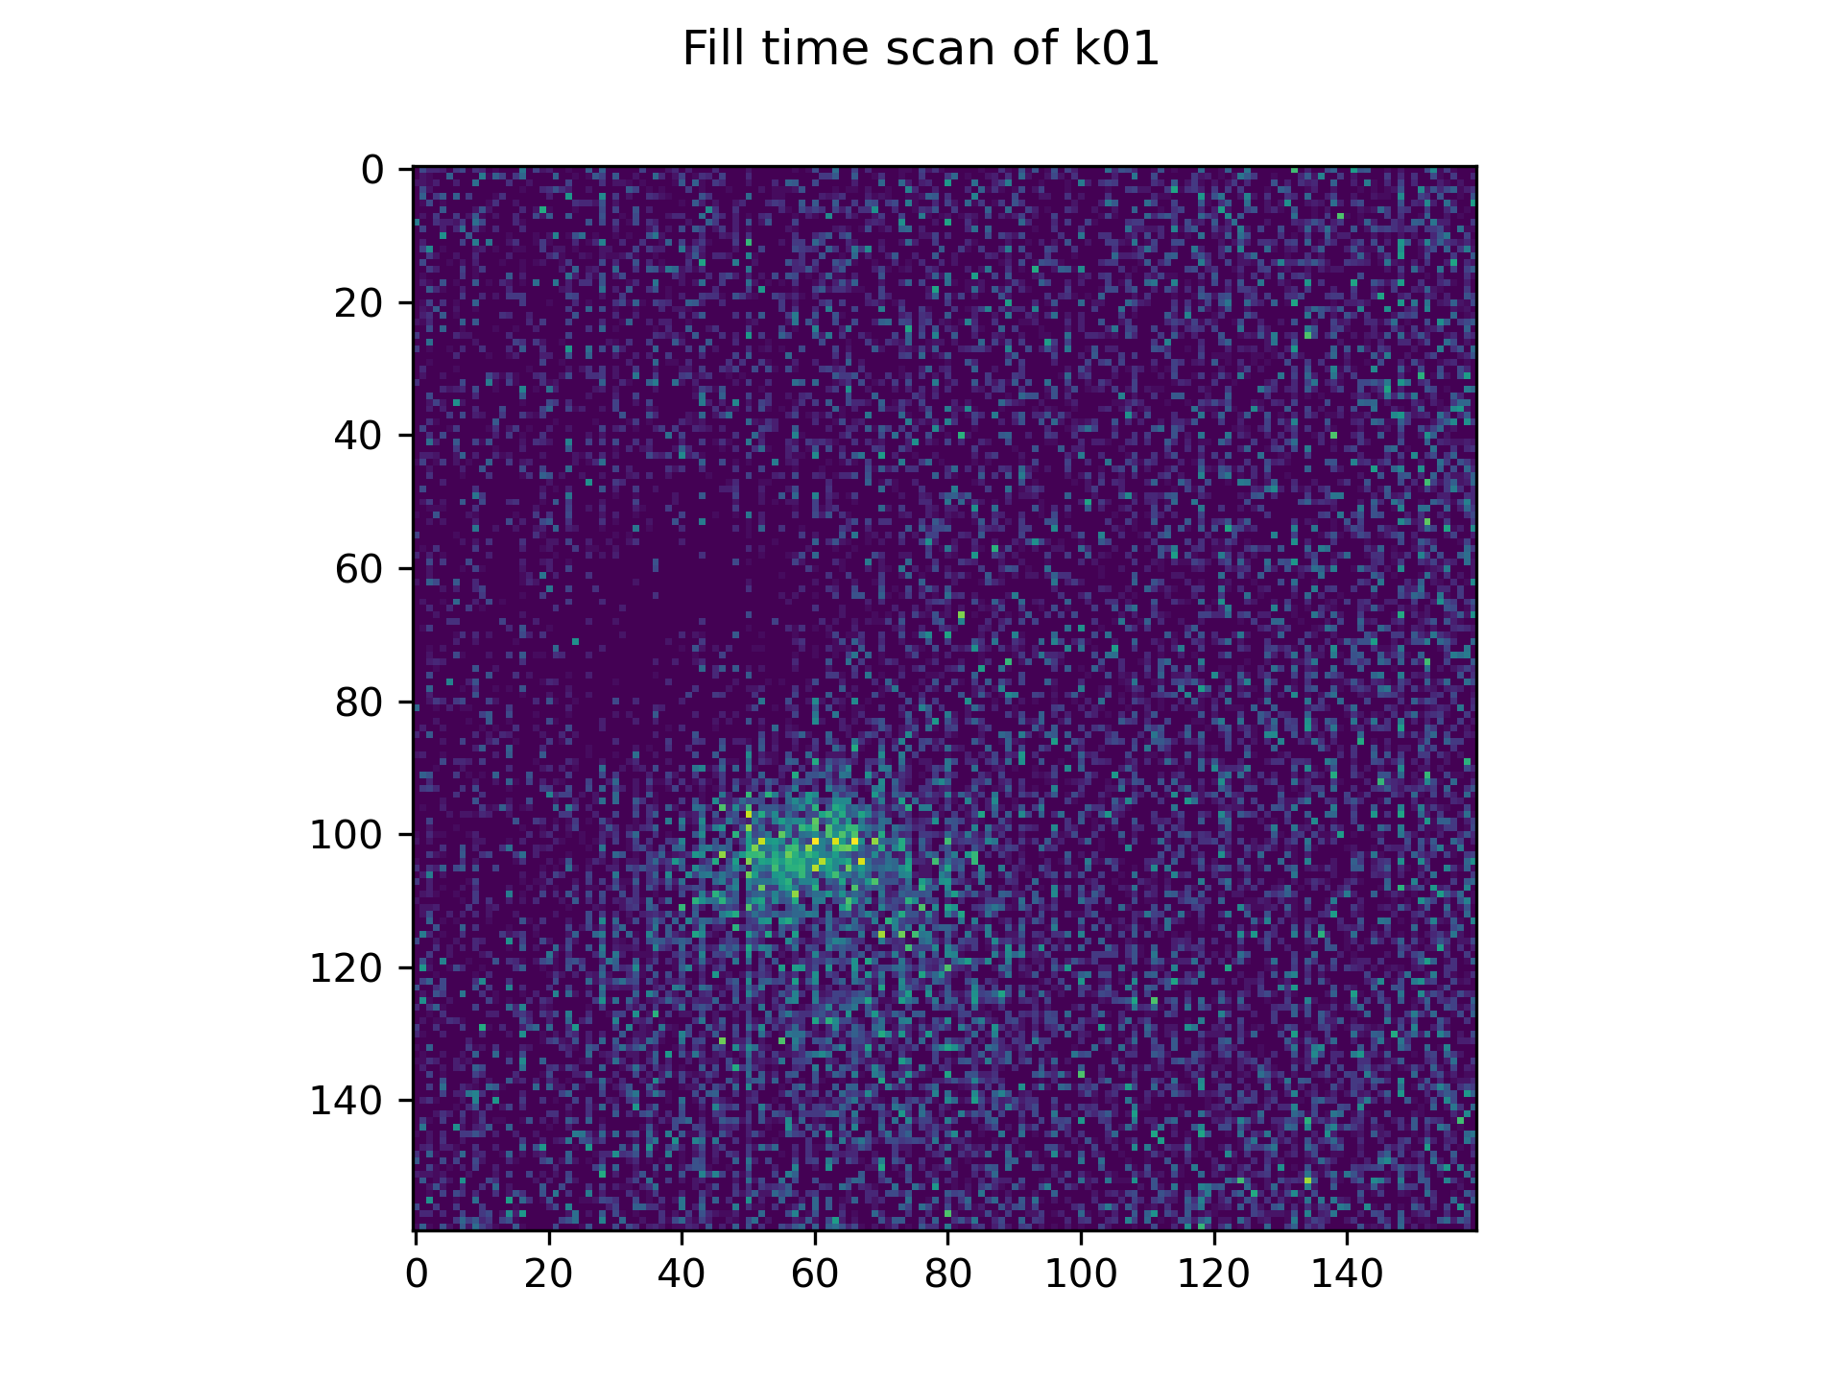
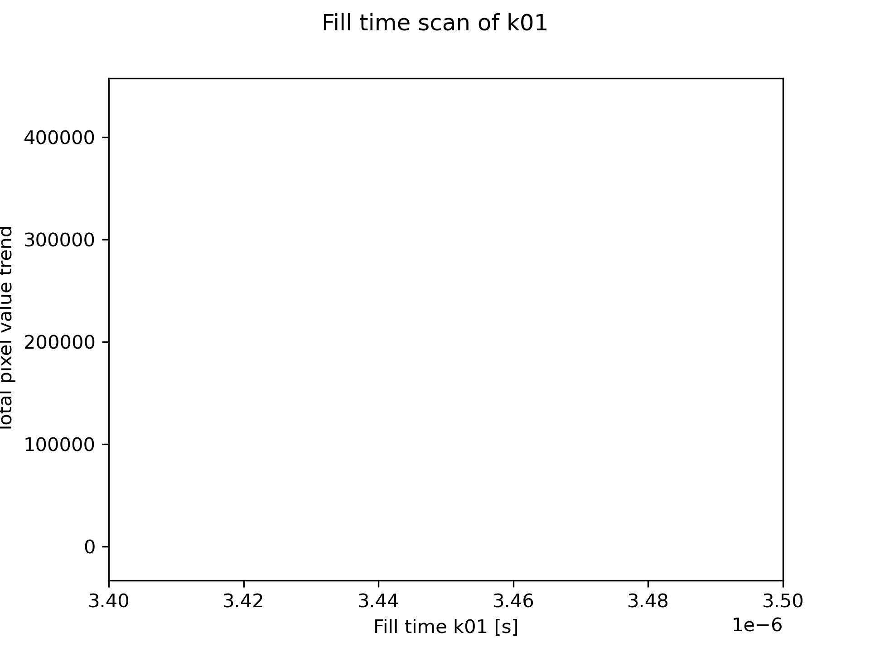
Bunch length – MAX IV Feb. ‘25
Average of 20 shots
J. Wolfenden (joseph.wolfenden@cockcroft.ac.uk)
22nd AWAKE Instrumentation meeting 11/03/2025
18

Slide 20
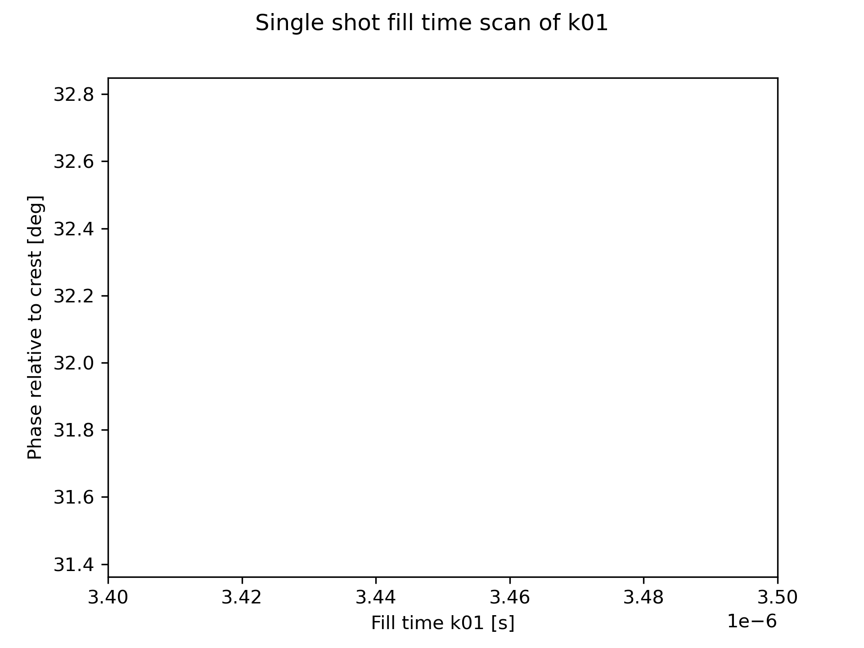
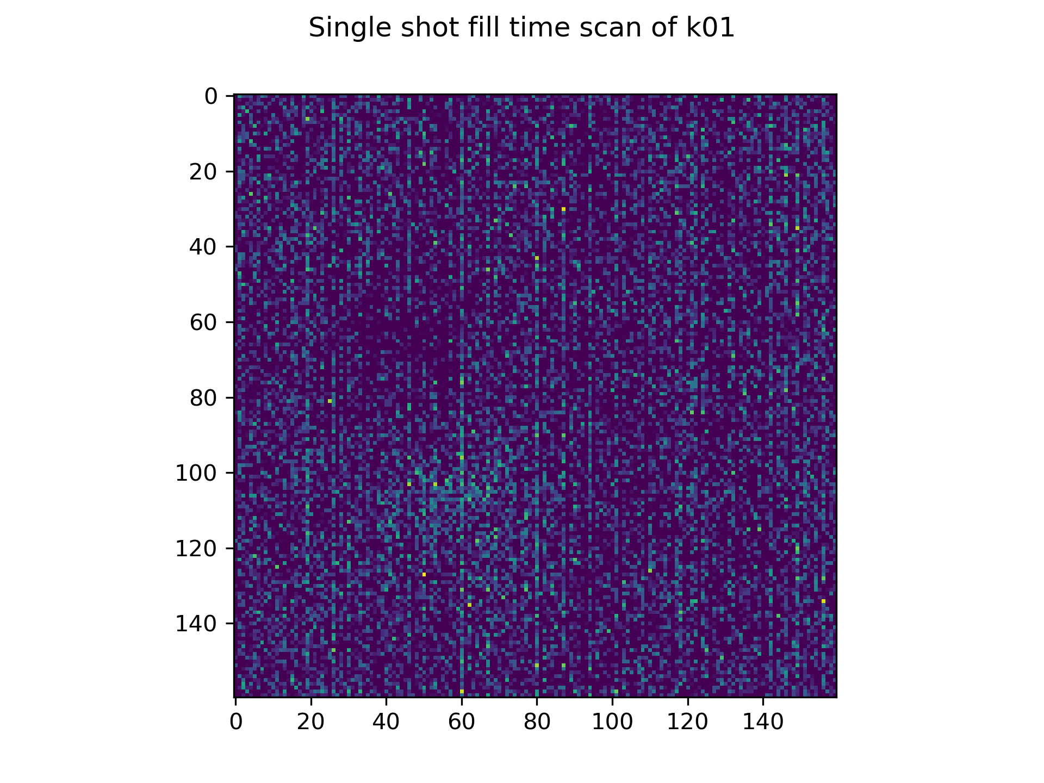
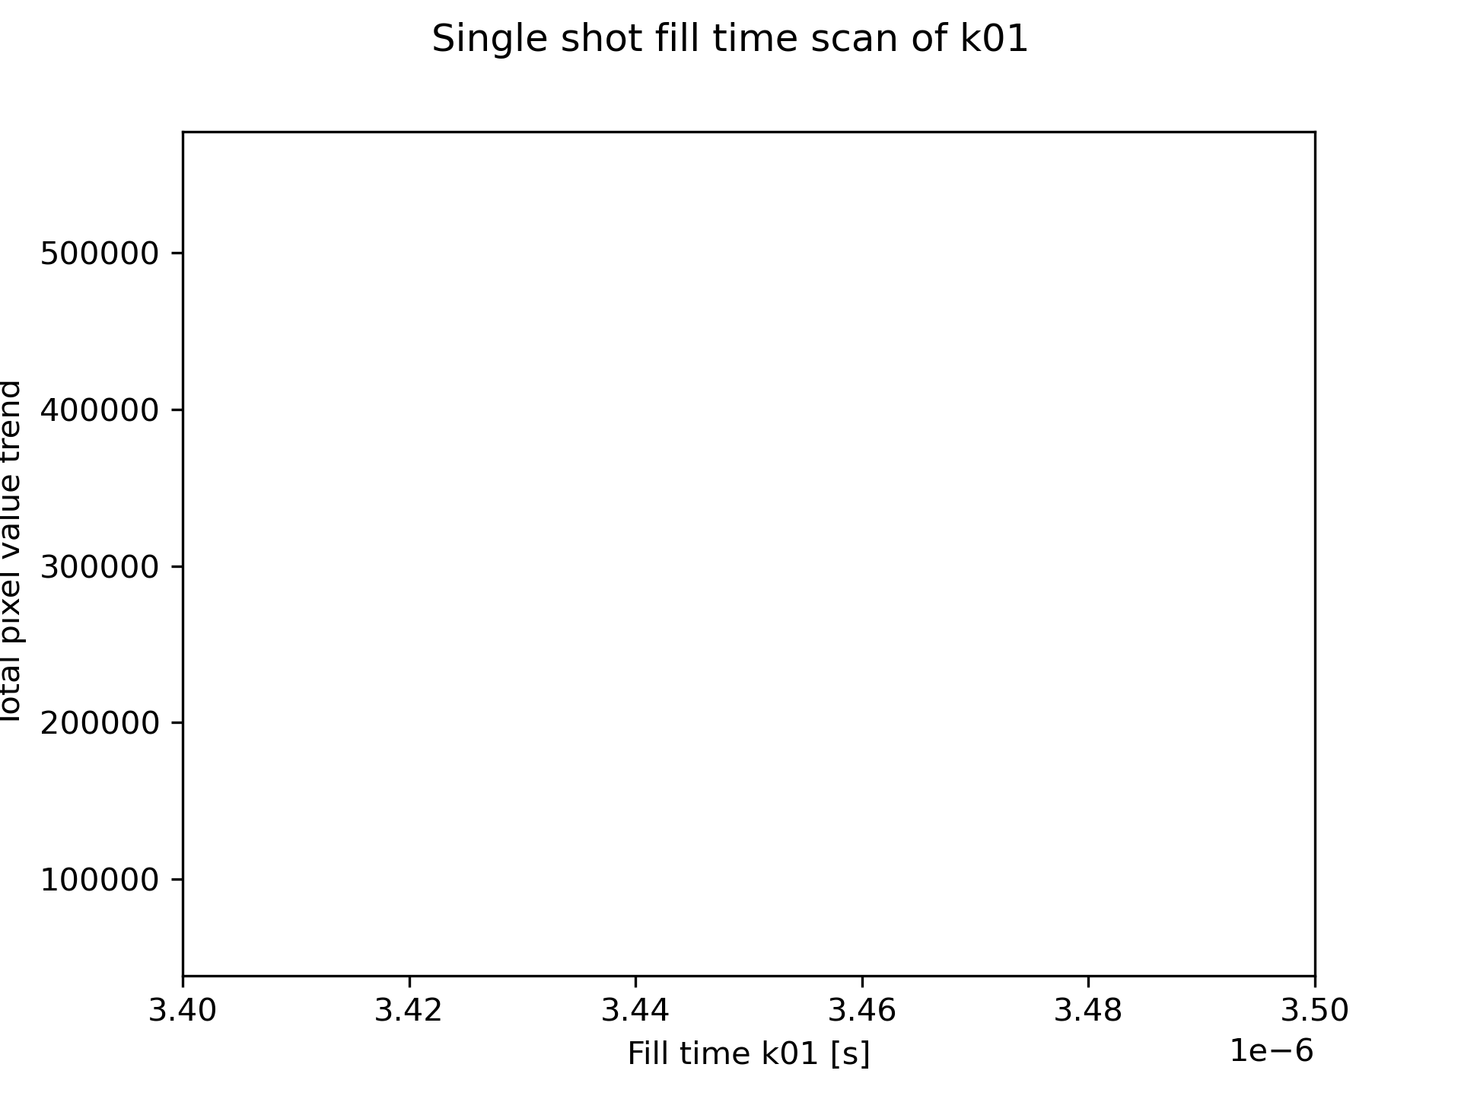
Bunch length – MAX IV Feb. ‘25
Single shot
J. Wolfenden (joseph.wolfenden@cockcroft.ac.uk)
22nd AWAKE Instrumentation meeting 11/03/2025
19

Slide 21
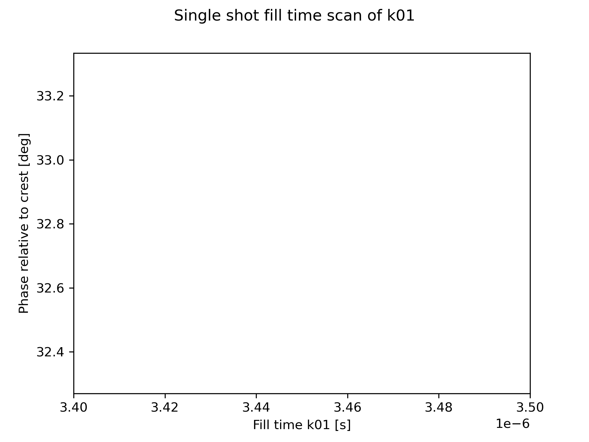
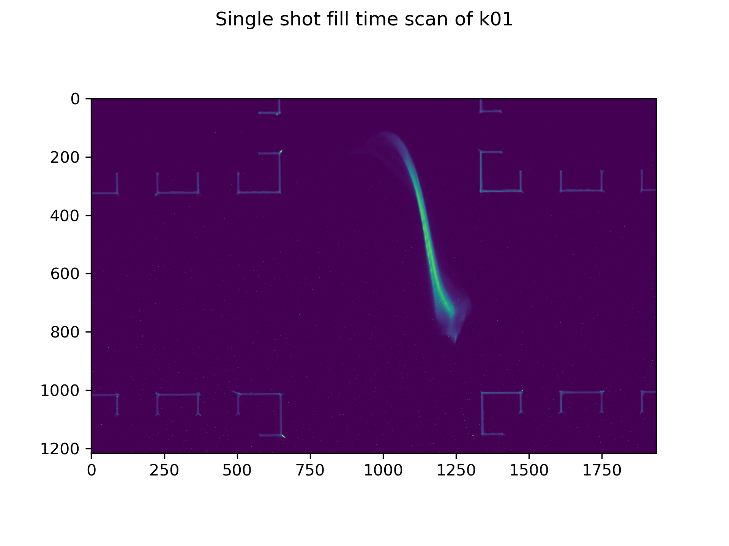
Bunch length – MAX IV Feb. ‘25
Single shot TDC
J. Wolfenden (joseph.wolfenden@cockcroft.ac.uk)
22nd AWAKE Instrumentation meeting 11/03/2025
20

Slide 22
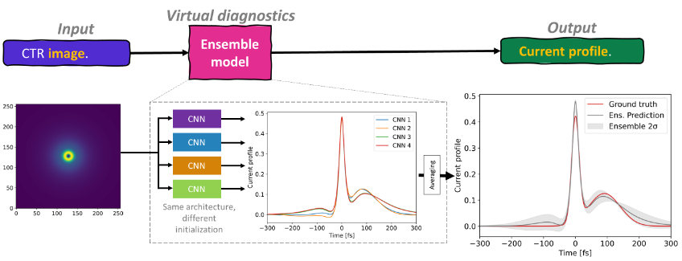
Bunch length – Simulations
(image credit: A-M Guisao Betancur)
J. Wolfenden (joseph.wolfenden@cockcroft.ac.uk)
22nd AWAKE Instrumentation meeting 11/03/2025
21

Slide 23
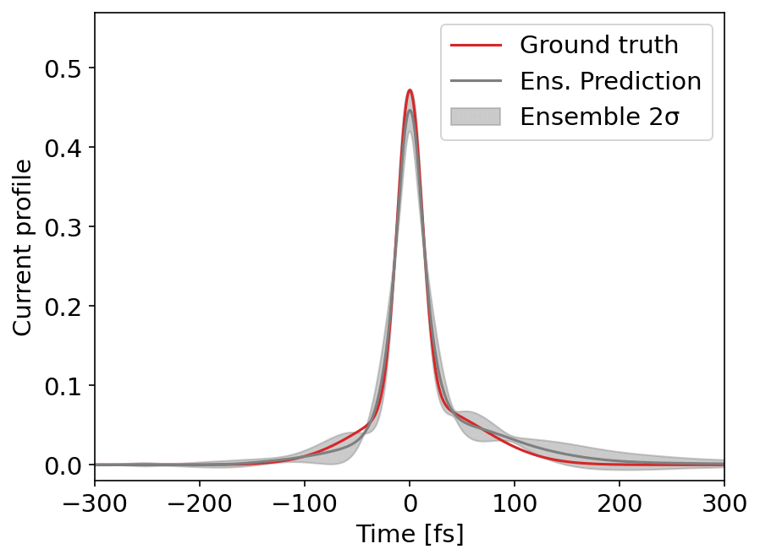
Bunch length – Simulations
Ensemble methods show:
  Estimate of error from ML
  Variation of error across the longitudinal profile
Can extract small features and irregularities
J. Wolfenden (joseph.wolfenden@cockcroft.ac.uk)
22nd AWAKE Instrumentation meeting 11/03/2025
22

Slide 24
Bunch length - Outlook
Analysis of MAX IV data (>30,000 images)
Simulations of machine settings for each scan point
Comparisons of images, simulations, BCM intensity, and TDC output
Application of ensemble method to experimental data
Future return to MAX IV:
  Test CSR version
  Replace HRFZ Si window with something optically transmissive
J. Wolfenden (joseph.wolfenden@cockcroft.ac.uk)
22nd AWAKE Instrumentation meeting 11/03/2025
23

Slide 25
Thank you for your attention.
Questions?
Special THANKS to CLEAR and MAX IV
J. Wolfenden (joseph.wolfenden@cockcroft.ac.uk)

