Slide 1
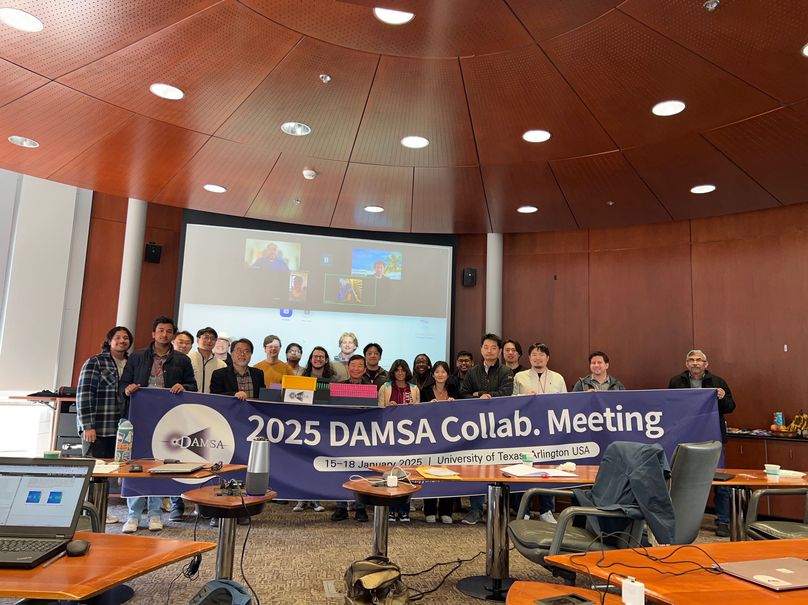
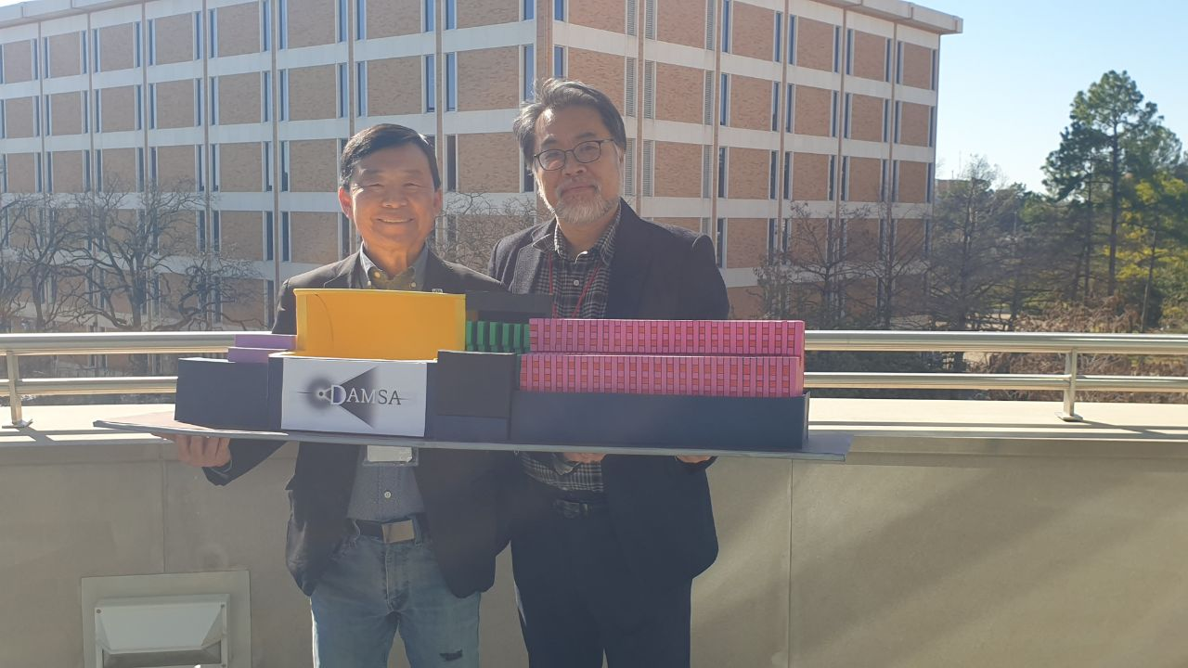
News and Updates
The inaugural CM@UTA 1/16 – 1/18/25 was a smashing success!
  About 30 in-person participants + up to 25 or so online participants
  Supported by UTA College of Science and the Department of Physics + SNU
  Some university media coverage
    UTA student news paper (Short Horn)
    UTA College of Science web site
  To many participants, it was the first time to meet face to face & first time in Texas!
  Showcased the 1-to-1 scale model of the DAMSA experiment

Slide 2
Meeting Outcome!
We’ve met & had a chance to be acquainted with each other!
  Wish everyone were there!
Discussed various physics topics and facilities that could help us expand our physics reach
  Settled on our benchmark facility to be 300MeV and 10GeV e
  Decided on background flux studies to be done
Had discussions on what we need to do to make the detector to meet the physics goals and how
  Target configuration becomes an essential element in further suppressing the background photons from the secondary interactions ➔ need detailed study for the geometry
  Detector granularity for 300MeV electron beam signal must be increased by >2 orders of magnitude for signal γ identification
CDR White Paper overleaf is set but need more studies to fill them in a credible manner ➔ Agreed to target completion 7/1/25

Slide 3
CDR-WP Writing Responsible
Overleaf: https://www.overleaf.com/3827187499vkkgchtcctcn#8575a3
Executive Summary – JY, UKY, JE
Introduction – JY, UKY, JE
Physics (CPB347) – DJK, BD, JB, AT, KJ, SC, AP, etc
Facilities – JY, AH, JW, JCP
Experiment and Detector
  Trackers and Magnet (CPB126) – SHK, ISY, UKY,AB
  Calorimeter (CPB303) – JP,SW,YW, AB,PR,WYJ,HYK,BHT,MSO, BB,RR,EG,
Cost Estimate – JY, UKY, JE, JP, AB, YW, PR
Strategic Direction – JY, UKY, JE
Conclusions - JY, UKY, JE

Slide 4
Subsequent Discussions w/ Facilities
Fermilab BD folks – Jonathan Williams and Kevin Lynch suggested using 8 GeV protons at AP0
  Will have a meeting with them during my visit next week, in the week of Feb. 24
Had a long discussion with Richard Jacobsson, the SHiP project manager at CERN on the potential to put DAMSA in front of the entire SHiP detector system, including the SND
  Agreed to continue look into the possibilities

