Slide 1

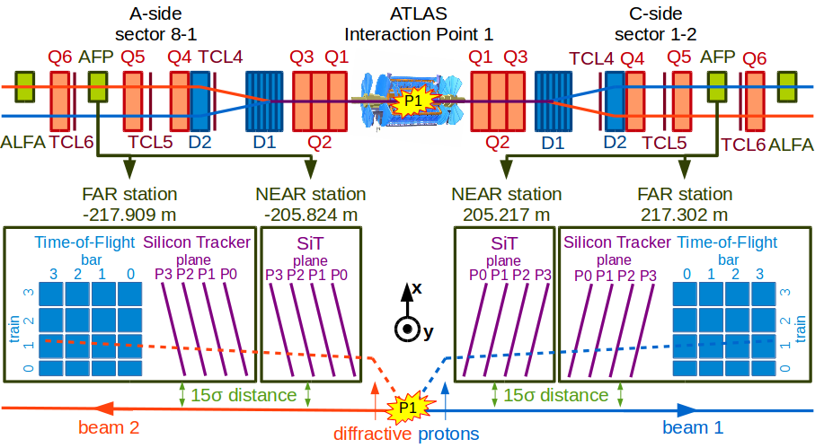
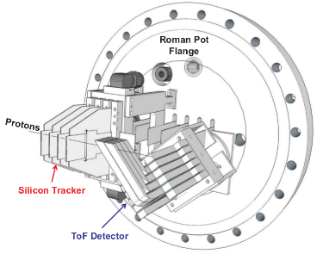
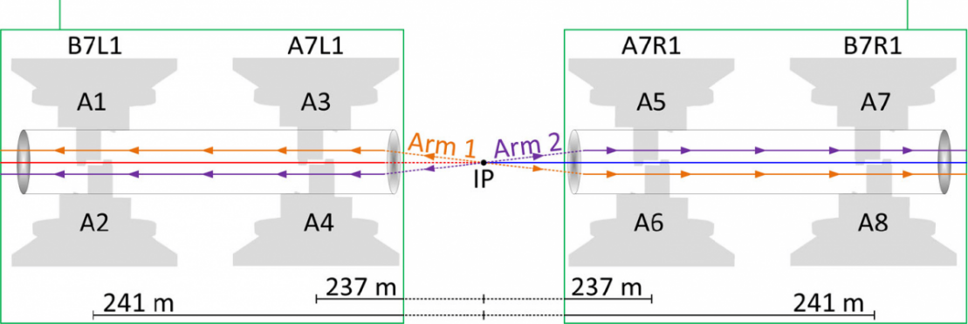
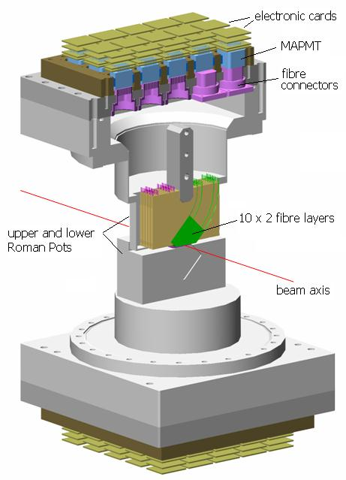
Status of AFP shielding/installation, ECR
LHC Tunnel Region Experiments Working Group (TREX) Meeting
Maciej Trzebinski,
Marko Milovanovic
21.02.2025.

Slide 2
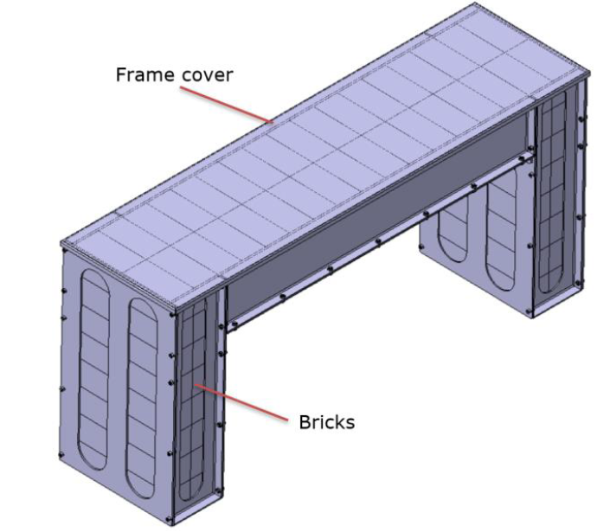
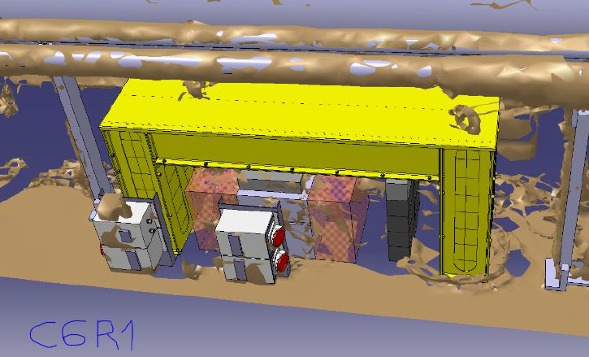
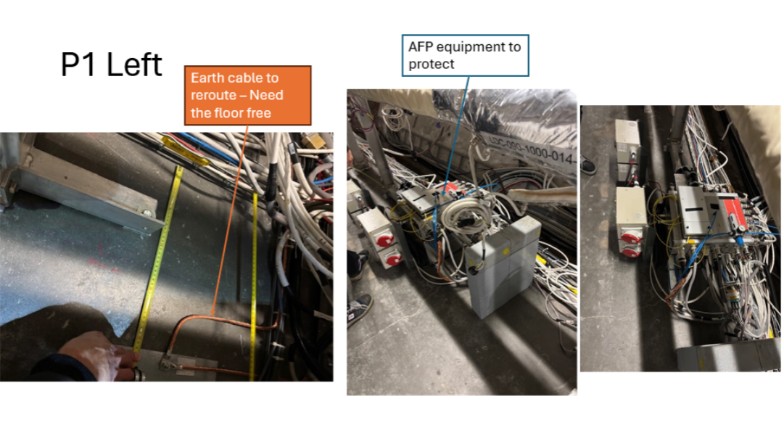
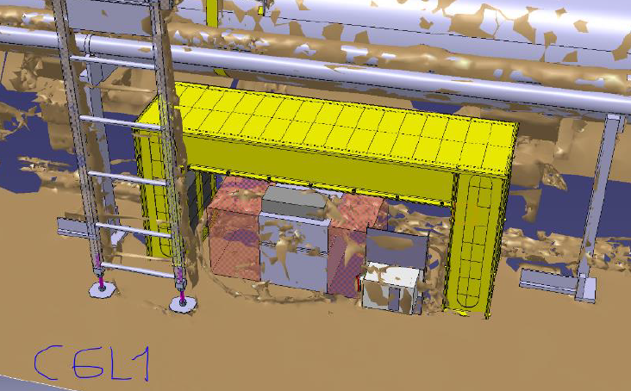
New AFP PP shielding update
Inspection visit(s) last week with JPC, ML et.al. to measure the available space for the new AFP PP shielding:
  Purpose: shield the PP electronics equipment with 200 mm of steel
  Shielding material: steel bricks of 200 x 100 x 100 mm (provided by M.Lazzaroni)
  Frame construction: an Al frame to support the bricks on top and hold the bricks on each side is already in production. To be transportable and installed by hand in the tunnel (to avoid using transport team services) – thanks to M.Lazzaroni, J.P.Corso, F.S.Galan for prompt reaction!
  ANSYS calculation: done by Marija M. (see backup)
  FLUKA simulations initiated; to be completed most likely next week.
  ECR draft completed (thanks to BE-EA-EC/Marija M.!)
Shielding should be completed/installed before 14.03!

Slide 3
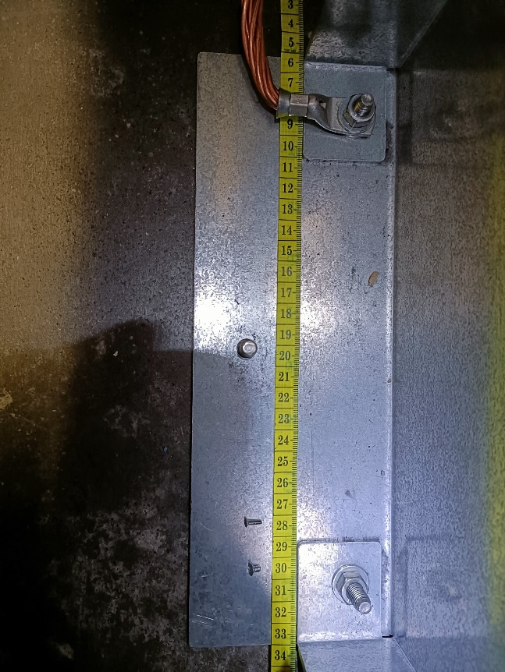
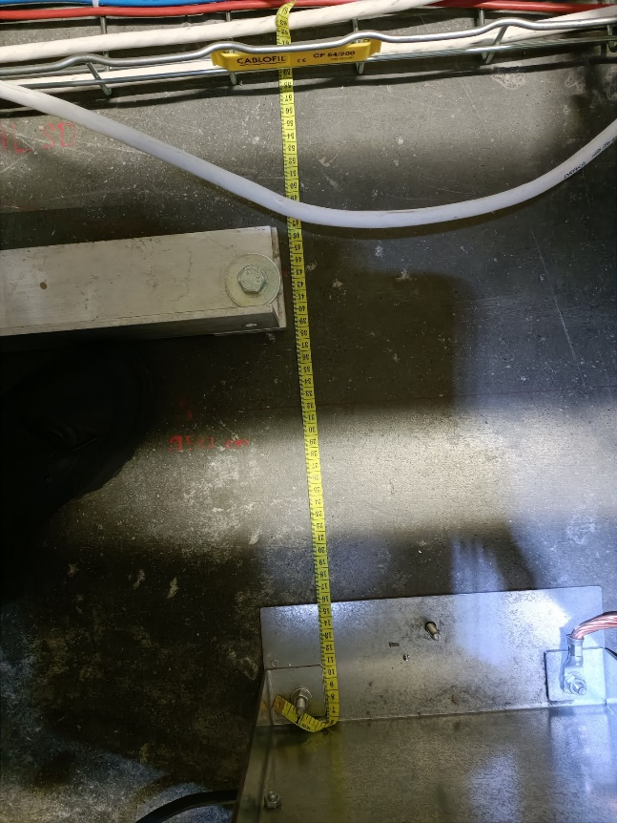
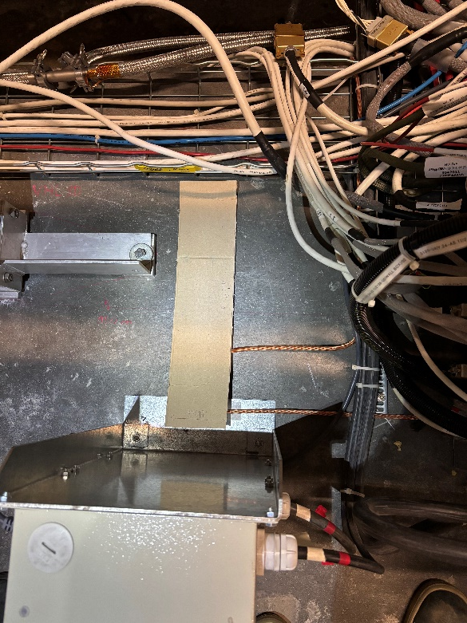
New AFP PP shielding update
Constraint:
  There was a need to need to re-route the grounding for the elelcric socket box in LSS1R (Sector 1-2), or move the whole box.
  EN-EL (Patrick VP) offered a quick solution which he already implemented, but some more work might have to be done (to remove the screw in the middle potentially, depending on the frame size?..)

Slide 4
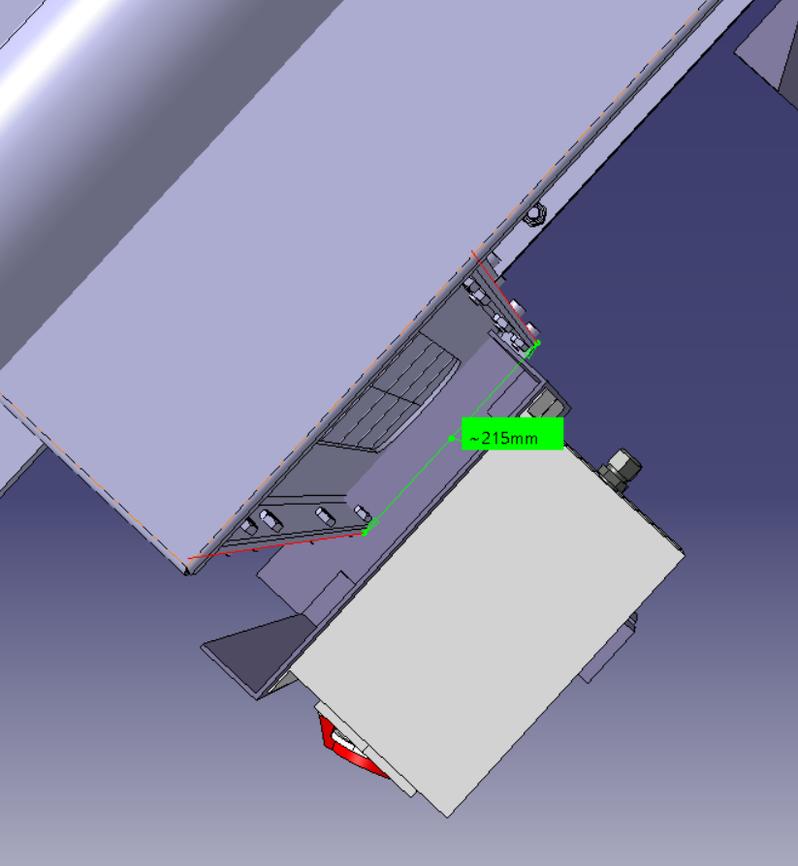
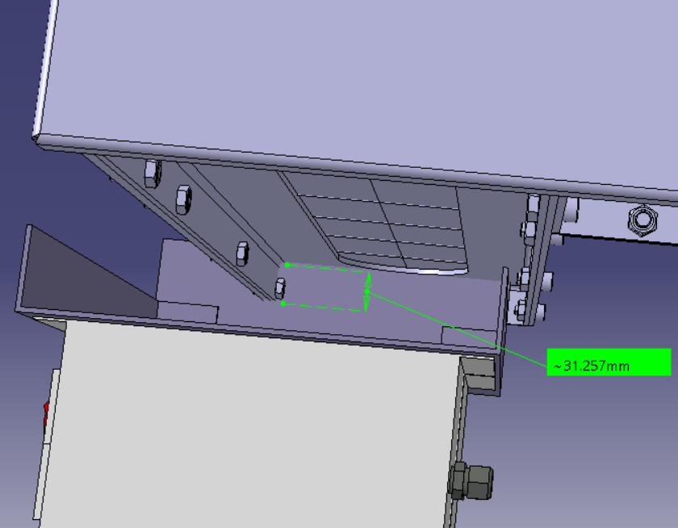
New AFP PP shielding update

Slide 5
Backup
Backup slides.

Slide 6
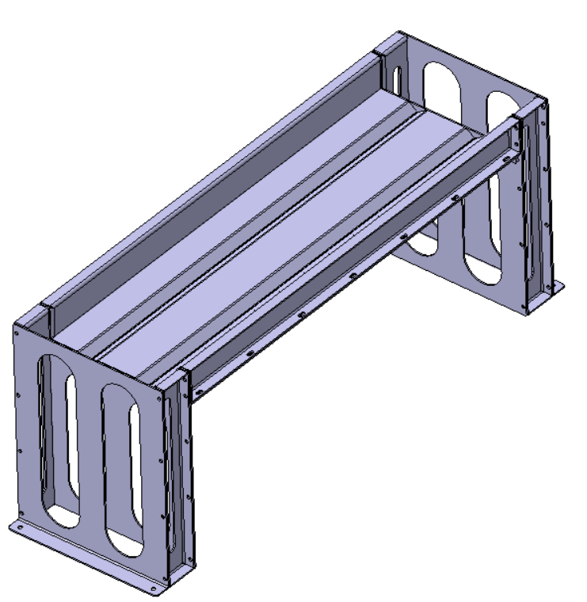
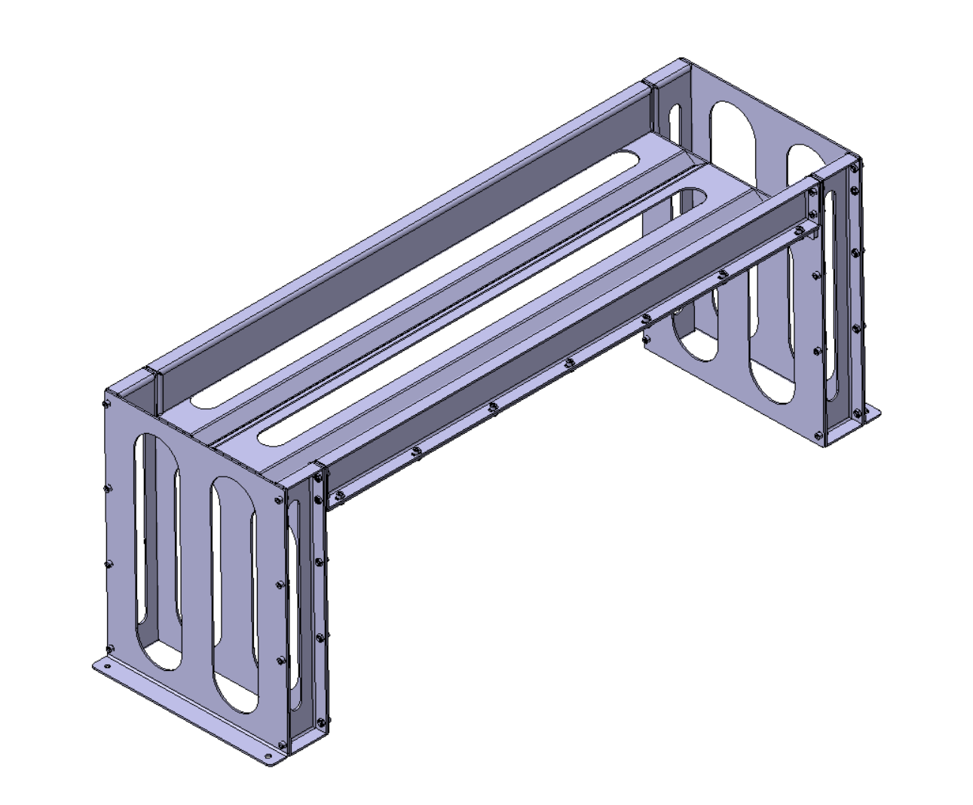
Modification of first 3D proposal
Initial proposal
Modified proposal
Modified plate for bricks

Slide 7
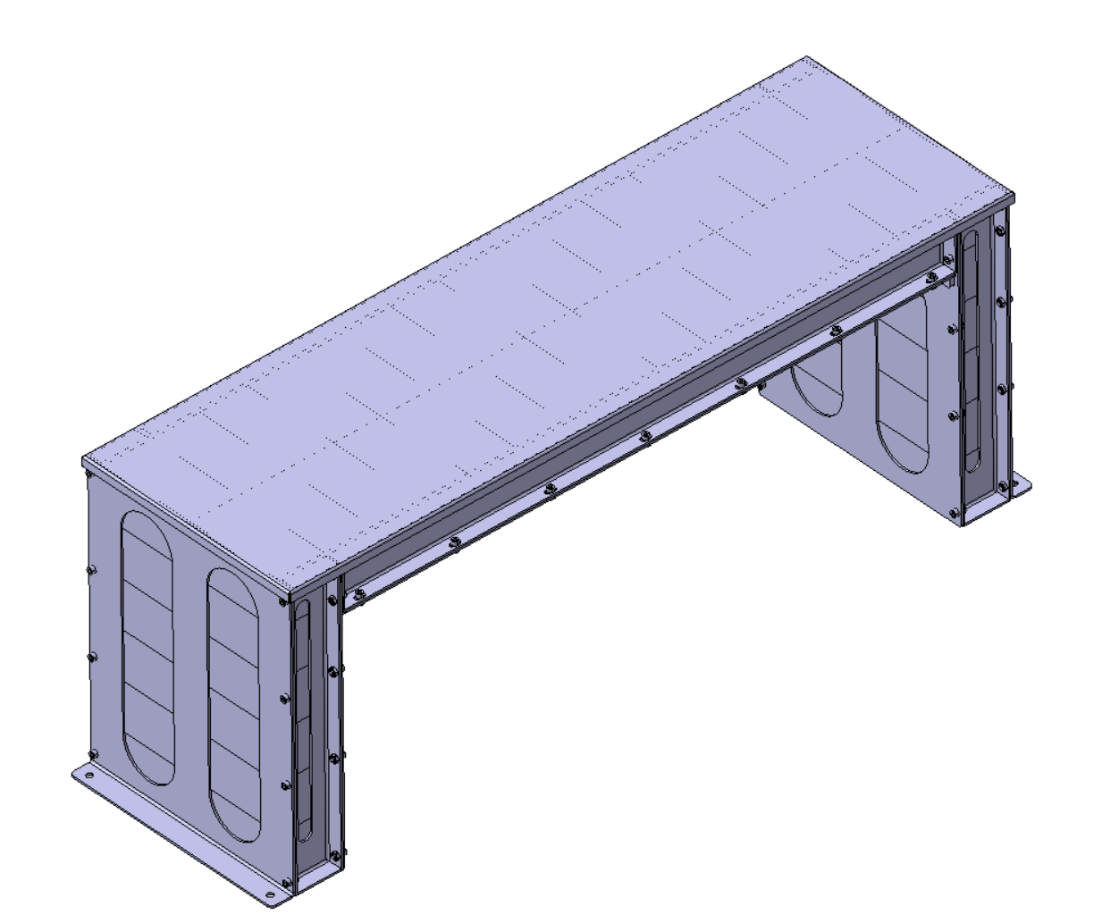
Modified proposal
Frame cover
Bricks 10x10x20 cm

Slide 8
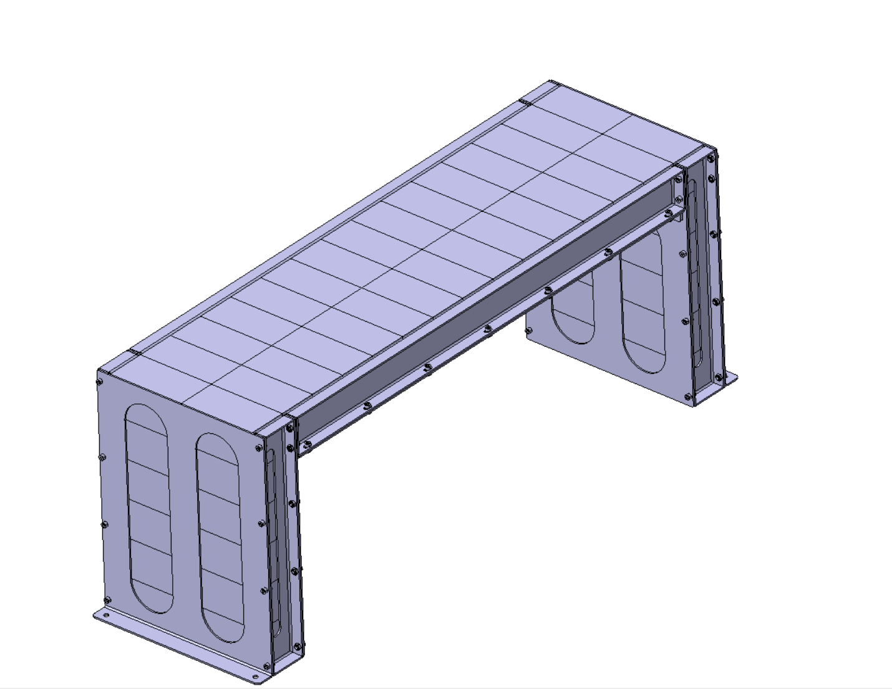
Shielding blocks
2 blocks
13 blocks
2 * 13 = 26 blocks
1 block = 16kg

Slide 9
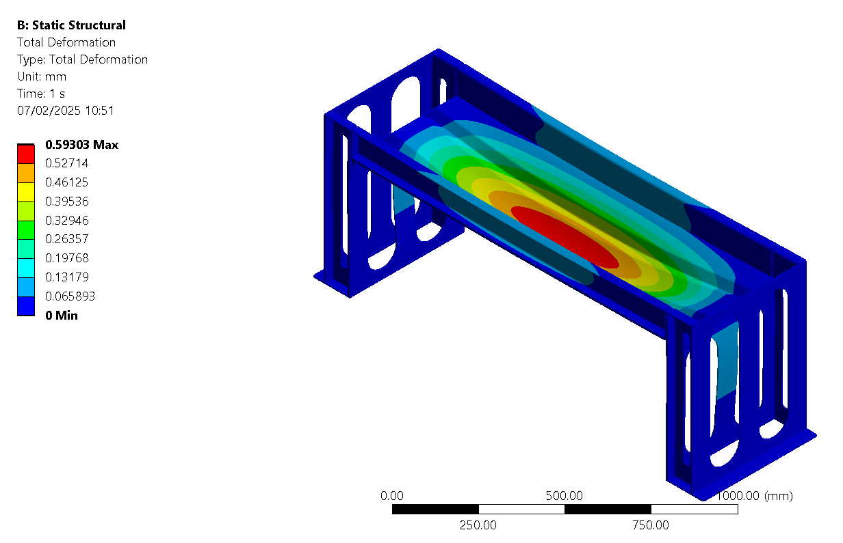
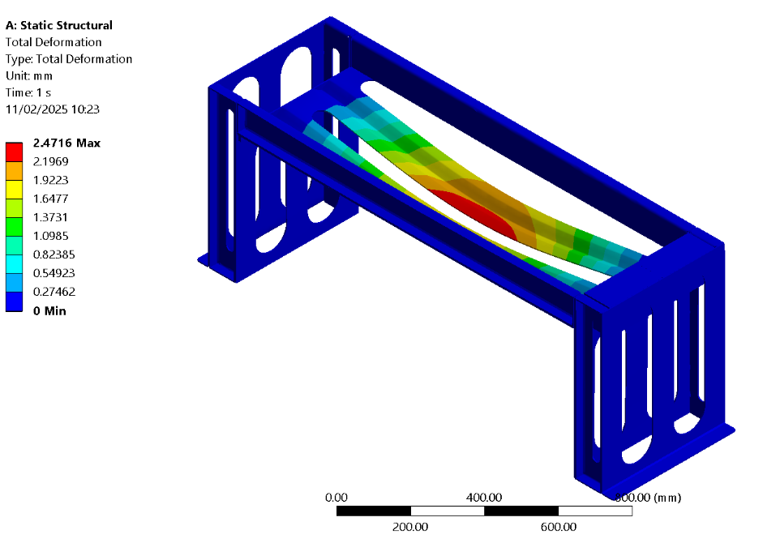
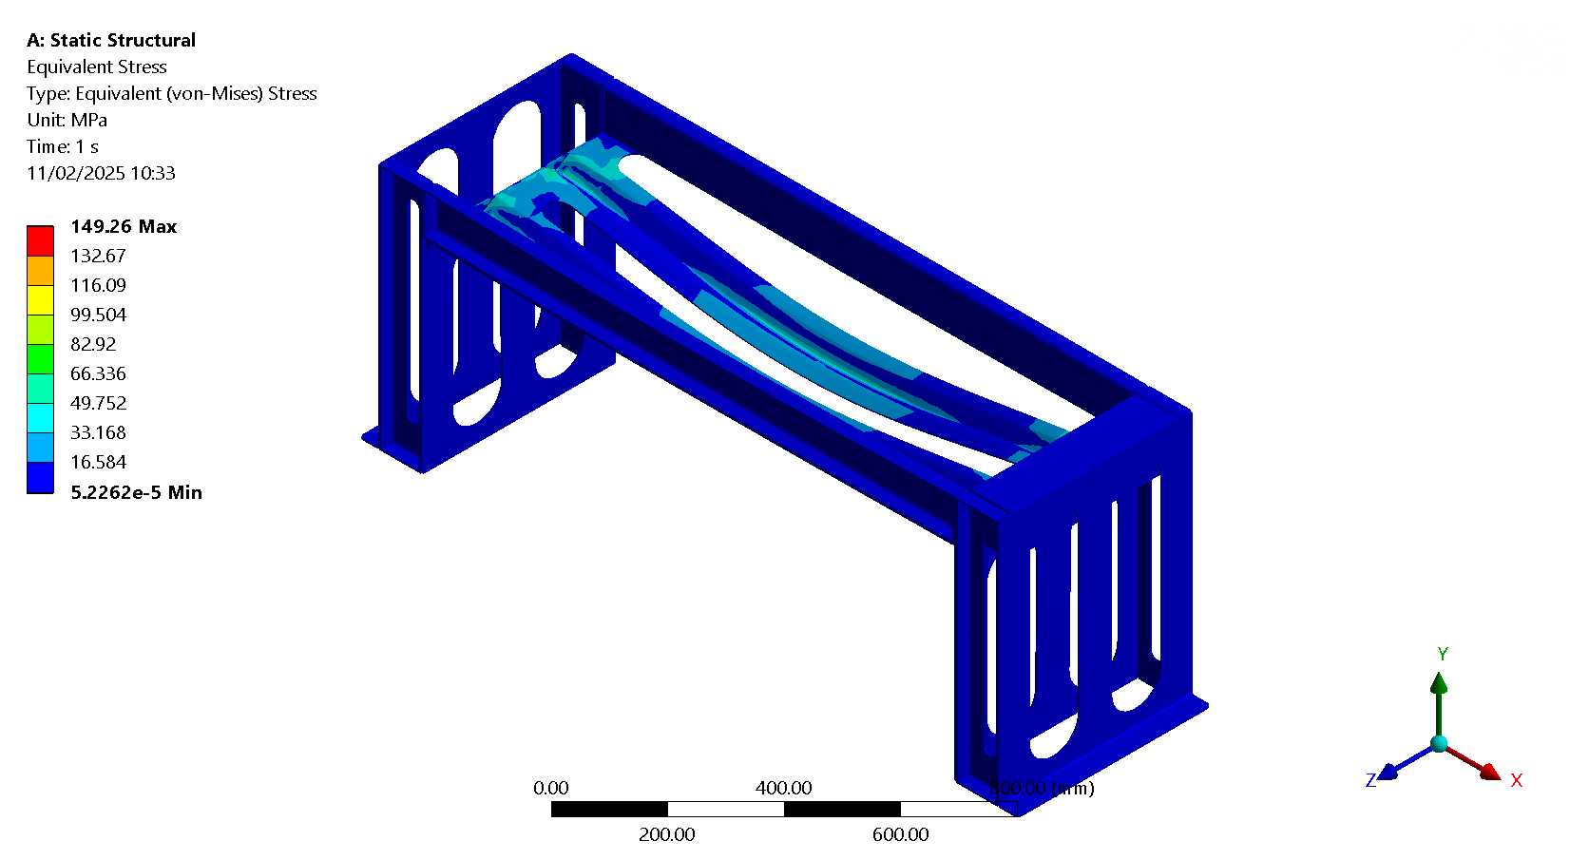
Total Deformation – load : 26 blocks * 16kg = 416kg
Initial proposal
Modified proposal
Material: S235 Structural steel

Slide 10
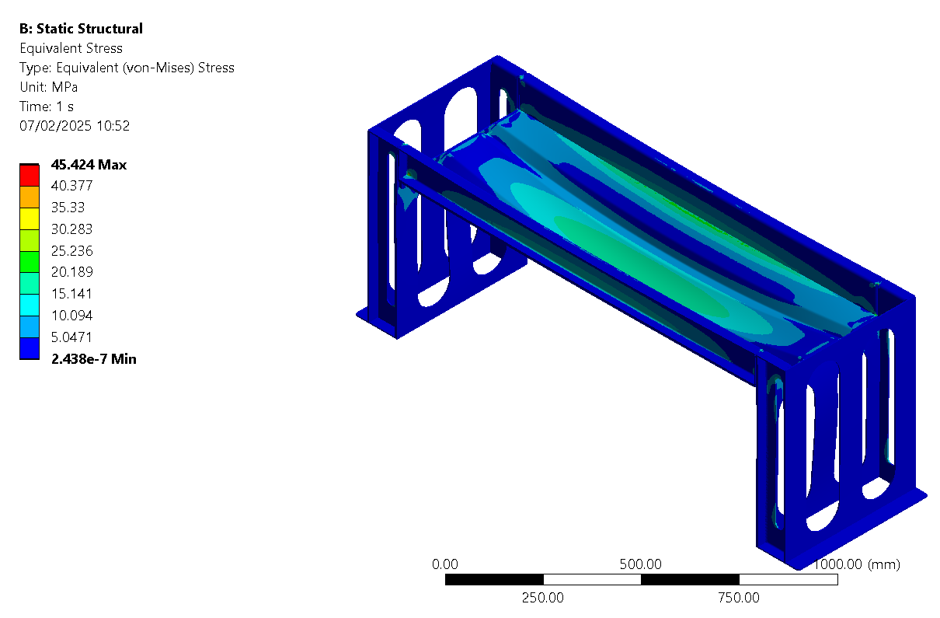
Equivalent Stress – load : 26 blocks * 16kg = 416kg
Initial proposal
Modified proposal
Material: S235 Structural steel

Slide 11


Total Deformation – load : 52 blocks * 16kg = 832kg
Initial proposal
Modified proposal
Material: S235 Structural steel

Slide 12
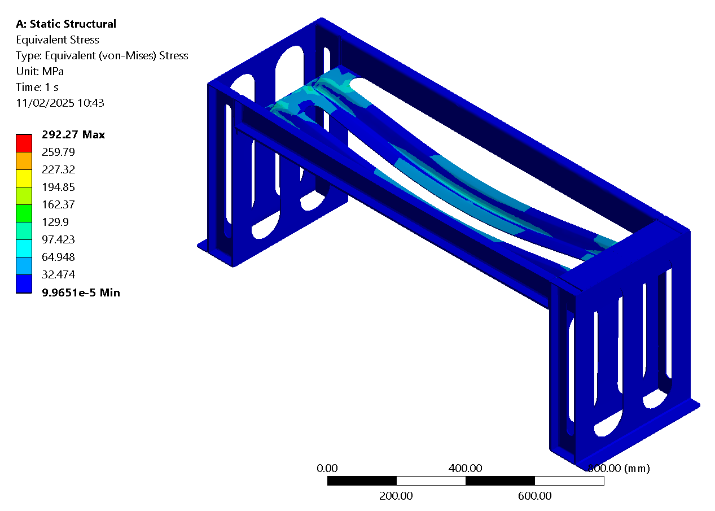

Equivalent Stress – load : 52 blocks * 16kg = 832kg
Initial proposal
Modified proposal
Material: S235 Structural steel

Slide 13

Results:
 | Initial proposal |  | Modified proposal
Weight | 416kg | 832kg | 416kg | 832kg
Max Equivalent Stress [MPa] | 149.26 | 292.27 | 45.424 | 86.32
Max Total Deformation [mm] | 2.4716 | 4.8515 | 0.59303 | 1.1467
Material: S235 Structural steel

