Slide 1
SND EYETS activities - 21th Feb 2025
TREX meeting
Marija Majstorovic, Gerardo Vasquez, Luigi Guiducci, Giulia Paggi

Slide 2
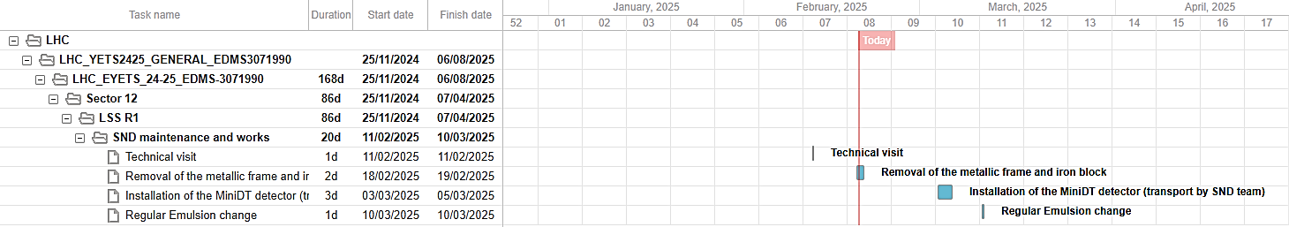
SND EYETS 24-25 schedule

Slide 3
SND EYETS 24-25 schedule
VIC organized on February 10th
Minutes of the VIC: 3234746
Points clarified:
  Transport of the 200kg block EN-HE – EDH submitted,
  Gas bottle will be placed in the flat area in UJ18 and there are already holes for it,
  Total volume and pressure of the gas bottle, chemical composition inside, relace rate in LHC tunnel, number of gas bottles,
  Safety aspects during the transport and installation of MDT.

Slide 4
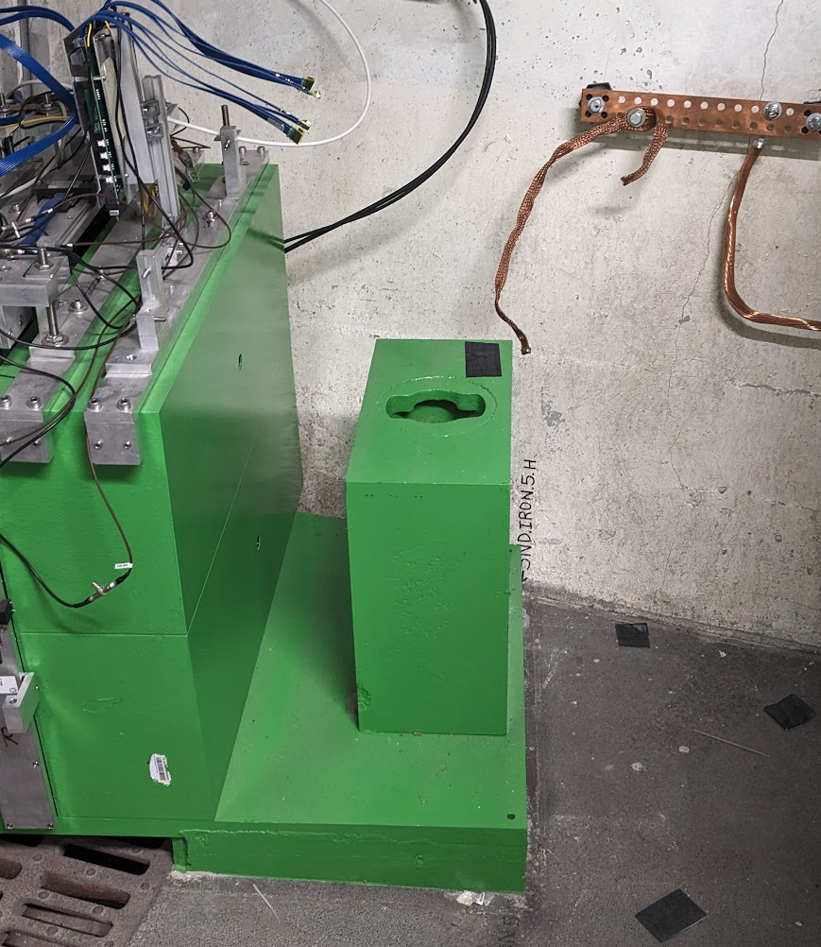
SND EYETS 24-25
Last week (W7) – Measurements taken for cabling and DS3-4 planes removed and mechanics to allow the removal of the iron block,
Wednesday 19th February the transport service removed the iron block,
IMPACT: 248210
EDH for handling: 10855276

Slide 5
SND EYETS 24-25
ECR is submitted and under circulation,
For the gas bottle Domenico Dattola will install the holders that will be placed in UJ18,
Next week (W10) – transporting mechanics and MiniDT to IP1,
All things will be moved to surface area in the week of Feb 24th,
Installation of the detector will be on the March 3rd.

