Slide 1
Forward Physics Detectors activities - LHC machine related - LS3
M. Majstorovic & O. Boettcher
(Coordinators for Physics Experiments in the LHC Machine)
21. February 2025

Slide 2
Content
Chamonix : Physics experiments in the LHC machine
PLAN Version 4 Timeline
IT-CS cable request – LS3 project

Slide 3
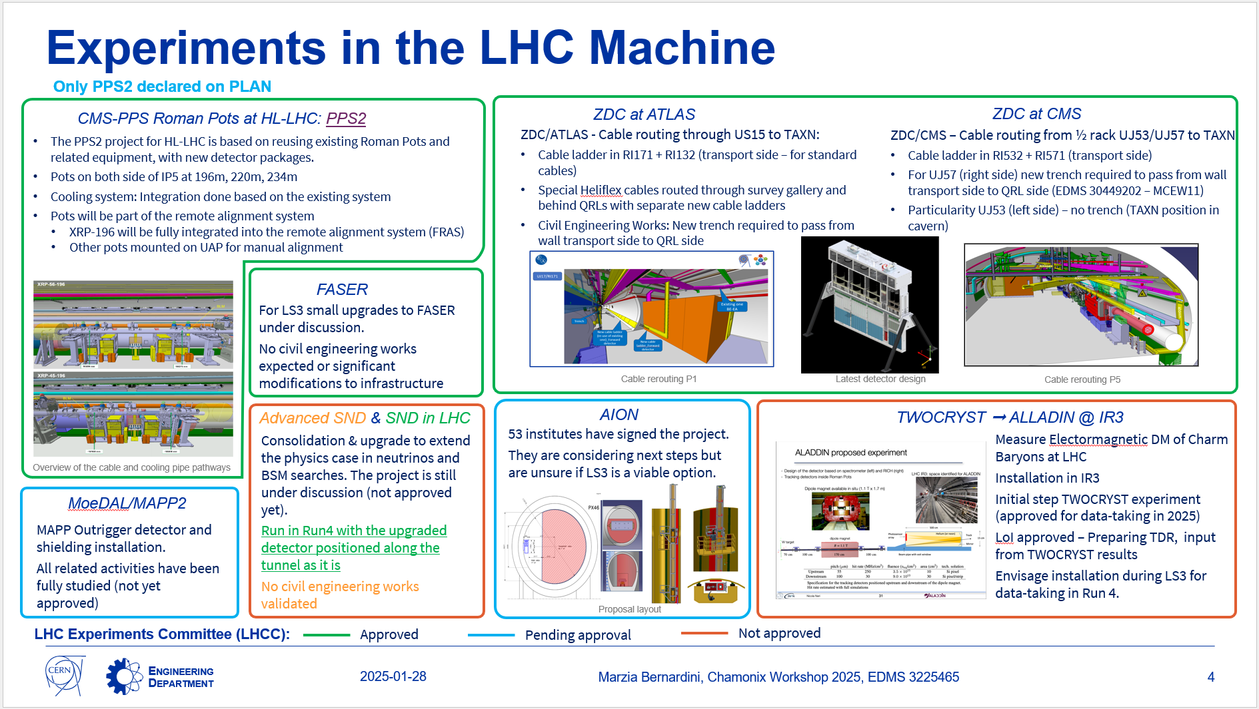
Chamonix Workshop 2025
https://indico.cern.ch/event/1469359/

Slide 4
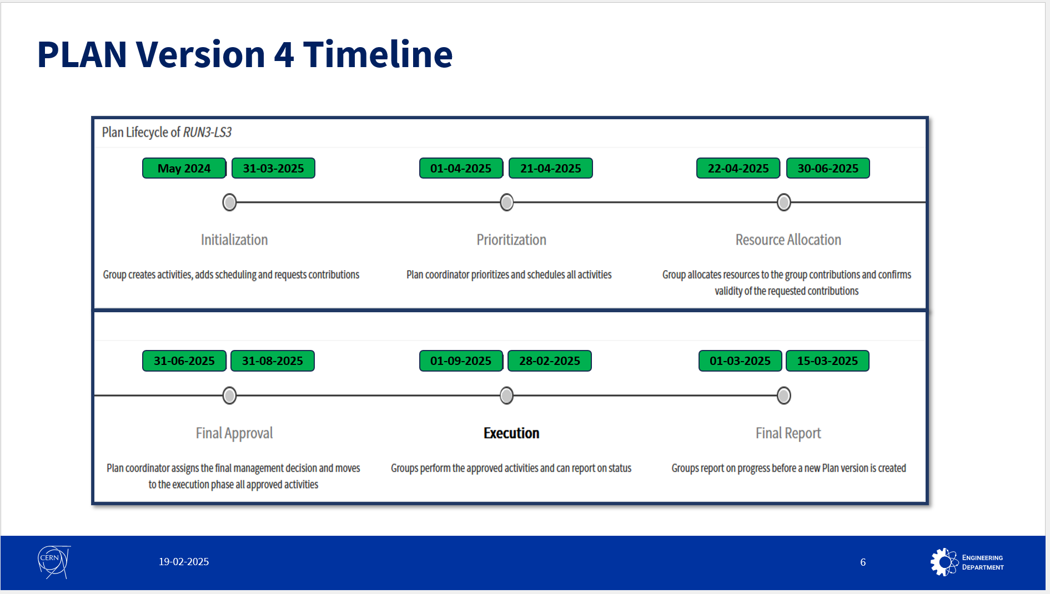
Long Shutdown 3 Committee - #14
https://indico.cern.ch/event/1481270/
https://plan.cern.ch/app/plan/61/dashboard
New PLAN iteration – forecast 2025

Slide 5
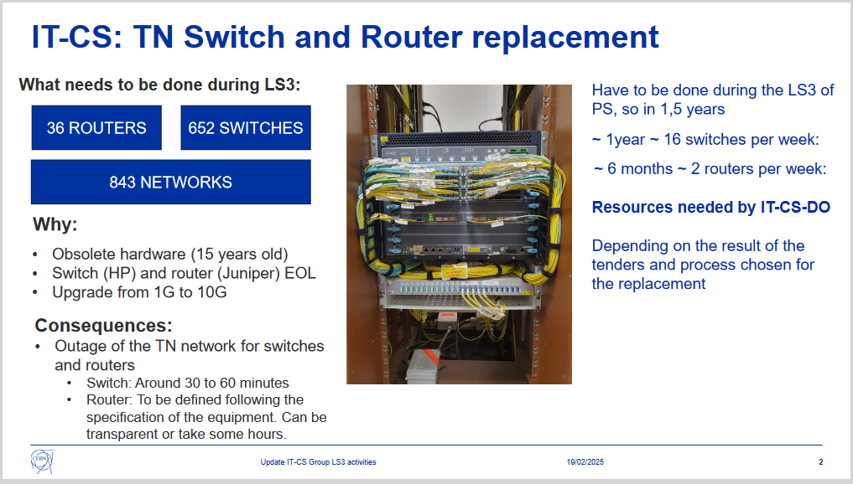
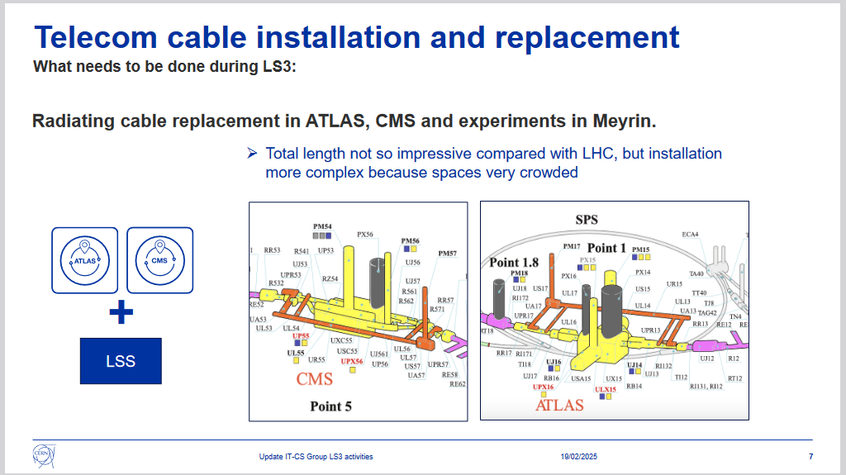
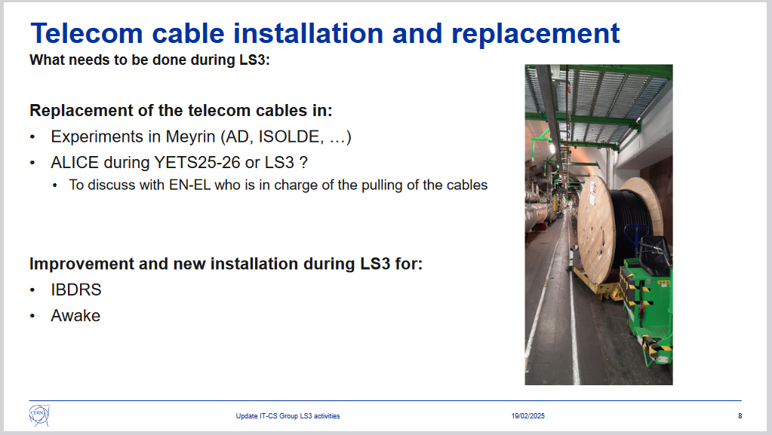
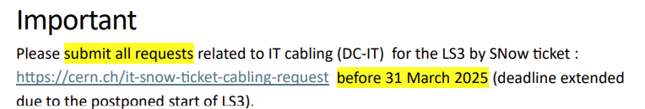
https://indico.cern.ch/event/1481270/#preview:5322854

