Slide 1
EAM to AFT linking plug-in - Workflow for 2025 & Demo
EAM/AFT Integrations Meeting
R. Almeida, A. Asko, L. Felsberger, P. Jursco, G. Perinic

Slide 2
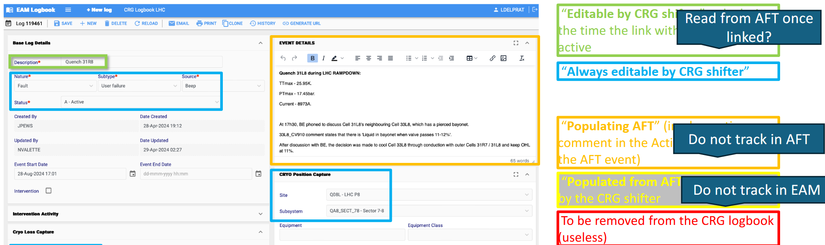
Re-cap on EAM & AFT Integration
Started out ~1 year ago
Discussed integration requirements with CRG, CV, EL, TIOC, AFT, EAM & RAWG
Motivations:
  Less workload – avoiding double bookkeeping & reviewing
  Added value from combining information of both databases
    Beam impact in AFT, equipment code from EAM,…
  Opportunity to homogenize data recording and build common tools for data analysis/KPI definition
First proposal from CRG:

Slide 3
Vision
Accelerators &
Equipment
AFT tool
AFT event
AFT owns operations impact data
EAM owns equipment fault data
1:N link - 1 EAM log links N AFT events
  useful for infrastructures
Linking primarily from EAM logbook to AFT events.
Link is key - basis for:
  Combining data
  Populating AFT/EAM
  Auto-review
High degree of automation
Beam
Log
AFT event
AFT event
Link, populate & review
1:N
EAM:AFT
Optional: log & link
Equipment/TIOC Accelerator Operations
EAM tool
Log
Equipment
Logbook event
Logbook event
Work order
Physical/Operations Database
Notes:
What about CRG & CV
If it is not your fault – don’t link to AFT but link to the EAM log that brought you down

Slide 4
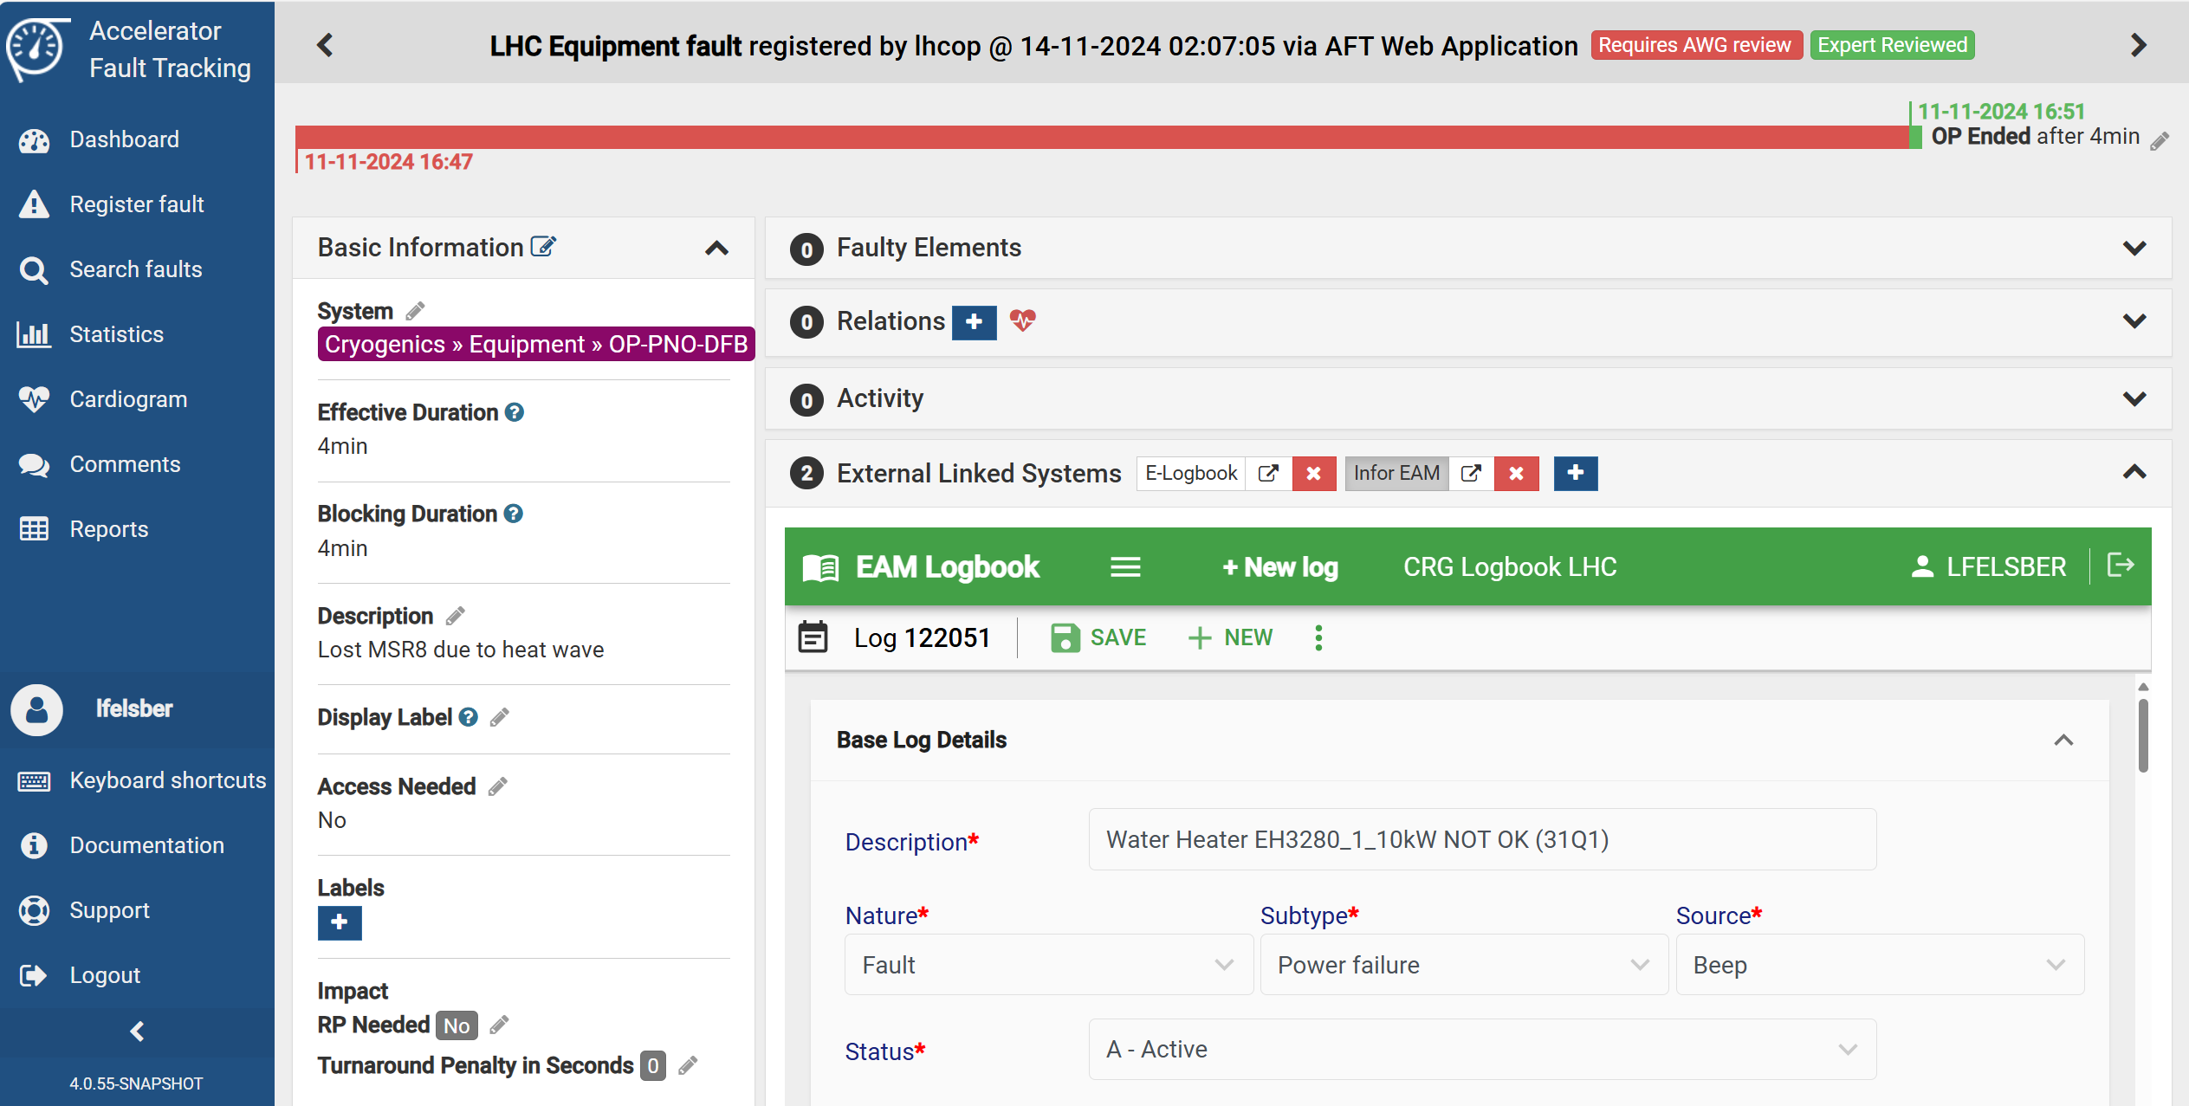
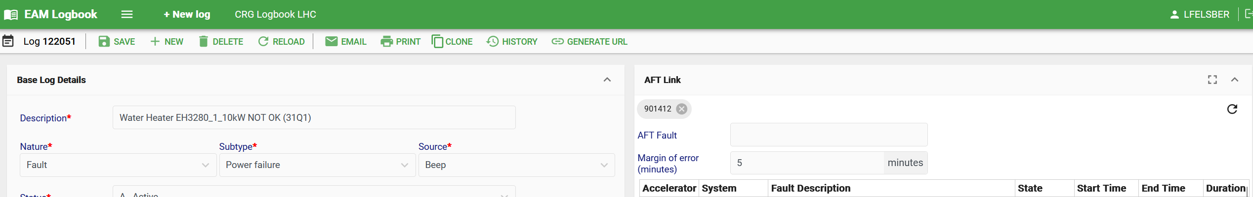
Available for 2025: EAM Linking Plug-In
Allows efficient linking from EAM to AFT:
Systems pre-filtered for each logbook & by time
Time filter can be fine-tuned
Search results ordered by start time
Generates link on both EAM & AFT & prevents double linking
Can be deployed to production version of logbooks!

Slide 5
Workflow, Demo & Discussion
https://testeamlogbook.cern.ch/LBQLHC/log2/122051
AFT – Fault details (1107322)
Fault gets recorded in AFT
AFT system sends Email notification to experts
Equipment experts follow up fault
Logging of fault in EAM logbook
Fault confirmed by equipment expert → link to AFT & mark linked AFT fault as reviewed
RAWG review & reassignment
Reclassifications trigger new AFT notifications
Existing EAM link gets deleted
Fault not confirmed → request change
Logged by BE-OP
Discussion point: role of TIOC
99% of cases are done here
1% of cases are reclassified

Slide 6
What could be the next steps?
Auto-Review
Auto-Populate
Consider an EAM ‘claimed’ AFT fault to toggle automatically reviewed
Would save manual step
Idea remains to separate information between EAM (equipment) & AFT (beam) instead of duplicating
Nevertheless, certain fields useful in both EAM & AFT. E.g.
  EAM description as comment into AFT, Functional position/equipment code, Sub-systems
  System specific properties (implemented by group) – e.g. CRG timestamps, EN-EL glitch dip/swell & duration
Auto-Log
AFT to publish pre-filled logbook events to EAM
  1:N relationship problematic for infrastructures across machines
Would save manual step

Slide 7
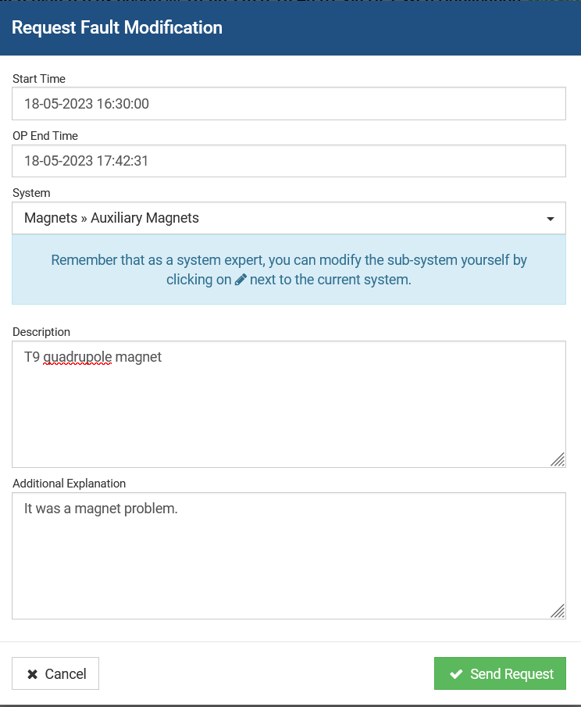
Why not implemented yet?
Clarification of data modification rights and rules
AFT APIs need to grant different rights to different EAM logbooks
  Avoids EAM integration of system X modifying AFT log of system Y
AFT API extensions to access review state and change requests
How to handle links under reassignment of fault from system X to system Y?
  Not considering all edge cases can have big impact when tool is operational
Resource allocation
AFT tool essentially feature frozen
Currently, no development resources allocated

Slide 8
Next steps
RAWG, EAM & AFT team to
  Narrow down next integration steps (roles & rules)
  Look for resources
EAM logbook users have linking plug-in available for 2025 operation
  Please share your experience and feedback – eam.support@cern.ch
  Review of added value mid-2025
Many thanks for the inputs provided and efforts put into development by all involved teams!

Slide 10
Machines control rooms or Experiment control rooms (CCC-PS, CCC-SPS, CCC-LHC, Isolde control room,..)
Infrastructure control room (CCC-TI)
Equipment expert (AA, ACE, CV, EL, HE)
AFT Working Group
Check problem alarms
Fault potentially linked to infrastructure
Contact TI
Request modification of attribute
Assess equipment responsible in collaboration with groups concerned, and TIOC
Create AFT faults with the suspected equipment in agreement with TI
No
Contact Machines / Exp
Yes
Fault confirmed for the equipment
Automatic notification
Yes
Create an Event for TIOC analysis linked to the AFT fault
Pass to status Fault reviewed

Slide 11
Machines control rooms or Experiment control rooms (CCC-PS, CCC-SPS, CCC-LHC, Isolde control room,..)
Infrastructure control room (CCC-TI)
Equipment expert (CV, EL, HE)
AFT Working Group
Check problem alarms
Fault potentially linked to infrastructure
Contact TI
Request modification of attribute
Assess equipment responsible in collaboration with groups concerned, and TIOC
Create AFT faults with the suspected equipment in agreement with TI
No
Contact Machines / Exp
Yes
Fault confirmed for the equipment
Automatic notification
Yes
Change the status of AFT Fault (reviewed)
Fill the logbook event (filling automatically the AFT)
Create additional work orders
Define action plan (followed at the TIOC)
Create:
a logbook event for CV
A work order for the intervention

Slide 12
Workflows with and without plug-in
(experts’ point of view)
Currently
With EAM/AFT integration
OP records fault
AFT system sends Email notification to experts
Experts follow up fault
Documents in EAM
Reviews & Documents (/links EAM) in AFT
RAWG review & reassignment
Reclassifications trigger new notifications
Existing EAM link gets deleted - tbc
OP records fault
AFT system sends Email notification to experts – still relevant?
Experts follow up fault
Documents in EAM
Use plug-in to link to AFT
RAWG review & reassignment
Reclassifications trigger new notifications
Existing EAM link gets deleted – notification?
Auto-document & review?
AFT creating EAM log if desired (already linked)
Notes:
Data consistency, less redundant information,
How to update faults that are reassigned from one eam to another eam logbook

Slide 13
Plug-in to link to AFT
Feedback received
What could we propose?
Lionel (CRG)
  It does not take into account the Site/Subsystem/equipment : for instance, in the LHC logbook, we may have the following Accelerators: LHC, ELENA, PS, AD, EA, etc.
  For the LHC Cryogenic logbook, we have all systems: Injector Complex, Radio Frequency, etc.
  It looks like the margin of error takes into account the start date and the end date as well.
  The same AFT id can be recorded multiple time whenever the logbook is saved.
Jesper (TIOC)
  Limit the list of AFT events to those within the same time frame. Perhaps with the possibility to manually expand the list - done
  Group the list by machine, then order by start time ?
  Remove from the list the ones you have already attached
  Perhaps add more description when the AFT is attached. You see only the ID now, perhaps it could be useful to see also the description from the AFT inside EAM? - next slide
System filter for each logbook
  Egroup based
    Long-term: integration with IT egroups - grabber
  Mapping (how to maintain? Put reference on start page of eam logbook & send yearly reminder)
Ordering search results - done
Avoid double linking - easy
Fine-tuning of duration - unclear

