Slide 1
CERN Civil Engineering – Future Studies
Tamara Bud
28/01/2025

Slide 2


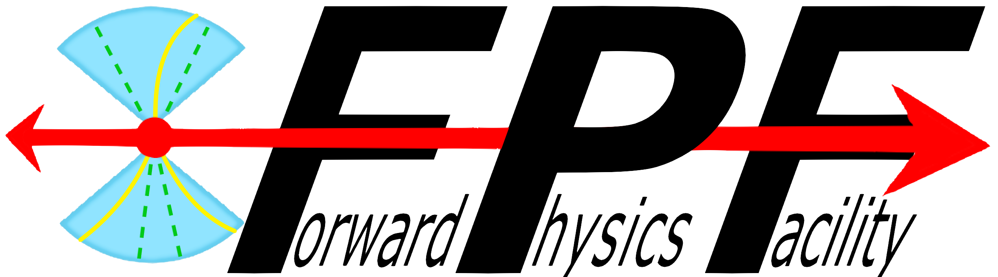
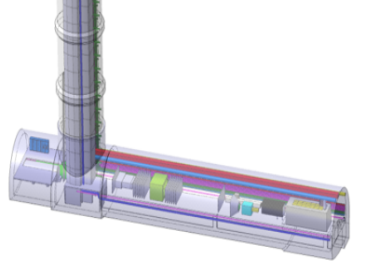
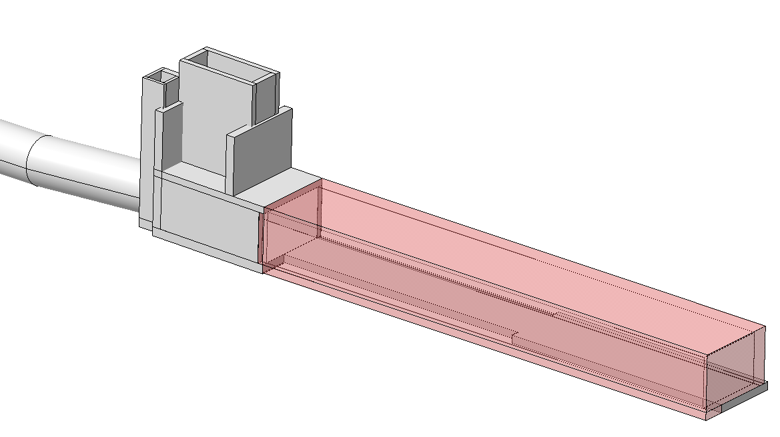
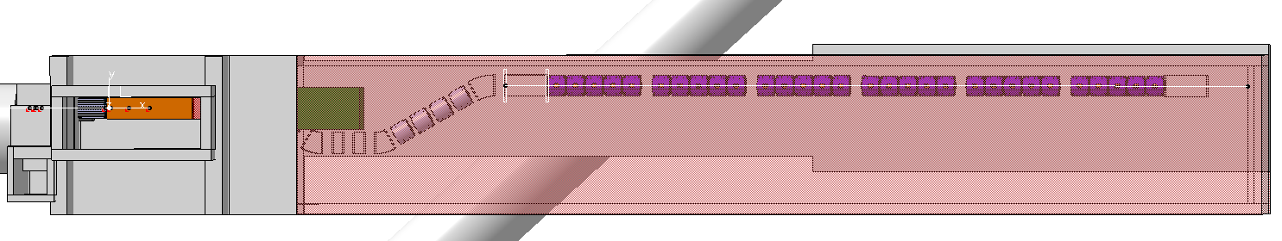
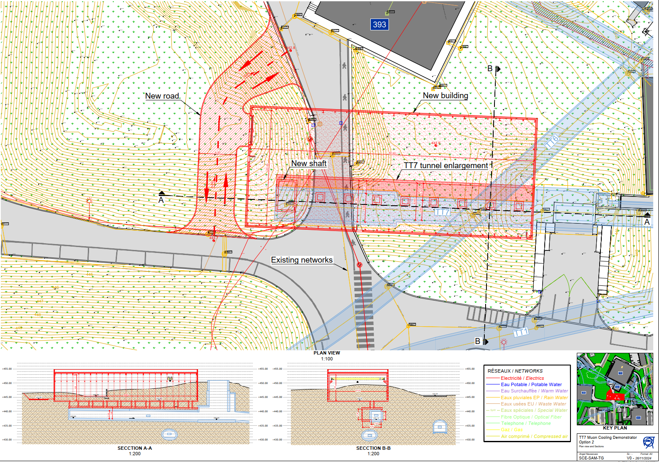
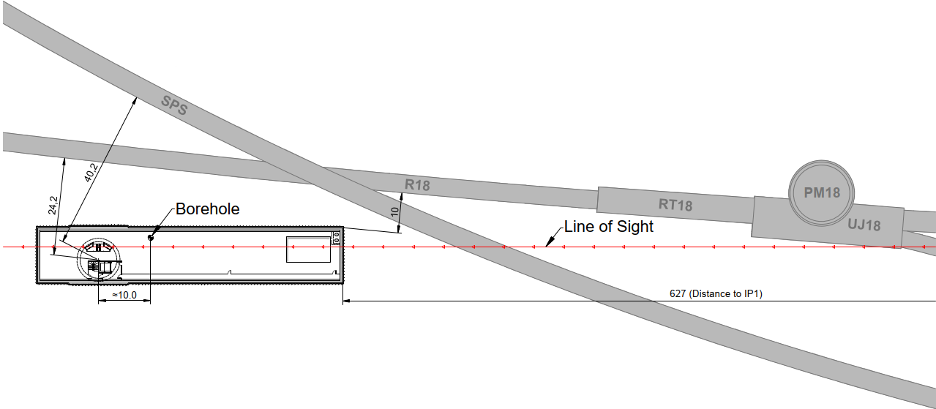
Physics Beyond Colliders
Forward Physics Facility
Muon Cooling Demonstrator
Undergound:
A 75m x 11.8m experimental cavern
An 84m deep access shaft
Safety corridor inside the cavern
Overview
Proposed enlargement of existing tunnel by 3m widening over 50m length.
Surface building over tunnel, 20m wide x 50m length
Diversion of local road and networks
Above ground:
  Access building
  Electrical building
  Cooling & Ventilation building
Project Stage
  Awaiting budget approval before detailed design stage
These projects are yet to be decided on at the ESPP

Slide 3

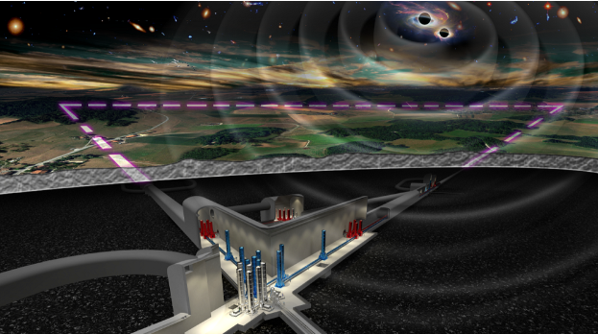
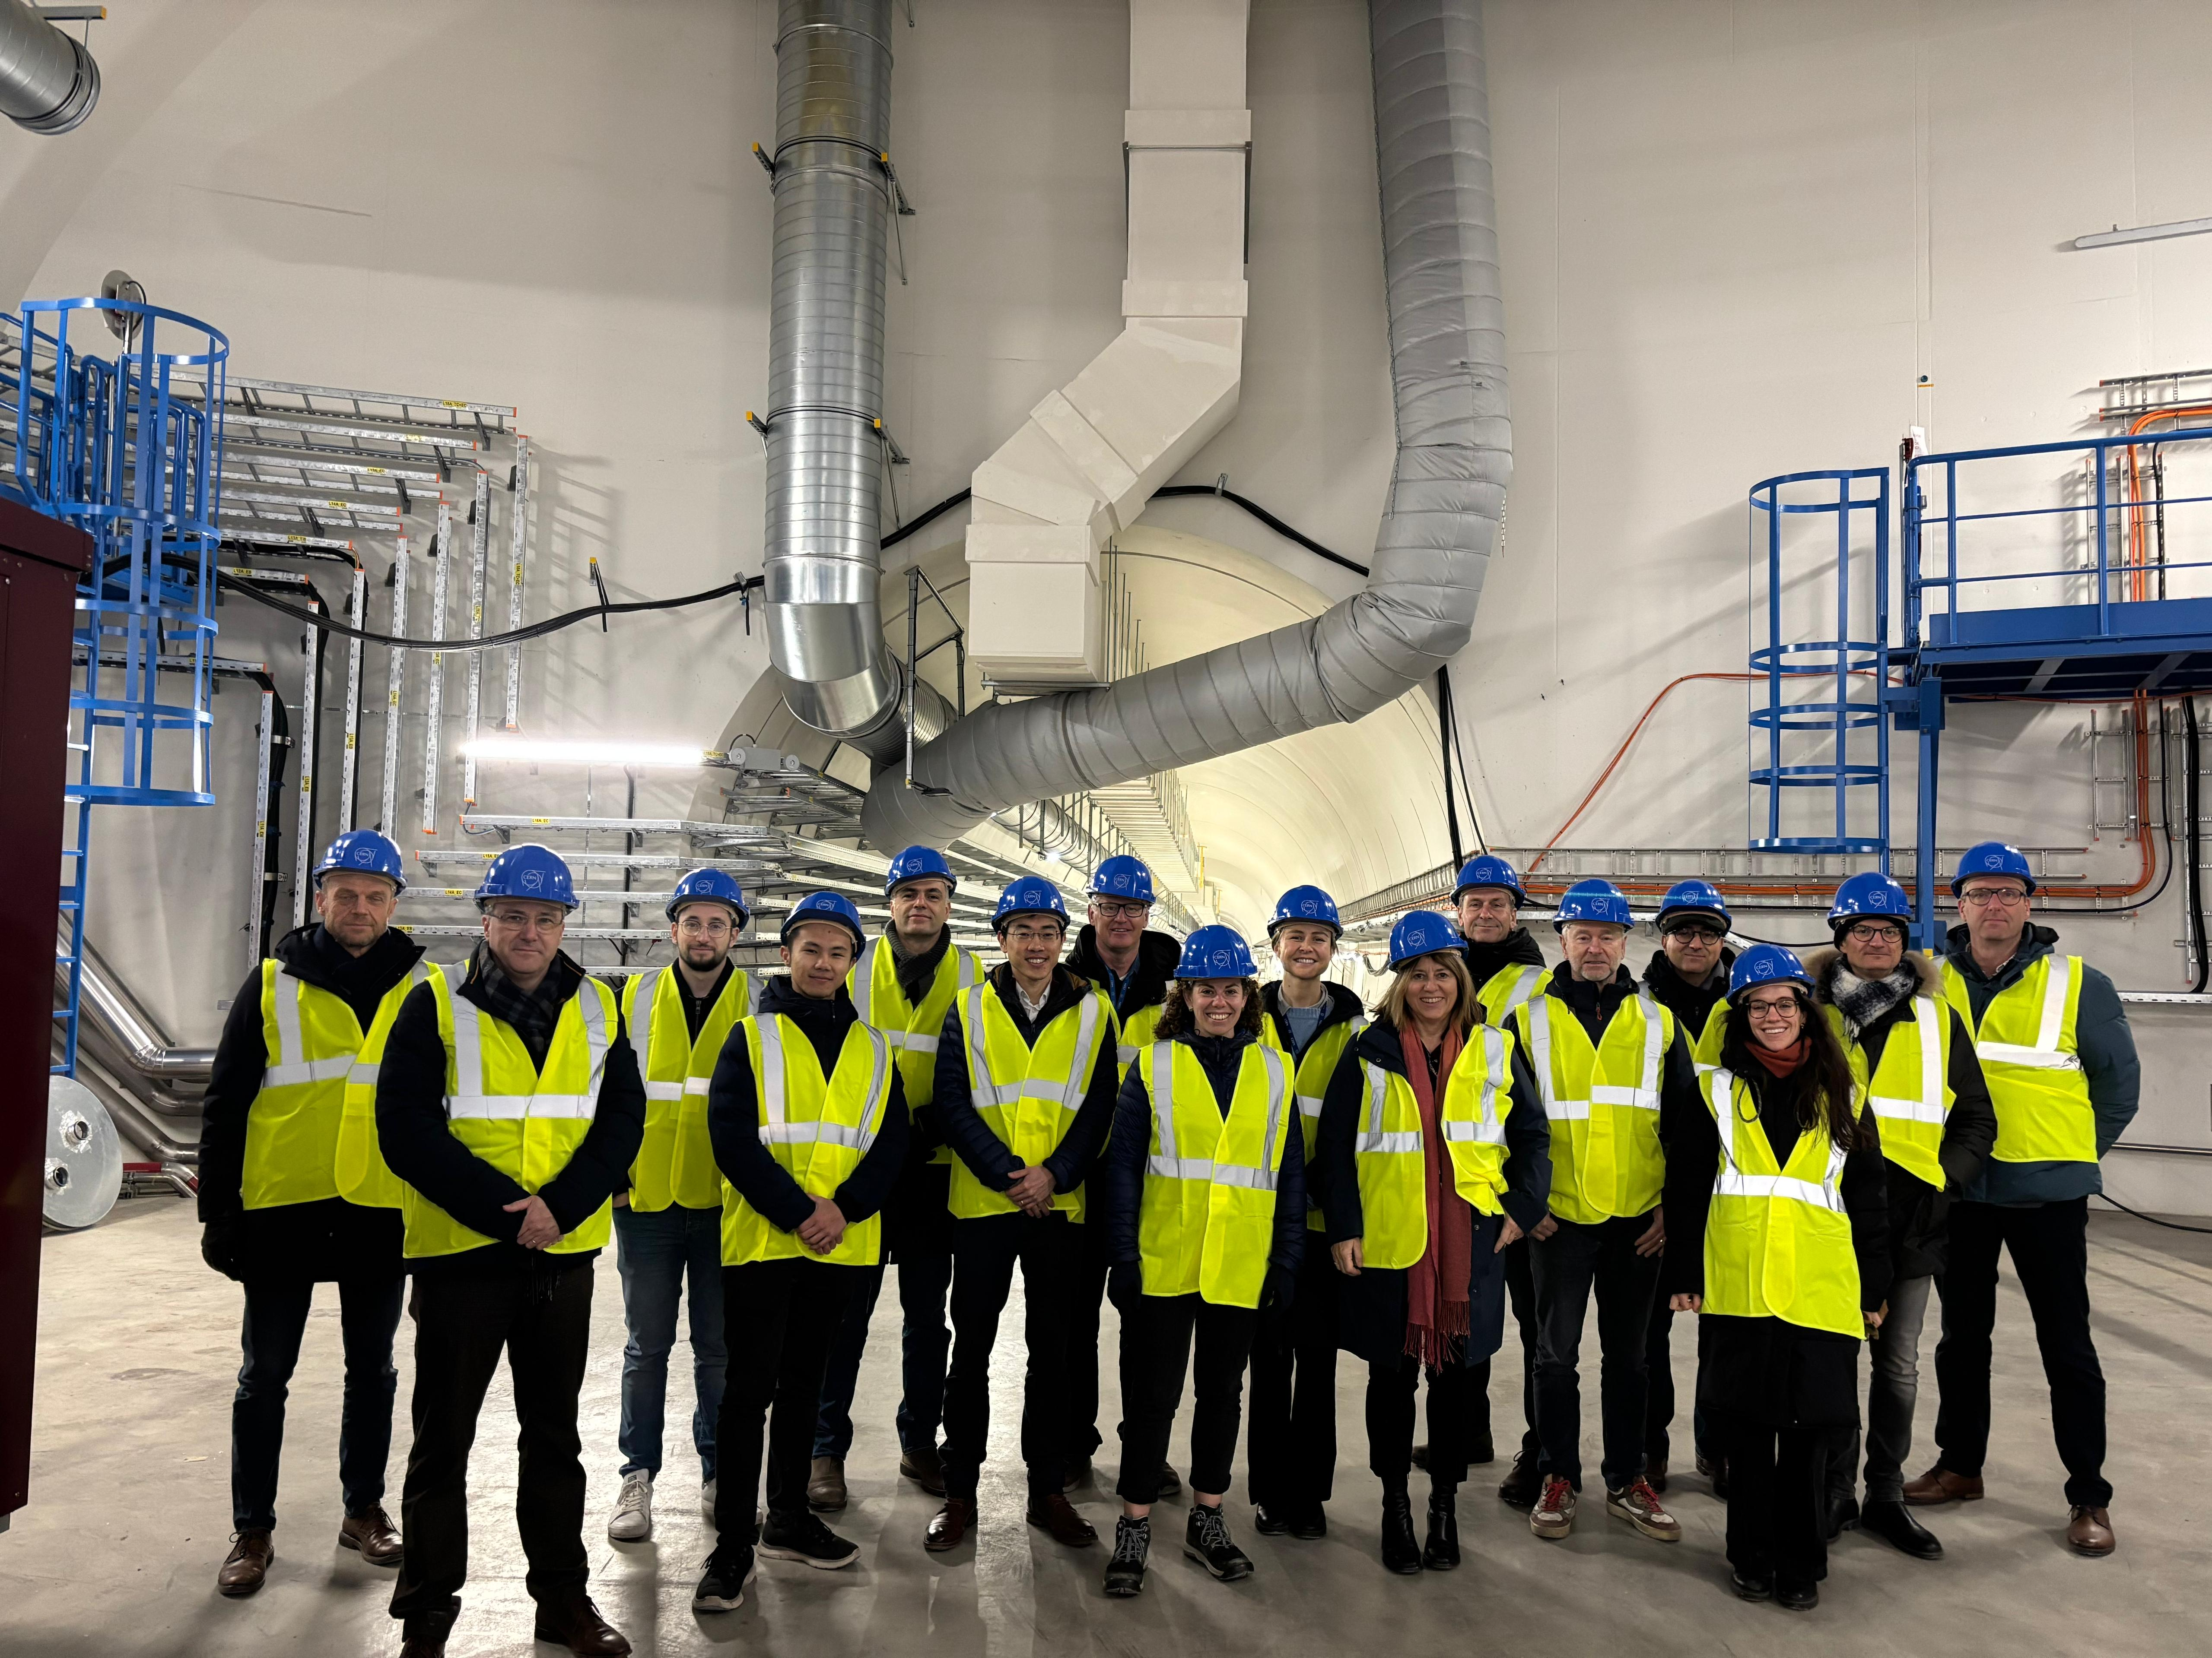
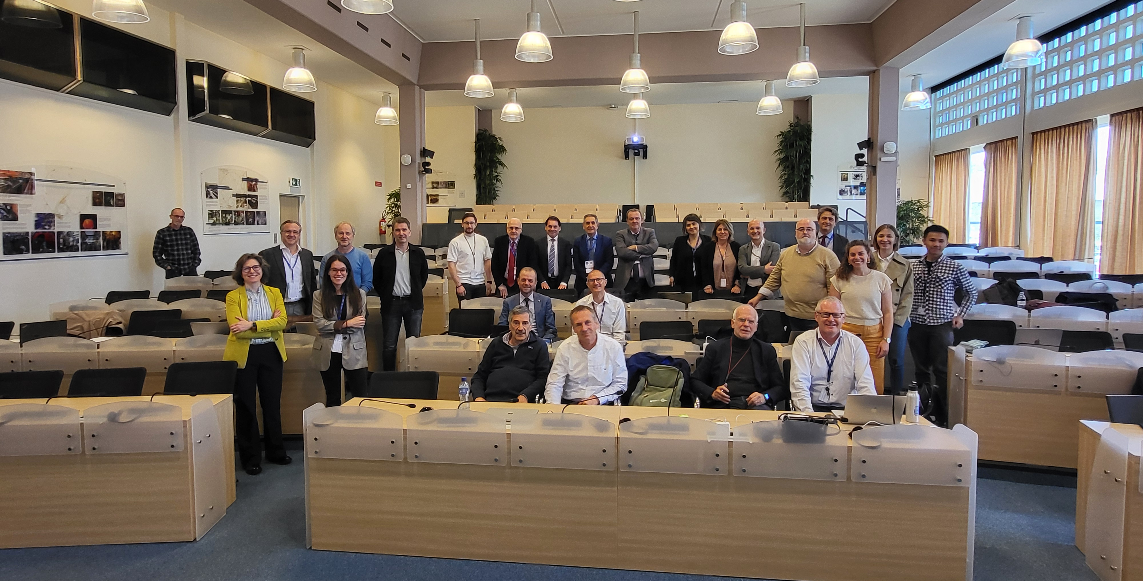
Einstein Telescope
Collaboration between CERN and ETO involves:
  Ongoing collaboration agreement ongoing until 31st December 2026
  Future Studies Section will provide support in the civil engineering activities required for the delivery of a TDR
  Site independent
  Support for the ET Engineering Department
  Advice on shared design platforms
  Technical reviews of civil engineering reports
  Technical input where appropriate
Collaboration Achievements…
Successful workshops at CERN, hosting colleagues from ETO, INFN, Nikhef, IFAE, Local Teams,
Comments from local teams’ on roadmap document addressed
Identified challenges and considered next steps together
Decision to start a taskforce involving local teams and ETO and CERN together

