Slide 1
CERN-Intera
Future Circular Collider
Roddy Cunningham
17.02.2025

Slide 2
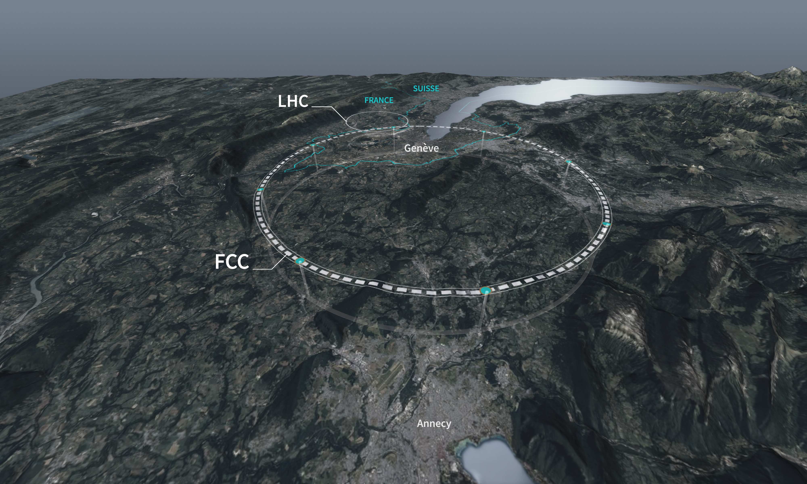
The Future Circular Collider
The FCC is being studied as the successor to the LHC
91km circumference tunnel located in Geneva at the foothills of the Alps
Feasibility study to be presented at next European Strategy for Particle Physics Update (ESPP)
Planned construction is foreseen to begin in the early 2030s
A two-stage operation is planned, first FCC-ee then FCC-hh
Geotechnical investigation & detailed design
Feasibility Study
ESPP
Construction
FCC-ee Operation
FCC-hh Adaptation
FCC-hh Operation
5
10
15
20
25
30
35
40
45
70 years

Slide 3
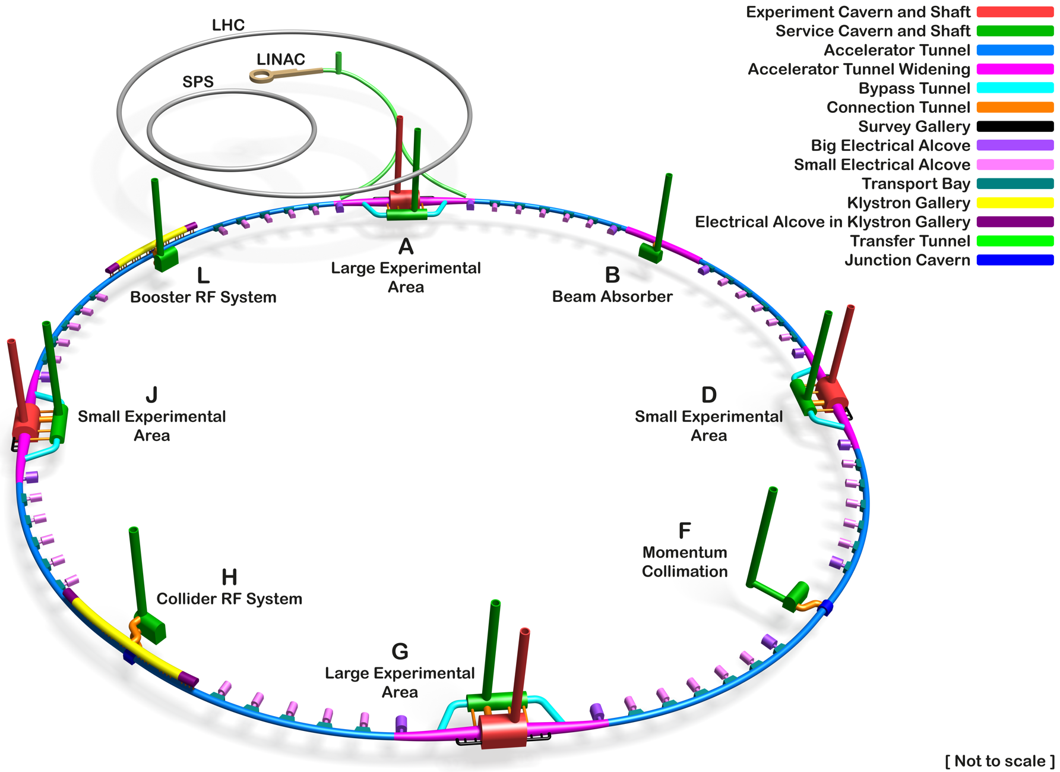
FCC Underground Infrastructure
8 surface sites
13 shafts
4 experiment caverns
8 service caverns
Beam Absorber
A new LINAC
Credit: Angel Navascues Cornago

Slide 4
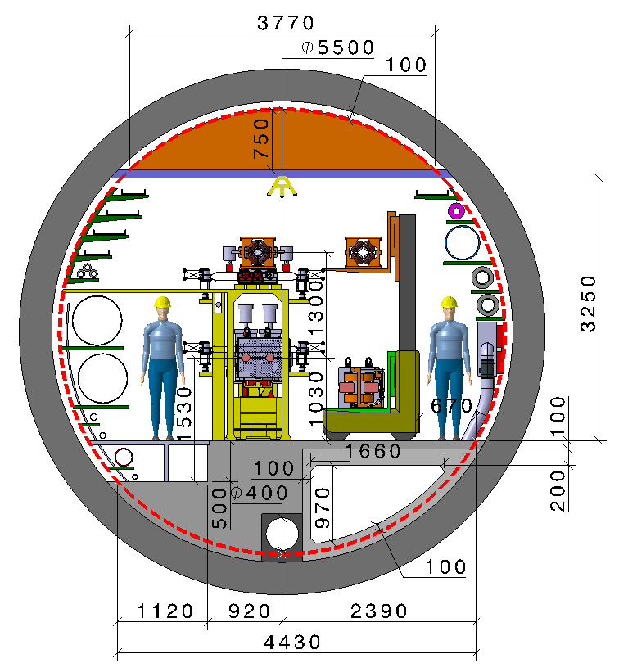
Main Beam Tunnel
Smoke extraction duct
Precast concrete tunnel segments
Tunnel monitoring / maintenance robot
In-situ concrete floor
Tunnel invert drainage
Ventilation duct
Credit: Fani Valchkova-Georgieva

Slide 5
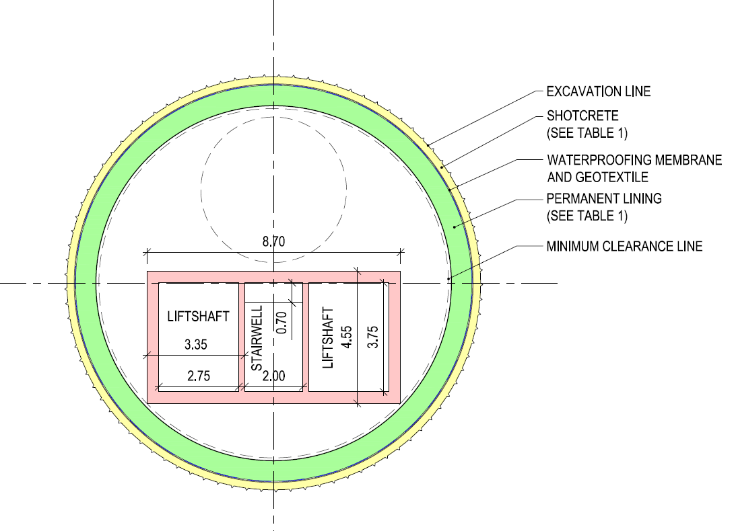
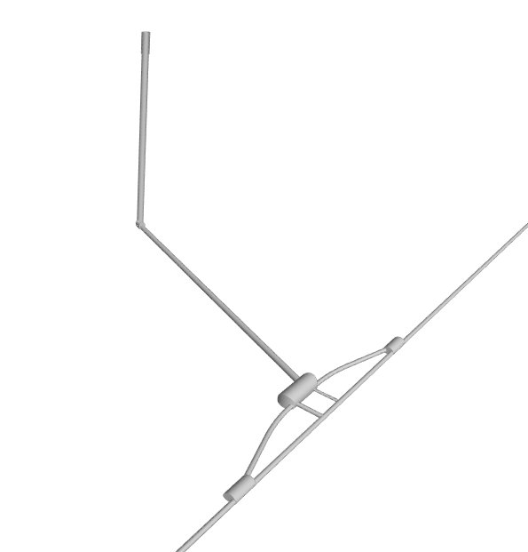
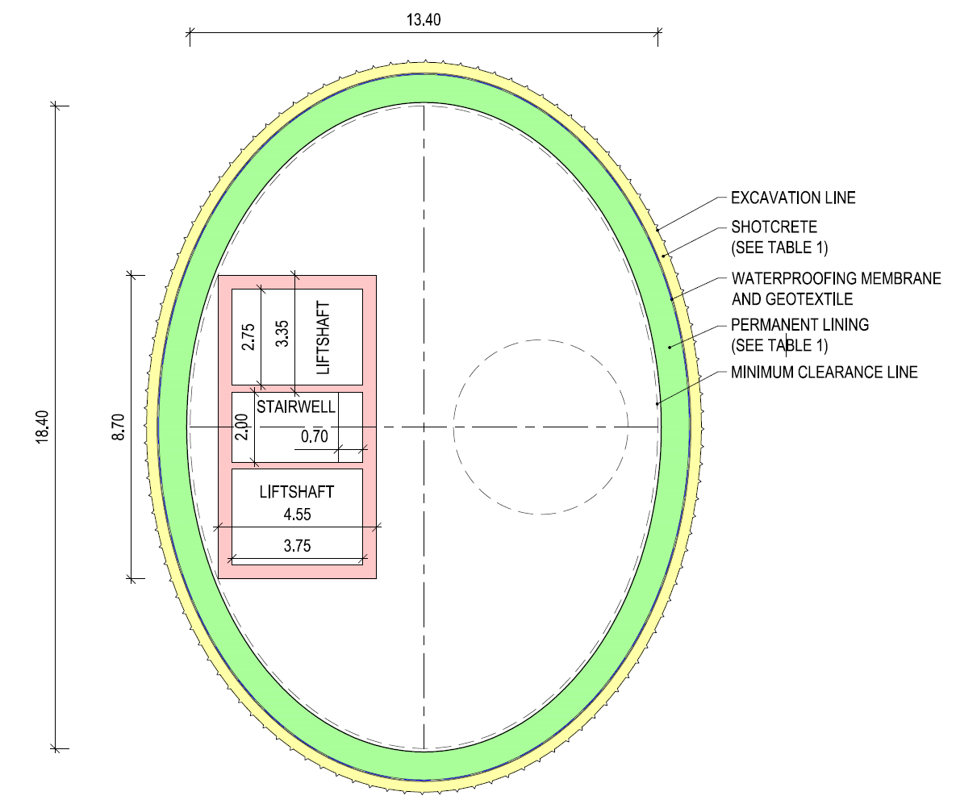
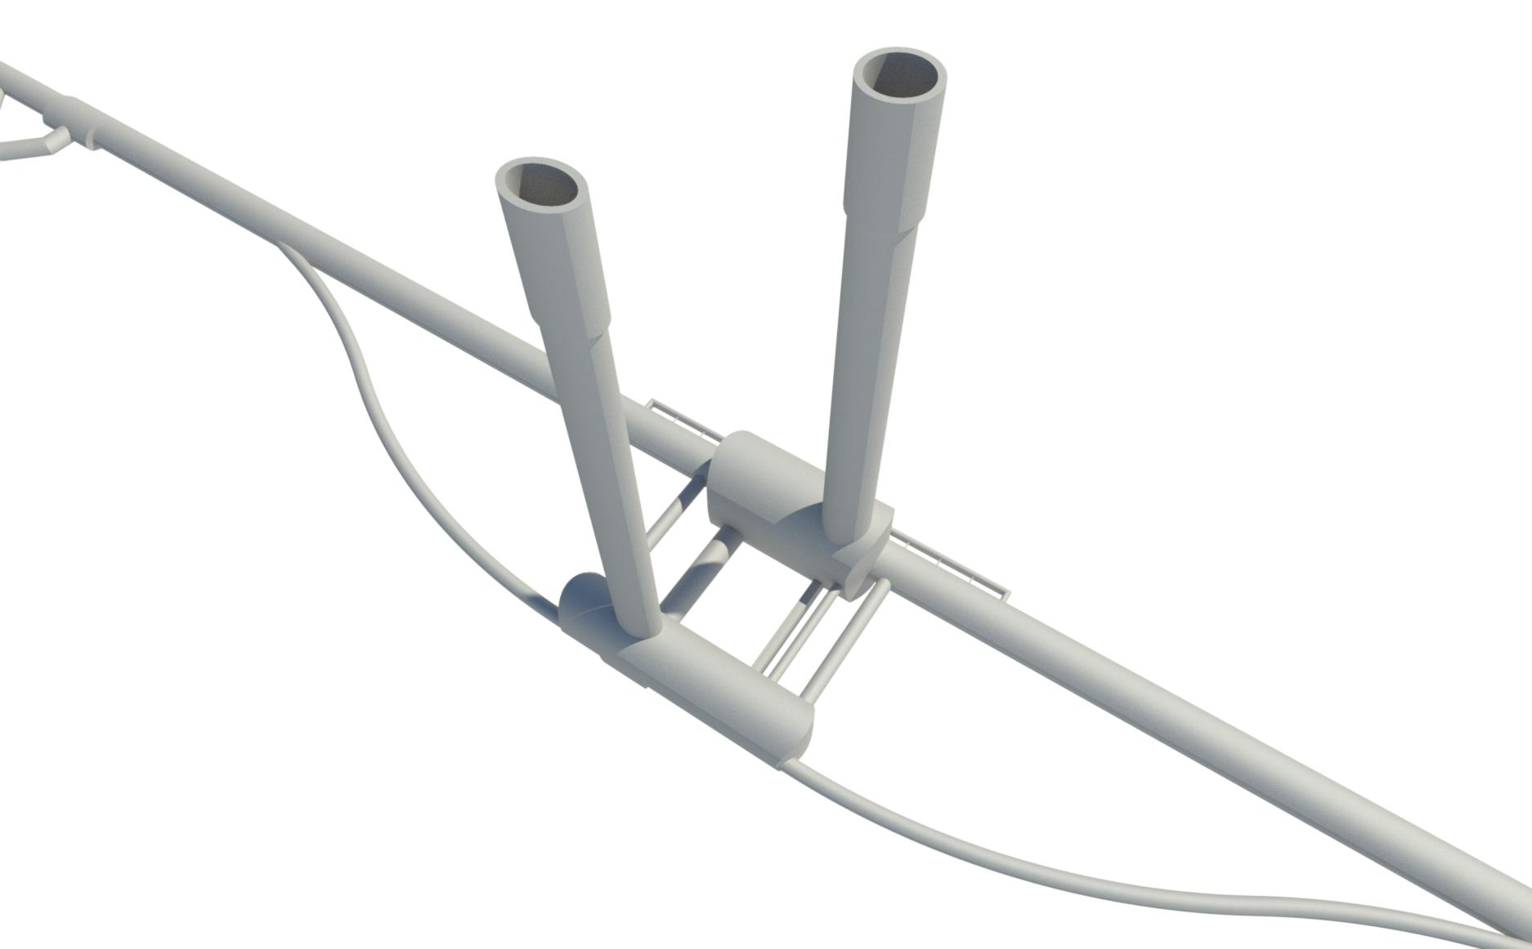
Shafts
13 Shafts
Depths range from 180m to 400m
2 x 18.4m elliptical
4 x 18m circular
7 x 12m circular
12m
18.4m
Credit: Angel Navascues Cornago

Slide 6
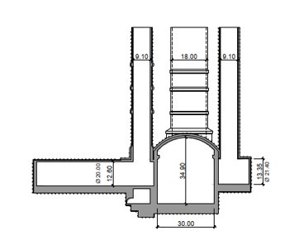
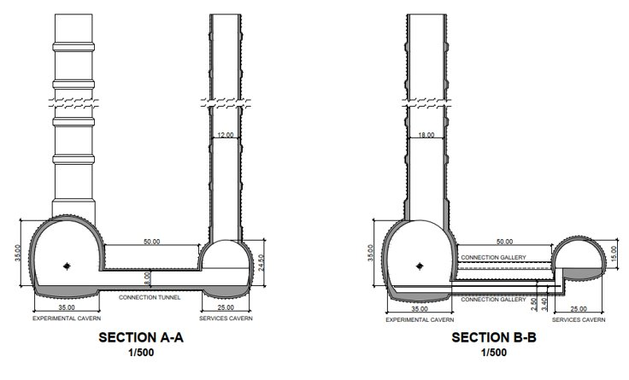
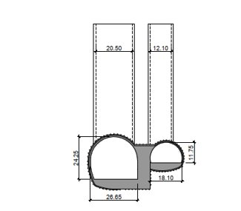
Caverns
ATLAS (LHC)
FCC
Credit: Angel Navascues Cornago
CMS (LHC)

Slide 7
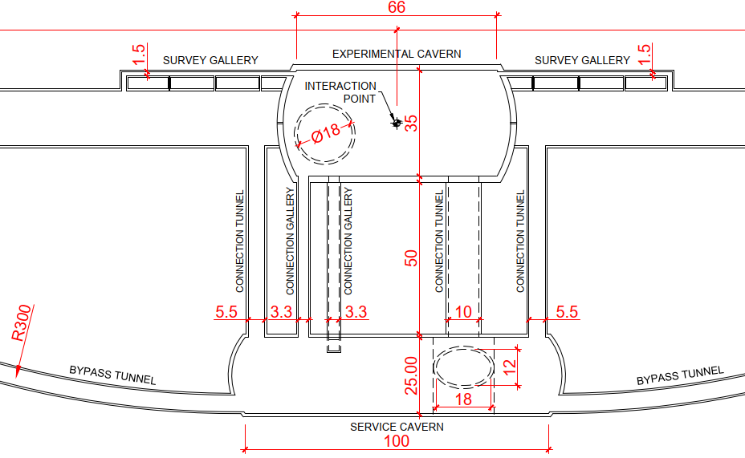
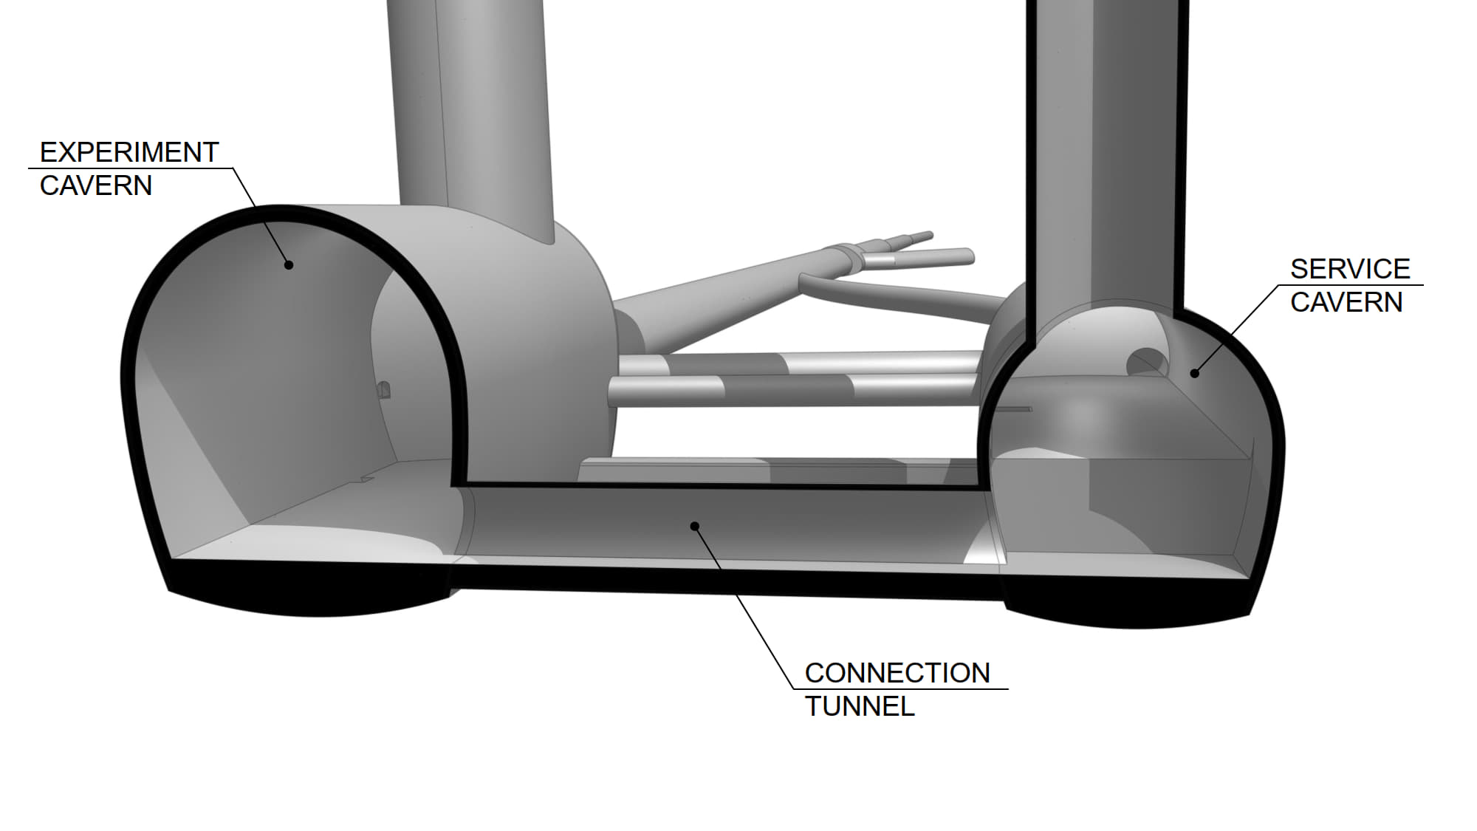
Experimental Area
Credit: Angel Navascues Cornago

Slide 8

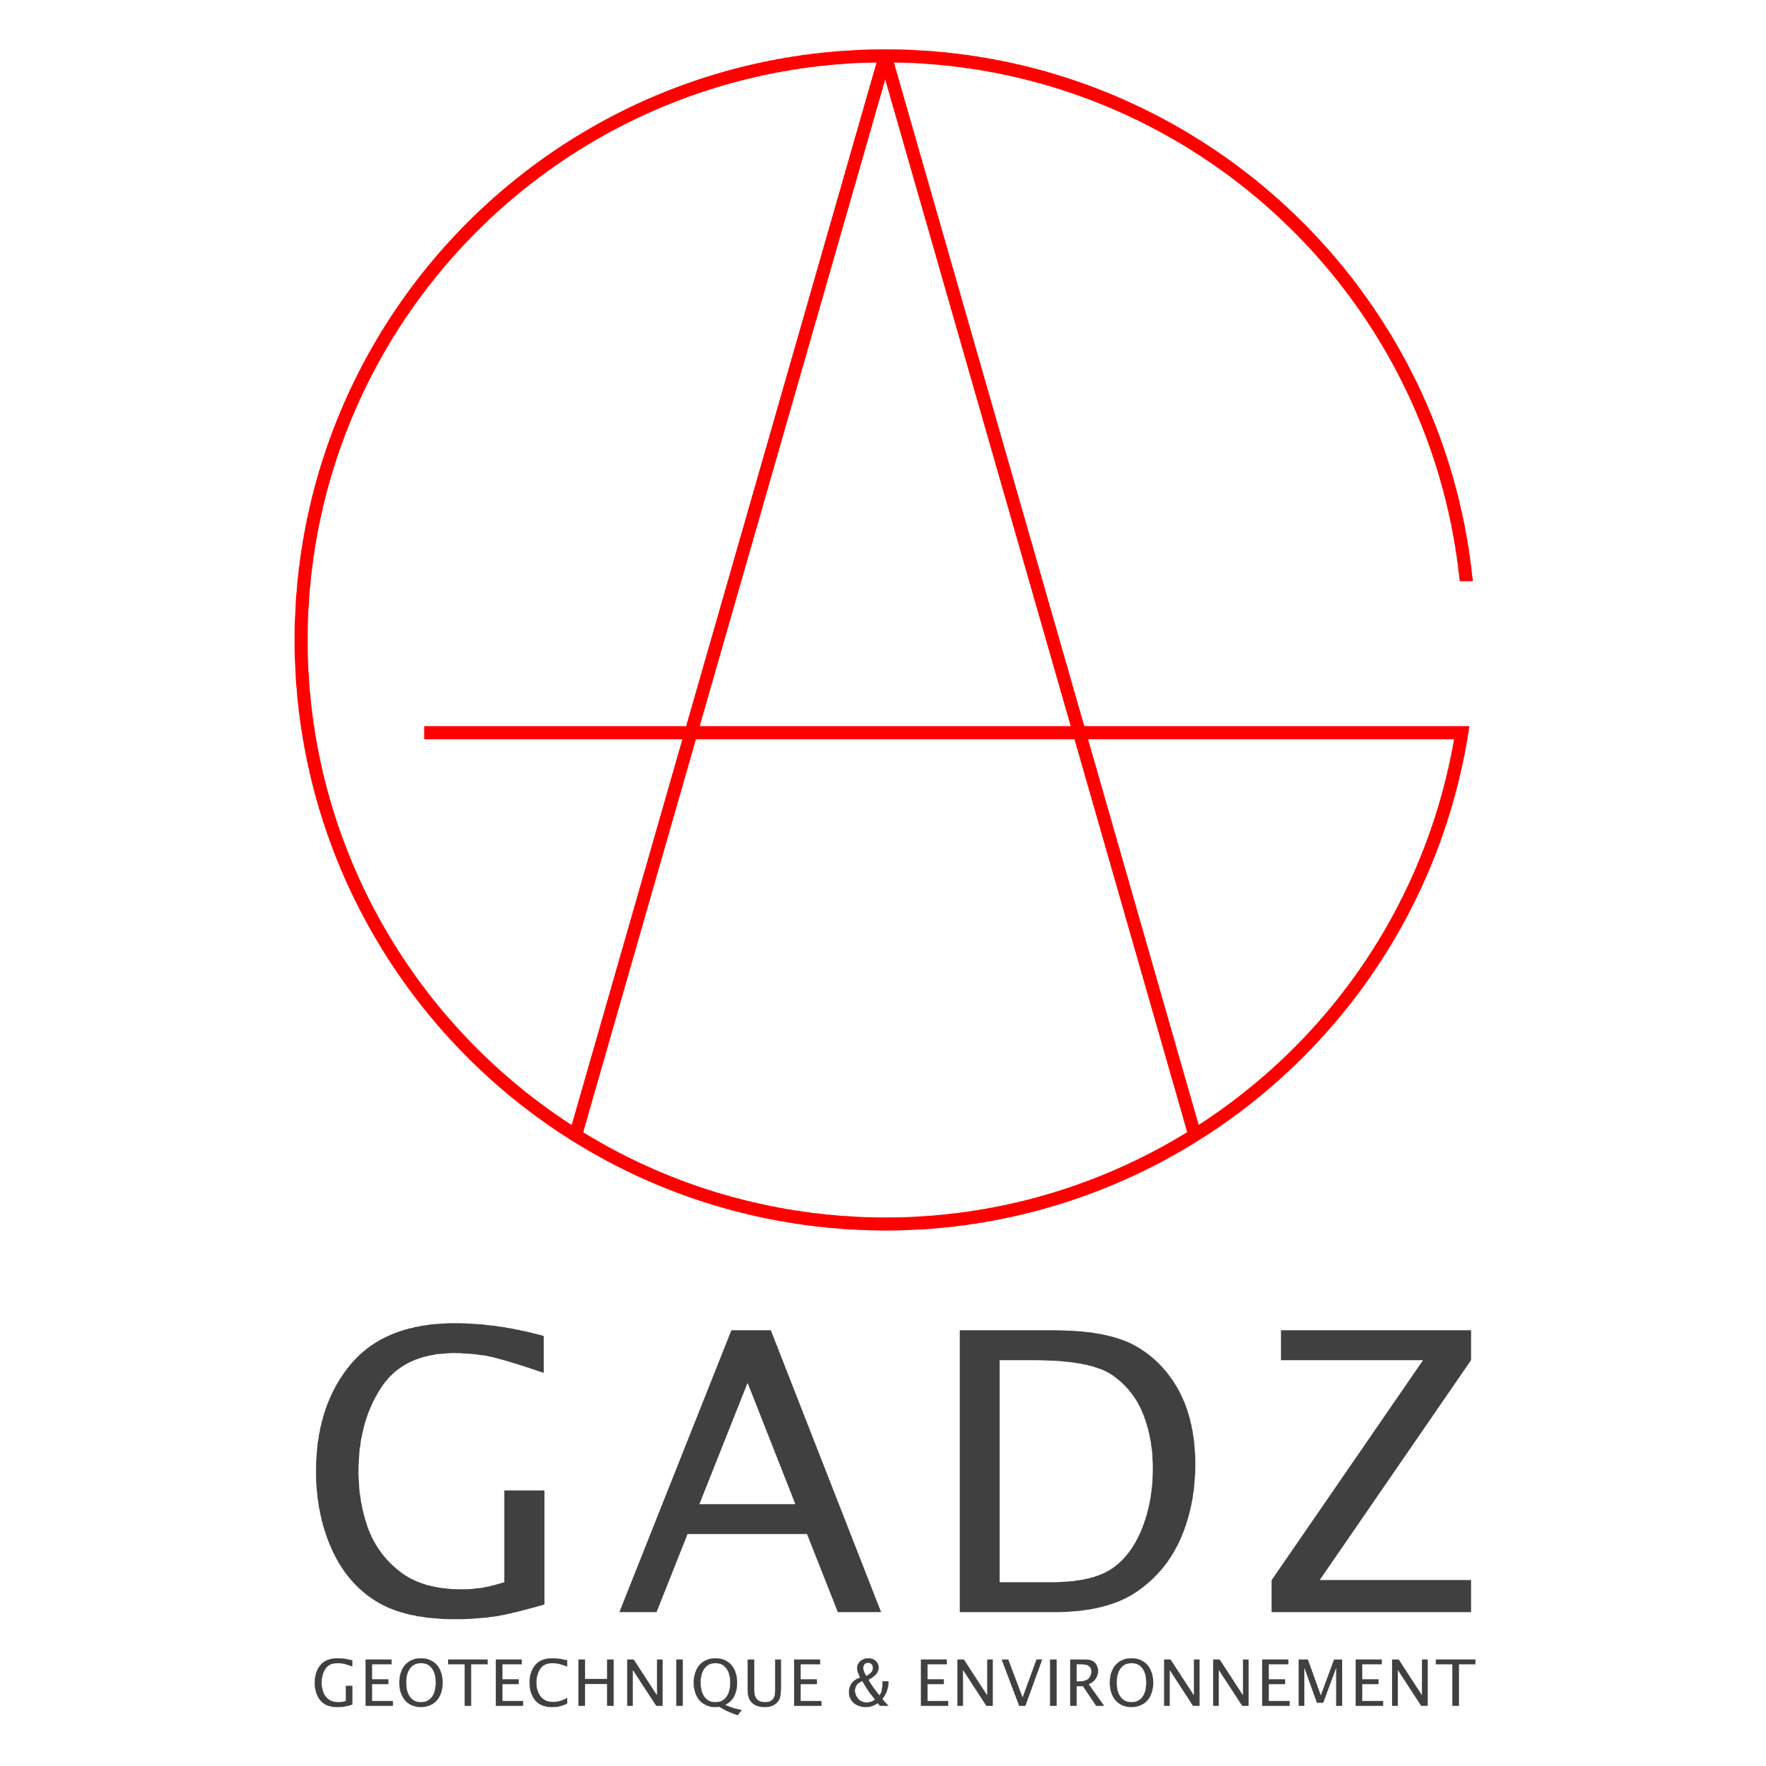

Site Investigation Studies (i)
ILF/GADZ 2020/21
Definition of ‘Areas of Geological Uncertainty’ for the preferred alignment scenario(s)
Input into footprint exploration –comparison of scenarios and Geological Risks Assessment
Initial proposals of site investigations in targeted areas to reduce the uncertainty of the geological model
Cost estimates and schedule for target site investigation campaign
ILF/GADZ study focused on the construction risks for underground works
Université de Genève 2021-current
Updating 3D geological model
Technical reporting on hydrogeological, tectonic and seismic characteristics of the Geneva region
Data gathering of existing and new data from drilling and geophysics campaigns

Slide 9




Site Investigation Studies (ii)
QUANTUM 2022-2025
Detailed analysis of ‘Areas of Geological Uncertainty’ for the amended alignment and updated geological models
Optimization of proposed SSI campaign scope of works
Preparation of Technical Specifications for SSI Contractor MS and IT
Cost estimates and schedule for SSI
Site visits and preparation of site drawings, survey requirements and works schedules
Act in the role of Engineer during the execution of the Works

Slide 10
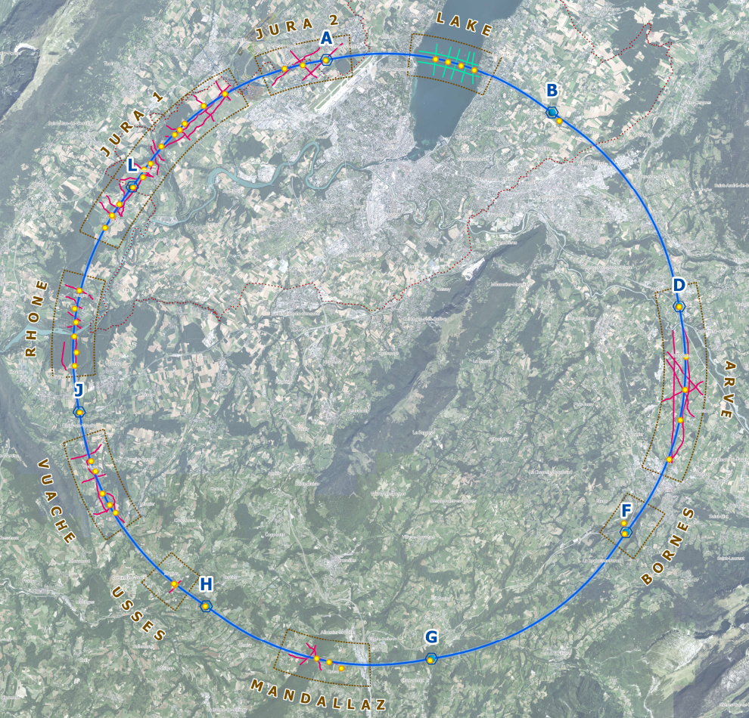

Subsurface Site Investigation Campaign 1
The site investigation campaign will remove some level of uncertainty in current 3D geological model and provide a better understanding of:
The molasse-moraine and molasse-limestone interfaces along the proposed alignment
Vertical profiling of shafts for PA, PD, PF and PL
The investigations are split into 2 work packages consist of:
2D seismic geophysics
Fully and partially cored boreholes
The campaign started in October 2024 and will last until December 2025

Slide 11
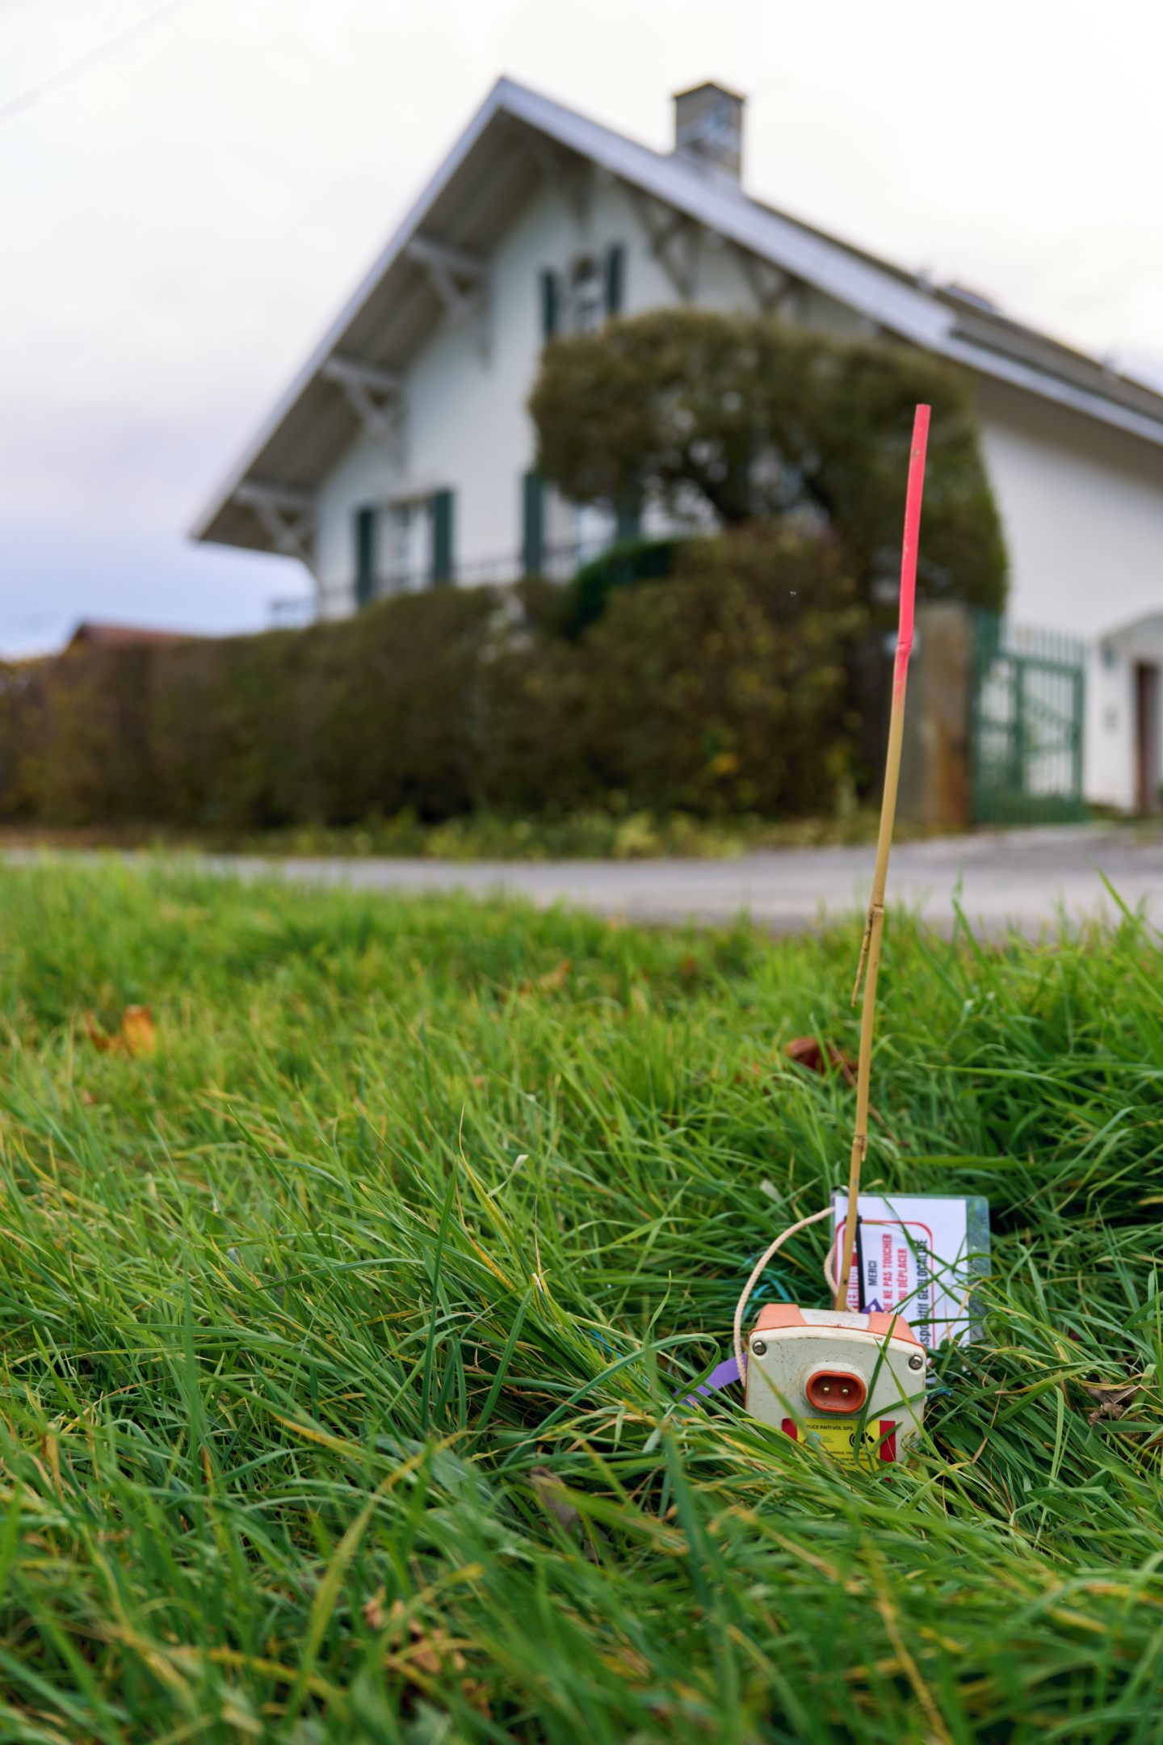
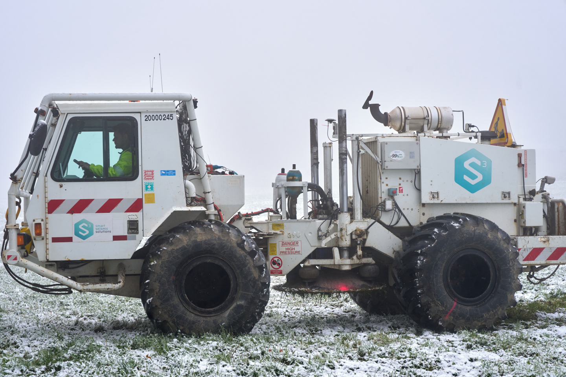
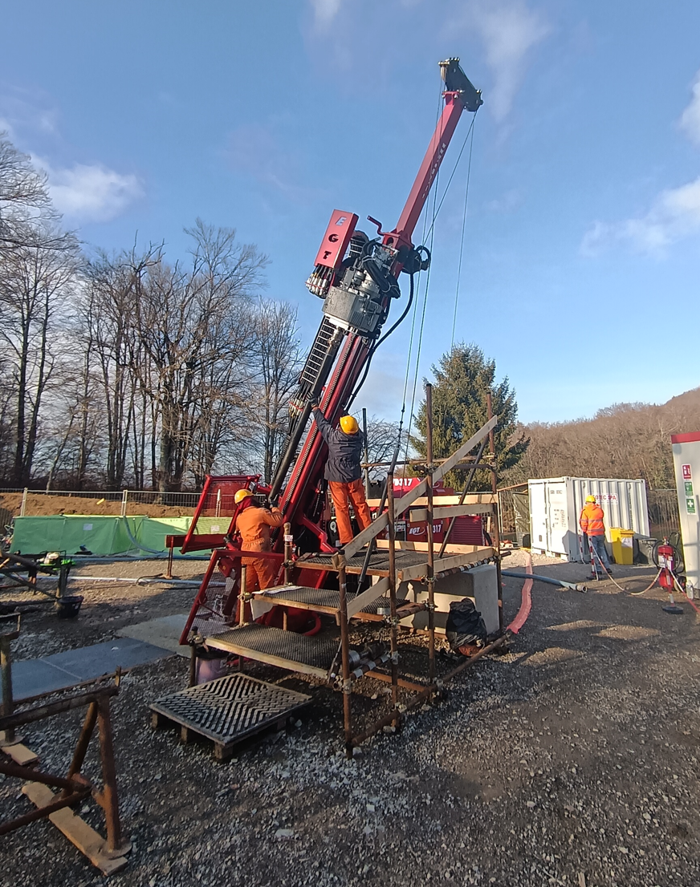
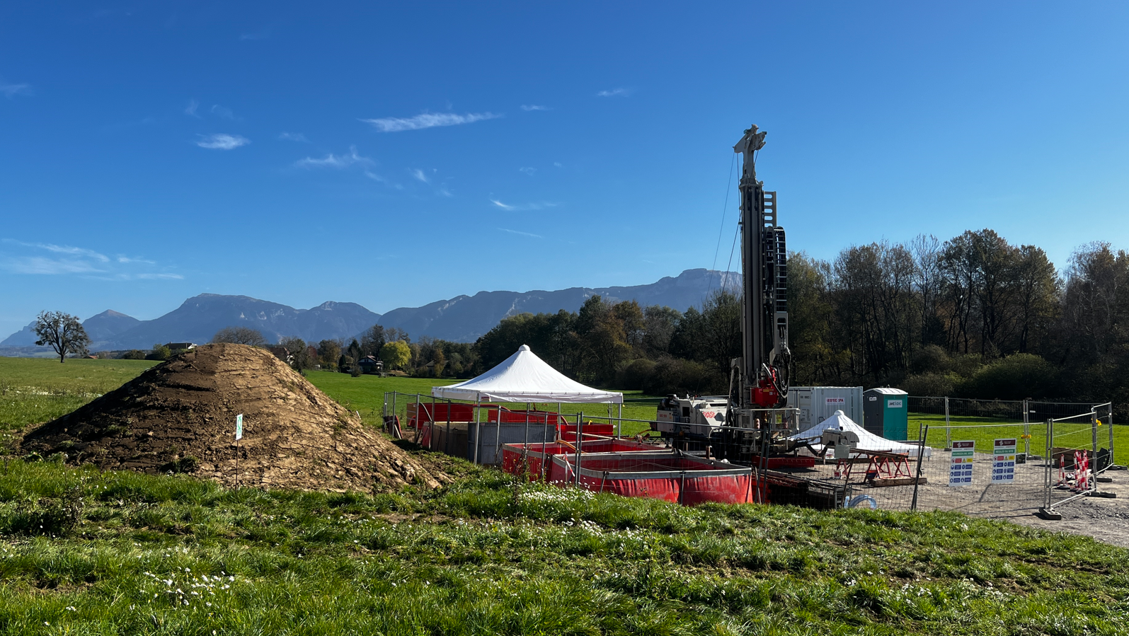
Site Investigations
Geophysics:
Total of over 80km of seismic investigation, both seismic reflection and refraction
Both on land and on the lake
Boreholes:
29 boreholes in total
4 boreholes on the lake
Fully and partially cored boreholes
Some equipped with piezometres

Slide 12
Subsurface Site Investigation Campaign 2
Post-feasibility Investigation Works (i)
A larger campaign of ground investigations
Targeted boreholes around the experimental and technical caverns and their access shafts
Geophysics and boreholes at regular intervals along the entire alignment
Sufficient in detail to allow for the tender of construction works packages
Market Survey for Consultant to be launched early Q2 2025 with qualified bidders being invited to tender in Q3 2025
Consultants to define investigations campaign, produce technical specifications for Invitation to Tender, manage permitting/environmental issues and act as Engineer during works
Consultant should have expertise in underground design (similar the infrastructure for the FCC), knowledge of the local geology and experience in permitting and environmental studies
Post-feasibility Investigation Works (ii)
Additional supplementary investigations in areas where gaps still exist to be identified by design consultant
These will allow the engineer to fully design the full scope of works

Slide 13
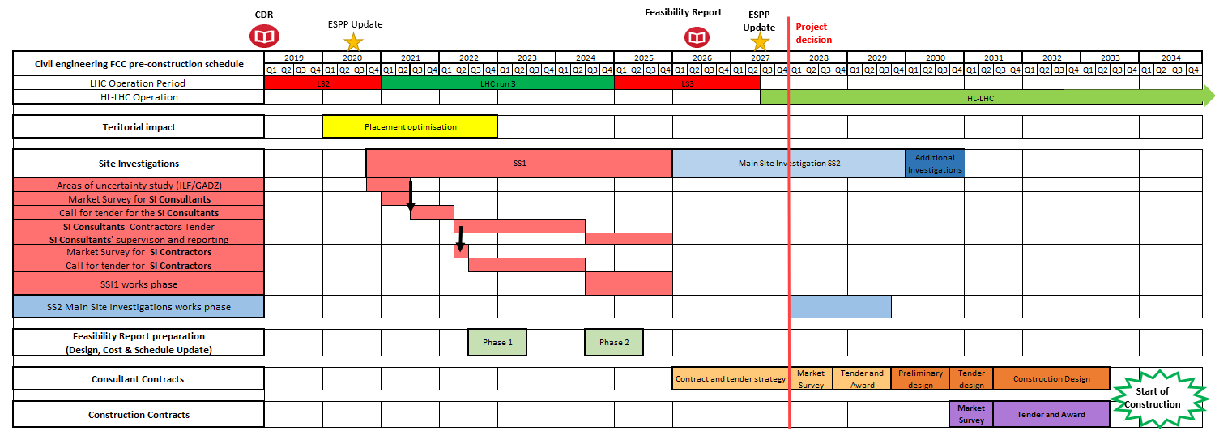
Project schedule
Notes:
Here we see the rough outline of the sequence I’m going to give an overview on (later, I will further elaborate on the terms in bold)
Site installation
Shaft → the experiment shaft with larger diameter → the excavation takes longer
Conventional excavations → connection tunnels, klystron galleries, tunnel widening
caverns
Main Beam tunnel excavation with TBM
Inner lining
Cavern steel and concrete construction

