Slide 1
NP02 news and update
Feb 19th

Slide 2
List of activities performed on NP02
Evaporate and refill to decrease and increase the level to calibrate the level meters:
  evaporation from Feb 3rd to 10th
  Refill started on Feb 17th
TDE DAQ servers restarted on Feb 5th
Check remotely the status of the CRPs and/with electronics: Done last week, difficult due to problem on switch transceivers (cf: Dario)
Run the motors to reposition the top CRP/cathode plane at first order (Feb 14th)
Tests of PDs: LED flasher for PD calibration (cf: Manuel)
Progress on PD to DAQ integration
When refill is completed next week: test top CRP biasing
When the activities can restart and approved:
- Check the noise related to HV. But HV PS needs to be connected! (For improvement of grounding, some schema was foreseen with FP)
….
….

Slide 3
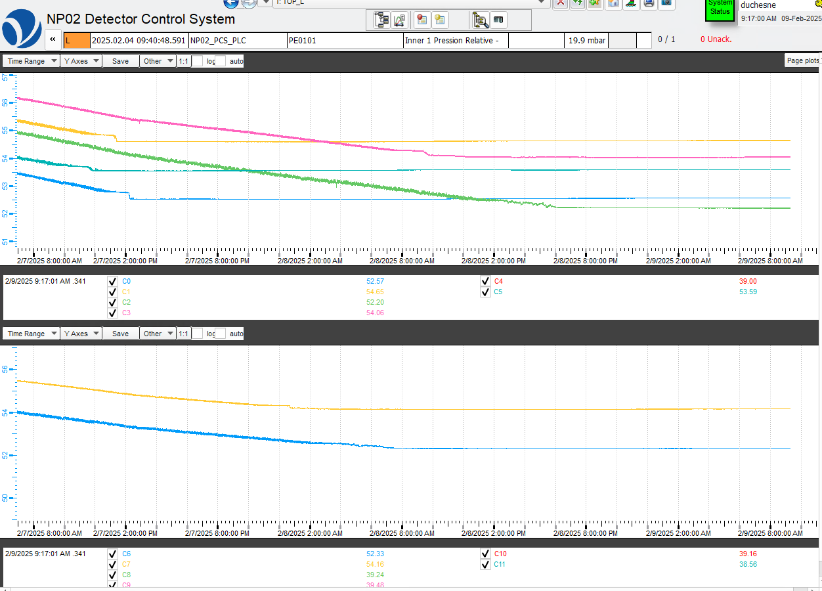
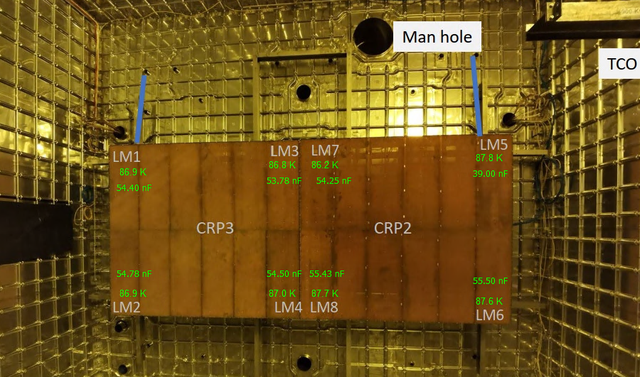
CRP level adjustment
Using data of the level meter when they came out of the liquid on Feb 8th
Using the time delay relative to the first ones coming out and the capacitance change
Level meter capacitances
At the center of the cryostat the CRP corners were about 8mm lower than on the sides

Slide 4
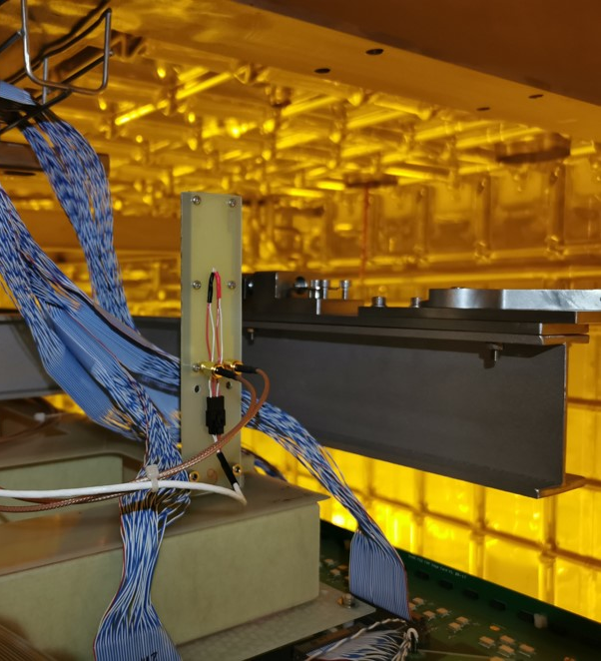
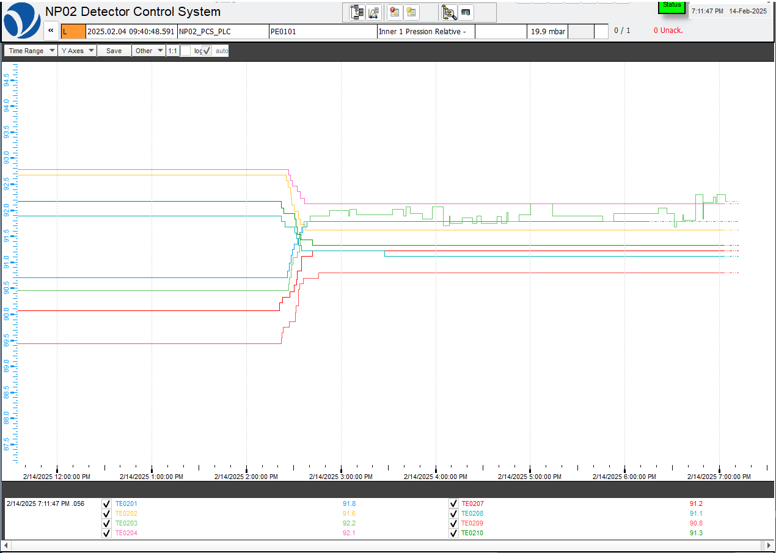
CRP level adjustment
Temperature measured at the 8 CRP corners (Pts at about 6 cm above the liquid)
Raising by 8mm the CRP borders in the center of the cryostat
The gradient is now much reduced between the 8 coners of the 2 CRPs
Adjustments to be refined when the liquid reaches again the Pts and level meters

