Slide 1


ATLAS Diphoton Trigger Level Analysis (aTLAs)
Owen M. Van Horn

Slide 2
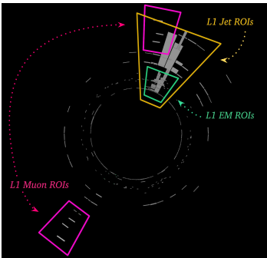
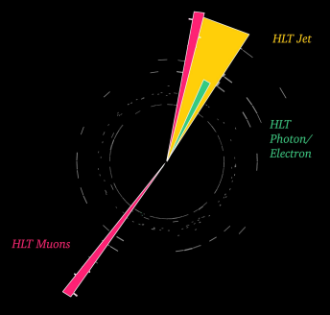
The Purpose of Triggers in ATLAS
ATLAS collects a lot of data
  LHC produces information at a rate of 30 MHz
Triggers limit the information saved in two levels:
  L1 accepts information at 95 kHz
  High Level Triggers (HLT) accept filters this further to 2 kHz
Why is this necessary?
  The ATLAS DAQ is capped at 8 GB/s
  The T0 Processing CPU is limited to 2kHz
What this means
  Triggers only keep “interesting” data
  Signatures without high object multiplicity or high energy objects are discarded immediately
  Limits the reach of ATLAS in studies of the Higgs, certain SUSY and Dark matter candidates, and photon dominated areas
HLT reconstructed event
Fully reconstructed event

Slide 3
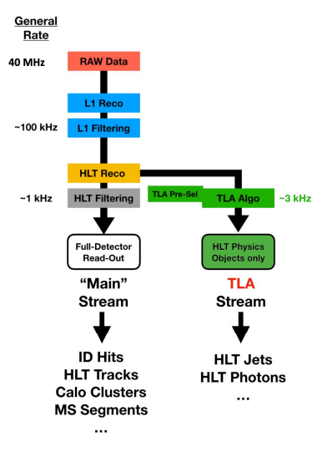
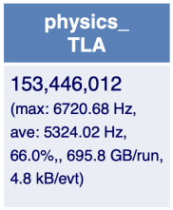
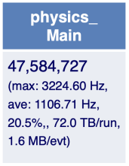
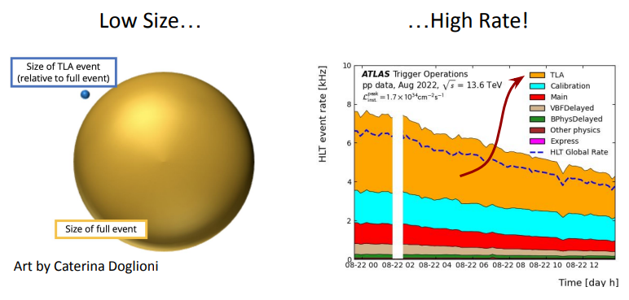

Trigger Level Analysis (TLA)
TLA tries to recover the data discarded by the HLT.
  The HLT creates small reconstructions of events, but saves the full event
  TLA saves only these HLT reconstructed events
  Reconstructions contain variables for identification, performance, and calibration in addition to 4-vectors
TLA relies on the idea that meaningful physics research can be done on these limited HLT reconstructions

Slide 4
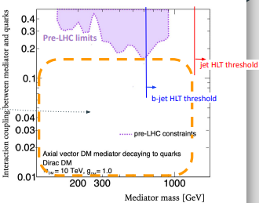
Limitations of TLA
TLA can be a great tool for looking at specific types of events
  Events with low masses or a high level of overlapping, for example
TLA is not a complete overhaul of the current trigger technologies at ATLAS
For research where TLA analysis is not expressly required, the normal L1 and HLT processes are better
  These processes maximize the amount of information that you have access to
  TLA allows us to save more information, but puts stricter limitations on the types if searches we can do on the reconstructed events
Still, it is accurate to non-TLA data as early comparisons with jets noted differences less than 0.05%

Slide 5
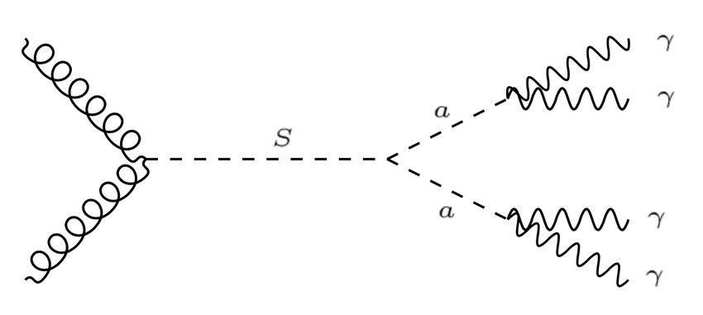
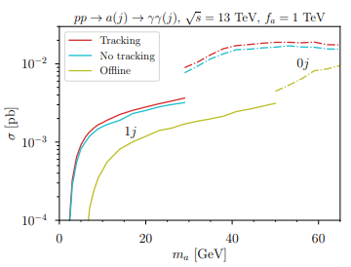
Low Mass Diphoton Resonances
Diphoton resonances are one of the biggest motivators of this type of research
  Interactions between scalar and pseudoscalar particles and charged fermions generate two photons
We are interested in searching for axion-like particles
  Pseudoscalar particles linked to a variety of BSM HEP topics like dark matter and SUSY
Previous studies have searched from 65 GeV to 3 TeV
  Our research is focused on very low energy searches between 1 GeV and 10 GeV
  Recent advancements in photon isolation using TLA have made this energy scale possible

Slide 6
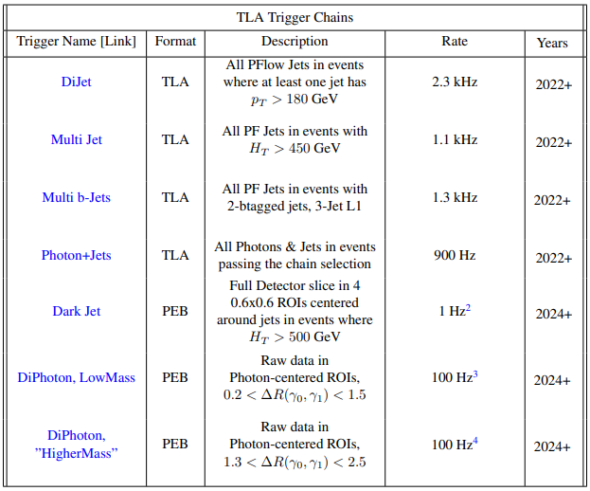
Current Work of the ATLAS TLA Group
The group is relatively new to ATLAS
  Most active groups began in 2022
Current work is searching for new physics in each HLT reconstructed object
  I am working on low mass diphoton resonances
Work is mostly proof of concept
  We are working with the offline data available of reconstructed HLT events
  This allows us to test the accuracy of the TLA cuts in the data against the fully reconstructed data
The future goal is to have a complete TLA filter implemented on ATLAS by the beginning of Run 4
  There is still plenty of progress to be made before then, and much research that can be done on the offline data

Slide 7
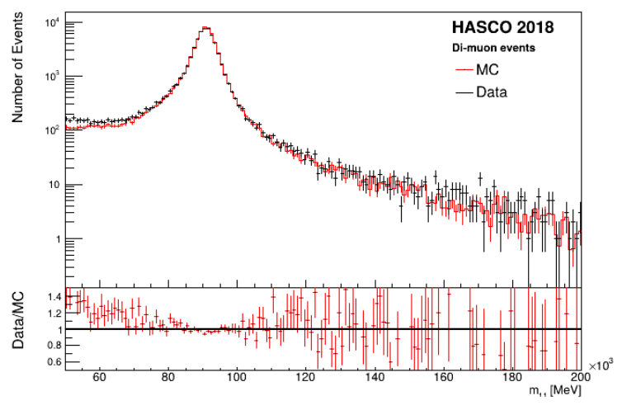
My Current Work
Building a stronger sense of the foundations and motivations for this research
  Getting more familiar with ROOT
  Learning about how the detector and analysis work
Computational work comparing the results from offline HLT reconstructed data to the complete data
  These should match if the TLA filters are working correctly
This work requires an adapted version of TLA called Partial Event Building (PEB)
  This type of analysis is needed for many overlapping objects or low momentum objects
  Only partially saves the data received, focusing on the data collection of specific types of objects

Slide 8
Q&A

