Slide 1
HGCal progress report
Jackson Lake

Slide 2
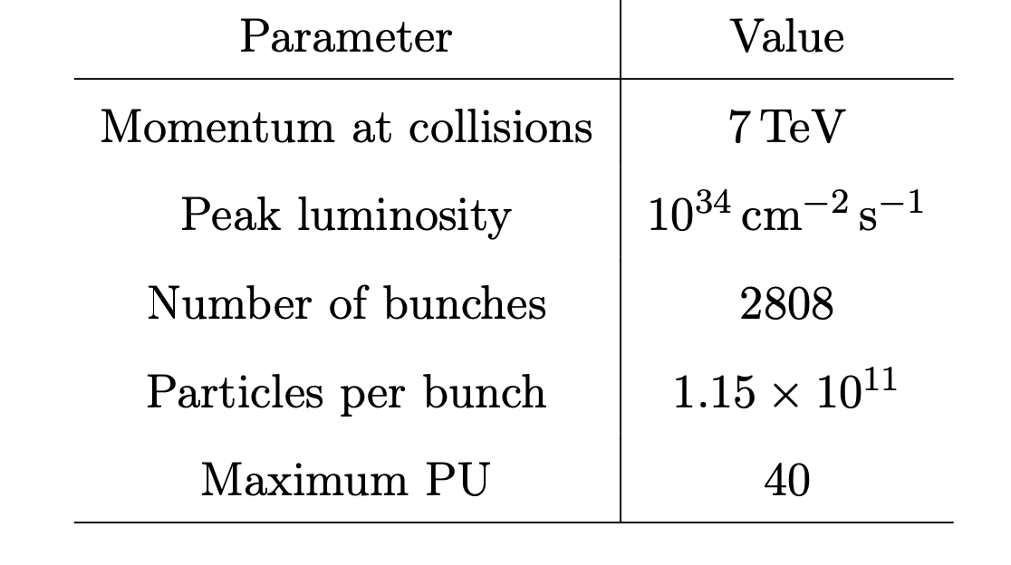
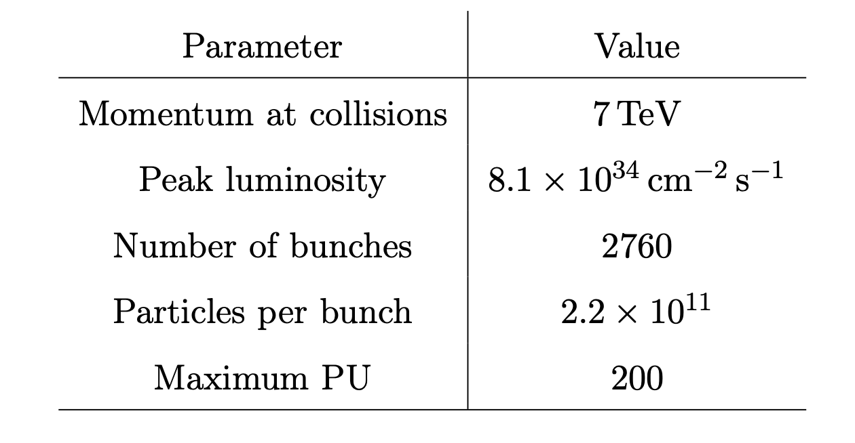
HL-LHC Plan
Increases number of events to study by an order of magnitude from phase 1 → More data to study, greater confidence of previous discoveries
Notes:
Right now, on average, there are about 40 simultaneous proton-proton interactions per BX, commonly referred to as pileup (PU).
The LHC is currently operating above the design luminosity (by about a factor of 2..?)
By the end of Phase-2, the instantaneous luminosity will increase up to 7.5 × 10^(34) cm−2 s−1 and the integrated luminosity will have reached as much as 4000 fb^-1 (cumulative number of potential collisions). (This is an ENORMOUS amount of data and will allow for highly precise measurements.)

Slide 3
Upgrading CMS for HL-LHC
For CMS, need to be able to resolve a greater vertex density under increased levels of radiation due to a greater PU of collisions per BX.
  Upgrade existing detector to have higher radiation tolerance; better 3D granularity; a timing resolution of about 50 ps; more info to base trigger decision on; computing that can exploit all this info; and store these data to permanent storage while dealing with increased data rates.
Endcap calorimeters will be completely rebuilt: ECAL and HCAL systems will be replaced by HGCAL
Notes:
A higher density of vertices (points where collisions happen) makes it harder to separate individual interactions, especially for rare processes like Higgs decays.
HGCAL will have 47 active layers interwoven with absorber material. It will bring high transverse and longitudinal spatial granularity in the endcap region whilst also providing precise timing measurement of electromagnetic and hadronic showers.
Right now in the ECAL endcap (electromagnetic calorimeter) there are crystals that act as the absorber and active medium for high-energy photons and electrons. This accurately measures the energy deposited in an eta, phi grid by the EM showers, and provides timing information, but it does not provide longitudinal information about the showers. The HGCAL’s 47 active layers will bring higher granularity both in the transverse and longitudinal directions. (Also it will be throughout the whole endcap, not divided into ECAL and HCAL.) [6 million readout channels]

Slide 4
Current status
Reading mentor’s thesis on on-detector and off-detector electronics for HGCal: gain more complete understanding of CMS detector, HGCal electronics system (FE, BE, Timing and Control Distribution System), implementation of a vertical slice of HGCal electronics, and testing it with the beam.
Meeting after reading a portion of the paper to pose questions (arrangement thus far)
Soon to be set up with software-related project, but no details yet
Notes:
Vertical slice: single module Train in the FE, an optical FE ←→ BE interface, and a Serenity BE board. The FE contains the full variety of real ASICs and PCBs, while the BE would mainly consist of a small number of Stage 1 TPG BE unpacker and DAQ BE capture block instances. (providing sufficient complexity to interface with such a FE.)

Slide 5
Current challenges
The thesis deals mostly with the electronics of the HGCal FE and BE
  Silicon sensor cells
  HGCAL Read-out Chip
  ECON-T, ECON-D
  lpGBT
  VTRx+
  In the BE: Fireflies, lpGBT firmware, TPG and DAQ BE algorithms
  Timing distribution, fast control, slow control
ASICs (radiation hard)
Notes:
FE
Si Sensor Cells
Highly segmented radiation-tolerant sensors that detect energy deposits from charged particles
Generate raw analog signals proportional to the deposited energy, then processed by FE electronics.
HGCROC
FE ASIC that amplifies, shapes, digitizes, and time-stamps signals from the Si sensors
Produces both trigger primitives (TPG), which summarize energy deposits per bunch crossing, and full-resolution DAQ data, which is temporarily stored and sent to the BE only if an L1A signal is received.
ECON-T, ECON-D (E-Link Concentrators)
ECON-T collects, concentrates, and re-formats trigger primitive data from multiple HGCROCs before transmission to the Trigger BE.
ECON-D aggregates and formats full DAQ data, ensuring efficient bandwidth use before sending selected BXs to the DAQ BE.
Data Transmission
lpGBT (Low-Power Gigabit Transceiver)
lpGBT ASIC serves as an intermediary between FE and BE electronics, handling high-speed data serialization, de-serialization, and clock distribution.
Transmits to BE at 10.24 Gbit/s per fiber (while also managing fast and slow control communication)
VTRx+ (Versatile Link Transceiver Plus)
This module converts electrical signals to optical signals for transmission over the 100m fiber optic links between the FE and BE.
BE
Fireflies (Optical Receivers in BE)
Fireflies convert the optical signals from VTRx+ back into electrical signals for processing in BE FPGAs.
Ensure low-latency, high-bandwidth communication with minimal signal degradation.
lpGBT Firmware
The firmware running on BE FPGAs processes lpGBT data, applying error correction, clock recovery, and data unpacking to restore signals to their original format.
It performs inverse operations to those done in FE lpGBTs to make the electronics chain functionally transparent.
TPG and DAQ BE Algorithms
The TPG BE algorithms further refine trigger primitives, applying calibrations and clustering before passing data to the CMS Level-1 Trigger. (L1T: ~10 µs)
The DAQ BE algorithms reconstruct and format selected full-resolution events, preparing them for transfer to the CMS Central DAQ (cDAQ) and the High-Level Trigger (HLT).

Slide 6
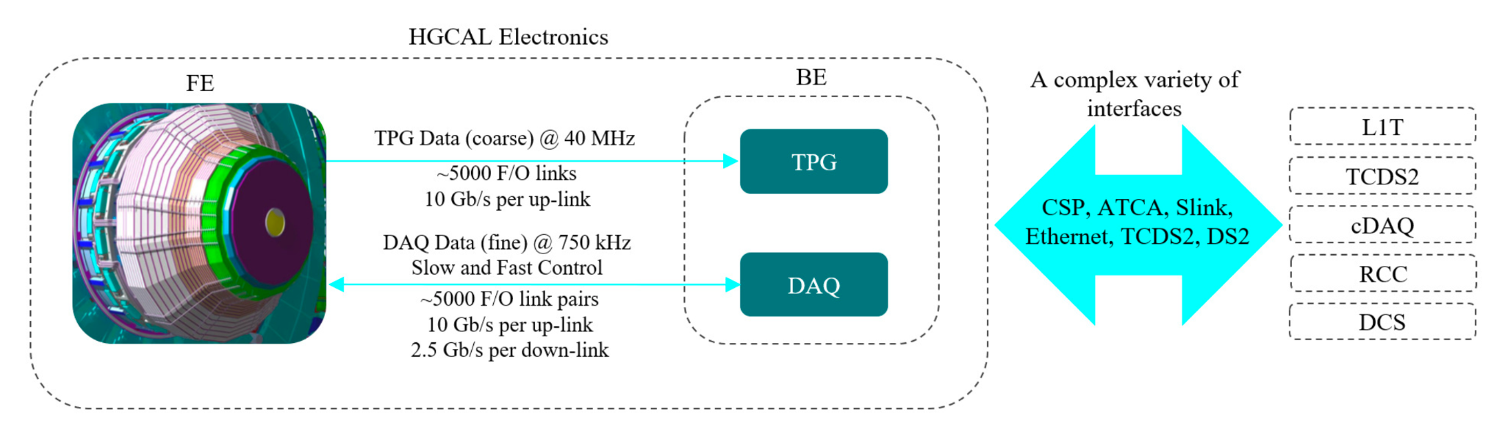
Current goal: understanding the electronics system

Slide 7
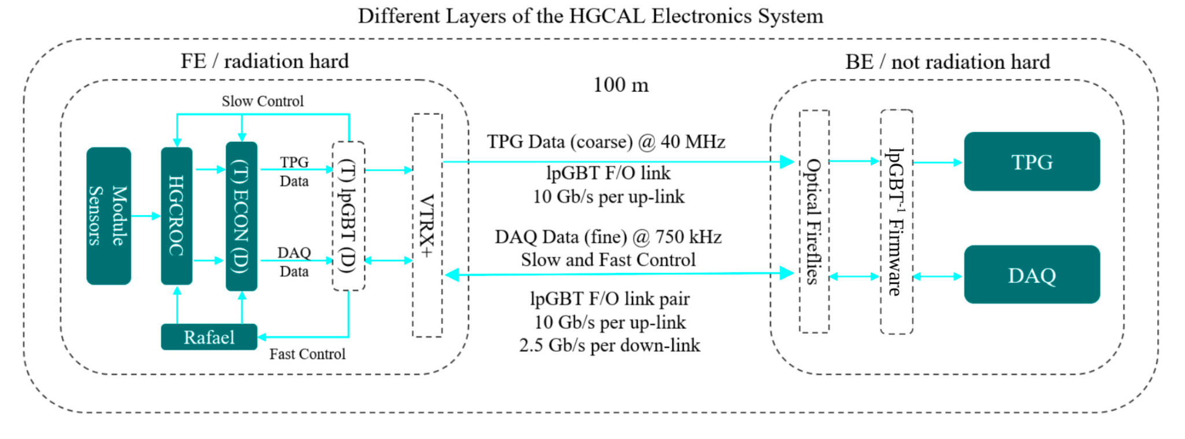
Current goal: understanding the electronics system
Notes:
This is general overview, but the goal is to delve deeper (since work will require good knowledge of the system)

Slide 8
Current goal: understanding the electronics system
HGCROC ASIC
Amplifies and digitizes signals from silicon sensors (analog → digital)
Measures Time-over-Threshold (ToT) and Time-of-Arrival (ToA) for precise timing.
Data buffering for both Trigger (TPG) and DAQ streams.
ECON-T
Aggregates and formats trigger data from multiple HGCROCs.
Applies the Best Choice (BC) algorithm for trigger decisions.
Sends low-latency trigger primitives to the BE every 40 MHz BX.
Notes:
This is general overview, but the goal is to delve deeper (since work will require good knowledge of the system). These are some of the specifics I’m reading into right now.

Slide 9
Current goal: understanding the electronics system
ECON-D (DAQ e-Link Concentrator)
Collects and processes full-resolution DAQ data.
Performs zero suppression and data formatting.
Ensures synchronized, efficient transmission to DAQ BE.
DAQ BE + TPG BE System Structure
DAQ BE: full event data for analysis (high definition photograph)
TPG BE: processes trigger primitives to select “interesting” BXs.
High-speed optical data transfer via lpGBT and VTRx+.
BE FPGAs execute DAQ and trigger algorithms, synchronized with LHC timing.
Notes:
This is general overview, but the goal is to delve deeper (since work will require good knowledge of the system)

