Slide 1
March 4 Status Report
Dongha Simon Lim

Slide 2
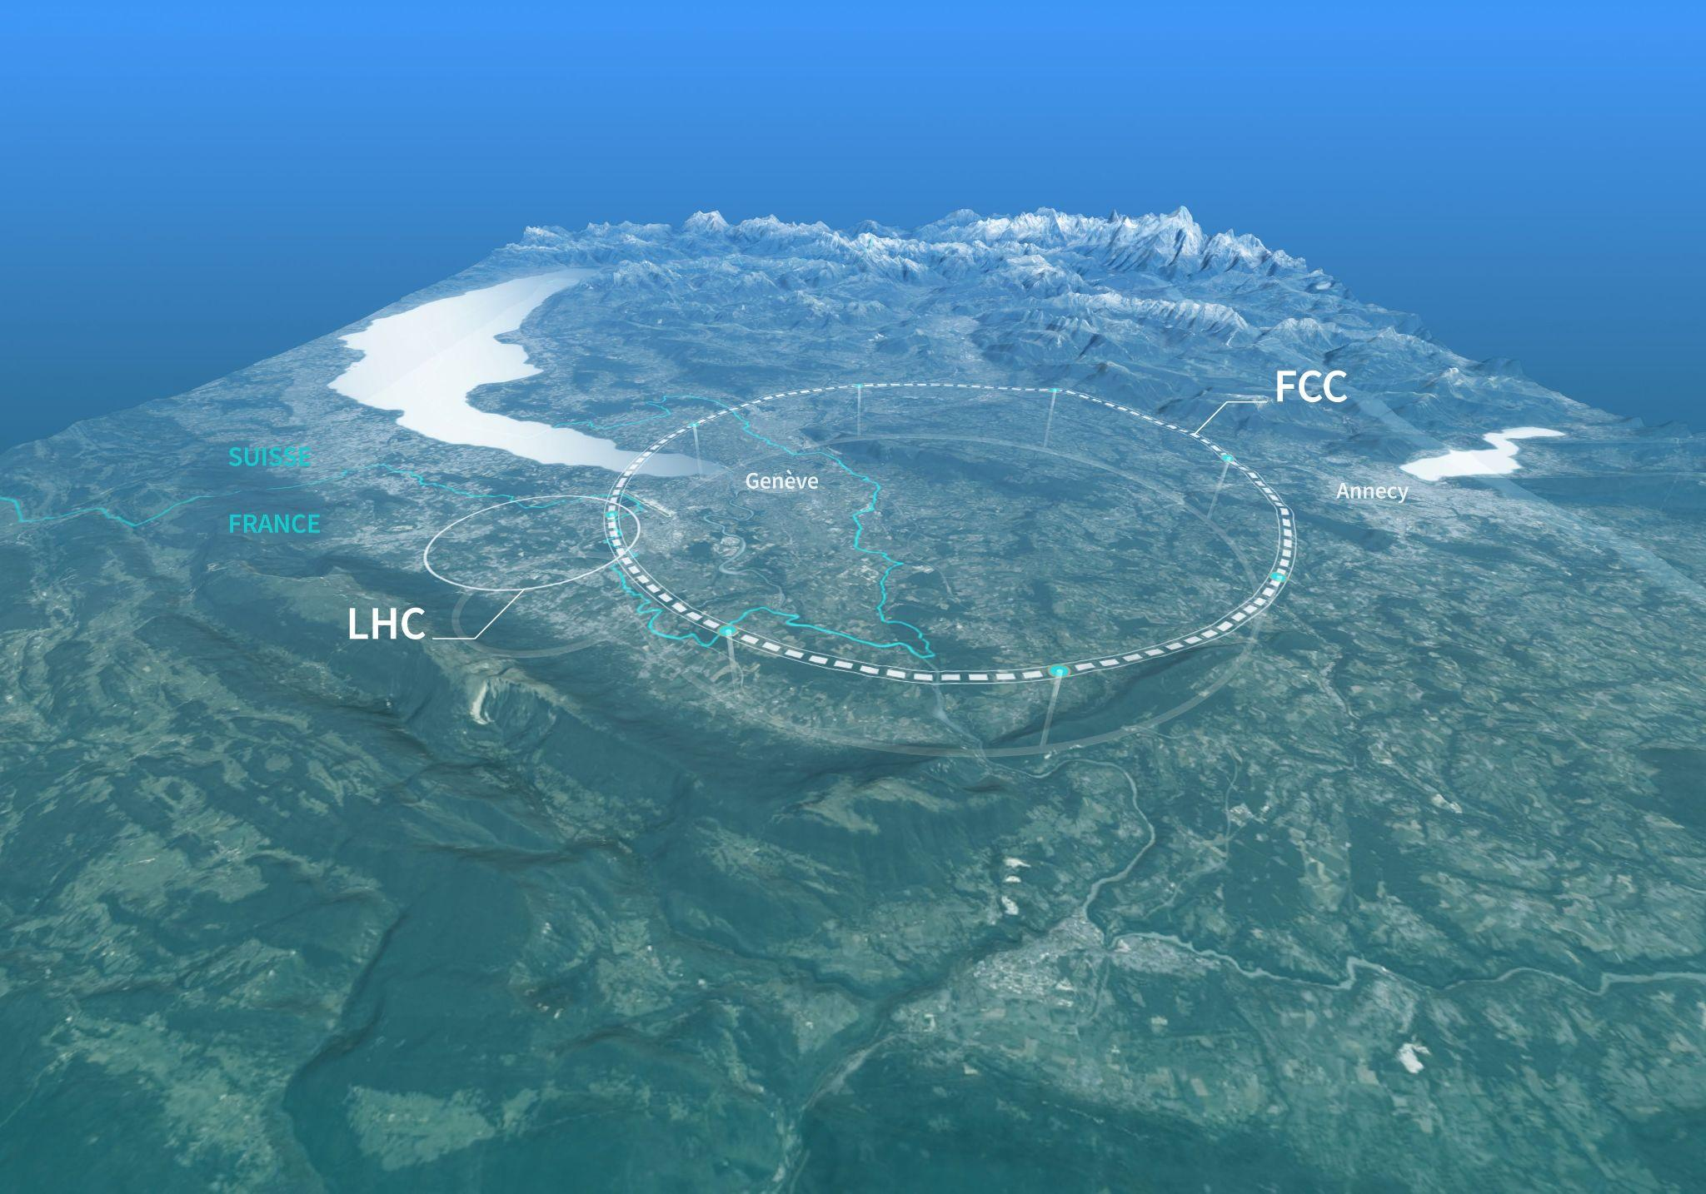
Future Circular Collider (FCC)
“One of the core goals of the FCC programme is to directly observe and study these interactions of the Higgs, with the W and Z bosons, quarks and leptons, and of the Higgs with itself”
To follow LHC’s High-Luminosity phase
Will house two machines
  FCC-ee
  FCC-hh

Slide 3
Some Numbers…
  90.7 km in circumference
  200 m deep
  Construction starts 2030s
  FFC-ee operating ~mid-2040s for ~15 years
  FFC-hh operating ~2070s for ~25 years
  Costs:
    15 Billion CHF over at least 15 years (for 4 interaction points)
    ⅓ of it goes to the tunnel

Slide 4
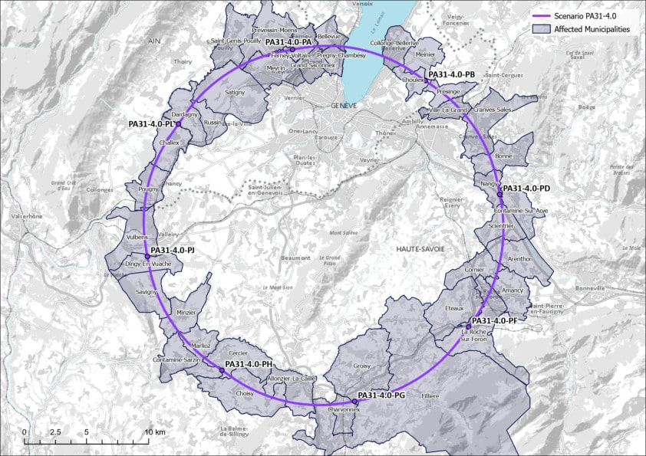

HEFTY!

Slide 5
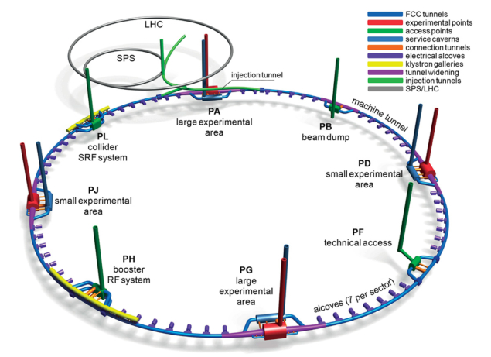
What am I doing?
  So far, calculated cross sections for processes involving Higgs production with multiple EW bosons in ee-collisions
  Later, “will assess these processes as potential backgrounds for key measurements at future lepton facilities”

Slide 6
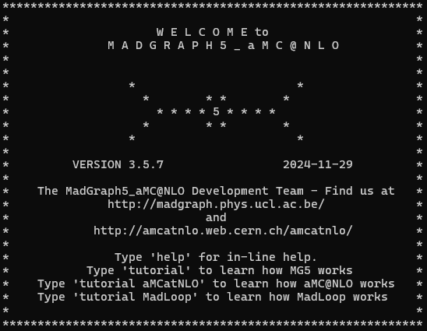

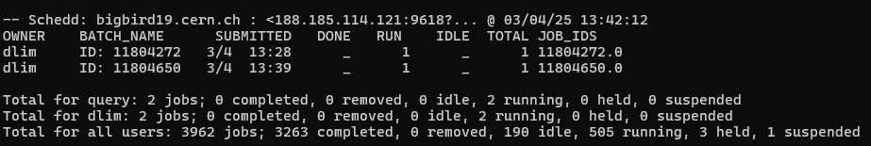

Slide 7
