Slide 1


Weekly Updates
Pedro Baculima – 03/11/2025
1

Slide 2
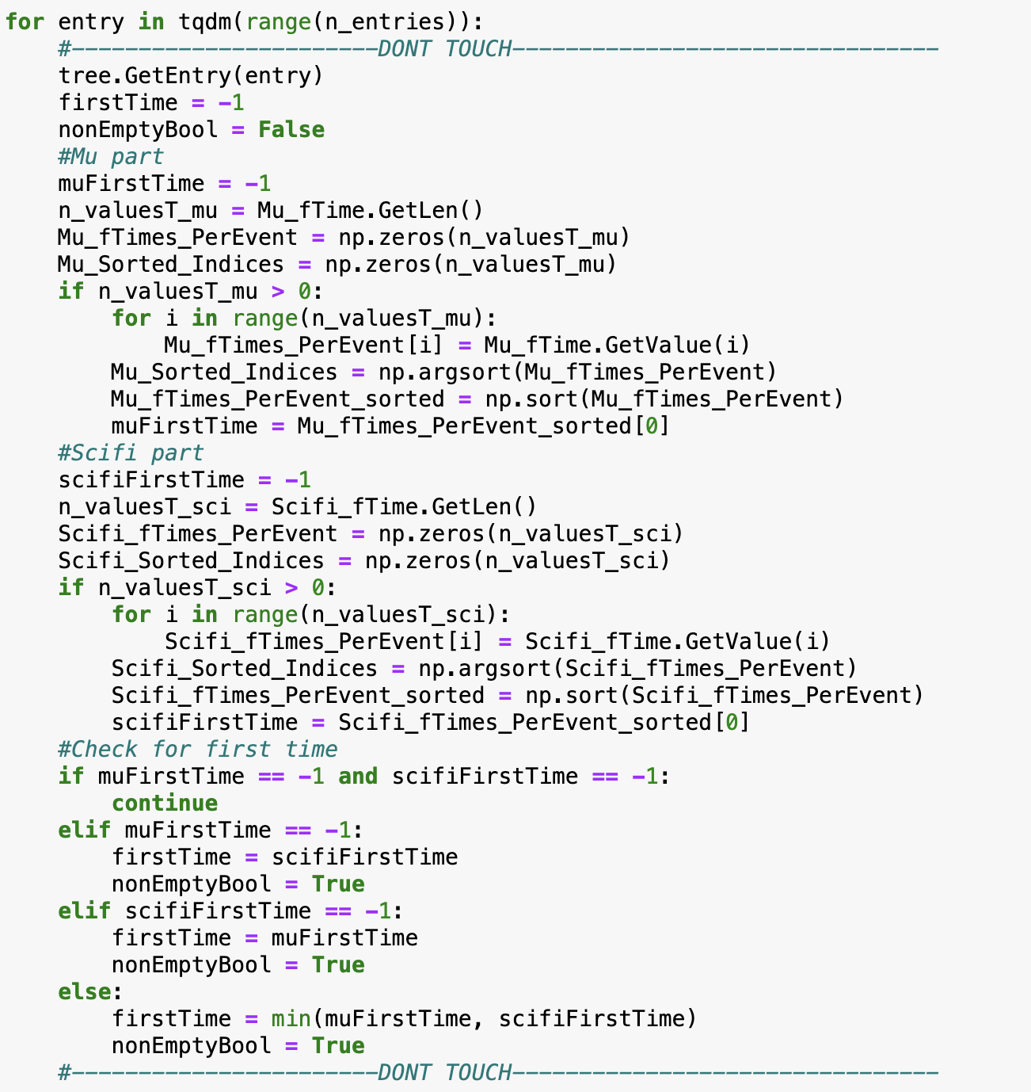
Time Selection
Find the earliest time in the SciFi and MU Filter Point time leafs.
Pedro Baculima – 03/11/2025
2

Slide 3
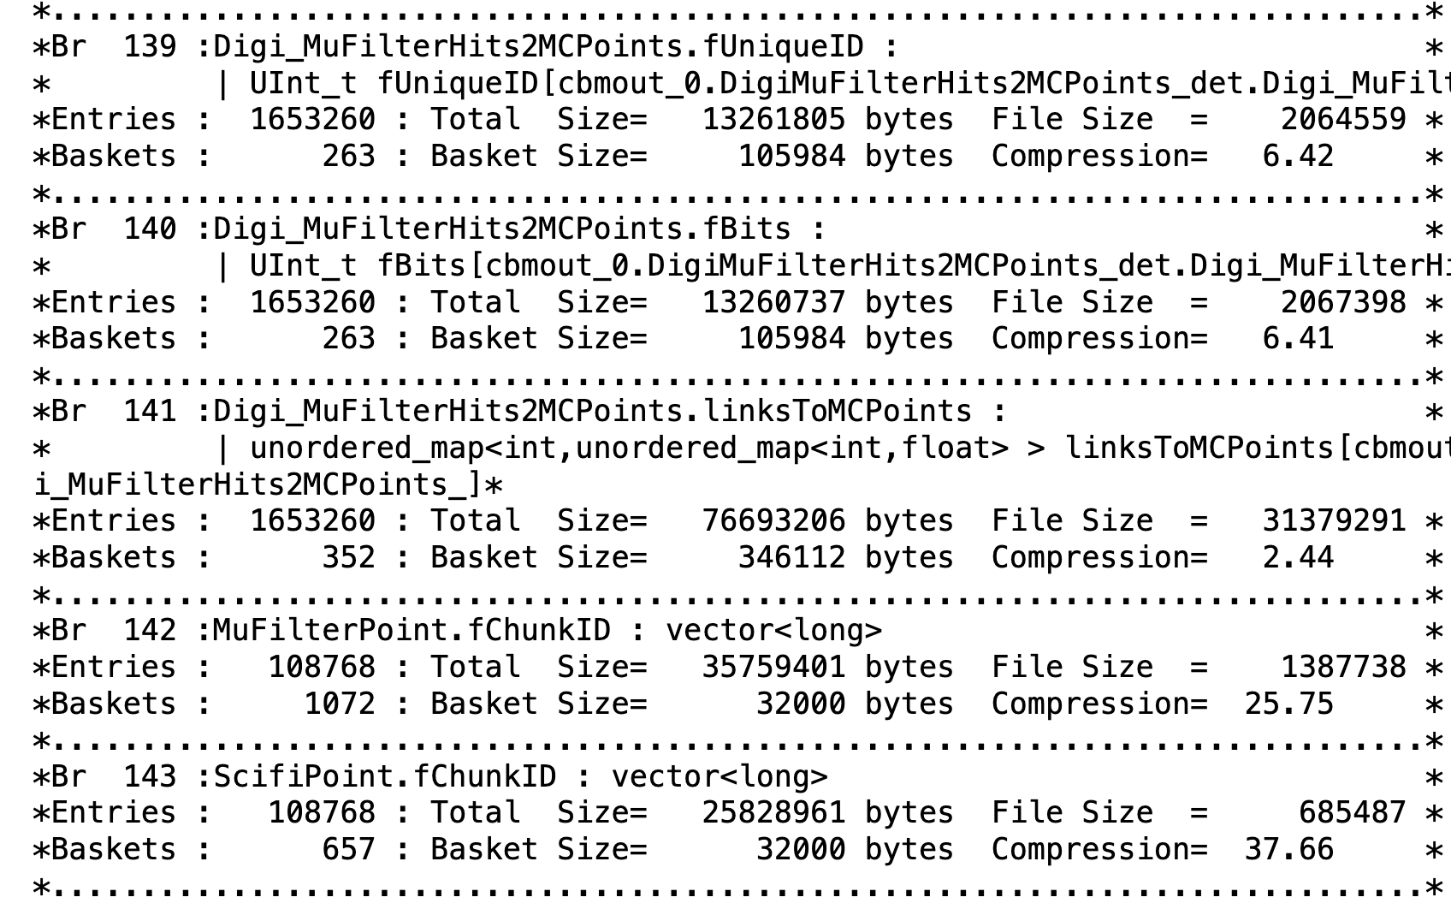
Progress
I was able to recreate the root file but not with the required format.
I kept the old structure but assigned an extra leaf for SciFi and Mu Filter point that contained their ChunkIDs:
0 [Earliest-25ns]
1 (25ns – 50ns]
2 (50ns - …]
Some events happen seconds later.
Pedro Baculima – 03/11/2025
3

Slide 4
Main Issues
Old format: 1 entry
I have to recreate the root file.
Each entry will contain events corresponding to each ChunkID but with an overall MockID that will go from 0 to the total number of entries.
Dealing with the other branches and their information takes a lot of computing time and storage space for Swan (currently working on a solution).
Example for 3 second chunks:
Mu Filter Point
SciFi Point
1
4
5
6
10
11
2
3
7
8
9
New format: Multiple entries
ChunkID
MockID
0
1
2
3
0
1
4
5
6
1
2
7
8
9
2
3
10
11
3
0
4
1
5
…
…
Pedro Baculima – 03/11/2025
4

Slide 5
Other Updates
Programming
I’m testing code that only stores certain branches to reduce the computational time and storage space (for now, the final version will contain all the branches).
Fixing bugs in the code.
General
I got to meet other members from the team.
My supervisor is at a conference but will be back soon and help me debug my code.
Pedro Baculima – 03/11/2025
5

Slide 6
Thank you!
Pedro Baculima – 02/25/2025
6

