Slide 1



Characterizing Lead Perovskite Crystals as Radiation Detection Materials
Michael Durant

Slide 2
Some Clarifications

Slide 3
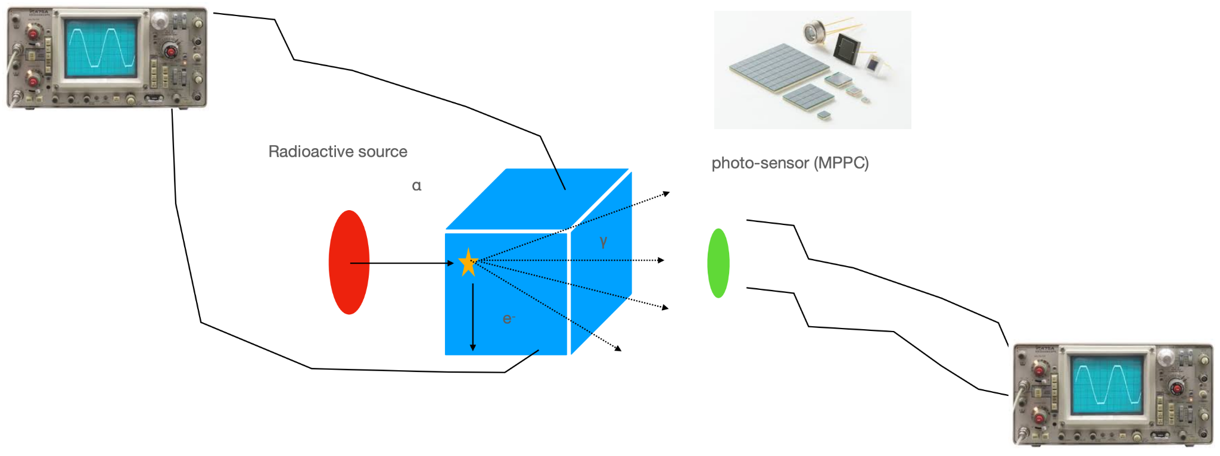
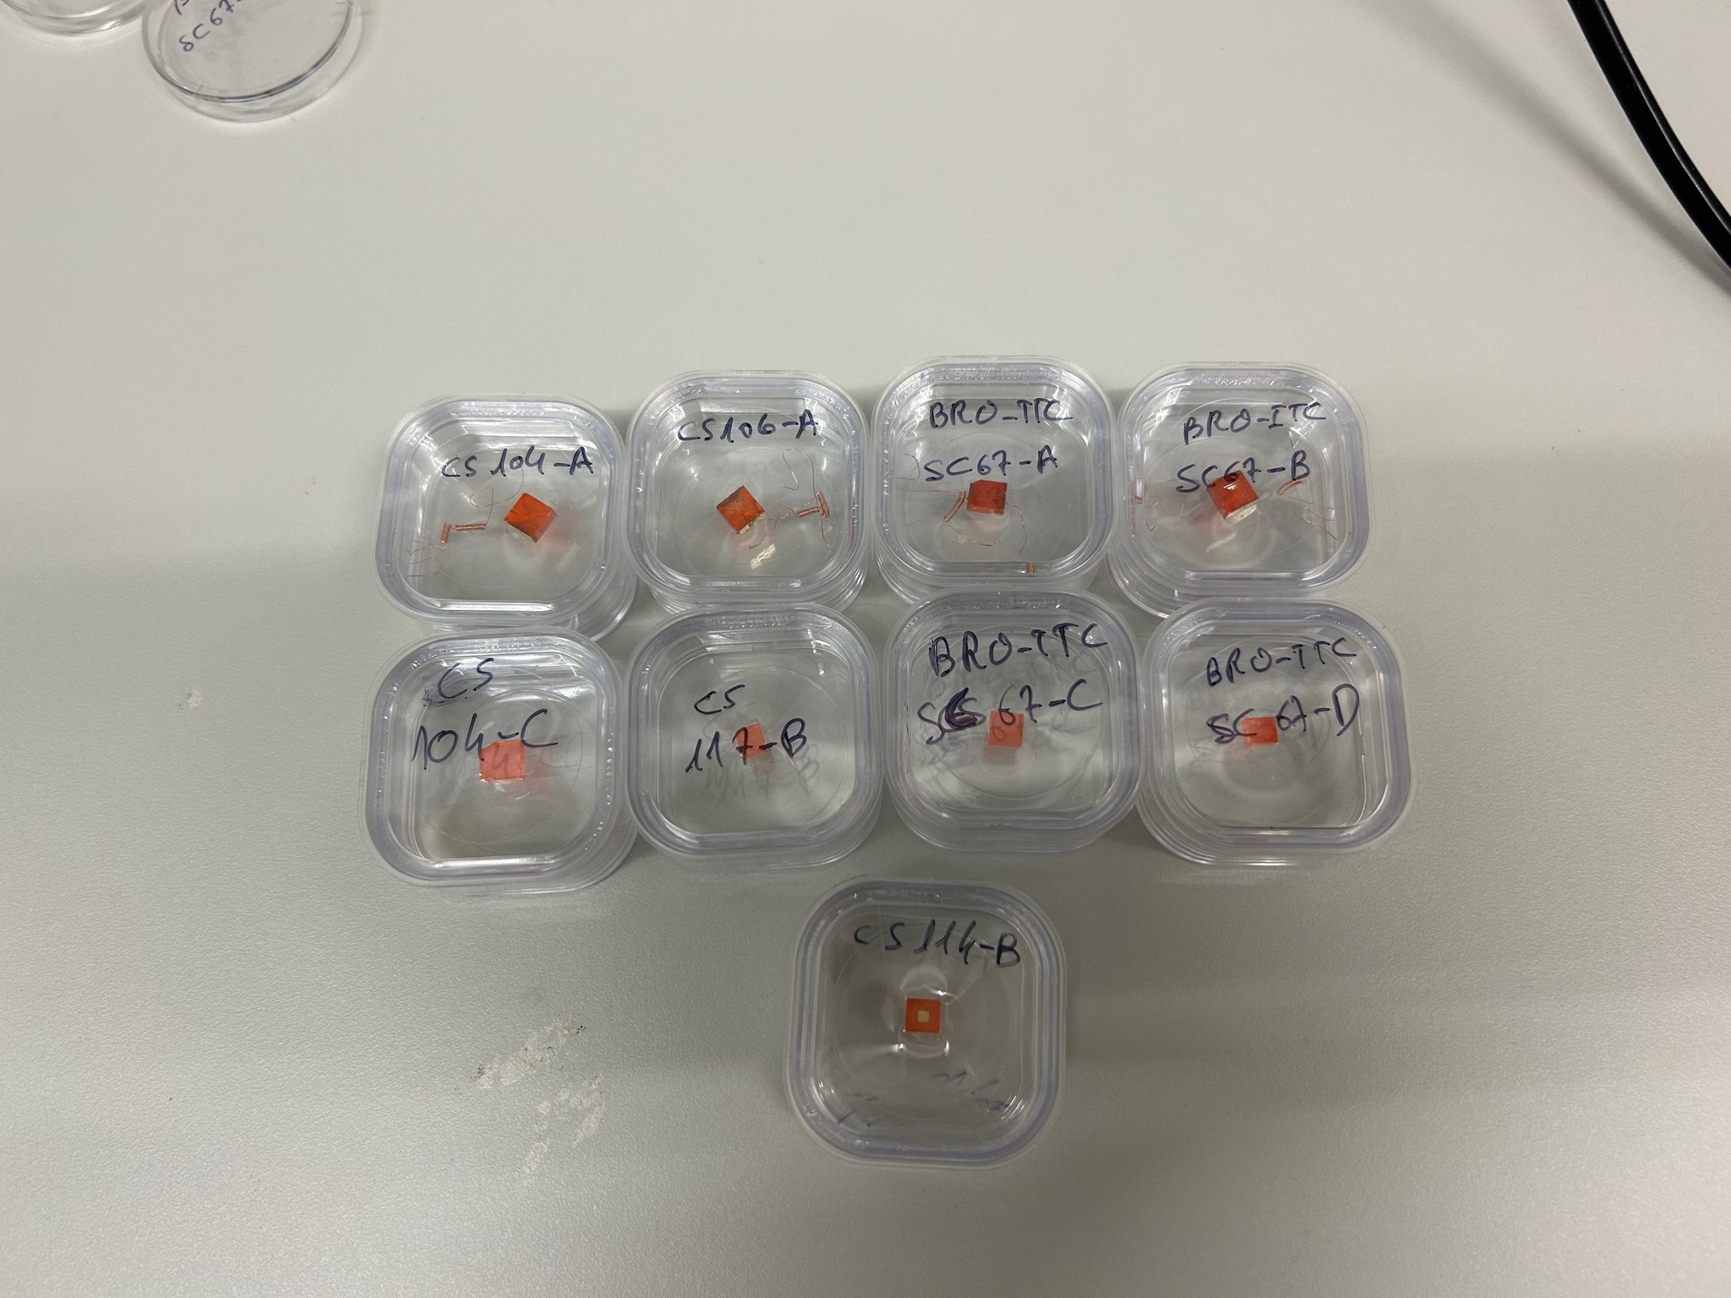
Crystal gives off green light ~ 500-550 nm
Foreseen benefits of Lead Perovskite crystals:
  Higher photon emission
  Tunable emission spectra via doping
  High bulk resistivity
  Low exciton binding energy
  Long diffusion length

Slide 4
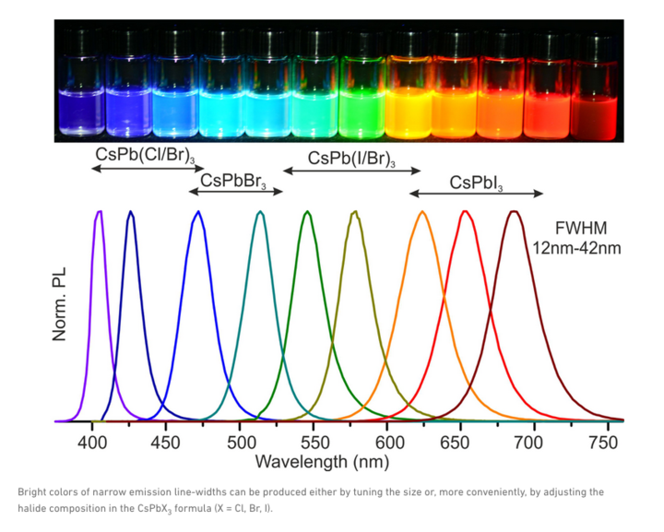
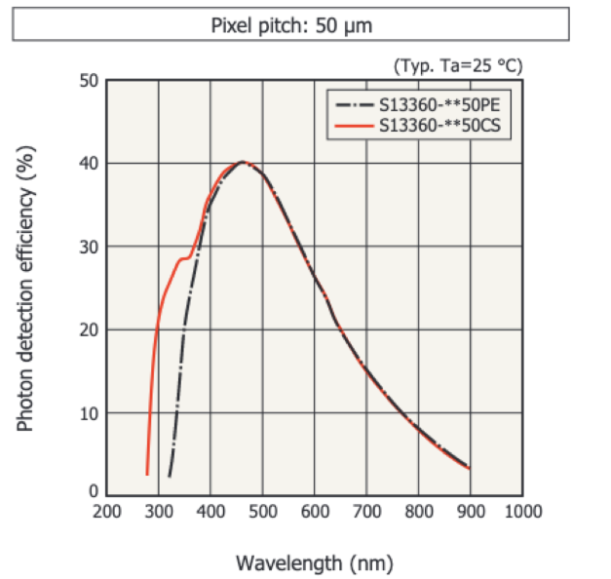
The Crystal
The lead perovskite crystal’s emission spectra peaks slightly above where our SiPM is most efficient
Notes:
Peak we see is due to performance of silicon photomultiplier (~220 nm) or so I thought, x-axis is number of entries if I understand correctly, so is the placement of the peak just a coincidence?

Slide 5
Plotting
Sample Data -
CsPbBr3
(Cs104-A)

Slide 6
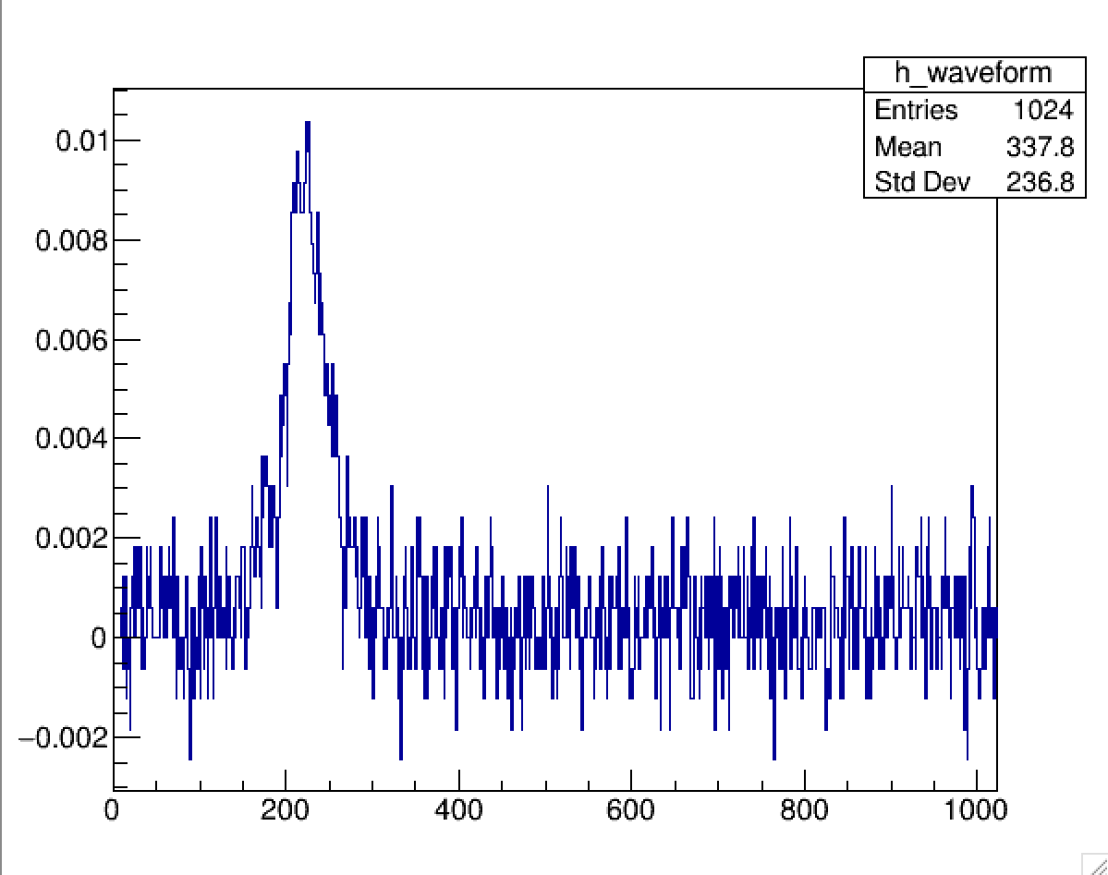
No Sample
Run 2
Peak we see is due to background light (faraday cage not being perfectly sealed) and dark noise of SiPM
Notes:
Peak we see is due to performance of silicon photomultiplier (~220 nm) or so I thought, x-axis is number of entries if I understand correctly, so is the placement of the peak just a coincidence?

Slide 7
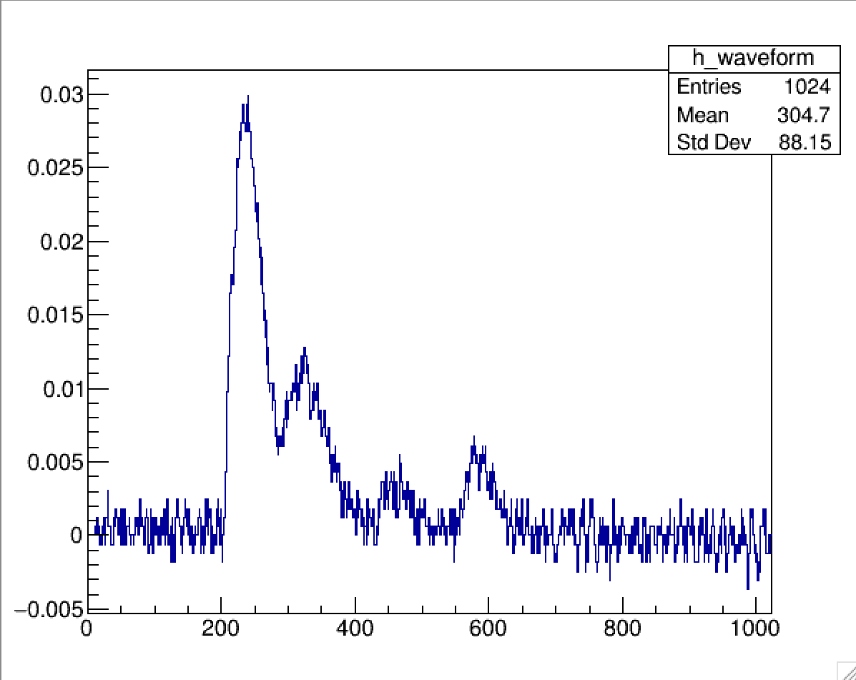
No Sample
Run 6
Same as before but with more pronounced secondary and tertiary peaks
Notes:
Same as before
***Why are there two additional peaks? Is that just noise?***

Slide 8
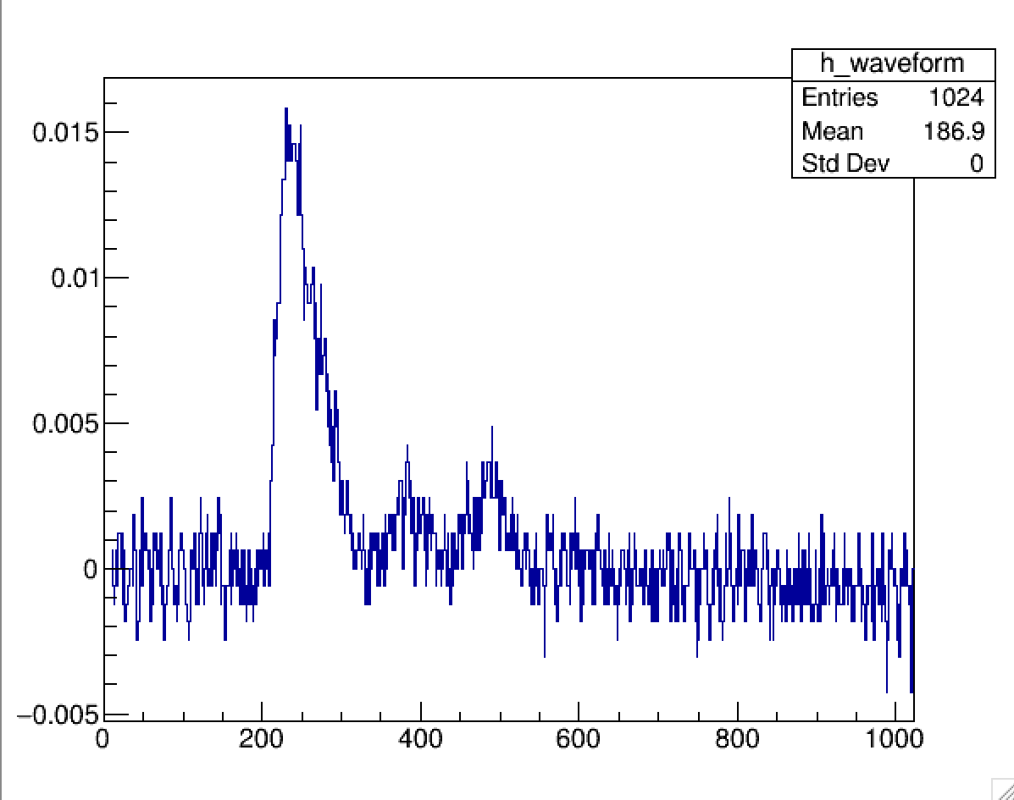
No Sample
Run 6
Remaining questions:
Can we identify more precisely the source of this signal? Is it primarily background noise, crystal activity, or SiPM noise?

Slide 9
Goals for Plotting
Estimate baseline background noise
Estimate max amplitude of waveform
Estimate number of peaks and their separation
Compare data sets with and without samples present using this analysis

Slide 10
Experimental Set-Up Update

Slide 11
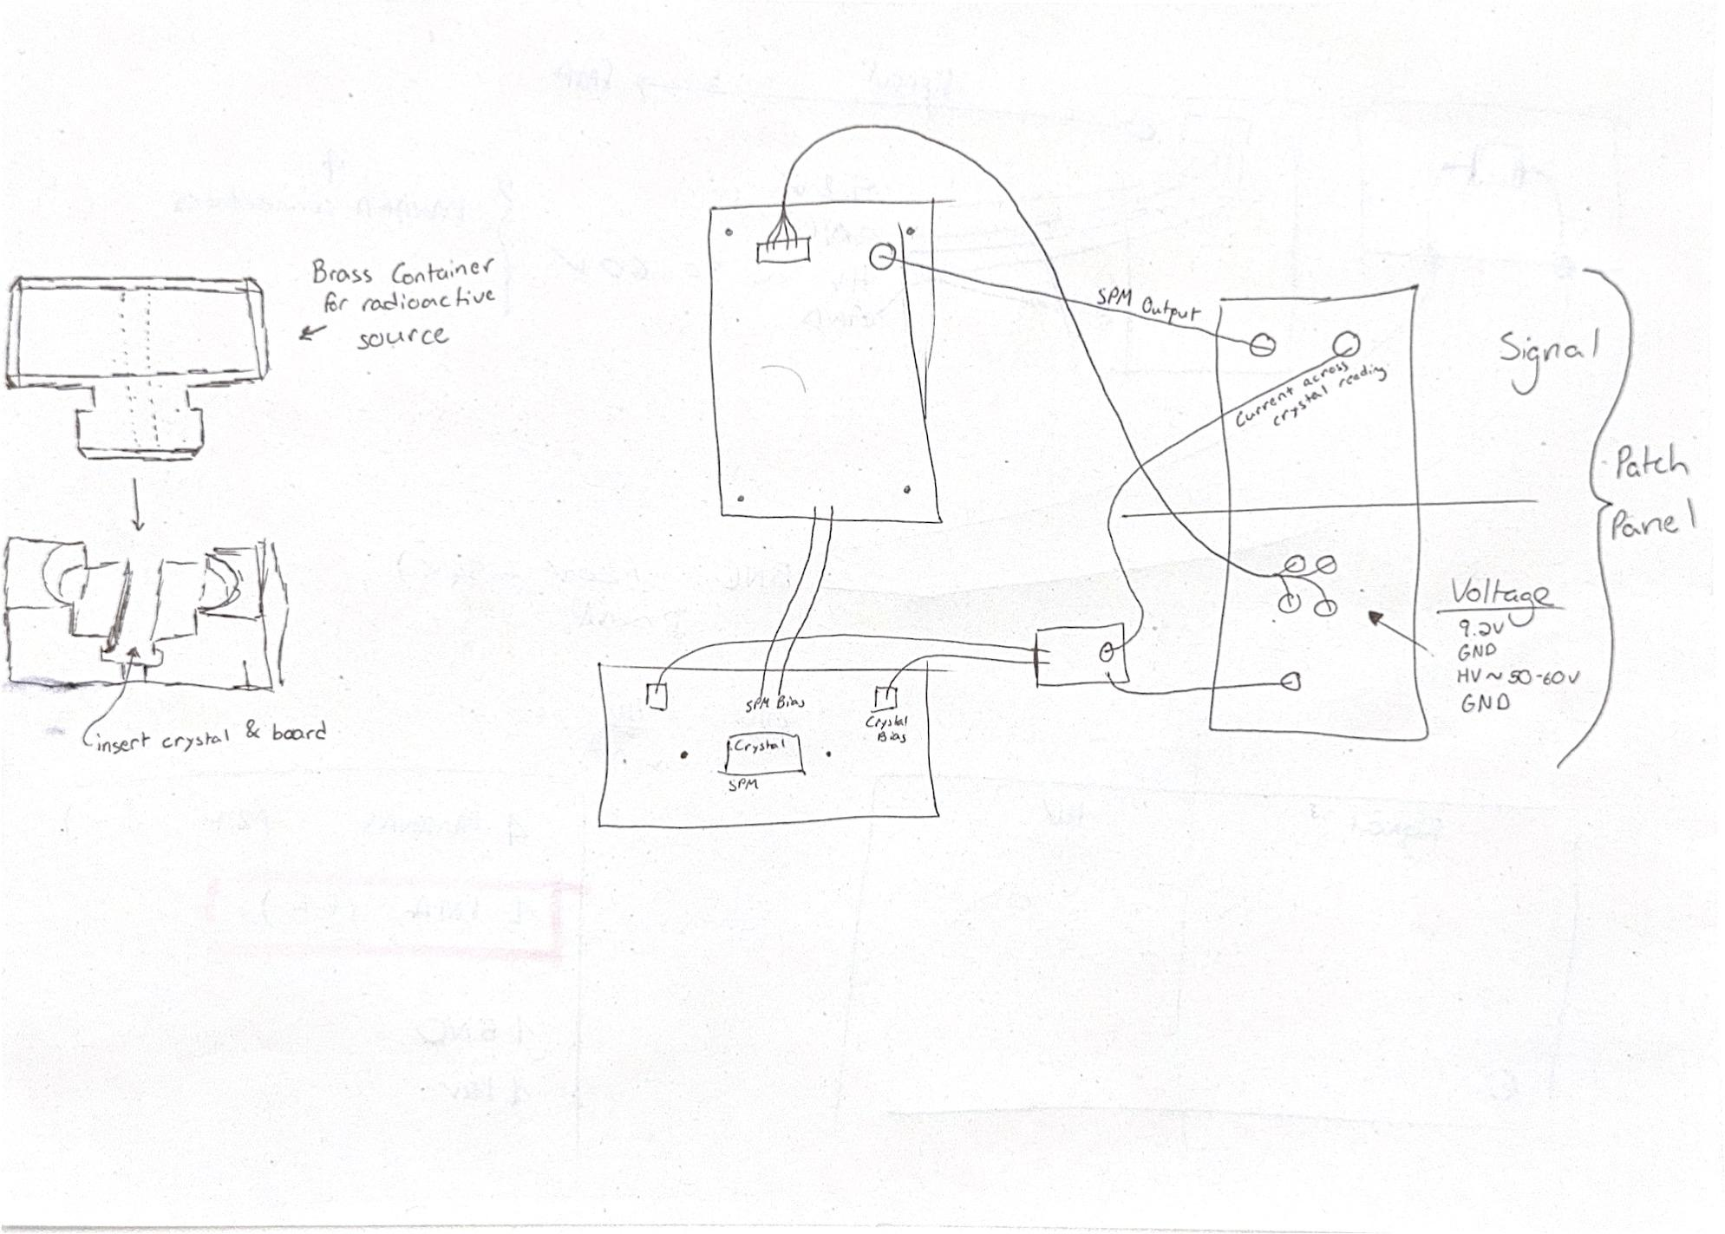
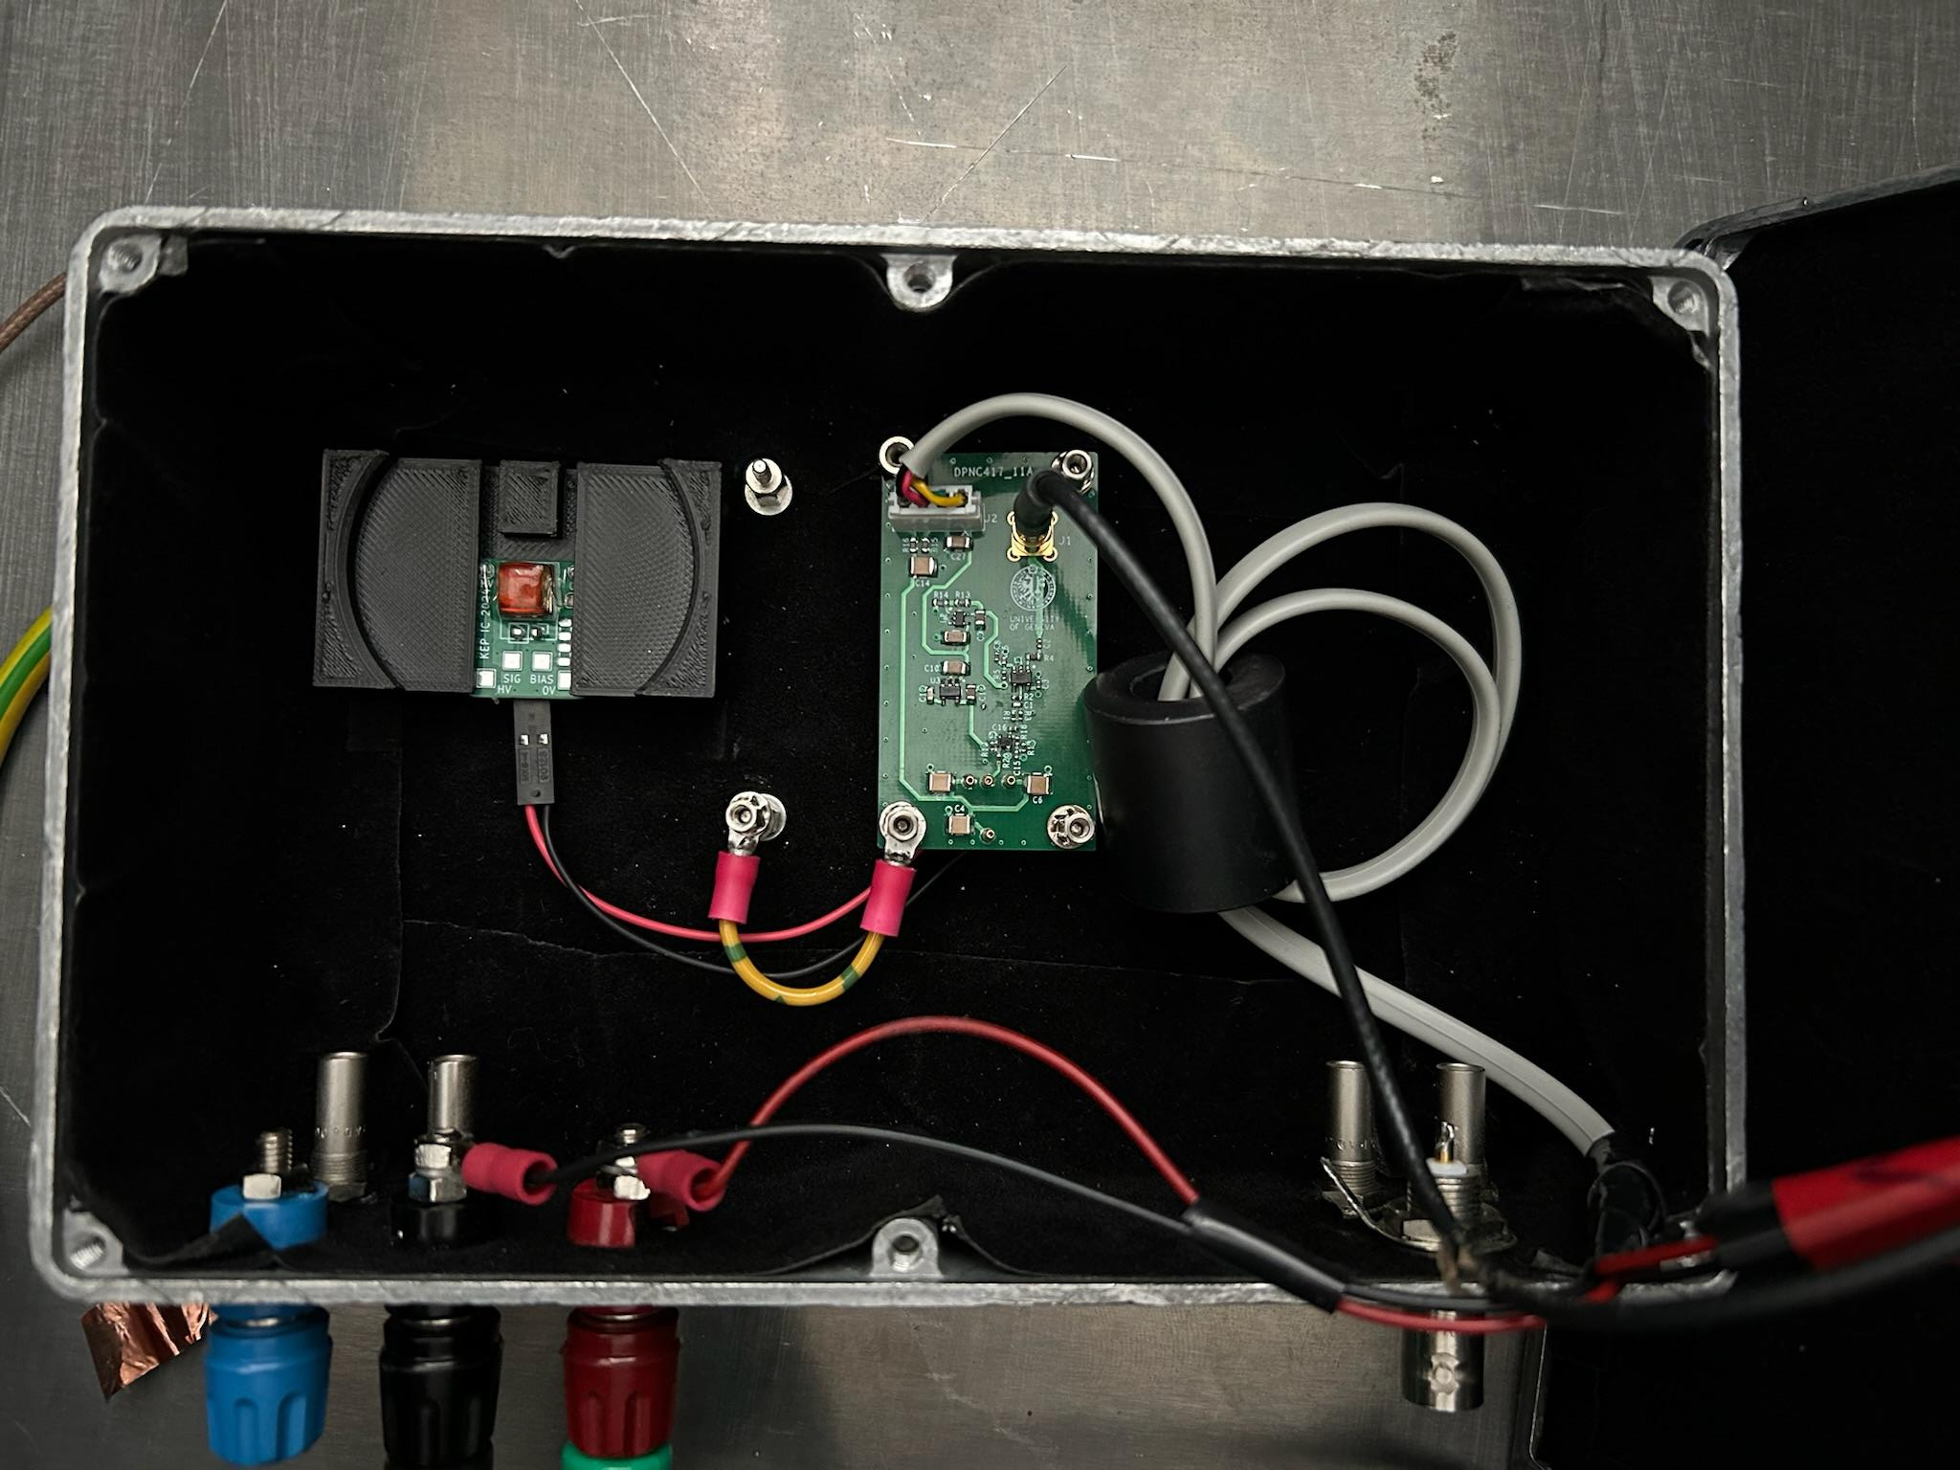
Experimental layout nearly finalized
Patch panel layout isolates signal and input wires to limit background noise

Slide 12
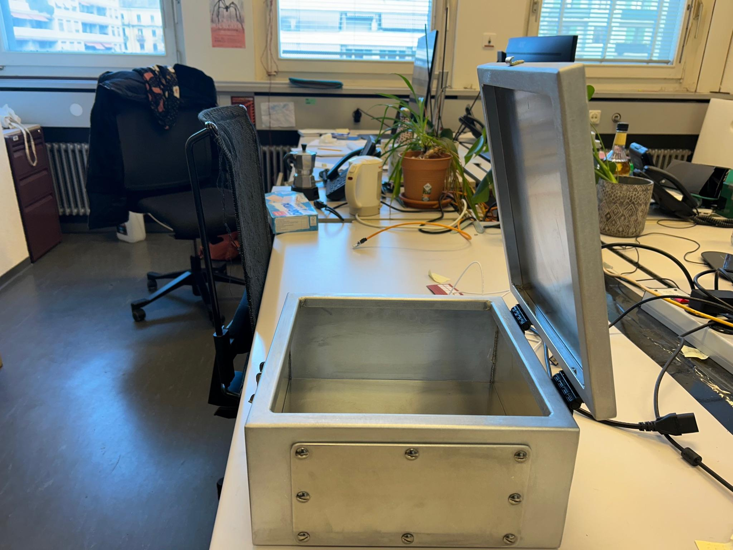
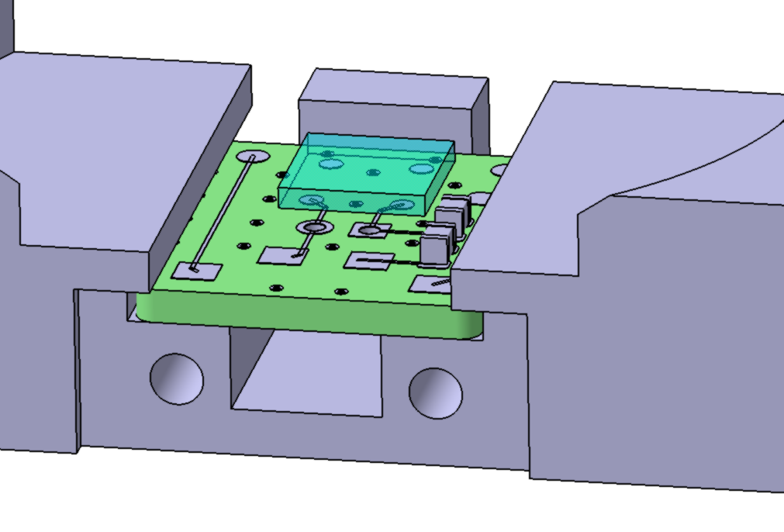
New Box
Need to update design of sample holder
New box has much more space, so we have more flexibility with arrangement
Need to keep in mind adaptability for future experiments
Notes:
Peak we see is due to performance of silicon photomultiplier (~220 nm) or so I thought, x-axis is number of entries if I understand correctly, so is the placement of the peak just a coincidence?

Slide 13
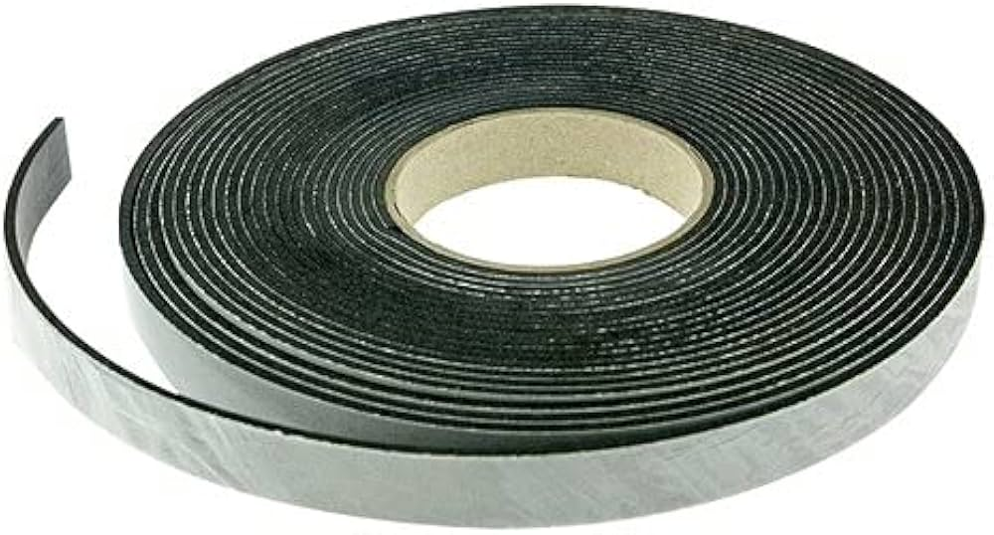
Metal gasket has arrived
Essential for sealing Faraday cage
Next steps:
Paint interior
Insert gaskets
Finalize design
Drill holes for patch panel
Install boards
Estimated completion date:
By the end of March

Slide 14
Looking Forward
-
Long Term Goals

Slide 15


Hoping to present at two conferences in June which will highlight the two directions for the project
Industry
EPHJ Conference in Geneva
Focus on collaboration with KEP, applications in medical imaging etc.
HEP
EPS HEP Conference in Marseilles
Focus on uses in HEP (i.e. in particle detectors)

Slide 16
Questions?

