Slide 1
March 18 Status Report
Dongha Simon Lim

Slide 2
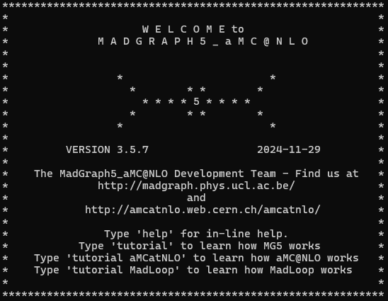

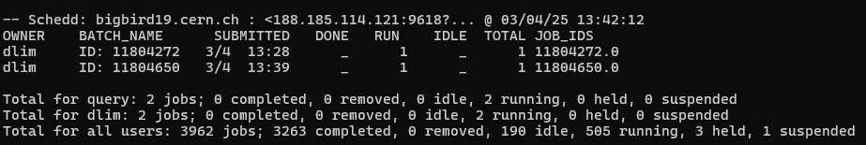
Last time…

Slide 3

Turns out…
e+ e- > Z 𝞬 > H 𝛕+ 𝛕- / H b ̅b
Should’ve just been e+ e- > H 𝛕+ 𝛕- / H b ̅b
“I don’t know why I wrote that…”
Additional task finding the Next-to-leading-order (NLO) cross section
e+ e- > H Z Z / H W+ W- [QED] (NLO electroweak corrections)

Slide 4
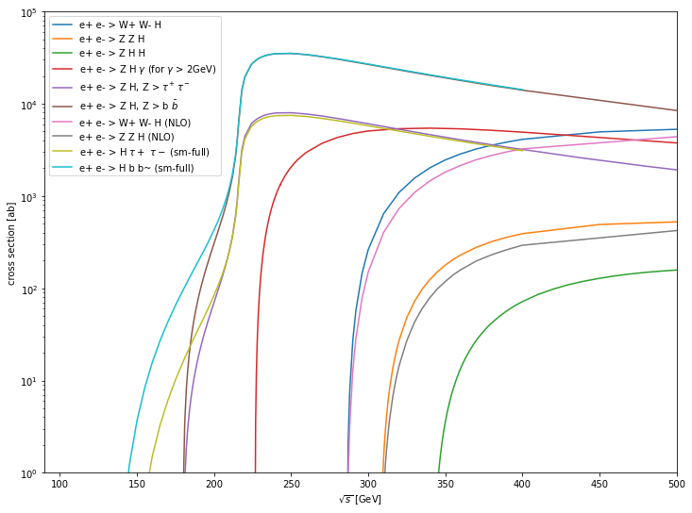
After additions…
They appeared reasonable, but the difference between LO and NLO computed cross section for the HZZ and HWW processes were quite large…
Literature: 3.953 fb for √s=400 GeV at m_{H}=120 GeV
I had 3.691 fb…

Slide 5
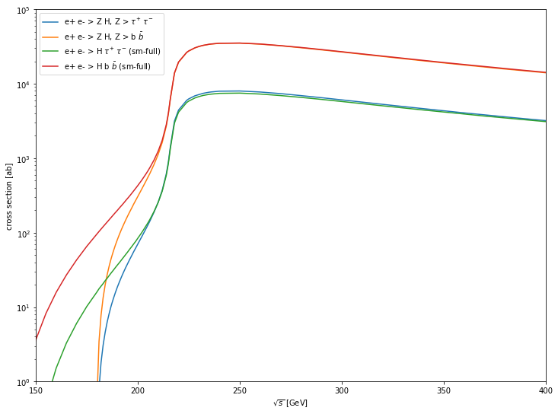

Slide 6
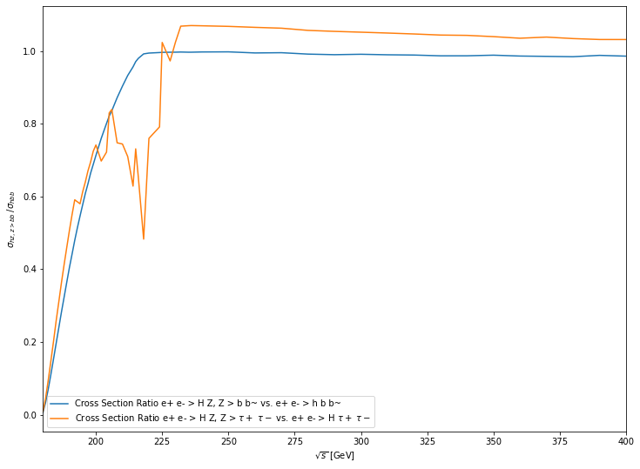


Slide 7
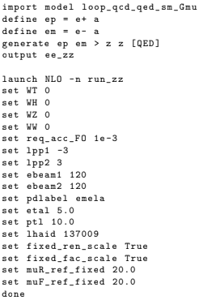
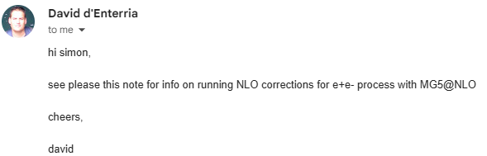
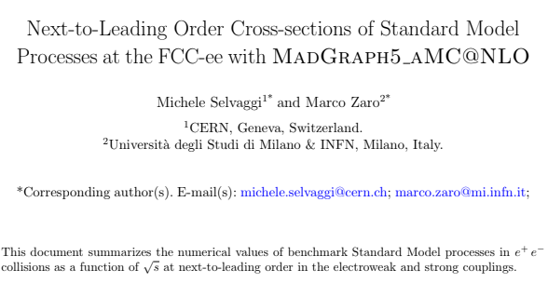
Yesterday

Slide 8


Slide 9

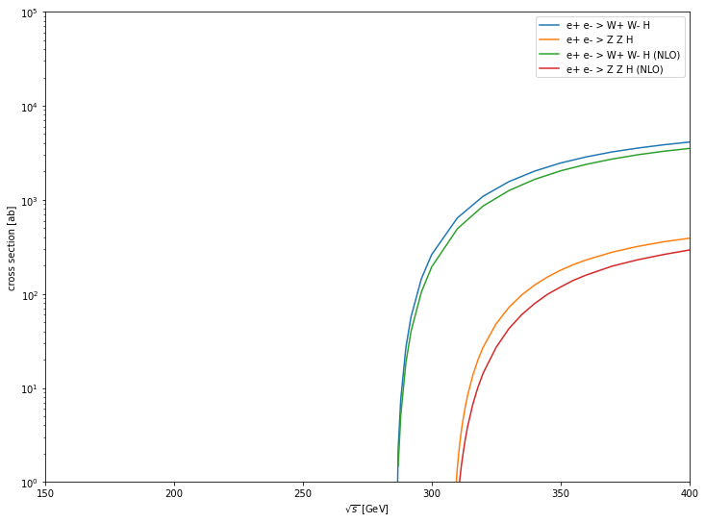
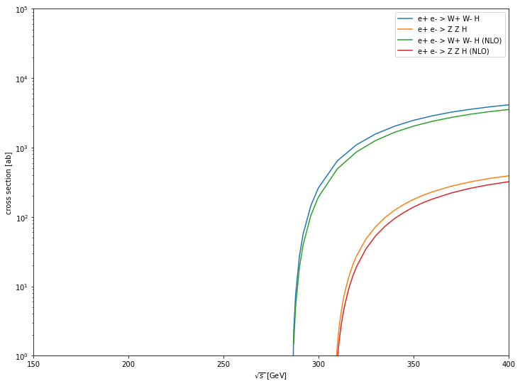

Slide 10
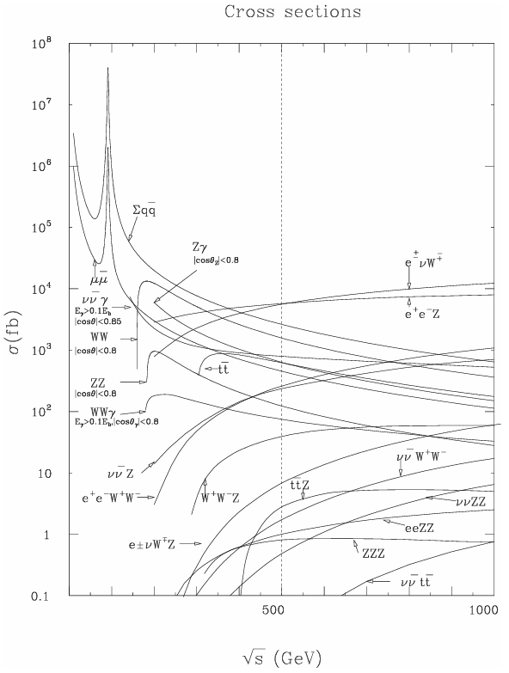

What’s next
Add processes
ZHH @ NLO
HH @ LO/NLO
WWZ @ LO/NLO
ZZZ @ LO/LNO
Single Tau events @ LO/NLO
Figure out H Tau+ Tau- issue
Then analysis can begin(?)

