Slide 1
HGCal progress report: understanding FE electronics
Jackson Lake

Slide 2
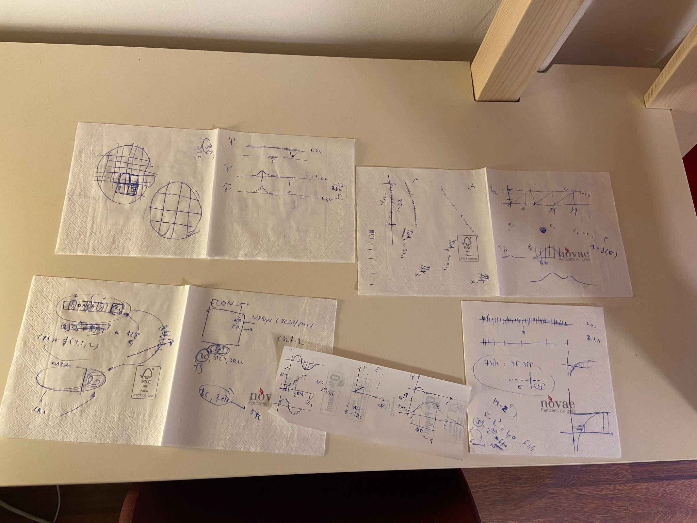
Meeting without a notebook
Notes:
CURRENT STATUS UPDATE SLIDE

Slide 3
Differential signaling (e-Links)
ROC resolution (10b) vs minimum separation (1 BX)
Explaining BC vs STC algorithms
Sampling theorem
Saving bandwidth using 4E3M
Analog to digital conversion, ToT
Cyclic redundancy check
Notes:
4E3M is ECON-T since for the higher charge measurements we just need to know that they’re there. (7 bit floating point)
ROC assigns a 32-bit Cyclic Redundancy Check (CRC) Sum (CRC-32) computed for the Header and all channel fields to allow for a signal integrity check in the ECON-D.

Slide 4
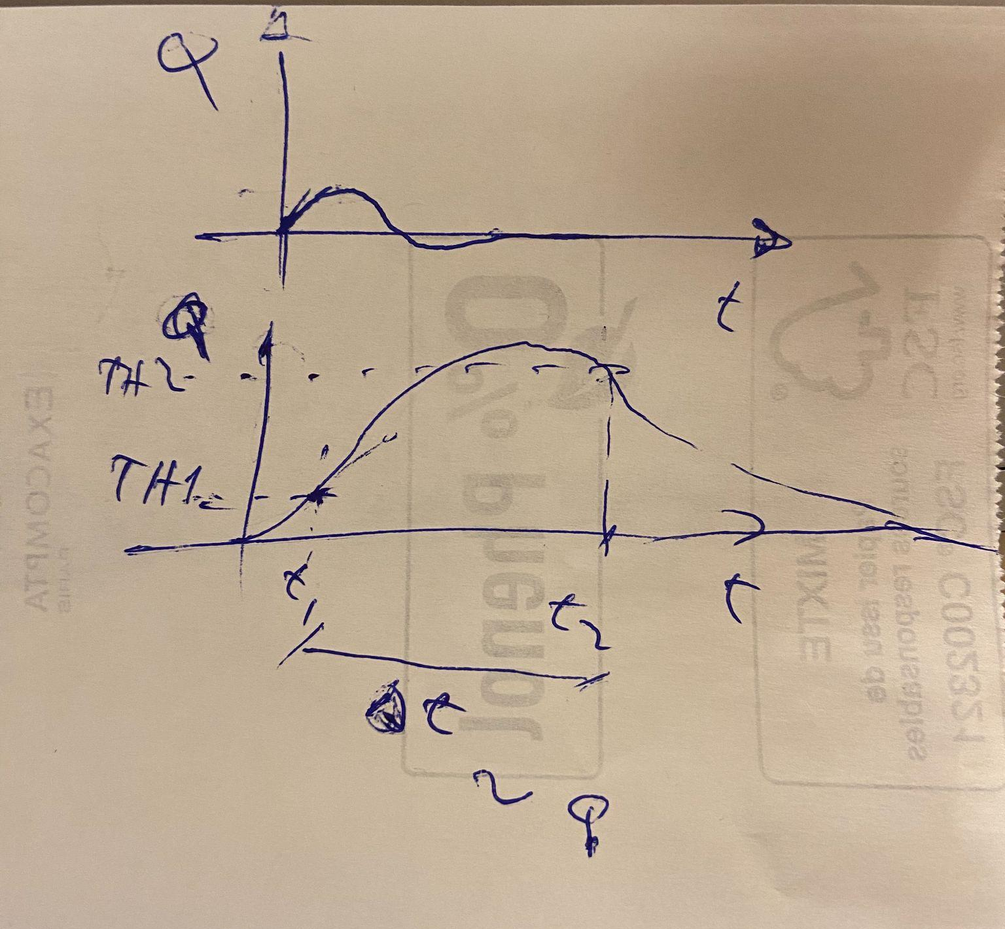
Front-End Overview
Sensor modules produce charge corresponding to deposited energy
ROC: takes analog signal, turns it into voltage signal, then
  If signal is small enough: 10-bit ADC samples the signal (converts to digital)
  Large signal: use ToT (proportional to charge peak) & ToA,
  ADC and TDC measurements
  Latency Manager
  TPG and DAQ data start parallel co-existence in HGCAL electronics system
  Latency manager

Slide 5
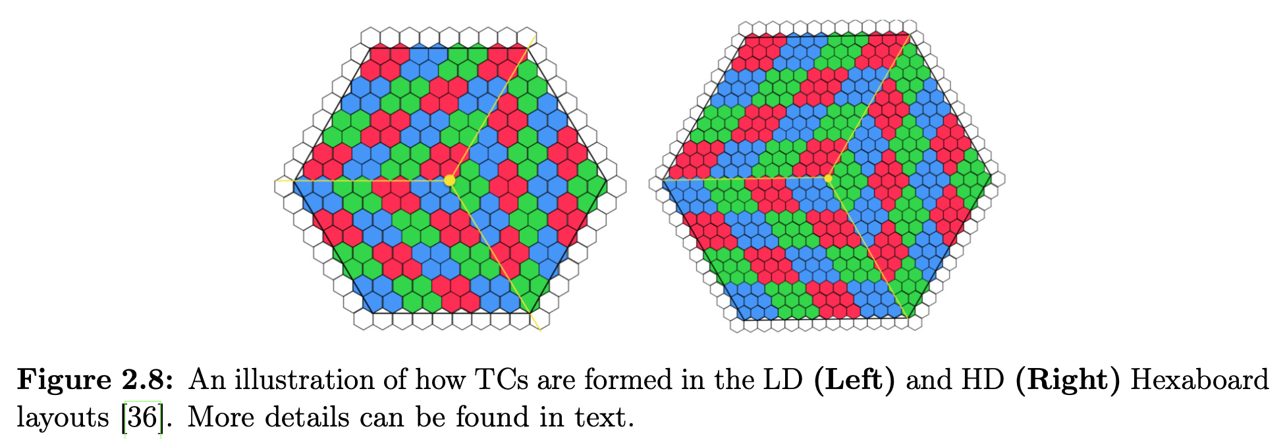
Front-End Overview (TPG)
Trigger Cells: individual ROC channel values are summed in neighborhoods of 4 or 9 (LD or HD hexaboards). (19-bit and 21-bit pos. integers in linear range respectively.) Then they are compressed into a 7-bit unsigned floating point representation to save output bandwidth.
Notes:
Bandwidth-saving measures (zero suppression, aggregation, compression) reduce data volume but do not fundamentally lower the fixed L1T decision latency (~10 µs).
However, they help ensure smooth, timely delivery of the most important trigger information, reducing transmission delays and processing bottlenecks.
Less data per link improves system reliability, avoiding congestion that could indirectly increase latency in extreme event conditions.
(FE circuit boards): HD Hexaboards process more sensor channels and handle higher data rates, while LD Hexaboards cover lower-density regions with fewer readout channels.

Slide 6
Front-End Overview
Different constraints on DAQ vs TPG
Depending on mode and thresholds passed, a set of 3 out of 4 of ADC (BX-1), ADC, ToT, and ToA is selected for transmission
DAQ data (all channels, every BX) taken to circular buffer (RAM1) (can only stay < 512 BX)
If L1A received from BE, data for selected BX moved to RAM2 FIFO memory.
Transformed, serialized, sent to ECON-D

Slide 7
ECON-T and ECON-D ASICs
ECON-T (Main goal = reduce data bandwidth)
Collects TPG data from multiple ROCs, convert 7-bit to custom 21-bit fixed point, applies STC and BC algorithms to be able to fit the final TPG description of any given BX over a number of available output 1.28 Gbit s−1 e-Links and the 25 ns time window.
ECON-D
Zero-suppression algorithm, Vertical Reconstruction (resolves inconsistencies in BX number, event counter, orbit counter, CRC) [extremely general overview]

Slide 8
Current challenges
Each part of the electronics system hinges on seemingly bottomless layers of theory testing
Challenge is to get a solid overall understanding of the system while also permitting myself to delve into specific details of the decisions behind each circuit, algorithm, threshold, placement in the detector, etc.

Slide 9
Current goal: understanding the electronics system
FE sends info to the BE which sends signals to the FE which sends data to the BE
Very important to understand both sides since they interact for every BX
Whatever I will be working will deal with both, have to know the system
BE is next.
Questions ?

