Slide 1

HL-LHC New Infrastructure Integration – Status Update & Key Deadlines
Stephane Maridor, Paolo Fessia, Miguel Navarro Baeza
HL-LHC WP15 Integration
21/02/2025
INDICO

Slide 2
Introduction to Integration Review
Provide each service and equipment a reserved space in HL-LHC integration 3D models of each facility according to project baseline.
Overview of HL-LHC new underground integration review:
  Performed by HL-LHC WP15 in collaboration with the ‘HL-LHC Installation Review Mailing List’
  Discussed and approved in “HL-LHC WP15 Monday Integration Meetings”
  Pertinent members of the HL-LHC project's relevant WPs invited.
Due to key equipment installation timelines, integration approval has been phased to maintain coherence with installation planning.
Once a Phase is approved by HL-LHC Technical De-/Installation Coordinator it becomes integration baseline that consolidates equipment space allocation.
INTEGRATION APPROVAL
INSTALLATION

Slide 3
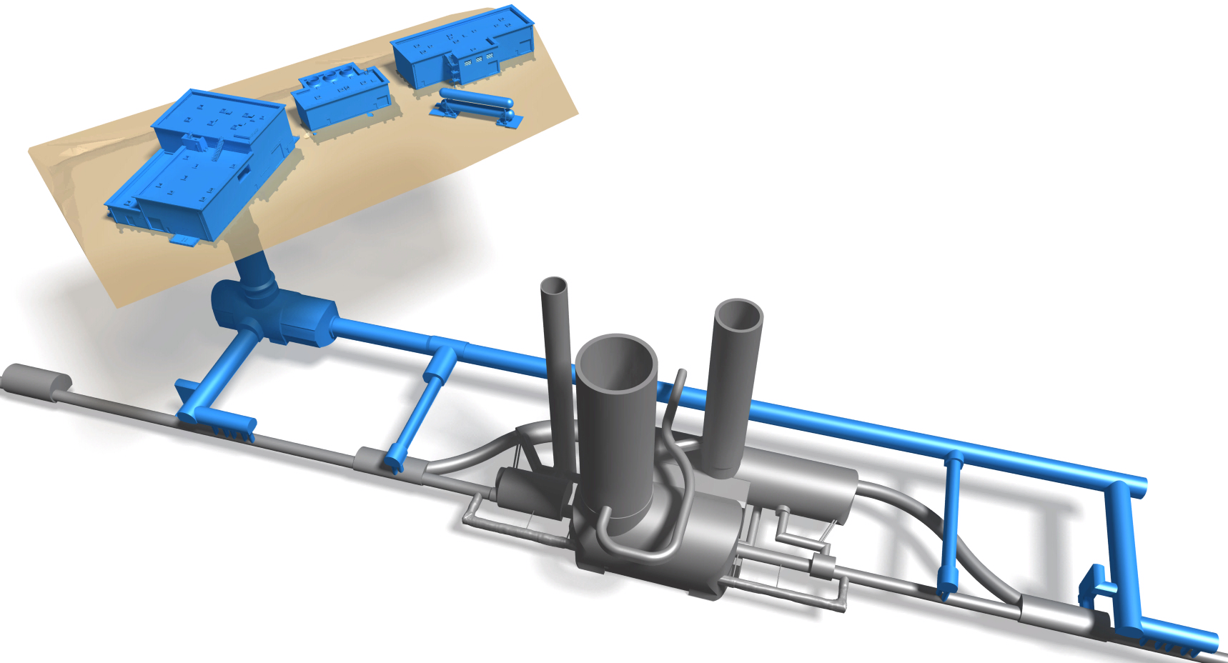
HL-LHC new technical infrastructure integration completion
80%
100%
SHM57
80%
SF57
SD57
100%
SHE57
SE57
100%
100%
SU57
PM57
100%
US57
UW57
80%
100%
UR55
UA57
80%
UL57
100%
70%
LHC Tunnel
UL53
70%
UA53
IP5 (CMS)
100%
P. Fessia at Chamonix Workshop

Slide 4
Pending ITEMs for Surface Integration Approval
HL-LHC - P1/P5 Surface buildings - Phase II - Weekly integration review for installation, EDMS 2922909
ITEM | Facility | Description | Actions Pending | Responsible | Deadline
30 | SHM17 SHM57 | Cables and electrical infrastructure of the WP9 compressors in SHM17 and SHM57. | Integration | WP9, EN-EL | 03/03/2025
36 | SHM17 SHM57 | Transportability of WP9 equipment in SHM buildings. | OK confirmation from transport. | WP9, EN-HE | Completed
43 | SD17 | Integration of venting pipe exit towards harmonic filters area. | OK confirmation from EPC. | WP9, SY-EPC | Completed
44 | SD17 | Accessibility for cabling to cable tray section next to sectional door due to potential interference with cryogenic metallic structure. | Agree on a temporary solution that permits cabling (metallic cover?). | EN-ACE, SCE, EN-EL | 03/03/2025
45 | SD17 SD57 | Integration of cryogenic line supporting structure on top of control room. | WP9 contact SCE for feasibility study once design is received. | WP9, SCE | 30/03/2025

Slide 5
Pending ITEMs for US17/US57 Integration Approval
HL-LHC - US17/US57 - Weekly integration review for installation, EDMS 2804653
ITEM | Facility | Description | Actions Pending | Responsible | Deadline
60 | US17 US57 | US17/57 cold box metallic structure modification. | Feasibility study to be provided by SCE. Meetings ongoing. | WP9, SCE | 07/03/2025
61 | US17 US57 | Integration of warm pipes and their supports at US17/57 vault. | Final integration to be confirmed when design available. | WP9, EN-EL | 24/02/2025
62 | US17 US57 | Positioning of control racks for cold box. | Converge on final position. | WP9 | 24/02/2025
XX | US17 US57 | Integration of new fire-resistant cable tray below the smoke extraction duct. | Final position integration | EN-EL, EN-AA | 03/03/2025

Slide 6
Pending ITEMs for UR15/UR55 Integration Approval
HL-LHC - UR15/UR55 - Weekly integration review for installation, EDMS 2796441
ITEM | Facility | Description | Actions Pending | Responsible | Deadline
79 | UR15 UR55 | Flexibles for Power Converters. | Integration | EN-CV | 03/03/2025
80 | UR15 UR55 | Lights on transport side. | Addition of supports from WP9. Final integration from EN-EL. | WP9, EN-EL | 24/02/2025
89 | UR15 UR55 | Installation Sequence and Transport Volumes for SC Link, DFHX and DFHM (discussion offline and outcome to be added later). | Global discussion on actions taken. Several actions ongoing. | WP6A, EN-EL, EN-ACE, SCE | 03/03/2025
91 | UR15 UR55 | Integration of EN-AA equipment. ASDs, Loudspeakers. | Final position integration | EN-AA | 03/03/2025
92 | UR15 UR55 | Integration of new fire-resistant cable tray below the smoke extraction duct. | Final integration check | EN-EL, EN-AA | 24/02/2025
94 | UR15 UR55 | Integration of ODH systems and electrical service boxes | Final integration check | EN-EL, EN-AA, WP15 | 24/02/2025

Slide 7
Pending ITEMs for UL13/UL17, UL53/UL57 Integration Approval
HL-LHC - UL13/UL17, UL53/UL57 - Weekly integration review for installation, EDMS 3018054
ITEM | Facility | Description | Actions Pending | Responsible | Deadline
60 | UL13/UL17, UL53/UL57 | Integration around cores area. | Converge on final integration at cores area. | WP9, EN-EL, EN-CV, WP6A | 28/04/2025
XX | UL13/UL17, UL53/UL57 | Integration of QXL short branch. | Final integration check. | WP9, ALL | 28/04/2025

Slide 8
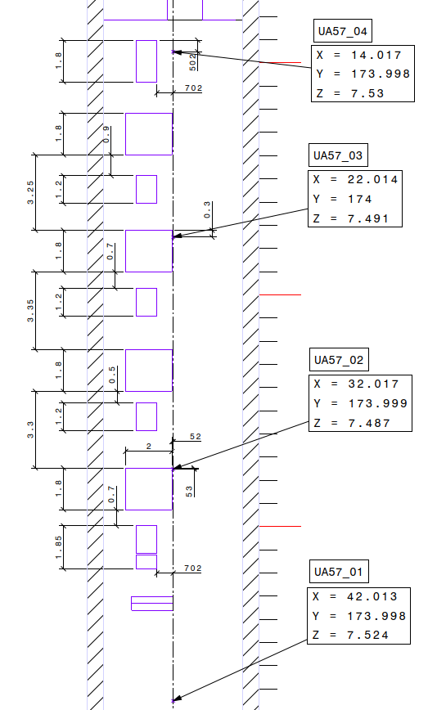
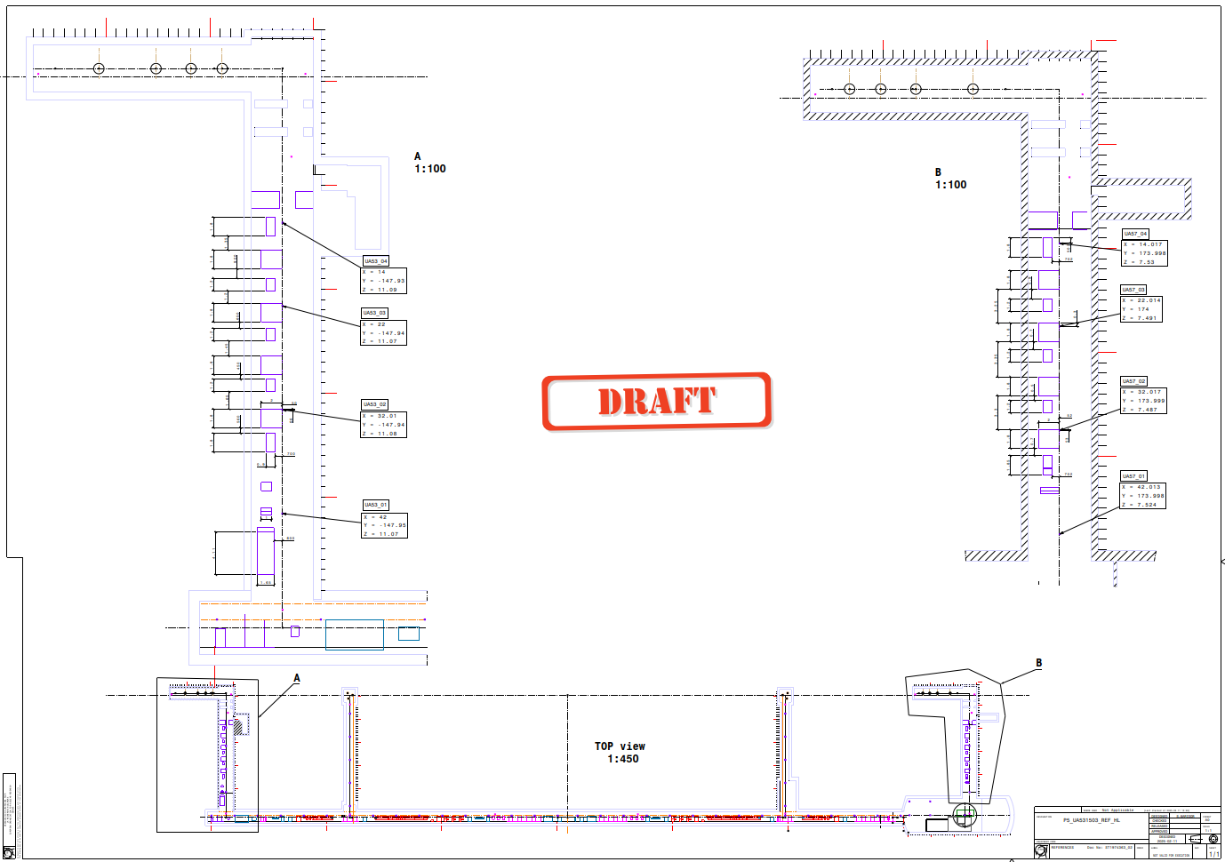
UAs floor marking for installation of equipment
Detail the floor markings for the installation of equipment on the UAs according to each WP installation needs with respect to referenced nails placed by BE-GM along the length of the UR.
Drawings of are being produced by S. Maridor (WP15) and will be approved after HL Engineering Check.
Floor marking to commence end of March and to be performed by SCE (S. D’Armancourt).

Slide 9
Conclusions & Next Steps
HL New Infrastructure complete integration approval by
  Surface — 30/03/2025 (SD17/57)
  Underground — 28/04/2025 (ULs)
Completing integration will ensure a smooth an ongoing installation process.
We are in the final stages of integration—last efforts are crucial.
We must free up resources to fully focus on the integration of the LHC tunnel.
Thank you all for your hard work and dedication in this final stretch!

Slide 10
Thanks!

Slide 11
Extra slides

Slide 12
Additional Material
Integration Review for Installation – SharePoint Link
HL-LHC Installation Discrepancies – SharePoint Link
HL-LHC Integration Reference Models for Underground and Surface Buildings – SharePoint Link

