Slide 1
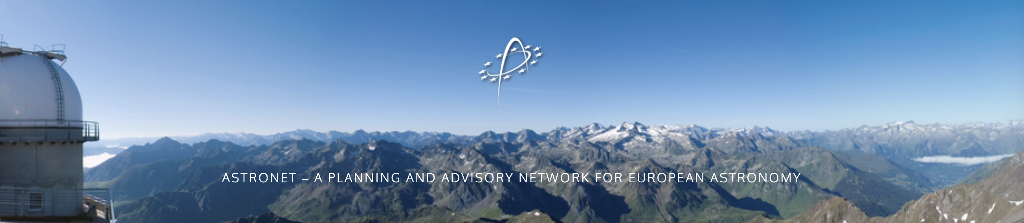
https://www.astronet-eu.org/
ASTRONET: a strategic planning and coordination mechanism for all of European astronomy

Slide 2
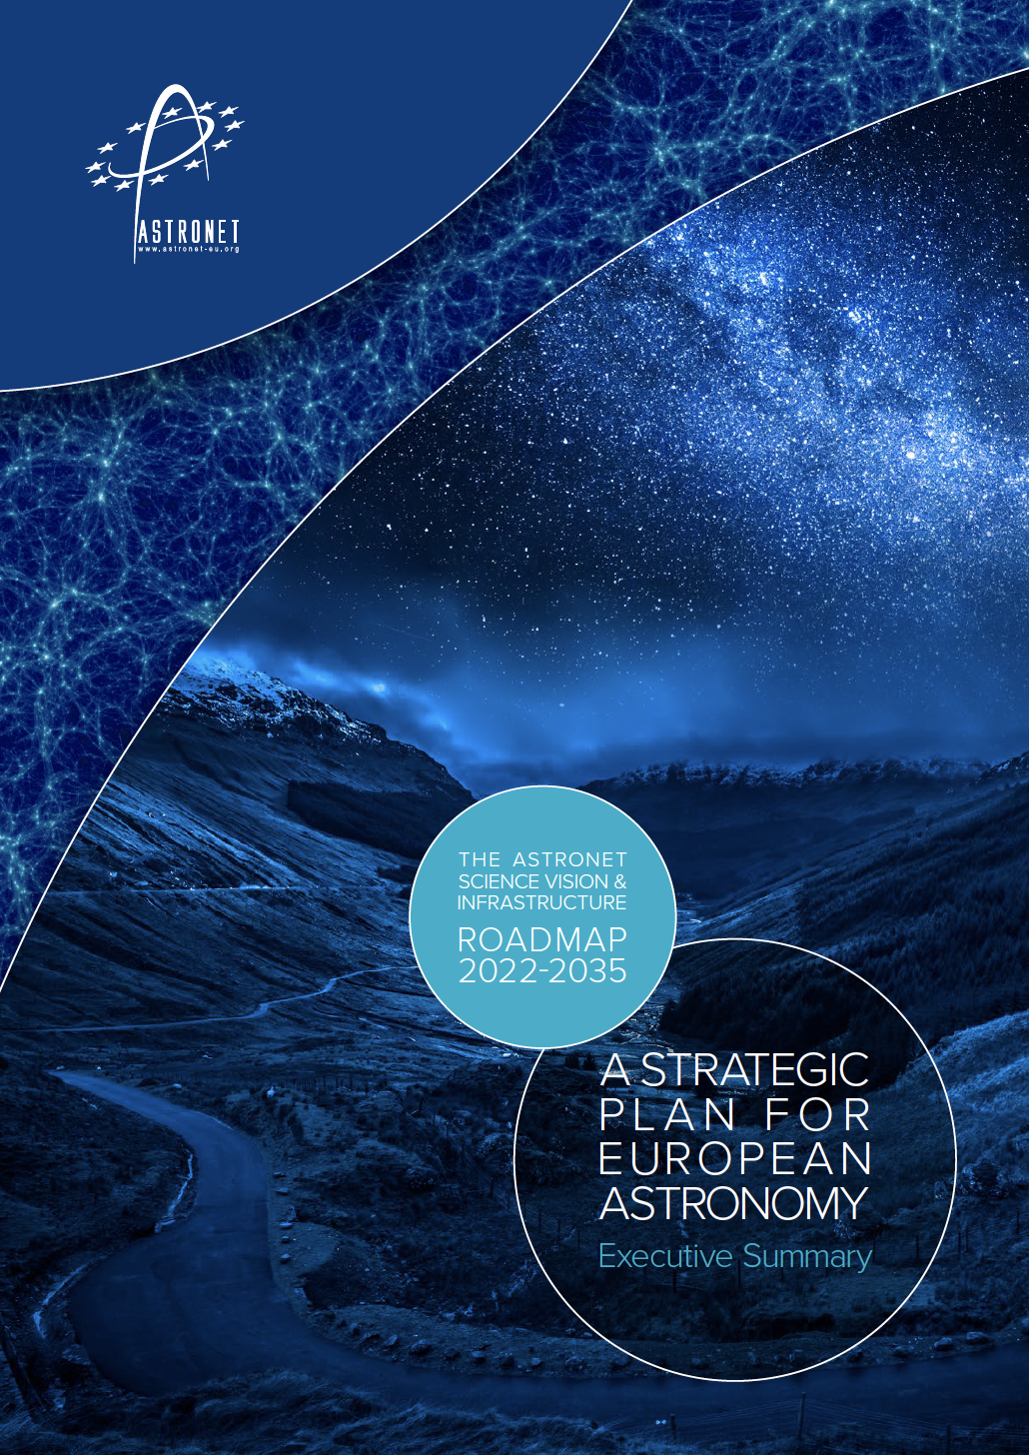
About ASTRONET
Network of European funding agencies and associated bodies
  Self-sustained: 2015 – present, EU funding: 2005 – 2015
  All of astronomy – regardless of ground/space, frequency, facility or technique
Focus: strategic planning, facilitating European coordination
  Liaise with national and European science strategy providers -> science-based, rational and coordinated decisions
  Enhance communication and coordination between planned and existing research infrastructures
Science Vision and Infrastructure Roadmap
  Providing a common vision, identifying common needs

Slide 3
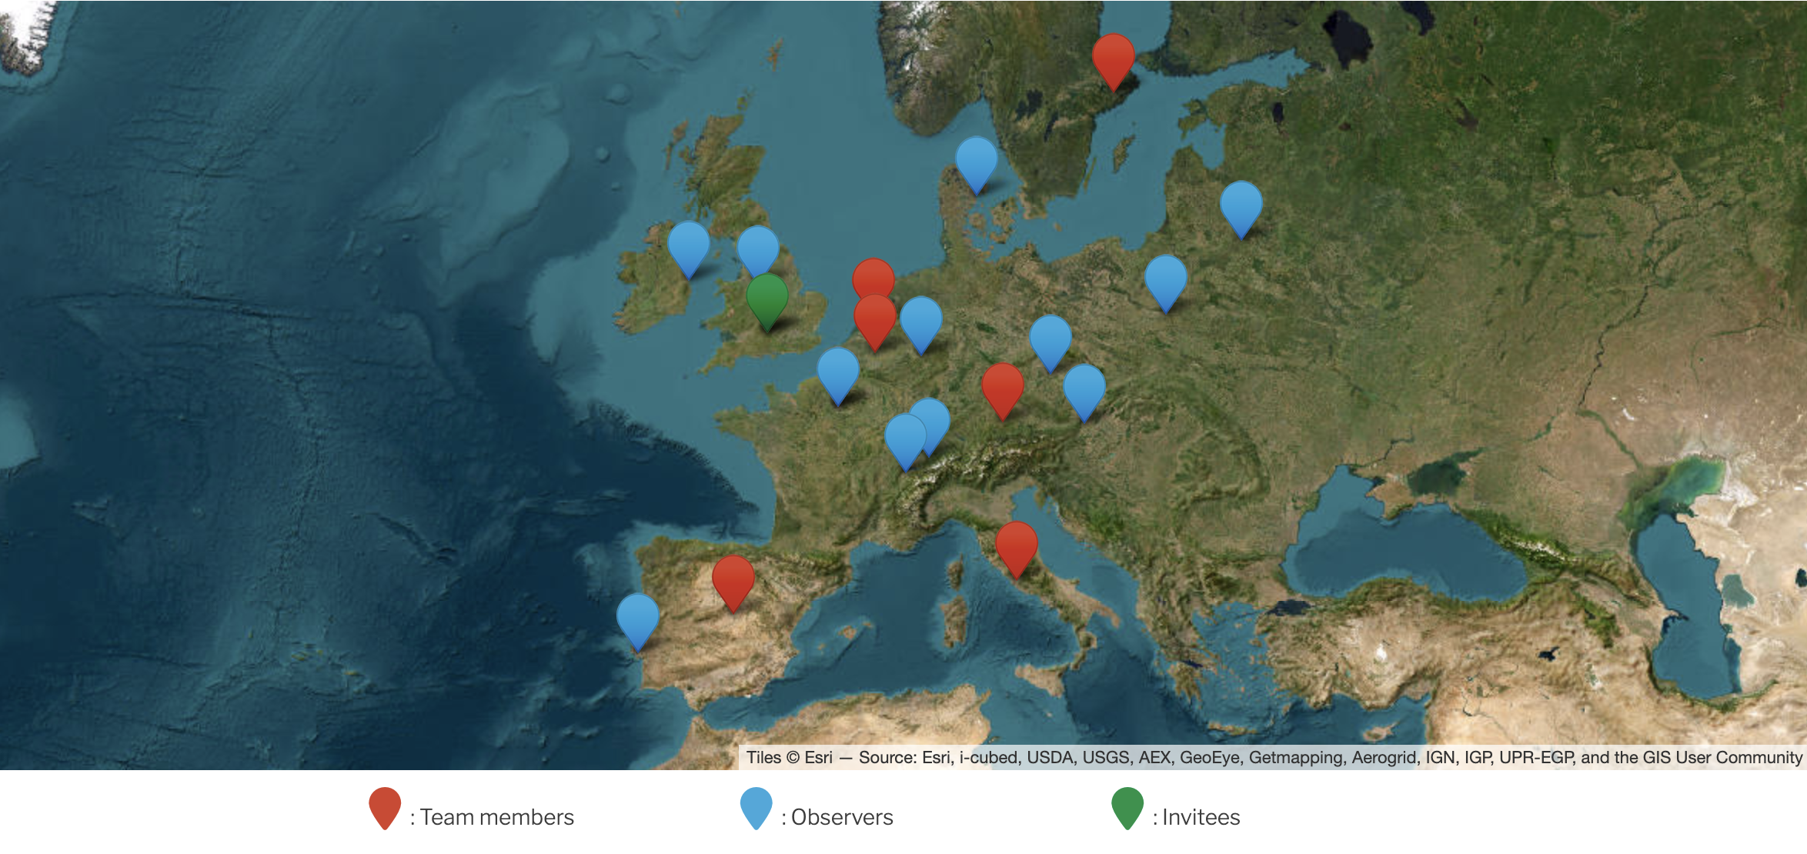

SRC
ASTRONET members :
CNRS, France
CMIN, Spain
FWO, Belgium
INAF, Italy
NWO, The Netherlands
SRC, Sweden
STFC, United Kingdom
ESO
IDA
TFAI
ASI
SKAO
STFC
NWO
PTA
FWO
RDS
CNKA
+
ESA
EAS
APPEC
CNRS
ESO
OAW
SCNAT
INAF
Spain
PSA
CSIC

Slide 4
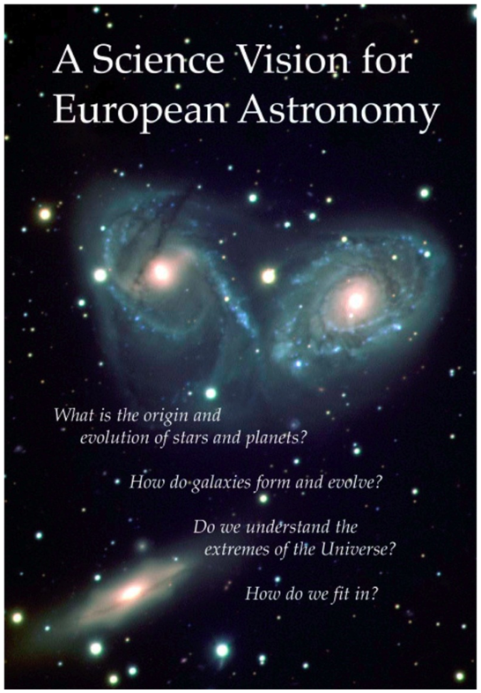
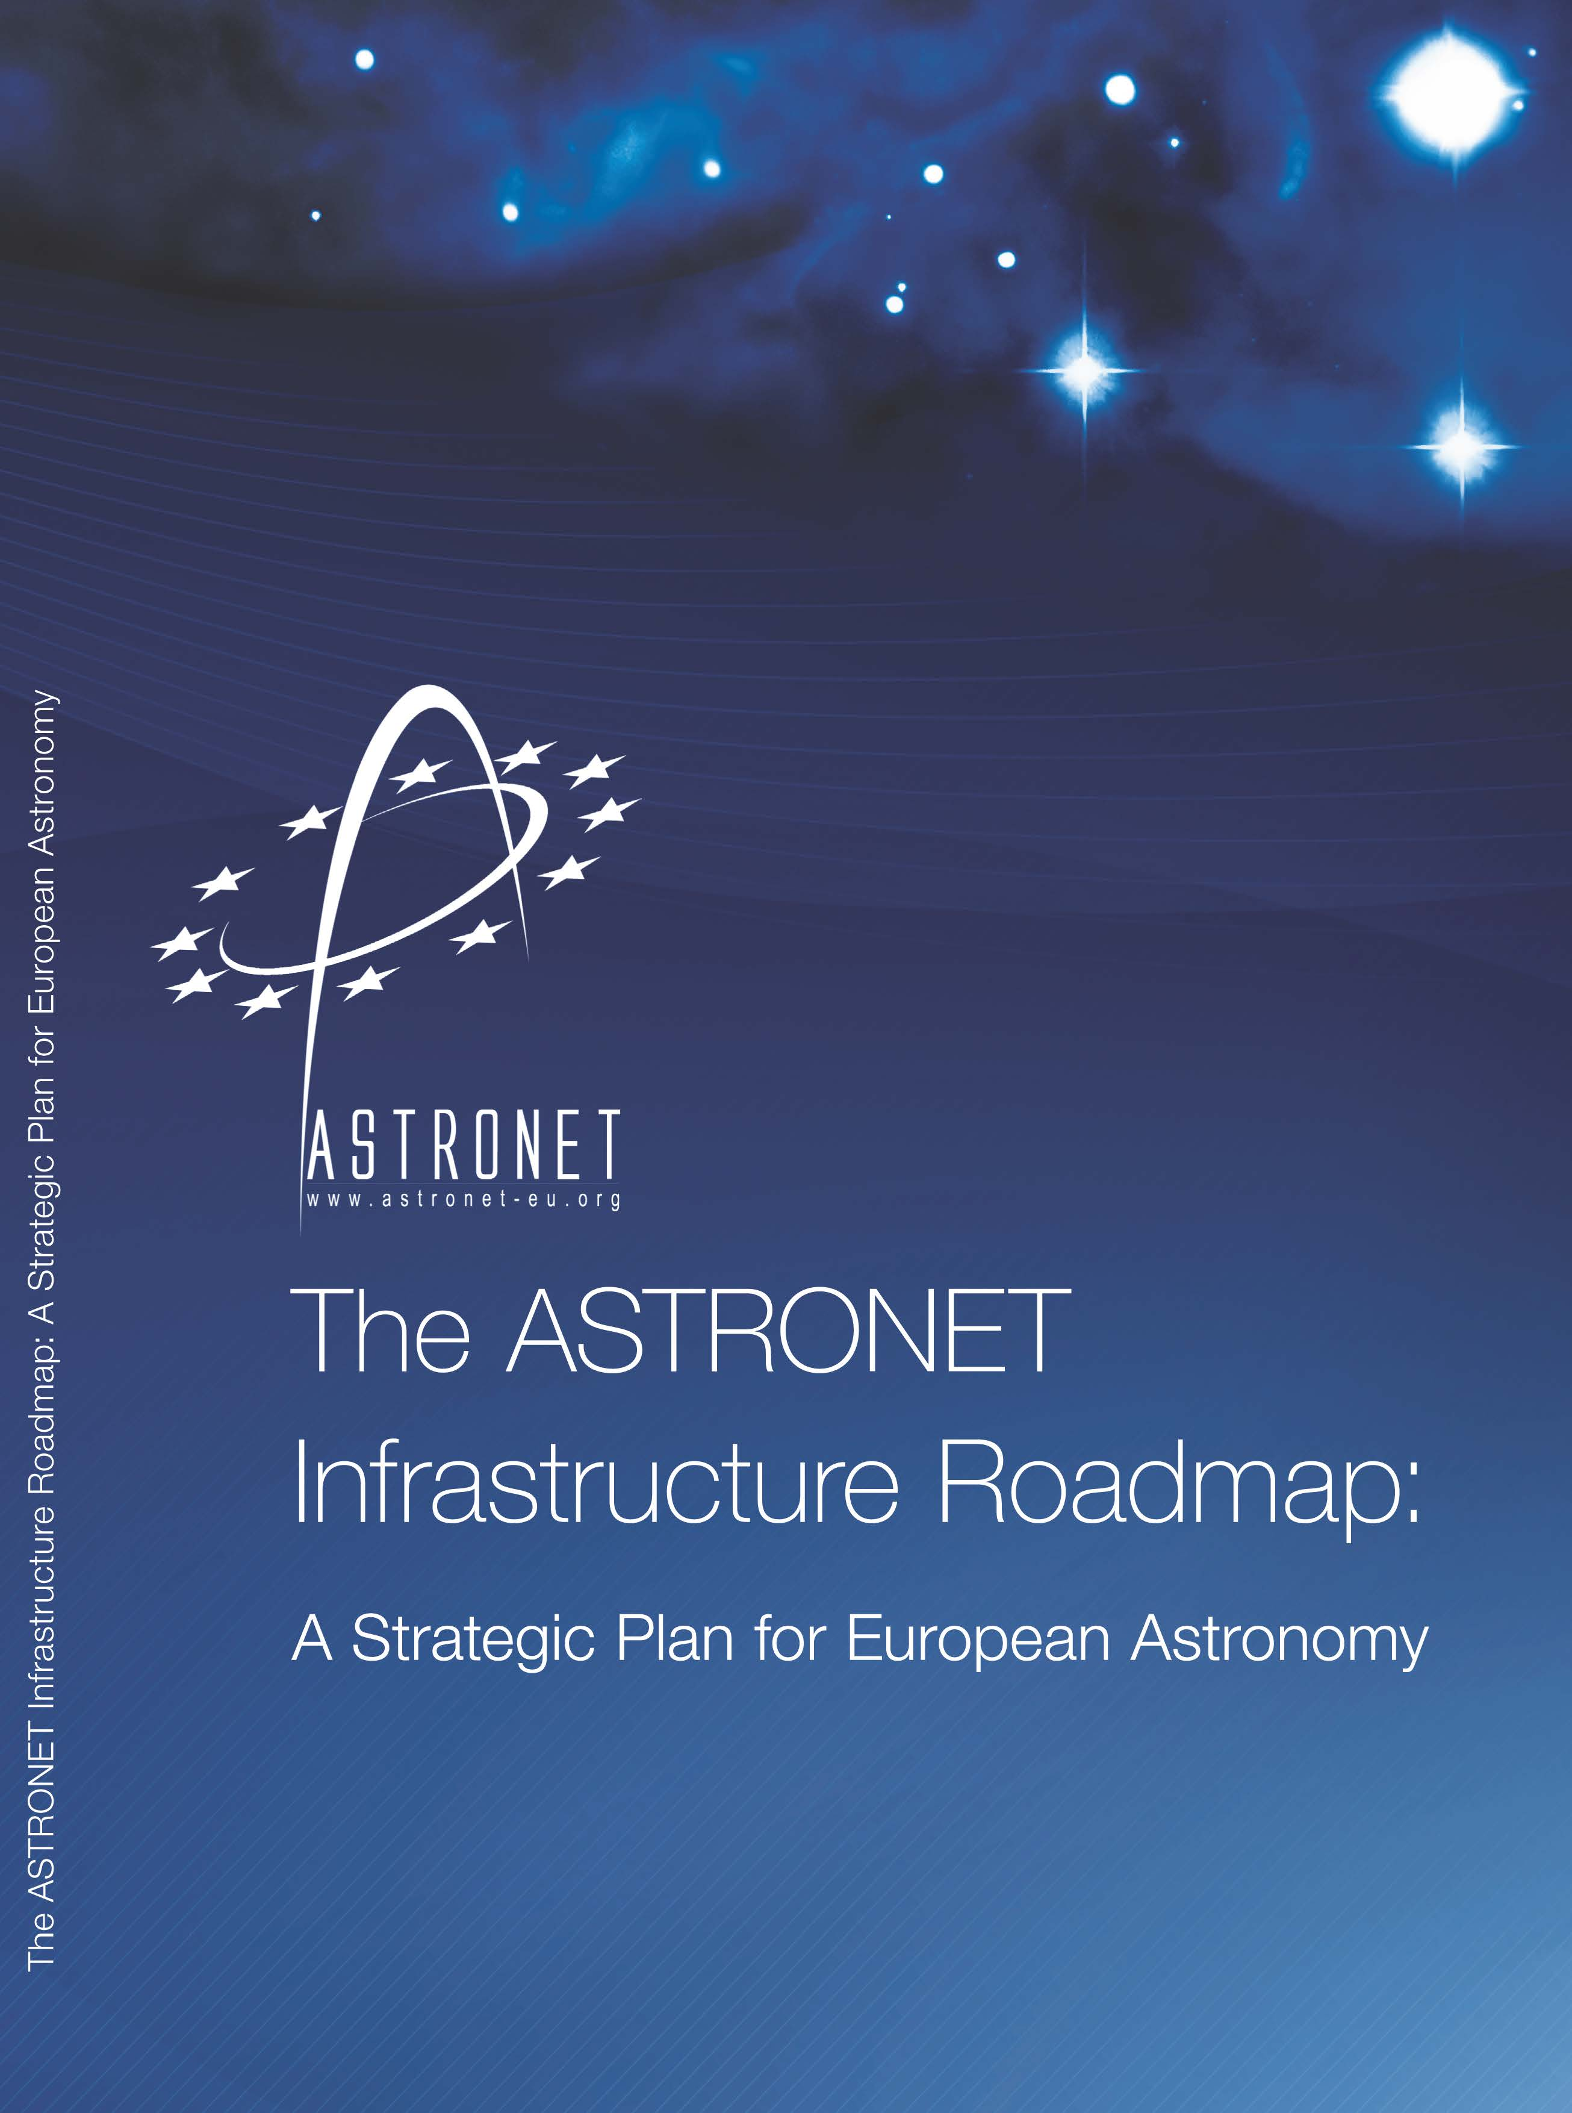
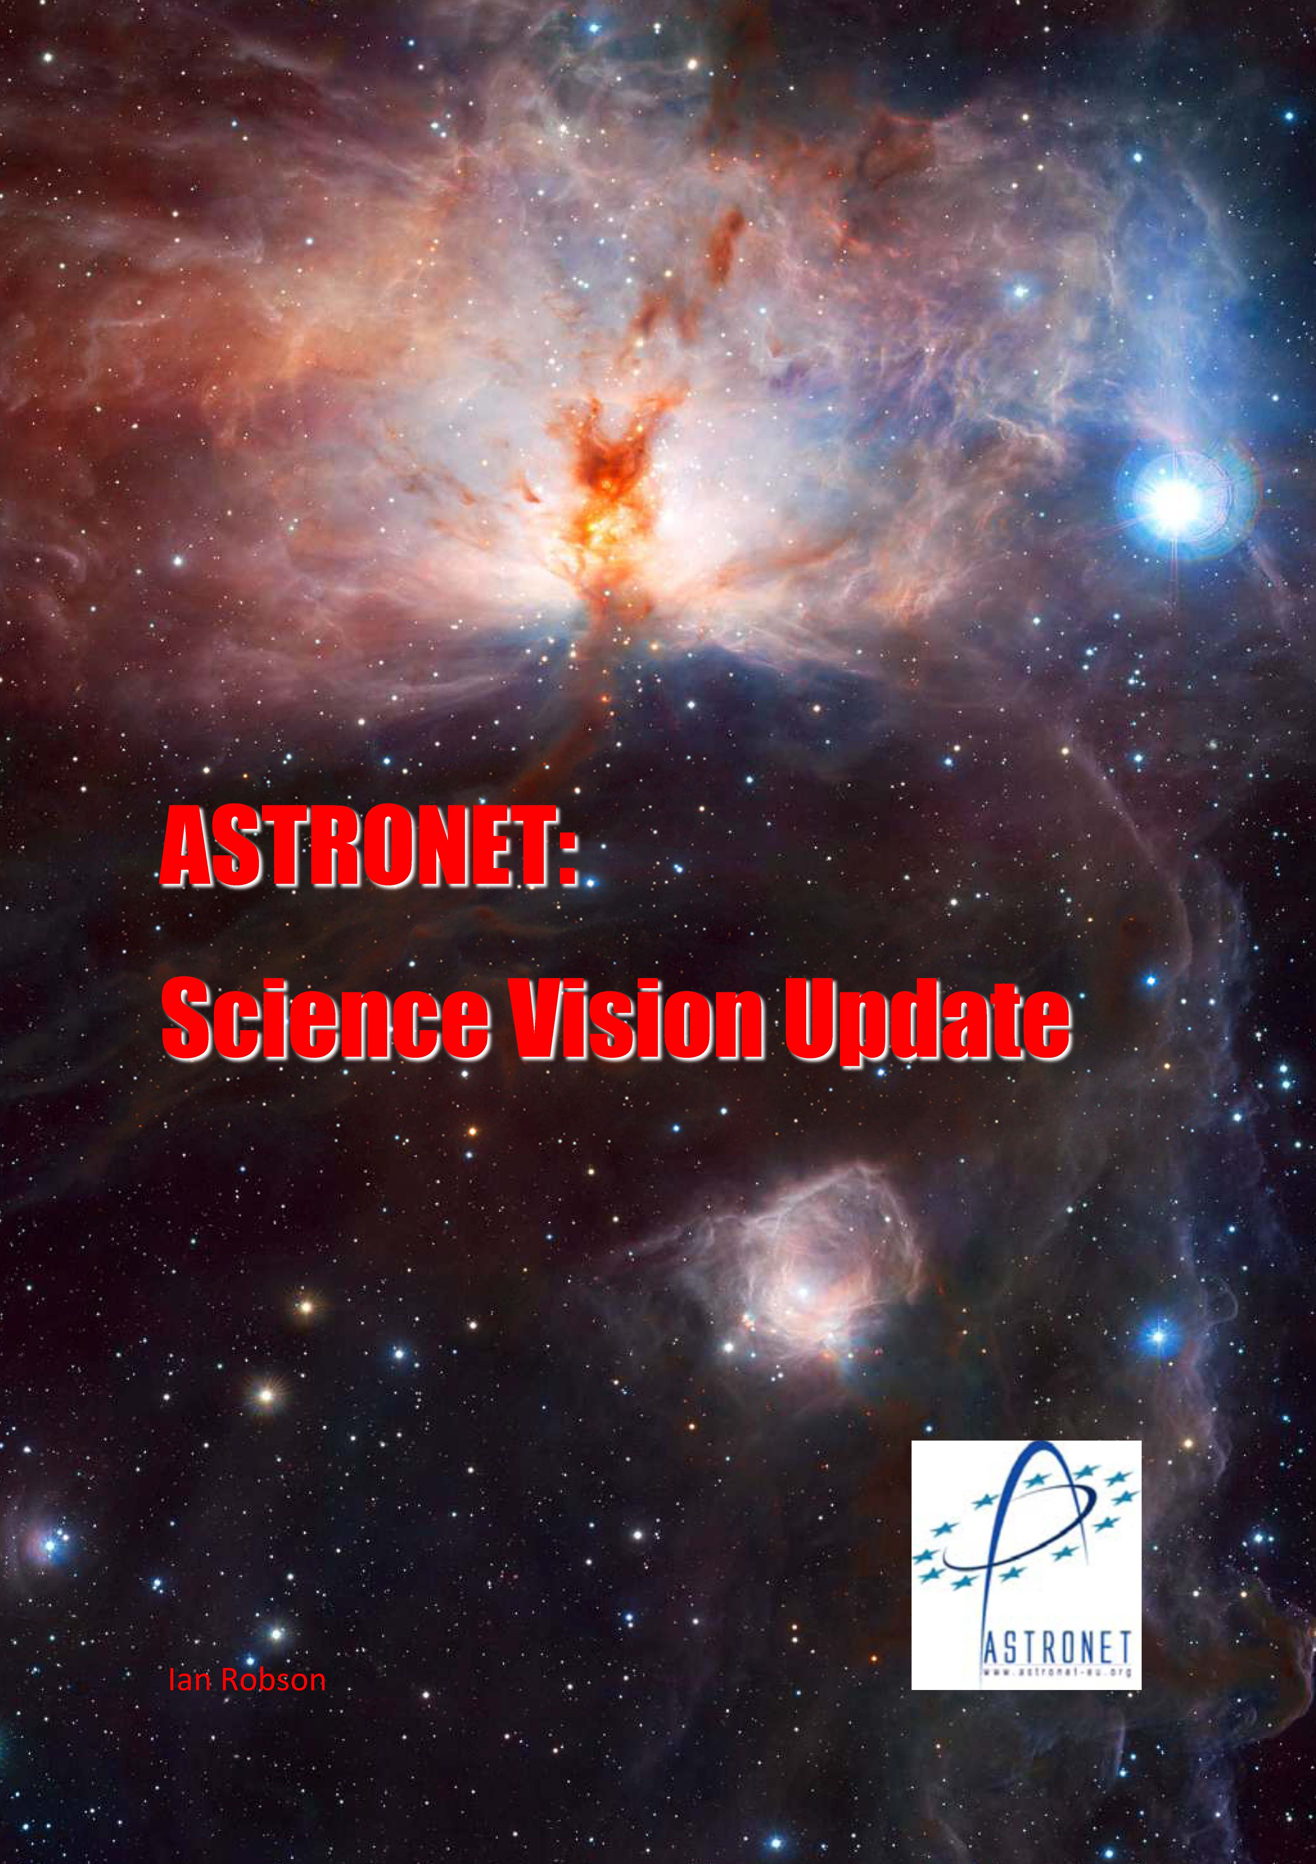
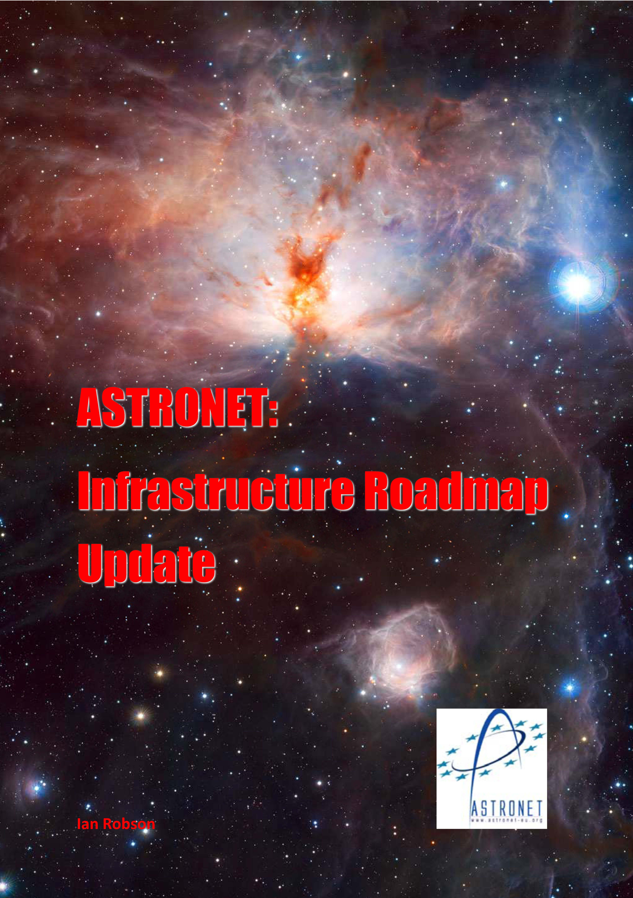
ASTRONET Science Vision and Infrastructure Roadmap
2007
2008
2013
2014
2022

Slide 5
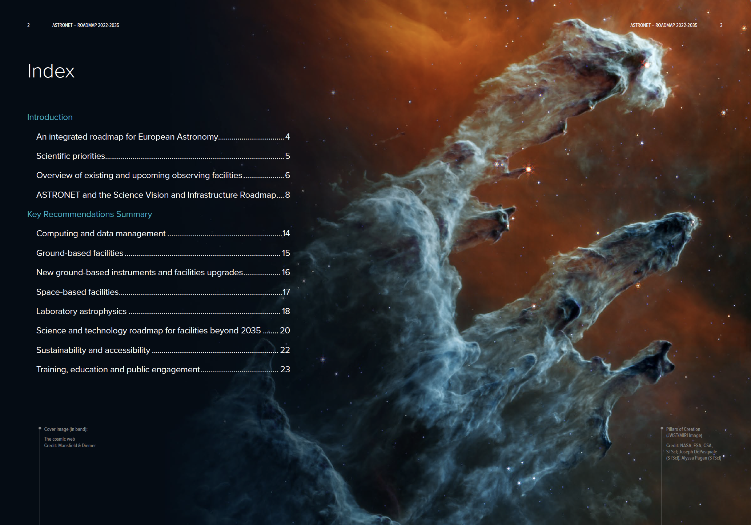
Documents: https://www.astronet-eu.org/

Slide 6
What is ASTRONET doing now ?
ASTRONET activities focus on the level of funding agencies (policies, coordination / independent position)
WG1 : Link with APPEC and elaboration of common strategies
WG2 : Future strategies for science with small telescopes : a concerted European exercise
WG3 : Building strategies to materialize the roadmap (EST, SKA-SRC, data science, etc.)
WG4 : Connections and joint policies with the EC and with key stakeholders
WG5 : Sustainability and societal issues
AND: timely update and renewal of the Science Vision and Infrastructure Roadmap

Slide 7

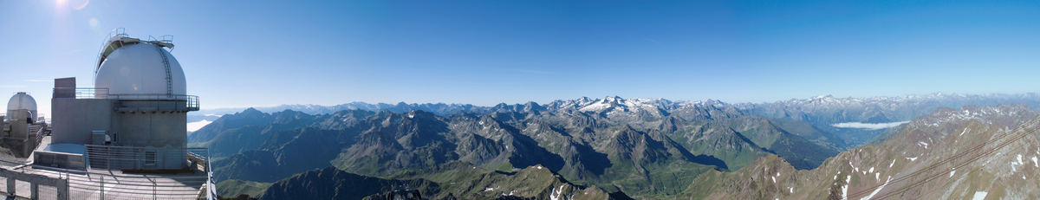

Towards synergies and common interests between the ASTRONET and APPEC
Visions and Roadmaps
APPEC/ASTRONET common Working Group 2025
WORK IN PROGRESS
Co-chaired by:
Martin Giard, for ASTRONET & Carlos Peña Garay, for APPEC
working Group members:
Paula Chadwick, Antoine Kouchner, Saskia Matheusen, Teresa Montaruli,
Nanda Rea, Amélie Saintonge, Salvatore Sciortino

Slide 8
Common scientific questions / domains
Common methodologies
Common infrastructures
Common priorities for 2026 – 2035 ?

Slide 9

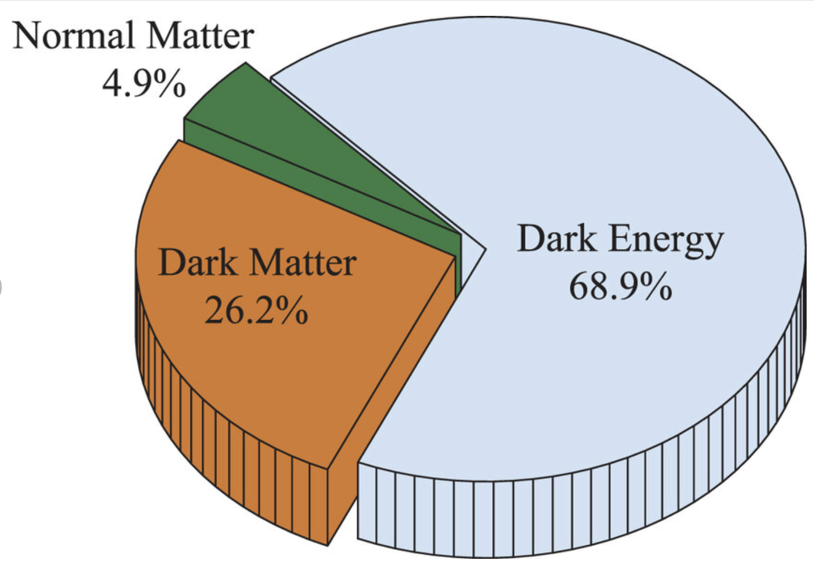
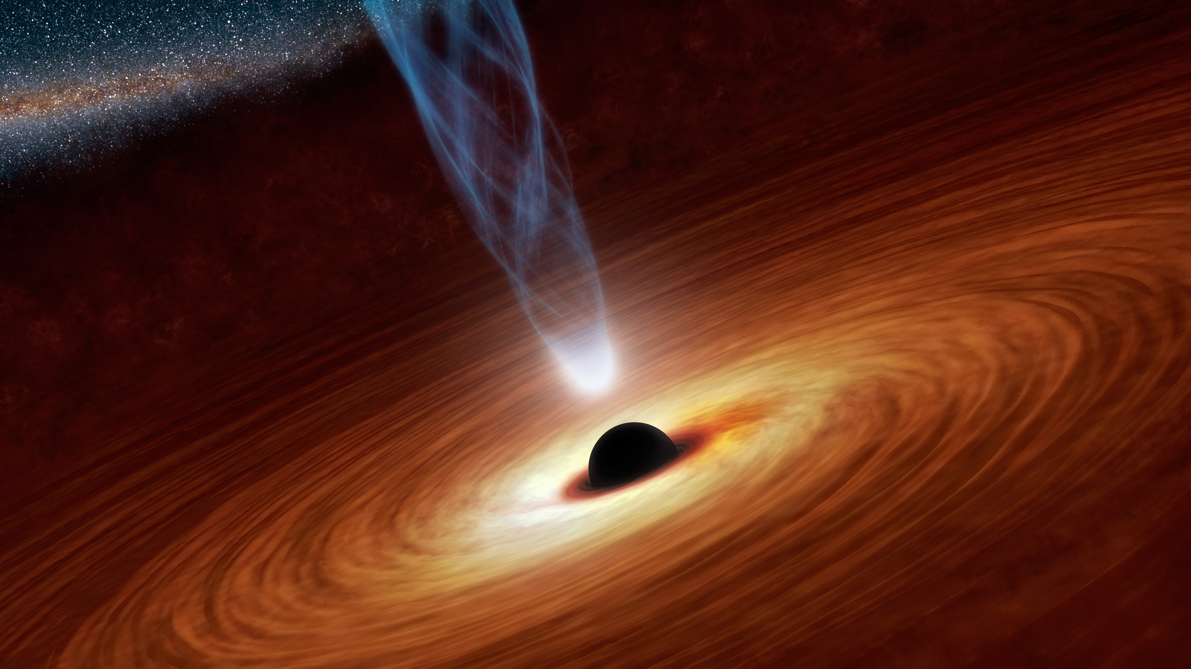
Common scientific questions/domains
I/ Probe the primordial universe
- very early universe models
- primordial black holes
- non-gaussianities
- quantum / modified gravity
II/ Elucidate the dark sector of cosmological models
- what is the nature of dark matter ?
- what is the nature of dark energy ?
- resolve the tensions in the concordance model
III/ Understand the violent and extreme universe
- the origin of cosmic rays
- the nature of neutrinos
- mecanisms giving rise to high energy transient phenomena
- testing fundamental physics

Slide 10
From common questions to common methodologies
I/ Probe the primordial universe
I.1 high precision measurements of the CMB: polarisation, spectral distorsions
I.2 stochastic background of gravitational waves (directly or trough pulsar timing)
II/ Elucidate the dark sector of cosmological models
II.1 large surveys of distant galaxies
II.2 direct dark matter detection
II.3 indirect dark matter detection
III/ Understand the violent and extreme universe
III.1 multimessenger (all kinds) & time domain astronomy
III.2 gravitationnal waves astronomy
III.3 neutrino astronomy

Slide 11
From common questions to common methodologies
Interest for communities
I/ Probe the primordial universe
I.1 high precision measurements of the CMB: polarisation, spectral distorsions
I.2 stochastic background of gravitational waves (directly or trough pulsar timing)
II/ Elucidate the dark sector of cosmological models
II.1 large surveys of distant galaxies
II.2 direct dark matter detection
II.3 indirect dark matter detection
III/ Understand the violent and extreme universe
III.1 multimessenger (all kinds) & time domain astronomy
III.2 gravitationnal waves astronomy
III.3 neutrino astronomy
APPEC | ASTRONET
WORK TO BE DONE

Slide 12
From common methodologies to Infrastructures
Methodolgy | Existing or decided infrastructures
I.1 high precision measurements of the CMB: polarisation, spectral distorsions | SPT, Simons Observatory
I.2 stochastic background of gravitational waves (directly or trough pulsar timing) | PTA, LISA
II.1 large surveys of distant galaxies | EUCLID, DESI, Vera Rubin, GAIA, WEAVE, 4MOST, SKA, XMM, NewAthena, Roman
II.2 direct dark matter detection | XENON, DAMIC-M, MIMAC
II.3 indirect dark matter detection | HESS, CTA, KM3NET
III.1 multimessenger (all kinds) & time domain astronomy | Many, from GW to radio, ground based and satellite
III.2 gravitationnal waves astronomy | VIRGO/LIGO/KAGRA, LISA
III.3 neutrino astronomy | KM3NET, GRAND
WORK IN PROGRESS

Slide 13
From common methodologies to Infrastructures
Interest for communities
APPEC | ASTRONET
Methodolgy | Existing or decided infrastructures
I.1 high precision measurements of the CMB: polarisation, spectral distorsions | SPT, Simons Observatory
I.2 stochastic background of gravitational waves (directly or trough pulsar timing) | PTA, LISA
II.1 large surveys of distant galaxies | EUCLID, DESI, Vera Rubin, GAIA, WEAVE, 4MOST, SKA, XMM, NewAthena, Roman
II.2 direct dark matter detection | XENON, DAMIC-M, MIMAC
II.3 indirect dark matter detection | HESS, CTA, KM3NET
III.1 multimessenger (all kinds) & time domain astronomy | Many, from GW to radio, ground based and satellite
III.2 gravitationnal waves astronomy | VIRGO/LIGO/KAGRA, LISA
III.3 neutrino astronomy | KM3NET, GRAND
WORK TO BE DONE

Slide 14
Strategic common infrastructures for the future
Methodolgy | Future infrastructures
I.1 high precision measurements of the CMB: polarisation, spectral distorsions | LiteBIRD
I.2 stochastic background of gravitational waves (directly or trough pulsar timing) | ?
II.1 large surveys of distant galaxies | ?
II.2 direct dark matter detection | ?
II.3 indirect dark matter detection | ?
III.1 multimessenger (all kinds) & time domain astronomy | Theseus
III.2 gravitationnal waves astronomy | ET
III.3 neutrino astronomy | ?
WORK IN PROGRESS

Slide 15
Strategic common infrastructures for the future
Interest for communities
APPEC | ASTRONET
Methodolgy | Future infrastructures
I.1 high precision measurements of the CMB: polarisation, spectral distorsions | LiteBIRD
I.2 stochastic background of gravitational waves (directly or trough pulsar timing) | ?
II.1 large surveys of distant galaxies | ?
II.2 direct dark matter detection | ?
II.3 indirect dark matter detection | ?
III.1 multimessenger (all kinds) & time domain astronomy | Theseus
III.2 gravitationnal waves astronomy | ET
III.3 neutrino astronomy | ?
WORK TO BE DONE

Slide 16
THANKS !

