Slide 1
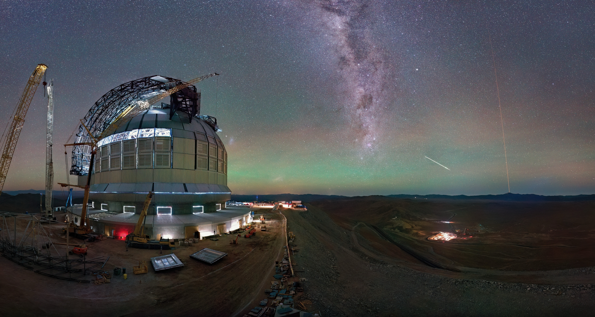
ESO – status update and
forward look to the 2040s
Xavier Barcons
ESO Director General

Slide 2


ESO Mission
We design, build, and operate advanced ground-based observatories
We foster international
collaboration for astronomy

Slide 3
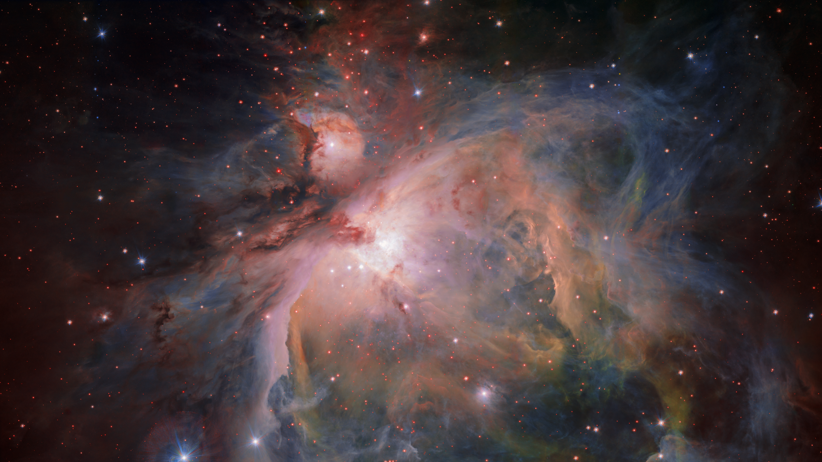
ESO Vision
Credit: ESO/G. Beccari
To advance humanity’s understanding of the Universe by working with and for the astronomy community, providing it with world-leading facilities

Slide 4






ESO Values
We strive for excellence
We achieve this through innovation
We provide outstanding services to our communities
We foster diversity and inclusion
We believe in the key role of sustainability for our future
These values are realised and maintained by ESO’s people on the basis of accountability, collaboration, clear and open communication, commitment, integrity and respect

Slide 5

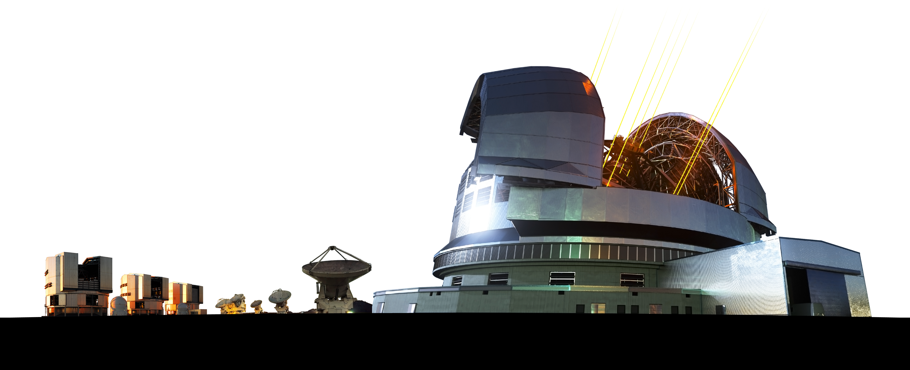
ESO Strategy for the 2020s
The ESO Council has adopted the following strategic milestones for ESO during the decade 2021–2030:
Implement and operate the ELT as the world-leading extremely large telescope
Ensure that the current facilities remain at the forefront of astronomical investigations
Ensure that the Organisation is prepared for future projects when financial projections so permit
Retain ESO’s leadership role in astronomy

Slide 6
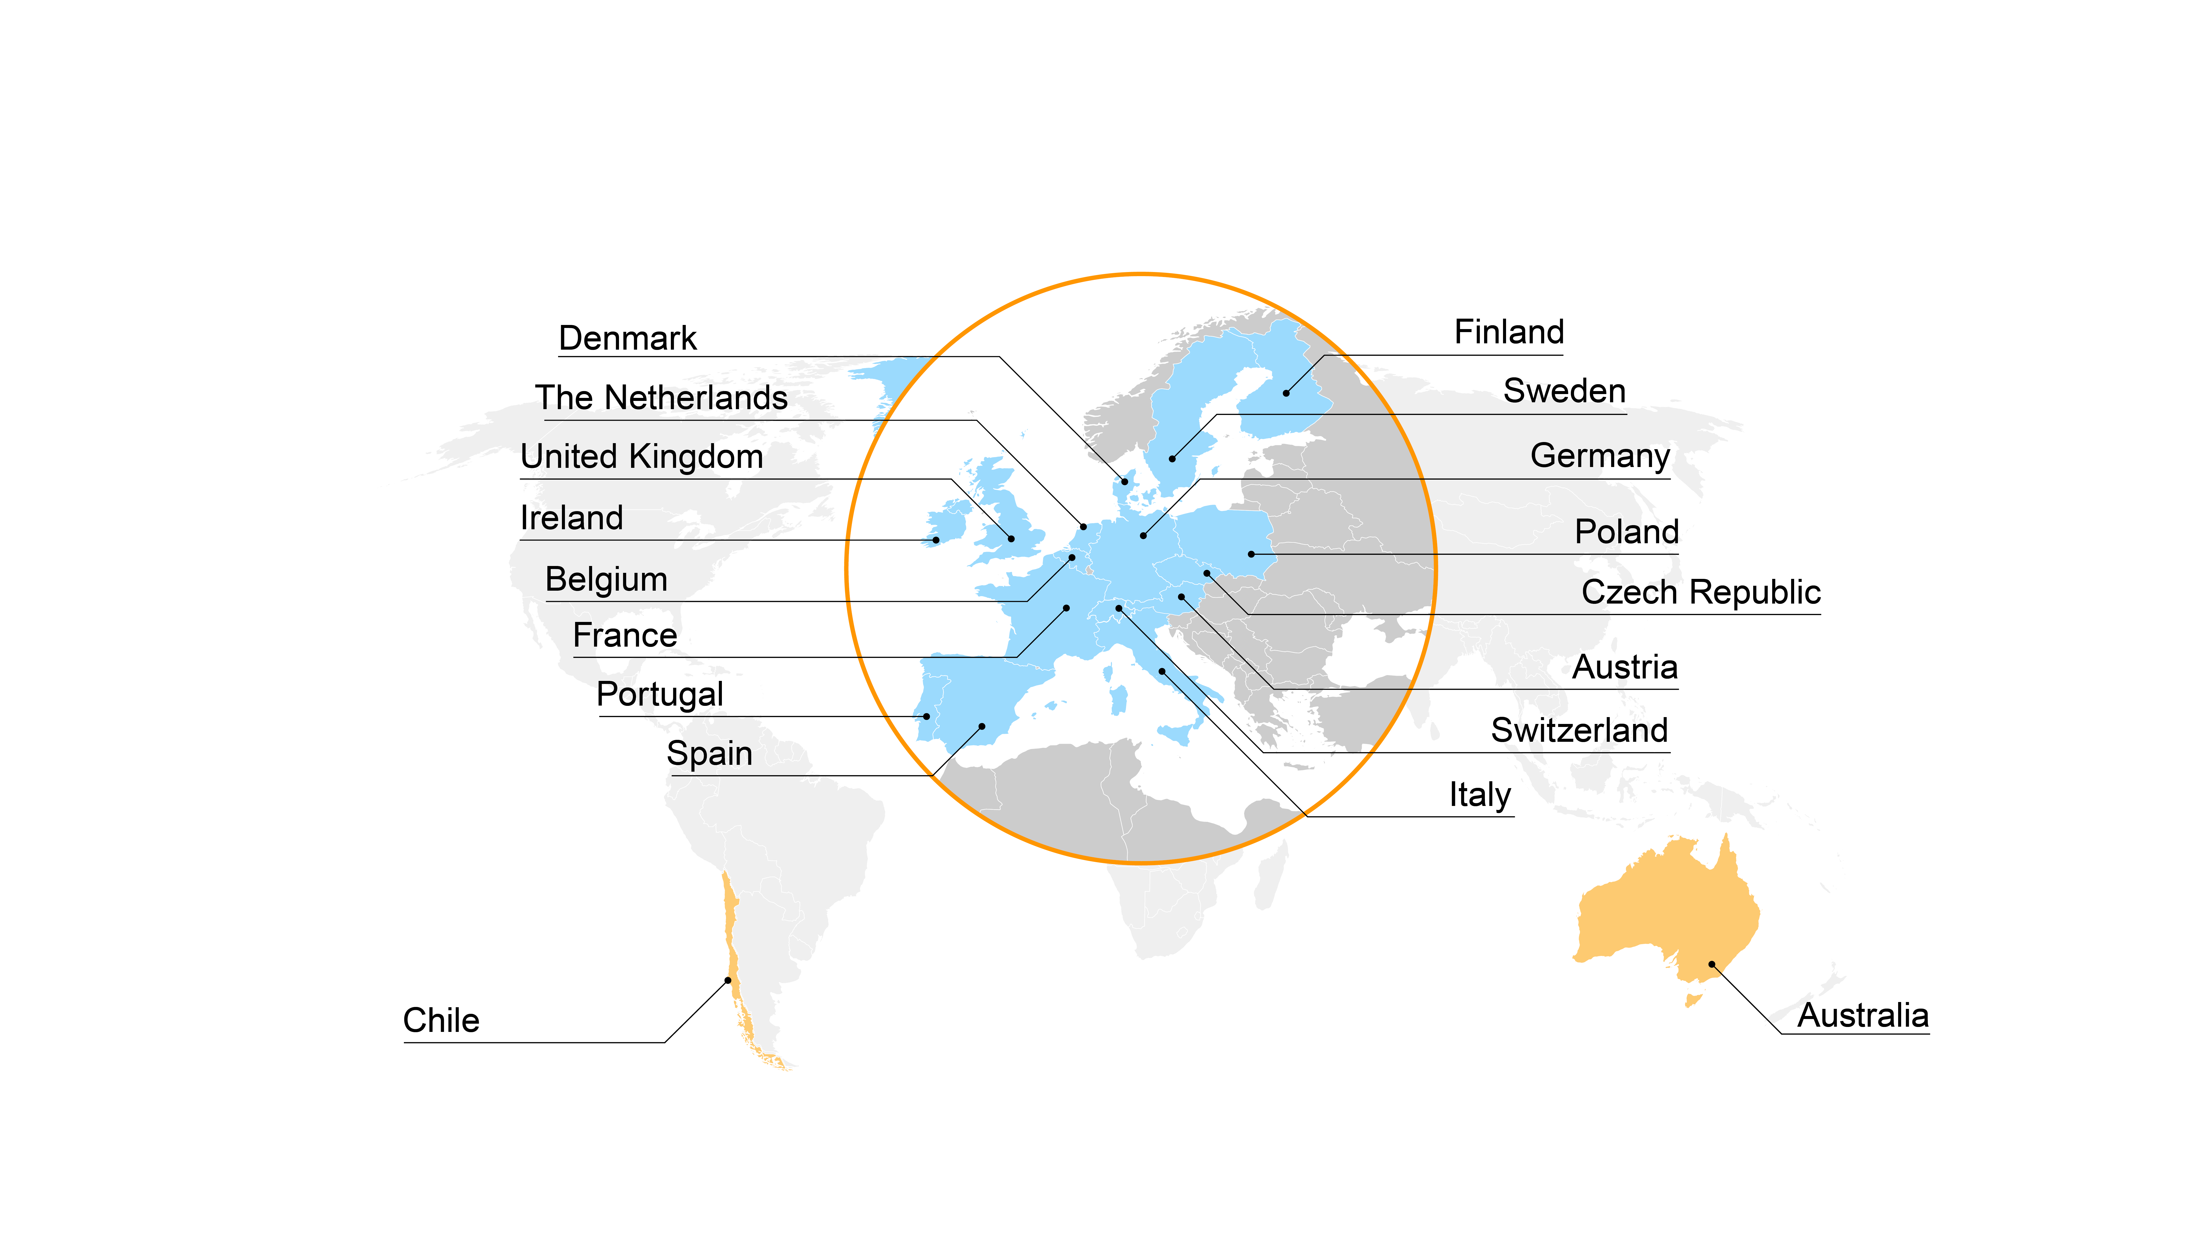
ESO Member States and Partners
Today ESO encompasses 16 Member States
Chile is the host state to ESO’s telescopes and Australia is a strategic partner

Slide 7
ESO: facts and figures
Intergovernmental Organisation founded in 1962 by 5 countries (BE, DE, FR, NL, SE)
Today 16 member states: AT, BE, CH, CZ, DE, DK, ES, FI, FR, IE, IT, NL, PL, PT, SE, UK
Partnerships with Chile (since 1963) and Australia (Jul 2017-Jul 2027)
Currently 795 staff of over 40 nationalities: 493 in Germany and 302 in Chile
Yearly financial income (from Member States and Australia): 231 MEUR (in 2025)
In proportion to GDP
Expenditure budget 2025: ca. 400 MEUR, including ELT construction costs
About 60% is used to design and develop new telescopes and instruments
Important role in international science policy
Participation in international forums: EIROforum, ESFRI, UNOOSA/COPUOS
Cooperation agreements with ESA, CERN and SKAO. Informal exchanges with EPO and ITER

Slide 8
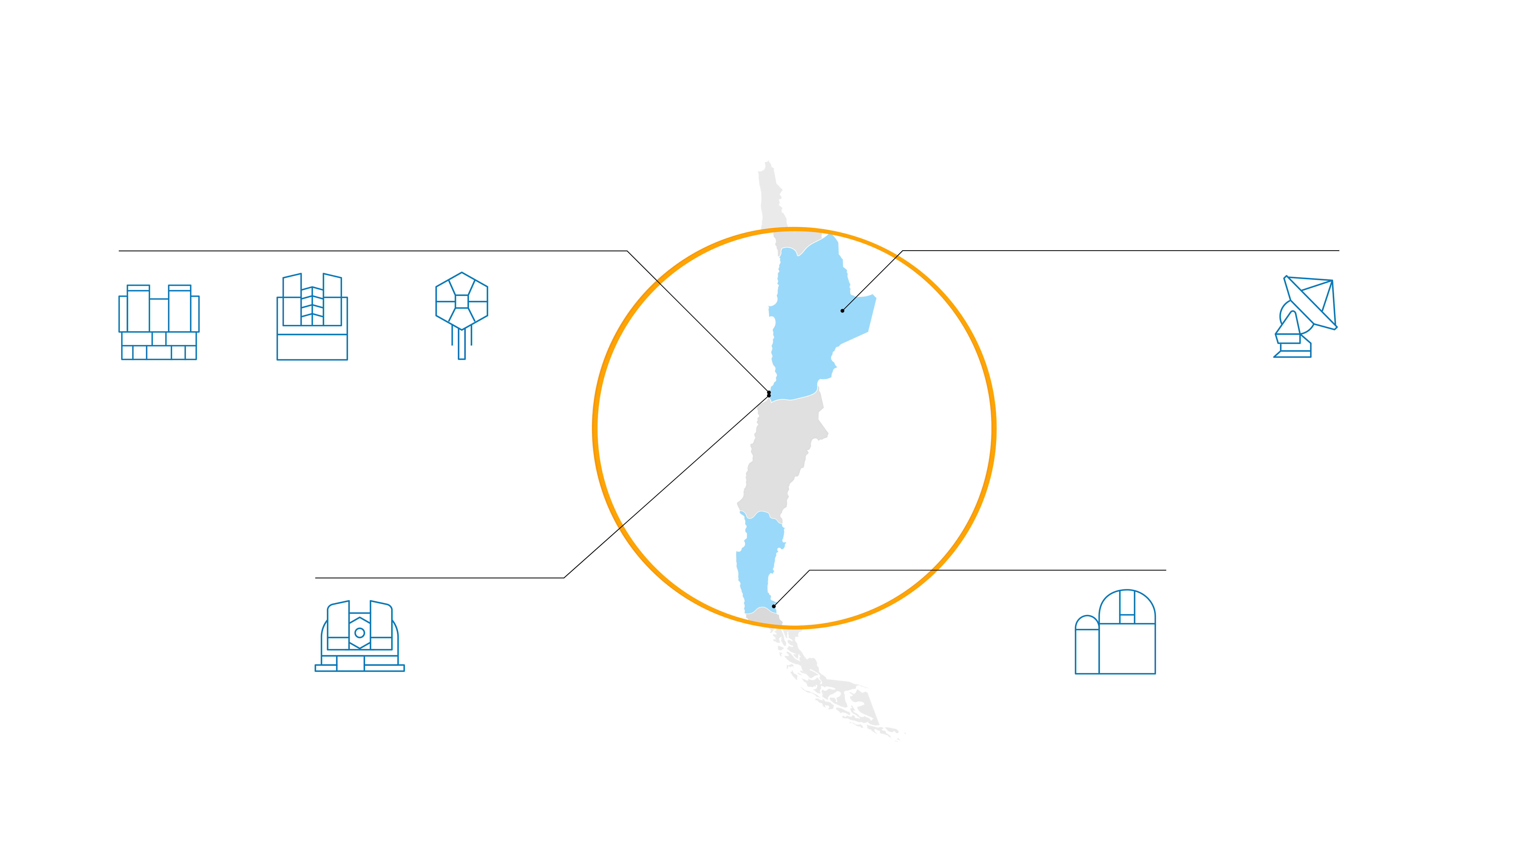
ESO observatory sites in Chile
Paranal
Chajnantor
VLT
VLTI
VISTA
CTA South*
ALMA
Armazones
La Silla
ELT**
Telescopes at La Silla
* in preparatory phase
** under construction

Slide 9
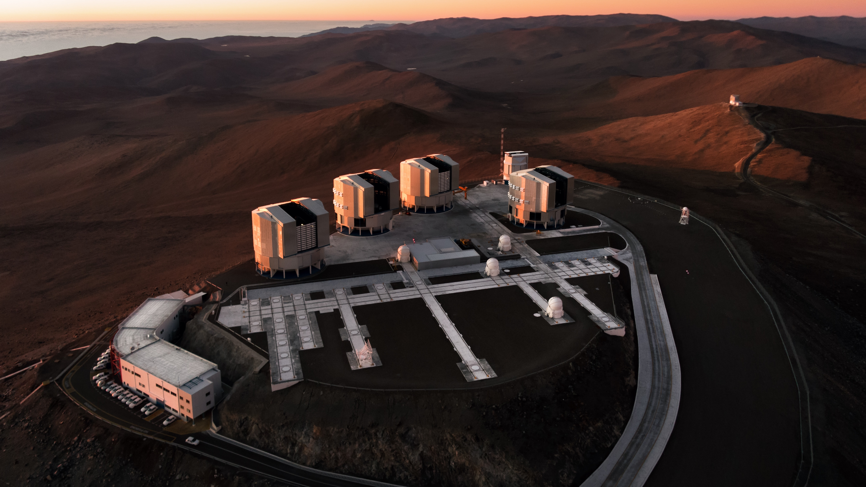
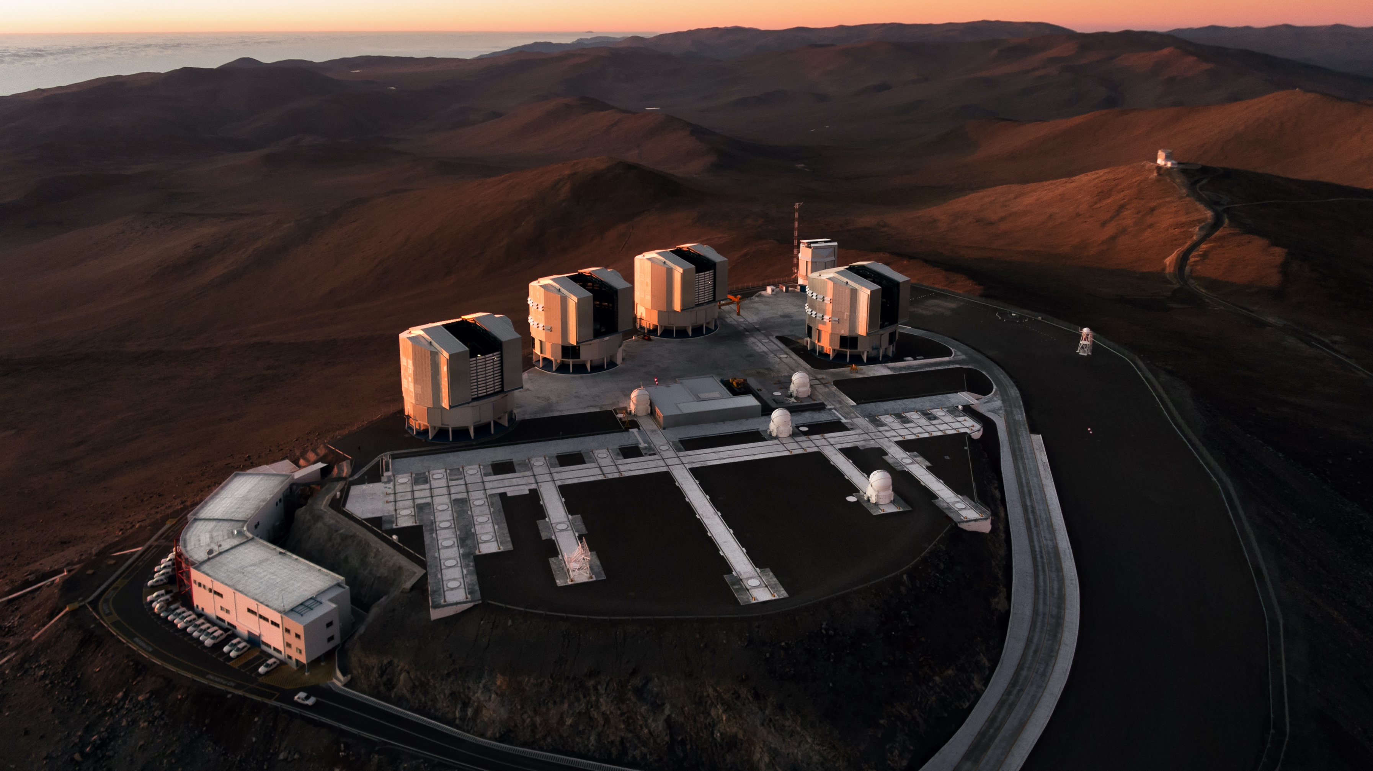
UT1
Antu
UT2
Kueyen
UT3
Melipal
UT4 Yepun
VISTA
4 Unit Telescopes
Each primary mirror:
8.2-metre diameter,
17.5 cm thick, weighing 23 tonnes
VST
Credit: G.Hüdepohl (atacamaphoto.com)/ESO
Auxiliary Telescopes
4 movable AT’s, 1.8-metre mirror
Control
building

Slide 10
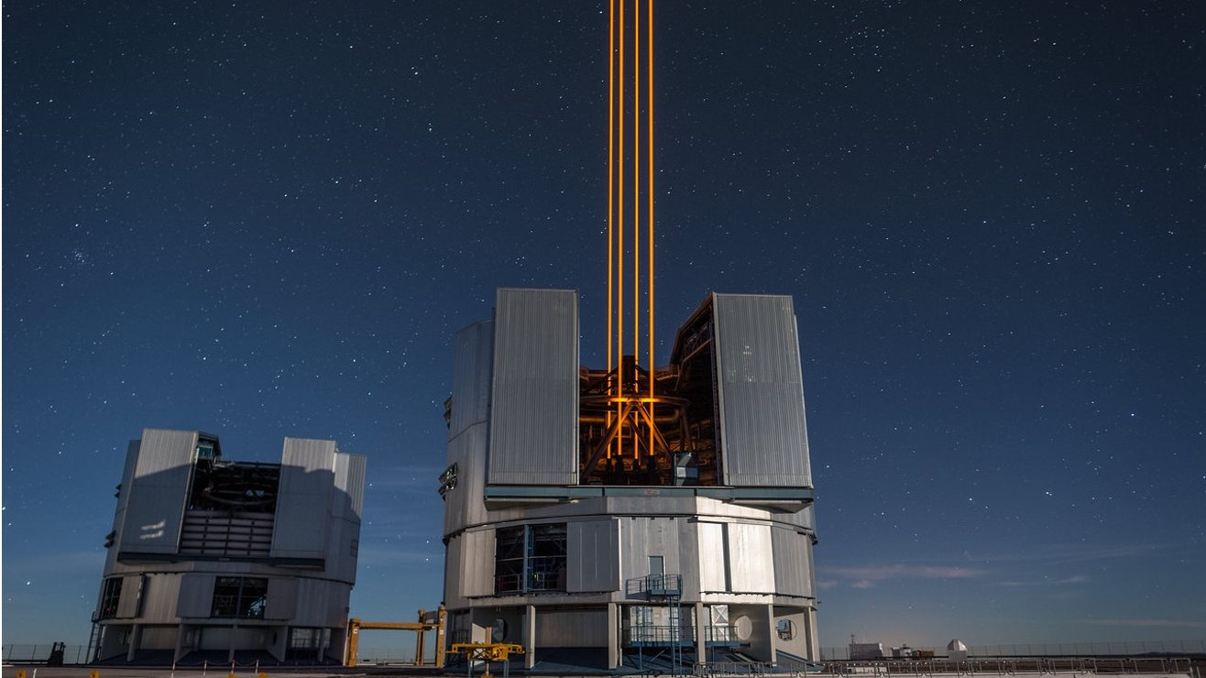
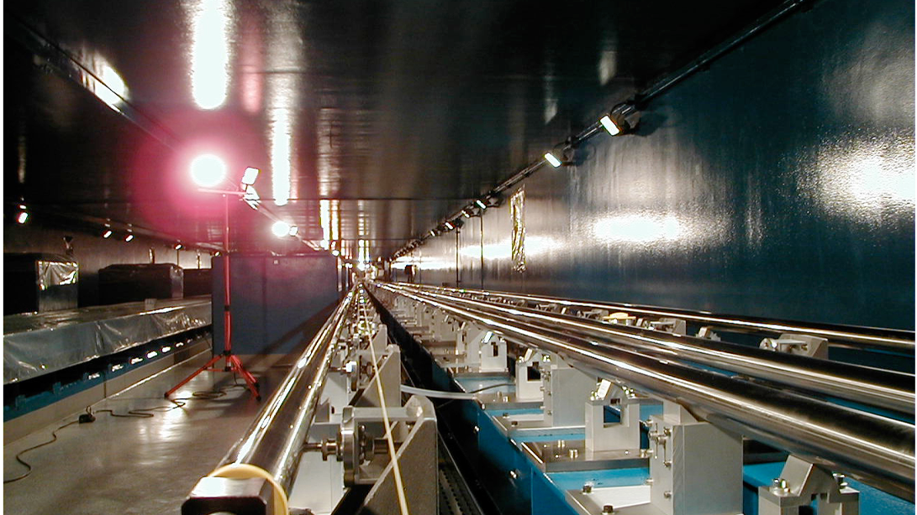
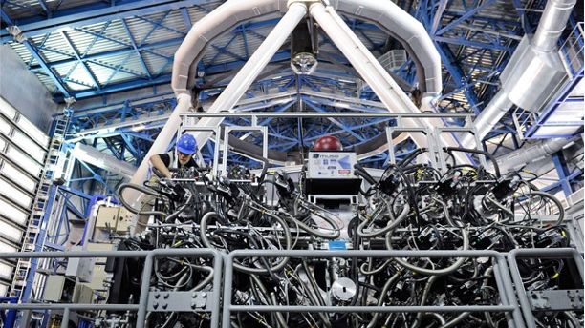
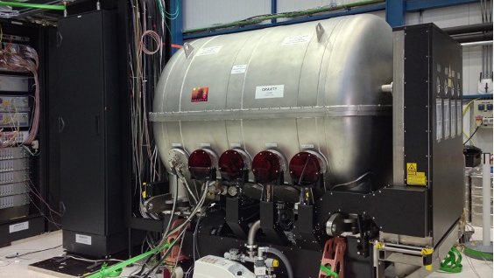
Notes:
ESO also needs to operate the “high-tech” in the telescopes to be able to acquire the scientific data

Slide 11

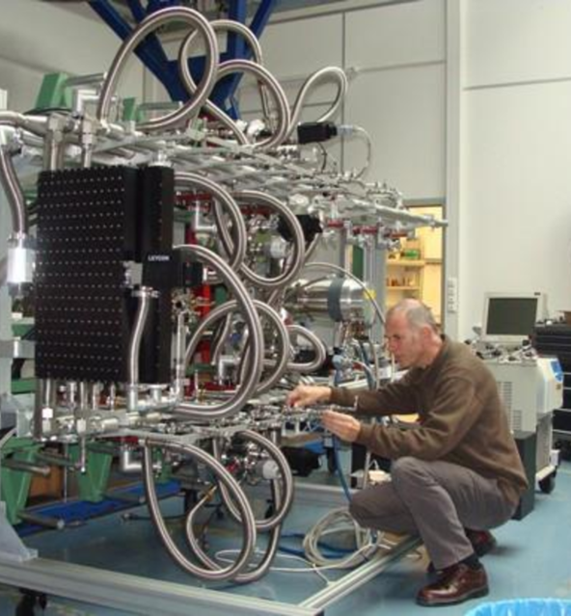
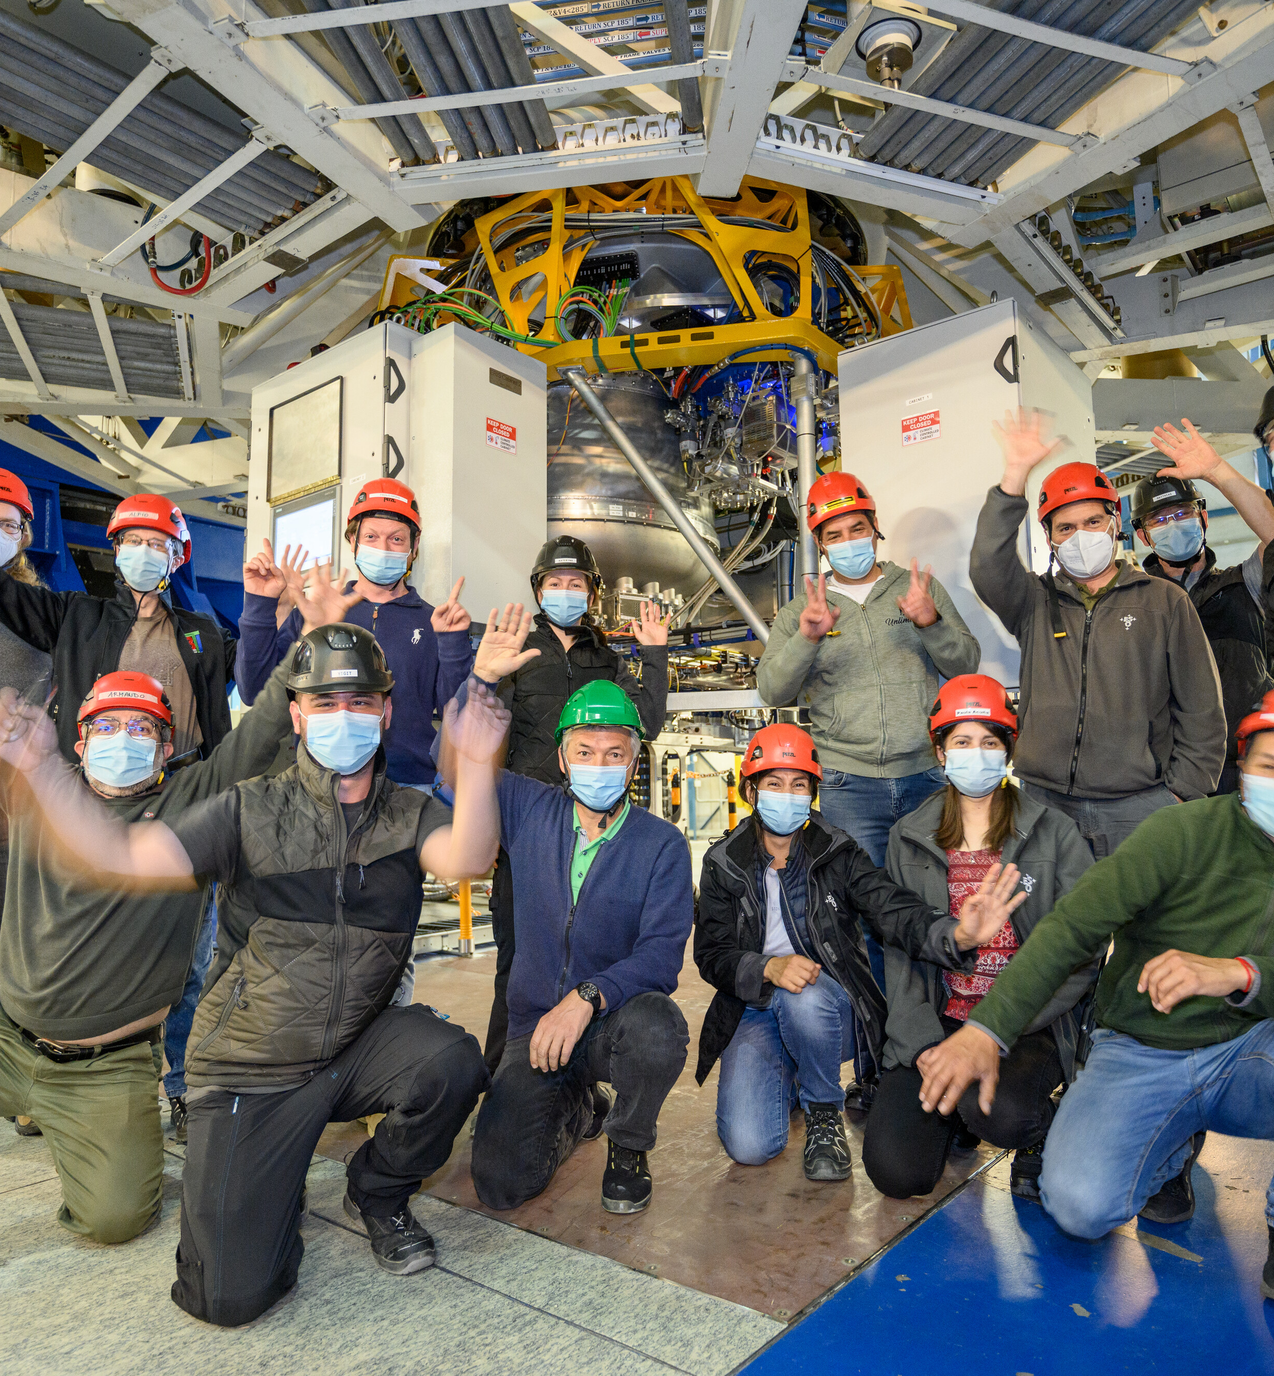

Instrument development and upgrades
Scientific questions drive requirements for new instruments. A consortium of R&D institutes leads the development
ESO participates and funds part of the costs. The consortium provides work and obtains Guaranteed Observing Time.
The instrument is installed and commissioned at the telescope, operations can start
Scientific results are obtained by the lead consortium and by the international scientific community

Slide 12
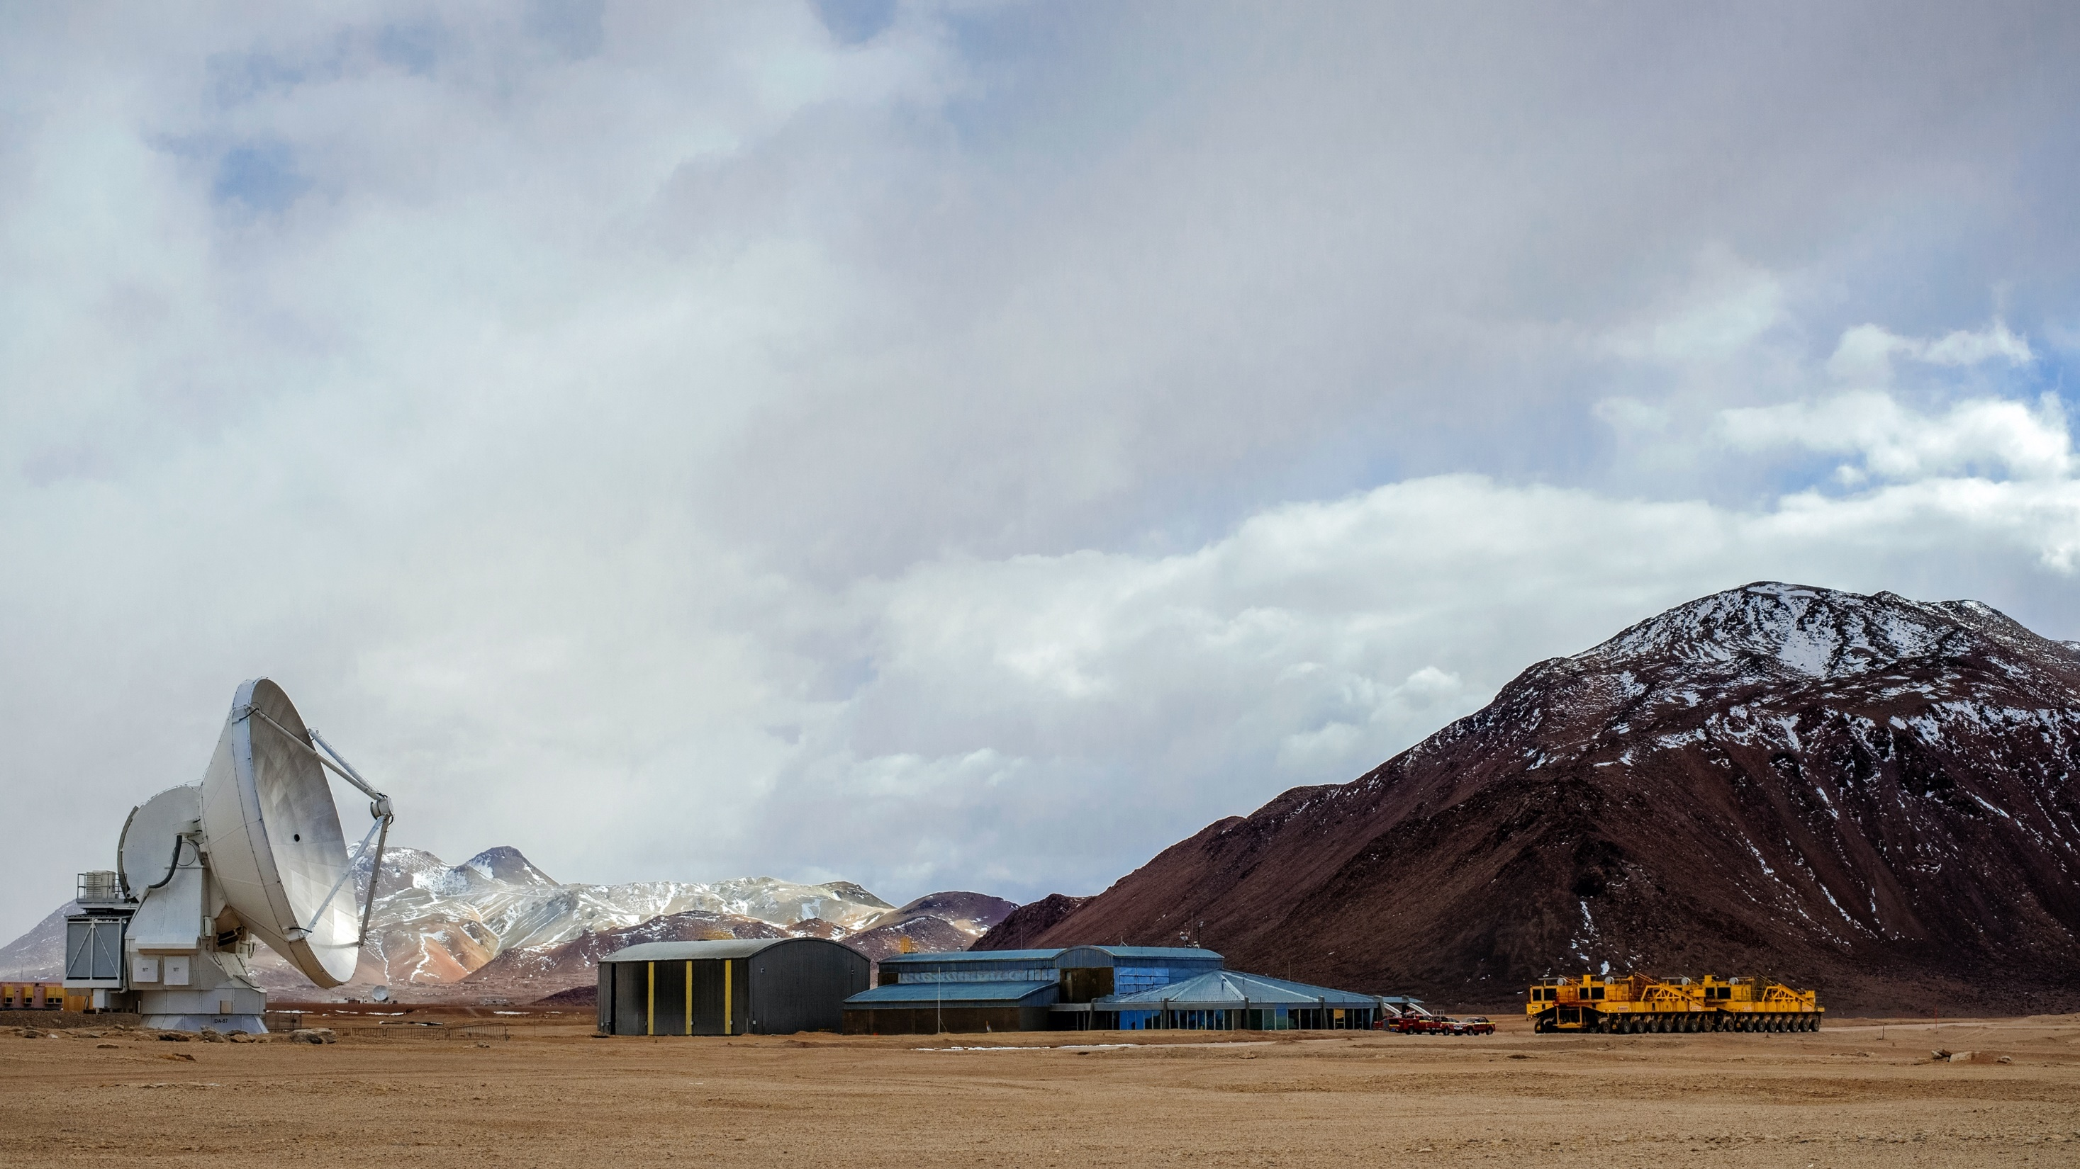
The ALMA observatory is a global partnership between NINS (25%), ESO (37.5%) and NSF (37.5%).
Array Operations Site in Chajnantor (5050 m): ​
66 movable antennas, over a 16-km plateau,​
front-ends, back-end and correlator
Credit: ESO/S. Otarola

Slide 13
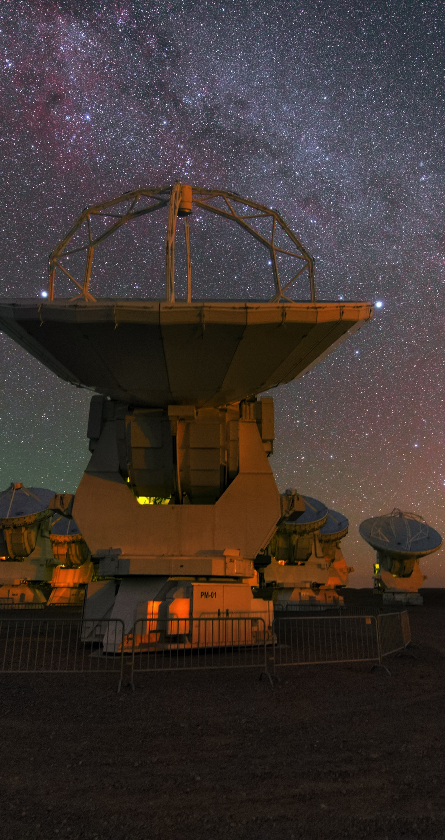
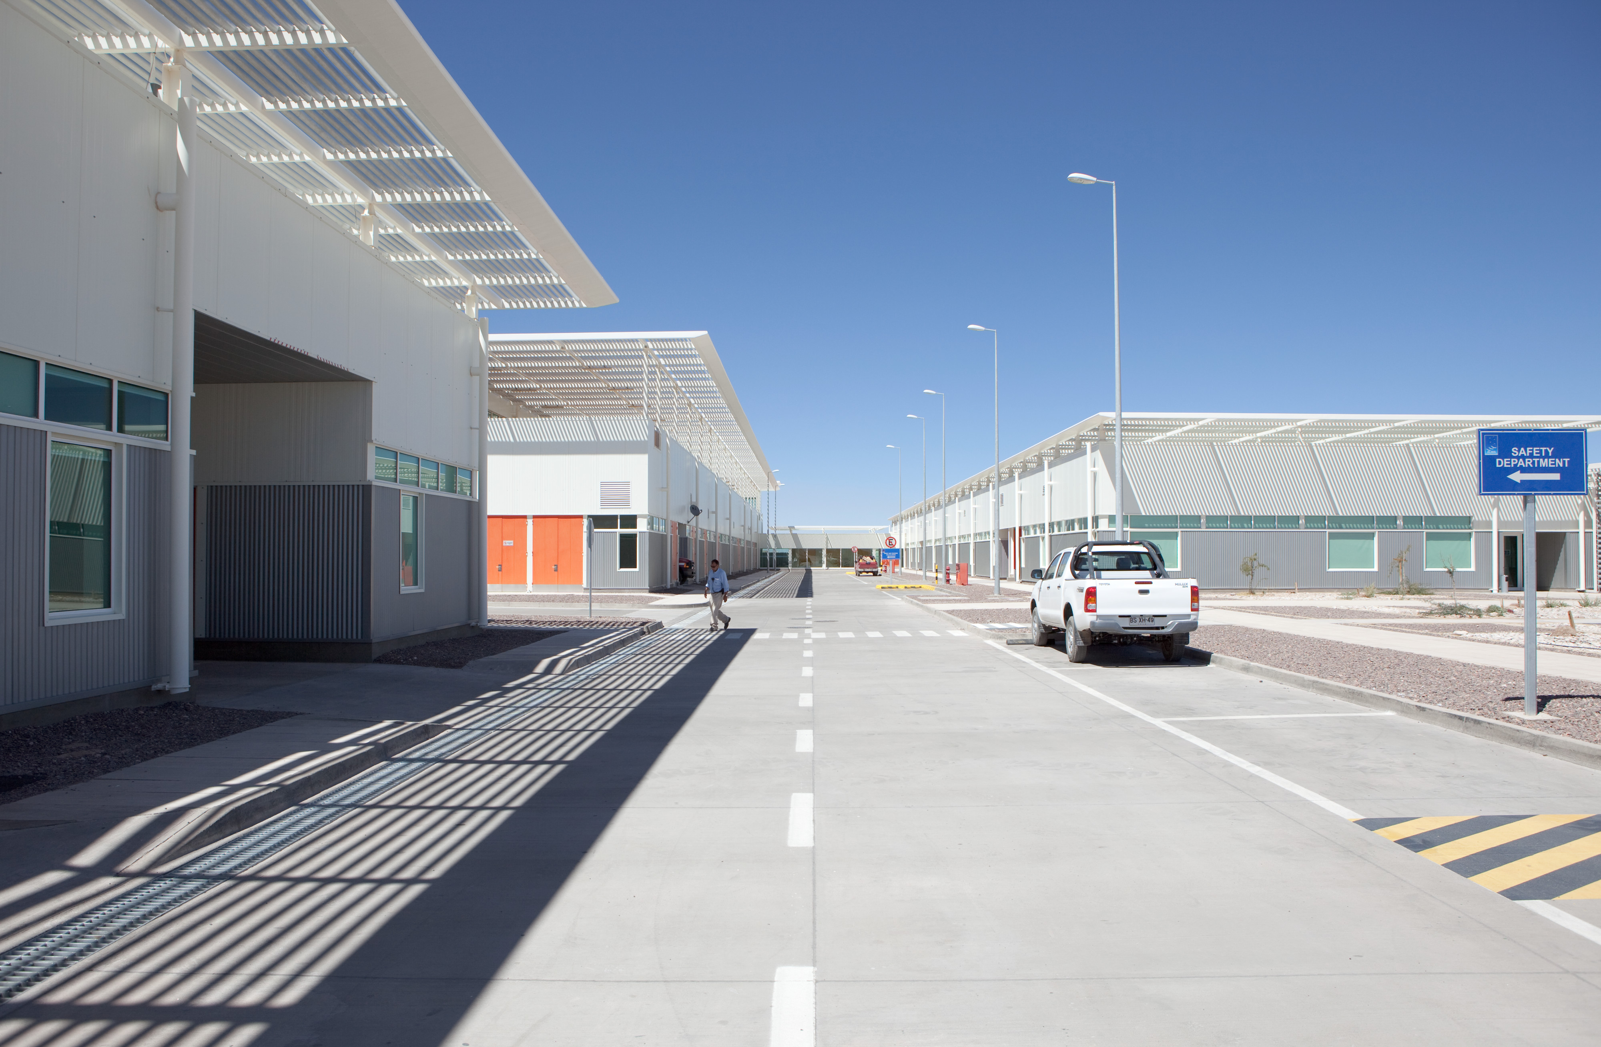
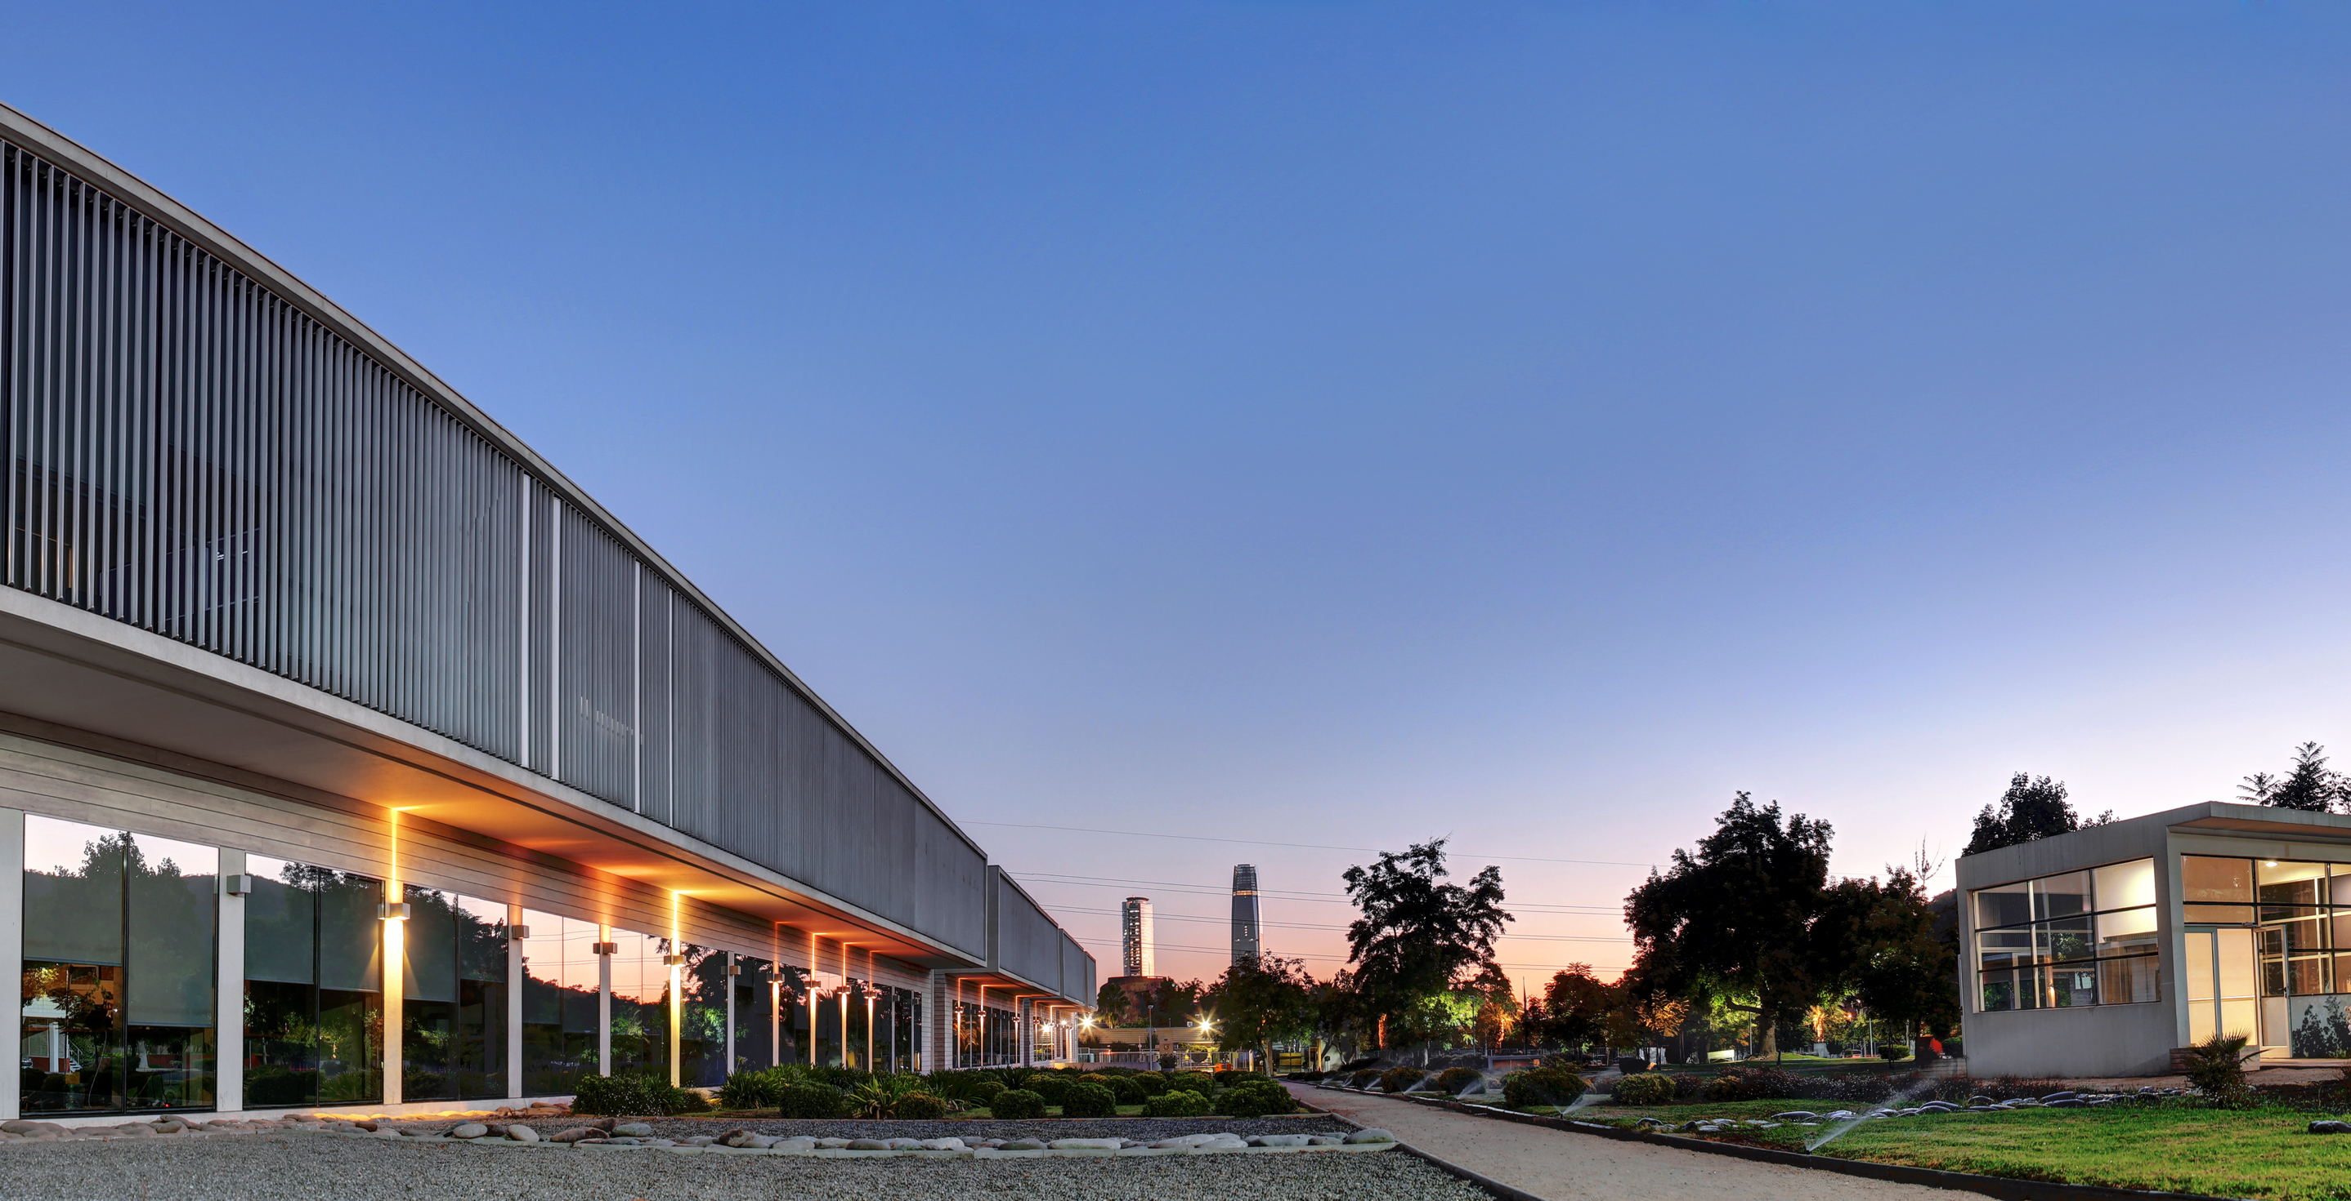
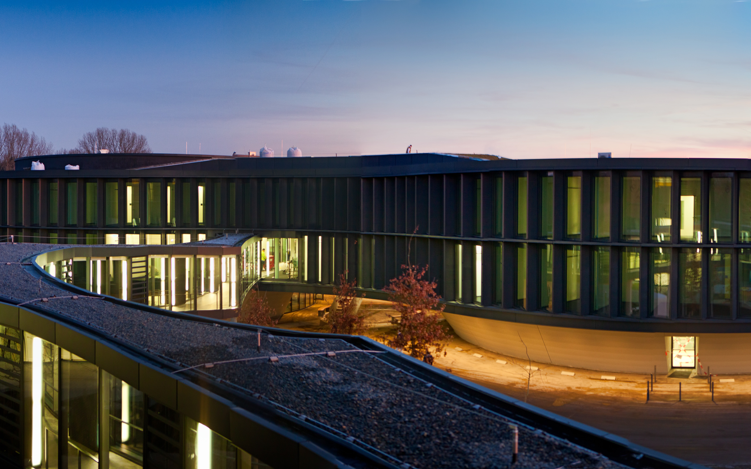
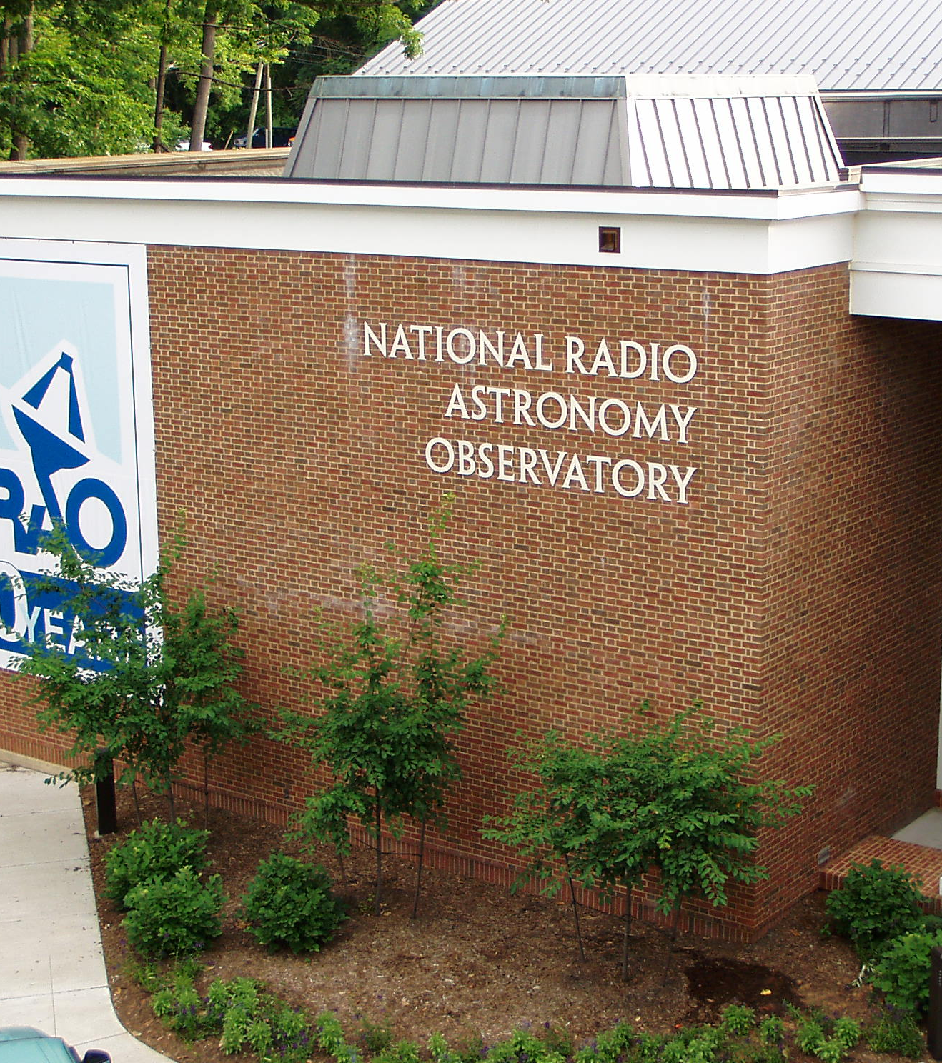
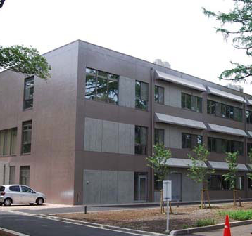
The ALMA observatory – a world-wide effort
OSF San Pedro de Atacama
SCO Santiago
AOS Chajnantor
NRAO Charlottesville
(USA)
NAOJ Mitaka (Japan)
ESO Garching (Europa)

Slide 14
ALMA Wide-band Sensitivity Upgrade (WSU)
Comprehensive development Programme of ALMA, focussing on the ALMA2030 scientific objectives: Origins of Galaxies, Origins of chemical complexity and Origins of Planets
WSU focusses on extending the signal bandwidth of the existing array. Scope delivery
Implementation of signal chain: digitisers, transmission system, fiber link, new correlator data ingest 4x and correator 2x (expandible to 4x)
SW and computing infrastructure adequate for 4x chain
Commissioning modes with current receivers
New receiver bands: Band 2 (ongoing), Band 6, Band 7 and Band 8.
Systems PDR passed with relevant actions. Preparations for a cost review.
ALMA Board has established an WMAC to support programme oversight (Chair Colin Londsdale)
Potential approval by the ALMA Board in 2026

Slide 15
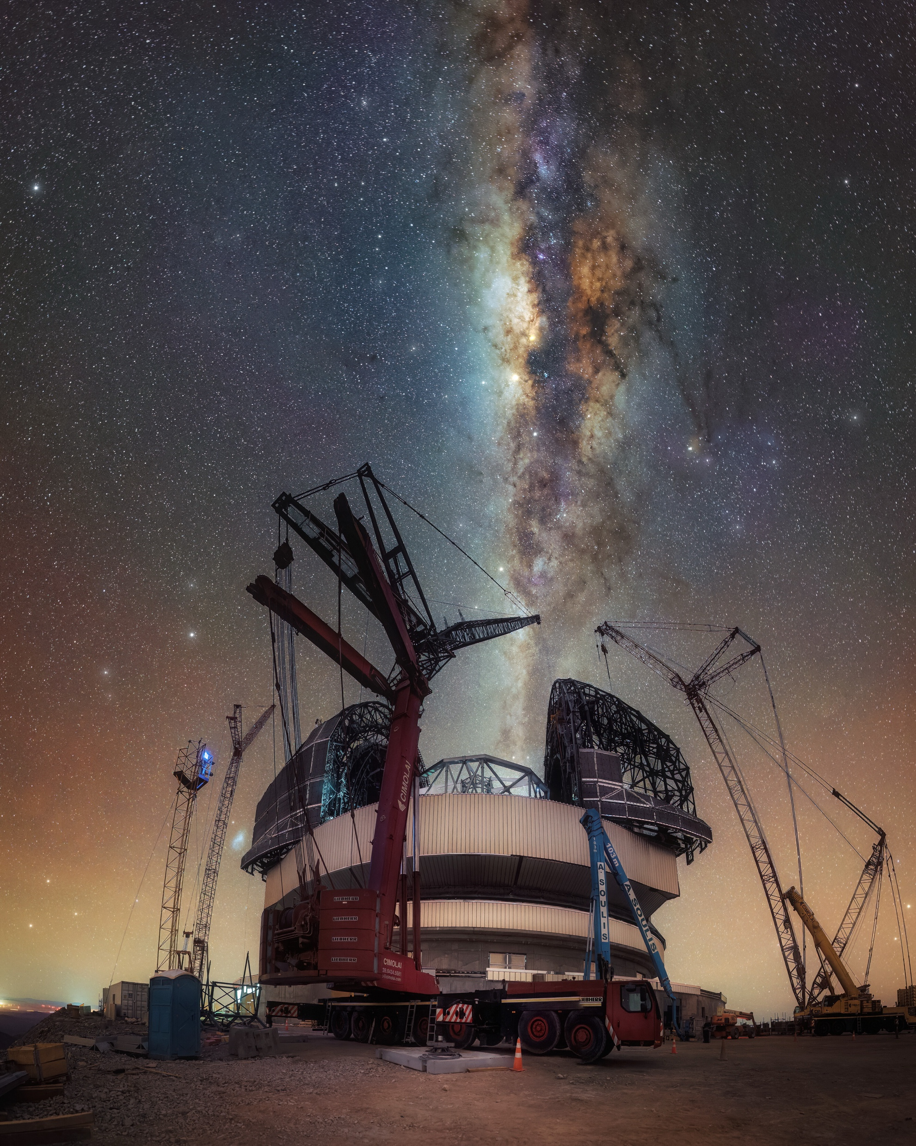
ELT - Extremely Large Telescope
Will be the largest optical/infrared telescope ever built or planned
Segmented primary mirror of 39.3 m diameter (798 tiles); adaptive optics
Construction 2015-2030
CtC: 1600 MEUR + Organisational support + in-kind contributions to the instrumentation (total ~ 2.3 Bn€)
First Telescope Light: Mar 2029
First Scientific Light: Dec 2030
Erected on Cerro Armazones. To be operated jointly with the VLT and VLTI in Paranal (24 km)
The ELT is the most powerful telescope of the new generation, the only one with secured funding and the one which is more advanced in its construction.

Slide 16
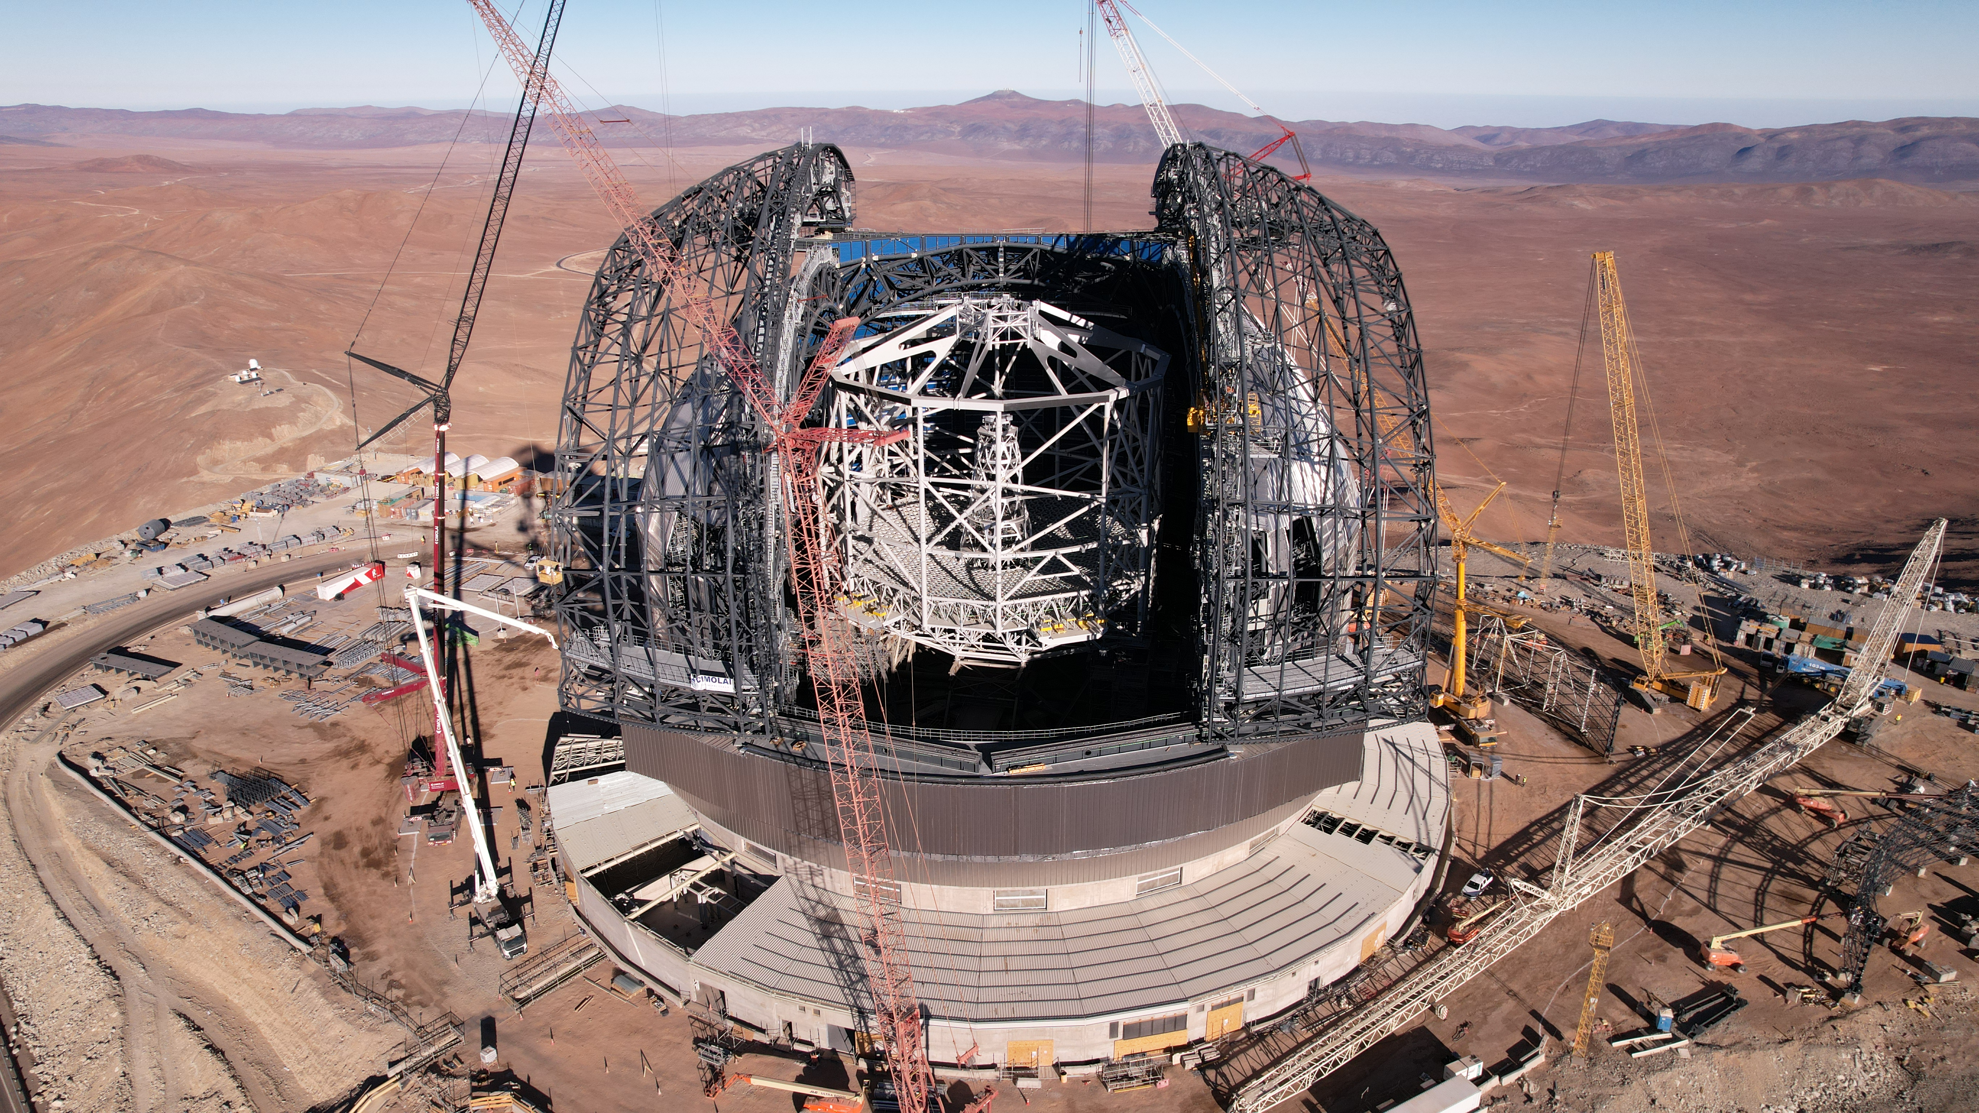

Slide 17
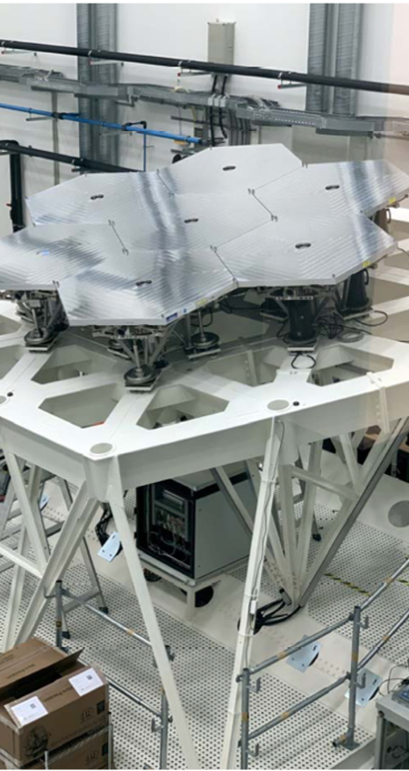
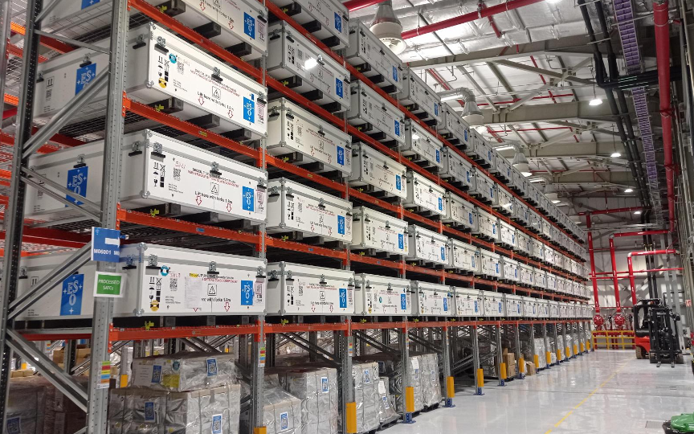
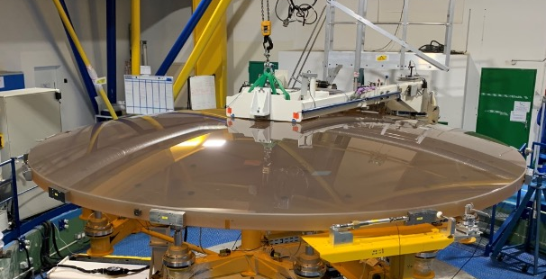
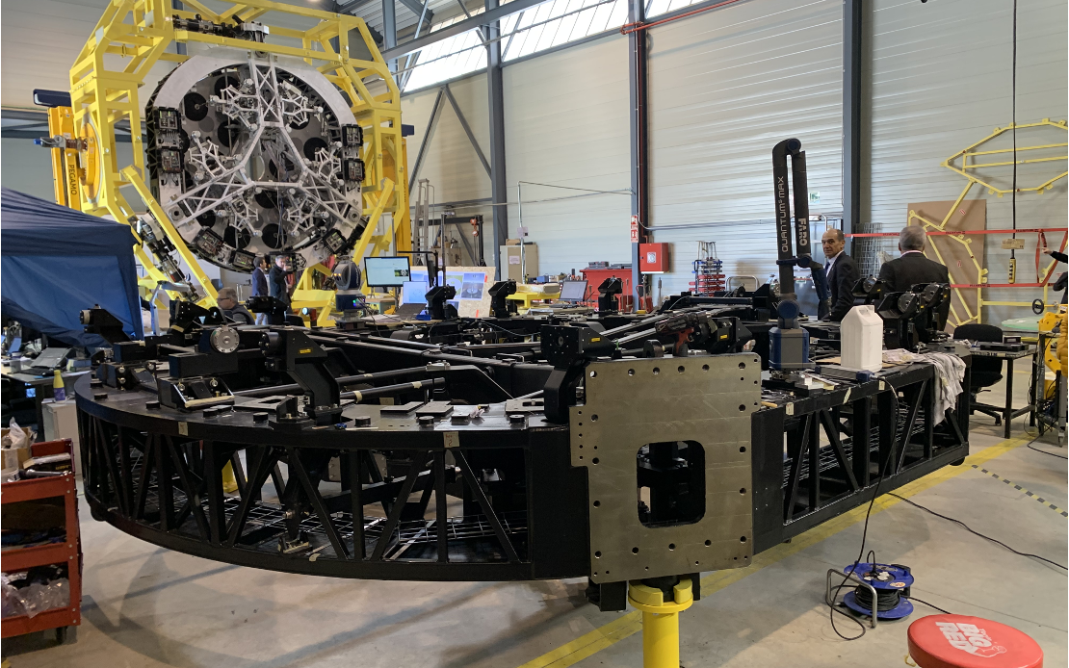
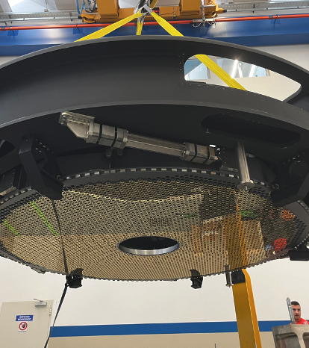
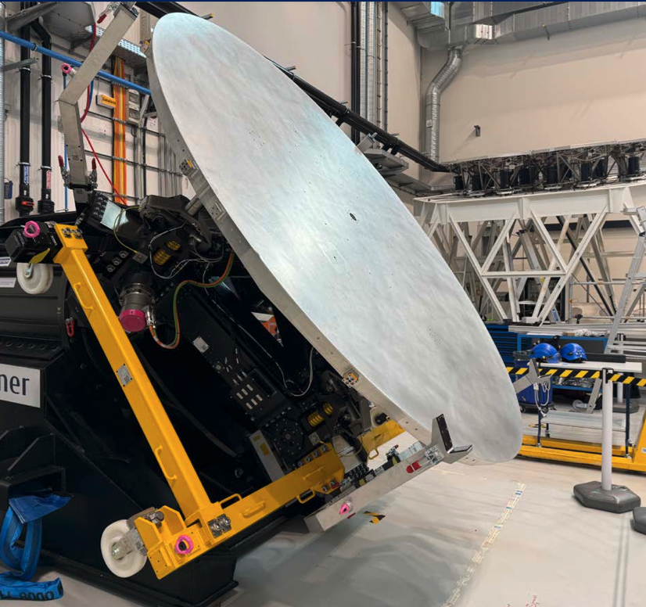
ELT at more than 70% construction completion

Slide 18
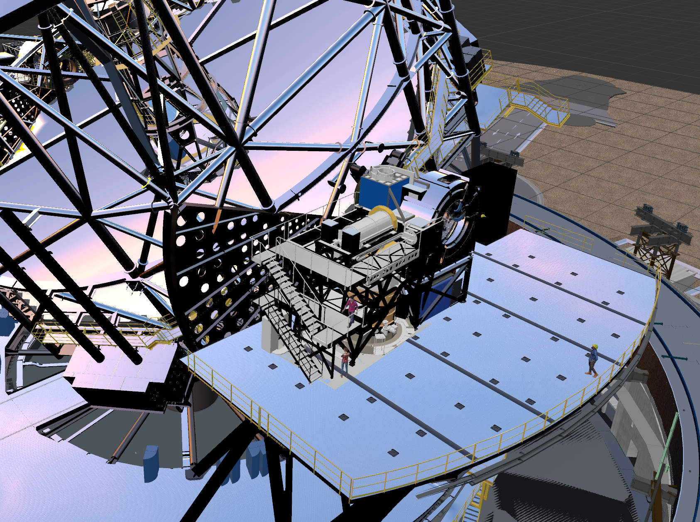
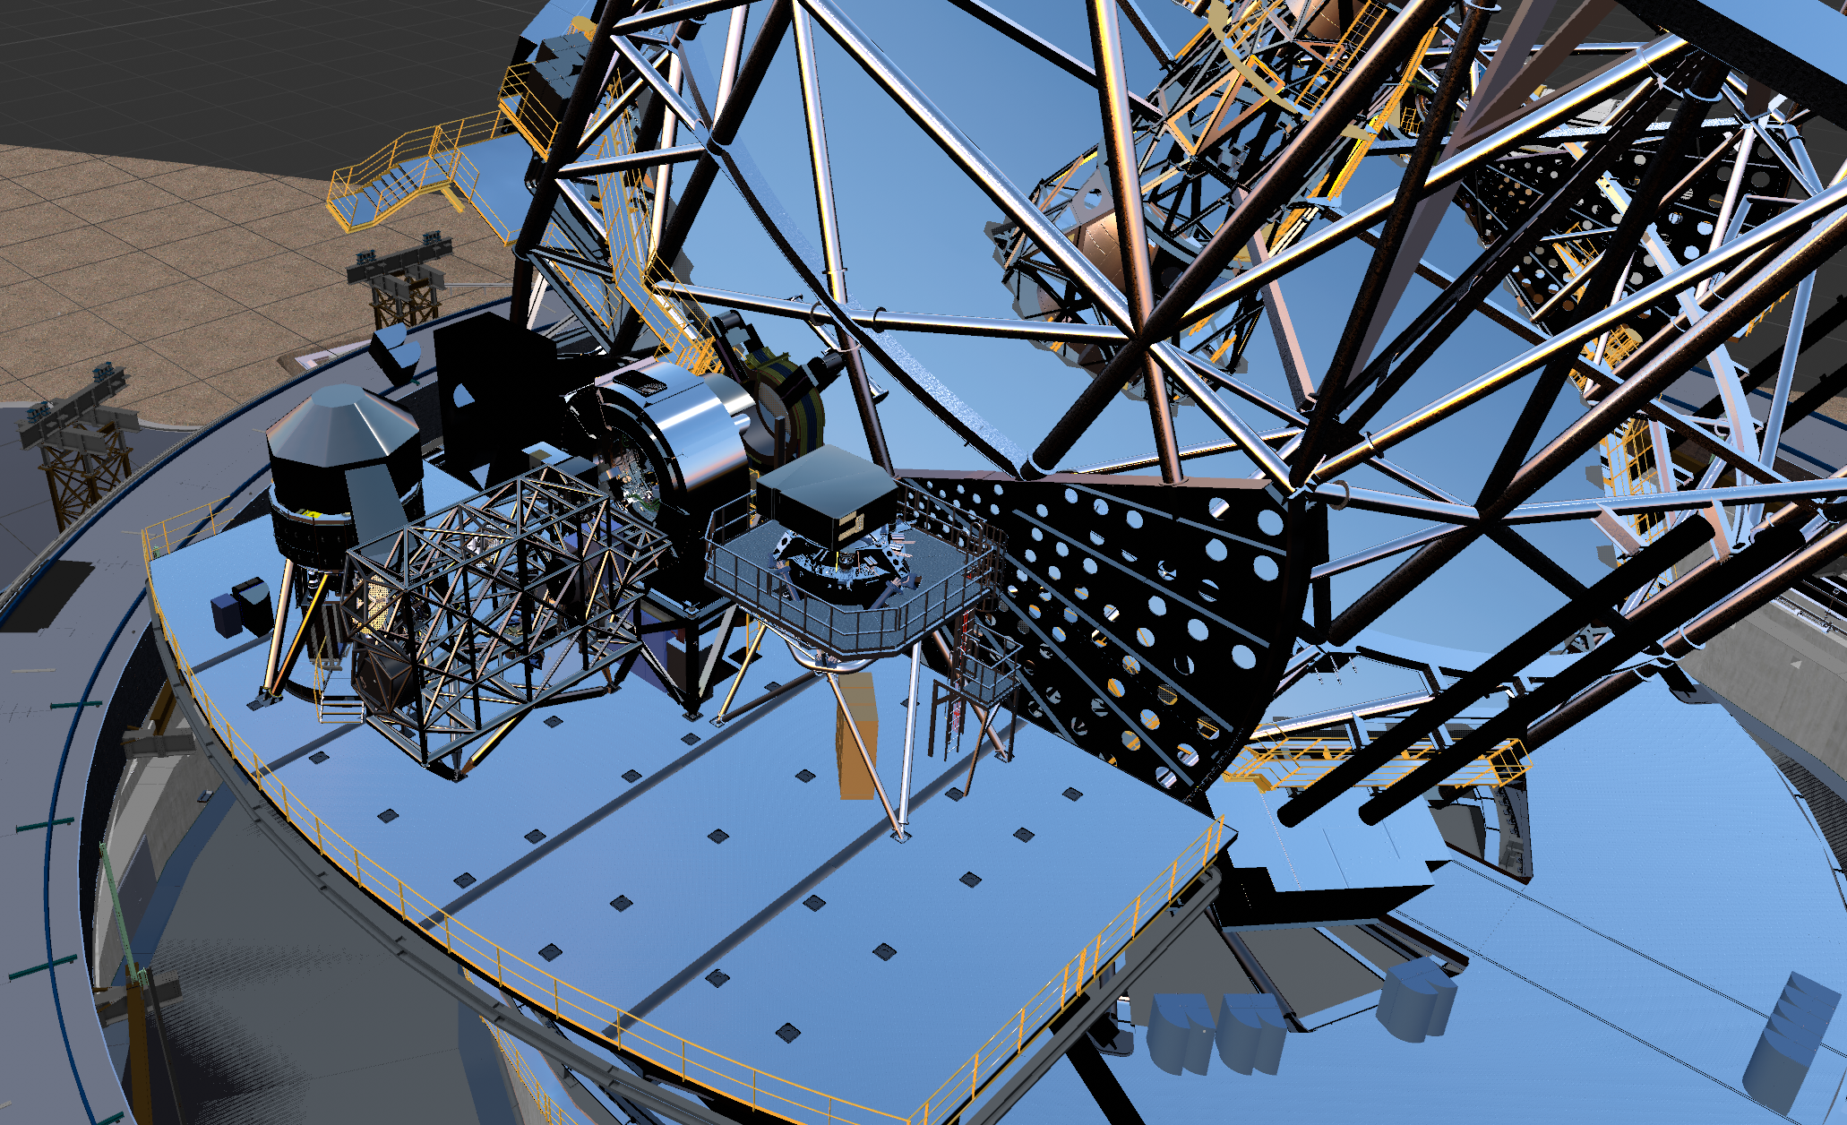
ELT Instrumentation
MICADO
Diffraction limited Imager and spectrograph
Near-Infrared (0.8 - 2.45 μm), R~8000
Final Design Review passed
METIS
Imager and (IFU) spectrograph
Mid-Infrared (3 - 14 μm), R up to 100 000
Final Design Review passed
HARMONI
3D spectrograph (IFU)
Optical (0.47 μm) to NIR (2.45 μm), R=3500 - 20000
In-depth instrument consortium reorganisation and instrument definition ongoing
MORFEO
Multi-conjugate adaptive optics module for MICADO
2 deformable mirrors inside instruments
FDR ongoing
16 Sep
11:00
Second generation instruments starting: ANDES heading towards PDR, MOSAIC to follow

Slide 19
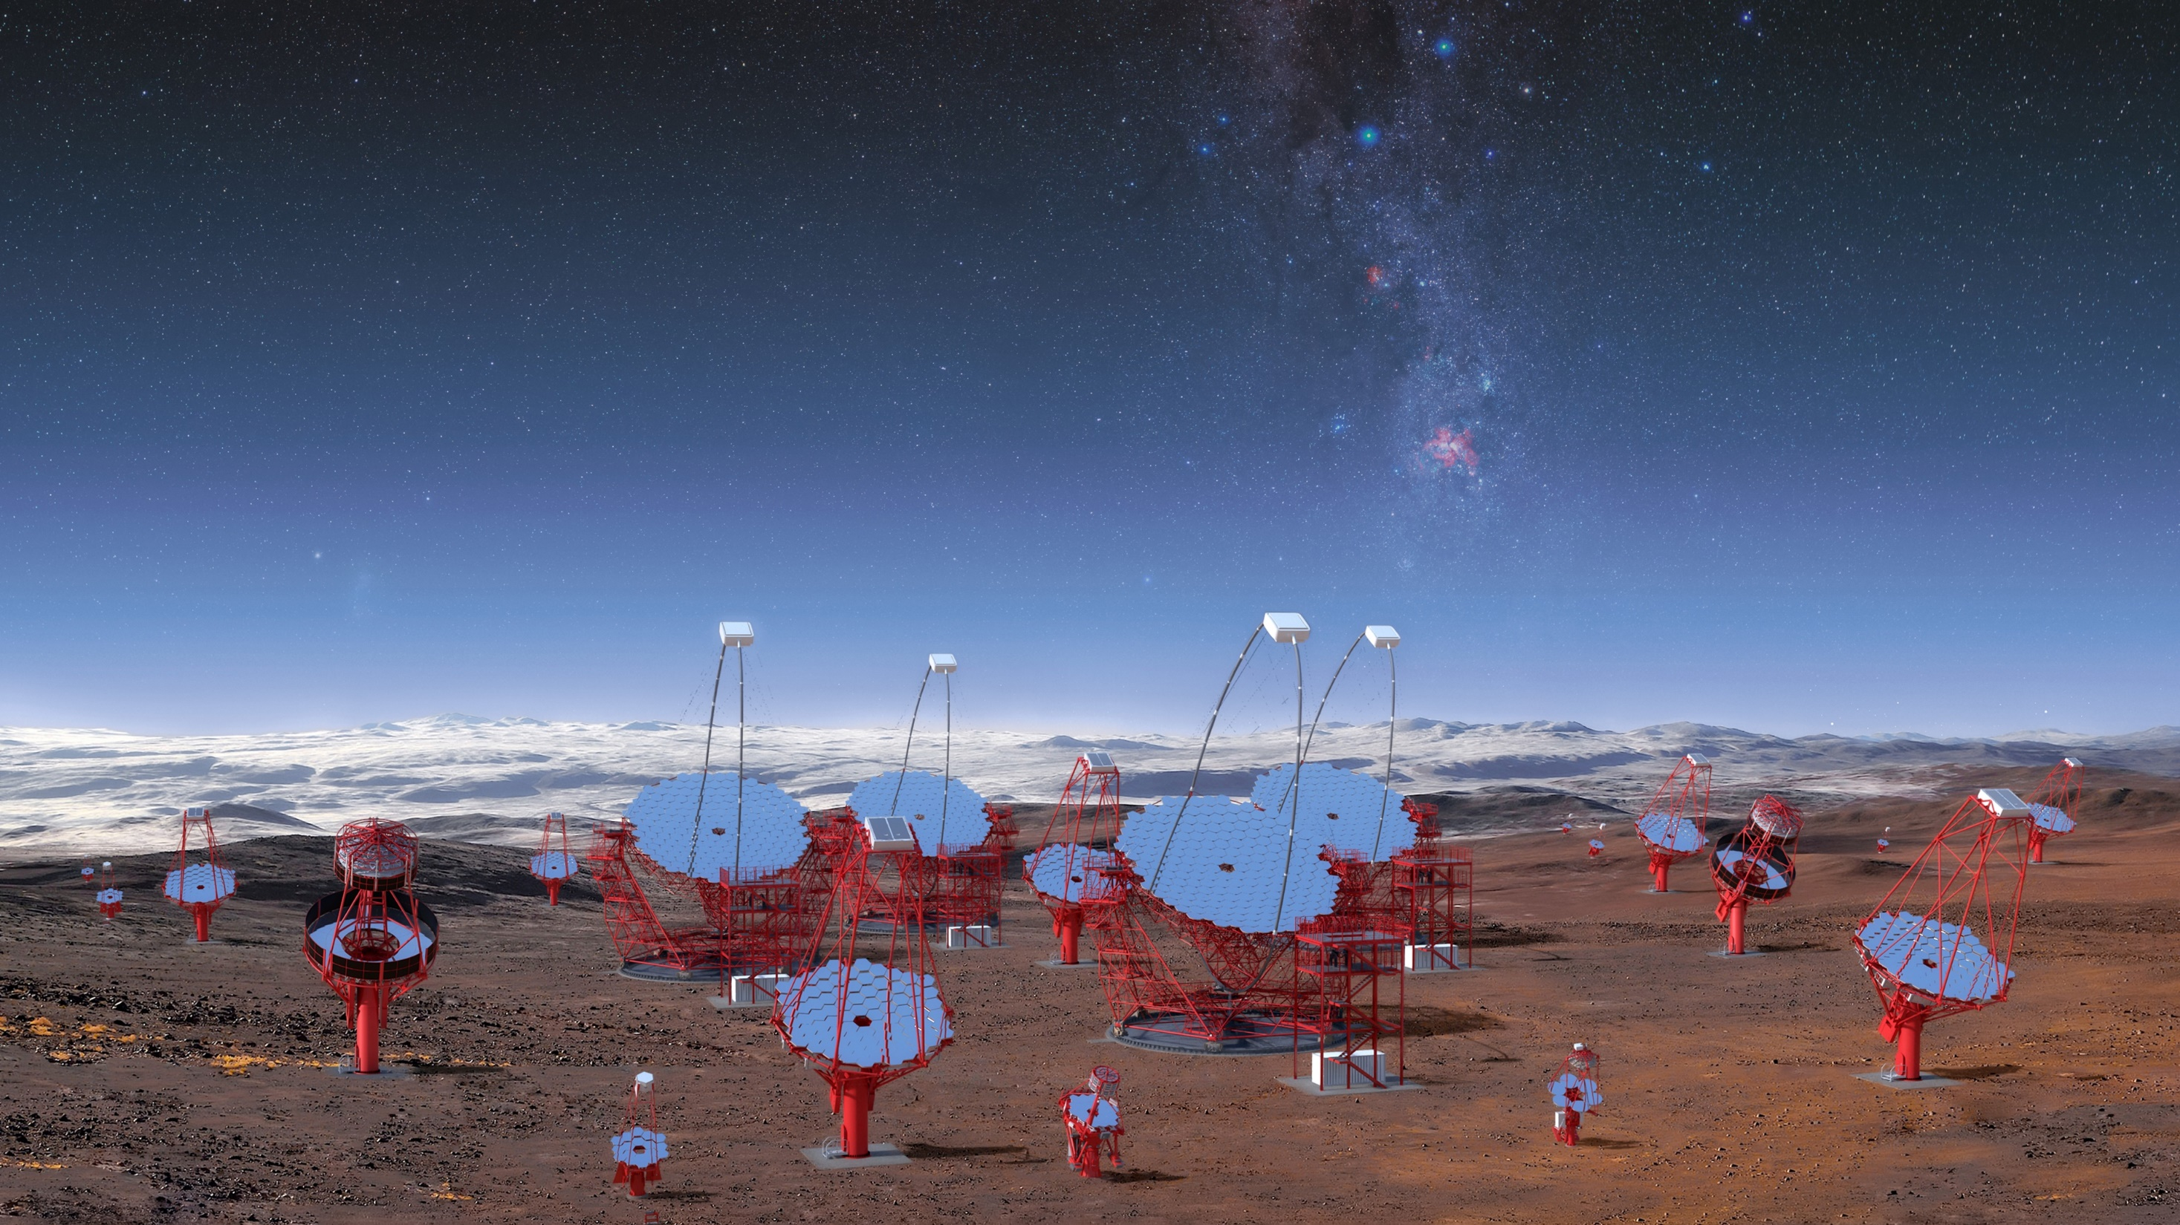
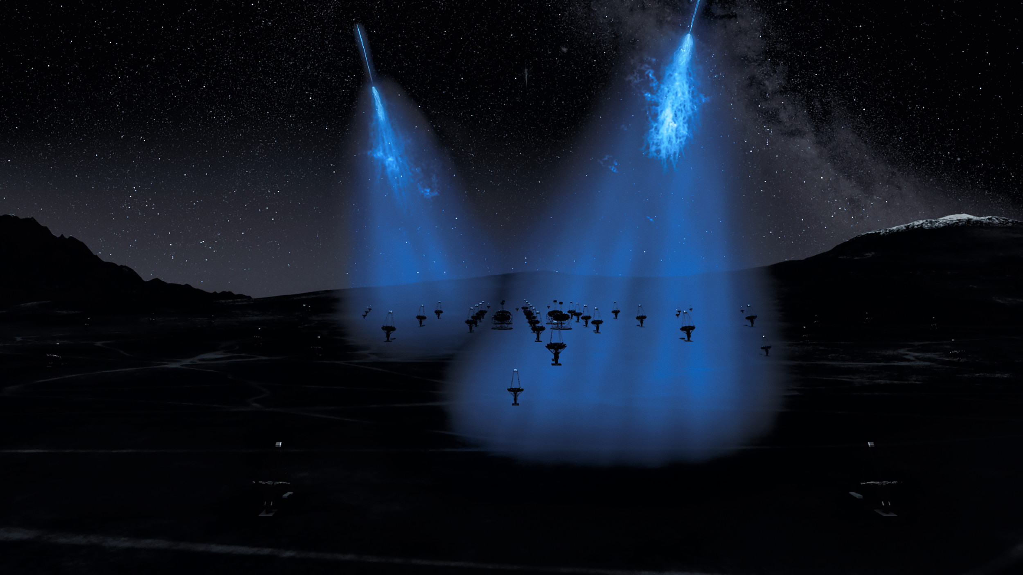
Cherenkov Telescope Array – South (CTA-S)
CTAO will be the first high-energy gamma-ray observatory on the ground, with a part (CTA-N) in La Palma and a part (CTA-S) in the Paranal-Armazones territory.
ESO will host and operate CTA-S inside the Paranal-Armazones observatory.
Infrastructure work in Chile on-going, while telescopes and cameras are being manufactured
Credit: CTA/M-A. Besel/IAC (G.P. Diaz)/ESO

Slide 20
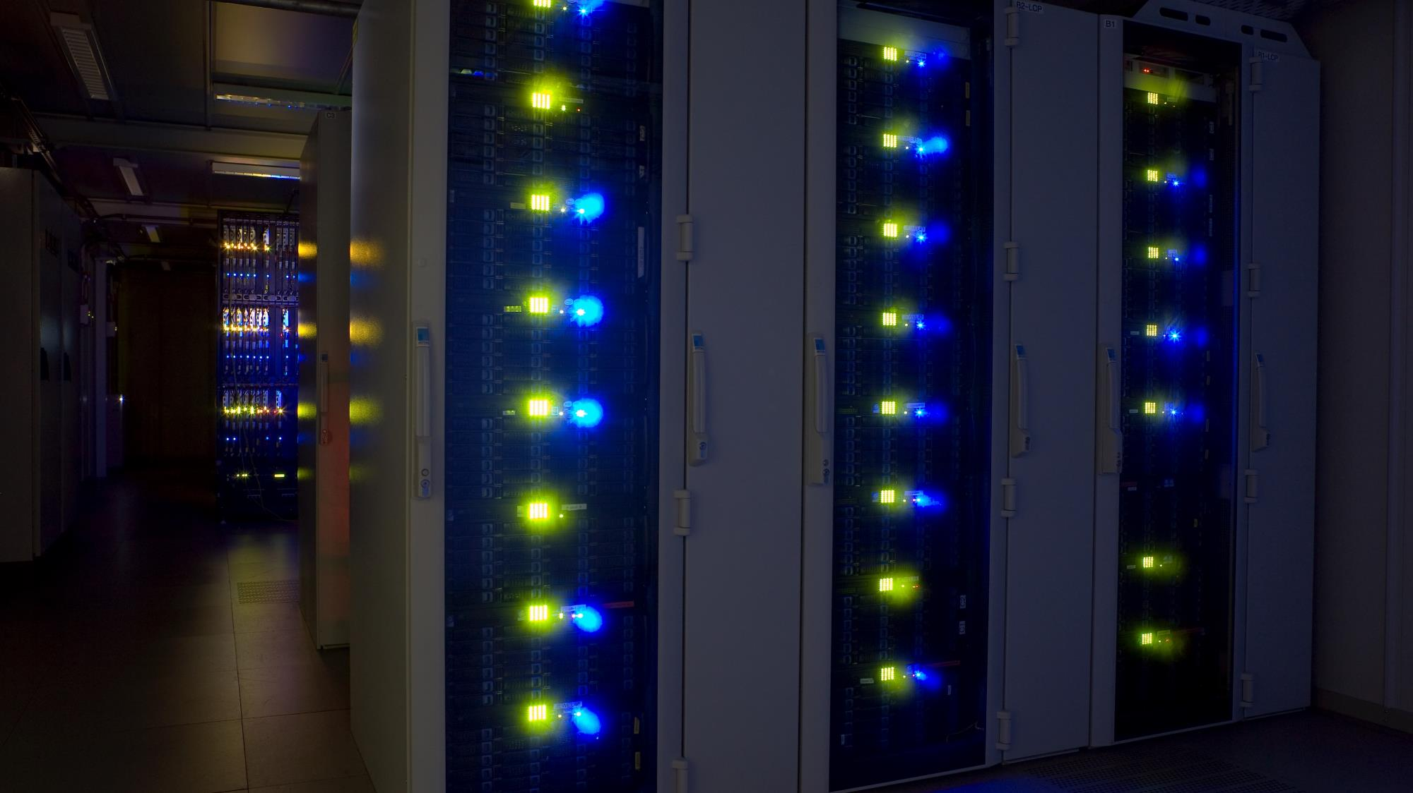
Credit: ESO/H.H.Heyer
The ESO end-to-end data flow system and the science data archive:
Open data for open science

Slide 21
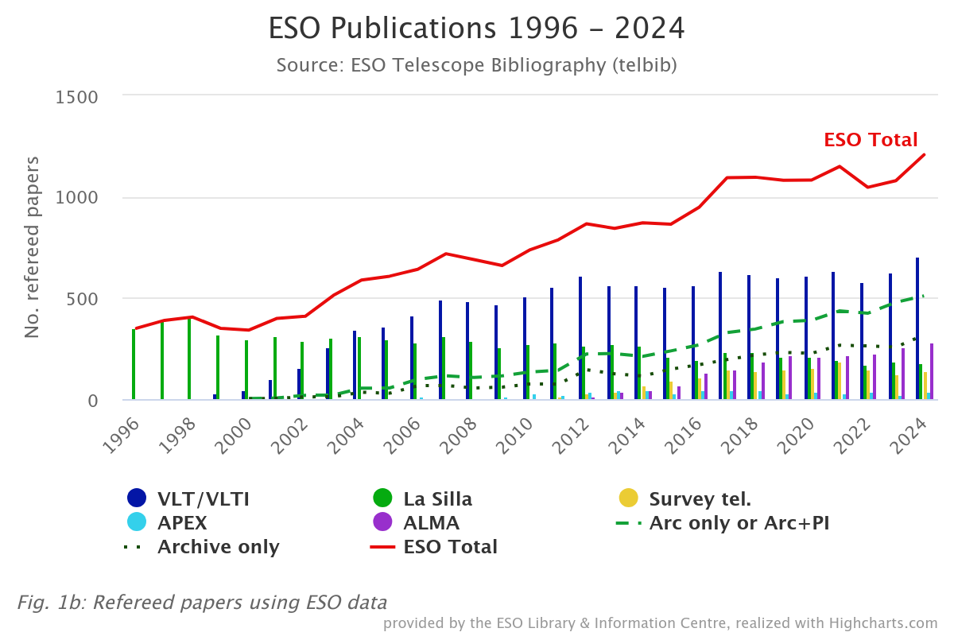
ESO science enabled
Scientific output
Obs | Pub 2024
LPO | 970
ALMA | 280
Archive+PI | 510
Archive only | 310
Total | 1207

Slide 22
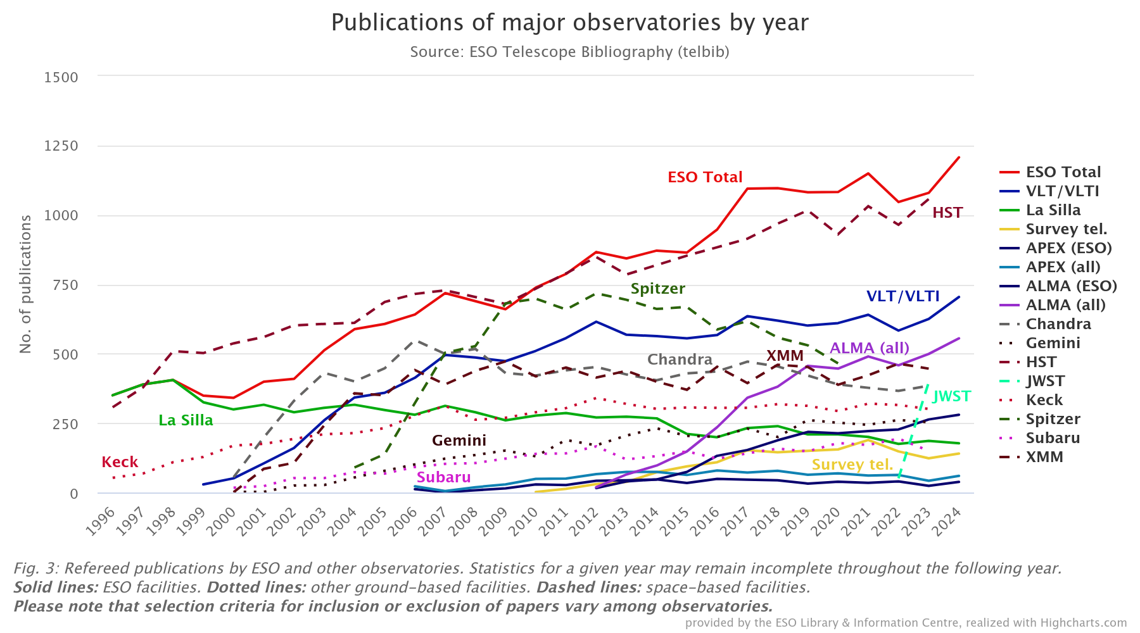
ESO science enabled
Scientific output
Obs | Pub 2023
HST | 1057
LPO | 970
ALMA | 555
Chandra | 384
XMMNewton | 446
Keck | 301
Gemini | 253
Subaru | 150
JWST | 397

Slide 23

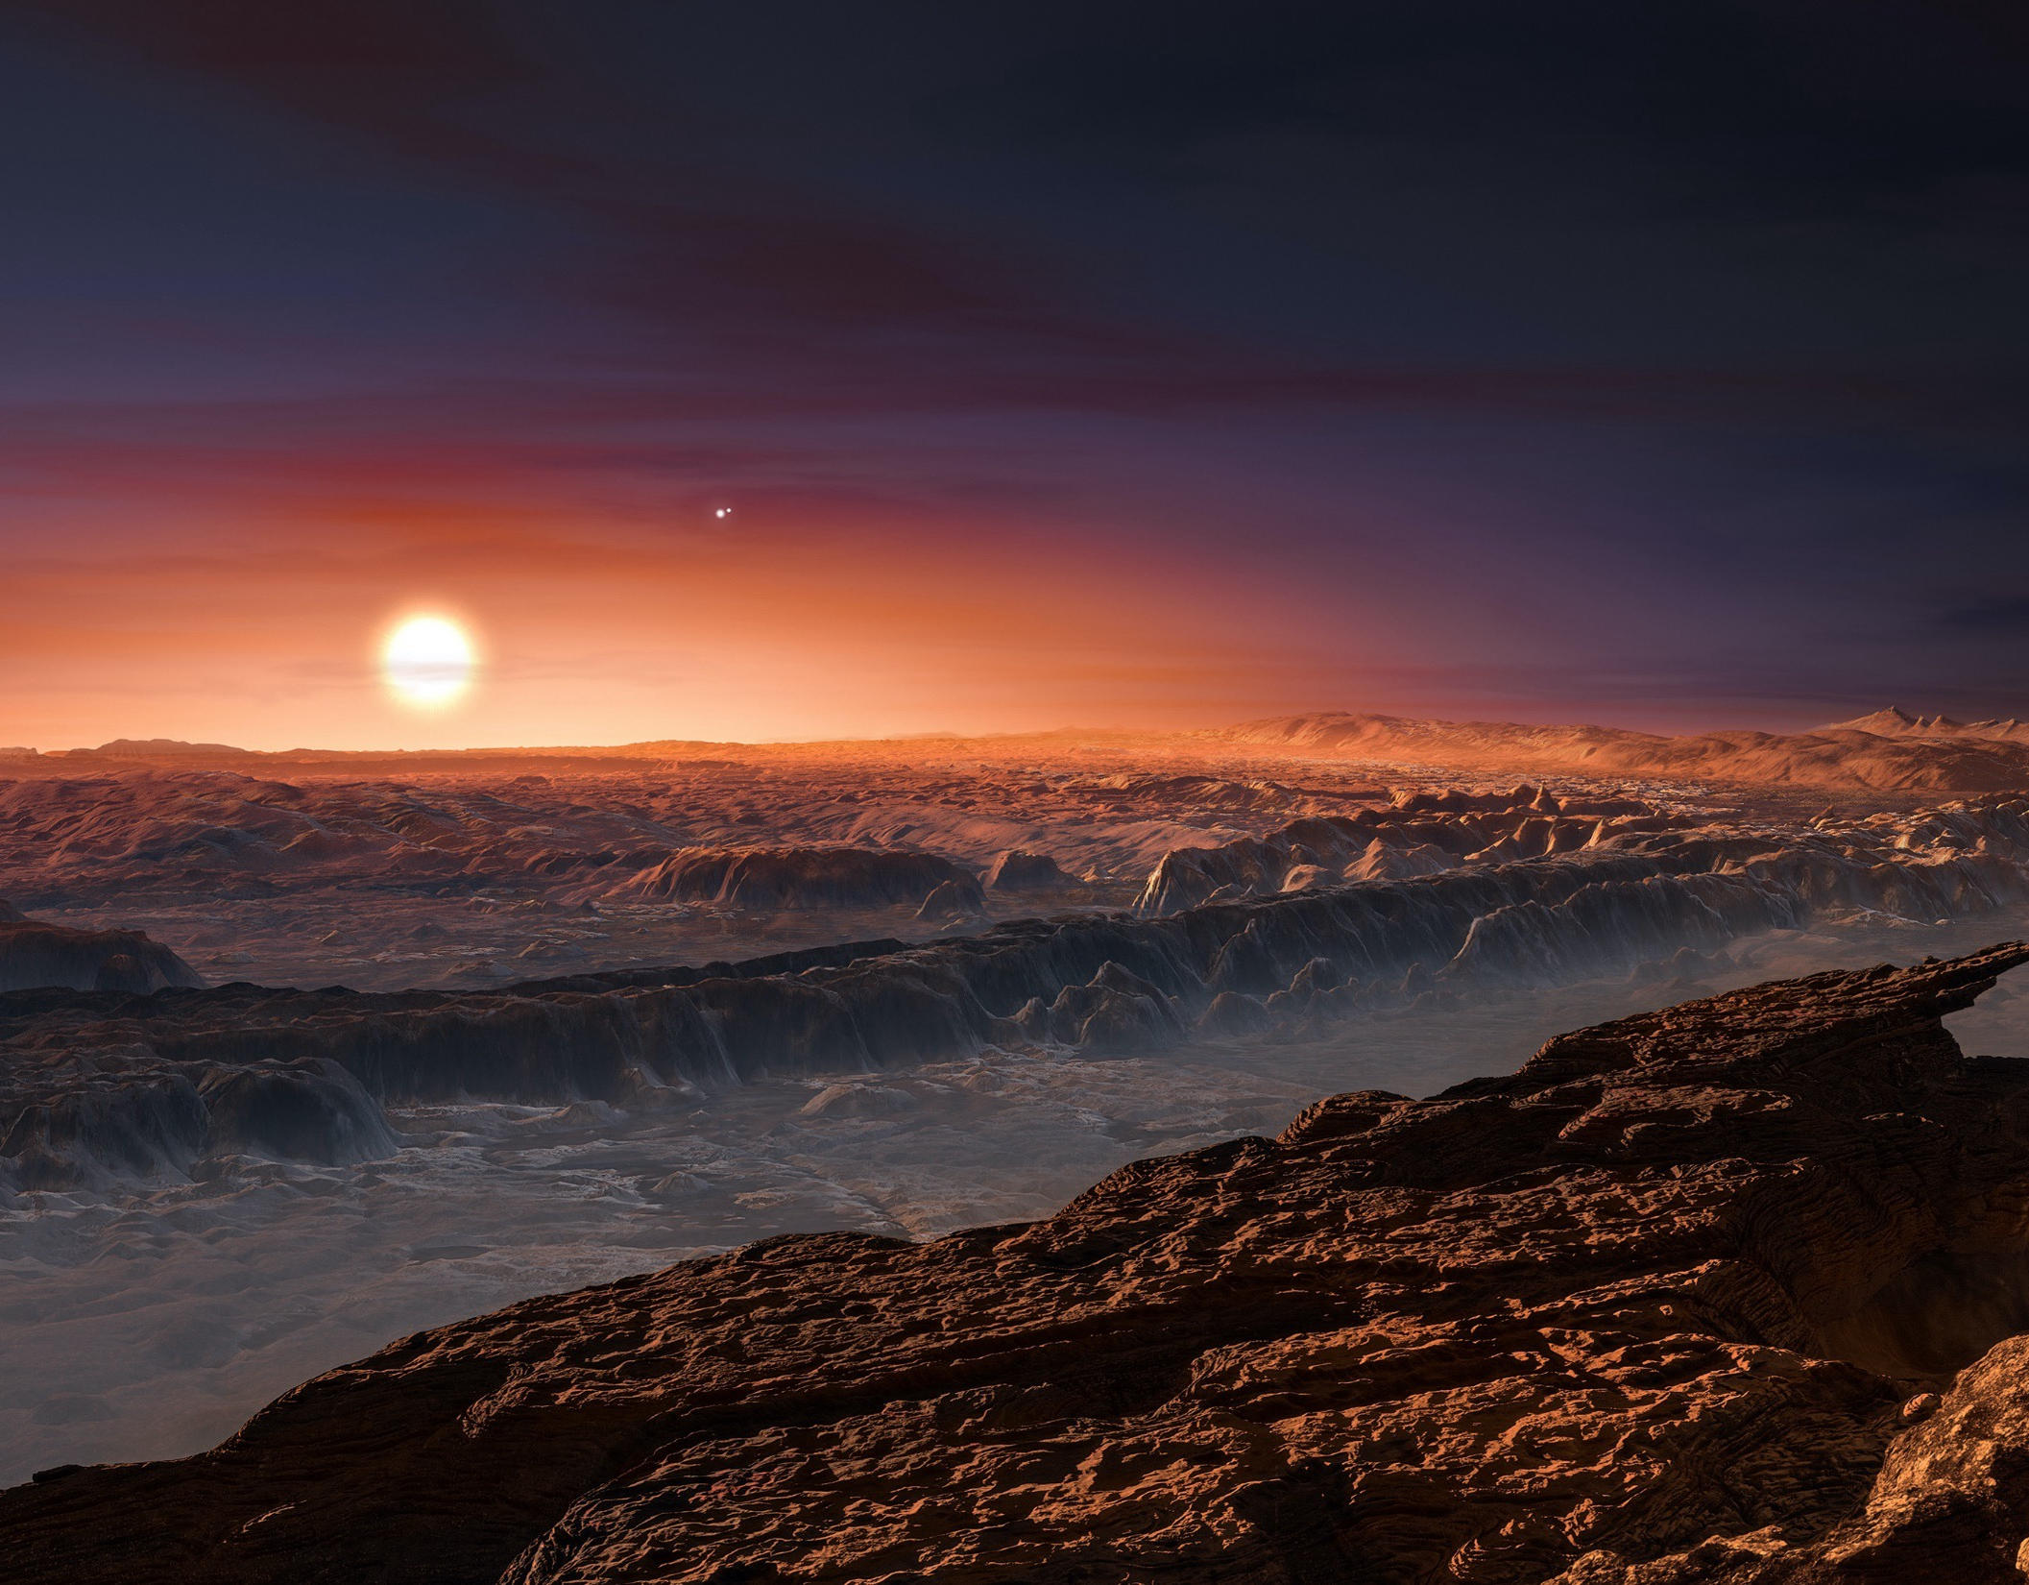
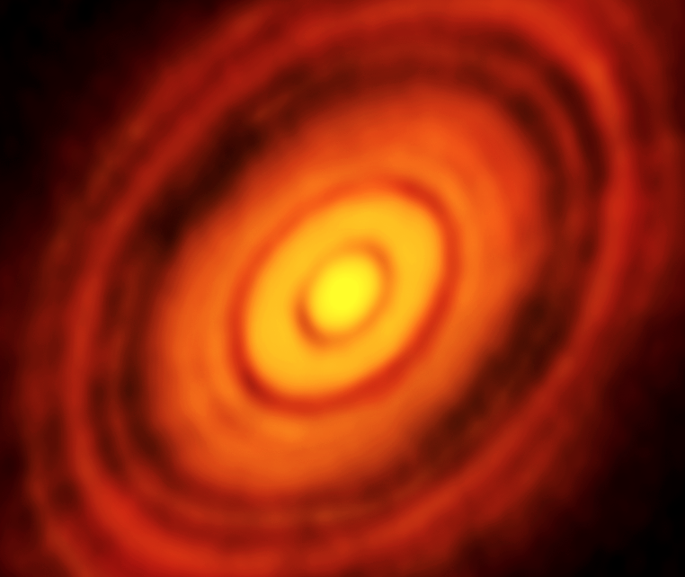
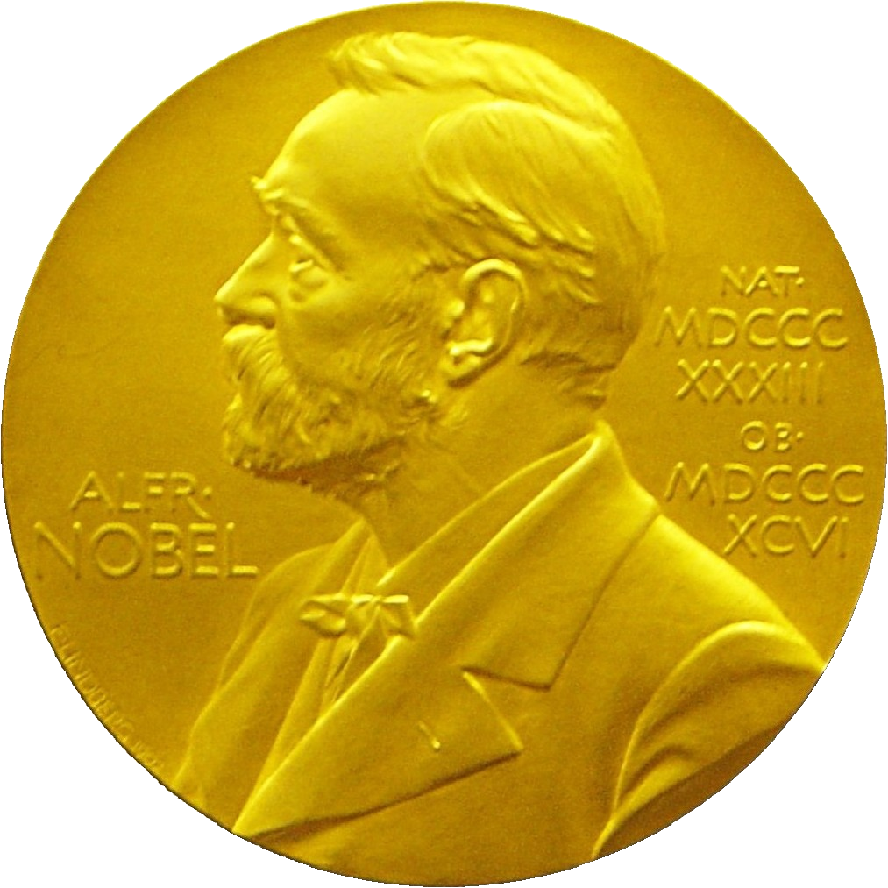


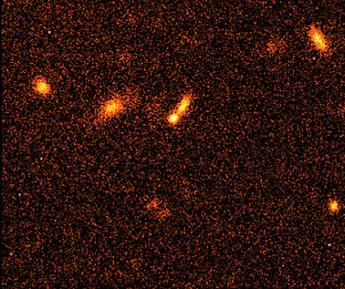
Click icon to add SmartArt graphic
First image of an exoplanet
Planets around solar-type stars
Planet formation
First image of a black hole
Black hole at the centre of the Milky Way
Accelerating Universe

Slide 24

Transforming Astronomy in the 2040s
http://next.eso.org

Slide 25
What ESO’s next programme could be
The next ESO Programme should be identified in line with ESO’s vision and strategy. It should be a transformational facility in the 2040s landscape that enables scientific benefits in several areas and serves a large part of the scientific aspirations of the community. It could be:
A new telescope facility at an existing or new observatory site;
A significant upgrade of an existing facility that is (co-)owned by ESO;
Other ideas or combinations,
Important: ESO does not operate as a funding agency. The new facility will be led and owned by ESO alone or in partnership with other organisations.
Note: the maturity of the proposal will not be a crucial point (as long as it can be assessed being doable)

Slide 26
Expanding Horizons timeline
Preparatory phase
Call for ideas
Assessment phase
Decision
White papers
July 2024–Q3 2026
Present and explain the process to the community
Trigger dialogue about astronomy challenges & disruptive technologies in 2040s
Jun-Nov 2025
Launch of call: July 25
White papers due: Nov 2026
3 pages max
Science focus.
Q3 2026–Q2 2027
Launch of call: Q3 2026
Letters of Intent due 1 Dec 2026
Proposals due: 1 Jun 2027
Q3 2027–Q3 2028
Performed by SSC and ESO Executive
Transparently share what ideas are being proposed at a dedicated community workshop
Q3–Q4 2028
Presented at STC and Finance Committee
Council decision
Decision is not the start of the new Programme

Slide 27
The Senior Science Committee (SSC)
The SSC is a diverse group of experts in a broad variety of areas of astronomy and associated technologies. It provides independent and unconflicted advice on the scientific drive of the new programme.
Mandate of the SSC – Preparatory Phase
Helping to identify scientific challenges in astronomy for the 2040 and support community engagement activities to discuss them;
Provide guidance on which disruptive technologies may enable transformational science in 2040 or beyond.
Mandate of the SSC – Call for Ideas, Assessment and Decision Phase
Provide independent scientific assessment of the proposals in response to the Call for Ideas
The SSC may also be tasked with other support activities related to the Expanding Horizons process, as requested by the ESO Director General or ESO Council.

Slide 28
Senior Science Committee (SSC)
Angela Adamo, University of Stockholm (ESO STC, Galaxies)
Joss Bland-Hawthorn, University of Sydney (Astrophotonics)
Marica Branchesi, Gran Sasso Science Institute (Multi-messenger)
Paul Callanan, University College Cork (ESO Council, Compact objects, chair)
Heather Cegla, University of Warwick (Life & Habitability)
Stéphane Charlot, Institute d’Astrophysique de Paris (Cosmology)
Vik Dhillon, University of Sheffield (ESO Council, Transients & stars)
Norbert Hubin, formerly ESO (Technology Development, starting 1 Nov 2025)
Marcella Marconi, INAF- Osservatorio Astronomico di Capodimonte (ESO STC, Stellar populations)
Nanda Rea, Institut de Ciències de l’Espai – CSIC (Transients & high-energy)
Hans-Walter Rix, MPIA (Galaxies)
Karin Öberg, Harvard (star/planet formation)

Slide 29
Science & technology in the 2040s
The main focus at the moment
What is/are the main science question(s) in astronomy that need to be answered in the 2040s?
Need to convince the member states to invest resources into the next major ESO facility. Science must be the driver. That science cannot be done with the facilities available in the 2030s.
White papers → workshops
The SSC decided to open a call for white papers focused purely on the science questions to focus on for the 2040s. This will then be a base to organise on-line workshop(s) where the scientific community should discuss which will be the scientific challenges of astronomy in the 2040s in different areas.
Disruptive Technologies Workshops
A place to discuss which potential disruptive technologies may become game changers for a transformational facility in the 2040s;

Slide 30
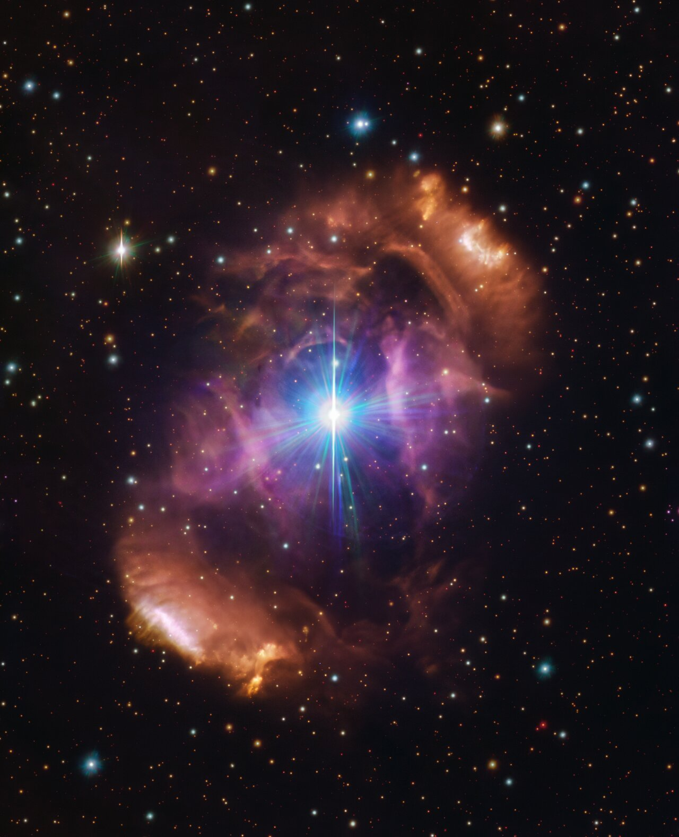
How ESO’s next programme will be selected
A transparent selection process
Expanding Horizons is an open and inclusive call to ESO’s community
Call for ideas to motivate convergence among the community;
Assessment of the proposals will be made based on scientific drive and organisational ability;
Ample preparation time and activities foreseen to incentivise the community and foster dialogue and debate.

Slide 31
Selection criteria for ESO’s next programme
Recommendation to Council will be prepared by ESO’s Executive, including input by a Senior Science Committee (appointed by Council), based on:
Scientific drive: Which fundamental problems in astronomy are expected to be addressed? How broad an impact will the new facility have? What synergies are there with other ESO facilities?
Organisational ability: Are competencies and skillsets available to own the design and development of the new facility? Is the organisation able to fulfil its operational requirements?
Sustainability: To what degree the new facility could be designed, built and operated in an environmentally, socially and financially sustainable manner?
Institutional model: Should the new facility be developed in a partnership with another organisation?
Risks assessment: Will the new programme compromise the successful operation and development of ESO’s existing facilities?

Slide 32
Some FAQs
When:
Some time in the 2040s, timeline linked to ELT.
Where:
No preference.
Does ESO have a favourite?
No.
There are ESO scientists involved in most of the ideas under development – but they do this on their own science time and the projects they work on are not approved or favoured by ESO. They will not be involved in the evaluation of the proposals.

Slide 33
Expanding Horizons Summary – for now
Think about/discuss what science areas/questions you judge will be the highest priority in the 2040s
Submit a White Paper
Determine what kind of facility will be able to address those scientific questions.
Submit a Letter of Intent
Work out the rough details of the facility needed.
Submit a proposal.
…

Slide 34
Xavier Barcons
Director General
dg@eso.org
@ESOAstronomy
@esoastronomy
@ESO
european-southern-observatory
@ESOobservatory

