Slide 1
MTN Transfer Function and Hysterisis
Fabian Metzger, Laurie Nevay, Dipanwita Banerjee, Luke Dyks, Florian Stummer
03.02.2025

Slide 2
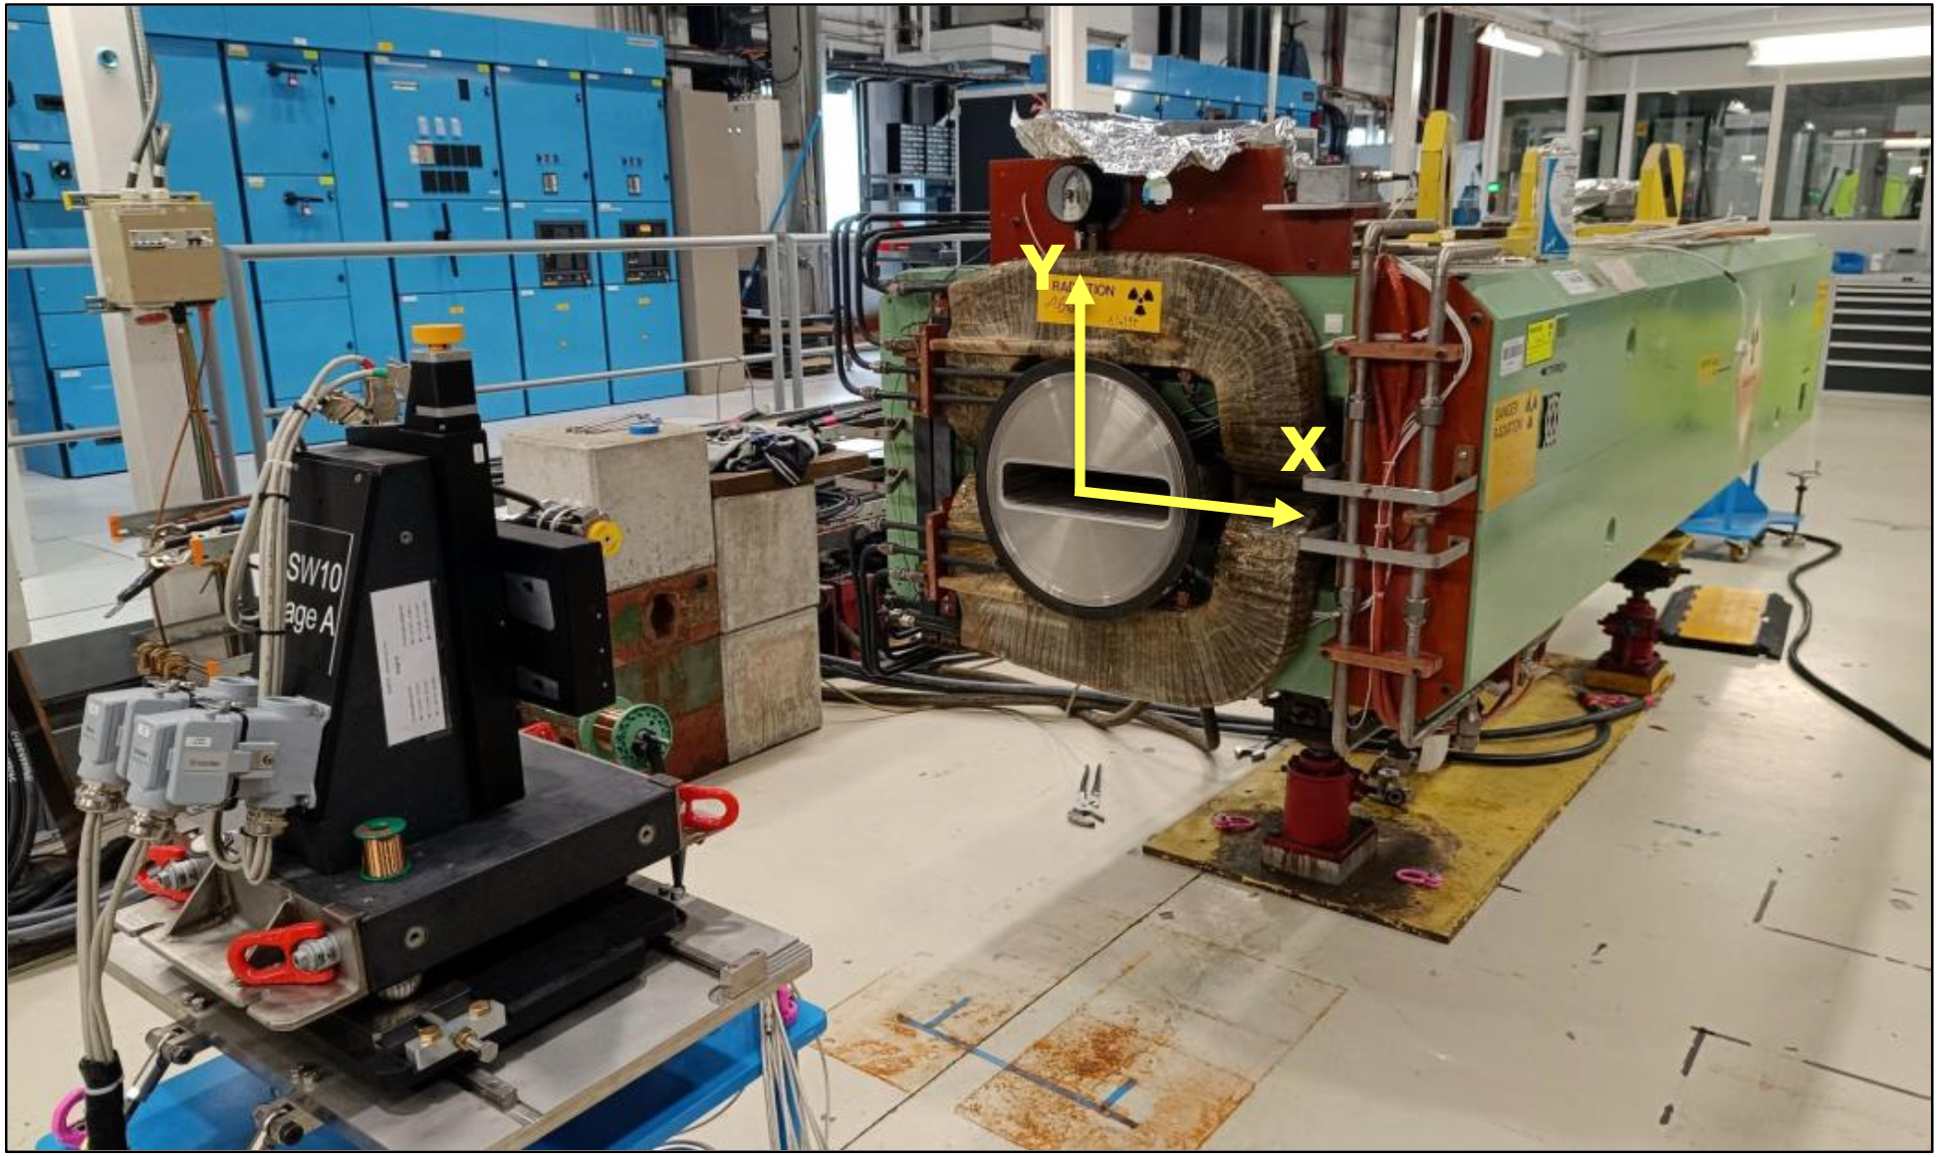
What was measured?
One spare MTN has been put on the measurement bench
end of last year
  It’s actually the one that replaced the broken one of bend 2 of the
  T4 Wobbling
By default, they measure the transfer function
Field quality in the transverse plane has been investigated
Following some requests from our side, the following has been measured too
  Dynamic behaviour → How long does it take to stabilise to 1% for different initial and final currents
  Hysterisis effect → We don’t degauss the MTNs when changing the wobbling, but we switch polarities
Report is written here

Slide 3
Transfer Function
Difference is on sub-percent level in the linear region, but becomes reasonable when going into saturation
New measurement implies kick was always higher than it was assumed to be

Slide 4
Hysterisis
The transfer function we assume is based on a fully degaussed magnet → Hysterisis changes the actual field that is in the magnet
Such an effect might be partially compensated as we kick opposite with bend 2 and 3
  But it’s not straightforward as we don’t drive bend 3 into saturation with negative wobbling
  And we use the current that is predicted for a degaussed magnet
The shown values have been measured after a full hysterisis cycle after full degaussing
  Situation becomes better when we aren’t on outermost hysterisis loop
Current in A | Measured BL in Tm | Expected BL from TF in Tm | Difference in Tm | Deviation in %
-500 | -3.0384 | -3.0631 | 0.0247 | 0.81
-900 | -5.3889 | -5.4777 | 0.0888 | 1.62
-1200 | -6.8160 | -6.8556 | 0.0396 | 0.58
500 | 3.0452 | 3.0631 | -0.0179 | -0.58
1300 | 7.1793 | 7.1886 | -0.0093 | -0.13

