Slide 1
CERN Design release milestone
RFD cryomodule for LHC
Teddy Capelli on behalf of CERN WP4 Team
19th February 2025

Slide 2
Agenda
Introduction –10min
Brief overview of the milestone's purpose and objectives
Collaboration with TRIUMF and CERN contribution
Master Planning
RFD Cryomodule engineering Overview –20min + 10min Q/A
-Introduction to the RFD cryomodule
-Overview of the overall assembly sequence
-Status update on drawings and calculation
Close out & open discussions

Slide 3
Purpose of this meeting
Provide a formal design release milestone to Triumf
Give a reminder to CERN stakeholders about the design, status of drawing packages & implications of any changes
Give an overview about the collaboration with Triumf
Gather and address any comments about design

Slide 4
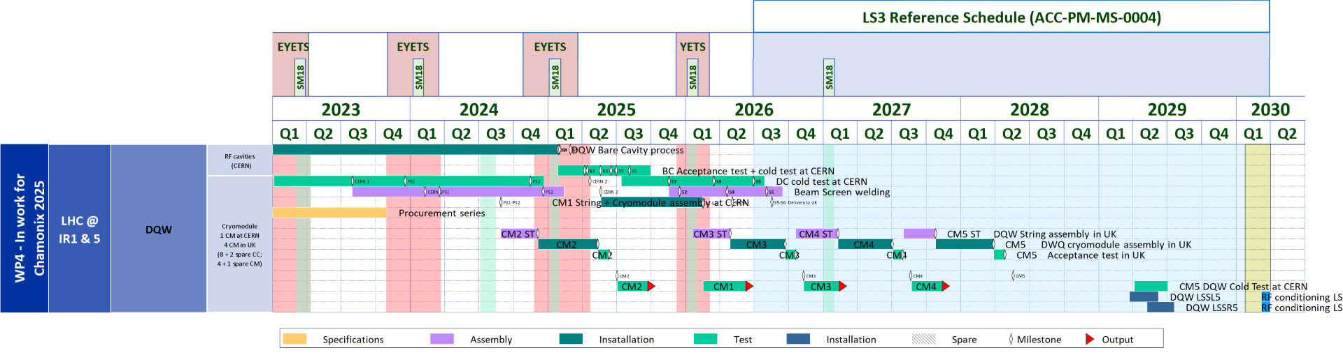
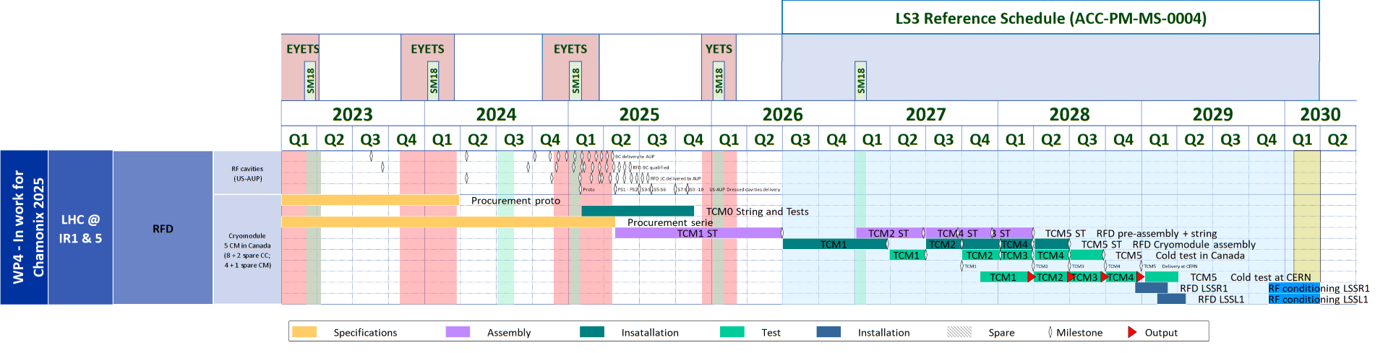
WP4 Master Plan - RFD CM for information only
Latest installation
DQW
RFD

Slide 5
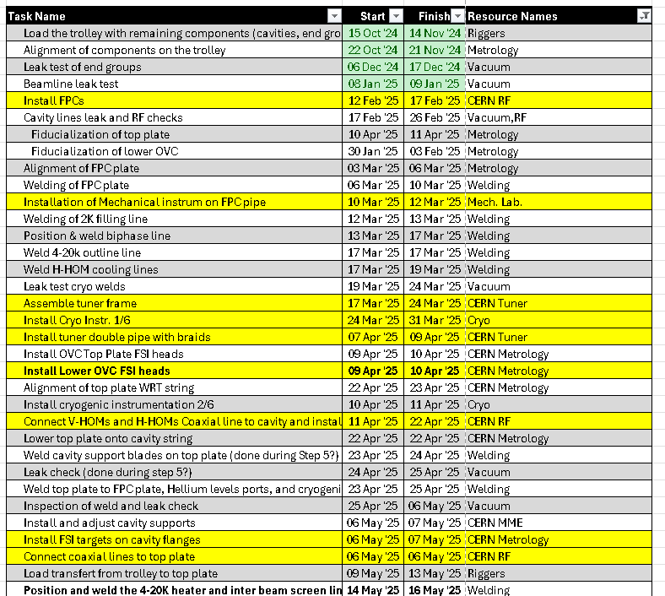
CERN Contribution 1/2: Tech. Support
Provide technical specifications for the design, manufacturing and testing of main components (see spare slide for the full list – Courtsesy L.DASSA)
Tech. Support on specific topics during CM manufacturing:
  Feedback on activities : QA, fabrication (welding, outsource)…
  Tech. documentation of Collab : Check ass.y and test procedures, techSpecs for prod
CERN specialists visits on site :
  Assembly intermediate checks/tests
  Coaching & shadowing for assembly of components
  under CERN responsibility
To be provided by Triumf

Slide 6
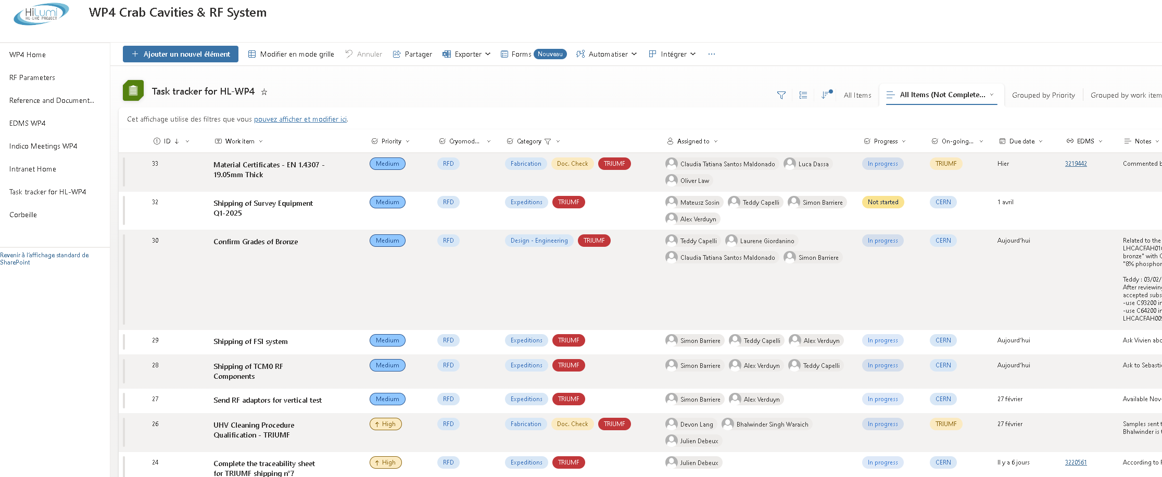
(Task tracker for WP4)
CERN internal tool stored on WP4 sharepoint (Link here)
Follow up of open actions (NCR, Dev. Req., Document review … etc)
Courtesy I.BEJAR ALONSO, J.DEBEUX, M.BENAHMED
Today ~70 tasks opened – ONLY 1 Cryomodule under assembly at STFC
Many more tasks to come !

Slide 7
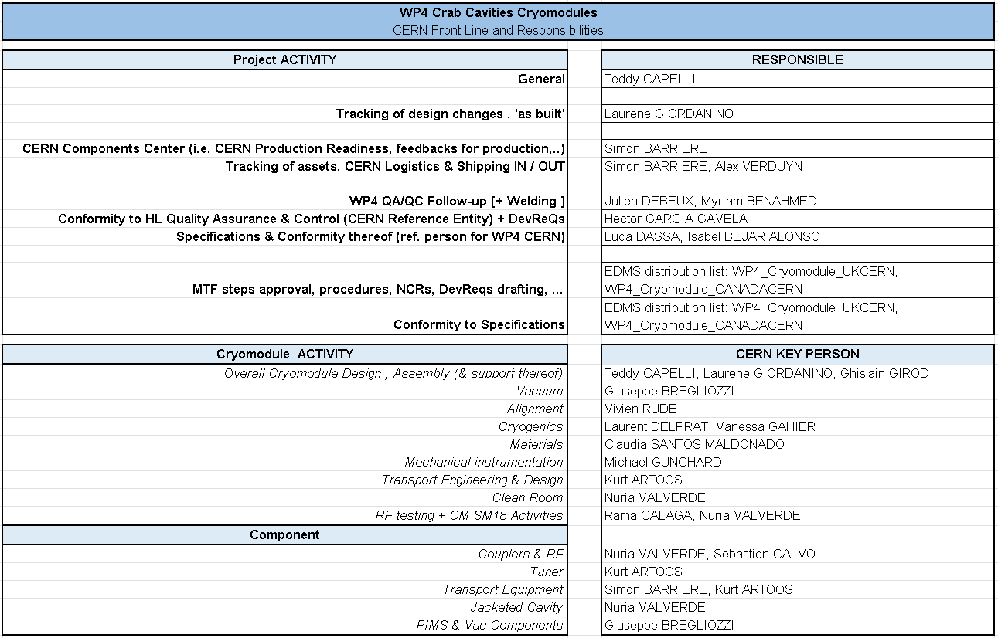
Interfaces CERN/Triumf
CERN Reference people for topic / component / activity:
Triumf Reference people for topic / component / activity :
(to be updated by triumf)
Bob Laxdal – project lead
Devon Lang – fabrication, assembly, alignment
Ben Matheson – Design
James Keir – fabrication, assembly, vacuum
Oliver Law – Engineering
Bhalwinder Waraich – clean assembly
Zhongyuan Yao – cavity and cryomodule testing

Slide 8
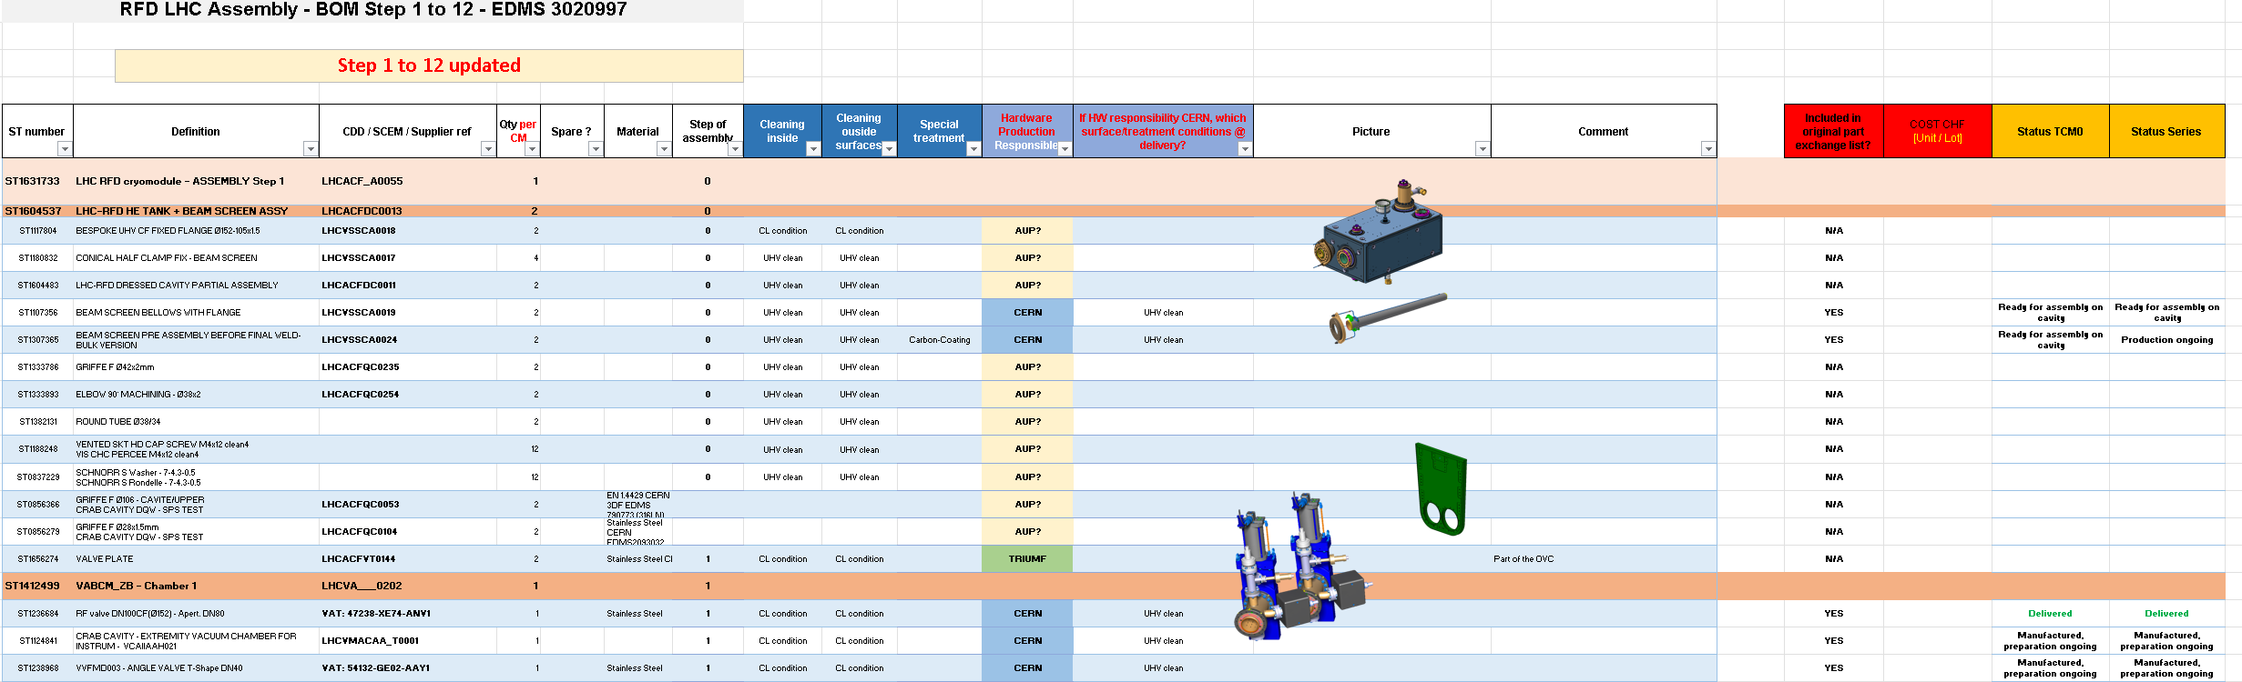
CERN Contribution 2/2: Hardware
Triumf to Manufacture components and assemble 4 RFD series cryomodules :
Collaboration agreement on part exchange and responsibilities of production :
Ref. Part Exchange UK-CAN : EDMS 2508819 + Amnd Add5 of P095
Detailed bill of material with responsibilities and status : EDMS 3020997

Slide 9
Conclusions
Change in the design of the cryomodule or one of its sub-components impacts not only drawings but also :
  Assembly procedures
  Calculation/simulations
  Technical specifications
  Planning
  Integration
Every modification must be documented and validated by both CERN and Triumf -> Contact us
Follow up cryomodule activities are of upmost importance, and we need everybody involved to review request from the collaboration

Slide 10
Questions ?
T.Capelli on behalf of WP4

Slide 11
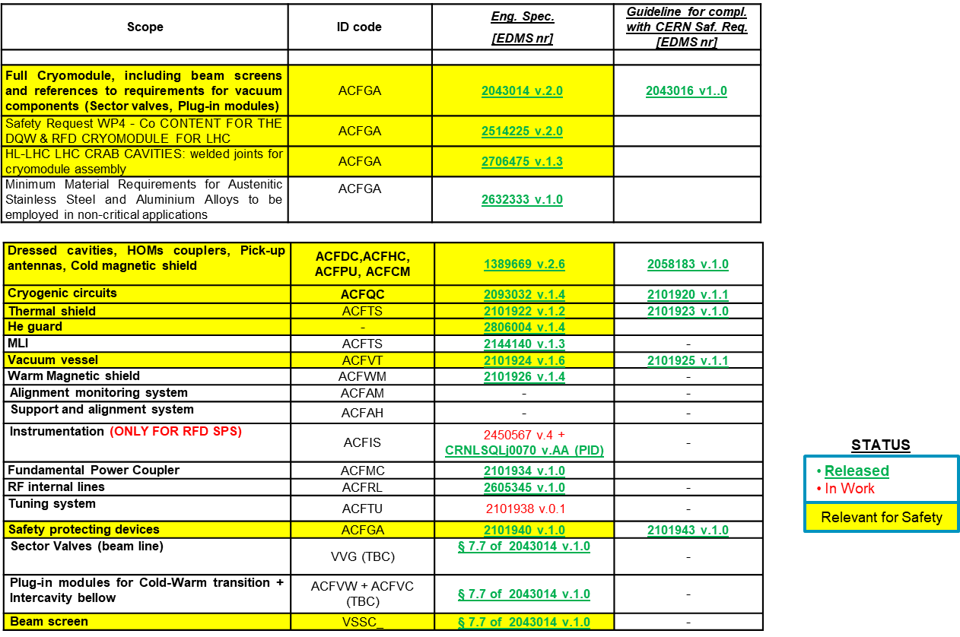
Cryomodule & Components Specifications
CRYOMODULE
COMPONENTS

Slide 12
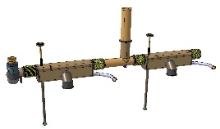
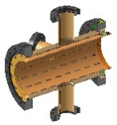
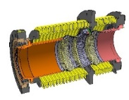
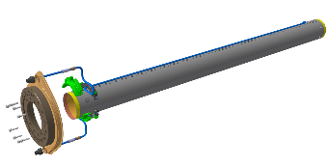
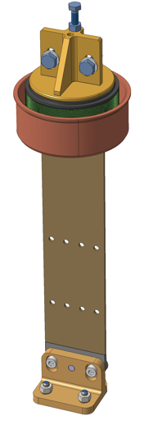
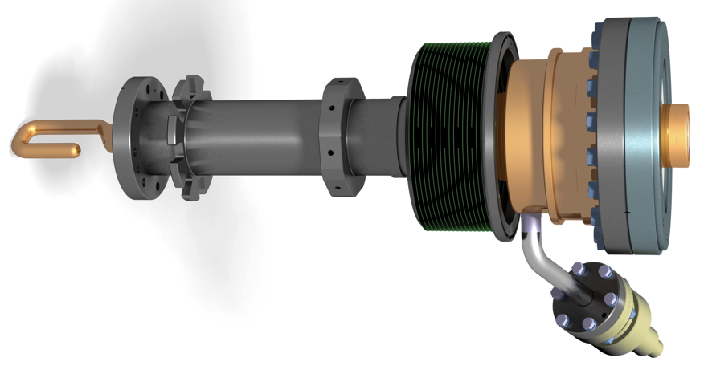
Status of next shipments
Cryogenic lines :
  Upper lines – TCM0 sent – 1x series ready for march delivery TBC
  Auxiliary lines – TCM0 sent – 1x series ready for march delivery TBC
Beam vacuum equipment:
  Instrumentation and pumps – TCM0 sent – Series under preparation for March delivery
  Vacuum chambers and PIMS – TCM0 1x PIM under repair – Series under production
  Beam screen for cavities – Production done – Shipping to be organised
Tuner internal double pipe with bellows –1x set for march delivery TBC – Series under production
Cavity support blades with bellows – 1x set for march delivery TBC - Series under production
Tuner external actuation - Design under review
FSI :
  Interferometer system – Ready to ship
  Feedthroughs – to be sent at the last moment once calibrated
  Target and support for cavities – 1x set Ready to ship
RF adaptors – 2x sets calibration on-going for shipping week 7
FPC – 1x FPC set in preparation on-going for shipping week 7 – Series under production
FPC outer pipe– 1x FPC set in preparation on-going for shipping week 7 – Series under production

