Slide 1
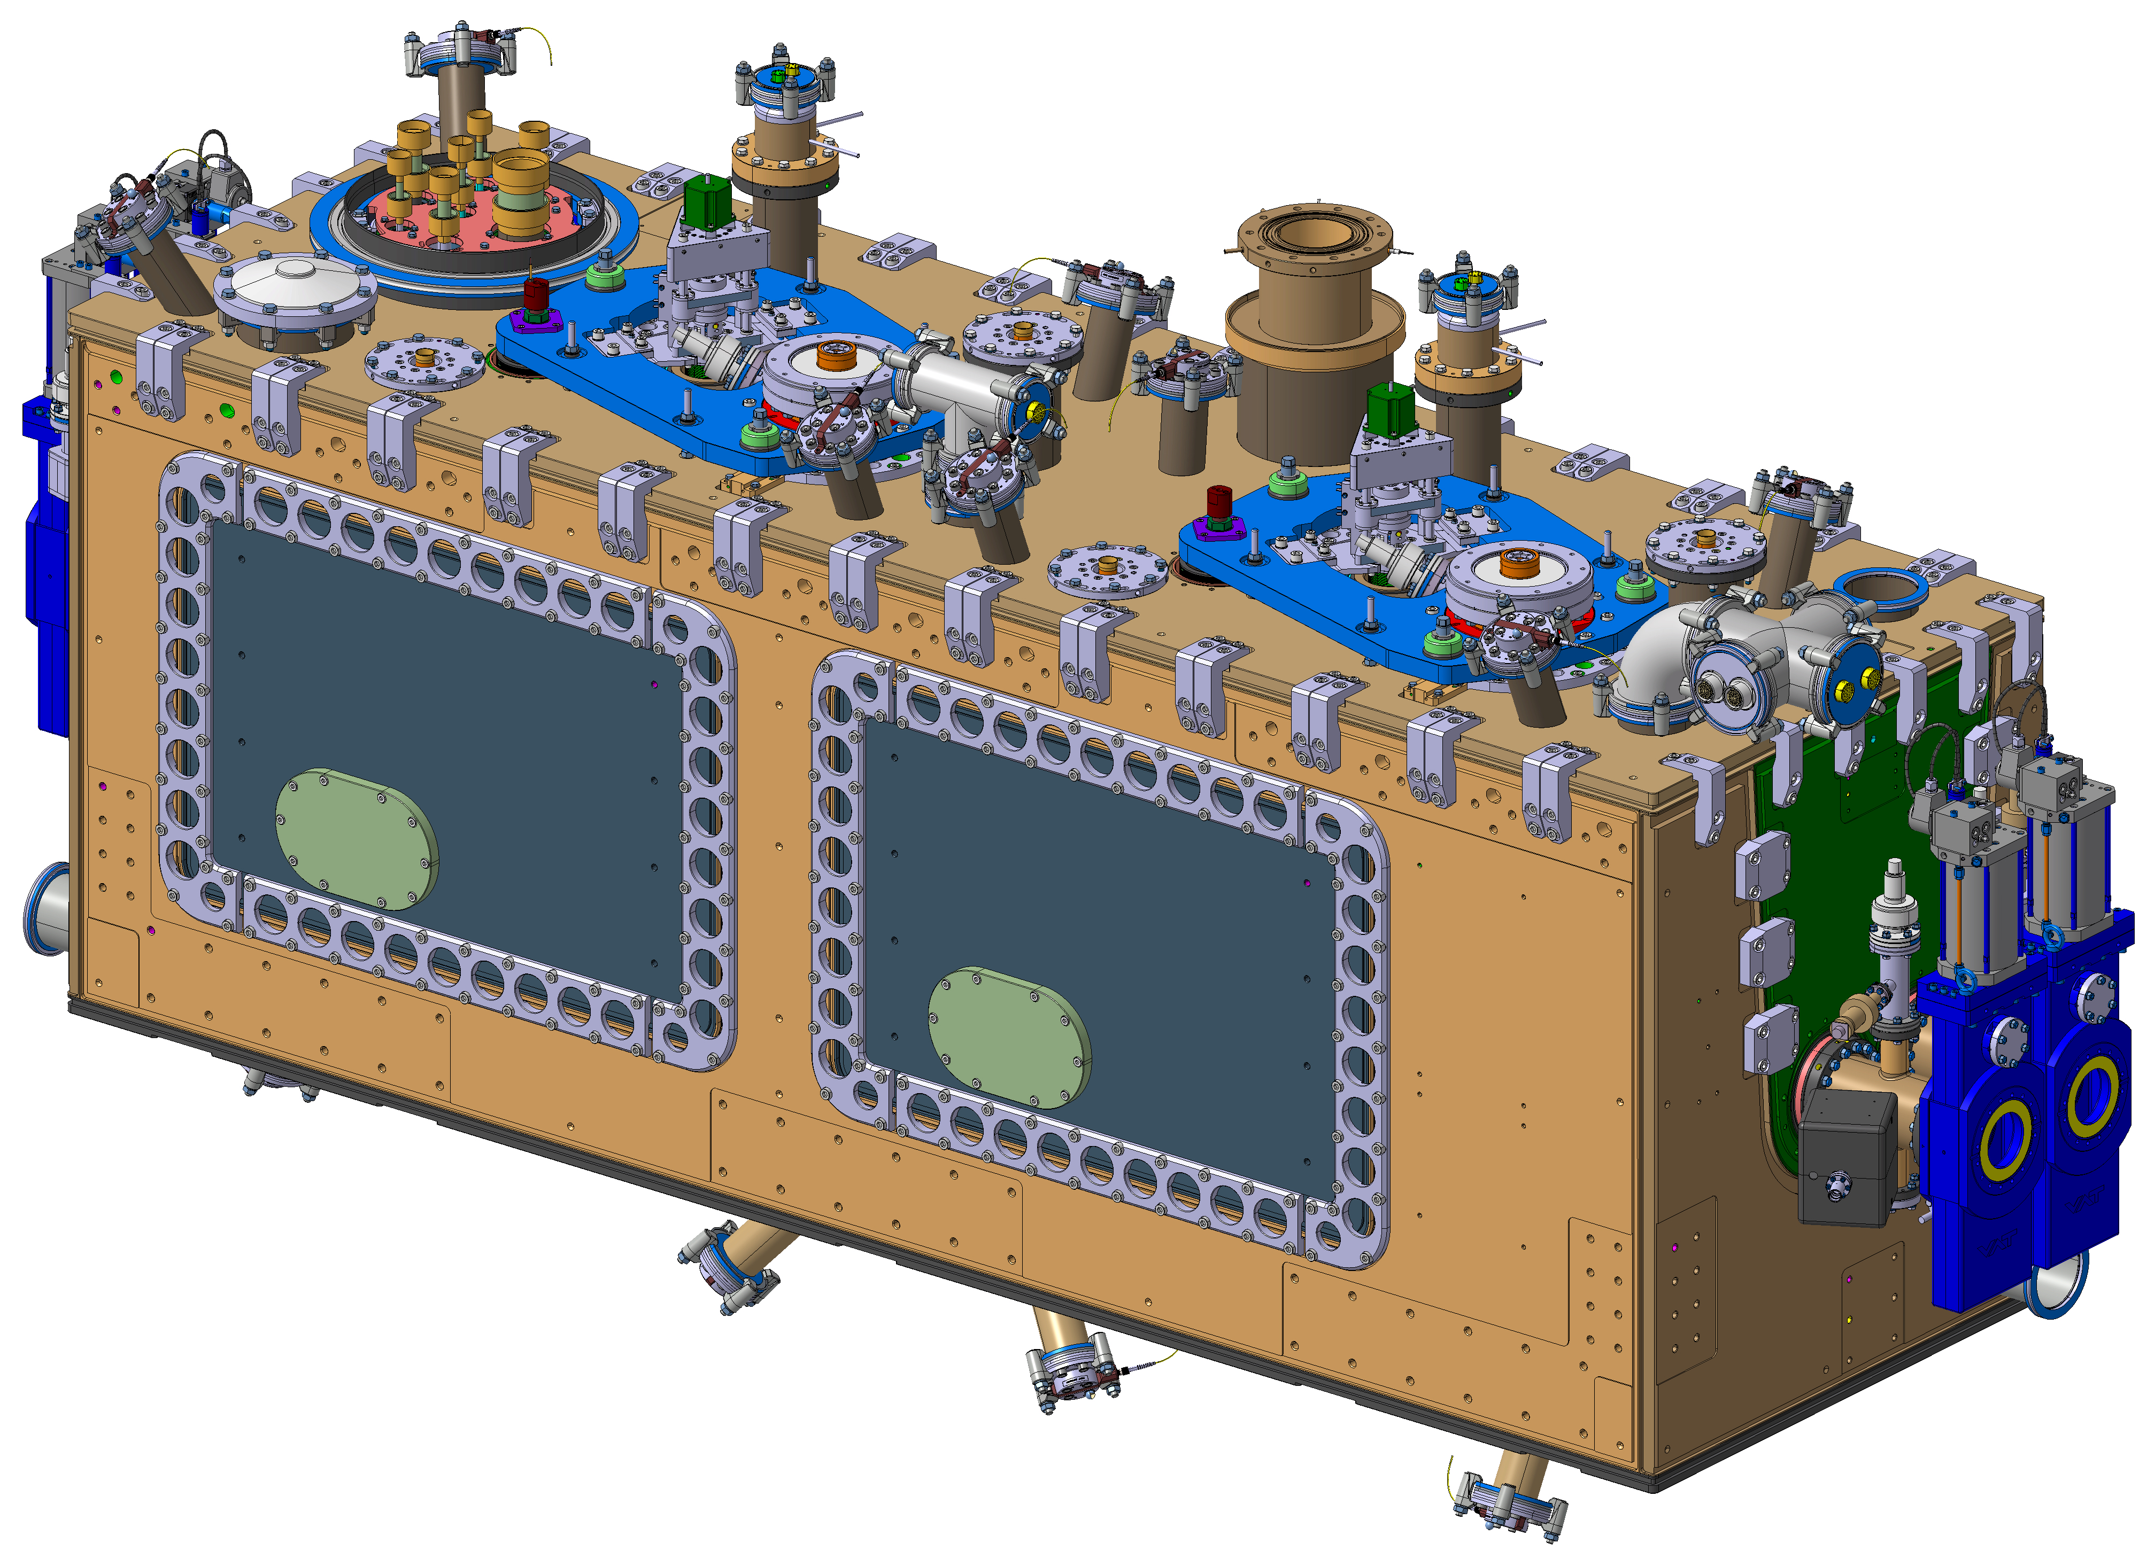
RFD Cryomodule Design Overview
Laurène Giordanino on behalf of the WP4 collaboration

Slide 2
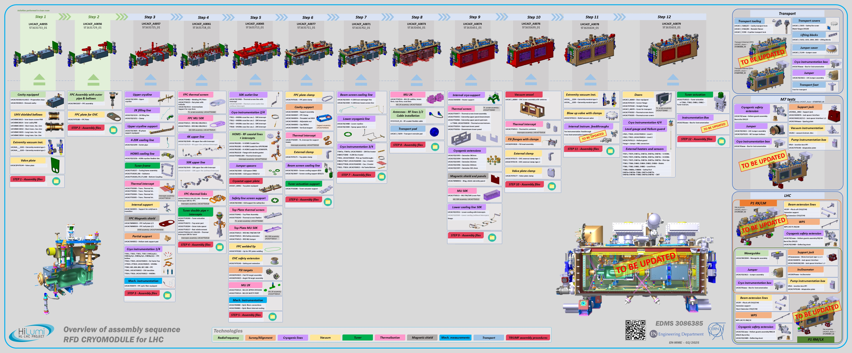
RFD Cryomodule assembly sequence
Engineering specifications:
https://edms.cern.ch/document/2706475 (welded joints for DQW and RFD cryomodules)
https://edms.cern.ch/document/2043014 (cryomodules for Crab Cavities)
https://edms.cern.ch/document/3086385

Slide 3
RFD Cryomodule assembly sequence
3D models + 2D drawings Released
Engineering specifications:
https://edms.cern.ch/document/2706475 (welded joints for DQW and RFD cryomodules)
https://edms.cern.ch/document/2043014 (cryomodules for Crab Cavities)
https://edms.cern.ch/document/3086385

Slide 4
RFD Cryomodule assembly sequence
Finalization of the design ongoing
Engineering specifications:
https://edms.cern.ch/document/2706475 (welded joints for DQW and RFD cryomodules)
https://edms.cern.ch/document/2043014 (cryomodules for Crab Cavities)
https://edms.cern.ch/document/3086385

Slide 5
Main groups of components

Slide 6
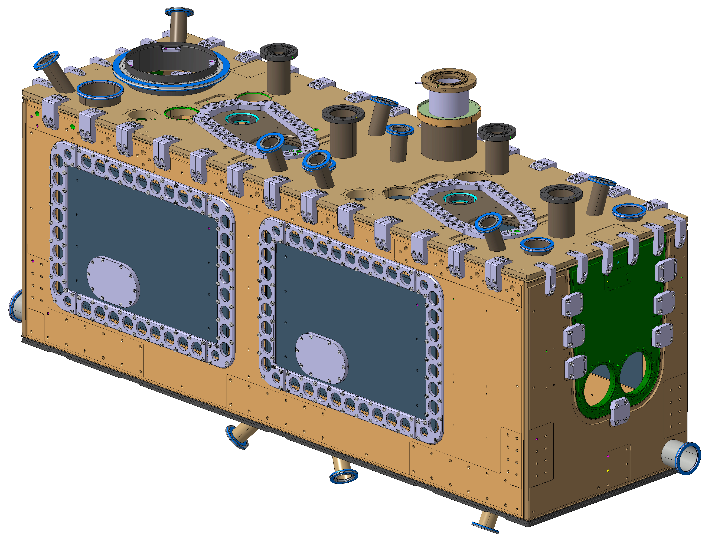
Outer Vacuum Chamber (OVC)
 |  | Drawing number | EDMS references
 | Vacuum Tank Dummy Assembly | LHCACFVT0183 LHCACFVT0184 | Drawing folder: https://edms.cern.ch/document/2823214 Engineering specification: https://edms.cern.ch/document/2101924 Calculation: https://edms.cern.ch/document/2272855 (vacuum vessel) https://edms.cern.ch/document/3024966 (safety port)

Slide 7


Slide 8
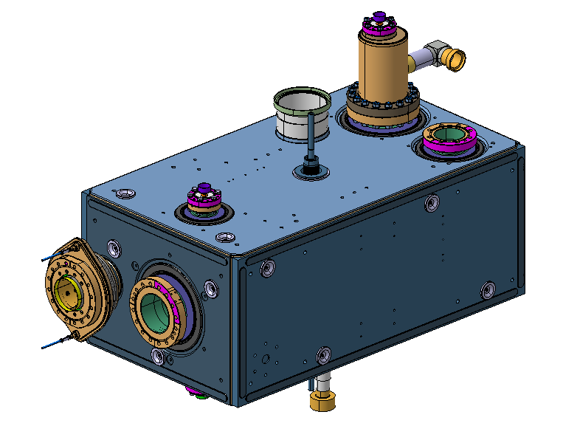
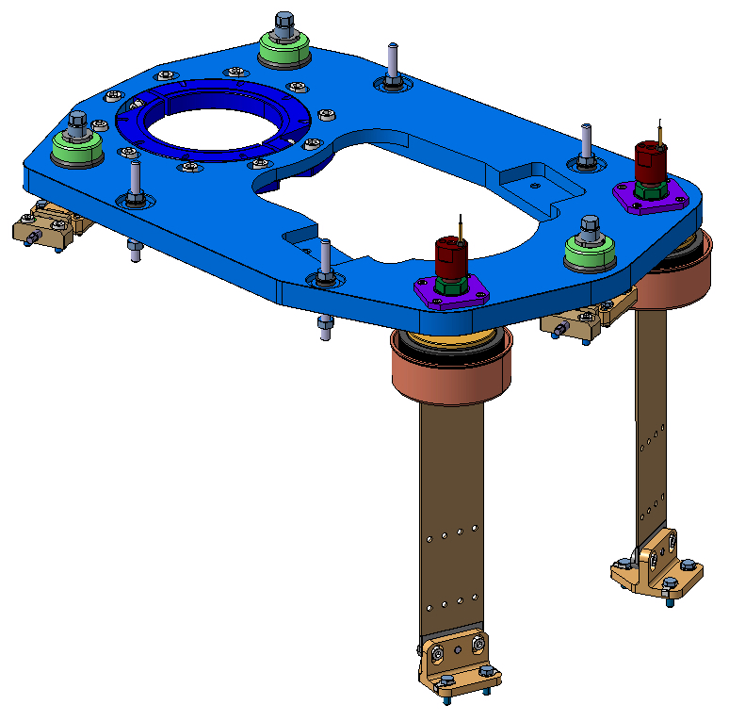
Cavity and cavity support
 |  | Drawing number | EDMS references
 | Dressed cavity | LHCACFDC0013 | Drawing folder: http://edms.cern.ch/document/2780621 Engineering specification: https://edms.cern.ch/document/1389669 Calculation: https://edms.cern.ch/document/2276057
 | Cavity support | LHCACFAH0101 | Drawing folder: https://edms.cern.ch/document/2966544 Engineering specification: https://edms.cern.ch/document/2632333 (material) Calculation: https://edms.cern.ch/document/3175999

Slide 10
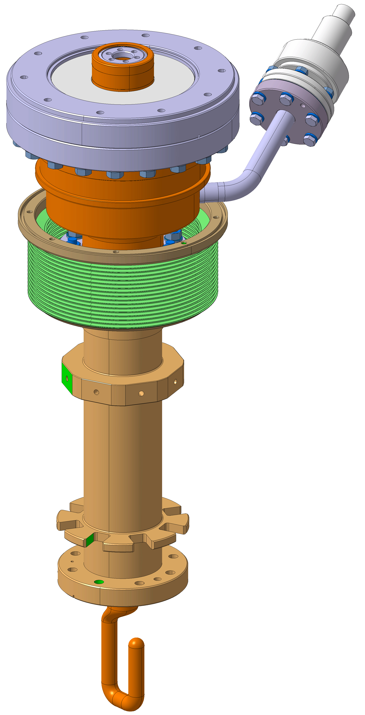
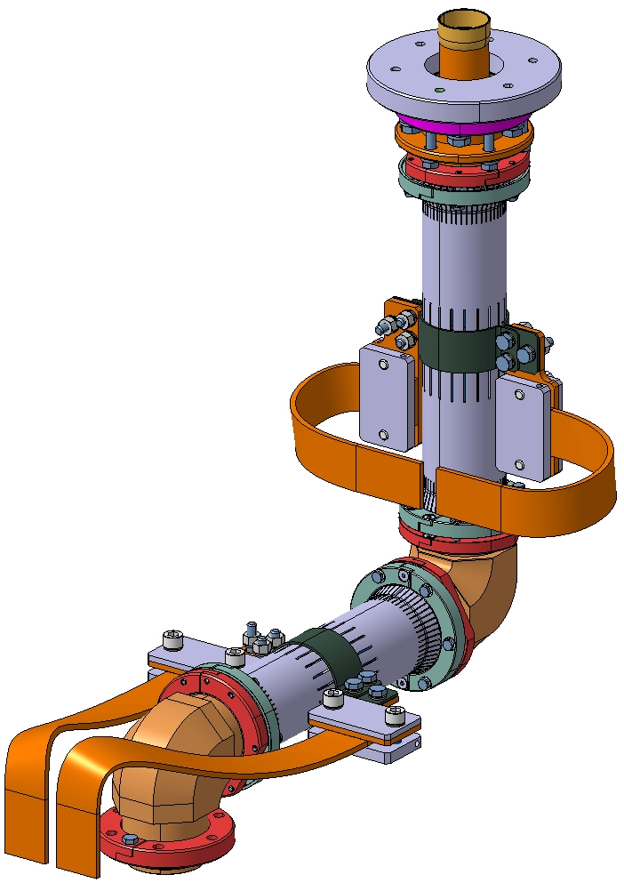
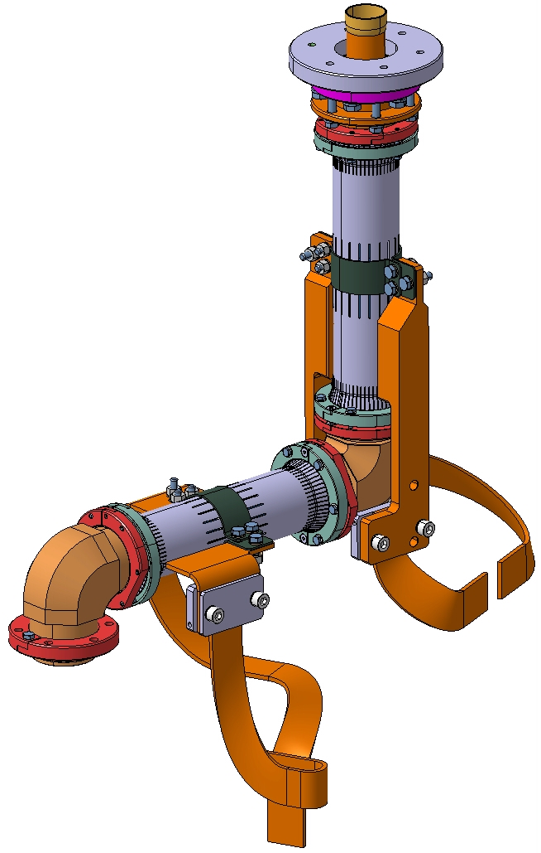
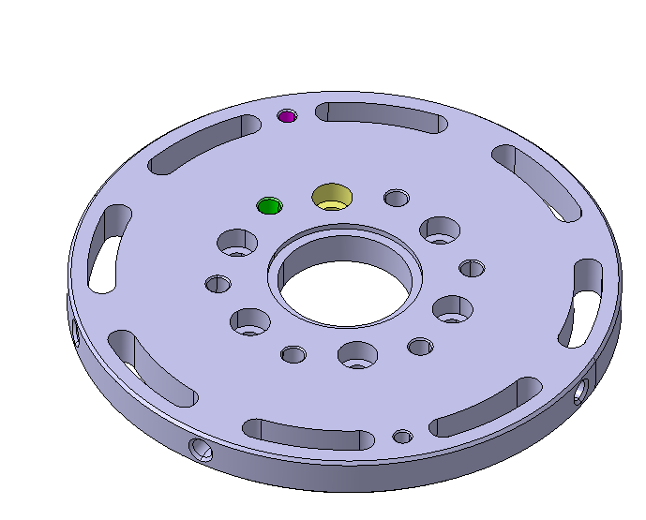
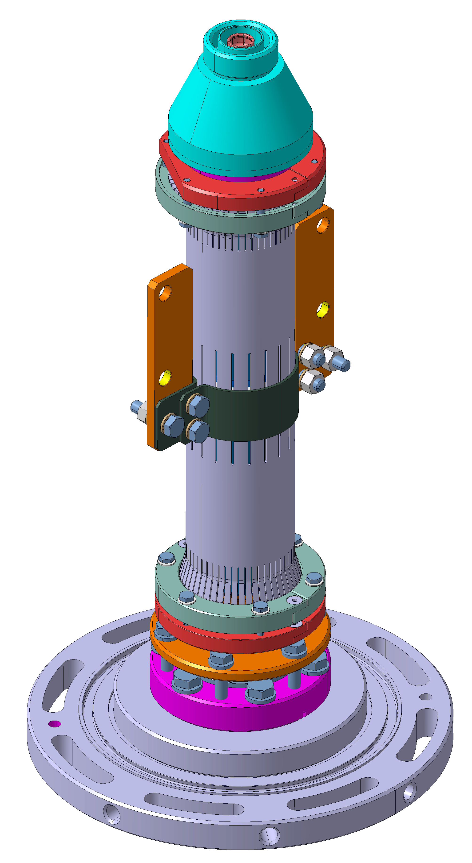
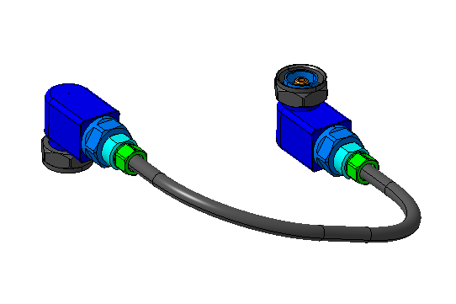
RF equipment (design by SY-RF team)
 |  | Drawing number | EDMS references
 | FPC with outer pipe | LHCACFMC0207 | Drawing folder: https://edms.cern.ch/document/2595726 Engineering specification: https://edms.cern.ch/document/2101934 Calculation: https://edms.cern.ch/document/2218580 https://edms.cern.ch/document/2767197
 | H-HOMS/V-HOMS coaxial lines | LHCACFRL0218 LHCACFRL0281 LHCACFRL0282 LHCACFRL0285 | Drawing folders: https://edms.cern.ch/document/2769089 https://edms.cern.ch/document/2769165 Engineering specification: https://edms.cern.ch/document/2605345 Calculation: https://edms.cern.ch/document/2233186
 | Pick up antenna coaxial lines | LHCACFRL0278 | Drawing folder: https://edms.cern.ch/document/2769047 Engineering specification: https://edms.cern.ch/document/2605345 Calculation: https://edms.cern.ch/document/2592079
 | Antennas flexible cable

Slide 11


Slide 12
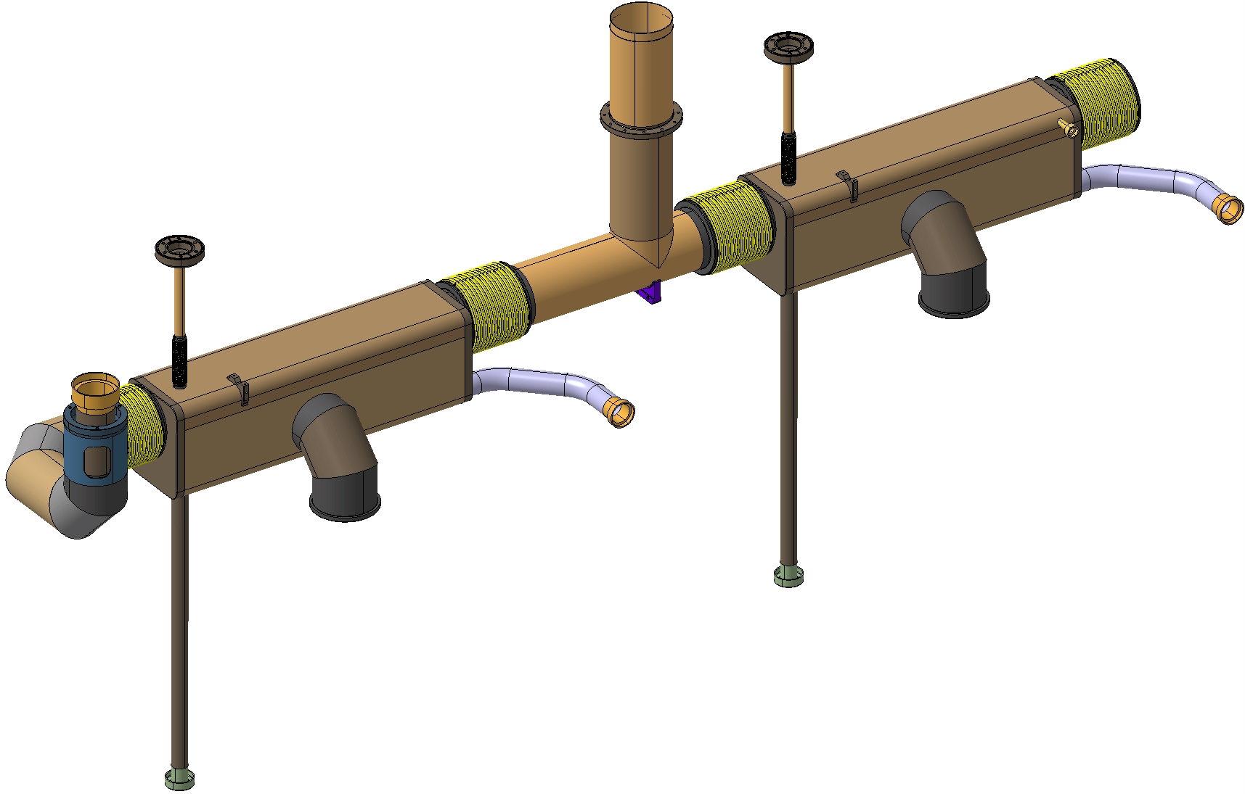
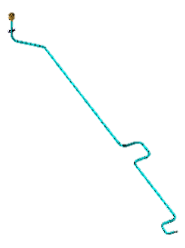
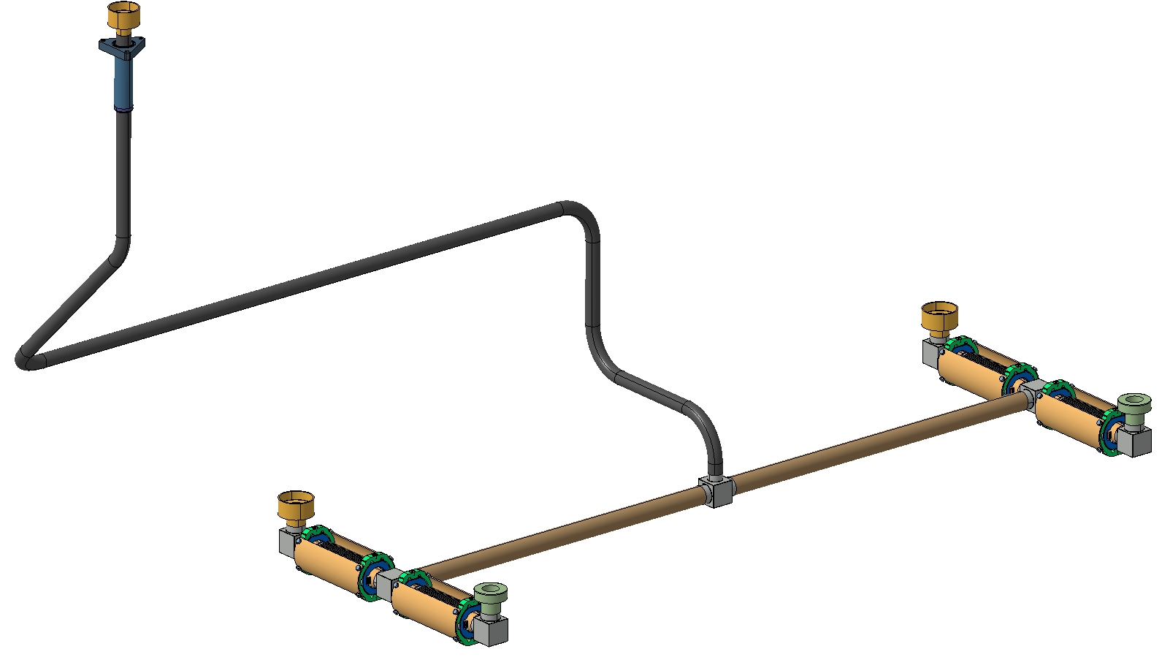
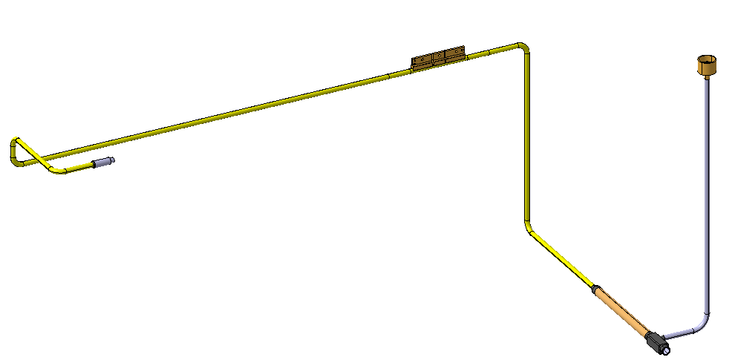
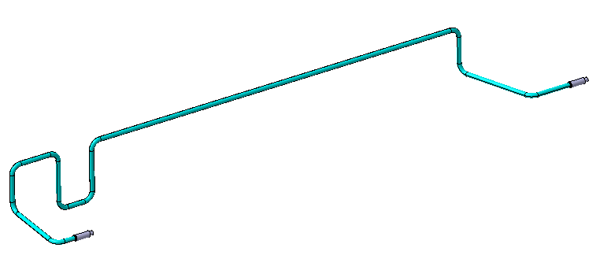
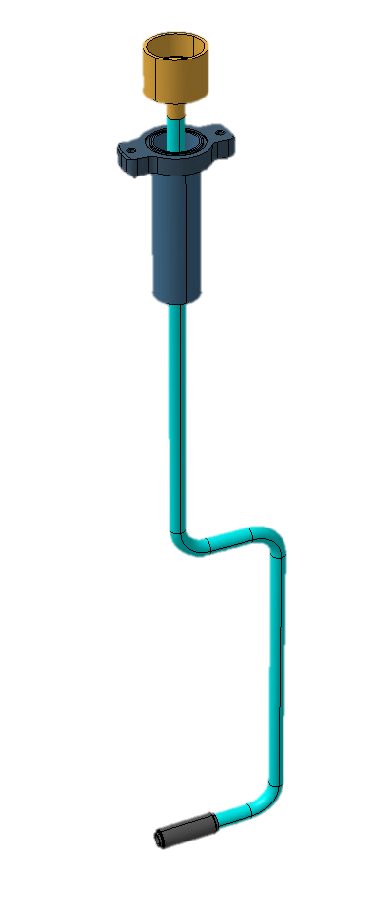
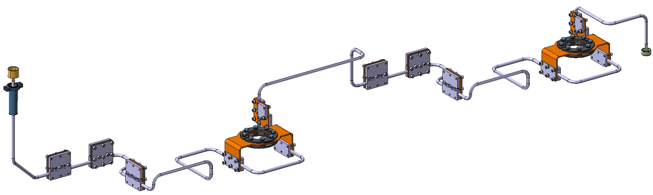
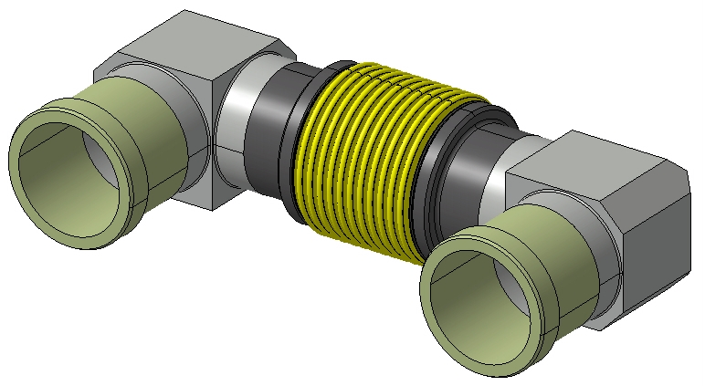
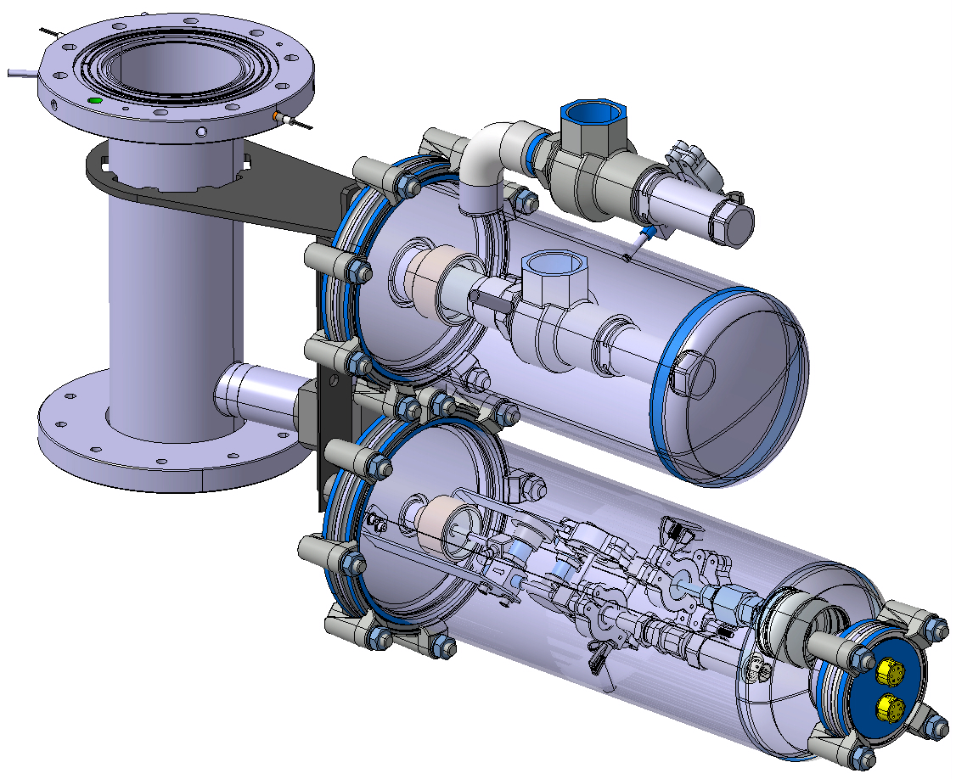
Cryogenic equipment and supports
 |  | Drawing number | EDMS references
 | Biphase line | LHCACFQC0494 | Drawing folder: https://edms.cern.ch/document/2873198 Engineering specification: https://edms.cern.ch/document/2093032 Calculation: https://edms.cern.ch/document/2477175
 | 2K filling line | LHCACFQC0224 | Drawing folder: https://edms.cern.ch/document/2566161 Engineering specification: https://edms.cern.ch/document/2093032
 | Lower line | LHCACFQC0488 | Drawing folder: https://edms.cern.ch/document/2566179 Engineering specification: https://edms.cern.ch/document/2093032 Calculation: https://edms.cern.ch/document/2477175
 | 4-20K cooling line | LHCACFQC0303 LHCACFQC0300 LHCACFQC0299 LHCACFQC0525 | Drawing folders: https://edms.cern.ch/document/2566185 https://edms.cern.ch/document/2566184 https://edms.cern.ch/document/2566181 https://edms.cern.ch/document/3007180 Engineering specification: https://edms.cern.ch/document/2093032
 | HOM flexible link | LHCACFQC0256 | Drawing folder: https://edms.cern.ch/document/2566188 Engineering specification: https://edms.cern.ch/document/2093032
 | Cryogenic safety extension | LHCACFQC0428 | Drawing folder: https://edms.cern.ch/document/2721714 Engineering specification: https://edms.cern.ch/document/2806004
after step 12, design in progress

Slide 13
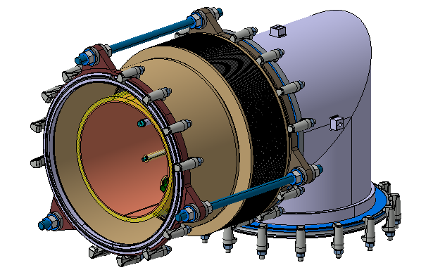
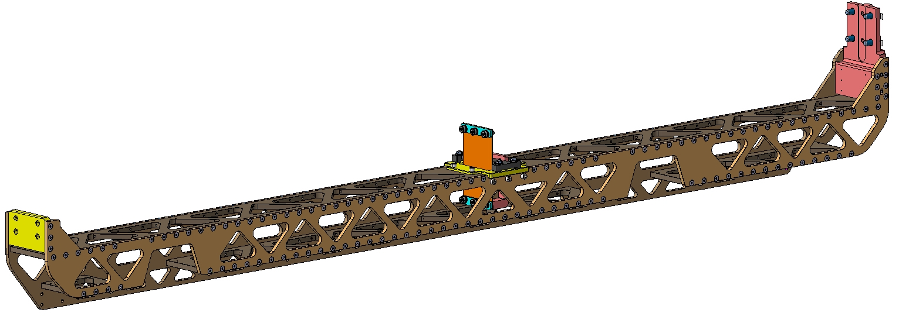
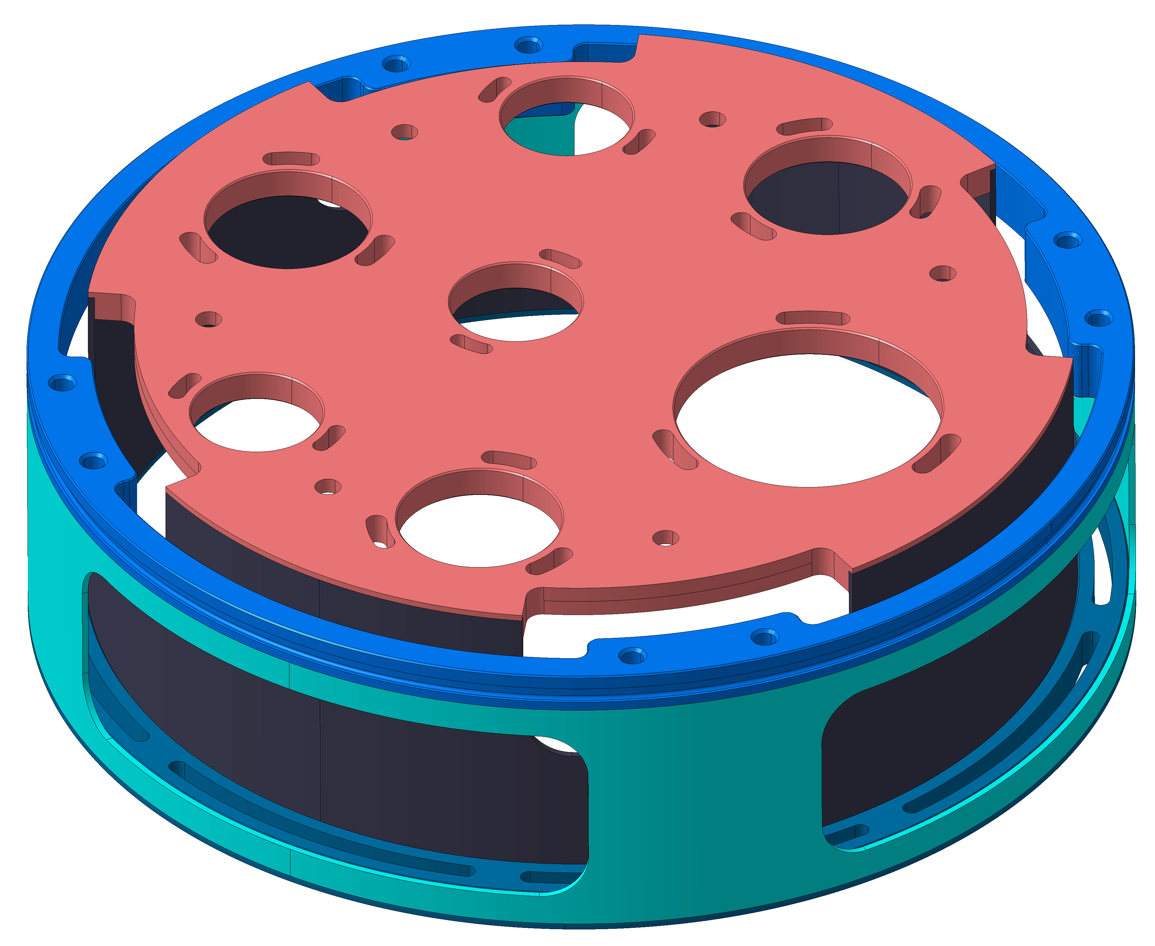
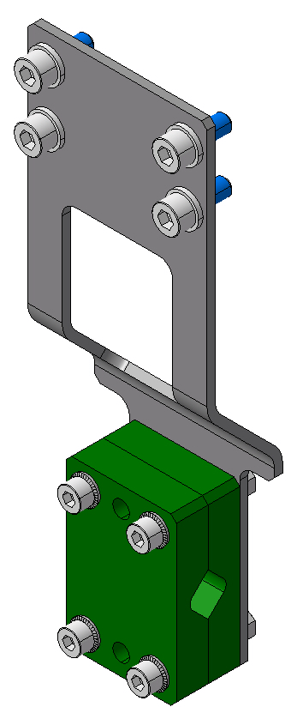
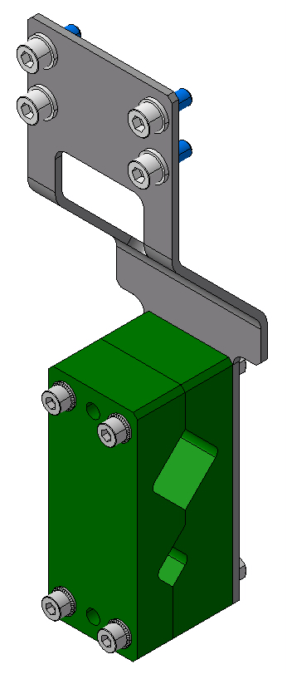
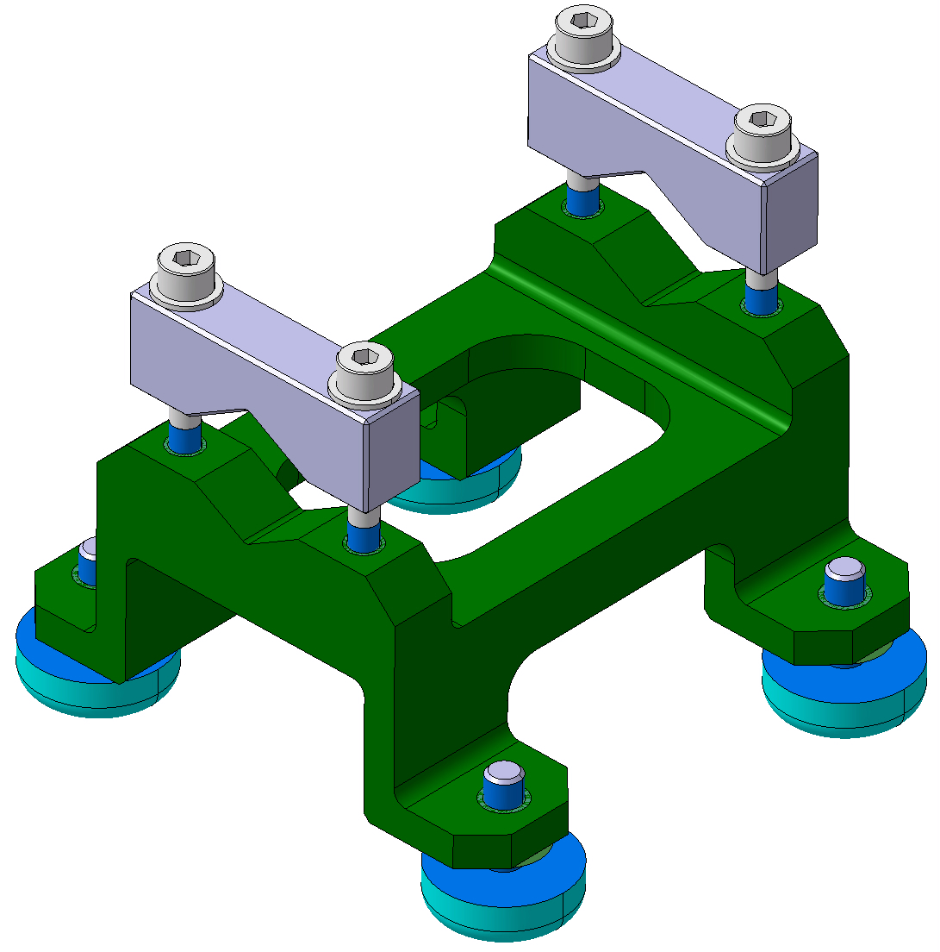
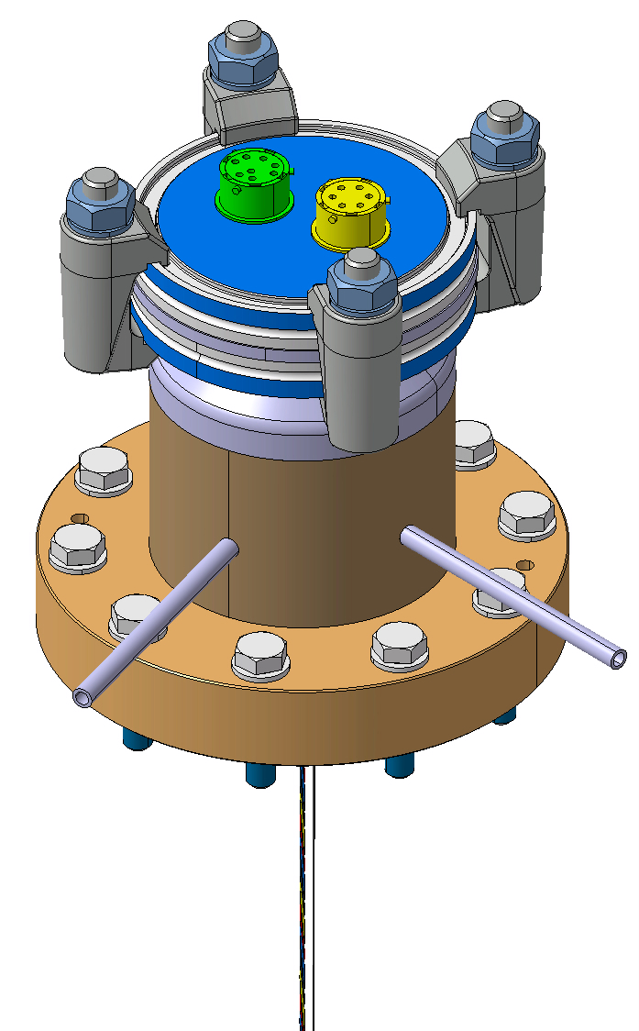
Cryogenic equipment and supports
 |  | Drawing number | EDMS references
 | Jumper |  | Engineering specification: https://edms.cern.ch/document/3055177
 | Biphase support | LHCACFQC0605 | Drawing folder: https://edms.cern.ch/document/2977699 Engineering specification: https://edms.cern.ch/document/2093032 Calculation: https://edms.cern.ch/document/3063725
 | Jumper support | LHCACFQC0310 | Drawing folder: https://edms.cern.ch/document/2577950
 | 4-20K cooling line support | LHCACFQC0647 LHCACFQC0650 | Drawing folders: https://edms.cern.ch/document/3193632 https://edms.cern.ch/document/3193633
 | Heater support | LHCACFAH0090
 | Helium guard for level gauge | LHCACFVT0113 | Drawing folder: https://edms.cern.ch/document/2883208 Engineering specification: https://edms.cern.ch/document/2806004
 | Instrumentation and supports |  | Drawing folder: https://edms.cern.ch/document/3140654
after step 12, design in progress

Slide 15
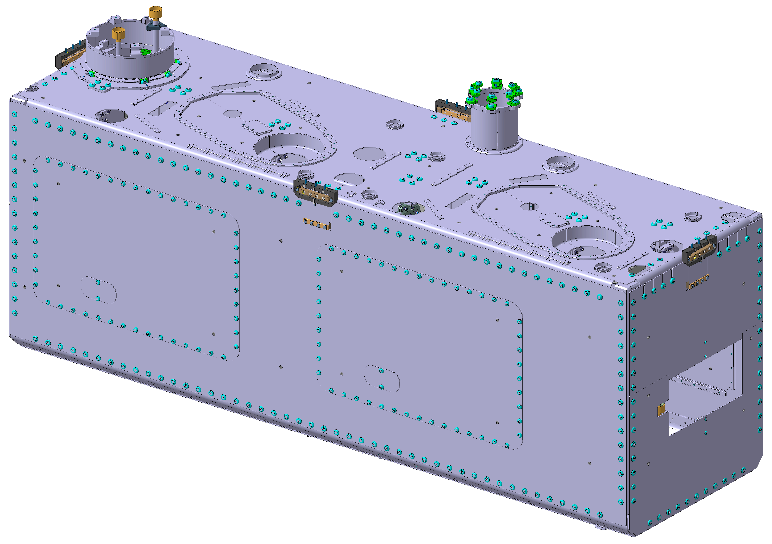
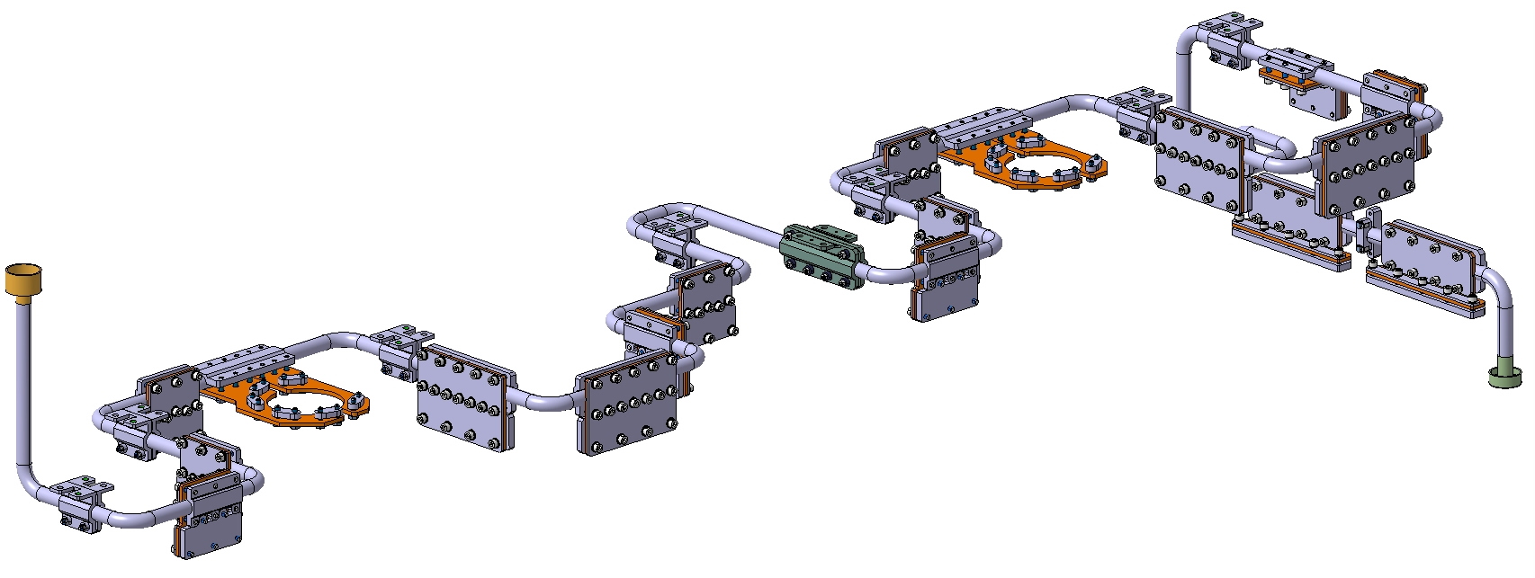
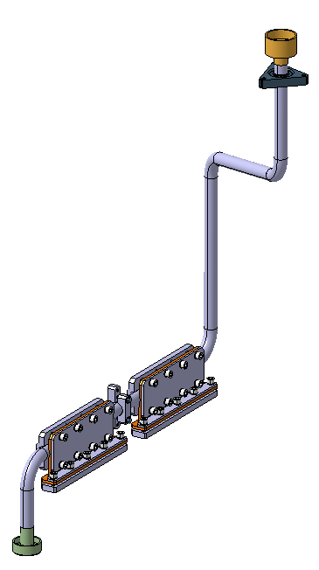
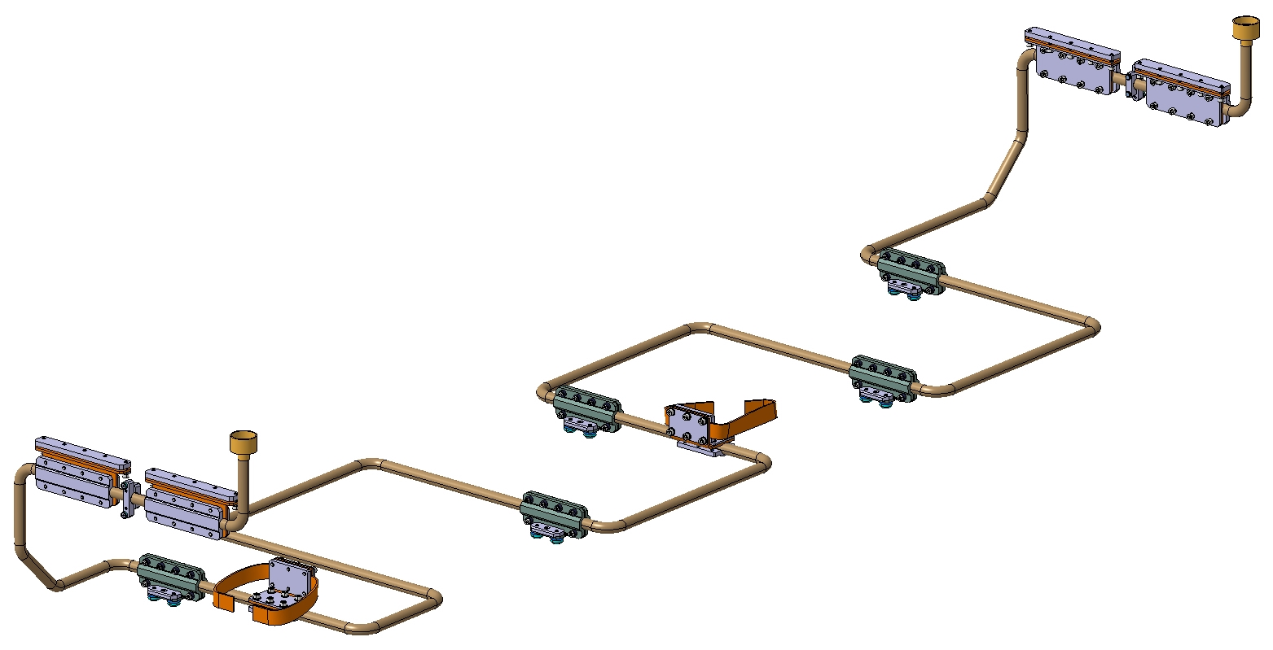
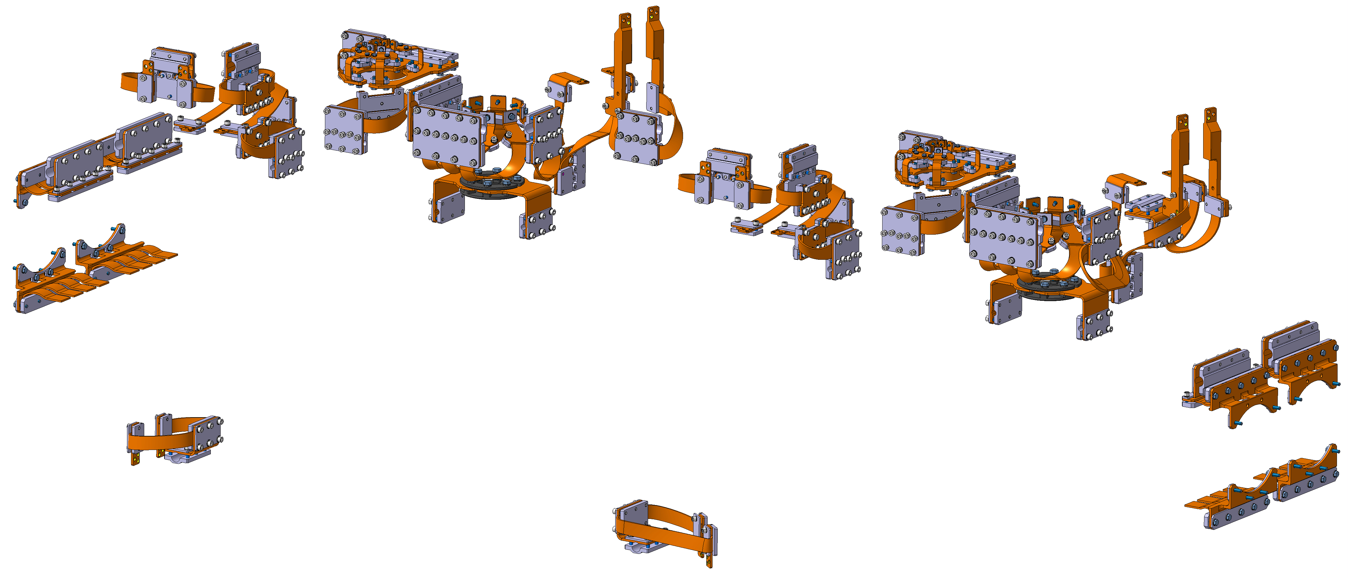
Thermal screen
 |  | Drawing number | EDMS references
 | Thermal screen | LHCACFTS0460 | Drawing folder: https://edms.cern.ch/document/2826339 Engineering specification: https://edms.cern.ch/document/2101922 Calculation: https://edms.cern.ch/document/2936498
 | 50K upper line | LHCACFQC0505 | Drawing folder: https://edms.cern.ch/document/3193924 Engineering specification: https://edms.cern.ch/document/2101922 Calculation: https://edms.cern.ch/document/2936498
 | 50K outlet line | LHCACFQC0390 | Drawing folder: https://edms.cern.ch/document/3193926 Engineering specification: https://edms.cern.ch/document/2101922 Calculation: https://edms.cern.ch/document/2936498
 | 50K lower line | LHCACFQC0500 | Drawing folder: https://edms.cern.ch/document/3193919 Engineering specification: https://edms.cern.ch/document/2101922 Calculation: https://edms.cern.ch/document/2936498
 | Braids for thermal intercept | LHCACFTS0518 | Drawing folder: https://edms.cern.ch/document/3016774 Engineering specification: https://edms.cern.ch/document/2101922 Calculation: see RF lines calculations

Slide 17
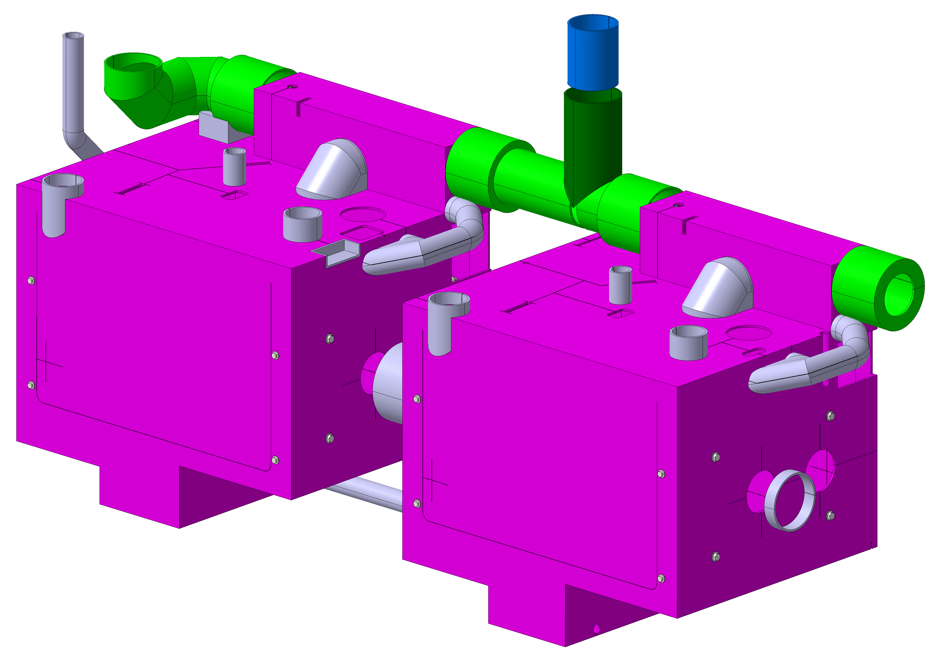
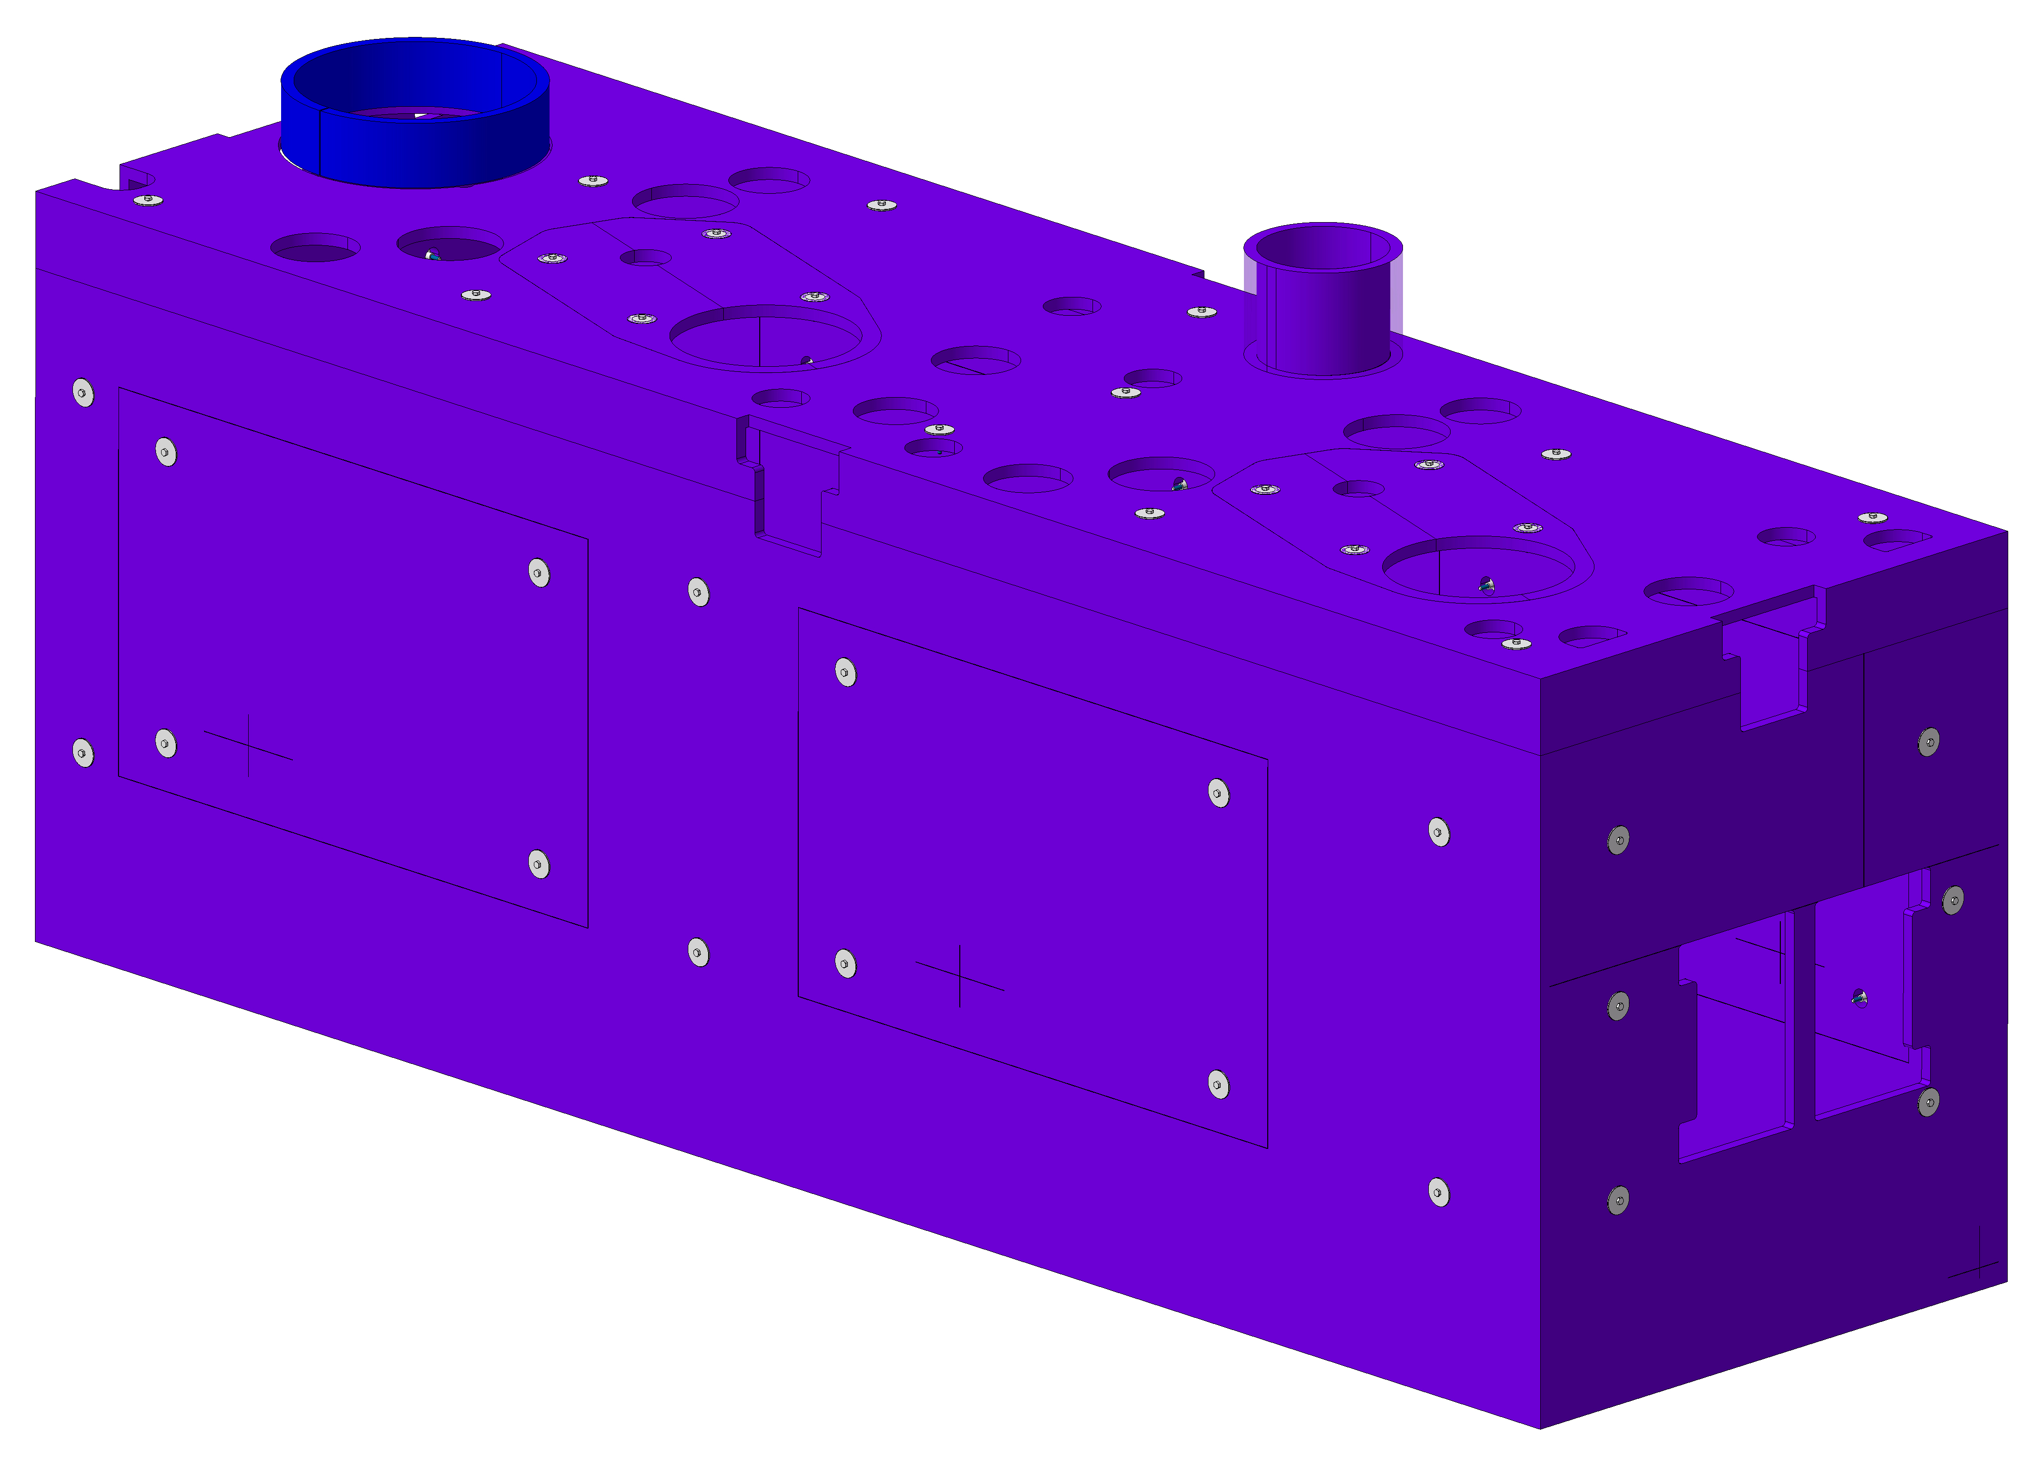
MLI (detailed design managed by manufacturer)
 |  | Drawing number | EDMS references
 | MLI 2K | LHCACFTS0514 | Drawing folder: https://edms.cern.ch/document/3015832 Engineering specification: https://edms.cern.ch/document/2144140
 | MLI 50K | LHCACFTS0515

Slide 18


Slide 19
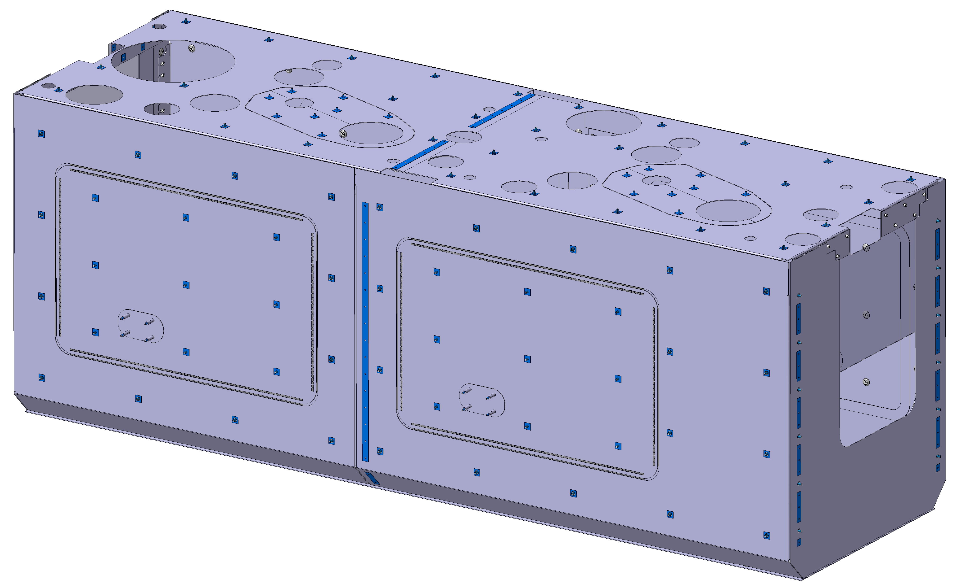
Warm Magnetic Shield
 |  | Drawing number | EDMS references
 | Warm Magnetic Shield | LHCACFWM0058 | Drawing folder: https://edms.cern.ch/document/2825848 Engineering specification: https://edms.cern.ch/document/2101926

Slide 21
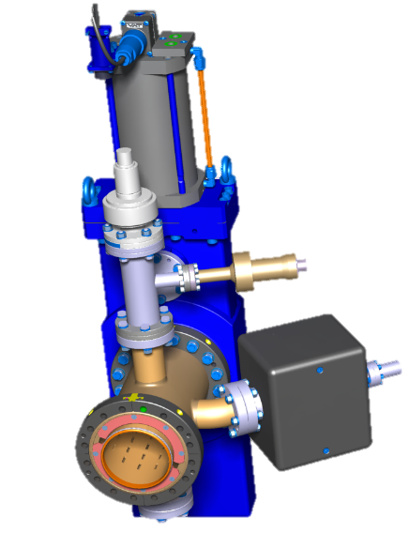
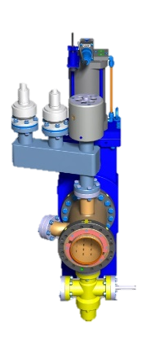
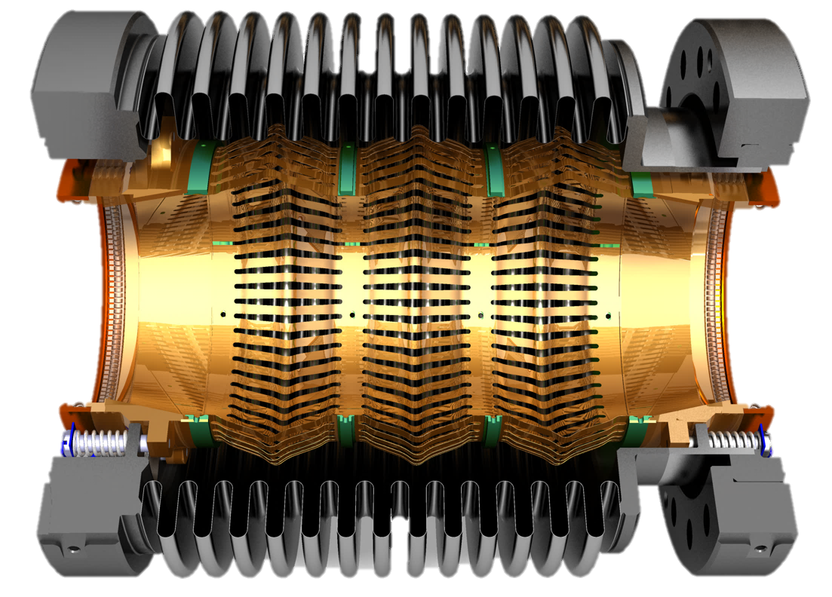
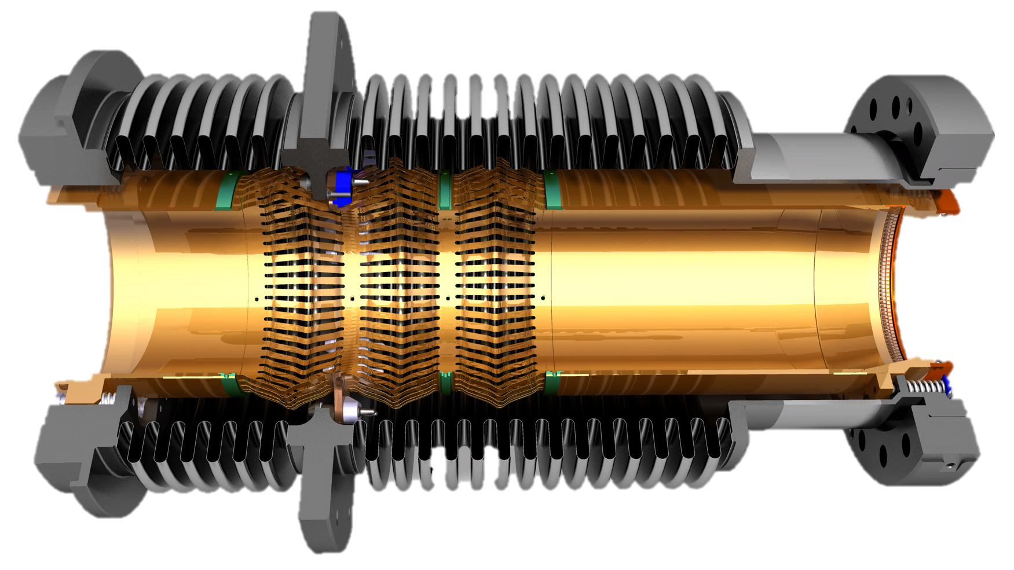
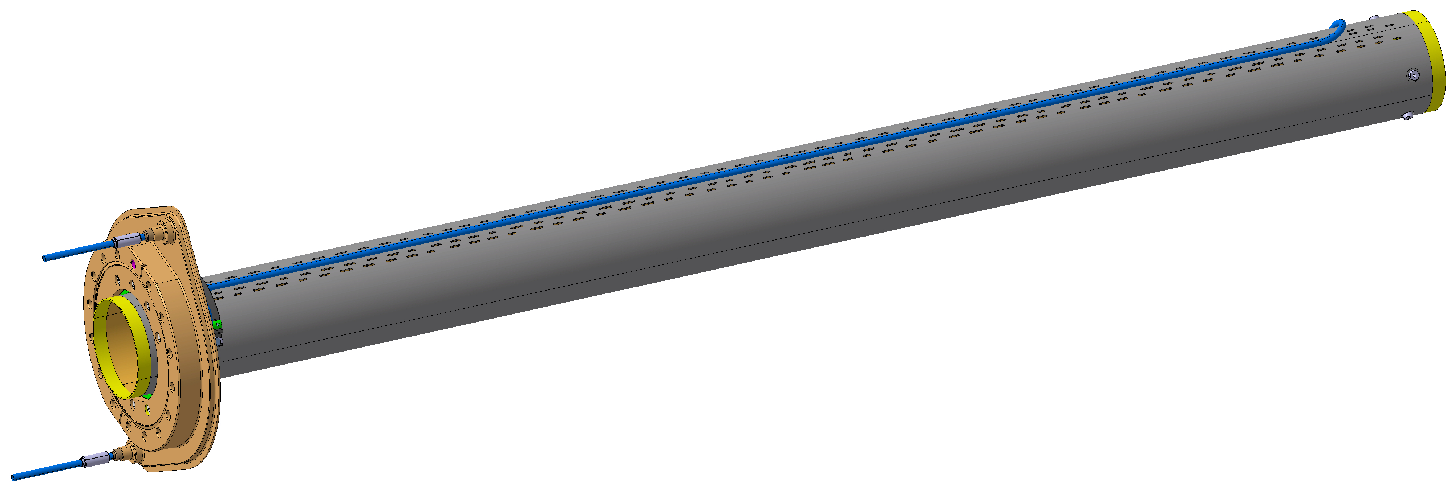
UHV Chambers
 |  | Drawing number | EDMS references
 | Extremity vacuum chamber | LHCAVA__0202 LHCAVA__0203 LHCAVA__0204 LHCAVA__0205 | Drawing folder: https://edms.cern.ch/document/2728852
 | Cold warm transition cavity line SHORT | LHCVBMCC0032 | Drawing folder: https://edms.cern.ch/document/2274615
 | Cold warm transition cavity line LONG | LHCVBMCC0034 | Drawing folder: https://edms.cern.ch/document/2274634
 | Cold warm transition secondary line SHORT | LHCVBMCC0033 | Drawing folder: https://edms.cern.ch/document/2273908
 | Cold warm transition secondary line LONG | LHCVBMCC0035 | Drawing folder: https://edms.cern.ch/document/2274732
 | Inter cavity chamber | LHCVBMCI0014 | Drawing folder: https://edms.cern.ch/document/2396174
 | Inter beam screen chamber | LHCVBMCI0015 | Drawing folder: https://edms.cern.ch/document/2396178
 | Beam screen (included in Dressed Cavity) | LHCVSSCA0024 | Drawing folder: https://edms.cern.ch/document/2359491 Calculation: https://edms.cern.ch/document/2399620

Slide 23
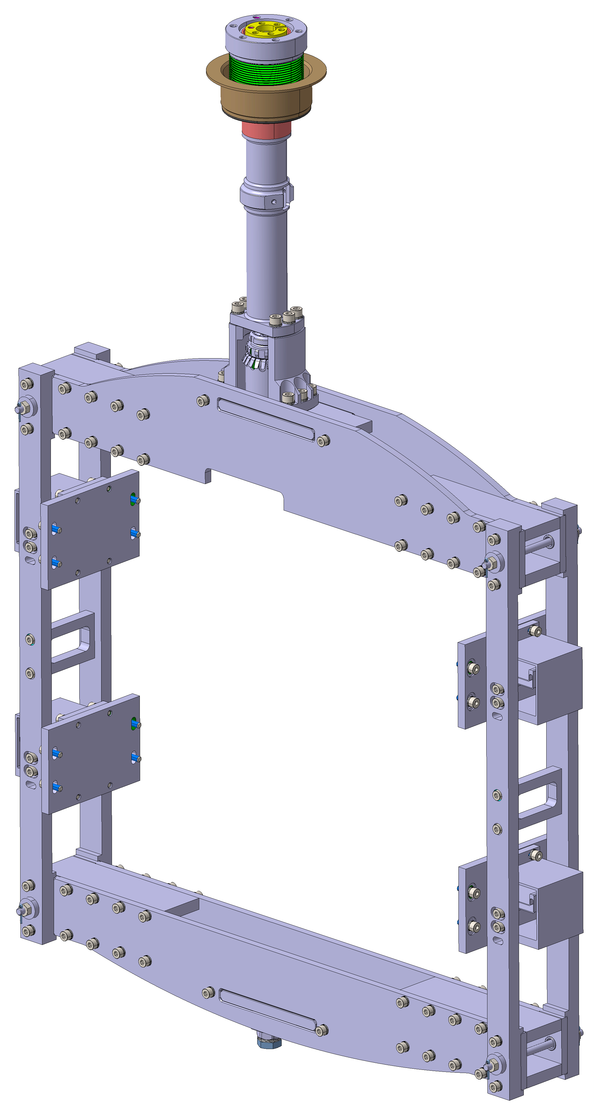
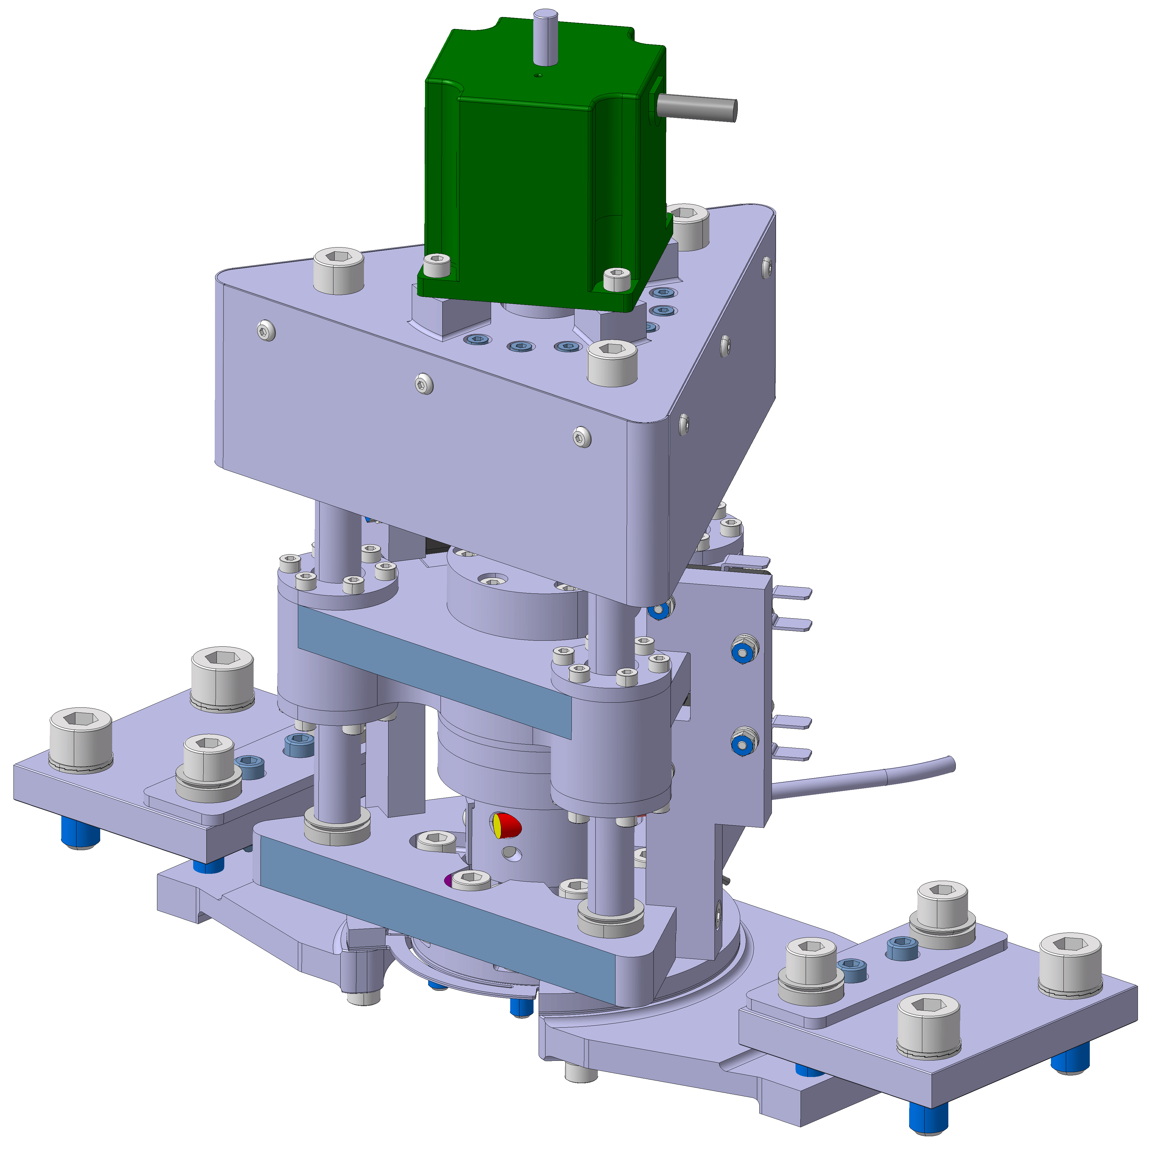
Tuner
 |  | Drawing number | EDMS references
 | Tuner Frame | LHCACFTU0257 | Drawing folder: https://edms.cern.ch/document/3000555 Engineering specification: https://edms.cern.ch/document/2101938 Calculation: https://edms.cern.ch/document/2310327
 | Tuner Actuation Bellows | LHCACFTU0260
 | Bottom coupling | LHCACFTU0269, 171, 068, 270 + lip washer
 | Top coupling | LHCACFTU0271, 272, 210, 211 + lip washer
 | Tuning rod reinforcement | LHCACFTU0217
 | Outer tube spacer | LHCACFTU0264
 | Flexural guidance | LHCACFTU0265, 266
 | Tuner actuation | LHCACFTU0286 LHCACFTU0315 | Drawing folder: https://edms.cern.ch/document/3087421 Engineering specification: https://edms.cern.ch/document/2101938

Slide 25
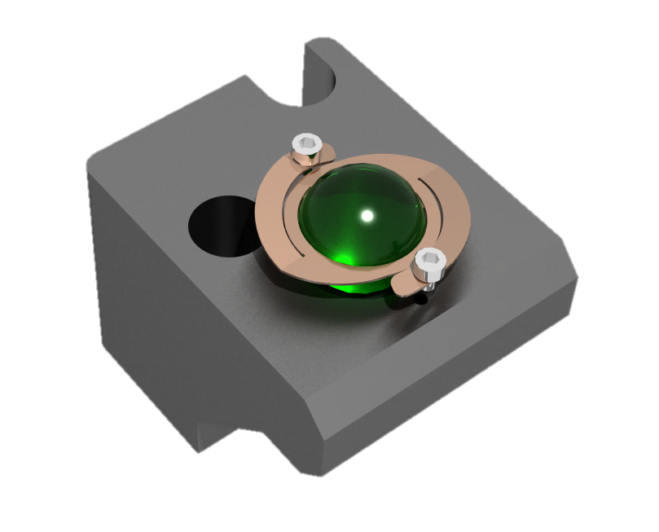
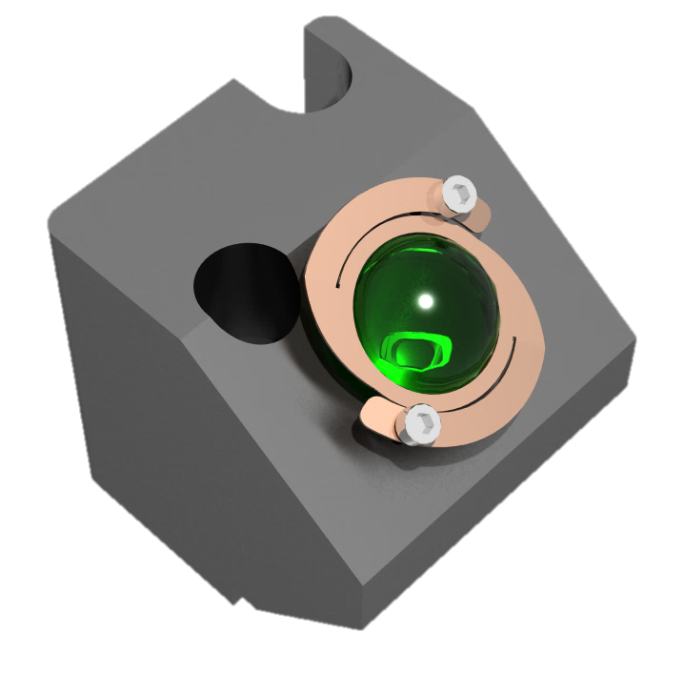
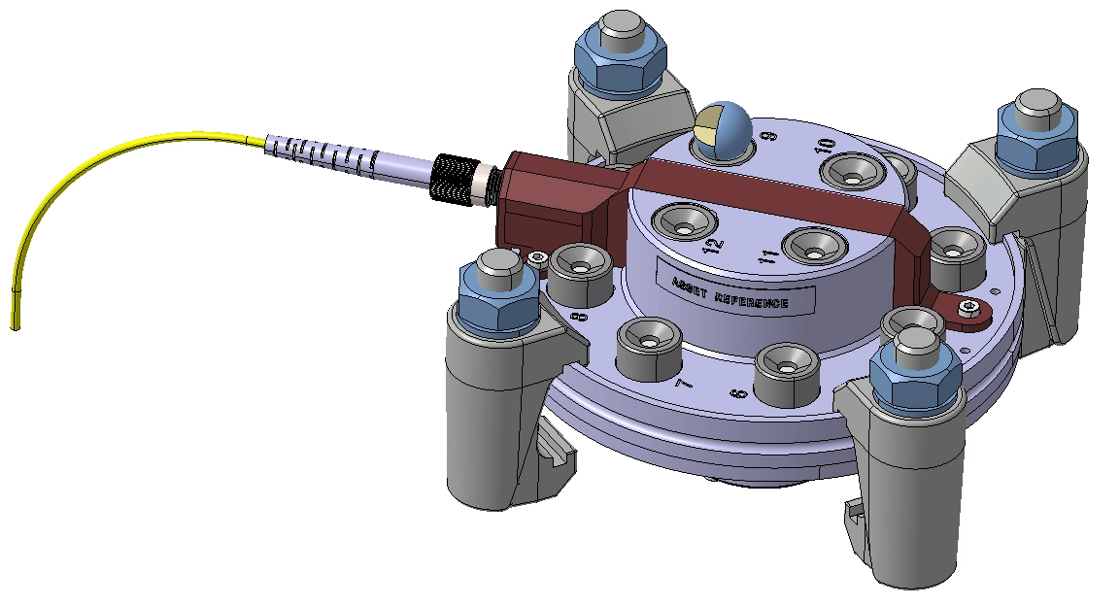
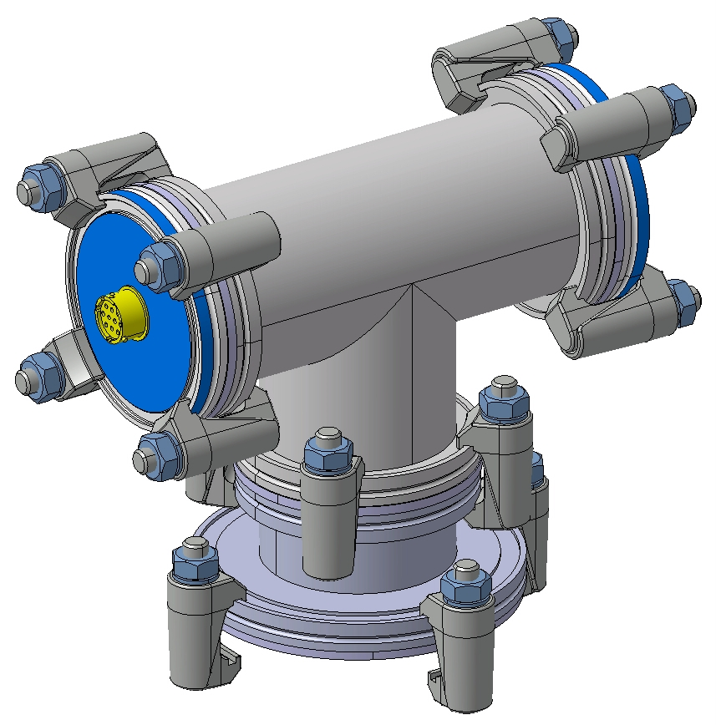
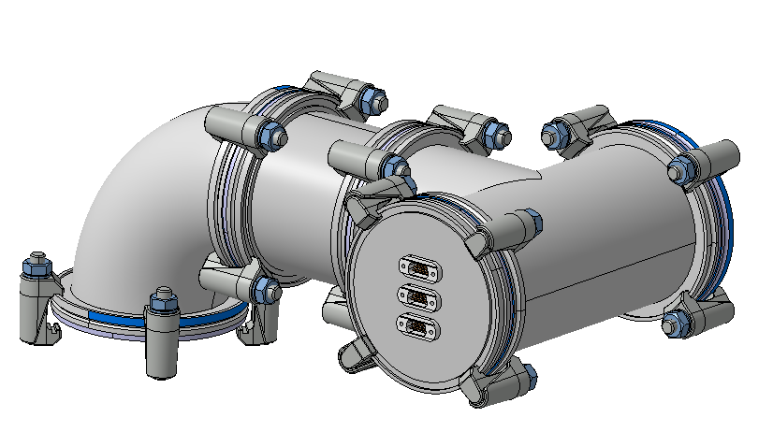
Other equipment
 | FSI targets | LHCGIOFV0023 LHCGIOFV0025
 | FSI flanges | LHCGIOFV0026
 | Instrumentation feedthroughs | standard components
 | Instrumentation box | design ongoing

Slide 28
Thank you for your attention

