Slide 1
Quantum Information at LHC
Maximiliano Sioli
University of Bologna and INFN
10th BCD International School on High Energy Physics
Cargese – 19 March 2025

Slide 2
Outline
Motivations for this new line of research
Quantum vs Classical correlations
A working example: top-antitop pairs at LHC
QI as a proxy for BSM physics

Slide 3
Motivations
Foundations of QM have typically been explored in the low energy regime (e.g. quantum optics)
At high energy, QM (and therefore QFT) is simply given for granted
Quantum Computing has provided a new impetus to reorganize the vocabulary of QI
Can we exploit this for:
  test QM foundations at the TeV scale?
  can we use QI-inspired observables as new handles to search for new physics?

Slide 4
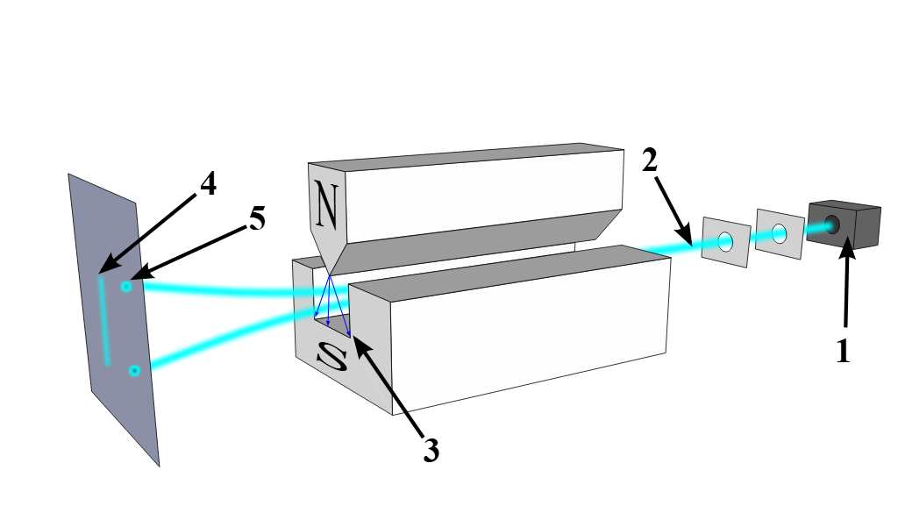
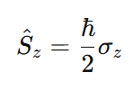
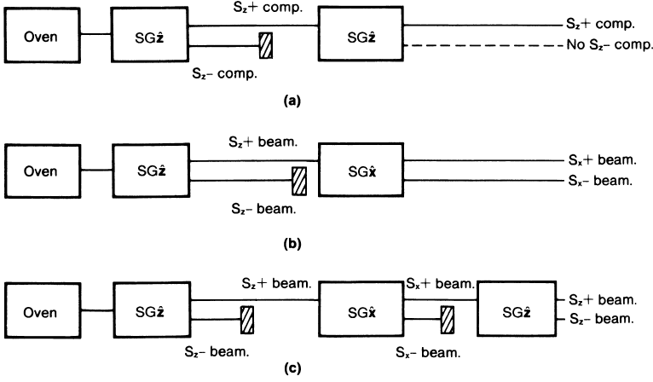
Deep inside QM: S&G
The 1921 Stern and Gerlach experiment is perhaps the one at the heart of quantum mechanics.
We have learned two things: spin projections are dichotomic and
non-commuting variables

Slide 5
Deep inside QM: S&G
The non-homogeneous magnetic field measures (in a quantum-mechanical sense) the spin projections
This is a projective quantum measurement, which in the language of quantum mechanics is an observable with discrete eigenvalues.
After the measurement, the system “collapses” in the eigenstate corresponding to the measured eigenvalue: for the moment let us assume that this is true, and neglect the decoherence phenomenon, i.e. let us assume that the measurement is a non unitary quantum process

Slide 6


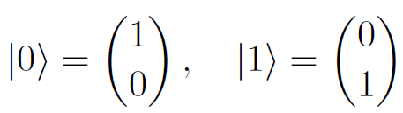
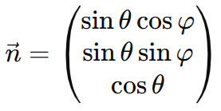

S&G in a mature QI language
A classical bit can assume two states: 0 and 1
A quantum bit (q-bit or qubit) is in general in a superposition of these two states:
These states live in a 2-dim Hilbert space and we can represent them as:
Spin ½ particle is a qubit: its spin direction is described with a vector in the 3-dim space which specifies the spin quantization direction

Slide 7
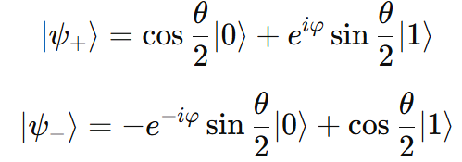
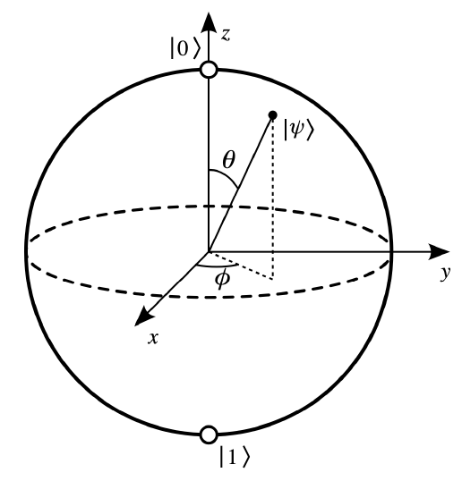
Spin ½ particle = qubit
The solution of the eigenvalue equation is:
which can be visualized by means of the Bloch Sphere

Slide 8
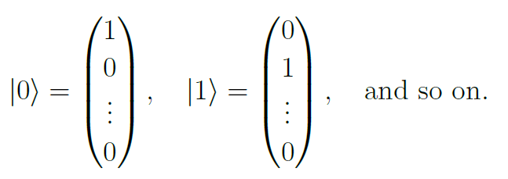
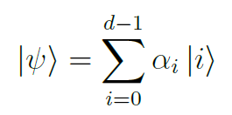
Qudits
In addition to the case of qubits (e.g. spin of fermions or polarization of photons), we can have multi-level systems:
qu-d-its
In this case:

Slide 9
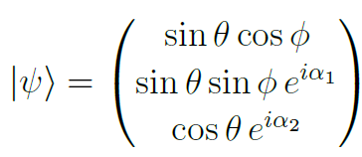

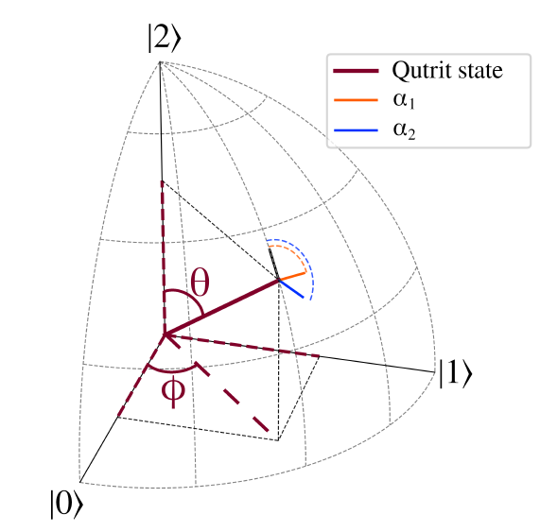
Qutrits
We can extend the concept to 3-state systems: qutrits
Example: polarization of massive vector bosons (W, Z)
In this case:
In general, a state can be
parameterized by d-1 angles
and d-1 phases

Slide 10
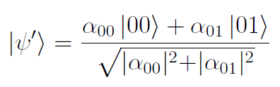
Systems of two qubits
Things become interesting when we consider composite systems
For instance, two (qu)bits. In the classical case, we have:
00, 01, 10, 11
In the quantum case:
with |α₀₀|² + |α₀₁|² + |α₁₀|² + |α₁₁|² = 1
If we measure the first qubit (with outcome = 0) the system “collapses” onto:

Slide 11
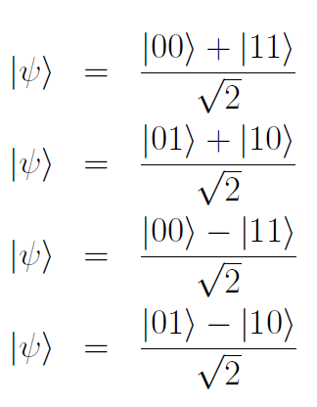
Systems of two qubits
Let us consider again the generic state:
It exists particular configurations of coefficients α_{ij} (Bell States)
➔ a measurement of the first qubit let the second instantaneously collapse
The correlation is so strong that a classical counterpart does not exist
→ entanglement

Slide 12


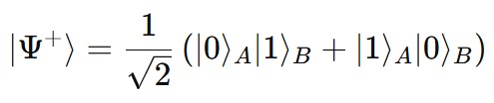
Quantum vs classical correlations
Classical:
Quantum: a state of a particle cannot be described independently from the other
Mathematically: a system composed by two subsystems is entangled if the global state is not separable, i.e. it cannot be described as
for some
Example, the Bell State
is maximally entangled

Slide 13
Correlations
Classical correlations
Entanglement

Slide 14
Einstein, Podolsky and Rosen
Quantum mechanics represents a radical change in the way we think about reality. In the classical way of thinking the property of what we want to measure, a particle spin projection for example, exists independently of the measurement itself: the measurement is simply a way of revealing this property. This concept is called realism
In quantum mechanics this is not true, an unobserved particle does not possess physical properties that exist independently of the measurement
Another well-established and accepted concept is locality: information can only be transmitted subluminally
Local Realism is at the very heart of a physicist common sense
EPR challenged this concept

Slide 15
EPR paradox
Let's take a practical example, invoking the spin again: according to QM, a particle does not possess, before the measurement, the property "spin along z" S_{z} and "spin along x" S_{x}
In fact, we have seen that the formalism of QM provides us with the recipe to calculate the probability of observing an eigenvalue of S_{z} and S_{x}
This fact made Einstein very dissatisfied: with his collaborators Podolsky and Rosen he devised a gedankenexperiment (which was then actually done) to demonstrate that QM is incomplete
The basic concept is that of an element of reality, or properties pre-existing to the measurement (i.e. realism)

Slide 16


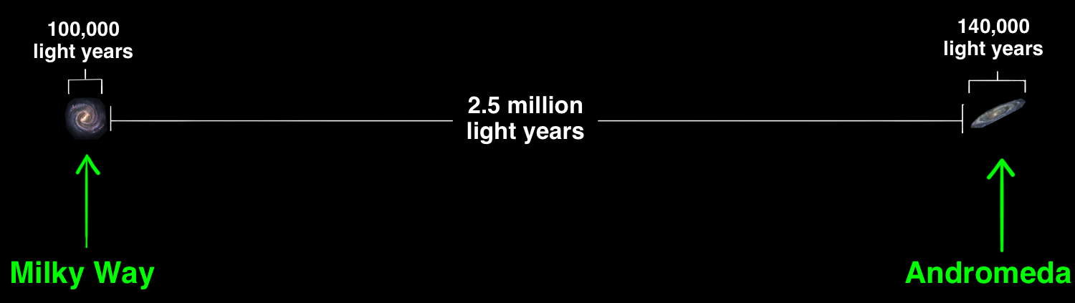
EPR paradox
This is the idea: take a scalar particle (spin 0) which decays into two fermions (spin ½) A e B
Now let's make A and B travel so that they are space-like separated
(d_{AB} > ct)
A
B

Slide 17
EPR paradox
Now suppose I measure the spin of A along a certain direction, say z
Since A and B are in a Bell state, if I measure the spin of A along this direction, B instantly collapses into the corresponding eigenstate with opposite eigenvalue
But I could have chosen to measure the spin along x, and instantly the element-of-reality S_{x} of B would have collapsed into the corresponding opposite eigenstate
So S_{x} and S_{z} must pre-exist at the time of measurement, so it is not true that [S_{x}, S_{z}] ≠ 0, contradicting Heisenberg!

Slide 18
EPR and Bell
In 1964 Bell put this argument under stress
Consider a pair of entangled fermions A and B of which I can measure the projection of the spin on axes chosen at will (pure state of two qubits)
The correlations between the measurements predicted by QM depend on the relative orientation of the axes and – interestingly – in some cases are different from the classical ones (= generated by hidden variables)
Let's see how...

Slide 19



EPR and Bell
Suppose we have a spin ½ particle prepared in such a way that S_{z} = ½.
Now I want to measure the projection of the spin along an axis n with direction θ with respect to n
Since
  I have a probability p⁺ = |cos(θ/2)²| of finding the parallel spin and
  p⁻ = |sin(θ/2)²| of finding the anti-parallel spin
If we want to describe such a system by means of a hidden variable theory, we must assume that there is an unknown variable λ that determines the outcome depending on the value of θ

Slide 20
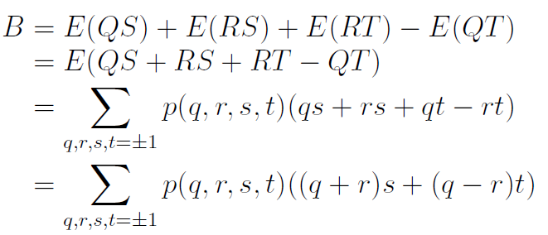
EPR and Bell
Suppose Alice measures two properties Q and R of particle A, whose outcomes are q and r, which can take dichotomous values, e.g. -1 or 1
Similarly, Bob measures two properties S and T on B whose outcomes are s and t, also of value -1 or 1
According to the hidden variable theory, at each decay the values ​​of q, r, s, t are predetermined by the value of λ. Let us calculate the value of the observable B (called Bell operator) defined as follows:
where p(q, r, s, t) is the probability that Q = q, R = r, Q = q, S = s, T = t
infact
(q+r) = ±2 and (q-r) = 0
or
(q-r) = ±2 and (q+r) = 0
B ≤ 2, independently on p

Slide 21
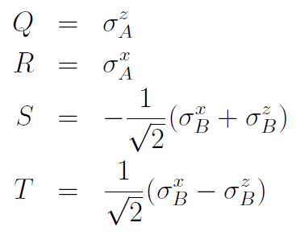
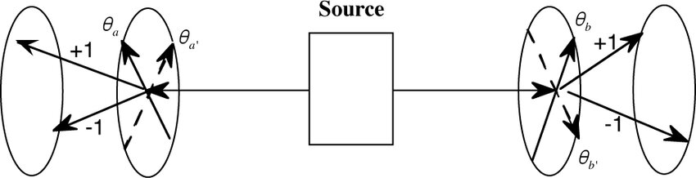
EPR and Bell
What is the prediction of QM instead? To calculate it, suppose that A and B are spin ½ particles prepared in a Bell state. The four quantities we choose to measure are:
Alice e Bob misurano ciascuno lo spin su assi ortongonali, ma ruotati di 45 gradi l’uno rispetto all’altro. Ciascun outcome è di nuovo +1 o -1. Ma ora:
B > 2 ➔ QM not realistic and/or not local

Slide 22
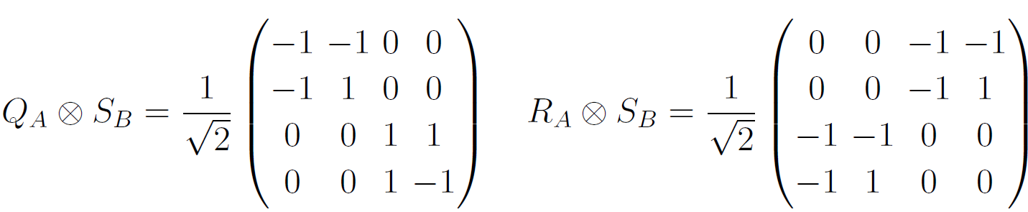
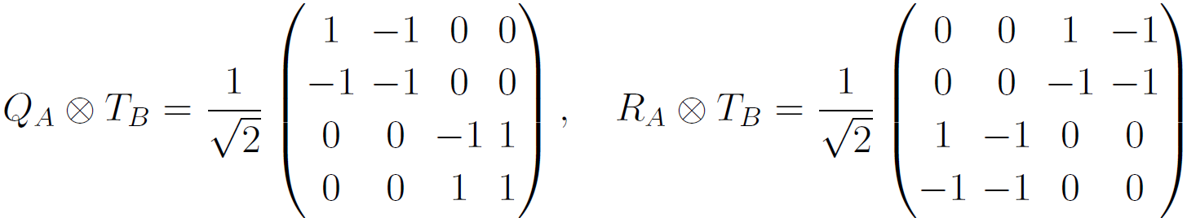
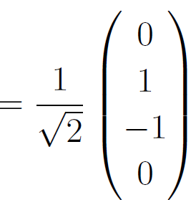
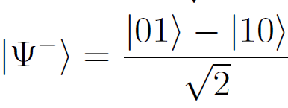
Proof
B=<ψ⁻|B|ψ⁻ > = 2√2

Slide 23
EPR and Bell
Since the 80s a multitude of experiments have confirmed QM (Nobel in 2022)
  With different observables (spin, polarizations, flavor etc)
  At different distances
  At different energies
These experiments have shown that Nature does not respect realism and/or locality

Slide 24
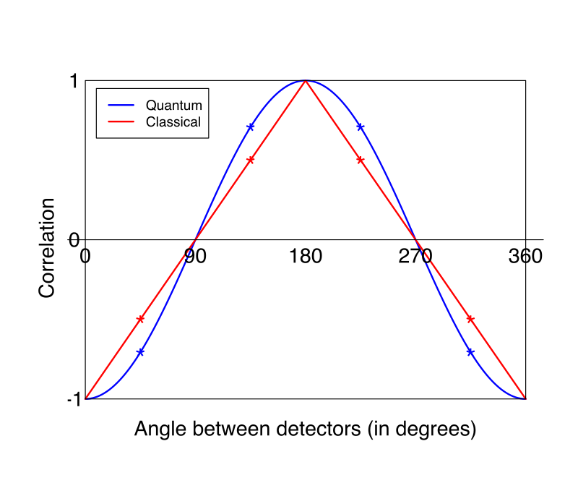
Comments
The observables were chosen precisely to
maximize the difference between HVT
and QM
Loopholes:
  Locality. This loophole is easy to close, as long as the two experiments are separated in a space-like way
  Fair Sampling. If an experiment records only a part of the data, it is possible that nature conspires to introduce a bias in that portion of the data
  Free will: Alice and Bob must freely choose on which axis to measure the spin

Slide 25
Correlations
Classical Correlations
Entanglement
Bell Inequalities Violations (BIV)

Slide 26
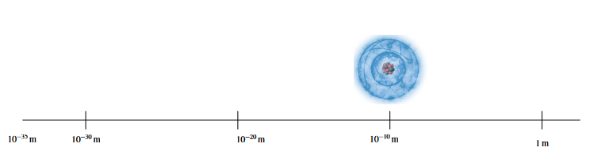
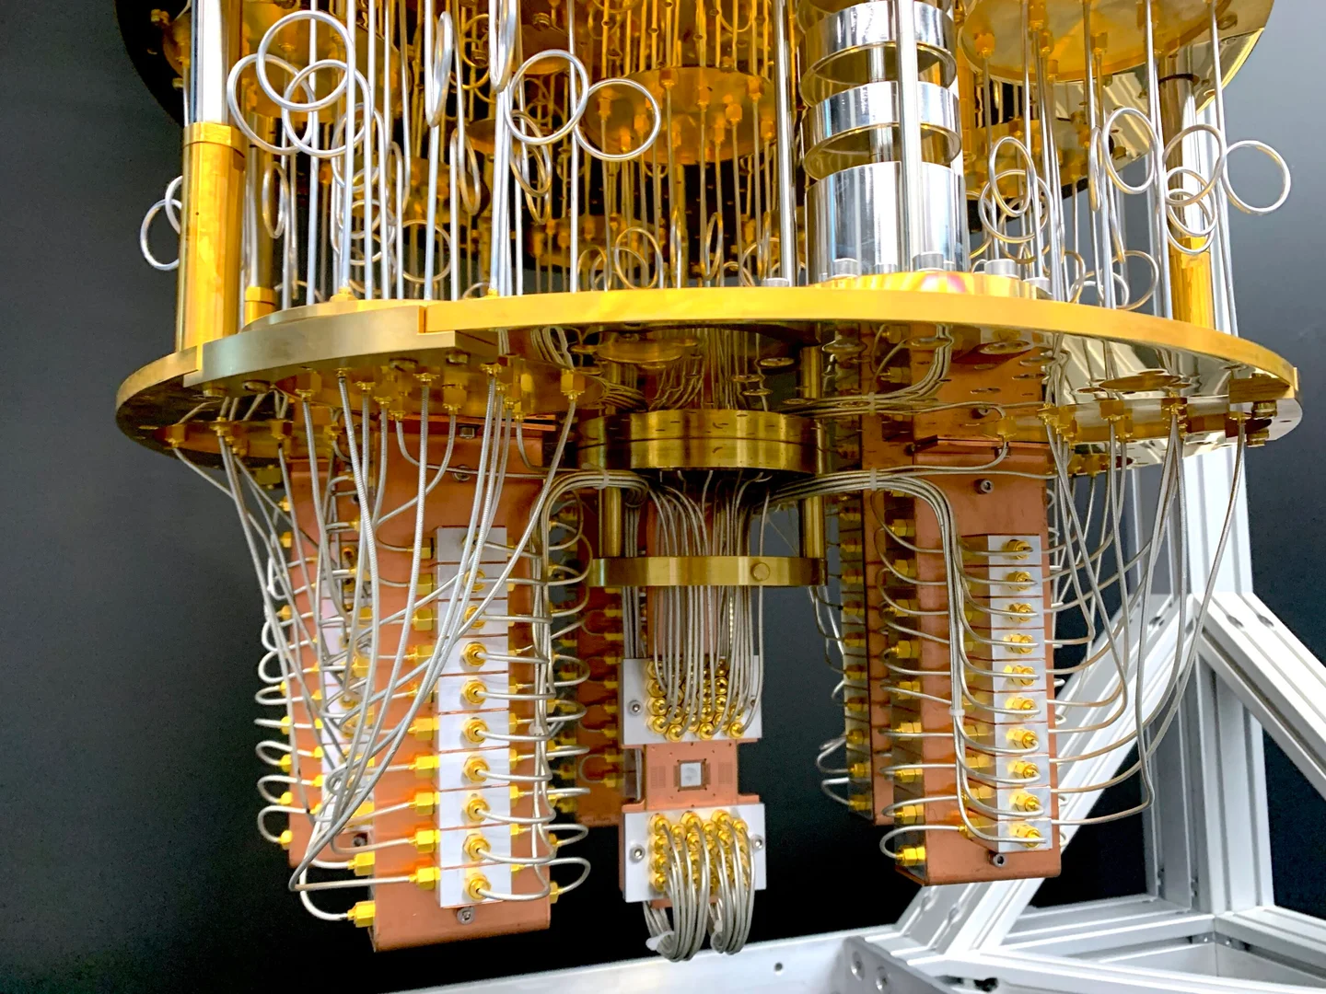
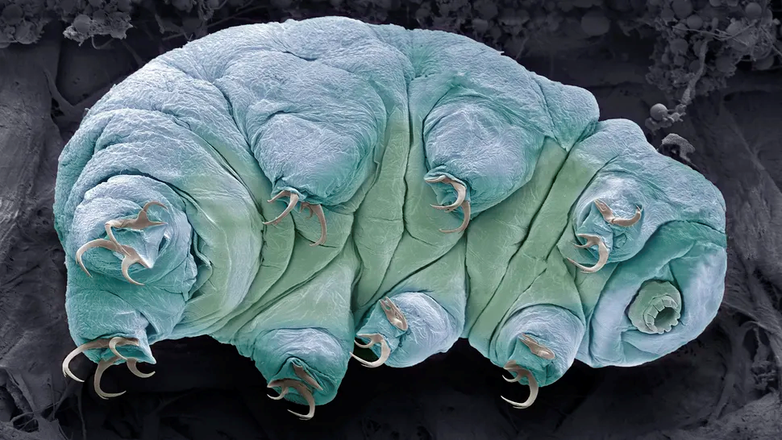
QI in HEP
Can we do something similar at TeV energy? For instance, using pairs of fermions produced at the LHC?

Slide 27
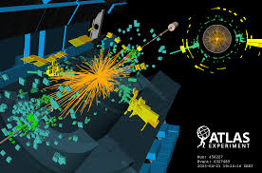
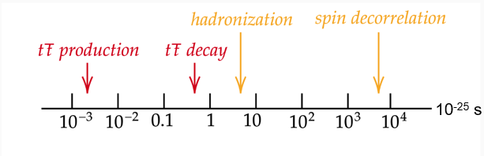
QI in HEP
Can we do something similar at TeV energy? For instance, using pairs of fermions produced at the LHC?
Let us use again the spin as dichotomic observable
Top-antitop pairs are a natural candidate to study quantum correlations
they decay so quickly that spin are not decorrelated
σ = 800 pb,
millions of
t-tbar events
in a LHC run

Slide 28
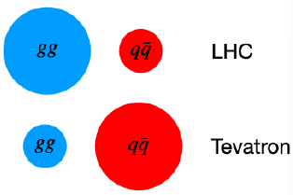
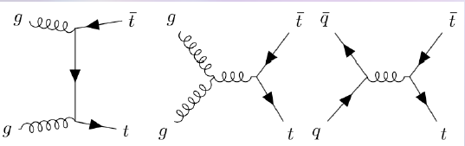
Quantum Tops
If we want to use tops to study strong quantum correlations, we face
two types of problems
Tops are not produced in a controlled way, in particular there are two
types of production processes
How can we measure Top spins in a S&G fashion?
Let us start from problem n. 1
At LHC the total quantum state is and incoherent mixture of q-qbar and gg-initiated processes

Slide 29
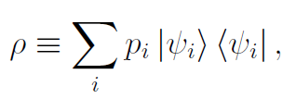






Mixed states
We need to introduce the density operator (→matrix) which describes an incoherent ensemble of states, each one with a probability p_{i} to manifest itself
It’s hermitian, it has unitary trace and it’s positive
The associated matrix can be obtained by expanding the state
on an orthonormal basis

Slide 30






Mixed states
If all p_{i} are null except one, we retrieve the special case of pure states:
Example: pure state in a two-level system (i.e. a qubit)
The corresponding density matrix is
After the measurement:
  if we know the outcome: or
  if we do now know the
  outcome:

Slide 31


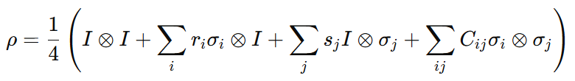
Quantum Tomography
Since any 2×2 Hermitian matrix can be written as a linear combination of the identity matrix 𝐼 and the Pauli matrices 𝜎_{𝑥},𝜎_{𝑦},𝜎_{𝑧}, the density matrix takes the form:
where is the Bloch vector which, in this case, describes the polarization of the top quark
If instead we have a pair of top quarks:
where C_{ij} is the correlation matrix that captures the spin correlations between the two particles.

Slide 32
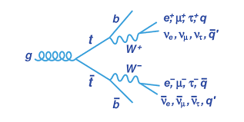
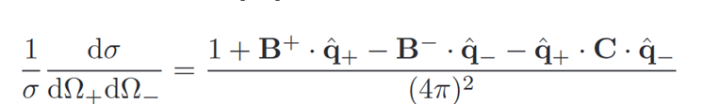
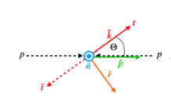

Problem n. 2: How can we measure Top spins in a S&G fashion?
We cannot do it directly, but...
Since the top quark decays before hadronizing,
its spin information is transferred to its decay
products.
The distribution of the charged leptons carries
maximal spin information:
The β coefficients quantify the relation between the direction of the particle of interest spin and the direction of the decay product
For the (anti)top quark it is -1/+1 only for charged leptons and down-type quarks.
$$C_{ii}=\frac{9 \left\langle \cos\left(θ_{i}^{a}\right)cos⁡(θ_{i}^{b})\right\rangle }{β_{a}β_{b}}$$

Slide 33
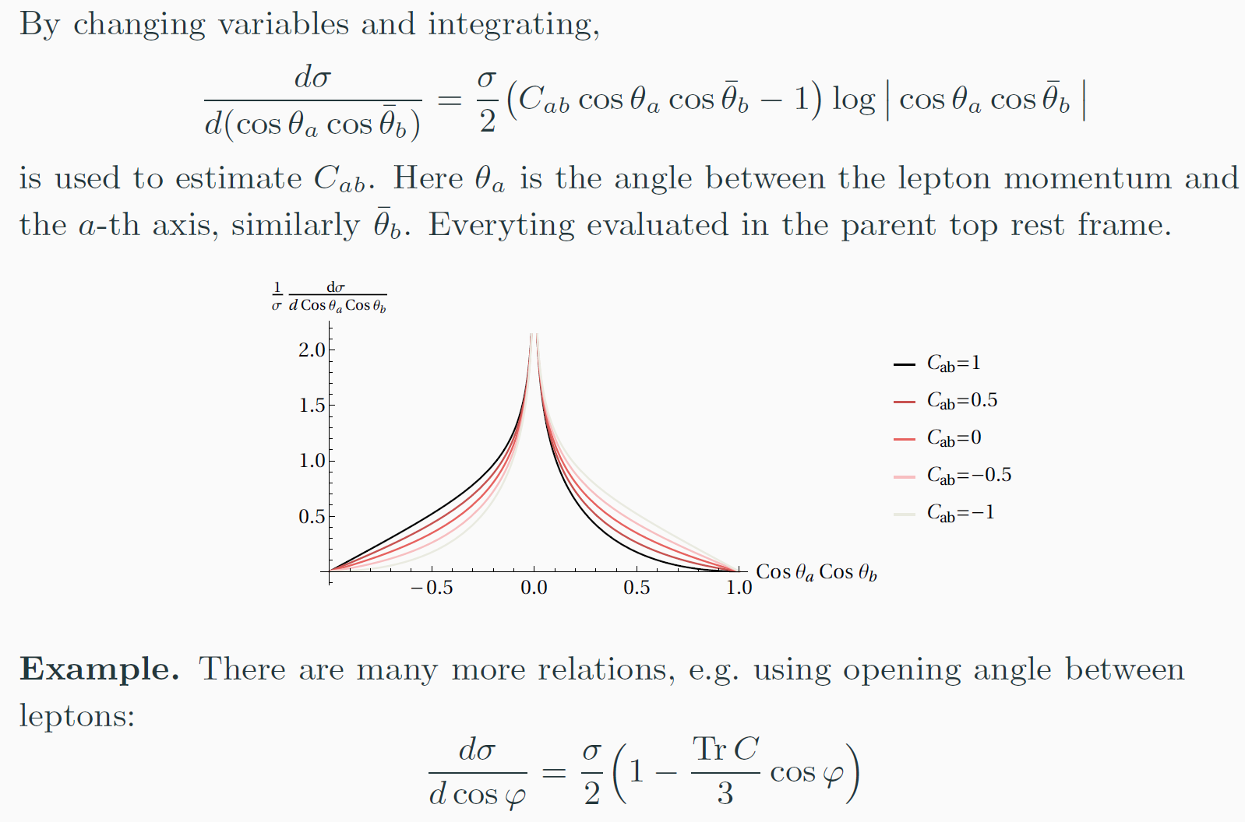

Slide 34
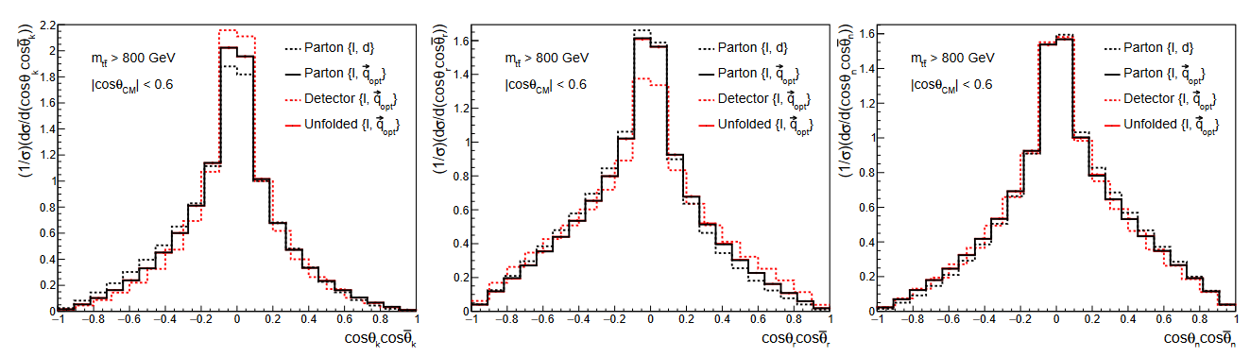
Smearing effects

Slide 35


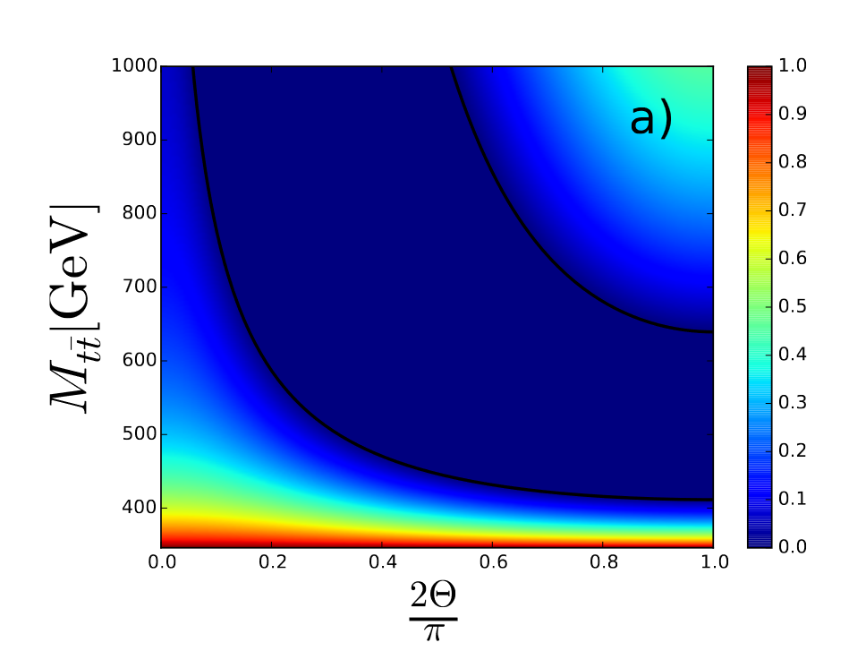
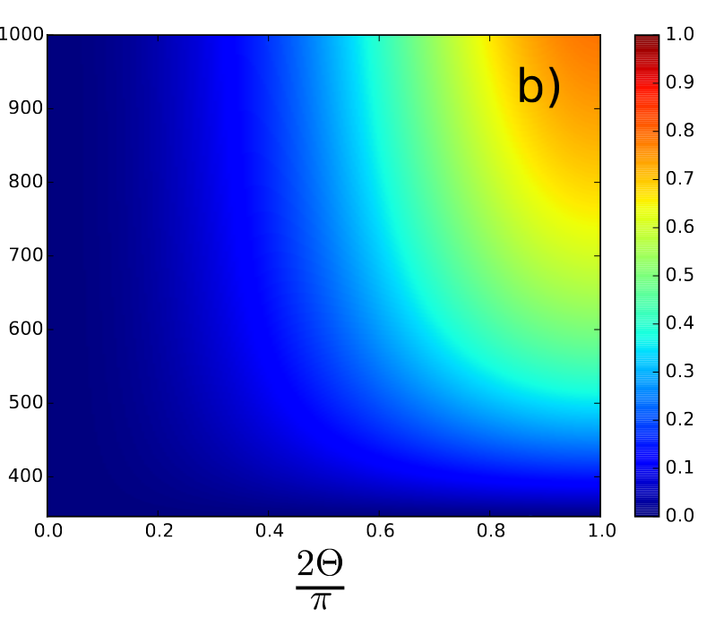
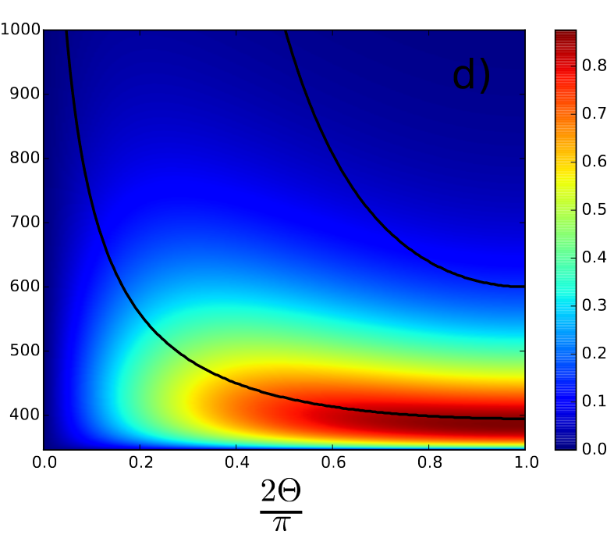

Entanglement in $t\overline{t}$ system
The level of entanglement is quantified by the concurrence, given by:
where λ₁, λ₂, λ₃, λ₄ are the square roots of the eigenvalues (in descending order) of the matrix:
Concurrence gg
Concurrence qq
σ (cross-section)

Slide 36
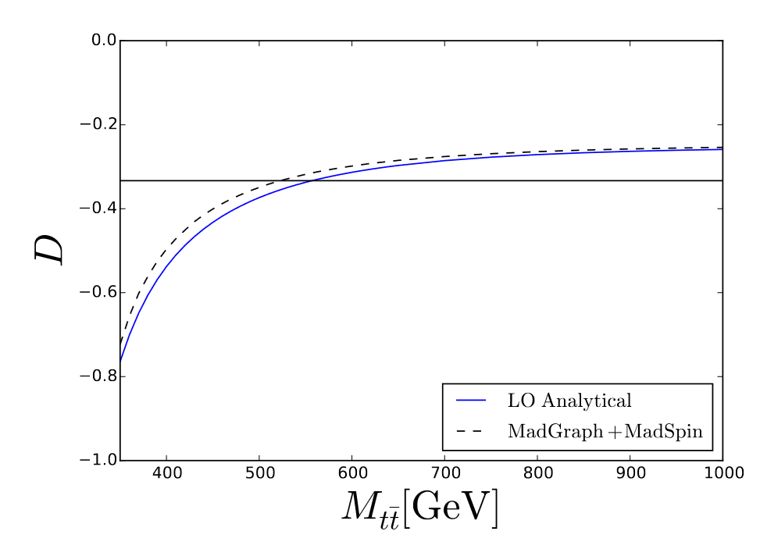
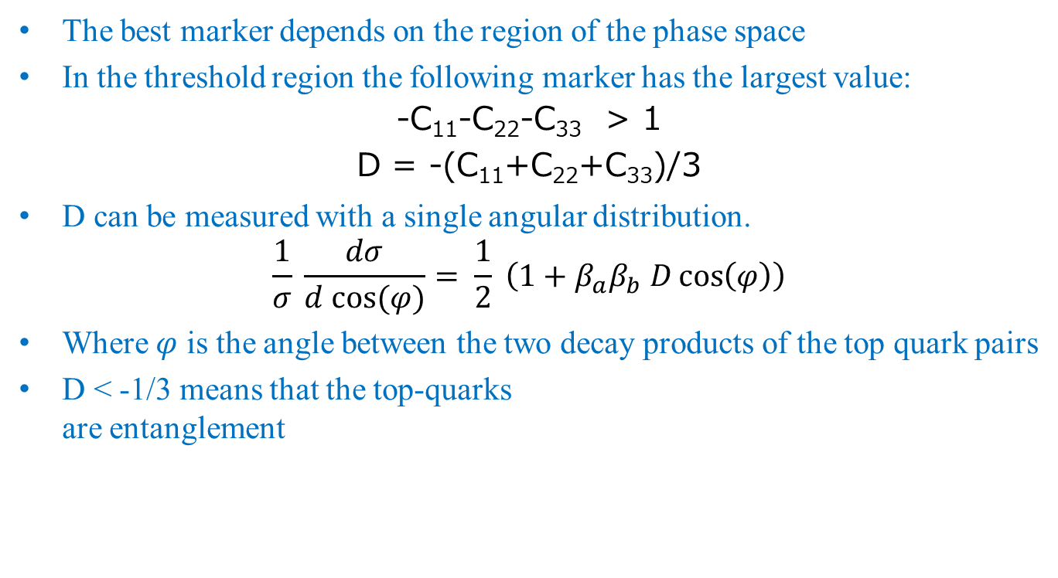
Entanglement in $t\overline{t}$ system
The best marker depends on the region of the phase space
In the threshold region the following marker has the largest value:
-C₁₁-C₂₂-C₃₃ > 1
D = -(C₁₁+C₂₂+C₃₃)/3
D can be measured with a single angular distribution.
$$\frac{1}{σ} \frac{dσ}{d cos⁡(φ)}= \frac{1}{2} \left(1+β_{a}β_{b} D\cos\left(φ\right)\right)$$
Where $φ$ is the angle between the two decay products of the top quark pairs
D < -1/3 means that the top-quarks
are entanglement

Slide 37
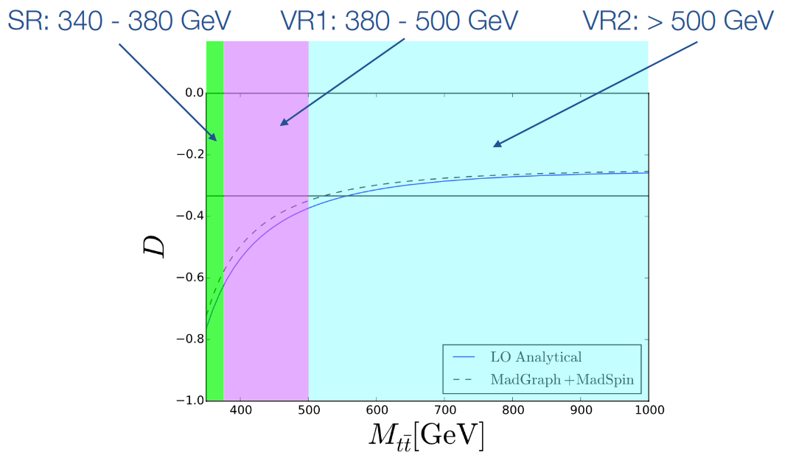
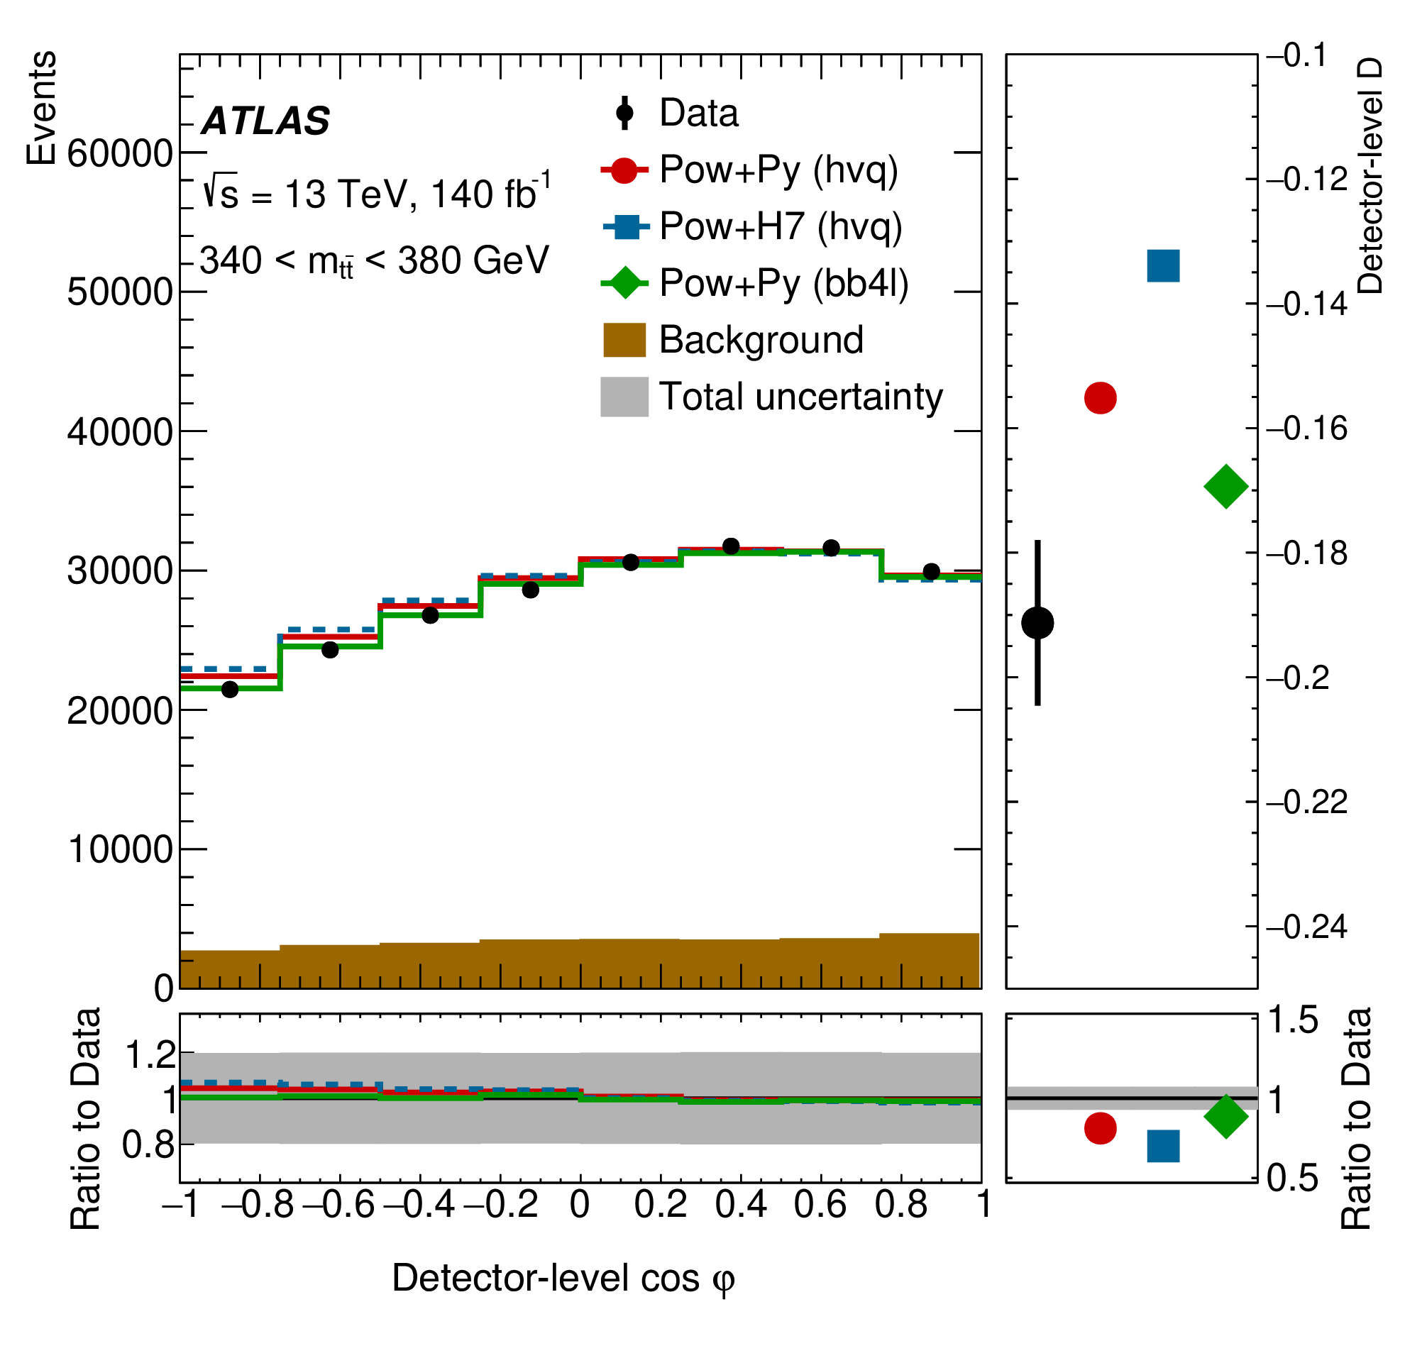
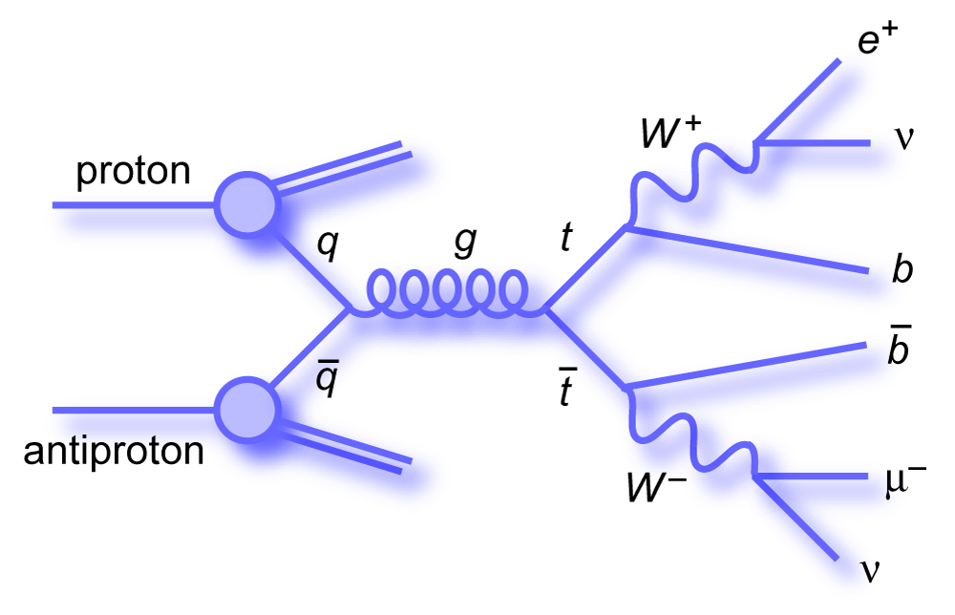
Analysis strategy
Observation of entanglement between top quarks
ATLAS Collaboration, arXiv:2311.07288
Select events in the dilepton channel
Select only events in the threshold region
Reconstruct the entire final state assuming to the central value:
  the two W masses
  the two top-quark masses
Measure the angle ϕ and extract D
Correct for smearing effects caused from the detector and estimate the associated uncertainties

Slide 38
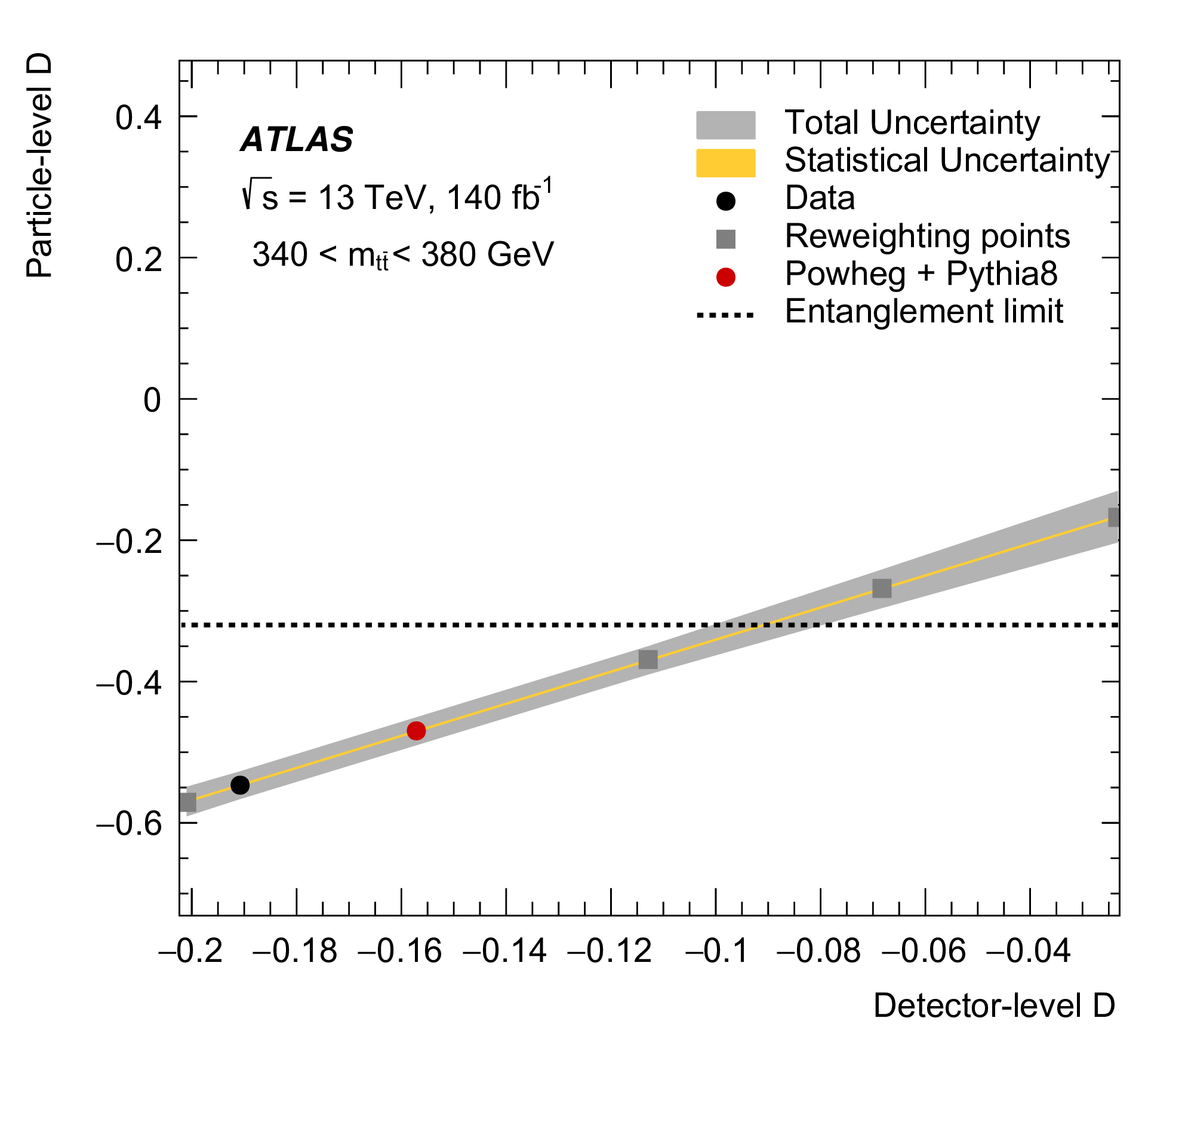
Removing detector effects
Observation of entanglement between top quarks
ATLAS Collaboration, arXiv:2311.07288
Calibration curve connecting every measured value of D to the corresponding truth distribution.
  Based on MC distributions
To construct this curve we need to change the amount of entanglement in our MC.
  We create 5 hypothesis points corresponding to the SM and 4 different reweighing points: (+20%, -20%, -40%, -60%)
All systematic effects modify the line

Slide 39
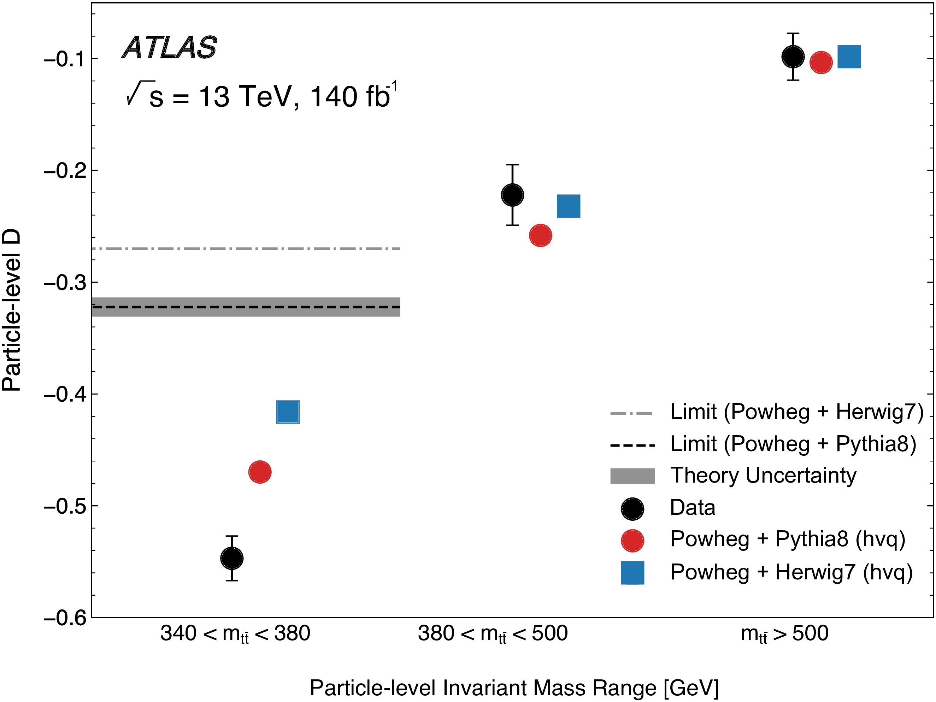
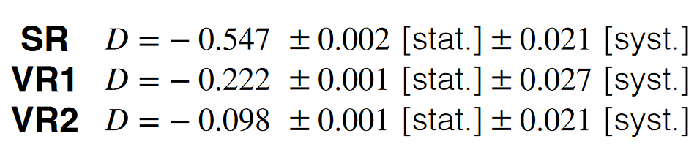
Results
Observation of entanglement between top quarks
ATLAS Collaboration, arXiv:2311.07288
Entanglement is observed with very high significance.
The data show a level of entanglement higher than the SM predictions
There are differences in the expected level of entanglement for different generators

Slide 40
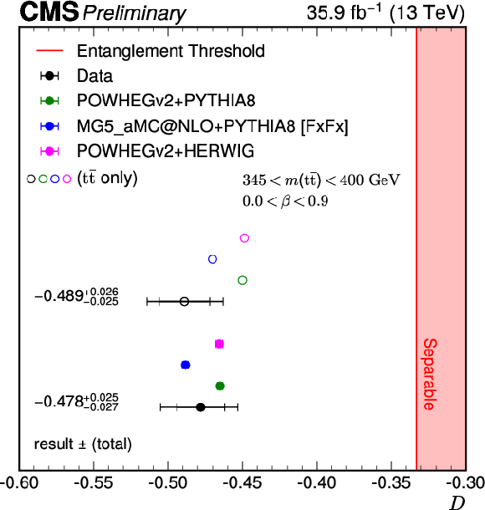
CMS results
Observation of entanglement between top quarks
Also CMS confirmed the observation of entanglement using a technique similar to ATLAS
In this publication there is less discrepancy between the data and predictions when adding to the predictions an approximated simulation for a new particle
This particle called toponium is a top-pair bound state predicted by the SM but never observed
  Missing in “standard” MC
  This new particle should enhance the entanglement between top-quark pairs at threshold
CMS Collaboration, TOP-23-001

Slide 41
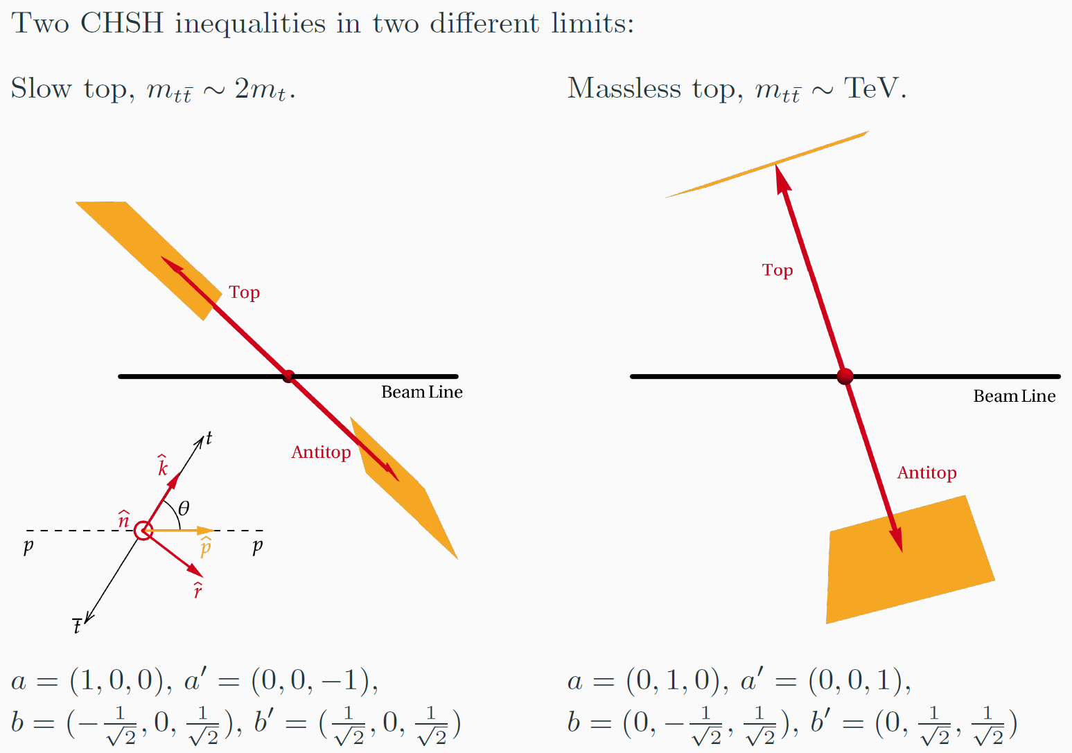

BIV in $t\overline{t}$ system

Slide 42

BIV in $t\overline{t}$ system
Fraction of t and tbar decays that are
space-like separated as a function of m_{tt}

Slide 43


BIV in $t\overline{t}$ system
The entanglement between the two top quarks is only a necessary but not sufficient condition for the violation of Bell’s inequality.
Dedicated Bell’s operators applied to the spin density matrix allow to identify a relation between Bell’s inequality violation and the coefficient of the spin density matrix
ℬ₁ ≡ |C_{rr} − C_{nn}| − √2 > 0
These will be harder to observe in LHC collisions:
  Possible only in the high mass region
  Very limited corner of the phase space

Slide 44



BIV in $t\overline{t}$ system
Difficult to detect, but full of opportunities for creative solutions!

Slide 45

Example of
H->WW* analysis

Slide 46


Selection of the final state
The dileptonic final state contains 2 neutrinos
  Very limited background
  Under-constrained system
  It is not possible to reconstruct with high precision the Higgs and W frames.
The semi-leptonic final state can be fully reconstructed
  There is a significant amount of background that needs to be reduced
  It is hard to identify the W decay product to be used to measure the angles
    Spin analysing power depends on the flavour of the jet
    Can be identified only for b,c quark initiated jets

Slide 47


Reconstructing the final state
F. Fabbri, J. Howarth, T. Maurin Eur. Phys. J. C 84, 20 (2024)
Require that the hadronically decaying W is on-shell
Sample the phase space of W_{lep} mass and P_{z} of the neutrino
  Reconstruct the neutrino px and py
For each point evaluate a weight as:
P_{miss} is the measurable missing energy on the transverse plane
The solution with the highest weight is the preferred solution
This technique allows also to have a handle on the background

Slide 48


Measure Bell’s inequality violation
There is the need to identify a hadronic W decay product with known spin analysing power
  Focus on a specific decay channel of the W, where we can identify the c-quark
  Identify the s-quark fixing the W mass to the known PDG value
Once the s-jet is identified it is possible to reconstruct the Bell’s operator
  Apply dedicated technique to remove smearing effects caused by selection and reconstruction
  Analysis applied on MC simulated events

Slide 49

Search for new physics

Slide 50
Physics beyond the standard model
Open questions:
Nature of dark matter
Source of the asymmetry between matter and antimatter
Understand the origin of the mass hierarchy (why top-quark is 172.5 GeV and the up-quark is 2.2 MeV)
Unification with gravity
Current status:
No unexpected particles observed at LHC
New physics must be at very high energy or light and not very interactive
Approaches to new physics search:
Bump in the number of events as a function of the invariant mass
Employ a model-independent effective theory to search for hints of new physics
Can the quantum observables enter in the game?
Only if “new physics” can change the entanglement between particles

Slide 51




Direct searches
https://doi.org/10.22323/1.235.0032
F. Maltoni, C. Severi et al JHEP03(2024)099
CMS Collaboration, Phys. Rev. D 97, 112003
Effective models
The presence of new particles results in an enhancement in the cross section around the mass of the new particle
To observe a shape the resolution of the measurement must be good enough, otherwise the only effect is a mild enhancement in the cross-section
A new resonance highly modify the correlations, this feature can be used to observe a new particle
  Hopefully toponium will be the first case
  Not exactly a particle beyond the Standard Model, it is a pseudo-bound state predicted in the gg→tt color singlet

Slide 52




Effective searches
If a particle has a too high mass to be created at LHC it will modify other distributions, that can be used as hints of the presence of new physics
Multiple distributions originating from different processes can be combined to search physics beyond the LHC scale with an effective approach
Extend the Lagrangian with operators not included in the SM, each weighted by a coefficient
    Translates in a modification in the couplings
    A global fit to various distributions is used to put constraints to these coefficients
    Fit compatible with 0 means no new physics beyond the SM.
$$ℒ_{SMEFT}=ℒ_{SM}+\frac{1}{Λ^{2}}\sum{c_{i}O_{i}}$$
@Ilaria Brivio

Slide 53


Effective searches
The operators included in the effective Lagrangian highly modify the quantum correlations between particles
The concurrence, D, the coefficient of the spin density matrices
Include these quantities to the global fit will enhance the sensitivity to the presence of new physics
R. Aoude, E. Madge, F. Maltoni Phys. Rev. D 106, 055007

Slide 54
Conclusions
The possibility of studying the foundations of quantum physics at the highest energies that we can experimentally explore in a controlled way,
- the energies of the LHC - has recently opened up
This has forced and allowed us to rework concepts of Quantum Information to make them adaptable to the context of collider physics, which by its nature requires the extension of the formalism with respect to that used at lower energies
The ambitions of this exercise are twofold:
  To experimentally verify that the foundations of Quantum Mechanics – think for example of “local realism” – continue to be valid at the energies of the LHC, ~12 orders of magnitude higher than those relating to Alain Aspect’s experiments...
  To find new observables never used before to leverage BSM research into “new physics”
This new field of study has just been born, and its implications are currently unpredictable.

Slide 55
References
Yoav Afik and Juan Ramon Munoz de Nova, Entanglement and quantum tomography with top quarks at the LHC. In: Eur. Phys. J. Plus 136.9 (2021), p. 907. doi:10.1140/epjp/s13360-021-01902-1. arXiv:2003.02280 [quant-ph].
Claudio Severi et al., Quantum tops at the LHC: from entanglement to Bell inequalities. In: Eur. Phys. J. C 82.4 (2022), p. 285. doi:10.1140/epjc/s10052-022-10245-9. arXiv: 2110.10112 [hep-ph].
Fabio Maltoni et al., Quantum detection of new physics in top-quark pair production at the LHC. In: JHEP 03 (2024), p. 099. doi:10.1007/JHEP03(2024)099. arXiv: 2401.08751 [hep-ph].
Rafael Aoude et al. Probing new physics through entanglement in diboson production. In: JHEP 12 (2023), p. 017. doi:10.1007/JHEP12(2023)017. arXiv: 2307.09675 [hep-ph].
Rafael Aoude et al. Quantum SMEFT tomography: Top quark pair production at the LHC. In: Phys. Rev. D 106.5 (2022), p. 055007. doi:10.1103/PhysRevD.106.055007. arXiv: 2203.05619 [hep-ph].
Rachel Ashby-Pickering, Alan J. Barr, and Agnieszka Wierzchucka. Quantum state tomography, entanglement detection and Bell violation prospects in weak decays of massive particles”. In: JHEP 05 (2023), p. 020. doi: 10.1007/JHEP05(2023)020. arXiv: 2209.13990 [quant-ph].
Alan J. Barr. Testing Bell inequalities in Higgs boson decays. In: Phys. Lett. B 825 (2022), p. 136866. doi:10.1016/j.physletb.2021.136866. arXiv: 2106.01377 [hep-ph].
ATLAS Collaboration. Observation of quantum entanglement in top-quark pairs using the ATLAS detector. In: (Nov. 2023). arXiv:2311.07288 [hep-ex].
Federica Fabbri, James Howarth, and Theo Maurin. Isolating semi-leptonic H → WW∗decays for Bell inequality tests. In: Eur. Phys. J. C 84.1 (2024), p. 20. doi: 10.1140/epjc/s10052-023-12371-4. arXiv:2307.13783 [hep-ph].

