Slide 1
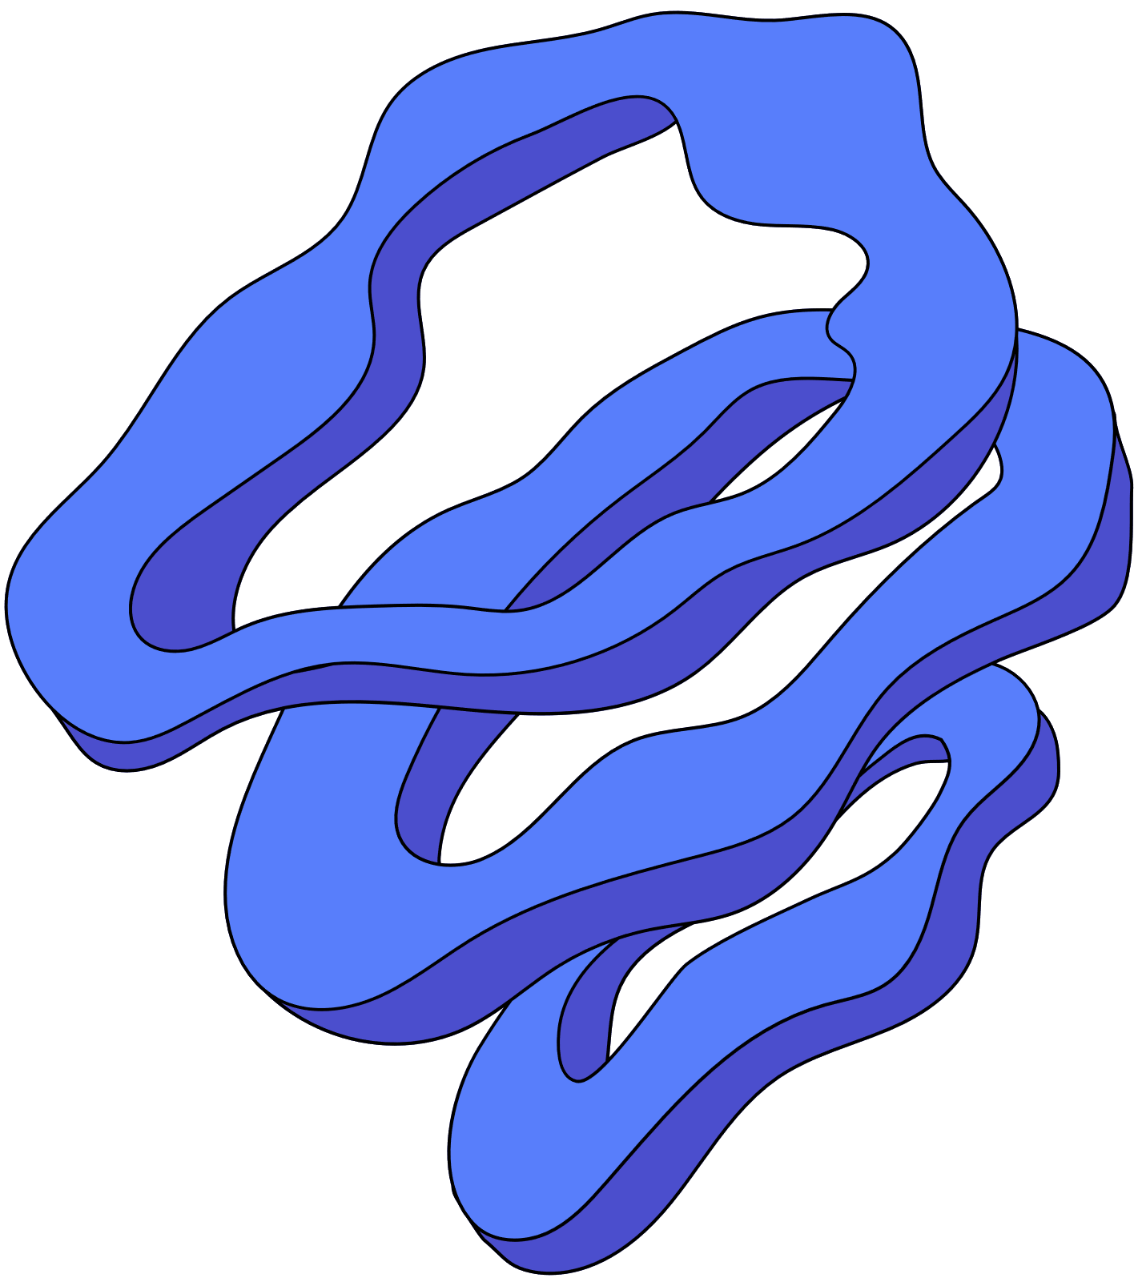

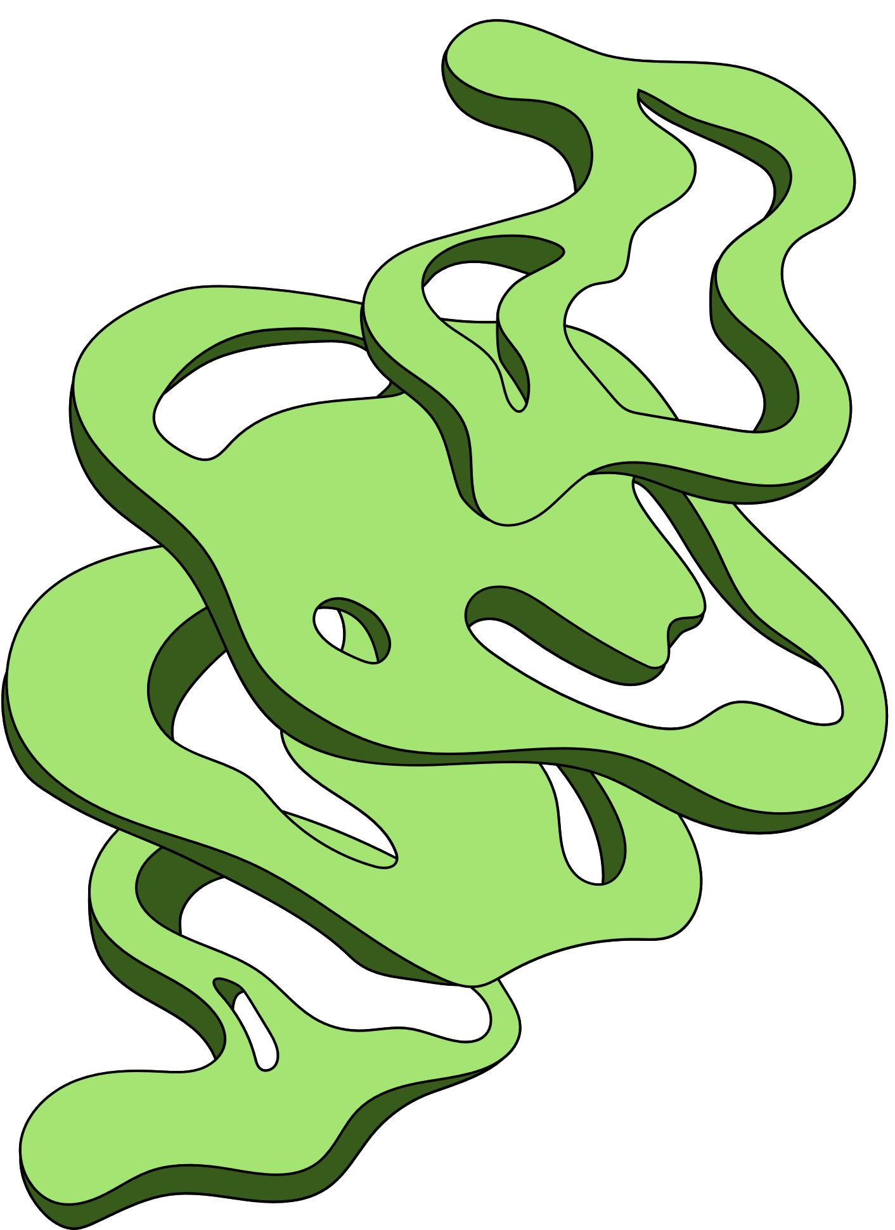
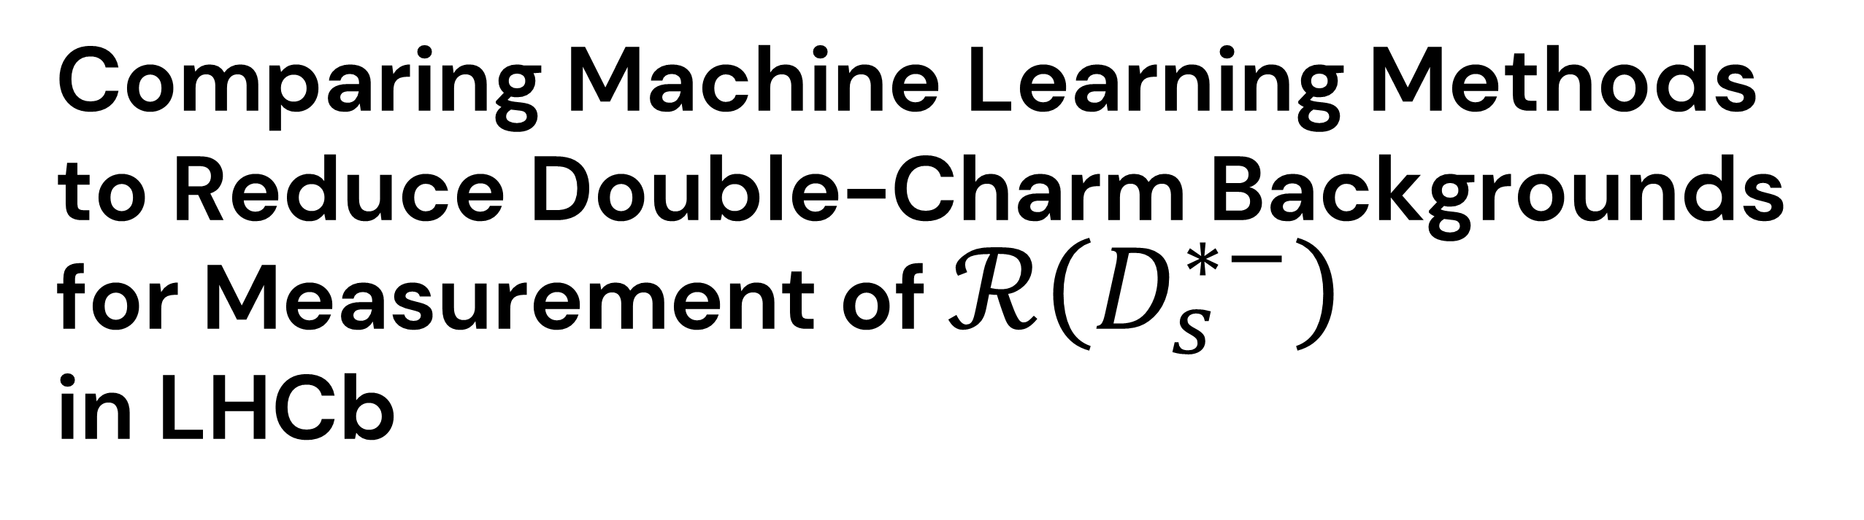
UNIVERSITY COLLEGE ROOSEVELT
Comparing Machine Learning Methods to Reduce Double-Charm Backgrounds for Measurement of $ℛ\left(D_{s}^{∗−}\right)$
in LHCb
Koen Denekamp
MARCH 19 2025
External Supervisor
Primary Supervisor
Secondary Supervisor
Dr. S. Klaver
Dr. H. M. Jansen
Dr. L. de Wit

Slide 2
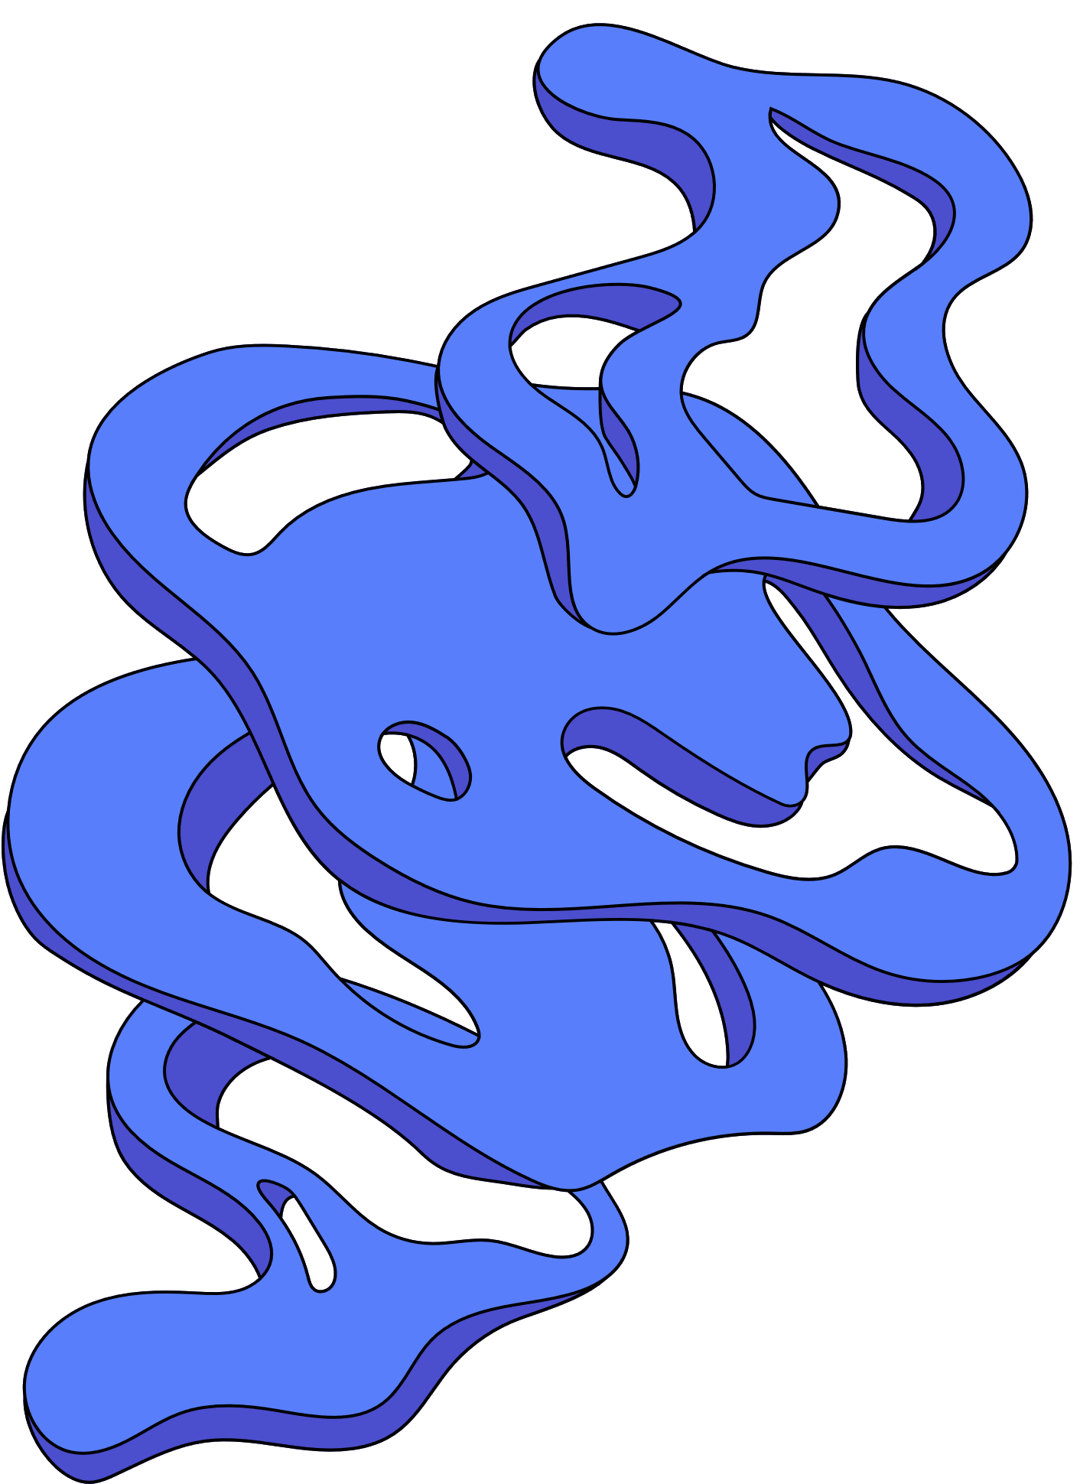
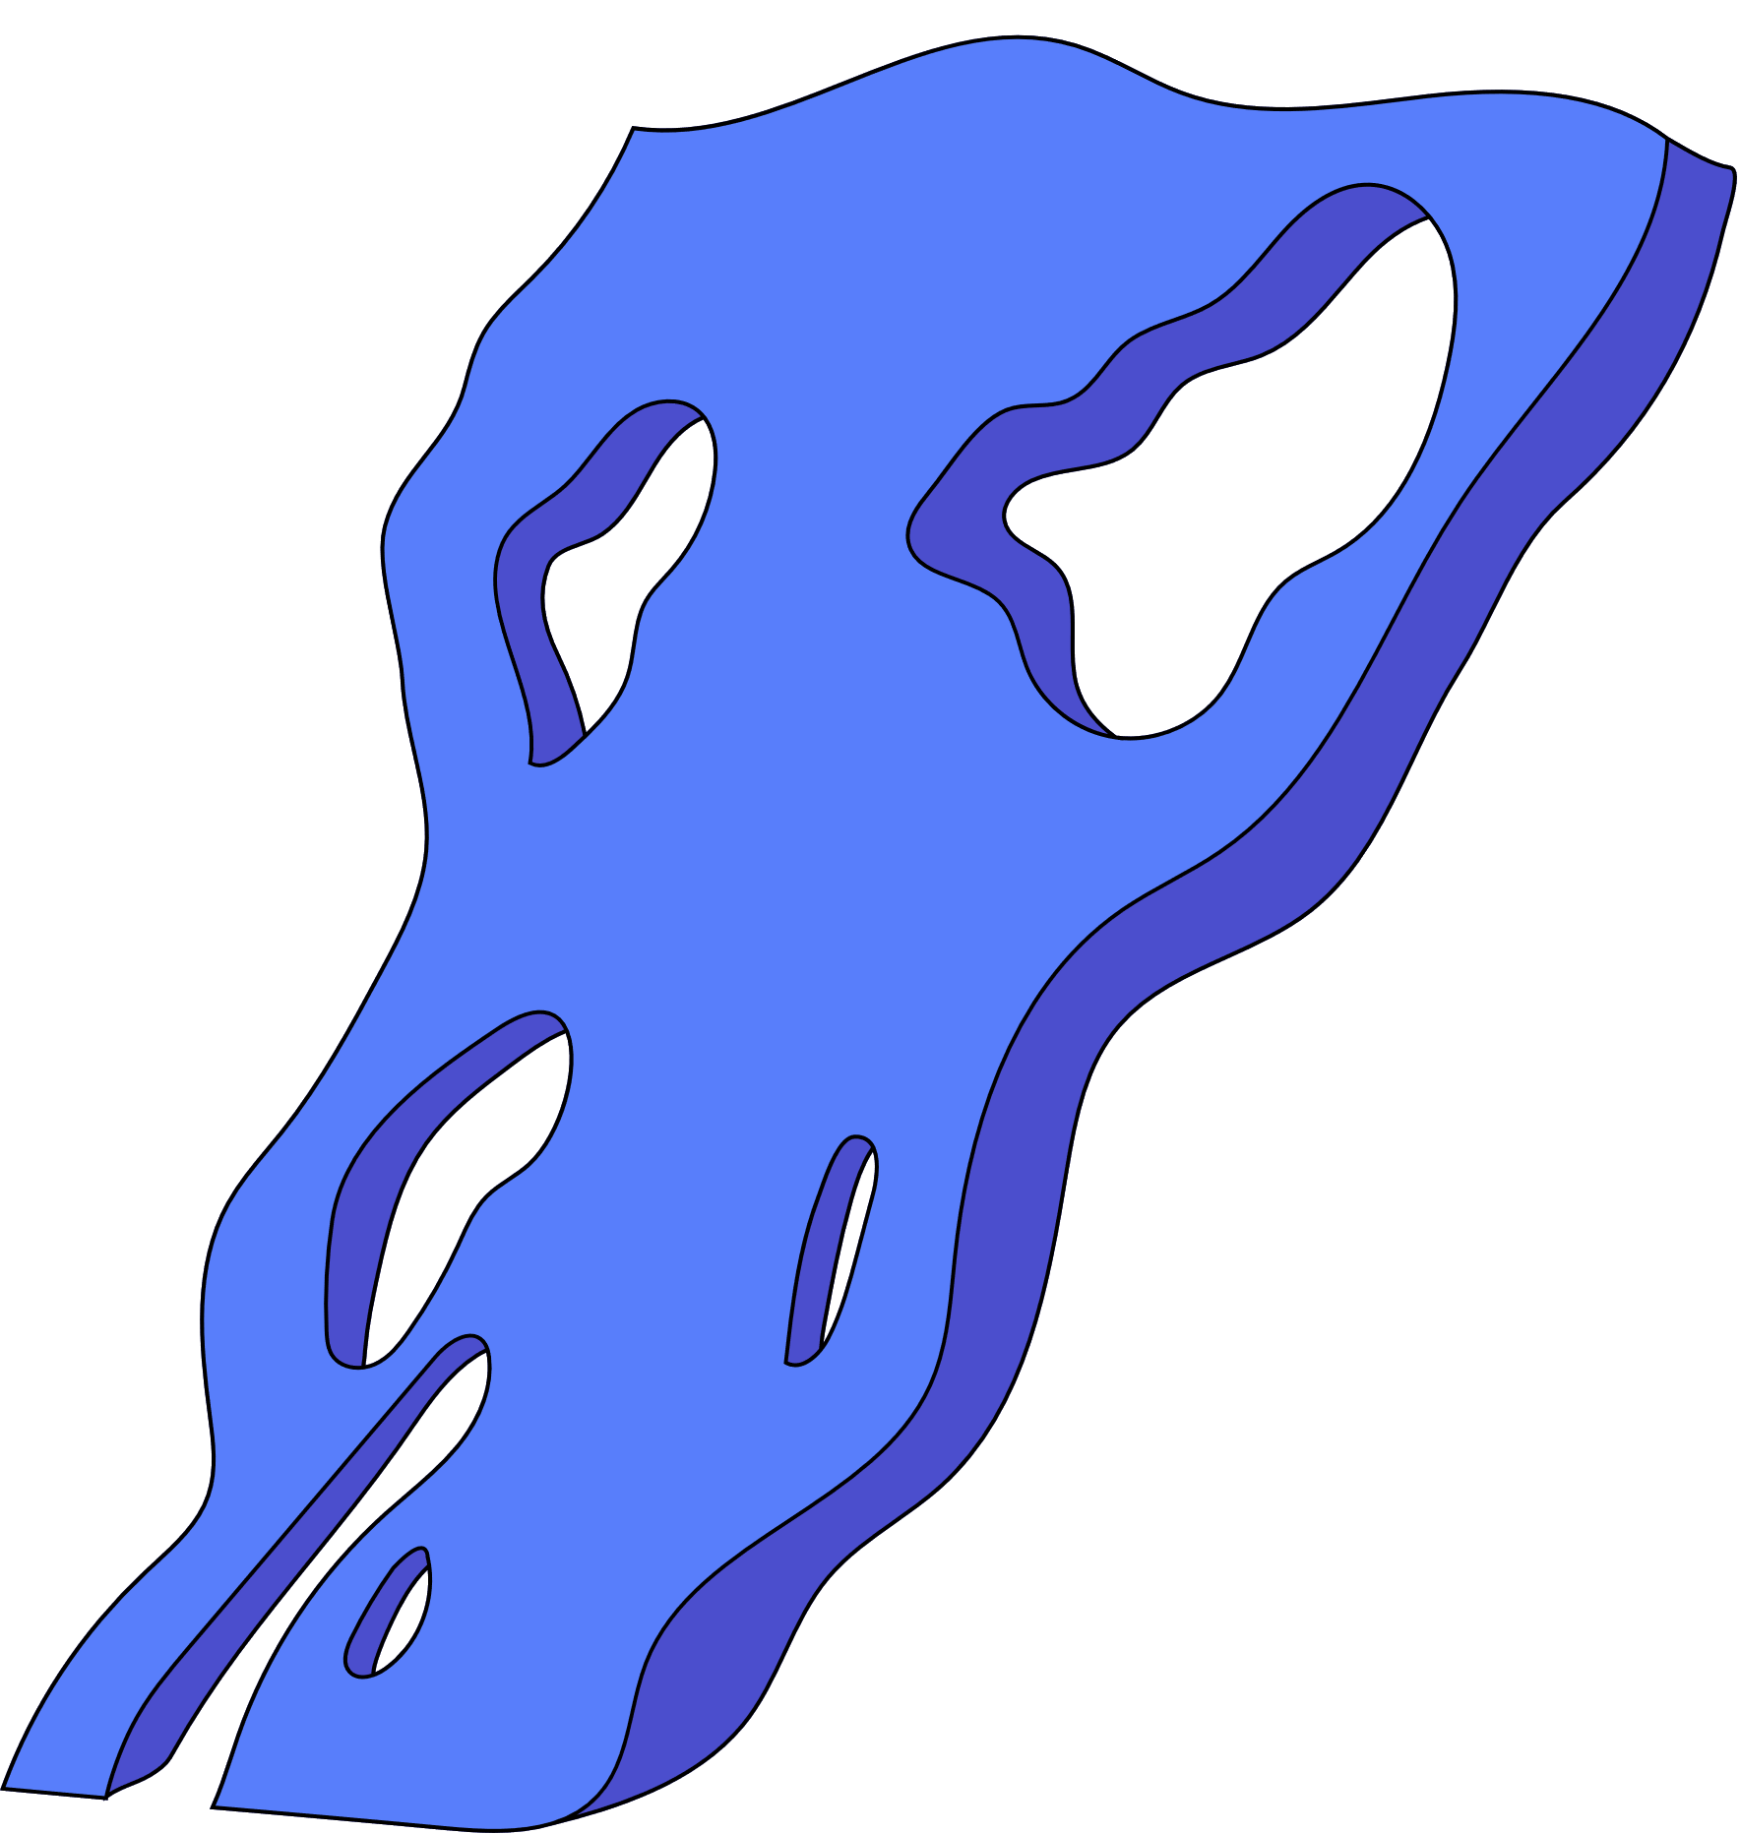
RESEARCH QUESTION
Can neural networks outperform boosted decision trees in optimizing the signal-to-noise ratio in double-charm backgrounds?

Slide 3
CONTEXT

Slide 4
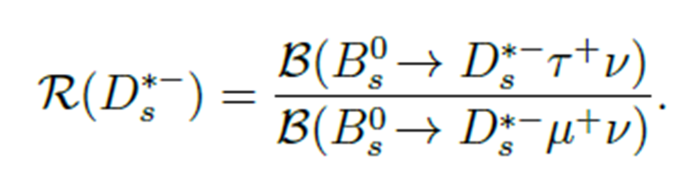

$$ℛ\left(D_{s}^{∗−}\right)$$
  Strange and anti-charm quark
  Rarer decay than previous studies
  No backgrounds from excited D states

Slide 5
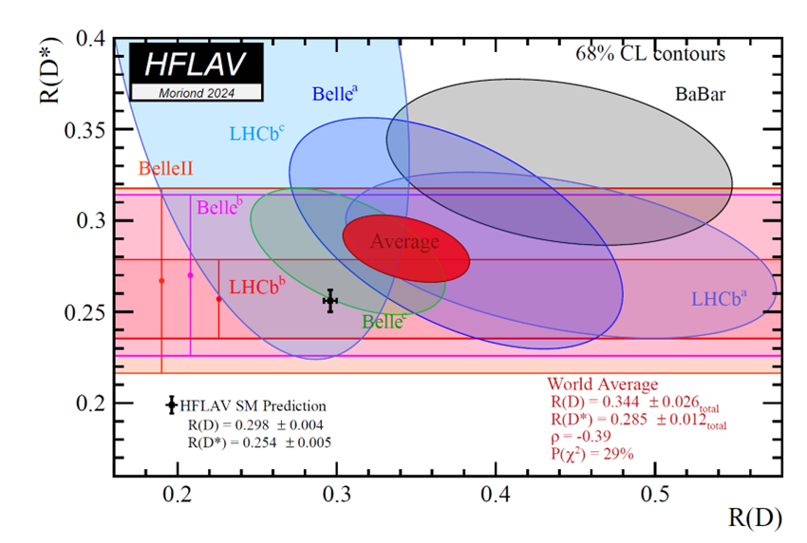
Lepton Flavour Universality (LFU)
  Prediction versus measurement
  Other measurements
Image by The Heavy Flavor Averaging Group, taken from https://hflav-eos.web.cern.ch/hflav-eos/semi/moriond24/html/RDsDsstar/RDRDs.html.
Y. Amhis et al., Averages of b-hadron, c-hadron, and τ -lepton properties as of 2021, Phys. Rev. D 107 (2023) 052008.

Slide 6
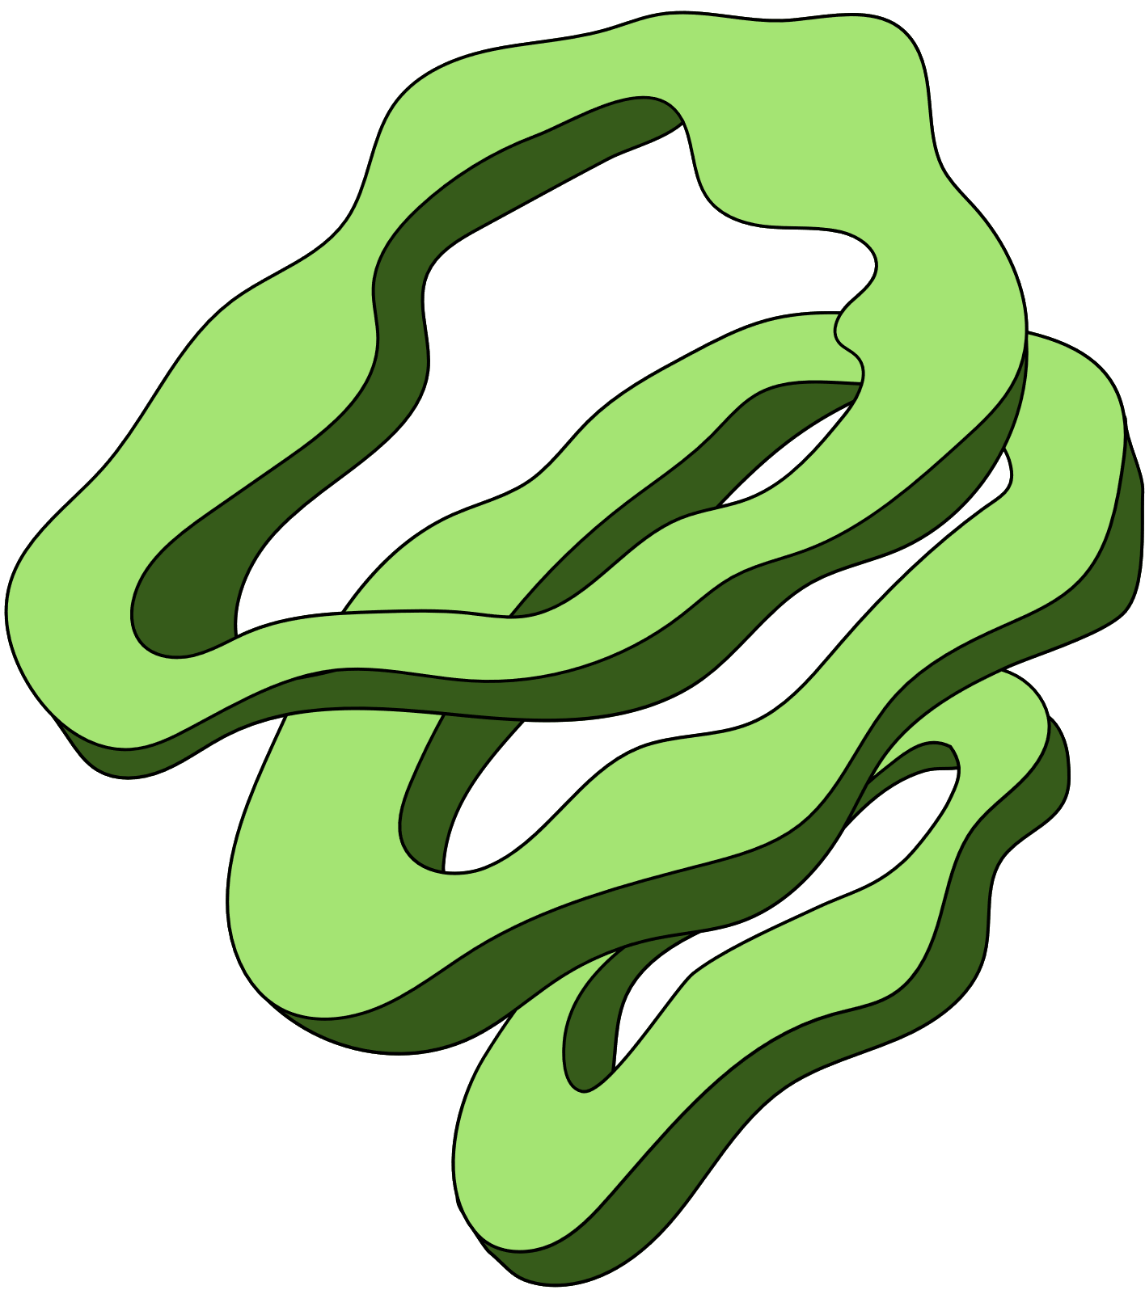
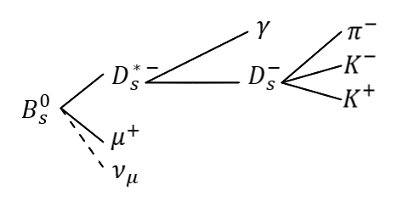
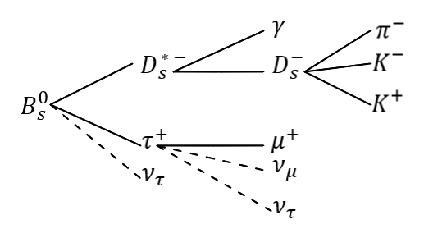
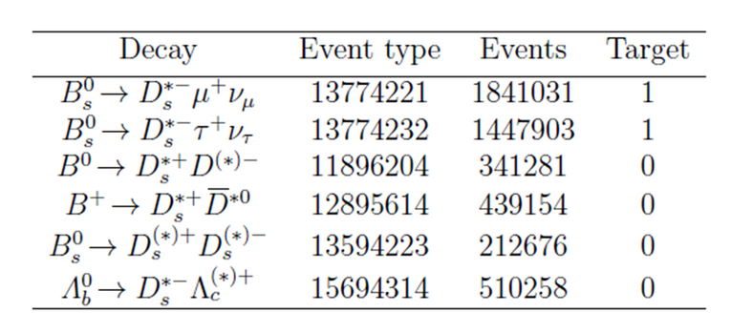
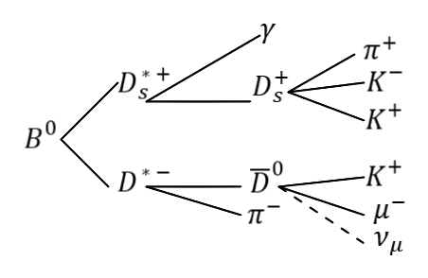
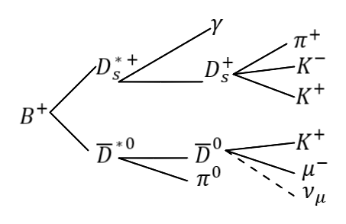
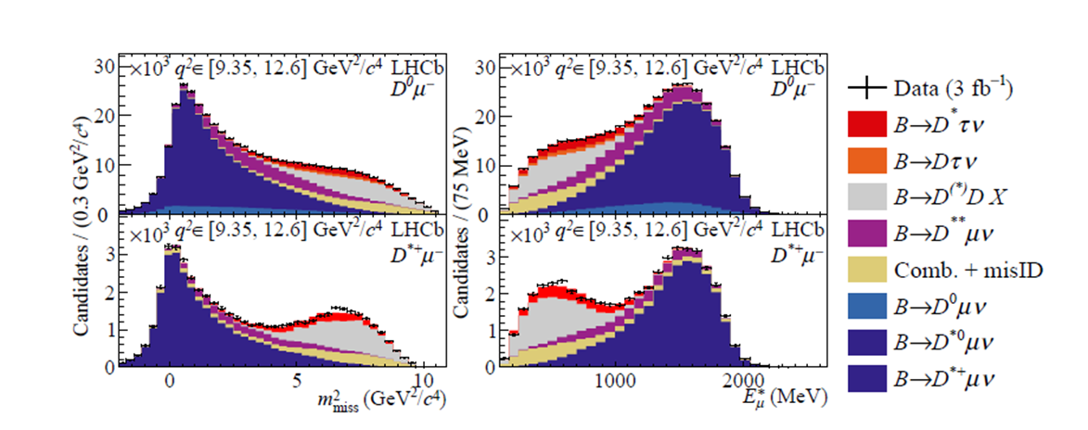
Backgrounds

Slide 7
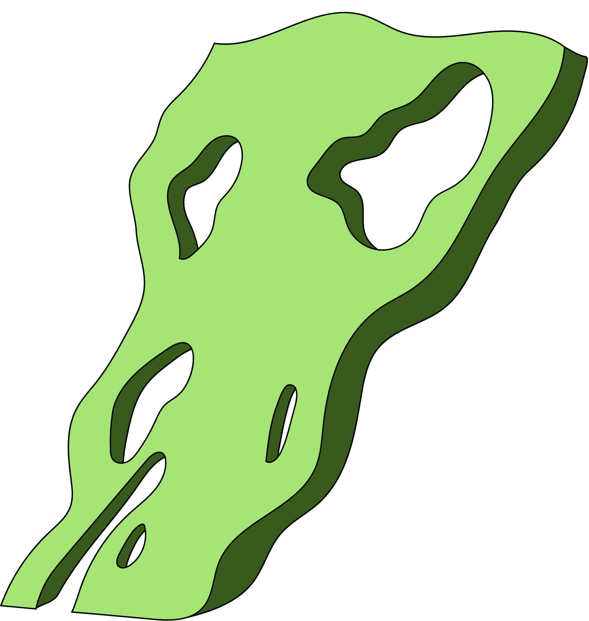
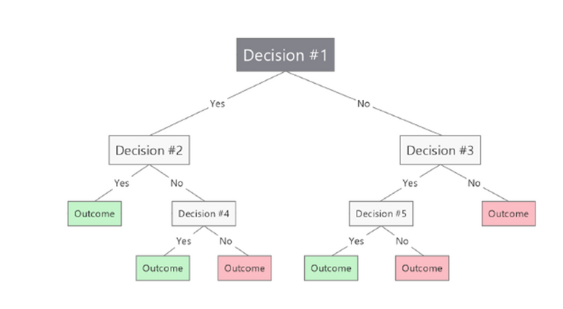
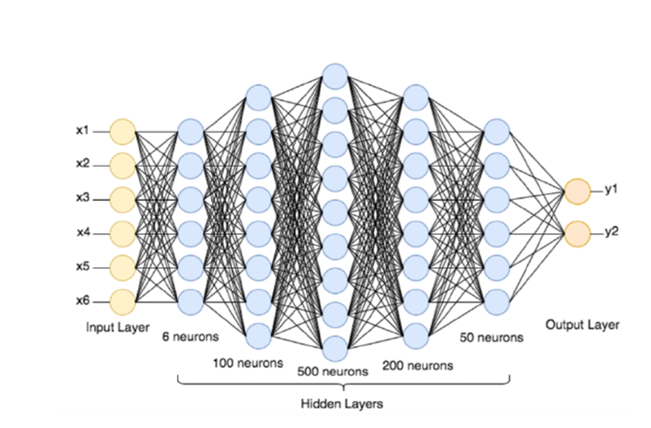
Models
  Boosted Decision Trees
  Neural Networks
Image by L. Armstrong, taken from https://blog.mindmanager.com/decision-tree-diagrams/.
  SuperLearner
M. Bahi and M. Batouche, Deep Learning for Ligand-Based Virtual Screening in
Drug Discovery, in 2018 3rd International Conference on Pattern Analysis and
Intelligent Systems (PAIS), pp. 1–5, Oct., 2018. doi: 10.1109/PAIS.2018.8598488.

Slide 8
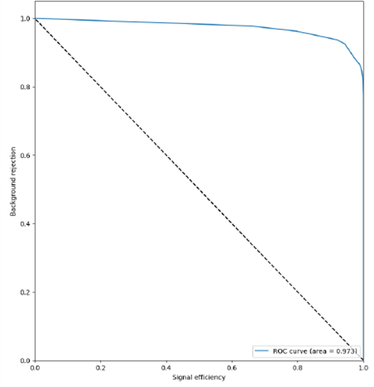
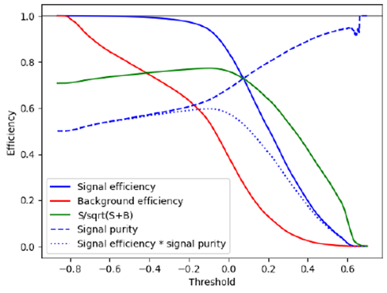
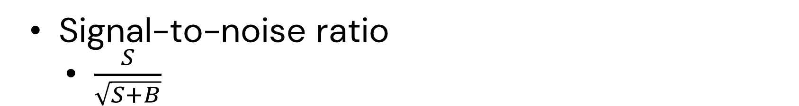
Metrics
  Area Under the Curve (AUC) of Receiver Operating Characteristic (ROC) curve
  Signal-to-noise ratio
    $\frac{S}{\sqrt{S+B}}$

Slide 9

RESULTS

Slide 10
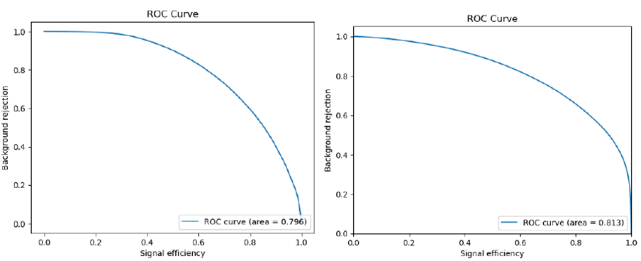
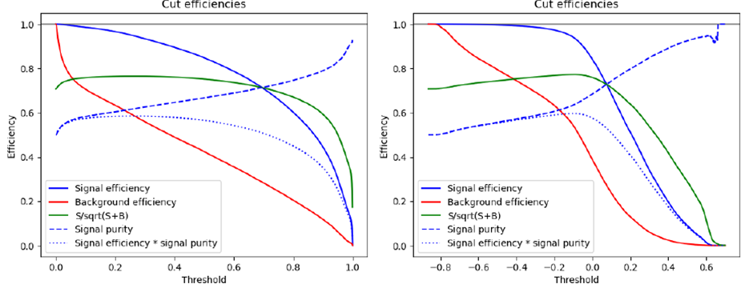
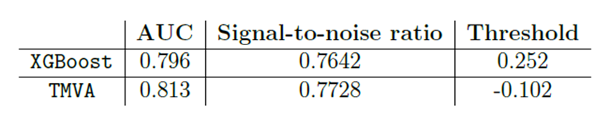
Boosted Decision Trees
  Hyperparameters found through RandomizedSearchCV
    300 trees
    Max depth of 4
  Seem to have a different approach
XGBoost
TMVA

Slide 11
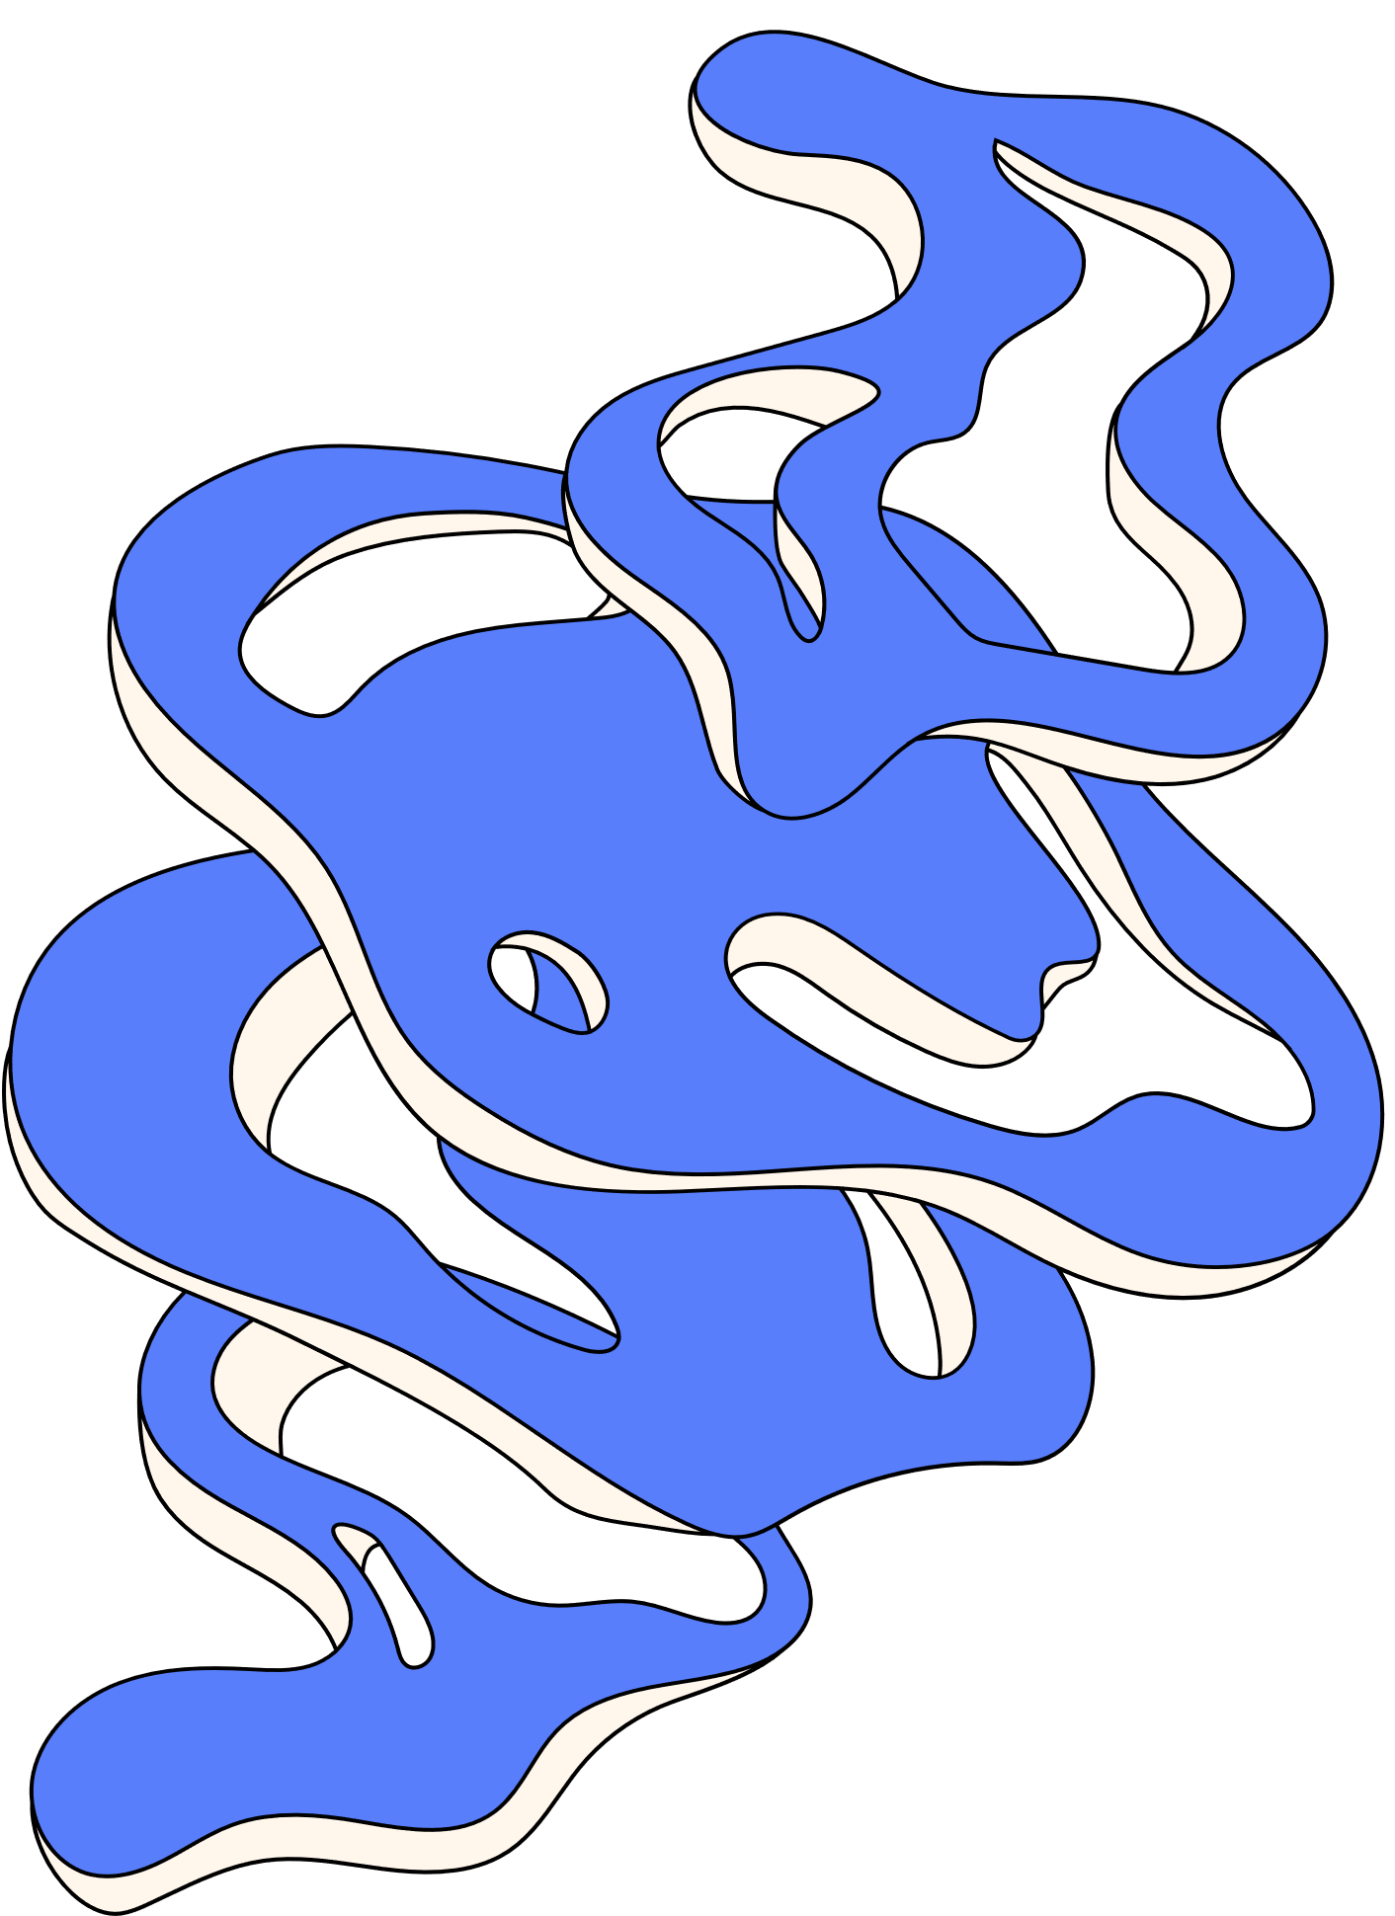
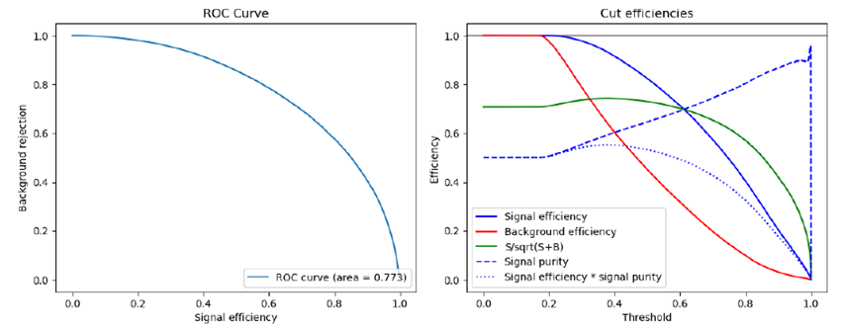
Neural Networks
  Architecture found through starting small and expanding
    2 hidden layers with 128 neurons each, ReLU activation functions and Dropout layer (0.5)

Slide 12
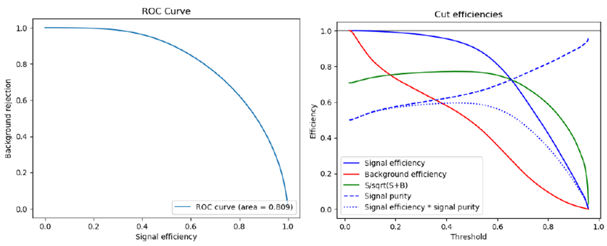
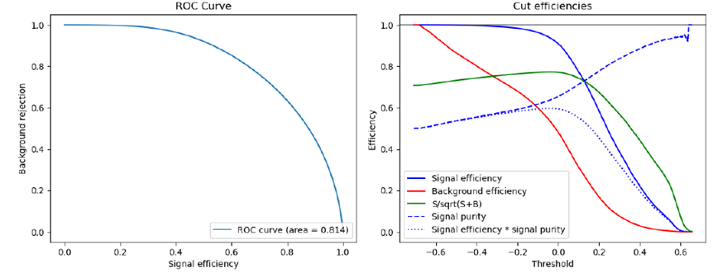
SuperLearner
  One combining the XGBoost BDT and keras NN
    NN weights: 0.1690
    XGBoost weight: 0.809
  One combining the TMVA BDT and keras NN
    NN weights: 0.0921
    TMVA weights: 0.8418

Slide 13
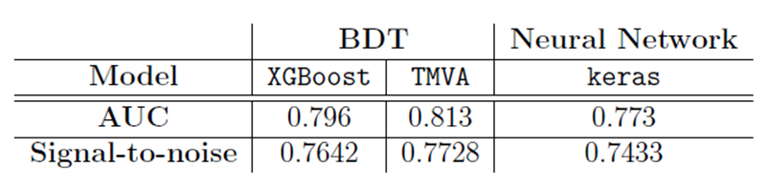
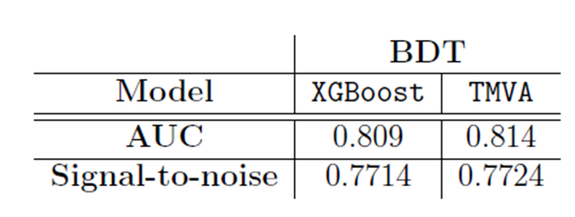
Conclusion
  sWeights can be exponentiated if required
  Models ranking
  TMVA BDT
  SuperLearner combining TMVA and keras
  SuperLearner combining XGBoost and keras
  XGBoost BDT
  keras NN
Individual models
SuperLearners

Slide 14
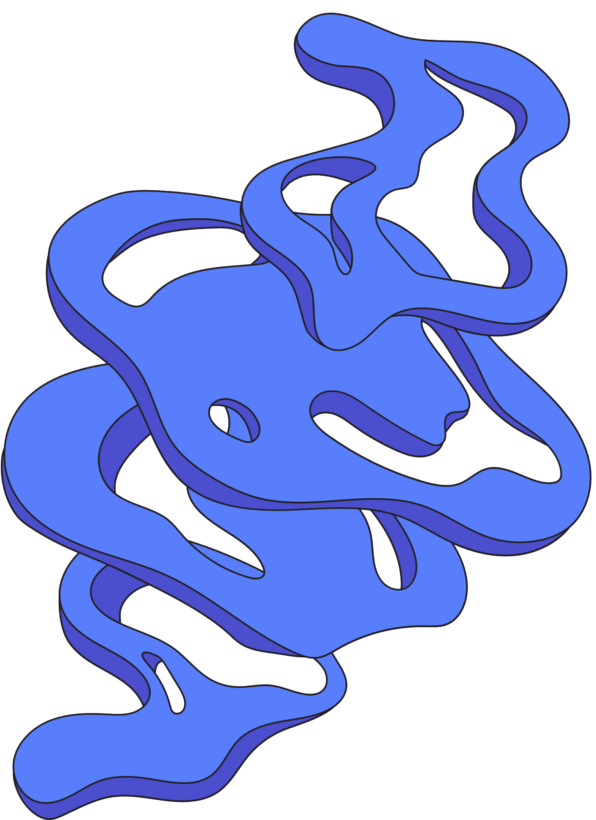
Discussion
  Future work
    Attempt different SuperLearners
    Use different methods for dealing with negative (s)weights
    Different types of Neural Networks
  XGBoost seemed to perform better with less training data

Slide 15
Thank You!

Slide 16
Backup slides

Slide 17
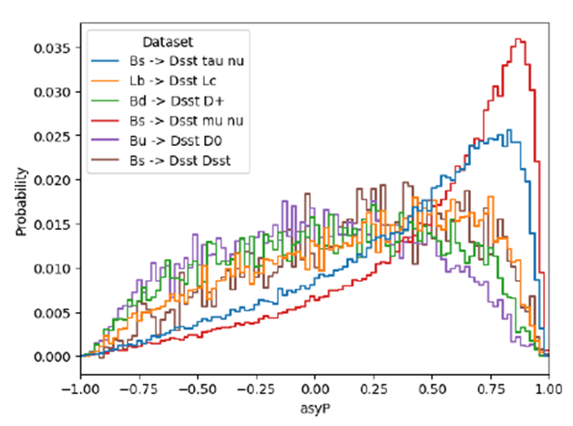

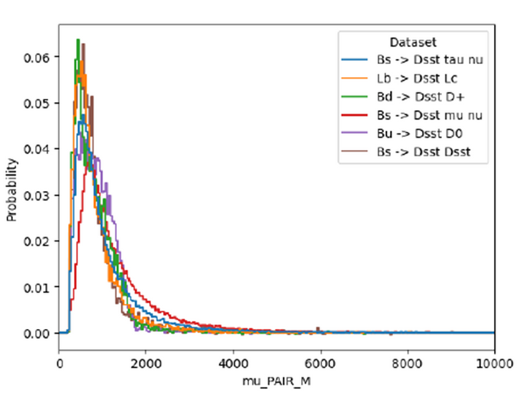
Variables
  7 variables were used
  Examples:
    Momentum asymmetry (asyP)
      Shows how many particles in the decay
    Invariant mass of the pair (mu_PAIR_M)
      Indication of kinematic properties

Slide 18
sWeights
  Aim to supress Combinatorial background
  Can be negative due to normalization
  Issues of negative weights
    XGBoost: Error
    scikit learn: Sets weights to zero
    keras: Sets weights to zero
    TMVA: No issues

Slide 19
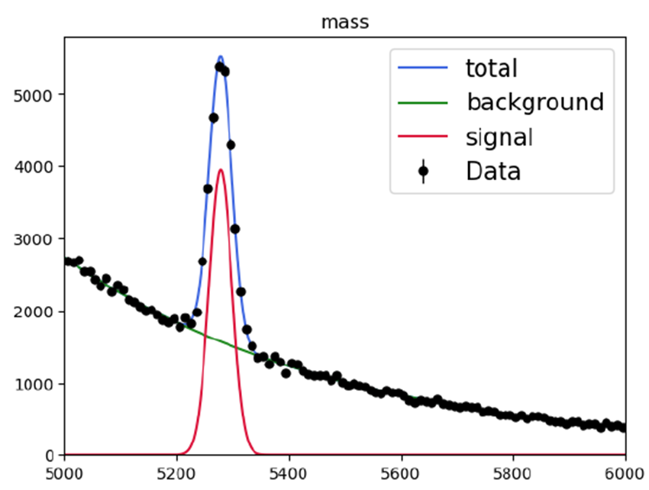
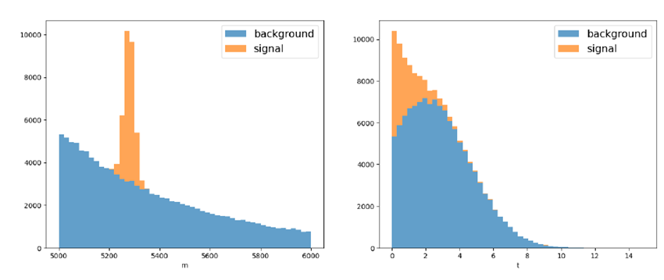
Example: 2-D toy data

Slide 20
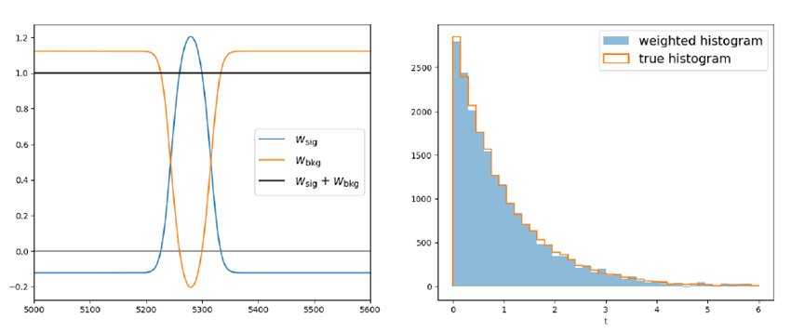
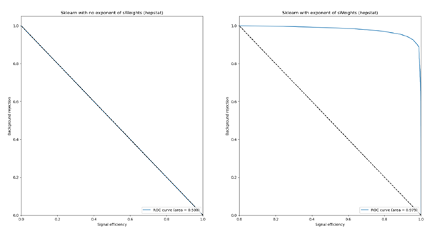
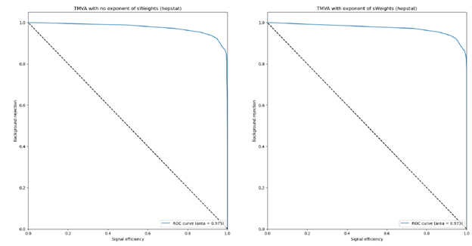
Example: 2-D toy data
  Taking the exponent

Slide 21
NoNeg-weights
  Different way to create weights without negatives
    Had to scale them by one
  Works as well as sWeights and exponent of sWeights

