Slide 1
E-CLIQ Quench Protection for High-Field Magnets
Tim Mulder, 21-03-2025

Slide 2
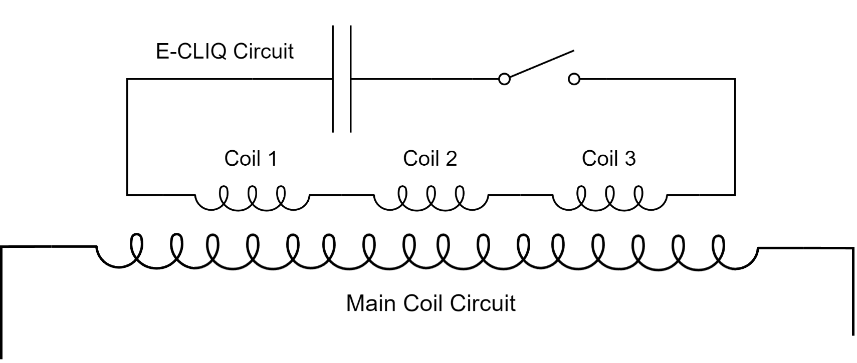
The Concept
External Coil Coupled Loss Induced Quench (E-CLIQ)
Inductive quench heater
✔ Set of compact resistive coils positioned near the main magnet coils.
✔ Loss generated directly inside the superconducting cables.
✔ Potential to be faster than resistive quench heaters.
✔ Thick insulation between magnet and E-CLIQ coils is possible.
✔ Separate electrical circuit.
✔ Small envelope, can withstand large mechanical preload.
✔ Can be designed for use with a power supply or with a capacitor bank.

Slide 3
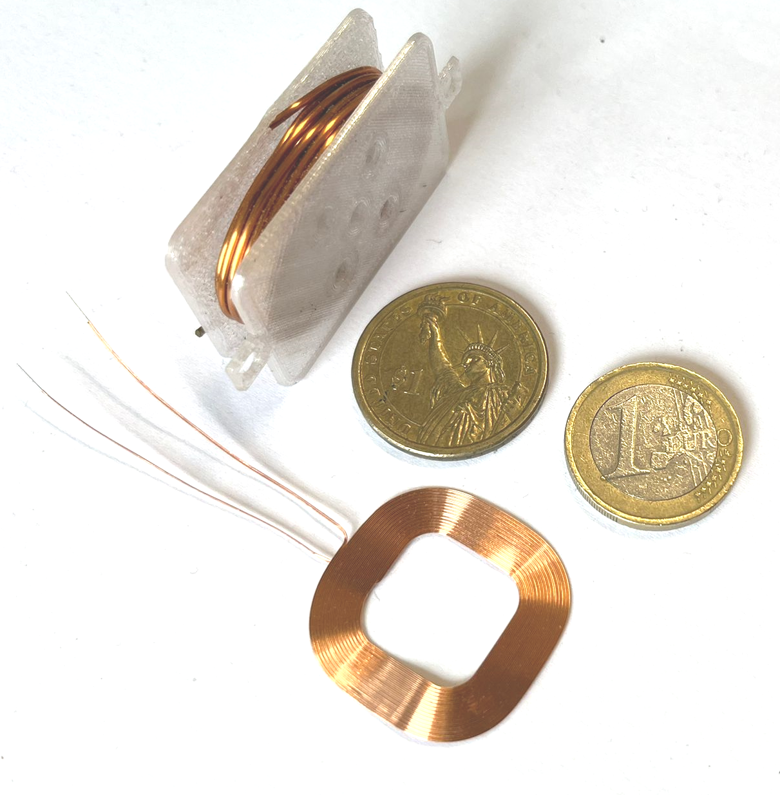
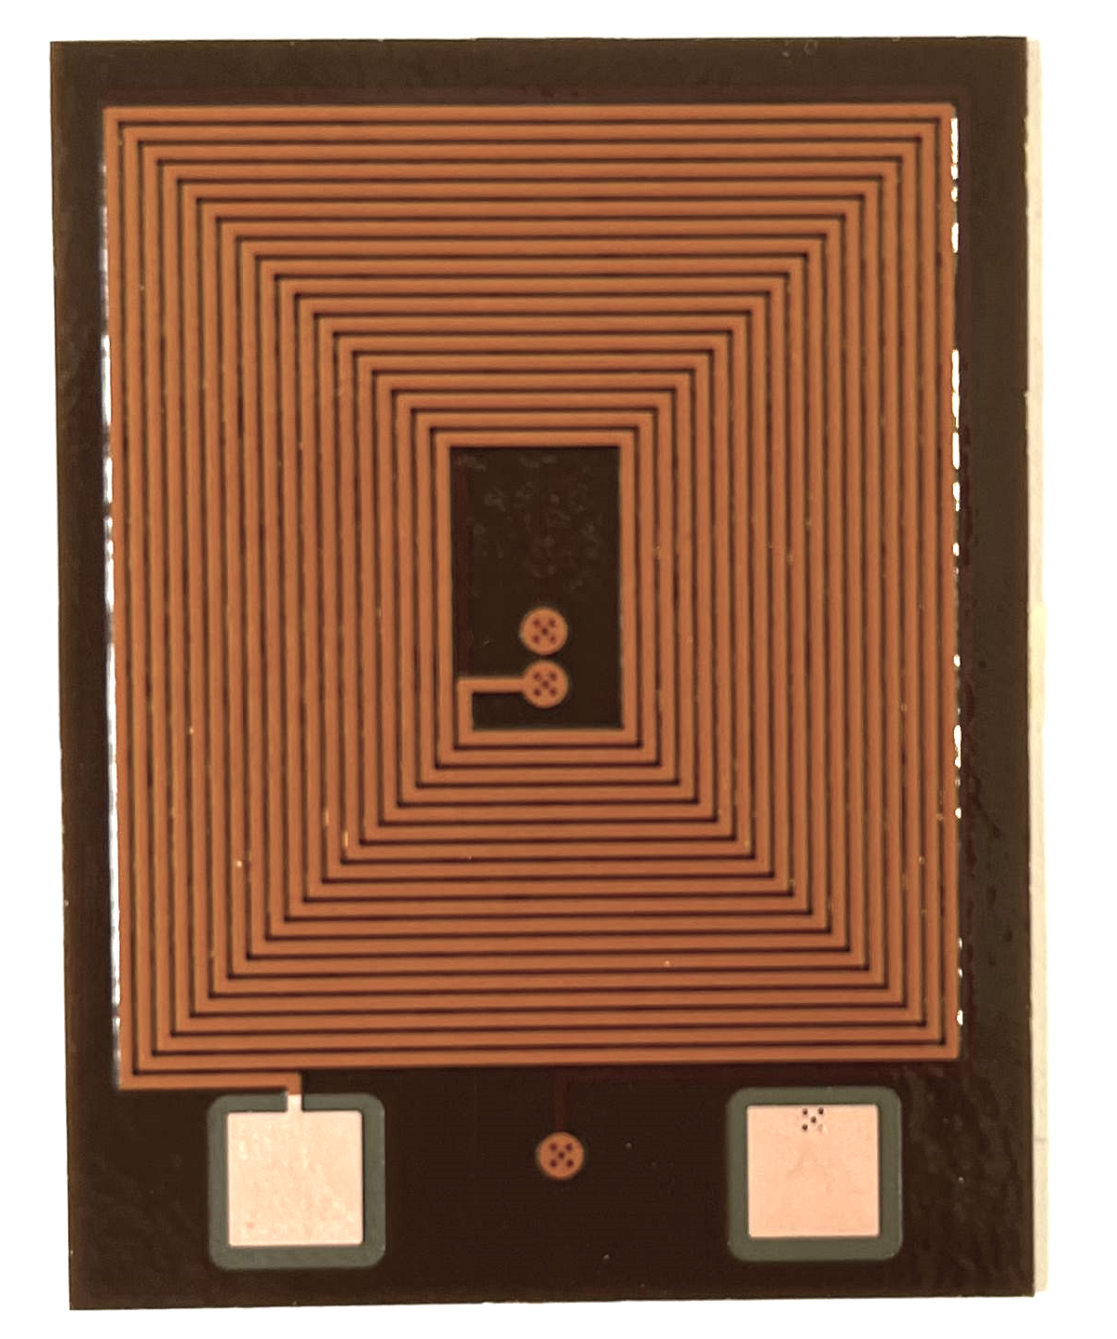
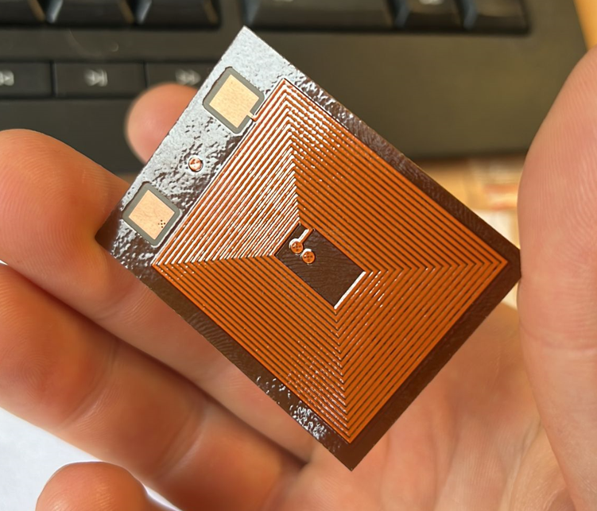

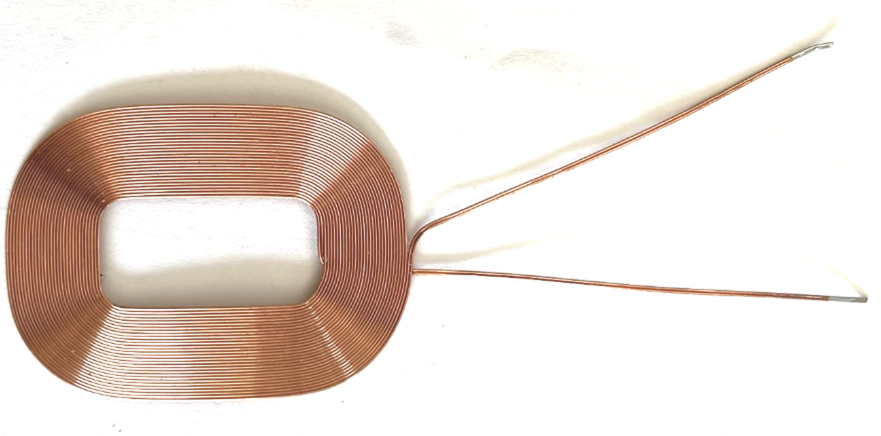

Compact E-CLIQ demonstrators
Non-flexible, very robust and easily mountable.
Development of 3 types of small demonstrators:
based on copper wound (thicker) coils,
based on, commercially available, inductive charging coils,
based on tracks on polyimide film.
Non-optimized,
yet quite flexible.
Notes:
At CERN 3 different types of small E-CLIQ are in development.
The first is a very robust version based on copper wire wound on a former.
The second is based on commercially available inductive charging coils. They are very flexible, yet not optimized for high voltage discharges.
The last is a multilayer PCB track on Kapton film, designed for short high current, high voltage capacitor discharges.
The devices are designed as sets of a few in series strategically places around the magnet you wish to protect.

Slide 4
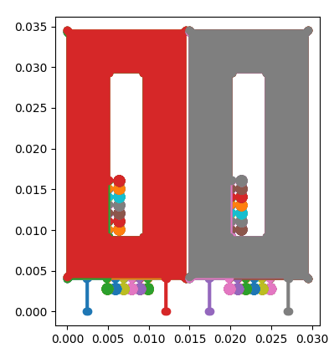
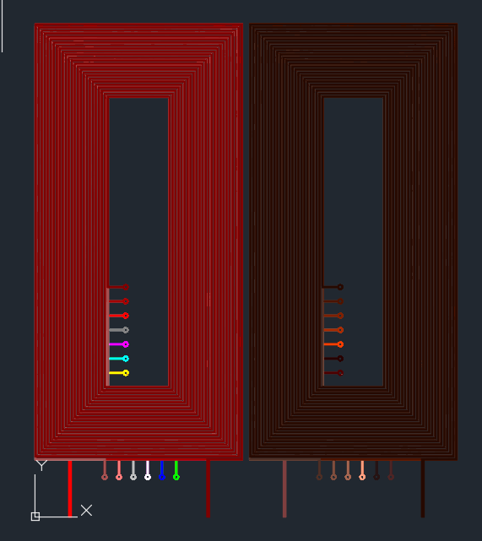
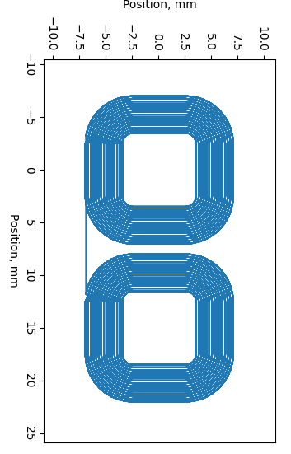
Design software in Python
Step 1: E-CLIQ design
to .dxf
Inductance
Field/Ampere
Track length
Expected resistance
Calc. properties

Slide 5
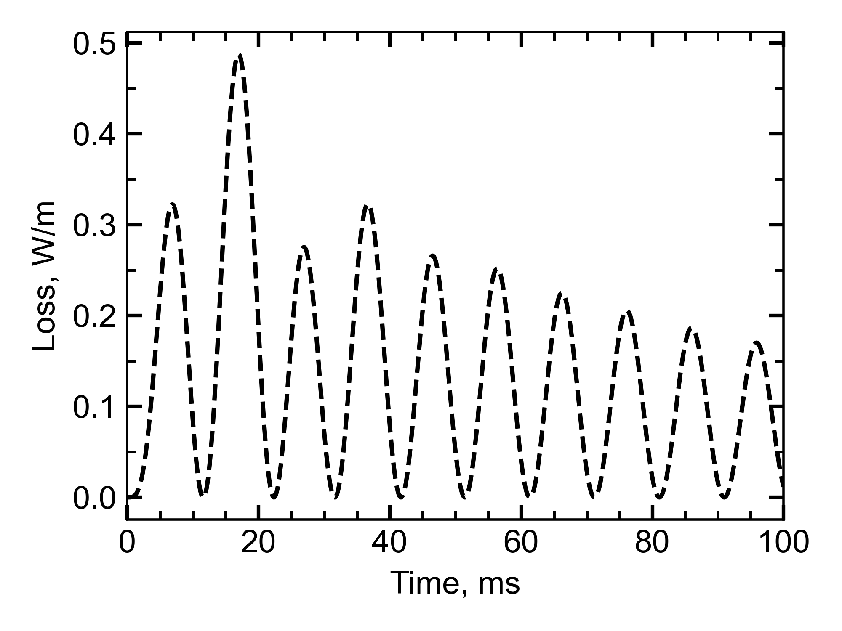
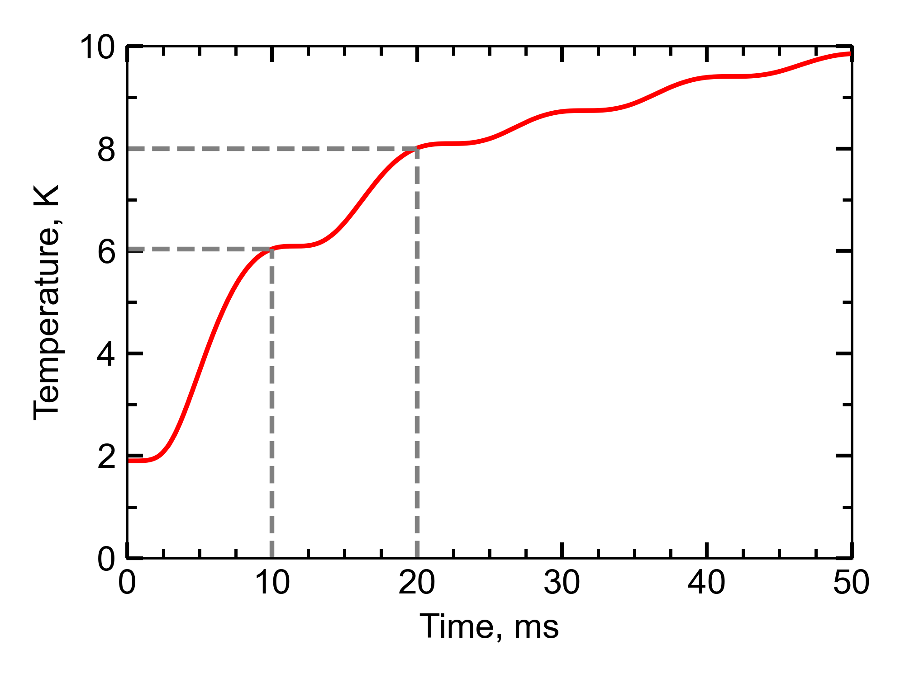
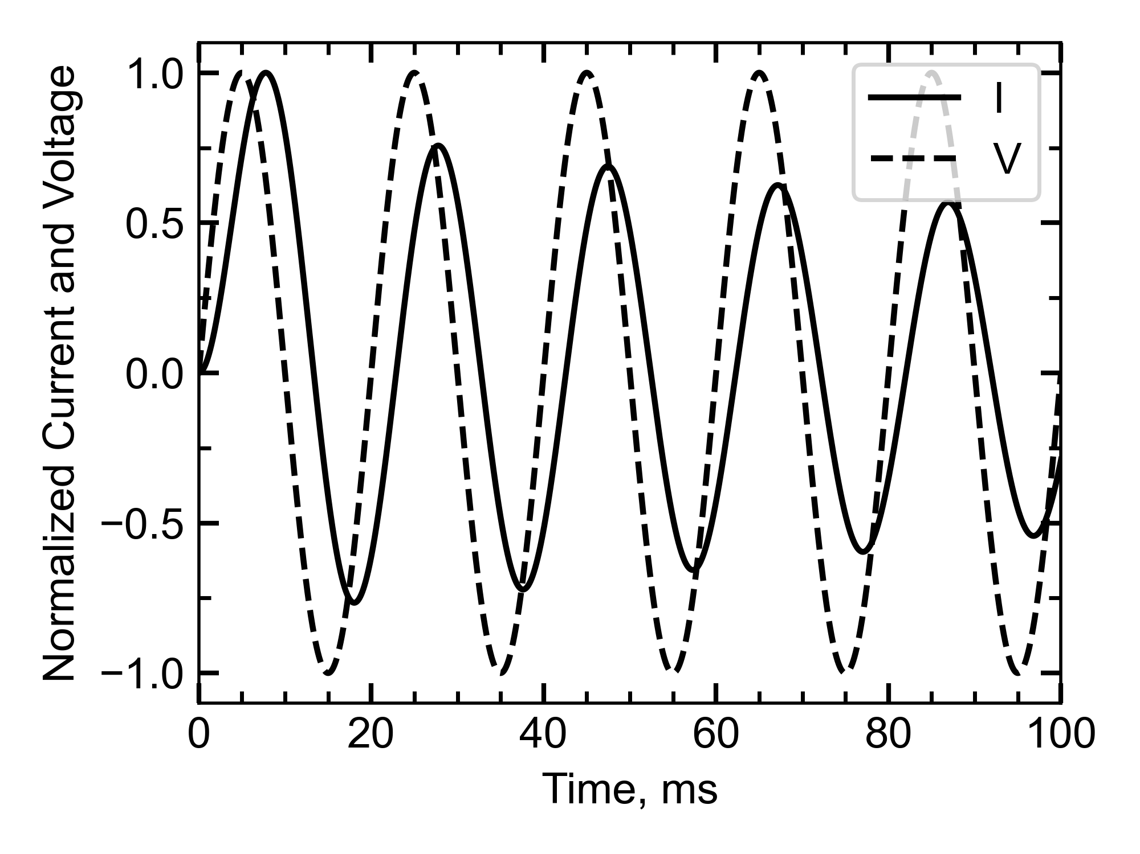
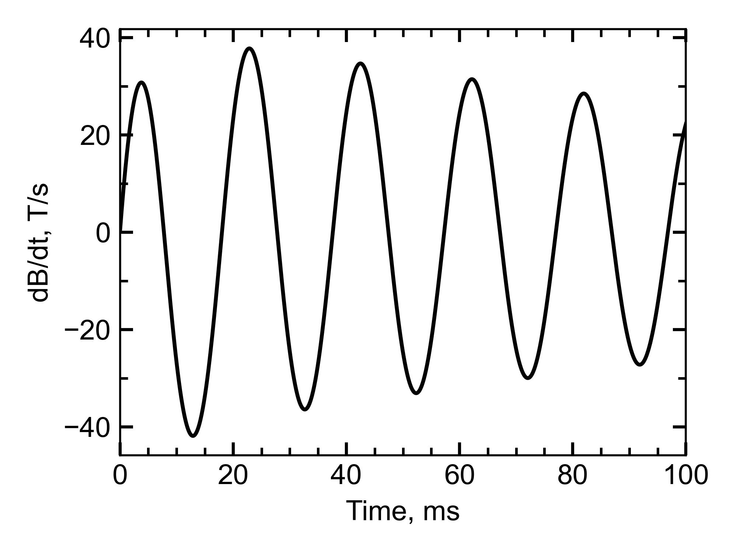
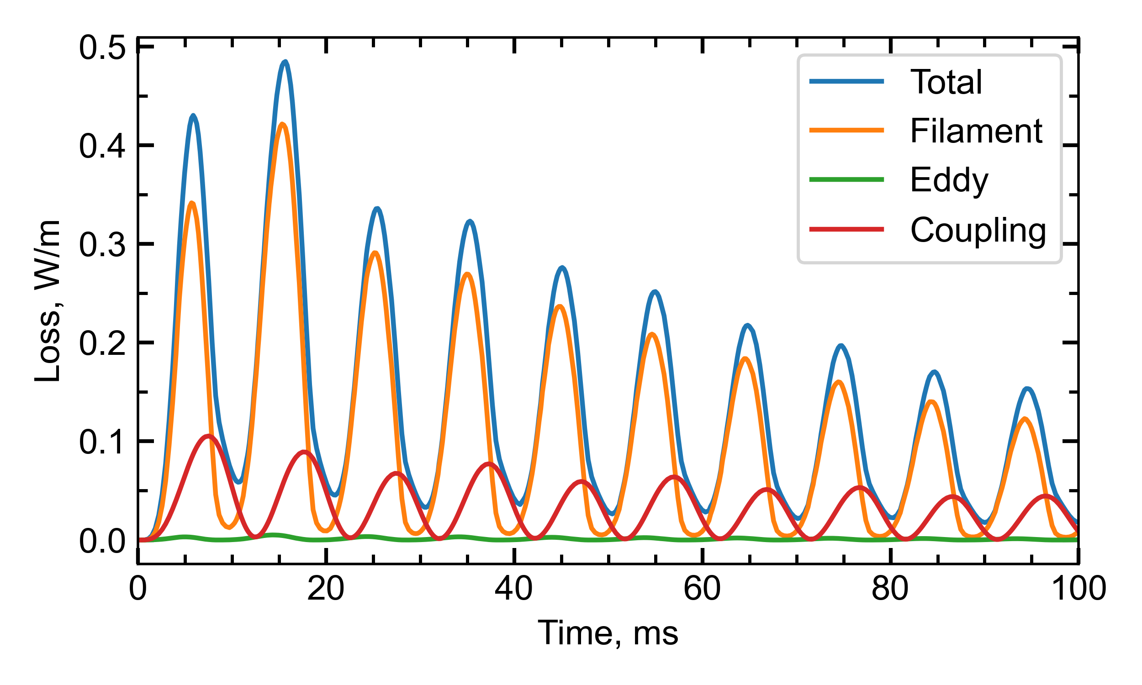
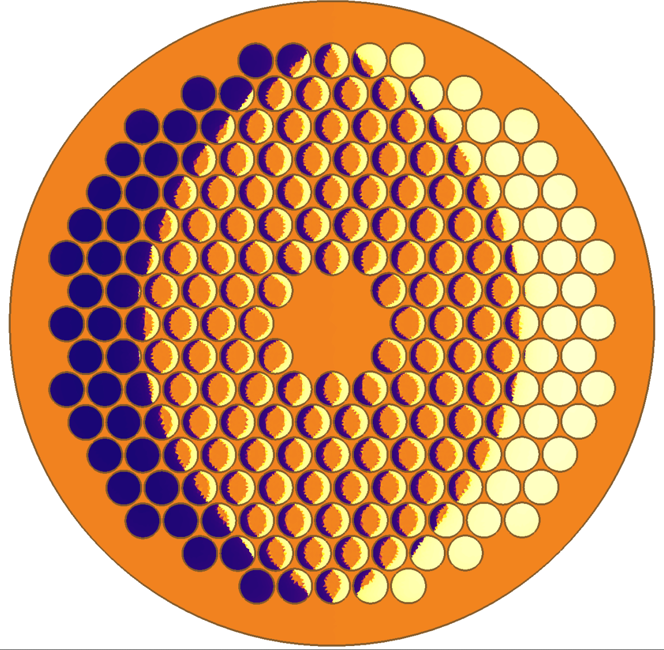

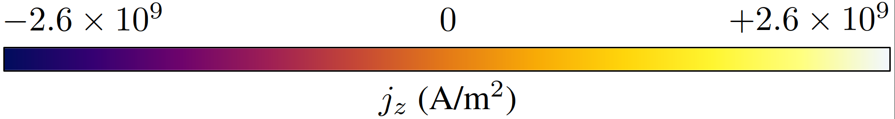
Design software in Python
Step 3: Loss calculations
Step 2: Powering response
Decrease in loss due to heating → increase of R.
Expected temperature increase using the calculated loss.
Example E-CLIQ EM behavior (change in temperature considered).

Slide 6
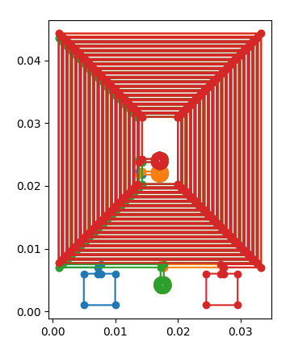
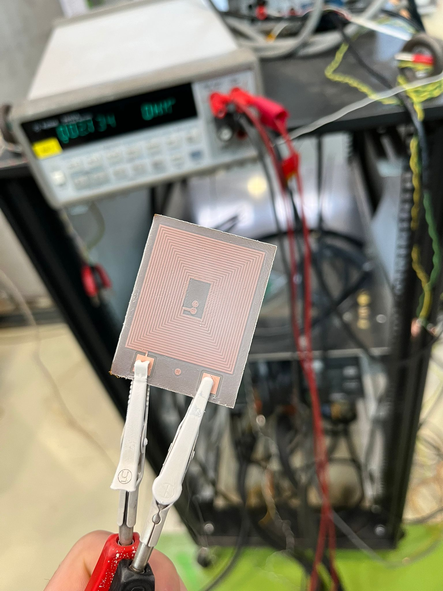
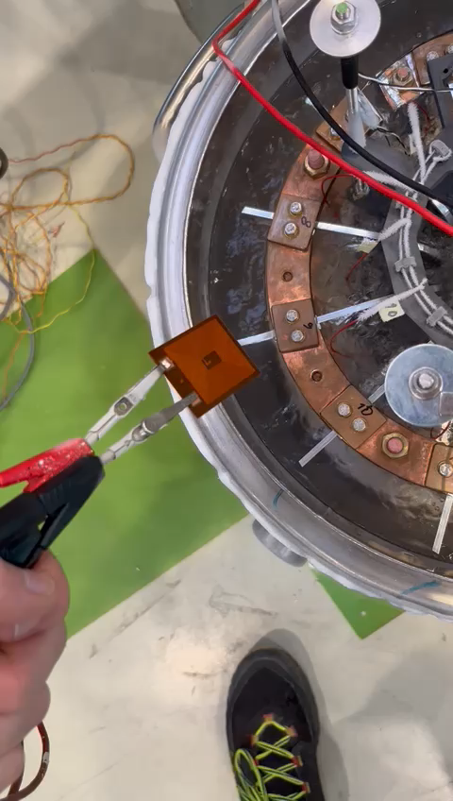
1st Generation of E-CLIQ
 | Designed | Measured | Unit
Layers | 4 | 4
Turns | 18 | 18
Inductance | 118.0 | 124.5 | µH
Resistance (293K) | 3.16 | 3.25 | Ω
Resistance (77K) | 0.39 (RRR=80) | 0.44 (RRR=~45) | Ω
T/A (center) | 0.003 | - | T/A
21.03.2025

Slide 7
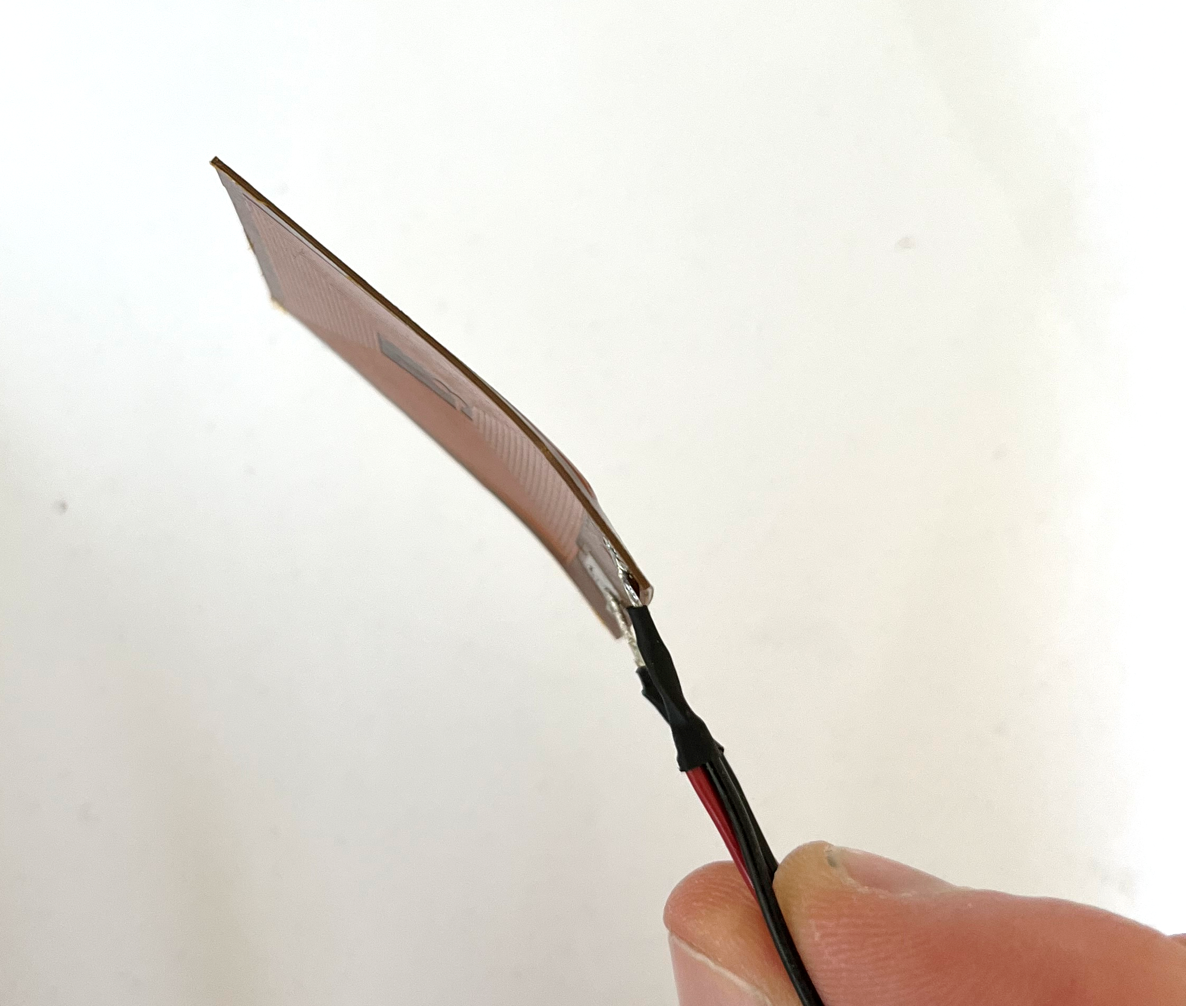
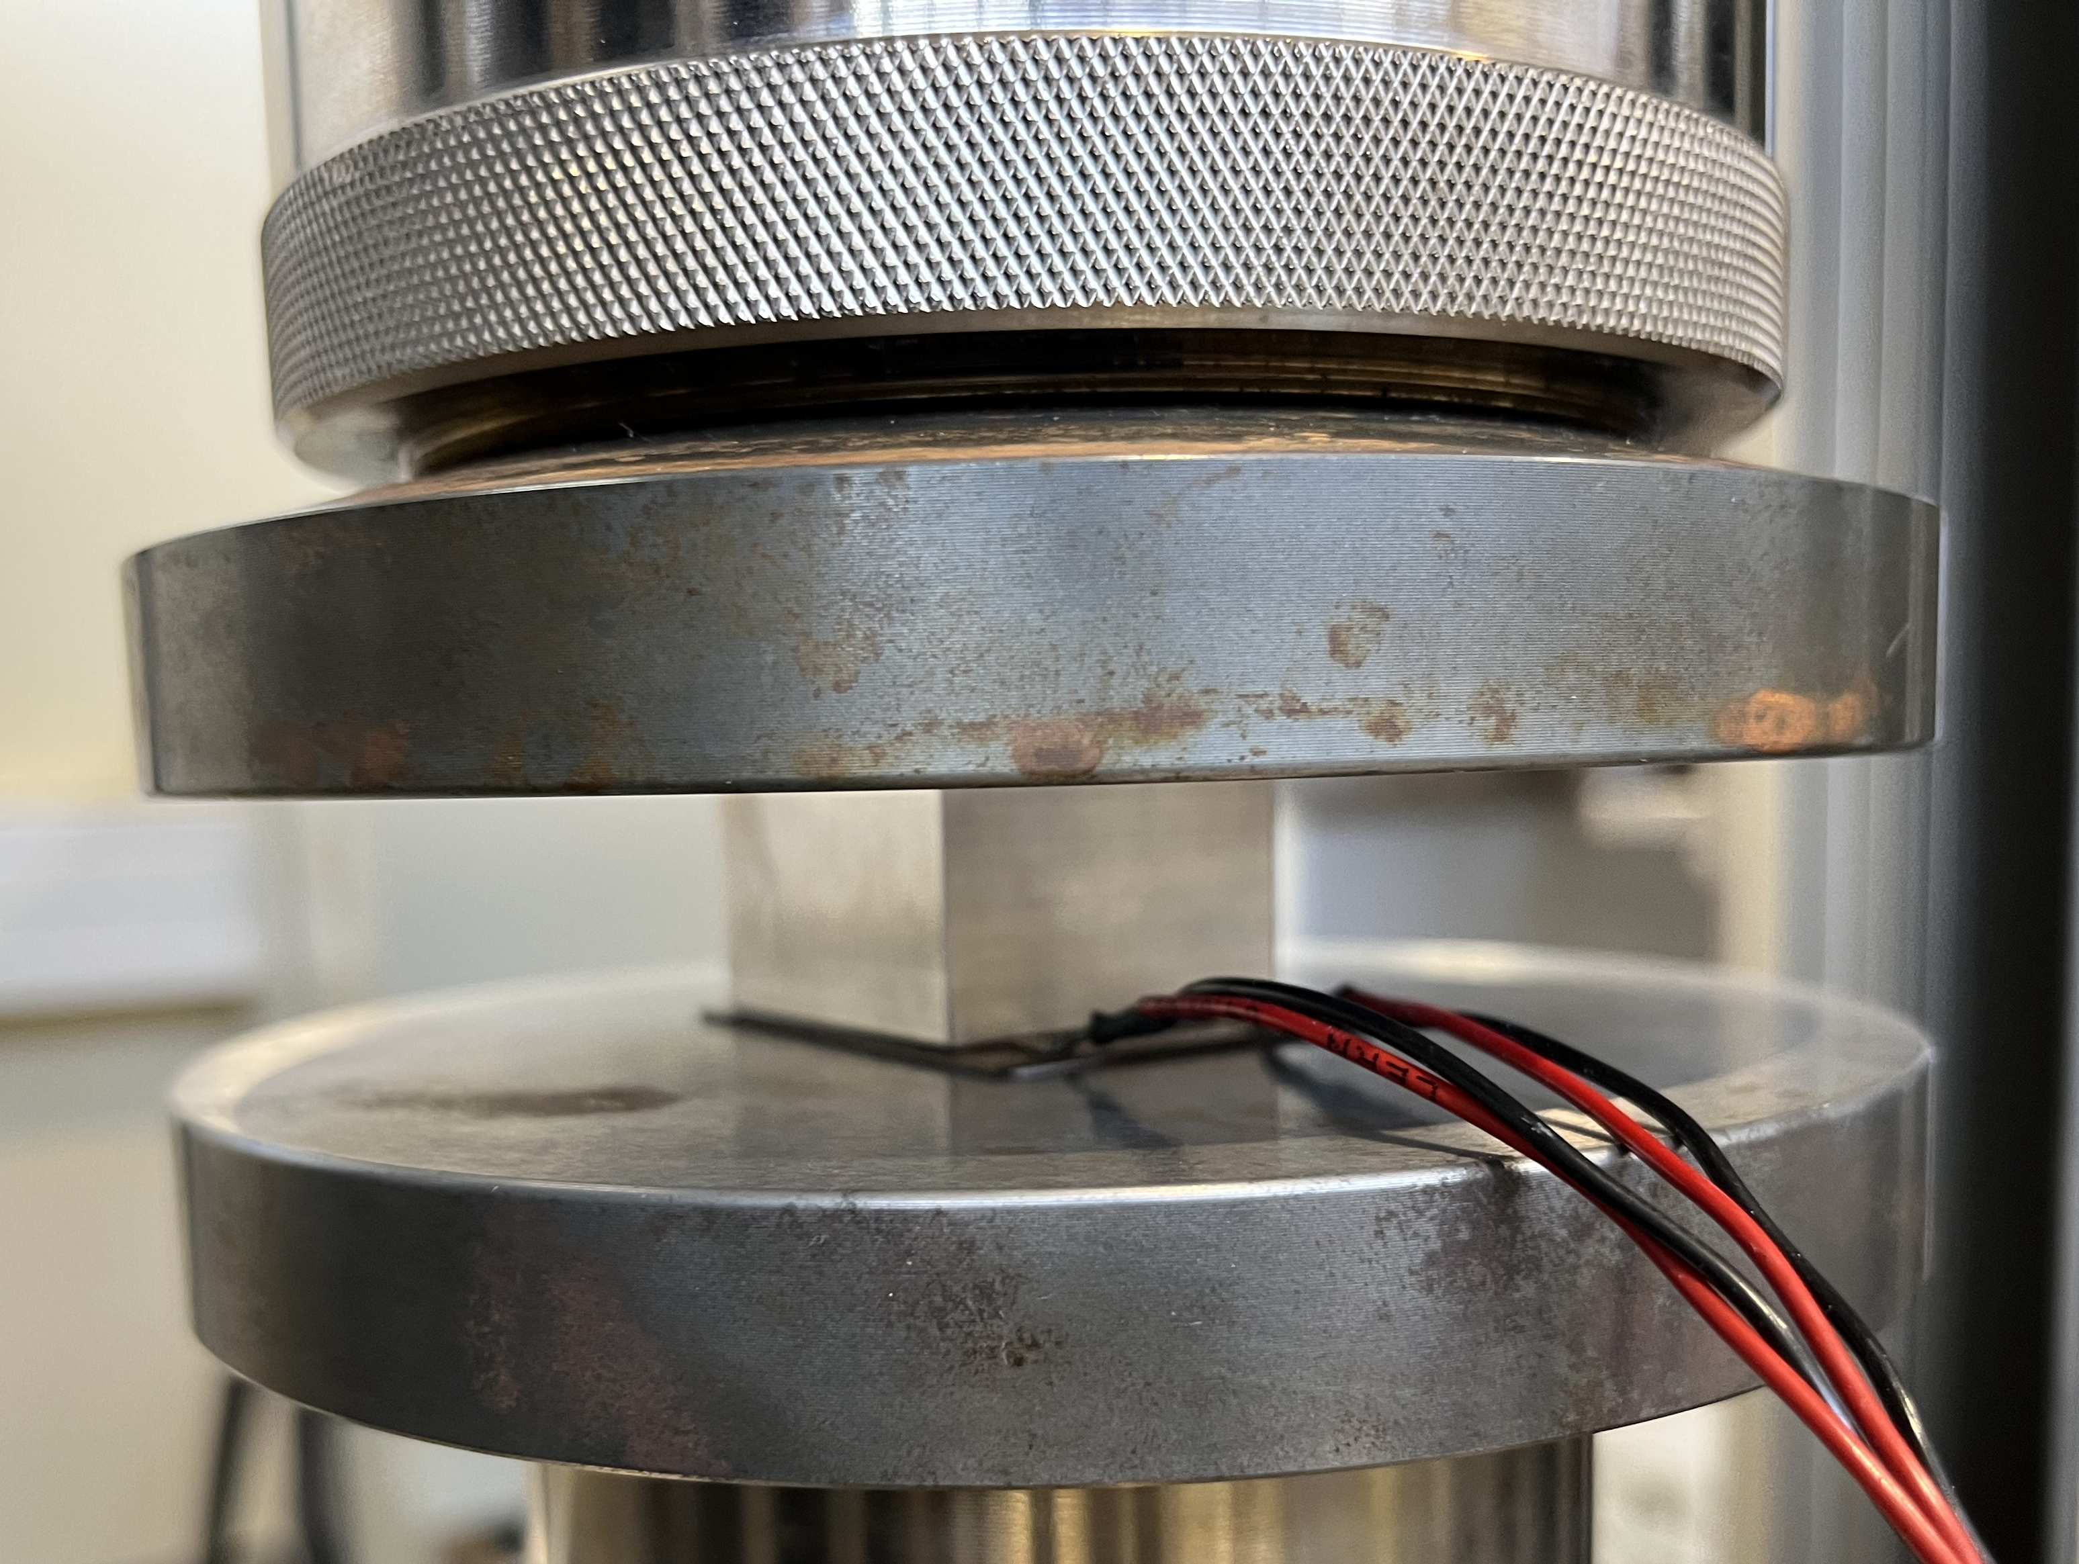
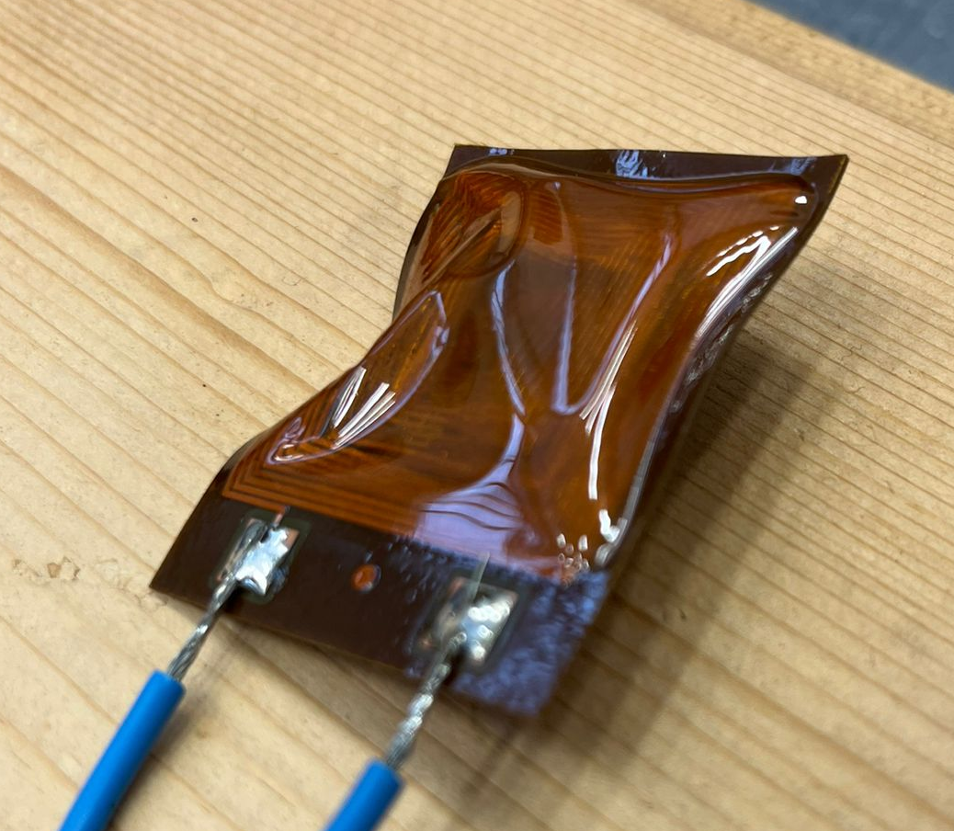
Robustness Testing
Tested up to 240 kN, no change in resistance/inductance (together with EN-MME).
Banana shape remained, no change in electrical parameters.
Tested with DC current of 6A for ~ 15 seconds. E-CLIQ ballooned, no change in electrical parameters.

Slide 8

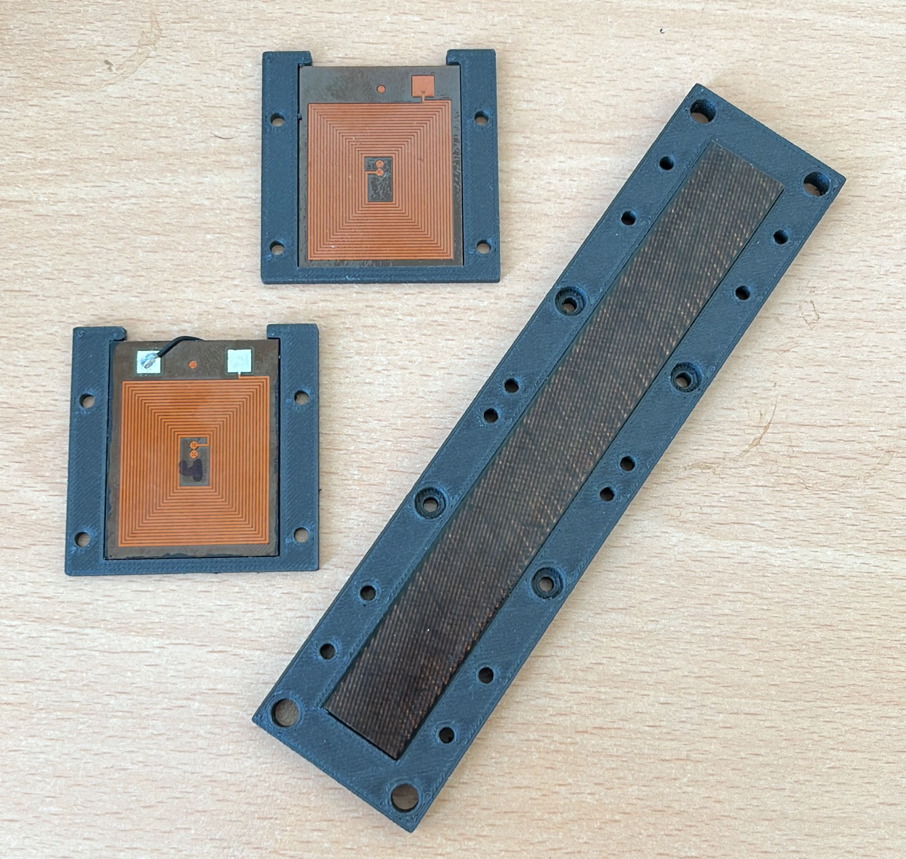
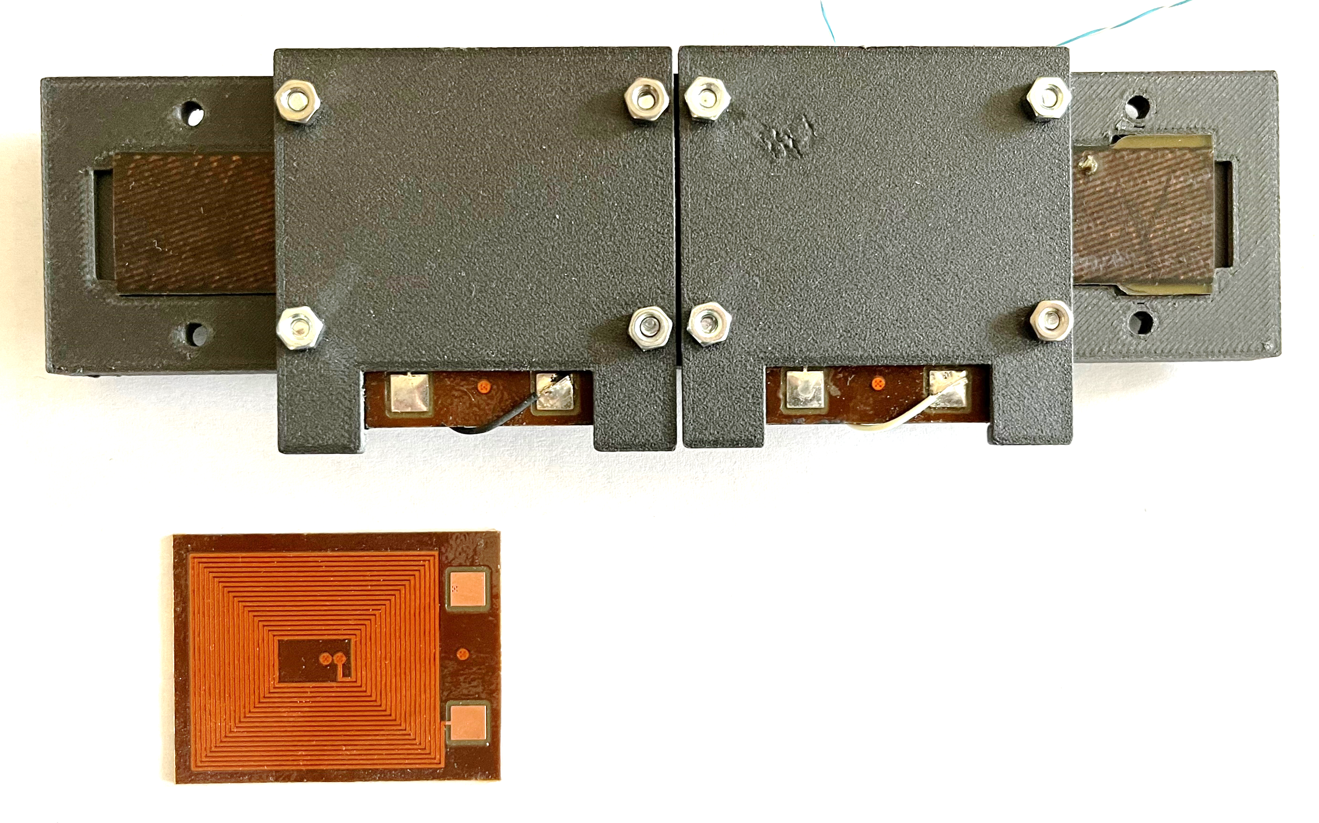
1st Generation of E-CLIQ
Temperature sensors + pickup coils
Nb₃Sn cable sample
E-CLIQ Devices
3D-printed sample holder

Slide 9
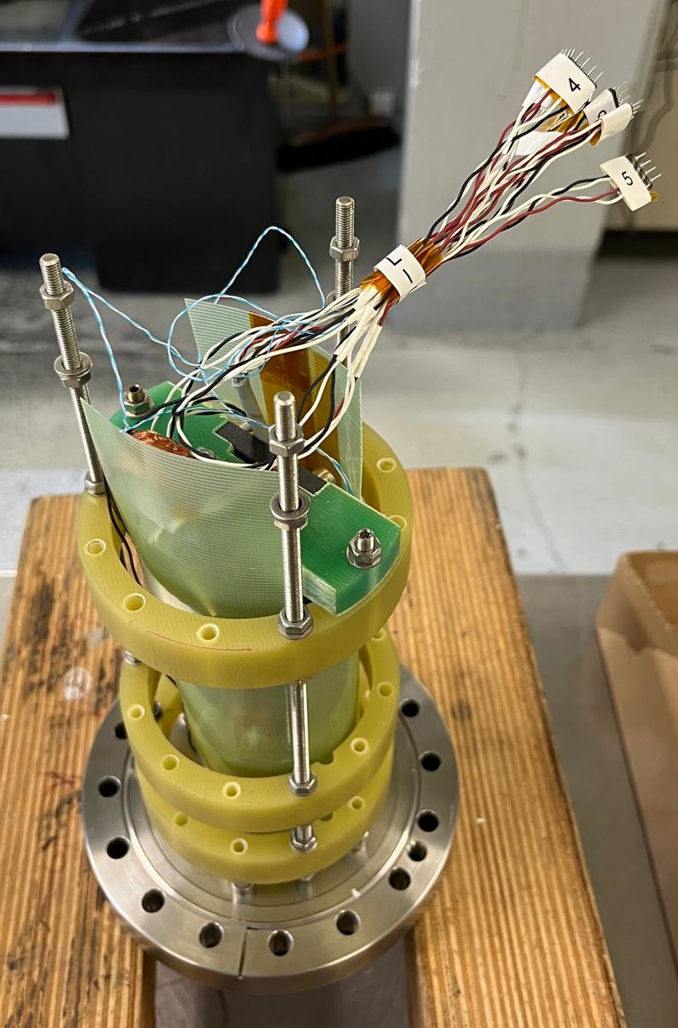
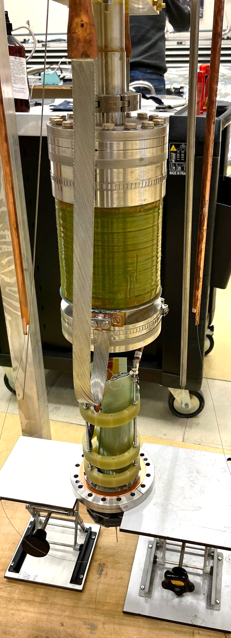
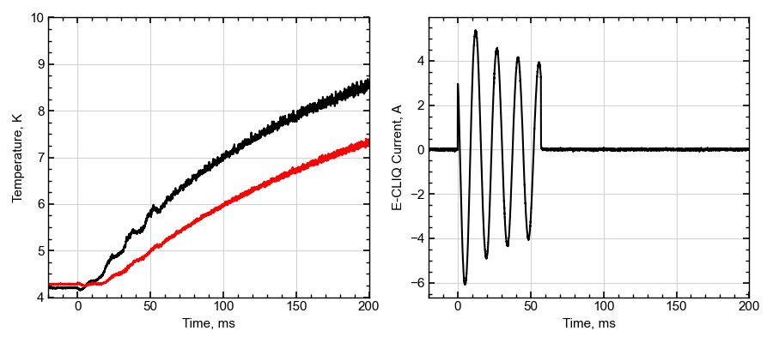
First E-CLIQ test on an Nb₃Sn cable sample
Exemplary result:
Results are promising, but still many unknowns:
E-CLIQs clamped directly on the Nb₃Sn cable.
Heating due to AC loss or conductive heating?
Large conductive heat flow out of the E-CLIQ ‘loss’ area.
Unknown thermal resistance between the cable and temperature sensors.
Setup + sample inserted in to a 5 T magnet. Magnet cooled by LHe, E-CLIQ sample cooled by GHe (< mBar).

Slide 10
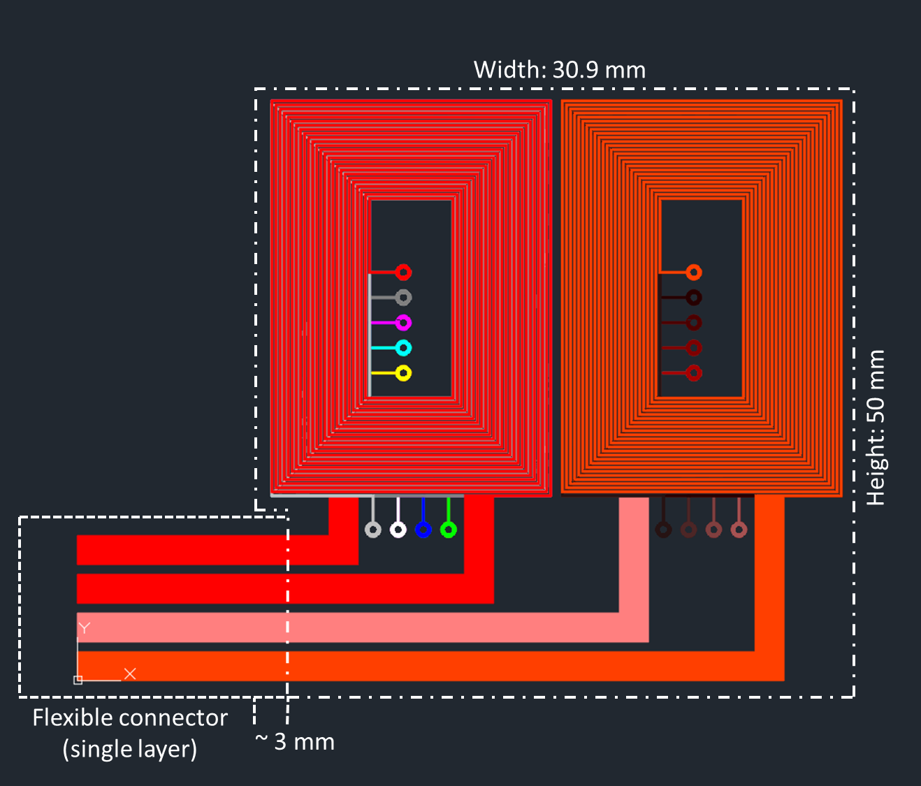
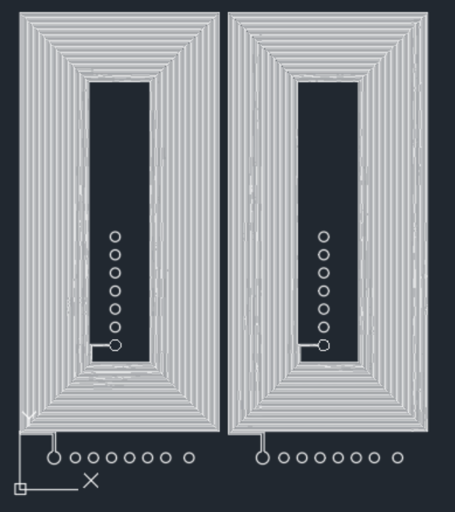
2nd Generation of E-CLIQ
Designed for use with an Nb₃Sn Short Model Coil (SMC)
Two coils: one for each layer of Nb₃Sn racetracks.
Flexible connector, needs to make a bend.
Optimized for use with an existing amplifier for the frequency range of 50-300 Hz.
Several design iterations to make optimal use of the available envelope.
Initial design
Final design

Slide 11
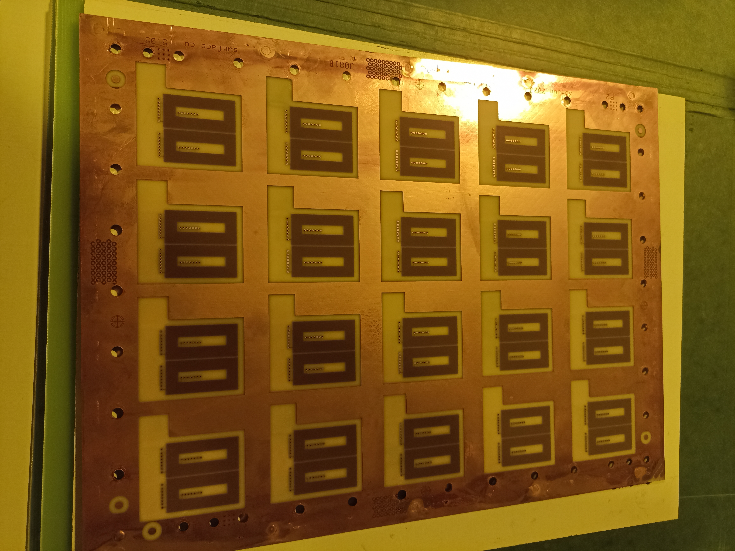
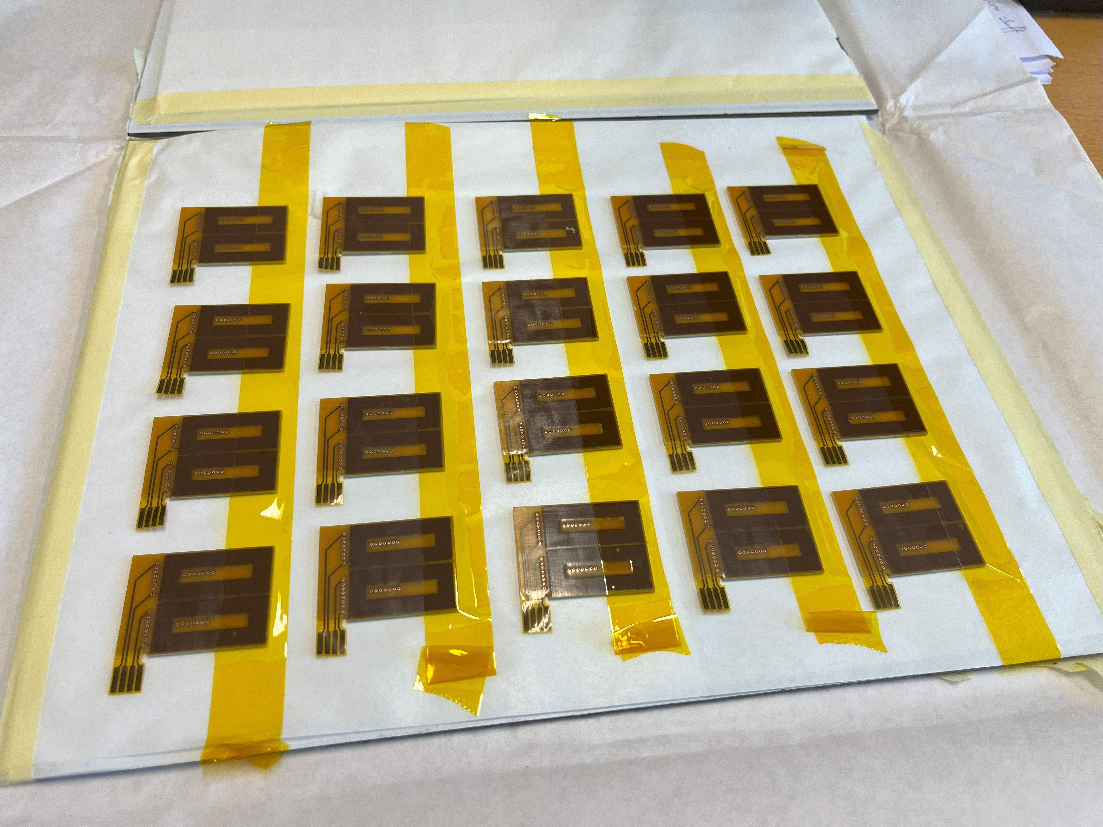
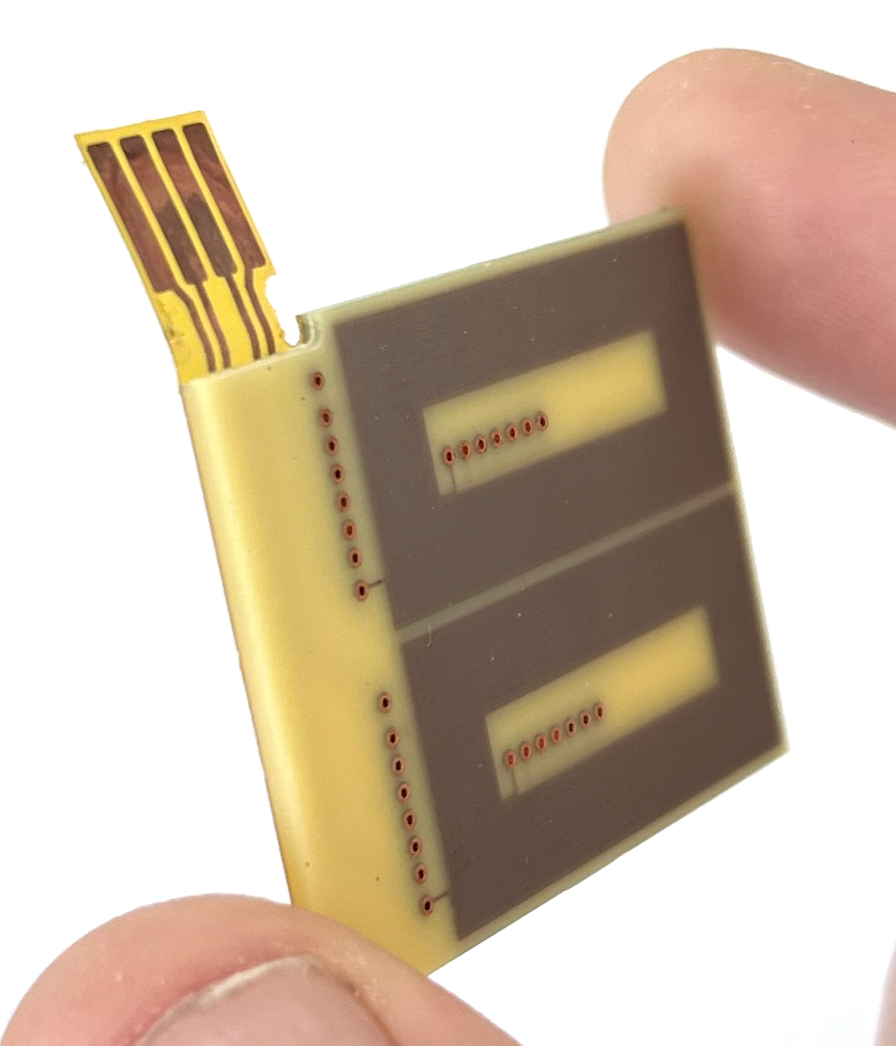
2nd Generation of E-CLIQ
 | Value | Unit
Layers | 14 | -
Turns | 24 | -
Inductance | 3.2 | mH
Magnetic Field | 0.05 | T/A

Slide 12
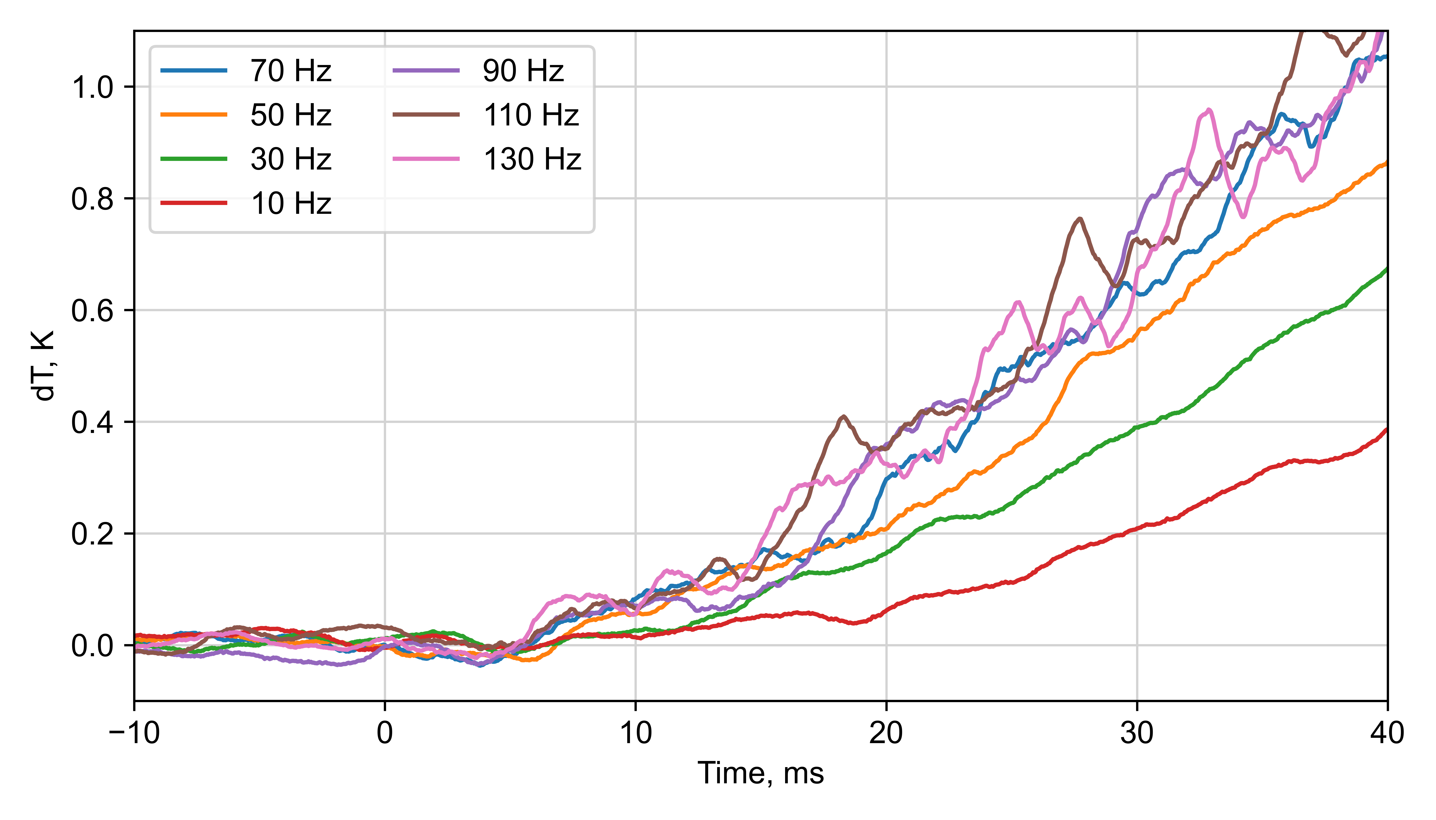
Second E-CLIQ test on an Nb₃Sn cable sample
2nd Generation of E-CLIQ coils in the setup in cryolab:
1 mm spacing between the E-CLIQ coils and the cable sample.
Very similar temperature rise observed in the 70-130 Hz range in the 0 to 50 ms timespan.
PSU issue, max 3 A E-CLIQ current, significant reduction in loss compared to max power.

Slide 13
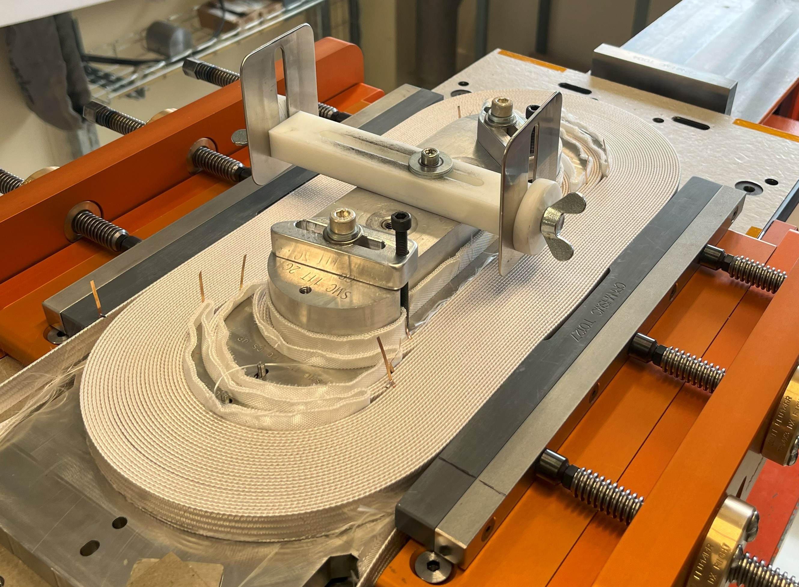
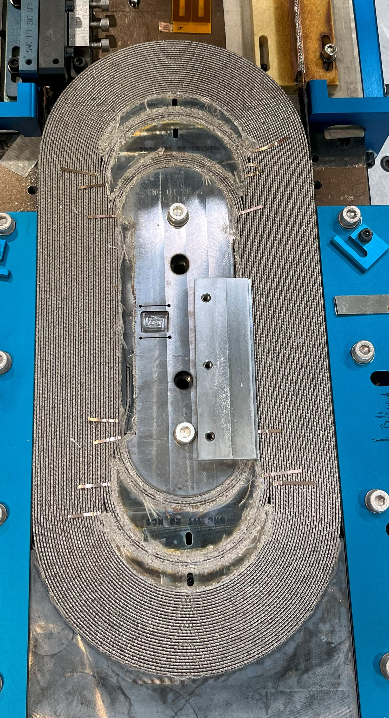
SMC is wound (B927, CERN)

Slide 14
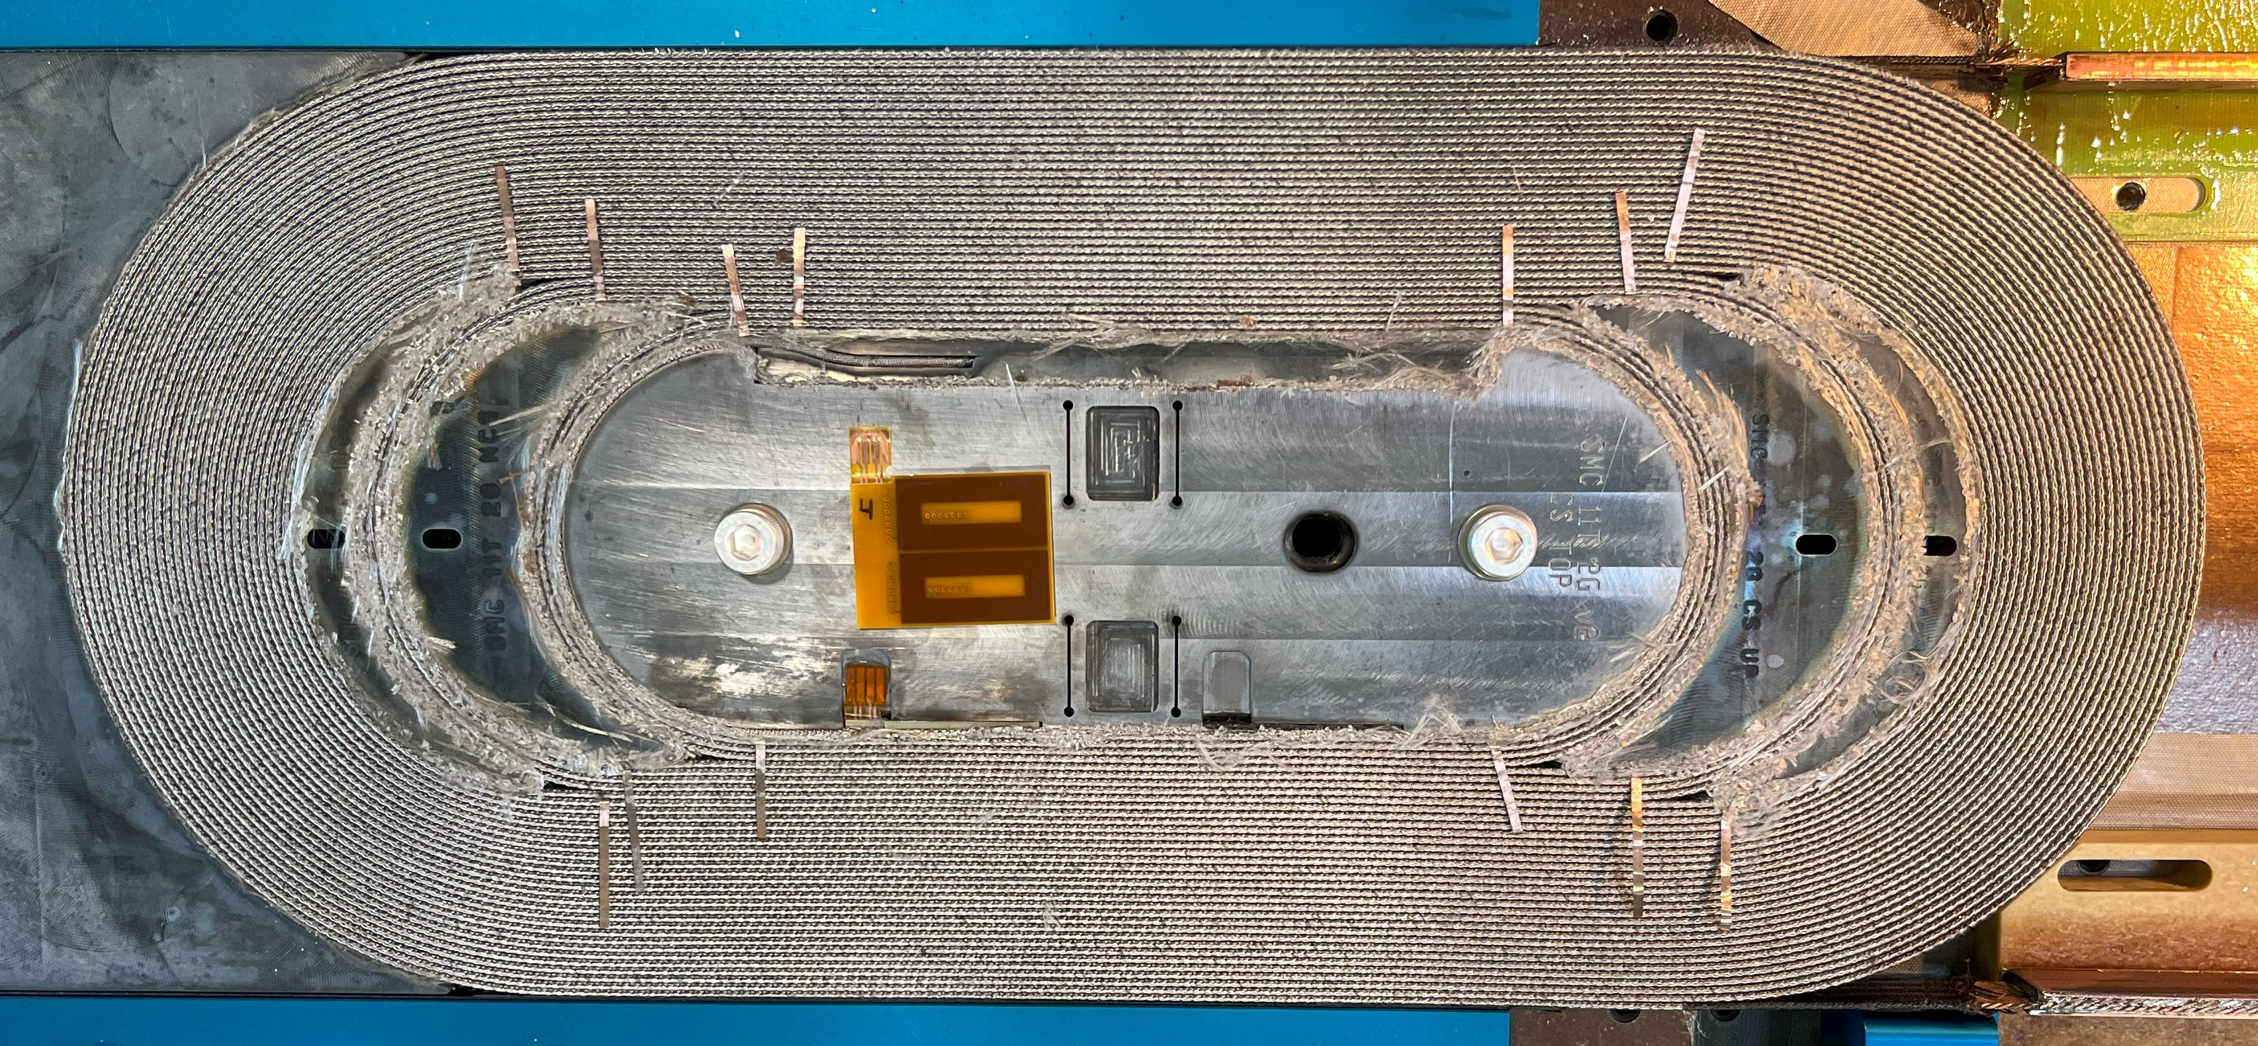
Insertion of the E-CLIQ coils (before impregnation)

Slide 15
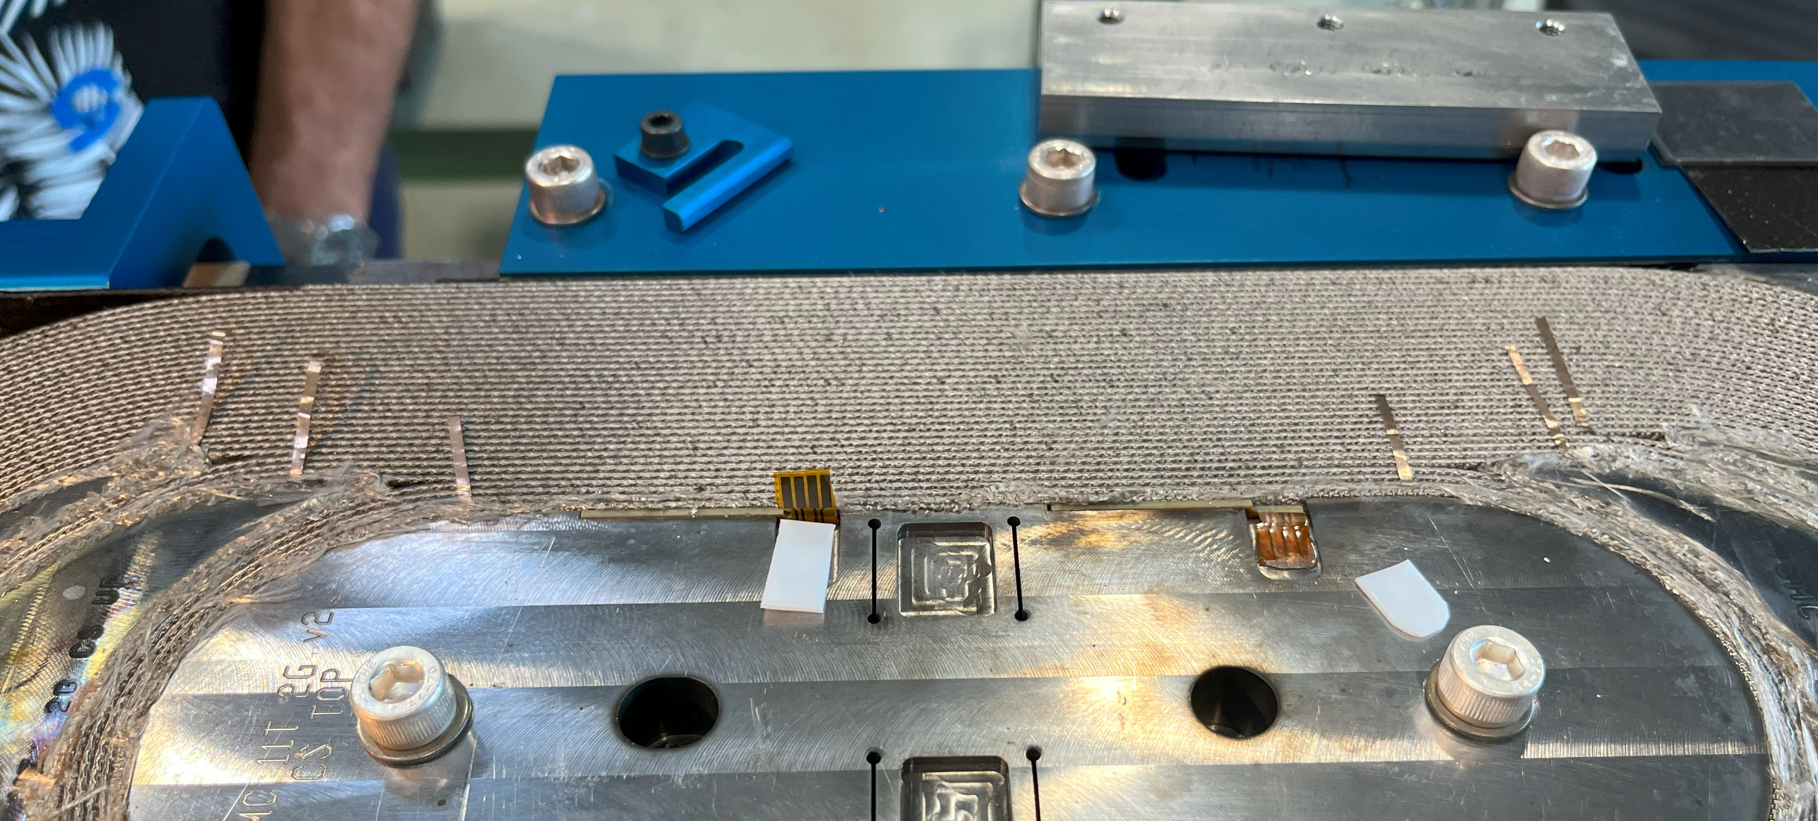
Insertion of the E-CLIQ coils (before impregnation)

Slide 16
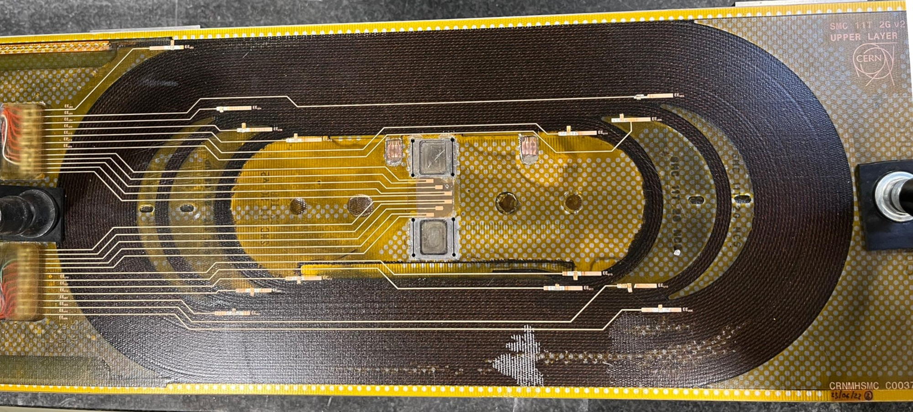
Trace is added.

Slide 17
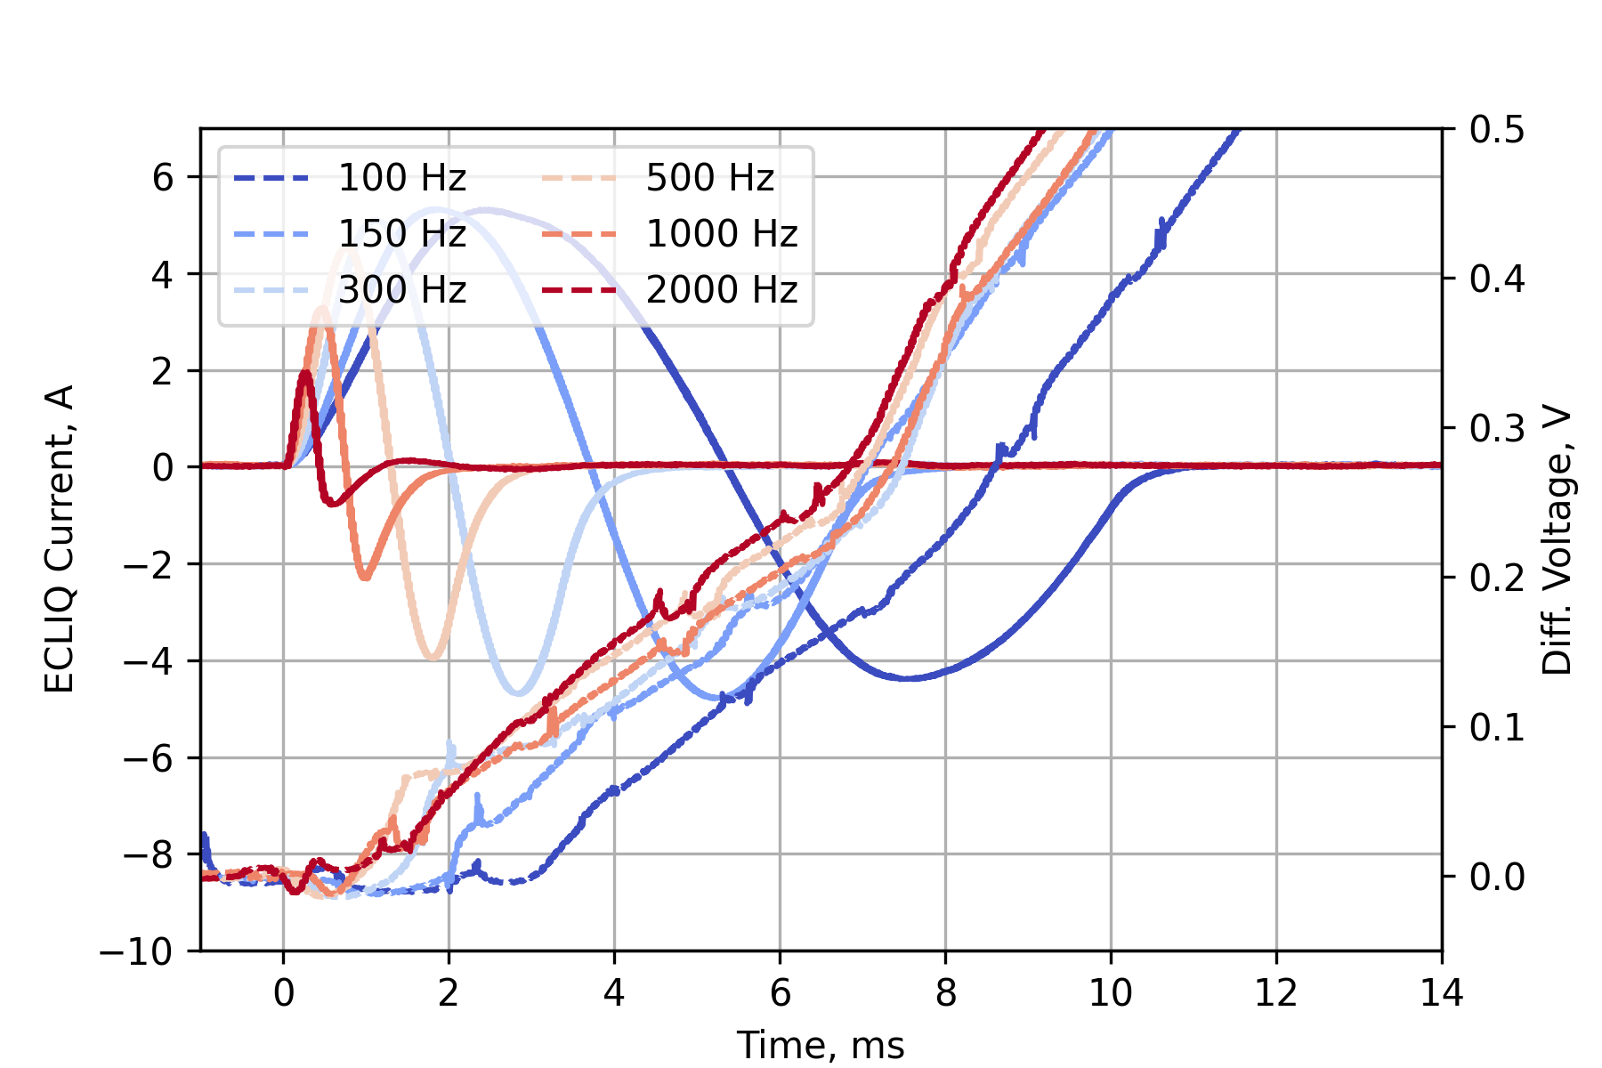
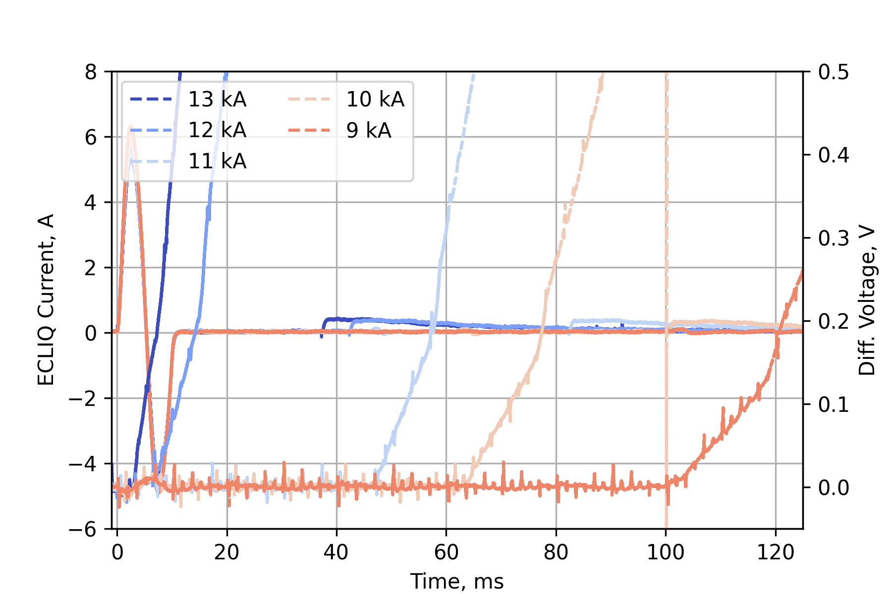
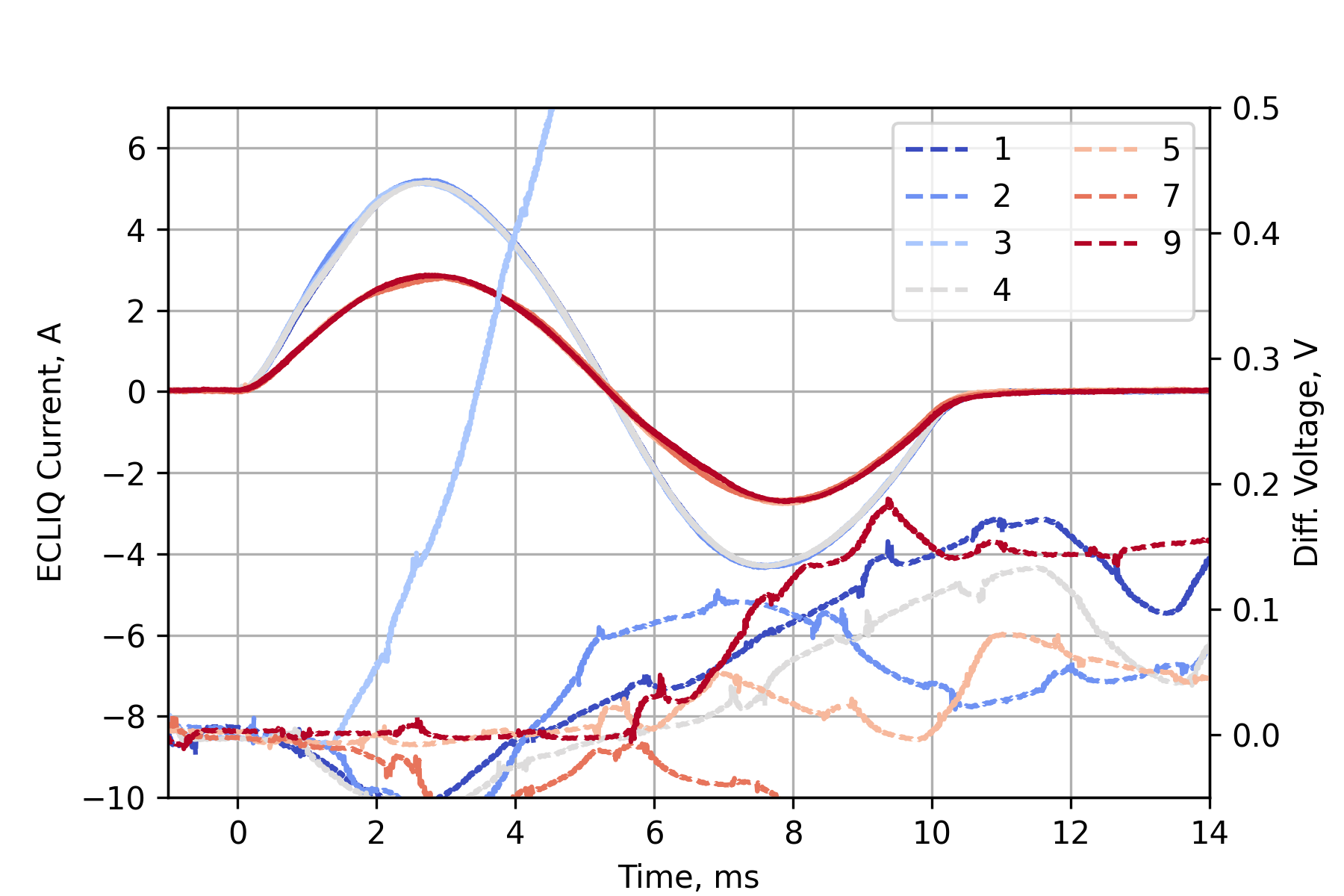
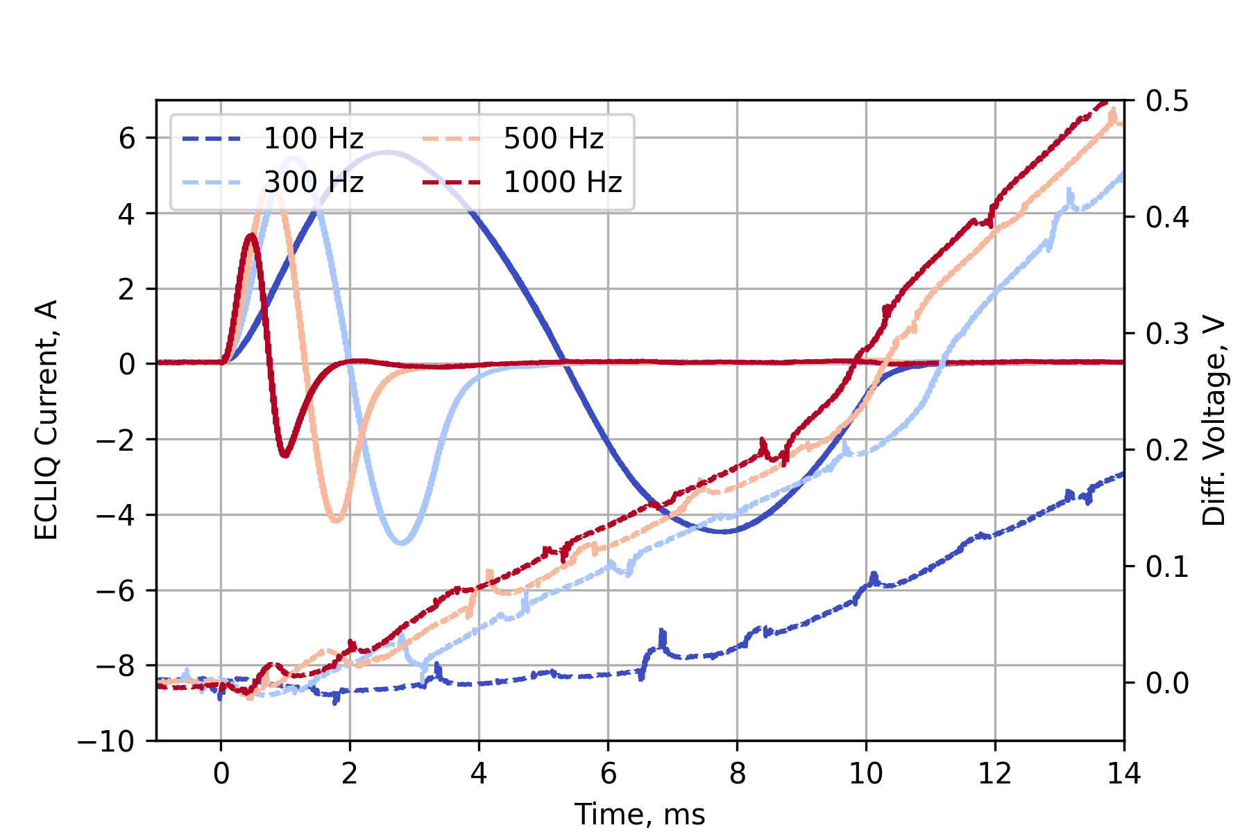
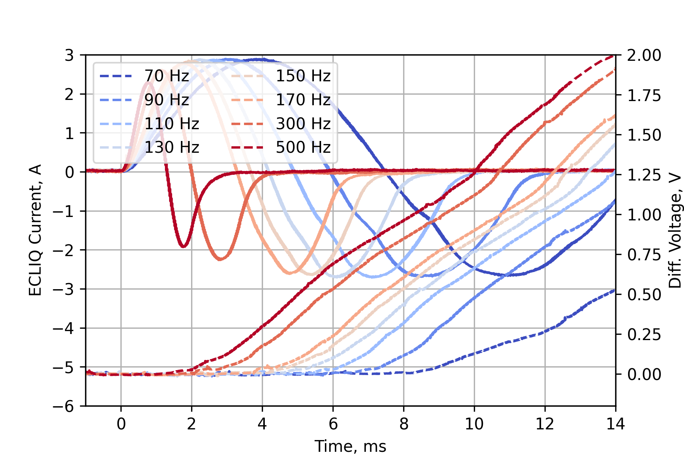
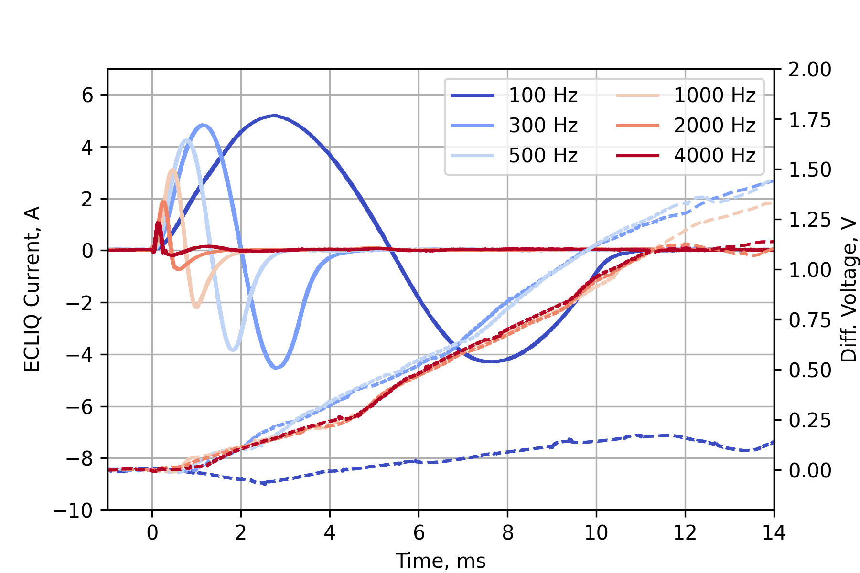
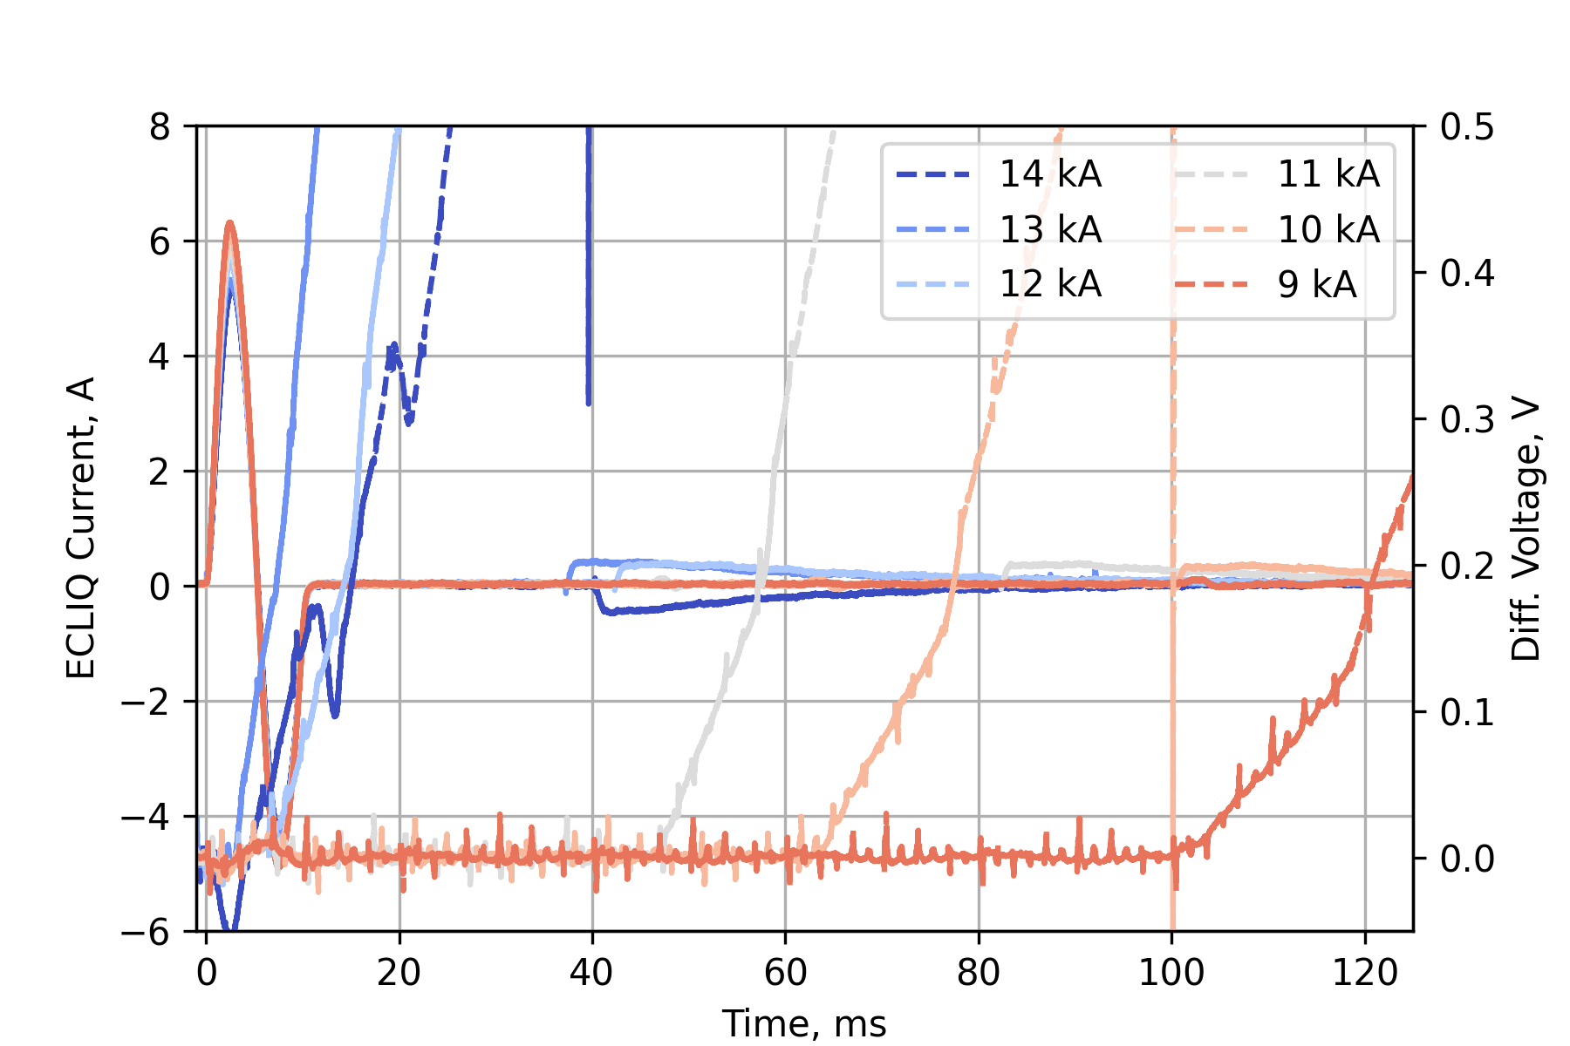
Measurement Results: 2nd generation of SMC11T
SMC108 (Feb 2025)
✓ 64 measurements at 4.5 K
✓ 12 measurements at 1.9 K
✓ E-CLIQ frequency of 70 Hz to 10 kHz
✓ Magnet current of 2.5 kA to 14 kA
✓ 7 different E-CLIQ configurations
SMC109 (March 2025)
✓ 27 measurements at 4.5 K
✓ E-CLIQ frequency of 50 Hz to 1000 Hz
✓ Magnet current of 12 kA to 14 kA
✓ 2 different E-CLIQ configurations

Slide 18
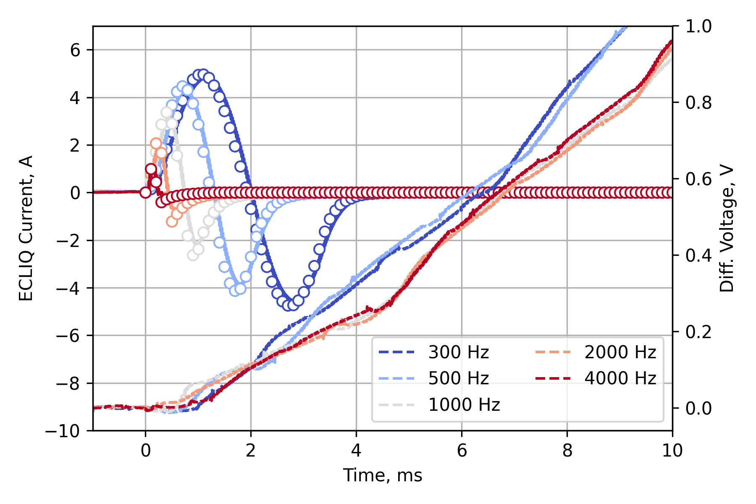
Success!
Quench initiation within a ms at a magnet current of 14 kA followed by NZP.
Quench initiation with some ms at lower currents.
Magnet current of 14 kA, frequency range of 300 to 4000 Hz, E-CLIQ voltage of 70 V, 4.5 K.

Slide 19
Four modes of possible quench initiation
  AC loss
    Loss due to dB/dt by the E-CLIQ coils. Mix between interstrand- and interfilament coupling loss, eddy current loss and hysteresis loss.
  Resistive heating
    E-CLIQ comprises resistive copper coils and thus produce heat upon activation.
  Increase in peak field
    The peak field on the conductor increases by a few hundred mT due to the E-CLIQ field and affect the local conductor I_{c}.
  Forces and Vibrations
    The E-CLIQ coils are in parallel field and upon activation will vibrate due to Lorentz force.

Slide 20
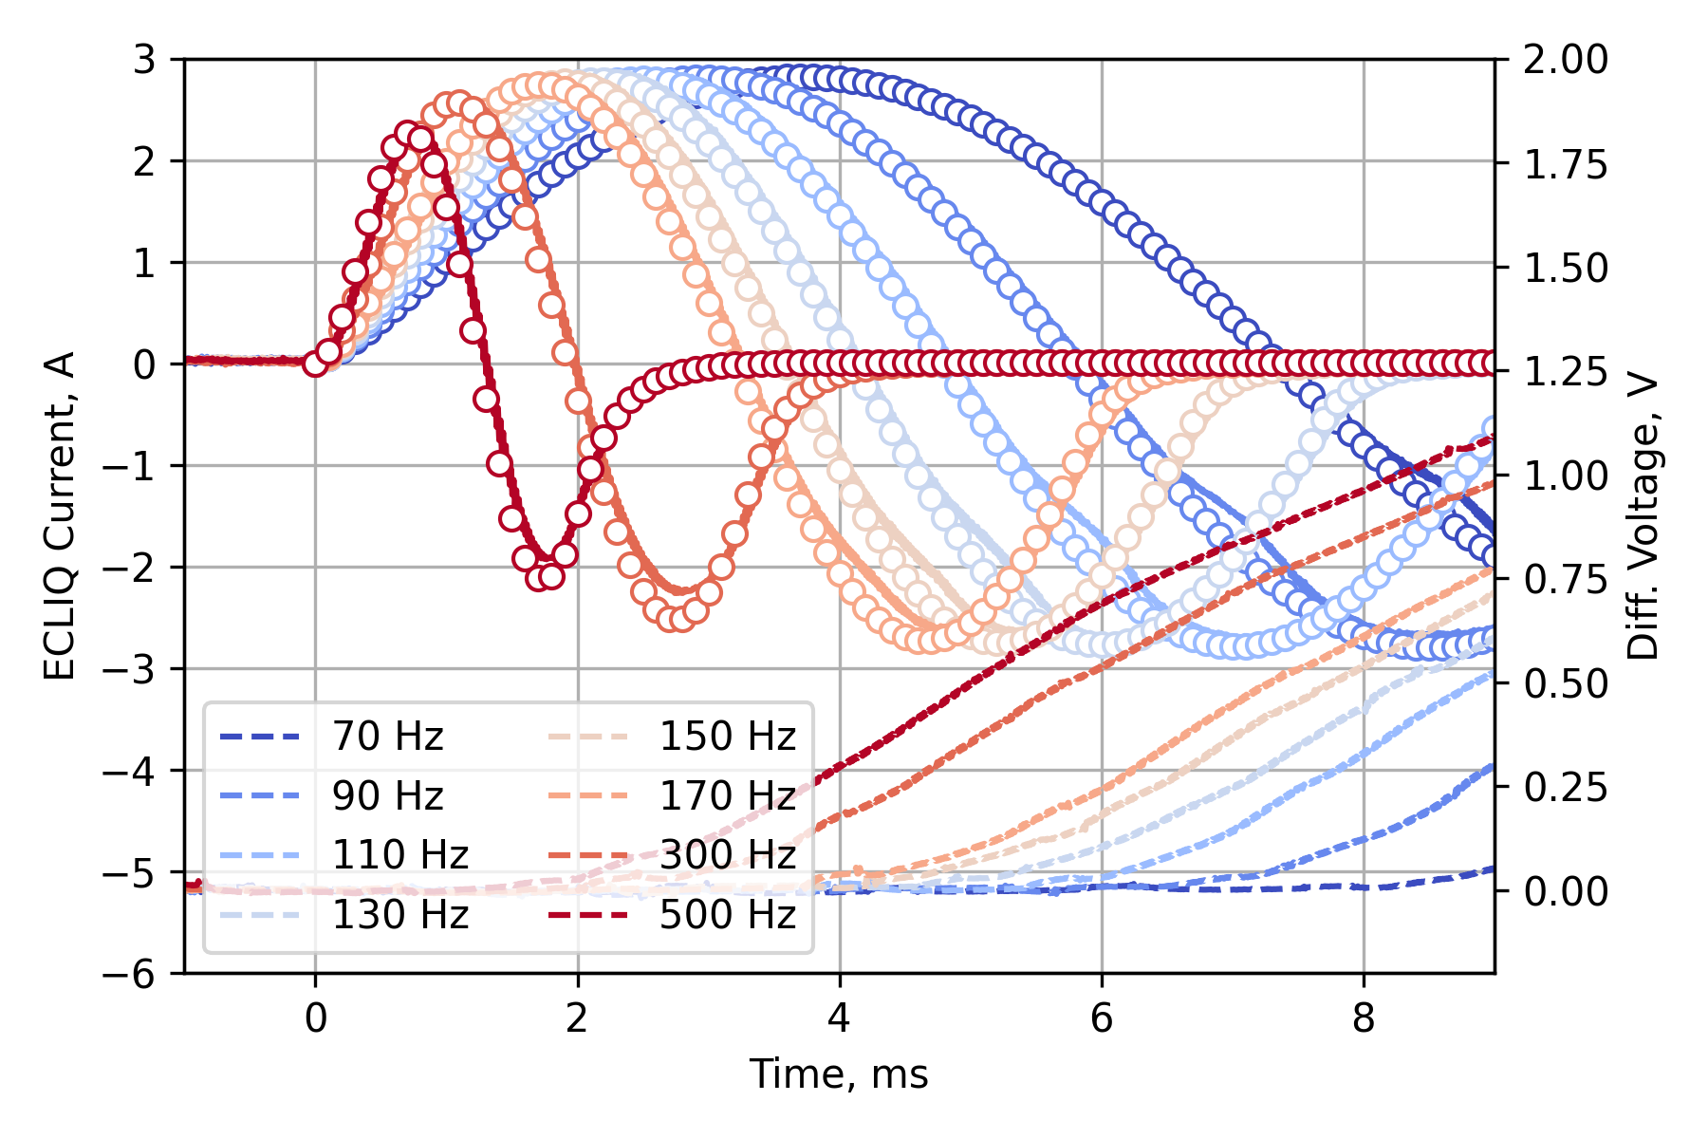
Understanding the measurement results
2.77A
2.82A
2.87A
2.86A
2.87A
Peak current fits with E-CLIQ resistance, RRR 60 + magneto-resistivity
2.88A
2.60A
2.28A
Using the measured input voltage, the expected E-CLIQ current is calculated (‘o’ markers).
Clear example of the time to quench as a function of E-CLIQ frequency.
Magnet current of 14 kA, frequency range of 70 to 500 Hz, E-CLIQ voltage of 35 V, 4.5 K.

Slide 21
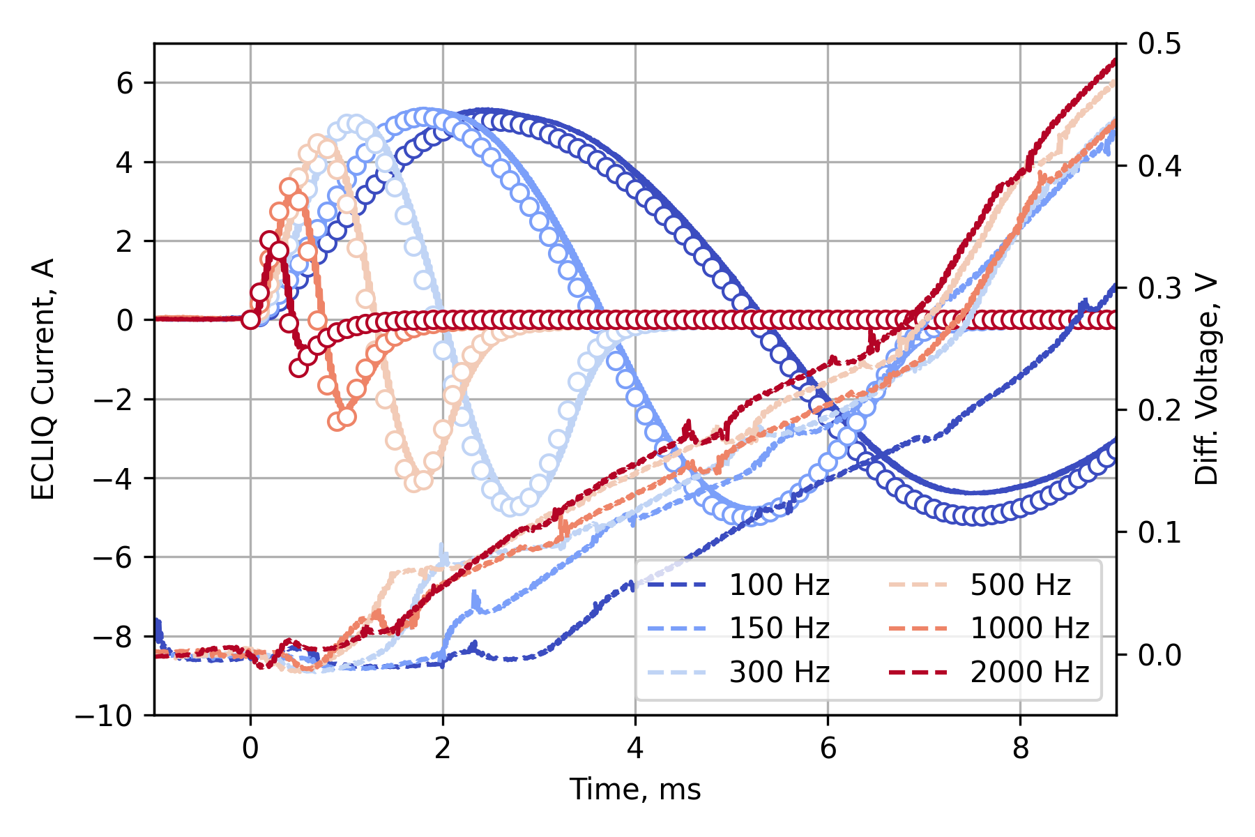
Magnet current of 13 kA, 100-500 Hz
Longer delay
Lower dB/dt
Highest peak current/field
Significant energy deposited
Faster Dif. V response
Higher dB/dt
Lower peak current/field
Magnet current of 14 kA, frequency range of 100 to 2000 Hz, E-CLIQ voltage of 70 V, 4.5 K.

Slide 22
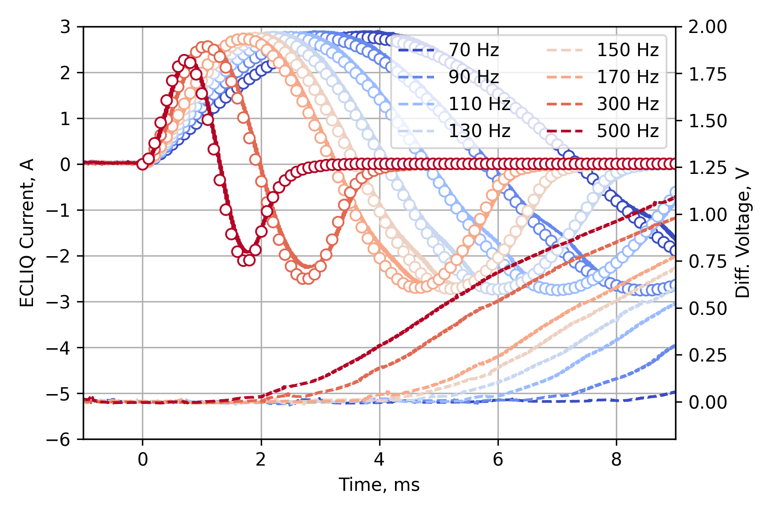
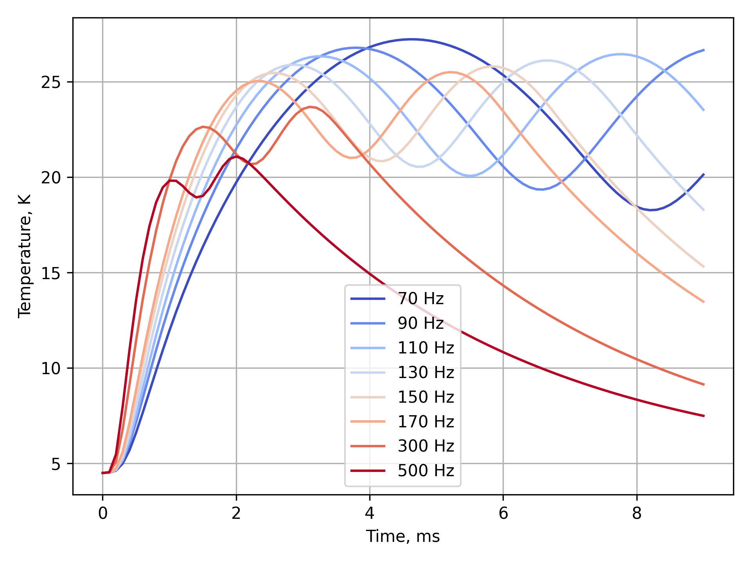
Effect of E-CLIQ temperature
10 K: 0.4-0.8 ms range
15 K: 0.6-1.3 ms range
20 K: 1-2 ms range
Simulated E-CLIQ temperatures
E-CLIQ temperature does not seem to be a dominant factor for initiating a quench when the magnet is at or near nominal operating conditions.

Slide 23
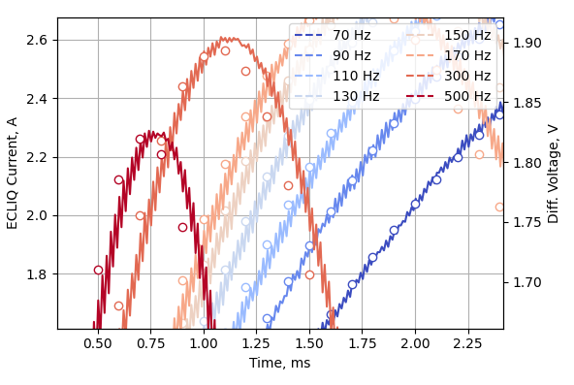
Effect of the peak produced magnetic field
Using the peak current of the 500 Hz test as a reference: all E-CLIQ currents reach 2.3 A (~ 115 mT) within the timespan of 0.75 – 2.1 ms.
E-CLIQ peak produced magnetic field does not seem to be a dominant factor for initiating a quench when the magnet is at or near nominal operating conditions.

Slide 24

Effect of the change in magnetic field
Using the input signal of E-CLIQ the output is simulated.
(cleaner signal to integrate compared to measured current)
Simulated dI/dt translated to dB/dt on the cable strand
(1 mm from the E-CLIQ surface)

Slide 25


Effect of the AC-loss
A clear correlation observed between integrated dB/dt and measured differential voltage. This indicates that the majority of the loss is hysteresis loss.
No clear correlation between the integrated (dB/dt)² and the time to quench.

Slide 26


Same method, but for higher E-CLIQ voltage.
A similar correlation was observed with a higher E-CLIQ voltage (thus also E-CLIQ current).
Successful E-CLIQ activation and quench up to 4000 Hz with a single sine wave.
At higher frequencies, inductive effects prevent effective current injection -> higher E-CLIQ voltage needed.
E-CLIQ heats up, many cycles at high frequencies (>= 2000 Hz) are not very effective with the current amplifier setup.

Slide 27


Lower operating currents
Down to 12 kA a quench could be initiated by AC-loss with a single sine wave.
At lower currents, it was not sufficient, and a quench would occur later due to thermal conduction of heat from the E-CLIQ coils towards the conductor.

Slide 28


4.5 K vs 1.9 K
Magnet current of 14 kA, frequency range of 500 Hz, E-CLIQ voltage of 70 V.
Magnet current of 12 kA @ 1.9K, frequency range of 100 Hz and 500 Hz, E-CLIQ voltage of 70 V.
Magnet is more stable at 1.9 K, more energy needed to initiate a quench.
Lower NZPV is observed.
Higher frequencies are more efficient at lower magnet current.

Slide 29



Finite Element Modelling of induced AC losses
Modelling framework (work in progress):
  Open-source implementation in (Python code based on Gmsh/GetDP),
  Multi-scale homogenization including various loss and magnetization contributions:
    hysteresis in $Nb_{3}Sn$ filaments (external field and transport current),
    inter-filament coupling currents in $Cu$ matrix,
    eddy currents in $Cu$ matrix,
    inter-strand coupling currents at strand interfaces.
Next steps:
  Validate model parameters,
  Investigate different configurations
  (E-CLIQ coil position, multiple cables, frequency …).
[1] J. Dular et al 2024 IOP SUST 37 095002.
[2] J. Dular et al 2025 IOP SUST 38 035017.
[3] J. Dular et al 2025 IEEE TASC 35 4700605.
Courtesy of J. Dular, M. Wozniak

Slide 30








Finite Element Modelling of induced AC losses
Preliminary results (work in progress):
  $Nb_{3}Sn$ strand; 40-strand cable (contact resistance $R_{c}=20$ µΩ).
  Parallel background field up to 13 T; transport current up to 14 kA; temperature 4.5 K.
  E-CLIQ excitation current 6 A (2016 A-turns), various frequencies.
Shown without background field and transport current for easier visualization
Instantaneous power loss for various frequencies:
$f=10$ Hz
$f=100$ Hz
$f=300$ Hz
Courtesy of J. Dular, M. Wozniak

Slide 31



Transfer Function Measurements (TFMs)
TFM to get a better understanding of the coupling between E-CLIQ and cable.
TFM done on an isolated single E-CLIQ coil.
TFM have been done on the E-CLIQs in SMC109 at RT and 4.5 K.
Data still has to be analyzed.
Isolated
RT
4.5 K (magnet is not powered)
Y-axes of the different plots are scaled differently.
Resistance is exactly as expected.
Region of interest.

Slide 32

What is next?
E-CLIQ placement on the top/bottom sides of the coil.
Similar to where a traditional quench heater would be placed.
Allows probing of high and low field performance.
Effect of distance between E-CLIQ and SMC, electrical robustness.
E-CLIQ positions are not yet fixed*

Slide 33
What is next?
Protection studies:
Quantify what kind of E-CLIQ configuration is needed to protect a full-sized accelerator magnet.
Realistically achievable?
New E-CLIQ devices:
Design new E-CLIQ devices optimized for use with a capacitor bank.
Size and quantify capacitor bank needs for the new E-CLIQs.

Slide 34
Conclusions
E-CLIQ v2 has been successfully demonstrated on SMC108 & SMC109.
Fast quench initiation in high field of < 1 ms.
Demonstrated effectiveness in a wide frequency range from 50 to 4000 Hz.
Demonstrated the ability to induce a quench down to low magnet currents.
Primarily loss mechanism is hysteresis loss, strongly suggested by experimental results and by simulation.
How does its performance scale to a full-size magnet?

Slide 35
Special thanks to:
927 Team
J.C. Perez, A. Haziot, N. Peray, C. Fernandes, F. Garnier, G. Maury, D. Cote and B. Fornes.
SM18 Team
G. Willering, M. Boczan, J.-L. Guyon and J. Feuvrier
PCB Manufacturing
B. Mehl
Cryolab
P. Borges de Sousa
Machine Protection
A. Verweij, M. Wozniak, J. Dular and G. West

Slide 36
Questions?

