Slide 1
CI update
BGC CI team

Slide 2
Cockcroft experimental update
Oliver continue analysis on Proton beam cross-section on going.
Hao working on the Lead ion cross-section on going.
Shakti works on the pulse jet setup
  Tested with 0.5 mm nozzle
  Correct the pressure readings
  Work on understanding of the movable gauge with pulse jet
  Plan with newly arrived 0.1 mm nozzle.

Slide 3
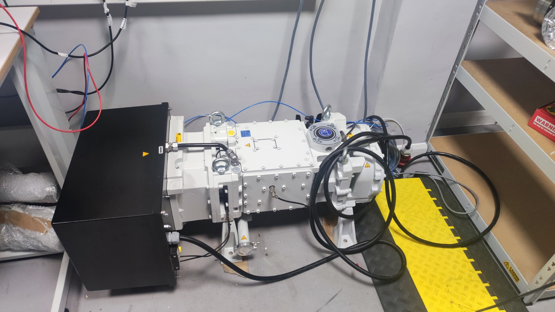
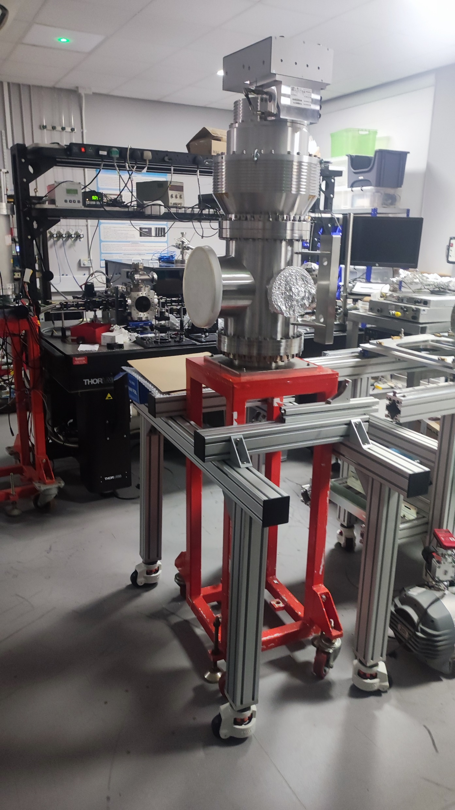
Large pumping speed test in plan
Backing pump: 280 m³/h
TMP: 2000 L/s
Current Backing pump: 20 m³/h
TMP: 300-700 L/s

Slide 4
BGC 4.1
Internal parts and alignment parts received.
Chambers will be end of this month.
Delay in EBTS means a late delivery of the system to CERN will not have a huge difference.

Slide 5
Plan
Continue the pulse jet work
BGC 4.1 test
Continue cross-section analysis

