Slide 1
Evolution of EN-EL Quality Standards in Power Systems Protection
E. Freddi, J. Leppilahti ▪ EN-EL
20.03.2025
INDICO 1518028 - EDMS 3255716
Notes:
Talk about what’s happened in the last ~15 years concerning HVNP
Not the protection system itself evolved but we’ll focus on how improved everything that revolves around the HVNP. In other words, we’re going to see how we improved the quality of HVNP.
The quality improvement is done via
standardization
critical review and update of processes and methods
feedback from real-fault experiences
introduction of new technologies

Slide 2
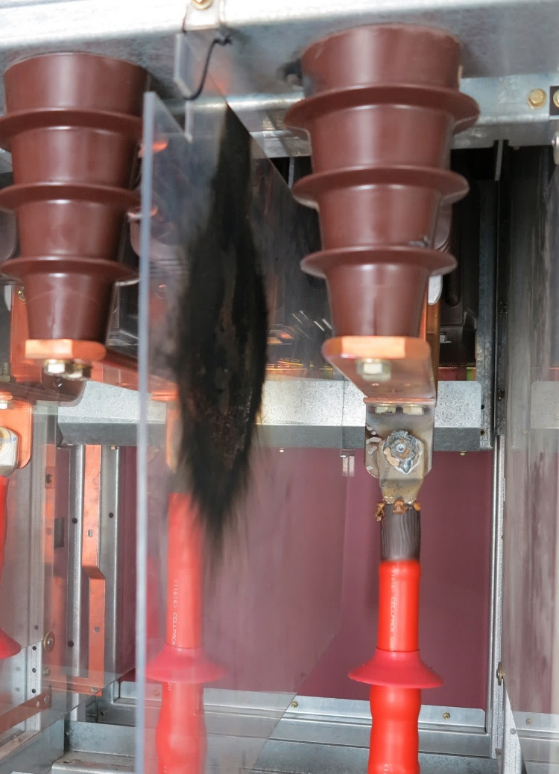
Introduction
The high voltage network protection system includes all the electrical equipment involved in control and protection of the HV electrical network.
The primary function of the protection system is to detect faults and isolate them to prevent damage to equipment, ensure personnel safety, and maintain system stability.
The protection system also enables monitoring and analysis of the power grid and is a key part of automation processes such as auto-transfer or normal/secours.
Notes:
Start with the 101, what is the protection system?
It is what allows to clear a fault before someone is hurt or something explodes
Ideally only acts where and when needed and doesn’t act when it shall not.
Part for automation processes like the AT or N/S.

Slide 3
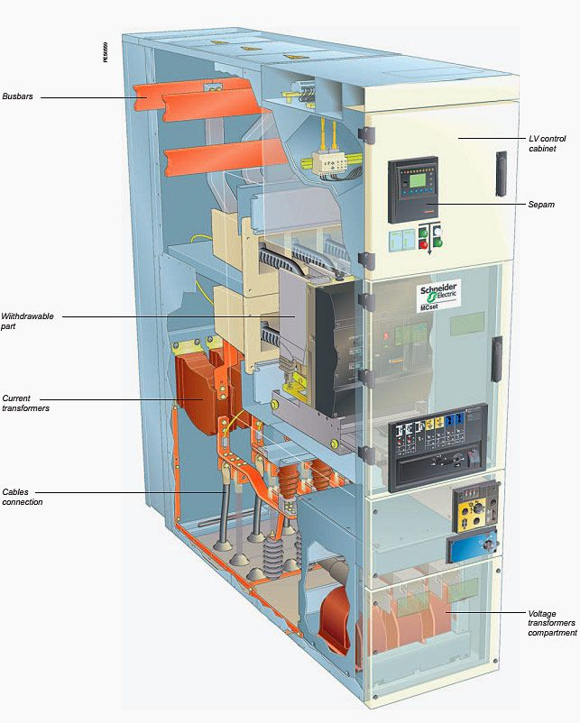
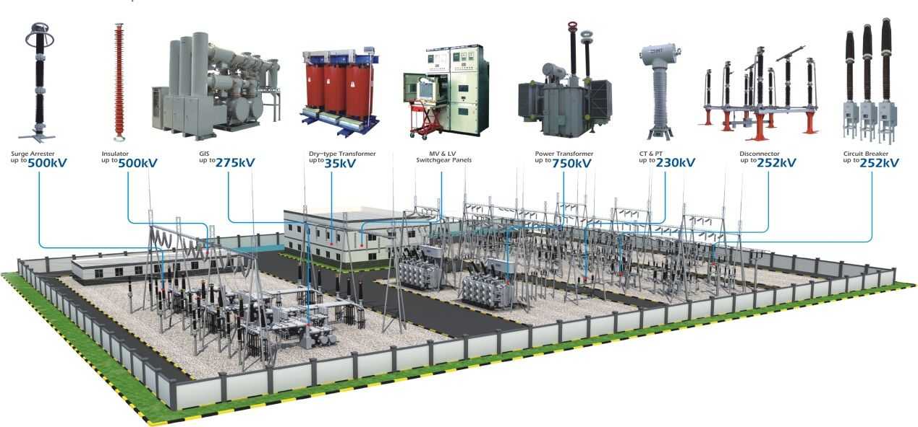
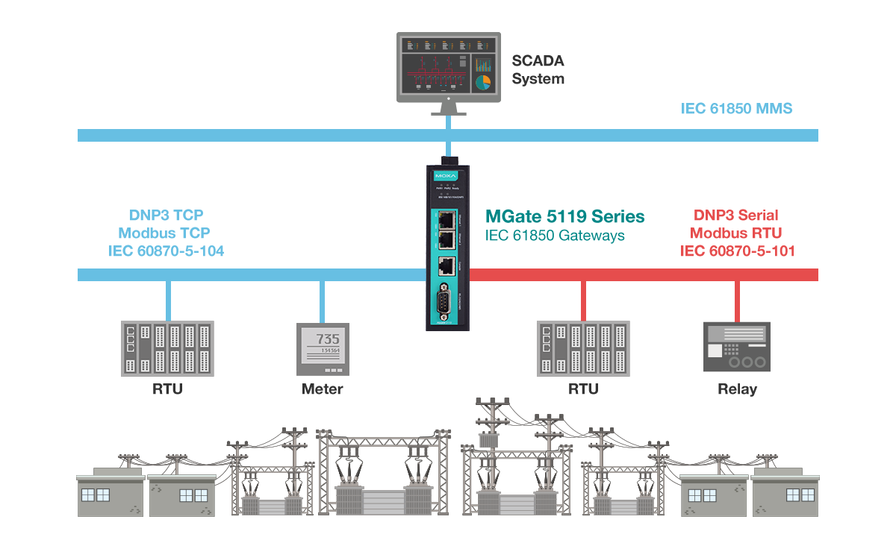
Introduction
Examples of protection system components
Notes:
HVNP components

Slide 4





Introduction
The protection system performance is conventionally expressed by five features*:
Reliability
Selectivity
Speed
Simplicity
Economy
Faults shall always be cleared, regardless of when, how or why they occur.
In case of faults, the section of the network isolated shall be as small as possible, closest to the fault.
The faults shall be cleared as fast as possible.
The protection system shall rely on as few as equipment as possible to carry out its functions.
The protection system shall provide its function at the lowest cost.
*More performance indicators exist (sensitivity, dependability, security, …) – these are the classic “textbook” features
Notes:
First three + maintainability are called dependability of the protection system

Slide 5






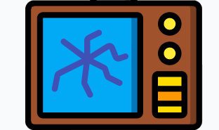




Introduction
The protection system performance is mainly affected by three types of problems:
Hardware
failures
Commissioning
errors
Design
errors
Actual failures or technical limits of the installed equipment
Primary instrument transformers, protections or blockings not correctly tested
Bad short circuit calculations, settings problems or bugs in
relay logics
Notes:
Categorisation of failures

Slide 6
Introduction
Statistically, the problems impacting the protection system performance are due to:
Source https://hvnp.web.cern.ch/statistics | 400-66-18-3.3 kV failures since 2009 on a total of 210 events
Notes:
The principal cause of unreliable intervention is due to equipment failure
Equipment failures include a relay that reboot and causes the breaker to trip, FW failures, …
The main causes of unselective intervention, however, are design errors and commissioning errors.

Slide 7
Introduction
Some – but not all! – of the problems can be avoided by applying correct quality standards.
The first step to address the problem is to establish the quality standards.
Notes:
Many of these events could have been avoided if good quality standards exist and are followed.
Those quality standards didn’t exist in the first place or were not documented enough some ~15-20 years ago.

Slide 8
Introduction
Which quality standards can improve the situation and achieve better protection system performances on the long run?
Commissioning procedures
Training
Logics standardisation
Settings guidelines
Standard and evolutive tendering documentation
Notes:
Logic (configuration) standardization:
bugs follow-up
evolutive programming (lessons learnt)
Settings guidelines:
reduce the workload on studies
coherent settings
benchmark the guidelines on actual faults.
Commissioning procedures:
streamline the commissioning practices
improves the capability of detecting issues

Slide 9

HV Network Protection Plan
HV Network Protection Plan
Establishing quality procedures is not effective unless they are readily available to all the stakeholders.
The HV Network Protection Plan (PP) is a single extensive standardisation document encompassing every aspect related to the HV network protection system.
In other words, it is the go-to document for everything you need to know.
Commissioning procedures
Logics standardisation
Settings guidelines
Standard and evolutive tendering documentation
1806081
Notes:
Governance of HVNP:
decisions are not single-handed: the HVNP Working Group is the steering body
the team collectively discusses protection related topics and takes decisions based on technical considerations
when decisions have a wider (e.g. economic) impact, these are submitted by the EN-EL management for approval

Slide 10

HV Network Protection Plan
Protection Guidelines
Protection Equipment
Protection-related
Processes and Methods
Gives practical settings calculation formulas and values
One section per equipment type
Bulk of the document
Equipment requirements
Installation guidelines (protection-related aspects)
Relays logics requirements and standard logic snippets
Protection studies
Commissioning
Maintenance
Fault analysis
Protections lifecycle management
The Protection Plan is an evolutive document with still incomplete sections and whose content keeps increasing year by year
Notes:
Evolutive document.
150+ pages as of today.
Written and maintained since 2016 → some parts are still not written or incomplete
The bulk is ready (all the greyed circled sections)

Slide 11

Protection Guidelines
The Protection Plan allowed switching from a designer-based protection criteria to a standard protection settings policy.
This speeds up the studies, allows a broader understating of settings, reduces the risk of mistakes and enables a systematic approach to settings maintenance.
In “operation” since LS2, its principles have already been stress tested by multiple real-life faults and the results have been very positive.
Notes:
Before the PP, each protection study was done individually.
Very time-consuming
Led to different settings criteria for similar or identical applications

Slide 12
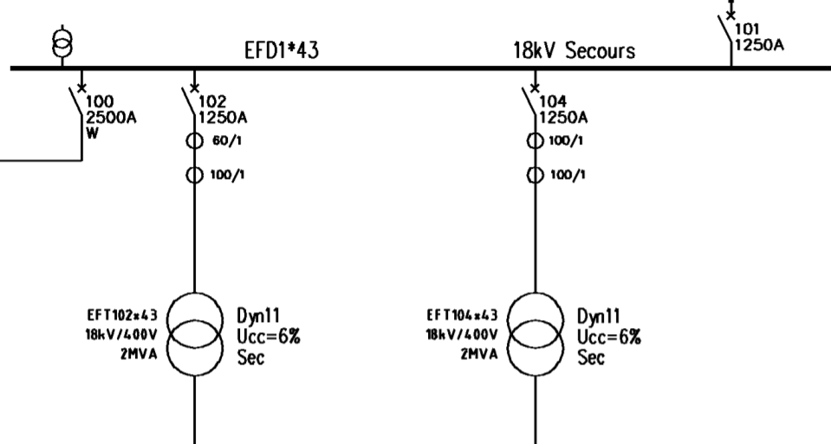

Protection Guidelines
Before the Protection Plan, due to different people and times in which HV projects were executed, it was easy to have situations like this…
I>> = 300 A @ 100 ms
I> = 200 A @ 500 ms
I>> = 500 A @ 50 ms
I> = 76 A @ 1.9 s
Same transformers,
same busbars,
different settings!
And both wrong.

Slide 13
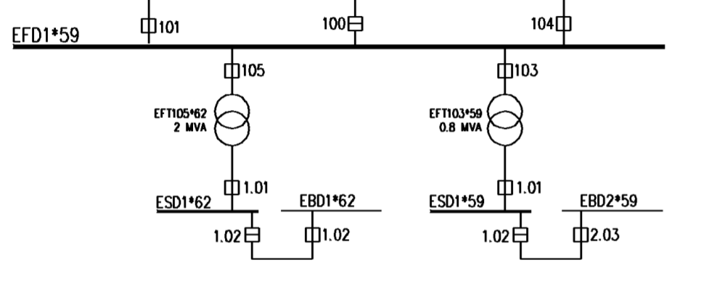
Protection Guidelines
… or this.
I>> = 500 A @ 50 ms
I> = 100 A @ 1.5 s
I>> = 500 A @ 50 ms
I> = 100 A @ 1.5 s
Different transformers, same busbars, same settings!
And again both wrong.

Slide 14
Protection Studies
Before the protection plan was established every protection studies included lengthy descriptive parts explaining the protection principles adopted and recalls to literature. The process was burdensome and inefficient.
The protection plan set up the framework in which a protection study can be reduced to a single settings table and multiple selectivity plots, without the need to justify the settings.
Cross checking is facilitated and the whole process is lean and effective.
After commissioning, the relays’ configuration files are checked against the protection study before being uploaded in the settings database.
Notes:
The protection study deliverable is a single excel table
No need to explain why settings are set like that
Young engineer can do settings

Slide 15
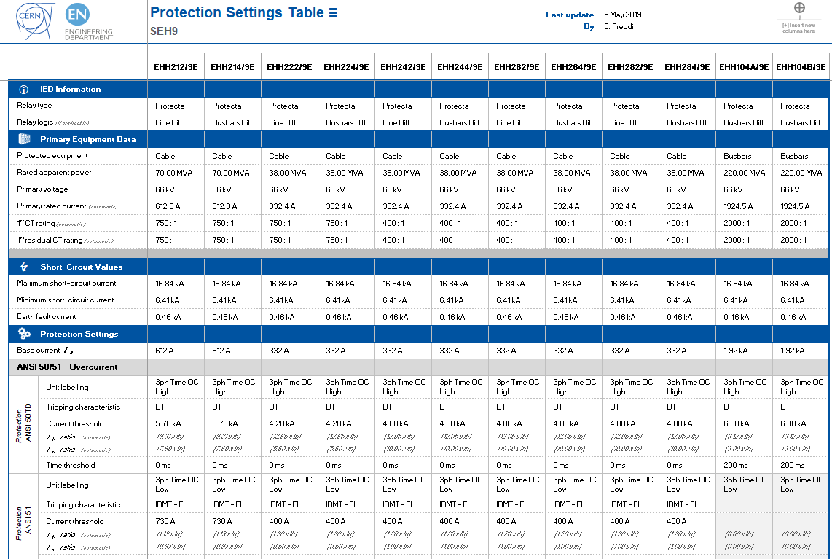
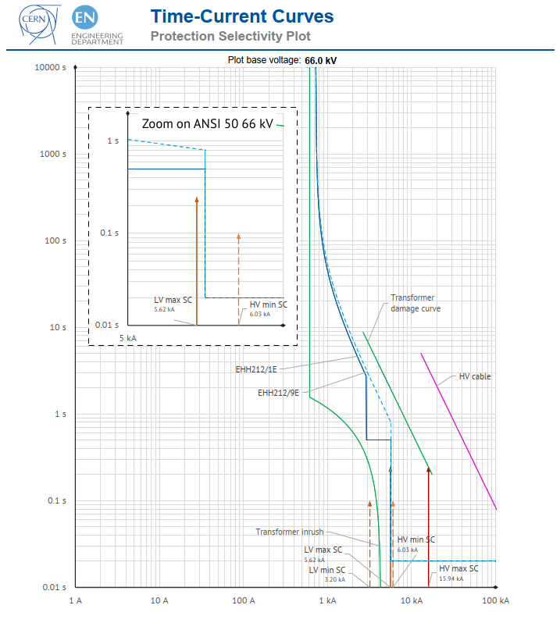
Protection Studies
Notes:
Example of protection study today

Slide 16
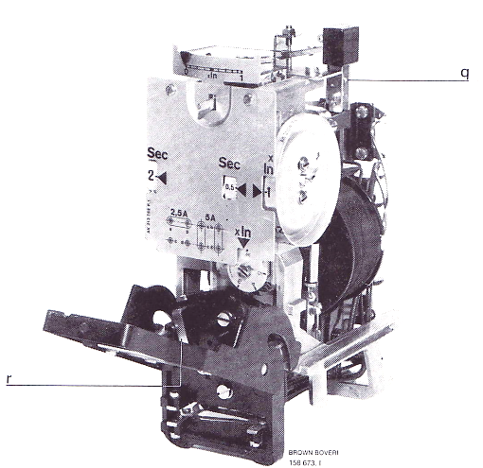
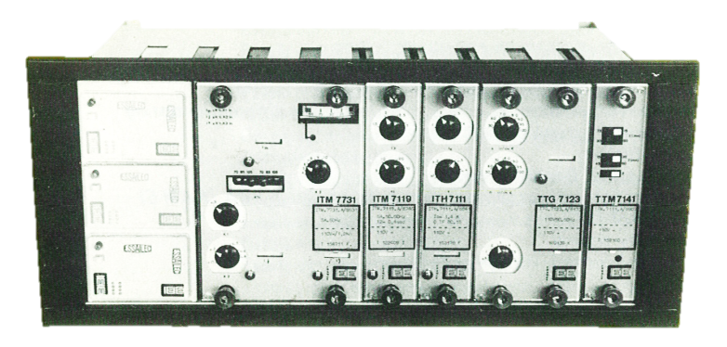
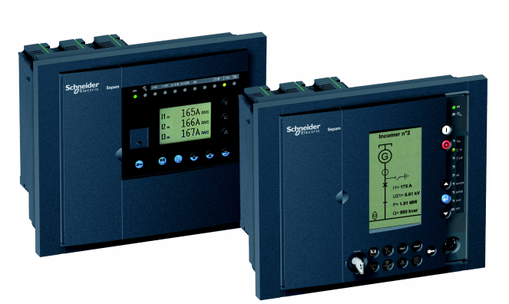
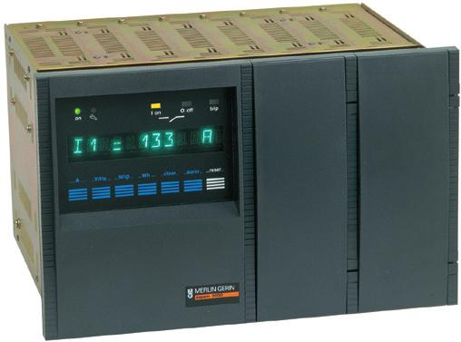
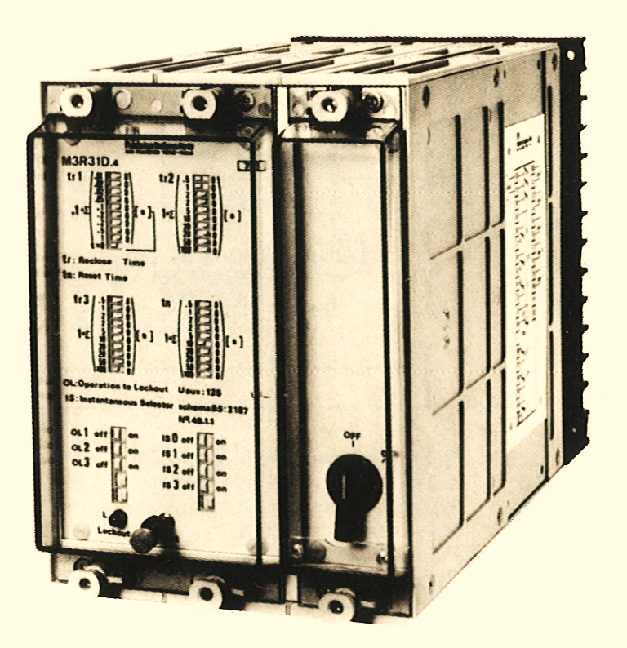
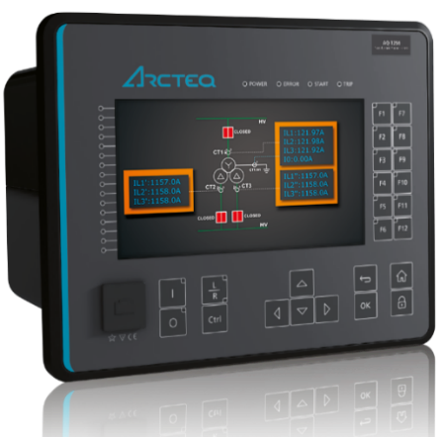
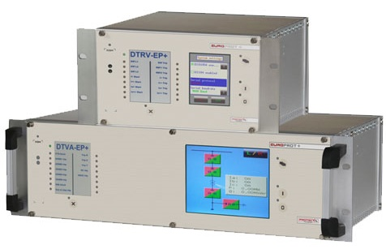
Protection Logics Standardisation
CERN’s HV network protection system is very heterogeneous: different manufacturers, technologies and ages.
Equipment’s age span more than 40 years and four generations of relay technologies are currently in service on the HV network.
Electro-mechanical
Static
Digital relays and IEDs
1954
1973
1990
Notes:
Lots of relays (>1000), lots of models

Slide 17
Protection Logics Standardisation
Functionality
Electro-mechanical
Static
Digital relays and IEDs
Ease of settings and commissioning
I> parameters
2
2
6
Selectivity
Time-based
Logic
Logic over IEC 61850
Notes:
The more modern the relay is, the more functionality it has, the more difficult (i.e. requiring trained personnel) is to configure and commission it.
Access to lots of functions can easily get out of hands if there is no clear specification of what shall be included as baseline because the possibilities are endless.

Slide 18


Protection Logics Standardisation
Logics standardisation simplifies the use of IEDs by having a small set of logics whose functions are clear and detailed in documentation.
It greatly reduces time for fault analysis, commissioning, protection studies and it simplifies preventive software maintenance.
50+ logics
17 logics
10 logics
1990
2004
2013
Standardisation effort starts here
2017
Notes:
Logic standardization allows
Settings configurations to be done by non-specialists having followed a short training on the specific relay (by the specialist)
Bug tracking (preventive maintenance)
Streamlined commissioning because “once you have done it once, the rest is the same”
Faster fault analysis (knowledge of what to expect from the relay)
(examples of documentation and simplification of settings in spare slides)

Slide 19
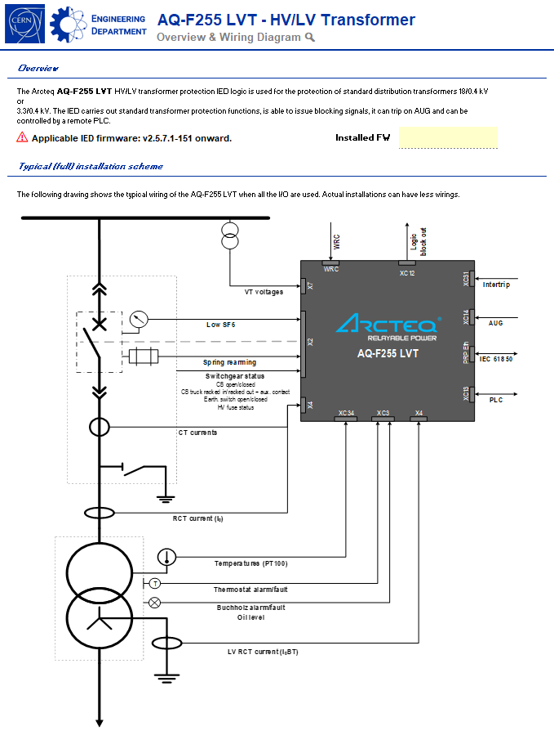
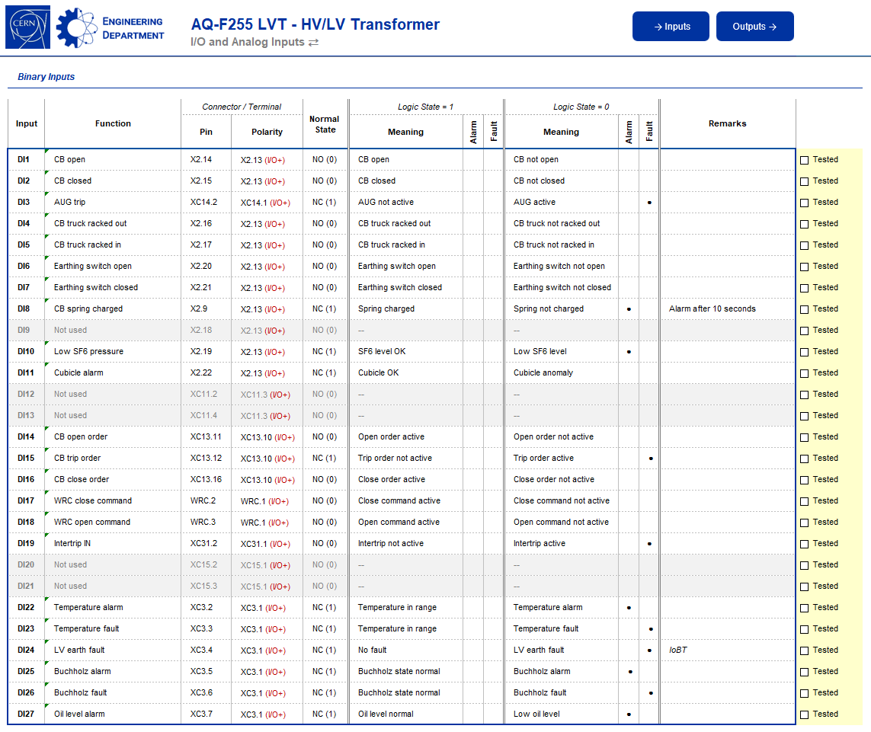
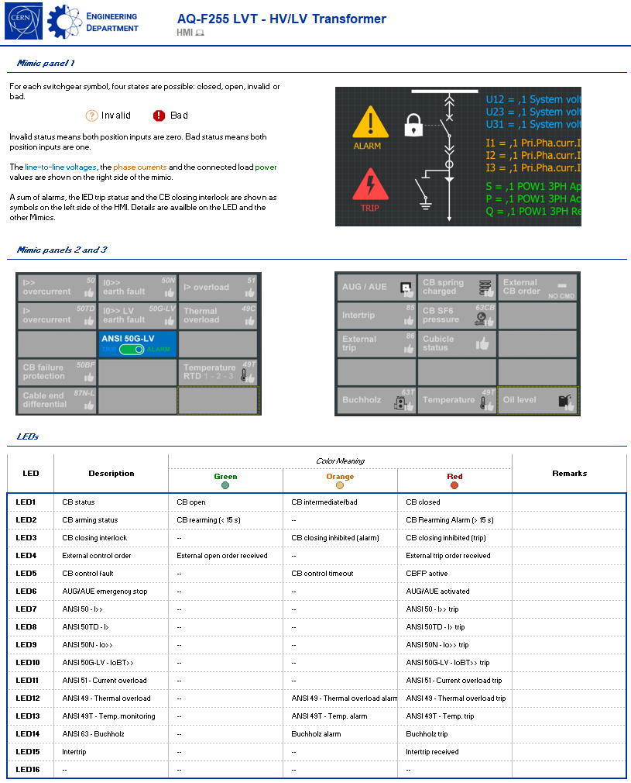
Protection Logics Standardisation
Some example of documentation of standard logics

Slide 20
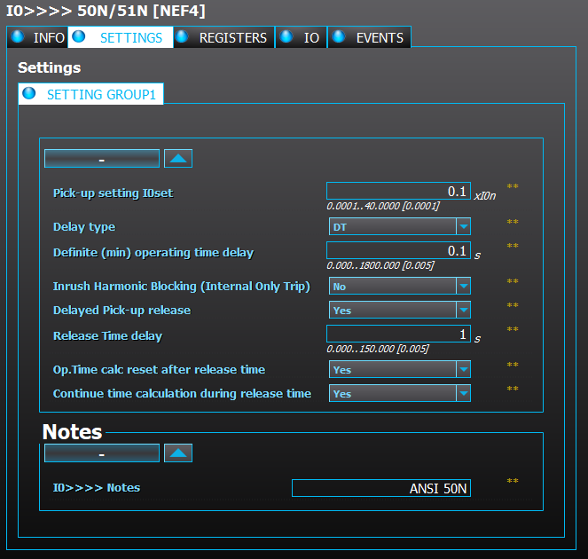

Protection Logics Standardisation
Thanks to logics standardisation only 2 out of 6 settings shall be defined during the study and parametrised during commissioning.

Slide 21
Asset Management
Before 2014 protection relays didn’t have a dedicated functional position, all work orders were attached to the cubicle even if the relays were not physically inside.
The creation of FPs allowed to assign custom properties such as “logic” and “application”, which in turns enabled consistent data management practices.
The creation of EAM assets for protection relays added the last missing piece to achieve an integrated equipment lifecycle management with standard CERN tools.

Slide 22
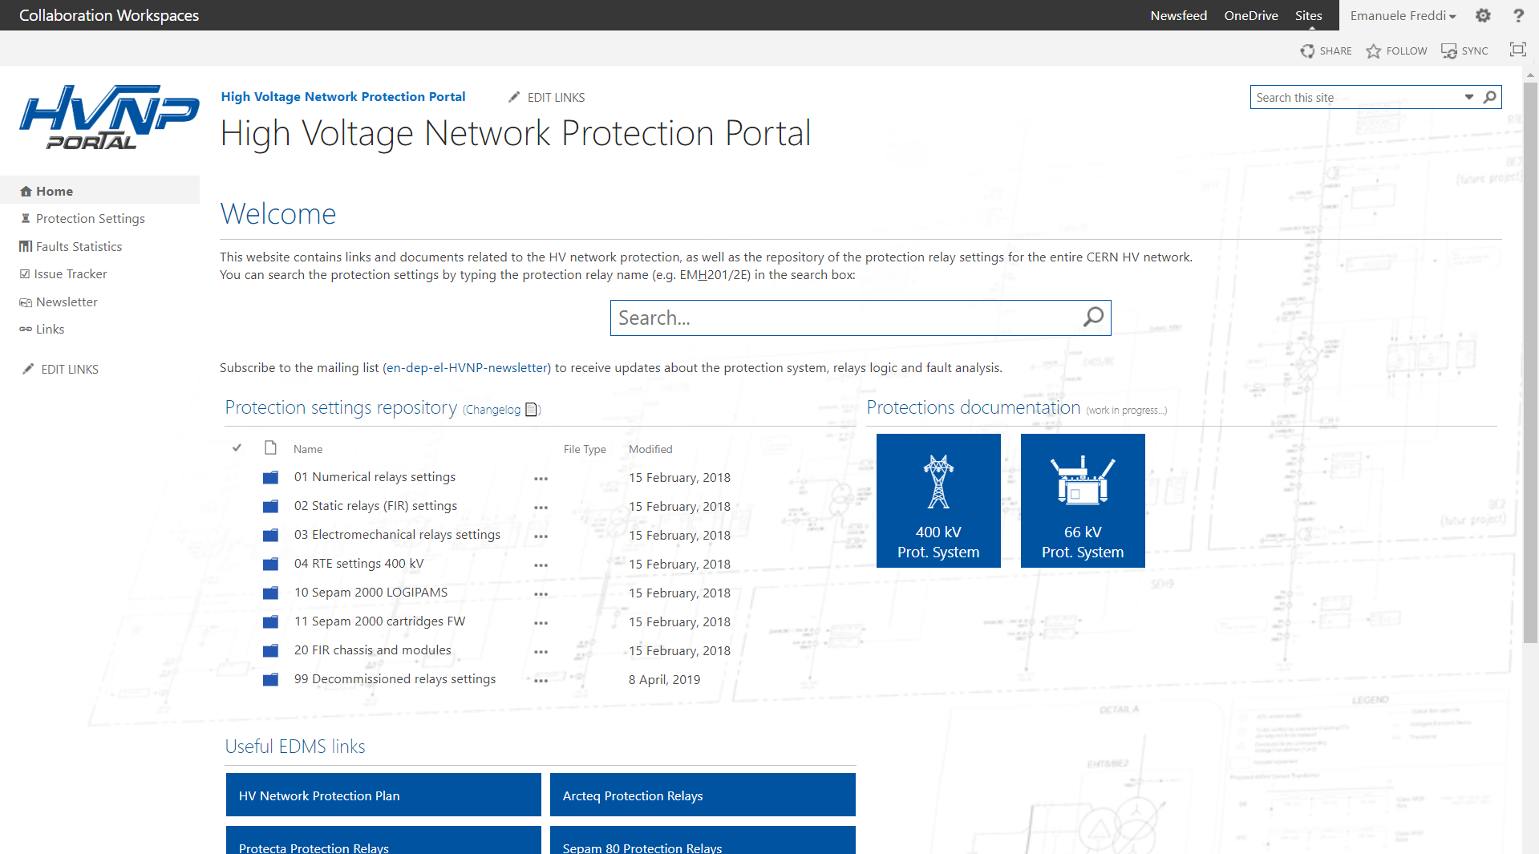
Protection Settings Database
Since ~2009 the settings of all the HV protection relays are stored in a database based on SVN.
SVN support, however, dropped in 2018 and the settings repository was transferred on a SharePoint, becoming the High Voltage Network Protection Portal or HVNP.
Sure enough, the support for SharePoint recently also dropped.
Notes:
Before 2009: no repository. To Know the settings the only way was to go onsite and read them from the relay
After 2009: settings stored and versioned in SVN
After 2017-2018: new HVNP portal on SharePoint

Slide 23
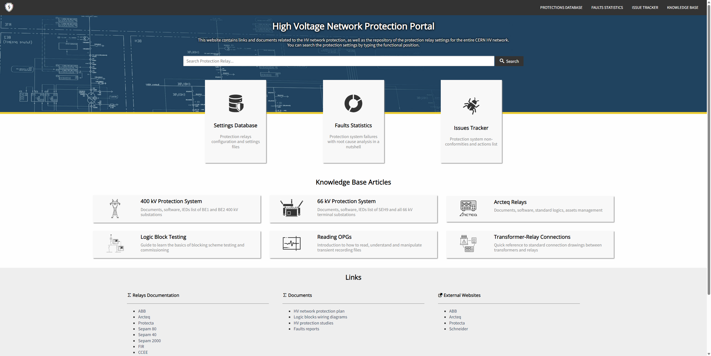
High Voltage Network Protection Portal
In 2023, the new HVNP portal was built from scratch leveraging open-source web technologies and CERN Box as storage solution for the protection settings.
https://hvnp.web.cern.ch/
Notes:
Since 2023: HVNP website, CERNBox based repository, fault statistics, issue trackers, EDMS links, and KB articles.

Slide 24
High Voltage Network Protection Portal
The HVNP portal is today not only a protection settings repository, but the one-stop website collecting everything related with the CERN HV network protection system.
The website is now bonding together all the information built so far and present it to the users in an accessible way…
… because quality procedures, standards, templates, etc., are only as good and effective as how many people can quickly find them when they need.
Notes:
Importance of having quality in how quality is presented and available to everyone.

Slide 25
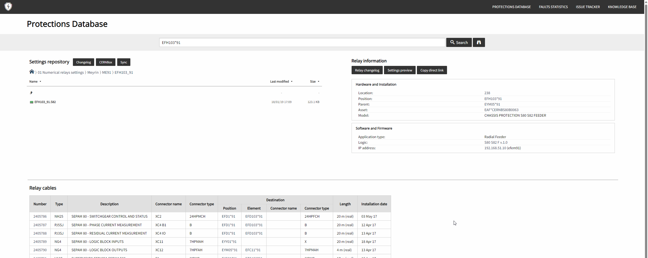
High Voltage Network Protection Portal
Online settings preview (no software needed!)
Asset information
Actual configuration file
Standard logic (EDMS link)
IP Address for remote access
Cables connected to the relay

Slide 26
Protection System Maintenance
The last, important missing piece of the puzzle concerns the maintenance of the protection system.
The protection system maintenance is on the edge between hardware and software maintenance: the IEDs, being almost entirely programmable, can be affected by bugs like any software, they require FW updates and, of course, can still suffer hardware failure or have HW-related issues like any other equipment.
Relays’ maintenance can have an impact on the availability of the feeders, hence planning is critical. Today’s installations are built with maintainability in mind, to minimise if not completely remove the downtime for maintenance.

Slide 27

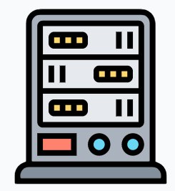




Protection System Maintenance
Corrective maintenance
Preventive maintenance
Relay replacement (stand-by), settings update, recommissioning, testing, …
Secondary injections, scheme validation,
FW updates, logics updates …

Slide 28
Protection System Maintenance
For years, there has been no structured preventive maintenance plan for Intelligent Electronic Devices (IEDs) in service.
Maintenance has been performed solely as corrective maintenance, where faulty IEDs were replaced upon failure detection – either through the device’s self-supervision functionality* or following a maloperation during an actual network fault.
A new maintenance contract is now being established for LS3, incorporating both preventive and corrective maintenance strategies.
*only for modern numerical protection relays
Notes:
Corrective maintenance for the relays that are found faulty during preventive maintenance checks and tests.

Slide 29
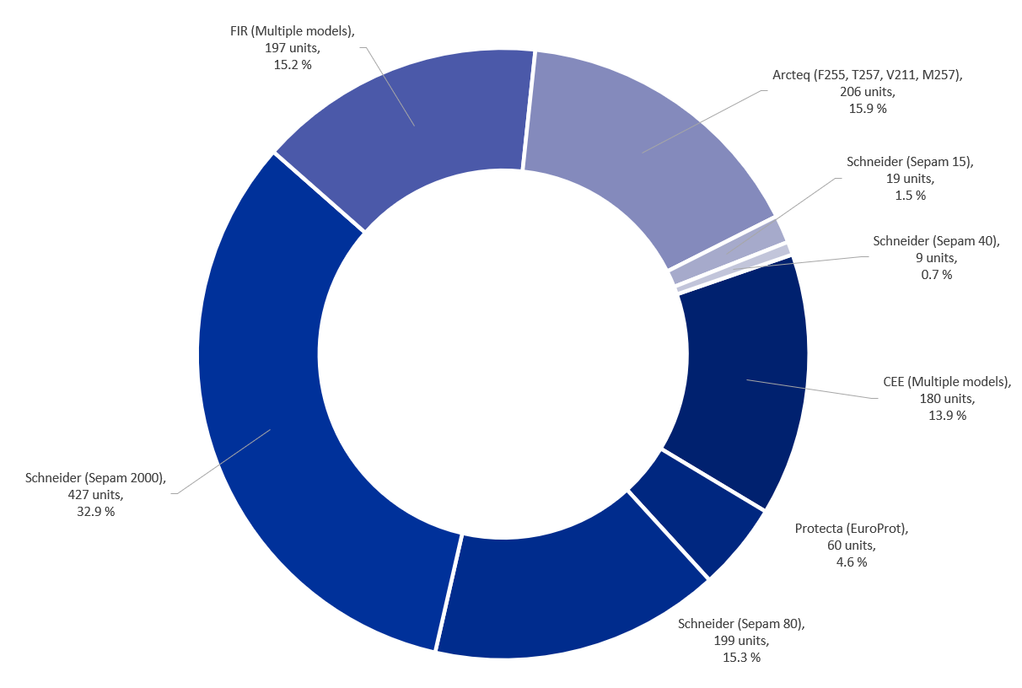
Protection System Maintenance
The preventive maintenance program will cover approximately 800 relays, prioritizing the oldest equipment still in service.
Assets data from July 2024
Notes:
Corrective maintenance for the relays that are found faulty during preventive maintenance checks and tests.
FIR models are all replaced.
SEPAM2000 will have preventive maintenance actions and partly replaced.
CEE models are partly replaced and partly having preventive maintenance actions.

Slide 30


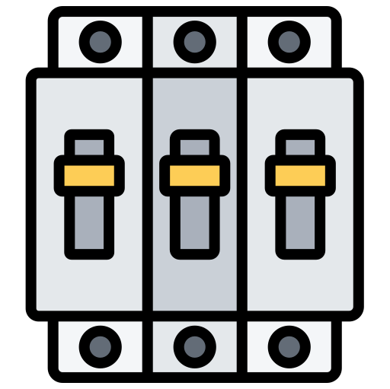
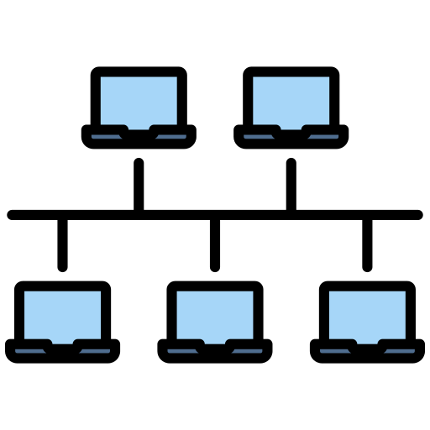


Preventive Maintenance Workflow
Protection accuracy
Protection response time
Circuit breaker
Disconnectors
Signaling to PSEN
Signaling between relays
Recording to CMMS
Displays and buttons
Wiring and casing
The typical maintenance workflow aims at ensuring that the protection relays still performs according to specification and no hardware problems are present.
It can also include updating FW or logic to solve known bugs.
Visual Inspection
Secondary Injection Testing
Functional Verification
Signaling Verification
Documentation
Notes:
The first phase of the preventive maintenance program is being carried out during LS3. The following maintenance actions are being performed:
Visual inspection to identify any physical or environmental issues affecting performance.
Secondary injection testing to verify protection accuracy and response time.
Functional testing, including verification of circuit breaker, disconnector, and earthing switch status, as well as control checks.
Signaling verification to ensure proper communication between protection relays and the automation system.
All maintenance activities and interventions will be documented in detail and recorded in the CMMS database.

Slide 31
LHC FIR Replacement Project
In the LHC FIR replacement project, 275 protection relays will be replaced as a preventive measure before the failure rate of the existing FIRs becomes too high. This replacement is necessary due to the unavailability of spare parts for the 40-year-old protection relays.
The procurement process for new protection relay crates is underway. These crates have been designed with a “plug-and-play” approach to simplify the physical installation process. They will be mounted in the same racks currently housing the FIR units.
Notes:
Leveraging a standardized logic library, the new IEDs can be pre-programmed and tested prior to installation.
As a result, commissioning tests after installation will primarily focus on system-level validation, including communication tests between the IEDs and the SCADA system.

Slide 32
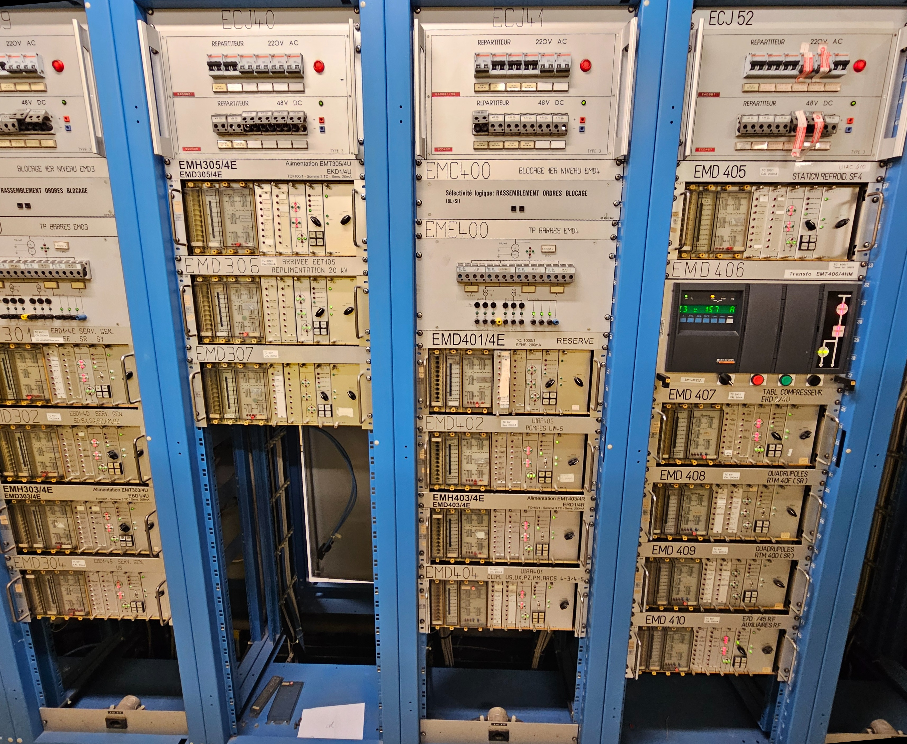
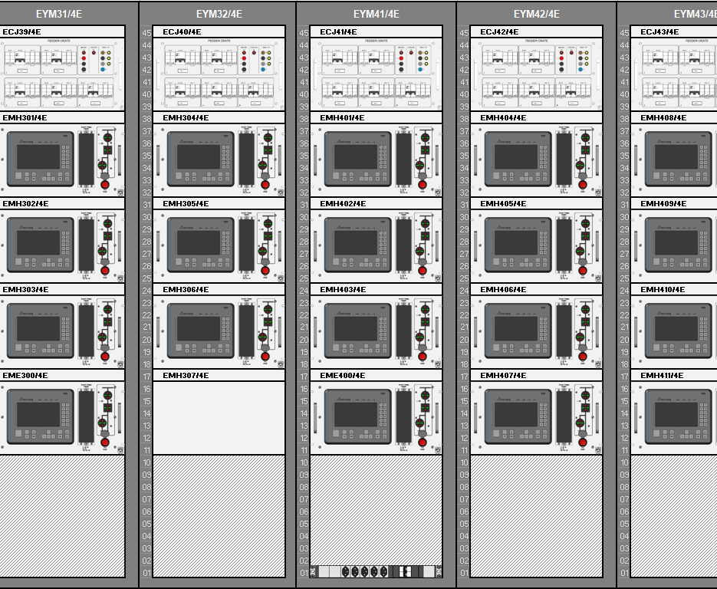
LHC FIR Replacement Project
Notes:
On the left we have the current installation in LHC point 4. Mix of FIR and SEPAM2000. For unity the SEPAM is also replaced in this case.
On the right the new design. Also, the auxialiary power supply and voltage measurement distribution chassis are replaced.
In the old there is EMH307/4E but it is not in use, so in the new one it will have only space reservation.

Slide 33
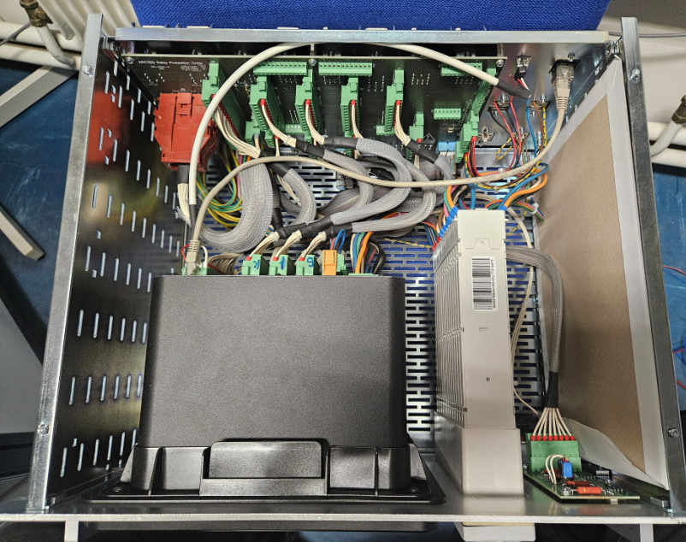
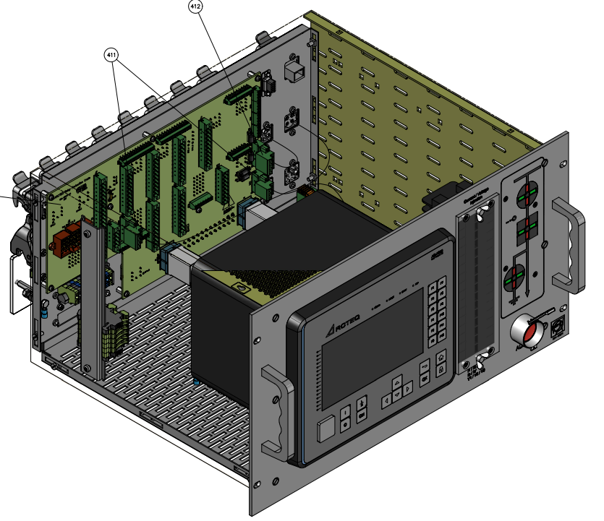
LHC FIR Replacement Project
The new protection relay crates have been designed to simplify IED maintenance and reduce downtime. In the current design, replacing an IED card is a time-consuming process, requiring the crate to be removed from the rack, disassembled, and the feeder de-energized. This procedure can take up to an hour.
Notes:
Removing crate from the rack
Removing crates top panel
Removing all connectors from the back side of the relay to allow
Removing crates back panel

Slide 34
LHC FIR Replacement Project
To enhance maintainability, the new protection relay crates introduce two key improvements:
A fixed front panel has been replaced with a door, providing direct access to the IED without disassembling the crate.
An undervoltage coil bypass switch has been added, allowing maintenance work without de-energizing the feeder.
With these enhancements, IED card replacements can now be performed while the feeder remains energized, reducing the required work time to just 15 minutes.

Slide 35
Conclusions
The quality of the protection system is often under the spotlights when a bad fault occurs.
The work “behind the scenes” to keep the lights on is continuous and progressive, within the limits of available resources.
In the last 15 years all the quality aspects related to the HV network protection system have been nurtured and today CERN is once again leading in this regard, with much more to come!
Notes:
Feedback received from newcomer’s (Joni) and manufacturer’s alike confirming that it is very rare – if at all – for an industrial client to have such a high level of documentation, tracking and organization of protection-related stuff, which confirms that what we have been doing is the right thing and CERN is on the good path, once again ahead of its peers in this regards.

Slide 36


The protection system is the medical
insurance of the electrical network.
The more you invest on it, the less
you pay when a problem occurs.

