Slide 1


TIIME & FIM4R
Ian Collier
31 March 2025
Notes:
The abstract pattern can be removed or repositioned if required. Be careful to ‘Send to Back’ so that it does not obscure any important information.

Slide 2
Welcome
Fire Alarms
  Meeting point down the stairs and out at the fronrt of the Palmer building
  We don’t expect a test alarm today
Great to see everyone here
  For FIM4R and for TIIME if you are staying
Code of conduct on the FIM4R website

Slide 3
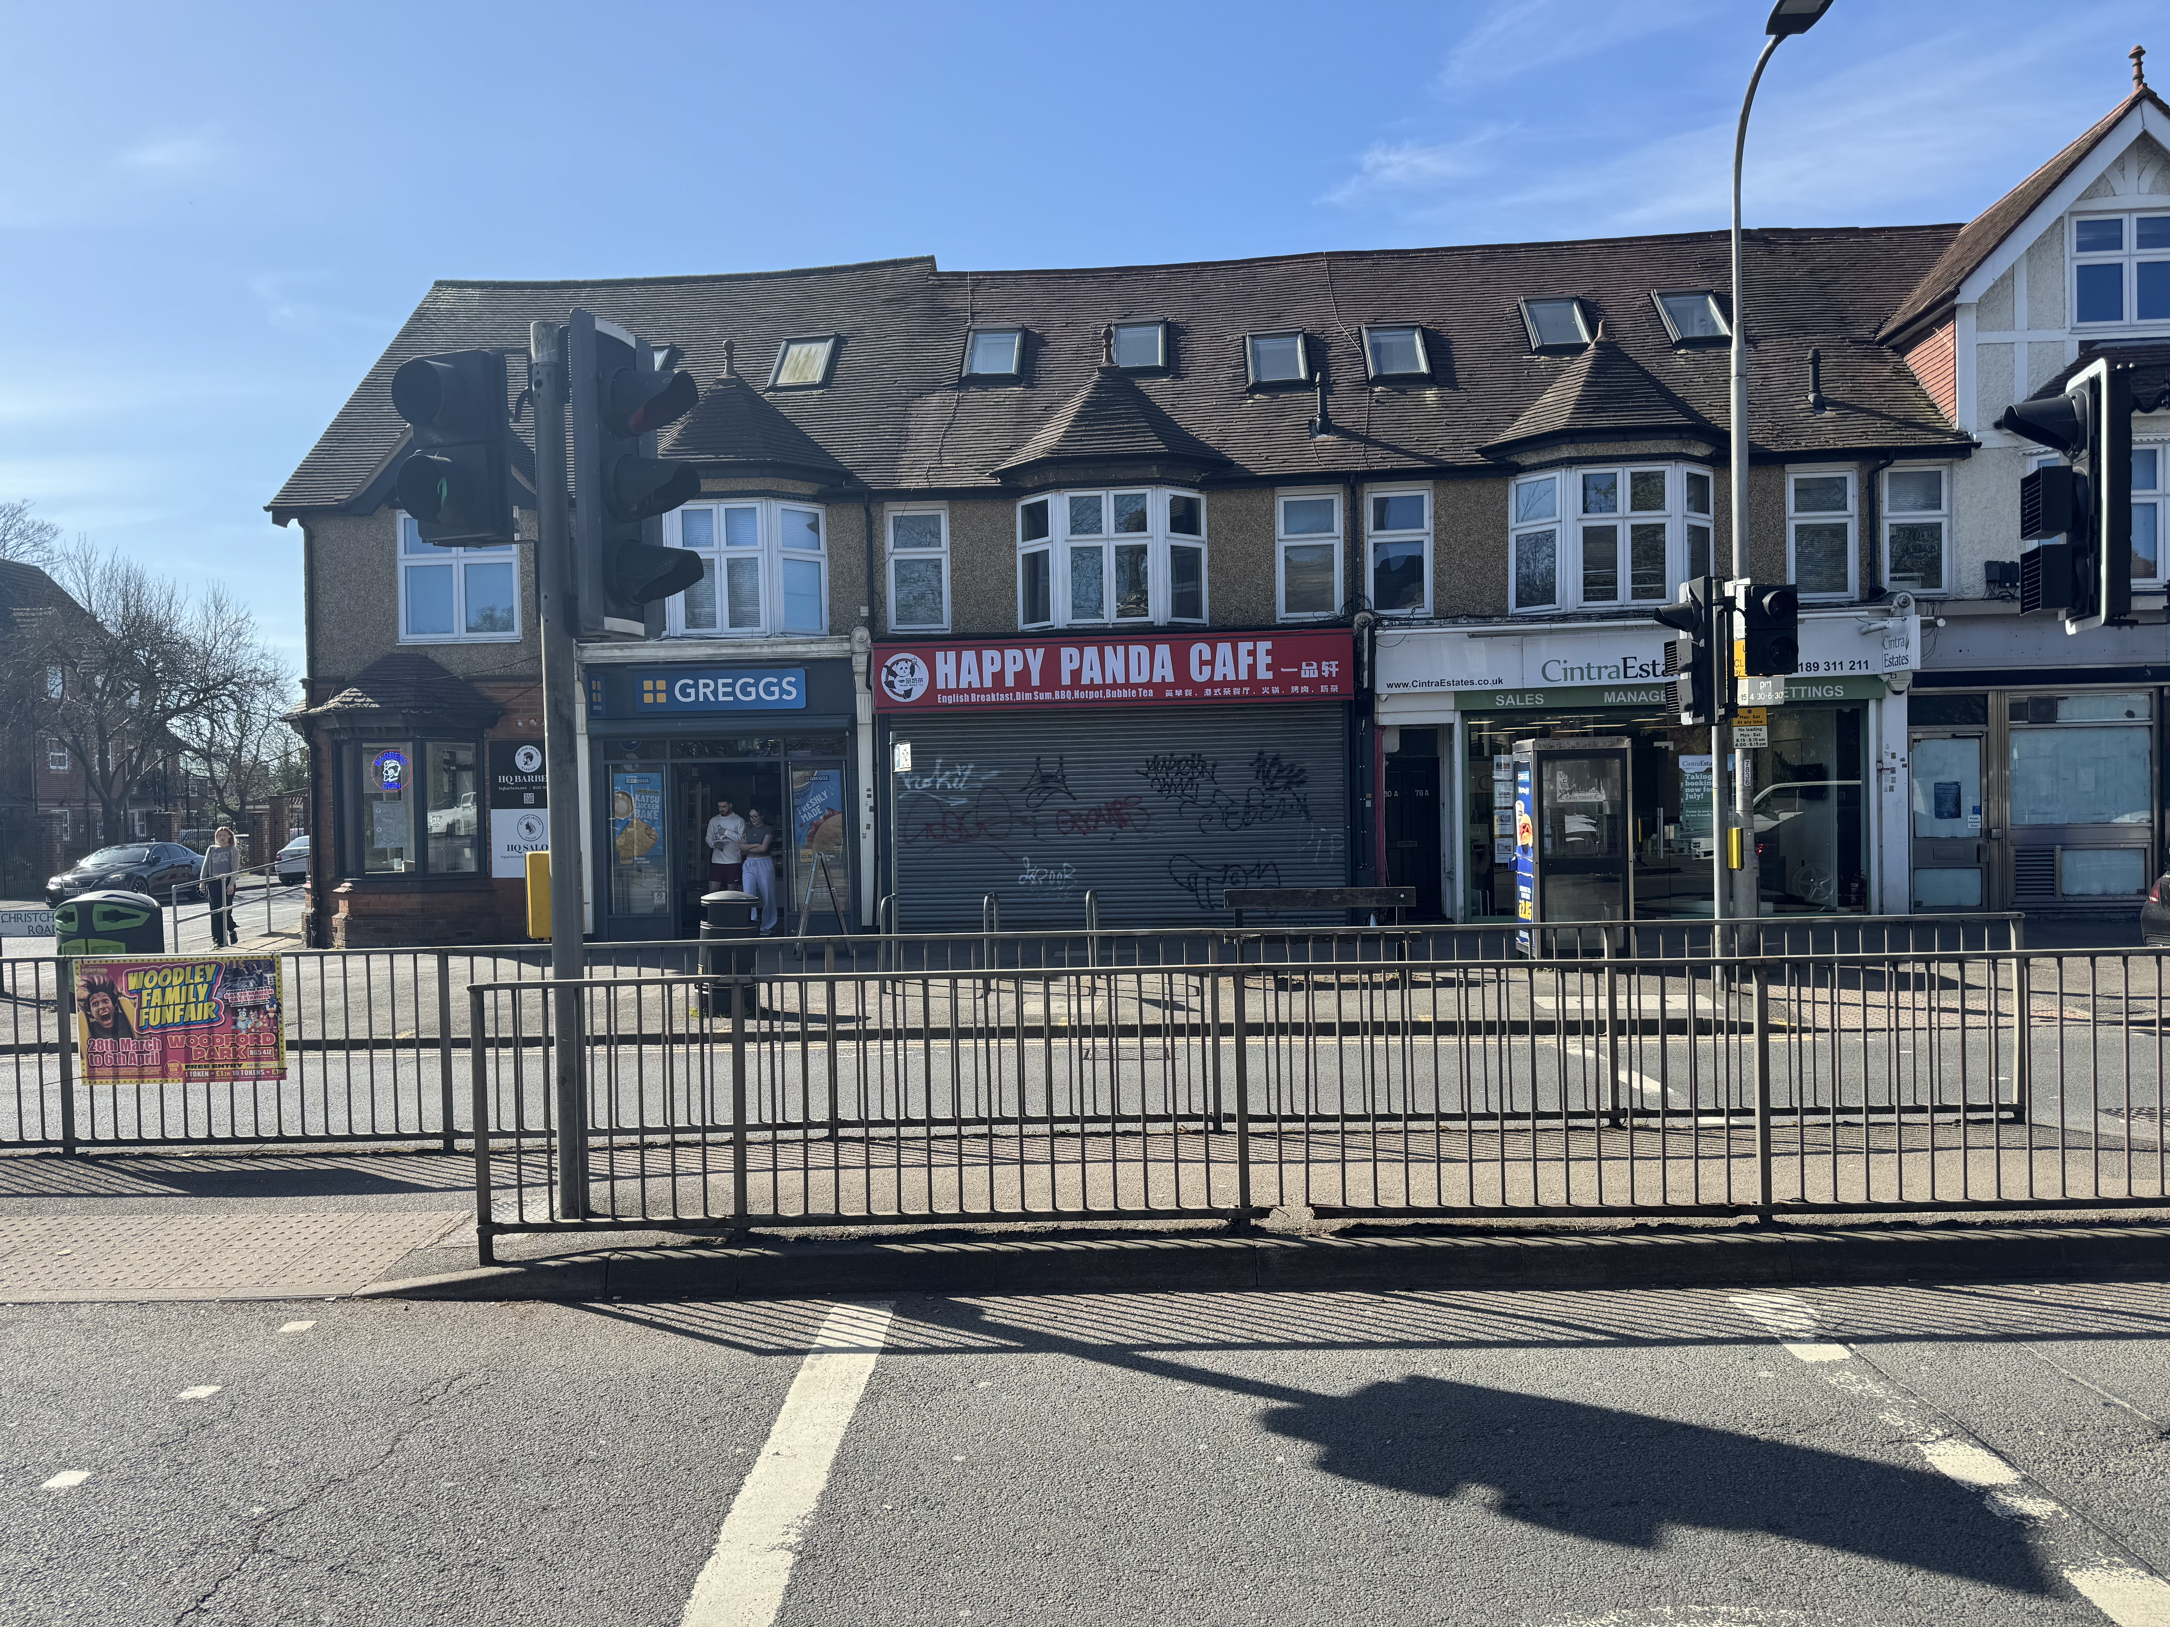
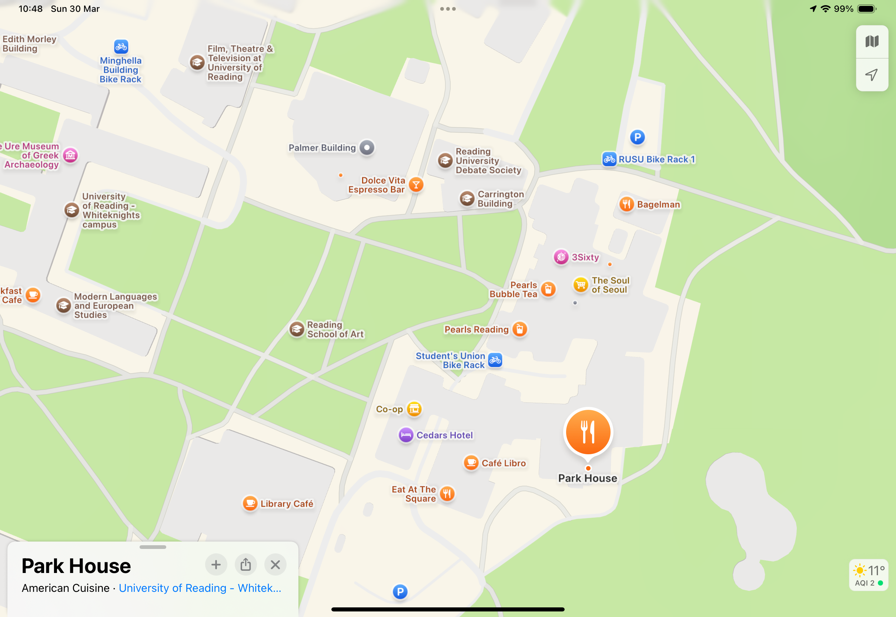
Dinner tonight
Thanks to those you responded to the survey
  Can manage a few more – let me know
19:00 at Happy Panda Café
  Christchurch Road –just across the road from the Shinfield Rd entrance to campus
You might want to visit the Park House in between

Slide 4
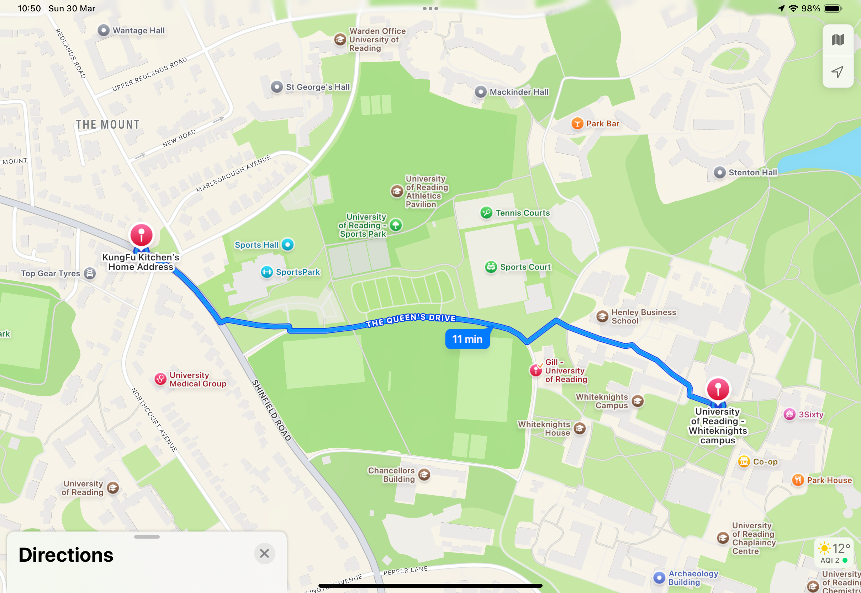
Dinner tonight

Slide 5


Notes:
The abstract pattern can be removed or repositioned if required. Be careful to ‘Send to Back’ so that it does not obscure any important information.

